Slide 1
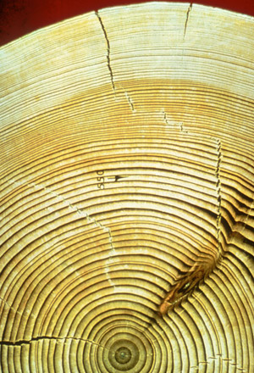
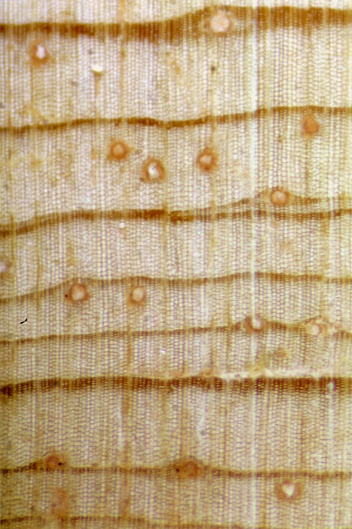
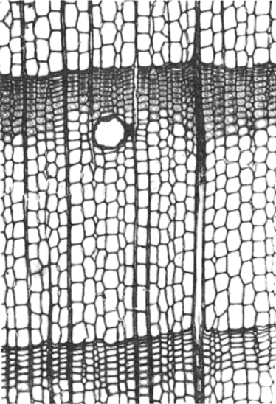
Two-toned Rings – Early Wood (light color, large cells)
and Late Wood (dark, small cells)
Early Wood
(light rings)
Late Wood
(dark rings)

Slide 2
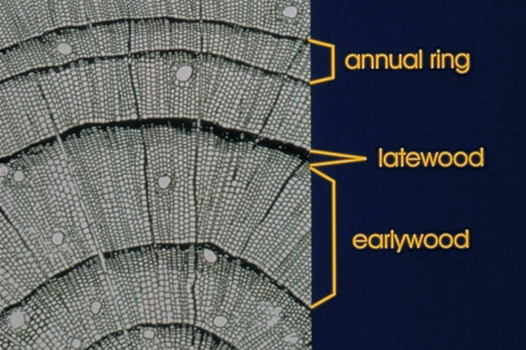
Two-toned Rings – Early Wood (light color, large cells)
and Late Wood (dark, small cells)

