Slide 1
EXPLAIN
1. Climate Sensitivity
How Many Degrees of Warming
per Watt/m² of Heating?

Slide 2
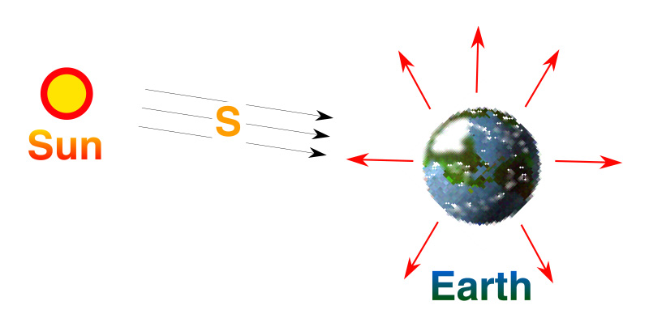
Planetary Energy Balance
Energy In = Energy Out
But the observed T_{s} is about 15° C

Slide 3
Earth’s Climate as a “Black Box”
T_{S}
Climate System
240
W m⁻²
15 °C
Absorbed
Sunshine
In
Surface
Temperature
Out

Slide 4
Climate Forcing,
Response, and Sensitivity
ΔT_{S}
Climate System
+ 1
W m⁻²
? °C
Forcing
(change in
absorbed
sunshine)
Response:
(Change in
Surface
Temperature)

Slide 5
Cause and Effect
Forcing
Watts per
square meter
Response
degrees
Celsius or F
Response
Sensitivity =
Forcing
degrees per Watt m⁻²

Slide 6
CO₂ Climate Forcing
FORCING = Energy in minus energy out
Proportional to change in average surface air temperature of the Earth
Adding CO₂ to atmosphere reduces energy out until rising temp can compensate to
re-establish energy balance

Slide 7
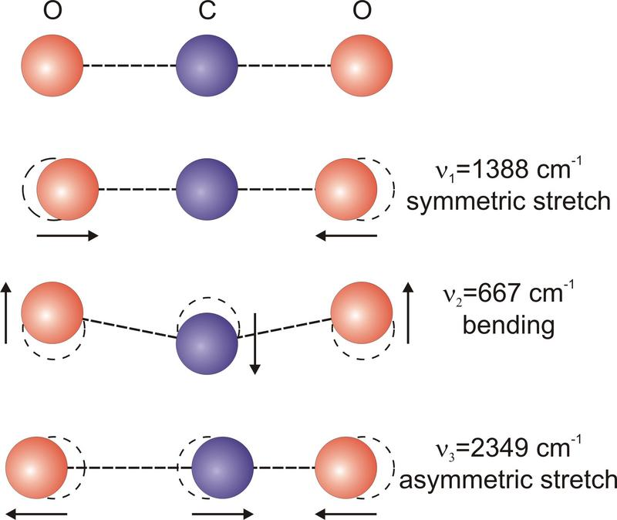
CO₂ Vibrations
Resting or ground state
O
C
O
No dipole … weak!
7.2 mm
O
C
O
15 mm
O
O
C
Temporary electric dipole … strong!
4.3 mm
O
C
O

Slide 8
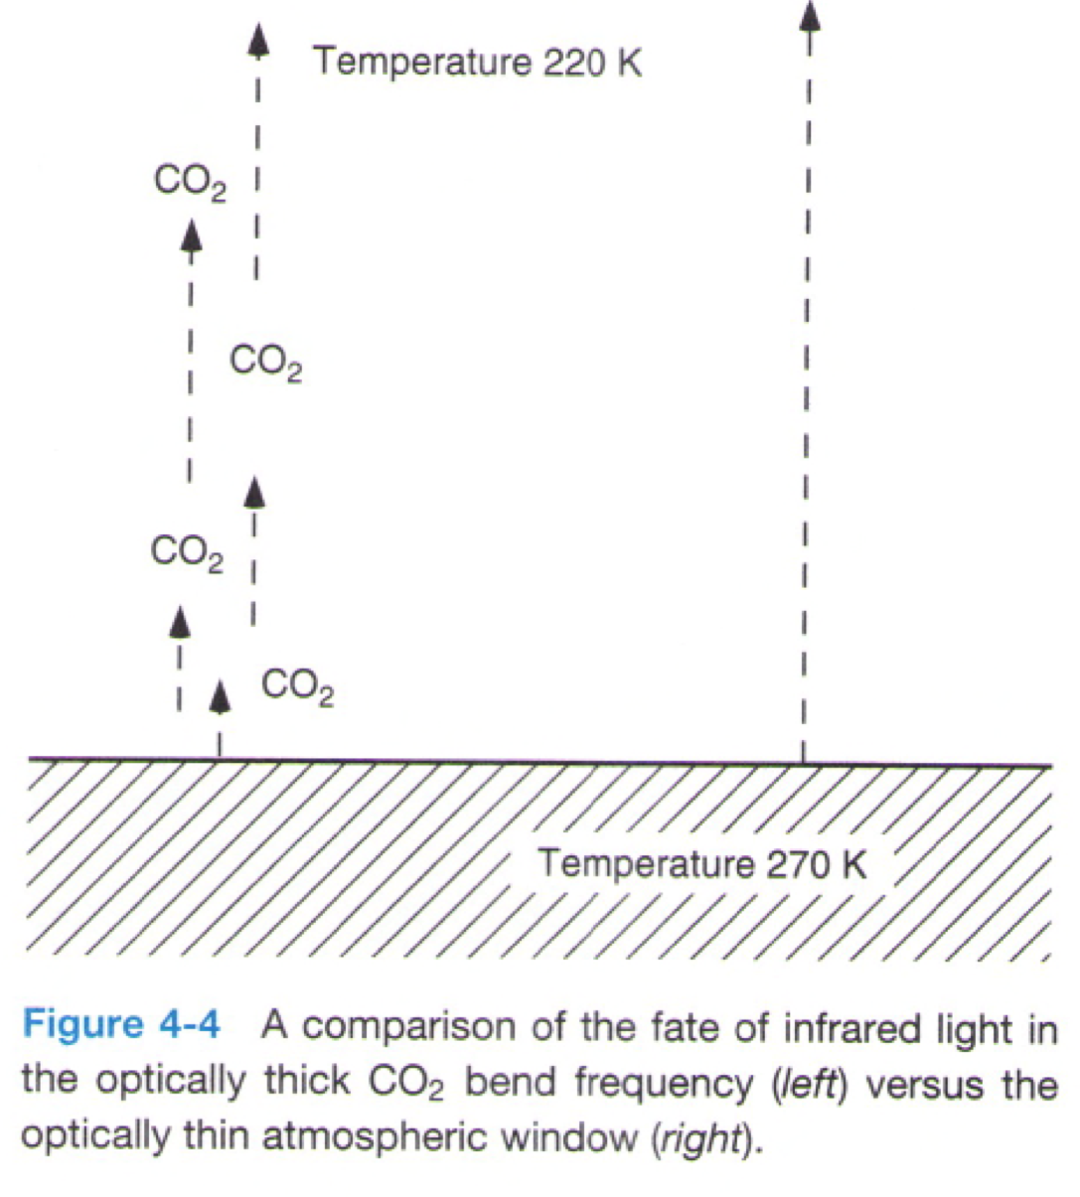
Optical “Thickness”
14.3 μm
CO₂ band
11 μm
“window”
In CO₂ absorption bands, atmosphere is totally opaque to IR photons
They get absorbed and re-emitted higher up
It’s cold up there!
Think about the
Layer Model
IR photons
IR photons

Slide 9
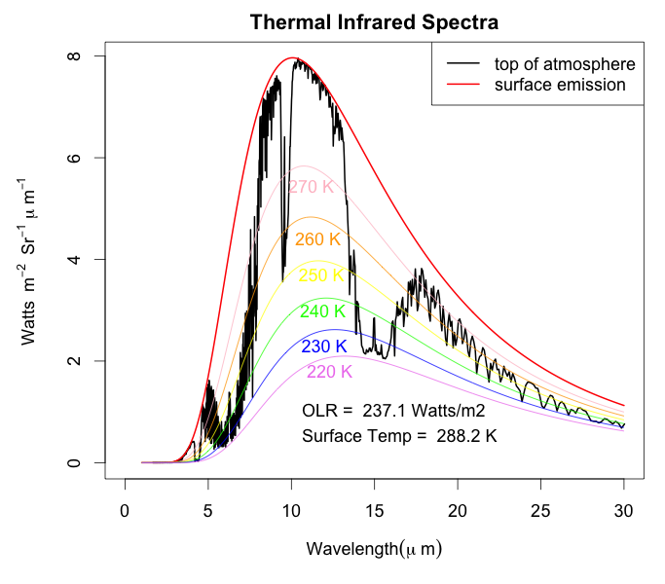
View from Space
Hot surface emits directly to space in window region
Cold upper layers emit to space in optically thick regions
Total emission much less than from sfc
O₃
CO₂
H₂O
H₂O

Slide 10
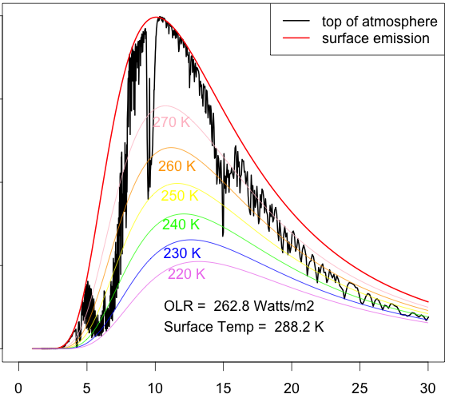
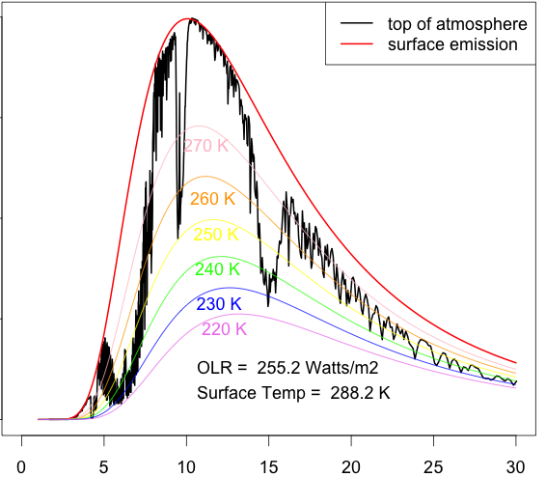
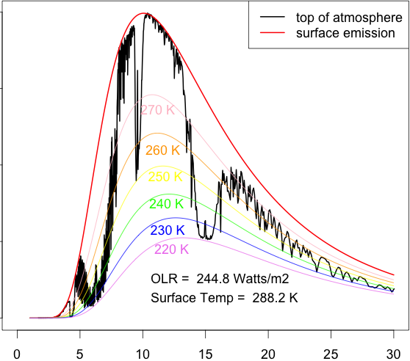
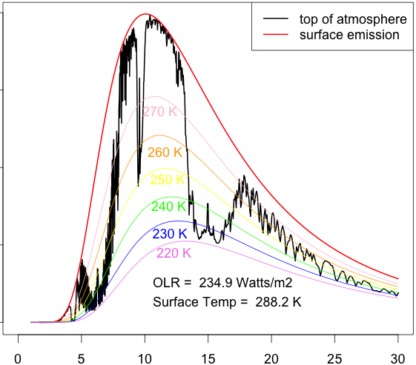
Effect of Adding CO₂
Optically thick regions are as cold as they can get
But the thick regions get wider with added CO₂
Rate of total emission (area under black curve) decreases less and less
1 ppm
10 ppm
100 ppm
1000 ppm
wavelength (μm)

Slide 11
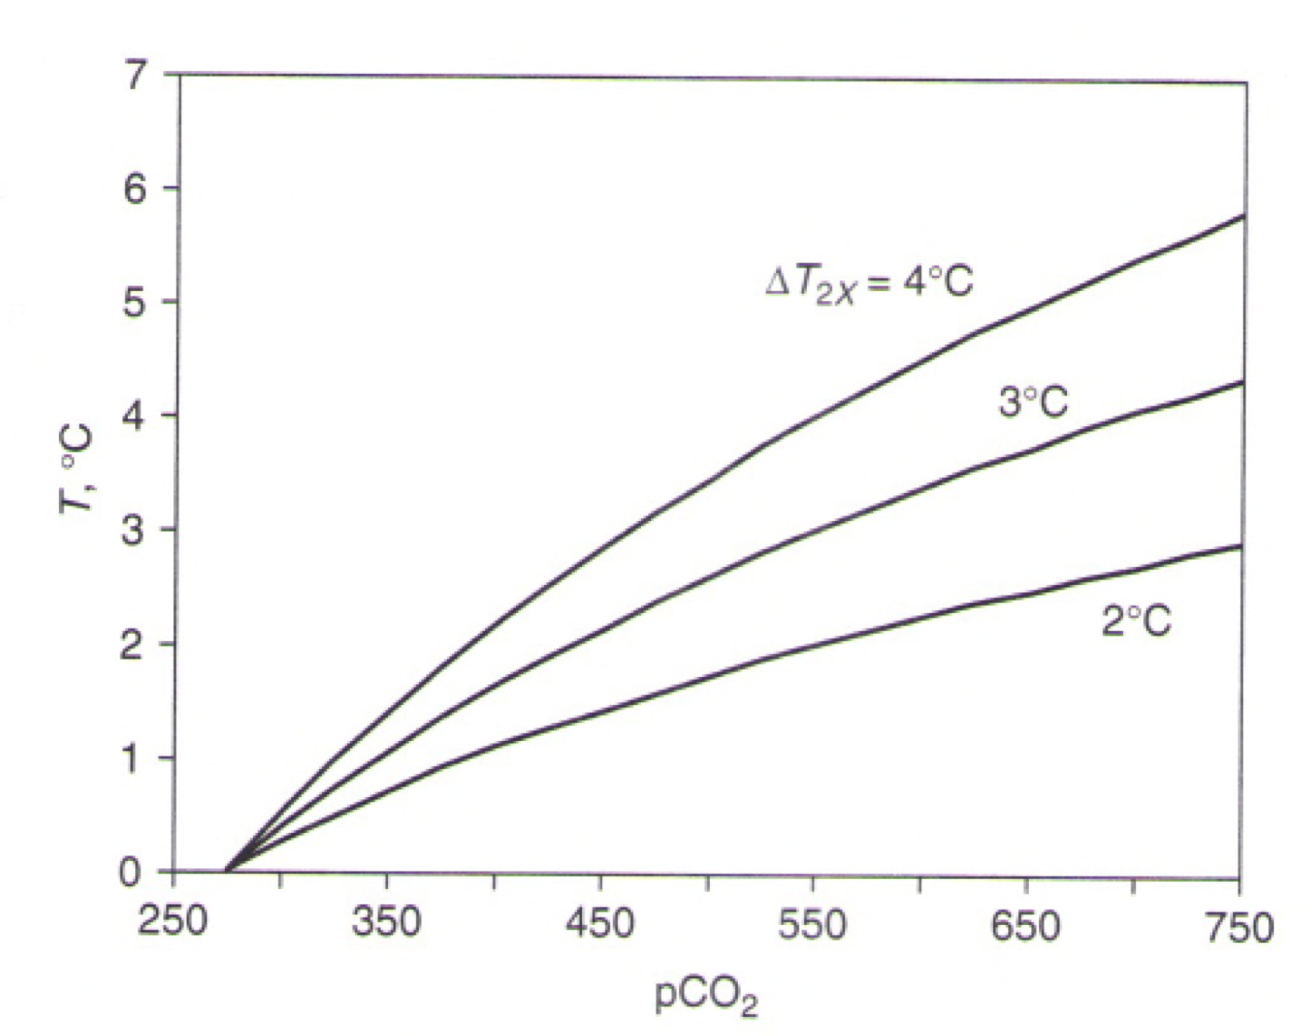
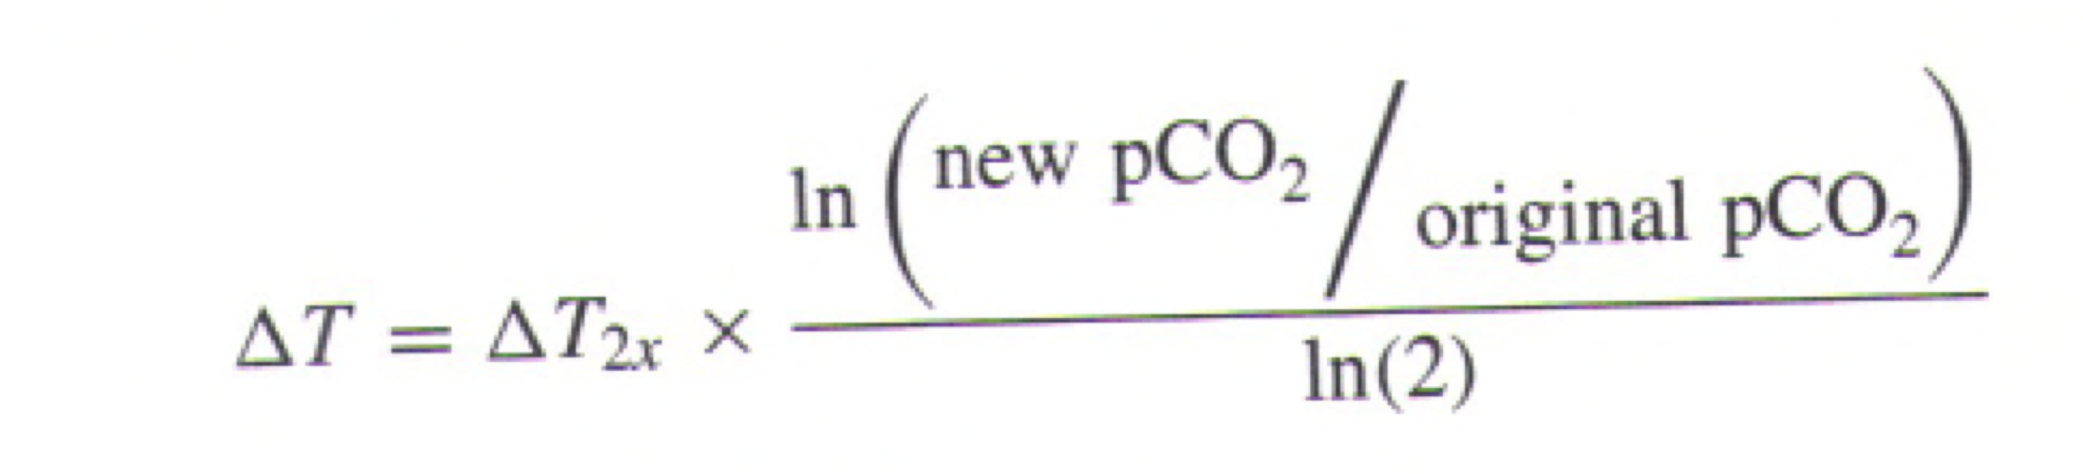
Logarithmic Effect due to band saturation
“Radiative forcing” of CO₂ is expressed as the number of Watts per square meter per doubling, not per unit change in concentration
Temperature changes are degrees per doubling too (not degrees per ppm)

Slide 12
Radiative Forcing by Increased CO₂
An instantaneous doubling of CO₂ reduces outgoing infrared by 3.7 Watts per square meter if temperature stays constant
As temperature gradually rises, more infrared emission results
Eventually, outgoing infrared increases to balance absorbed sunlight again, but with higher temperatures

Slide 13
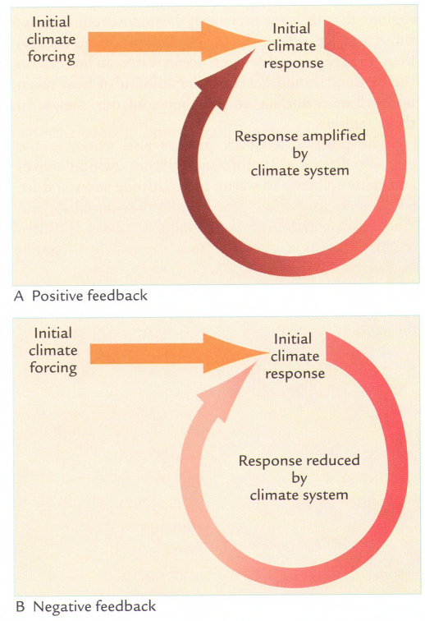
Feedback
Forcing can be either amplified or reduced by the climate system itself
Amplifying effects are called “positive feedback”
Damping effects are called “negative feedback”

Slide 14
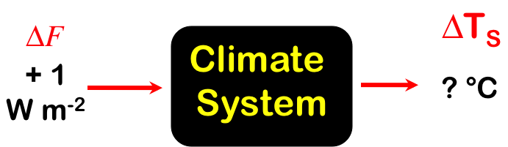
Climate Feedback Processes
Positive Feedbacks (amplify changes)
  Water vapor
  Ice-albedo
  High clouds
high cloud
mixing
low cloud
Negative feedbacks (damp changes)
  Vertical mixing
  Low clouds
F
T_{S}
vapor
albedo

Slide 15
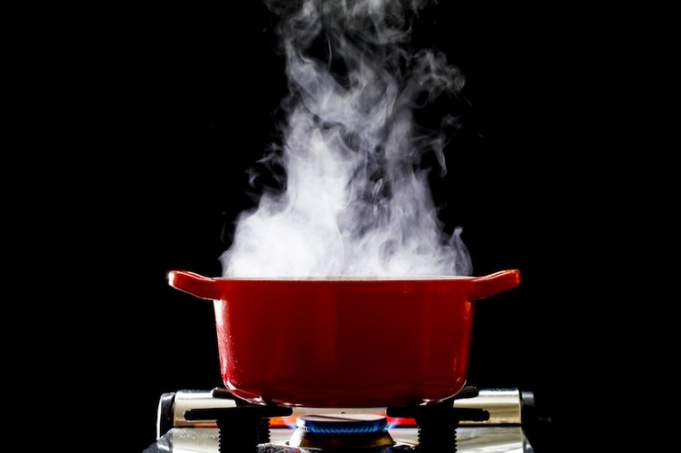
Water Vapor Feedback
Radiative forcing warms surface
Warmer surface evaporates more water
Warmer air can “hold more water”
Increased water vapor (GHG) absorbs more outgoing radiation, amplifying warming

Slide 16

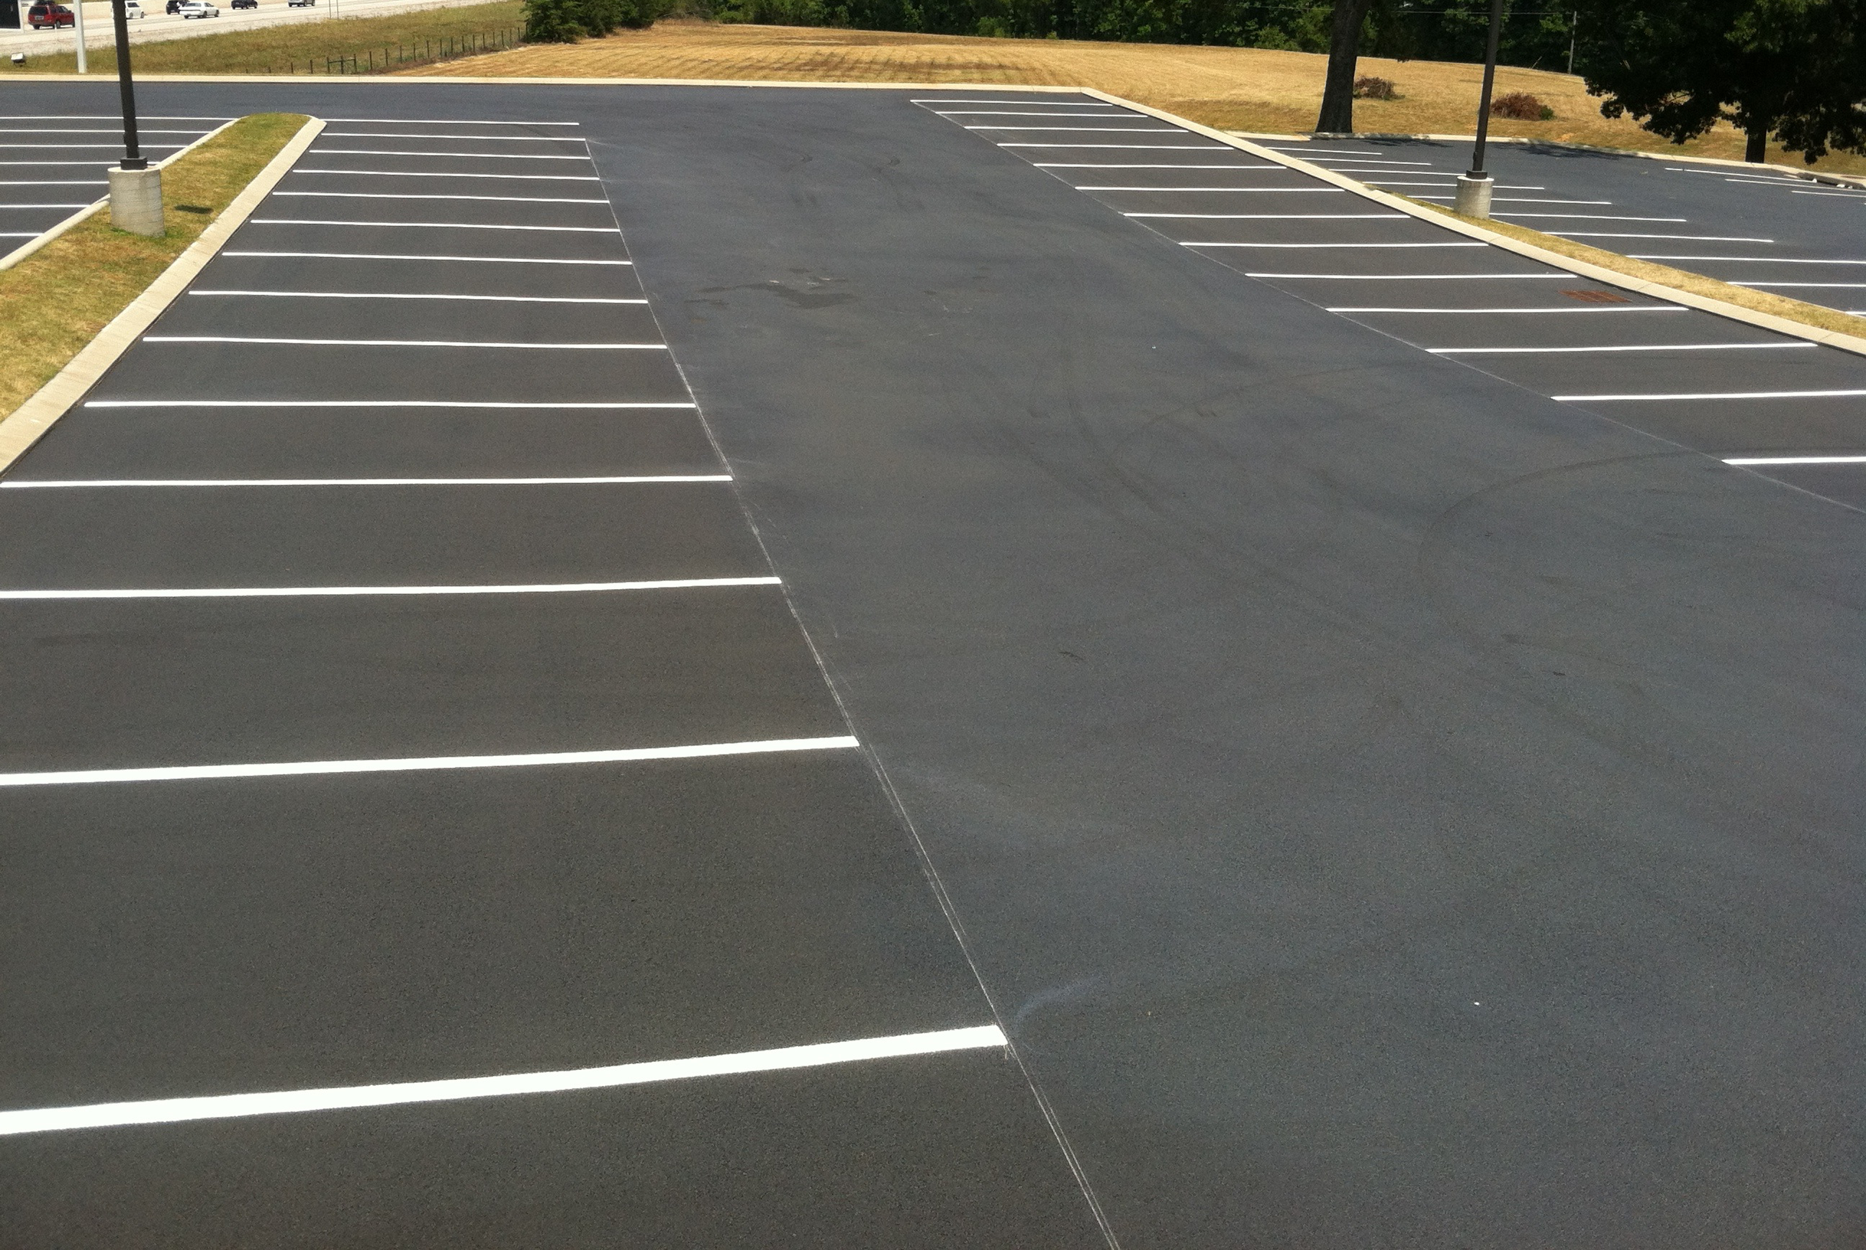
Ice Albedo Feedback
Radiative forcing melts snow and ice
Darker surface absorbs more radiation
Amplifies warming or cooling

Slide 17
Vertical Mixing Feedback
H
E
A
T
Cold
Cold
Greenhouse effect depends on emission to space from higher (colder) levels of the atmosphere
If radiative forcing produces increased vertical mixing by convection, then more heat is mixed to higher levels
Warm air aloft emits more radiation to space, compensating for original forcing

Slide 18
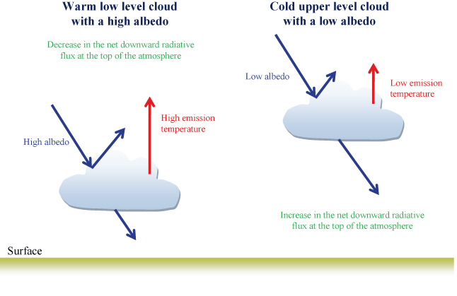
Cloud Feedbacks
Additional water vapor makes more clouds
Low clouds cool, but high clouds warm

Slide 19
Estimating Total Climate Sensitivity
Calculation from physical principles including feedback processes
(complex global climate models)
  Advantage: Physical insight
  Disadvantage: “All models are wrong …”
Paleoclimate analogs: how much has climate changed in the past when forcing of known strength was applied?
  Advantage: all feedbacks included
  Disadvantage: hard to know exactly how much forcing & global temperature response

Slide 20

Learning from the Past
Geologic past
(100’s of millions of years)
Deglaciation analog
(18,000 years ago to preindustrial time)
Last Millennium analog
(Medieval Warm Period to Little Ice Age)
Modern Climate Record
(20th Century changes)
The further back we go, the less data we have to work with.
Using modern data, we have only brief transients to study.

Slide 21
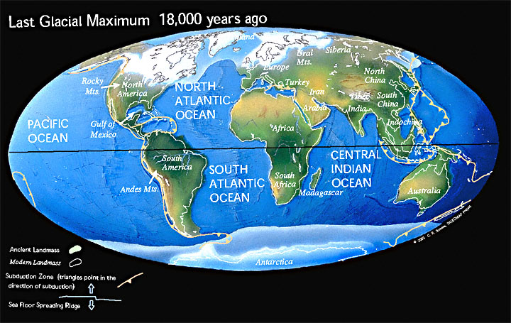
Ice Age World
High albedo
Low CO₂

Slide 22
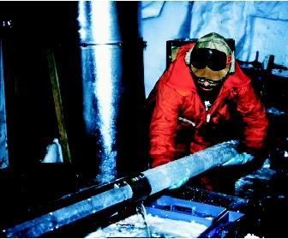
CO₂ and the Ice Ages
Over the past 420,000 years atmospheric CO₂ has varied between 180 and 280 ppm, beating in time with the last four glacial cycles
CO₂
370 ppm in 2000
ice
ice
ice
ice
Vostok (400k yr) Ice Core data (Petit et al, 1999)

Slide 23
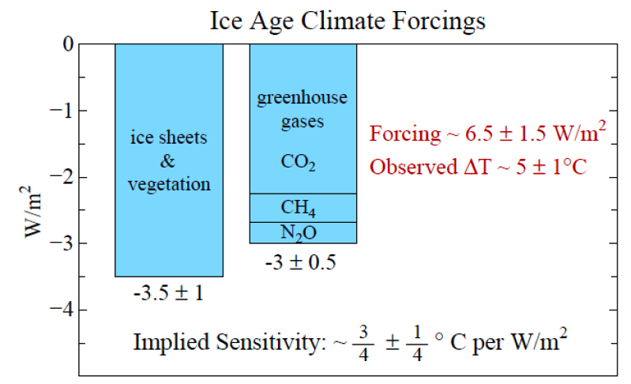
LGM Climate Forcing
Source: Hansen and Sato (2011)

Slide 24
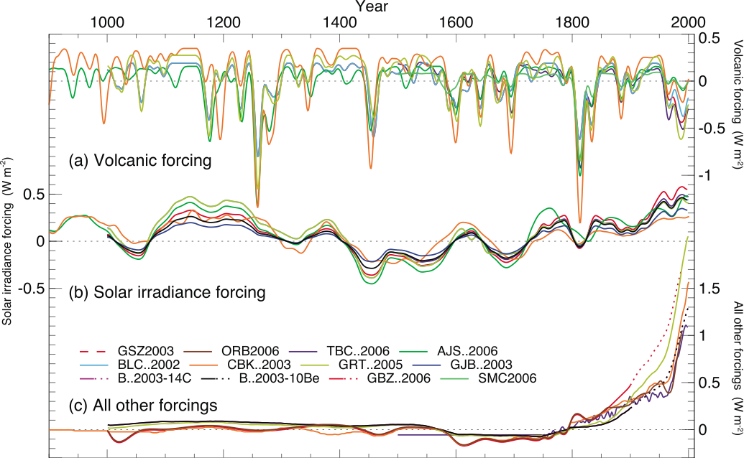
Reconstructed Climate Forcing Since 1000 AD
1816
1991
0.5
Pinatubo
Tambora
“year w/out
a summer”
1.0 W m⁻²

Slide 25

The Past 2000 Years
0.8 K

Slide 26
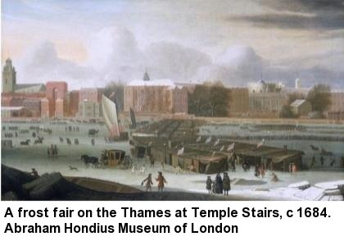
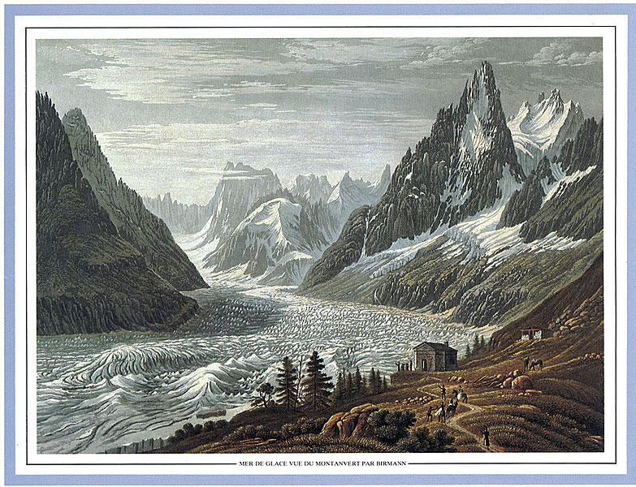
Second Millennium Analog
Cooling from Medieval Warm Period to
Little Ice Age ~ 0.8 K
Solar forcing ~ 1.0 W m⁻²
(somewhat complicated
by volcanic forcing)
Total climate sensitivity
(including feedback)
0.8 K per (W m⁻²)
1826

Slide 27
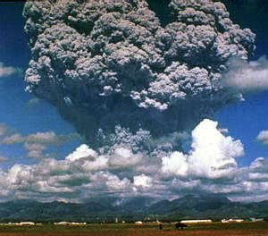
Volcanic Analog
Cooling following eruption of
Mount Pinatubo in 1991 ~ 0.5 K
Volcanic forcing ~ 0.7 W m⁻²
Total climate sensitivity (including feedback) 0.7 K per (W m⁻²)

Slide 28
Climate Sensitivity to enhanced CO₂
Many lines of evidence suggest about
0.8 °C of warming per (W m⁻²)
Remember each doubling of CO₂
adds 3.7 Watts per square meter
So expect about
(3.7 W m⁻²) x (0.8 °C (W m⁻²)⁻¹)
= 3 °C per doubling of CO₂

Slide 29
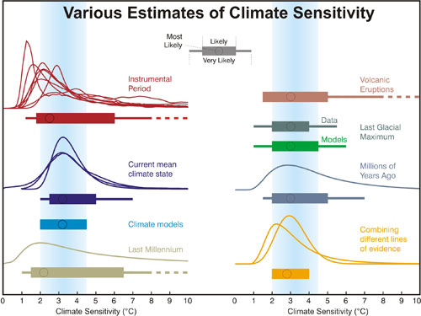
Climate Sensitivity
Distributions and ranges for climate sensitivity from different lines of evidence. The circle indicates the most likely value. The thin colored bars indicate very likely value (more than 90% probability). The thicker colored bars indicate likely values (more than 66% probability). Dashed lines indicate no robust constraint on an upper bound. The IPCC likely range (2 to 4.5°C) and most likely value (3°C) are indicated by the vertical grey bar and black line, respectively (Source: Knutti & Hegerl, Nature, 2008)

Slide 30
Remember
CO₂ forcing ~ 4 W m⁻² per doubling
Climate Sensitivity = Response / Forcing
Sensitivity depends on balance of
positive & negative feedback
  Pos Feedbacks: water vapor, ice/albedo
  Neg Feedback: low clouds, vertical mixing
Past climate sensitivity ~ 0.8 ºC / (W m⁻²)
SENSITIVITY ~ 3 ºC global average per doubling of CO₂, agrees w / models

