Slide 1
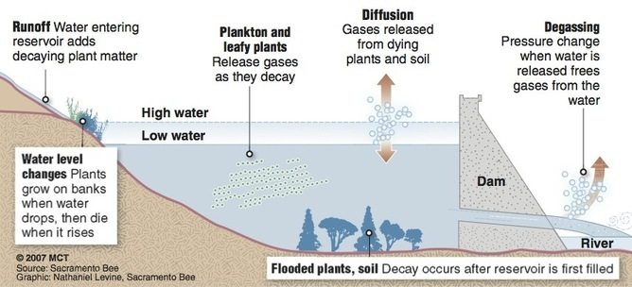
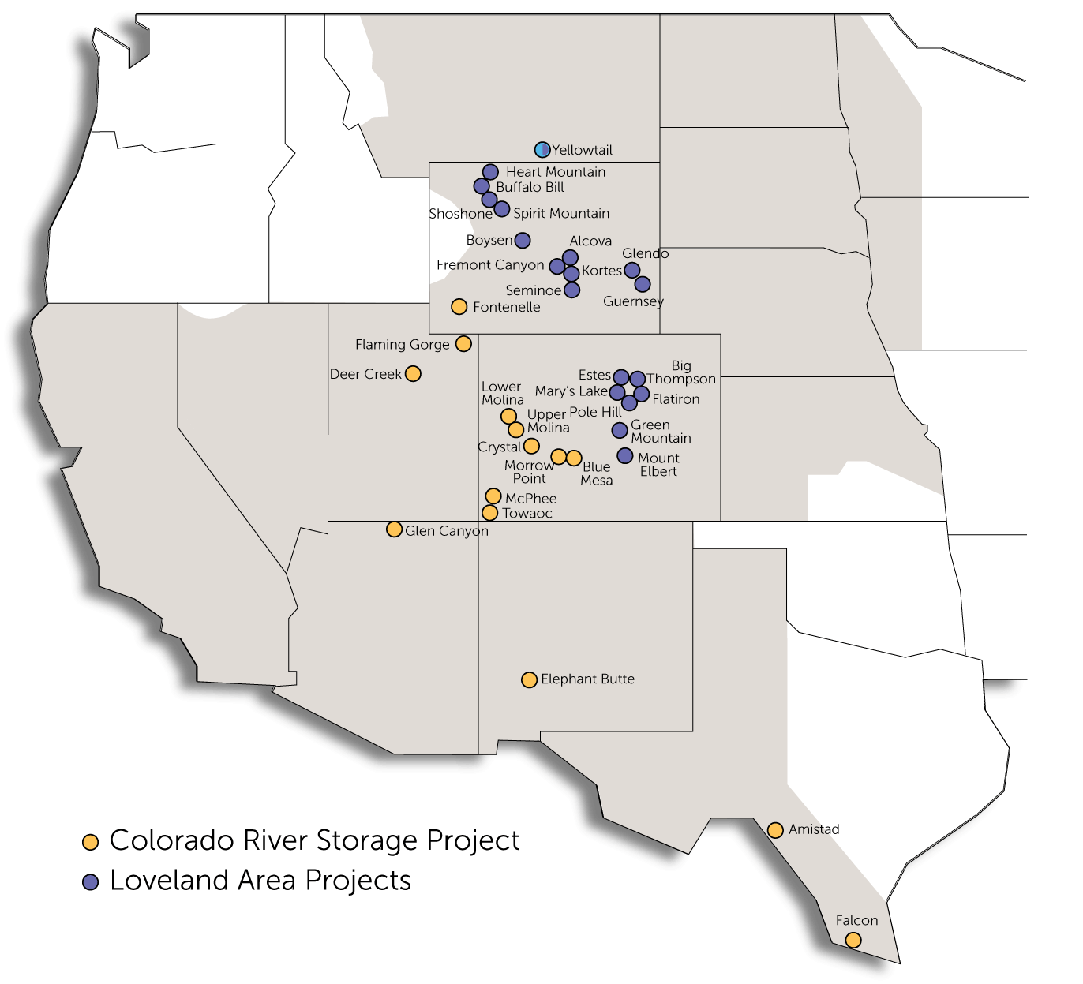
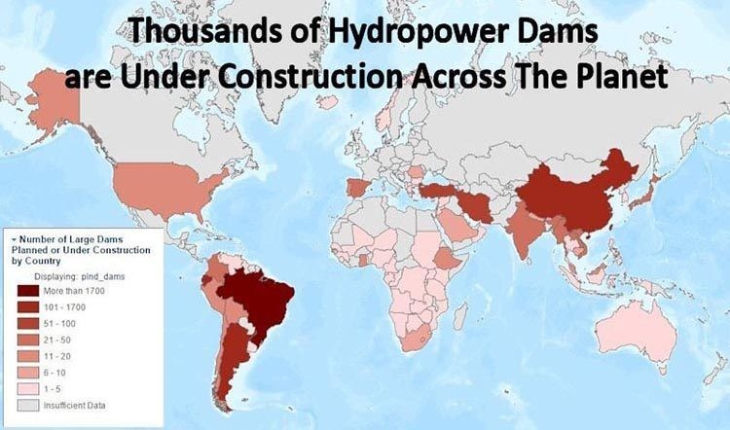
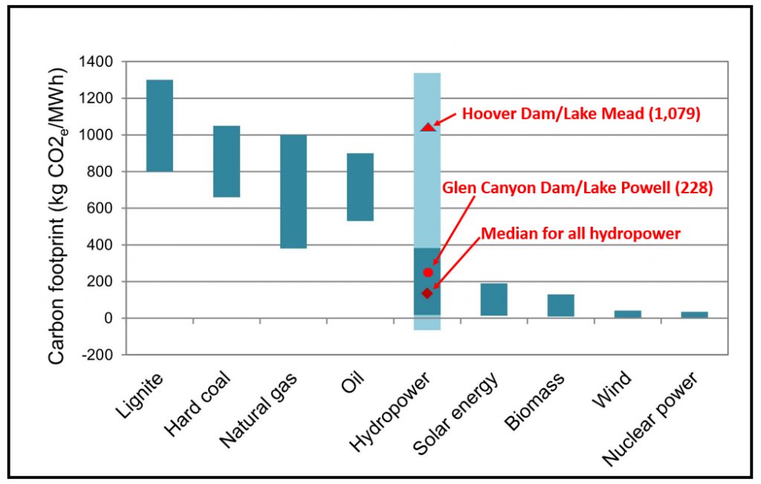
PRPA Hydropower Facilities – 21% of portfolio
“emissions free resource” per PRPA website

Slide 2
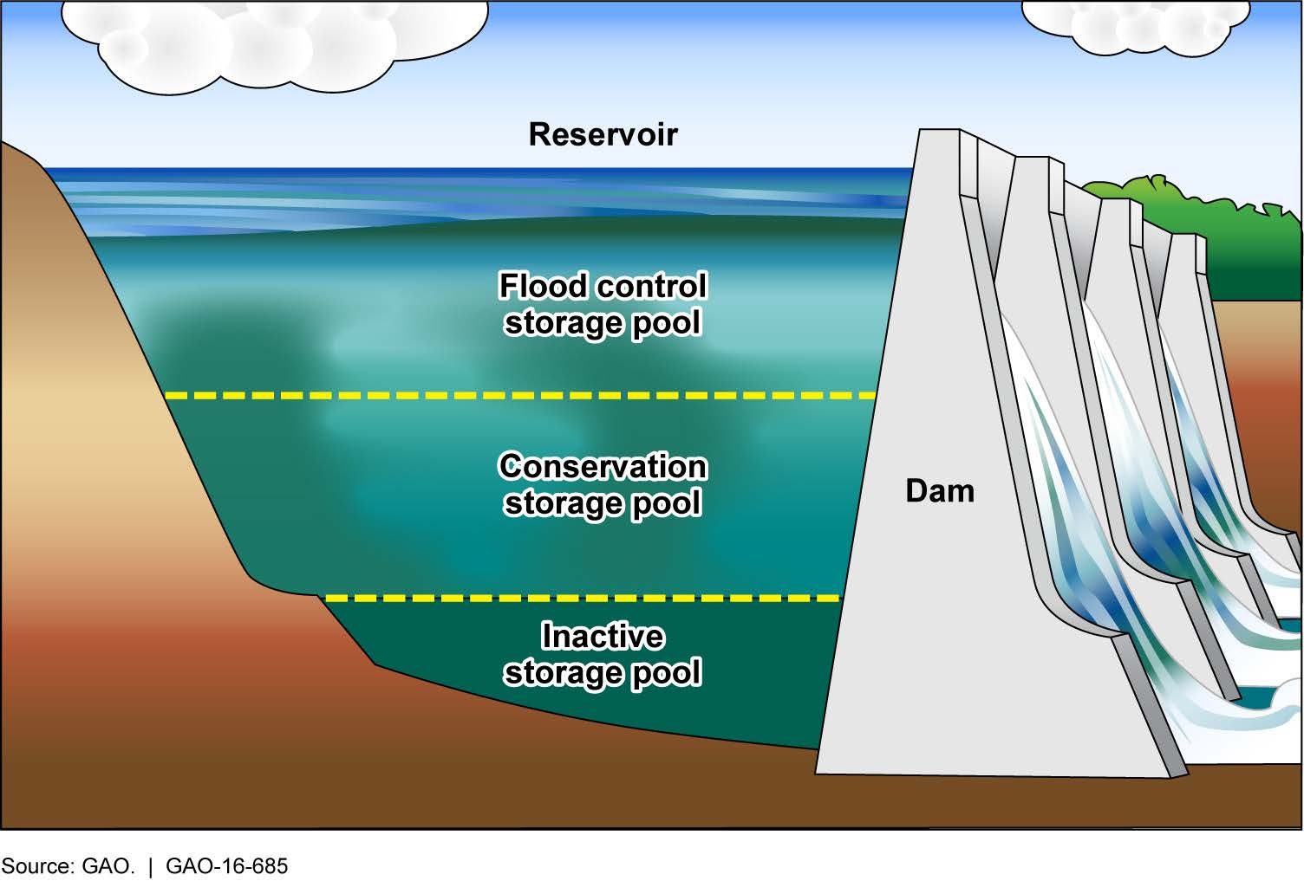
Reservoirs are described to have these uses:
Irrigation Water Supply
Municipal Water Supply
Shipping/Transportation
Flood Control
Hydropower
Recreation
- The majority of emissions from most hydropower reservoirs come from operating the turbines.
- The IHA protocol does not appear to rank the uses proportionally to emissions sources.
- A reservoir with large emissions (e.g. 1,000 kg CO2e/MWh) could have just one-sixth or less of those emissions attributed to hydropower through accounting measures, even though the primary use and source of the emissions is hydropower.
- The ISO standard for GHG life cycle inventories calls for attributing GHG emissions to their principal source activities, and/or ranking the emissions according to their primary use.
- The “uses” of reservoirs have historically been very loosely defined. For example, U.S. reservoirs built by the BuRec, which were primarily destined for irrigation water, could be administratively designated for “flood control”, allowing water deliveries to farmers at drastically lower reduced rates. This is described well in Cadillac Desert by Marc Reisner.
+ Recreation
+ Shipping
+ Hydropower
Turbines

