Slide 1
ESS Lecture 24
Solutions to climate change
Closing statements.

Slide 2
Today: Last standard lecture.
Wednesday: Entire course in review.
Friday’s lecture: Final exam review.
Housekeeping - schedule.

Slide 3
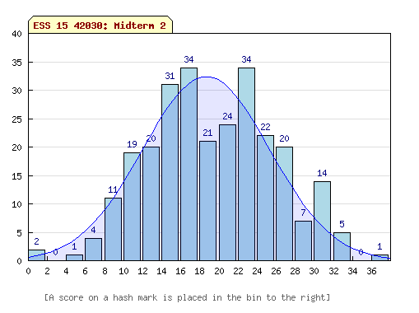
Housekeeping - corrected midterm 2 distribution.
(previously
mean was 16.7)
There was a scantron grading issue that affected many grades
The mean is 2-3 points higher now.

Slide 4
Solving the Energy-Carbon-Climate Problem
by Prof. Steve Davis, ESS
Notes:
To set the stage, this is a schematic of how I think about how humans drive climate change. Mention LU. Similar cycle could be used to portray the drivers of other GHGs and LUC.
Cheap energy: fossil fuels supply roughly 85% of the primary energy used worldwide in recent years.
CO2 Emissions: Burning of fossil fuels is the largest anthropogenic source of CO2 (~91%, land use is 9% but with much higher uncertainty).
CO2 in Atm: Increasing levels of atmospheric CO2 are the primary cause of global warming and ocean acidification.
I like breaking the cycle down this way because it also nicely organizes the options we have for dealing with the climate-carbon problem. Different strategies break the cycle in different place.
Conservation: Eat less meat. Turn down the air conditioner. Stay-cations. There are many things we can collectively do to reduce our demand for goods and services. Of course, not everyone lives in the US and conservation may not be a viable strategy in some places, but I’ll touch on that later in the talk.
Efficiency: Buy a Prius. Use fluorescent light bulbs. Green buildings. Efficiency is about getting more out of the energy we already use.
Carbon-free energy: As we’ll talk about more in a moment, there’s little doubt that no matter our efforts to be efficient and use less, human demand for energy will continue to grow. One way out of this cycle, then, is to generate energy from sources that don’t add CO2 to the atmosphere.
CCS: Similarly, we can use carbon-based energy but capture and store the produced CO2 out of the atmosphere.
Geoengineering: Another approach that’s beginning to be discussed is actively intervening in the climate system by doing things like adding aerosols to the stratosphere to “manage” solar radiation.
Adaptation: Lastly, there may be ways to adapt to the changing climate that can lessen its negative effect on our well-being.
Suffering: I didn’t label this last arrow, but I suppose it could say “suffering.”
Today, I’ll be discussing some work I’ve done in the area of mitigation, which is what we label any efforts to avoid CO2 emissions.
I’m also interested in these areas of intervention and adaptation—assessing the downstream impacts and opportunities to reduce them, but most of my work to date is on the upstream drivers of emissions.

Slide 5
Noor I power plant, Morocco in the Sahara desert (160 MW)
NPR, Feb. 2016.

Slide 6
“Thermal solar” plant - how it works.
Half a million parabolic mirrors focus light to heat a fluid to almost 400 degrees Celsius.
Heat used to make steam, drive turbines.
Heat can be stored in molten salt.
Unlike PV, provides power 3 hours after sunset (eventually 20 hours/day).
NPR, Feb. 2016.
Notes:
Like nukes, heat water to make steam.
Unlike nukes, no nuclear waste left behind. Lower maintenance costs per lifetime expected.

Slide 7
Visible from space.
power plant
NPR, Feb. 2016.
city
reservoir
Notes:
Link to the power density concept.

Slide 8
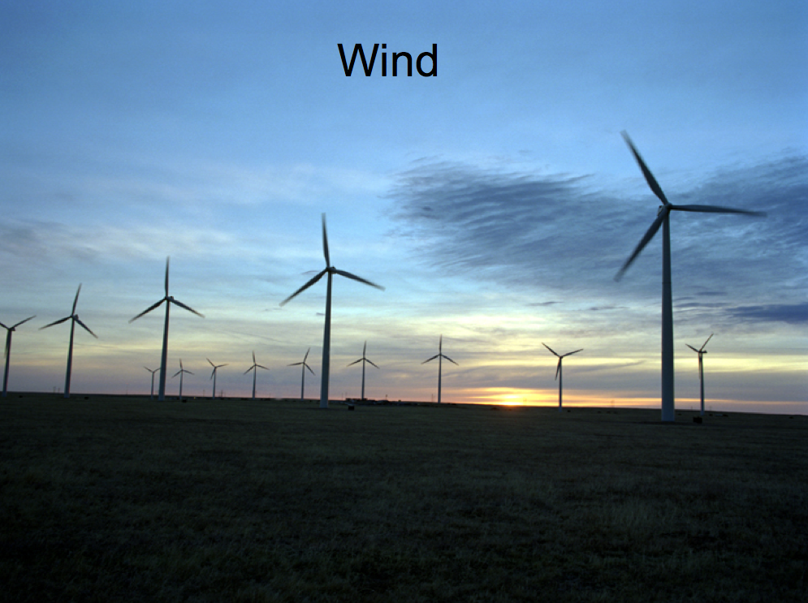

Slide 9
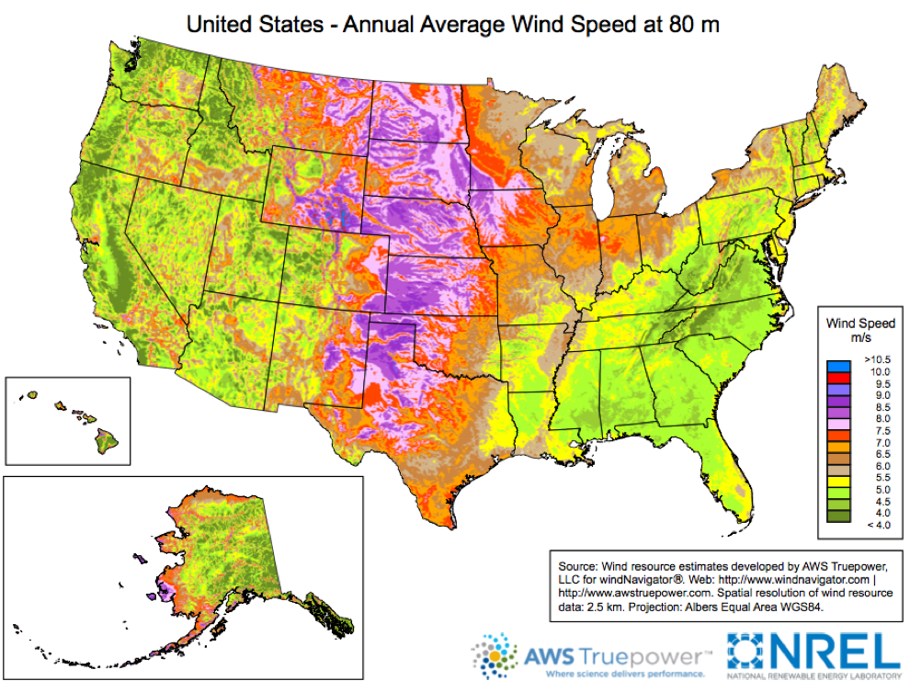
Wind Resource
Notes:
How fast are the average wind speeds along our coast?

Slide 12
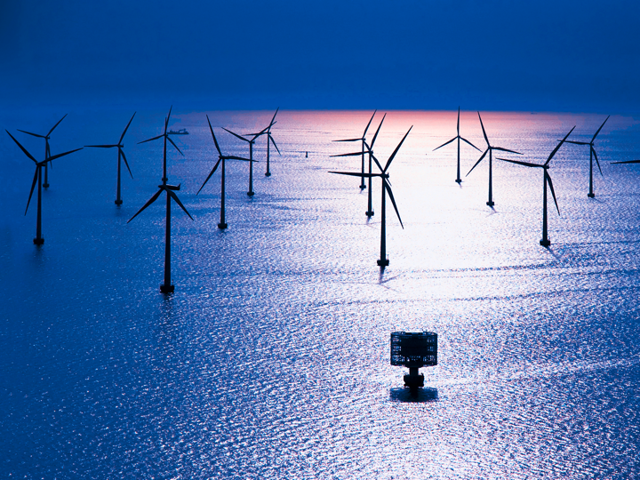
Offshore wind.

Slide 13
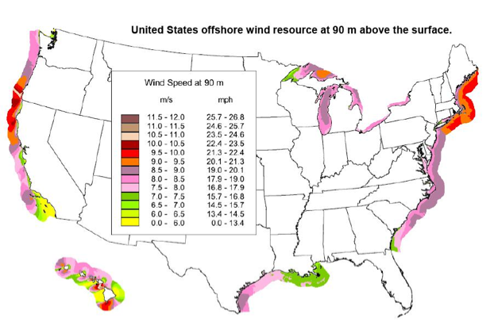

Slide 14
i-clicker: How loud is a modern wind turbine if you’re standing directly beneath it?
Regrigerator
Vacuum cleaner
Lawn mower
Blender

Slide 16
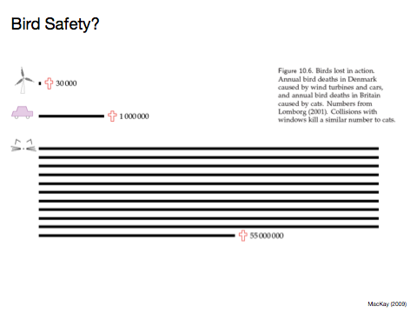

Slide 17
There is massive potential for wind and solar energy in America and around the world.

Slide 18
Compared to wind & solar, there is less potential for generating new carbon free energy in America from
Wave energy
Limited coastlines, fetch, mass & maintenance of seaworthy infrastructure.
Hydro-electric
Much of potential already exploited.

Slide 19
Carbon capture & sequestration.

Slide 20
Solving the Energy-Carbon-Climate Problem
by Prof. Steve Davis, ESS
Notes:
To set the stage, this is a schematic of how I think about how humans drive climate change. Mention LU. Similar cycle could be used to portray the drivers of other GHGs and LUC.
Cheap energy: fossil fuels supply roughly 85% of the primary energy used worldwide in recent years.
CO2 Emissions: Burning of fossil fuels is the largest anthropogenic source of CO2 (~91%, land use is 9% but with much higher uncertainty).
CO2 in Atm: Increasing levels of atmospheric CO2 are the primary cause of global warming and ocean acidification.
I like breaking the cycle down this way because it also nicely organizes the options we have for dealing with the climate-carbon problem. Different strategies break the cycle in different place.
Conservation: Eat less meat. Turn down the air conditioner. Stay-cations. There are many things we can collectively do to reduce our demand for goods and services. Of course, not everyone lives in the US and conservation may not be a viable strategy in some places, but I’ll touch on that later in the talk.
Efficiency: Buy a Prius. Use fluorescent light bulbs. Green buildings. Efficiency is about getting more out of the energy we already use.
Carbon-free energy: As we’ll talk about more in a moment, there’s little doubt that no matter our efforts to be efficient and use less, human demand for energy will continue to grow. One way out of this cycle, then, is to generate energy from sources that don’t add CO2 to the atmosphere.
CCS: Similarly, we can use carbon-based energy but capture and store the produced CO2 out of the atmosphere.
Geoengineering: Another approach that’s beginning to be discussed is actively intervening in the climate system by doing things like adding aerosols to the stratosphere to “manage” solar radiation.
Adaptation: Lastly, there may be ways to adapt to the changing climate that can lessen its negative effect on our well-being.
Suffering: I didn’t label this last arrow, but I suppose it could say “suffering.”
Today, I’ll be discussing some work I’ve done in the area of mitigation, which is what we label any efforts to avoid CO2 emissions.
I’m also interested in these areas of intervention and adaptation—assessing the downstream impacts and opportunities to reduce them, but most of my work to date is on the upstream drivers of emissions.

Slide 21
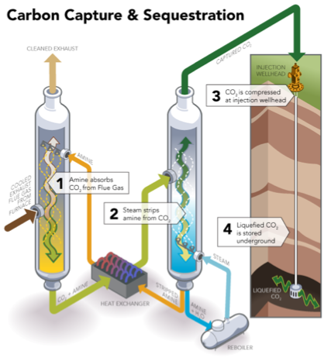
Example of a capture technology (post-combustion)

Slide 22
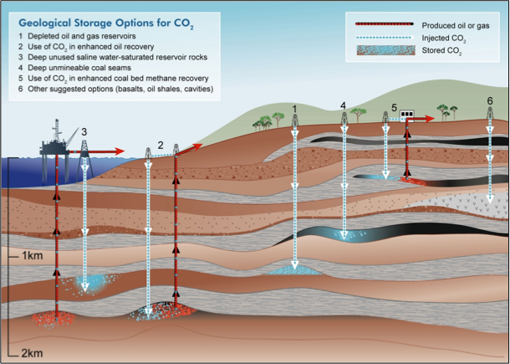

Slide 23
Carbon capture and sequestration.
Several technologies exist that can retrofit existing or equip new fossil fuel plants to remove CO2 from the emissions.
Post-combustion, pre-combustion, oxyfuel
But the energy produced costs more (20%-55%)
And the CO2 has to be transported & stored somewhere.
So far only pilot projects, has not been tried at scale.
Notes:
Costs - new pipelines (1.2X as many as we already have for oil infrastructure).

Slide 24
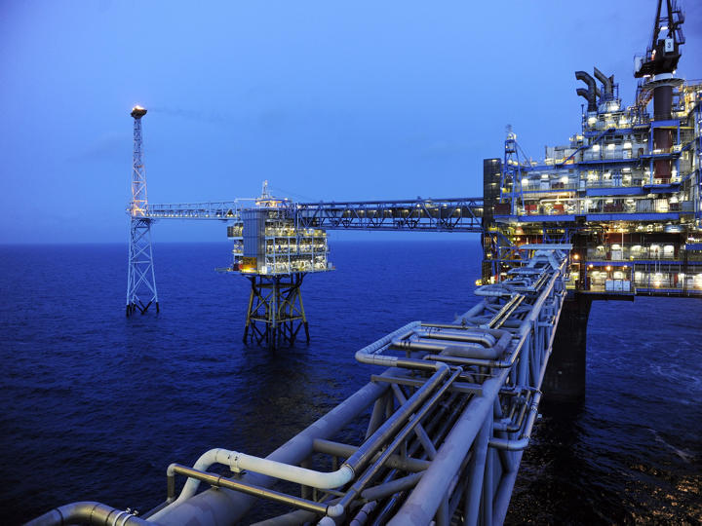

Slide 25
Pitfalls of carbon capture and sequestration.
“Clean” coal is not really clean - just putting the garbage (CO2) somewhere else.
Problem: It’s a lot of garbage!
Currently, average American is responsible for 120 pounds of CO2 each day. (source: Prof. Steve Davis)
What would it take to capture, transport and store all of this securely?
Notes:
Costs - new pipelines (1.2X as many as we already have for oil infrastructure).

Slide 26
How expensive is carbon-free energy?

Slide 27
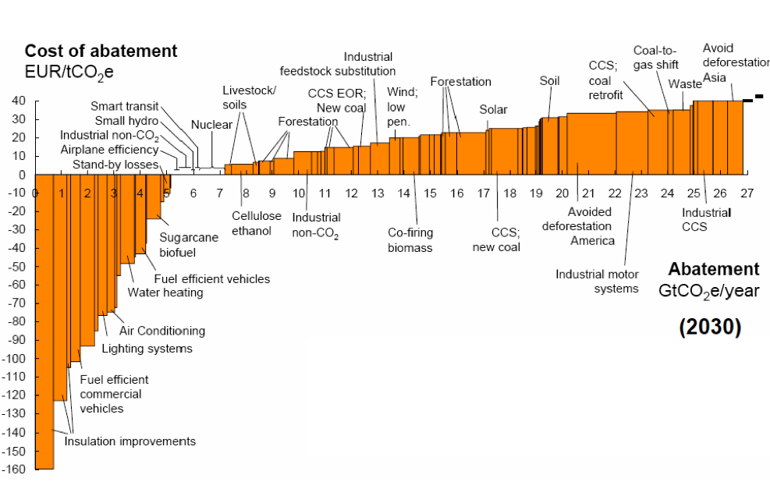
Costs & Benefits
McKinsey & Company (2009)
Height of each bar is cost per ton of CO2
Width of each bar is emissions reduction
Balance positive and negative areas

Slide 28
Costs: Storage

Slide 31
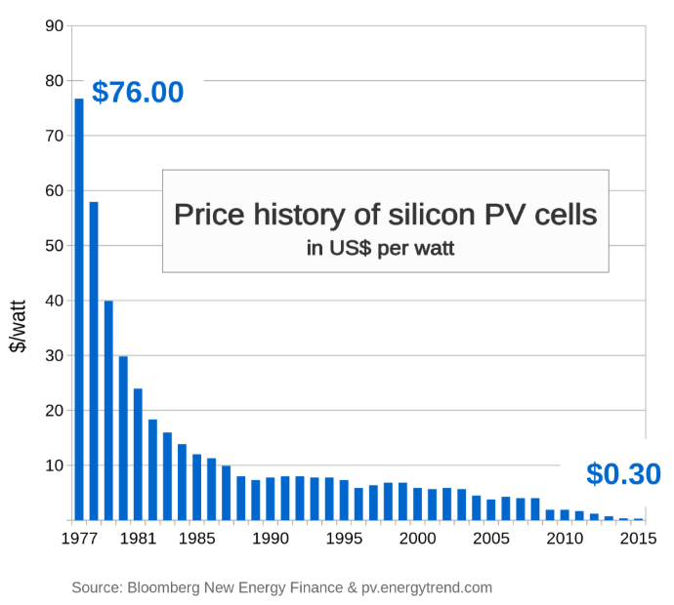
Notes:
Up until the price crash, was cClose to parity with oil or gas.

Slide 32
Solutions to climate change - in a nutshell.
Solutions to avoiding CO2 emissions exist.
There is huge potential for wind and solar energy in America.
Prices for carbon-free energy have been plummeting and are becoming more competitive with fossil fuel energy.
Technologies exist to meet energy demands with vastly reduced CO2 emissions to the atmosphere.

Slide 33
Closing statements.

Slide 34
I am torn between leaving you with an optimistic or a sobering closing message…

Slide 35
… so I’ll give you both.

Slide 36
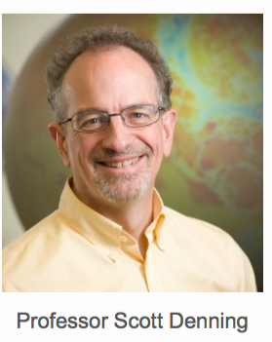
The optimistic message is inherited from this guy…
( who generously lent us many of the course materials I have shown you )

Slide 37
Free Market Solutions
A new industrial revolution won’t happen because people want to “do the right thing”
The government can’t just pass a law and create a new global energy economy, any more than they could 200 years ago
If low-carbon-footprint goods and services cost less than “dirtier” ones, people will buy them
Role of policy is to set incentives and then get out of the way

Slide 38
A Policy Spectrum
“command and control”
“market capitalism”
direct subsidy
“cap and trade”
“tax and rebate”

Slide 39
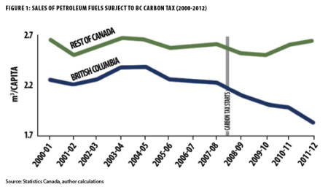
Popular Solutions
Province of British Columbia began a revenue neutral carbon tax in 2008
Per capita emissions are down 20%
Carbon taxes are 100% offset by reduced income taxes
Huge bipartisan support for policy (70%): repeal would raise income taxes!

Slide 40
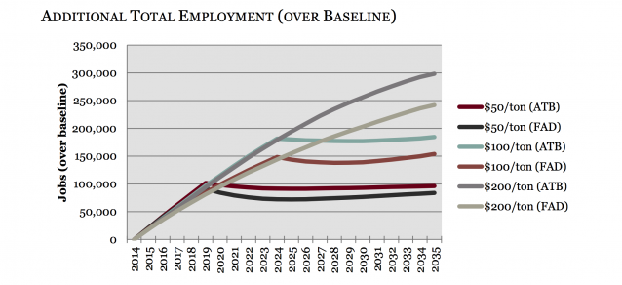
Growing Economy
Estimated impact of revenue-neutral carbon
taxes on total employment in California (Regional Economic Models, Inc.)

Slide 41
Imagine it’s 1800, and you’re in charge …
Somebody presents you with a grand idea for transforming the world economy:
Dig 10 billion tons of carbon out of the ground every year
Build a system of pipelines, supertankers, railroads, highways, and trucks to deliver it to every street corner on the planet
Build millions of cars every year, and millions of miles of roads to drive them on
Generate and pipe enough electricity to every house to power lights & stereos & plasma TVs
… “and here’s the itemized bill …”

Slide 42
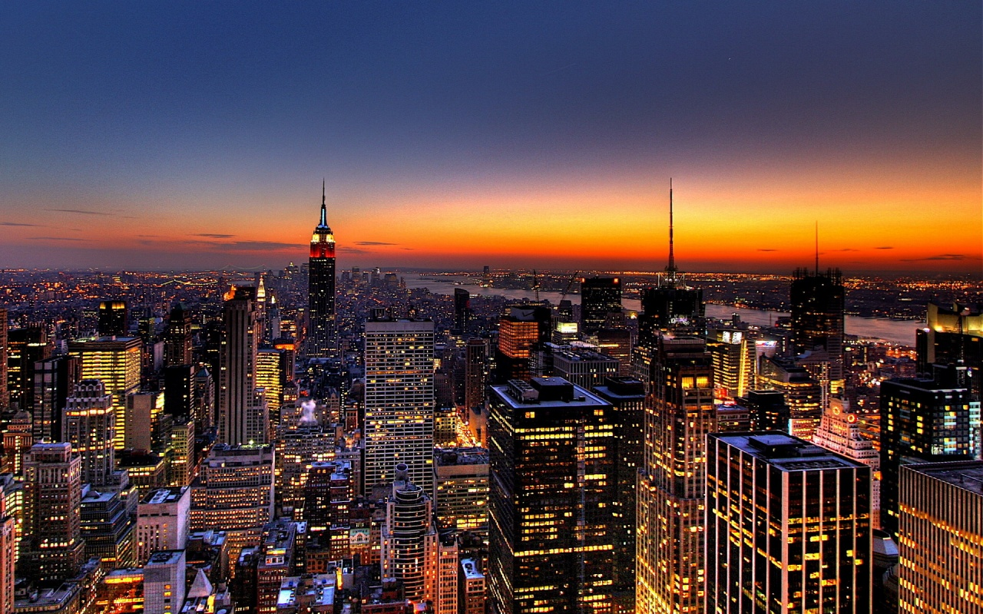
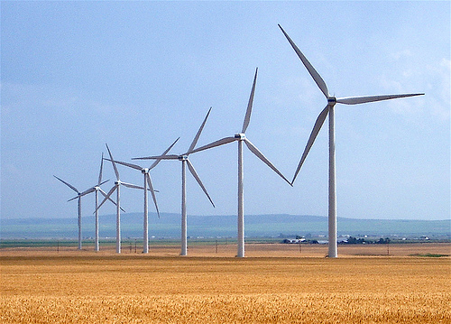
Who Built That?
Our ancestors built that very system
It cost them every dime of global GDP for 200 years (now $72T/yr)
It created every dime too!
Now our kids get to do it again!

Slide 43
Choose Your Future
Some people think:
“Our modern lifestyle is only possible because of the subsidy of cheap fossil fuel. When we stop burning coal we’ll freeze in the dark!”
I prefer:
“Our well-being depends on creativity and hard work. Before we run out of oil, we’ll deploy energy technologies for the 21st Century.
Our future is bright.”

Slide 44
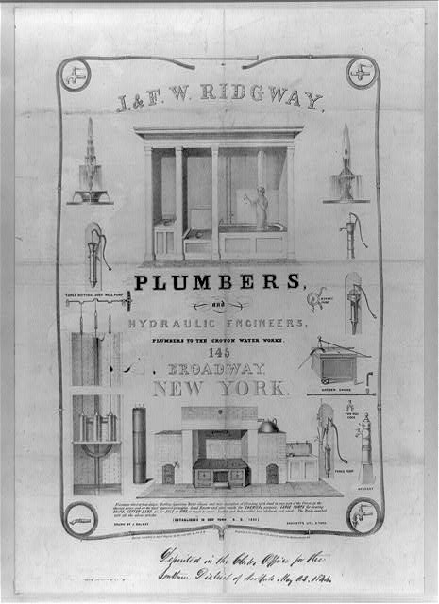
Costs
Conversion to 100% noncarbon energy will cost about 1% to 3% of global GDP
That’s about what it cost to retrofit all the world’s cities with indoor plumbing a century ago …
It was worth it!

Slide 45
The second message is a sobering reality check from Prof. Steve Davis.
Steve Davis
Professor, UC Irvine, ESS.
B.A., J.D., Ph. D. (!)
( who also lent us many of the course materials I have shown you in the last few lectures )

Slide 46
On the one hand, Steve affirms the idea that emissions are a solveable problem!
by Prof. Steve Davis, ESS
Notes:
To set the stage, this is a schematic of how I think about how humans drive climate change. Mention LU. Similar cycle could be used to portray the drivers of other GHGs and LUC.
Cheap energy: fossil fuels supply roughly 85% of the primary energy used worldwide in recent years.
CO2 Emissions: Burning of fossil fuels is the largest anthropogenic source of CO2 (~91%, land use is 9% but with much higher uncertainty).
CO2 in Atm: Increasing levels of atmospheric CO2 are the primary cause of global warming and ocean acidification.
I like breaking the cycle down this way because it also nicely organizes the options we have for dealing with the climate-carbon problem. Different strategies break the cycle in different place.
Conservation: Eat less meat. Turn down the air conditioner. Stay-cations. There are many things we can collectively do to reduce our demand for goods and services. Of course, not everyone lives in the US and conservation may not be a viable strategy in some places, but I’ll touch on that later in the talk.
Efficiency: Buy a Prius. Use fluorescent light bulbs. Green buildings. Efficiency is about getting more out of the energy we already use.
Carbon-free energy: As we’ll talk about more in a moment, there’s little doubt that no matter our efforts to be efficient and use less, human demand for energy will continue to grow. One way out of this cycle, then, is to generate energy from sources that don’t add CO2 to the atmosphere.
CCS: Similarly, we can use carbon-based energy but capture and store the produced CO2 out of the atmosphere.
Geoengineering: Another approach that’s beginning to be discussed is actively intervening in the climate system by doing things like adding aerosols to the stratosphere to “manage” solar radiation.
Adaptation: Lastly, there may be ways to adapt to the changing climate that can lessen its negative effect on our well-being.
Suffering: I didn’t label this last arrow, but I suppose it could say “suffering.”
Today, I’ll be discussing some work I’ve done in the area of mitigation, which is what we label any efforts to avoid CO2 emissions.
I’m also interested in these areas of intervention and adaptation—assessing the downstream impacts and opportunities to reduce them, but most of my work to date is on the upstream drivers of emissions.

Slide 47
On the other hand, things look grim enough that intervention in the climate system may be needed.
Notes:
To set the stage, this is a schematic of how I think about how humans drive climate change. Mention LU. Similar cycle could be used to portray the drivers of other GHGs and LUC.
Cheap energy: fossil fuels supply roughly 85% of the primary energy used worldwide in recent years.
CO2 Emissions: Burning of fossil fuels is the largest anthropogenic source of CO2 (~91%, land use is 9% but with much higher uncertainty).
CO2 in Atm: Increasing levels of atmospheric CO2 are the primary cause of global warming and ocean acidification.
I like breaking the cycle down this way because it also nicely organizes the options we have for dealing with the climate-carbon problem. Different strategies break the cycle in different place.
Conservation: Eat less meat. Turn down the air conditioner. Stay-cations. There are many things we can collectively do to reduce our demand for goods and services. Of course, not everyone lives in the US and conservation may not be a viable strategy in some places, but I’ll touch on that later in the talk.
Efficiency: Buy a Prius. Use fluorescent light bulbs. Green buildings. Efficiency is about getting more out of the energy we already use.
Carbon-free energy: As we’ll talk about more in a moment, there’s little doubt that no matter our efforts to be efficient and use less, human demand for energy will continue to grow. One way out of this cycle, then, is to generate energy from sources that don’t add CO2 to the atmosphere.
CCS: Similarly, we can use carbon-based energy but capture and store the produced CO2 out of the atmosphere.
Geoengineering: Another approach that’s beginning to be discussed is actively intervening in the climate system by doing things like adding aerosols to the stratosphere to “manage” solar radiation.
Adaptation: Lastly, there may be ways to adapt to the changing climate that can lessen its negative effect on our well-being.
Suffering: I didn’t label this last arrow, but I suppose it could say “suffering.”
Today, I’ll be discussing some work I’ve done in the area of mitigation, which is what we label any efforts to avoid CO2 emissions.
I’m also interested in these areas of intervention and adaptation—assessing the downstream impacts and opportunities to reduce them, but most of my work to date is on the upstream drivers of emissions.

Slide 48
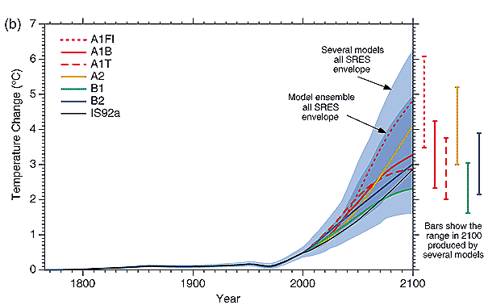
Temperatures continue to increase throughout this century in every plausible emissions scenario
There is no practical way for emissions reduction to reduce temperatures this century
What do we do if there is a climate emergency?
IPCC TAR
Notes:
But first, let’s talk about why anyone is even considering geoengineering.
So, here’s a plot showing warming this century under a range of scenarios meant to span the range of plausible paths along which the world’s economy and population will develop. What’s important here is not the path of any one of these scenarios (of course, specific future predictions of these sorts of things are notoriously bad), but that substantial warming occurs in every single projection. Emissions reductions can reduce rates of warming, but there is simply to reasonable way for emissions reductions to start cooling this century.
No one doing research on the topic of geoengineering thinks that it is a replacement for reducing emissions. However, given the unavoidable reality of ongoing warming, it’s being suggested that we need an emergency response system. In other words, what do we do if in 2040 or 2060 there were a climate crisis, say widespread famine or Greenland starts suddenly sliding off into the North Atlantic. A metaphor might be flood insurance--living in New Orleans, no one is opposed to building levees to hold back the water, but it seems prudent to have a back-up plan if the levees fail.

Slide 49
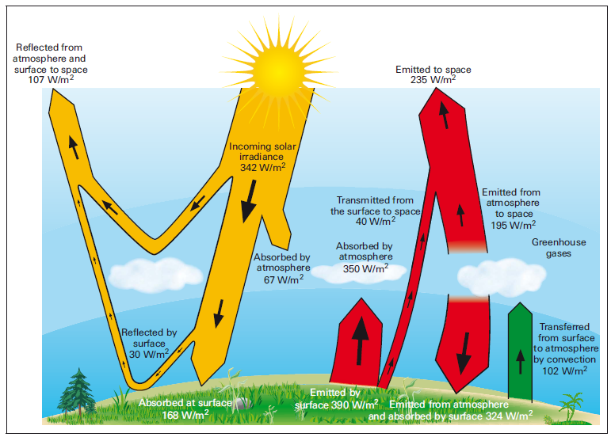
Solar Radiation Management options
Carbon Dioxide Removal options
Notes:
So with at least some explanation of why, let’s look at how it’s been suggested we might intervene.
Here’s the earth, warmed by incoming solar radiation, with some of the heat trapped by greenhouse gases in the atmosphere. Four main ways to deal with the problem of warming due to increasing GHGs:
1- decrease demand for energy (efficiency/conservation/pop. control) 2- generate energy without CO2 (reduce carbon intensity) 3- Remove CO2 from the atmosphere 4- Reflect solar radiation
Another metaphor could be helpful: the same process accounts for how hot the inside of your car can be after it has been parked in the sun for a few hours. Using this metaphor, you could think of efforts to reduce greenhouse gas emissions or remove them from the atmosphere are trying to roll down the windows of the car. “Sunblock” or solar radiation management (SRM) strategies are instead about parking in the shade.

Slide 50
Four leading “geo-engineering” strategies for Solar Radiation Management (SRM)
Space reflectors
Stratospheric aerosols
Cloud albedo
Surface albedo

Slide 51
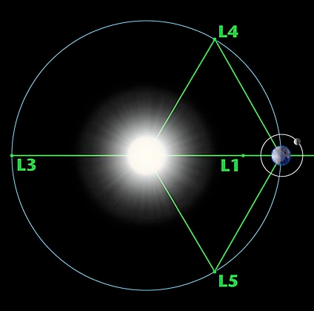
1. Space reflectors
Launch space mirrors to orbit
at the special L1 “Lagrange point”
Reduces the Watts per square meter coming from the sun.

Slide 52
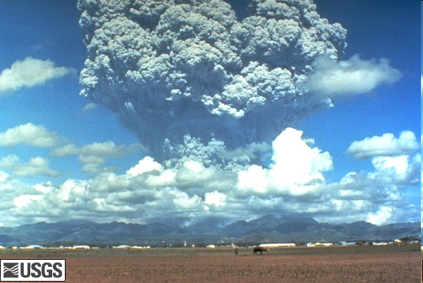
Volcanoes caused global cooling by putting small particles in the stratosphere
2. Stratospheric aerosols.
Mt. Pinatubo
1991
Soden et al., 2002
Notes:
We have the benefit of natural experiments like this. For several years after the eruption of Mt. Pinatubo in 1991, we observed global cooling (as well as reductions in stream runoff, e.g. Ganges lowest in history).

Slide 53
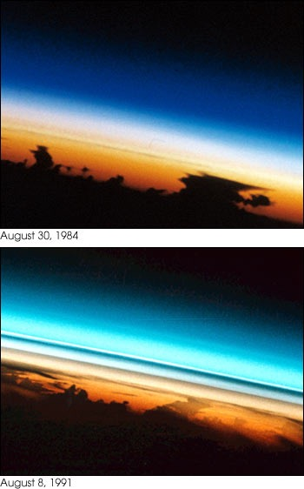
2. Stratospheric aerosols.
These two photos show the Earth’s limb at sunset before and after the Mt. Pinatubo eruption. The first view (STS41D-32-14) shows a relatively clear atmosphere, taken August 30, 1984. Astronauts were looking at the profiles of high thunderstorms topping out at the tropopause at sunset; different atmospheric layers absorbed the last rays of light from the sun as the spacecraft moved eastward.
The same type of photograph (STS043-22-23) was taken August 8, 1991, less than two months after the Pinatubo eruption. Two dark layers of aerosols make distinct boundaries in the atmosphere. The estimated altitude of aerosol layers in this view is 20 to 25 km.
Courtesy Alan Robock
Notes:
From http://earthobservatory.nasa.gov/Study/AstronautPinatubo/astronaut_pinatubo2.html

Slide 54
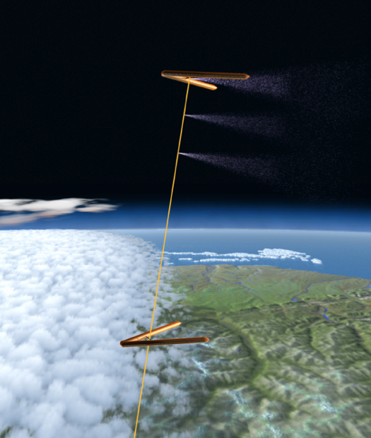
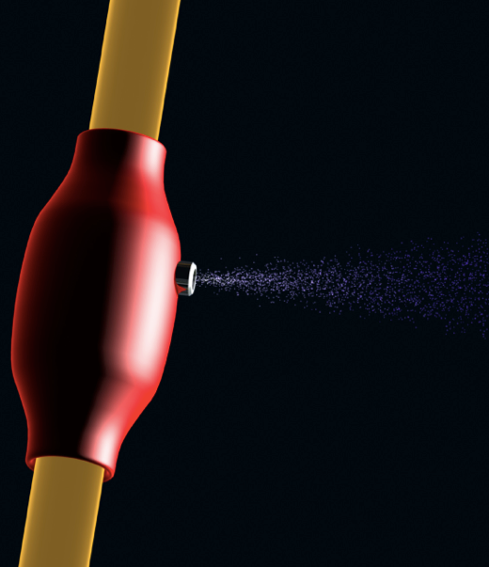
2. Stratospheric aerosols.
(Stratospheric ShieldTM)
A dozen installations like this could offset a doubling of CO₂ and would cost in the neighborhood of $300M in the first year, less per year to maintain.
Even if $1B per year, that’s 0.02% of federal budget and <4% of the US Department of Energy budget.
Mimic volcanoes by spraying
particles into the stratosphere.
http://intellectualventureslab.com/wp-content/uploads/2009/10/Stratoshield-white-paper-300dpi.pdf
Notes:
Might be $1B, but this is 3-4 orders of magnitude less than even the most sanguine estimates of transitioning the energy system.

Slide 55
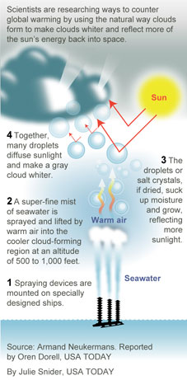
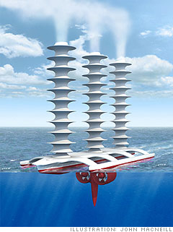
3. Cloud albedo - cloud reflectivity modification.

Slide 56
4. Surface albedo management
Painting roofs white.

Slide 57
Interventions to climate change - in a nutshell.
We are committed to a certain amount of global warming no matter what.
Our built infrastructure commits us to an additional amount based on its lifetime.
Decarbonizing the economy is possible but hard.
Climate emergencies may occur.
Unintended consequences of geo-engineering responses to emergencies raise new troubling questions

Slide 58
I share both views.
I think our future is bright.
But that serious risks may lurk.

Slide 59
Thanks.

