Slide 1
Fossil Fuel Combustion and the Economics of Energy

Slide 2
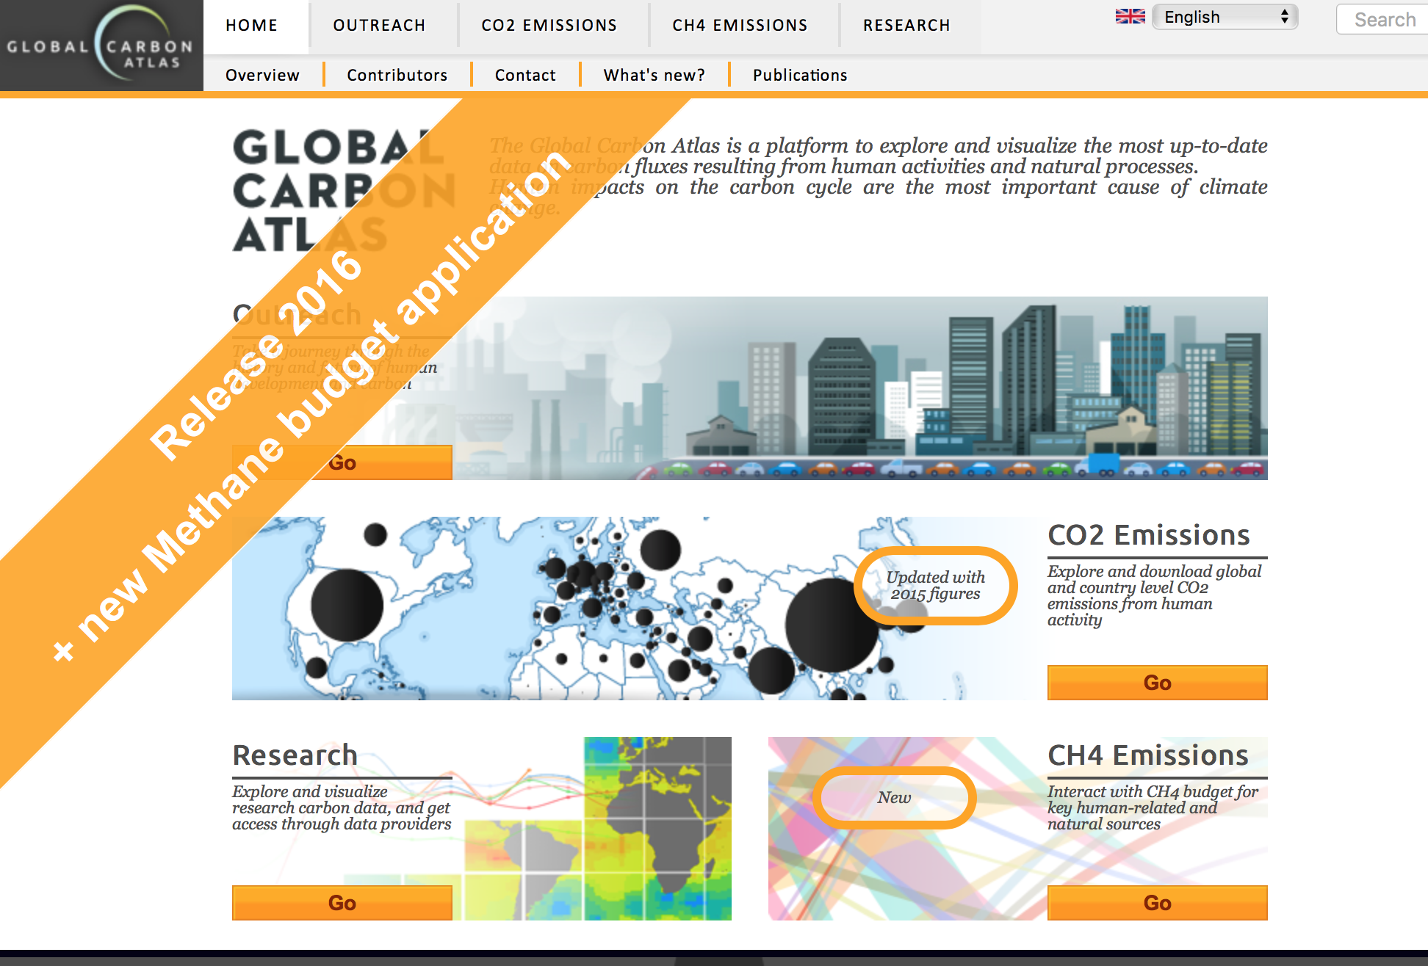

Slide 3
All the data is shown in GtC
1 Gigatonne (Gt) = 1 billion tonnes = 1×10¹⁵g = 1 Petagram (Pg)
1 kg carbon (C) = 3.664 kg carbon dioxide (CO₂)
1 GtC = 3.664 billion tonnes CO₂ = 3.664 GtCO₂
Disclaimer
The Global Carbon Budget and the information presented here are intended for those interested in learning about the carbon cycle, and how human activities are changing it. The information contained herein is provided as a public service, with the understanding that the Global Carbon Project team make no warranties, either expressed or implied, concerning the accuracy, completeness, reliability, or suitability of the information.

Slide 4
Carbon, Life, and Energy
Photosynthesis uses energy from the sun to convert inorganic air (CO2) to living biomass!
Most of this energy is released through respiration (back to CO2) when plants are eaten by animals, bacteria, people

Slide 5
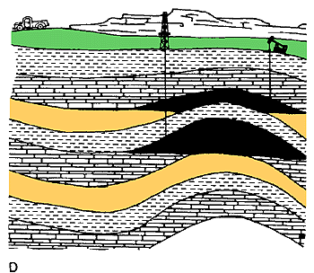
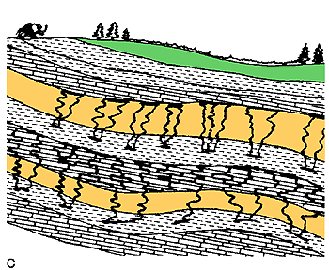
Fossil Fuels
Some of the stored solar energy in biomass can be preserved in fossilized remains

Slide 6
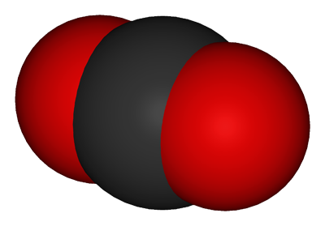
Hydrocarbons, Energy, and CO2
H
H
H
H
H
C
C
C
C
energy
energy
energy
energy
energy
energy
energy
H
C
C
C
C
H
H
H
H
We dig this stuff (“fossil fuels”) up and burn it, harvesting the stored energy to power civilization
O
O
O
C
energy
energy
energy
C
H
O
O
H
O
C
O
O
C
O
O
O
H
H
H
H
energy
O
energy
H
energy
H

Slide 7
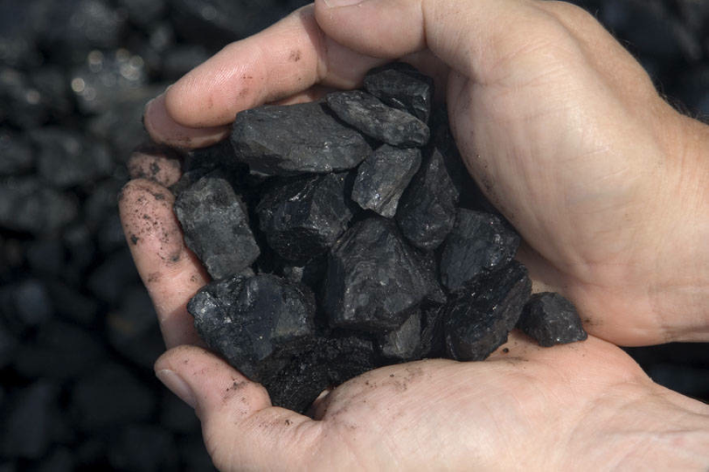

Slide 8
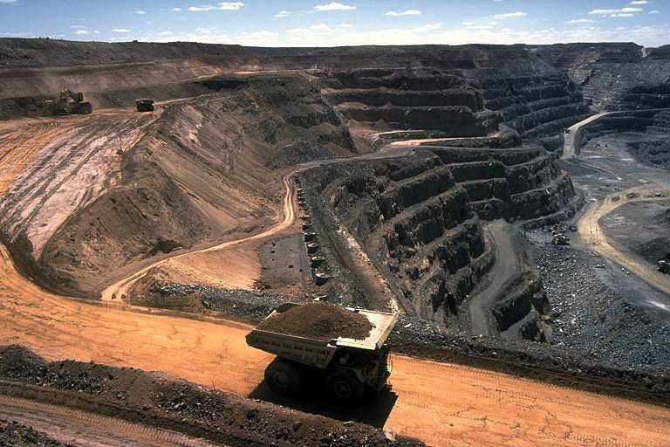
Mining Coal

Slide 10
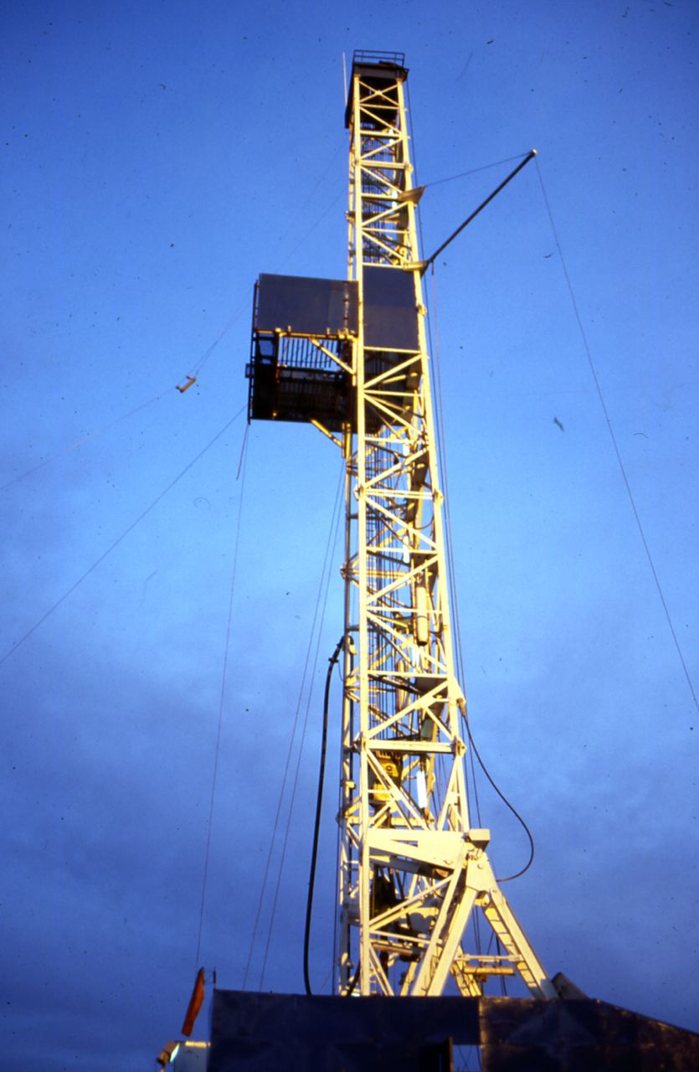
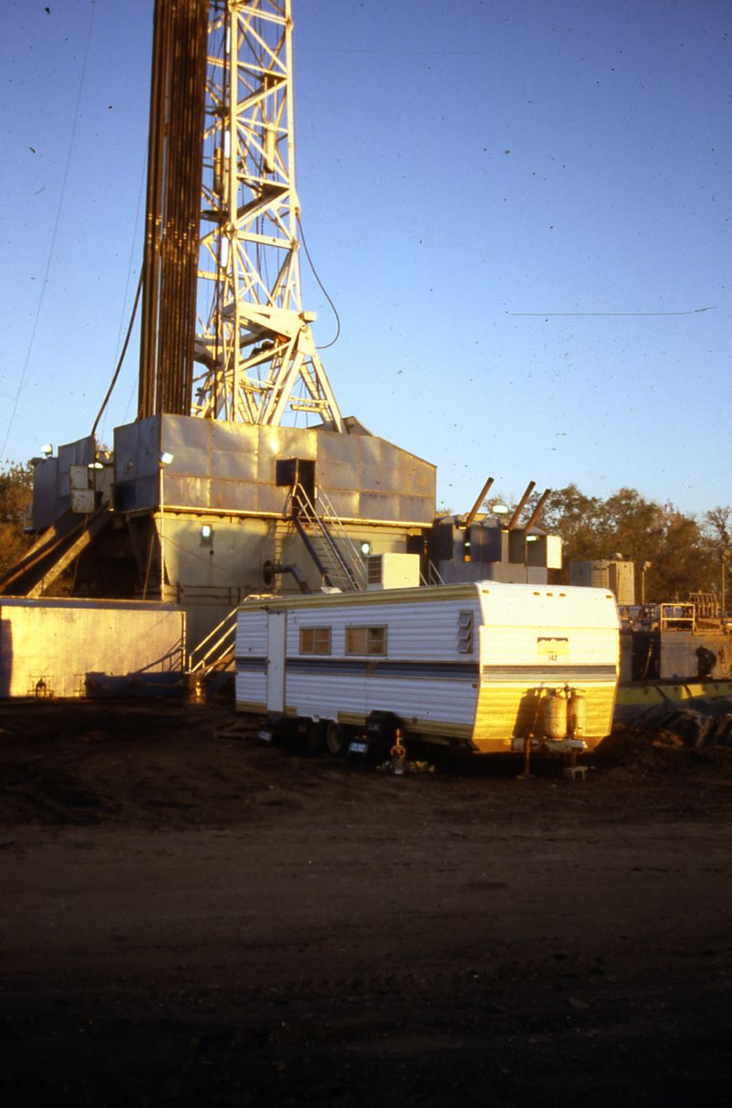
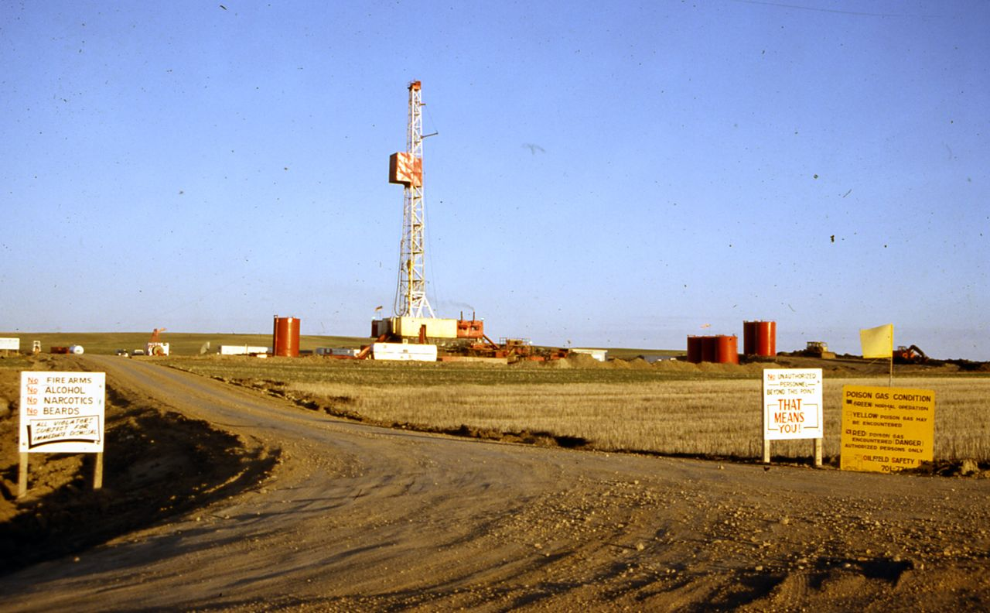
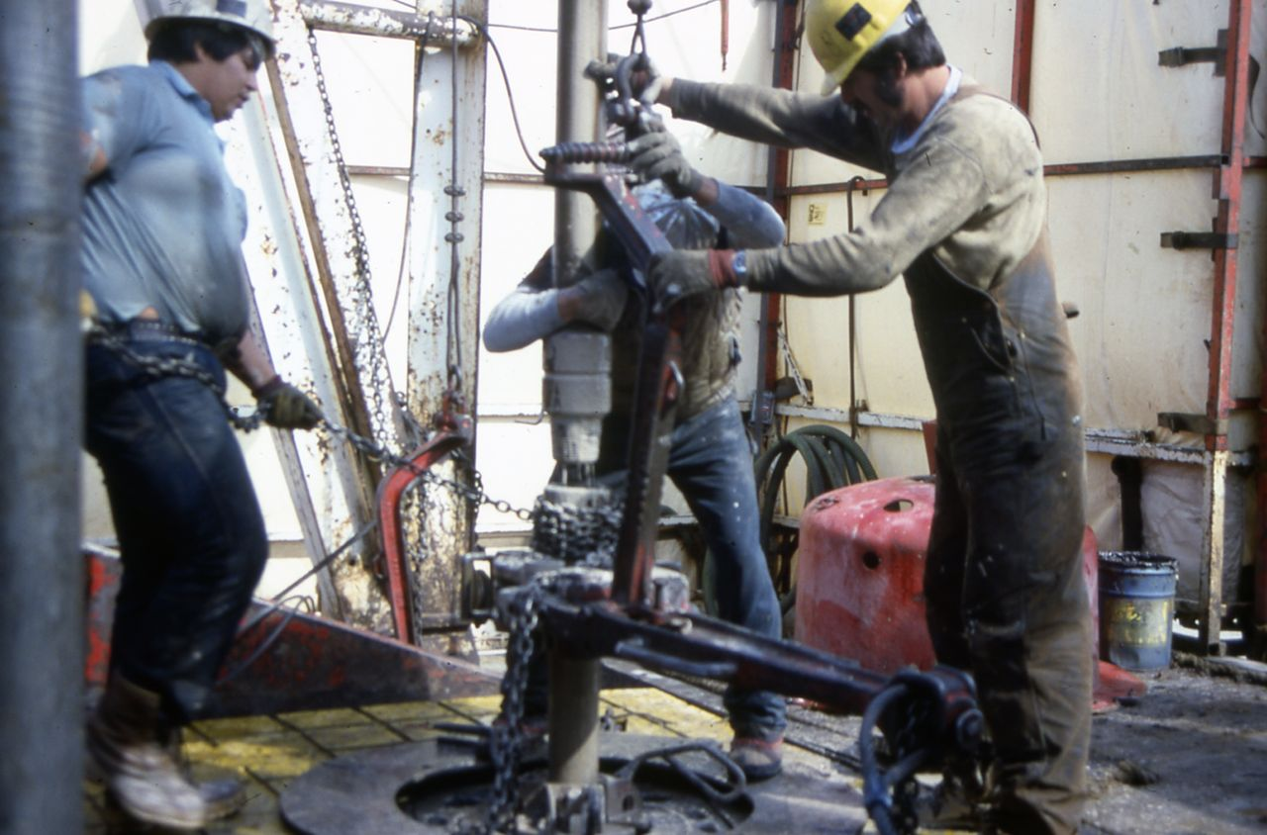
On a Personal Note
Scott
Petroleum production is extremely dangerous work!
I was a wellsite geologist long ago
I lived and worked on oil rigs for a year

Slide 11
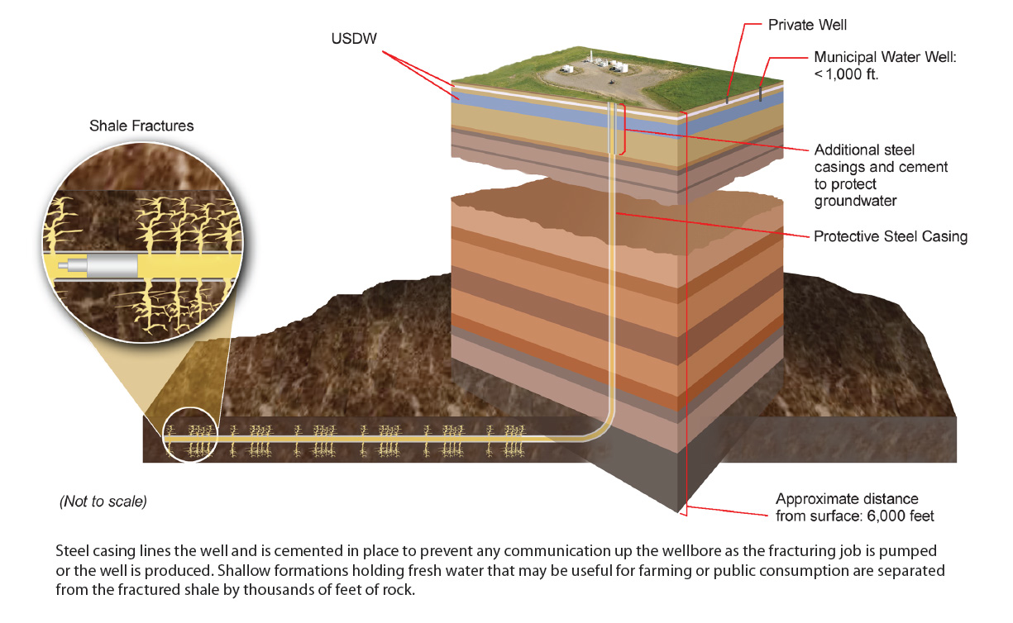
Hydraulic Fracturing

Slide 12
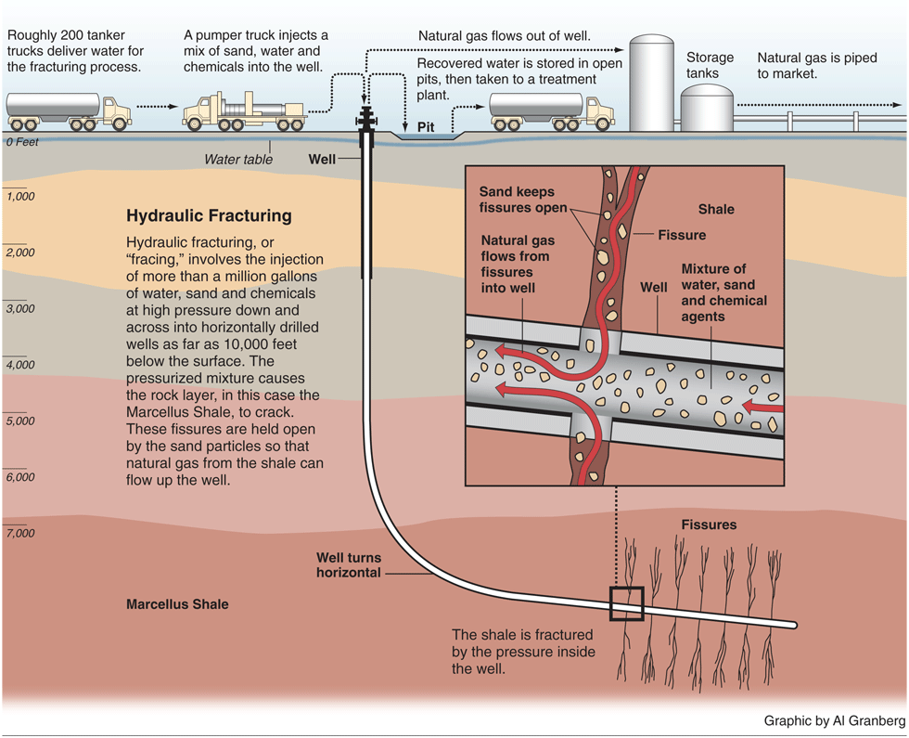

Slide 13
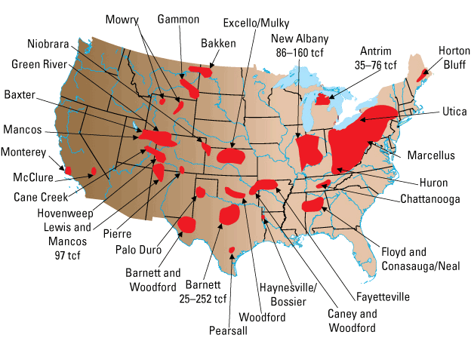
US Gas Reserves from Fracking

Slide 14
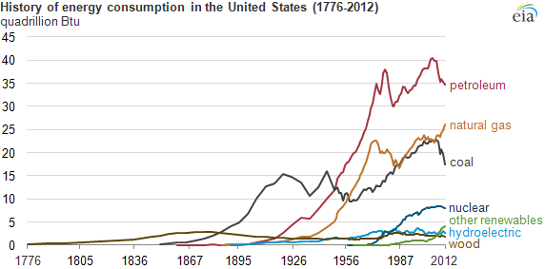
Changes in US Energy Consumption
Wood … then Coal … then Oil … then Gas … then Nuclear … then Renewables

Slide 15
The “Kaya Identity”
Four factors determine future emissions:
Population
Economic activity
Energy efficiency of economy
Carbon efficiency of energy

Slide 16
Billions and Billions Shanghai 1991 and 2012
Currently 7 billion people on Earth but only 1 billion use lots of energy
Rapid development to 4 billion energy users over coming decades
Population growth only 30% but energy growth 300% by 2100

Slide 17
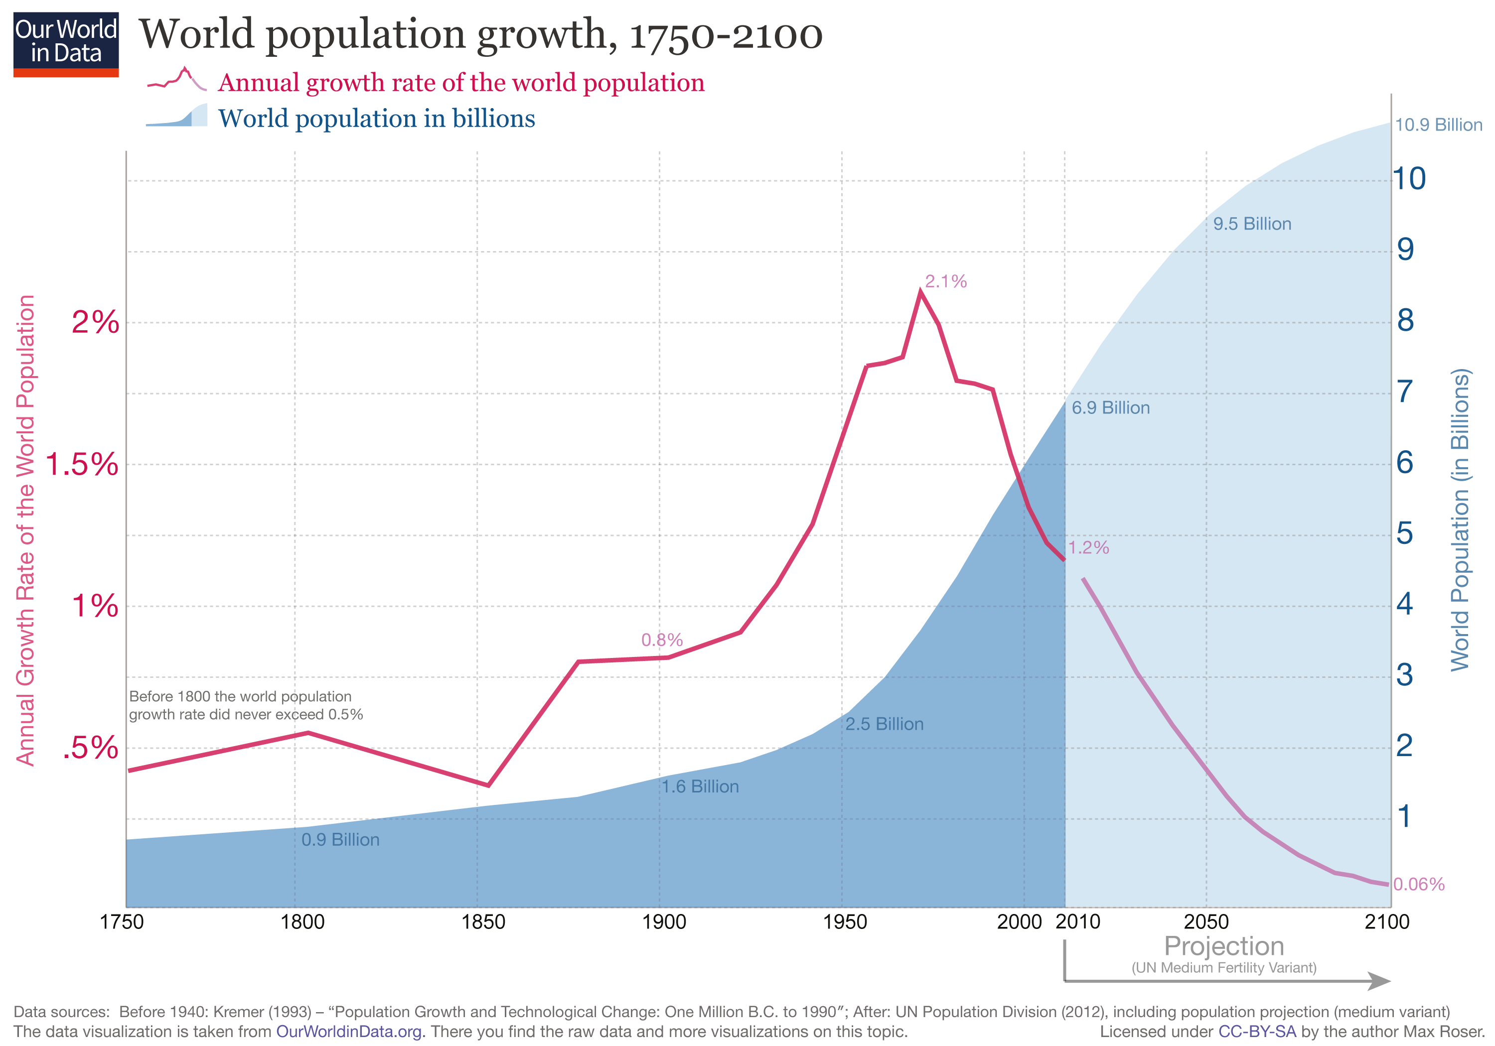
Population

Slide 18
2014 Population Growth Rates
Definition: The average annual percent change in the population, resulting from a surplus (or deficit) of births over deaths and the balance of migrants entering and leaving a country. The rate may be positive or negative. The growth rate is a factor in determining how great a burden would be imposed on a country by the changing needs of its people for infrastructure (e.g., schools, hospitals, housing, roads), resources (e.g., food, water, electricity), and jobs. Rapid population growth can be seen as threatening by neighboring countries.
Source: CIA World Factbook - Unless otherwise noted, information in this page is accurate as of January 1, 2014
USA = +0.77 %/yr

Slide 19
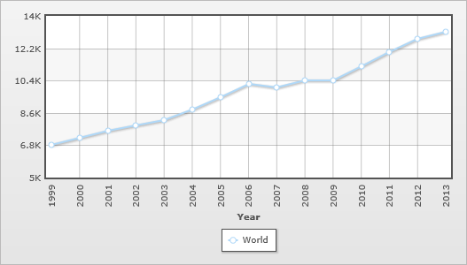
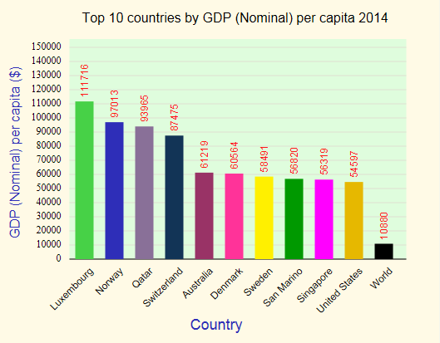
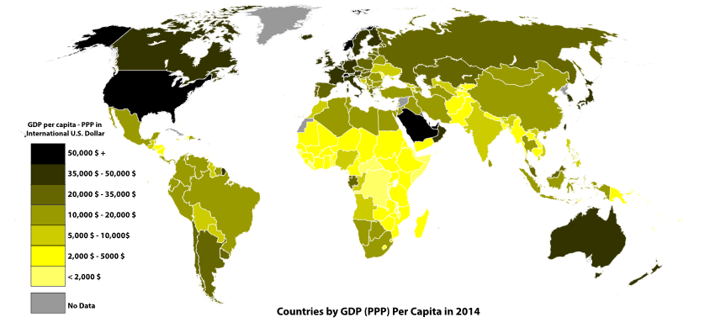
GDP/Population
Luxembourg-10.27x world
United states- 5.02x world
http://statisticstimes.com/economy/world-gdp-capita-ranking.php
Source: International Monetary Fund World Economic Outlook

Slide 20
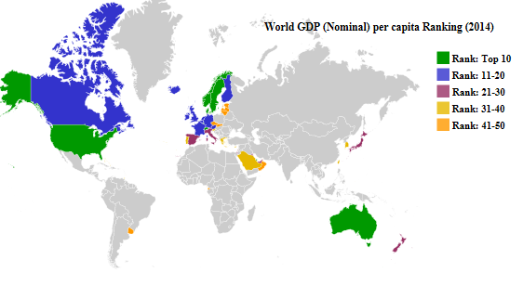
GDP/Population
Affluence- average consumption of each person in the population
It is assumed that as the GDP increases, consumption of good/services/energy will increase
http://statisticstimes.com/economy/world-gdp-capita-ranking.php
http://www.imf.org/external/pubs/ft/weo/2015/01/weodata

Slide 21
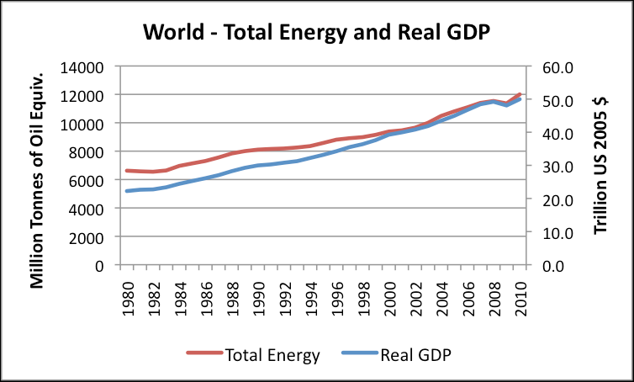
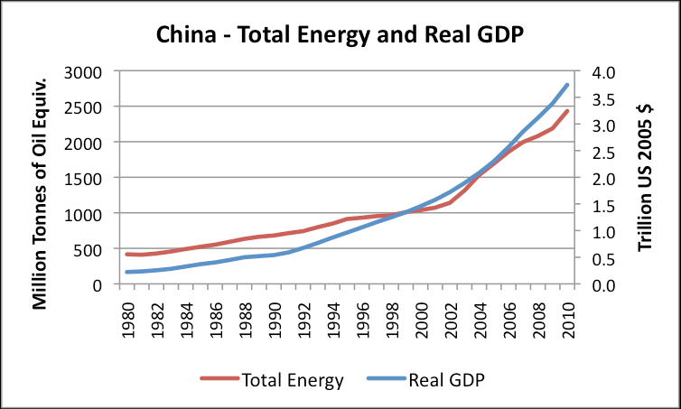
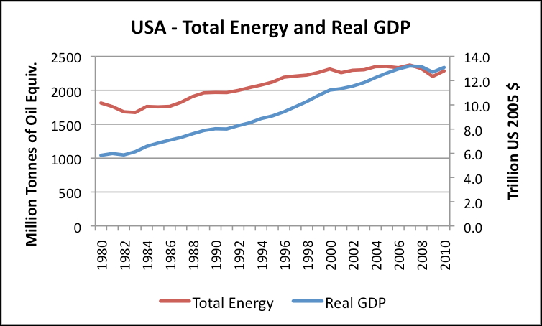
Energy/GDP
The energy intensity required to produce a unit of GDP is falling in most countries of the world
China GDP grew by about 10% a year between 1980 and 2005, while energy use grew by a little less than 6% per year
Between 2005 and 2010, real GDP continued to grow by about 10% per year, while energy use grew by about 7.5% per year
Up until 2005, the USA was able to increase real GDP by 3% per year, while increasing energy use by only 1% per year

Slide 22
CO2/Energy
2014 IPCC

Slide 23
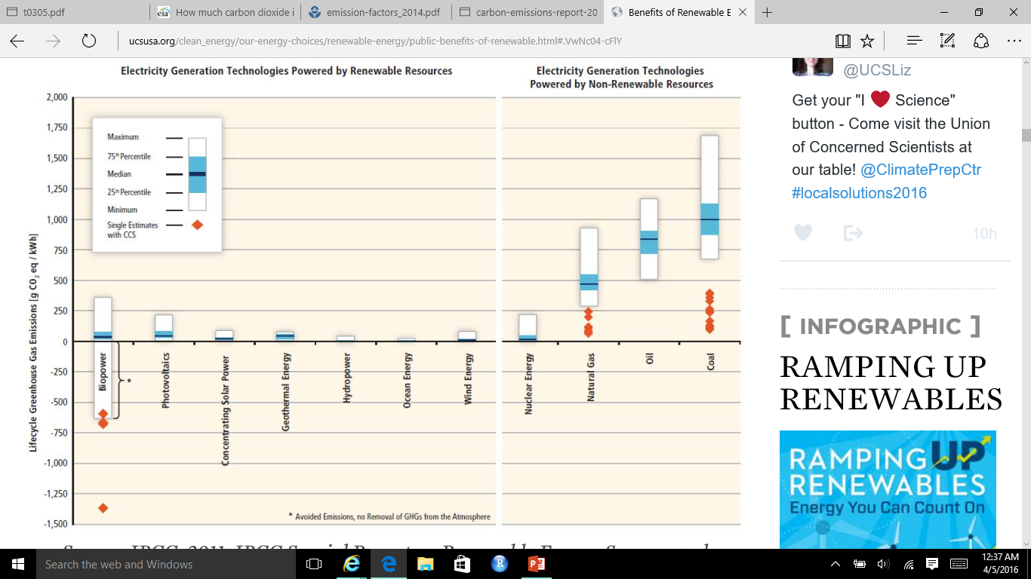
CO2/Energy
lbs. CO2e/kWh
Natural Gas: 0.6-2
Coal: 1.4-3.6 lbs.
Wind 0.02 to 0.04
Solar 0.07 to 0.2
Geothermal 0.1 to 0.2
Source: IPCC, 2011: IPCC Special Report on Renewable Energy Sources and Climate Change Mitigation

Slide 24
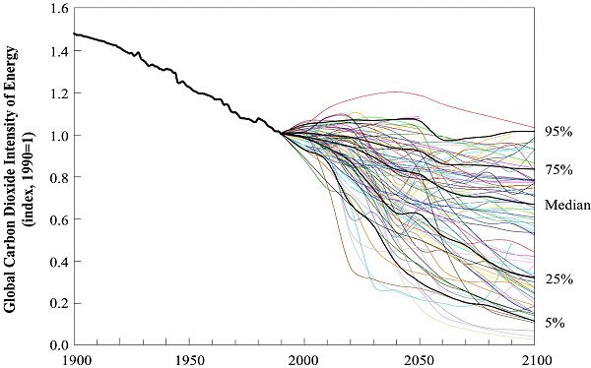
Decarbonization: Reduce CO2/Energy
Declining average carbon intensity of primary energy over time
Figure 2-11 shows rate of 0.3% per year decline
Global rate is decreasing but in some countries carbon intensity is increasing
Median scenarios indicate rate of 1.1%
most intensive uses of fossil fuels lead to no reduction
Highest decarbonization rate of 2.5% per year indicate complete transition to non fossil fuels
http://www.ipcc.ch/ipccreports/sres/emission/index.php?idp=46
Figure 2-11: Global decarbonization of primary energy - historical development and future scenarios, shown as an index (1990 = 1). The median (50th), 5th, 25th, 75th and 95th percentiles of the frequency distribution are shown. Statistics associated with scenarios from the literature do not imply probability of occurrence. Data source: Nakicenovic, 1996; Morita and Lee, 1998.

Slide 25
Kaya Components
Rich Countries
Poor Countries
CO2 emissions almost tripled
+137% GDP/population
+42% population growth
C intensity increase due to increased Coal use
TPES (Total Primary Energy Supply)
CO2 emissions: 6% lower in 2013 than 1990
Carbon intensity: declined 8*

Slide 26
Components of Emissions Growth
https://www.iea.org/publications/freepublications/publication/CO2EmissionsFromFuelCombustionHighlights2015.pdf

Slide 27
Case Study: United States
- CO2/Energy Consumption is 8.2% lower than 1990 levels
- Energy Consumption and CO2/GDP - Shift from a manufacturing economy to a service-based
economy, increases in efficiency, energy consumption and energy-related CO2 emissions per
dollar of gross domestic product (GDP) have both declined since 1990
https://www3.epa.gov/climatechange/Downloads/ghgemissions/US-GHG-Inventory-2016-Chapter-3-Energy.pdf

Slide 28
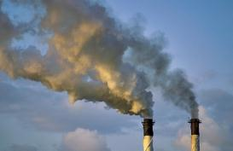
Emissions from fossil fuel use and industry
Global emissions from fossil fuel and industry: 36.3 ± 1.8 GtCO₂ in 2015, 63% over 1990
Projection for 2016: 36.4 ± 2.3 GtCO₂, 0.2% higher than 2015
Uncertainty is ±5% for one standard deviation (IPCC “likely” range)
Estimates for 2014 and 2015 are preliminary. Growth rate is adjusted for the leap year in 2016. Source: CDIAC; Le Quéré et al 2016; Global Carbon Budget 2016

Slide 29
Observed emissions and emissions scenarios
The emission pledges to the Paris Agreement avoid the worst effects of climate change (4-5°C) Most studies suggest the pledges give a likely temperature increase of about 3°C in 2100
The IPCC Fifth Assessment Report assessed about 1200 scenarios with detailed climate modelling on four Representative Concentration Pathways (RCPs) Source: Fuss et al 2014; CDIAC; IIASA AR5 Scenario Database; Global Carbon Budget 2016

Slide 30
New generation of scenarios
In the lead up to the IPCC’s Sixth Assessment Report new scenarios have been developed to more systematically explore key uncertainties in future socioeconomic developments
Five Shared Socioeconomic Pathways (SSPs) have been developed to explore challenges to adaptation and mitigation. Shared Policy Assumptions (SPAs) are used to achieve target forcing levels (W/m²).
Source: Riahi et al. 2016; IIASA SSP Database; Global Carbon Budget 2016

Slide 31
Top emitters: fossil fuels and industry (absolute)
The top four emitters in 2015 covered 59% of global emissions
China (29%), United States (15%), EU28 (10%), India (6%)
Bunker fuels are used for international transport is 3.1% of global emissions. Statistical differences between the global estimates and sum of national totals are 1.2% of global emissions. Source: CDIAC; Le Quéré et al 2016; Global Carbon Budget 2016

Slide 32
Top emitters: fossil fuels and industry (per dollar)
Emissions per unit economic output (emissions intensities) generally decline over time
China’s intensity is declining rapidly, but is still much higher than the world average
GDP are measured in purchasing power parity (PPP) terms in 2005 dollars.
Source: CDIAC; IEA 2015 GDP to 2013, IMF 2016 growth rates to 2015; Le Quéré et al 2016; Global Carbon Budget 2016

Slide 33
Emissions from coal, oil, gas, cement
Share of global emissions in 2015: coal (41%), oil (34%), gas (19%), cement (6%), flaring (1%, not shown)
Source: CDIAC; Le Quéré et al 2016; Global Carbon Budget 2016

Slide 34
Energy consumption by energy type
Energy consumption by fuel source from 2000 to 2015, with growth rates indicated for the more recent period of 2010 to 2015
Source: BP 2016; Jackson et al 2015; Global Carbon Budget 2016

Slide 35
Historical cumulative emissions by country
Cumulative emissions from fossil-fuel and cement were distributed (1870–2015): USA (26%), EU28 (23%), China (13%), Russia (7%), Japan (4%) and India (3%)
Cumulative emissions (1990–2015) were distributed China (21%), USA (20%), EU28 (14%), Russia (6%), India/Japan (4%) ‘All others’ includes all other countries along with bunker fuels and statistical differences Source: CDIAC; Le Quéré et al 2016; Global Carbon Budget 2016

Slide 36
Carbon intensity of economic activity
Global emissions growth has generally recovered quickly from previous financial crises
It is unclear if the recent slowdown in global emissions is related to the Global Financial Crisis
Economic activity is measured in Purchasing Power Parity
Source: CDIAC; Peters et al 2012; Le Quéré et al 2016; Global Carbon Budget 2016

Slide 37
Emissions per capita
The 10 most populous countries span a wide range of development and emissions per person
Emission per capita: CO₂ emissions from fossil fuel and industry divided by population
Source: Global Carbon Budget 2016

Slide 38
Major flows from production to consumption
Flows from location of generation of emissions to location of
consumption of goods and services
Values for 2011. EU is treated as one region. Units: MtCO₂ Source: Peters et al 2012

Slide 39
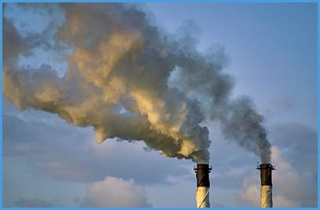
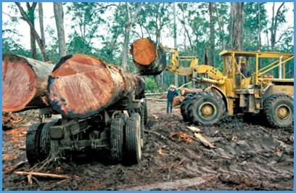
Total global emissions
Total global emissions: 41.9 ± 2.8 GtCO₂ in 2015, 49% over 1990 Percentage land-use change: 36% in 1960, 9% averaged 2006-2015
Three different methods have been used to estimate
land-use change emissions, indicated here by different shades of grey Source: CDIAC; Houghton et al 2012; Giglio et al 2013; Le Quéré et al 2016; Global Carbon Budget 2016

Slide 40
Total global emissions by source
Land-use change was the dominant source of annual CO₂ emissions until around 1950
Others: Emissions from cement production and gas flaring Source: CDIAC; Houghton et al 2012; Giglio et al 2013; Le Quéré et al 2016; Global Carbon Budget 2016

Slide 41
Global carbon budget
The carbon sources from fossil fuels, industry, and land use change emissions are balanced by the atmosphere and carbon sinks on land and in the ocean
Source: CDIAC; NOAA-ESRL; Houghton et al 2012; Giglio et al 2013; Joos et al 2013; Khatiwala et al 2013; Le Quéré et al 2016; Global Carbon Budget 2016

Slide 42
Cumulative global CO₂ emissions and temperature
Cumulative global CO₂ emissions from fossil fuels, industry, and land use change and four simplified future pathways compared to probability of exceeding different temperatures
The green boxes show the year that the exceedance budgets are exceeded assuming constant 2016 emission levels
The years are indicative and vary depending on definition and methodology
Source: Jackson et al 2015b; Global Carbon Budget 2016

Slide 43
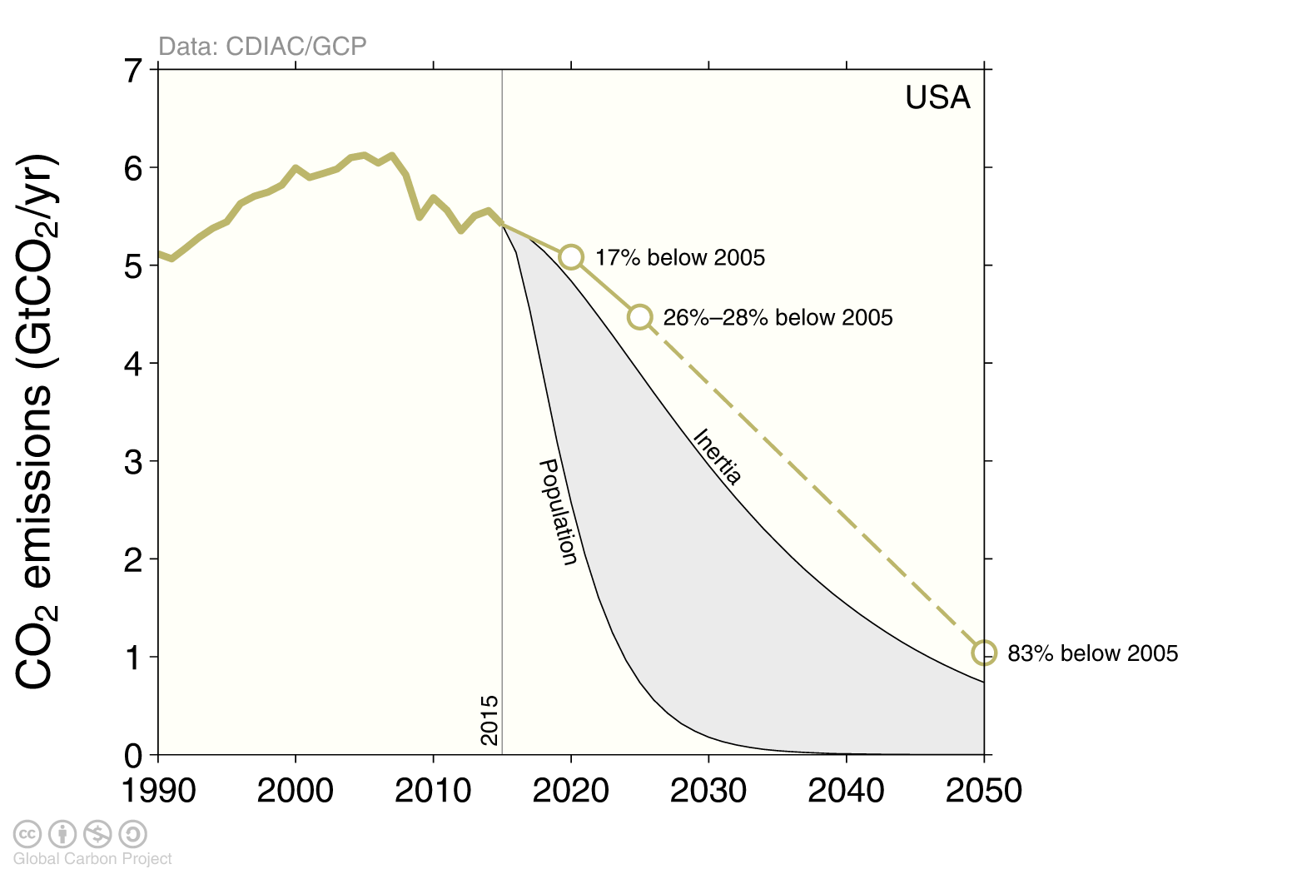
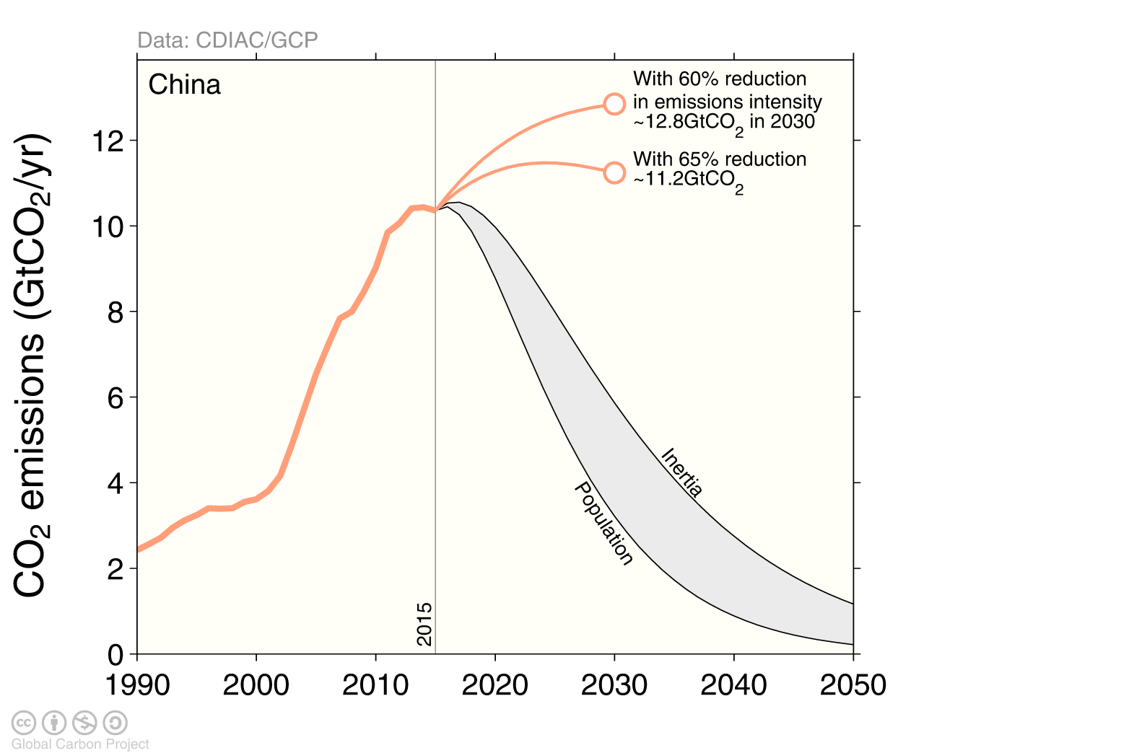
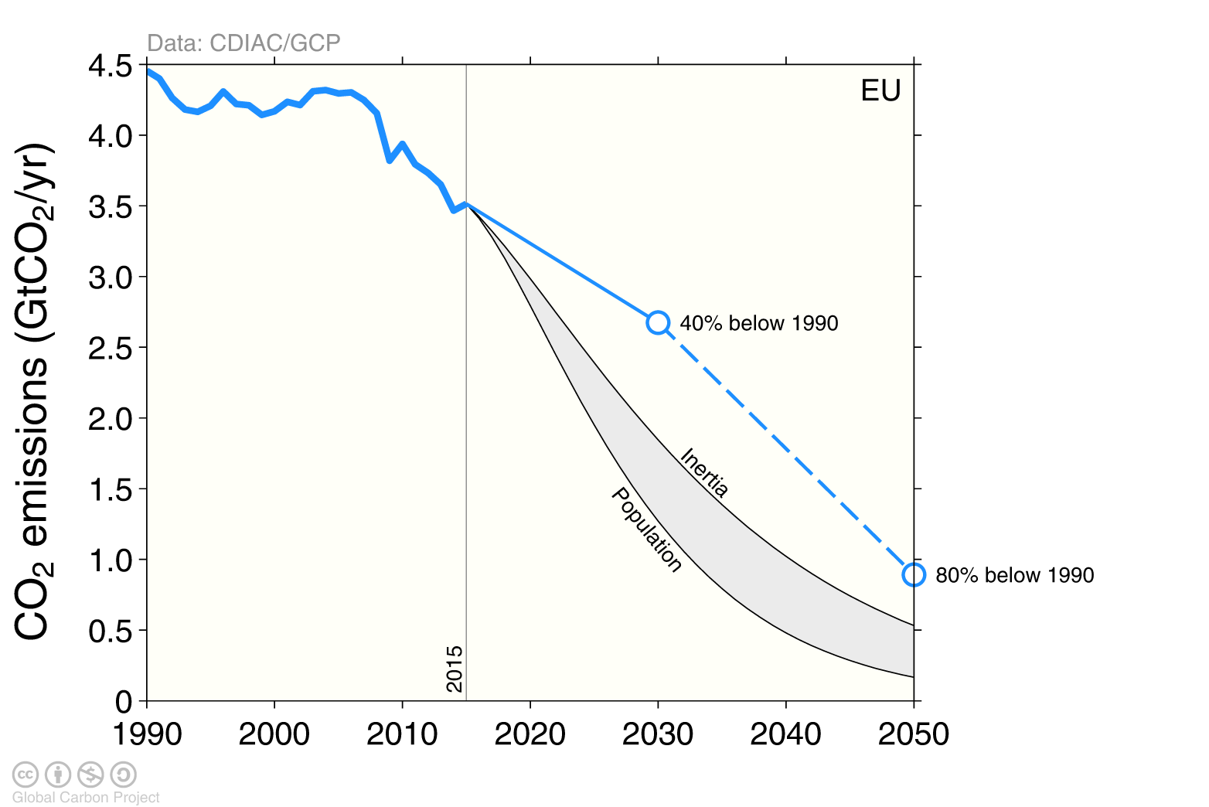
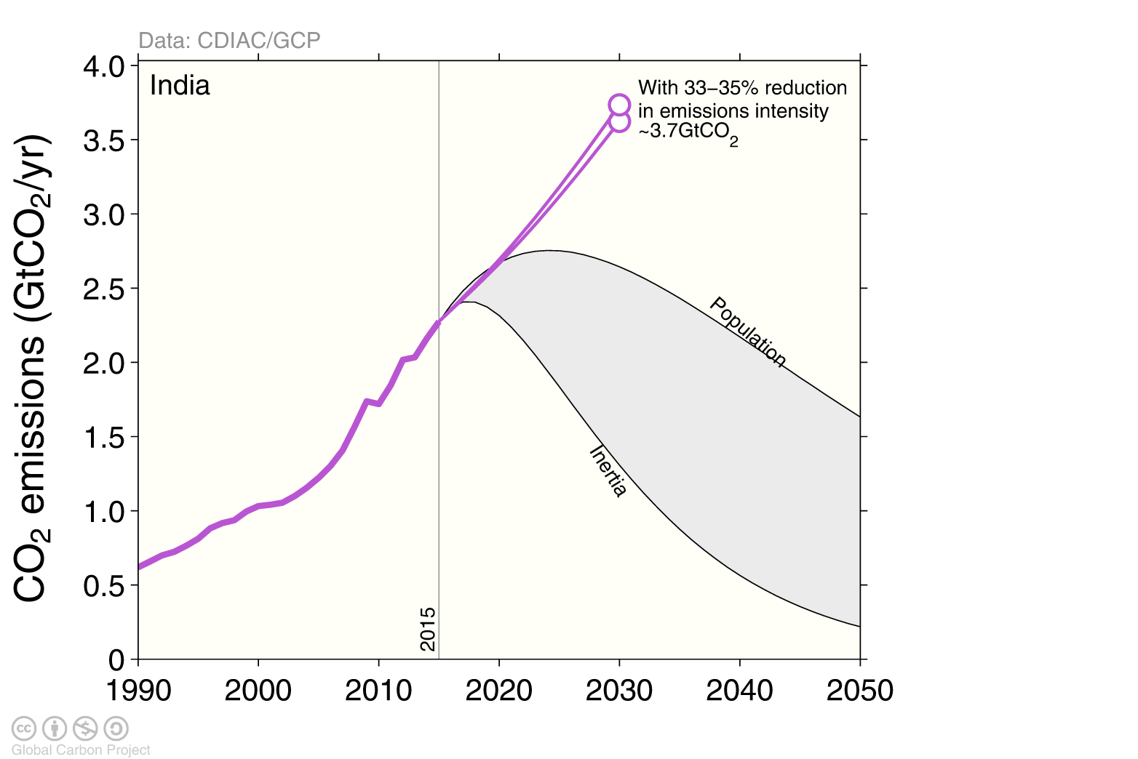
The emission pledges (INDCs) of the top-4 emitters
The emission pledges compared to different ways of sharing the remaining 2°C quota
Equity: Remaining quota shared by current population. Inertia: The remaining quota shared by current emissions.
Source: Peters et al 2015; Global Carbon Budget 2016

Slide 44
The emission pledges (INDCs) of the top-4 emitters
The emission pledges from the US, EU, China, and India leave no room for other countries to emit in a 2°C emission budget (66% chance)
Source: Peters et al 2015; Global Carbon Budget 2016

Slide 45
Negative emissions required for 2°C
To achieve net-negative emissions globally after 2050 requires deployment as early as 2020-2030
If negative emission technologies do not work at scale, society is locked into higher temperatures
Source: Anderson & Peters 2016

