Slide 1
International Climate Change Agreements: UNFCCC & Beyond
Desirée Fiske
Ph.D. in political science
For atmos 150

Slide 2
Think:
Take class information and critically analyze:
Are the right actors involved in these agreements/working groups?
Who should be responsible for advising climate change policy?
How do we reconcile social and environmental needs in policy?
Is anything left out in the application of scientific knowledge?

Slide 3
Process and Debates:
UN agreements can be “binding” but the UN is not a government
Conventions “adopt”
Countries “sign”
“join”
“ratify”
Then entered into “force”
”Multilateralism”
“Civil Society”
Big debates: “environmental justice”; “developing (global South) v. Developed (global North)”; “social v. economy v. environment”

Slide 4
Montreal Protocol (1987): Success of an Environmental Agreement
Global/multilateral effort to reduce CFCs in the atmosphere
SUCCESS! All 197 United Nations members ratified
Still being updated: last update in 2016 on hydrofluorocarbons

Slide 5
And so it begins: Earth Summit, Rio de Janeiro (1992)

Slide 6
UNFCCC is Born
Rio Convention
(CBD & CCD too!)
Ratified in March 1994
COP 1 in 1995
Meets annually in different cities around the world (never met in the US)
197 ”parties”
Advised by IPCC

Slide 7
The UNFCCC’s Mission
The ultimate objective of the Convention is to stabilize greenhouse gas concentrations to “a level that would prevent dangerous anthropogenic (human induced) interference with the climate system.
...such a level should be achieved within a time-frame sufficient to allow ecosystems to adapt naturally to climate change, to ensure that food production is not threatened, and to enable economic development to proceed in a sustainable manner.”
But have they been successful?

Slide 8
Timeline:
1990: IPCC 1st Assessment
1992: Earth Summit
1992: IPCC 2nd Assessment
1994: UNFCCC enters into force
1995: COP1, Bonn, Germany
1996: COP2, Geneva, Switzerland
1997: COP3, Kyoto, Japan (The Kyoto Protocol)
1998: COP4, Buenos Aires, Argentina
1999: COP5: Bonn, Germany
2000: COP6: The Hague, Netherlands/Bonn, Germany
2001: COP7: Marrakesh, Morocco
2001: IPCC 3rd Assessment
2002: COP8, New Delhi, India
2003: COP9: Milan, Italy
2004: COP10, Buenos Aires, Argentina
2005: COP11, Montreal, Canada
2006: COP12, Nairobi, Kenya
2007: IPCC 4th Assessment
2007: COP13, Bali, Indonesia
2008: COP14, Poznań, Poland
2009: COP15: Copenhagen, Denmark
2010: COP16, Cancún, Mexico
2011: COP17, Durban, South Africa
2012: COP18, Doha, Qatar
2013: COP19, Warsaw, Poland
2014: COP20, Lima, Peru
2014: IPCC 5th Assessment
2015: COP21, Paris, France
2016: COP22, Marrakesh, Morocco
2017: COP23, Bonn, Germany

Slide 9
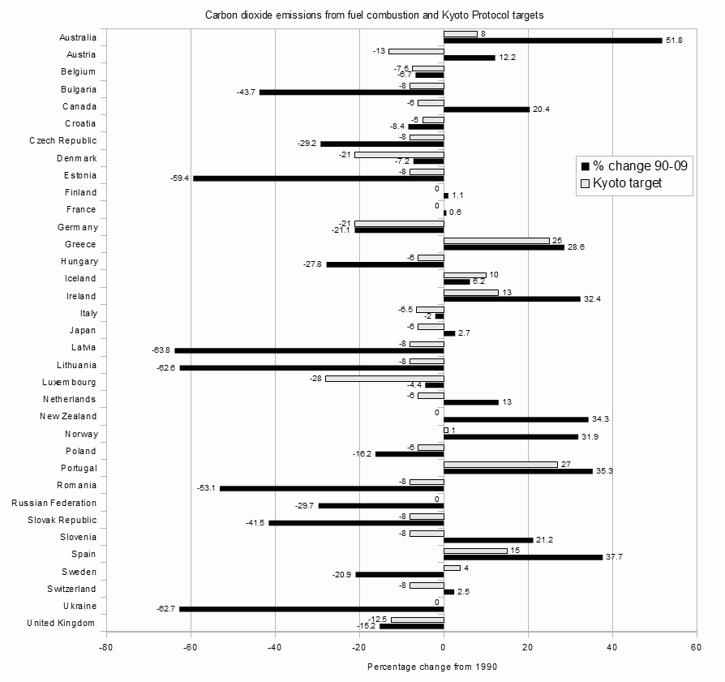
Trials and Tribulations: Kyoto Protocol (1997 - 2012)
Unanimously adopted in 1997
Marrakesh Accords (2001) - steps towards ratification
Didn’t enter into force until 2005!!
2006: Clean development negotiations
Assistance for developing states; joint implementation starts in 2008
Doha Accord (2012) – emission reduction by 2015 2020
Goals were not met!

Slide 10
Copenhagen Accord
High hopes for a new deal…
COP15, 2009 in Copenhagen
Yet again, problems of consensus, exclusion, and tension
Only five countries drafted the deal (US, China, India, Brazil, South Africa)
Civil society (ex: NGOs) had little involvement and were restricted, even discouraged from attending
It was vague!
Recognized IPCC report (2°C goal)
Not binding; no real commitments - emission reduction targets
Up to states to determine emission reductions
(Was it bad timing?)

Slide 11
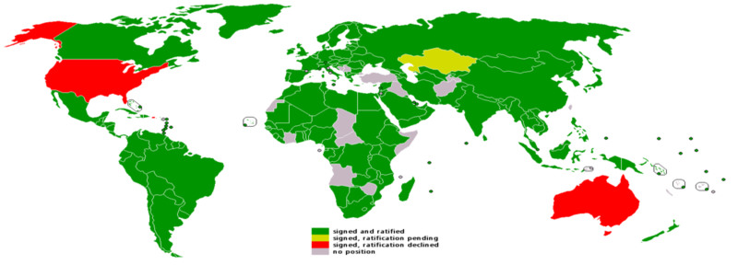
Why is Kyoto considered a failure?
Variations in curbing GHGs
Different standards (developing economies’ concerns)
Targets were dependent on economy and emissions
Ranges -8% to +10%
US never ratified; countries pulled out; China didn’t ratify until 2014
Global South did not participate until after Doha
Constant process of negotiation and extensions

Slide 12
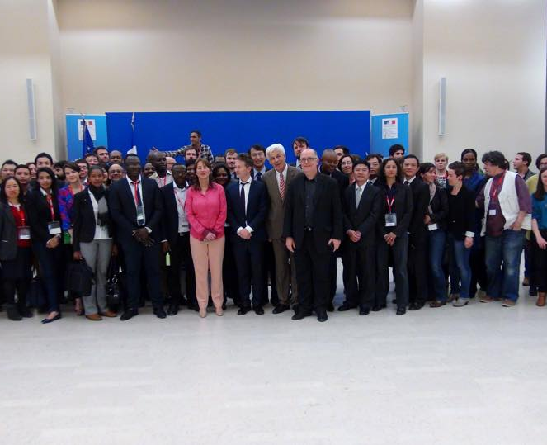
Let’s start over… COP21: Paris Agreement (2015)
Why was Paris different?
More parties
Flexible/sophisticated targets
Main targets:
Enhanced transparency
Technical solutions
Financial support for developing countries until 2020
Committed to holding global temperature rise to under 2˚C
“Nationally determined contributions”
World Wide Views on Climate and Energy with Ségolène Royal, Paris, 2015

Slide 13
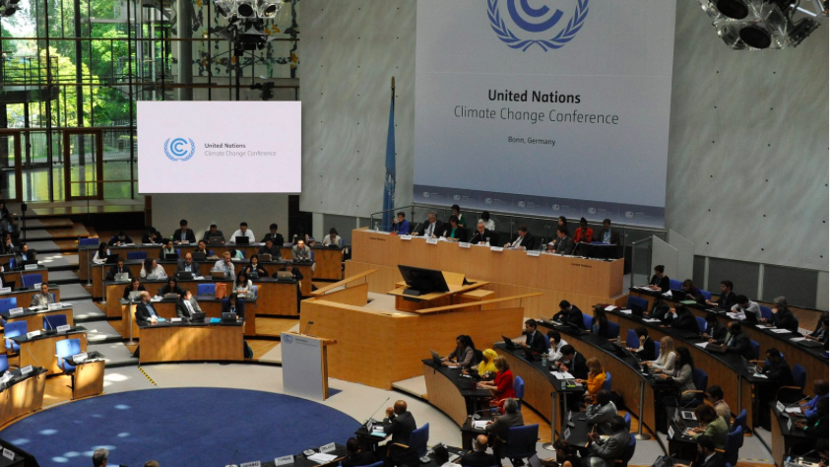
COP21: Hope for the Paris Agreement (2015)
To Ratify Parties must:
1) Come up with a national plan;
2) Share instruments (methods) on how to execute the plan
All eyes on US and China: Joint statement announced September 2016
“common but differentiated responsibilities”
US: Clean Power Plan
Entered into force November 4, 2016
To date 143/197 Parties ratified

Slide 14
Looking forward: Paris Agreement
U.S.:
2020 target of reducing emissions by 17% below 2005
Reduction of GHG by 26% – 28% below its 2005 level in 2025
Annual reduction of 2.3% – 2.8%
2050: 80% reduction
Clean Air Act; Clean Power Plan; Energy Independence and Security Act
China:
By 2030: Peak CO₂ emissions
lower CO₂ emissions per unit of GDP by 60% - 65% from 2005 levels (by 2030)
increase non-fossil fuels as primary energy source
National/regional strategies; and commitments to low-carbon energy system, low-carbon/energy efficient industry, improving building and transportation emissions, increasing carbon sinks, “promoting the low-carbon way of life” and growth patterns, climate resilience, R&D, financial/policy support, carbon emissions trading, engaging stakeholders, improved GHG record-keeping…

Slide 15
Looking forward: COP23
COP23 President: Fijian PM Vorege Bainimarama – first time a Pacific Islander has been a COP president.
Honoring multilateral commitments from the Paris Agreement
The 2017 COP is emphasizing climate adaptation through financial models and technical solutions (embracing science and technology).
Changing relations between ’developed’ and ‘developing’ nations?
“The time for casting blame is over… to be sure, it’s the developed economies that produce the most carbon emissions. But they are also responsible for most of the gains in technology, science, medicine and other fields that have improved the lives of all people – and the technology and learning we will need to solve the crisis.”

Slide 16
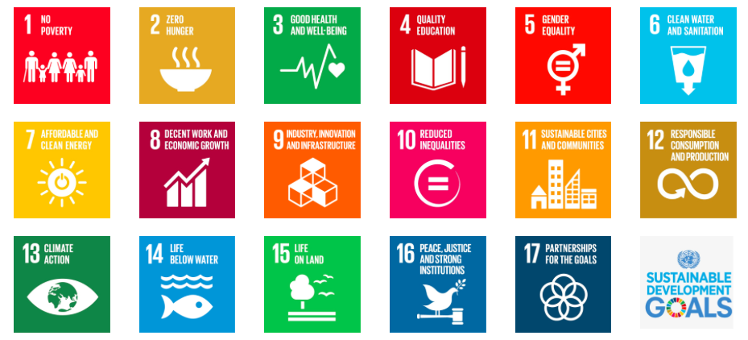
UN Oceans Conference 2017
First ever Oceans Conference
Likely reason for a Fijian President
Bainimarama is looking to bridge the Conferences
Agenda includes discussions on ocean pollution, sustainable development, and sustainable use of oceans (SDG 14)
But also an important opportunity to think about ocean relations to climate change

Slide 17
Discussion:
Questions? Responses?
Is COP valuable to climate change mitigation and adaptation?
Who should do the heavy lifting?
How does class material, to date, fit into today’s lecture?
Thanks!

