Slide 1
Photosynthesis, Transpiration, and Surface Energy Balance
Please read
Denning (1993, unpublished)
Bonan Chapter on Photosynthesis

Slide 2
Photosynthesis
Levels of control
Controls in individual leaves
Control by canopy processes
Controlling factors
Direct controls: light, CO₂
Indirect controls: water, nutrients

Slide 3
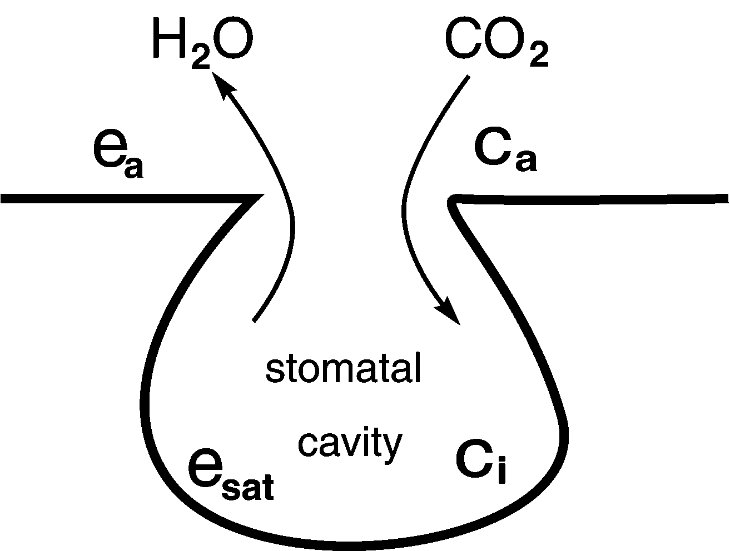
Carbon and Water
Plants eat CO₂ for a living
They open their stomata to let CO₂ in
Water gets out as an (unfortunate?) consequence
For every CO₂ molecule fixed about 400 H₂O molecules are lost

Slide 4
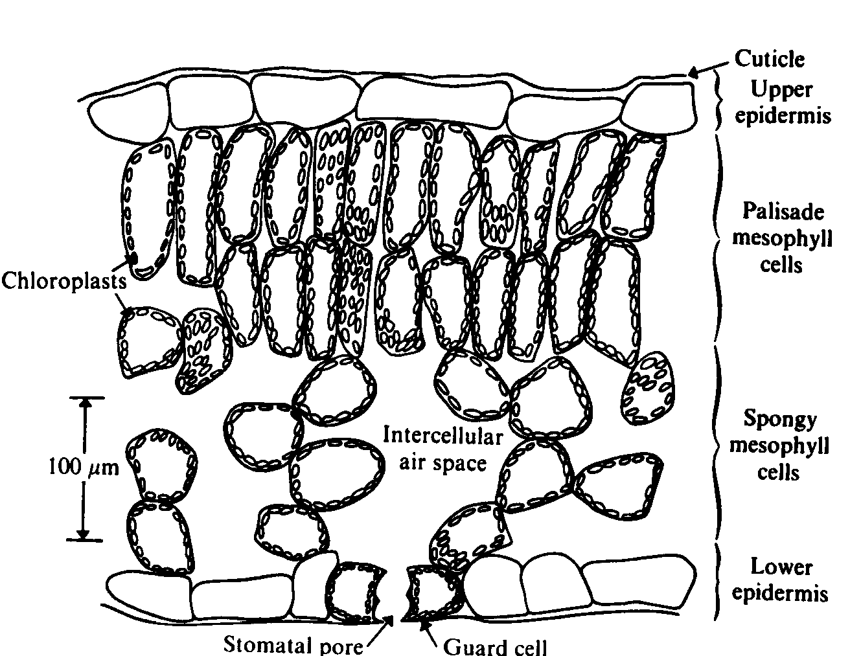
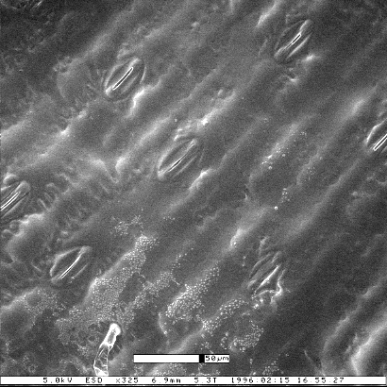
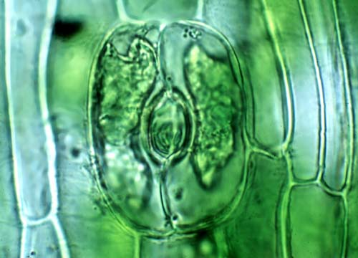
Leaf Anatomy
Stomate
(pl. stomata)

Slide 5
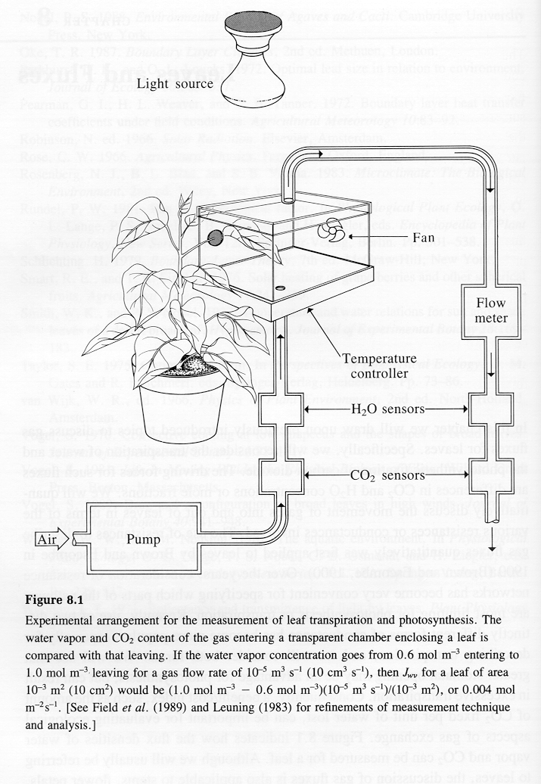
Measuring Transpiration and Photosynthesis
Control temperature, light level, humidity, and flow rates
Measure changes in water vapor and CO2 concentration per unit time and leaf area
Nobel, 1991

Slide 6
Two major sets of reactions
Light-harvesting reactions
Convert light into chemical energy (chlorophyll pigments inside the chloroplast)
Generate stored energy and “reductant”
Carbon fixation (“dark”) reactions
Uses chemical energy to convert CO₂ into sugars for later use by plant (or heterotrophs!)
Conversion of inorganic, oxidized carbon to organic, reduced carbon in an oxidizing environment requires energy and reductant
Primary fixation enzyme is called Rubisco

Slide 7
Amino Acids, Proteins, and Enzymes
All proteins are composed of amino acids, combined in long chains
All amino acids contain nitrogen, which is therefore a key nutrient
Some proteins act as catalysts for biochemical reactions (speed them up without being consumed)
Catalytic proteins are called enzymes
Structure of a generic amino acid
R can be any functional group bonded to central C atom

Slide 8
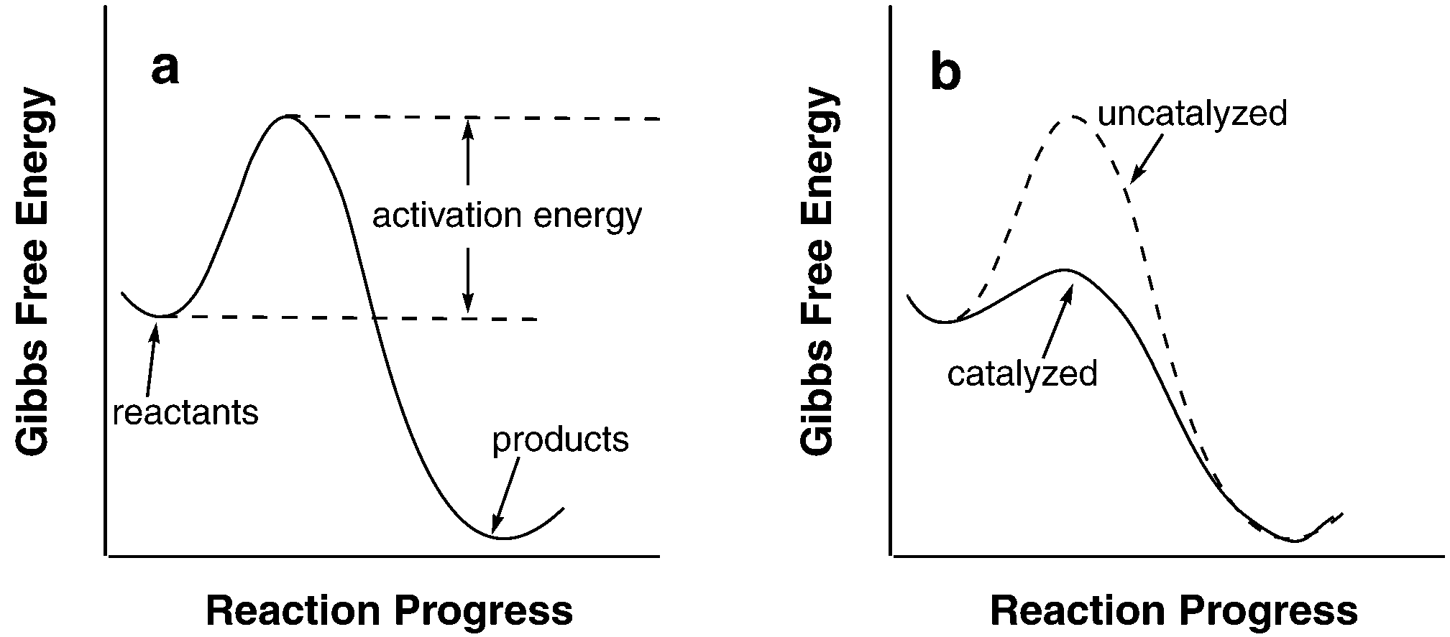
Chemical Kinetics
Chemical reaction proceeds towards lower free energy
Reaction rate depends on activation energy to form an intermediate complex before products can be created
Catalysts are chemicals which reduce the activation energy of a reaction, allowing it to run faster without consuming the catalyst

Slide 9
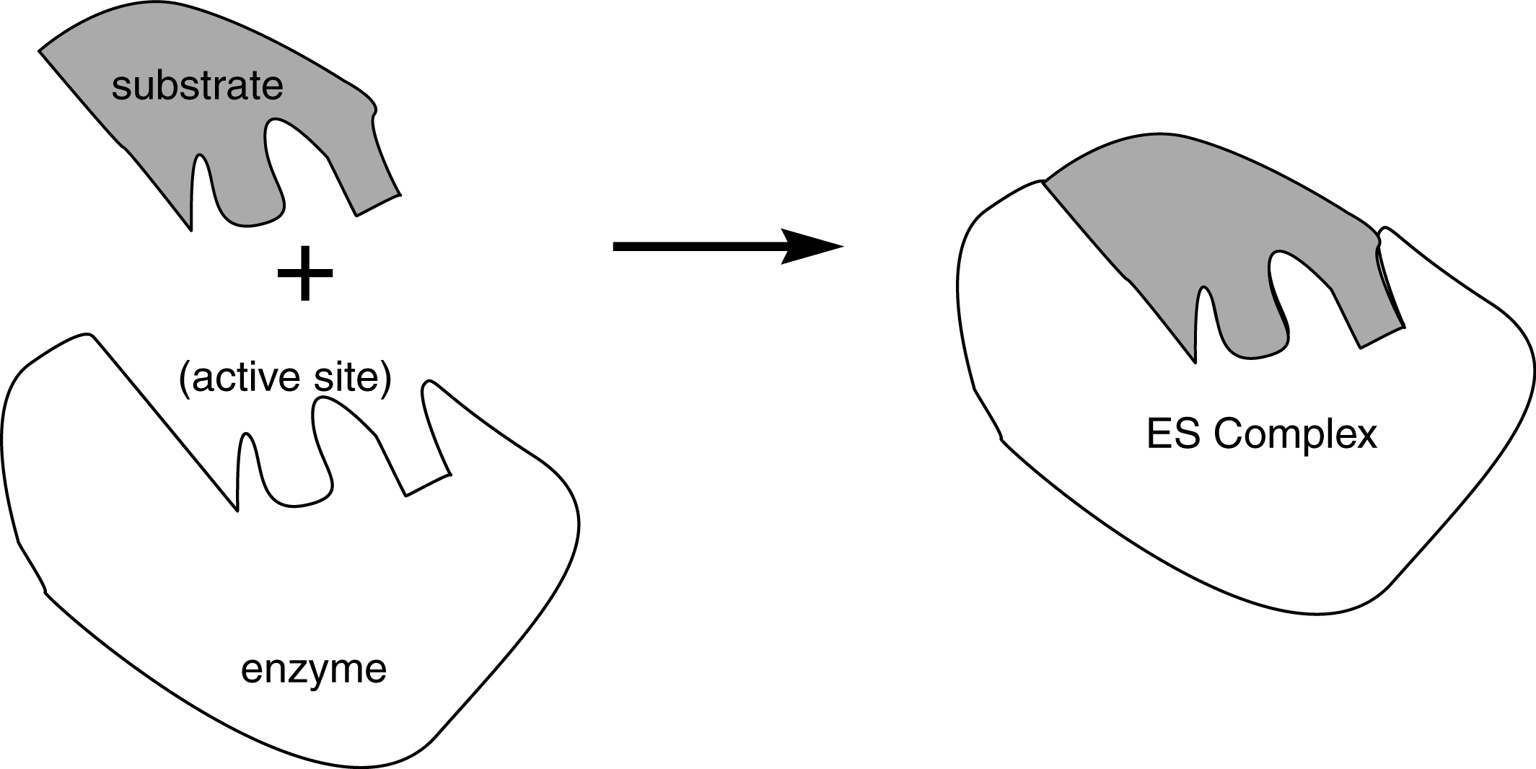
Enzyme Catalysis
Enzymes have unique molecular structures that catalytic effects are specific to certain reagents
Enzyme bonds to substrate molecule to form an enzyme-substrate (ES) complex
ES complex then reacts with other reagent to form products, leaving enzyme free to bond with another substrate molecule

Slide 10
Michaelis-Menten Kinetics
Consider catalyzed reaction:
Rate of product formation depends only on [ES]
Amount of ES complex depends on
production
dissociation
“Michaelis constant”
At steady state,

Slide 11
Michaelis-Menten Kinetics (cont’d)
Steady-state amount of ES
Define total amount of enzyme E_{T} = E + ES, then
Solve for ES:
Finally, rate of production of product is given by

Slide 12
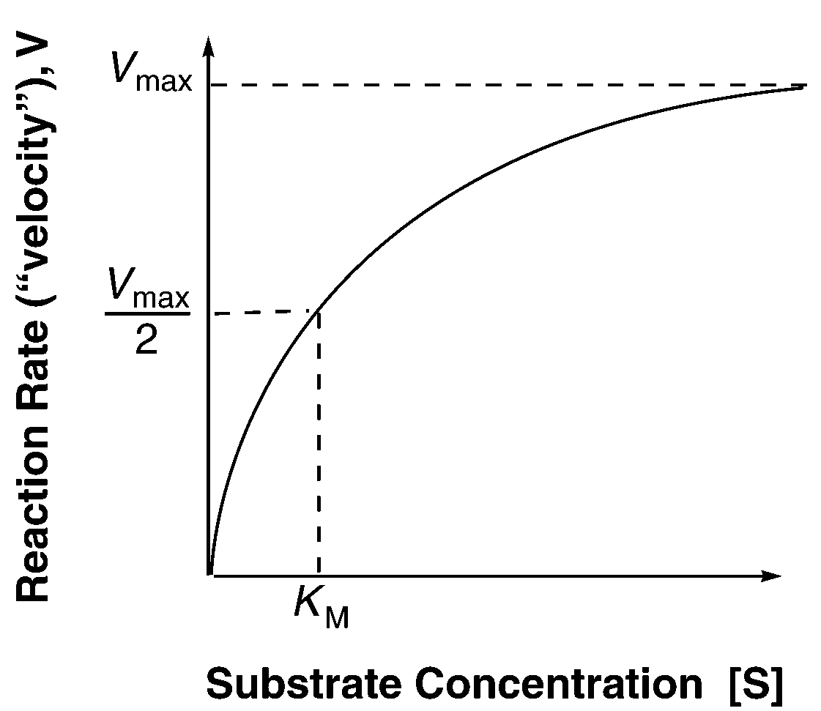
Michaelis-Menten Kinetics (cont’d)
As substrate concentration increases, reaction speeds up
When [S] >> K_{m} active sites are saturated, and V approaches V_{max}
Recall V_{max} is proportional to E_{T}, the total amount of enzyme present

Slide 13
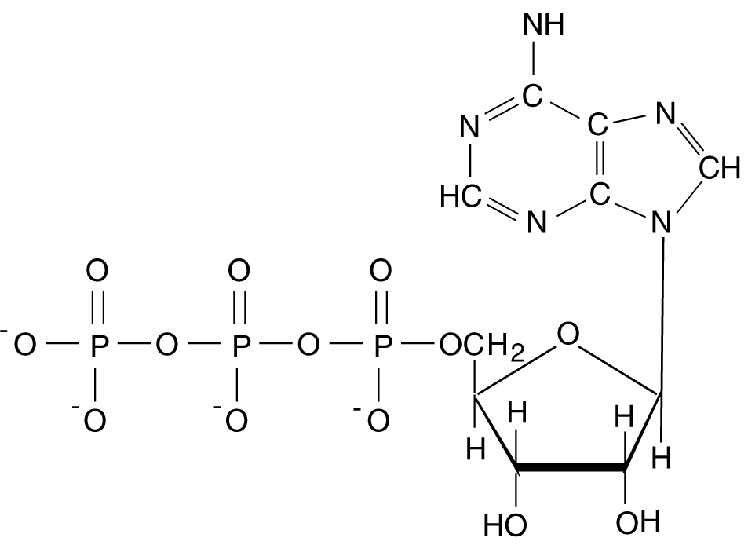
Energy and ATP
Many biological reactions consume energy … “driven uphill” away from chemical equilibrium!
This requires energy storage and later recovery
ATP is the “currency” of energy in the biosphere
Allows energy to be stored, transported, and recovered
ATP
Coupling ATP hydrolysis to another increases the equilibrium constant by 10⁸

Slide 14
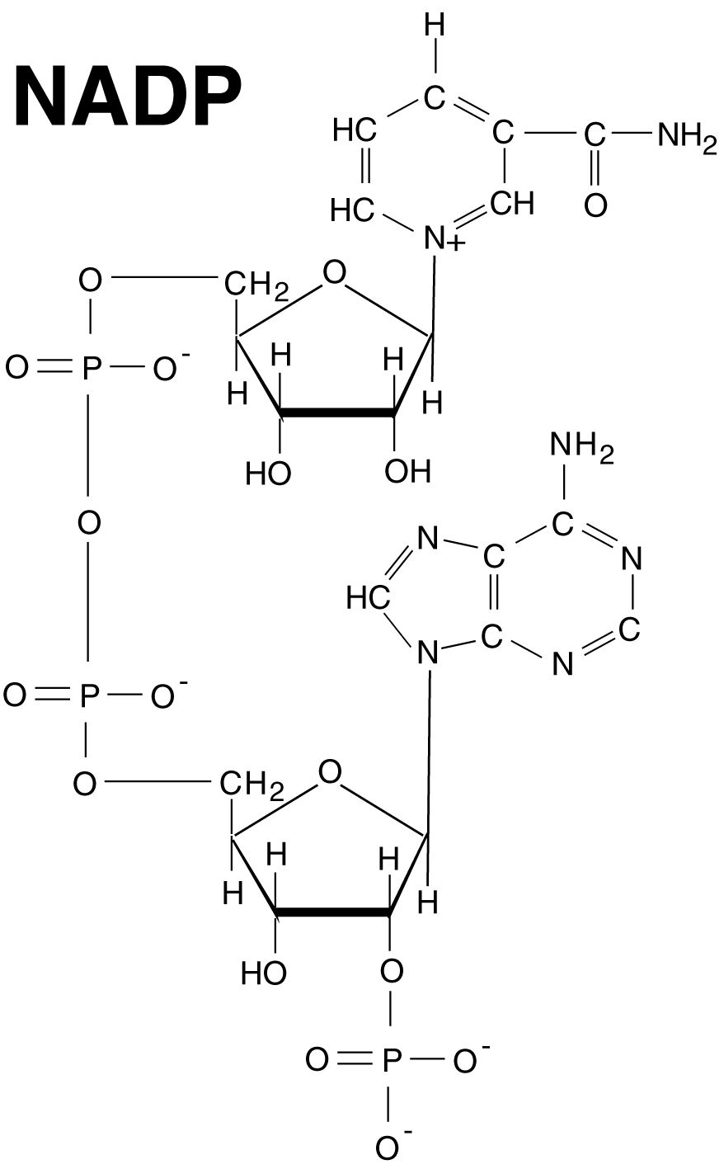
Oxidation and Reduction
Oxidation involves a “donor” species which loses an electron, becoming positively charged or “oxidized”
Organic molecules are reduced … that is, they are electron donors
Electrical batteries use pairs of redox reactions
Photosynthesis uses NADPH₂ and NADP to provide reducing power required for formation of reduced carbon compounds from oxidized CO₂ in an oxidizing environment

Slide 15
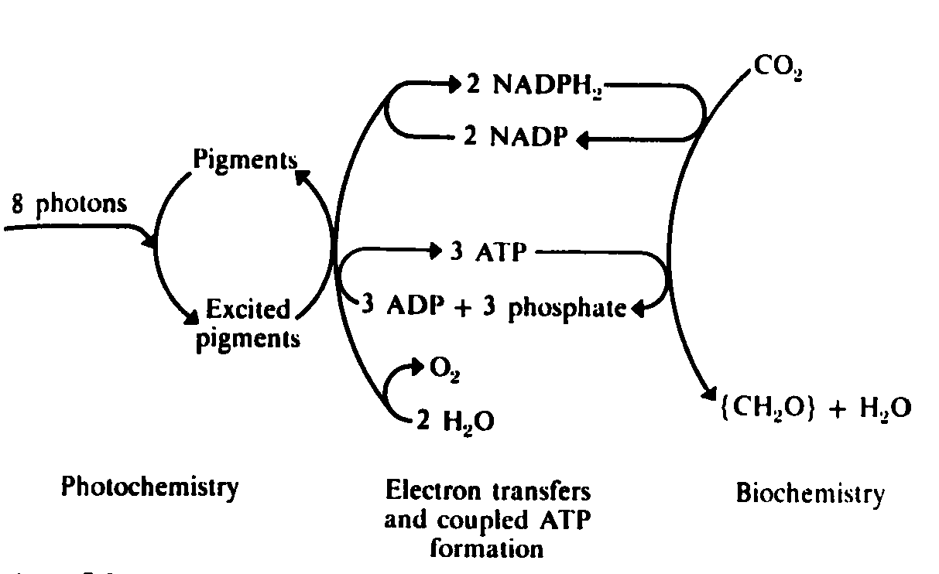
Farquhar Photosynthesis Model

Slide 16
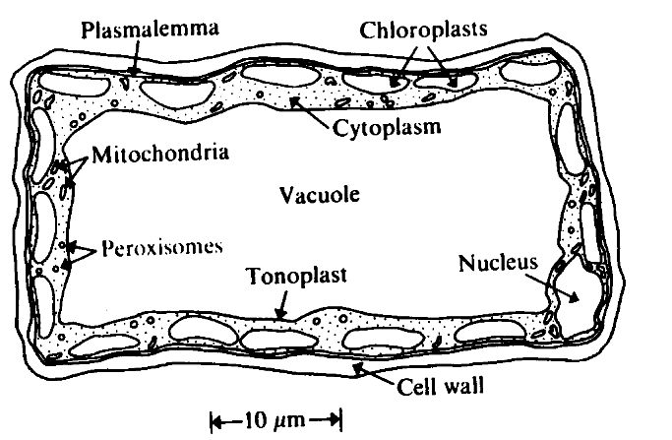
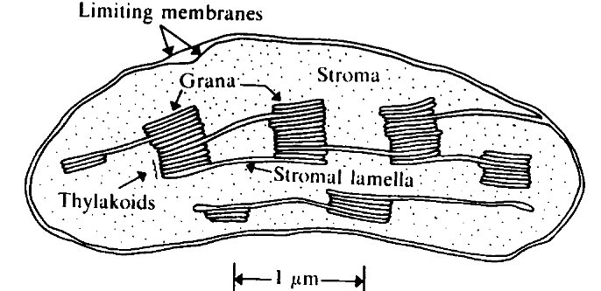
Anatomy and Physiology
Plant cells are mostly water-filled space
Outer margins contain chloroplasts
Chloroplasts contain chlorophyll, which is where the action is!

Slide 17
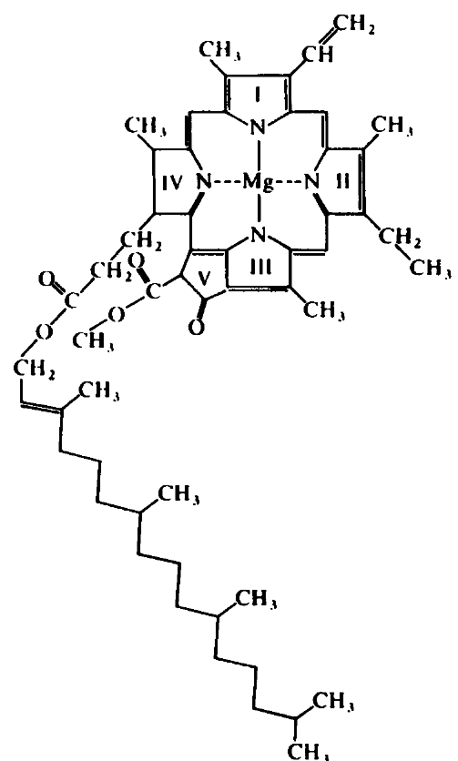
Chlorophyll Structure
Chlorophyll is a pigment
“Head” and “tail” structure very closely related to hemoglobin
Lots of N in head
Head acts like an “antenna” to capture photons!
Excited bonds in head transfer energy to adjacent molecules

Slide 18
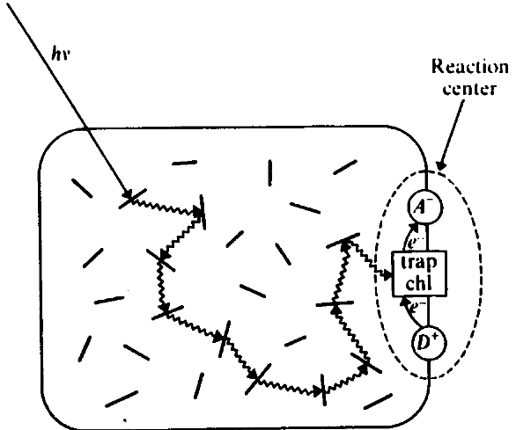
Photochemical Reaction Center
Absorbed energy is passed among pigment molecules until it reaches a special molecule called “trap chlorophyll”
Slightly lower energy level, energy can’t get out
Redox reactions reset trap, pass energy on as chemical potential

Slide 19
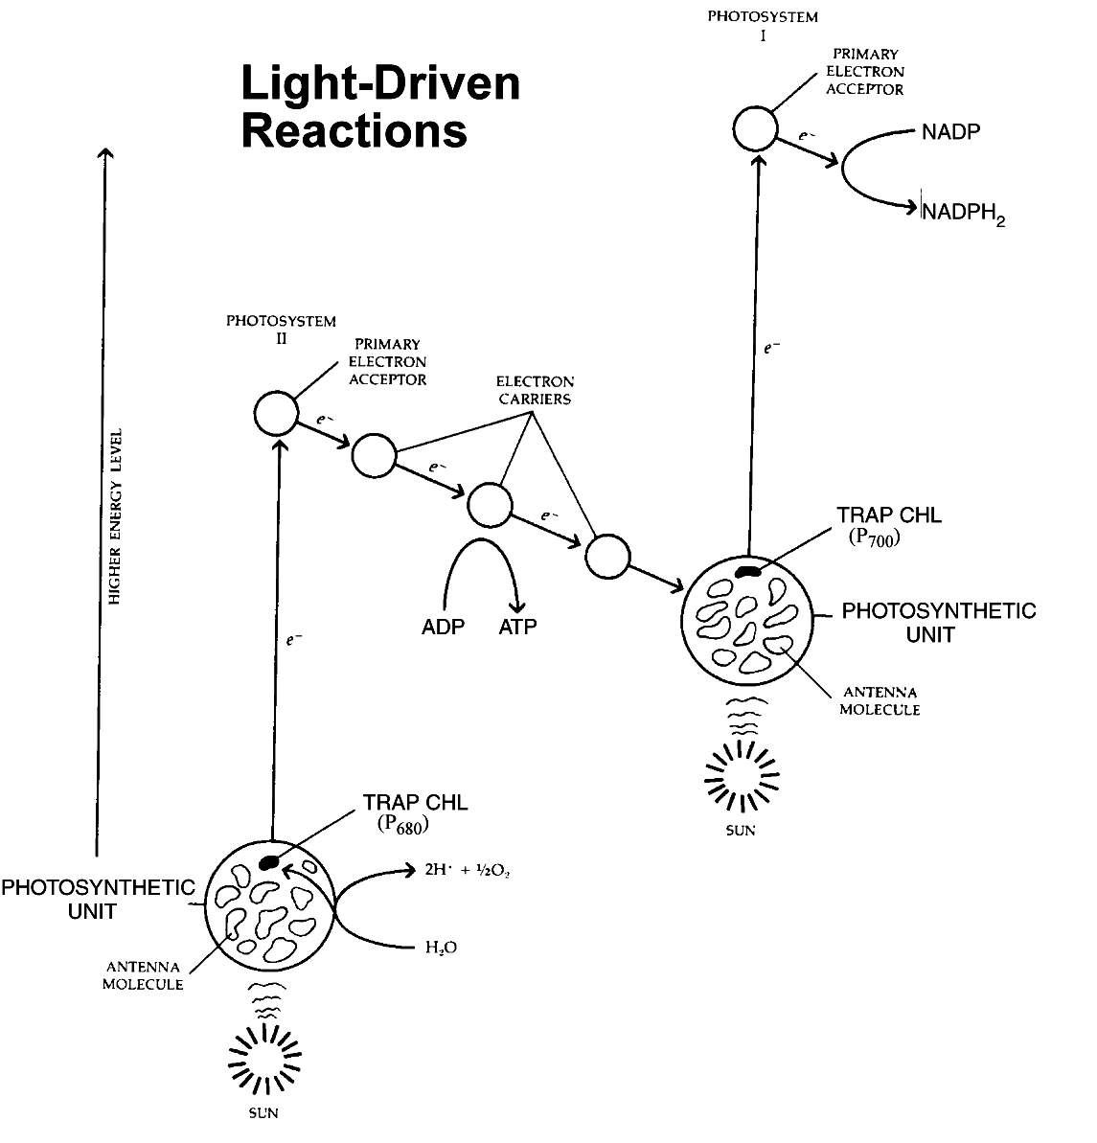
Photochemical Reactions
Two primary “photosystems” use specific wavelengths (red)
PS I drives formation of NADPH₂
PS II splits water
Redox half-cell used to drive ATP formation

Slide 20
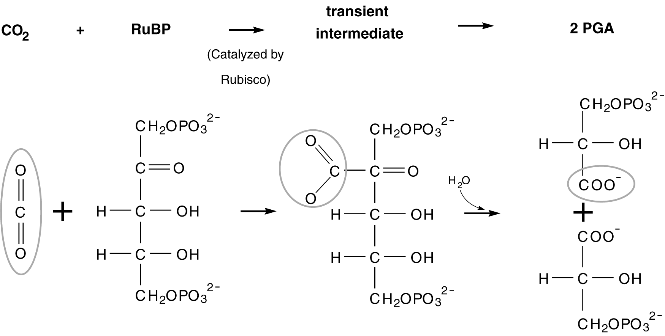
Carbon Fixation
3-carbon compond PGA is formed from ribulose bis-phosphate
Reaction catalyzed by RuBP Carboxylase
Also goes “backward” to O₂ (oxygenase)
ribulose bis-phosphate carboxylase oxygenase “RUBISCO”

Slide 21
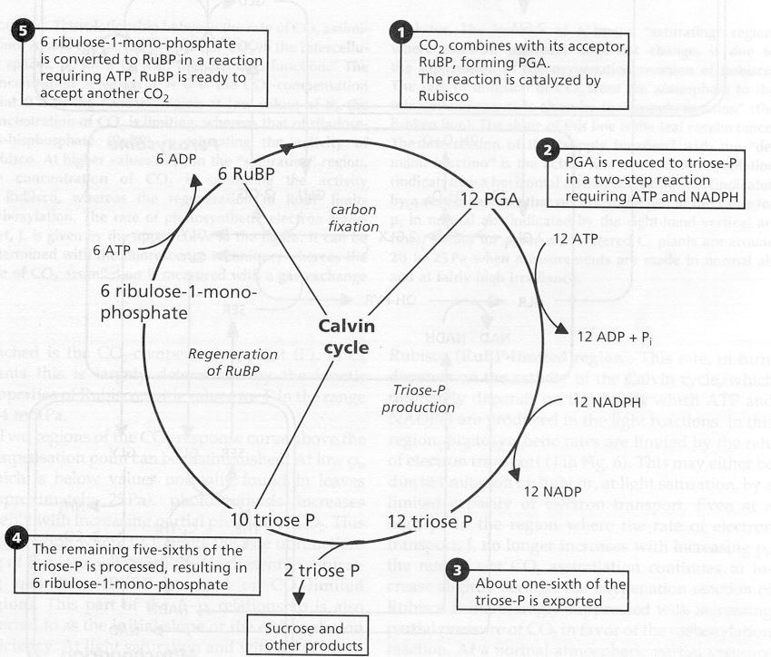
Dark Reactions
The “Calvin Cycle”
Consumes ATP and NADPH₂
Fixes CO₂ into organic intermediates
Produces simple sugars
Regenerates reagents

Slide 22
Photorespiration
Rubisco molecule can work both ways (“carboxylase-oxygenase”)
Catalyses formation of {CH₂O}_{n} from CO₂ (assimilation)
Catalyses destruction of {CH₂O}_{n} to form CO₂ (photorespiration)
Unlike “dark” respiration, photorespiration provides no benefit at all to the plant … just a wasteful loss of energy
Relative rates of carboxylation vs. oxygenation determined by competition between CO₂ and O₂ molecules for active sites on Rubisco enzyme
Higher temperatures, increased O₂, and decreased CO₂ all favor photorespiration over assimilation

Slide 23
Rubisco can gain or lose carbon
Carboxylase
Reacts with CO₂ to produce sugars
Leads to carbon gain
Oxygenase
Reacts with O₂ to convert sugars to CO₂
Respires 20-40% of fixed carbon
Process known as photorespiration
Photoprotection mechanism

Slide 24
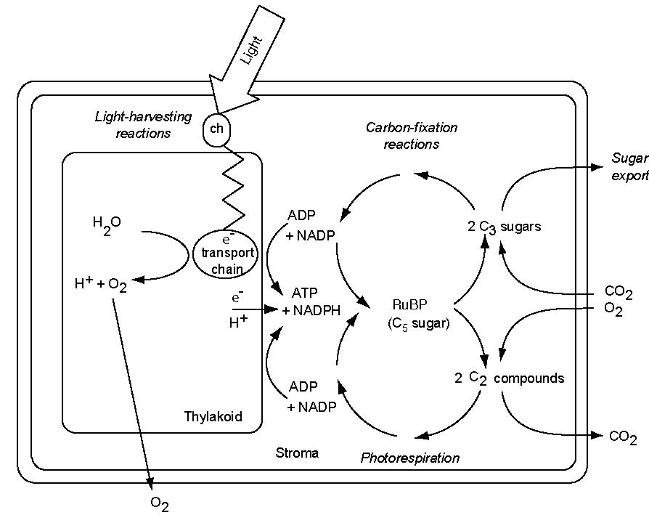
Summary of Photosynthetic Processes
Light Reactions
Dark Reactions

Slide 25
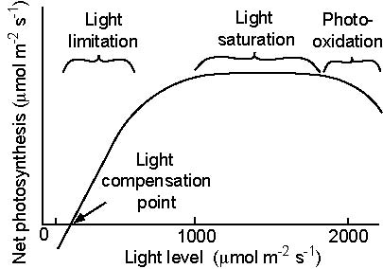
Light Response of Photosynthesis

Slide 26
Photosynthetic Assimilation (Farquhar-Berry-Collatz model)
Three limits:
Rubisco/CO₂
Light
“Sink” or starch
Rubisco/CO₂ limited rate calculated by Michaelis-Menten catalysis
Light limited rate: available PAR and stoichiometry of NADPH₂ and ATP consumption
Sink limitation: related to V_{m}
Dark respiration related to protein maintenance (V_{m})

Slide 27
Leaf Physiology in SiB2
Heat, water, and carbon fluxes are coupled by physiology
Scaling to canopy and landscape fluxes based on resource allocation

Slide 28
Canopy Integration
Farquhar photosynthesis model and Ball-Berry stomatal conductance calculation are derived for leaf-level fluxes
How to integrate to entire canopy?
Could multiply fluxes (mol m⁻² s⁻¹) at leaf level by total leaf-area index
That would assume all leaves have same properties and physical environment
What about shading inside canopy?
How does a plant respond to shading over time?

Slide 29
Canopy Attenuation of Radiation
Radiation is absorbed and also scattered by individual leaves and stems
Drops off steeply through canopy depth
Penetration is deeper for diffuse than direct solar

Slide 30
Within-Canopy Radiative Transfer
Attenuation is greater for visible (photosynthetically active radiation, PAR) than for near IR
Attenuation is nearly log-linear with cumulative leaf-area index

Slide 31
Canopy Integration (Sellers et al, 1992)
L = “cumulative LAI” (vertical coordinate)
How to efficiently integrate leaf-level equations across all leaf angles and light levels?
Assume light levels drop off inside canopy according to Beer’s Law
Maximum photosynthesis rate (V_{max}) depends on Rubisco, an enzyme used to catalyze C fixation
Rubisco is mostly nitrogen (most abundant protein on Earth)
Assume plant allocates scarce N where it will yield the most C gain (following time-mean light!)
G(μ) = projected LAI normal to beam
Canopy scaling factor P ~ FPAR … get by remote sensing

Slide 32
Economics of Carbon and Nitrogen
Plants are not dumb
Most plants are N-limited … more N makes them grow new tissue (leaves)
Given scarce N, they invest it where it will return the highest yield in C gained
Top (“sun”) leaves are N-rich, green and juicy and healthy

Slide 33
C₃ and C₄ Photosynthesis
Most plants produce sugars by the pathway outlined above, in which the first organic compounds have three carbon atoms (C₃)
Some tropical and subtropical plants have evolved a separate mechanism in which the first products have four carbon atoms (C₄)
C₄ photosynthesis is a mechanism to overcome photorespiration (high O₂/CO₂ ratio, high T)
Involves active transport of dissolved CO₂ to specialized “bundle-sheath” cells to overwhelm O₂ at Rubisco active sites
Uses energy to do this … only “pays off” when photorespiration is a big problem
Evolved only ~ 10 My BP, when CO₂ levels dropped

Slide 34
C₃ and C₄ Physiology & Biochemistry
distributed
chloroplasts
bundle sheath
Berry

Slide 35
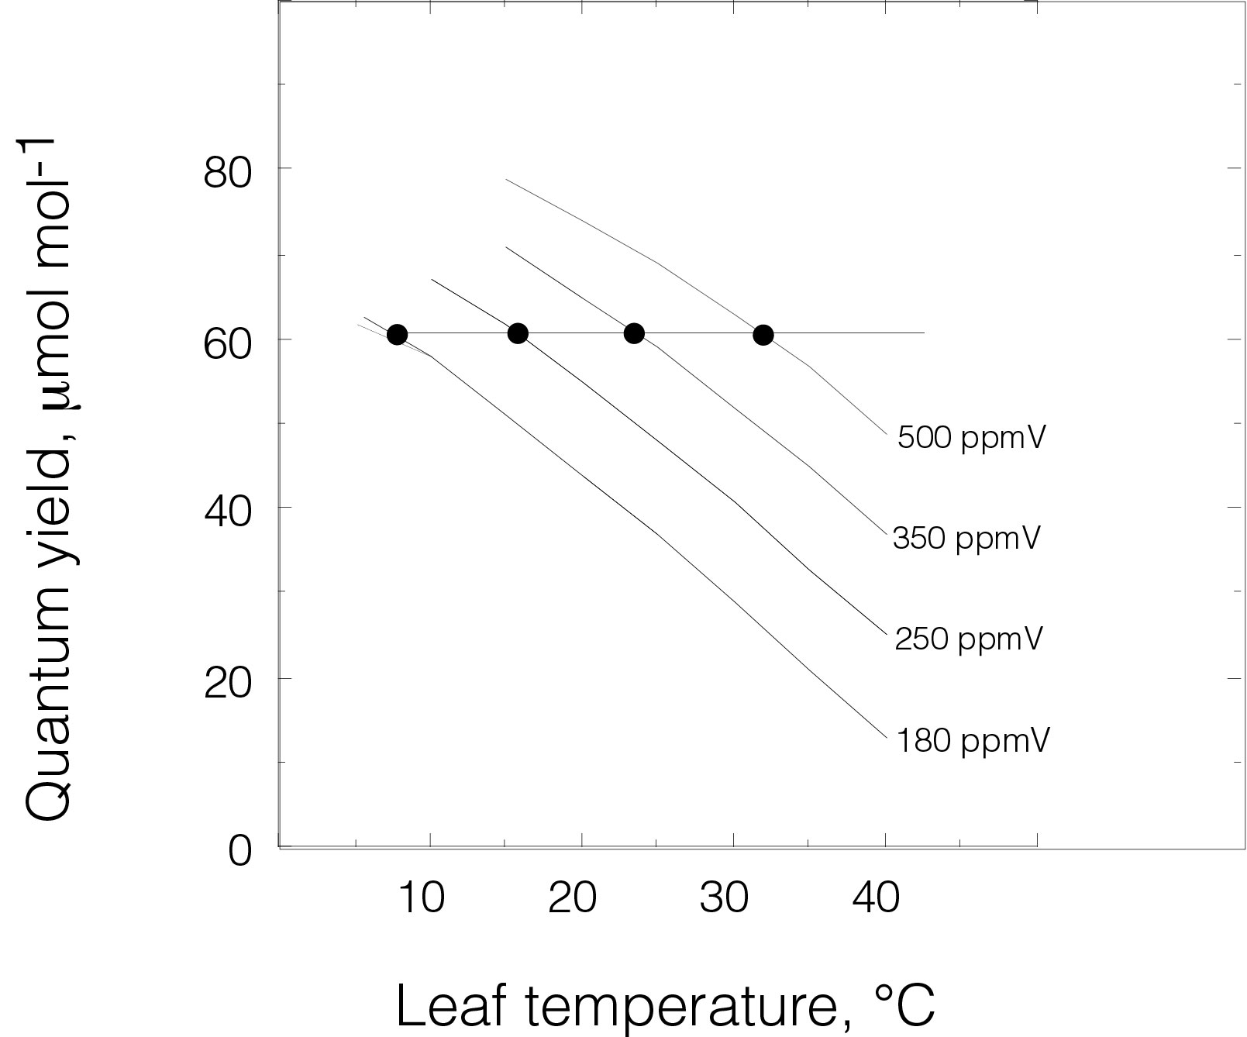
The light-use efficiencies of C₃/C₄
plants are intrinsically different
photorespiration is
temperature sensitive
C₄
C₃
a temperature - dependent
tradeoff is created
J. Ehleringer

Slide 36
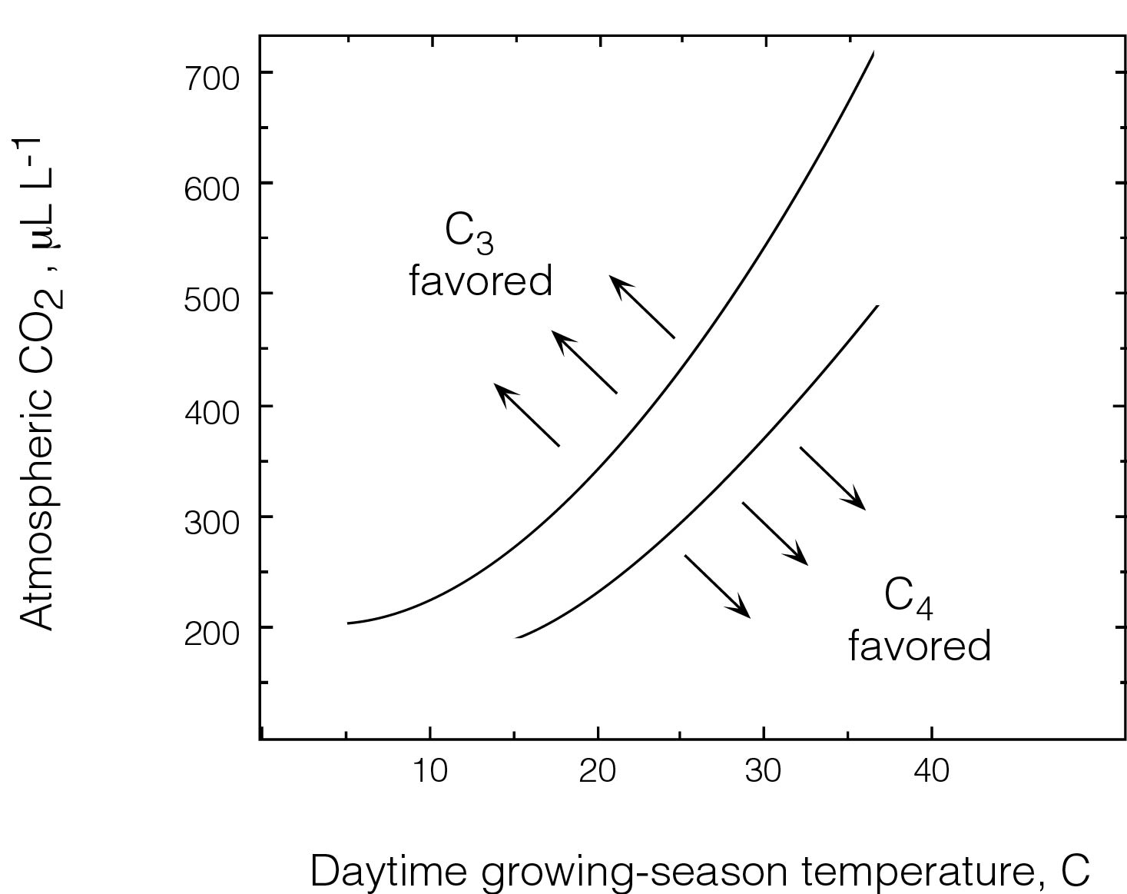
The quantum yield model of C₄ distribution
J. Ehleringer

Slide 37
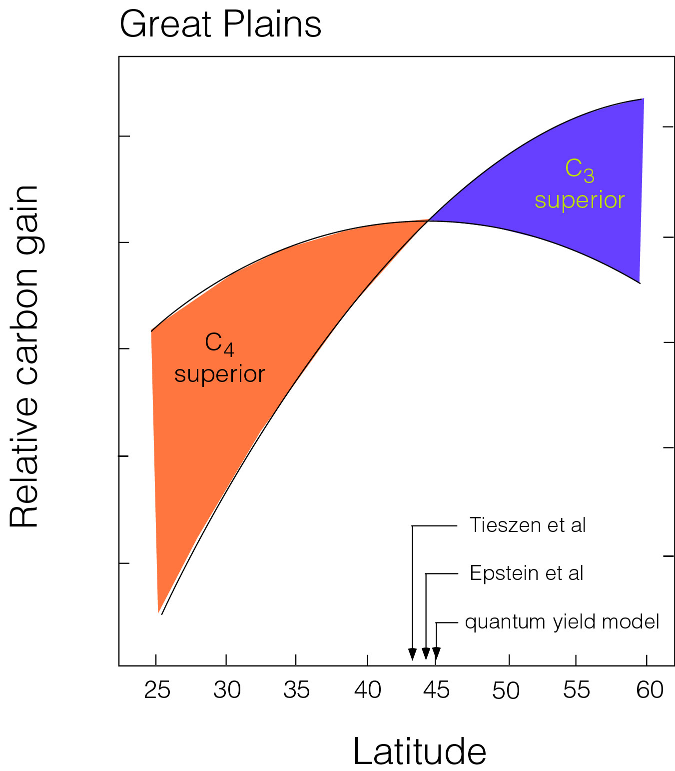
J. Ehleringer J. Ehleringer

