Slide 1
Terrestrial Carbon Cycle:
Allocation, Decomposition,
Nutrient Cycling, and Sink Processes
Please read:
  Schulze, E.-D., 2002. “Carbon Turnover.”
  In: Plant Ecology. Springer. p. 427-438.
  Norby, R. J. et al (2010), CO₂ enhancement of forest productivity constrained by limited nitrogen availability, Proc. Nat. Acad. Sci, 107, 19368–19373.
  Pan, Y. et al (2011a), Age structure and disturbance legacy of North American Forests. Biogeoscienes 8, 715-732

Slide 2
Carbon Allocation:
What happens to photosynthate (glucose) after it is formed in chloroplast?
Some is consumed to drive biosynthesis processes in leaf
Some is stored in easily-available form for later
Some stored photosynthate is transported to other parts of the plant (roots, stems) to be used there for maintenance and growth
Relative allocation to leaves, stems, and roots depends on resource needs
  Plant is shaded (light-limited): grow more stem
  Water or nutrient limited: grow more roots
  Fat and happy: grow more leaves
Question: Where does carbon & nitrogen come from when it’s time to grow new leaves in spring?

Slide 3
Plant Respiration
Gross Primary Production – Plant respiration
= Net Primary Production
GPP – R_{a} = NPP
GPP – R_{m} – R_{g} = NPP
R_{m} = f(N, temperature, O₂) Maintenance respiration
R_{g} - growth respiration, involves construction costs of building new tissues f(new growth)
GPP – R_{leaf} (m + g) – R_{stem}(m + g) – R_{root}(m +g) = NPP
Allocation and respiration processes occur simultaneously

Slide 4
Factors controlling plant respiration
NPP = GPP - R_{a}
Tissue N -- protein turnover; 6% replaced daily
Temperature -- increased protein and membrane turnover at higher temperatures
GPP and R_{a} generally related,
so NPP and GPP are proportional
However, at high temperatures, GPP may be maintained or inhibited, while R_{plant} increases. NPP/GPP decreases.

Slide 5
Water Controls NPP
At global scale,
ppt and T are strongly correlated with NPP
Water increases plant growth in drier ecosystems. Also increases decomposition and nutrient cycling.
In extremely wet climates,
ppt can limit NPP by decreasing light or nutrient availability
25
¡
20
¡
¡
¡
15
¡
ú
NPP (Mg C ha⁻¹ yr ⁻¹ )
ú
¡
¡
¡
¡
ú
ú
¡
¡
ú
¡
¡
¡
ú
¡
¡
¡
10
ú
¡
l
¡
l
¡
¡
¡
¡
¡
ú
¡
¡
l
ú
¡
ú
ú
¡
¡
l
ú
ú
ú
¡
ú
ú
¡
¡
¡
ú
ú
ú
l
¡
ú
ú
ú
ú
¡
¡
5
ú
ú
ú
ú
ú
ú
ú
ú
¡
ú
ú
ú
l
ú
ú
ú
ú
ú
ú
¡
ú
ú
ú
¡
ú
ú
ú
ú
ú
ú
ú
0
ú
0
2000
4000
6000
8000
Mean Annual Precipitation (mm)

Slide 6
Temperature
Controls NPP
25
¡
Annual mean temperature is related to growing season length
Temperature stimulates decomposition and nutrient cycling
20
¡
¡
15
¡
¡
Mg C ha⁻¹ yr ⁻¹
¡
¡
ú
ú
ú
¡
¡
¡
¡
¡
ú
ú
10
¡
¡
¡
¡
¡
ú
l
l
¡
¡
¡
¡
¡
ú
¡
l
¡
ú
ú
ú
ú
l
ú
ú
¡
¡
ú
ú
¡
¡
¡
¡
ú
ú
ú
ú
l
ú
¡
5
ú
ú
ú
ú
ú
ú
¡
¡
ú
ú
ú
ú
ú
ú
l
ú
ú
ú
ú
ú
ú
¡
¡
ú
ú
0
-15
-10
-5
0
5
10
15
20
25
30
Mean Annual Temperature (ºC)

Slide 7
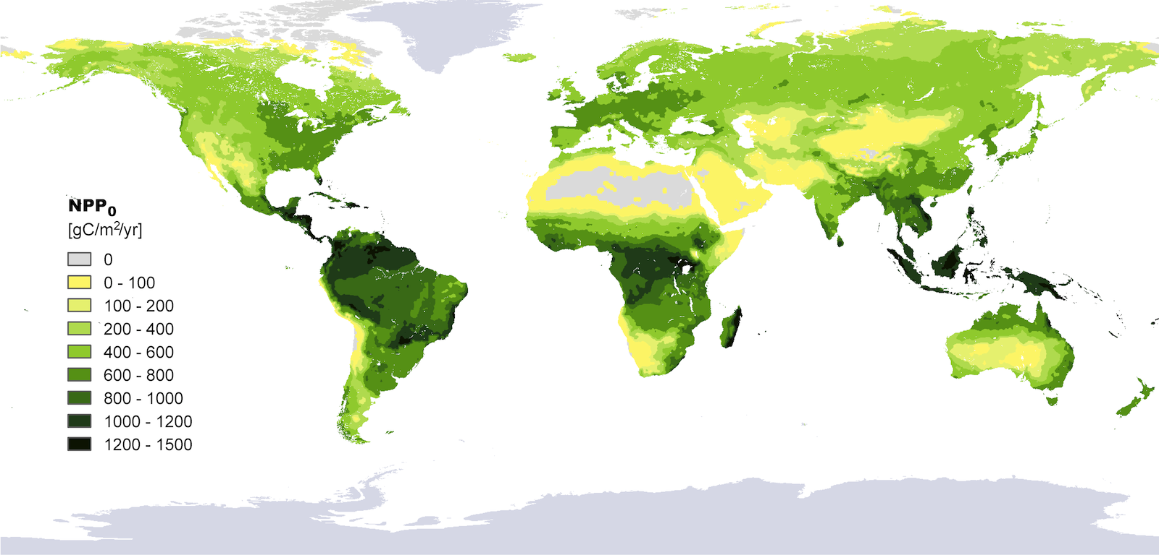
Global NPP
Haeberl et al, 2007, PNAS
“Potential” NPP, not actual because management effects, agriculture, irrigation, urbanization, and other land use not accounted for
Latitude effects (growing season, decomp); Aridity effects

Slide 8
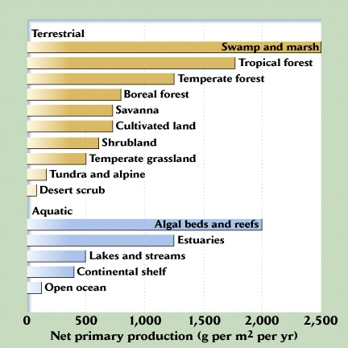
NPP by “Biome”
Note that these are per unit area!
Forests & grasslands dominate because of larger areas
Coral reefs are like forests!

Slide 9
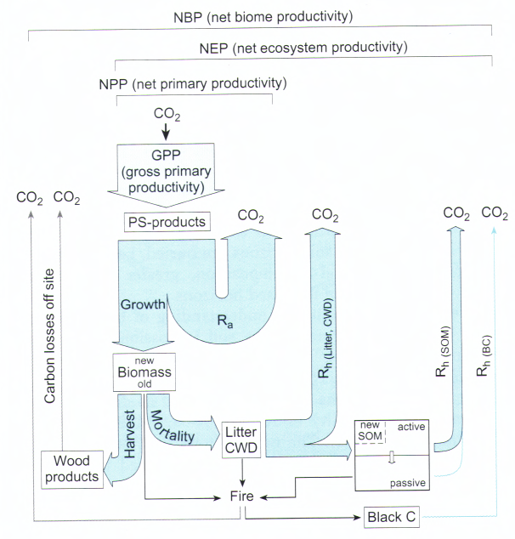
Flows of Fixed Carbon
Through Terrestrial Ecosystems
NPP = GPP - R_{a}
NEP = GPP – R_{a} – R_{h}
NEP = NPP – R_{h}
NBP = NEP – disturbance
NBP = NEP – harvest - fire
NBP is what the atmosphere “sees”
it is equal to carbon accumulation within the ecosystem

Slide 10
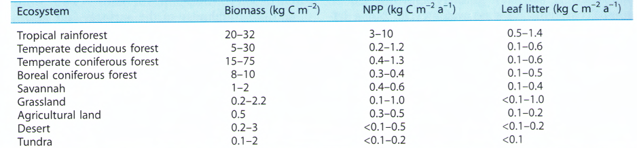
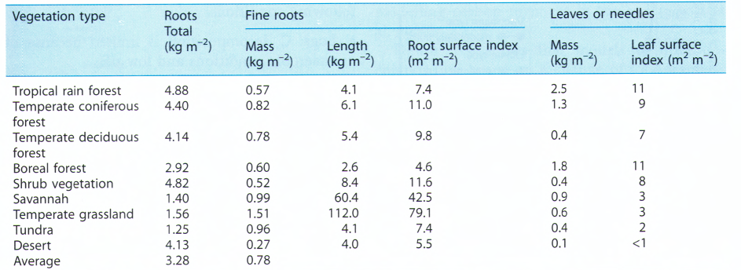
Carbon “Pools”
by “Biome” (Schulze 2002)
m m⁻²

Slide 11
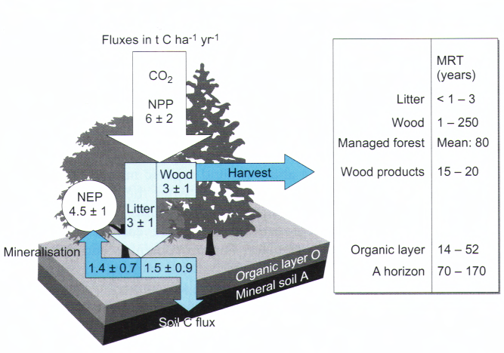
Typical Carbon Flows
in a rapidly growing forest (Schulze 2002)

Slide 12
Decomposition
k_{max} – maximum rate constant for litter or SOM loss under ideal conditions
C – mass of litter at the beginning of time interval
f(chemistry) – scalar describing the rate at which microbes degrade the plant
material (typically a function of N, cellulose, lignin)
f(temperature) – scalar describing sensitivity of microbes to temperature
f(water availability) – scalar describing microbial response to soil/surface moisture

Slide 13
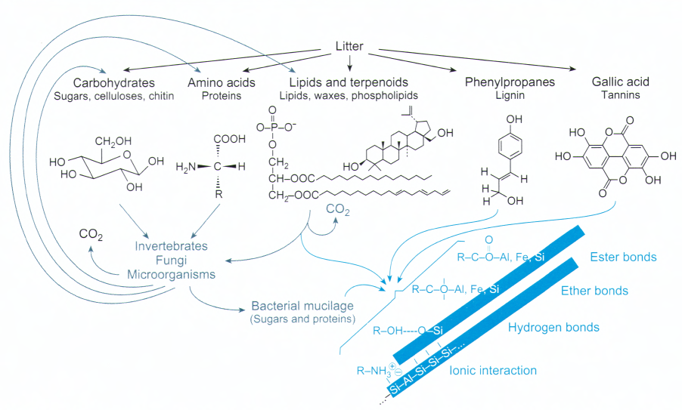
Litter Decomposition
Yum!
Yuck!
(Schulze 2002)

Slide 14
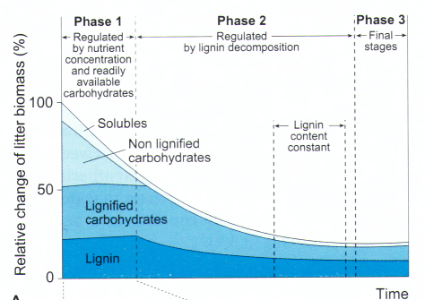
Litter Decomposition
Yum!
Yuck!
(Schulze 2002)

Slide 15
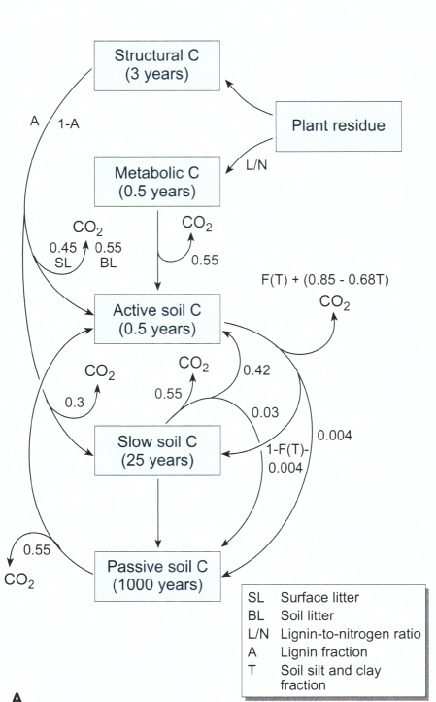
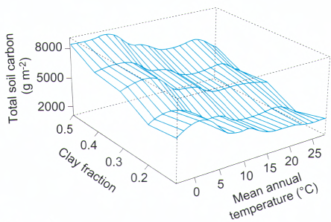
CENTURY
Litter Decomposition
and Soil Organic Matter Transformations
modeling approach for litter and soil organic matter dynamics, widely employed
Parton 1988

Slide 16
Global Terrestrial Ecosystem Fluxes
(1 Pg C = 10¹⁵ g C)
Concept
Acronym
Global Flux
Definition
Gross Primary Production
GPP
~100 –150 Pg C yr¹
Carbon uptake by plants during photosynthesis
Autotrophic Respiration
R_{a}
~ ½ of GPP
Respiratory loss by plants for growth or maintenance
Net Primary Production
NPP
~ ½ of GPP
GPP – R_{a}
Heterotrophic Respiration
(on land)
R_{h}
~82% – 95% of NPP
Respiratory loss by the heterotrophic community (herbivores, microbes, etc.)
Ecosystem Respiration
R_{a}
~91% – 97% of GPP
R_{a} + R_{h}
Non-CO₂ Losses
~2.8 – 4.9 Pg C yr⁻¹
CO, CH₄, terpenes, dissolved inorganic and organic carbon, etc
Non-Respiratory CO₂ Losses (Fire)
~1.6 – 4.2 Pg C yr⁻¹
Combustion flux of CO₂
Net Ecosystem Production
or
Net Biome Production
NEP
~±2.0 Pg C yr⁻¹
Total carbon accumulation within the ecosystem

Slide 17
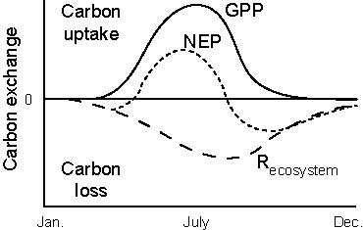
Seasonal Cycles

Slide 18
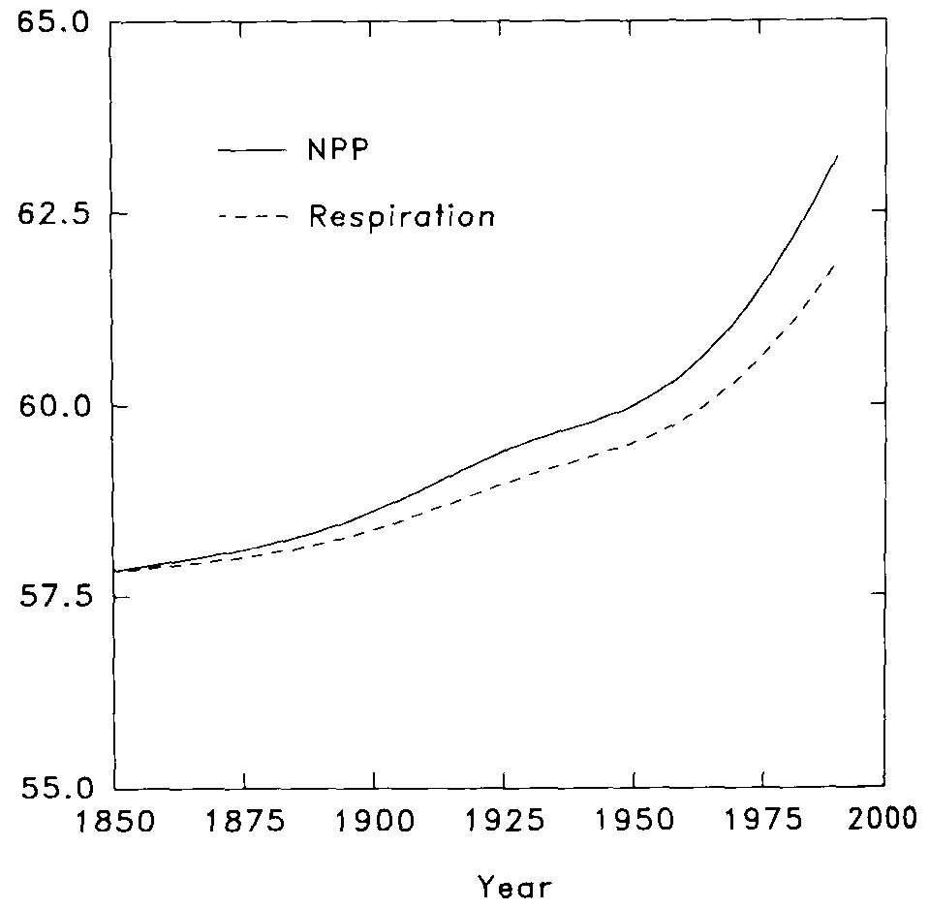
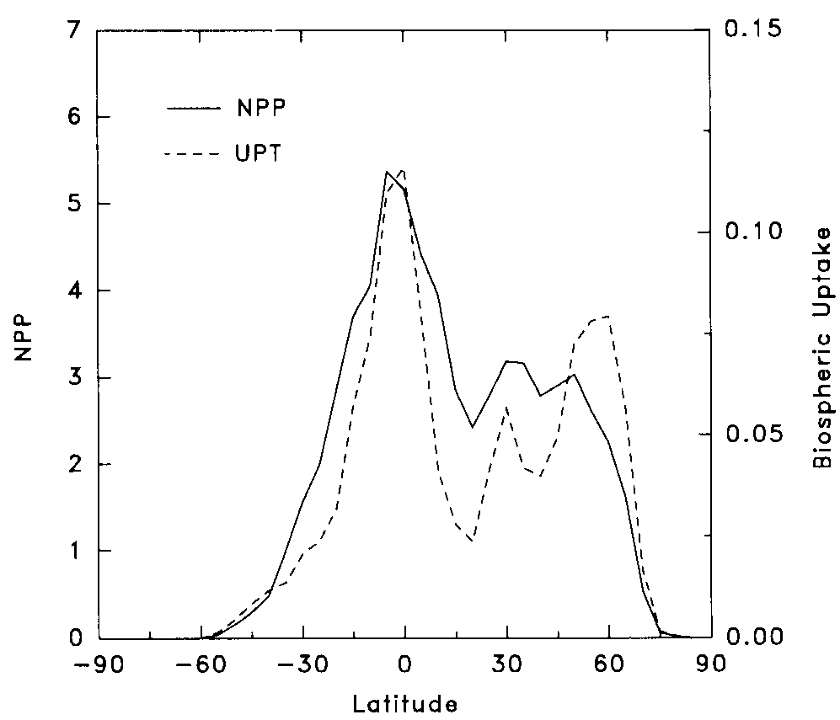
CO₂ Fertilization
sink
τ
time
space
NPP(t) = NPP₀(1 + β ln[C(t)/C₀])
Increasing plant growth (NPP) due to enhanced atmospheric CO₂
Delayed increased respiration (residence time)
Spatial pattern follows both NPP & residence time

Slide 19






Net Primary Production and mean residence times of carbon determines source/sink potential of ecosystems
CO₂ Fertilization
NPP(t) = NPP₀(1 + β ln[C(t)/C₀])
Distribution of NPP favors tropical CO₂ sink
NPP
dC/dt~ b·t_{b} · NPP₀
Distribution of residence time favors boreal CO₂ sink
turnover time

Slide 20
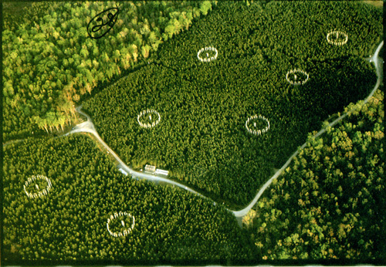
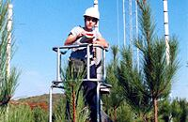
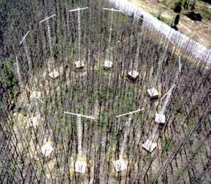
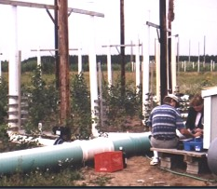
Free Air Carbon Enrichment
(FACE)
Fumigation rings maintain steady levels of elevated CO₂ in canopies under changing weather conditions
Control and replicated treatments test effects of CO₂, water, N, etc

Slide 21
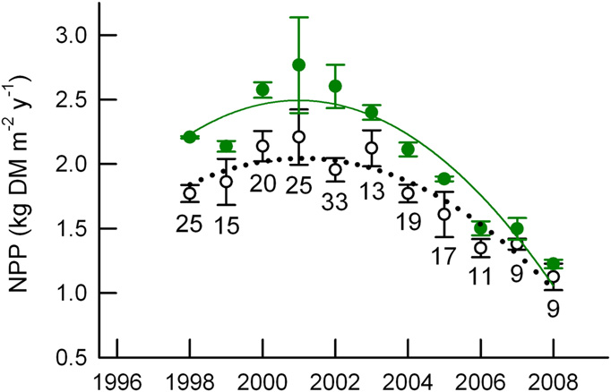
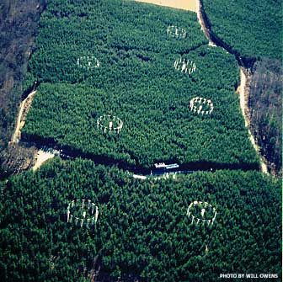
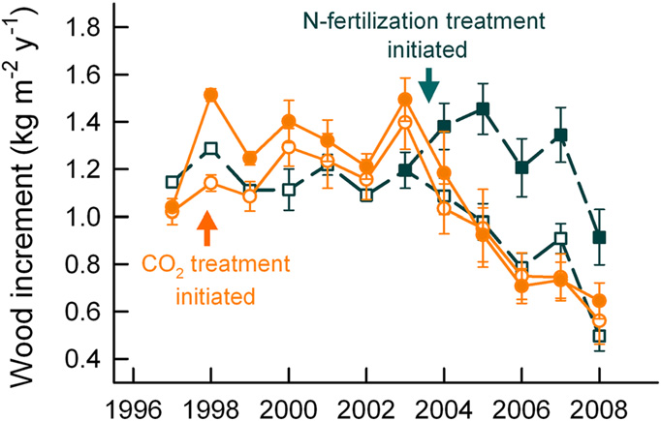
Duke FACE Results
elevated CO₂
ambient CO₂
Enhanced growth
in elevated CO₂
“Acclimitization” after a few years
Norby et al (2010)

Slide 22
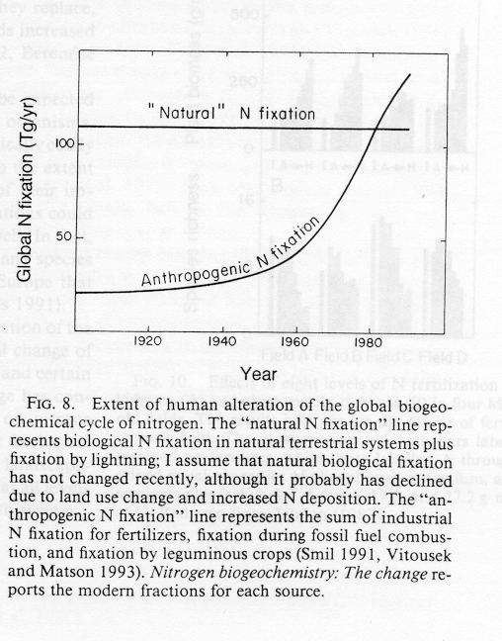
Nitrogen Fertilization
Atmospheric N₂ is triply-bound so chemically and biologically inert
Natural N-fixation by lightning and by specialized microbes, linked to very tight N cycling in biosphere
Manufacture of fertilizers uses energy to fix N
Combustion burns air!

Slide 23
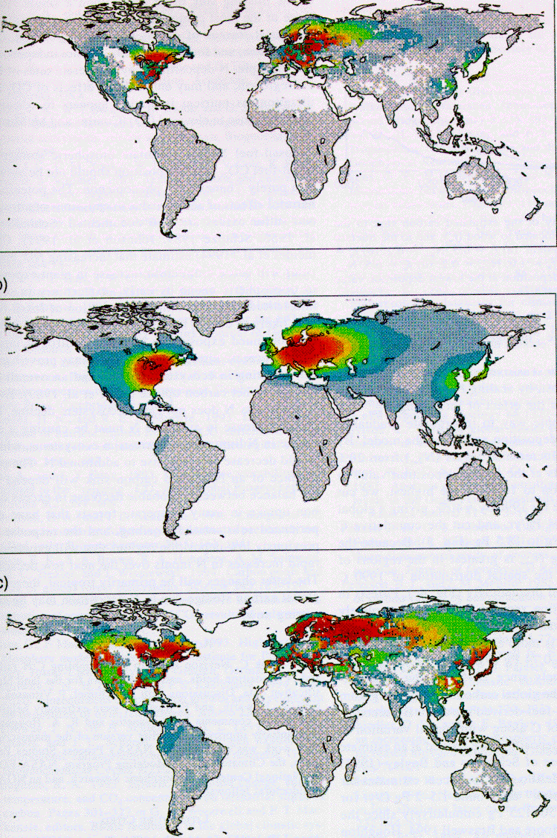
Atmospheric Deposition of Fixed N
Emissions
Combustion
burns air!
N₂ + O₂ -> 2 NO
(NO, NO₂) -> NO₃
Geography of industry and westerly winds
N-limited forests take up C:N at 200:1
Transported
Assimilated
Townsend et al. 1996

Slide 24
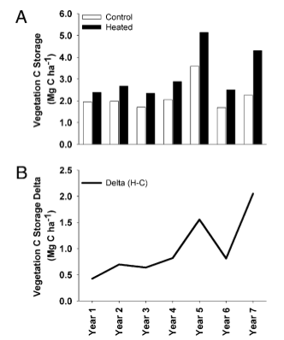
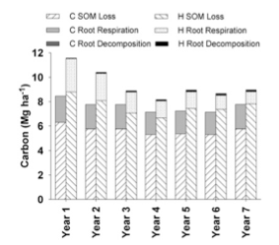
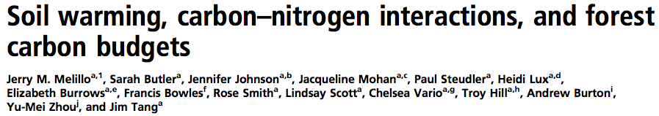
Soil Warming Experiments
Warming enhances both decomposition and vegetation carbon storage

Slide 25
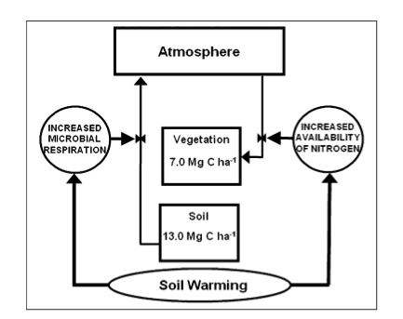
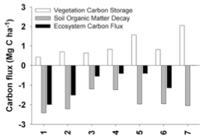
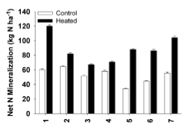
Competing Carbon-Climate Feedbacks
Early C loss due to enhanced decay
Enhanced N mineralization
Later enhancement of NPP

Slide 26
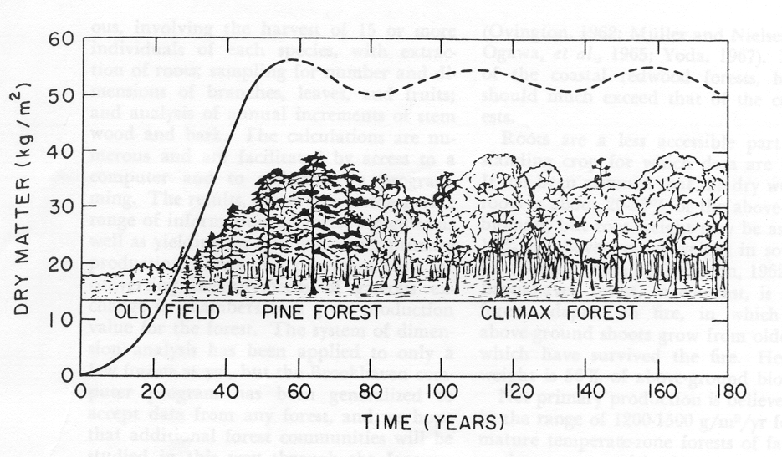
Ecosystem Succession
NPP
C
k·C
Woodwell and Whittaker, 1968

Slide 27
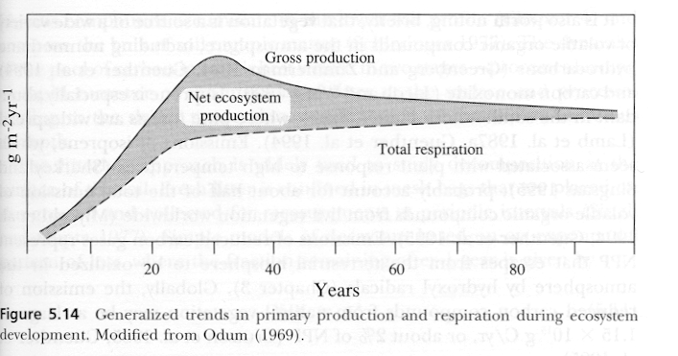
Ecosystem Succession

Slide 28
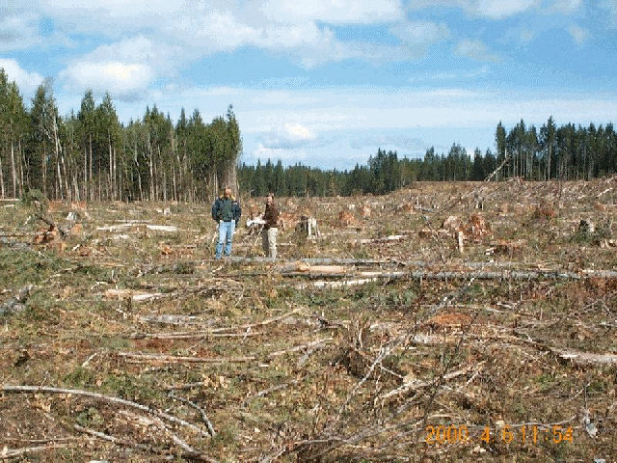
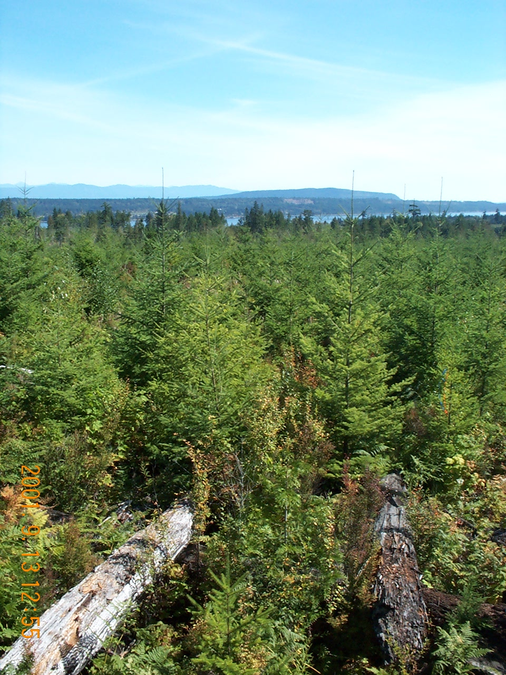
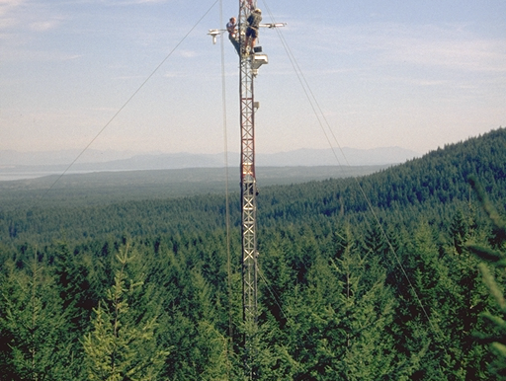
Disturbance
and Recovery
6-year-old
18-year-old
57-year-old
Planted
2000
1988
1949
Height (m)
0.8
3-8
30-35

Slide 29

Fluxnet-Canada Annual Carbon Budgets
Sink
Interannual
Variability
Gap
Source

Slide 30
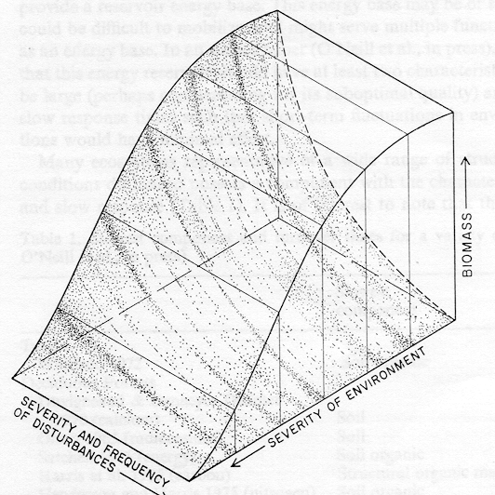
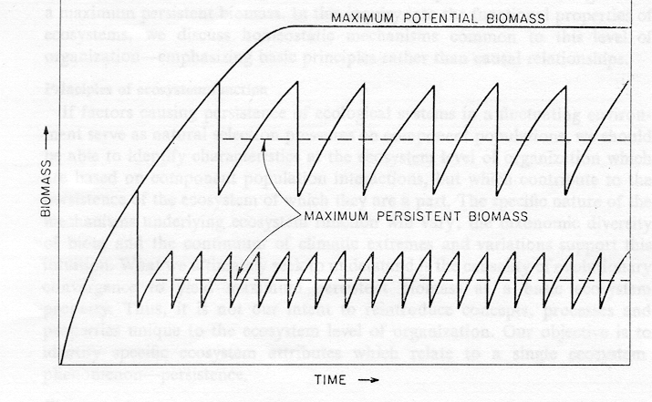
Disturbance and Steady State
At a regional scale, patches of terrestrial ecosystems are always in different stages of recovery from disturbance. If the disturbance regime is constant, then the distribution of different successional states of ecosystems will remain constant.
Reichle, 1974

Slide 31
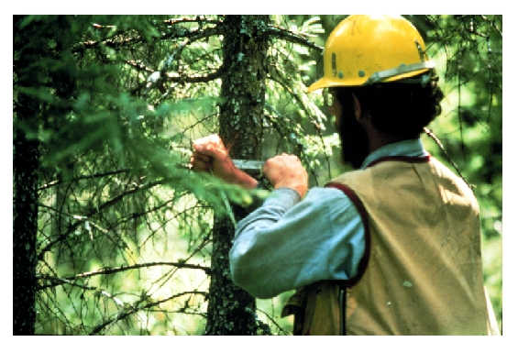
Forest Inventory Sampling
USDA Forest Service measures hundreds of thousands of plots!

Slide 32
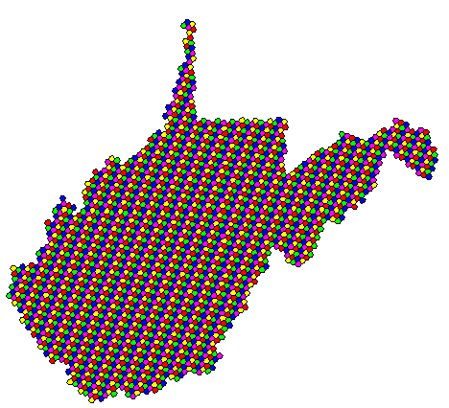
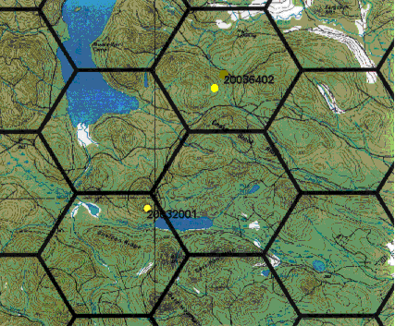
USDA Forest Service FIA Plots
Five-Year Panel:
6000 acre grid cells
1 plot per grid cell
>800K plots
each plot visited every 5 (east) or 10 (west) years
Year One
Year Two
Year Three
Year Four
Year Five

Slide 33
Disturbance Patterns
Pan et al (2011a)
Reconstructed clearing, fuelwood, and pulp & paper production in North America over 300 years
Fuelwood and farm clearing peaked around 1850
Lumber and paper production peaked about 1900

Slide 34
Disturbance Patterns
Pan et al (2011a)
PNW and SE forests are young
NE forests are intermediate
Canadian patterns are complicated!
BC forests are old

Slide 35
Disturbance, Recovery, and NEP
Pan et al (2011a)
Decades of carbon loss following disturbance, decades of slow carbon gain, eventual equilibration

Slide 36
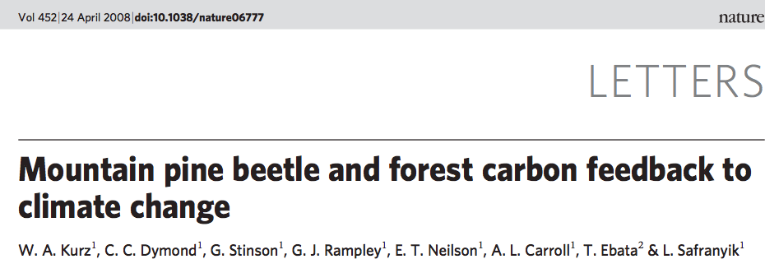
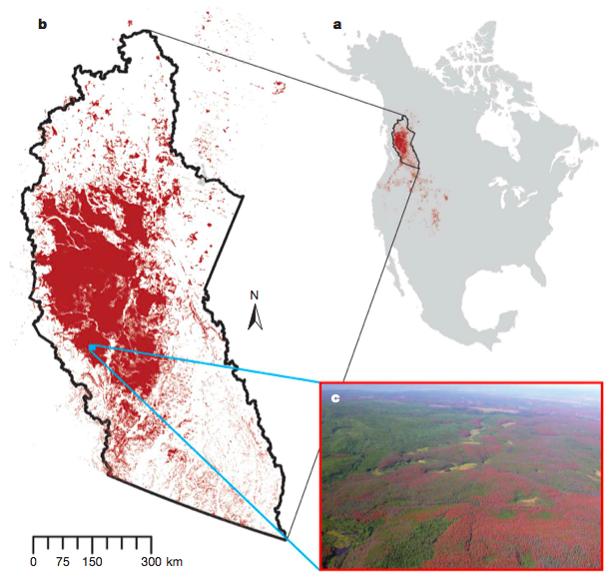
Bugs!

Slide 37
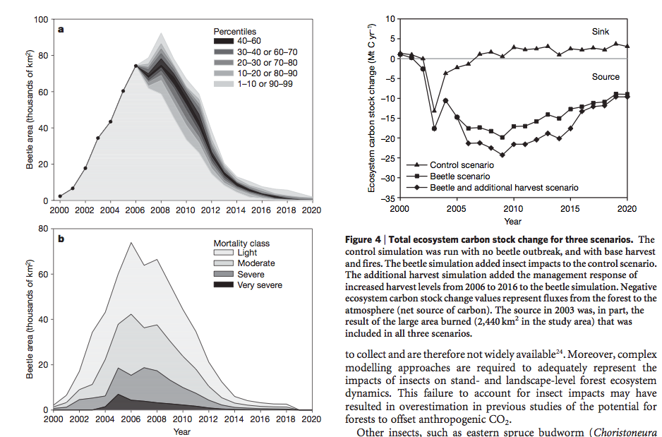
A Decadal Phenomenon
Fires related to drought in 2002
Beetle outbreak peaked about 2006
About 0.3 GtC lost over 20 years

Slide 38
Global Forest Carbon Sources and Sinks
Pan et al (2011b)

