Slide 1
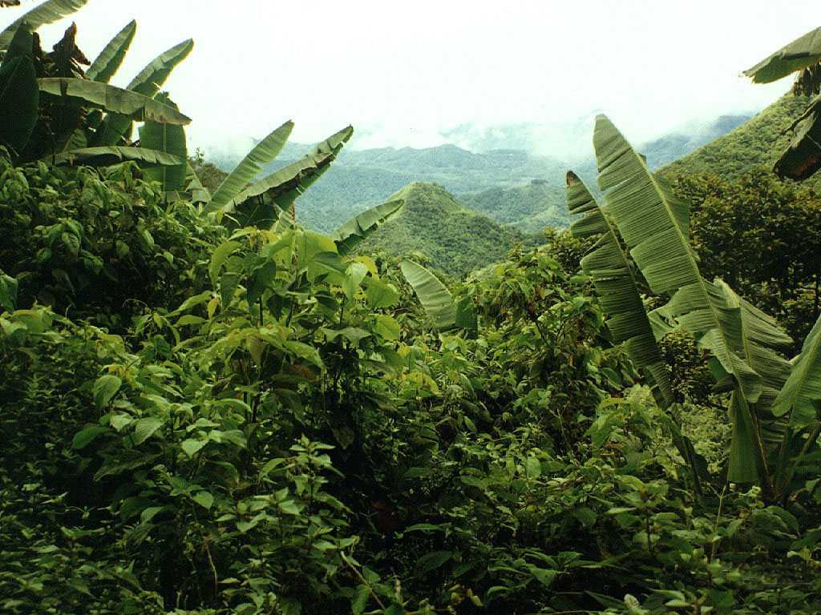
Modeling the
Land Carbon Cycle
Please see
http://biocycle.atmos.colostate.edu/shiny/Land/

Slide 2
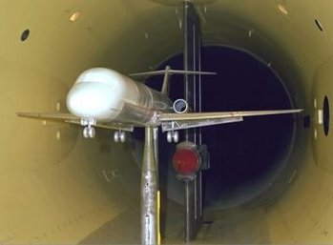
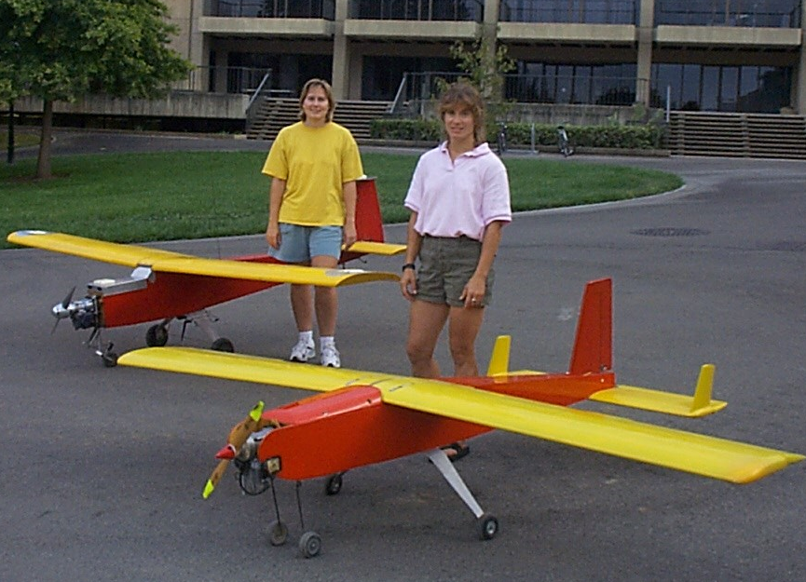
What is a Model?
Models are simplifications of reality which we use to organize and make sense of what we see in the world around us
Models are abstractions which seek to capture the essence of real processes
Simple models are not intended to be perfect representations of the real world
Models help us understand

Slide 3
Levels of Abstraction
6. Computer program
(Stella, MATLAB, Python, R)
5. Numerical algorithm
(arithmetic procedure)
4. Discrete model (algebra)
3. Mathematical model
(differential equations)
2. Conceptual model
(in our heads,
maybe with a diagram)
1. Real world
(impossibly complicated)
More abstract
More realistic

Slide 4
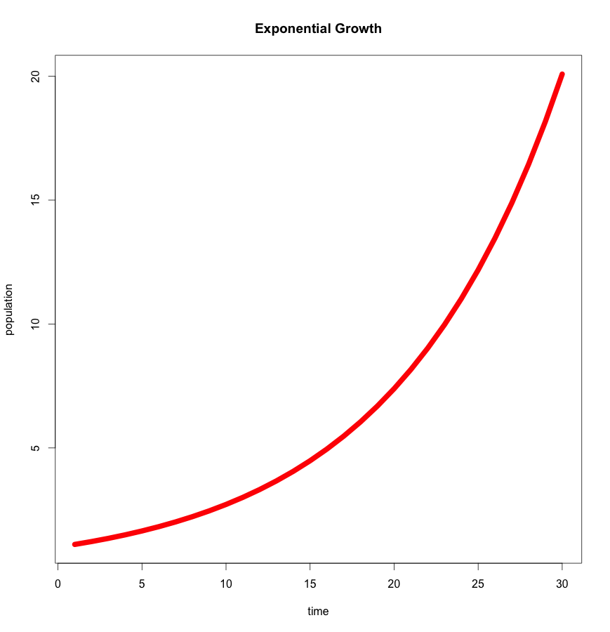
Exponential Growth
Rate of growth of new stuff (plants, populations) proportional to the amount of old stuff
Rate rises faster and faster
Quickly exceeds any reasonable limit
Not very realistic!
Population increases 20x in 30 time steps!
Let g = 10%

Slide 5

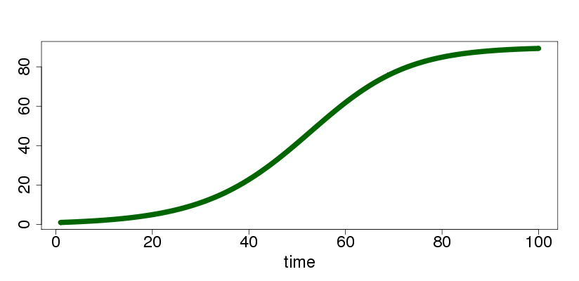
Logistic Growth
Let growth rate depend on population
Exponential growth when population is small
Growth rate shrinks as population approaches
“carrying capacity”
http://biocycle.atmos.colostate.edu/shiny/logistic/

Slide 6
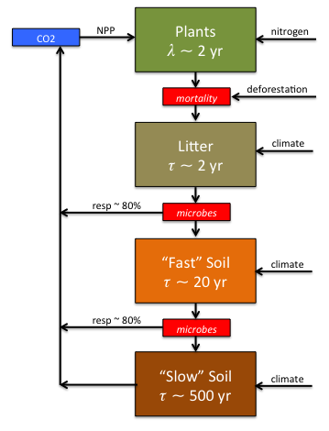
Cascading Carbon Pools
Plants grow logistically limited by nutrients
Carbon from dead plants becomes litter
Litter decomposes quickly into fast and then slow soil organic matter
Conceptual Model
Mathematical Model
http://biocycle.atmos.colostate.edu/shiny/Land/

Slide 7
Discretize the Model
Replace all the differentials with differences
Mathematical Model
(differential equations)
Discrete Model
(algebraic equations)
Approximate calculus with algebra

Slide 8
Algorithm (Recipe)
Write down a procedure to update (P,L,F,S)
Discrete Model
(algebraic equations)
Algorithm
(arithmetic to update pools)
qmult = Q₁₀^{(T-T0)/10} Dt
P^{new =} P^{old} + (NPP – MORT) Dt
L^{new =} L^{old} + (MORT-L^{old}/t_{L}) qmult
F^{new =} F^{old} + ((1-e)L^{old}/t_{L}– F^{old}/t_{F}) qmult
S^{new =} S^{old} + ((1-e)F^{old}/t_{F}– S^{old}/t_{S}) qmult
http://biocycle.atmos.colostate.edu/shiny/Land/

Slide 9
Computer Program
Convert arithmetic recipe into programming language
Algorithm
(arithmetic to update pools)
Computer Program
(instructions in R)
P^{new =} P^{old} + (NPP – MORT) Dt
L^{new =} L^{old} + (MORT-L^{old}/t_{L}) qmult
F^{new =} F^{old} + ((1-e)L^{old}/t_{L}– F^{old}/t_{F}) qmult
S^{new =} S^{old} + ((1-e)F^{old}/t_{F}– S^{old}/t_{S}) qmult
plant[i+1] <- plant[i] + NPP[i] - mortality[i]
litter[i+1] <- litter[i] + mortality[i]
– litter[i]/tau.litter * resp.enhancement
fast.soil[i+1] <- fast.soil[i] + resp.enhancement * (
(1.-eff.microbes) * litter[i]/tau.litter -
fast.soil[i]/tau.fast)
slow.soil[i+1] <- slow.soil[i] + resp.enhancement * (
(1.-eff.microbes) * fast.soil[i]/tau.fast -
slow.soil[i]/tau.slow)
http://biocycle.atmos.colostate.edu/shiny/Land/

Slide 10
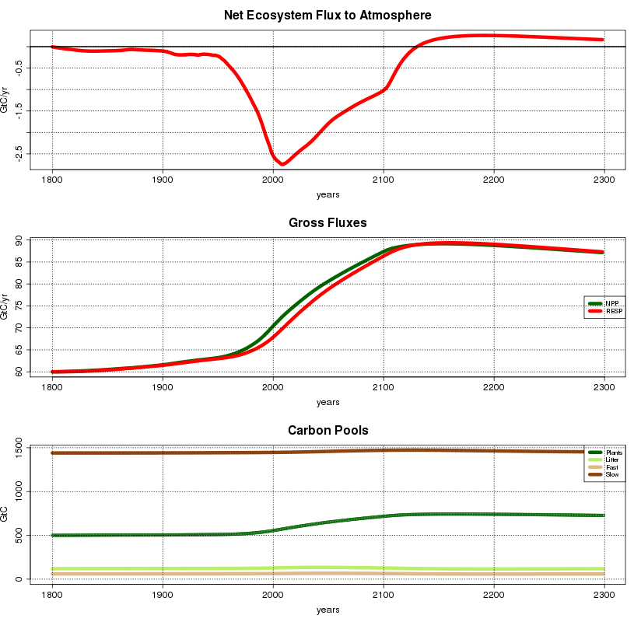


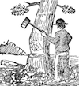
Results
Try it yourself and test the effects of CO₂ fertilization, nitrogen deposition, deforestation, and climate!
http://biocycle.atmos.colostate.edu/shiny/Land/

