Slide 1
Fossil Fuel Combustion and the Economics of Energy

Slide 2
Fossil Fuel Emissions Information
Tabulations of emissions by country:
Distribution within country by political subunit and population density
Oak Ridge National Lab (Greg Marland) http://cdiac.esd.ornl.gov/authors/marland.html
Andres et al (1996)
US DoE Energy Information Administration
http://www.eia.doe.gov

Slide 3
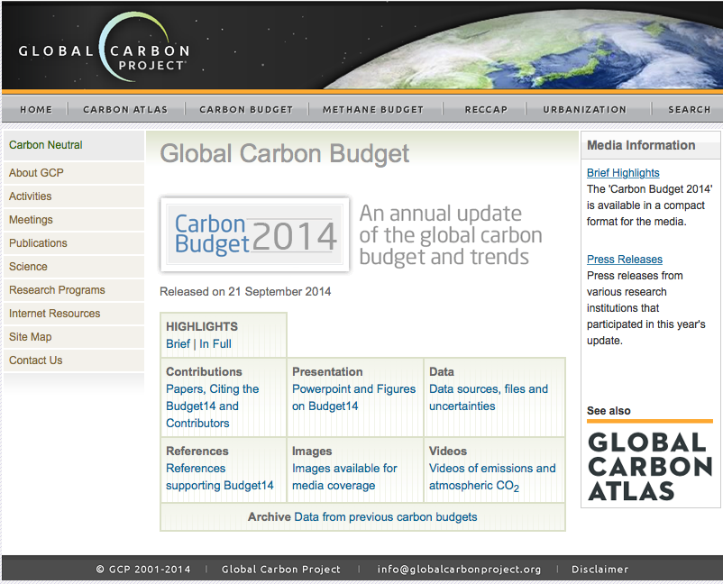

Slide 4
All the data is shown in GtC
1 Gigatonne (Gt) = 1 billion tonnes = 1×10¹⁵g = 1 Petagram (Pg)
1 kg carbon (C) = 3.664 kg carbon dioxide (CO₂)
1 GtC = 3.664 billion tonnes CO₂ = 3.664 GtCO₂
Disclaimer
The Global Carbon Budget and the information presented here are intended for those interested in learning about the carbon cycle, and how human activities are changing it. The information contained herein is provided as a public service, with the understanding that the Global Carbon Project team make no warranties, either expressed or implied, concerning the accuracy, completeness, reliability, or suitability of the information.

Slide 5
Carbon, Life, and Energy
Photosynthesis uses energy from the sun to convert inorganic air (CO2) to living biomass!
Most of this energy is released through respiration (back to CO2) when plants are eaten by animals, bacteria, people

Slide 6
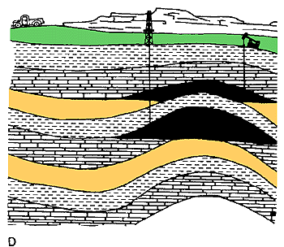
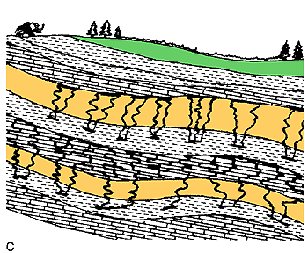
Fossil Fuels
Some of the stored solar energy in biomass can be preserved in fossilized remains

Slide 7
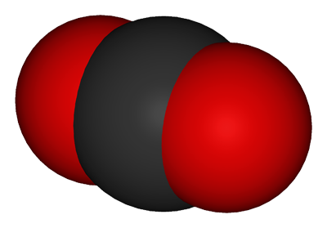
Hydrocarbons, Energy, and CO2
H
H
H
H
H
C
C
C
C
energy
energy
energy
energy
energy
energy
energy
H
C
C
C
C
H
H
H
H
We dig this stuff (“fossil fuels”) up and burn it, harvesting the stored energy to power civilization
O
O
O
C
energy
energy
energy
C
H
O
O
H
O
C
O
O
C
O
O
O
H
H
H
H
energy
O
energy
H
energy
H

Slide 8
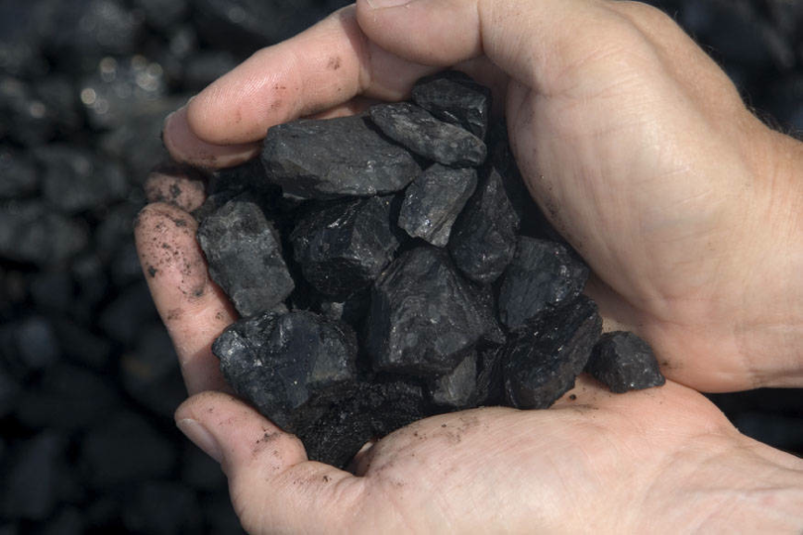

Slide 9
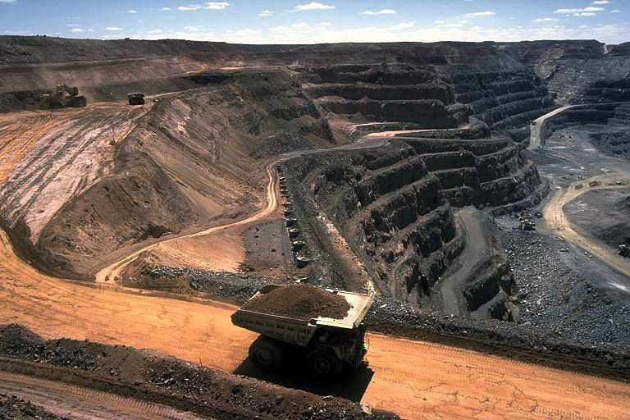
Mining Coal

Slide 11
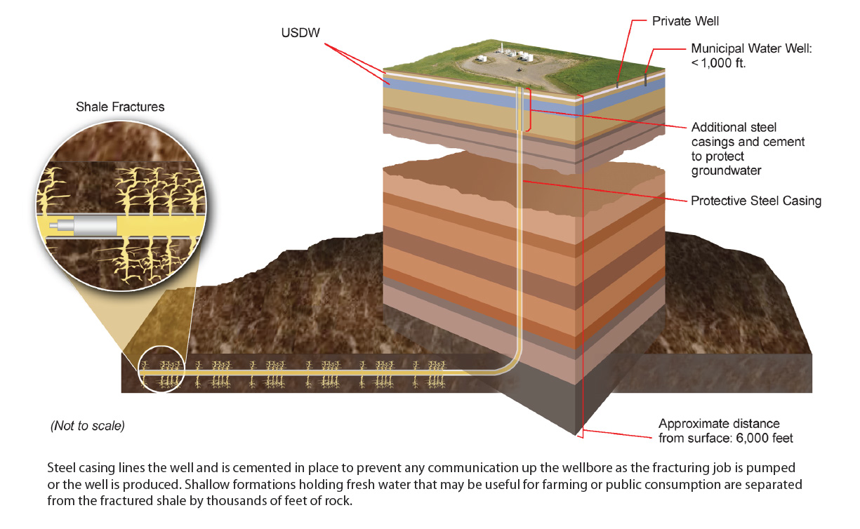
Hydraulic Fracturing

Slide 12
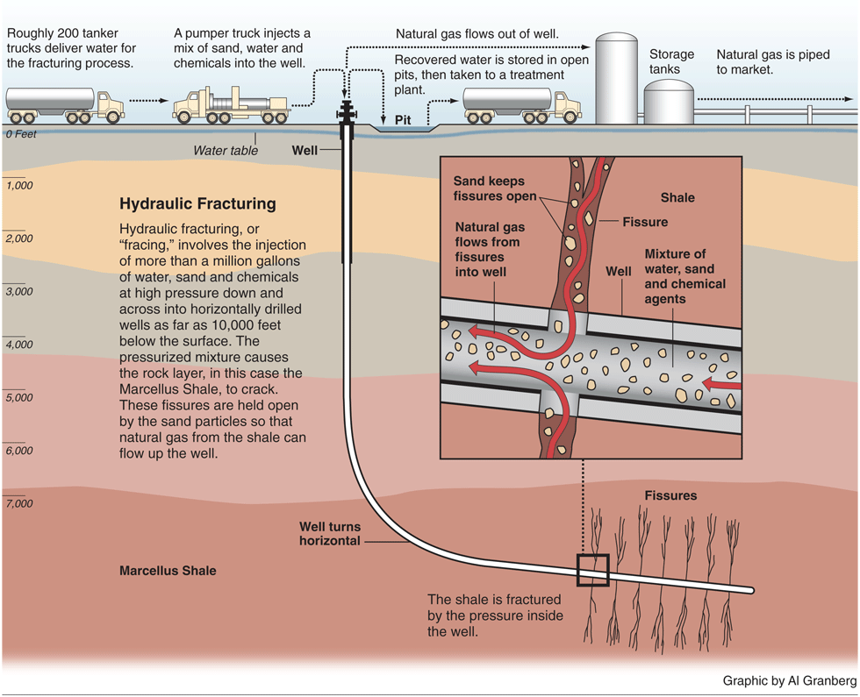

Slide 13
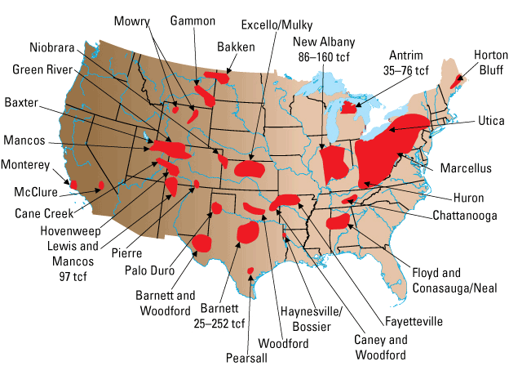
US Gas Reserves from Fracking

Slide 14
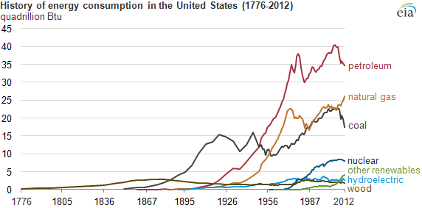
Changes in US Energy Consumption
Wood … then Coal … then Oil … then Gas … then Nuclear … then Renewables

Slide 15
The “Kaya Identity”
Four factors determine future emissions:
Population
Economic activity
Energy efficiency of economy
Carbon efficiency of energy

Slide 16
Billions and Billions Shanghai 1991 and 2012
Currently 7 billion people on Earth but only 1 billion use lots of energy
Rapid development to 4 billion energy users over coming decades
Population growth only 30% but energy growth 300% by 2100

Slide 17
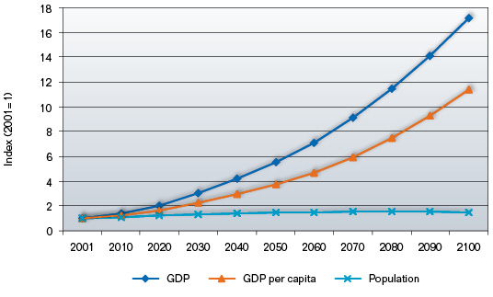
Population is not the driver of future climate!
UN Reference Scenarios
www.garnautreview.org.au
Population to grow by 40% in 100 years
Global economy to grow by 1600% (assumes 2.8% annual GDP growth)

Slide 18
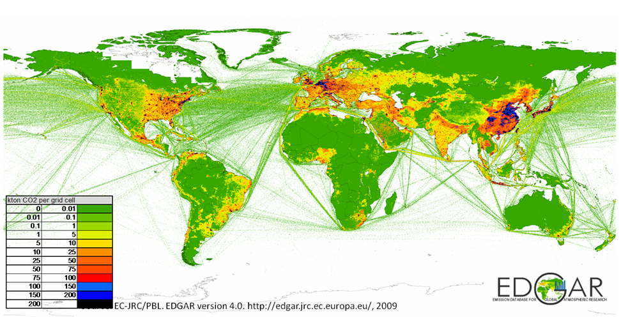
Global Fossil Fuel Emissions (2009)
Supply-Based Inventory Methods
(“follow the fuel”)

Slide 19
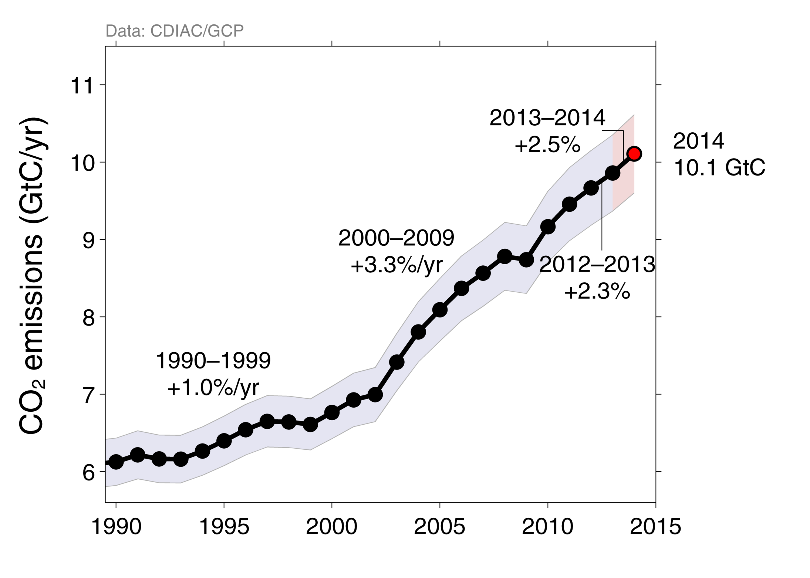
Fossil Fuel and Cement Emissions
Uncertainty is ±5% for one standard deviation (IPCC “likely” range)
Estimates for 2011, 2012, and 2013 are preliminary Source: CDIAC; Le Quéré et al 2014; Global Carbon Budget 2014

Slide 20
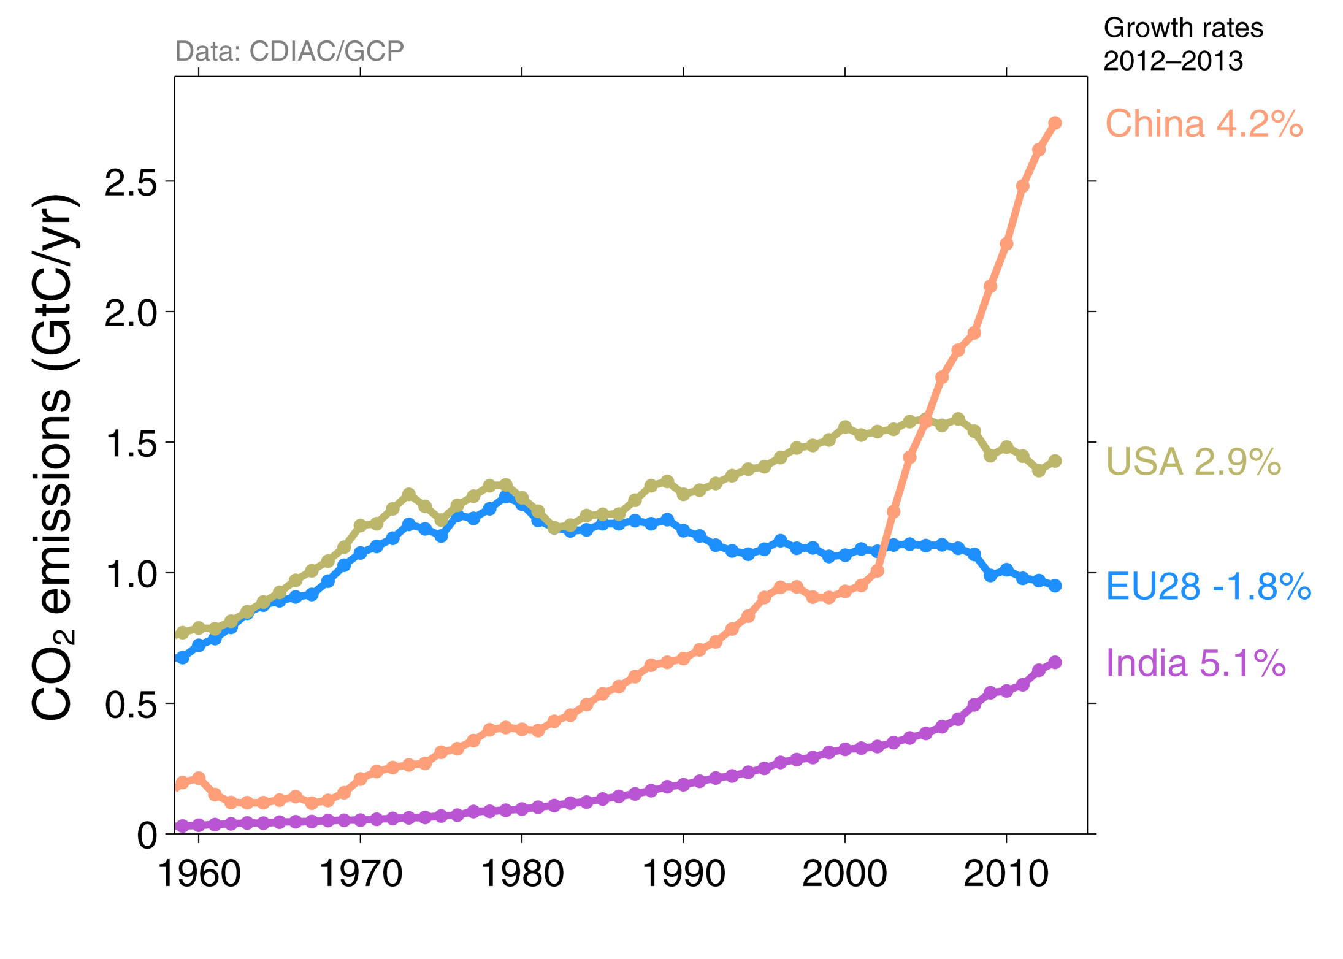
Top Fossil Fuel Emitters (Absolute)
The top four emitters in 2013 covered 58% of global emissions
China (28%), United States (14%), EU28 (10%), India (7%)
Bunkers fuel used for international transport is 3% of global emissions Statistical differences between the global estimates and sum of national totals is 3% of global emissions Source: CDIAC; Le Quéré et al 2014; Global Carbon Budget 2014

Slide 21
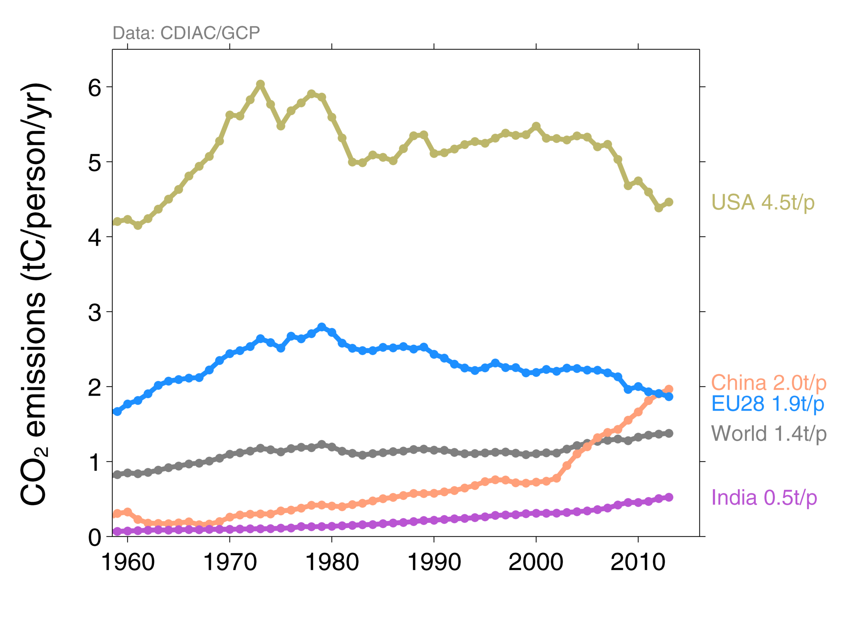
Top Fossil Fuel Emitters (Per Capita)
China’s per capita emissions have passed the EU28 and are 45% above the global average
Per capita emissions in 2013
Source: CDIAC; Le Quéré et al 2014; Global Carbon Budget 2014

Slide 22
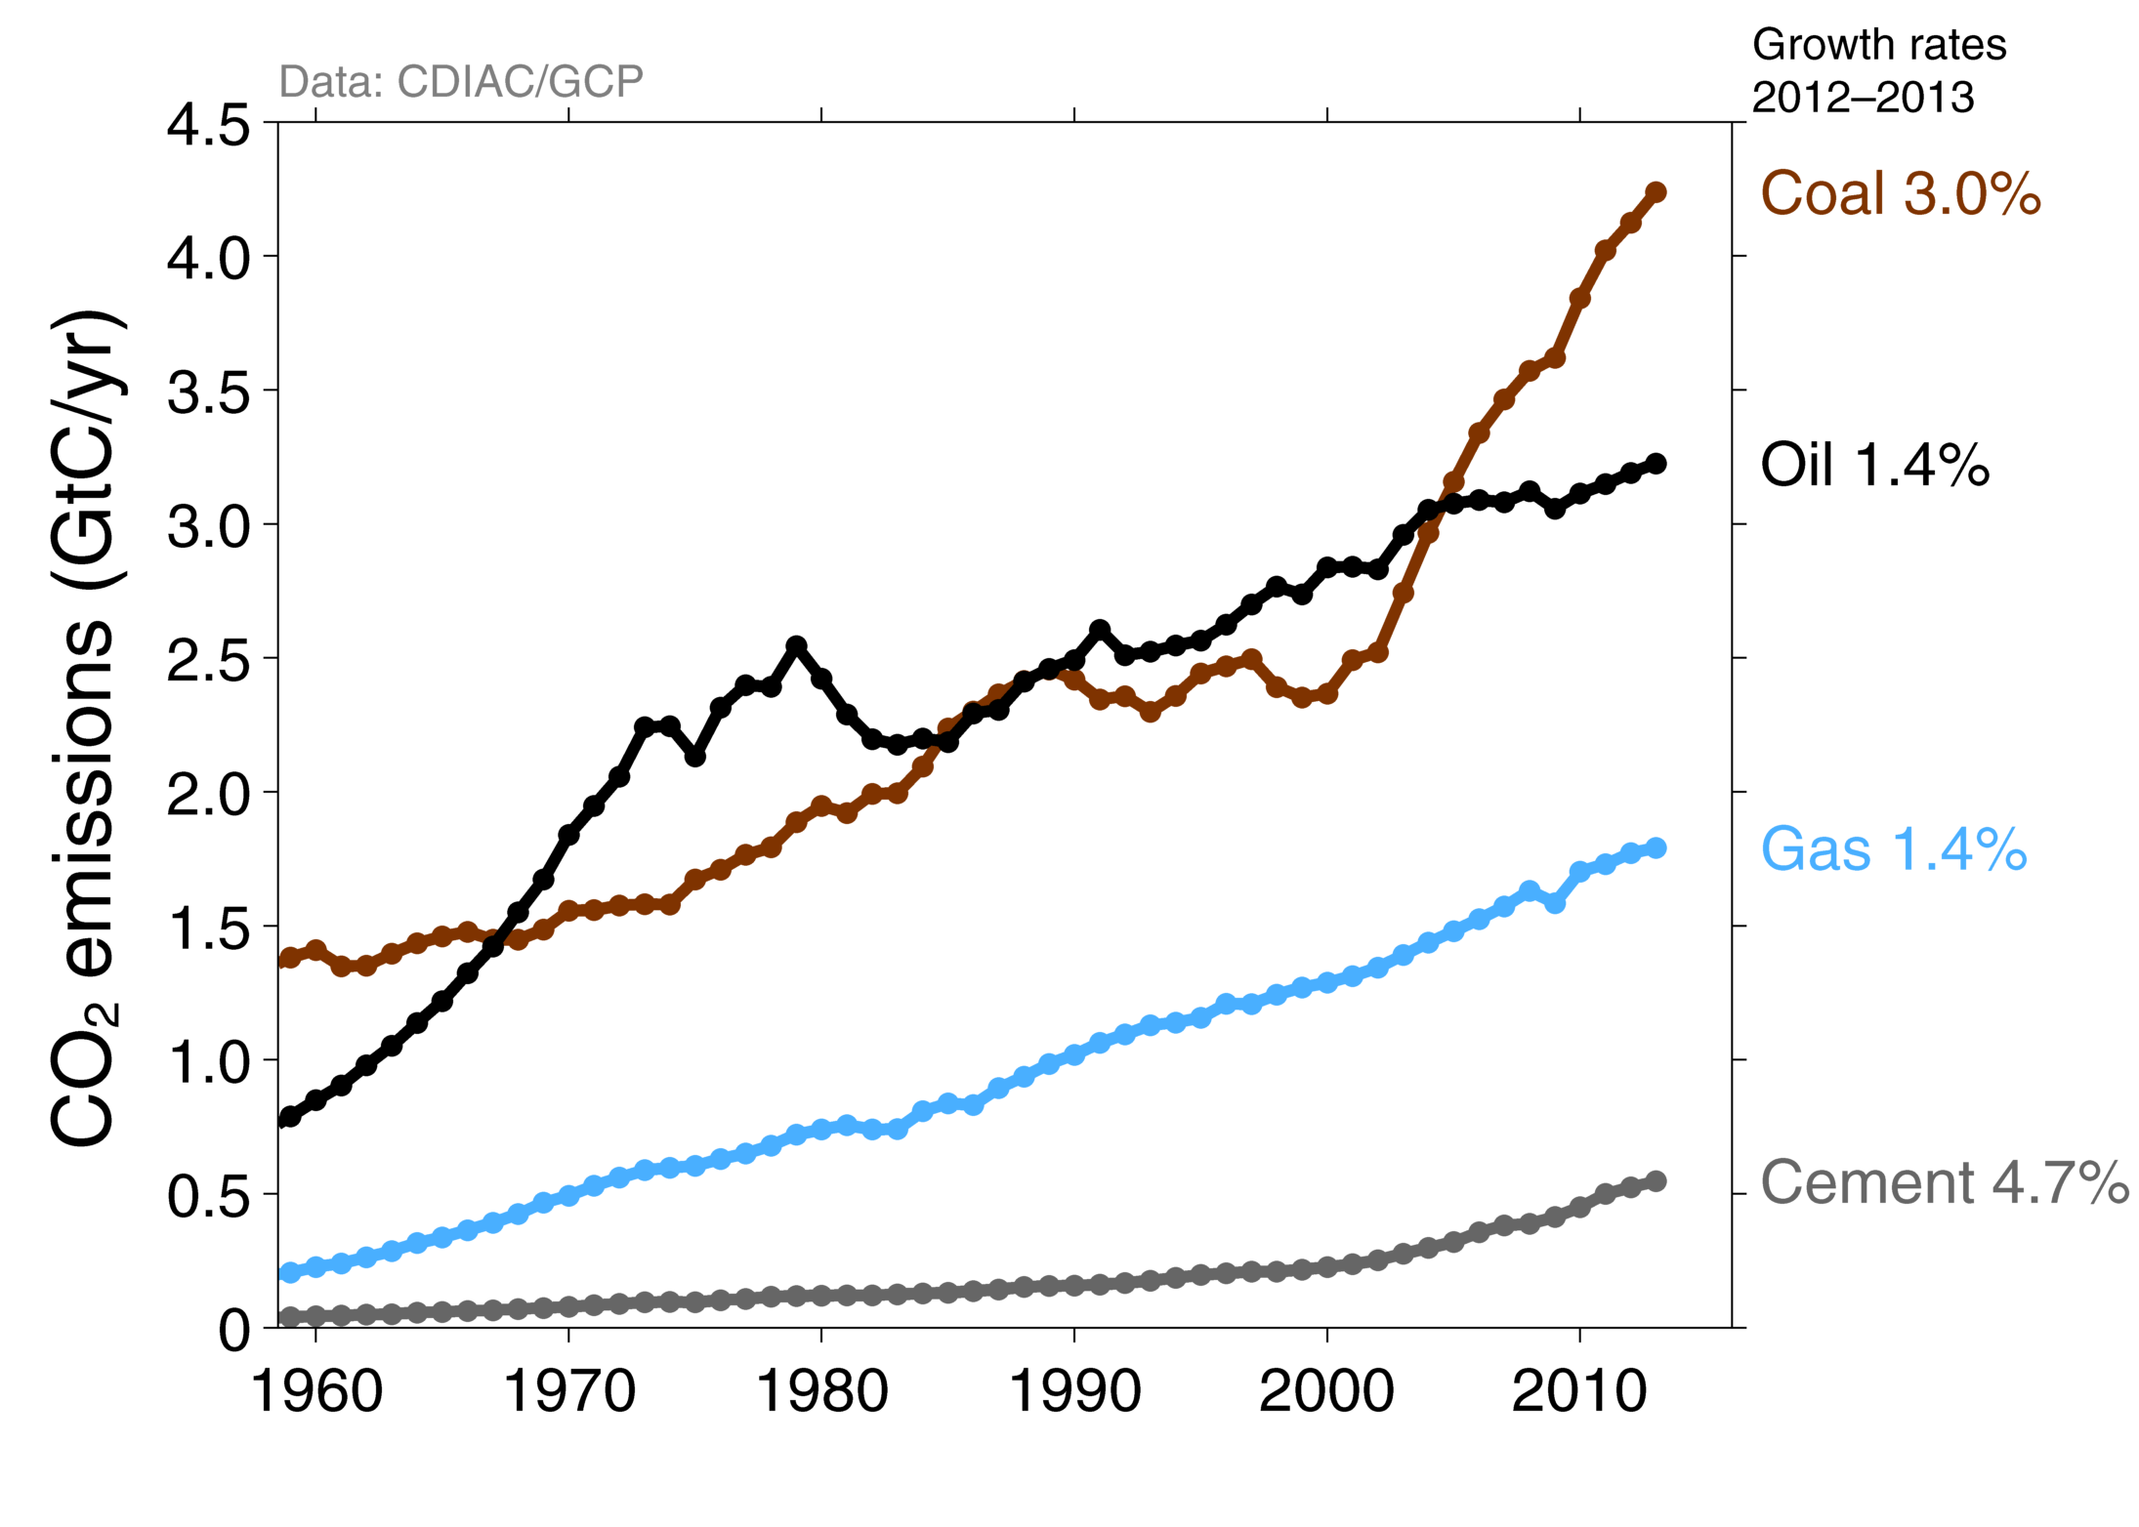
Emissions from Coal, Oil, Gas, Cement
Share of global emissions in 2013: coal (43%), oil (33%), gas (18%), cement (6%), flaring (1%, not shown)
Source: CDIAC; Le Quéré et al 2014; Global Carbon Budget 2014

Slide 23
Historical Cumulative Emissions by Country
Cumulative emissions from fossil-fuel and cement were distributed (1870–2013): USA (26%), EU28 (23%), China (11%), and India (3%) covering 63% of the total share
Cumulative emissions (1990–2013) were distributed USA (20%), China (20%), EU28 (14%), India (5%) ‘Other’ includes all other countries along with bunker fuels and statistical differences Source: CDIAC; Le Quéré et al 2014; Global Carbon Budget 2014

Slide 24
Major Flows from Production to Consumption
Start of Arrow: fossil-fuel combustion End of arrow: goods and services consumption
Values for 2007. EU is treated as one region. Units: MtCO₂ Source: Peters et al 2012

Slide 25
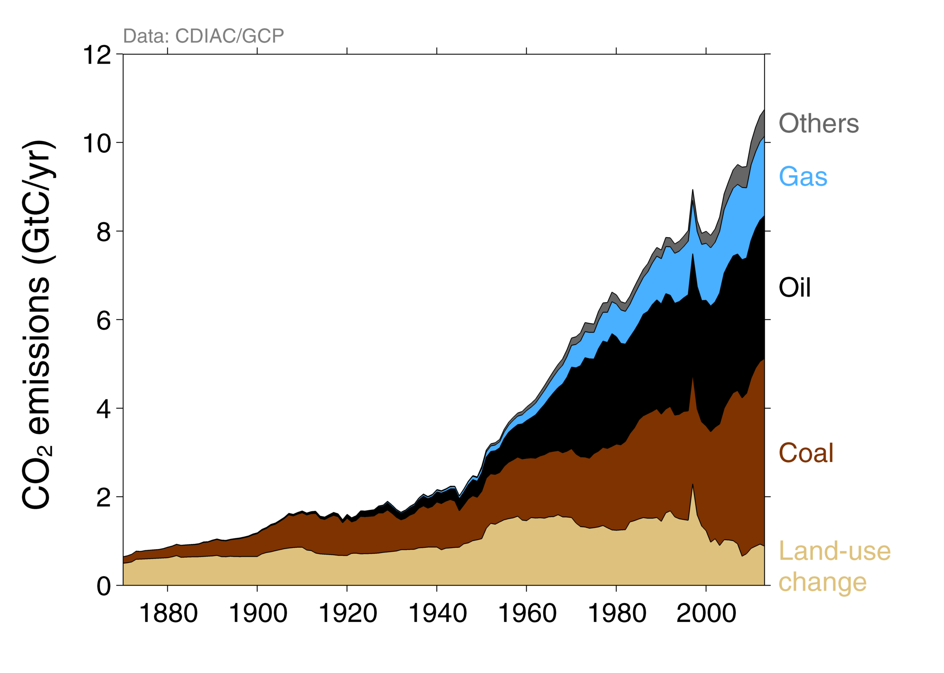
Total Global Emissions by Source
Land-use change was the dominant source of annual CO₂ emissions until around 1950 Coal consumption continues to grow strongly
Others: Emissions from cement production and gas flaring Source: CDIAC; Houghton et al 2012; Giglio et al 2013; Le Quéré et al 2014; Global Carbon Budget 2014

