Slide 1
Carbonate Chemistry, Air-Sea Gas Exchange, and Ocean Acidification
Readings:
Selections from Williams & Follows (2011)
Feeley et al (2009): Ocean Acidification

Slide 2
Notation and Units
Square brackets [ ] mean the concentration of the stuff inside the bracket, dissolved in seawater. Example: [CO₃²⁻] or [HCO₃⁻]
Units of concentration are typically either moles per kg or equivalents per kg
Equivalents are moles of solute times the charge on each ion of solute. Example: [CO₃²⁻] = 10⁻³ mol kg⁻¹ = 2x10⁻³ equiv kg⁻¹

Slide 3
Chemical Kinetics
For a chemical reaction in which reagents A and B react to form product C, we write:
If k is the reaction rate constant, we write

Slide 4
Chemical Equilibrium
Most chemical reactions in seawater “go both ways” so it’s arbitrary which side of the reaction is “reagents” and which is “products”
Now we refer to k_{f} as the rate constant of the forward reaction and k_{b} as the rate constant of the backward reaction

Slide 5
Chemical Equilibrium
At equilibrium, the rates of the forward and backward reactions are equal, so that
and we can write
K_{eq} is the ratio of products to reagents. It’s called the equilibrium constant for the reaction

Slide 6
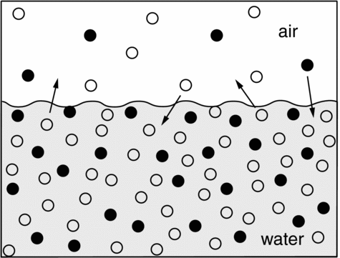
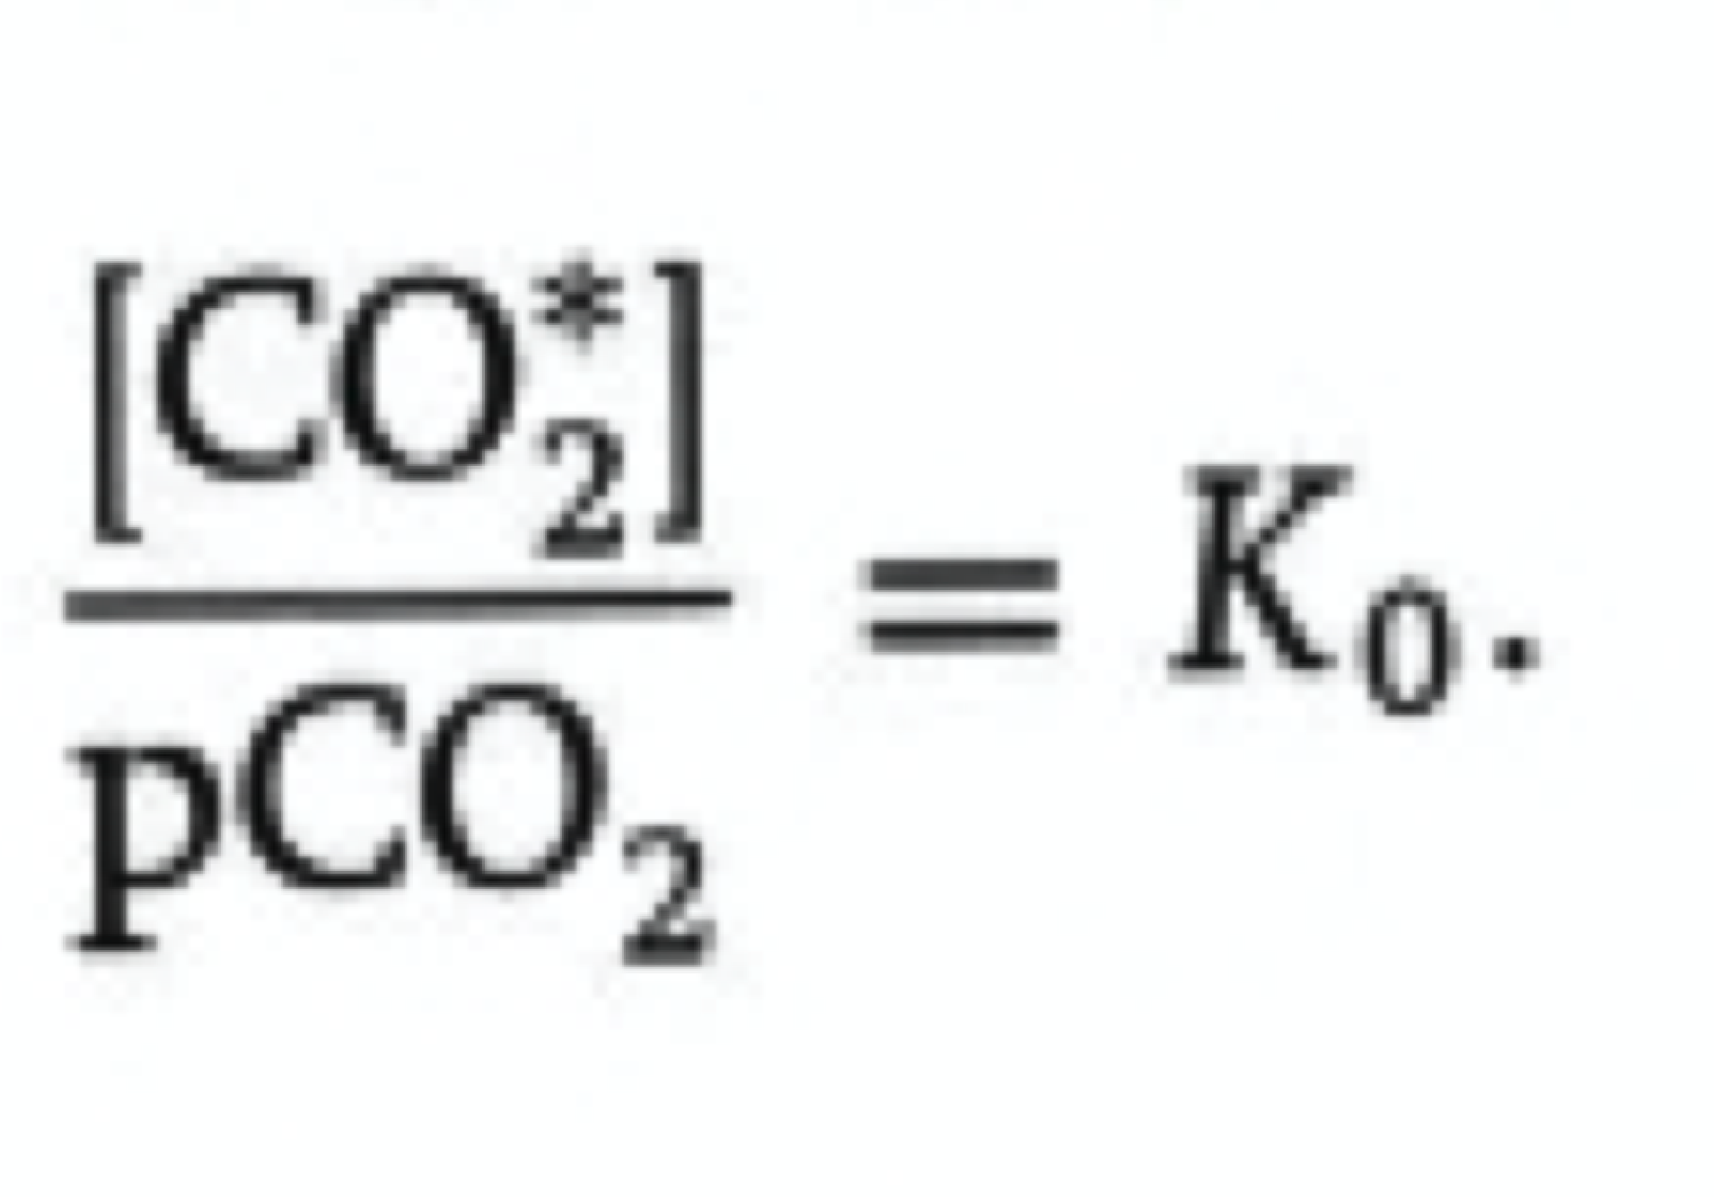
Solubility of CO₂ in Water
Henry’s Law
(really just a definition for K₀)
When the rate at which molecules
of gas dissolve into the water equals the rate at which they come out of solution into the air, the gas is in equilibrium with the aqueous (dissolved) form of the compound
Williams_Fig. 6.2
We define the partial pressure of CO₂ in seawater as the partial pressure of CO₂ in air that would be in equilibrium with dissolved CO₂ at a given concentration

Slide 7
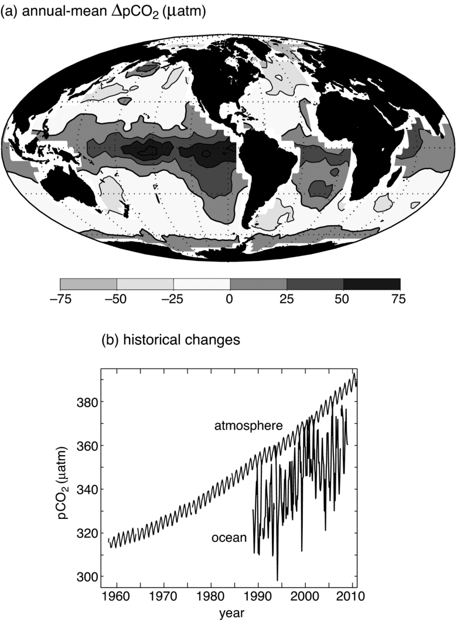
Differences of pCO₂ (μatm) between the atmosphere and ocean
Tropical oceans have high pCO₂, typically 50 μatm greater than atmosphere!
High latitude oceans have low pCO₂
Global ocean pCO₂ is less than atmosphere
Both are increasing fast!
Williams_Fig. 6.1

Slide 8
Jargon & Notation
Carbonic Acid: H₂CO₃
[CO₂*] = “Aqueous CO₂” + Carbonic Acid = [CO₂(aq)] + [H₂CO₃]
Bicarbonate: HCO₃⁻ single-charged anion, dominant form of DIC
Carbonate: CO₃²⁻ doubly-charged anion, much less abundant
DIC = “Dissolved Inorganic Carbon” = ΣC = [CO₂*] + [HCO₃⁻] + [CO₃²⁻]

Slide 9
More Jargon & Notation
Cation: an ion in solution with a positive charge
Anion: an ion in solution with a negative charge
TA = Titration alkalinity = concentrations of all “proton acceptors” minus “proton donors” = concentration of weak acid anions minus [H⁺]
pH = -log₁₀[H⁺], a measure of the acidity
pK_{eq}= -log₁₀[K_{eq}]

Slide 10
Carbonate Equilibria
Three equations (equilibria) in five unknowns
6.1
6.6
6.7
Add two more constraints
(“Titration Alkalinity”)
(Titration Alkalinity)
(Boric acid dissociation)
(S = Salinity)

Slide 11
Solving the Ocean Carbonate System
Combine equations 6.1, 6.6, and 6.7 to write
Divide (7) by (8) to get quadratic for [H⁺]
(7)
(8)
(9)

Slide 12
Ocean Carbonate System (cont’d)
(9)
(10)
Start with first guess of [H+] (e.g., pH=8)
Substitute into (10) to get CA then solve quadratic (9)
Iterate (9) and (10) until pH converges

Slide 13
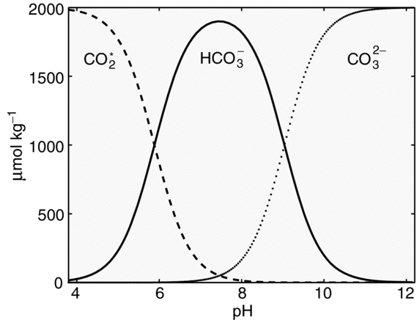
Speciation vs pH
“Bjerrum Plot”
pK₁
pK₂
Williams_Fig. 6.7

Slide 14
Partition of Marine DIC
Using surface values for DIC, alkalinity, and salinity, we obtain pCO₂ = 278 μatm and pH = 8.18
These are very close to preindustrial values
Speciation:
[CO₂*] = 10 μMol kg⁻¹
[HCO₃] = 1769 μMol kg⁻¹
[CO₃] = 223 μMol kg⁻¹
By far most dissolved CO₂ is bicarbonate!

Slide 15
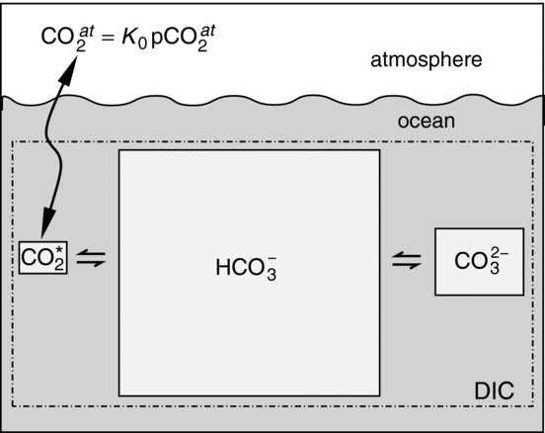
Buffering of Marine DIC
Only a small fraction of DIC (CO₂*) is in chemical equilibrium with atmospheric CO₂
Williams_Fig. 2.20

Slide 16
Buffering of Marine DIC
divide eqn 6.6 by eqn 6.7
As CO₂ is added to the atmosphere, [CO₂(aq)] increases in the ocean
Most of it reacts with CO₃²⁻ to form additional HCO₃⁻
Absorption of atmospheric CO₂ by the oceans is limited by [CO₃²⁻], which is quite low
Ratio of fractional change in pCO₂ per fractional change in DIC is called the Revelle Factor : R ~ 10
This means doubling the amount of atmospheric CO2 would only increase DIC by about 10%

Slide 17
Partition of Anthropogenic CO₂
Suppose we add CO₂ to the atmosphere by combustion of fossil fuel … what happens to dissolved carbon species in the oceans?
Add 10% to atmospheric pCO₂ (and [CO₂(aq)]), and find new equilibria
10% increase in pCO₂ produces less than 1% increase in DIC!

Slide 18
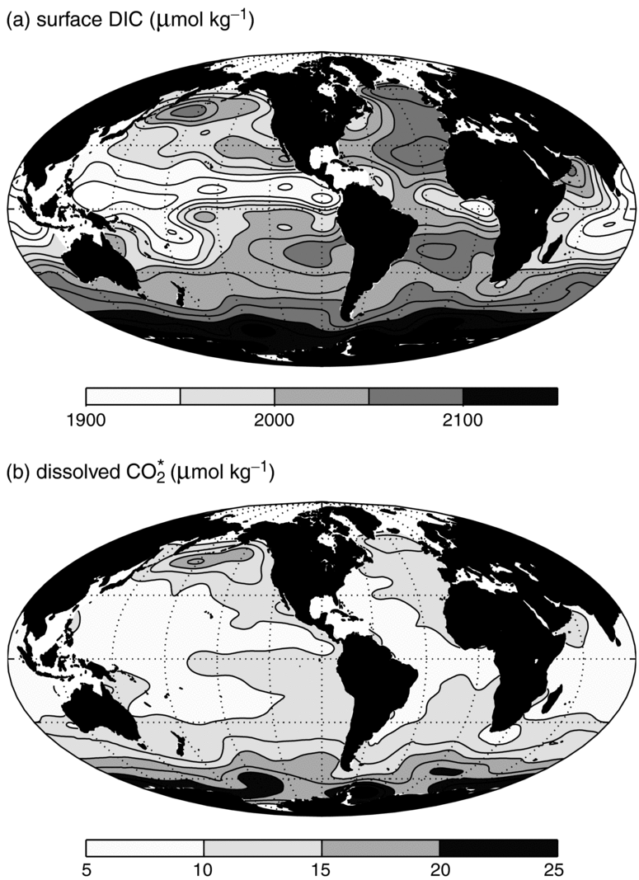
Global Variations
Surface DIC (μMol kg⁻¹)
Surface DIC varies by about 5%
Atlantic vs Pacific
Low DIC in tropics
CO₂* << DIC
More CO₂* in cold water
Surface CO₂* (μMol kg⁻¹)
Williams_Fig. 6.4a,b

Slide 19
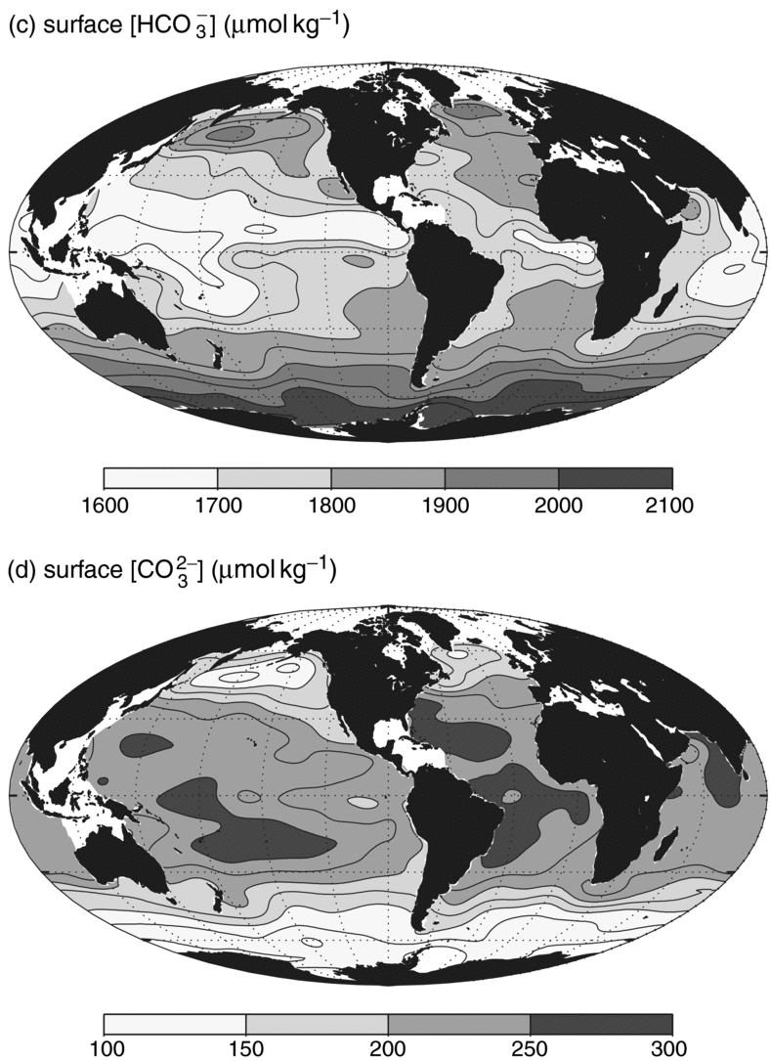
Global Variations
Surface HCO₃⁻ (μMol kg⁻¹)
HCO₃⁻ ~ DIC
Variations in CO₃²⁻ by factor of 2
Speciation much more variable than amount of DIC
Surface CO₃²⁻ (μMol kg⁻¹)
Williams_Fig. 6.4c,d

Slide 20
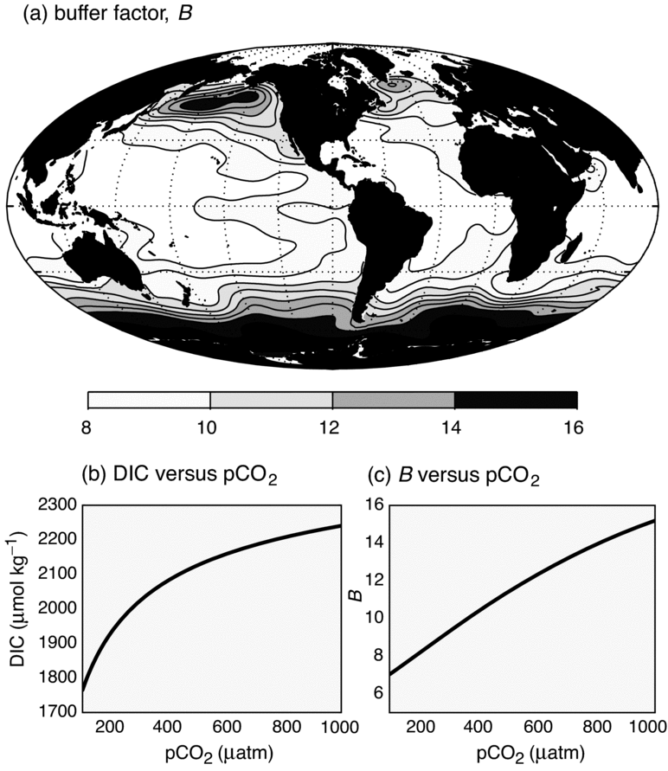
Buffer Factor
Revelle Buffer Factor
fractional change in DIC per fractional change in pCO₂
Logarithmic response of DIC to DCO₂
Williams_Fig. 6.12

Slide 21
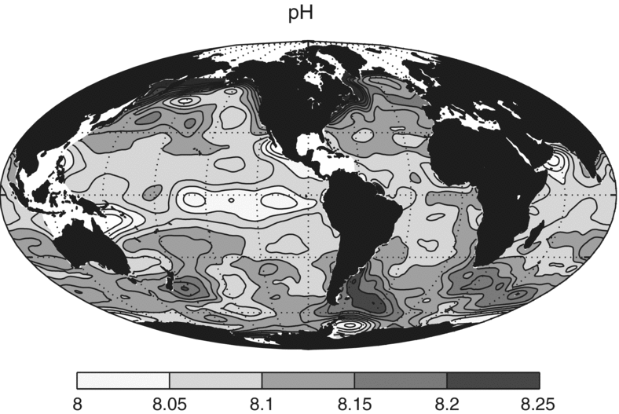
Global Variations: pH
Williams_Fig. 6.3
pH is low where water is warm

Slide 22
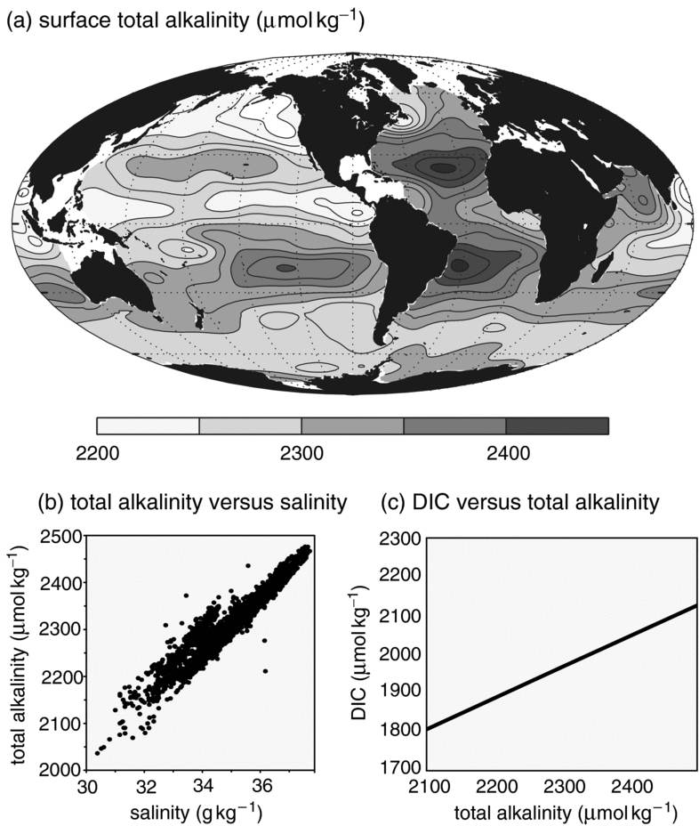
Surface Alkalinity (μequiv kg⁻¹)
Global Variations
Alkalinity varies with salinity – dilution!
Explains most of surface DIC variations too
Williams_Fig. 6.6

Slide 23
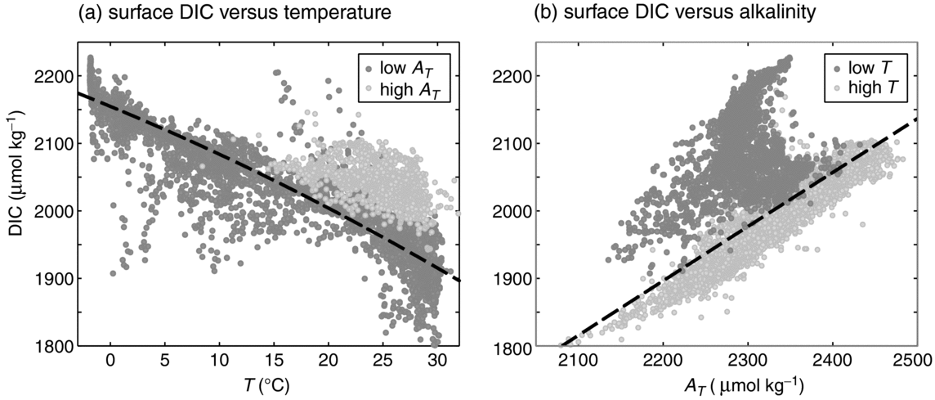
Global Variations: Surface DIC
Cold!
warm
DIC decreases with temperature
Warm ocean DIC ~ Alk, not so in cold ocean

Slide 24
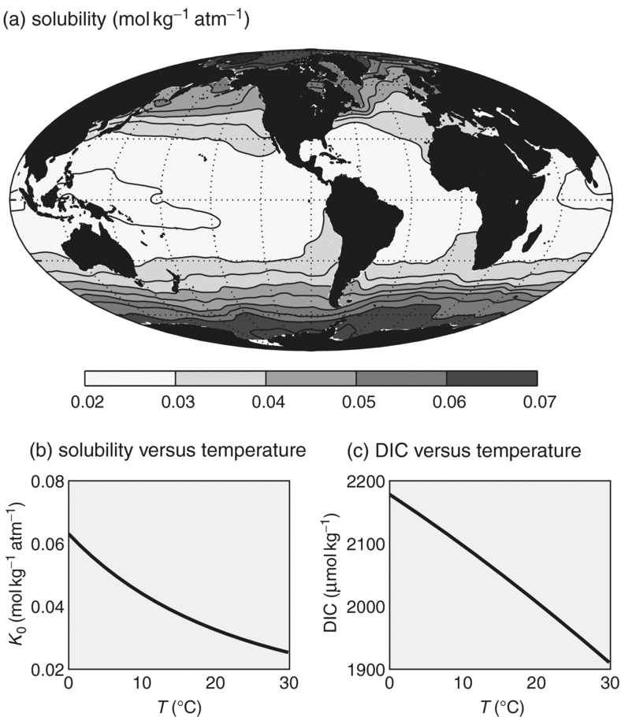
Solubility of CO₂
Henry’s Law coefficient
Varies by a factor of 2 with temperature!
Accounts for most of variance of surface DIC
Williams_Fig. 6.5

Slide 25
The “Solubility Pump”
CO₂ solubility in seawater depends sensitively on SST
CO₂ is highly soluble in cold high-lat waters
Transported to deep ocean by convection and isopycnal mixing
Dynamically-driven equatorial upwelling brings high-CO₂ water to surface
Atmospheric transport closes the loop

Slide 26
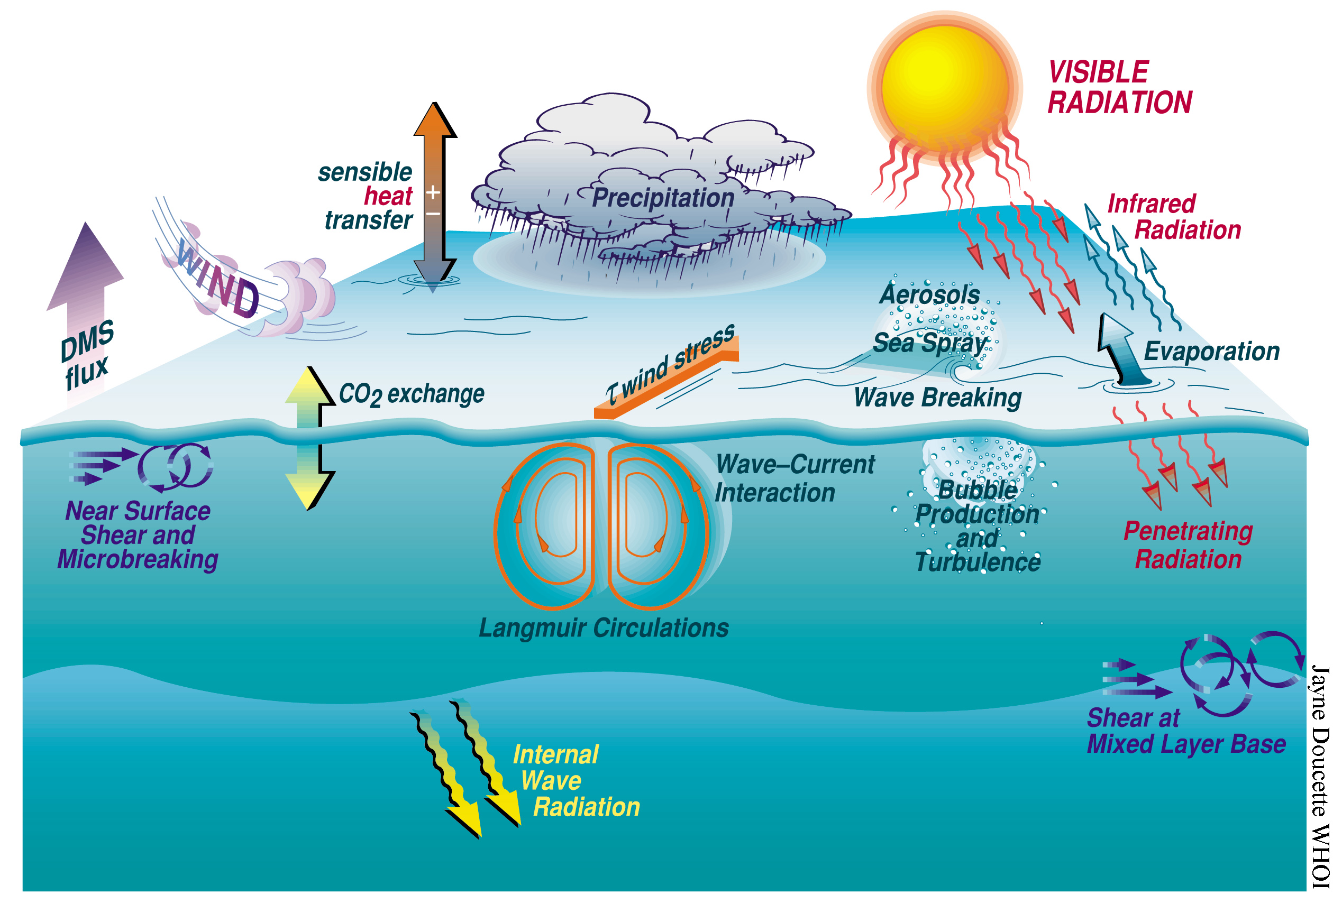
Air-Sea Gas Exchange

Slide 27
Air-Sea Gas Exchange
a simple view
Two well-mixed reservoirs, separated by a thin film of “stagnant” water at the surface
Air-sea gas flux depends on:
Thickness of film
Diffusivity of gas molecules within film
Magnitude of disequilibrium
Equivalently, we can describe this process in terms of “pistons” of gas moving upward and downward, with net gas flux being the difference between the two fluxes
well-mixed air
Gas concentration
stagnant film of water
equilibrium w/overlying air
depth
well-mixed water
surface ocean concentration
After Broecker and Peng (1982)
Tracers in the Sea

Slide 28
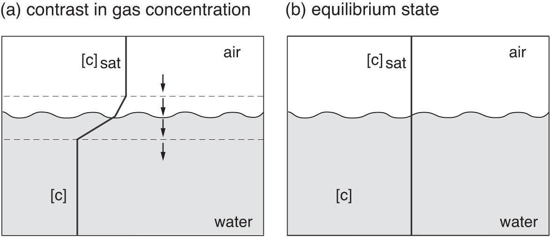
Air-Sea Gas Exchange
Williams_Fig. 6.13

Slide 29
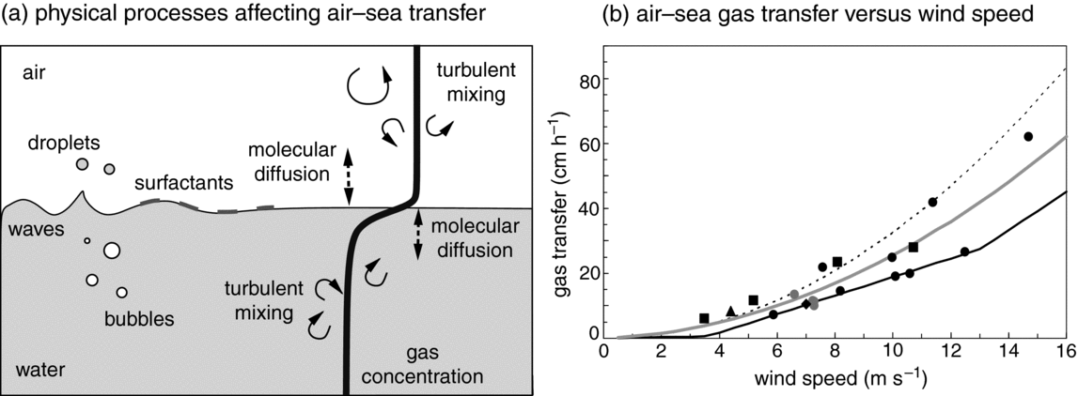
Gas Exchange Coefficient The “Piston Velocity”
Williams_Fig. 6.14
Very strong dependence (quadratic? cubic?) on windspeed
Turbulence disrupts stagnant film, must be “regrown” each time
“Regime-shifts” at higher wind speeds

Slide 30
Atmospheric CO₂ in Equilibrium with the Deep Ocean
Mix deep seawater with surface and warm it to 16º C (global mean SST)
pCO₂ would be 938 ppm! (observed is only 400 after 200 years of industry!)
pH would be 7.73 (observed is about 8.1)
How is this possible?

Slide 31
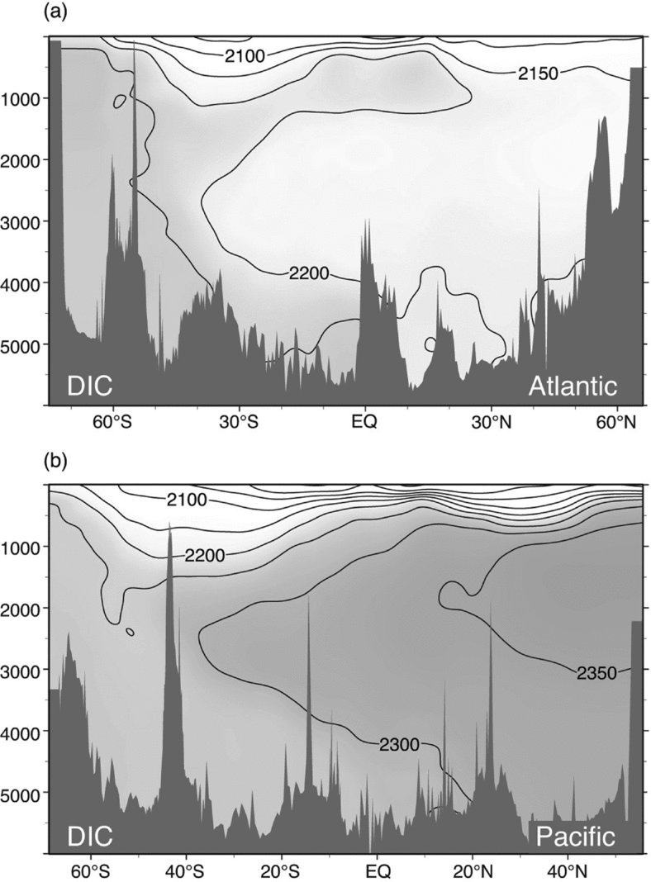
Deep Ocean
DIC strongly depleted at surface, enhanced at depth
Enhancement much stronger in Pacific than Atlantic
Williams_Fig. 6.9

Slide 32
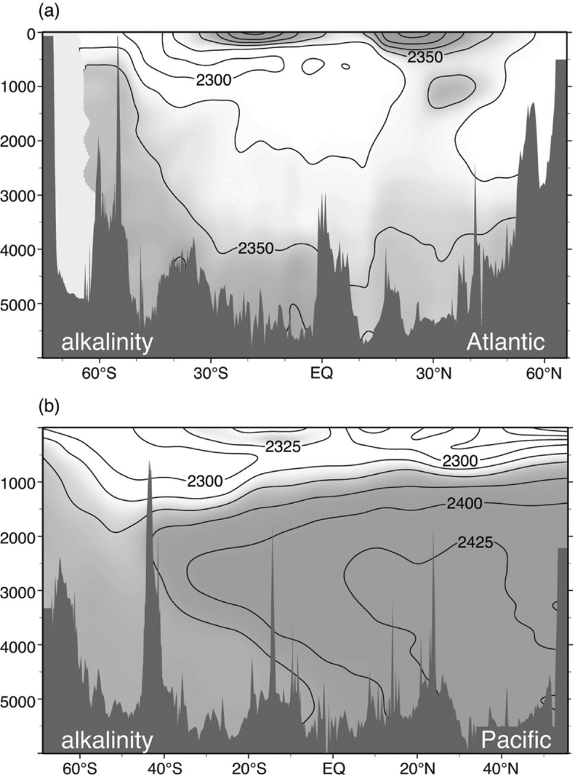
Deep Alkalinity
Biologically-mediated transfer of alkalinity from surface to deep in subtropical Atlantic
Progressive increase at depth from Atlantic to Pacific
Williams_Fig. 6.10

Slide 33
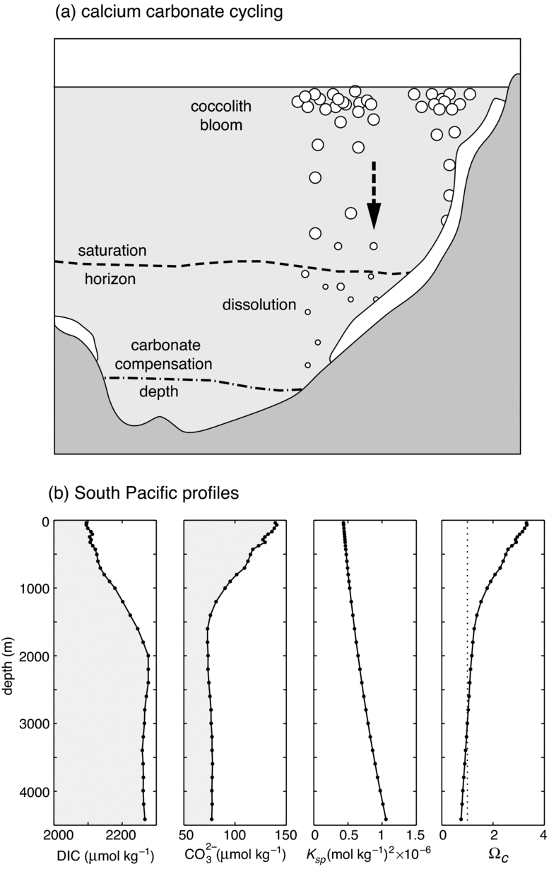
Calcium Carbonate
(CaCO₃) Pump
Coccoliths fix HCO₃⁻, make solid CaCO₃ shells, sink fast
Solubility of CaCO3 increases with pressure
Williams_Fig. 6.11

Slide 34
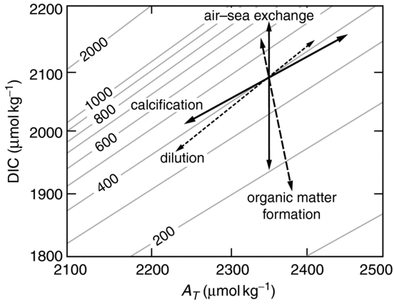
Chemistry & Biology
Williams_Fig. 6.16
Contours of surface pCO₂
Air-sea gas exchange affects DIC but not alk
Organic matter and calcification almost orthogonal

Slide 35
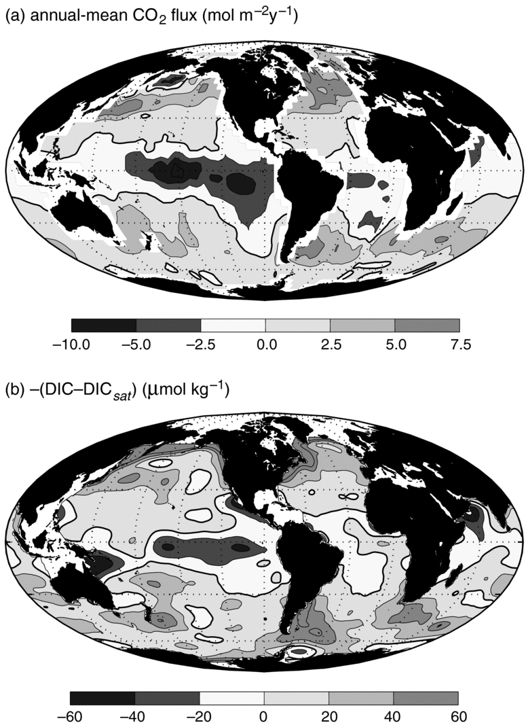
Air-Sea CO₂ Flux
Uptake by cold water over large regions
Emission from tropics, especially from cold upwelling region in Equatorial Pacific
Williams_Fig. 6.15

Slide 36
The Biological Pump
Photosynthesis depletes DIC (and nutrients) in the photic zone
Decomposition/mineralization deposits DIC and nutrients in deep ocean

