Slide 1
Nutrient Cycling and the Marine Biological Pump
Readings:
Selections from Williams & Follows (2011)
Sabine et al (2004): Ocean Sink for Anthropogenic CO₂

Slide 2
Phytoplankton
Diameter: < 1 mm to over 100 mm
Concentration: 1000's to 1,000,000 per milliliter
If you filled a Coke can with seawater sampled from a thick phytoplankton bloom, the can would contain about 100 million cells!
Global Biomass: < 1% of the plant biomass on earth
BUT responsible for nearly half the net photosynthesis of the biosphere!
What does this imply for turnover time?

Slide 3
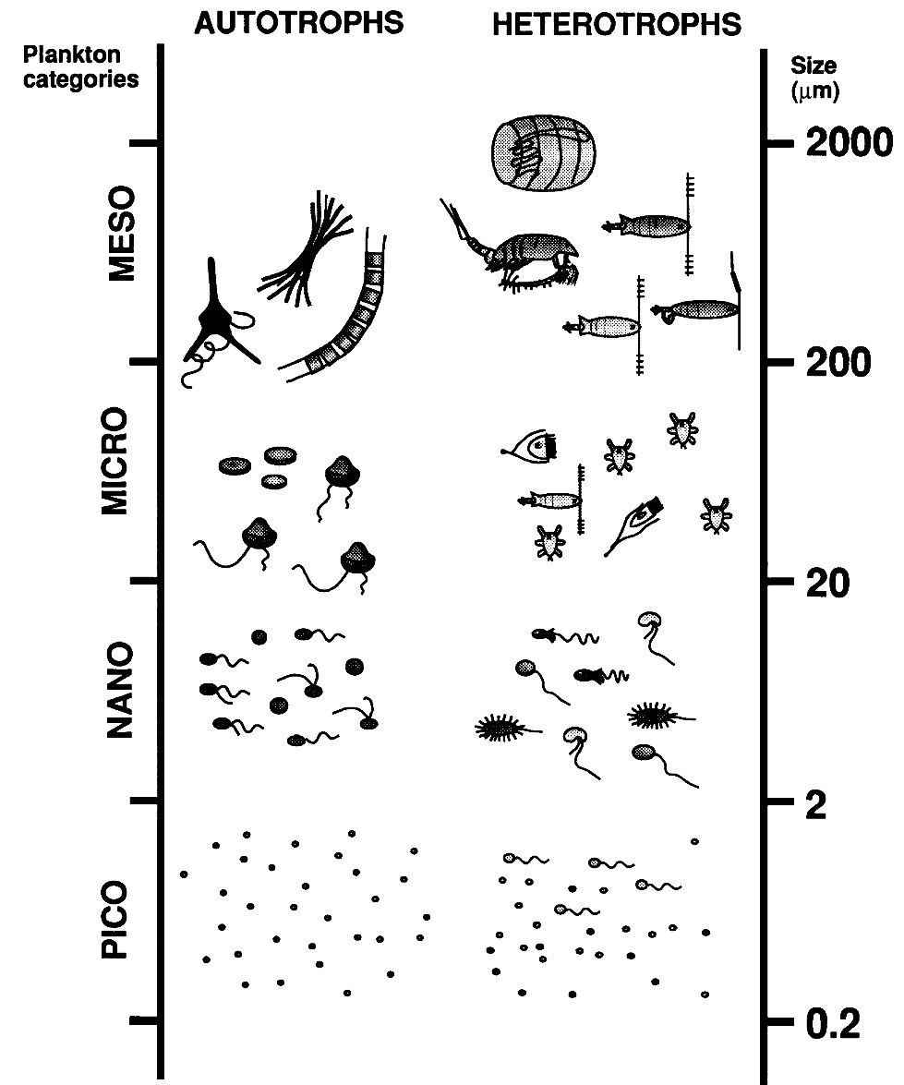
Phytoplankton and Zooplankton
Size can’t be used to distinguish between autotrophs and heterotrophs (note log scale!)
Smallest organisms don’t sink well
Some photosynthesize when they can, eat DOC when they can’t

Slide 4
The “Biological Pump”
“Primary production” generates communities of phytoplankton from DIC and nutrients in the presence of light
Zooplankton “graze” on phytoplankton
Bacterial decomposition and heterotrophic respiration recycle DIC and nutrients to the water column
Detrital particles from dead phytoplankton and zooplankton waste coagulate into progressively larger particles
Larger particles sink faster than turbulence can resuspend them, so fall below euphotic zone
Ducklow et al (2001)
Primary production limited by availability of nutrients and light
Loss of nutrients from light by sinking must equal delivery of nutrients by upwelling

Slide 5
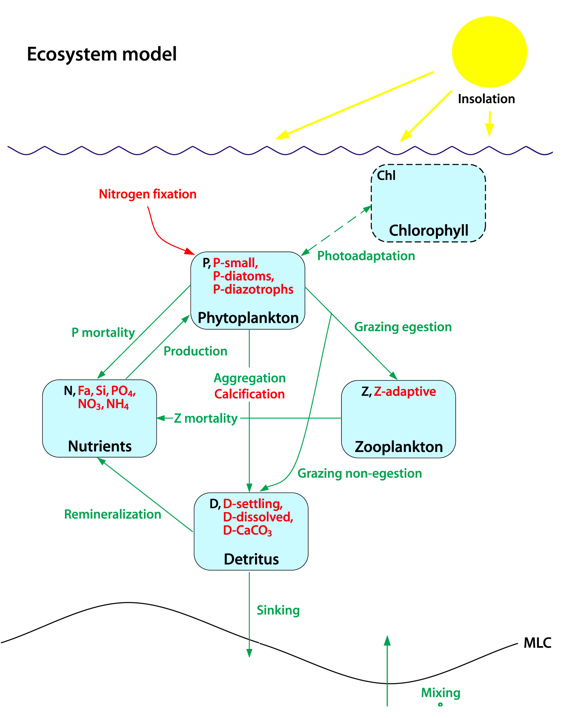
Marine Ecosystem Model
Predict PZND, plus Chlorophyll
Assume a single limiting “currency” (e.g., N) in each pool
No interactions among individuals, just “pools”
More recent models (red) include limitation by multiple nutrients, N-fixation, and size classes of organisms

Slide 6
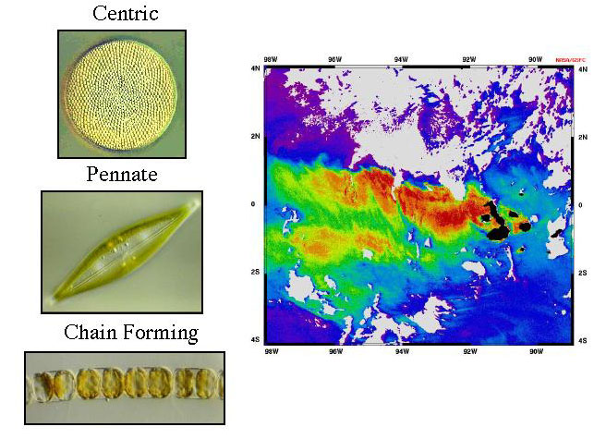
Diatoms (Bacillariophyceae)
SiO₂ “tests”
Important for forming large particles that sink efficiently

Slide 7
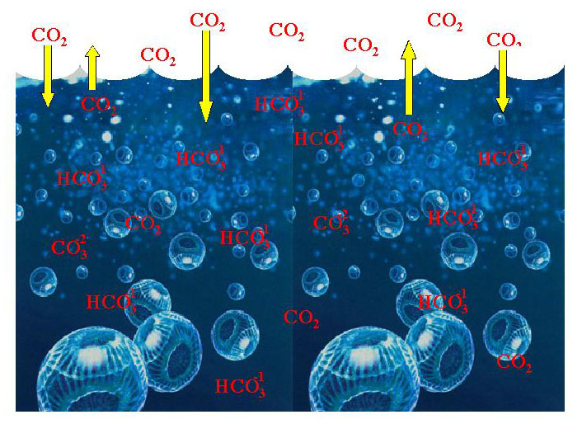
Carbonate and Coccoliths
Alteration of carbonate equilibria (pCO₂) near surface
Export of CaCO₃ to deep ocean … dissolution below lysocline

Slide 8
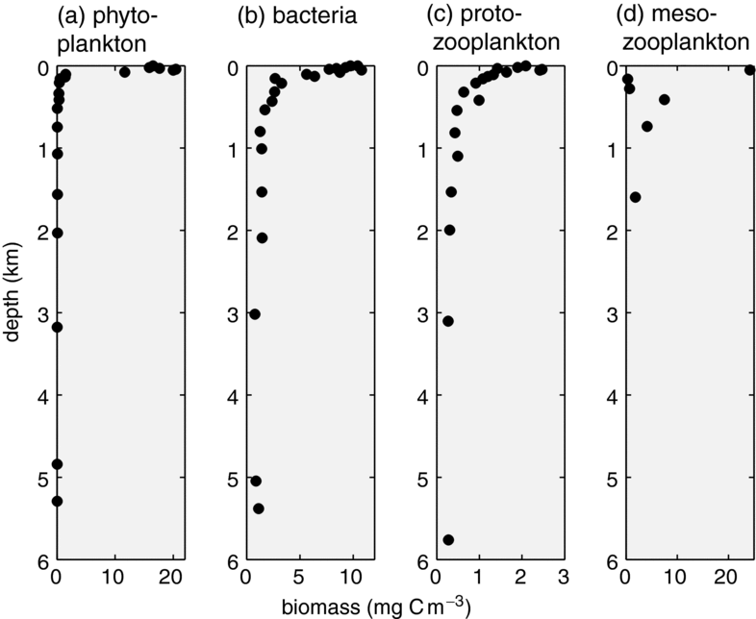
Williams_Fig. 2.15

Slide 9
Primary Production and the efficiency of the biological pump
New Production: driven by NO₃ delivered by vertical motion (upwelling, turbulence)
Recycled production: ~ 90% of NPP, driven by nutrients recycled from organic matter decomposed in euphotic zone
Export production: delivery of POM to deep water at base of euphotic zone
In steady-state, NP = EP
“f-ratio” is defined as NP/NPP
“e-ratio” defined as EP/NPP
Provides a link between remote sensing (of NPP) and carbon flux to the deep ocean

Slide 10
Nutrient Limitation
Primary production (photosynthesis) requires:
Light
“Macro” nutrients: C, N, P
Trace nutrients: Fe, other metals
Leibig’s Law of the Minimum “nutrient available in the smallest quantity relative to the requirement of a plant limits productivity”

Slide 11
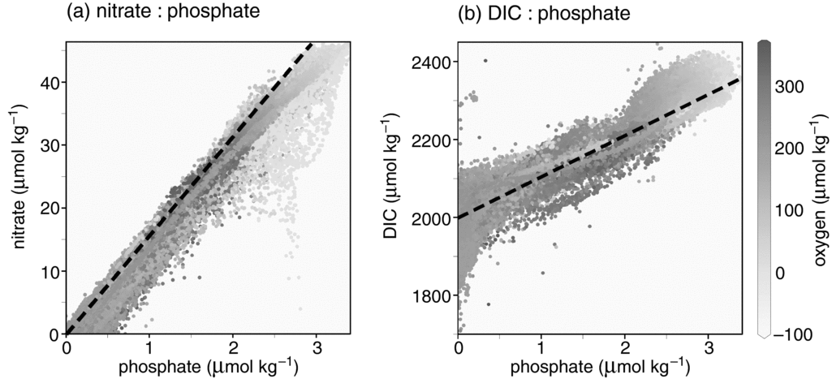
Redfield Ratio
106 CO₂ + 16 NO₃⁻ + HPO₄ + 122 H₂0 + 18 H⁺
(CH₂O)₁₀₆(NH₃)₁₆(H₃PO₄) + 138 O₂
photosynthesis (hv)
decomposition
Redfield, Ketchum, and Richards (1963) … RKR
Carbon dioxide and nitrate are reduced – only phosphate remains at the same oxidation state
P:N:C:O - 1:16:117:170 colimitation by N & P … not carbon limited!
data at constant density surfaces

Slide 12
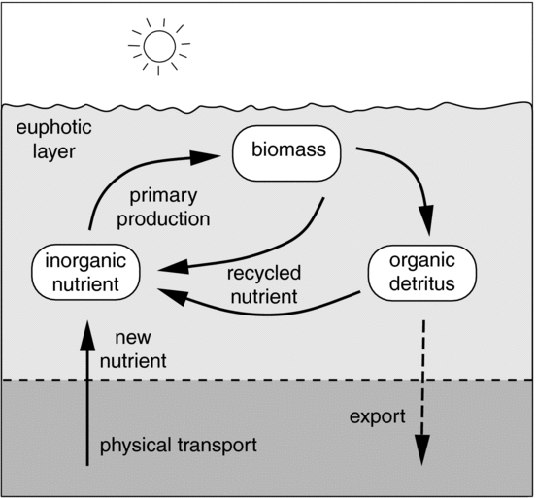
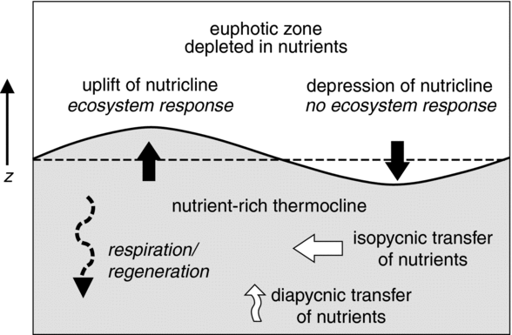
Bio-Carbon Cycle Near Ocean Surface
steady-state
perturbed by wind

Slide 13
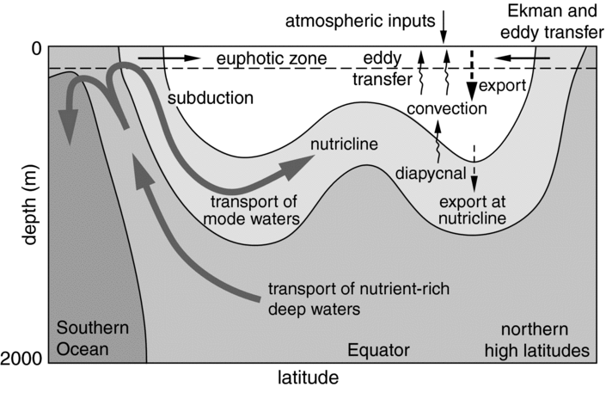
Biology & Circulation

Slide 14
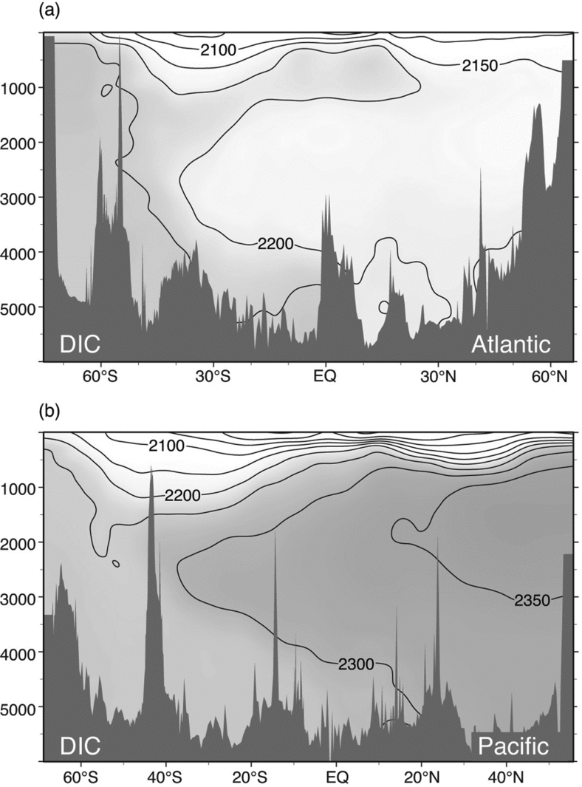
Deep Sea DIC
DIC is strongly depleted near surface, enhanced at depth
Progressive enhancement of DIC at depth with time as deep water flows through thermohaline circulation
Strong mixing in Southern Ocean (“mixmaster”)
Further enhancement as water moves North through Pacific
Williams_Fig. 11.19

Slide 15
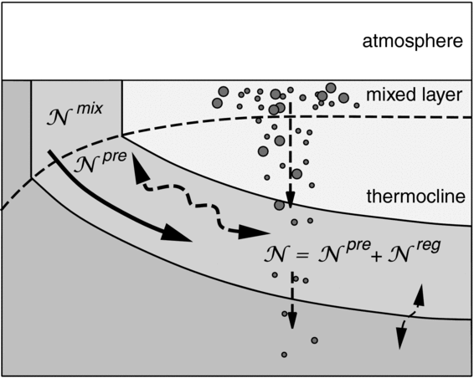
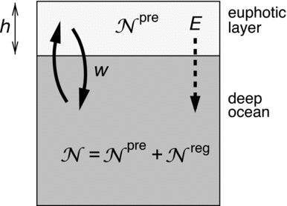
Preformed and Regenerated Nutrients

Slide 16
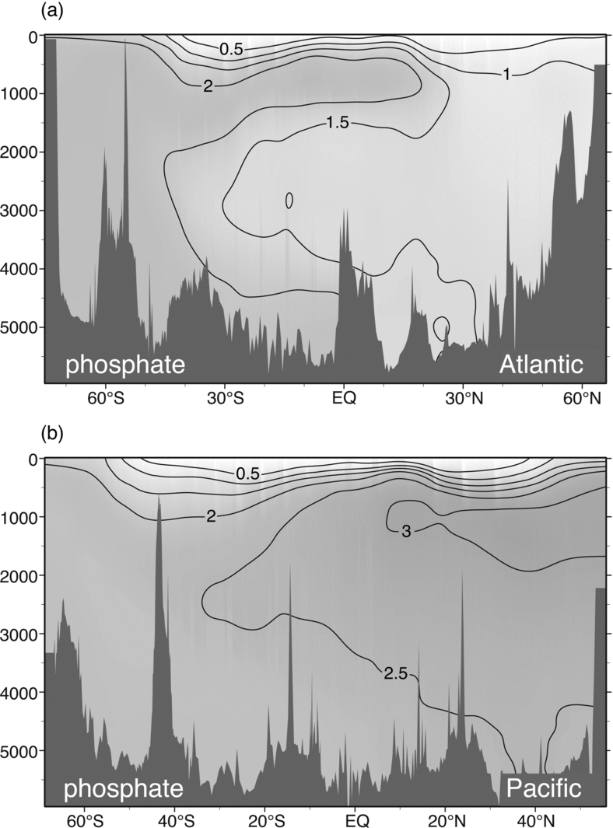
Deep Sea PO₄
PO₄ is strongly depleted near surface, enhanced at depth
Progressive enhancement of PO₄ at depth with time as deep water flows through thermohaline circulation
Strong mixing in Southern Ocean (“mixmaster”)
Further enhancement as water moves North through Pacific
Williams_Fig. 11.16

Slide 17
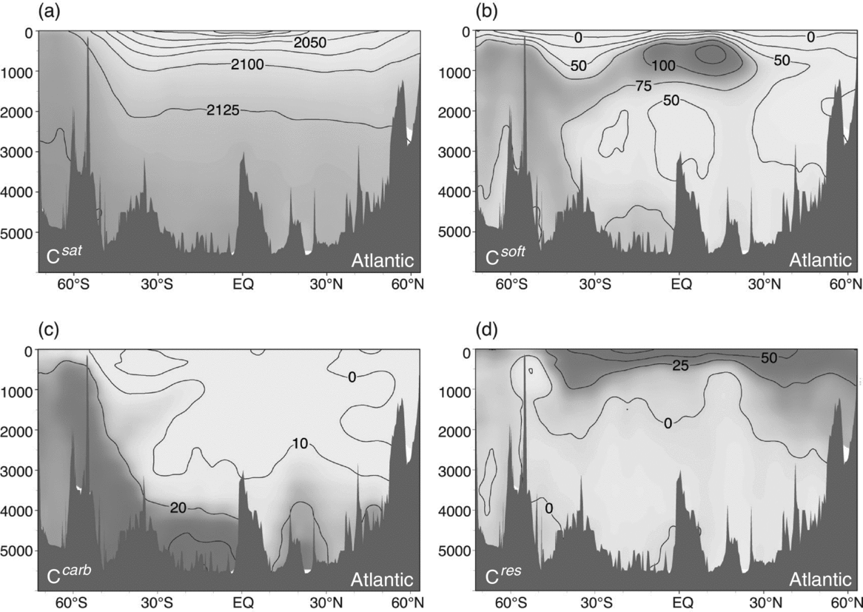
Components of Deep Sea DIC
ATLANTIC
Williams_Fig. 11.21

Slide 18
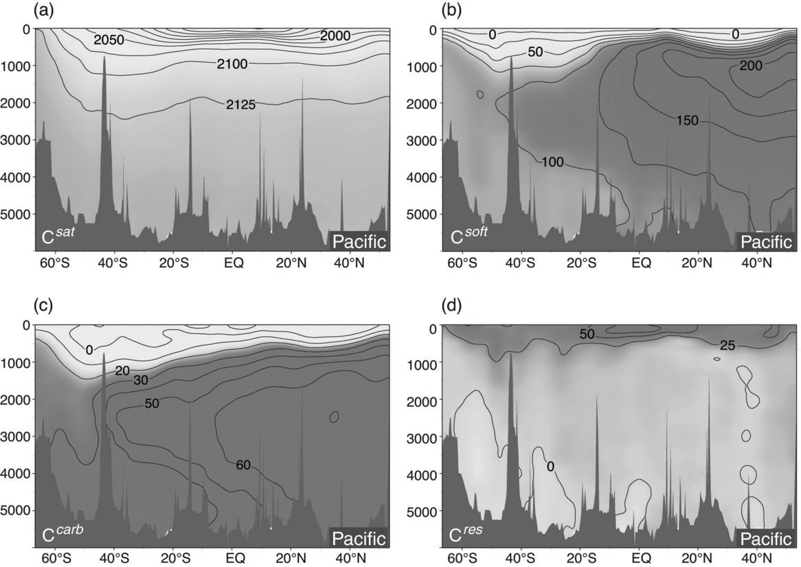
Components of Deep Sea DIC
PACIFIC
Williams_Fig. 11.22

Slide 19
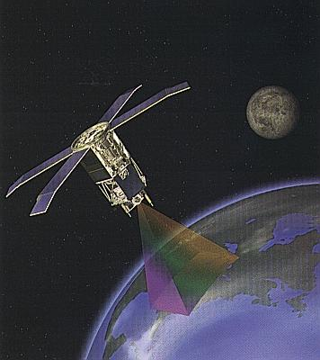
Remote Sensing of Ocean Color
Sea-viewing wide-field spectrometer (SeaWiFS) launched August 1, 1997
8 bands in visible and near-IR provide imagery of plant pigments
705 km circular, noon, sun-synchronous orbit
~ daily global coverage with < 5 km pixels

Slide 20
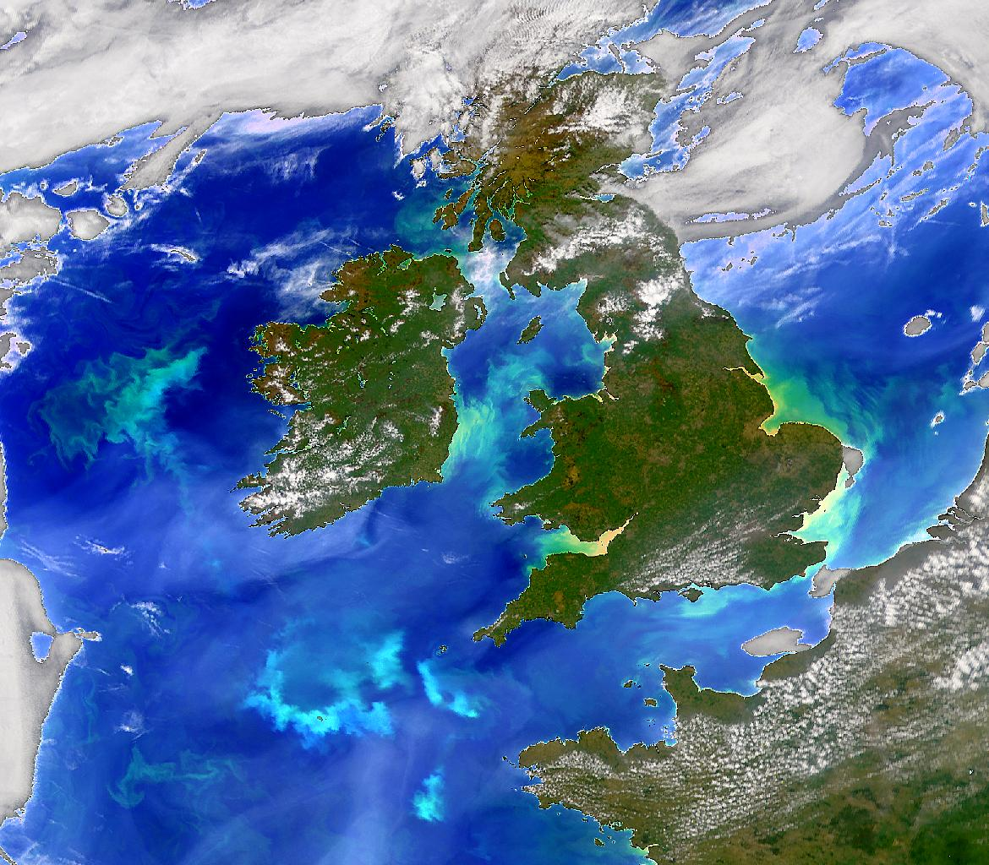

Slide 21
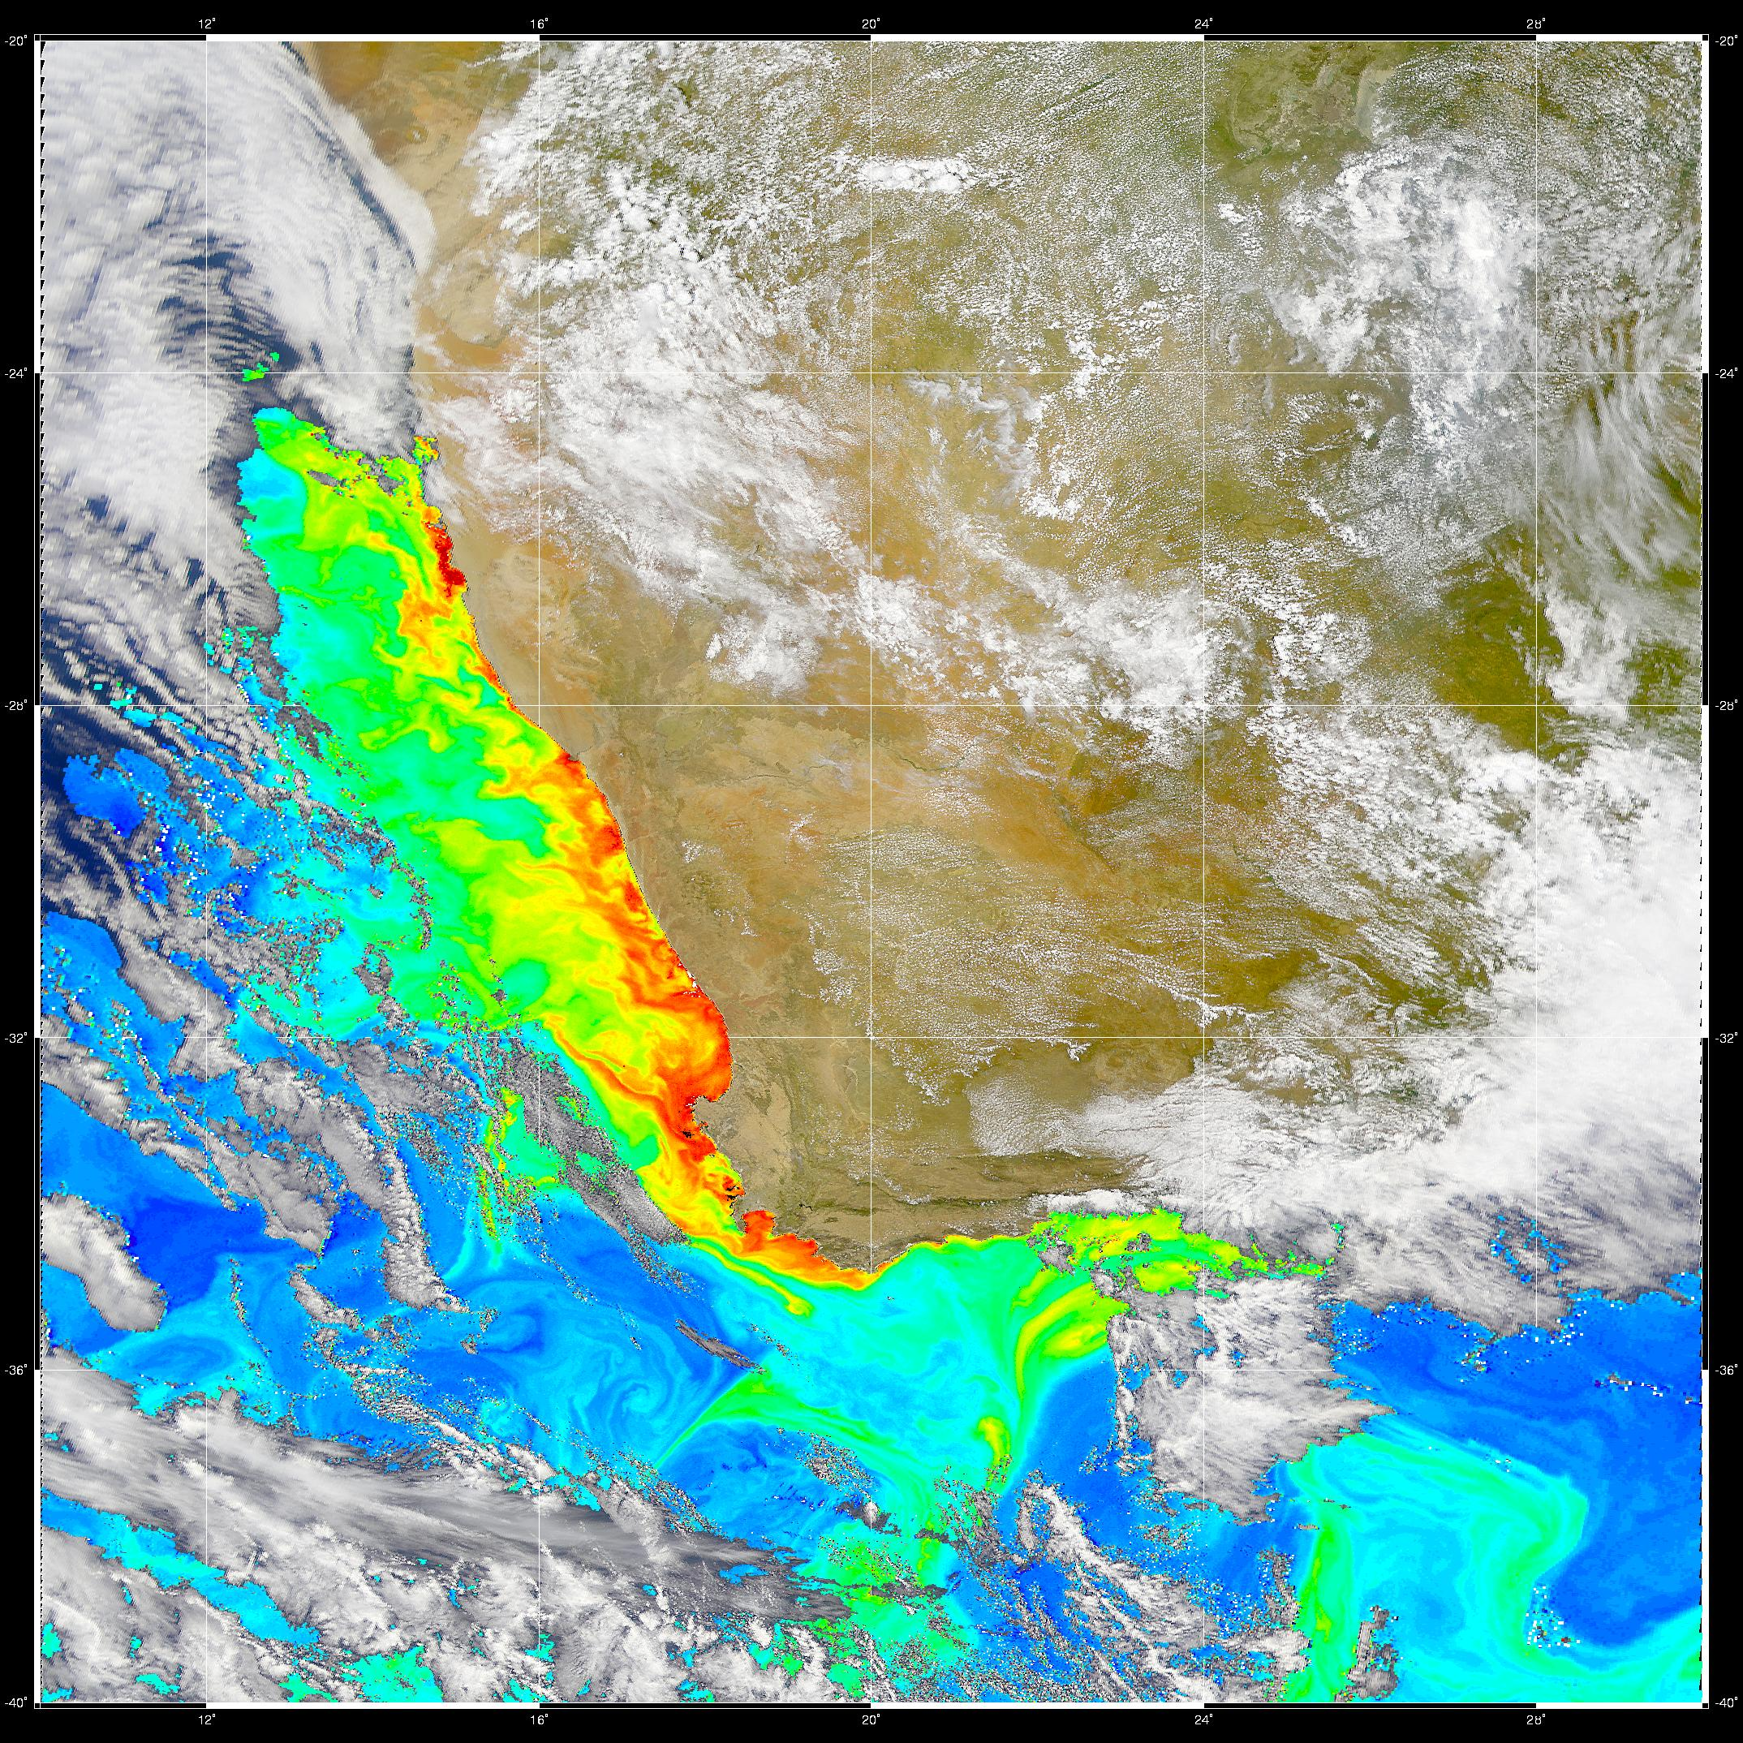

Slide 22
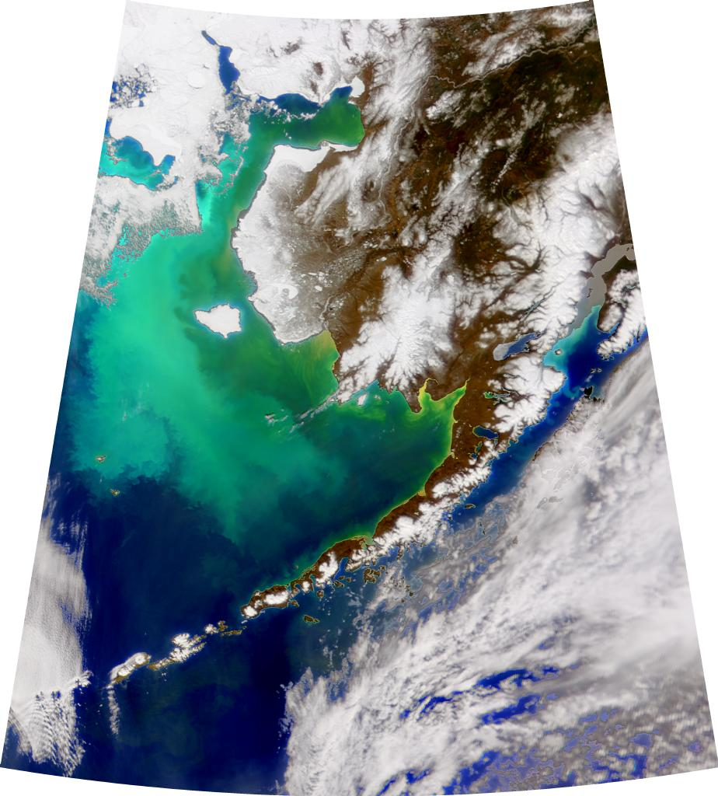

Slide 23
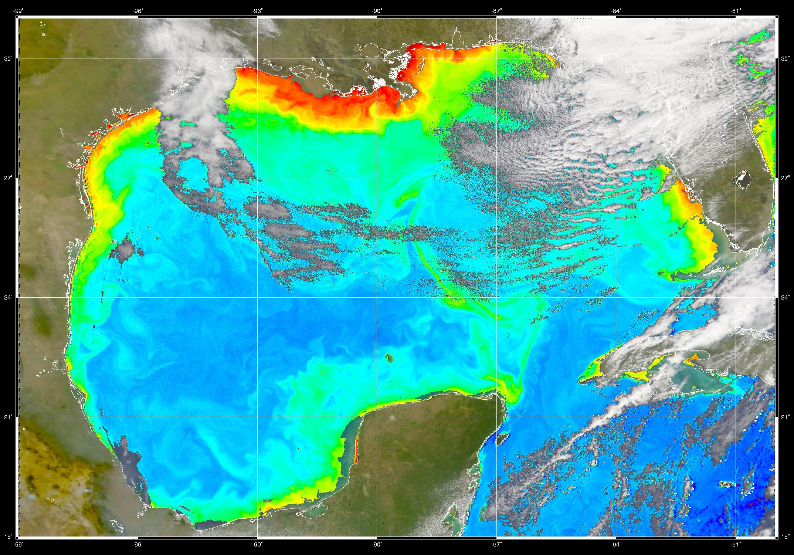

Slide 24
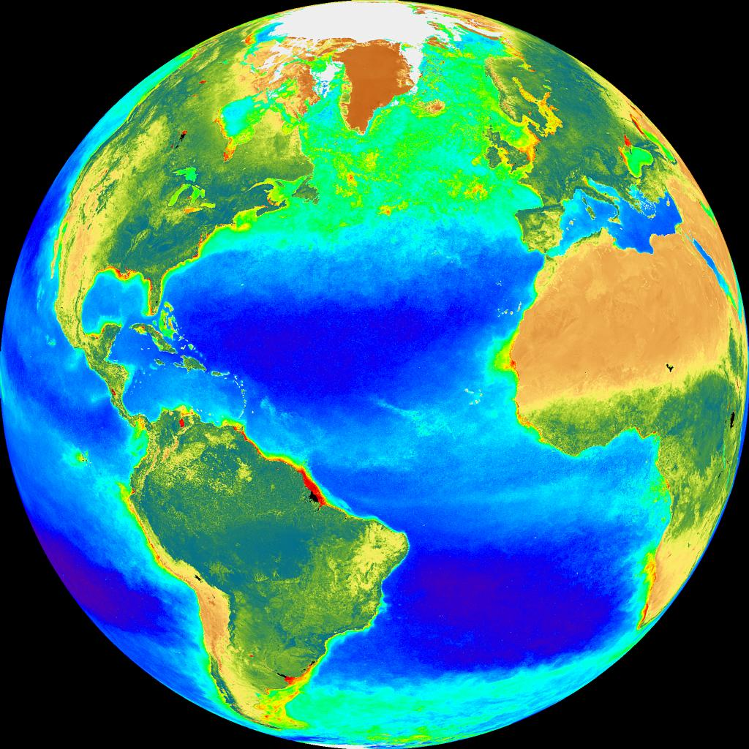

Slide 25
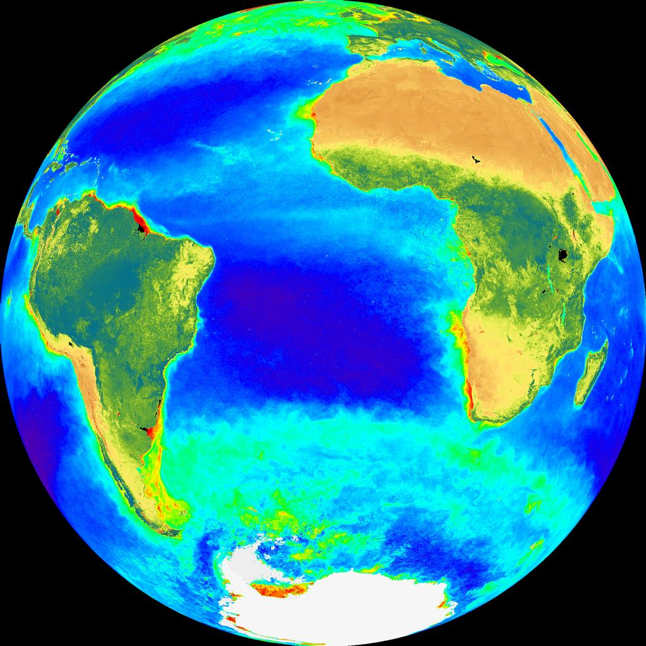

Slide 26
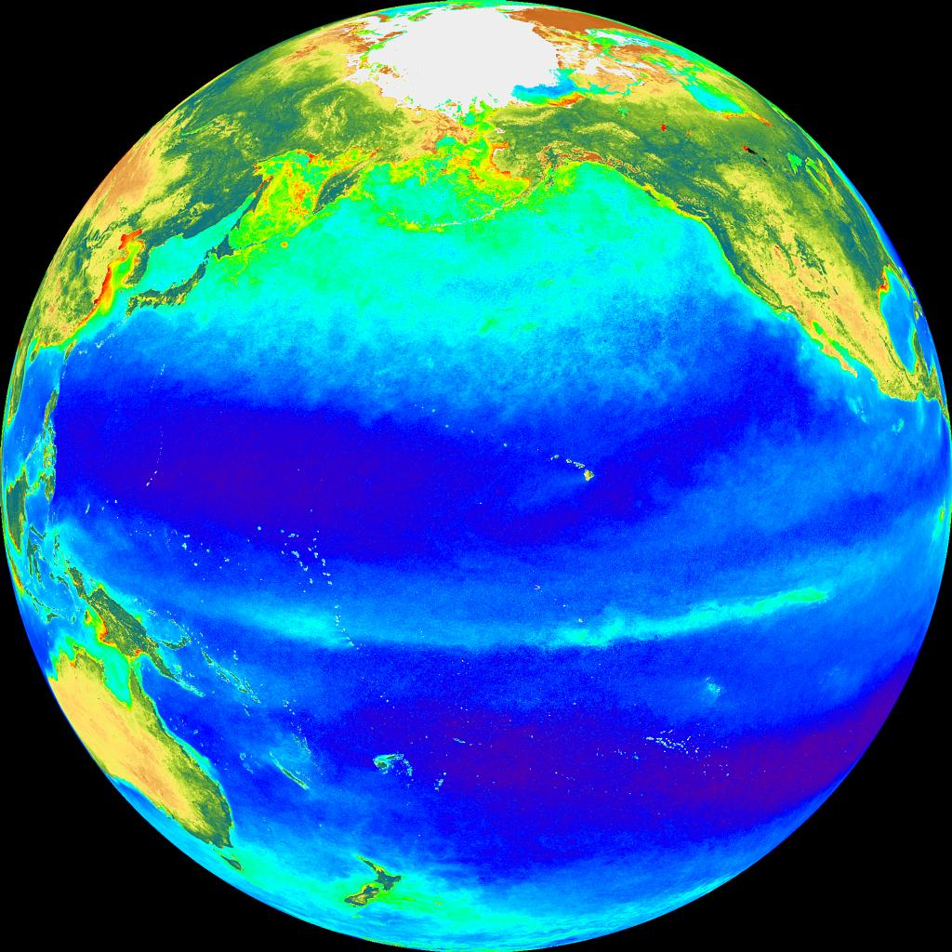

Slide 27
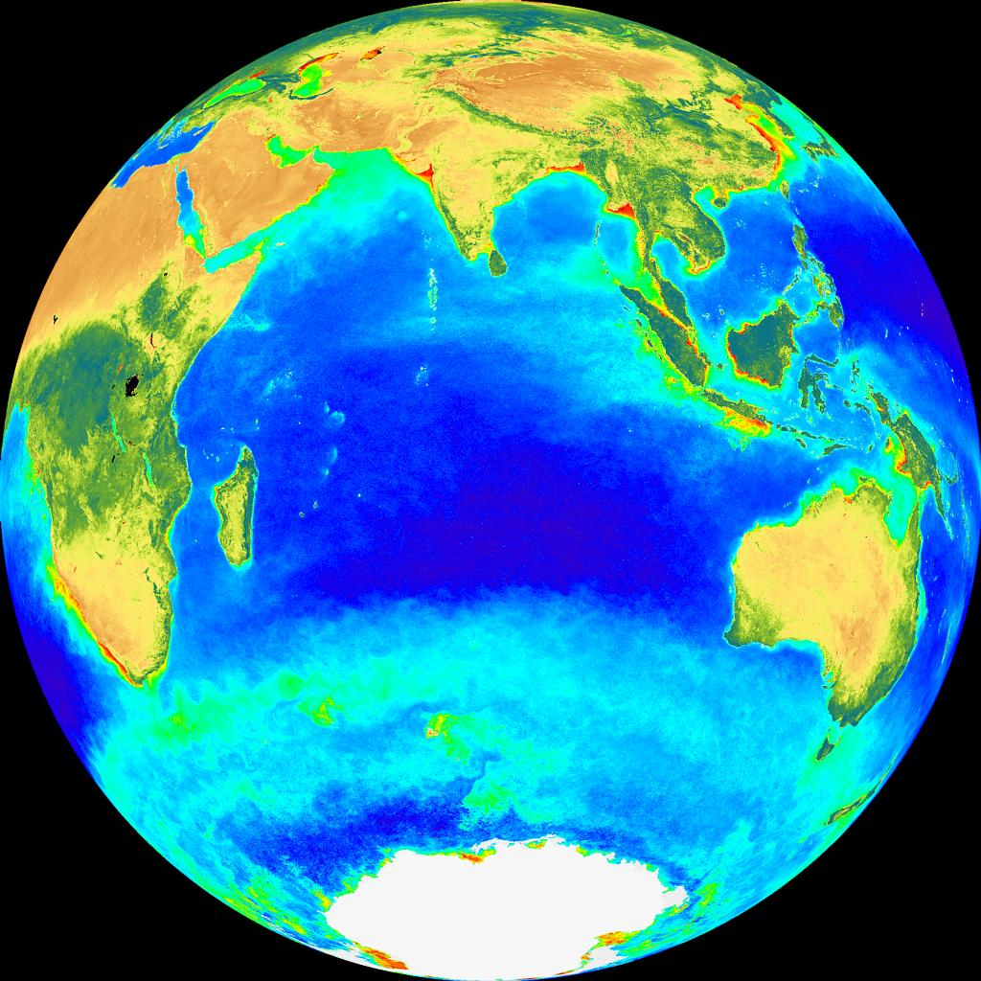

Slide 28
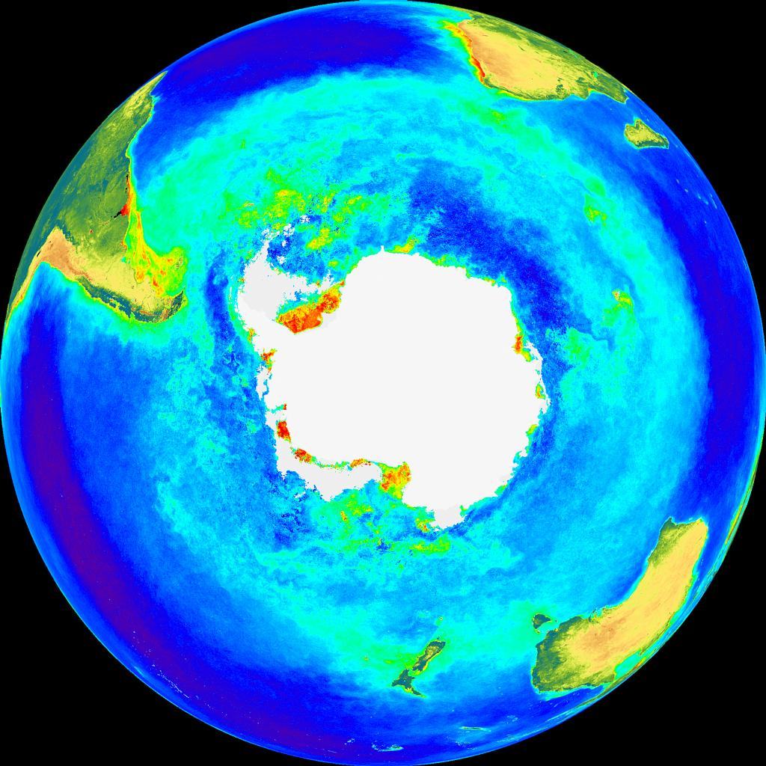

Slide 29
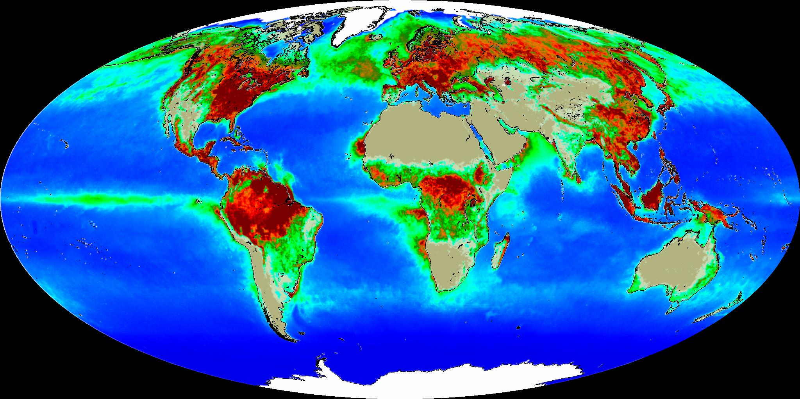
Net Primary Production
June, July, August of 1998
Note the stimulation of NPP from tropical upwelling in eastern Pacific
Behrenfeld et al. [2001]

Slide 30
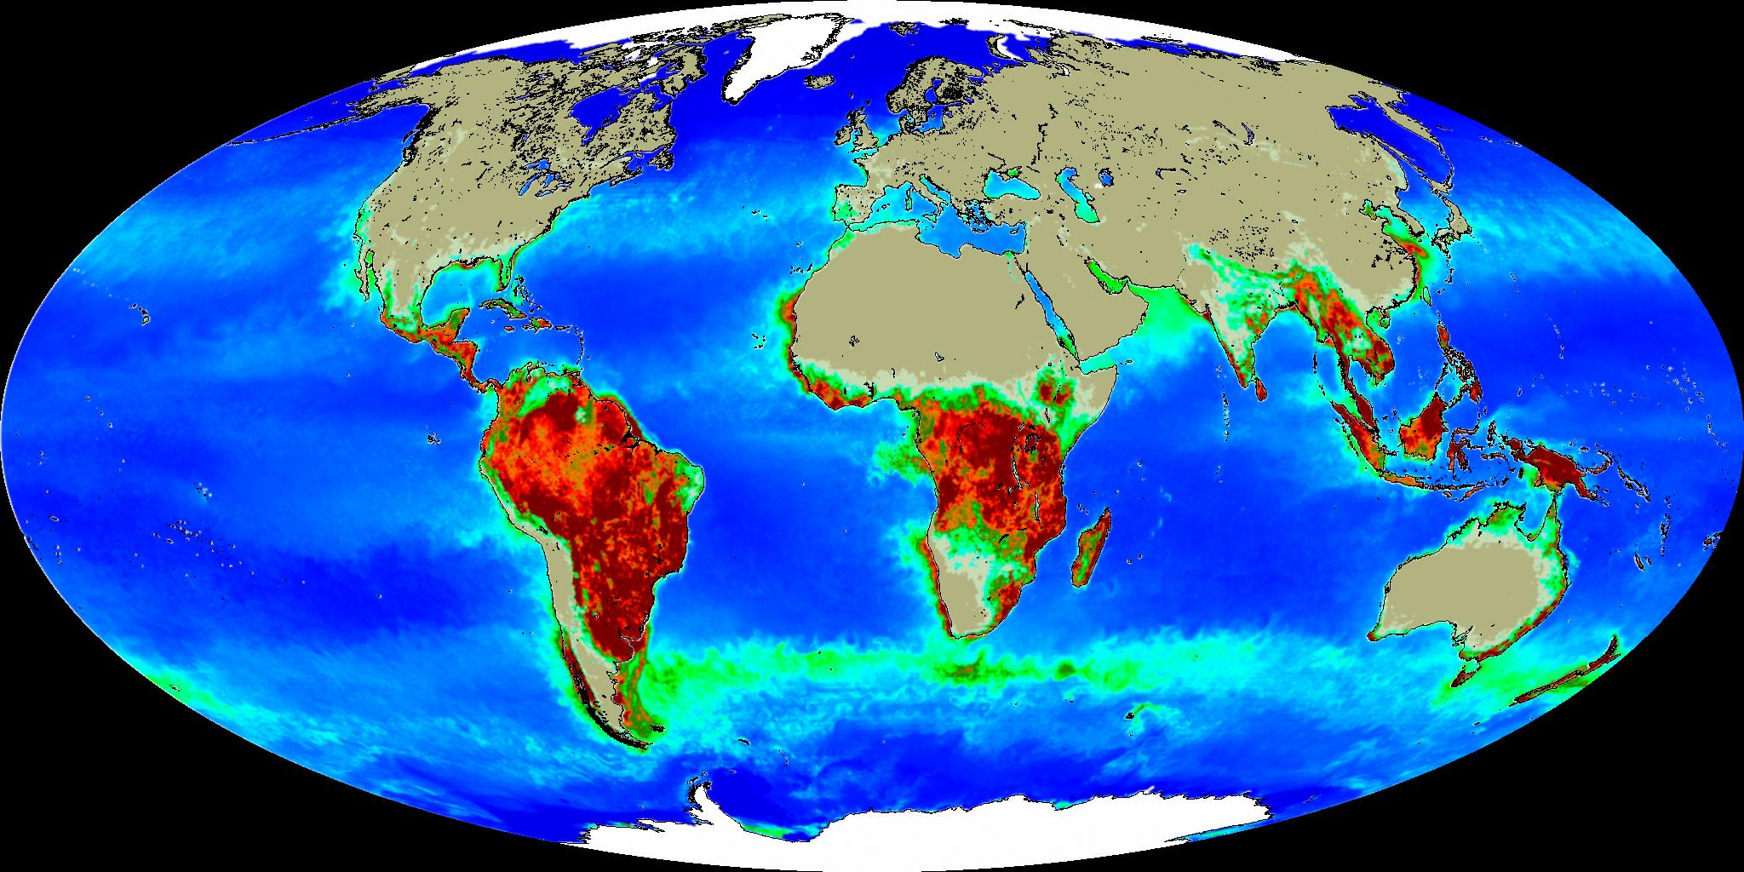
Net Primary Production December, January, February of 97 and 98
Behrenfeld et al. [2001]

Slide 31
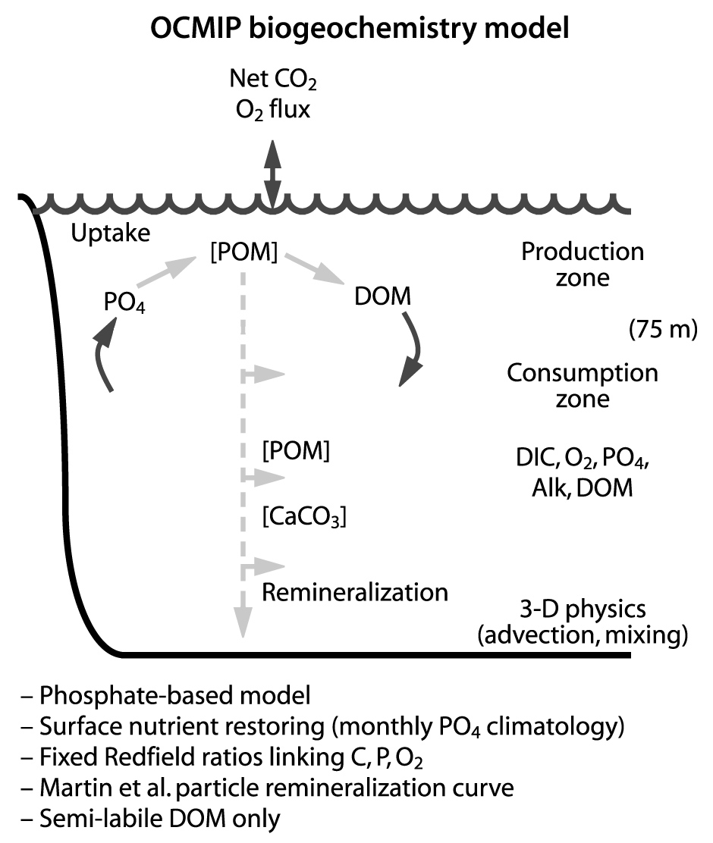
Minimalist Marine Biology (OCMIP-1)
Production/consumption just sufficient to restore model to “observed” sea-surface PO₄³⁻ (Redfield ratio)
Implemented in many ocean GCMs
Can reproduce many features of Chlorophyll distribution

Slide 32
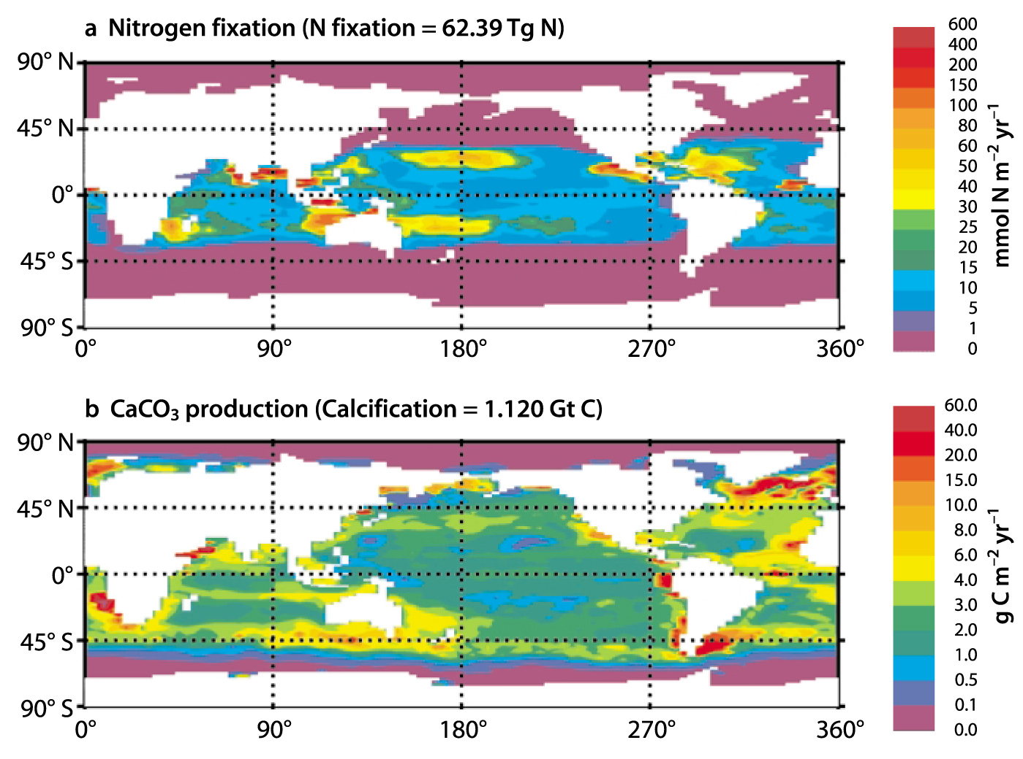
Biogeochemical Fixation
“Diazotrophs”

Slide 33
Iron Fertilization
Some areas have high N but low chlorophyll (HNLC)
These regions are far from land (Eq Pac, circumpolar)
Fe-limitation due to reduced atmospheric deposition of dust from continents
Model can’t capture Chl minima in HNLC regions without introducing Fe-limitation and prescribing Fe-deposition
Doney et al (2001)

Slide 34
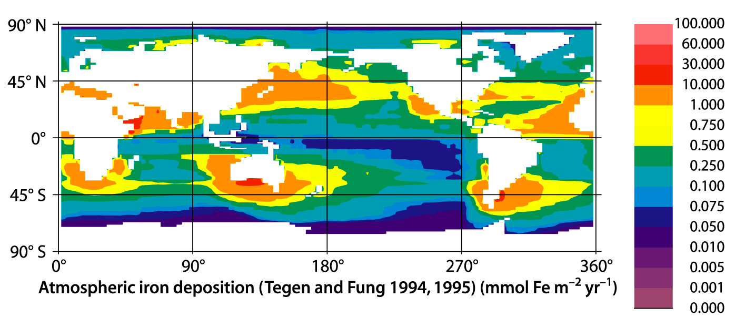
Estimated Iron Deposition
Dust model predicts “lofting” of terrestrial dust particles by the wind, transport, and deposition (composition)
Desert dust is important, but grain size and mineral composition control transport and Fe content

Slide 35
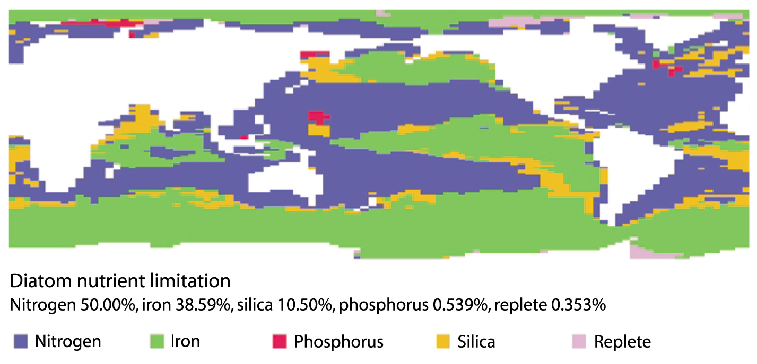
Simulated Nutrient Limitations
Most of the marine biosphere is N-limited
Large areas of iron limitation far (downwind) from arid continents

Slide 36
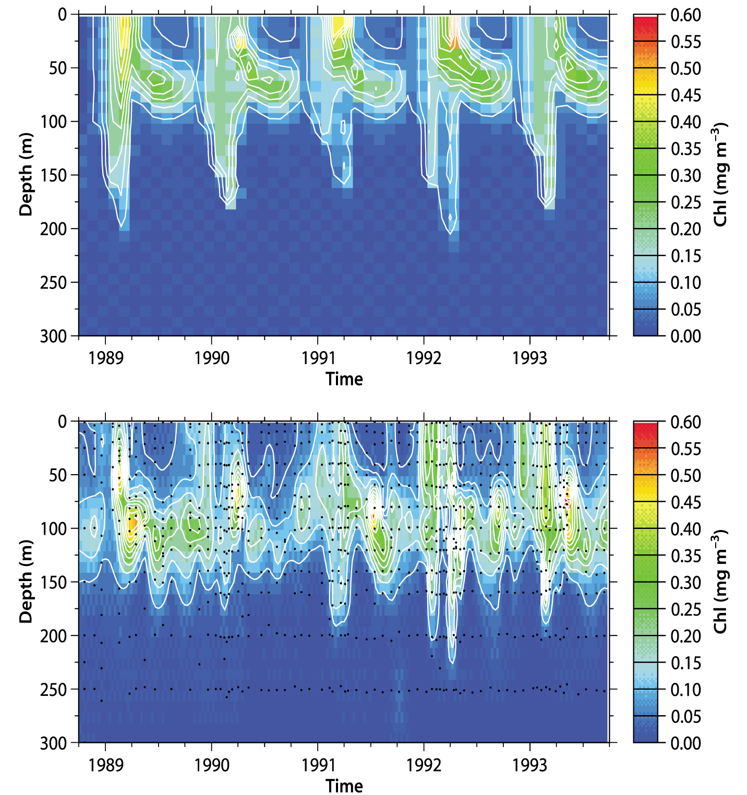
ML Ecosystem Model Evaluation
Ecosystem model forced with observed T, S, ppt, etc
Compared to Bermuda-Atlantic timeseries station (BATS) data
Seasonality, vertical profiles pretty well simulated
Simulation
Observations

Slide 37
Simulated Preindustrial DIC
Ecosystem model coupled to physical GCM
Advection of C, N, P, Fe, Si, Ca
Chemical equilibria
Agreement is pretty good!
Doney et al (2001)

Slide 38
Simulated Global Biological Pump
Importance of coastal zones
BioPump ~ 2/3 of total carbon delivery to deep ocean
Solubility pump accounts for the remaining ~ 1/3
Doney et al (2001)

Slide 39
Is there a Gulf Stream?
Trajectories of derelict (drifting) ships (19th century)

Slide 40
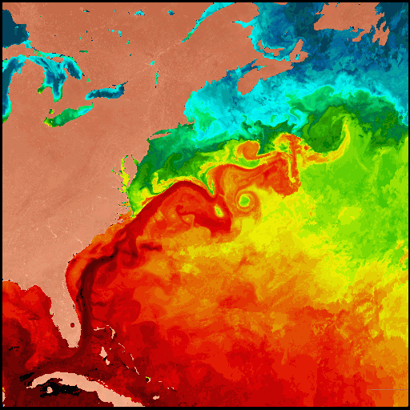
Sea-Surface Temperature
Note baroclinic eddies and “rings” in Gulf Stream
Slow currents, small Rossby radius
Much of the meridional heat transport in the oceans is accomplished by these motions
Effects on vertical motion and biology?

Slide 41
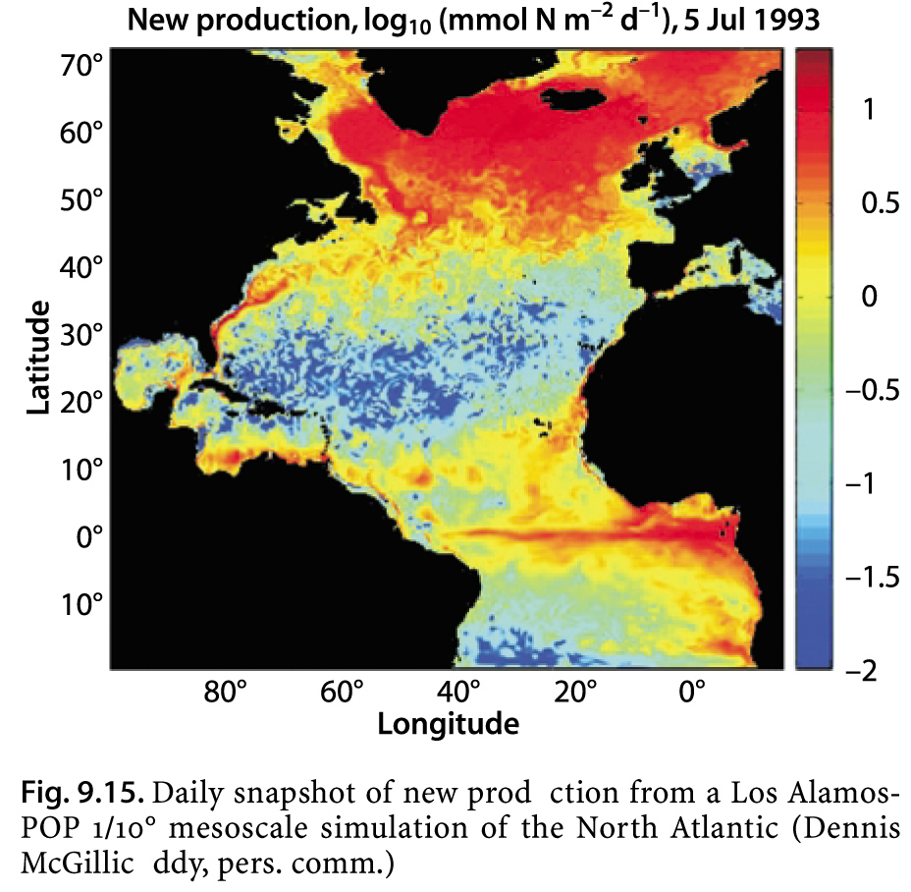
“Mesoscale” Physics -> Ecology

Slide 42
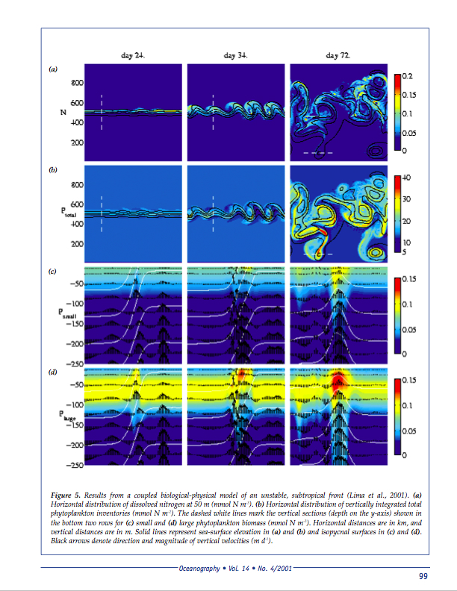
Vertical Motion, & the Biological Pump
Mesoscale Dynamics
Growth of a baroclinic disturbance in an eddy-resolving ocean model
Top panels show “maps,” bottom panels show x-sections
Big impact of vertical motions on NPP, shift from small to larger organisms, sinking POC
Physics not resolved by most ocean models!
Doney et al (2001)

Slide 43
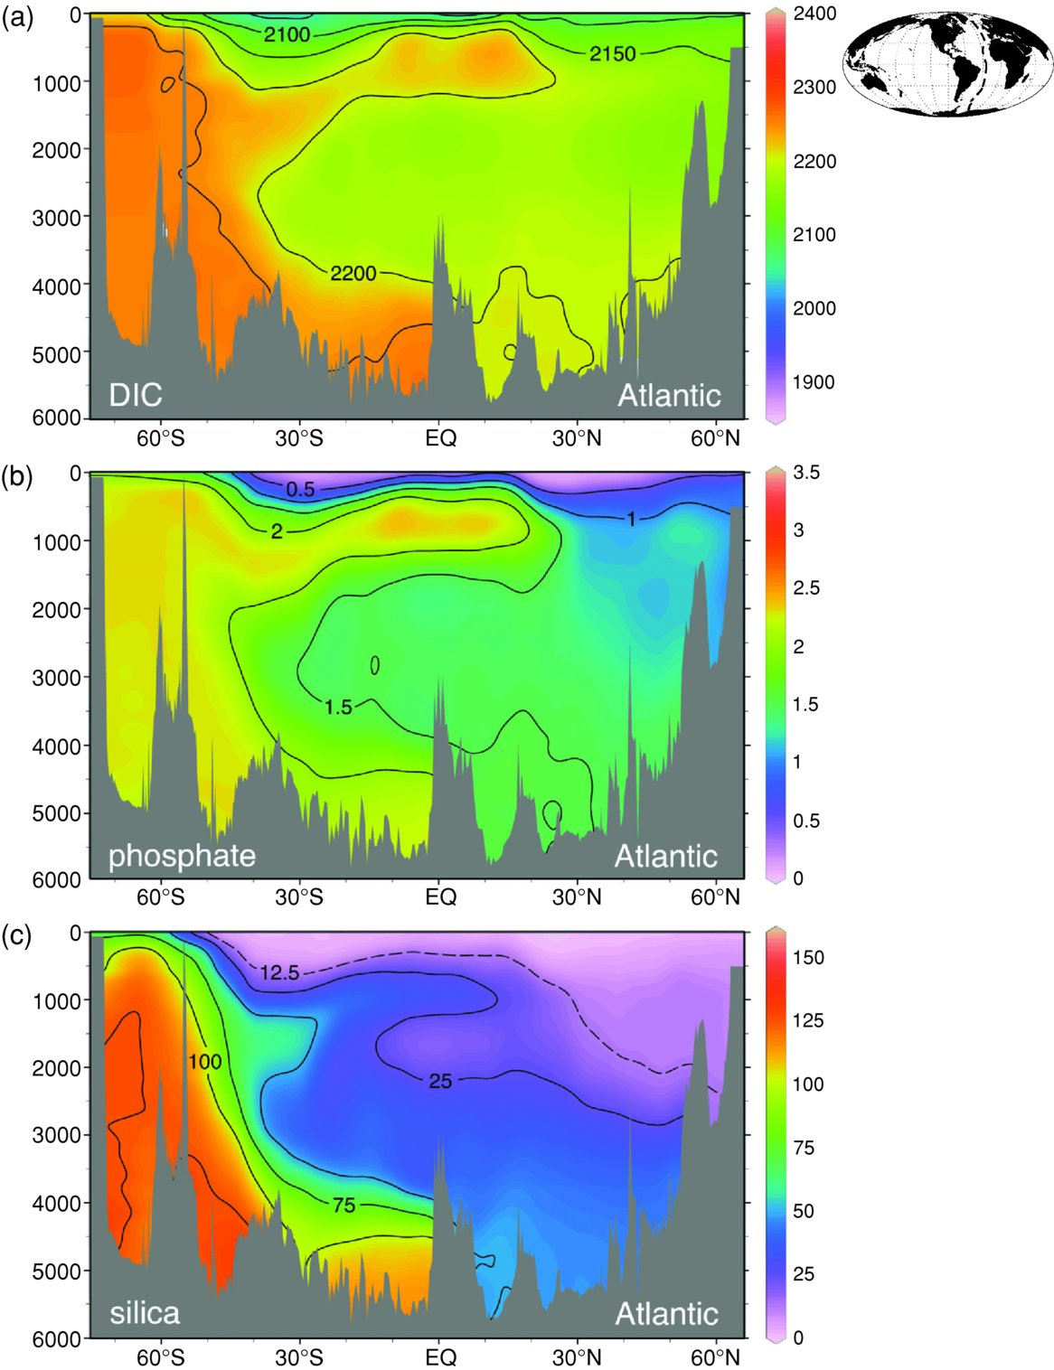
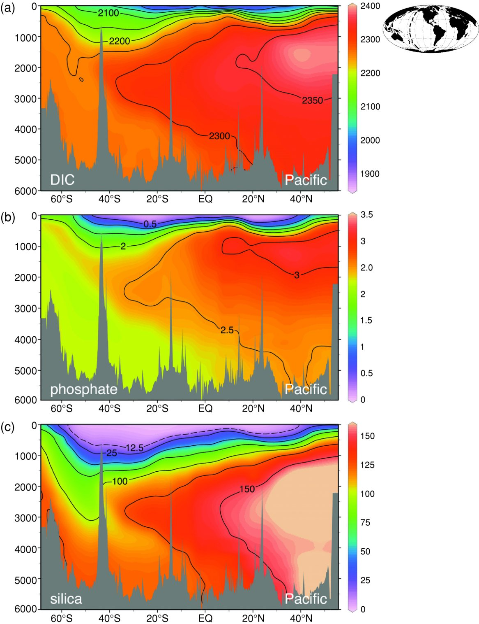
Biogeochemicals
Atlantic
Pacific
carbon
PO₄
SiO₄

Slide 44
ΔpCO₂ Analyses (after Takahashi)
Advection/diffusion interpolation from point measurements
Combines data from over 30 years of measurements, with corrections for d[pCO₂]/dt and SST
Note tropical upwelling, downwelling in gyres, highlatitude sinks
(Feeley et al, 2001)

Slide 45
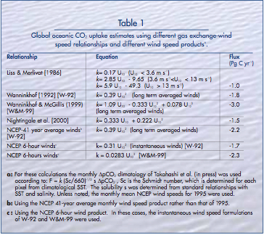
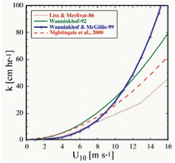
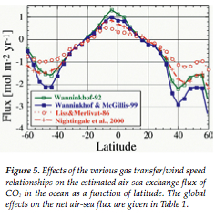
Spatial Patterns of Gas Exchange (Feeley et al, 2001)
F = k_{ex} S ΔpCO₂
Dependence of transfer velocity on wind speed convolved with wind and ΔpCO₂ patterns
Little difference in subtropics (weak ΔpCO₂)
More in tropics (lots of ΔpCO₂, weak winds)
Most differences in higher latitudes (big ΔpCO₂, high winds)

Slide 46
Annual Flux Result

Slide 47
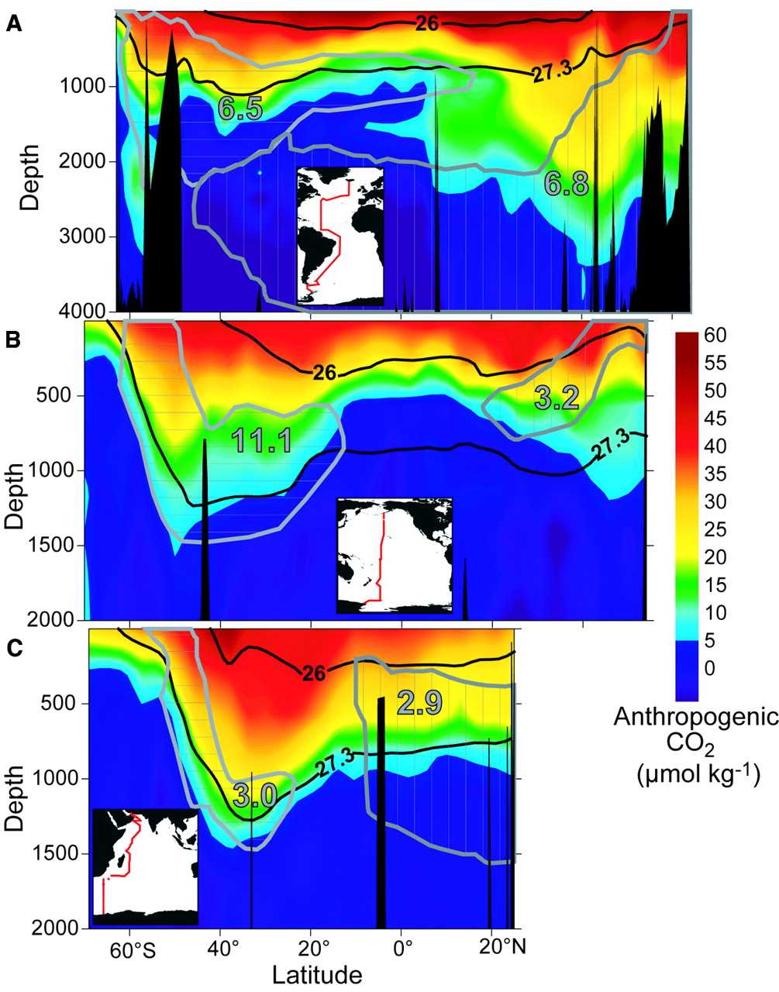
Anthropogenic CO₂
These are data from JGOFS stations
Anthropogenic component estimated by “correcting” total DIC for anthropogenic component using stoichiometry
Anthropogenic DIC is not accompanied by biological N and P
Sabine et al (2004)

Slide 48
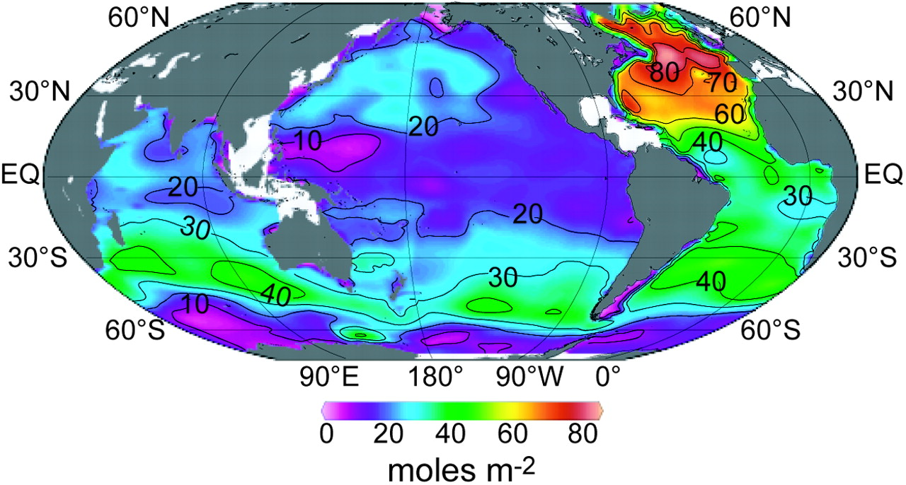
Column Integrated Anthropogenic DIC
Sabine et al (2004)

Slide 49
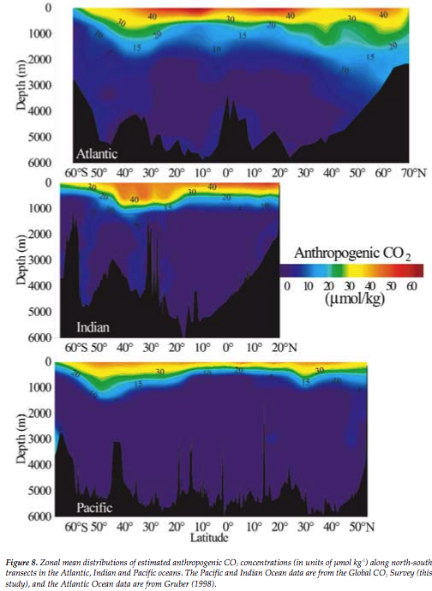
Anthropogenic DIC
Estimated from total observed DIC using stoichiometry
Most anthropogenic DIC confined to top few 100 m
“Shoaling” in tropics, convection at higher latitudes
Some “contamination” of bottom water in Atlantic (both hemispheres)

Slide 50
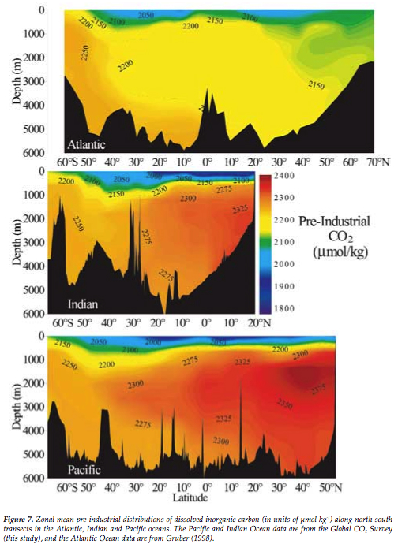
Preindustrial DIC
Surface water strongly depleted (~10%) due to biological removal
Convection and deep water formation in North Atlantic
Deep DIC: Pacific > Indian > Atlantic

