Slide 1
Inverse Modeling of Surface Carbon Fluxes
Please read Peters et al (2007)
and
Explore the CarbonTracker website

Slide 2
Consider Linear Regression
Given N measurements y_{i} for different values of the independent variable x_{i}, find a slope (m) and intercept (b) that describe the “best” line through the observations
Why a line?
What do we mean by “best”
How do we find m and b?
Compare predicted values to observations, and find m and b that fit best
Define a total error (difference between model and observations) and minimize it!

Slide 3
Defining the Total Error
Our model is
Error at any point is just
Could just add the error up:
Problem: positive and negative errors cancel … we need to penalize signs equally
Define the total error as the sum of the Euclidean distance between the model and observations (sum of square of the errors):

Slide 4
Minimizing Total Error (Least Squares)
Take partial derivs
Set to zero
Solve for m and b

Slide 5
Minimizing the Error
(1)
Solve for b
Plug this result into other partial deriv, and solve for m
(2)
(3)
(4)

Slide 6
Minimizing the Error (cont’d)
(4)
Plug (4) into (2) and simplify:
(5)
Now have simple “Least Squares” formulae for “best” slope and intercept given a set of observations

Slide 7
Geometric View of Linear Regression
Any vector can be written as a linear combination of the orthonormal basis set
This is accomplished by taking the dot product (or inner product) of the vector with each basis vector to determine the components in each basis direction
Linear regression involves a 2D mapping of an observation vector into a different vector space
More generally, this can involve an arbitrary number of basis vectors (dimensions)

Slide 8
Linear Regression Revisited
This notation can be rewritten in subscript notation:
and applied to a familiar problem. Imagine that there are 2 data points (d₁, d₂) and 2 model parameters (m₁, m₂).
Then the system of equations could be explicitly written as:
d₁ = G₁₁m₁ + G₁₂m₂
d₂ = G₂₁m₁ + G₂₂m₂
Or in matrix form
With two points, this is just two slope-intercept form equations:
y₁ = m x₁ + b
y₂ = m x₂ + b
This is an "even-determined" problem - there is exactly enough information to determine the model parameters precisely, there is only one solution, and there is zero prediction error.

Slide 9
Generalized Least Squares
The G's can be thought of as partial derivatives and the whole matrix as a Jacobian.

Slide 10
Linear Regression (again)
Take partial derivatives w.r.t. m, set to zero, solve for m.
The solution is

Slide 11
Matrix View of Linear Regression
Solution

Slide 12
Matrix View of Regression (cont’d)
Perform the matrix inversion on G^{T}G:
Recall:

Slide 13
Matrix View of Regression (cont’d)

Slide 14
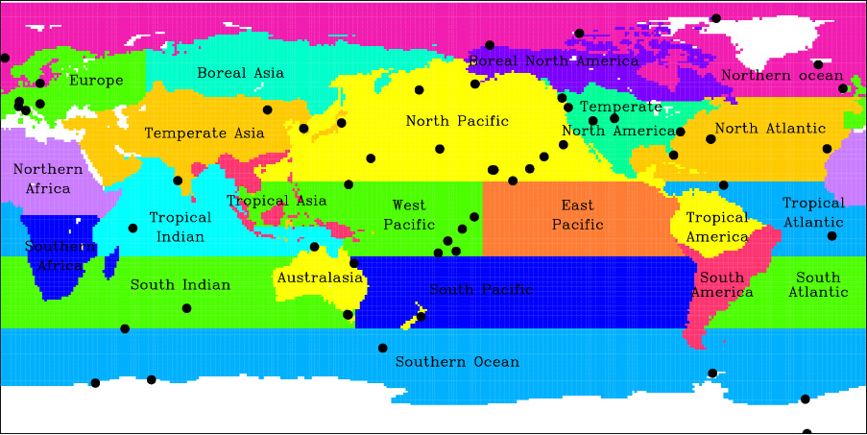
TransCom Inversion Intercomparison
Discretize world into 11 land regions (by vegetation type) and 11 ocean regions (by circulation features)
Release tracer with unit flux from each region during each month into a set of 16 different transport models
Produce timeseries of tracer concentrations at each observing station for 3 simulated years
Notes:
For Level 2: 22 regions x 12 months x 11 models x 3 years = 8712 tracer years of GCM runs, each with 4-hourly data saved at > 200 points!!

Slide 15
Synthesis Inversion
Decompose total emissions into M “basis functions”
Use atmospheric transport model to generate G
Observe d and N locations
Invert G to find m
data
transport
fluxes
d₁ = G₁₁ m₁ + G₁₂ m₂ + … + G_{1N} m_{N}
CO₂ sampled at location 1
partial derivative of
CO₂ at location 1 with
respect to emissions of type 2
Strength of emissions
of type 2

Slide 16
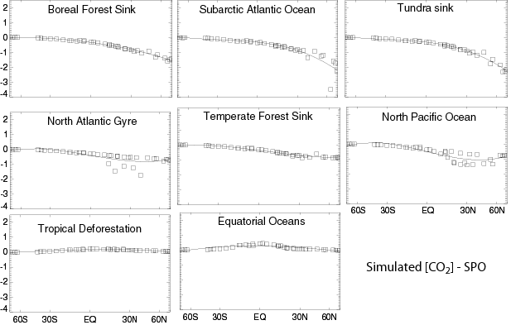
Near-Collinearity of Basis Vectors

Slide 17
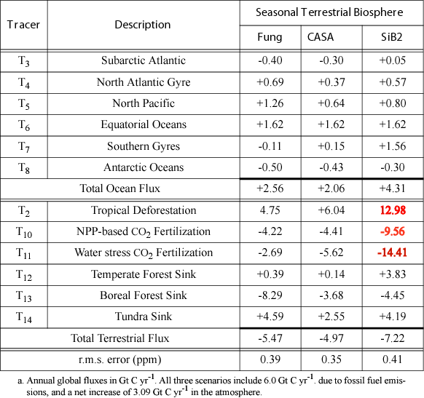
“Dipoles”

Slide 18
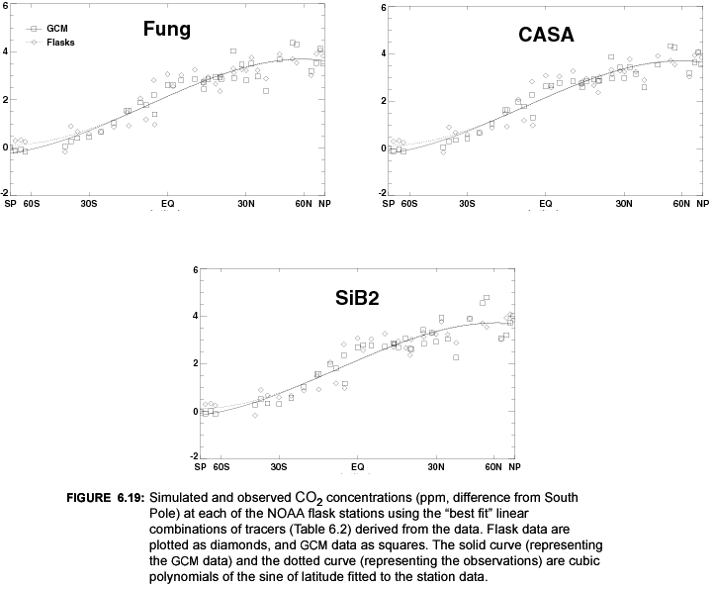
“Best Fit” Inverse Results

Slide 19
Rubber Bands
Prior estimates of regional fluxes
Solution: Fluxes, Concentrations
Observational Data
Inversion seeks a compromise between detailed reproduction of the data and fidelity to what we think we know about fluxes
The elasticity of these two “rubber bands” is adjustable

Slide 20
Bayesian Inversion Technique
a priori
emission
concentration
data
uncertainty
uncertainty
MODEL
emission
estimate
uncertainty

Slide 21
Bayesian Inversion Technique
a priori
emission
concentration
data
uncertainty
uncertainty
uncertainty
reduction
MODEL
emission
estimate
uncertainty

Slide 22
Bayesian Inversion Formalism
Our problem is ill-conditioned.
Apply prior constraints and minimize a more generalized cost function:
data constraint
prior constraint
Solution is given by
Inferred flux
Data Uncertainty
Flux Uncertainty
Prior Guess
observations

Slide 23
Uncertainty in Flux Estimates
A posteriori estimate of uncertainty in the estimated fluxes
Depends on transport (G) and a priori uncertainties in fluxes (C_{m}) and data (C_{d})
Does not depend on the observations per se!

Slide 24
Covariance Matrices
Inverse of a diagonal matrix is obtained by taking reciprocal of diagonal elements
How do we set these?
(It’s an art!)

Slide 25
Accounting for “Error”
Sampling, contamination, analytical accuracy (small)
Representativeness error (large in some areas, small in others)
Model-data mismatch (large and variable)
Transport simulation error (large for specific cases, smaller for “climatological” transport)
All of these require a “looser” fit to the data

Slide 26
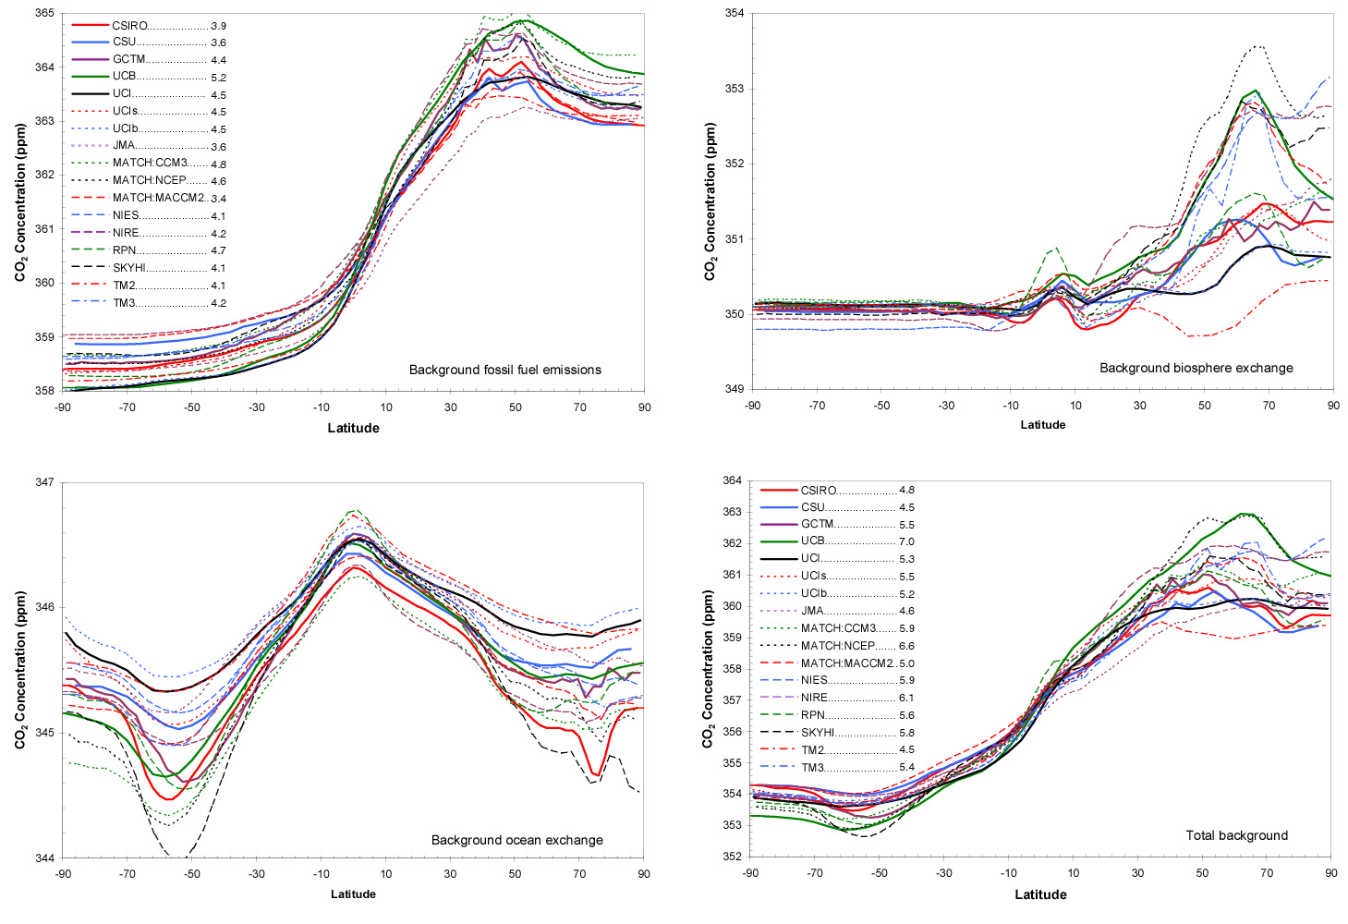
Individual models: background fields

Slide 27
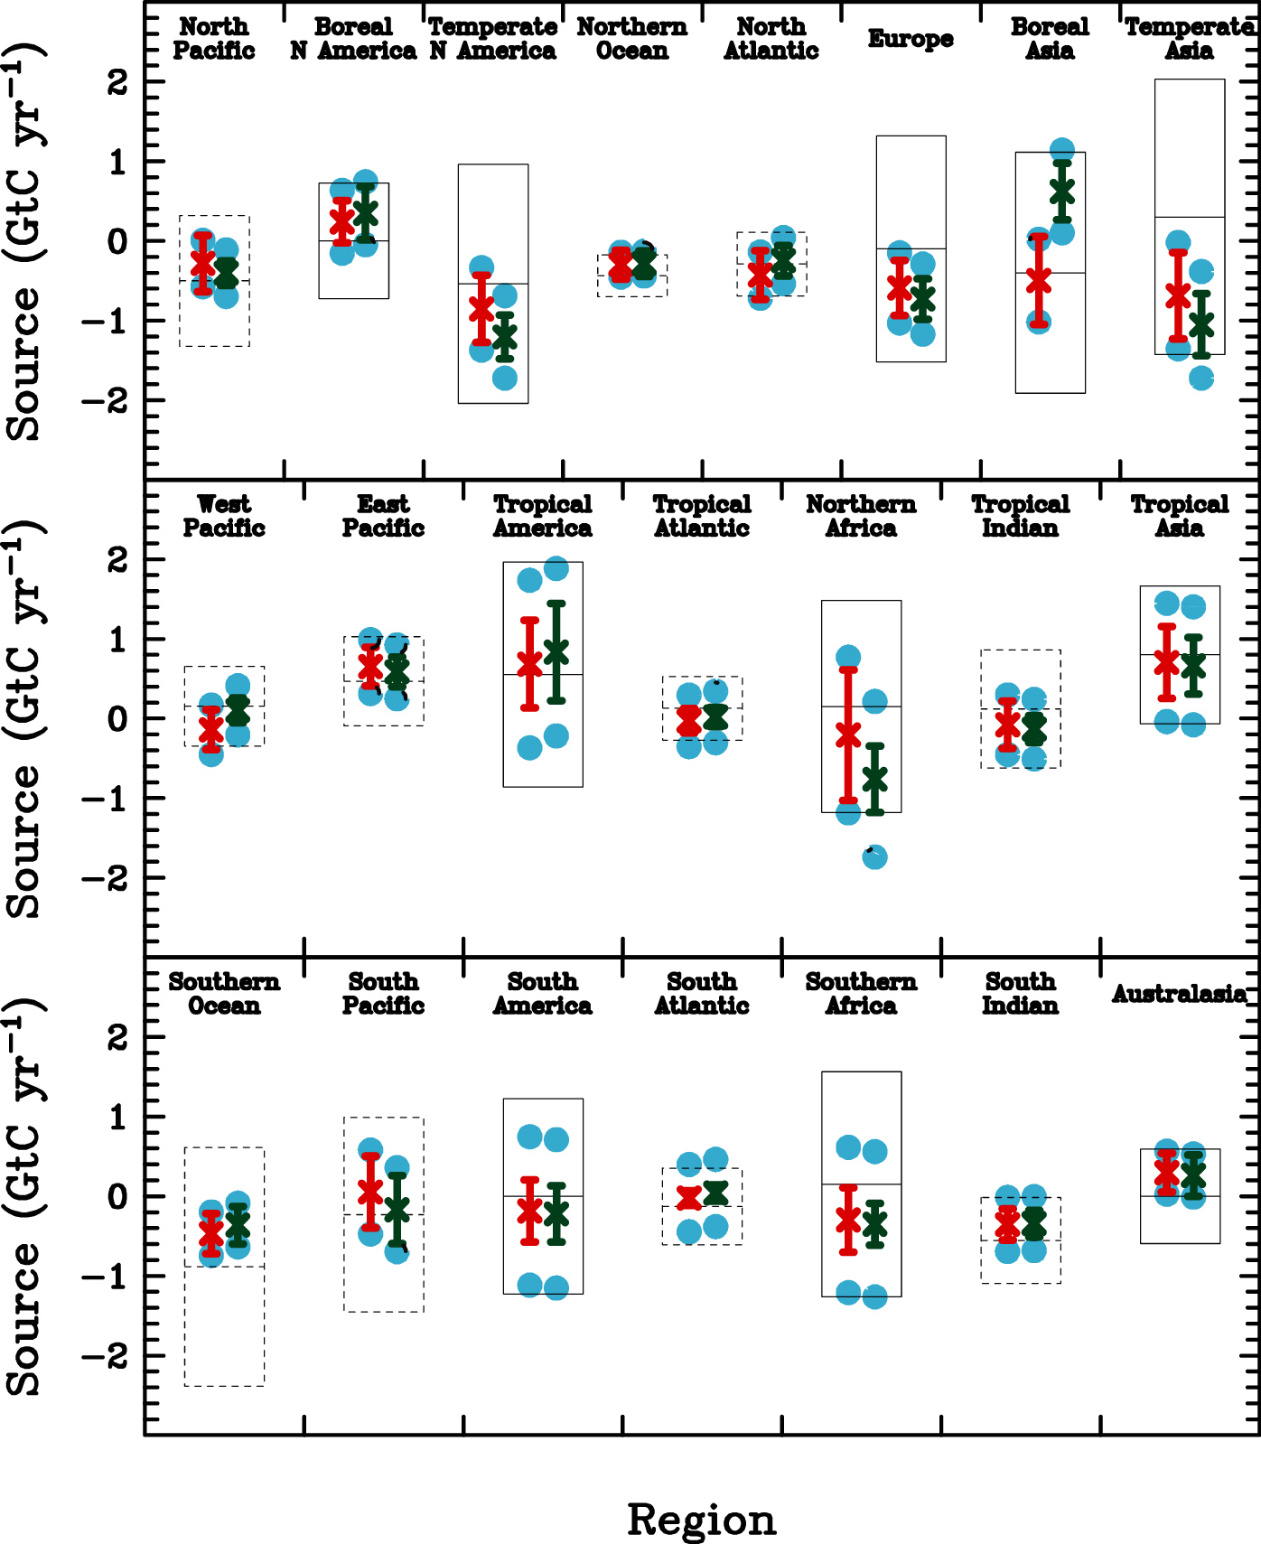
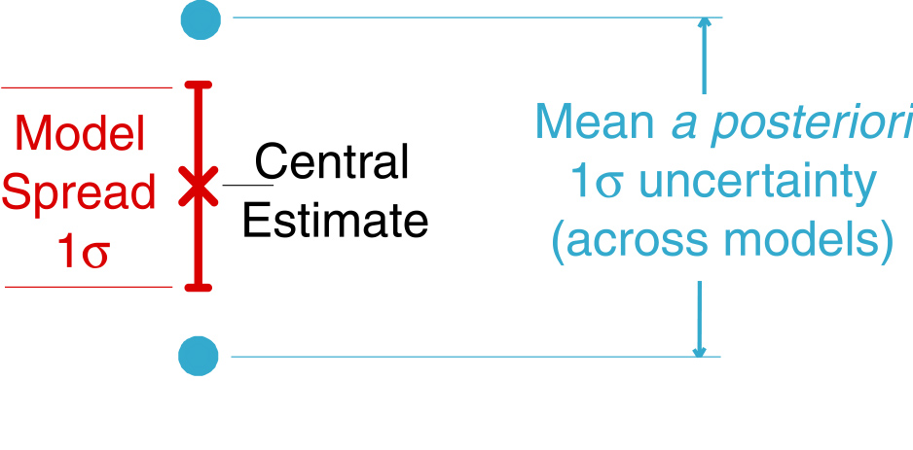
Annual Mean Results
Substantial terrestrial sinks in all northern regions is driven by data (reduced uncertainty)
Tropical regions are very poorly constrained (little uncertainty reduction)
Southern ocean regions have reduced sink relative to prior, with strong data constraint
Neglecting rectifier effect moves terrestrial sink S and W, with much reduced model spread
Gurney et al, Nature, 2002

Slide 28
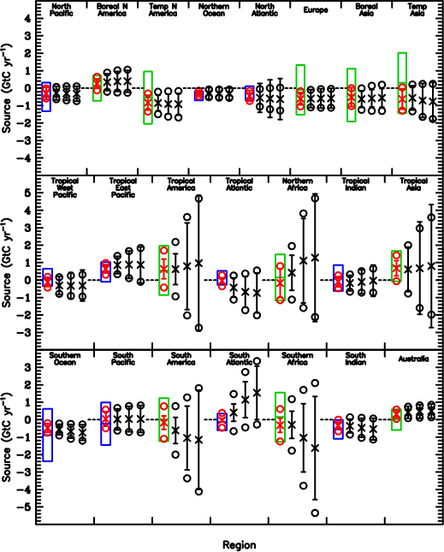
Sensitivity to Priors
Flux estimates and a posteriori uncertainties for data-constrained regions (N and S) are very insensitive to priors
Uncertainties in poorly constrained regions (tropical land) very sensitive to prior uncertainties
As priors are loosened, dipoles develop between poorly constrained regions

