Slide 1
20
20
19
19
18
18
17
17
July Temperature (°C)
July Temperature (°C)
16
16
15
15
14
14
13
13
1650
1700
1750
1800
1850
1900
1950
2000
1970
1975
1980
1985
1990
1995
2000
Figure 7.1
Ecological Climatology © 2008 G. Bonan

Slide 2
Figure 7.2
Ecological Climatology © 2008 G. Bonan

Slide 3
Figure 7.3
Ecological Climatology © 2008 G. Bonan

Slide 4
Figure 7.4
Ecological Climatology © 2008 G. Bonan

Slide 5
Figure 7.5
Ecological Climatology © 2008 G. Bonan

Slide 6
Warm Water
Cold Water
Warm Water
Cold Water
Figure 7.6
Ecological Climatology © 2008 G. Bonan

Slide 7
Figure 7.7
Ecological Climatology © 2008 G. Bonan

Slide 8
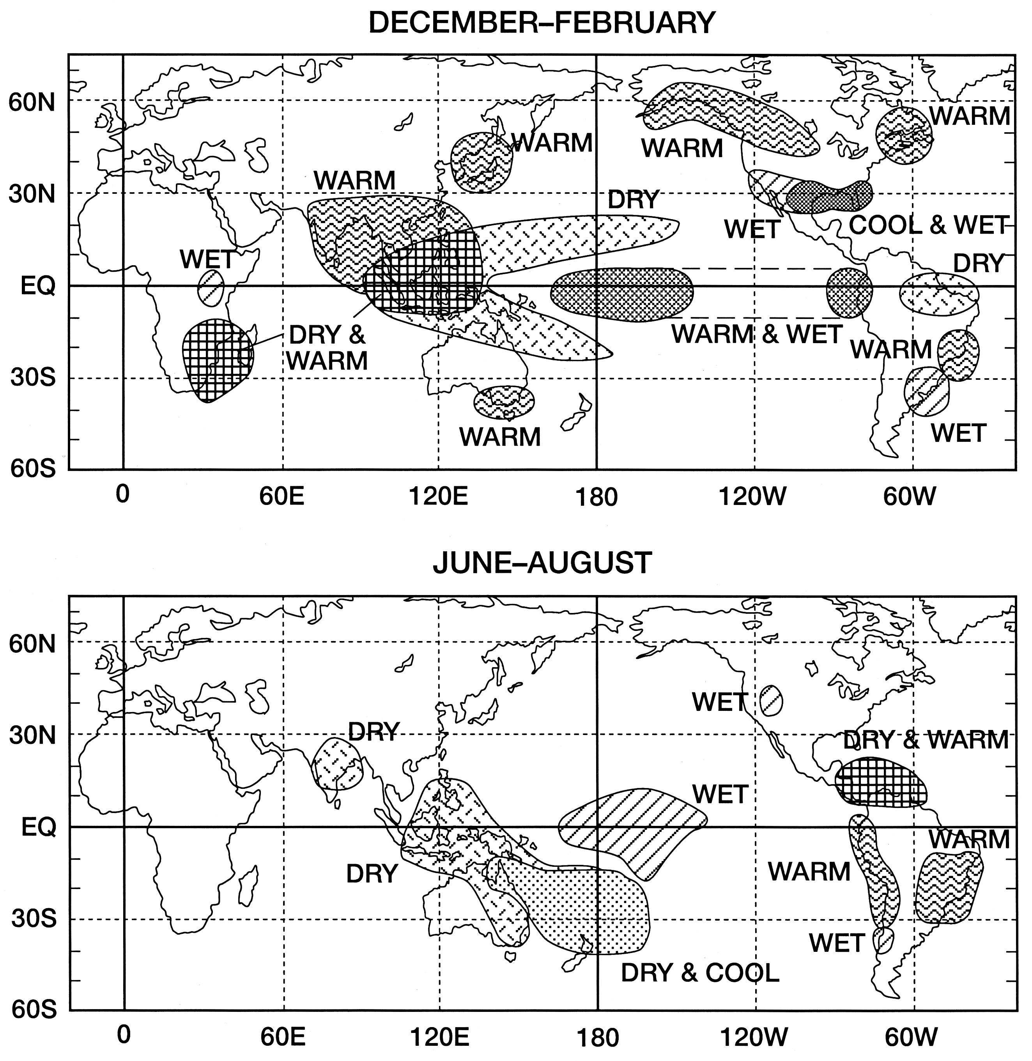
Figure 7.8
Ecological Climatology © 2008 G. Bonan

Slide 9
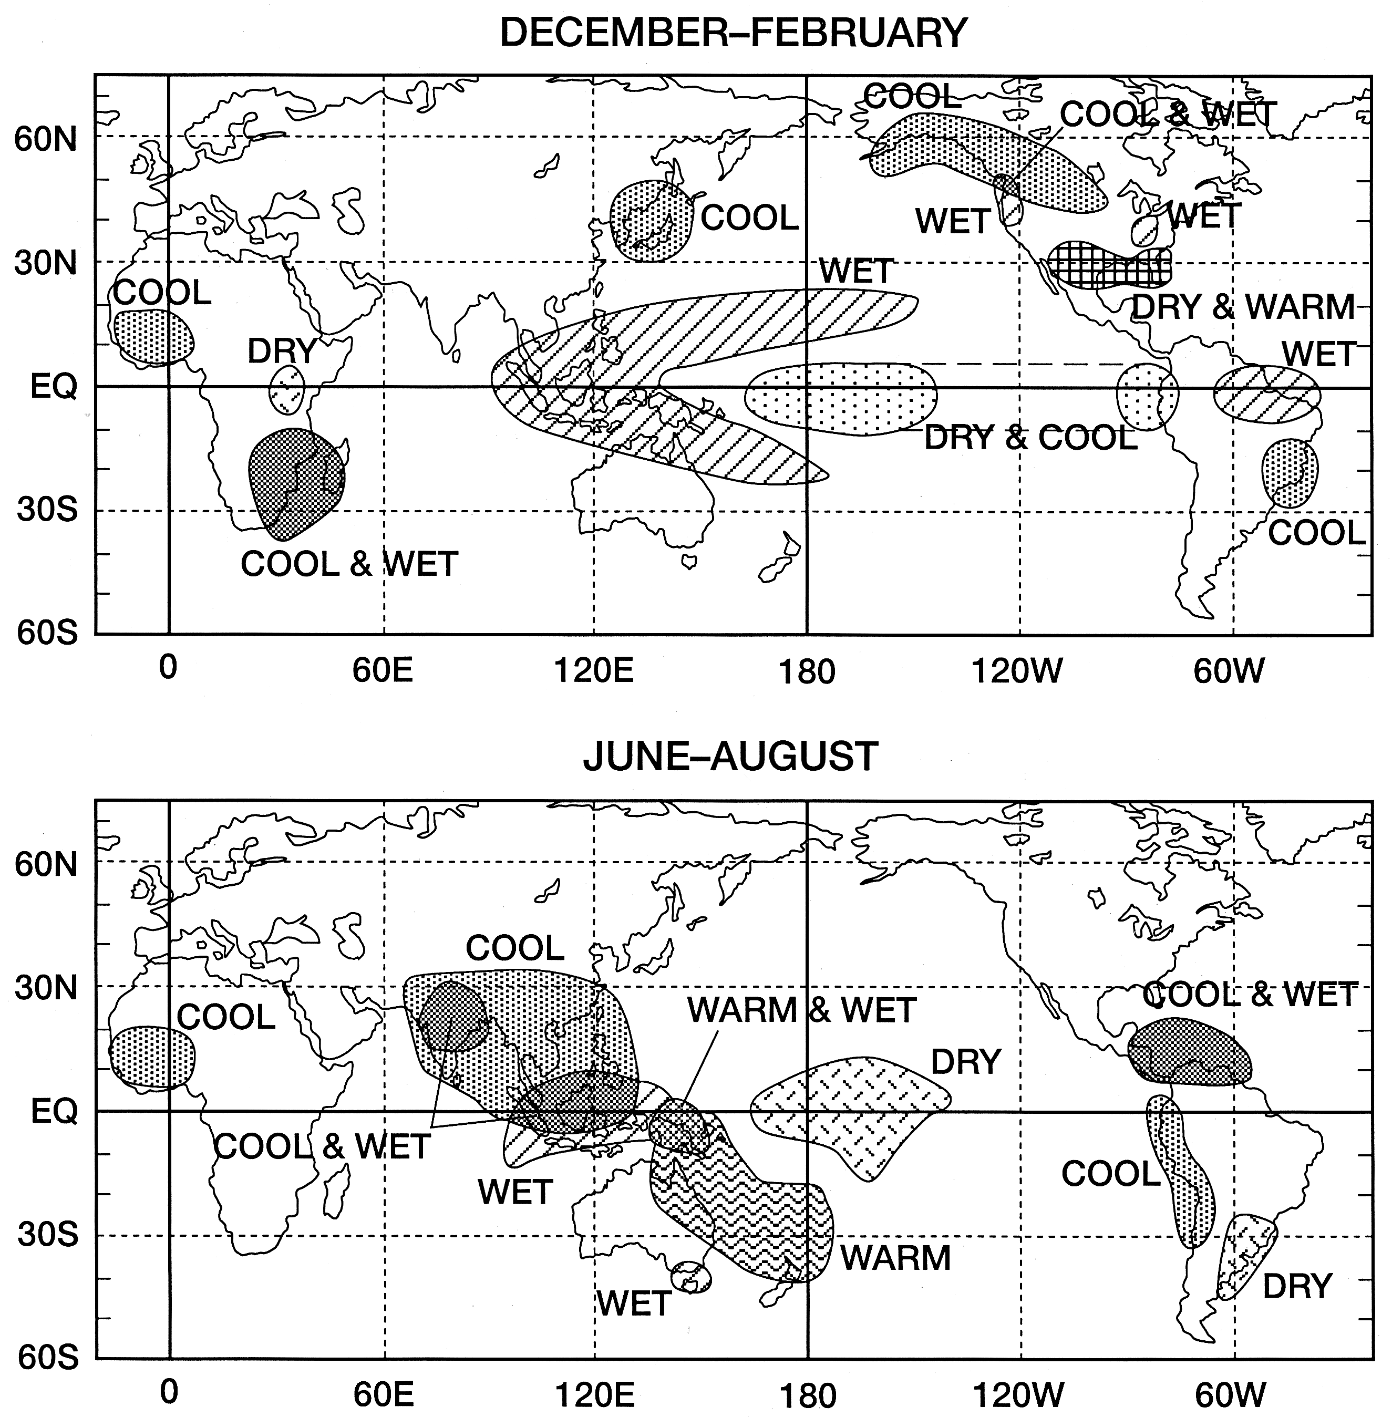
Figure 7.9
Ecological Climatology © 2008 G. Bonan

Slide 10
Figure 7.10
Ecological Climatology © 2008 G. Bonan

Slide 11
Figure 7.11
Ecological Climatology © 2008 G. Bonan

Slide 12
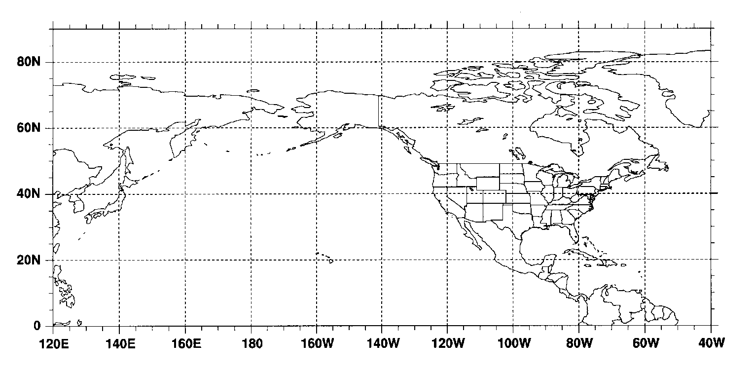
high pressure;
temperatures
above normal
Polar jet stream
north of normal
blocks cold air
Low pressure
normal Pacific jet stream
normal Polar
jet stream
strong Pacific jet stream well
south of normal directs major
storms and moisture into the
Southwest
persistent low
pressure; record
rains and floods
above normal temperatures in tropical Pacific
variable Polar jet stream strengthens
and shifts south of normal at times,
producing frequent cold and storms
variable Pacific jet stream strengthens
markedly toward the Pacific Northwest
at times, directing major storms into
the region
High
pressure
low pressure area;
heavy rains and floods
persistent high pressure
area;very dry and warm
below normal temperatures in tropical Pacific
Figure 7.12
Ecological Climatology © 2008 G. Bonan

Slide 13
(×0.1 °C)
Figure 7.13
Ecological Climatology © 2008 G. Bonan

Slide 14
Evaporation - Precipitation
(mm day⁻¹)
80N
60N
40N
20N
90W
60W
30W
0
30E
60E
Figure 7.14
Ecological Climatology © 2008 G. Bonan

Slide 15
6
4
2
NAO index
0
-2
-4
-6
1860
1880
1900
1920
1940
1960
1980
2000
Figure 7.15
Ecological Climatology © 2008 G. Bonan

