Slide 1
Precipitation (P)
Evapotranspiration (E)
Topographic Divide
Soil
Inflow
(G_{in})
Groundwater
Overland flow
(q_{over})
Bedrock
Outflow
(q_{base})
Figure 12.1
Ecological Climatology © 2008 G. Bonan

Slide 2
1400
1400
Hubbard Brook
Walker Branch
1200
1200
Streamflow
Streamflow
1000
1000
Annual Water Flux (mm)
Annual Water Flux (mm)
800
800
600
600
400
Evapotranspiration
400
Evapotranspiration
200
200
800
1000
1200
1400
1600
1800
2000
800
1000
1200
1400
1600
1800
2000
Annual Precipitation (mm)
Annual Precipitation (mm)
Figure 12.2
Ecological Climatology © 2008 G. Bonan

Slide 3
Deforested
600
Precipitation
500
400
Summer Water Flux (mm)
300
200
Streamflow
100
0
1957
1958
1959
1960
1961
1962
1963
1964
1965
1966
1967
1968
1969
Deforested
600
500
Evapotranspiration
400
Summer Water Flux (mm)
300
200
100
0
1957
1958
1959
1960
1961
1962
1963
1964
1965
1966
1967
1968
1969
Forested
Deforested
P
P
R
R
E
E
Figure 12.3
Ecological Climatology © 2008 G. Bonan

Slide 4
140
140
130
Forested
130
Deciduous
120
Deforested
120
Pine
110
110
100
100
90
90
80
80
Streamflow (mm)
Streamflow (mm)
70
70
60
60
50
50
40
40
30
30
20
20
10
10
0
0
May
Jun
Jul
Aug
Sep
Oct
Nov
Dec
Jan
Feb
Mar
Apr
May
Jun
Jul
Aug
Sep
Oct
Nov
Dec
Jan
Feb
Mar
Apr
Figure 12.4
Ecological Climatology © 2008 G. Bonan

Slide 5
Prior To Storm
Rising Hydrograph
At Peak Discharge
Percolation
Unsaturated
Overland flow
Return
flow
Base flow
Saturated
Base flow
Figure 12.5
Ecological Climatology © 2008 G. Bonan

Slide 6
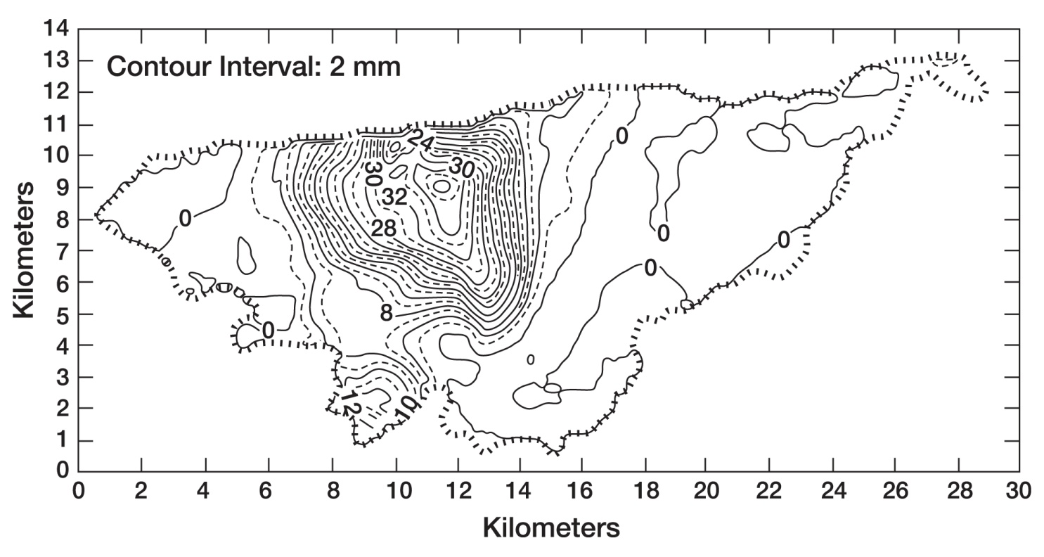
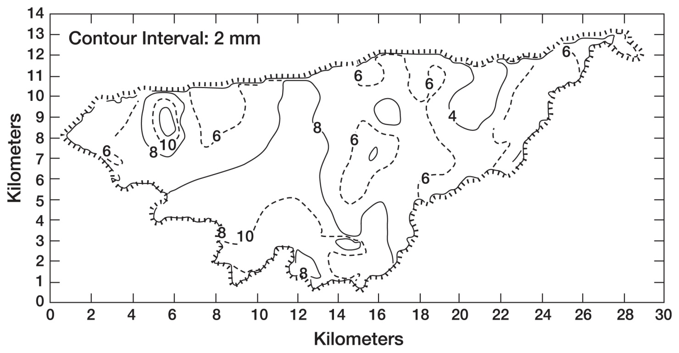
Figure 12.6
Ecological Climatology © 2008 G. Bonan

Slide 7
Figure 12.7
Ecological Climatology © 2008 G. Bonan

Slide 8
1.0
μ/P=1.2
1.0
0.9
μ/P=0.6
0.9
0.8
μ/P=0.2
0.8
0.7
0.7
μ=0.1
0.6
0.6
μ=0.3
Cumulative Probability, F(P)
Runoff Ratio (R/P)
0.5
0.5
0.4
0.4
0.3
0.3
μ=0.6
0.2
0.2
0.1
0.1
0.0
0.0
0
5
10
15
20
25
30
0
1
2
3
4
5
6
7
8
9
10
Precipitation (P)
i/P
Figure 12.8
Ecological Climatology © 2008 G. Bonan

Slide 9
0.40
Sandy loam
0.35
0.30
0.25
0.20
Runoff Ratio (R/P)
0.15
0.10
0.05
0.00
0.0
0.1
0.2
0.3
0.4
0.5
0.6
0.7
0.8
0.9
1.0
Soil Moisture (s)
1.0
Clay
0.9
0.8
0.7
0.6
0.5
Runoff Ratio (R/P)
0.4
0.3
0.2
0.1
0.0
0.0
0.1
0.2
0.3
0.4
0.5
0.6
0.7
0.8
0.9
1.0
Soil Moisture (s)
Saturation-excess runoff
Total runoff
Total runoff (gravity only)
Figure 12.9
Ecological Climatology © 2008 G. Bonan

Slide 10
350
a)
300
i = 315
i = 330
i = 260
250
200
i = 175
Water Depth (mm)
150
i = 70
100
50
0
0.05
0.05
0.10
0.20
0.60
Fractional Area
350
b)
300
250
200
Water Depth (mm)
150
100
50
0
0.05
0.05
0.10
0.20
0.60
Fractional Area
350
c)
300
250
200
Water Depth (mm)
W_{o}
150
100
ΔW
50
R
0
0.05
0.05
0.10
0.20
0.60
Figure 12.10
Fractional Area
Ecological Climatology © 2008 G. Bonan

Slide 11
B=0.05
B=0.1
B=0.2
i_{m}
i_{m} - W_{m}
W_{m} = i_{m}/(1+B)
0
1
Figure 12.11
Ecological Climatology © 2008 G. Bonan

Slide 12
i_{m}
i = i_{m}[1-(1-A)^{1/B}]
i_{o}+P
Point Infiltration Capacity, i
R
ΔW
i_{o}
W_{o}
ΔA_{s}
Fractional Area, A
A_{s}
Figure 12.12
Ecological Climatology © 2008 G. Bonan

Slide 13
cubic meters per second
J
F
M
A
M
J
J
A
S
O
N
D
J
F
M
A
M
J
J
A
S
O
N
D
10-year period
Figure 12.13
Ecological Climatology © 2008 G. Bonan

Slide 14
A
unsaturated
Stream
q_{recharge}
A_{sat}
c
D
saturated
q_{over}
q_{base}
β
Topographic Index = ln(a/tanβ)
a = A/c
A = area of hillslope segment (section of hillslope that drains past contour “c”)
A_{sat}/A = fraction of hillslope that is saturated
c = hillslope width (length perpendicular to direction of flow)
tanβ = slope
D = depth to bedrock
Figure 12.14
Ecological Climatology © 2008 G. Bonan

Slide 15
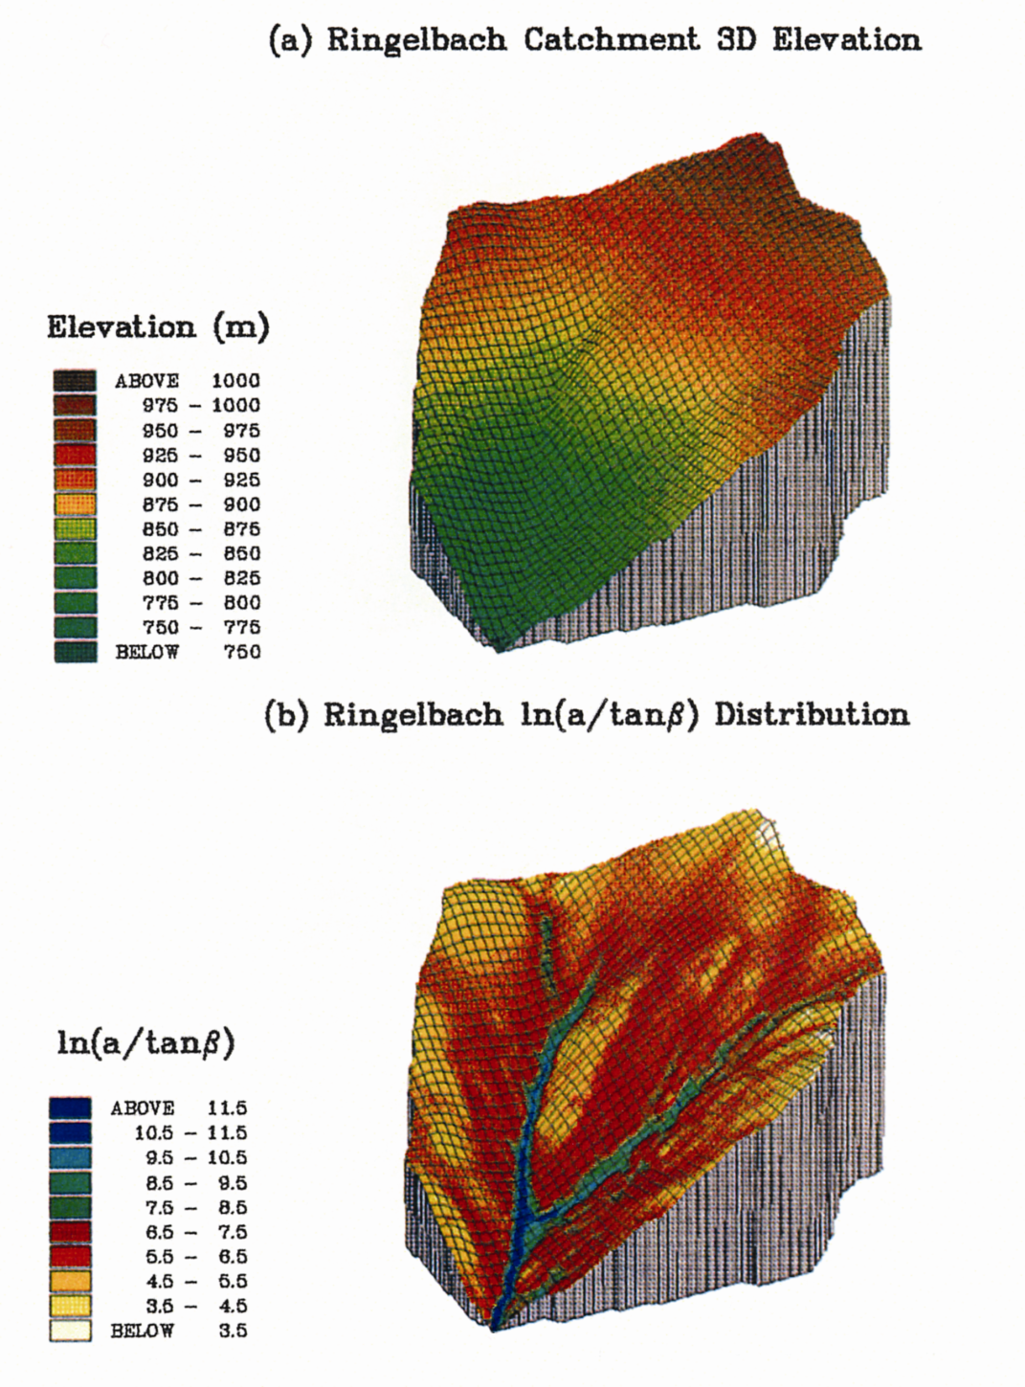
Figure 12.15
Ecological Climatology © 2008 G. Bonan

Slide 16
Peak Discharge At
Time Of Concentration
Rising
Limb
Discharge
Receding Limb
Stormflow
Base Flow
Time
Figure 12.16
Ecological Climatology © 2008 G. Bonan

Slide 18
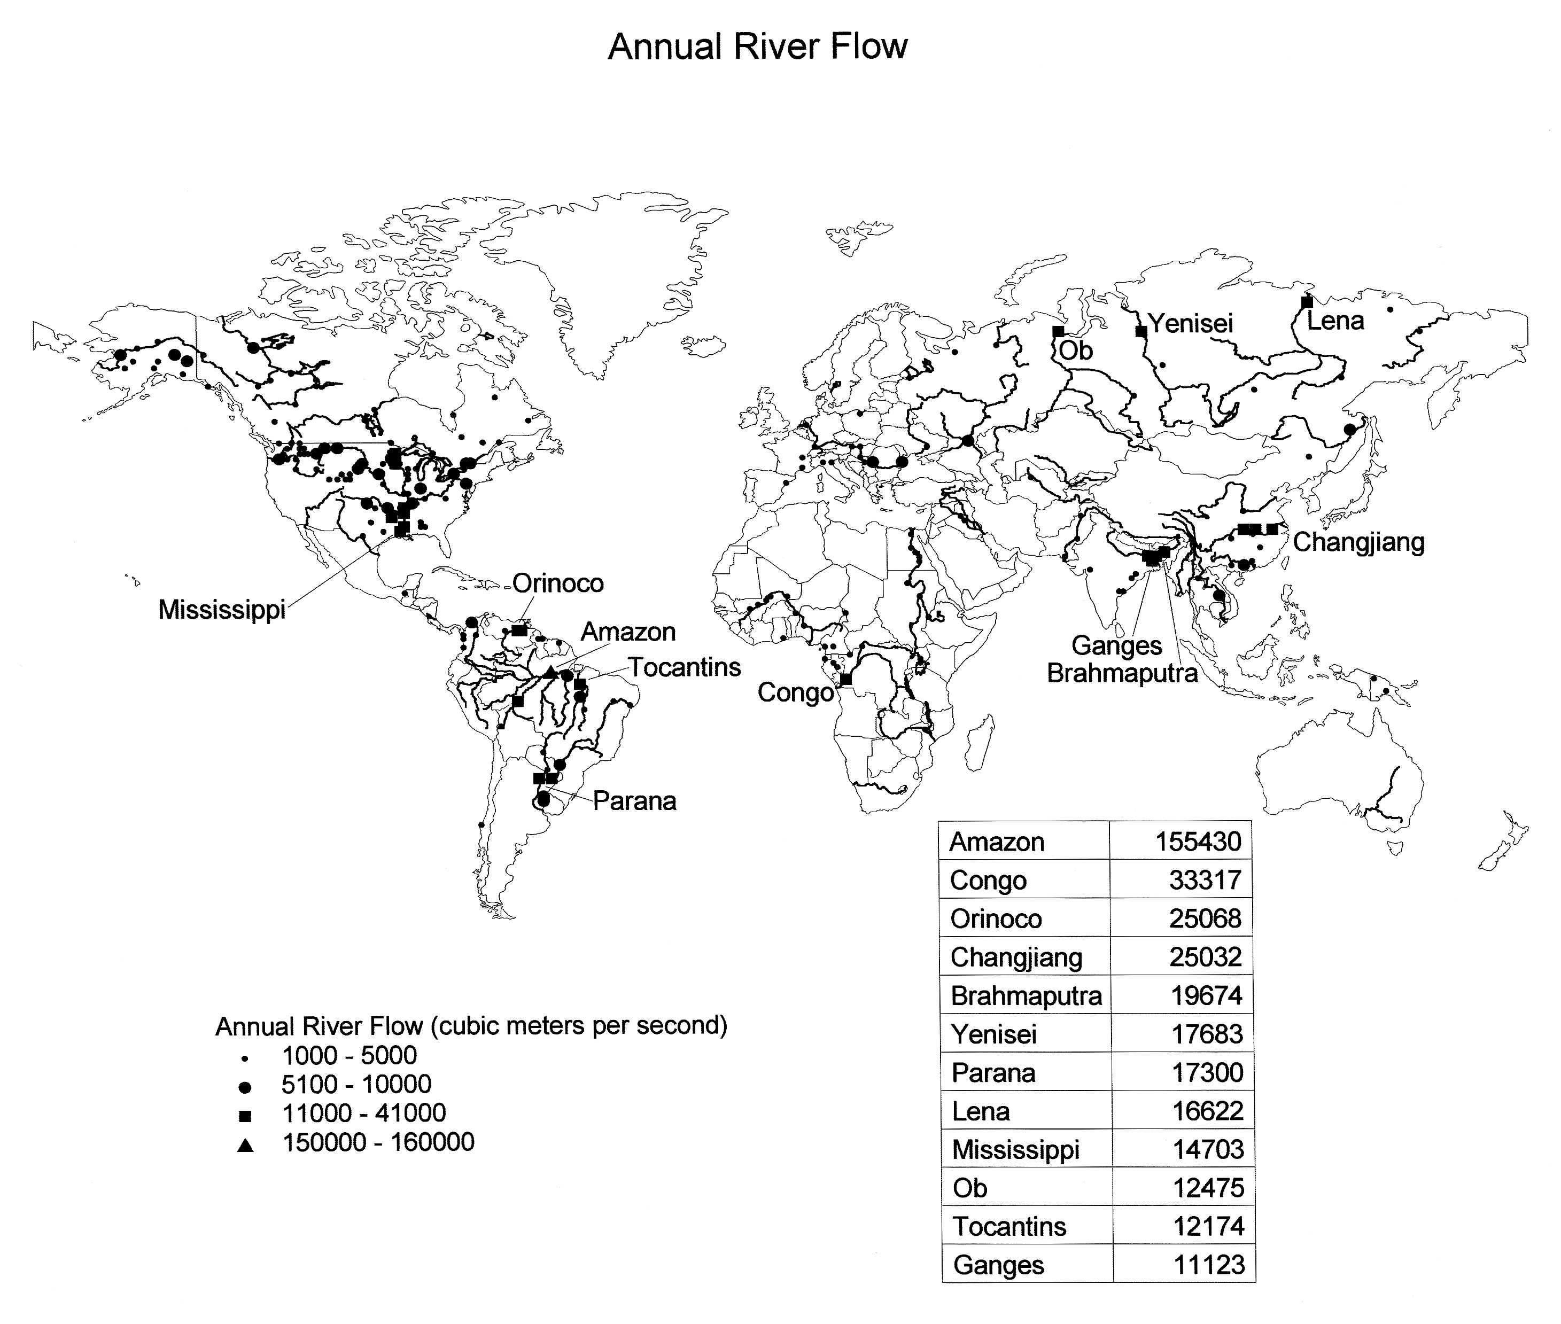
Figure 12.18
Ecological Climatology © 2008 G. Bonan

Slide 19
Figure 12.19
Ecological Climatology © 2008 G. Bonan

Slide 20
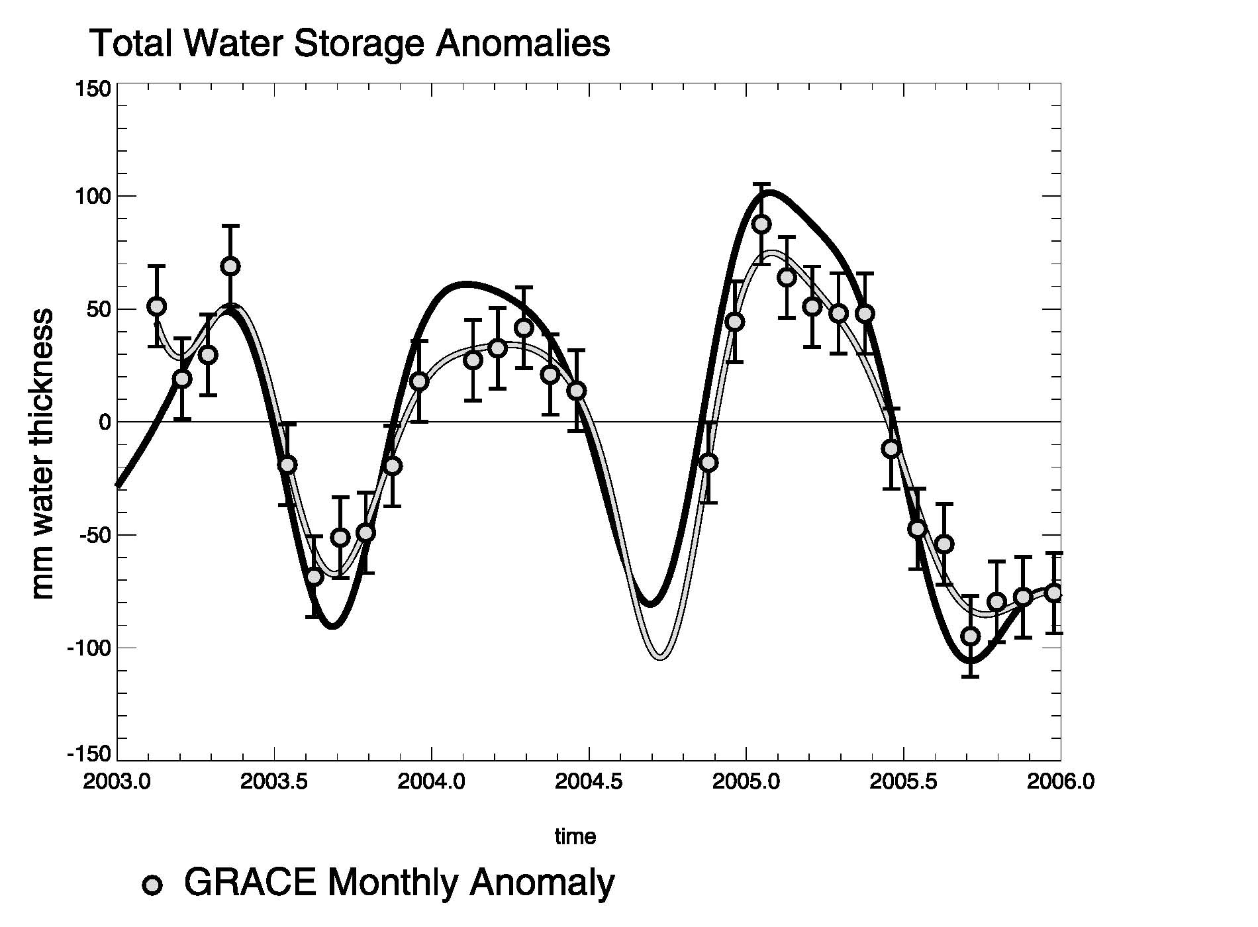
Figure 12.20
Ecological Climatology © 2008 G. Bonan

Slide 21
Figure 12.21
Ecological Climatology © 2008 G. Bonan

