Slide 1
200
200
Ocean
Land
R_{n}
H
λE
G
150
150
100
100
Energy flux (W m⁻²)
Energy flux (W m⁻²)
50
50
0
0
-50
-50
70-60 N
60-50
50-40
40-30
30-20
20-10
10-0
0-10 S
10-20
20-30
30-40
40-50
50-60
70-60 N
60-50
50-40
40-30
30-20
20-10
10-0
0-10 S
10-20
20-30
30-40
40-50
50-60
Latitude
Latitude
Figure 13.1
Ecological Climatology © 2008 G. Bonan

Slide 2
1.0
B
0.8
A
E/P
0.6
0.4
0.2
0.0
0
0.5
1
2
3
R_{n}/(λP)
Figure 13.2
Ecological Climatology © 2008 G. Bonan

Slide 3
140
140
120
120
20 W m⁻²
100
100 W m⁻²
100
40 W m⁻²
80
80 W m⁻²
80
60 W m⁻²
Annual Evaporation (cm)
Annual Runoff (cm)
60
60 W m⁻²
60
80 W m⁻²
40
40 W m⁻²
40
100 W m⁻²
20
20 W m⁻²
20
0
0
0
20
40
60
80
100
120
140
0
20
40
60
80
100
120
140
Annual Precipitation (cm)
Annual Precipitation (cm)
Figure 13.3
Ecological Climatology © 2008 G. Bonan

Slide 4
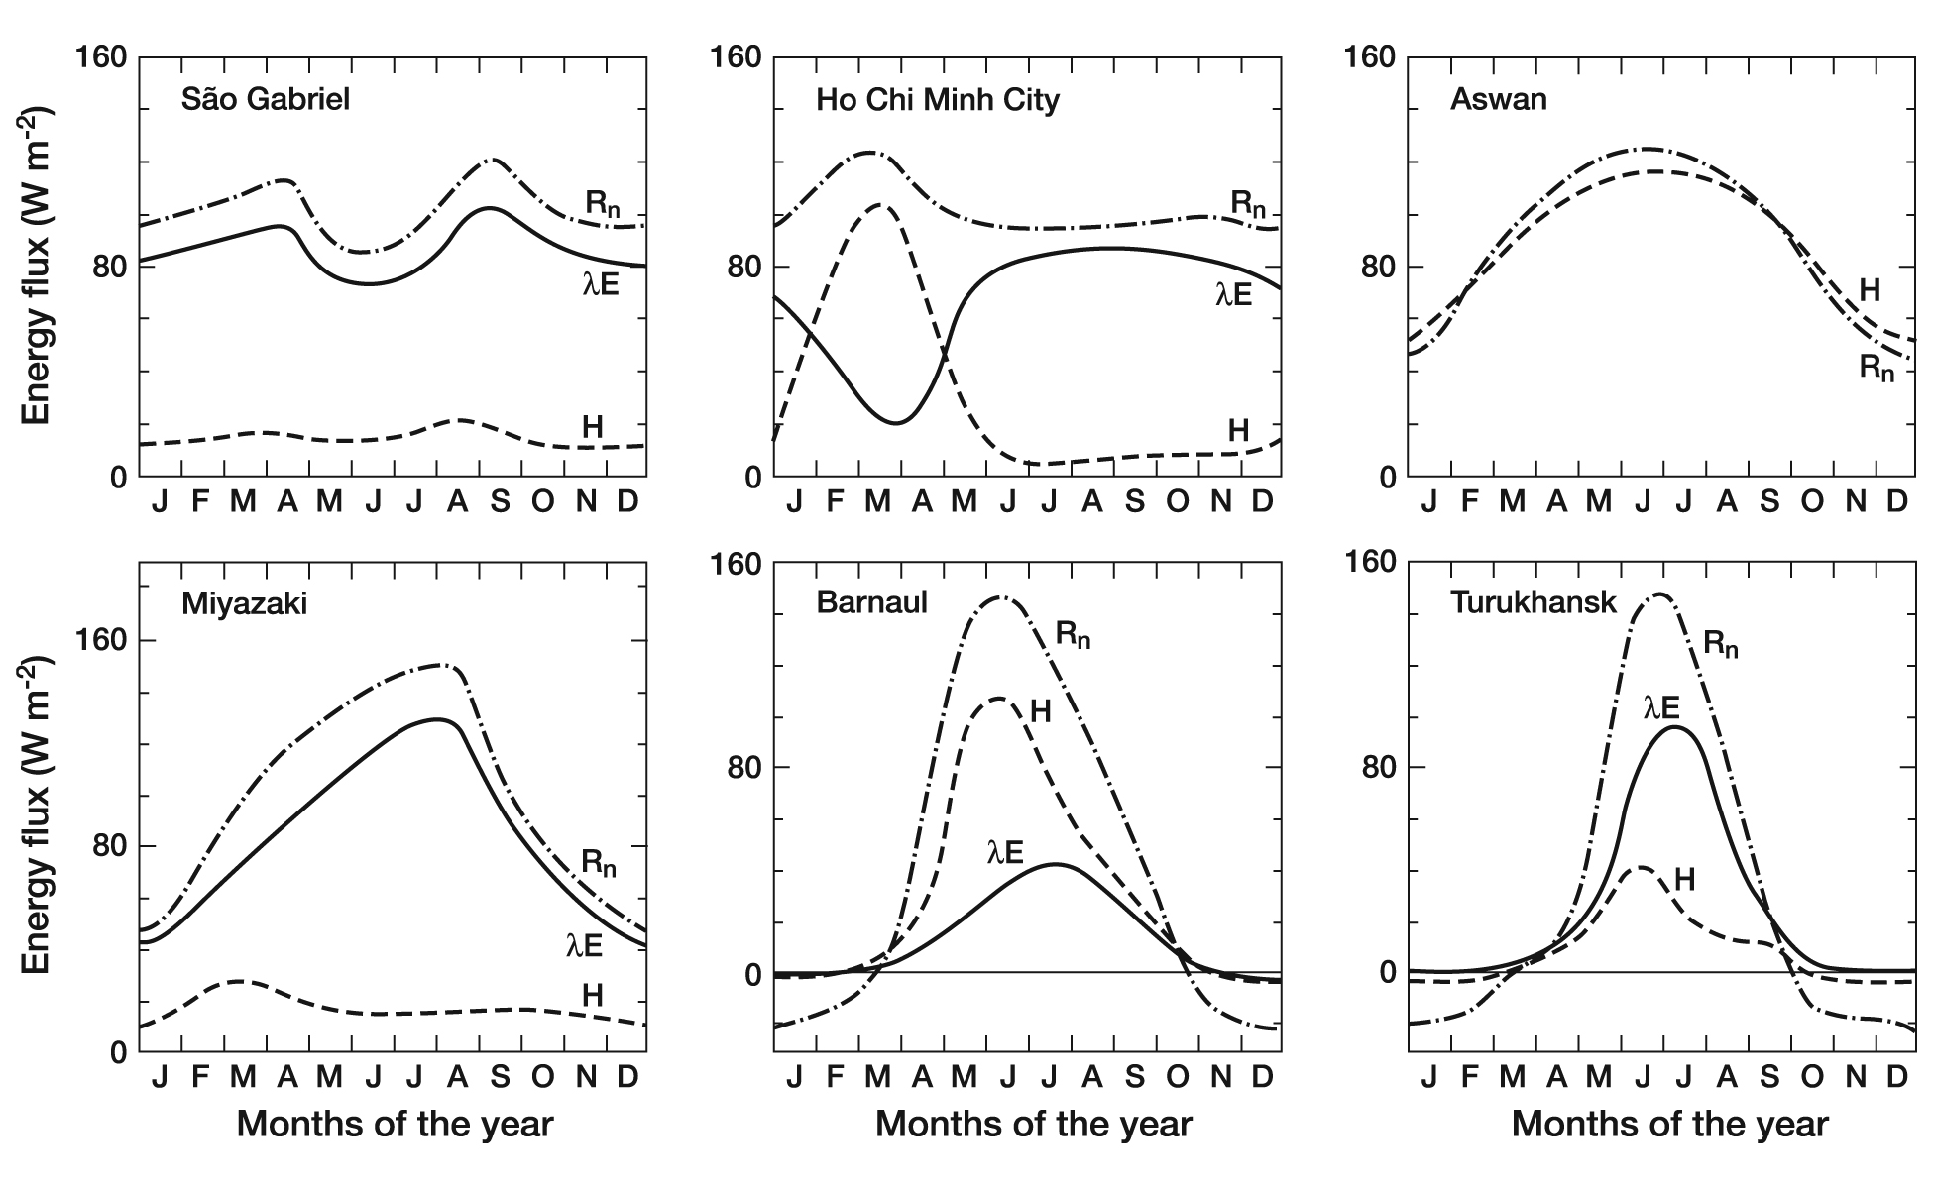
Figure 13.4
Ecological Climatology © 2008 G. Bonan

Slide 5
10
10
Net radiation
8
Precipitation
8
Evaporation
6
6
Water Flux (mm day⁻¹)
Water Flux (mm day⁻¹)
4
4
2
2
0
R_{n}
P
R_{n}
0
J
F
M
A
M
J
J
A
S
O
N
D
J
F
M
A
M
J
J
A
S
O
N
D
Month
Month
Figure 13.5
Ecological Climatology © 2008 G. Bonan

Slide 6
Precipitation (mm hour⁻¹)
Solar Radiation ( W m⁻²)
Albedo
14
1200
0.18
12
1000
0.17
10
800
0.16
8
600
0.15
6
0.14
4
400
0.13
2
200
0.12
0
0
0.11
95
96
97
98
99
100
95
96
97
98
99
100
6
7
8
9
10
11
12
13
14
15
16
17
18
19
Day of Year
Day of Year
Hour of Day
Net Radiation (W m⁻²)
Latent Heat Flux (W m⁻²)
Sensible Heat Flux (W m⁻²)
700
200
800
600
500
150
600
400
100
400
300
200
50
200
100
0
0
0
-100
-50
95
96
97
98
99
100
95
96
97
98
99
100
95
96
97
98
99
100
Day of Year
Day of Year
Day of Year
Figure 13.6
Ecological Climatology © 2008 G. Bonan

Slide 8
Southern Old Aspen, 24 May – 16 June
Southern Old Aspen, 19 July – 10 August
600
8
600
8
500
4
500
4
400
R_{n}
0
400
0
300
H
-4
300
-4
Energy Flux (W m⁻²)
Energy Flux (W m⁻²)
λE
CO₂ Flux (μmol m⁻² s⁻¹)
CO₂ Flux (μmol m⁻² s⁻¹)
200
-8
200
-8
100
CO₂
-12
100
-12
0
-16
0
-16
-100
-20
-100
-20
0
6
12
18
24
0
6
12
18
24
Hour of Day
Hour of Day
Southern Old Jack Pine, 19 July – 10 August
Northern Old Jack Pine, 19 July – 10 August
Energy Flux (W m⁻²)
Energy Flux (W m⁻²)
CO₂ Flux (μmol m⁻² s⁻¹)
CO₂ Flux (μmol m⁻² s⁻¹)
Hour of Day
Hour of Day
Figure 13.8
Ecological Climatology © 2008 G. Bonan

Slide 9
Figure 13.9
Ecological Climatology © 2008 G. Bonan

Slide 10
700
700
21 July 1993
600
29 August 1993
600
500
R_{n}
500
400
H
400
λE
G
Energy Flux (W m⁻²)
300
300
Energy Flux (W m⁻²)
200
200
100
100
0
0
-100
-100
0
3
6
9
12
15
18
21
24
0
3
6
9
12
15
18
21
24
Hour of Day
Hour of Day
Figure 13.10
Ecological Climatology © 2008 G. Bonan

Slide 11
700
Thermodynamic
600
r_{W} = 50 s m⁻¹
500
r_{W} = 100 s m⁻¹
400
Latent Heat Flux (W m⁻²)
300
200
100
0
20
22
24
26
28
30
32
34
36
Surface Temperature, T_{s} (°C)
Figure 13.11
Ecological Climatology © 2008 G. Bonan

