Slide 1
1.4
1.2
1.0
0.8
Height, z/h
0.6
0.4
0.2
0.0
-2
-1
0
1
2
0.6
0.8
1.0
Potential Temperature, θ-θ_{s} (°C)
Specific Humidity, q/q_{s}
Figure 15.1
Ecological Climatology © 2008 G. Bonan

Slide 2
500
400
300
Height (m)
200
100
0
4
6
8
10
12
14
16
Potential Temperature (°C)
Figure 15.2
Ecological Climatology © 2008 G. Bonan

Slide 3
1000
Height (m)
Mixed layer
500
Weak mixed layer
Weak mixed layer
0
Inversion
Inversion
0
0600
1200
1800
2400
Sunrise
Time of Day
Sunset
Figure 15.3
Ecological Climatology © 2008 G. Bonan

Slide 4
High
Maximum
1600
Temperature
Minimum
0600
Low
High
Solar
Radiation
Outgoing
Longwave
Radiation
Radiation
Low
Midnight
0600
Sunrise
Noon
1800
Sunset
Figure 15.4
Ecological Climatology © 2008 G. Bonan

Slide 5
1200
34
1000
32
30
800
28
26
Solar Radiation (W m⁻²)
Temperature (°C)
600
24
400
22
20
200
18
16
0
14
23-Jul-97
24-Jul-97
25-Jul-97
26-Jul-97
27-Jul-97
28-Jul-97
29-Jul-97
30-Jul-97
31-Jul-97
1-Aug-97
23-Jul-97
24-Jul-97
25-Jul-97
26-Jul-97
27-Jul-97
28-Jul-97
29-Jul-97
30-Jul-97
31-Jul-97
1-Aug-97

Slide 6
700
700
40
600
R_{n}
600
R_{n}
H
H
500
λE
500
λE
G
G
35
400
400
Energy Flux (W m⁻²)
300
300
Energy Flux (W m⁻²)
Temperature (°C)
200
200
30
100
100
0
0
25
Air temperature
-100
-100
Wet surface
-200
-200
20
Dry surface
0000
0300
0600
0900
1200
1500
1800
2100
2400
0000
0300
0600
0900
1200
1500
1800
2100
2400
0000
0300
0600
0900
1200
1500
1800
2100
2400
Time Of Day
Time Of Day
Time Of Day
Figure 15.6
Ecological Climatology © 2008 G. Bonan

Slide 7
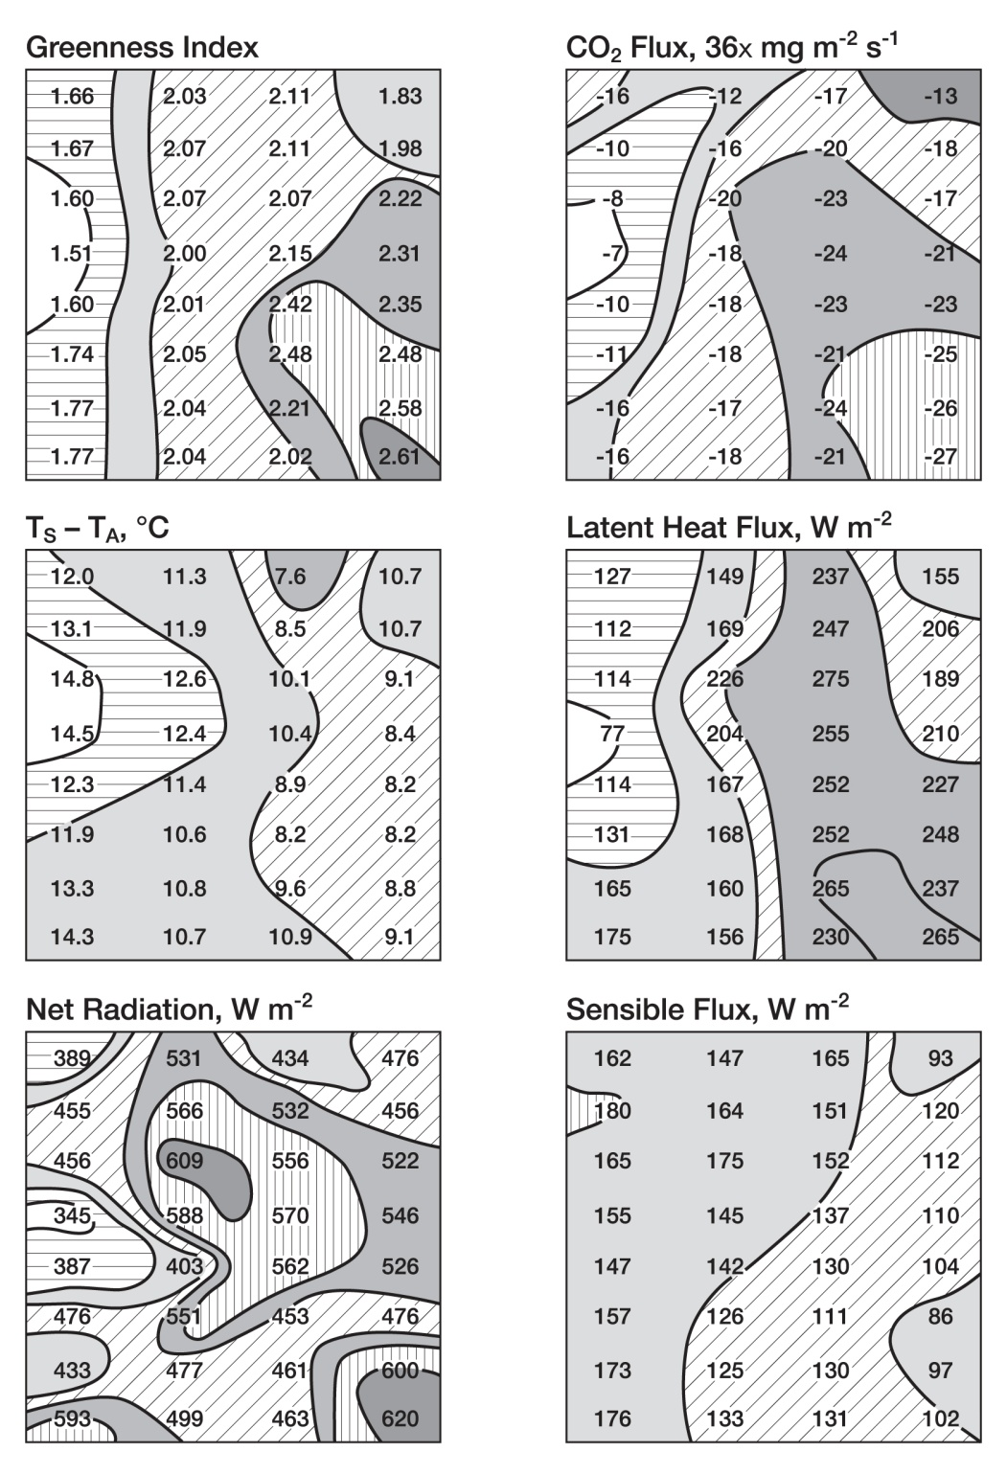
Figure 15.7
Ecological Climatology © 2008 G. Bonan

Slide 8
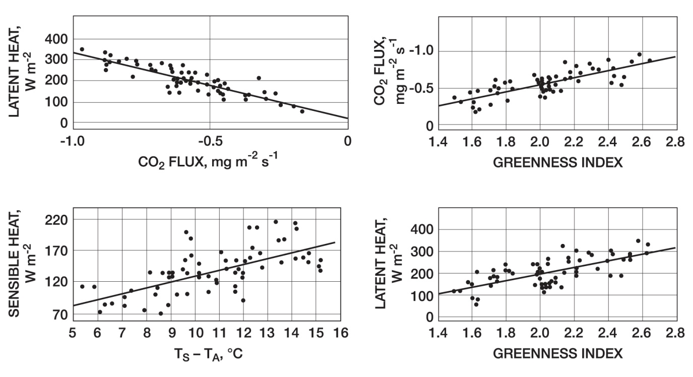
Figure 15.8
Ecological Climatology © 2008 G. Bonan

Slide 9
700
SM = 0.130
400
SM = 0.130
600
SM = 0.157
SM = 0.157
SM = 0.234
SM = 0.234
λE
500
300
400
300
200
Net Radiation (W m⁻²)
Heat Flux (W m⁻²)
H
200
100
100
0
0
-100
-100
0
0400
0800
1200
1600
2000
2400
0
0400
0800
1200
1600
2000
2400
Time Of Day (Hours)
Time Of Day (Hours)
1.0
SM = 0.130
314
SM = 0.130
SM = 0.157
SM = 0.157
0.9
SM = 0.234
312
SM = 0.234
800 hPa
310
0.8
308
Evaporative Fraction, λE/(H+λE)
306
Potential Temperature (K)
0.7
304
360 K
302
300
350 K
0.6
298
965 hPa
296
0.5
1200
1400
1600
1800
2000
2200
2400
12
13
14
15
16
17
18
Time Of Day (Hours)
Mixing Ratio (g kg⁻¹)
Figure 15.9
Ecological Climatology © 2008 G. Bonan

Slide 10
250
200
150
Lifting Condensation Level Pressure (hPa)
100
SM = 0.134
50
SM = 0.173
SM = 0.212
SM = 0.258
0
1100
1300
1500
1700
1900
2100
2300
Time Of Day (Hours)
Figure 15.10
Ecological Climatology © 2008 G. Bonan

Slide 11
Temperature Difference
(°C)
5000
Humidity Difference
(0.0001 g kg⁻¹)
5000
3
4000
0
4000
9
-1
0
0
15
3000
3000
3
Height (m)
0
Height (m)
0
2000
1
2000
-3
2
-9
1000
3
1000
-15
0
4
0
0
100
200
300
400
500
600
700
0
100
200
300
400
500
600
700
Distance (km)
Distance (km)
Contour From -1 To 4 By 1
Contour From -15 To 15 By 3
5000
Horizontal Wind Difference
(m s⁻¹)
5000
Vertical Velocity Difference
(cm s⁻¹)
4000
0
4000
0
2
0
2
0
2
4
3000
-2
0
3000
-2
4
Height (m)
Height (m)
0
2000
2000
-4
6
0
-4
-2
0
1000
2
1000
0
4
-2
0
0
100
200
300
400
500
600
700
0
100
200
300
400
500
600
700
Distance (km)
Distance (km)
Contour From -3 To 4 By 1
Contour From -6 To 10 By 2
Figure 15.11
Ecological Climatology © 2008 G. Bonan

