Slide 1
4500
4000
3500
tropical
rain forest
3000
temperate
rain forest
2500
Annual Precipitation (mm)
tropical
seasonal
forest
2000
temperate
forest
1500
boreal
forest
1000
thorn scrub
savanna
woodland
500
shrubland
grassland
desert
tundra
0
30
25
20
15
10
5
0
-5
-10
-15
Annual Mean Temperature (°C)
Figure 24.1
Ecological Climatology © 2008 G. Bonan

Slide 2
140
120
Tropical
100
Wet savanna
Savanna
80
Subtropical
Annual Net Radiation, R_{n} (W m⁻²)
Forest
Steppe
60
Mid-latitude
deciduous
Steppe, prairie
Semidesert
40
Desert
20
Needleleaf
0
Tundra
0.0
0.5
1.0
1.5
2.0
2.5
3.0
Radiative Dryness Index (R_{n}/λP)
Figure 24.2
Ecological Climatology © 2008 G. Bonan

Slide 3
0.125
62.5
0.25
125
0.50
250
Latitudinal
Regions
Altitudinal
Regions
polar
1.00
500
nival
Potential Evapotranspiration Ratio
1.5
1.5
Annual Precipitation (mm)
subpolar
2.00
dry
tundra
moist
tundra
wet
tundra
rain
tundra
1000
alpine
3
2000
3
boreal
4.00
desert
dry
scrub
moist
forest
wet
forest
rain
forest
subalpine
6
6
Annual Mean Biotemperature (ºC)
8.00
4000
cool
temperate
desert
desert
scrub
steppe
moist
forest
wet
forest
rain
forest
montane
12
12
16.00
desert
scrub
thorn
woodland
dry
forest
moist
forest
wet
forest
rain
forest
8000
lower
montane
warm temperate
or subtropical
desert
24
desert
scrub
thorn
woodland
very dry
forest
dry
forest
moist
forest
wet
forest
rain
forest
24
32.00
desert
tropical
superarid
perarid
arid
semiarid
subhumid
humid
perhumid
superhumid
32.00
16.00
8.00
4.00
2.00
1.00
0.50
0.25
0.125
Figure 24.3
Ecological Climatology © 2008 G. Bonan

Slide 4
3000
2500
2000
1500
NPP (g m⁻² yr⁻¹)
1000
500
0
-15
-10
-5
0
5
10
15
20
25
30
Annual Mean Temperature (°C)
3000
2500
2000
1500
NPP (g m⁻² yr⁻¹)
1000
500
0
0
500
1000
1500
2000
2500
3000
3500
4000
Annual Precipitation (mm)
3000
2500
2000
1500
NPP (g m⁻² yr⁻¹)
1000
500
0
0
200
400
600
800
1000
1200
1400
Figure 24.4
Annual Evapotranspiration (mm)
Ecological Climatology © 2008 G. Bonan

Slide 5
Figure 24.5
Ecological Climatology © 2008 G. Bonan

Slide 6
Figure 24.6
Ecological Climatology © 2008 G. Bonan

Slide 7
1600
800
Minimum Precipitation (mm yr⁻¹)
Vegetation Height
400
200
0
1
2
3
5
9
Desert
Grass
Shrub
Savanna
Temperate Forest
Tropical Forest
Leaf Area Index (m² m⁻²)
Figure 24.7
Ecological Climatology © 2008 G. Bonan

Slide 8
Cumulative Root Fraction
0.00
0.25
0.50
0.75
1.00
0.00
0.25
0.50
0.75
1.00
0.00
0.25
0.50
0.75
1.00
0
0
0
50
50
50
100
Tundra
30 cm: 93%
Deepest: 0.5 m
Root-to-Shoot: 6.6
100
Boreal Forest
30 cm: 83%
Deepest: 2.0 m
Root-to-Shoot: 0.32
100
Temperate Grassland
30 cm: 83%
Deepest: 2.6 m
Root-to-Shoot: 3.7
150
150
150
200
200
200
0.00
0.25
0.50
0.75
1.00
0.00
0.25
0.50
0.75
1.00
0.00
0.25
0.50
0.75
1.00
0
0
0
50
50
50
Soil Depth (cm)
100
Tropical Decid. Forest
30 cm: 70%
Deepest: 3.7 m
Root-to-Shoot: 0.34
100
Tropical Ever. Forest
30 cm: 69%
Deepest: 7.3 m
Root-to-Shoot: 0.19
100
Temp. Decid. Forest
30 cm: 65%
Deepest: 2.9 m
Root-to-Shoot: 0.23
150
150
150
200
200
200
0.00
0.25
0.50
0.75
1.00
0.00
0.25
0.50
0.75
1.00
0.00
0.25
0.50
0.75
1.00
0
0
0
50
50
50
100
Tropical Savanna
30 cm: 57%
Deepest: 15.0 m
Root-to-Shoot: 0.7
100
Desert
30 cm: 53%
Deepest: 9.5 m
Root-to-Shoot: 0.7, 4.5
100
Temp. Conif. Forest
30 cm: 52%
Deepest: 3.9 m
Root-to-Shoot: 0.18
150
150
150
200
200
200
Figure 24.8
Ecological Climatology © 2008 G. Bonan

Slide 9
1000
Broadleaf deciduous
1000
Broadleaf deciduous
900
Broadleaf evergreen
900
Broadleaf evergreen
800
Needleleaf deciduous
800
Needleleaf deciduous
700
Needleleaf evergreen
700
Needleleaf evergreen
600
600
Litterfall (g m⁻² yr⁻¹)
Litterfall (g m⁻² yr⁻¹)
500
500
400
400
300
300
200
200
100
100
0
0
0
5
10
15
20
25
30
0
500
1000
1500
2000
2500
3000
Annual Mean Temperature (°C)
Annual Precipitation (mm)
Figure 24.9
Ecological Climatology © 2008 G. Bonan

Slide 10
100
90
80
Mass Remaining (%)
70
60
50
-10
-5
0
5
10
15
20
25
30
Annual Mean Temperature (°C)
100
Desert
90
Grassland
Agriculture
80
Marsh
Mass Remaining (%)
Tundra
70
Broadleaf forest
60
Conifer forest
50
Tropical forest
0
1000
2000
3000
4000
Annual Precipitation (mm)
100
90
80
Mass Remaining (%)
70
60
50
0
250
500
750
1000
1250
1500
Figure 24.10
Annual Evapotranspiration (mm)
Ecological Climatology © 2008 G. Bonan

Slide 11
Boreal Forest
Deciduous Forest
0
2
4
6
8
Thousands Of Years Before Present
10
12
14
16
Fir
Pine
Oak
Ash
Spruce
Hickory
Hornbeam
0
25
50
75
100
Pollen (%)
Figure 24.11
Ecological Climatology © 2008 G. Bonan

Slide 12
Figure 24.12
Ecological Climatology © 2008 G. Bonan

Slide 13
Figure 24.13
Ecological Climatology © 2008 G. Bonan

Slide 14
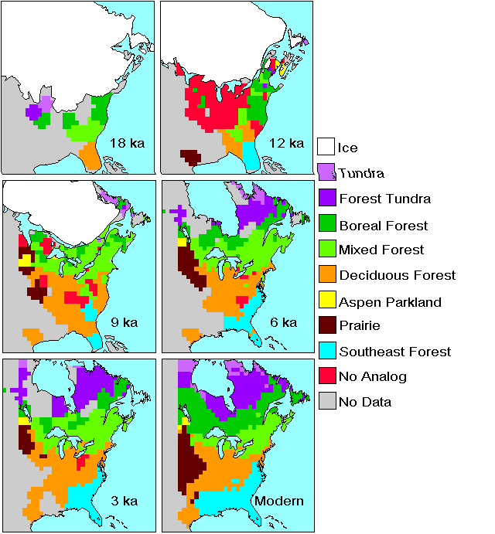
18000
12000
Ice
Tundra
Forest Tundra
Boreal Forest
Mixed Forest
Deciduous Forest
Aspen Parkland
9000
6000
Prairie
Southeast Forest
No Analog
No Data
3000
Modern
Figure 24.14
Ecological Climatology © 2008 G. Bonan

Slide 15
Mean January Temperature (°C)
-12
-30
-18
-30
-24
-24
-12
-24
-12
-18
-18
-18
-18
-12
-12
-18
-12
-12
-6
-12
-12
-12
-6
0
-6
0
6
-6
-12
-6
-18
-12
-6
-6
12
0
0
-6
0
6
0
6
12
0
6
6
Mean July Temperature (°C)
8
12
8
12
8
12
20
16
12
16
16
12
16
16
20
20
20
16
16
24
24
24
24
16
16
20
24
20
28
24
20
20
28
24
28
24
24
28
Annual Precipitation (mm)
800
600
800
400
600
800
400
1000
600
400
600
800
400
1000
600
1000
800
600
800
600
1000
800
600
800
600
800
1000
600
1200
1200
800
600
800
800
1200
1000
1400
1000
1000
800
1000
1000
1000
1200
1400
1400
1200
1200
800
1400
18 000
15 000
12 000
9000
6000
3000
Present
Figure 24.15
Ecological Climatology © 2008 G. Bonan

Slide 16
Figure 24.16
Ecological Climatology © 2008 G. Bonan

Slide 17
Spruce Migration
Thousand Years BP
Oak Migration
Thousand Years BP
10
8
10
11
7
11
8
9
9
12
12
10
13
11
10
14
13
12
15
14
15
13
11
14
12
14
15
12
13
14
15
400 km
400 km
Contour From 10 To 15 By 1
Contour From 7 To 15 By 1
Figure 24.17
Ecological Climatology © 2008 G. Bonan

Slide 18
Photosynthesis
0.5
Foliage
0.01
Sapwood
0.3
Root
6
Growth
Respiration
μg CO₂ g⁻¹ s⁻¹
μg CO₂ g⁻¹ s⁻¹
μg CO₂ g⁻¹ s⁻¹
4
0
0
0
μg CO₂ g⁻¹ s⁻¹
-10
25
60
-10
25
60
-10
25
60
2
Temperature (°C)
Temperature (°C)
Temperature (°C)
0
0
500
1000
0
15
30
Autotrophic
Respiration
PPFD
(μmol m⁻² s⁻¹)
Temperature
(°C)
6
Foliage
4
μg CO₂ g⁻¹ s⁻¹
2
Litterfall
0
0
-1
-2
0
500
1000
Heterotrophic
Respiration
Foliage Water
Potential (MPa)
Ambient
CO₂ (ppm)
Stem
6
8
1
4
Root
μg CO₂ g⁻¹ s⁻¹
2
Relative Rate
Relative Rate
0
0
1500
3000
0
1
2
1
0
Vapor Pressure
Deficit (Pa)
Foliage
Nitrogen (%)
Nutrient
Uptake
0
15
30
0
100
Temperature
(°C)
Soil Water
(% saturation)
Mineralization
Soil Carbon
Figure 24.18
Ecological Climatology © 2008 G. Bonan

Slide 19
Niwot Ridge, CO
Metolius, OR
Duke Forest, NC
120
120
120
100
100
100
80
80
80
ET (mm month⁻¹)
60
60
60
40
40
40
20
20
20
0
0
0
0
2
4
6
8
10
12
0
2
4
6
8
10
12
0
2
4
6
8
10
12
Month
Month
Month
-250
-250
-250
-200
-200
-200
-150
-150
-150
GPP (g C m⁻² month⁻¹)
-100
-100
-100
-50
-50
-50
0
0
0
0
2
4
6
8
10
12
0
2
4
6
8
10
12
0
2
4
6
8
10
12
Month
Month
Month
Figure 24.19
Ecological Climatology © 2008 G. Bonan

Slide 20
1100
1000
900
800
Evapotranspiration (mm yr⁻¹)
700
600
500
400
Watershed
covariance
BGC++
BIOME-BGC
CANOAK
EALCO
ecosys
LaRS
LoTEC
PnET-II
Eddy
INTRASTAND
-1000
-800
-600
Net Ecosystem Production (g C m⁻² yr⁻¹)
-400
-200
0
200
Biometric
covariance
BGC++
BIOME-BGC
CANOAK
EALCO
ecosys
LaRS
LoTEC
PnET-II
Eddy
INTRASTAND
Figure 24.20
Ecological Climatology © 2008 G. Bonan

Slide 21
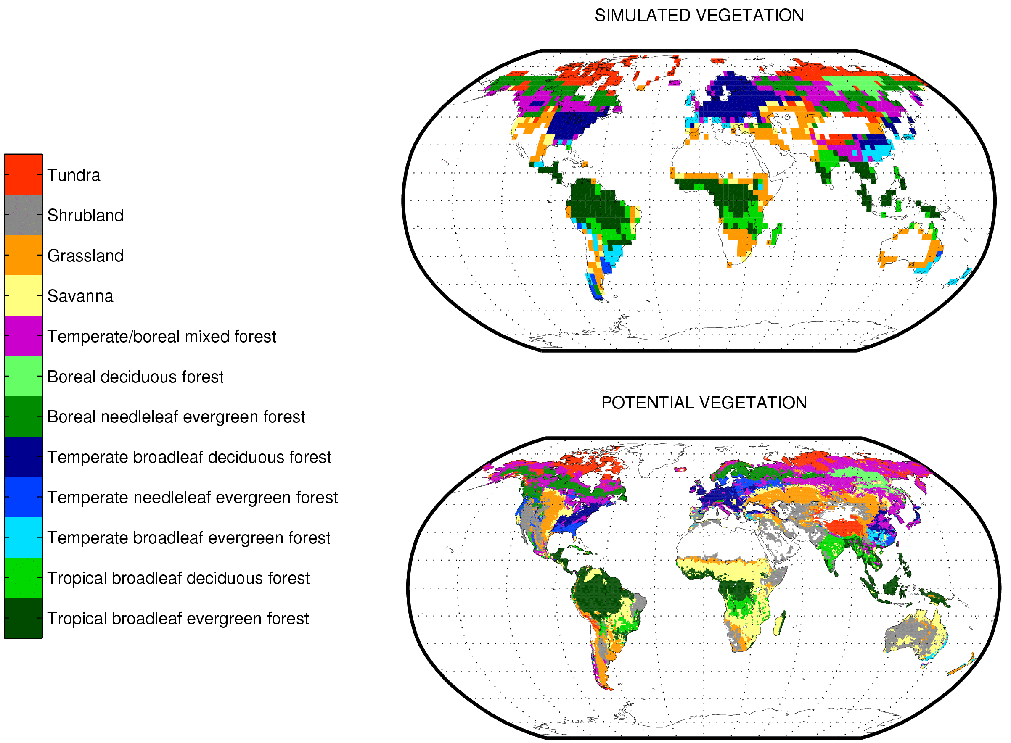
Figure 24.21
Ecological Climatology © 2008 G. Bonan

Slide 22
100
80
60
Percent Cover (%)
Arctic grass
40
Boreal deciduous tree
Boreal needleleaf evergreen tree
20
0
0
200
400
600
800
1000
Years
Figure 24.22
Ecological Climatology © 2008 G. Bonan

