Slide 1
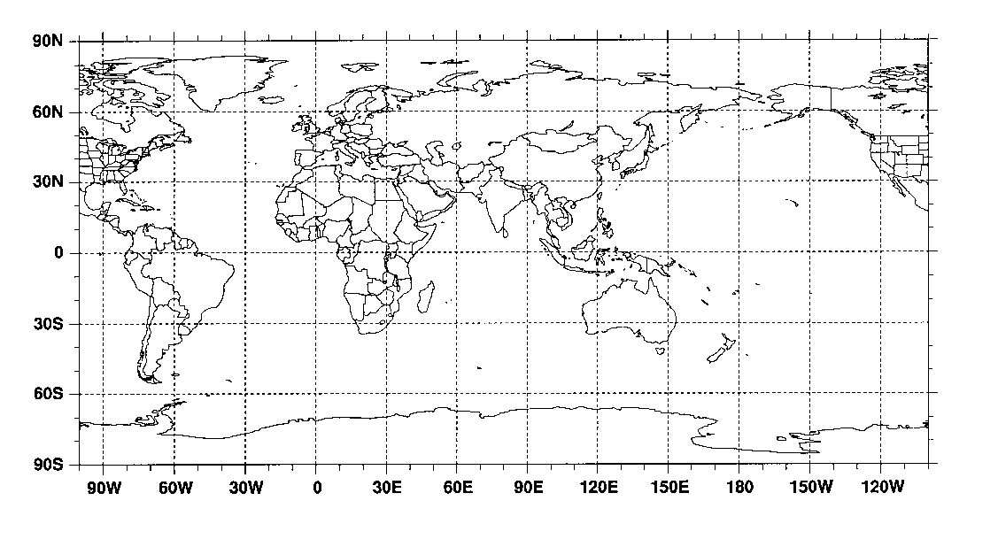
365
355
345
Alert (82°45′N, 62°52′W)
365
355
345
Mould Bay (76°25′N, 119°35′W)
365
355
345
Barrow (71°32′N, 156°60′W)
365
355
A
B
MB
345
Cold Bay (55°20′N, 162°72′W)
365
CB
CM
355
CK
345
Cape Meares (45°48′N, 123°97′W)
CI
365
Atmospheric Carbon Dioxide Concentration (parts per million)
355
S
345
Cape Kumukahi (19°52′N, 154°82′W)
CG
365
355
PS
SP
345
Christmas Island (1°70′N, 157°17′W)
365
355
345
Samoa (14°24′S, 170°57′W)
365
355
345
Cape Grim (40°68′S, 144°68′E)
365
355
345
Palmer Station (64°92′S, 64°00′W)
365
355
345
South Pole (89°98′S, 24°80′W)
1986
1987
1988
1989
1990
1991
1992
Figure 29.1
Ecological Climatology © 2008 G. Bonan

Slide 2
14
100
12
90
10
80
8
70
Amplitude (ppm)
Contribution To Amplitude (%)
6
60
4
50
2
40
Percent
Amplitude
0
30
90
60
30
0
-30
-60
-90
Latitude (degrees North)
Figure 29.2
Ecological Climatology © 2008 G. Bonan

Slide 3
60
60
Grass/savanna
Boreal forest
Crop
50
Deciduous/mixed forest
50
Tundra
Tropical forest
Shrub/desert
40
40
Contribution To Terrestrial Component (%)
30
30
20
20
10
10
0
0
90
60
30
0
-30
-60
-90
90
60
30
0
-30
-60
-90
Latitude (degrees N)
Latitude (degrees N)
Figure 29.3
Ecological Climatology © 2008 G. Bonan

Slide 4
3
3
2
2
1
1
0
Multivariate ENSO Index (MEI)
CO₂ Growth Rate Anomaly (Pg C yr⁻¹)
0
NPP Anomaly (Pg C yr⁻¹)
-1
-1
-2
-2
-3
NPP
CO₂
MEI
-3
1982
1984
1986
1988
1990
1992
1994
1996
1998
Figure 29.4
Ecological Climatology © 2008 G. Bonan

Slide 5
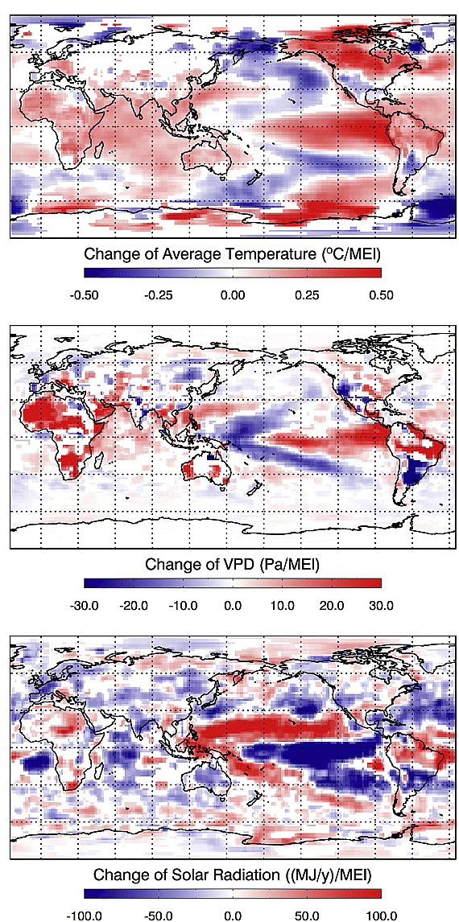
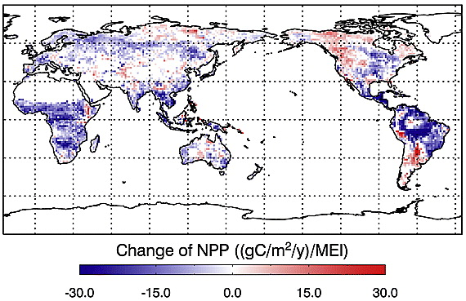
Figure 29.5
Ecological Climatology © 2008 G. Bonan

Slide 6
1.29
1.28
NPP_{[550]} / NPP_{[376]} = 1.18 + 55 / NPP _{[376]}
1.27
1.26
1.25
NPP Elevated / NPP Ambient
1.24
1.23
1.22
1.21
1.20
500
1000
1500
2000
2500
Ambient NPP (g C m⁻² yr⁻¹)
Figure 29.6
Ecological Climatology © 2008 G. Bonan

Slide 7
1.6
A_{sat}
1.4
1.2
Response (elevated / ambient)
1.0
0.8
0.6
All
C₃
C₄
Tree
Shrub
C₃
Forb
1.6
Grass
g_{s}
1.4
1.2
Response (elevated / ambient)
1.0
0.8
0.6
All
Tree
Shrub
C₃
C₄
Forb
Grass
Grass
1.6
ANPP
1.4
1.2
Response (elevated / ambient)
1.0
0.8
0.6
Figure 29.7
All
C₃
C₄
Tree
C₄
C₃
C₄
crop
grass
grass
Ecological Climatology © 2008 G. Bonan

Slide 8
80
60
Carbon (Mg C ha⁻¹)
40
Live aboveground carbon
20
Wood products
Other carbon pools
0
0
10
20
30
40
50
60
Years
60
40
Carbon Flux (Mg C ha⁻¹ yr⁻¹)
20
Source
0
Sink
0
10
20
30
40
50
60
Years
Figure 29.8
Ecological Climatology © 2008 G. Bonan

Slide 9
1.2
North America
1.2
Europe
1.0
1.0
0.8
0.8
0.6
0.6
Annual Carbon Flux (Pg C yr⁻¹)
0.4
0.4
0.2
0.2
0.0
0.0
-0.2
-0.2
1840
1860
1880
1900
1920
1940
1960
1980
2000
1840
1860
1880
1900
1920
1940
1960
1980
2000
1.2
1.2
1.0
Tropical America
1.0
Tropical Africa
0.8
0.8
Ecological Climatology © 2008 G. Bonan
0.6
0.6
Annual Carbon Flux (Pg C yr⁻¹)
0.4
0.4
0.2
0.2
0.0
0.0
-0.2
-0.2
1840
1860
1880
1900
1920
1940
1960
1980
2000
1840
1860
1880
1900
1920
1940
1960
1980
2000
1.2
2.5
Tropical Asia
Global
1.0
2.0
0.8
0.6
1.5
Annual Carbon Flux (Pg C yr⁻¹)
0.4
1.0
0.2
0.0
0.5
Figure 29.9
-0.2
0.0
1840
1860
1880
1900
1920
1940
1960
1980
2000
1840
1860
1880
1900
1920
1940
1960
1980
2000

Slide 10
0.4
0.3
0.2
Annual Carbon Flux (Pg C yr⁻¹)
0.1
0.0
-0.1
1700
1750
1800
1850
1900
1950
2000
Figure 29.10
Ecological Climatology © 2008 G. Bonan

Slide 11
1000
1500
800
600
1000
Atmospheric CO₂ (ppm)
Emissions
400
Cumulative Carbon (Pg C)
200
500
Atmosphere
0
Land
1850
1900
1950
2000
2050
2100
0
295
-500
Ocean
290
1900
1950
2000
2050
2100
Global
Surface Air Temperature (K)
285
Coupled carbon cycle-climate model
Without carbon cycle-climate feedback
Land
280
275
1850
1900
1950
2000
2050
2100
Figure 29.11
Ecological Climatology © 2008 G. Bonan

Slide 12
1000
6
800
4
2
Atmospheric CO₂ (ppm)
600
0
Land Carbon Uptake (Pg C yr⁻¹)
-2
400
-4
200
1950
2000
2100
-6
1950
2000
2100
1850
1900
2050
1850
1900
2050
800
1600
700
1400
Plant Carbon (Pg C)
Soil Carbon (Pg C)
600
500
1200
400
1000
1850
1900
1950
2000
2050
2100
1850
1900
1950
2000
2050
2100
Coupled carbon cycle-climate model
Without carbon cycle-climate feedback
Figure 29.12
Ecological Climatology © 2008 G. Bonan

Slide 13
Correlation Coefficient
Regression Slope (kg C m⁻² yr⁻¹ per °C)
Figure 29.13
Ecological Climatology © 2008 G. Bonan

Slide 14
0.8
Atmosphere
0.8
Land
0.7
0.7
0.6
0.6
0.5
0.5
Fraction
0.4
Fraction
0.4
0.3
0.3
0.2
0.2
0.1
0.1
0.0
0.0
UMD
MPI
CSM1
LLNL
UMD
MPI
CSM1
LLNL
FRCGC
CLIMBER
BERN-CC
FRCGC
CLIMBER
HadCM3LC
UVic-2.7
IPSL-CM2C
UVic-2.7
BERN-CC
IPSL-CM4-LOOP
HadCM3LC
IPSL-CM4-LOOP
IPSL-CM2C
0.8
Ocean
0.7
0.6
0.5
Coupled carbon cycle-climate model
Fraction
0.4
Without carbon cycle-climate feedback
0.3
0.2
0.1
0.0
UMD
MPI
CSM1
LLNL
FRCGC
CLIMBER
BERN-CC
HadCM3LC
UVic-2.7
IPSL-CM4-LOOP
IPSL-CM2C
Figure 29.14
Ecological Climatology © 2008 G. Bonan

Slide 15
0.75
0.1
0.0
0.70
Land Fraction
HadCM3LC
0.65
IPSL-CM2C
0.2
0.0
MPI
0.60
LLNL
CSM1
0.55
FRCGC
Airborne Fraction
UVic-2.7
0.3
0.1
UMD
0.50
BERN-CC
CLIMBER
IPSL-CM4-LOOP
0.45
0.2
0.40
0.4
0.3
0.35
0.15
0.20
0.25
0.30
0.35
0.40
Ocean Fraction
Figure 29.15
Ecological Climatology © 2008 G. Bonan

Slide 16
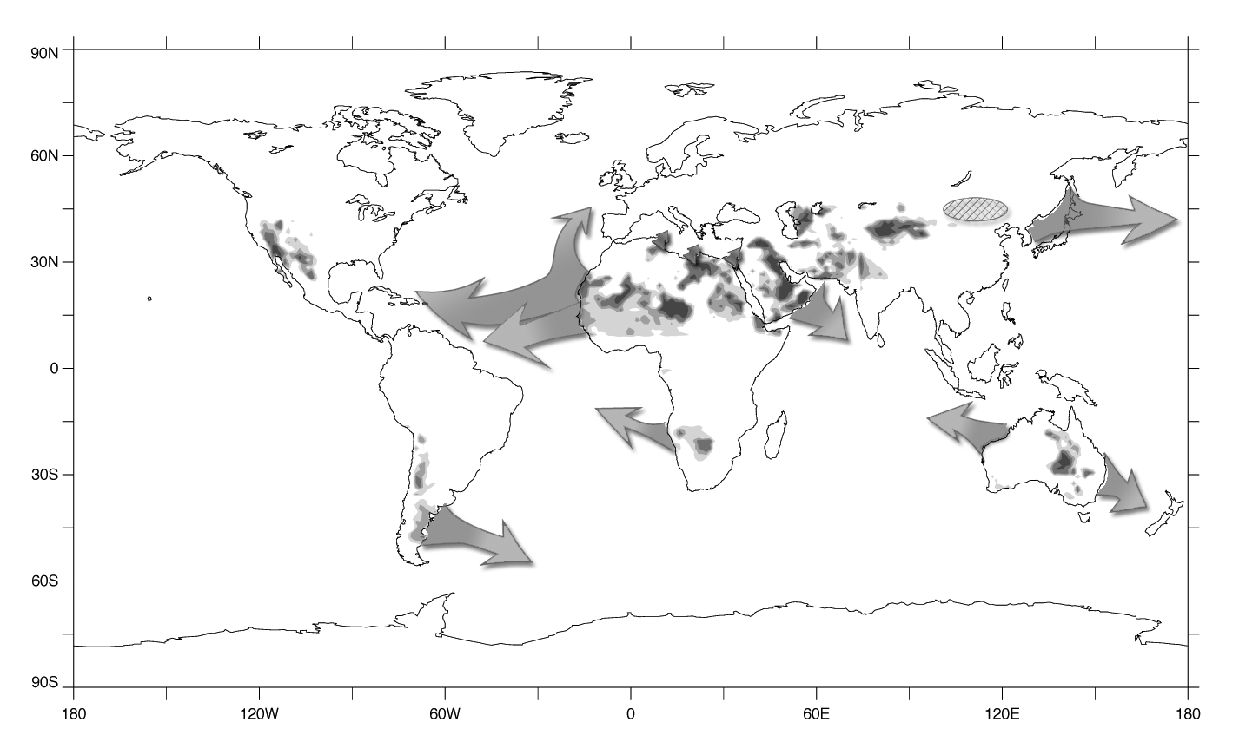
Figure 29.16
Ecological Climatology © 2008 G. Bonan

Slide 17
A2 biogeophysical
B1 biogeophysical
60N
60N
30N
30N
0
0
30S
30S
60S
60S
180W
120W
60W
0
60E
120E
180E
180W
120W
60W
0
60E
120E
180E
ΔT (°C)
A2 biogeochemical
B1 biogeochemical
60N
60N
0.5
30N
30N
0.25
0
0
0.1
30S
30S
-0.1
60S
60S
-0.25
180W
120W
60W
0
60E
120E
180E
180W
120W
60W
0
60E
120E
180E
-0.5
A2 net
B1 net
60N
60N
30N
30N
0
0
30S
30S
60S
60S
180W
120W
60W
0
60E
120E
180E
180W
120W
60W
0
60E
120E
180E
Figure 29.17
Ecological Climatology © 2008 G. Bonan

