Slide 1
Land-Surface Water Balance
Please read Bonan, Chapter 11

Slide 2
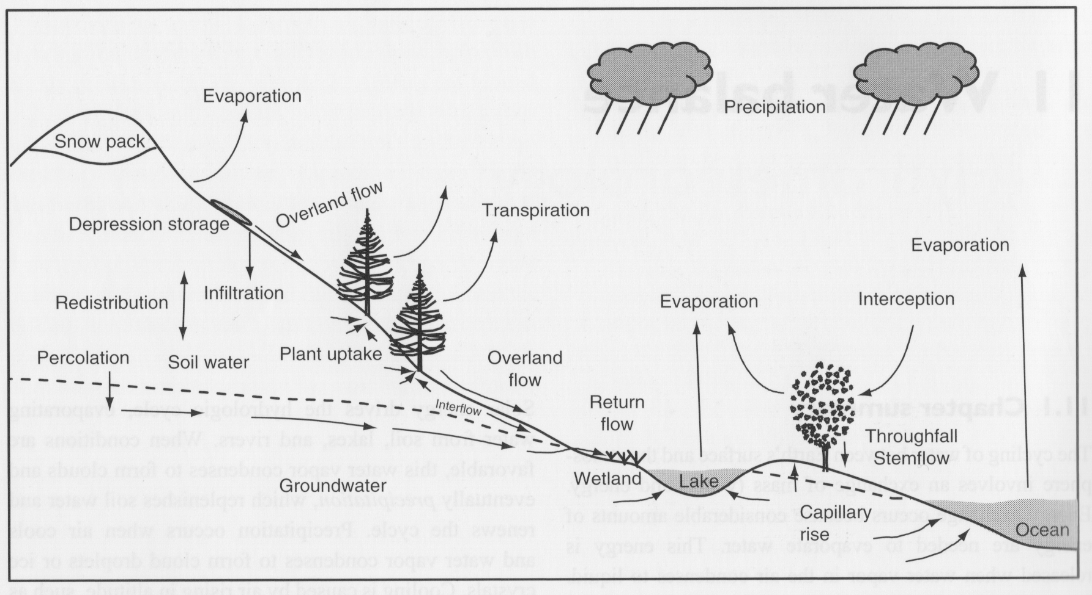
Hydrologic Cycle on Land
Change in Storage
ΔS = P – E - R
Runoff
Precipitation
Evapotranspiration

Slide 3
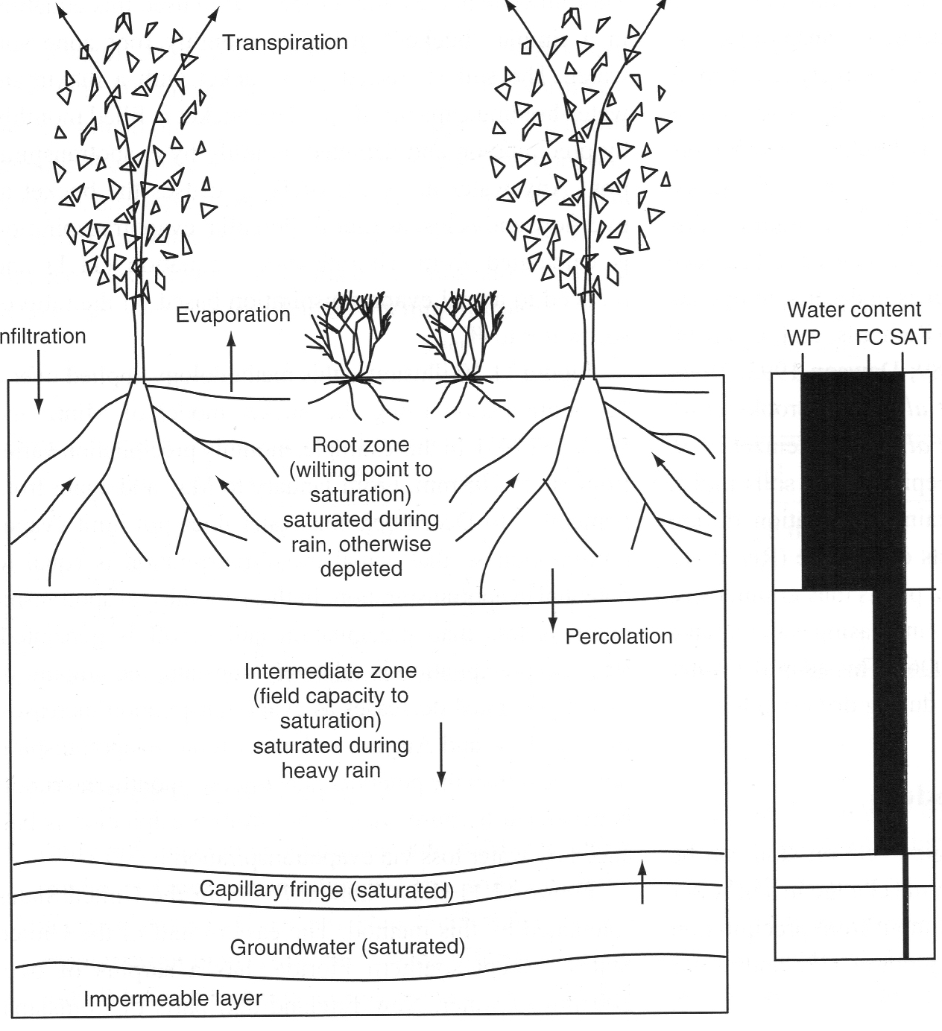
Soil Moisture “Zones”
I

Slide 4
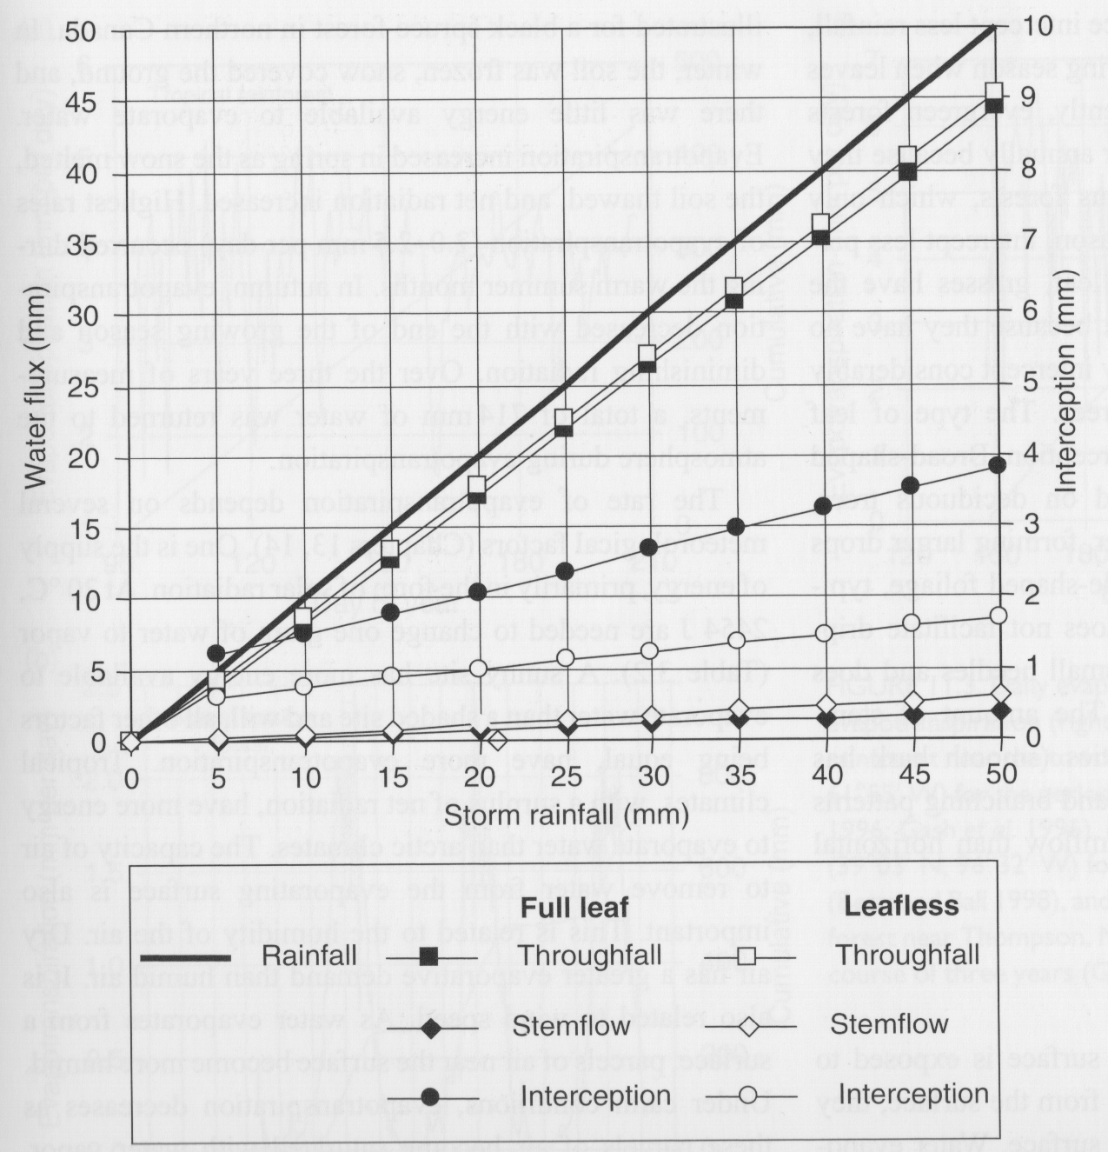
Canopy Partition of Rainwater
Typically > 85% of precip reaches the ground as throughfall
About 10% is intercepted by full leaf canopy (less in winter)
Intercepted water evaporates very readily!

Slide 5
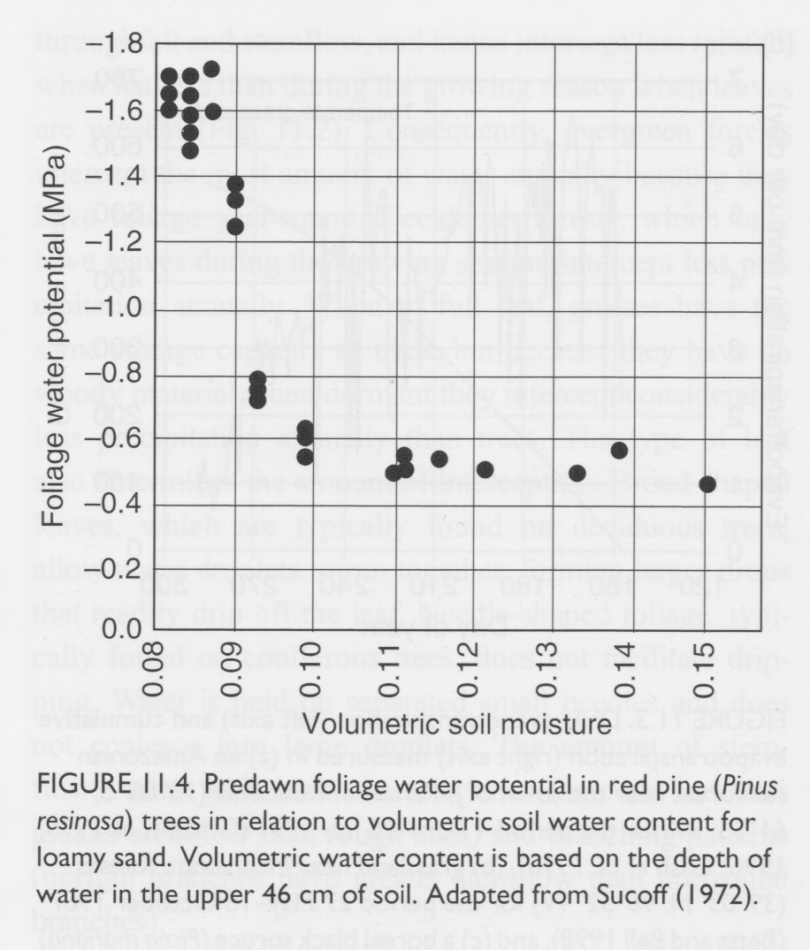
Estimation of Evapotranspiration
But leaf water potential depends very sensitively on soil moisture!
Thornthwaite (1948)
avg air
temp
daylength
# days
potential evapotranspiration (mm/month)
(much more about this later!)

Slide 6
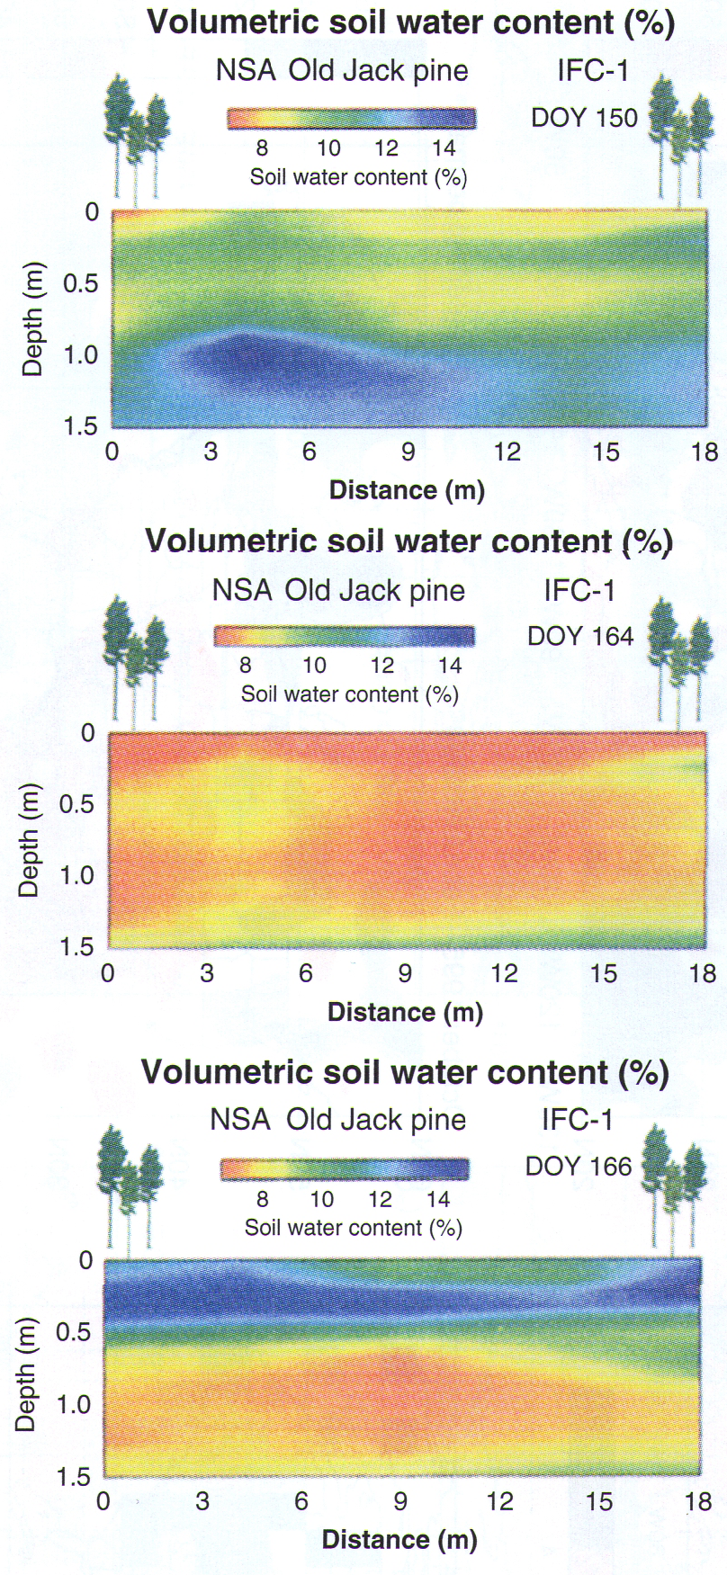
Movement of Soil Moisture in Vertical
Moist conditions on 30 May
Progressive drydown by 13 June
Wetting front on 15 June

Slide 7
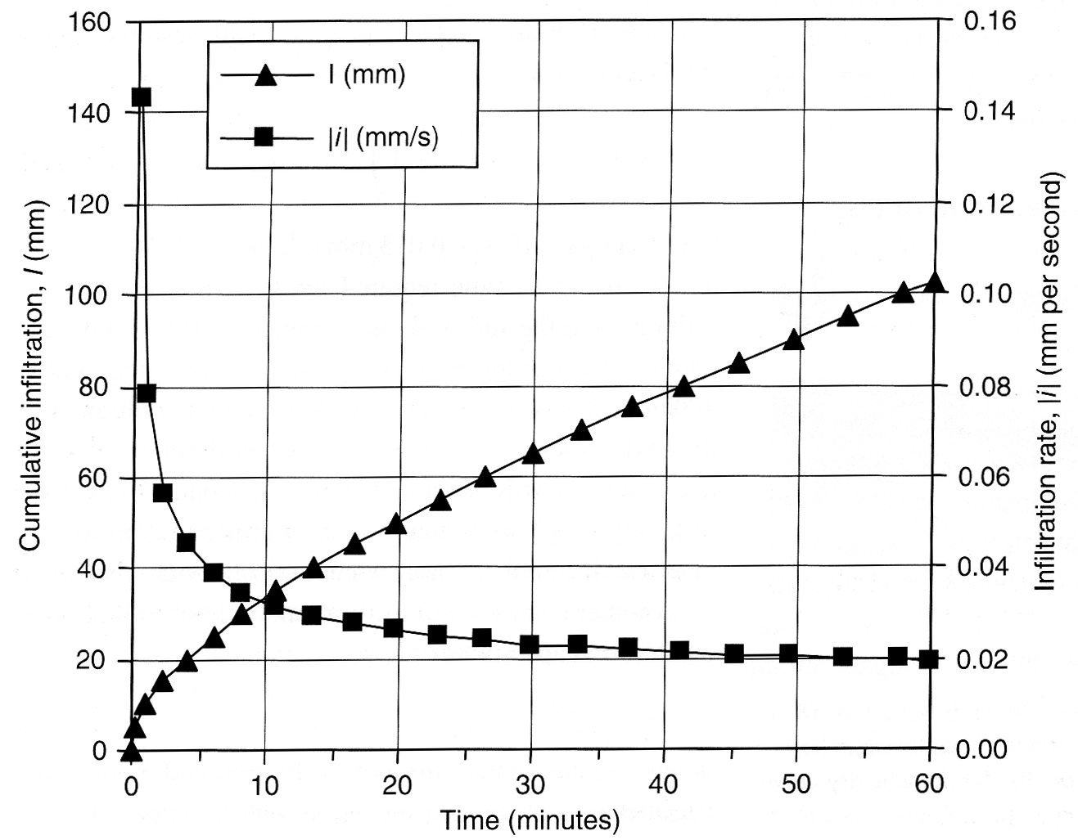
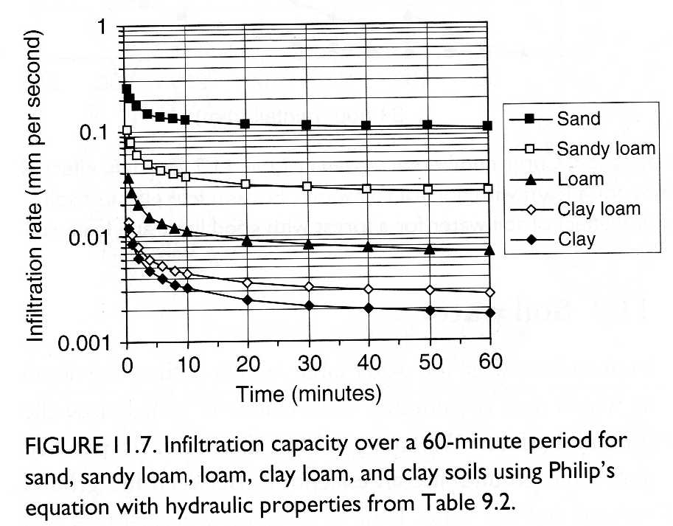
Infiltration
infiltration rate
Darcy’s Law
saturated hydraulic conductivity
depth to wetting front
Integrated infiltration
infiltration rate (again)
Set infiltration rates equal
solve for t
solve for i

Slide 8
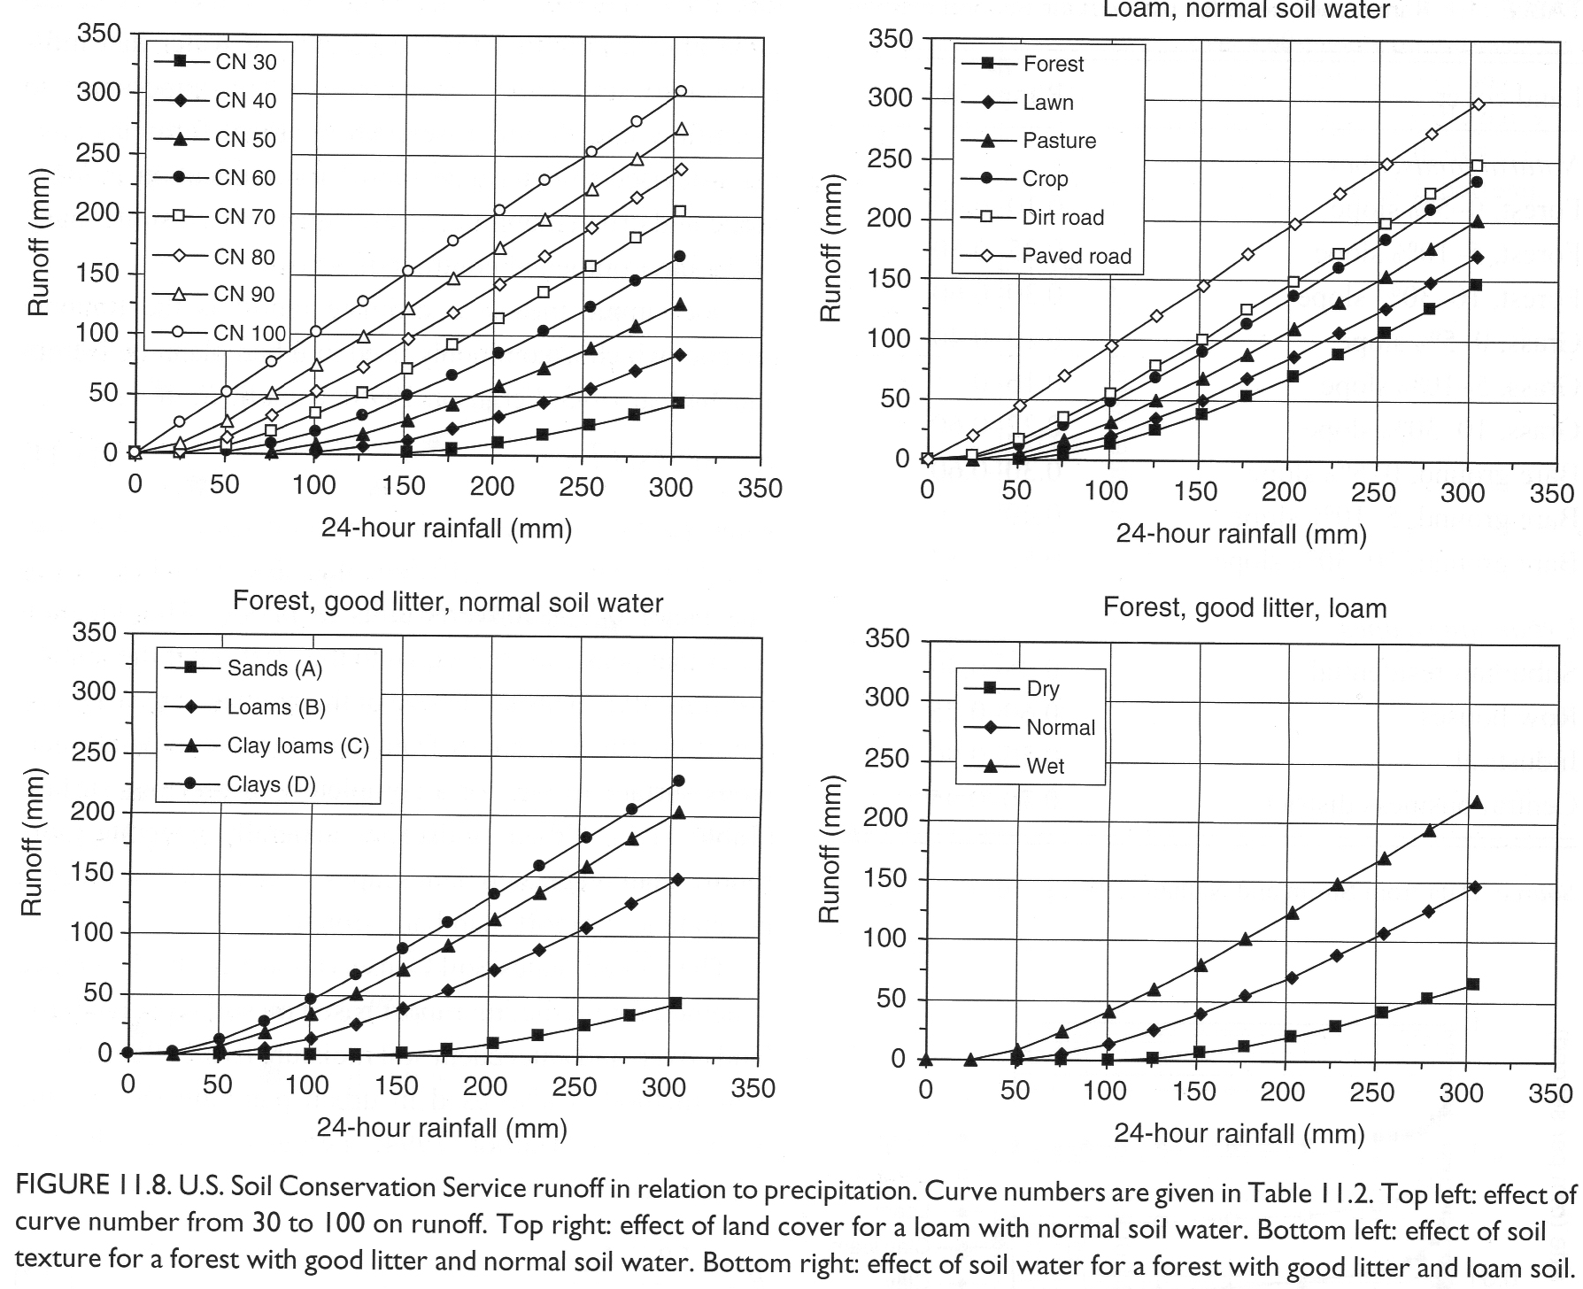
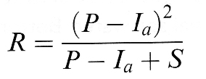
Estimating Runoff
(Depends on soil type, land use, land cover, soil moisture)
precipitation (mm/day)
“initial abstraction”

Slide 9
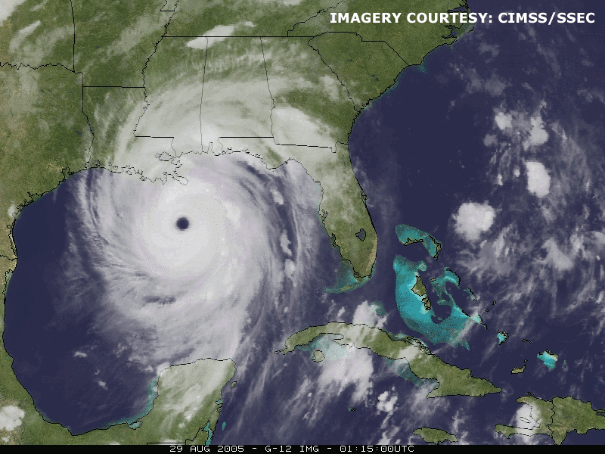
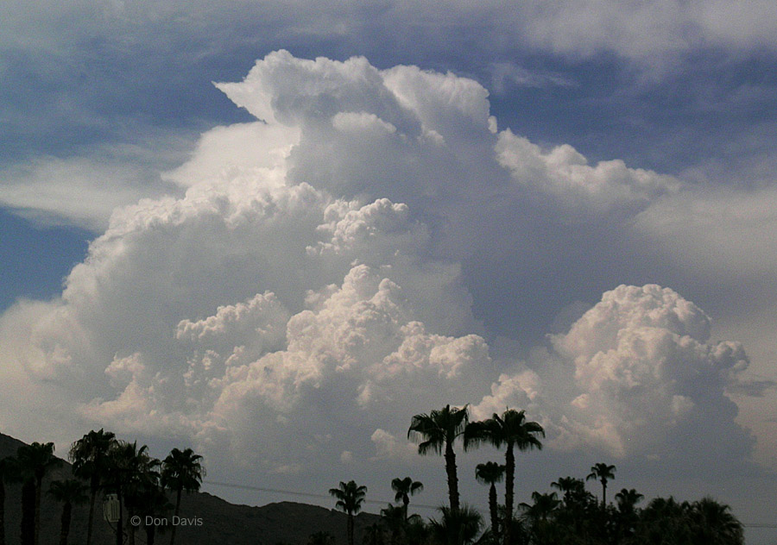
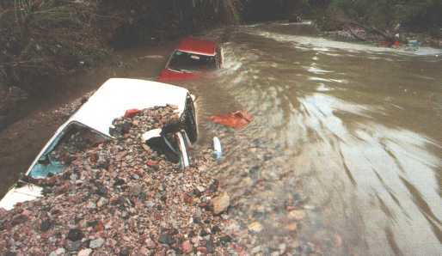
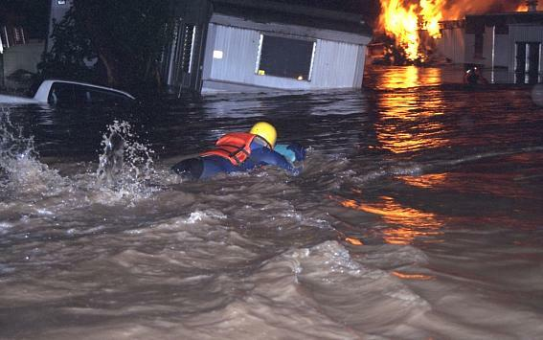
Why Runoff Estimates Matter

Slide 10
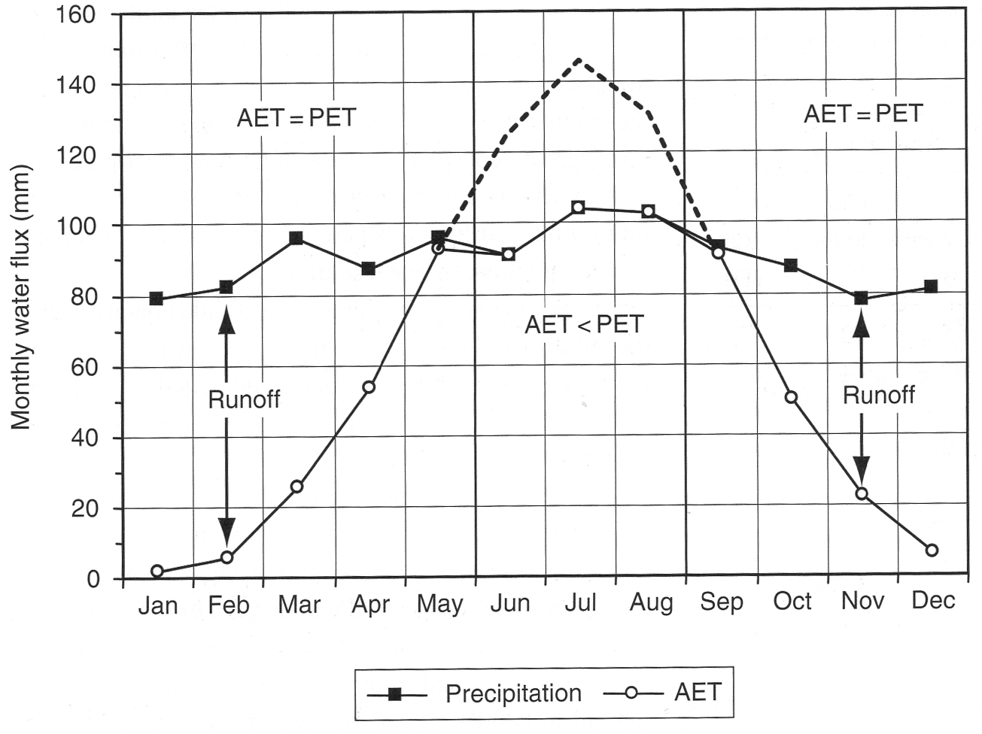
“Bucket Model”
Thornthwaite and Mather (1957)

Slide 11
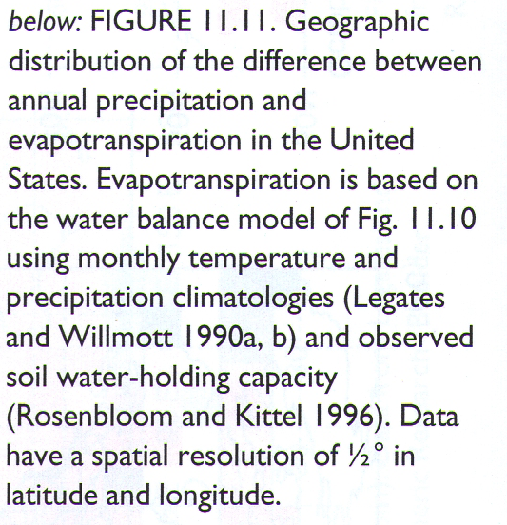
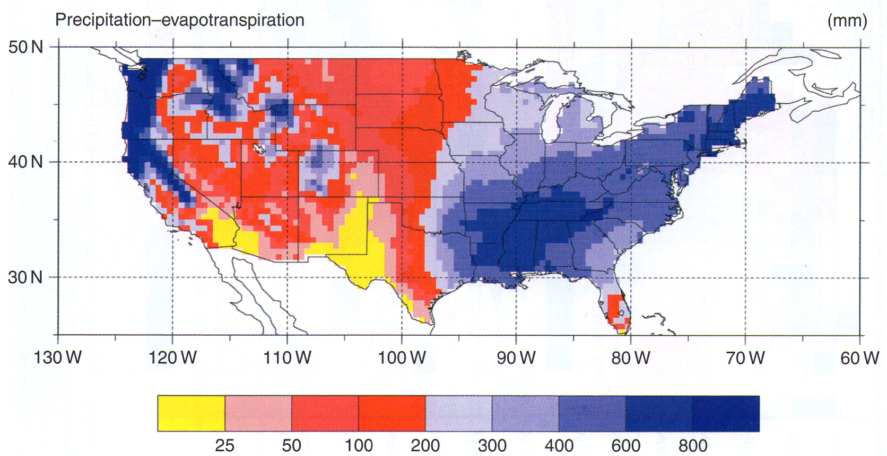
Annual Precipitation minus Evapotranspiration ~ Runoff

Slide 12
Watershed Hydrology
Please read Bonan, Chapter 12

Slide 13
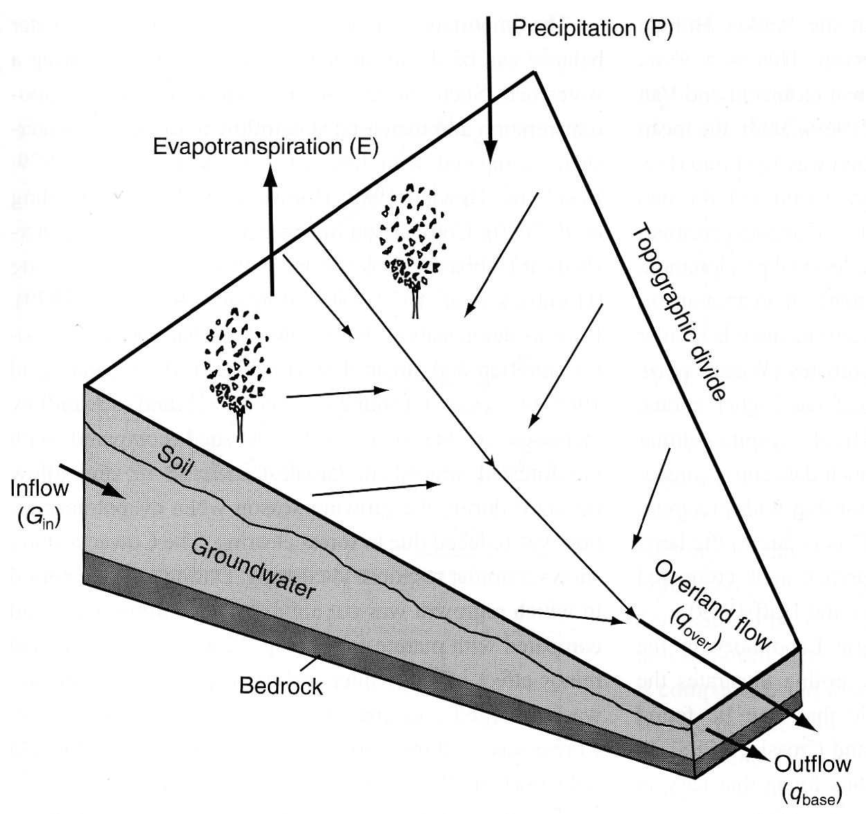
Watersheds “Shed Water”
A watershed is all the land from which water drains through a specified channel
ΔS = P + G_{in} – (E + q_{over} + q_{base})

Slide 14
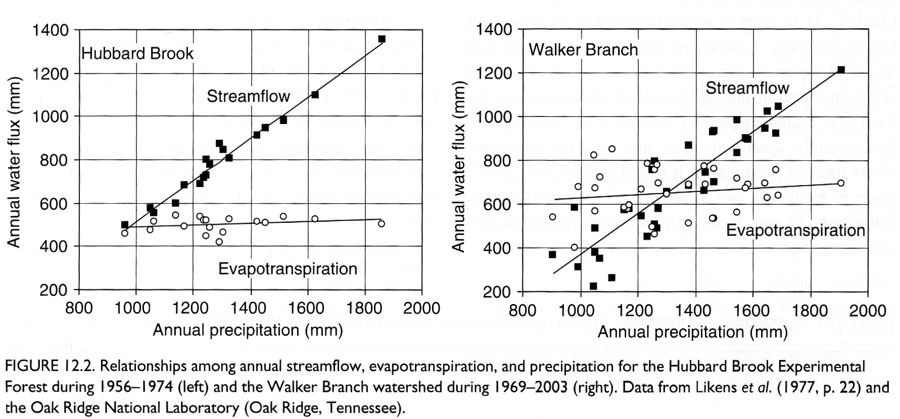
Annual Water Budgets
Watersheds with enough precipitation to satisfy evaporative demand shed excess water as stream discharge
How might a desert watershed compare?

Slide 15
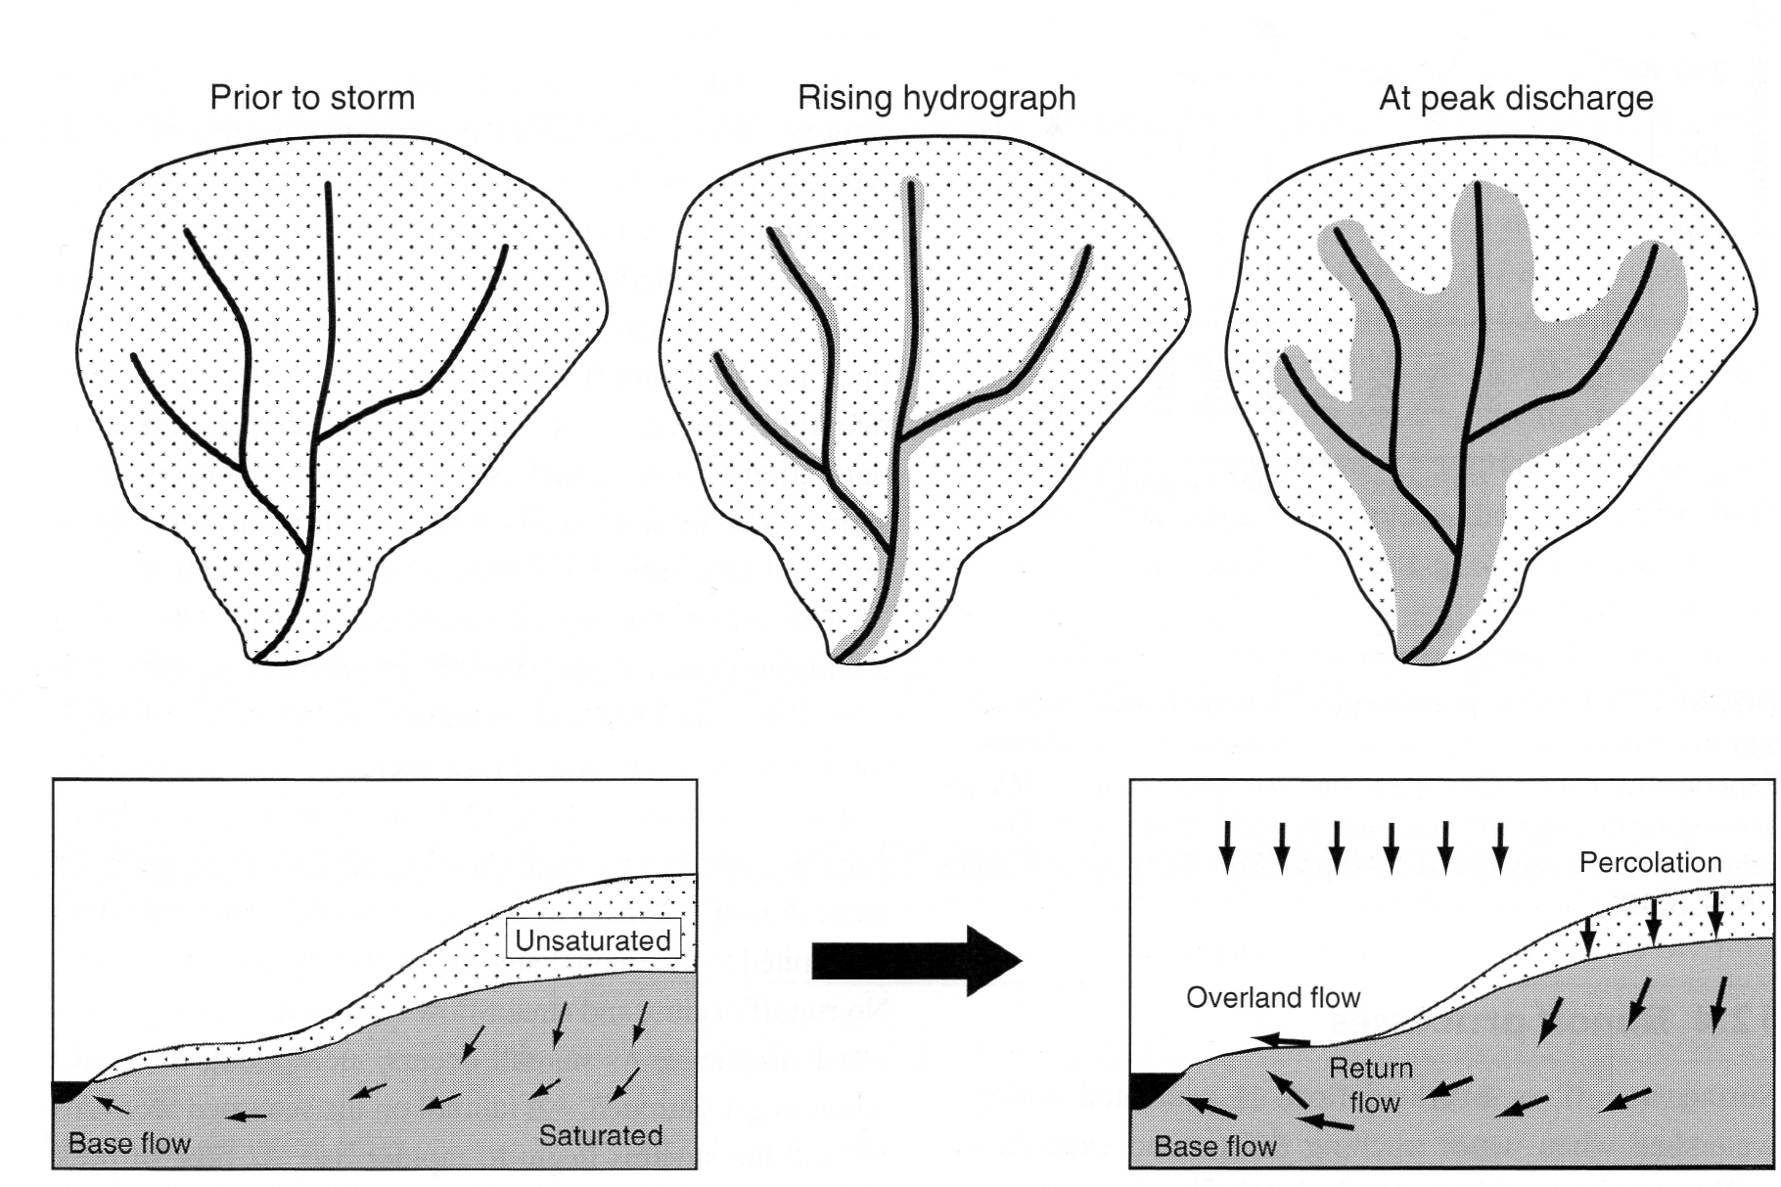
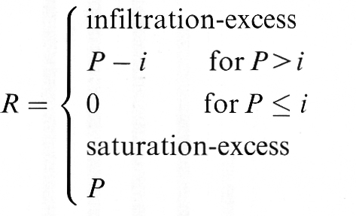
Saturated Soil and Overland Flow

Slide 16
Spatial (Exponential) Variation of Precipitation Across a Watershed
fractional area
receiving precip
frequency of occurrence
mean precip over whole watershed
The most intense rainfall occurs over the smallest area (think convective vs stratiform)

Slide 17
Runoff From Watershed With Variable Saturation and Precipitation
infiltration capacity
frequency
Unsaturated fraction (Horton)
Saturated fraction (Dunne)

Slide 18
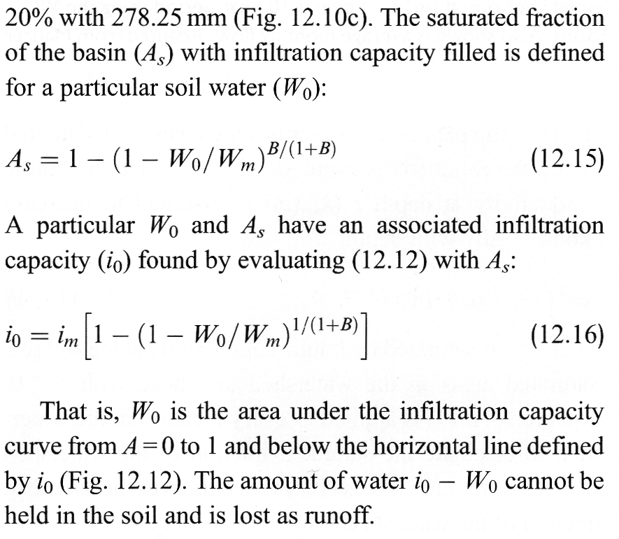
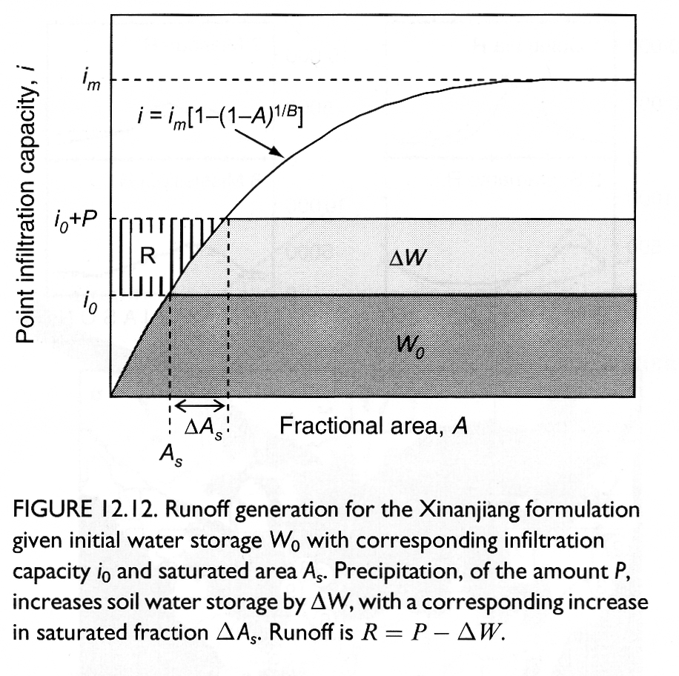
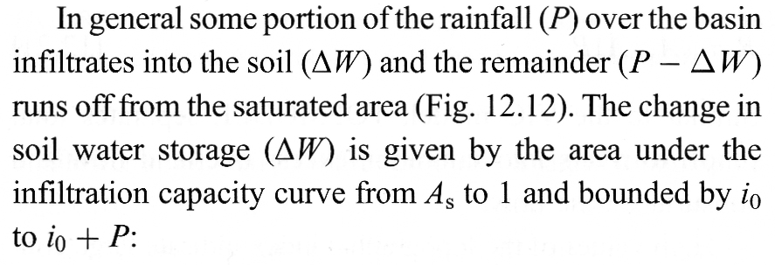
Variable Infiltration Capacity

Slide 19
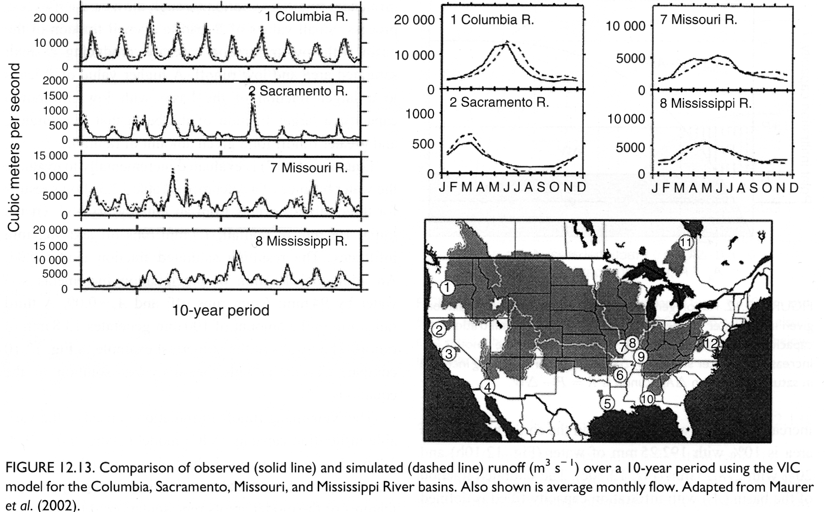
VIC Evaluation

Slide 20
Spatial Variability
Determined by
Topographic position
Soil type
Vegetation
Precipitation

Slide 21
More Spatial Variability
Entekhabi & Eagleson (1989)
2 parameter gamma function describes variability
Horton & Dunne runoff
Evaporation and Transpiration
Soil moisture stress on ET
Laio et al., 2002

Slide 22
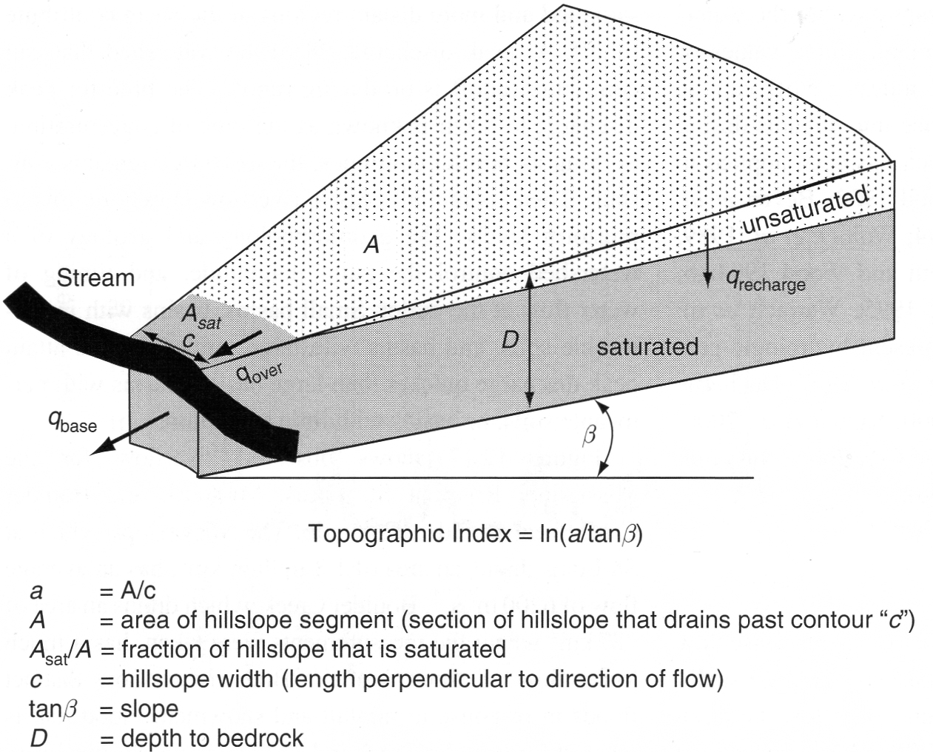
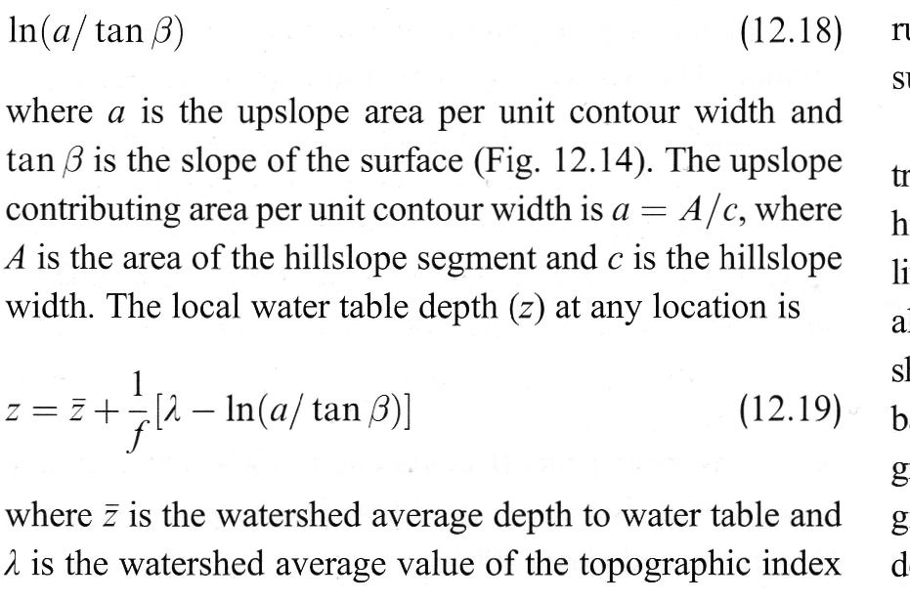
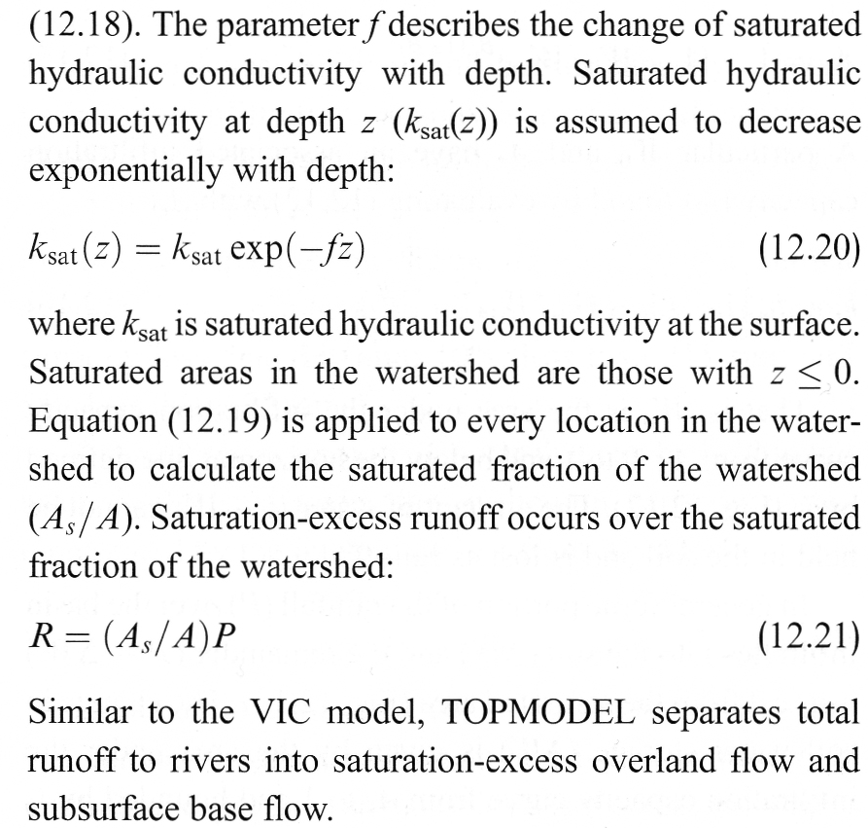
TOPMODEL
Like VIC, but tied directly to real topography (“hillslope” concept)

Slide 23
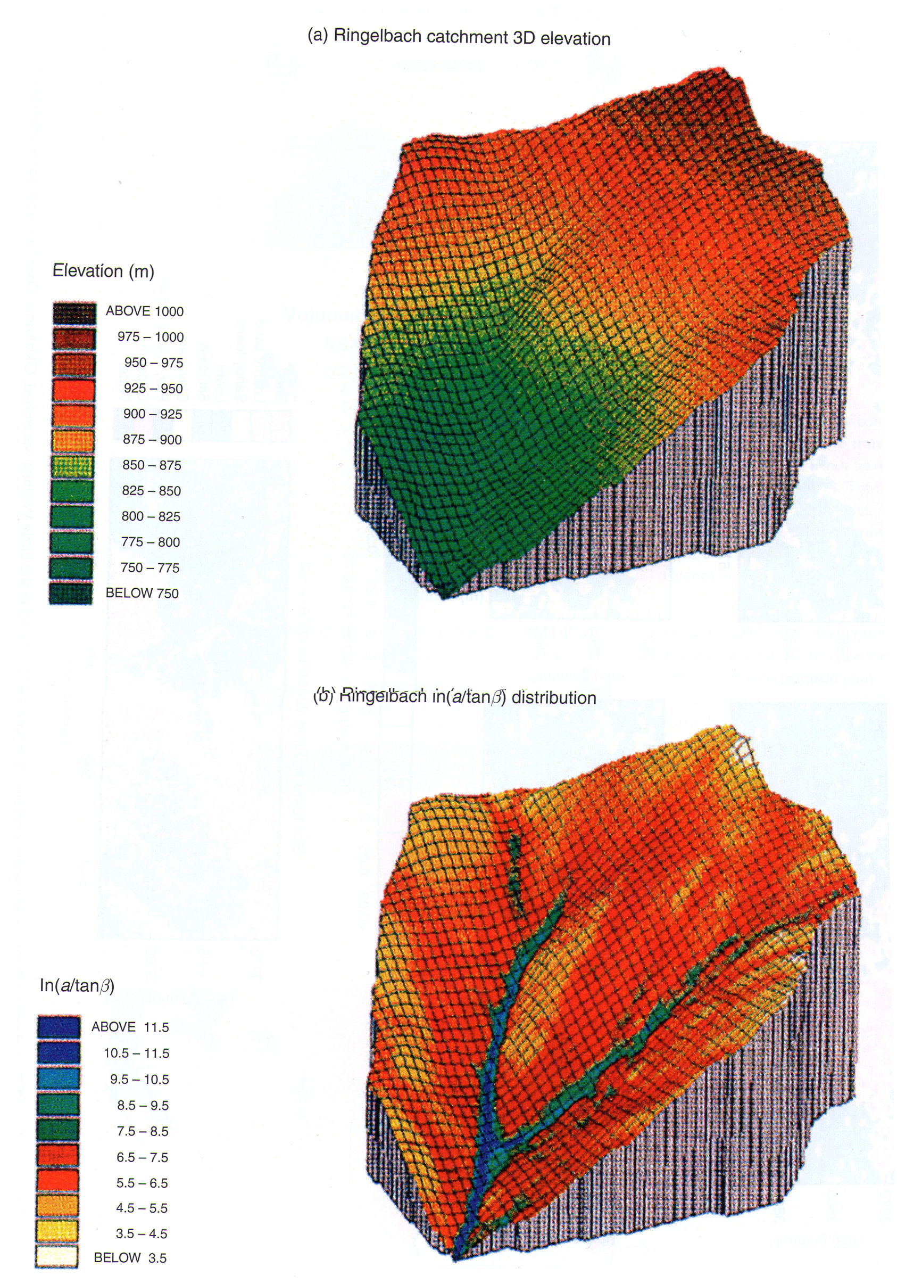
TOPMODEL
Start with high-resolution digital elevation model (“DEM,” elevation vs lat/lon)
Derive “topographic index”
Histogram (freqency dist’n) of λ across catchment allows prediction of sat’d area, infilt, & runoff

Slide 24
TOPMODEL-based variability
Famiglietti and Wood (1994) TOPLATS
TOPMODEL-based distribution
Discretized wetness
Multiple instances of model

Slide 25
TOPMODEL-based variability
Koster et al. (2000), CATCHMENT model

Slide 26
Koster CATCHMENT model
TOPMODEL-based mean water table depth for each catchment
Saturation Deficit
3 ‘zones’ based on Entekhabi s* value
Flexible area
No ET
E, no T
No restriction
1
2
3

Slide 27
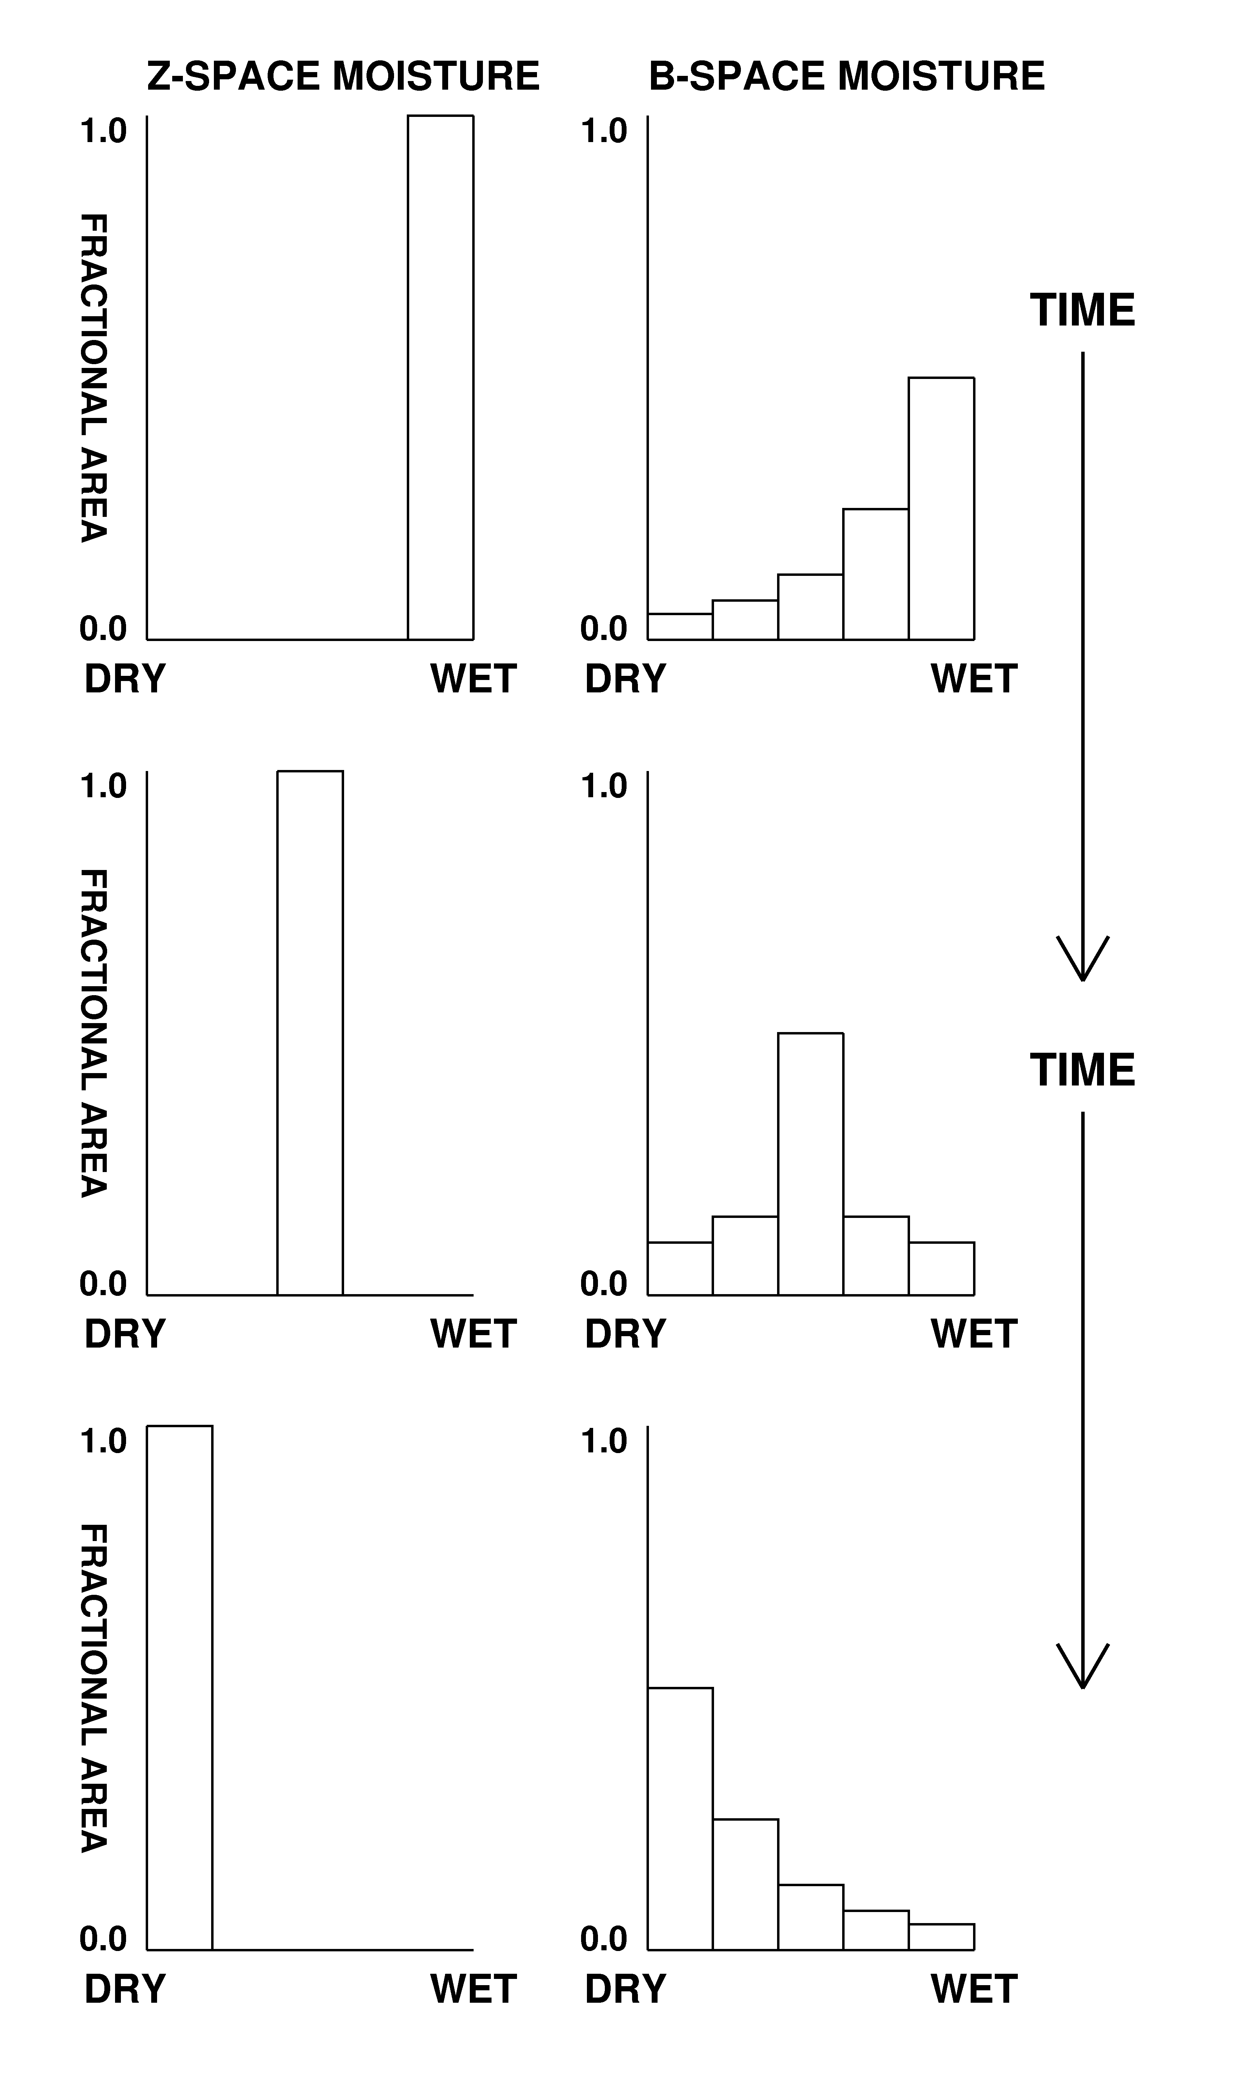
Soilmoisture BINS
Sellers et al., 2007
Nonlinear soil moisture response curve
Discretize wetness into ‘BINS’
ET restriction based on discretized f(W) and BIN area
Moisture, not topography, determines distribution

Slide 28
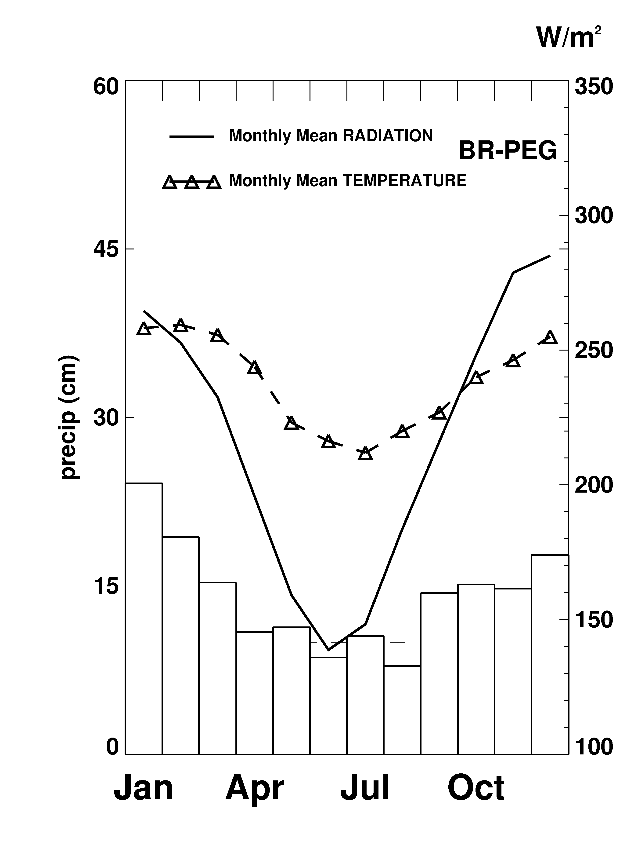
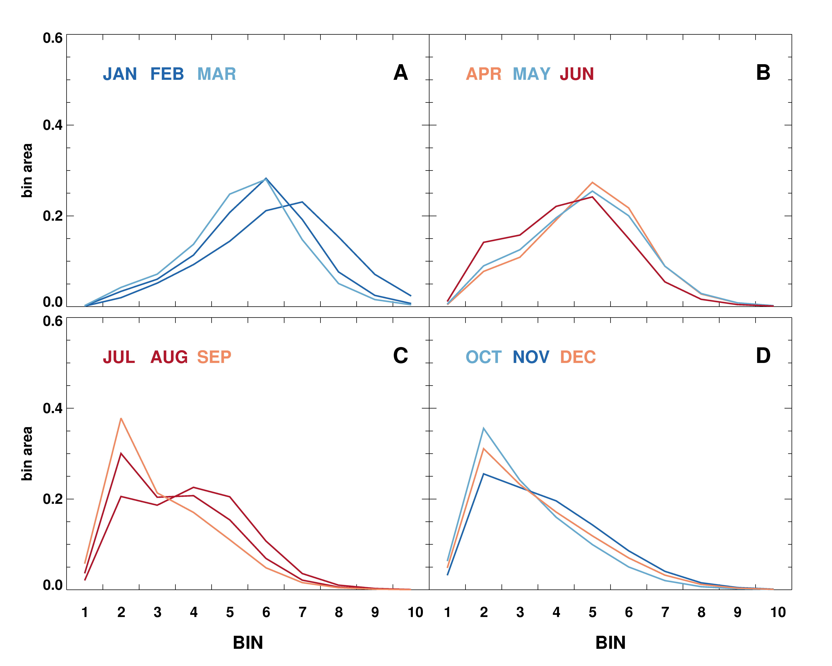
Soilmoisture BINS
BR-PEG (Brazil)
BINS distribution changes during year in response to precip, ET
BLUE = WET month
RED = DRY month
dry
wet
dry
wet

