Slide 1
Photosynthesis, Canopy Physiology & Micrometeorology
Please read Bonan, Chapter 16-17

Slide 2
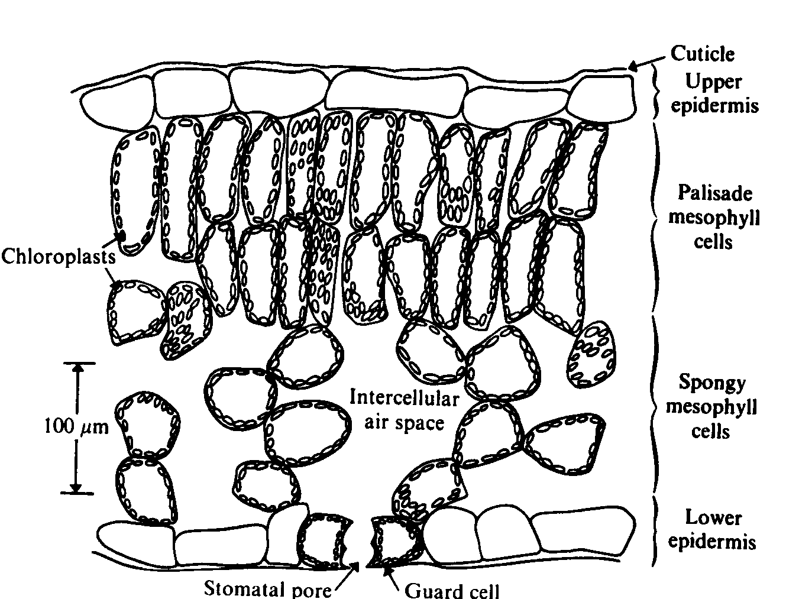
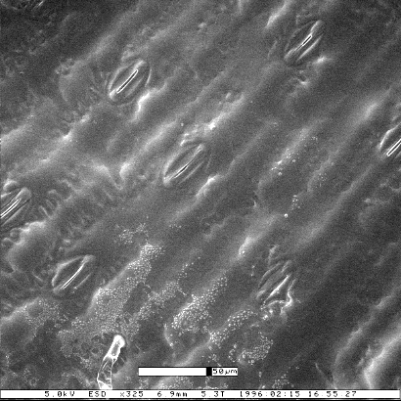
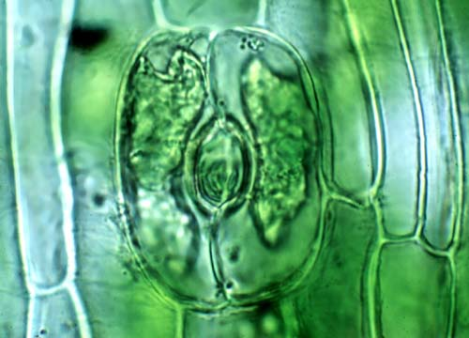
Leaf Anatomy
Stomate
(pl. stomata)

Slide 3
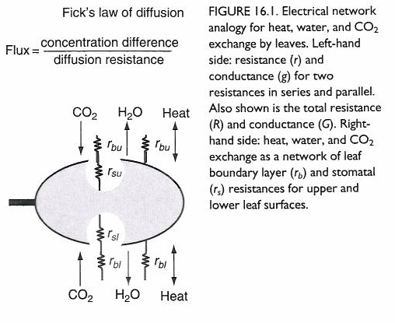
Leaf Fluxes and Resistances
Many leaves have stomata only on lower surface
Heat fluxes don’t pass through stomata

Slide 4
Adding Resistances
Resistors in series
Conductance is the reciprocal of resistance
Total resistance of a series of resistors is the sum of the individual resistors
Total conductance of a set of resistors in parallel is the sum of the individual conductances
add resistances
Resistors in parallel
add conductances

Slide 5
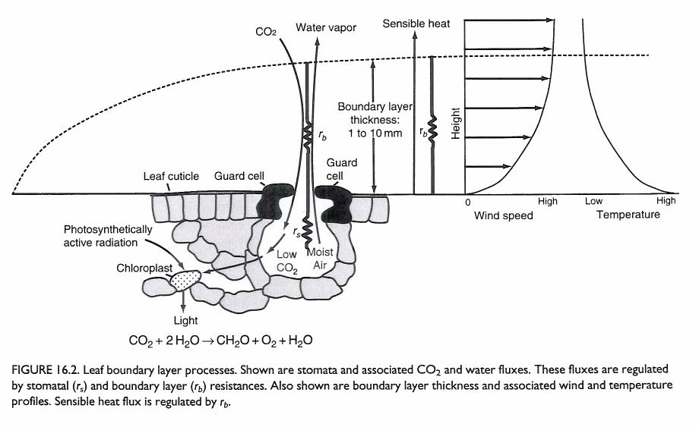
Stomata and Leaf Boundary Layers
Stomatal conductance is truly molecular
Leaf laminar boundary layer conductance is a mixture of molecular and turbulent diffusion

Slide 6
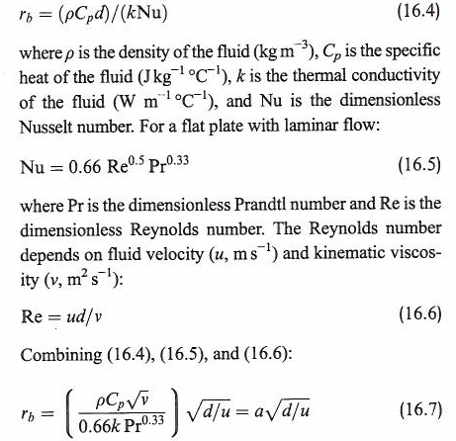
Laminar Boundary Layer
s/m
leaf size (m)
wind speed (m/s)
Flow in canopies is complex
How do we define “wind speed” a few mm above a pine needle?

Slide 7
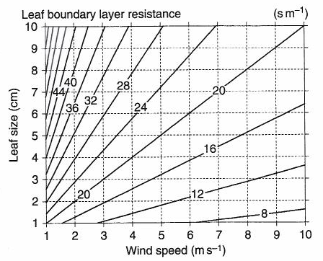
Laminar Boundary Layer Resistance
a ~ 200 s^{½} m⁻¹

Slide 8
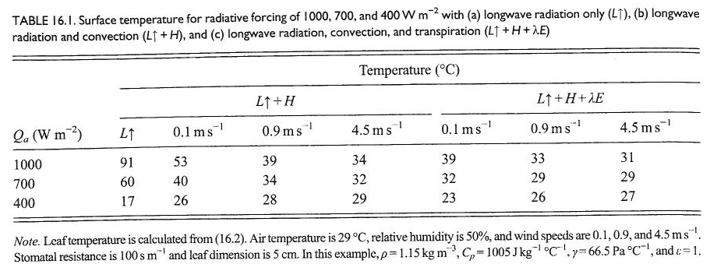
Leaf Temperatures
Influence of radiative, sensible, and latent cooling
Without H and LE, leaves get really hot!

Slide 9
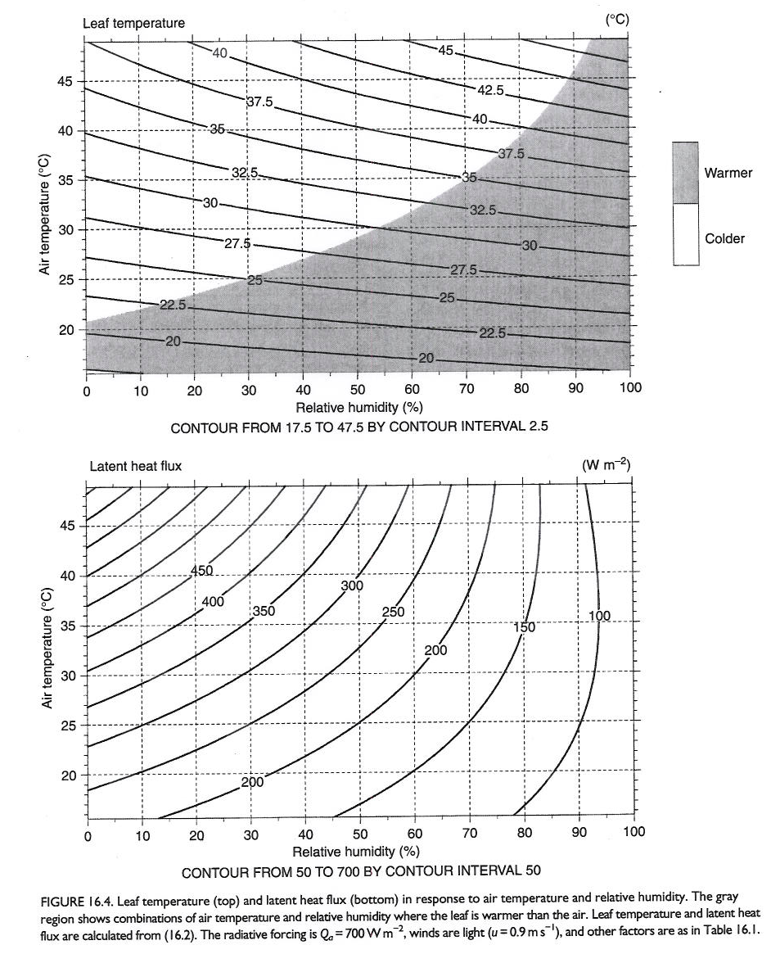
Leaf Energy Balance
Note dependence of latent cooling on air T and R.H.
Leaf may be either warmer or cooler than air
Imagine a forest full of dappled sunlight on a summer afternoon …

Slide 10
Coupling Between Leaf Fluxes and the Canopy Air Space
From Penman-Monteith
LE increases with VPD (duh!)
Lots of leaf transpiration tends to moisten canopy air space (CAS)
Moist CAS suppresses transpiration
Degree of dependence (coupling) depends on r_{b}
Consider two limiting cases:
r_{b} large, radiation limited
r_{b} small, stomata limited
Jarvis and McNaughton (1986)

