Slide 1
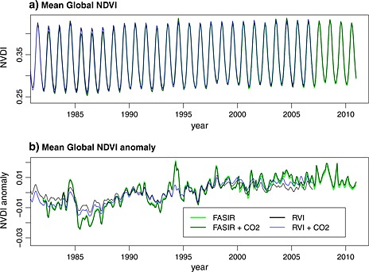

Slide 2
Vegetation Continuous Fields (VCF)
“Spectral Unmixing”
Not radiative spectrum but rather fourier series of seasonality
Grasses have a different seasonal cycle than forests; deciduous trees have a different seasonal cycle than evergreen forests

Slide 3
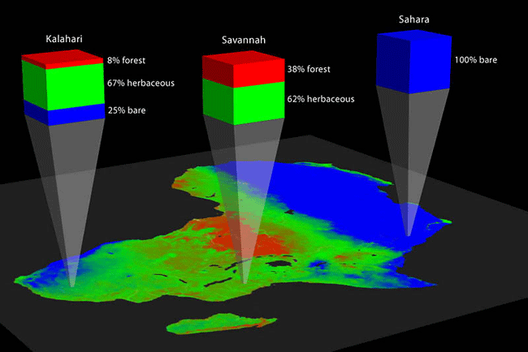
VCF
“Unmixing” the NDVI timeseries pixel by pixel gives a fractional cover of each vegetation type for each pixel (down to 1 km globally!)

Slide 4
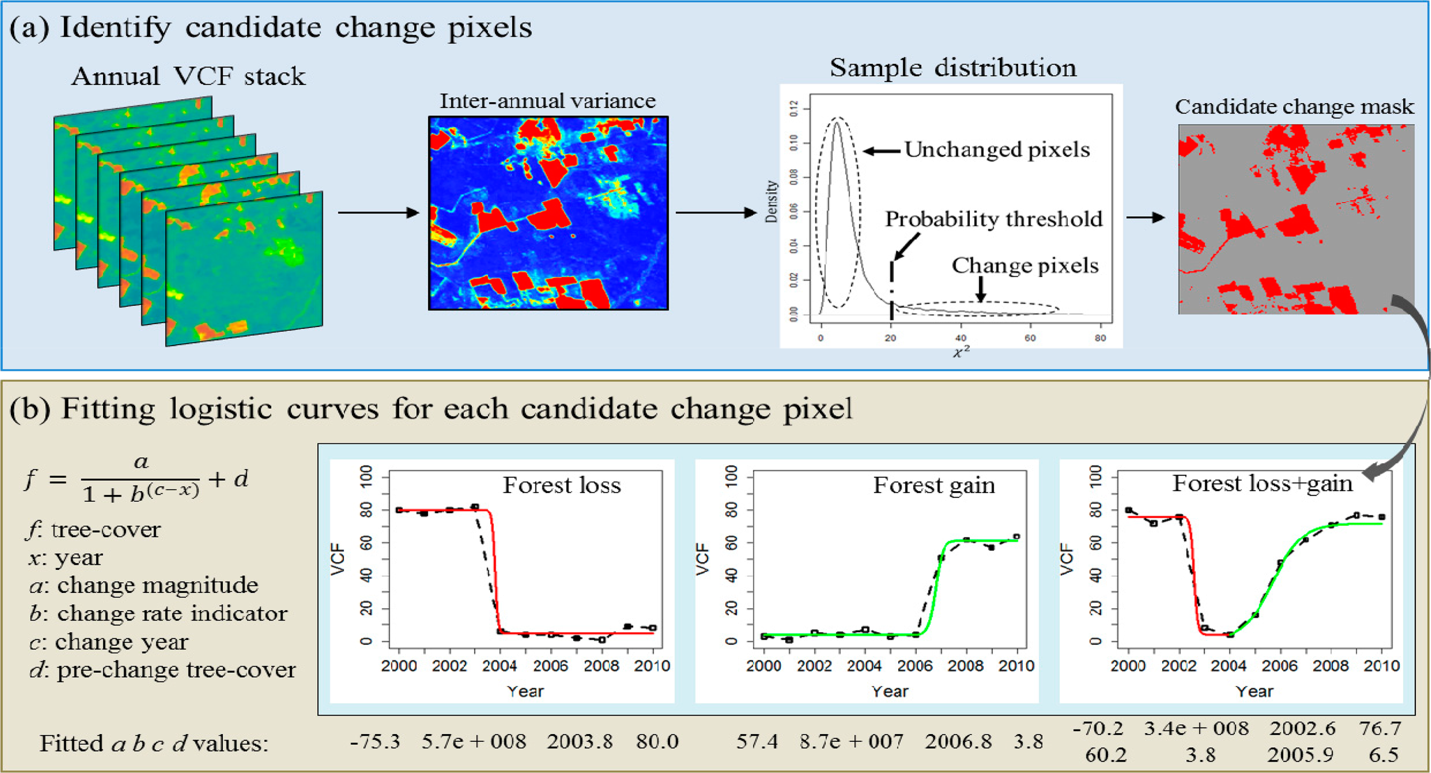
Land-Use Change & Disturbance

Slide 5
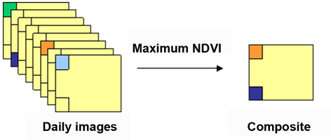
Maximum Value Compositing
“Atmospheric Effects” systematically decrease NDVI
Over some compositing period, choose the highest NDVI for each pixel in a given region
Compose an image of the maximum value of each pixel during the compositing period

Slide 6
FASIR: Fourier Adjustment, Seasonal Interpolation, Reconstruction
FA
SI
R

Slide 7
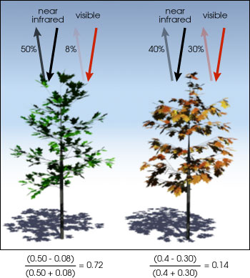

Slide 8
Satellite Orbital Artifacts
Orbital changes in NOAA satellites produce systematic changes in viewing angle and time of day

Slide 10
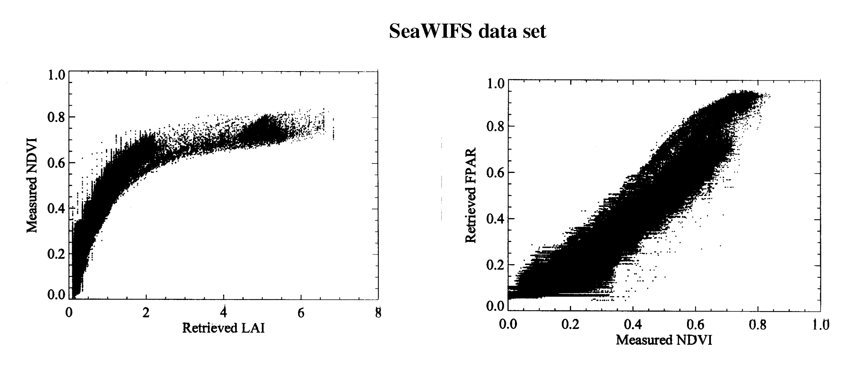

Slide 11
Biomass

Slide 12
“Biomass” vs “Height”
(allometry)

Slide 13
Biomass Result

