Slide 1
I’m Not a Warmist! Engaging Hostile Audiences about Climate Change
Scott Denning
Director of Education, CMMAP
Atmospheric Science, CSU
Email Scott.Denning@ColoState.edu for a copy of this presentation

Slide 2
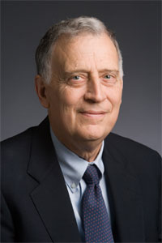
“Scientists are necessary, but not sufficient to solve the climate problem”
Dr. Ralph Cicerone, President of the National Academy of Science, November 2007

Slide 3
Effective Engagement
Theory:
Knowledge vs Belief
Elephants and riders
“Us vs Them”
Practice:
Simple
Serious
Solvable

Slide 4
Effective Engagement
Theory:
Knowledge vs Belief
Elephants and riders
“Us vs Them”
Practice:
Simple
Serious
Solvable

Slide 5
Knowledge vs Belief
“Knowledge” – considered “content knowledge”, “literacy” or “conceptual understanding” in science education circles.
- Facts, vocabulary, concepts, mental models are fundamental building blocks for understanding
- Science, and scientists, build knowledge
- We are comfortable communicating it
“Belief” - Trust or confidence in someone or some thing
- Beliefs are strongly tied to what a person values
Scientists value science and knowledge created. Belief stems from knowing. Not everyone thinks this way!
Prof. Steve Anderson, University of Northern Colorado

Slide 6
Belief, Trust and Values Steve Anderson, UNC
“When the value of science is pitted against other things that people value, such as family, religion, and jobs,” science loses!
Contrarians “pit the values held in the highest esteem by the public (religion, economy, family) directly against the value of climate change science, and in doing so give the public the impression that they must choose between climate science and their core principles”
“therefore easy to understand why less than half of American citizens believe climate change is worth changing behavior over”

Slide 7
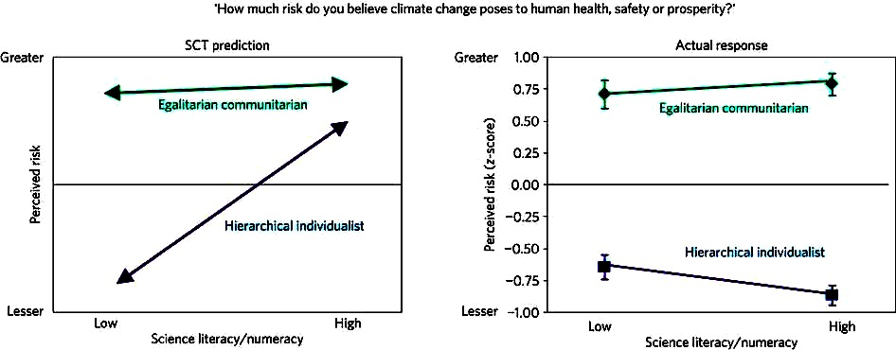
Cultural Identity vs Science Literacy
“Science Comprehension Thesis” fails miserably!
“The polarizing impact of science literacy and numeracy on perceived climate change risks.” D.M. Kahan, E. Peters, M. Wittlin, P. Slovic, L.L. Ouellette, D. Braman & G. Mandel. Nature Climate Change (2012) doi:10.1038/nclimate1547

Slide 8
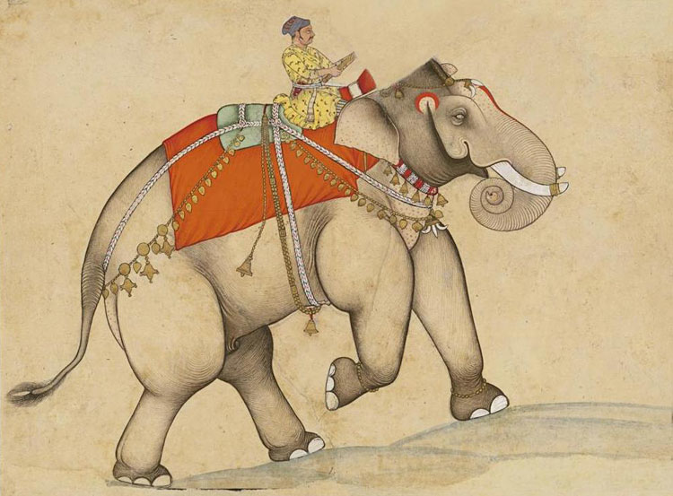
Elephants and riders
Flavors of morality
Belonging
The rider evolved to serve the elephant!

Slide 9
If you want to change somebody’s beliefs, talk to their elephant!

Slide 10
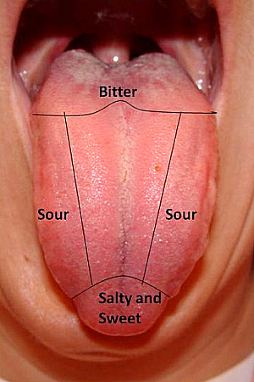
Taste Buds
People have 4 or 5 different kinds of taste buds for different flavors

Slide 11
Flavors of Morality
Care vs harm
Liberty vs oppression
Fairness vs cheating
Authority vs subversion
Loyalty vs betrayal
Sanctity vs degradation
Traditional societies
Western industrialized societies
Team Blue
Team Red

Slide 12
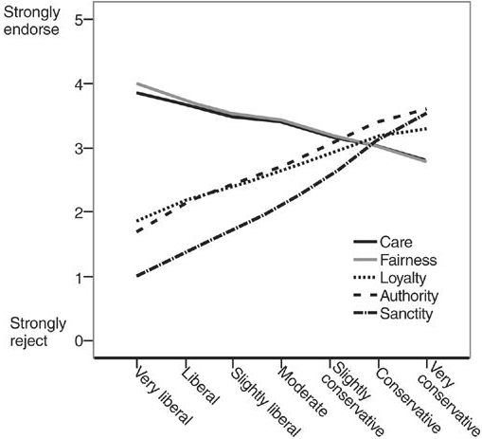
Flavors of Morality
Based on survey data N > 132,000
Take survey at YourMorals.org
J. Haidt (2007) The New Synthesis in Moral Psychology, Science 316, 998

Slide 13
In Less Than 1 Second
Your elephant can tell which side I’m on
Elephants move toward, or away
Your conscious mind (rider) can begin explaining why you support or oppose me

Slide 14
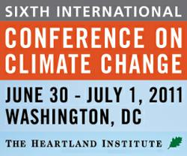
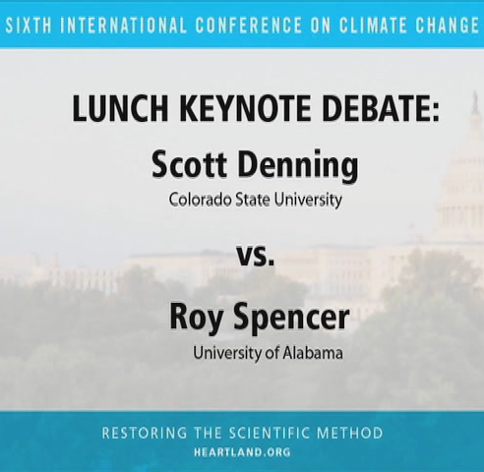
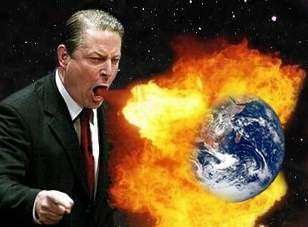

Slide 15
James Delingpole, British TV Personality

Slide 16
Who Are You?
What are your values?
What are your motivations?
What deeply meaningful characteristics do you share with your audience?
[These are your real credentials!]

Slide 17
What Doesn’t Work
Deniers are a fringe group … ignore them
Data deluge – bury the audience with graphs, numbers
Argument from authority: credentials, consensus
Messages of fear, alarm
Point-by-point refutation of details

Slide 18
What Works Better
Emphasize the basics –
argue from common sense, not from authority
Recognize that opposition is ideological
(not scientific). Ideas deserve respect.
Be human & authentic
Personal anecdotes, humor, a light touch
Be optimistic
Don’t try to sell doom and gloom
Stick to your message –
don’t get sucked off into the weeds

Slide 19
Effective Engagement
Theory:
A spectrum of opinion
“Us vs Them”
Belief vs Knowledge
Practice:
Simple
Serious
Solvable

Slide 20
Effective Engagement
Theory:
A spectrum of opinion
“Us vs Them”
Belief vs Knowledge
Practice:
Simple
Serious
Solvable

Slide 21
Global Warming is Based on Common Sense not computer models … not recent temperatures … not complicated!

Slide 22
Weather vs Climate what’s the difference?
If you don’t like the weather:
Wait five minutes!
If you don’t like the climate:
Move!

Slide 23
Location! Location! Location!
Climate is Place
Depends on where you live:
Latitude!
Altitude (mountains vs valley)
What’s upwind (ocean vs land)
Changes very slowly
Very predictable
We can predict that Miami is warmer than Minneapolis for precisely the same reasons that we can predict a warmer future!

Slide 24
Ever Wonder Why?
Day is warmer than night
Summer is warmer than winter
Miami is warmer than Minneapolis

Slide 25
Heat Budgets
Heat in
Heat in
Heat out
Heat out

Slide 26
Dancing Molecules and Heat Rays!
Nearly all of the air is made of oxygen (O₂) and nitrogen (N₂) in which two atoms of the same element share electrons
Infrared (heat) energy radiated up from the surface can be absorbed by these molecules, but not very well
O
O
N
N
Diatomic molecules can vibrate back and forth like balls on a spring, but the ends are identical

Slide 27
Dancing Molecules and Heat Rays!
Carbon dioxide (CO₂) and water vapor (H₂O) are different!
They have many more ways to vibrate and rotate, so they are very good at absorbing and emitting infrared (heat) radiation
O
C
O
O
H
H
Molecules that have many ways to wiggle are called “Greenhouse” molecules
Absorption spectrum of CO2 was measured by John Tyndall in 1863

Slide 28
CO₂ Emits Heat
Because of its molecular structure!
Not because capitalism is evil
Not to punish greedy rich people
It’s just bad luck!

Slide 29
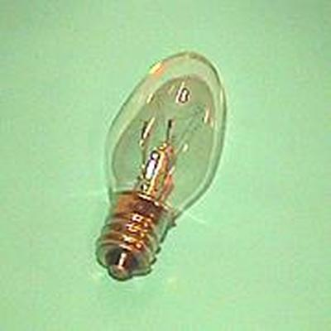
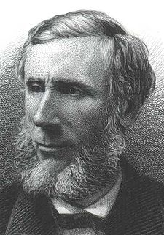
Common Sense
1 m
Doubling CO₂ would add 4 watts to every square meter of the surface of the Earth, 24/7
Doing that would make the surface warmer
This was known before light bulbs were invented!
4 Watts
1 m
John Tyndall, January 1863

Slide 30
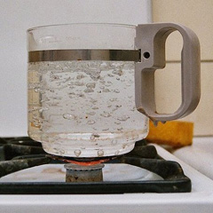
Common Myth #1
“Scientists are worried about climate change because it’s been warming up recently”
WRONG!
We’re worried because we know that when we add heat to things, they warm up

Slide 31
Effective Engagement
Theory:
A spectrum of opinion
“Us vs Them”
Belief vs Knowledge
Practice:
Simple
Serious
Solvable

Slide 32
Shanghai, China 1990

Slide 33
Shanghai, China 2012

Slide 34
Billions and Billions
There are currently 7 billion people, but
Only 1 billion of us use a lot of energy
There are 3 billion people in China and India who will soon use energy like us
Population will increase by 30% in the 21st Century, but energy use will increase by more than 300%

Slide 35
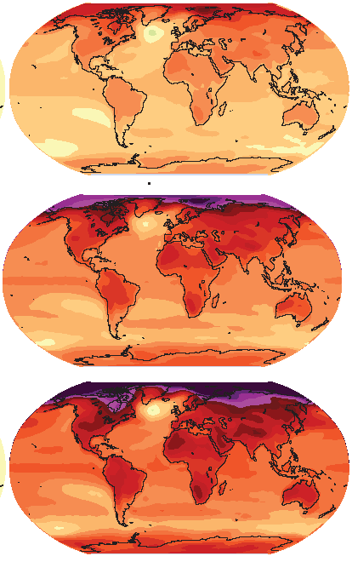
How much warmer?
Low
Emissions
Land vs ocean!
North vs South
Global mean warming of 2º to 5º C
North American warming of 3º to 6º C
= 5º to 11º F
Moderate
Emissions
High
Emissions
Rainfall? Agriculture? Water supply? Real estate?
Displaced people?

Slide 36
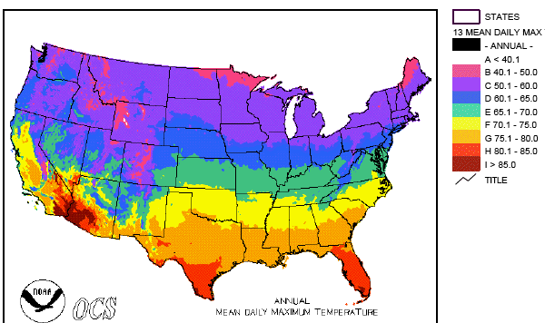
Where is it 10°F Warmer
“on average?”
Denver ➔ Amarillo
Illinois ➔ Mississippi
Washington➔ Tallahassee
Water? Crops? Real Estate? Health?

Slide 37
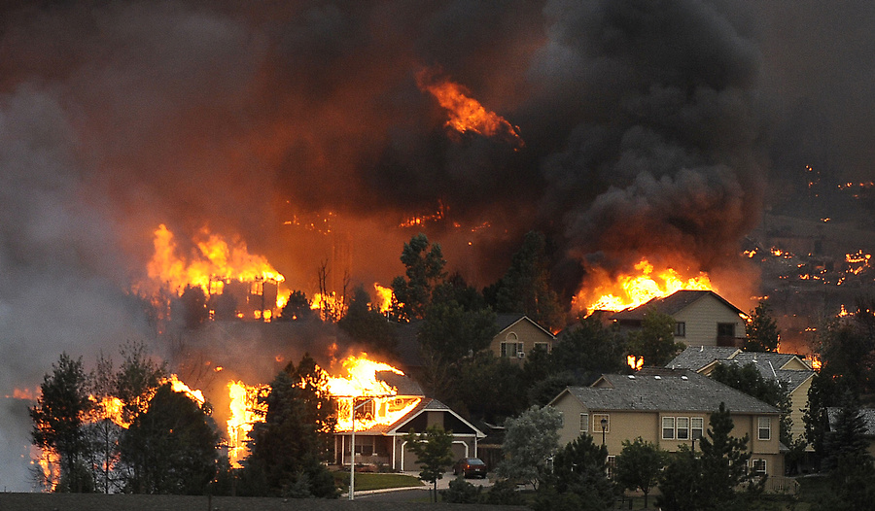
Wildfire

Slide 38
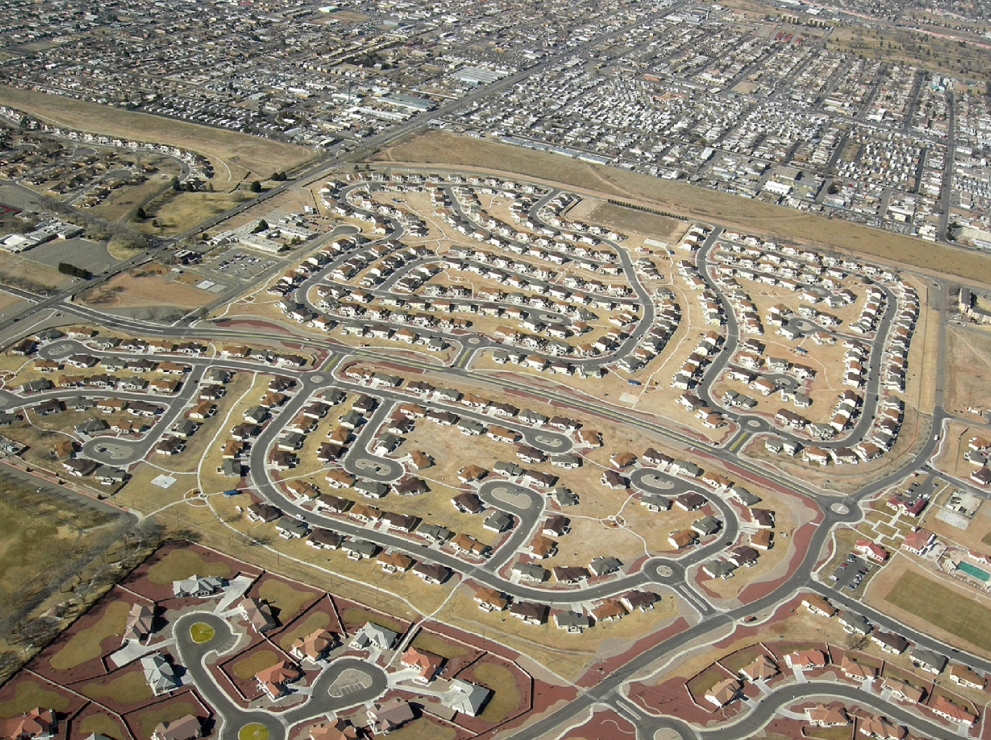
Real Estate Development

Slide 39
For How Long?
If China and India industrialize with coal, CO₂ will rise to 4x preindustrial
Extra CO₂ will last for centuries after coal is gone
CO₂
CO₂ (ppm)
Warming (Celsius)
warming
you are
here
GtC/yr
year
The heck with Polar Bears … what would that do to farmers?

Slide 40
What we Know for Sure
Burning carbon produces CO₂
CO₂ emits heat
Heat warms things up
Each doubling of CO₂ adds 4 Watts/sq m
Two doublings if China and India industrialize with coal
Extra CO₂ lasts for thousands of years (because oceans mix very slowly)

Slide 41
What we Really Can’t Know
Precisely how, when, & where climate will change (especially locally)
Effects of future changes on
Ecosystems
Economies
Politics
People
What to do about all this!

Slide 42
Effective Engagement
Theory:
A spectrum of opinion
“Us vs Them”
Belief vs Knowledge
Practice:
Simple
Serious
Solvable

Slide 43
The Worst Myth of All
Without the subsidy of cheap fossil energy, civilization will crumble!
People will freeze in the dark!
They’ll starve!
“The sky is falling!”
Be skeptical … be very skeptical !

Slide 44
Historical Emissions
Billions of Tons Carbon Emitted per Year
16
8
Historical
emissions
0
1950
2000
2050
2100
Notes:
44

Slide 45
The “Stabilization Triangle”
Billions of Tons Carbon Emitted per Year
16
Current path = “ramp”
Stabilization Triangle
Interim Goal
8
Historical
emissions
Flat path
1.6
0
1950
2000
2050
2100
Notes:
45

Slide 46
“Stabilization Wedges”
Billions of Tons Carbon Emitted per Year
16 GtC/y
16
Current path = “ramp”
Eight “wedges”
Goal: In 50 years, same
global emissions as today
8
Historical
emissions
Flat path
1.6
0
1950
2000
2050
2100
http://www.princeton.edu/wedges/
Notes:
46

Slide 47
What is a “Wedge”?
A “wedge” is a strategy to reduce carbon emissions that grows in 50 years from zero to 1.0 GtC/yr. The strategy has already been commercialized at scale somewhere.
1 GtC/yr
Total = 25 Gigatons carbon
50 years
A “solution” to the CO₂ problem should provide at least one wedge.
Pacala and Soclow described 15 quantitative wedges!

Slide 48
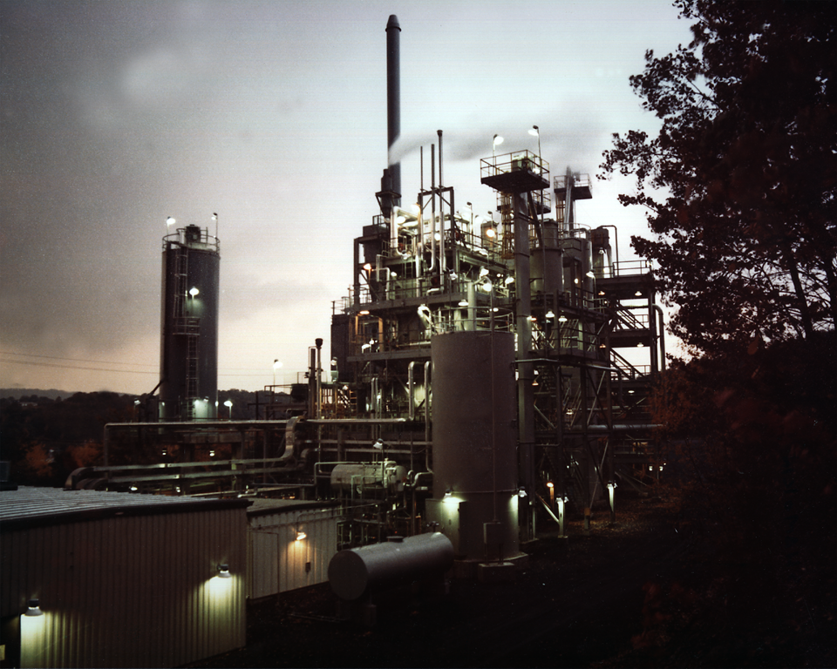
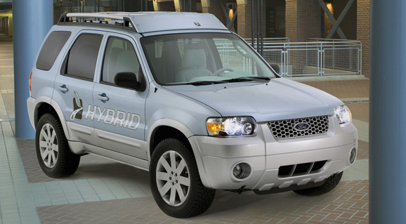
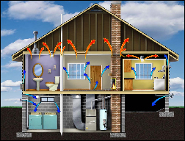
Efficiency
Photos courtesy of Ford Motor Co., DOE, EPA
Produce today’s electric capacity with double today’s efficiency
Double the fuel efficiency of the world’s cars or halve miles traveled
Average coal plant efficiency is 32% today
Use best efficiency practices in all residential and commercial buildings
There are about 600 million cars today, with 2 billion projected for 2061
Replacing all the world’s incandescent bulbs with CFL’s would provide 1/4 of one wedge
Notes:
“E,T, H” = can be applied to electric, transport, or heating sectors, $=rough indication of cost (on a scale of $ to $$$)

Slide 49
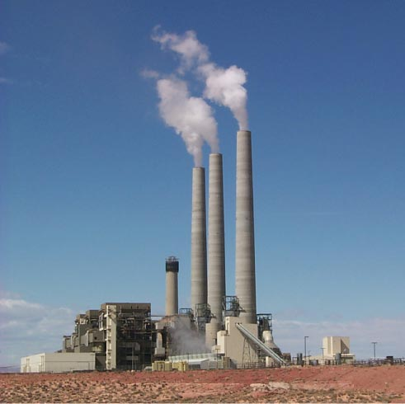
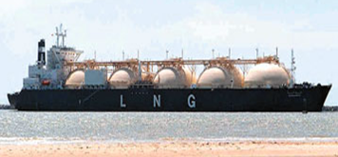
Fuel Switching
Photo by J.C. Willett (U.S. Geological Survey).
Substitute 1400 natural gas electric plants for an equal number of coal-fired facilities
A wedge requires an amount of natural gas equal to that used for all purposes today
Notes:
“E,H” = can be applied to electric or heating sectors, $=rough indication of cost (on a scale of $ to $$$)
Effort needed for 1 wedge:
Build 1400 GW of capacity powered by natural gas instead of coal (60% of current fossil fuel electric capacity)
Requires an amount of natural gas equal to that used for all purposes today
So a slice is 50 LNG tanker discharges/day by 2054 @200,000 m3/tanker, or
one new “Alaska” pipeline/year @ 4 Bscfd.
Detailed Description: NATURAL GAS TURBINES ARE BEING DEVELOPED TO PRODUCE ELECTRICITY IN A SIMPLE, LOW COST ENVIRONMENTALLY FRIENDLY WAY. DOE'S NATIONAL ENERGY TECHNOLOGY LABORATORY (NETL) INITIATED THE ADVANCED TURBINE SYSTEMS (ATS) PROGRAM AND HAS PARTNERED WITH INDUSTRY TO PRODUCE A NEW GENERATION OF HIGH EFFICIENCY GAS TURBINES FOR CENTRAL STATION ELECTRICITY PRODUCTION, USING CLEAN BURNING NATURAL GAS.
700 1-GW baseload coal plants (5400 TWh/y) emit 1 GtC/y.
Natural gas: 1 GtC/y = 190 Bscfd
Yr 2000 electricity:
Coal : 6000 TWh/y; Natural gas: 2700 TWh/y.

Slide 50
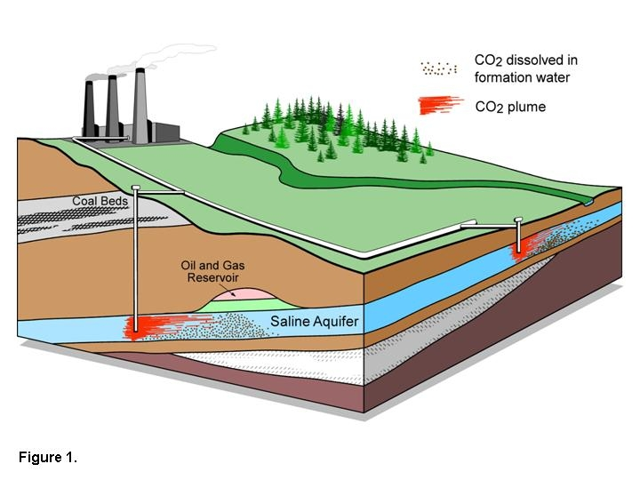
Carbon Capture & Storage
Implement CCS at
800 GW coal electric plants or
1600 GW natural gas electric plants or
180 coal synfuels plants or
10 times today’s capacity of hydrogen plants
Graphic courtesy of Alberta Geological Survey
There are currently three storage projects that each inject 1 million tons of CO₂ per year – by 2061 we’d need 3500.
Notes:
“E,T, H” = can be applied to electric, transport, or heating sectors, $=rough indication of cost (on a scale of $ to $$$)

Slide 51
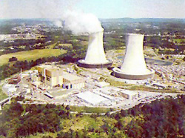
Nuclear Electricity
Triple the world’s nuclear electricity capacity by 2061
Graphic courtesy of NRC
The rate of installation required for a wedge from electricity is equal to the global rate of nuclear expansion from 1975-1990.
Notes:
“E” = can be applied to electric sector, $$=rough indication of cost (on a scale of $ to $$$)
Plutonium (Pu) production by 2054, if fuel cycles are unchanged: 4000 t Pu (and another 4000 t Pu if current capacity is continued).
Compare with ~ 1000 t Pu in all current spent fuel, ~ 100 t Pu in all U.S. weapons.
5 kg ~ Pu critical mass.

Slide 52
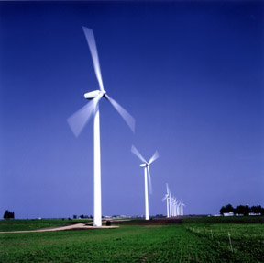
Wind Electricity
Install 1 million 2 MW windmills to replace coal-based electricity,
OR
Use 2 million windmills to produce hydrogen fuel
Photo courtesy of DOE
A wedge worth of wind electricity will require increasing current capacity by a factor of 30
Notes:
“E,T, H” = can be applied to electric, transport, or heating sectors, $-$$=rough indication of cost (on a scale of $ to $$$)

Slide 53
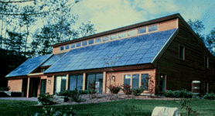
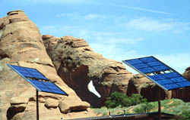
Solar Electricity
Install 20,000 square kilometers for dedicated use by 2054
Photos courtesy of DOE Photovoltaics Program
A wedge of solar electricity would mean increasing current capacity 700 times
Notes:
“E” = can be applied to electric sector, $$$=rough indication of cost (on a scale of $ to $$$)

Slide 54
Solutions
To provide a decent standard of living for billions of people on Earth
We must be able to generate huge amounts of energy without releasing CO₂
This is definitely do-able (as an engineering task) …
… but expensive and politically difficult
Can’t do it by “tinkering around the edges”
Will require profound changes to energy and economics

Slide 55
Free Market Solutions
A new industrial revolution won’t happen because people want to “do the right thing”
The government can’t just pass a law and create a new global energy economy, any more than they could 200 years ago
If low-carbon-footprint goods and services cost less, people will buy them

Slide 56
Imagine it’s 1800, and you’re in charge …
Somebody presents you with a grand idea for transforming the world economy:
Dig 8 billion tons of carbon out of the ground every year
Build a system of pipelines, supertankers, railroads, highways, and trucks to deliver it to every street corner on the planet
Build millions of cars every year, and millions of miles of roads to drive them on
Generate and pipe enough electricity to every house to power lights & stereos & plasma TVs
… “and here’s the itemized bill …”

Slide 57
Choose Your Future
Some people think:
“Our modern lifestyle is only possible because of the subsidy of cheap fossil fuel. If we stop burning coal we’ll freeze in the dark!”
I prefer:
“Our well-being depends on creativity and hard work. Before we run out of oil, we’ll invent energy technologies for the 21st Century.
Our future is bright.”

