Slide 1

Global Carbon Budget
2016
Published on 14 November 2016
PowerPoint version 1.0 (released 14 November 2016)

Slide 2
Acknowledgements
The work presented here has been possible thanks to the enormous observational and modelling efforts of the institutions and networks below
Atmospheric CO₂ datasets
NOAA/ESRL (Dlugokencky and Tans 2016)
Scripps (Keeling et al. 1976)
Fossil Fuels and Industry
CDIAC (Boden et al. 2016)
USGS, 2016
UNFCCC, 2016
BP, 2016
Consumption Emission
Peters et al. 2011
GTAP (Narayanan et al. 2015)
Land-Use Change
Houghton et al. 2012
GFED4 (van der Werf et al. 2010)
FAO-FRA and FAOSTAT
HYDE (Klein Goldewijk et al. 2011)
Atmospheric inversions
CarbonTracker (Peters et al. 2010)
Jena CarboScope (Rödenbeck et al. 2003)
MACC (Chevallier et al. 2005)
Land models
CABLE-POP | CLASS-CTEM | CLM4.5BGC | DLEM | ISAM | JSBACH | JULES | LPJ-GUESS | LPJ | LPX | OCNv2 | ORCHIDEE | SDGVM | VISIT
CRU (Harris et al. 2014)
Ocean models
NEMO-PlankTOM5 | NEMO-PISCES (IPSL) | CCSM-BEC | MICOM-HAMMOC | NEMO-PISCES (CNRM) | CSIRO | MITgem-REcoM2
Ocean Data products
Jena CarboScope (Rödenbeck et al. 2014)
Landschützer et al. 2015
SOCATv4 (Bakker et al. 2016)
Full references provided in Le Quéré et al 2016

Slide 3
Contributors 74 people | 57 organisations | 14 countries
C Le Quéré UK | RM Andrew Norway | GP Peters Norway | JG Canadell Australia | S Sitch UK | JI Korsbakken Norway | P Ciais France | P Friedlingstein UK | AC Manning UK
TA Boden USA | PP Tans USA | RA Houghton USA | RF Keeling USA
S Alin USA | OD Andrews UK | P Anthoni USA | L Barbero USA | L Bopp France | F Chevallier France | LP Chini USA | K Currie New Zealand | C Delire France | SC Doney USA | S Fuss Germany | T Gkritzalis Belgium | I Harris UK | J Hauck Germany | V Haverd Australia | M Hoppema Germany | R Jackson USA | K Jain USA | E Kato Japan | K Klein Goldewijk Netherlands | A Körtzinger Germany | P Landschützer Switzerland | N Lefèvre France | A Lenton Australia | S Lienert Switzerland | D Lombardozzi USA | JR Melton Canada | N Metzl France | F Millero USA | PMS Monteiro South Africa | DR Munro USA | JEMS Nabel Germany | S-I Nakaoka Japan | N Nakicenovic Austria | K O'Brien USA | A Olsen Norway | AM Omar Norway | T Ono Japan | D Pierrot USA | B Poulter USA | C Rödenbeck Germany | J Rogelj Austria | J Salisbury USA | U Schuster UK | J Schwinger Norway | R Séférian France | I Skjelvan Norway | BD Stocker UK | AJ Sutton USA | T Takahashi USA | H Tian USA | B Tilbrook Australia | IT van der Laan-Luijkx Netherlands | GR van der Werf Netherlands | N Viovy France | AP Walker USA | AJ Wiltshire UK | S Zaehle Germany
Atlas Science Committee | Atlas Team Members at LSCE, France (not already mentioned above)
A Peregon | P Peylin | P Brockmann | V Maigné | P Evano | C Nangini
Communications Team
A Minns | O Gaffney | B Woolliams

Slide 4
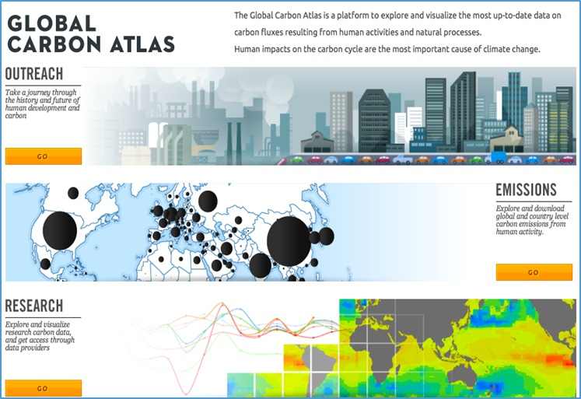
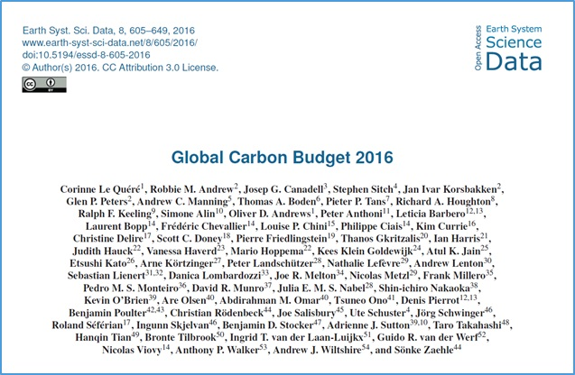
Data access
More information, data sources and data files:
www.globalcarbonproject.org
Contact: c.lequere@uea.ac.uk
More information, data sources and data files:
www.globalcarbonatlas.org
(funded in part by BNP Paribas Foundation)
Contact: philippe.ciais@lsce.ipsl.fr

Slide 5
All the data is shown in billion tonnes CO₂ (GtCO₂)
1 Gigatonne (Gt) = 1 billion tonnes = 1×10¹⁵g = 1 Petagram (Pg)
1 kg carbon (C) = 3.664 kg carbon dioxide (CO₂)
1 GtC = 3.664 billion tonnes CO₂ = 3.664 GtCO₂
(Figures in units of GtC and GtCO₂ are available from http://globalcarbonbudget.org/carbonbudget)
Disclaimer
The Global Carbon Budget and the information presented here are intended for those interested in learning about the carbon cycle, and how human activities are changing it. The information contained herein is provided as a public service, with the understanding that the Global Carbon Project team make no warranties, either expressed or implied, concerning the accuracy, completeness, reliability, or suitability of the information.

Slide 6
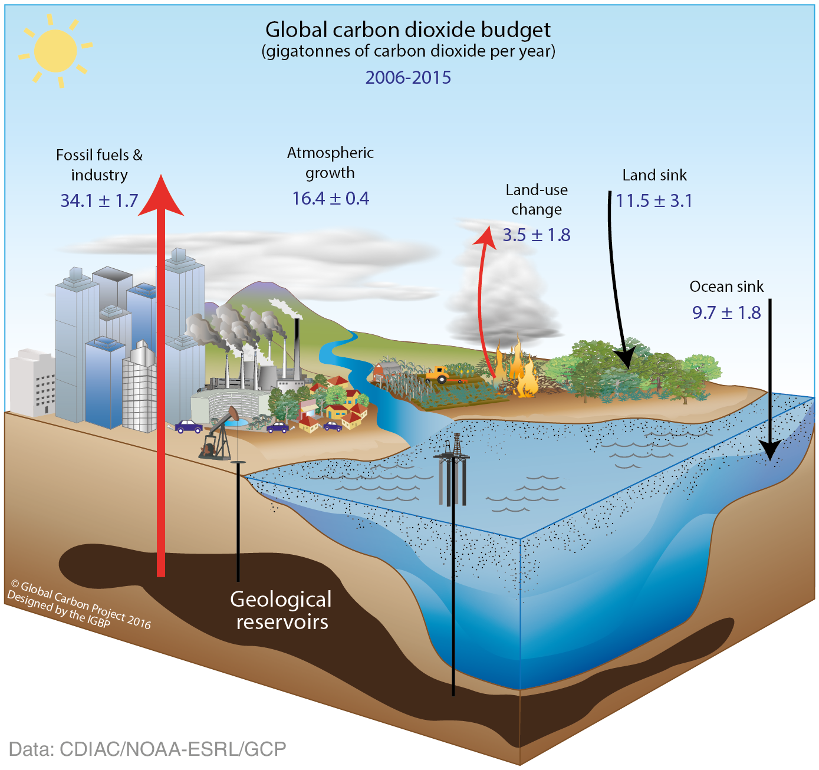
Anthropogenic perturbation of the global carbon cycle
Perturbation of the global carbon cycle caused by anthropogenic activities,
averaged globally for the decade 2006–2015 (GtCO₂/yr)
Source: CDIAC; NOAA-ESRL; Le Quéré et al 2016; Global Carbon Budget 2016

Slide 7
Fossil Fuel and Industry Emissions

Slide 8
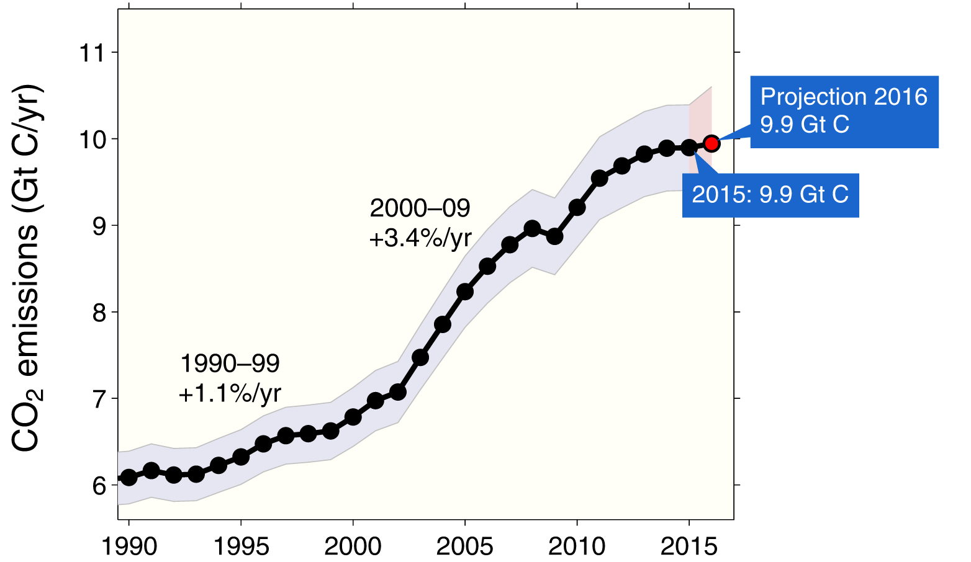
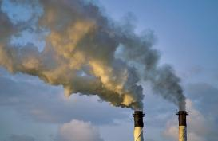
Emissions from fossil fuel use and industry
Global emissions from fossil fuel and industry: 36.3 ± 1.8 GtCO₂ in 2015, 63% over 1990
Projection for 2016: 36.4 ± 2.3 GtCO₂, 0.2% higher than 2015
Uncertainty is ±5% for one standard deviation (IPCC “likely” range)
Estimates for 2014 and 2015 are preliminary. Growth rate is adjusted for the leap year in 2016.
Source: CDIAC; Le Quéré et al 2016; Global Carbon Budget 2016

Slide 9
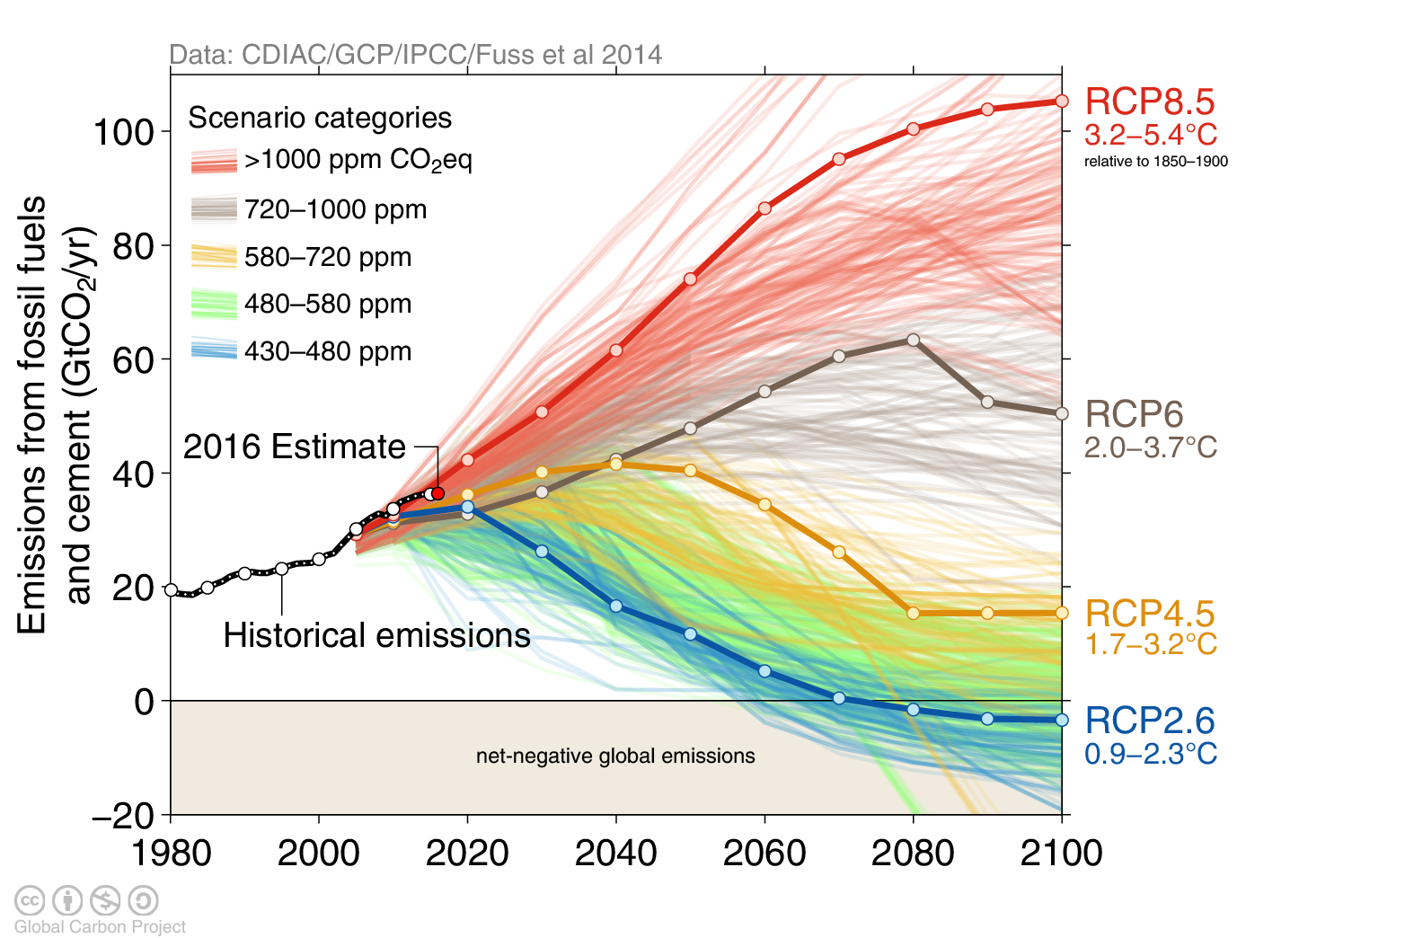
Observed emissions and emissions scenarios
The emission pledges to the Paris Agreement avoid the worst effects of climate change (4-5°C) Most studies suggest the pledges give a likely temperature increase of about 3°C in 2100
The IPCC Fifth Assessment Report assessed about 1200 scenarios with detailed climate modelling on four Representative Concentration Pathways (RCPs)
Source: Fuss et al 2014; CDIAC; IIASA AR5 Scenario Database; Global Carbon Budget 2016

Slide 10
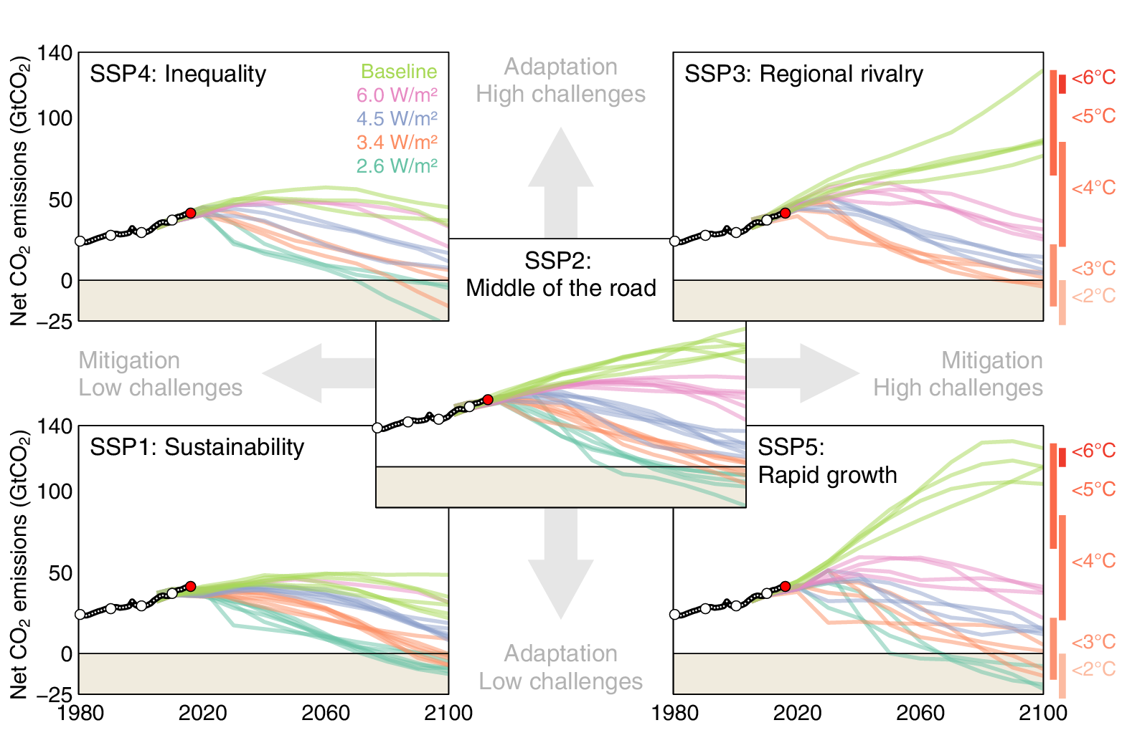
New generation of scenarios
In the lead up to the IPCC’s Sixth Assessment Report new scenarios have been developed to more systematically explore key uncertainties in future socioeconomic developments
Five Shared Socioeconomic Pathways (SSPs) have been developed to explore challenges to adaptation and mitigation. Shared Policy Assumptions (SPAs) are used to achieve target forcing levels (W/m²).
Source: Riahi et al. 2016; IIASA SSP Database; Global Carbon Budget 2016

Slide 11
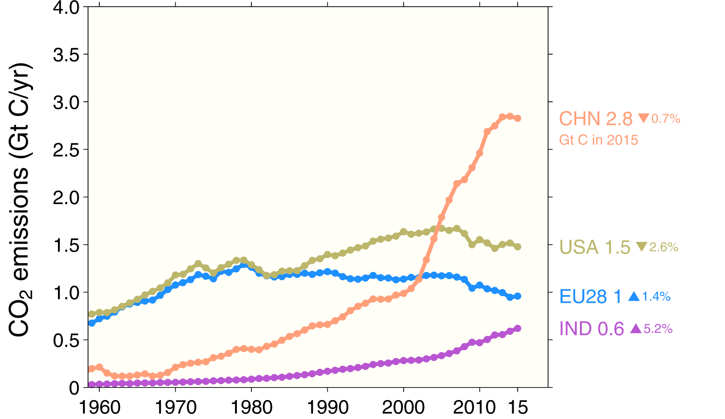
Top emitters: fossil fuels and industry (absolute)
The top four emitters in 2015 covered 59% of global emissions
China (29%), United States (15%), EU28 (10%), India (6%)
Bunker fuels are used for international transport is 3.1% of global emissions.
Statistical differences between the global estimates and sum of national totals are 1.2% of global emissions.
Source: CDIAC; Le Quéré et al 2016; Global Carbon Budget 2016

Slide 12
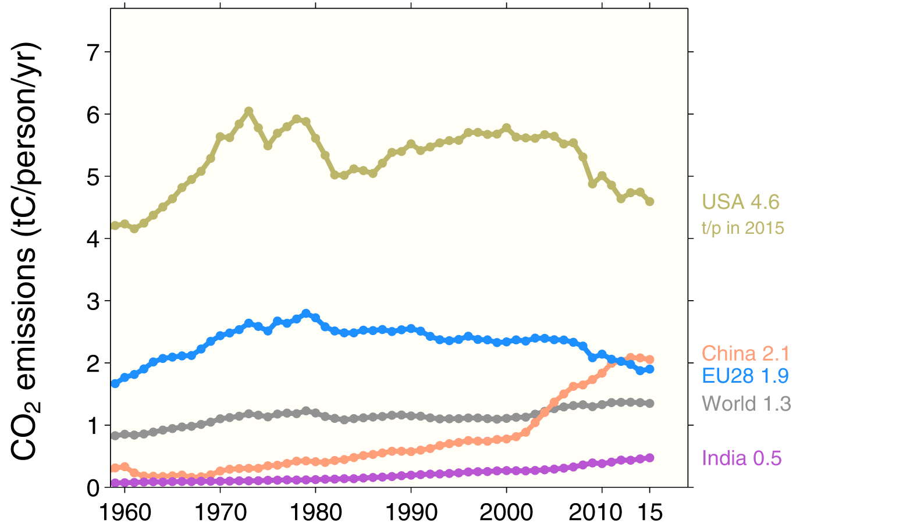
Top emitters: fossil fuels and industry (per capita)
Countries have a broad range of per capita emissions reflecting their national circumstances
Source: CDIAC; Le Quéré et al 2016; Global Carbon Budget 2016

Slide 13
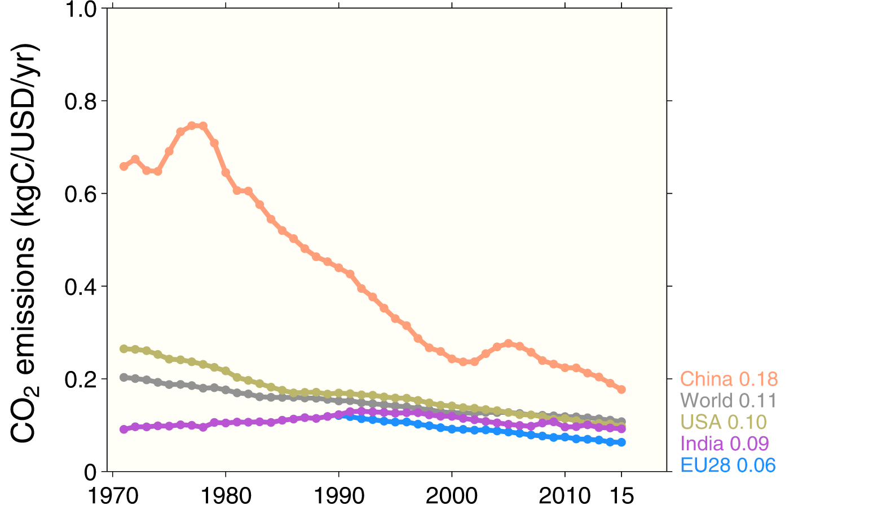
Top emitters: fossil fuels and industry (per dollar)
Emissions per unit economic output (emissions intensities) generally decline over time
China’s intensity is declining rapidly, but is still much higher than the world average
GDP are measured in purchasing power parity (PPP) terms in 2005 dollars.
Source: CDIAC; IEA 2015 GDP to 2013, IMF 2016 growth rates to 2015; Le Quéré et al 2016; Global Carbon Budget 2016

Slide 14
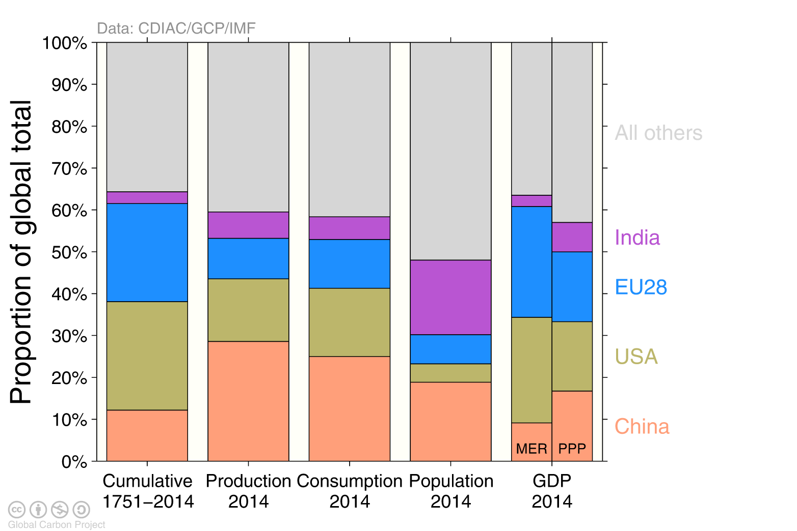
Alternative rankings of countries
Depending on perspective, the significance of individual countries changes
GDP: Gross Domestic Product in Market Exchange Rates (MER) and Purchasing Power Parity (PPP)
Source: CDIAC; United Nations; Le Quéré et al 2016; Global Carbon Budget 2016

Slide 15
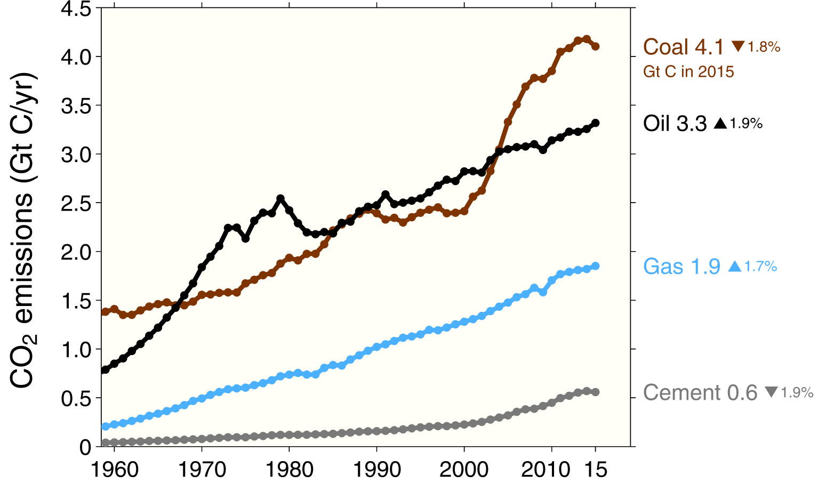
Emissions from coal, oil, gas, cement
Share of global emissions in 2015:
coal (41%), oil (34%), gas (19%), cement (6%), flaring (1%, not shown)
Source: CDIAC; Le Quéré et al 2016; Global Carbon Budget 2016

Slide 16
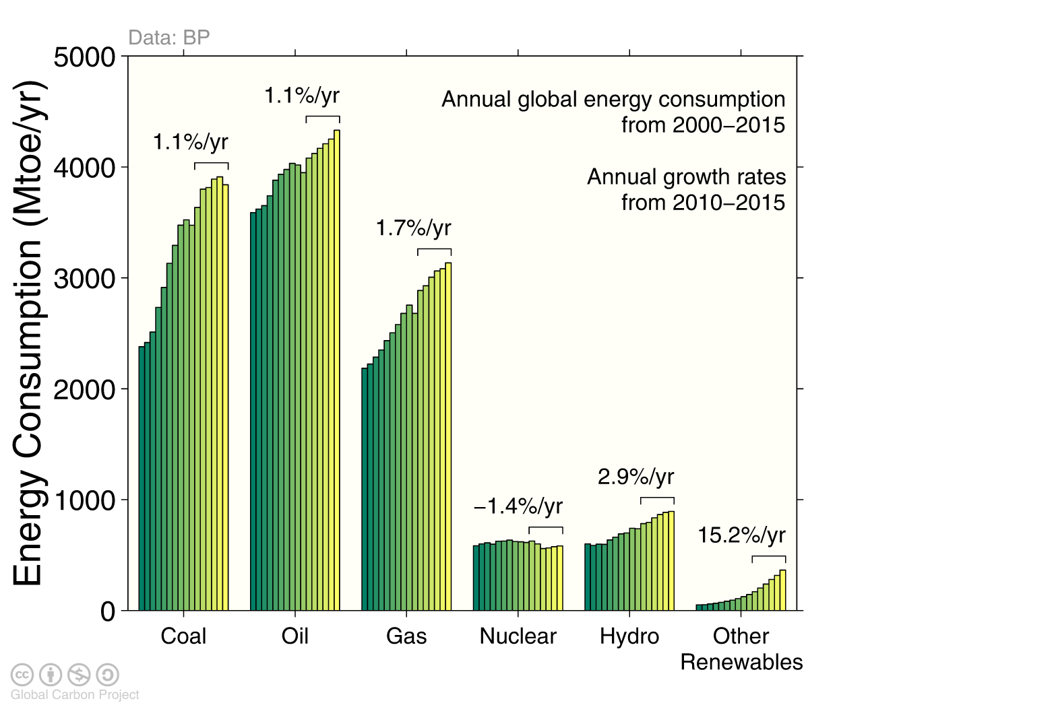
Energy consumption by energy type
Energy consumption by fuel source from 2000 to 2015, with growth rates indicated for the more recent period of 2010 to 2015
Source: BP 2016; Jackson et al 2015; Global Carbon Budget 2016

Slide 17
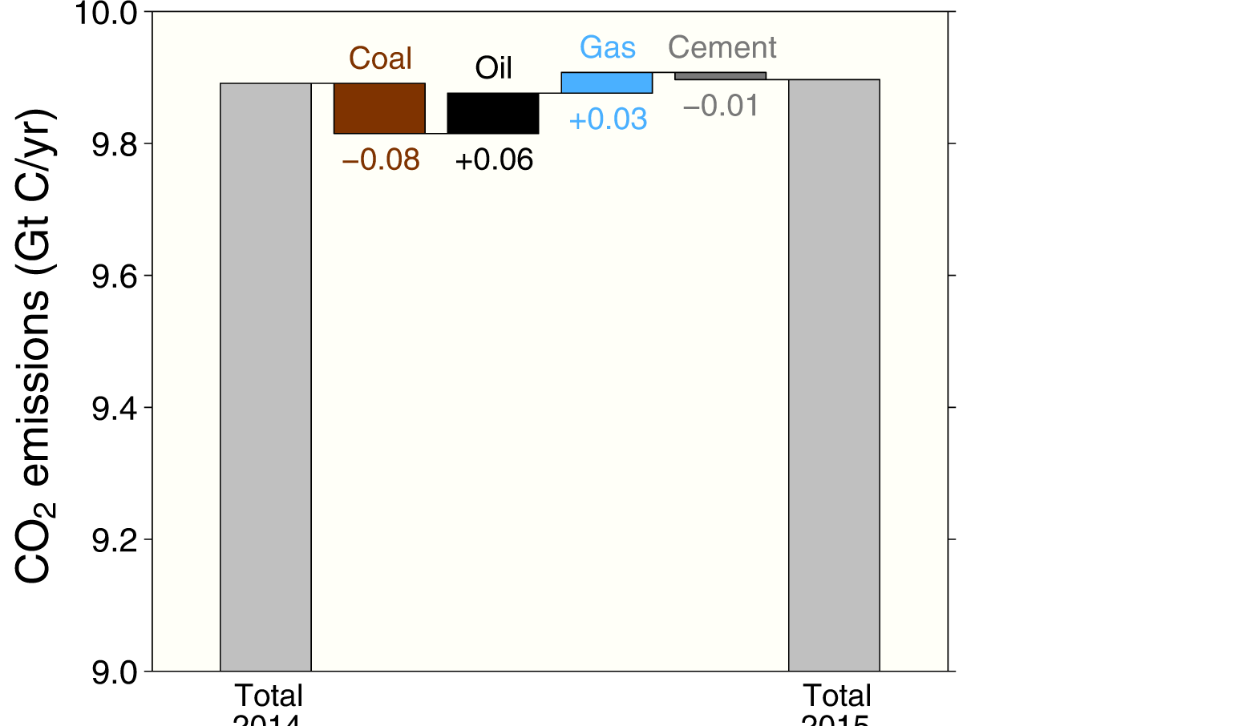
Fossil fuel and cement emissions growth
The biggest changes in emissions were from a decline in coal and an increase in oil
Source: CDIAC; Le Quéré et al 2016; Global Carbon Budget 2016

Slide 18
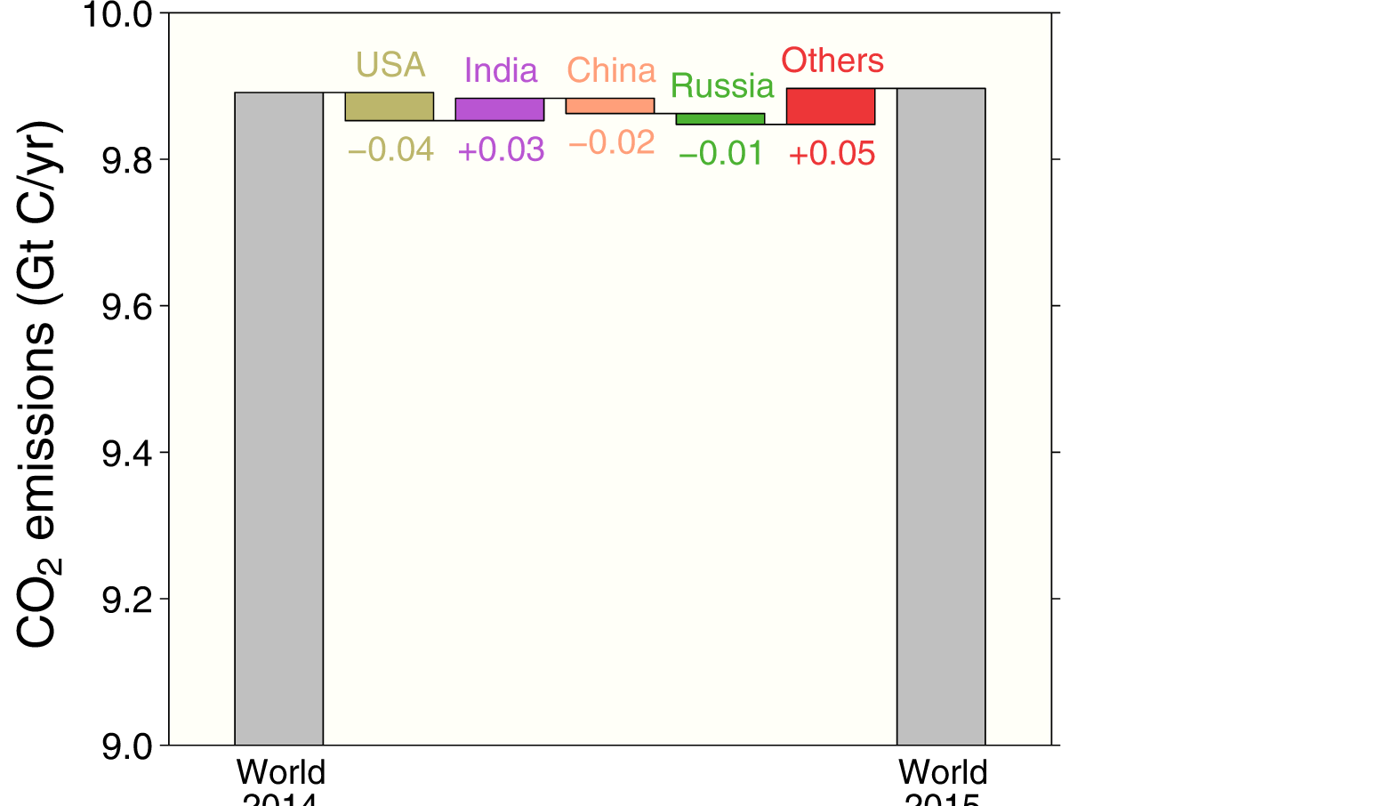
Fossil fuel and cement emissions growth
Emissions in the US, China and Russia declined
Emissions in India and all other countries combined increased
Figure shows the top four countries contributing to emissions changes in 2015
Source: CDIAC; Le Quéré et al 2016; Global Carbon Budget 2016

Slide 19
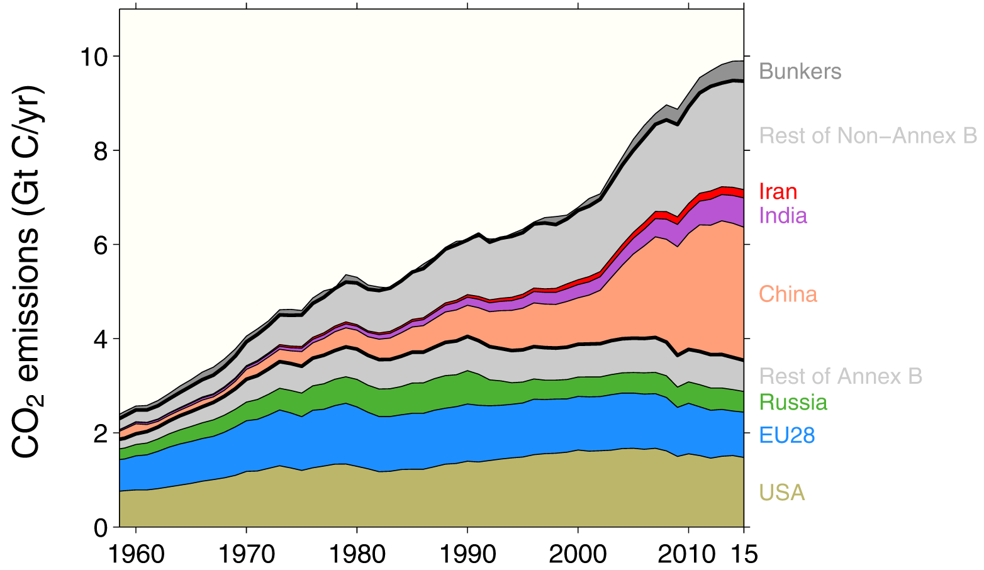
Breakdown of global emissions by country
Emissions from Annex B countries have slightly declined since 1990
Emissions from non-Annex B countries have increased rapidly in the last decade
Annex B countries had emission commitments in the Kyoto Protocol (USA did not ratify, Canada withdrew)
Source: CDIAC; Le Quéré et al 2016; Global Carbon Budget 2016

Slide 20
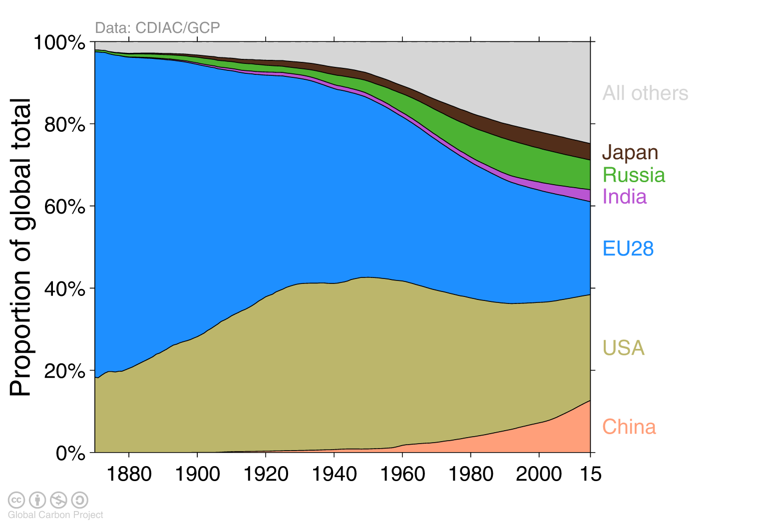
Historical cumulative emissions by country
Cumulative emissions from fossil-fuel and cement were distributed (1870–2015):
USA (26%), EU28 (23%), China (13%), Russia (7%), Japan (4%) and India (3%)
Cumulative emissions (1990–2015) were distributed China (21%), USA (20%), EU28 (14%), Russia (6%), India/Japan (4%)
‘All others’ includes all other countries along with bunker fuels and statistical differences
Source: CDIAC; Le Quéré et al 2016; Global Carbon Budget 2016

Slide 21
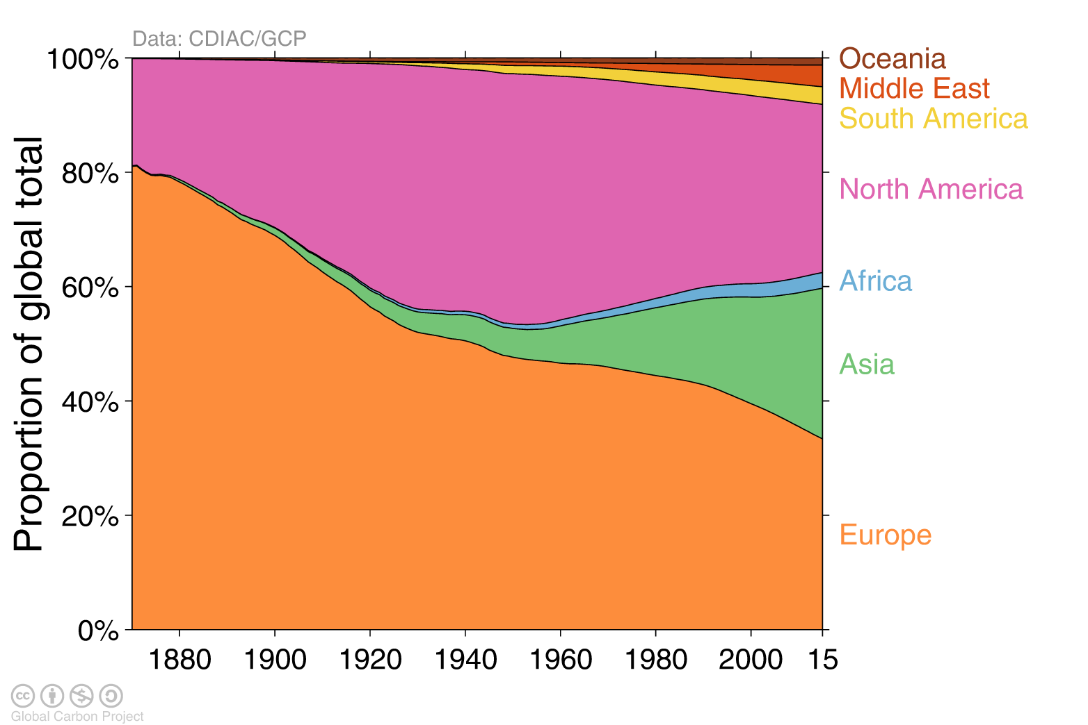
Historical cumulative emissions by continent
Cumulative emissions from fossil-fuel and cement (1870–2015)
North America and Europe responsible for most cumulative emissions, but Asia growing fast
The figure excludes bunker fuels and statistical differences
Source: CDIAC; Le Quéré et al 2016; Global Carbon Budget 2016

Slide 22
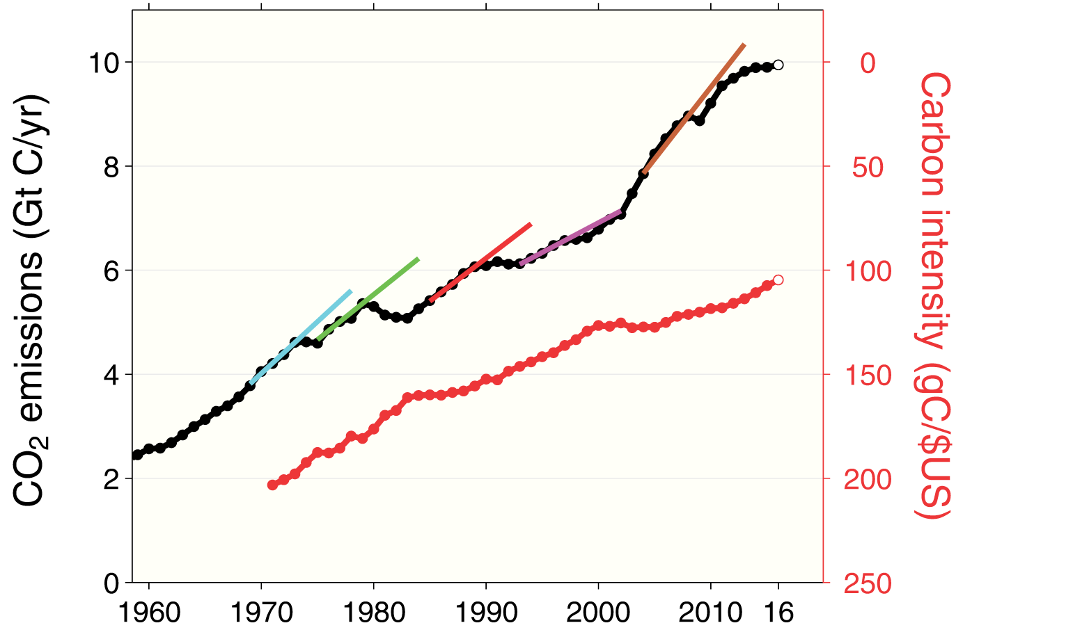
Carbon intensity of economic activity
Global emissions growth has generally recovered quickly from previous financial crises
It is unclear if the recent slowdown in global emissions is related to the Global Financial Crisis
Global
financial
crisis
Asian
financial
crisis
Collapse of
Soviet Union
US savings and
loan crisis
Oil crisis
Economic activity is measured in Purchasing Power Parity
Source: CDIAC; Peters et al 2012; Le Quéré et al 2016; Global Carbon Budget 2016

Slide 23
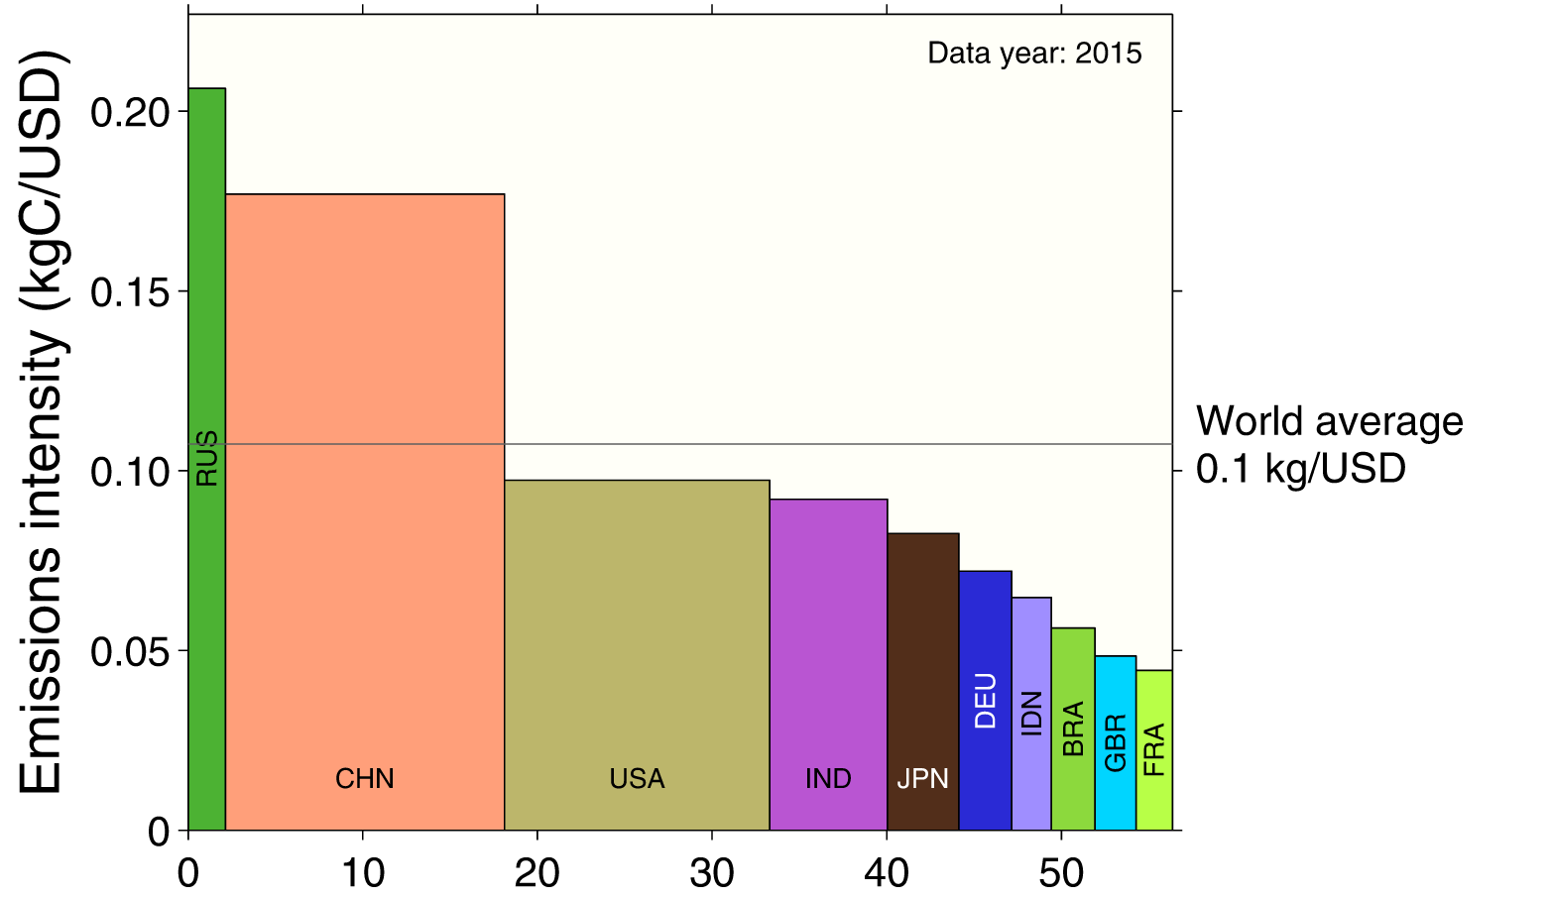
Emissions intensity per unit economic activity
The 10 largest economies have a wide range of emissions intensity of economic production
Emission intensity: CO₂ emissions from fossil fuel and industry divided by Gross Domestic Product
Source: Global Carbon Budget 2016

Slide 24
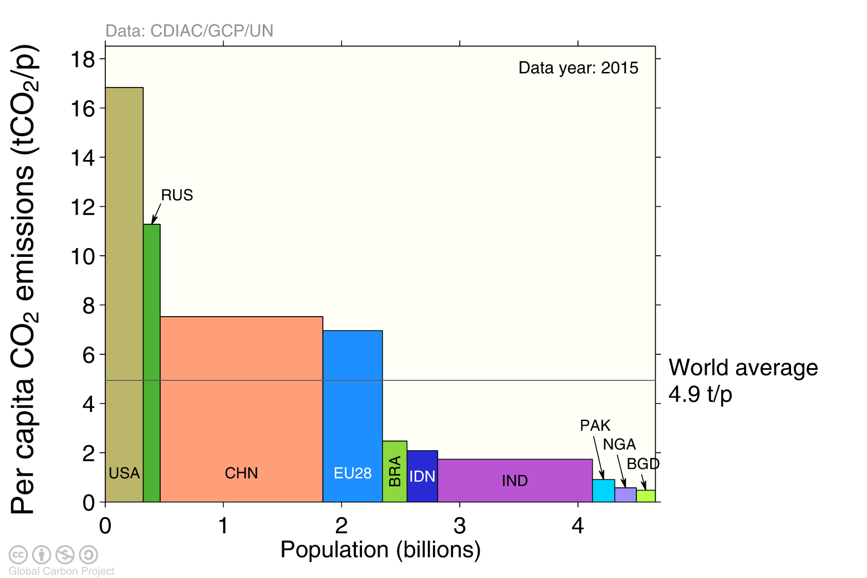
Emissions per capita
The 10 most populous countries span a wide range of development and emissions per person
Emission per capita: CO₂ emissions from fossil fuel and industry divided by population
Source: Global Carbon Budget 2016

Slide 25
Key statistics
 | Emissions 2015
Region/Country | Per capita | Total |  | Growth 2014-15
 | tCO₂ per person | GtCO₂ | % | GtCO₂ | %
Global (with bunkers) | 4.9 | 36.26 | 100 | 0.021 | 0.0
 | Developed Countries (Annex B)
Annex B | 10.6 | 12.97 | 35.8 | -0.228 | -1.7
USA | 16.8 | 5.42 | 14.9 | -0.141 | -2.6
EU28 | 7.0 | 3.51 | 9.7 | 0.048 | 1.4
Russia | 11.3 | 1.62 | 4.5 | -0.055 | -3.3
Japan | 9.8 | 1.24 | 3.4 | -0.028 | -2.2
Canada | 12.9 | 0.46 | 1.3 | -0.014 | -3.0
 | Developing Countries (Non-Annex B)
Non-Annex B | 3.5 | 21.72 | 59.9 | 0.184 | 0.9
China | 7.5 | 10.36 | 28.6 | -0.077 | -0.7
India | 1.7 | 2.27 | 6.3 | 0.113 | 5.2
Iran | 8.2 | 0.65 | 1.8 | 0.010 | 1.5
Saudi Arabia | 19.0 | 0.60 | 1.7 | 0.026 | 4.4
South Korea | 11.8 | 0.59 | 1.6 | 0.001 | 0.2
 | International Bunkers
Aviation and Shipping | - | 1.57 | 4.3 | 0.065 | 4.3
Source: CDIAC; Le Quéré et al 2016; Global Carbon Budget 2016

Slide 26
Consumption-based Emissions
Consumption–based emissions allocate emissions to the location that goods and services are consumed
Consumption-based emissions = Production/Territorial-based emissions minus emissions embodied in exports plus the emissions embodied in imports

Slide 27
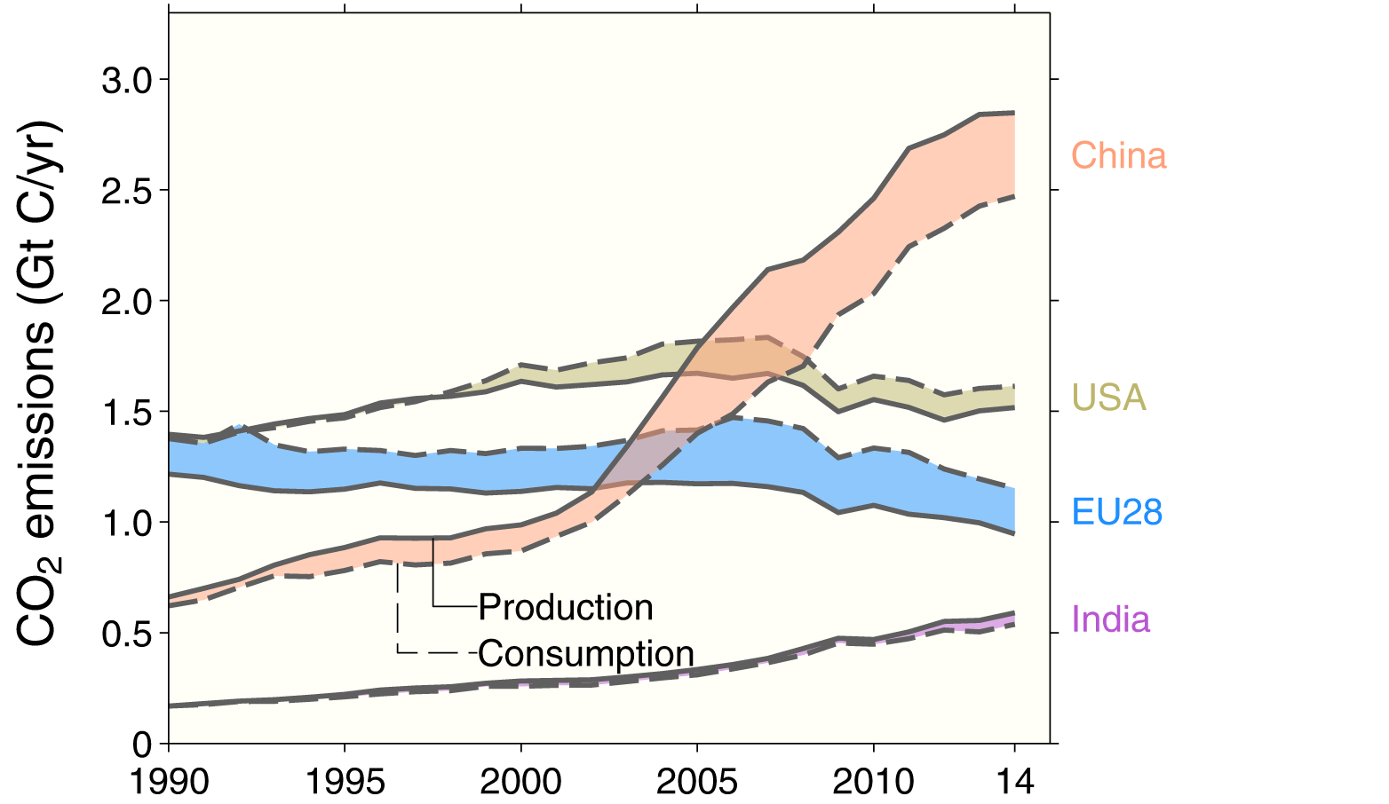
Consumption-based emissions (carbon footprint)
Allocating emissions to the consumption of products provides an alternative perspective
USA and EU28 are net importers of embodied emissions, China and India are net exporters
Consumption-based emissions are calculated by adjusting the
standard production-based emissions to account for international trade
Source: Peters et al 2011; Le Quéré et al 2016; Global Carbon Project 2016

Slide 28
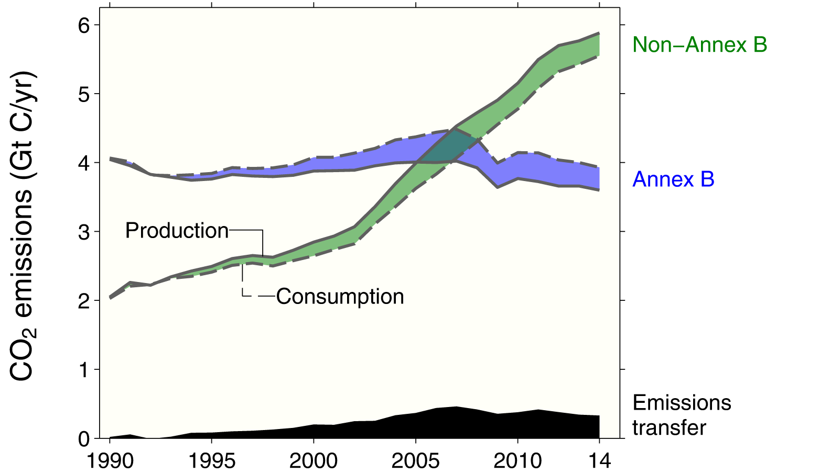
Consumption-based emissions
Transfers of emissions embodied in trade from non-Annex B countries to Annex B countries grew at about 19% per year between 1990 and 2007, but have since declined at nearly 4% per year.
Annex B countries were used in the Kyoto Protocol, but this distinction is less relevant in the Paris Agreement
Source: CDIAC; Peters et al 2011; Le Quéré et al 2016; Global Carbon Budget 2016

Slide 29
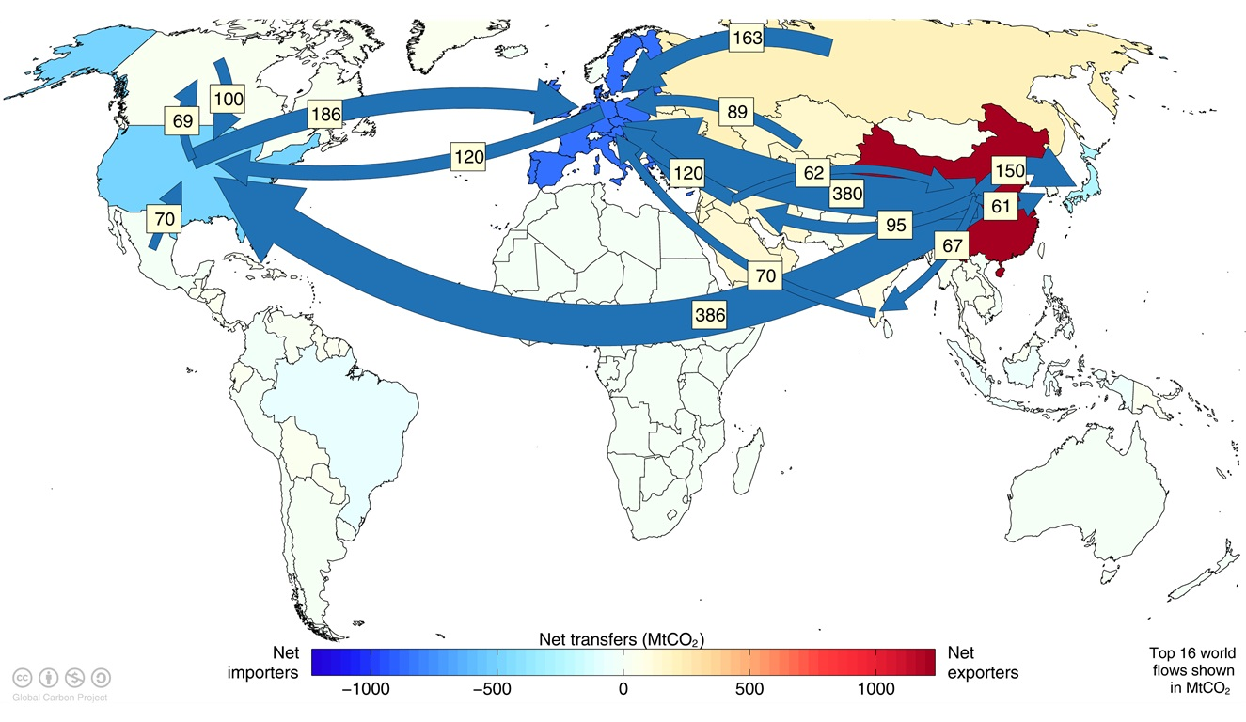
Major flows from production to consumption
Flows from location of generation of emissions to location of
consumption of goods and services
Values for 2011. EU is treated as one region. Units: MtCO₂
Source: Peters et al 2012

Slide 30
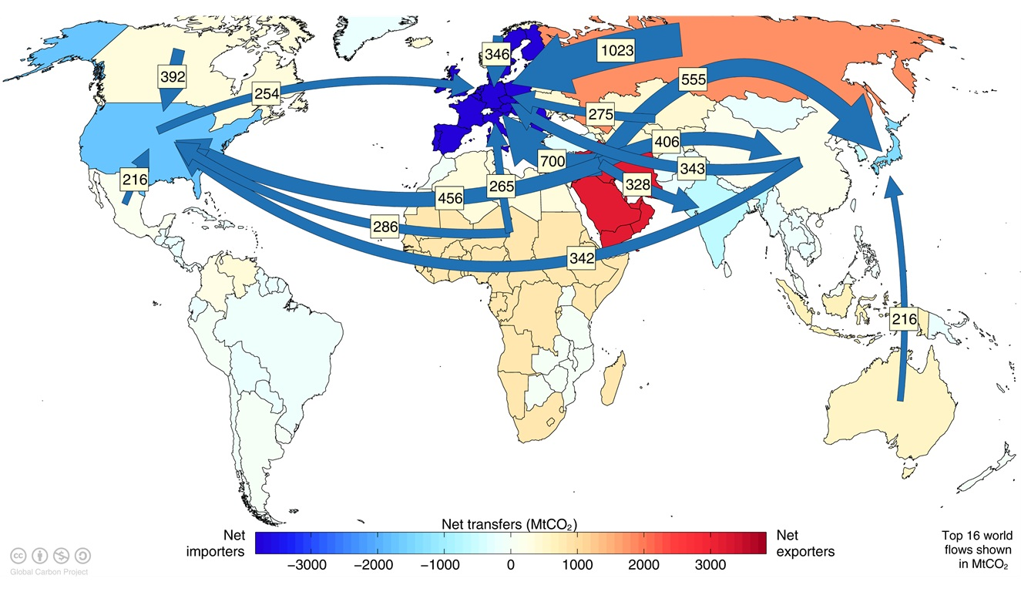
Major flows from extraction to consumption
Flows from location of fossil fuel extraction to location of
consumption of goods and services
Values for 2011. EU is treated as one region. Units: MtCO₂
Source: Andrew et al 2013

Slide 31
Land-use Change Emissions

Slide 32
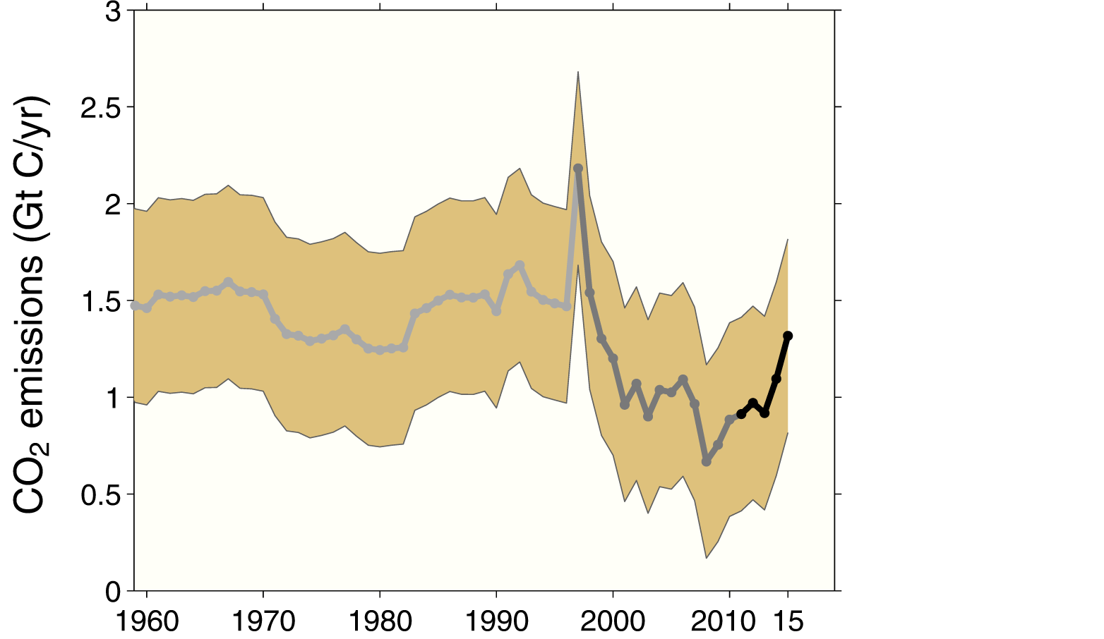
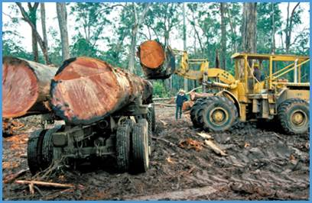
Land-use change emissions
Emissions in the 2000s were lower than earlier decades, but highly uncertain
Higher emissions in 2015 are linked to increased fires during dry El Niño conditions in Asia
Indonesian fires
Indonesian fires
Three different estimation methods have been used, indicated here by different shades of grey
Land-use change also emits CH₄ and N₂O which are not shown here
Source: Houghton et al 2012; Giglio et al 2013; Le Quéré et al 2016; Global Carbon Budget 2016

Slide 33
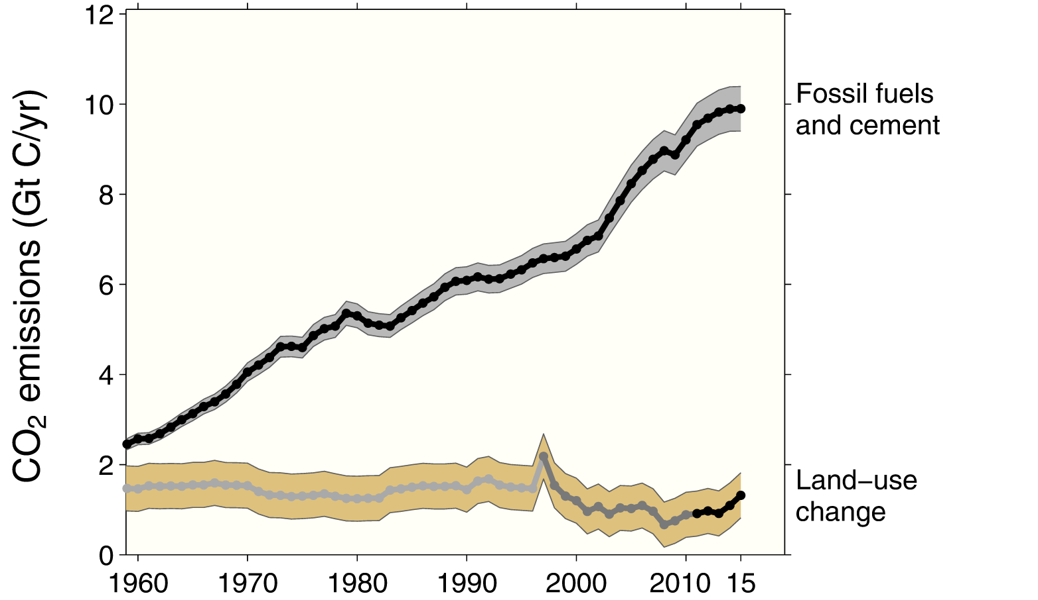
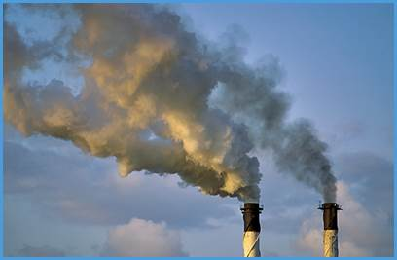
Total global emissions
Total global emissions: 41.9 ± 2.8 GtCO₂ in 2015, 49% over 1990
Percentage land-use change: 36% in 1960, 9% averaged 2006-2015
Three different methods have been used to estimate
land-use change emissions, indicated here by different shades of grey
Source: CDIAC; Houghton et al 2012; Giglio et al 2013; Le Quéré et al 2016; Global Carbon Budget 2016

Slide 34
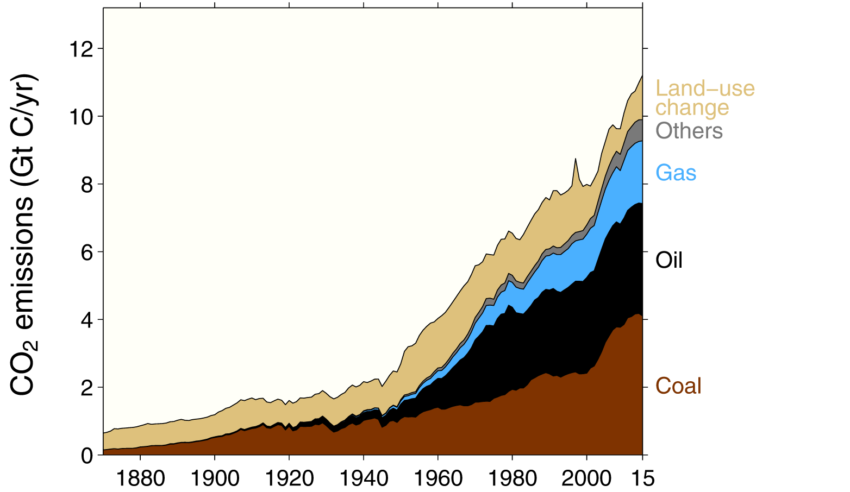
Total global emissions by source
Land-use change was the dominant source of annual CO₂ emissions until around 1950
Others: Emissions from cement production and gas flaring
Source: CDIAC; Houghton et al 2012; Giglio et al 2013; Le Quéré et al 2016; Global Carbon Budget 2016

Slide 35
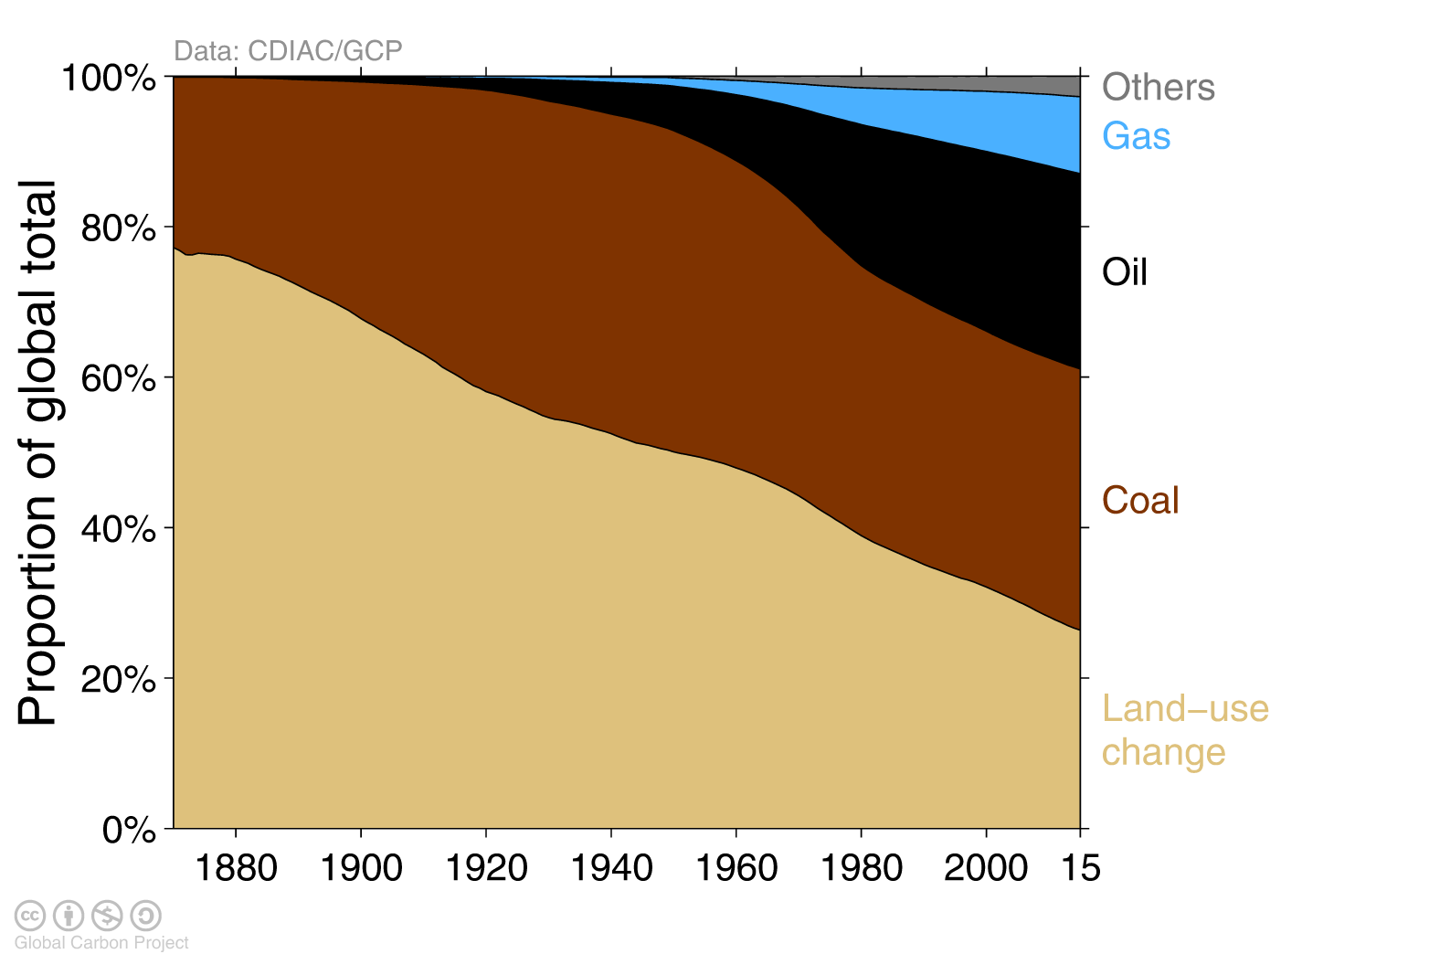
Historical cumulative emissions by source
Land-use change represents about 26% of cumulative emissions over 1870–2015,
coal 35%, oil 26%, gas 10%, and others 3%
Others: Emissions from cement production and gas flaring
Source: CDIAC; Houghton et al 2012; Giglio et al 2013; Le Quéré et al 2016; Global Carbon Budget 2016

Slide 36
Closing the Global Carbon Budget

Slide 37

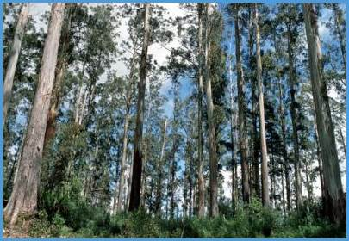

Fate of anthropogenic CO₂ emissions (2006-2015)
16.4 GtCO₂/yr
44%
34.1 GtCO₂/yr
91%
Sources = Sinks
31%
11.6 GtCO₂/yr
9%
3.5 GtCO₂/yr
26%
9.7 GtCO₂/yr
Source: CDIAC; NOAA-ESRL; Houghton et al 2012; Giglio et al 2013; Le Quéré et al 2016; Global Carbon Budget 2016

Slide 38
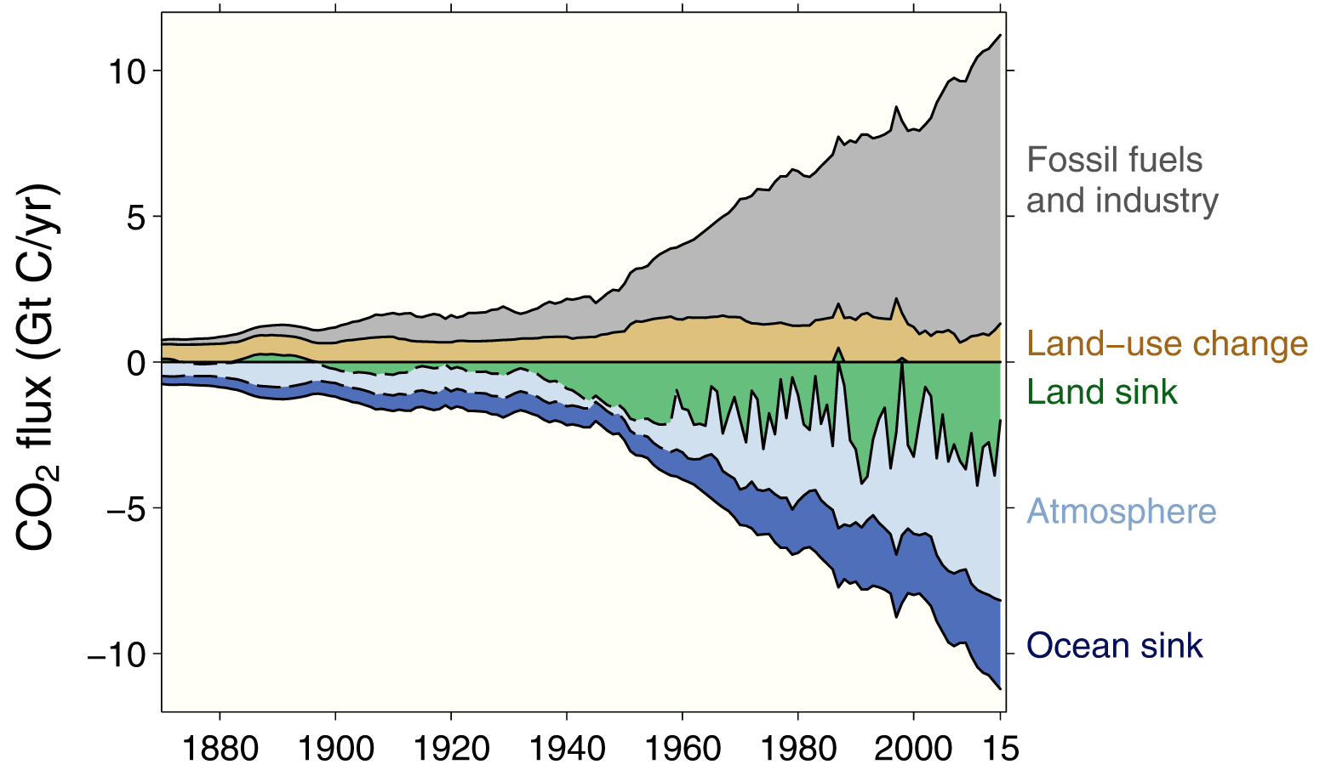
Global carbon budget
The carbon sources from fossil fuels, industry, and land use change emissions are balanced by the atmosphere and carbon sinks on land and in the ocean
Source: CDIAC; NOAA-ESRL; Houghton et al 2012; Giglio et al 2013; Joos et al 2013; Khatiwala et al 2013;
Le Quéré et al 2016; Global Carbon Budget 2016

Slide 39
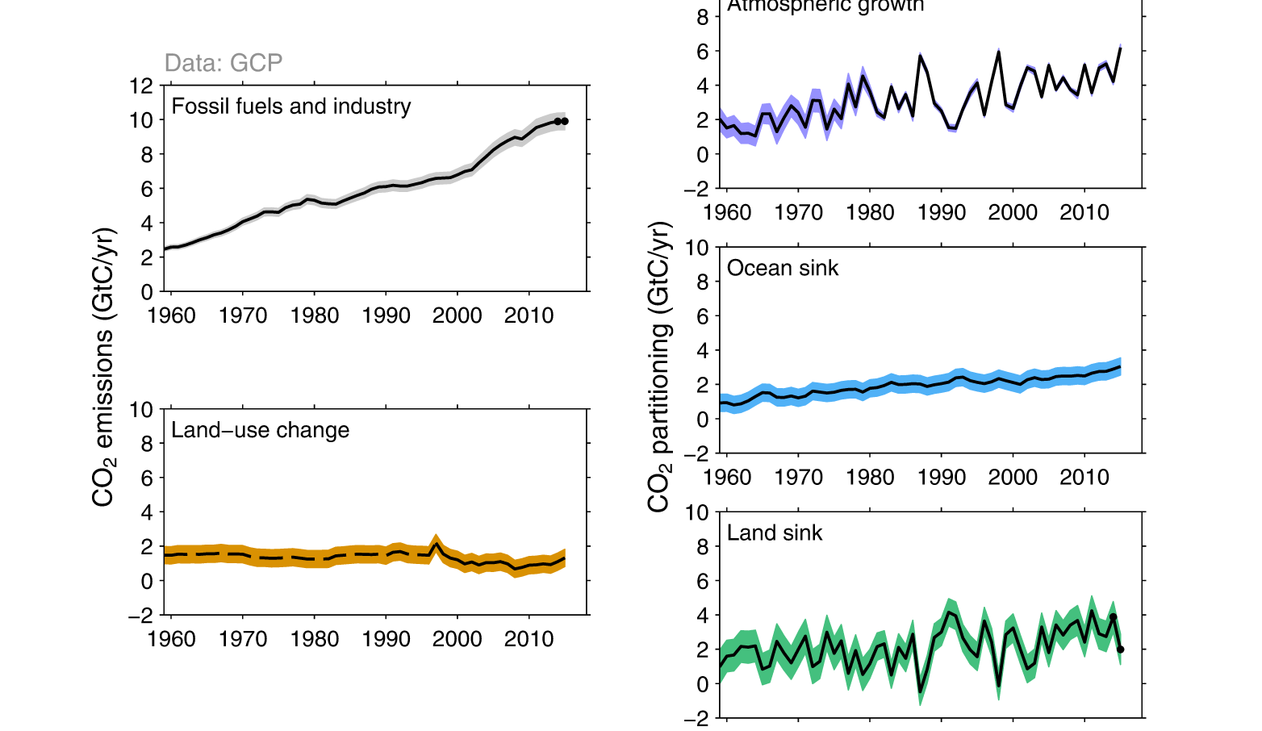
Changes in the budget over time
The sinks have continued to grow with increasing emissions, but climate change will affect carbon cycle processes in a way that will exacerbate the increase of CO₂ in the atmosphere
Source: CDIAC; NOAA-ESRL; Houghton et al 2012; Giglio et al 2013; Le Quéré et al 2016; Global Carbon Budget 2016

Slide 40
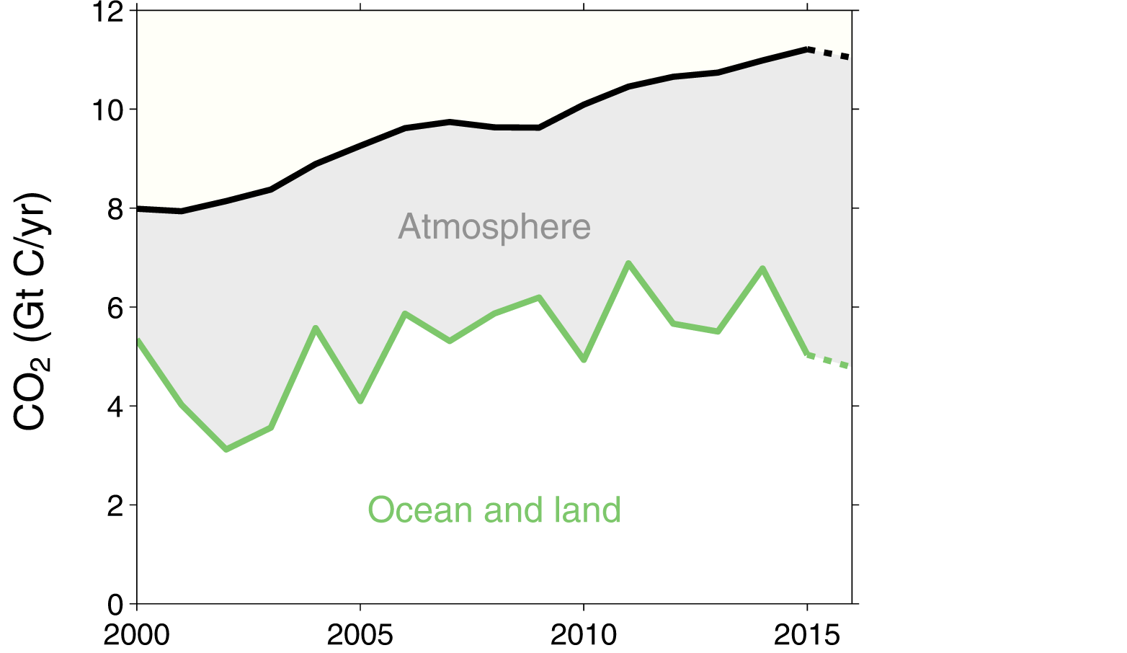
Partitioning of total CO₂ emissions
Atmospheric CO₂ growth rate was a record high in 2015 in spite of no growth in fossil fuel and industry emissions because of a weaker CO₂ sink on land from hot & dry El Niño conditions
The emissions (shown in black) include fossil fuels and industry and land-use change
Source: CDIAC; NOAA-ESRL; Houghton et al 2012; Giglio et al 2013; Joos et al 2013; Khatiwala et al 2013;
Le Quéré et al 2016; Global Carbon Budget 2016

Slide 41
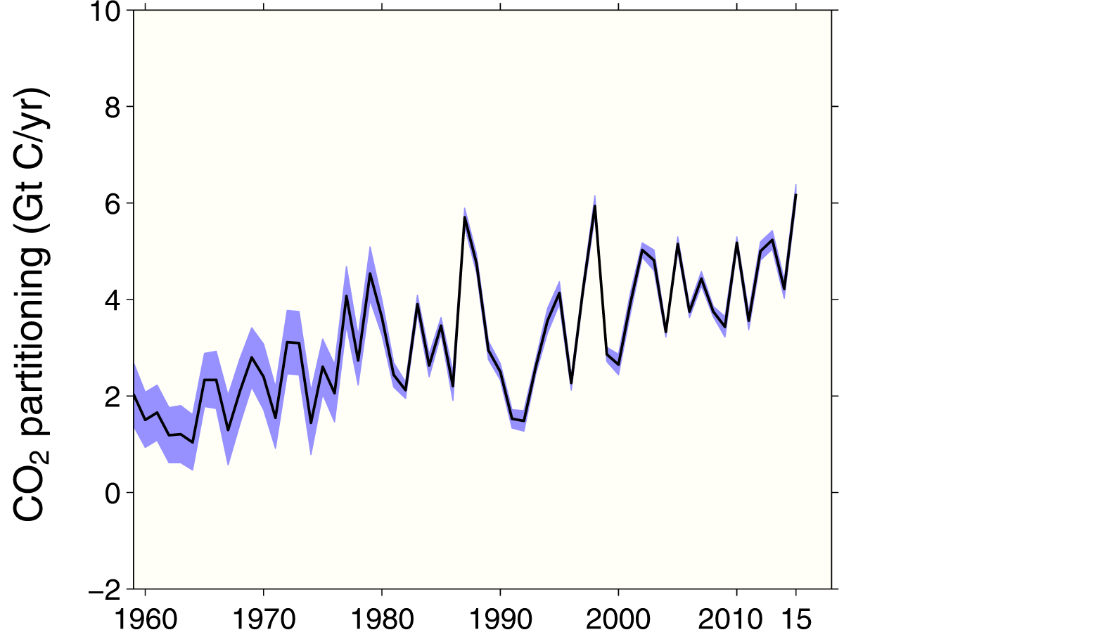
Atmospheric concentration increase
The atmospheric concentration growth rate has shown a steady increase
The high growth in 1987, 1998, & 2015 reflects a strong El Niño, which weakens the land sink
Source: NOAA-ESRL; Global Carbon Budget 2016

Slide 42
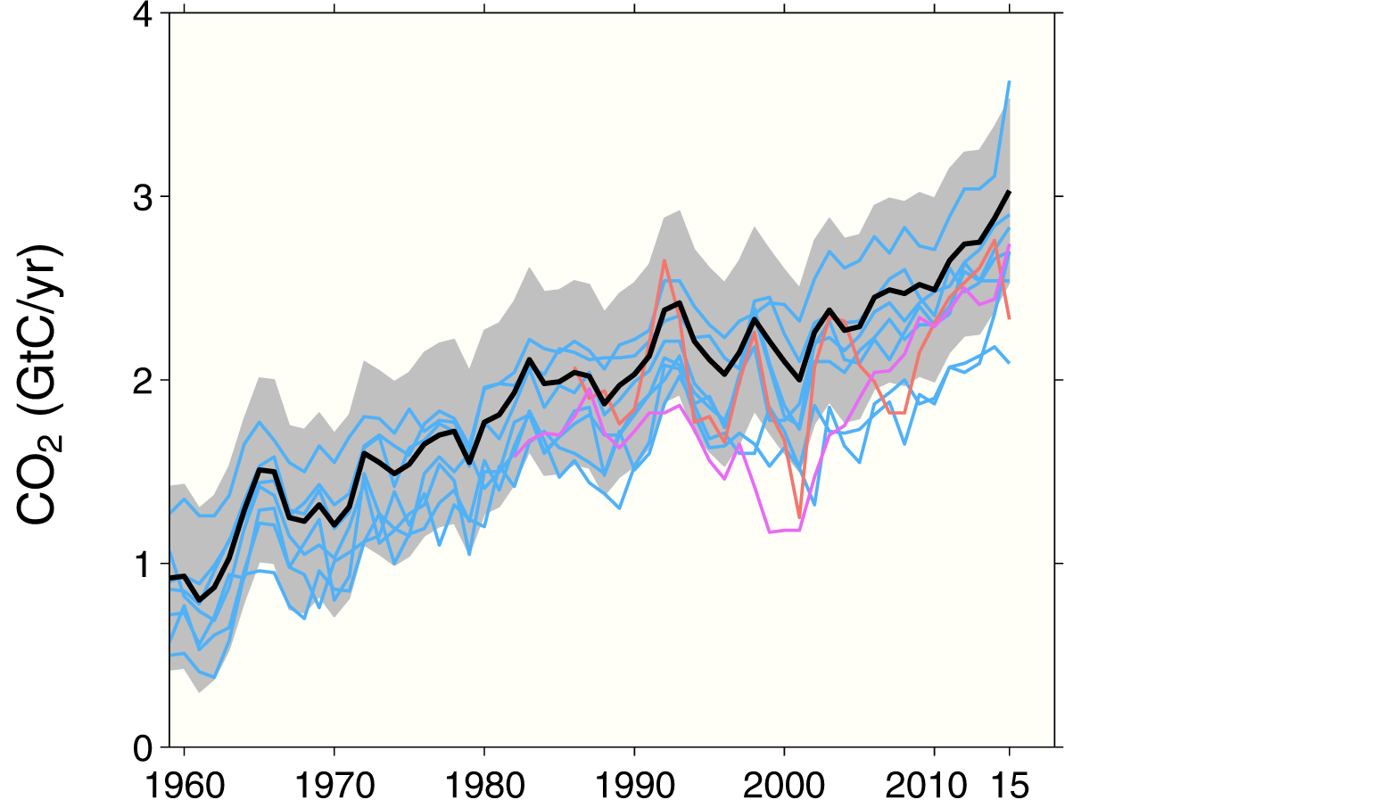
Ocean sink
The ocean carbon sink continues to increase
9.7±1.8 GtCO₂/yr for 2006-2015 and 11.1±1.8 GtCO₂/yr in 2015
this carbon budget
individual ocean models
data products
Source: Le Quéré et al 2016; Global Carbon Budget 2016
Individual estimates from: Aumont and Bopp (2006); Buitenhuis et al. (2010); Doney et al. (2009); Hauck et al. (2016); Landschützer et al. (2015);
Oke et al. (2013); Rödenbeck et al. (2014); Sérérian et al. (2013); Schwinger et al. (2016). Full references provided in Le Quéré et al. (2016).

Slide 43
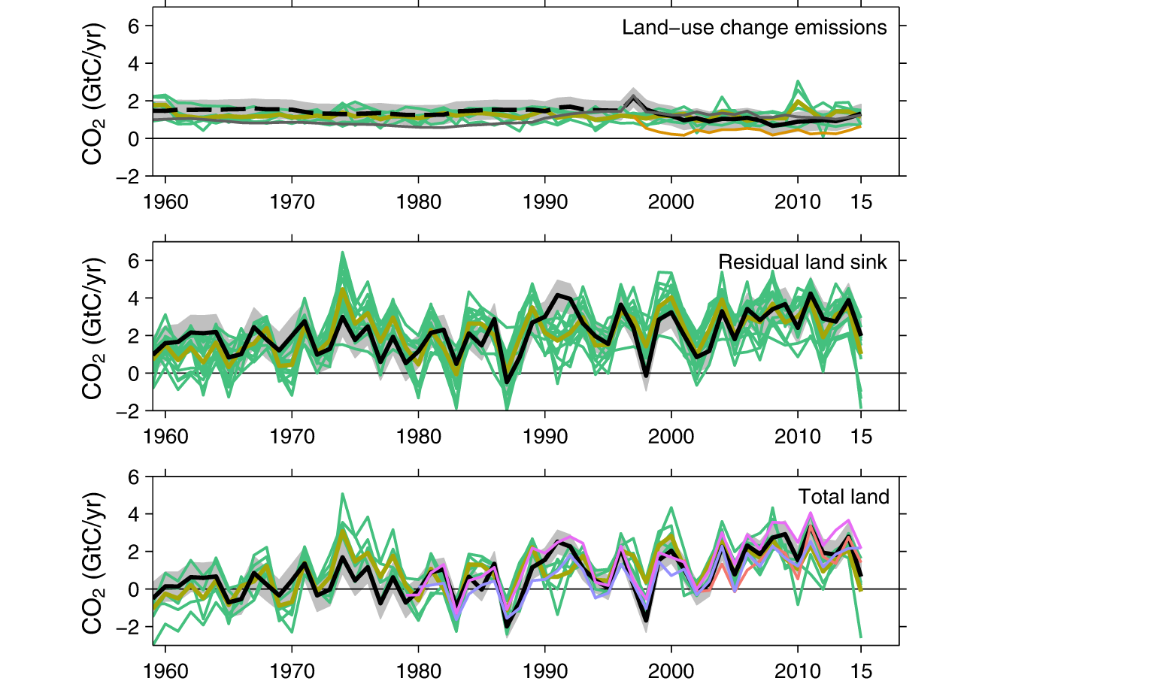
Terrestrial sink
The residual land sink decreased to 6.9±3.2 GtCO₂/yr in 2015, due to El Niño conditions
Total CO₂ fluxes on land (including land-use change) are constrained by atmospheric inversions
this carbon budget
individual land models
fire-based estimate
this carbon budget
individual land models
this carbon budget
individual land models
atmospheric inversions
Source: Le Quéré et al 2016; Global Carbon Budget 2016
Individual estimates from: Chevallier et al. (2005); Clarke et al. (2011); Jain et al. (2013); Kato et al. (2013); Krinner et al. (2005); Melton and Arora (2016); Oleson et al. (2013);
Peters et al. (2010); Reick et al. (2013); Rodenbeck et al. (2003); Sitch et al. (2003); Smith et al. (2014); Stocker et al. (2013); Tian et al. (2010); Woodward et al. (1995);
Zaehle and Friend (2010); Zhang et al. (2013). Full references provided in Le Quéré et al. (2016).

Slide 44
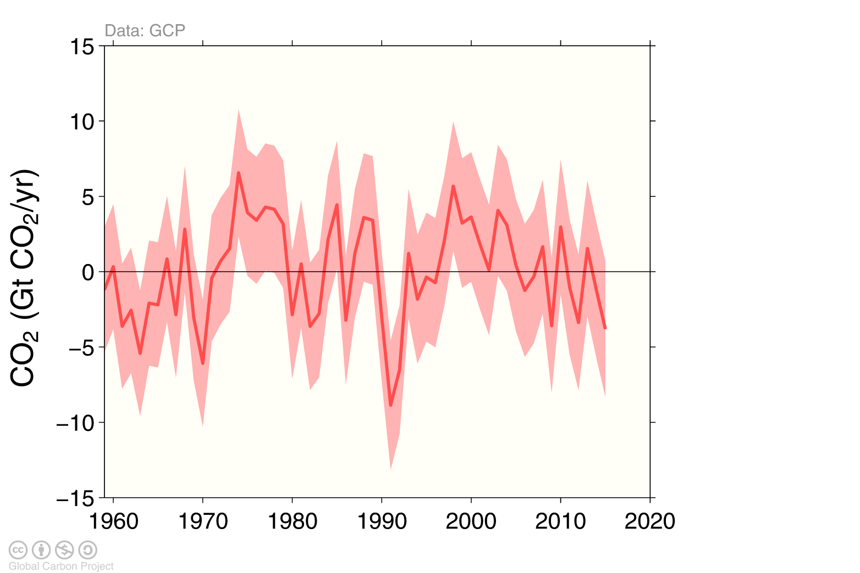
Remaining uncertainty in the global carbon balance
Large uncertainties in the global carbon balance remain
and hinder independent verification of reported CO₂ emissions
The remaining uncertainty is the carbon left after adding independent estimates for total emissions, the atmospheric growth rate, and model-based estimates for the land and ocean carbon sinks
Source: Le Quéré et al 2016; Global Carbon Budget 2016

Slide 45
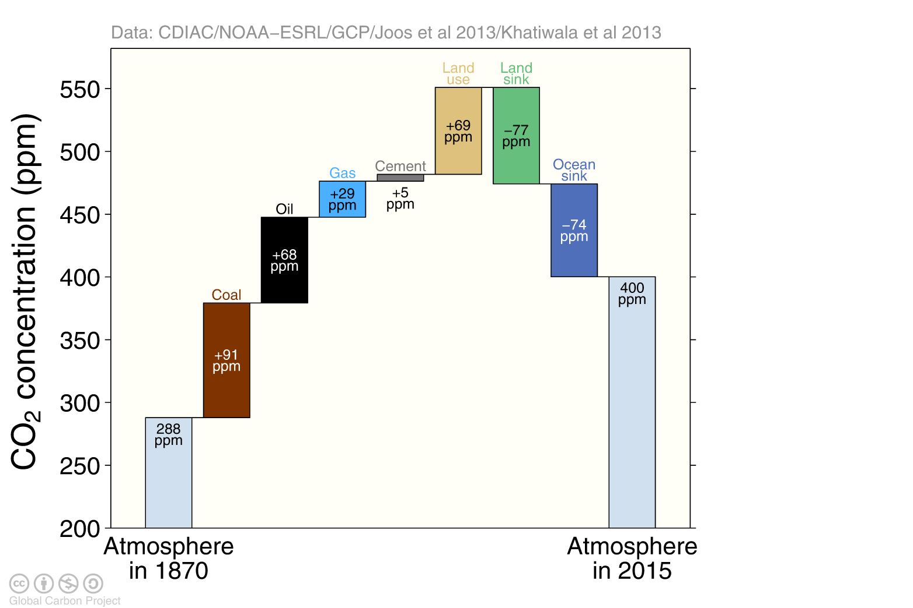
Global carbon budget
The cumulative contributions to the global carbon budget from 1870
Figure concept from Shrink That Footprint
Source: CDIAC; NOAA-ESRL; Houghton et al 2012; Giglio et al 2013; Joos et al 2013; Khatiwala et al 2013;
Le Quéré et al 2016; Global Carbon Budget 2016

Slide 46
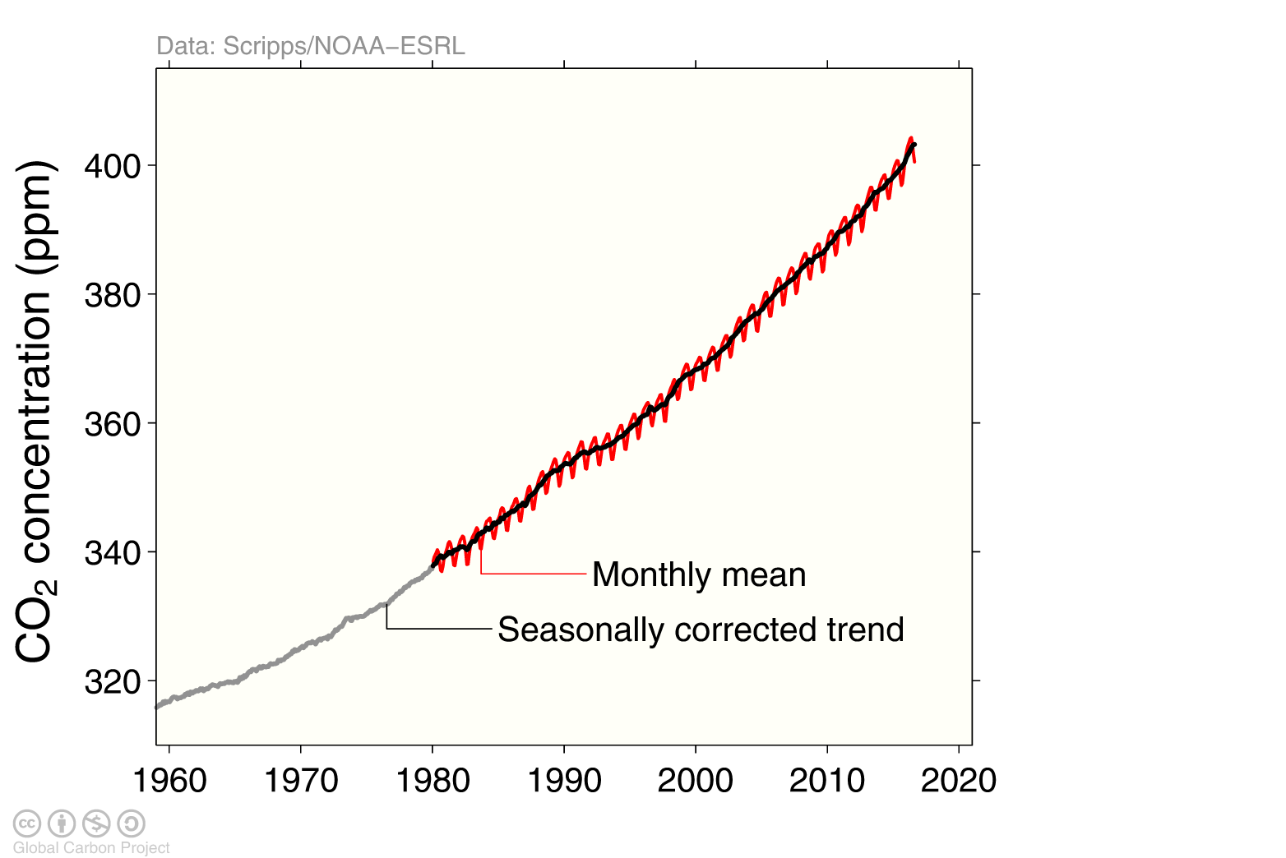
Atmospheric concentration
The global CO₂ concentration increased from ~277ppm in 1750 to 399ppm in 2015 (up 44%)
2016 will be the first full year with concentration above 400ppm
Globally averaged surface atmospheric CO₂ concentration. Data from: NOAA-ESRL after 1980;
the Scripps Institution of Oceanography before 1980 (harmonised to recent data by adding 0.542ppm)
Source: NOAA-ESRL; Scripps Institution of Oceanography; Le Quéré et al 2016; Global Carbon Budget 2016

Slide 47
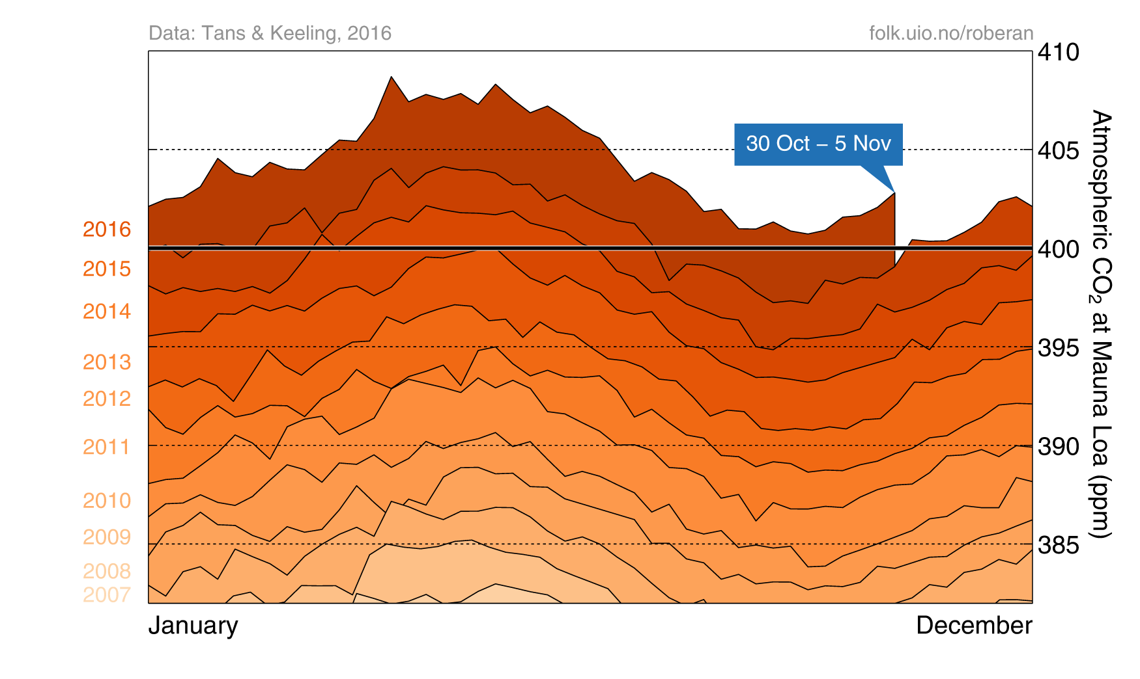
Seasonal variation of atmospheric CO₂ concentration
Weekly CO₂ concentration measured at Mauna Loa will stay above 400ppm throughout 2016
An animation of this figure is available, and another on the drivers of the atmospheric growth
Source: Tans and Keeling (2016), NOAA-ESRL, Scripps Institution of Oceanography

Slide 48
Carbon Quotas to
Climate Stabilization

Slide 49
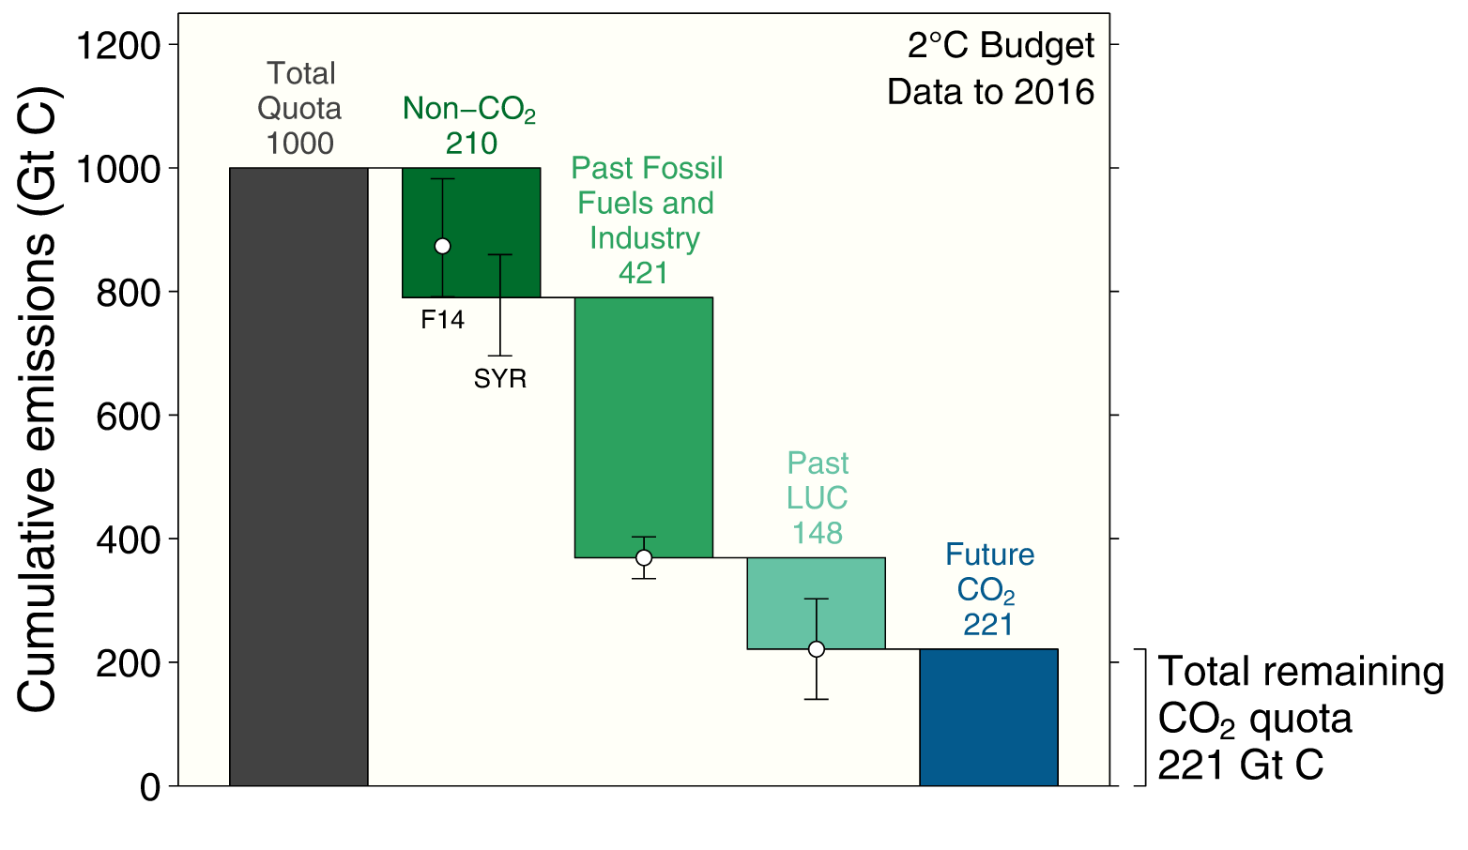
Carbon quota for a 66% chance to keep below 2°C
The total remaining emissions from 2017 to keep global average temperature below 2°C
(800GtCO₂) will be used in around 20 years at current emission rates
Grey: Total CO₂-only quota for 2°C with 66% chance. Green: Removed from CO₂ only quota. Blue: Remaining CO₂ quota.
The remaining quotas are indicative and vary depending on definition and methodology
Source: Peters et al 2015; Global Carbon Budget 2016

Slide 50
Carbon quota for a >66% chance to keep below 2°C
For a >66% chance to keep global average temperature below 2°C above pre-industrial levels,
society can emit 2900 billion tonnes CO₂ from 1870 or about 800 billion tonnes CO₂ from 2017
<2.0°C, >66%
800
GtCO₂
Indicative range
450-1050GtCO₂
2100
GtCO₂
Historical emissions 1870-2016: 2100GtCO₂. All values rounded to the nearest 50 GtCO₂
The remaining quotas are indicative and vary depending on definition and methodology (Rogelj et al 2016).
Source: IPCC AR5 SYR (Table 2.2); Le Quéré et al 2016; Global Carbon Budget 2016

Slide 51
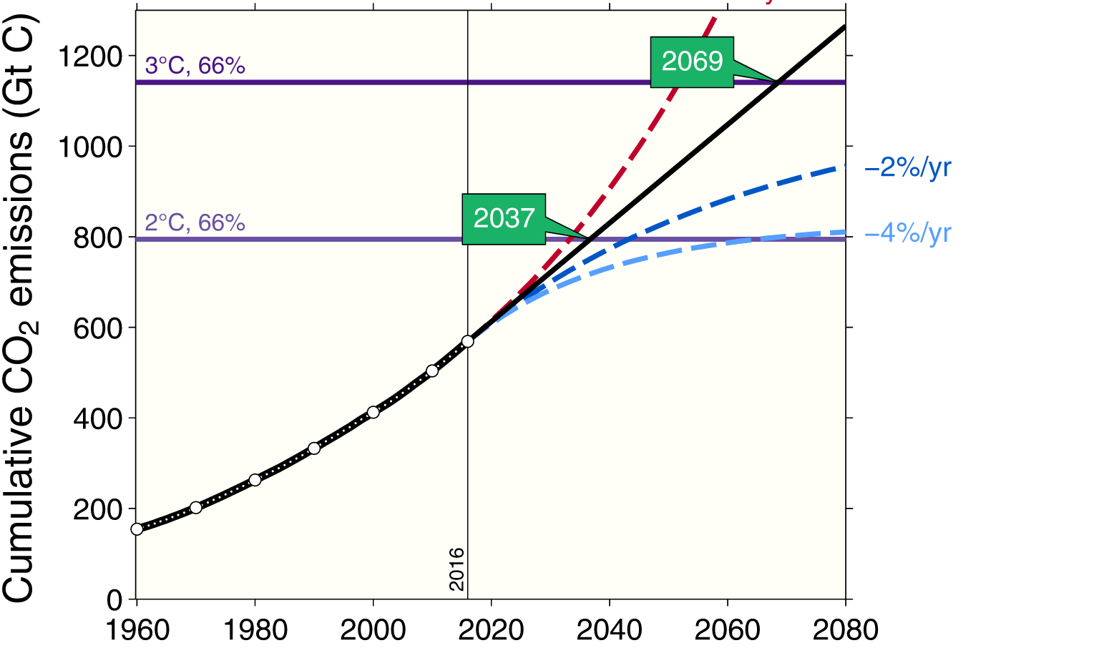
Cumulative global CO₂ emissions and temperature
Cumulative global CO₂ emissions from fossil fuels, industry, and land use change and four simplified future pathways compared to probability of exceeding different temperatures
The green boxes show the year that the exceedance budgets are exceeded assuming constant 2016 emission levels
The years are indicative and vary depending on definition and methodology
Source: Jackson et al 2015b; Global Carbon Budget 2016

Slide 52
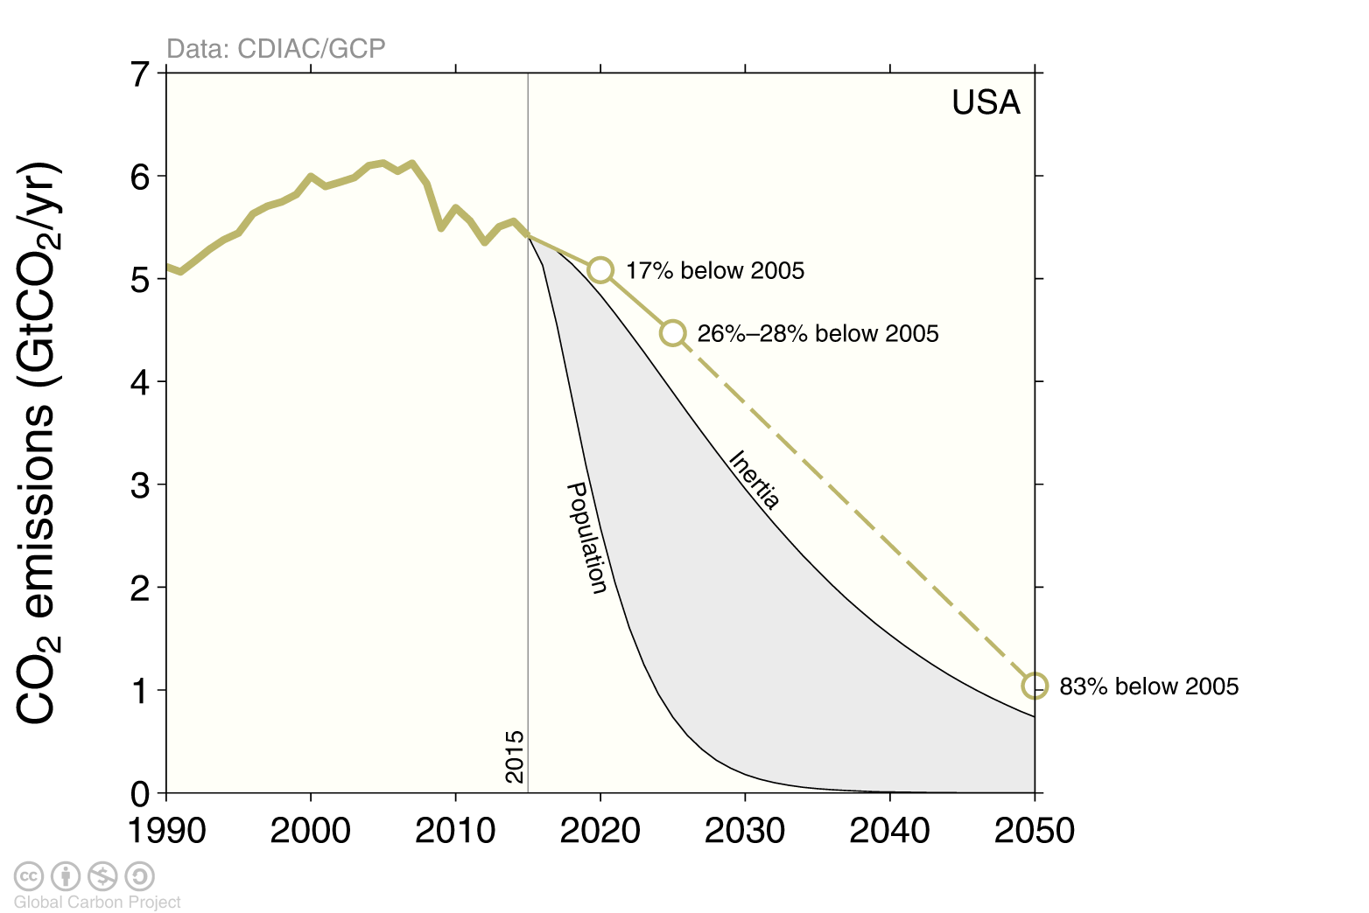
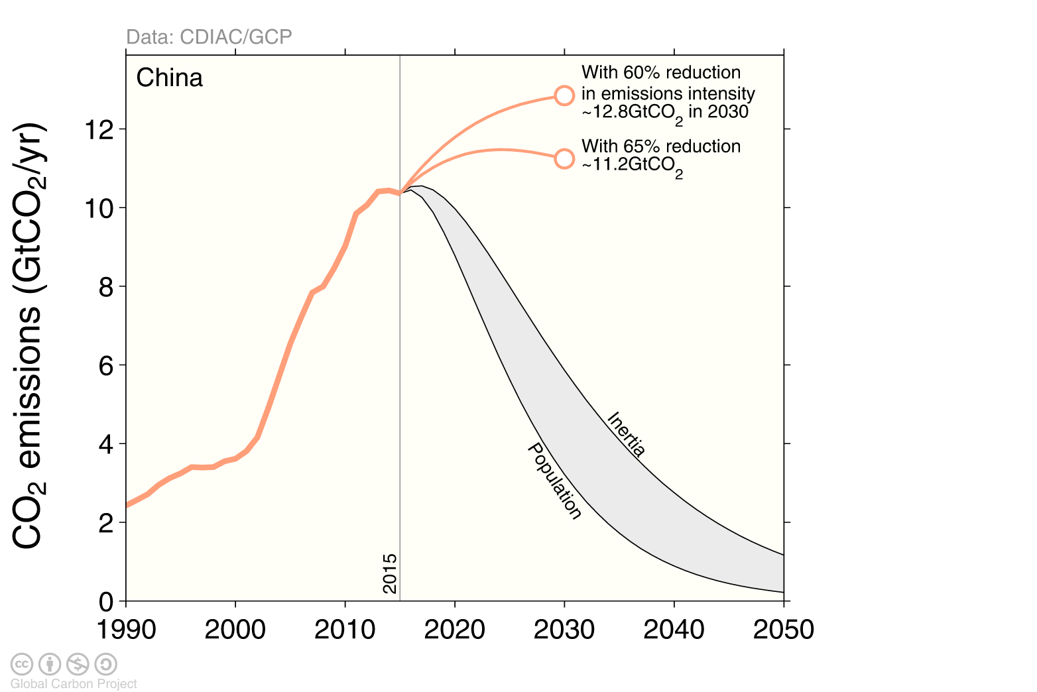
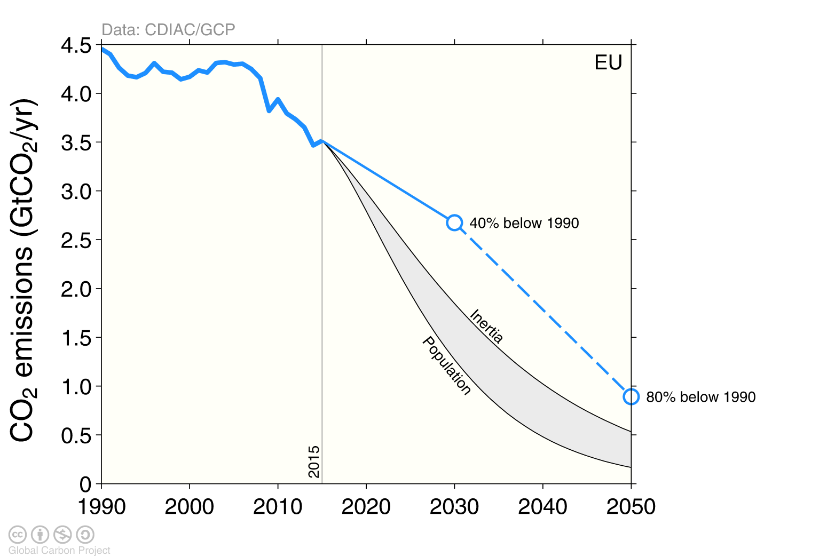
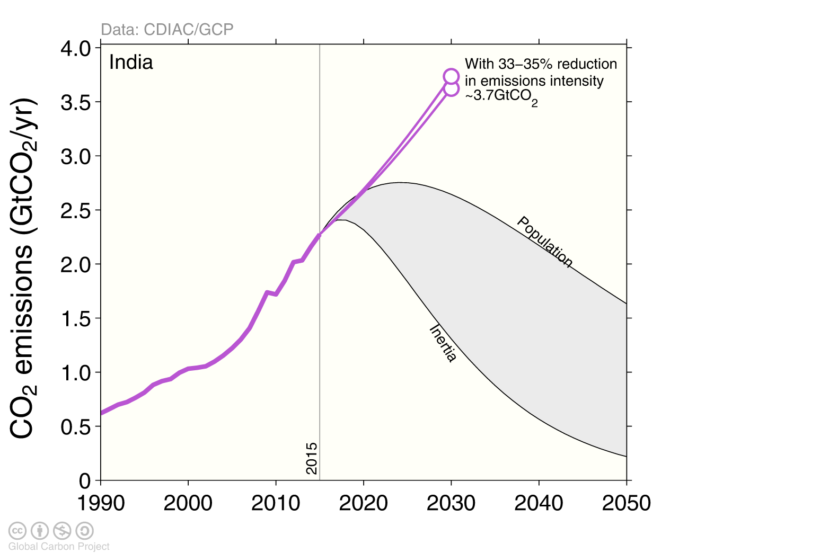
The emission pledges (INDCs) of the top-4 emitters
The emission pledges compared to different ways of sharing the remaining 2°C quota
Equity: Remaining quota shared by current population. Inertia: The remaining quota shared by current emissions.
Source: Peters et al 2015; Global Carbon Budget 2016

Slide 53
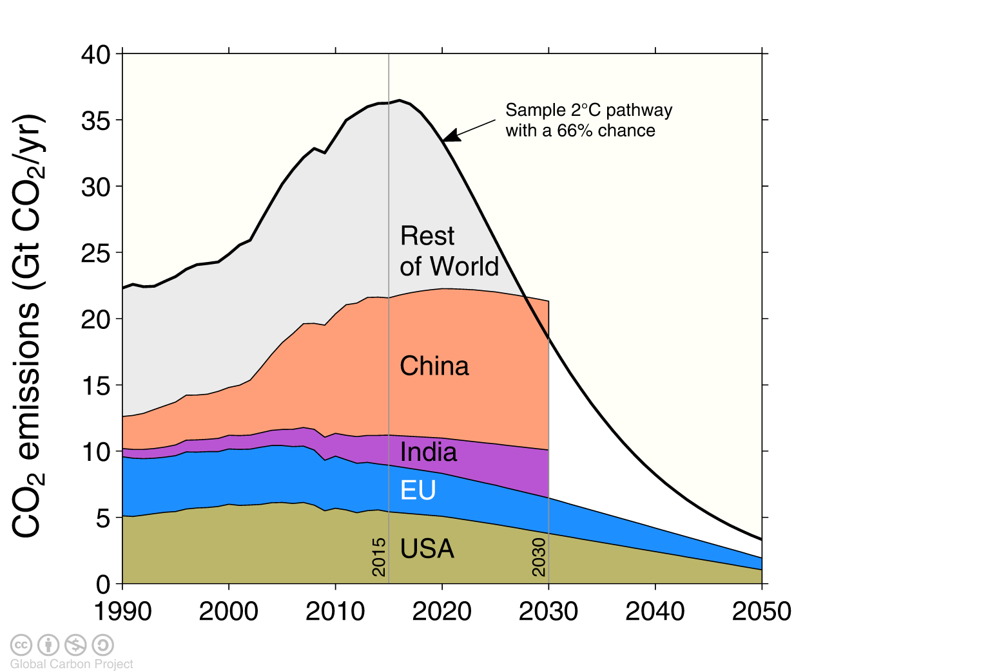
The emission pledges (INDCs) of the top-4 emitters
The emission pledges from the US, EU, China, and India leave no room for other countries to emit in a 2°C emission budget (66% chance)
Source: Peters et al 2015; Global Carbon Budget 2016

Slide 54
Additional Papers

Slide 55
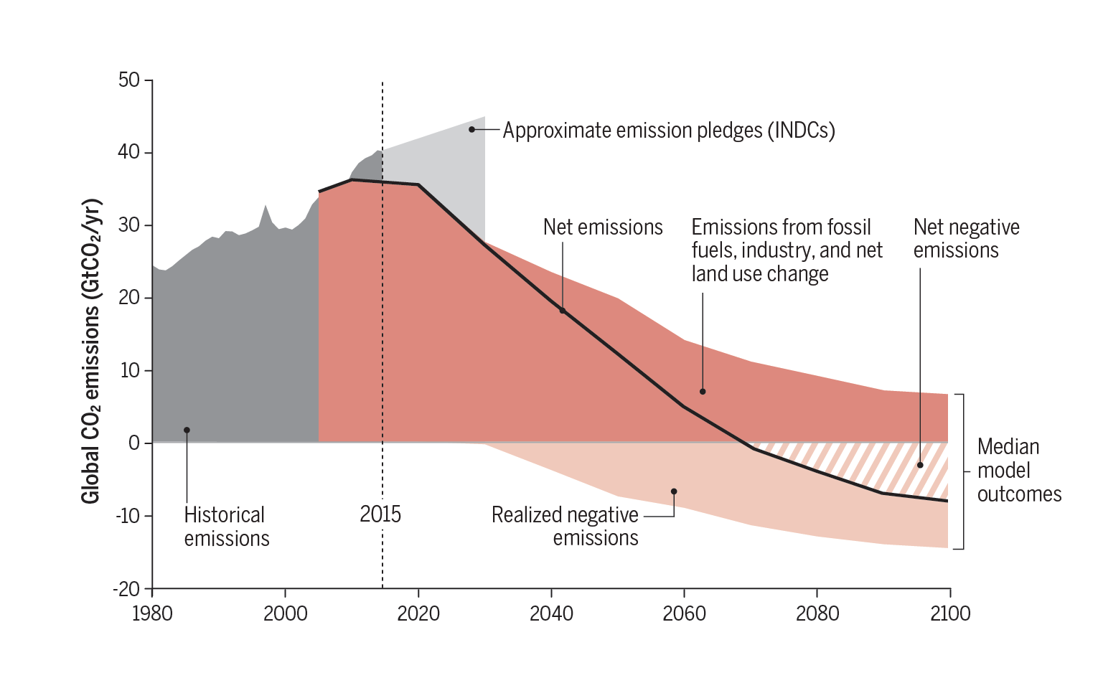
Negative emissions required for 2°C
To achieve net-negative emissions globally after 2050 requires deployment as early as 2020-2030
If negative emission technologies do not work at scale, society is locked into higher temperatures
Source: Anderson & Peters 2016

Slide 56

Reducing uncertainty through Bayesian analysis
Bayesian optimization decreases the uncertainty in the land sink by 41%, ocean sink by 46%, land-use change by 47%, while fossil fuel uncertainty is marginally improved
Source: Li et al 2016

Slide 57

The Earth system response to negative emissions
Earth system models suggest significant weakening, even potential reversal, of the ocean and land sinks under future low emission scenarios
Source: Jones et al 2016

Slide 58

Impact/limit summary for Negative Emission Technologies
The impacts and investment requirements of Negative Emissions Technologies
to limit warming to 2°C
Water requirement is shown as water droplets, with quantities in km³ per year.
All values are for the year 2100 except relative costs, which are for 2050
Source: Smith et al 2015; Global Carbon Budget 2016

Slide 59


Infographic

Slide 60
References used in this presentation
Global Carbon Budget (2016) More information, data sources and data files at http://www.globalcarbonproject.org/carbonbudget/
Le Quéré, C., Andrew, R. M., Canadell, J. G., Sitch, S., Korsbakken, J. I., Peters, G. P., Manning, A. C., Boden, T. A., Tans, P. P., Houghton, R. A., Keeling, R. F., Alin, S., Andrews, O. D., Anthoni, P., Barbero, L., Bopp, L., Chevallier, F., Chini, L. P., Ciais, P., Currie, K., Delire, C., Doney, S. C., Friedlingstein, P., Gkritzalis, T., Harris, I., Hauck, J., Haverd, V., Hoppema, M., Klein Goldewijk, K., Jain, A. K., Kato, E., Körtzinger, A., Landschützer, P., Lefèvre, N., Lenton, A., Lienert, S., Lombardozzi, D., Melton, J. R., Metzl, N., Millero, F., Monteiro, P. M. S., Munro, D. R., Nabel, J. E. M. S., Nakaoka, S., O’Brien, K., Olsen, A., Omar, A. M., Ono, T., Pierrot, D., Poulter, B., Rödenbeck, C., Salisbury, J., Schuster, U., Schwinger, J., Séférian, R., Skjelvan, I., Stocker, B. D., Sutton, A. J., Takahashi, T., Tian, H., Tilbrook, B., van der Laan-Luijkx, I. T., van der Werf, G. R., Viovy, N., Walker, A. P., Wiltshire, A. J., and Zaehle, S. (2016) “Global Carbon Budget 2016”, Earth System Science Data, 8, 605-649, http://dx.doi.org/10.5194/essd-8-605-2016
Anderson K & Peters G (2016) “The trouble with negative emissions” Science, http://dx.doi.org/10.1126/science.aah4567
Andrew, RM, GP Peters & S Davis (2013) “Climate Policy and Dependence on Traded Carbon” Environmental Research Letters, http://dx.doi.org/10.1088/1748-9326/8/3/034011
Boden, T, G Marland & R Andres (2016) “Global, Regional, and National Fossil-Fuel CO₂ Emissions in Trends”, Carbon Dioxide Information Analysis Center (CDIAC), http://cdiac.ornl.gov/trends/emis/meth_reg.html
BP, “BP Statistical Review of world energy” (2016), http://www.bp.com/en/global/corporate/energy-economics/statistical-review-of-world-energy.html
Dlugokencky, E & P Tans (2016) “Trends in Atmospheric Carbon Dioxide”, National Oceanic & Atmosphere Administration, Earth System Research Laboratory (NOAA-ESRL), http://www.esrl.noaa.gov/gmd/ccgg/trends/
Fuss S, Canadell JG, Peters GP, Tavonie M, Andrew RM, Ciais P, Jackson RB, Jones CD, Kraxner F, Nakicenovic N, Le Quéré C, Raupach MR, Sharifik A, Smith P, & Yamagata Y (2014) Betting on Negative Emissions. Nature Climate Change 4: 850-853. http://dx.doi.org/10.1038/nclimate2392
Giglio, L, JT Randerson & GR van der Werf (2014) “Analysis of daily, monthly, and annual burned area using the fourth-generation global fire emissions database (GFED4)”, Journal Geophysical Research Biogeosciences, http://onlinelibrary.wiley.com/doi/10.1002/jgrg.20042/abstract
Houghton, RA. JI House, J Pongratz, GR van der Werf, RS DeFries, MC Hansen, C Le Quéré & N Ramankutty (2012), “Carbon emissions from land use and land-cover change”, http://www.biogeosciences.net/9/5125/2012/bg-9-5125-2012.html, DOI:10.5194/bg-9-5125-2012
Jackson, RB, JG Canadell, C Le Quéré, RM Andrew, JI Korsbakken, GP Peters & N Nakicenovic (2015a), “Reaching peak emissions”, Nature Climate Change, http://dx.doi.org/10.1038/nclimate2892
Jackson, RB , P Friedlingstein, JG Canadell & RM Andrew (2015b) “Two or three degrees: CO2 emissions and global temperature http://folk.uio.no/roberan/docs/Jackson_etal2015-Bridgev45n2.pdf
Joos, F, R Roth, J Fuglestvedt, G Peters, I Enting, W von Bloh, V Brovkin, E Burke, M Eby, N Edwards, T Friedrich, T Frölicher, P Halloran, P Holden, C Jones, T Kleinen, F Mackenzie, K Matsumoto, M Meinshausen, G-K Plattner, A Reisinger, J Segschneider, G Shaffer, M Steinacher, K Strassmann, K Tanaka, A Timmermann & A Weaver (2013) “Carbon dioxide and climate impulse response functions for the computation of greenhouse gas metrics: a multi-model analysis“, Atmospheric Chemistry and Physics, http://www.atmos-chem-phys.net/13/2793/2013/acp-13-2793-2013.html
Khatiwala, S , T Tanhua, S Mikaloff Fletcher, M Gerber, S Doney, H Graven, N Gruber, G McKinley, A Murata, A Rios & C Sabine (2013), “Global ocean storage of anthropogenic carbon”, Biogeosciences, http://www.biogeosciences.net/10/2169/2013/bg-10-2169-2013.html
Peters, GP, J Minx, C Weber & O Edenhofer (2011) “Growth in emission transfers via international trade from 1990 to 2008”, Proceedings of the National Academy of Sciences, www.pnas.org/content/108/21/8903
Peters, GP, SJ Davis & RM Andrew (2012) “A synthesis of carbon in international trade”, Biogeosciences, http://www.biogeosciences.net/9/3247/2012/bg-9-3247-2012.html
Smith, P, SJ Davis, F Creutzig, S Fuss, J Minx, B Gabrielle, E Kato, RB Jackson, A Cowie, E Kriegler, DP van Vuuren, J Rogelj, P Ciais, J Milne, JG Canadell, D McCollum, GP Peters, RA Andrew, V Krey, G Shrestha, P Friedlingstein, T Gasser, A Grübler, WK Heidug, M Jonas, CD Jones, F Kraxner, E Littleton, J Lowe, JR Moreira, N Nakicenovic, M Obersteiner, A Patwardhan, M Rogner, E Rubin, A Sharifi, A Torvanger, Y Yamagata, J Edmonds & C Yongsung (2015). “Biophysical and economic limits to negative CO2 emissions”, Nature Climate Change (online); http://dx.doi.org/10.1038/nclimate2870
UN (2015) United Nations Statistics Division http://unstats.un.org/unsd/default.htm

Slide 61











Acknowledgements
We thank the many funding agencies that supported this release:
European Commission
Australia: National Environmental Science Program – ESCC hub
France: BNP Paribas Foundation
Institut National des Sciences de l'Univers
Institut Paul Emile Victor
Institut de recherche pour le développement
Germany: Federal Ministry of Education and Research
Research Foundation’s Emmy Noether Program
Max Planck Society
Helmholtz PostDoc Programme
Japan: Ministry of Agriculture, Forestry and Fisheries
Ministry of Environment
New Zealand: National Institute of Water and Atmospheric Research
Norway: Research Council
Environment Agency
Netherlands Research Fund – Flanders
South Africa: Council for Scientific and Industrial Research
UK: Natural Environment Research Council
Newton Fund
US: NASA
Department of Agriculture
Department of Energy
Department of Commerce
National Science Foundation
The work presented in the Global Carbon Budget 2016 has been possible thanks to the contributions of hundreds of people involved in observational networks, modeling, and synthesis efforts.
We thank the institutions and agencies that provide support for individuals and funding that enable the collaborative effort of bringing all components together in the carbon budget effort.
We also thank the sponsors of the GCP and GCP support and liaison offices.

Slide 62

License
Attribution-NonCommercial-ShareAlike 4.0 International (CC BY-NC-SA 4.0)
This deed highlights only some of the key features and terms of the actual license. It is not a license and has no legal value. You should carefully review all of the terms and conditions of the actual license before using the licensed material. Creative Commons is not a law firm and does not provide legal services. Distributing, displaying, or linking to this deed or the license that it summarizes does not create a lawyer-client or any other relationship. This is a human-readable summary of (and not a substitute for) the license.
You are free to:
Share — copy and redistribute the material in any medium or format
Adapt — remix, transform, and build upon the material
The licensor cannot revoke these freedoms as long as you follow the license terms.
Under the following terms:
Attribution — You must give appropriate credit, provide a link to the license, and indicate if changes were made. You may do so in any reasonable manner, but not in any way that suggests the licensor endorses you or your use. What does "Attribute this work" mean? The page you came from contained embedded licensing metadata, including how the creator wishes to be attributed for re-use. You can use the HTML here to cite the work. Doing so will also include metadata on your page so that others can find the original work as well.
NonCommercial — You may not use the material for commercial purposes.
ShareAlike — If you remix, transform, or build upon the material, you must distribute your contributions under the same license as the original.
No additional restrictions — You may not apply legal terms or technological measures that legally restrict others from doing anything the license permits.
You do not have to comply with the license for elements of the material in the public domain or where your use is permitted by an applicable exception or limitation.
No warranties are given. The license may not give you all of the permissions necessary for your intended use. For example, other rights such as publicity, privacy, or moral rights may limit how you use the material.

