Slide 1
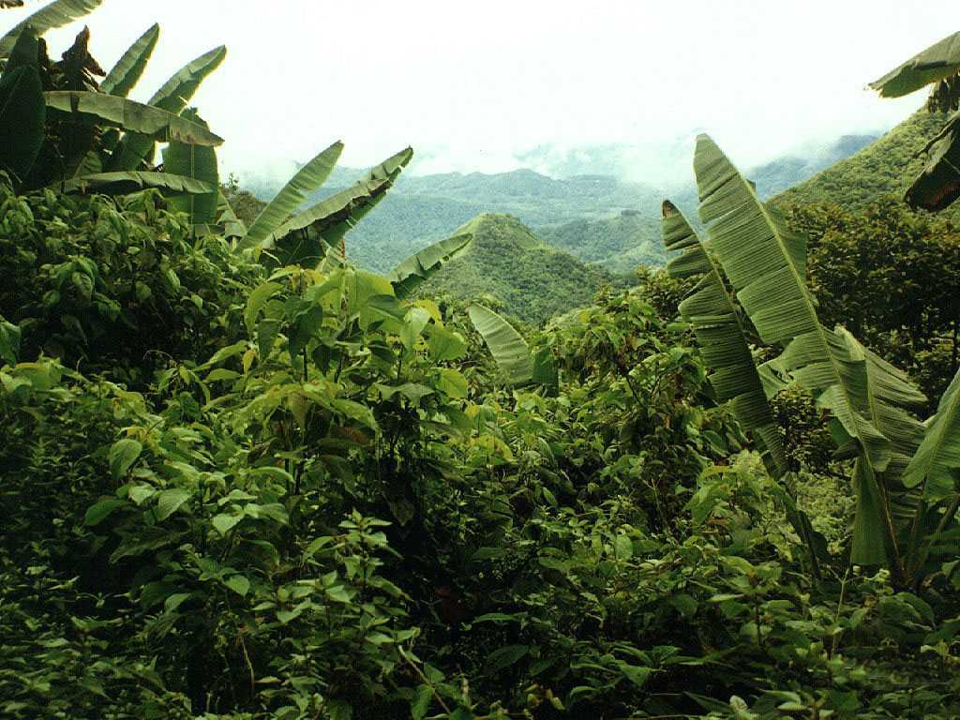
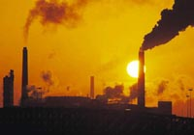


The Global Carbon Cycle
“Missing” carbon is hard to find among large natural fluxes
About half the CO₂ released by humans is absorbed by oceans and land
Atmosphere
800+ 5/yr
~120
~90
~90
~120
10 GtC/yr
Ocean
Land
Humans
38,000
2000

Slide 2
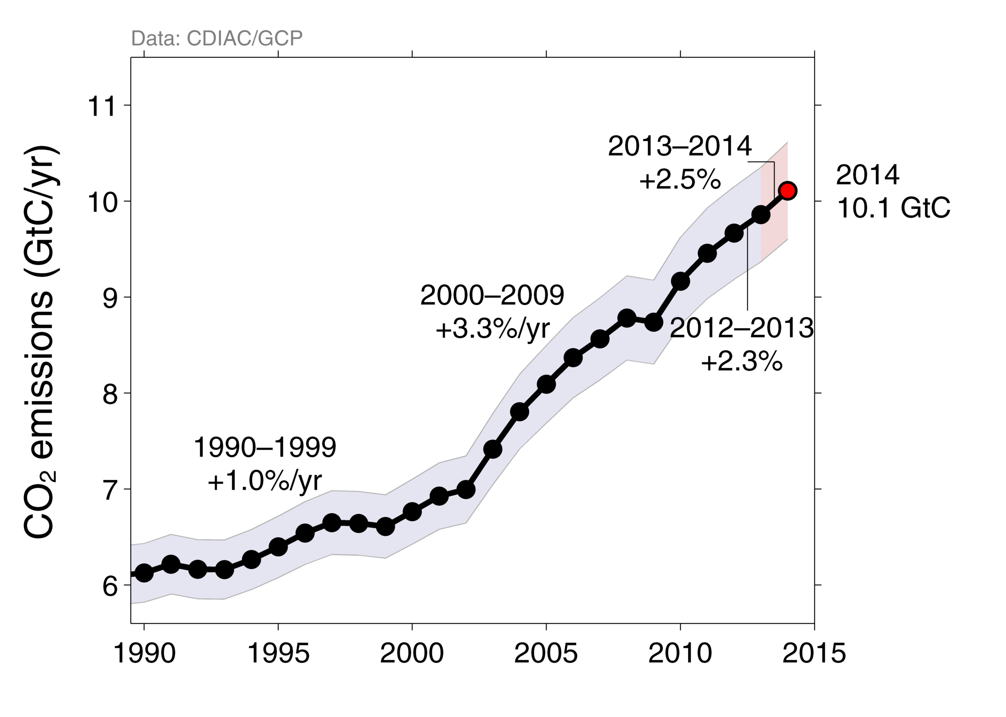
Fossil Fuel Emissions

Slide 3
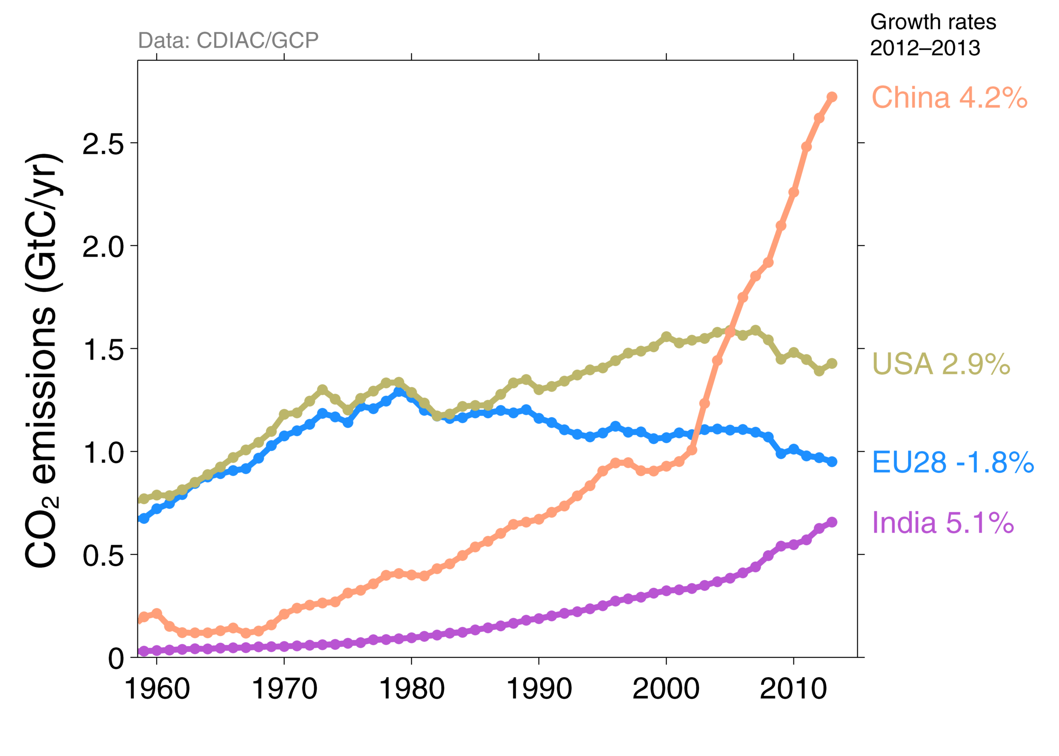
FF By Country

Slide 4
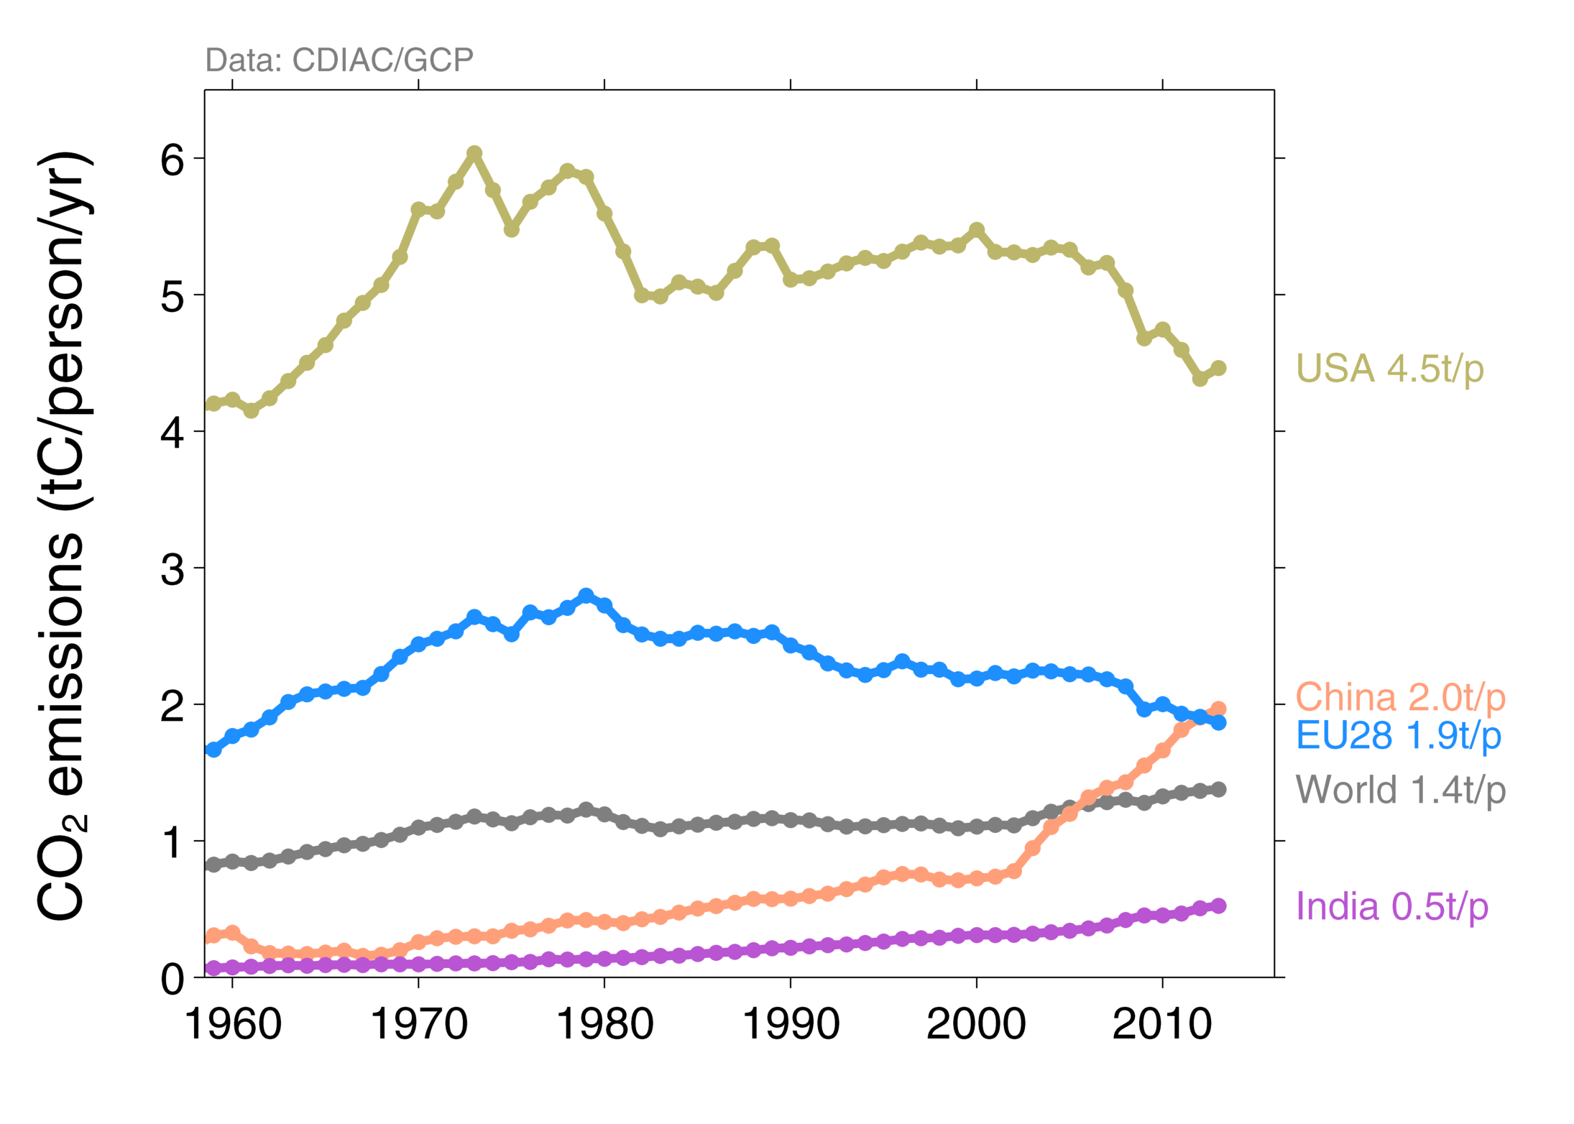
FF per Capita

Slide 5
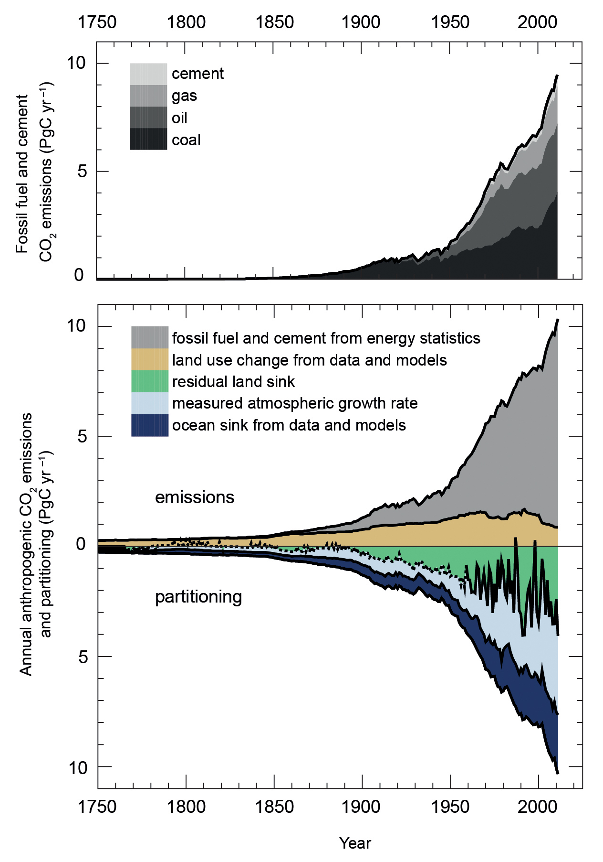
Carbon Sources and Sinks
Half the carbon from fossil fuels remains in the atmosphere
The other half goes into land and oceans
Land sink was unexpected is very noisy, and remains unreliable in future
Future of carbon sinks is much harder to predict than temperatures
Global Carbon Project

Slide 6
Where Has All the Carbon Gone?
Into the oceans
  Solubility pump (CO₂ very soluble in cold water, but rates are limited by slow physical mixing)
  Biological pump (slow “rain” of organic debris)
Into the land
  CO₂ Fertilization
  (plants eat CO2 … is more better?)
  Nutrient fertilization
  (N-deposition and fertilizers)
  Land-use change
  (forest regrowth, fire suppression, woody encroachment … but what about Wal-Marts?)
  Response to changing climate
  (e.g., Boreal warming)

Slide 7
The Oceans

Slide 8
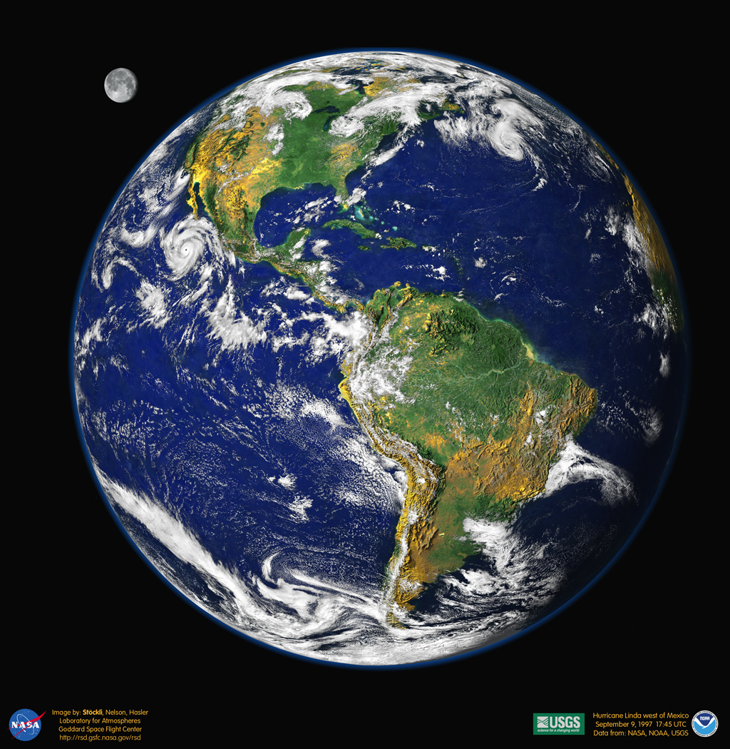

Planetary Titration

Slide 9
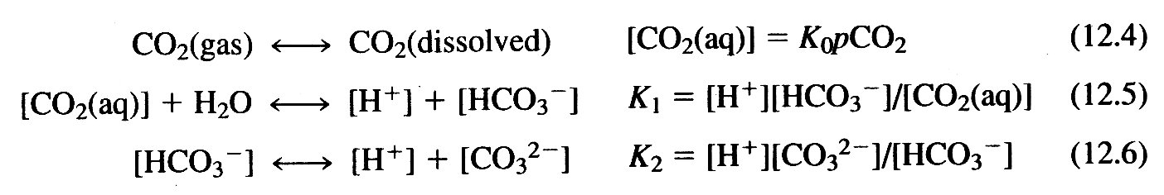

Carbonate Equilibria in Solution
Three equations (equilibria) in five unknowns
Add two more constraints
(Titration Alkalinity)
(Boric acid dissociation)
(Salinity)

Slide 10
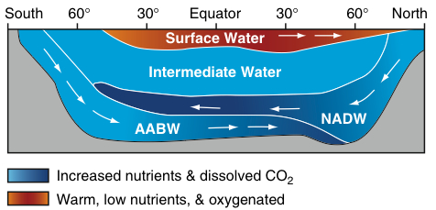
Vertical Structure of the Oceans
sfc
4 km
Warm buoyant “raft” floats at surface
Cold deep water is only “formed” at high latitudes
Very stable, hard to mix, takes ~ 1000 years!
Icy cold, inky black, most of the ocean
doesn’t know we’re here yet!

Slide 11
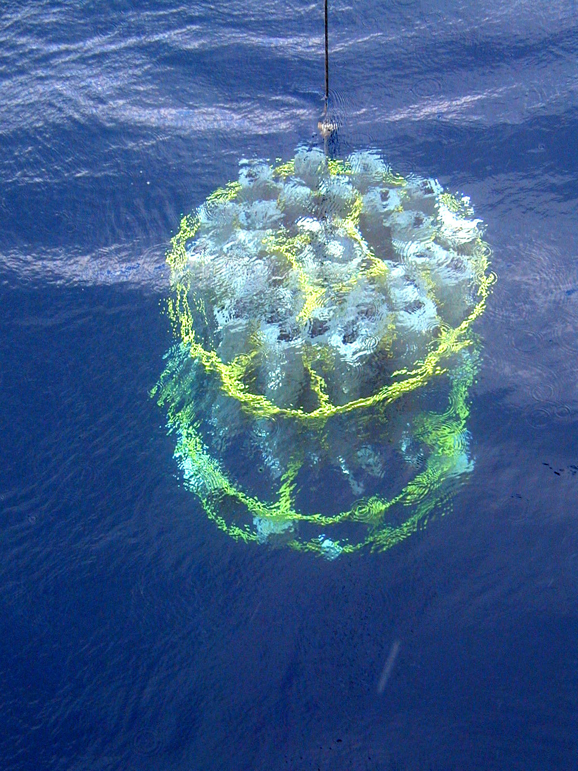
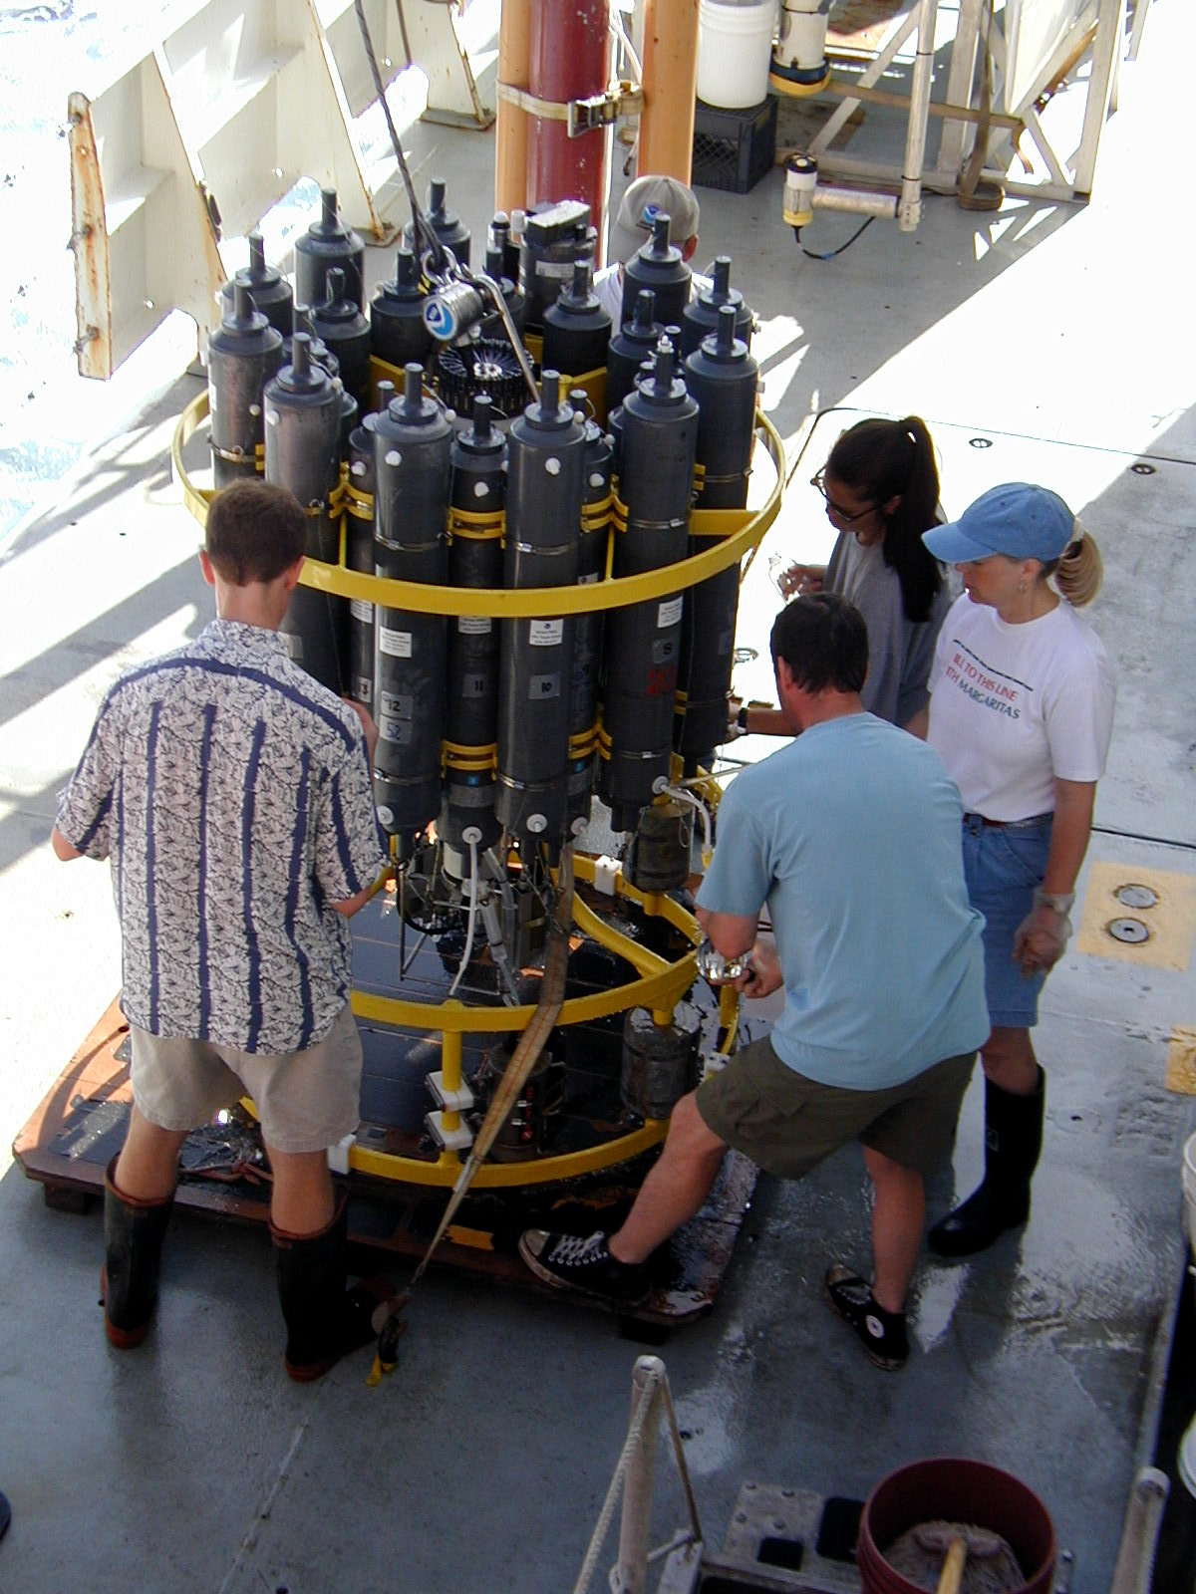
Observing the Deep Ocean
Notes:
Rosette on deck and niskin bottles. The bottles are open and there’s a computer in the middle that can close each bottle at a different depth. They use an echosounder to figure out how deep it is. Plus, there’s a ‘pinger’ how high above the bottom the rosett is. There’s also a pressure sensor on the rosette it self that give depth information. Bottle clousre proportional to gradients. More bottles insurface than in deeper waters. Gradients based on whatever physical properties you want to sample.

Slide 12
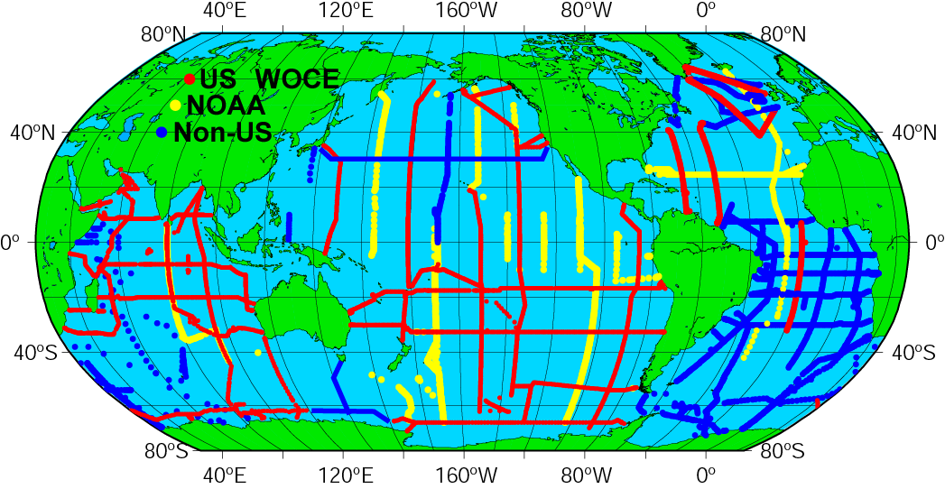
WOCE/JGOFS/OACES Global Survey Data
Notes:
From the JGOFS synthesis. During the 90’s there were three major programs (WOCE - primarily physical; DOE funded carbon measuremnts; JGOFS the rest of JGOFS was process and time series. The NOAA OACES complimentary to JGOFS process efforts.
JGOFS/ NOAA total CO2 discrete, alkalinity, pCO2 and pH. With the JGOFS synthesis and modeling project (OCMIP) after the project (1990-1997 for cruises). To synthesize into a coherent basin analysis. E.g in pacific, there were 26 individual cruises run by 15 labs in 4 different countries. We’ve been working to ensure data consistency. Data QA and consistency very important. For instance, deep ocean with residence times of hundreds of years, deep water can be compared. And analysis of certified reference materials. Indian and Pacific are done, working on the Atlantic. Will be published by middle of 2002 releasing a CD with combined bottle files and generating gridded basin-wide carbon distributions for all of the oceans. Available through CDIAC. The last global carbonsurvey was GEOSECS with a little over 6000 samples over the globe, and this combined survey will be 100,000 samples.
DIC = good to +/= 3 micromoles alkalinity good to ~4-5 micromoles/kg

Slide 13
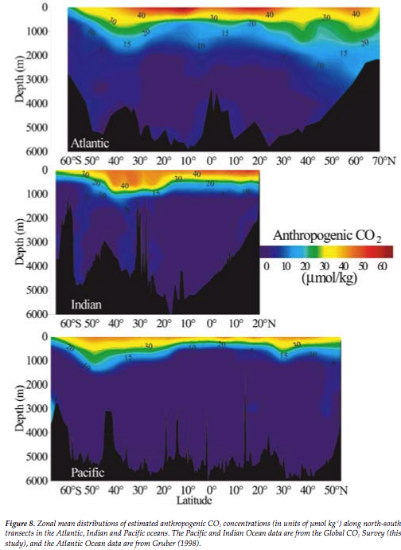
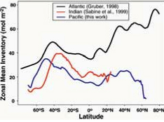
Anthropogenic DIC
Estimated from total observed DIC using stoichiometry
Most anthropogenic DIC confined to top few 100 m
“Shoaling” in tropics, convection at higher latitudes
Some “contamination” of bottom water in Atlantic
(both hemispheres)
(Feeley et al, 2001)

Slide 14
The Land

Slide 15
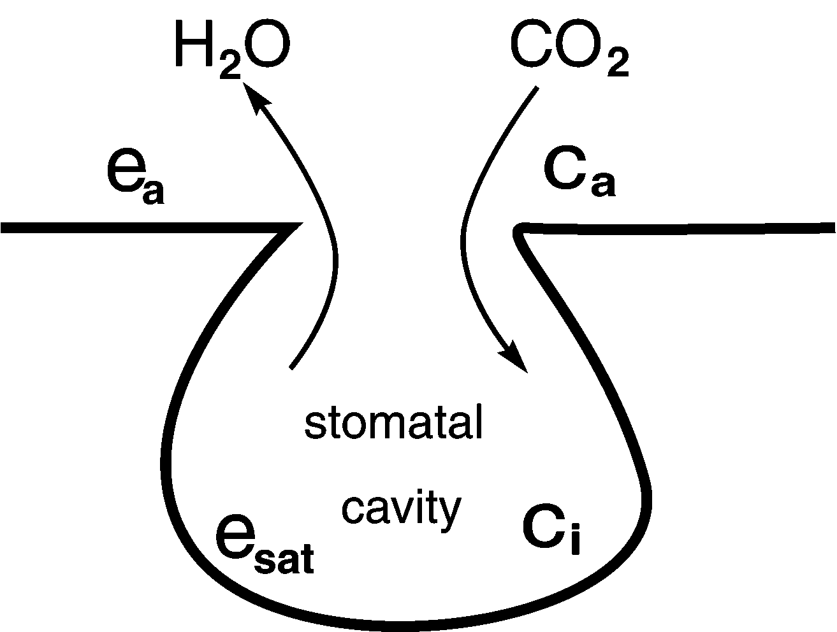
Carbon and Water
Plants eat CO₂ for a living
They open their stomata to let CO₂ in
Water gets out as an (unfortunate?) consequence
For every CO₂ molecule fixed about 400 H₂O molecules are lost

Slide 16
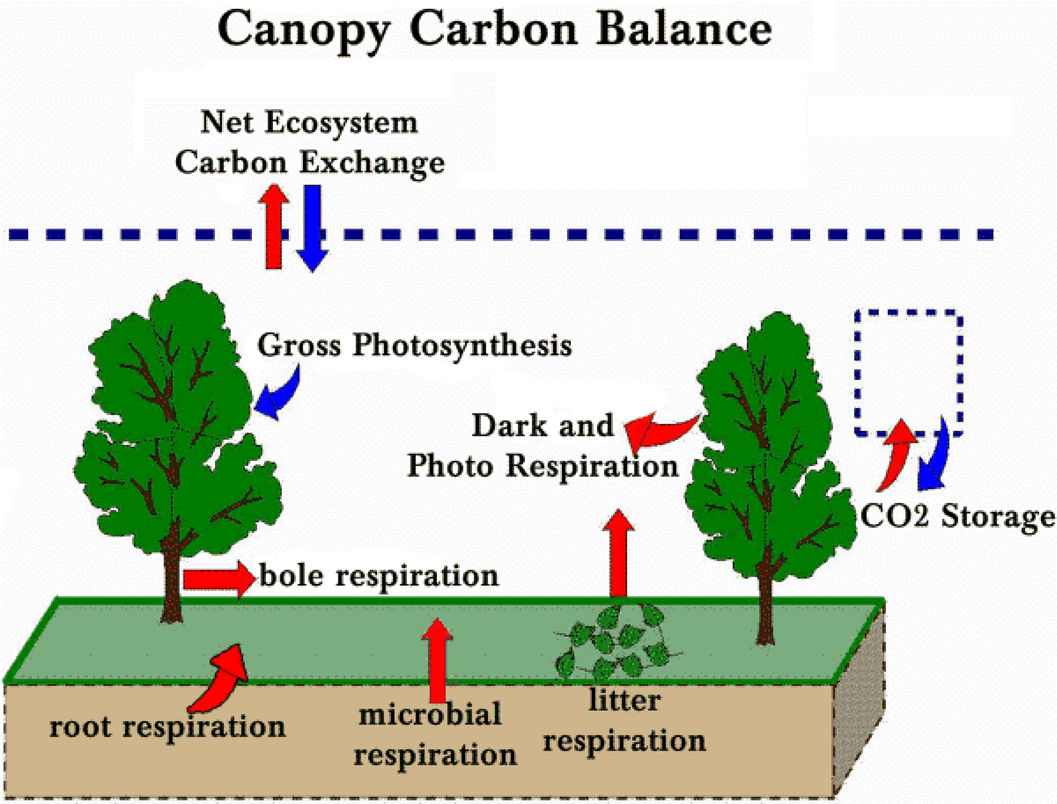

Slide 17
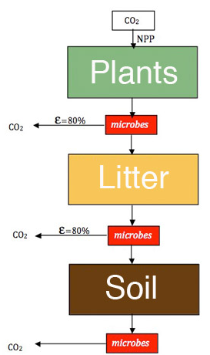
Carbon Storage & Turnover
in Land Ecosystems
Photosynthesis converts inorganic gas into living plants
Plants die and become “litter”
Microbes eat litter and poop soil carbon
Soil carbon is eventually also eaten by microbes, but some lasts for many centuries

Slide 18








Net Primary Production and mean residence times of carbon determines source/sink potential of ecosystems
1500
1200
900
g C / m²
600
300
NPP
0
dC/dt~r·τ_{b} · NPP₀
Where r is the fractional perturbation to NPP or MRT with units (1/time)
50
40
30
Years
20
MRT
10
0

Slide 19
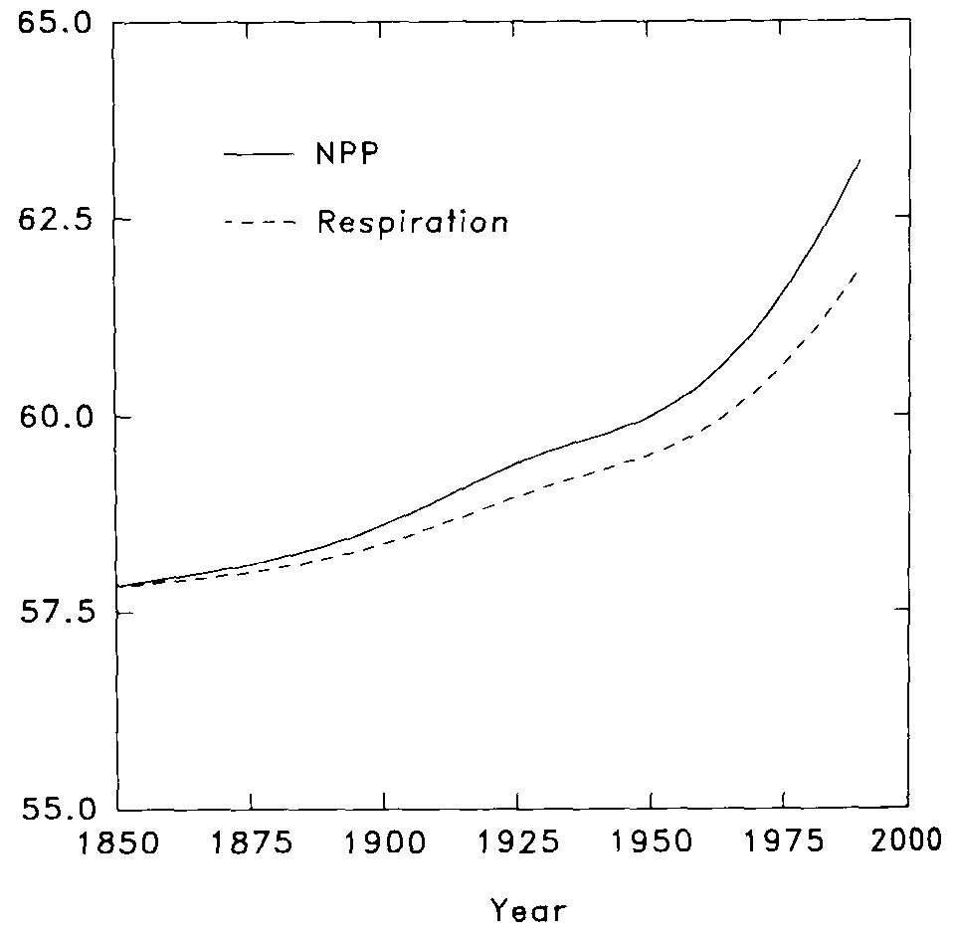
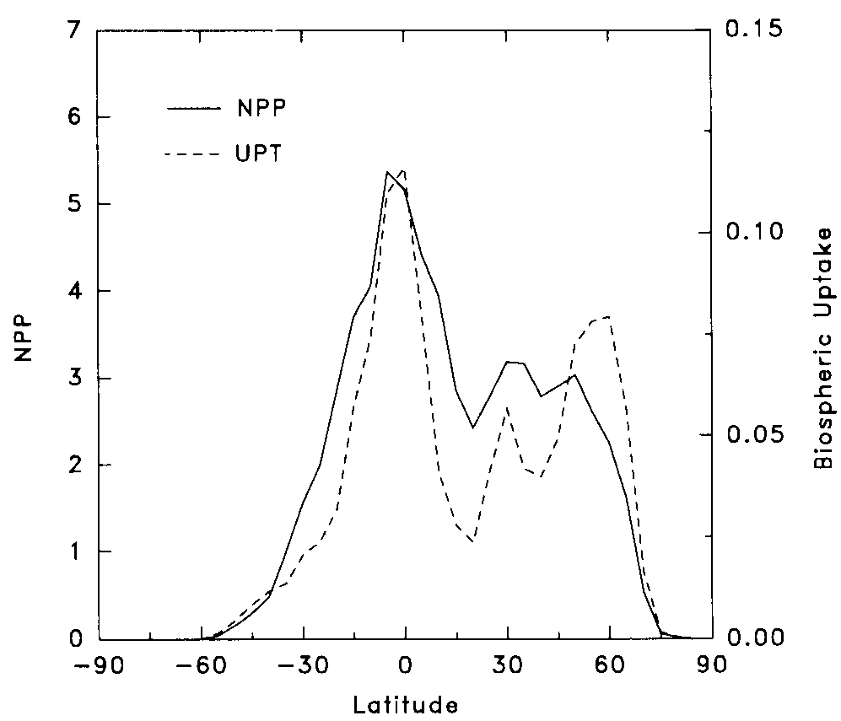
CO₂ Fertilization
sink
τ
Friedlingstein et al, 1995
Increasing plant growth (NPP) due to enhanced atmospheric CO₂
Delayed increased respiration (residence time)
Spatial pattern follows both NPP and residence τ

Slide 20
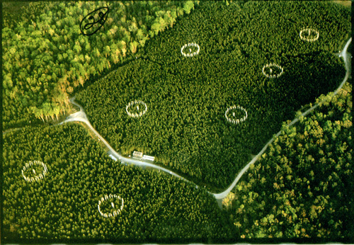
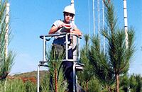
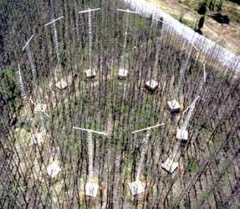
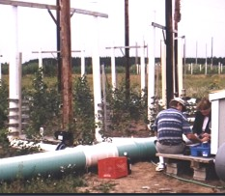
Free Air Carbon Enrichment (FACE)
Fumigation rings maintain steady levels of elevated CO₂ in canopies under changing weather conditions
Control and replicated treatments test effects of CO₂, water, N, etc

Slide 21
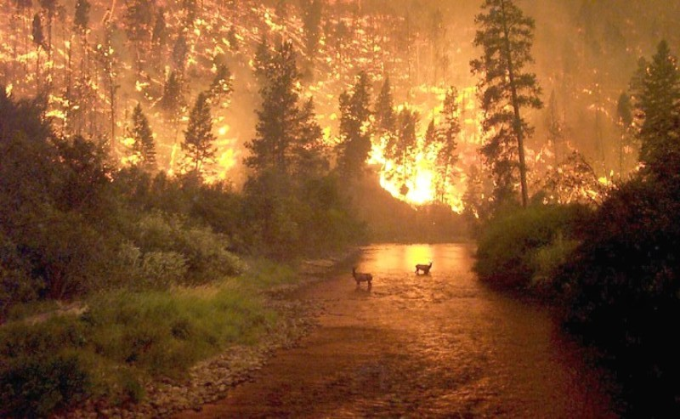
Disturbance

Slide 22
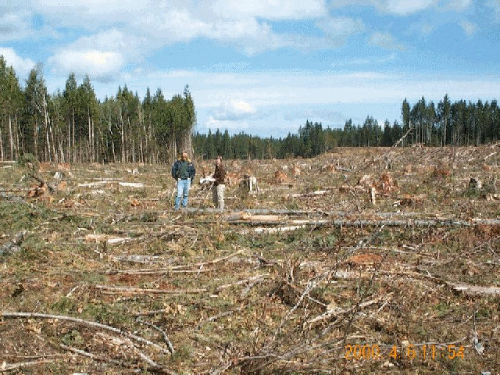
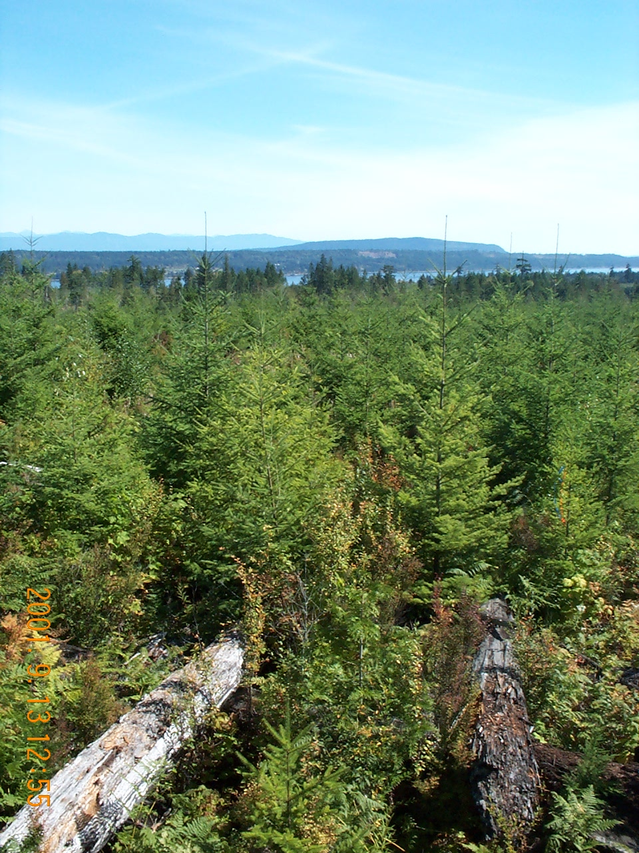
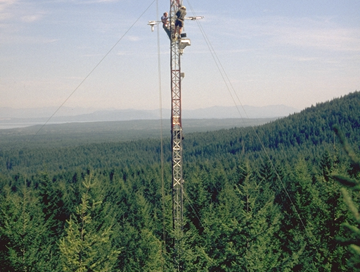
Disturbance and Recovery
6-year-old
18-year-old
57-year-old
Planted
2000
1988
1949
Height (m)
0.8
3-8
30-35

Slide 23
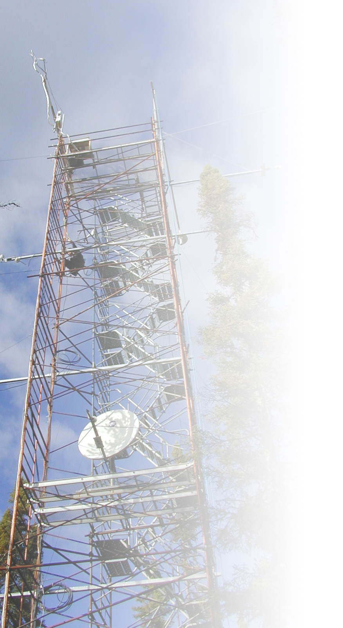
Fluxnet-Canada Annual Carbon Budgets
Sink
Interannual
Variability
Gap
Source

Slide 24
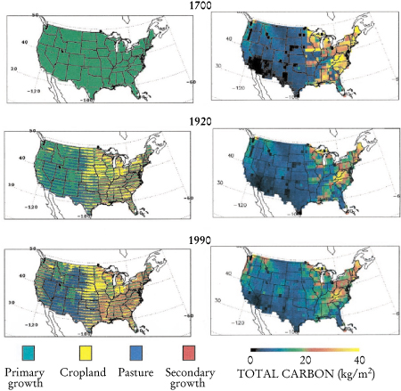
Agricultural
Development & Abandonment
Land clearing in 18th and 19th centuries released large amounts of CO₂ to atmosphere
Shift of agriculture to Midwest and California in 20th century
Regrowing forests are a carbon sink
ED model result: Moorcroft et al (2001)

Slide 25
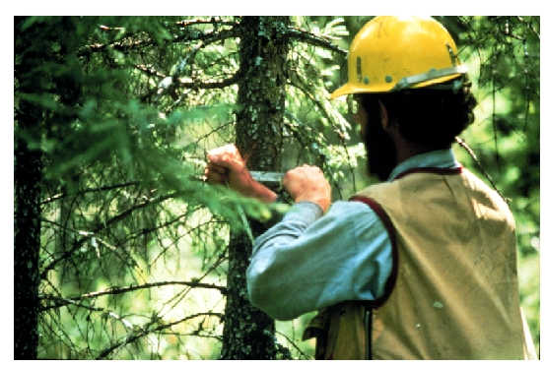
Forest Inventory Sampling
USDA Forest Service measures hundreds of thousands of plots!

Slide 26
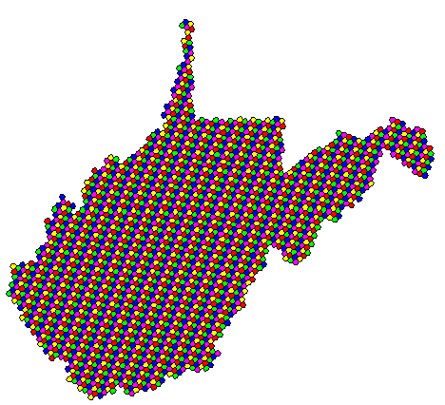
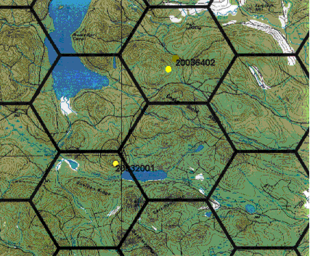
USDA Forest Service FIA Plots
Five-Year Panel:
6000 acre grid cells
1 plot per grid cell
>800K plots
each plot visited every 5 (east) or 10 (west) years
Year One
Year Two
Year Three
Year Four
Year Five

Slide 27
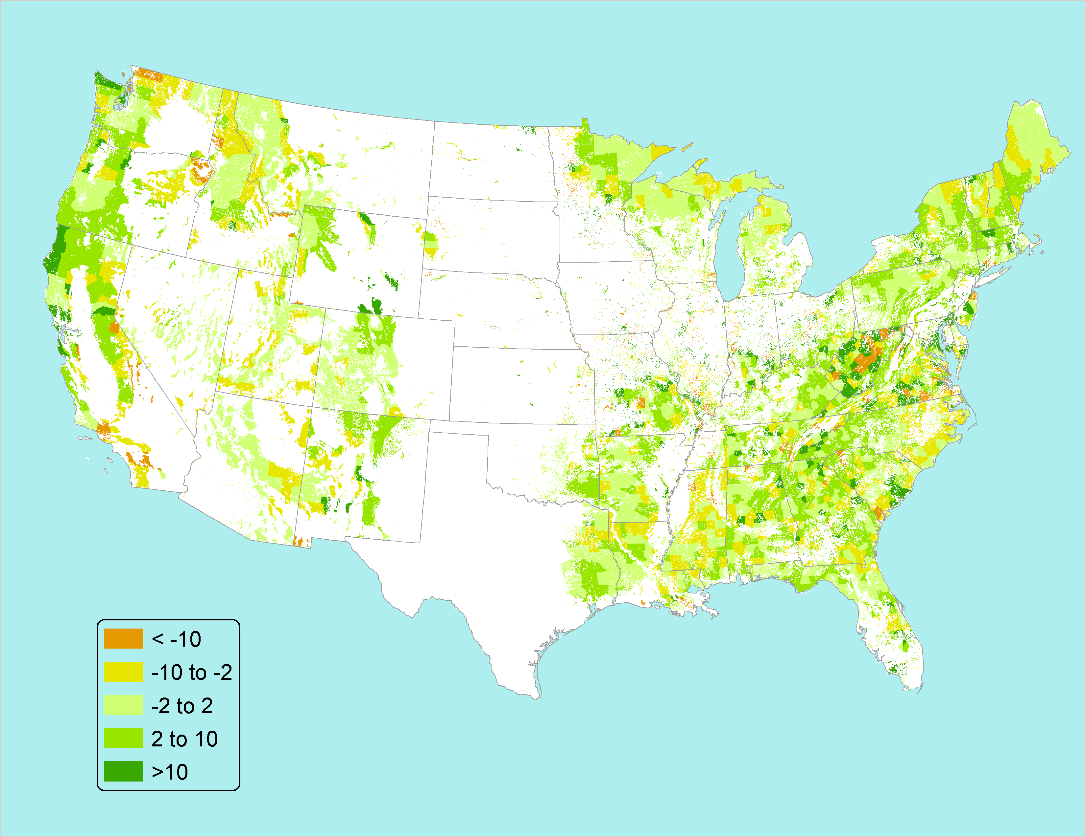
Average annual live tree C stock change by county, estimated from FIA data
MgC/ha/yr
Courtesy of Linda Heath, USFS
Notes:
Fresh off the computers, in review for the US Environmental Protection Agency’s annual greenhouse gas emissions and sinks annual inventory.

Slide 28
The Atmosphere

Slide 29

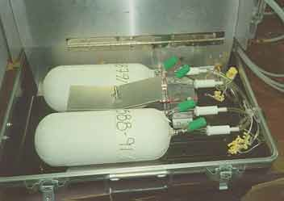
Atmospheric CO₂
Observations (in-situ)

Slide 32
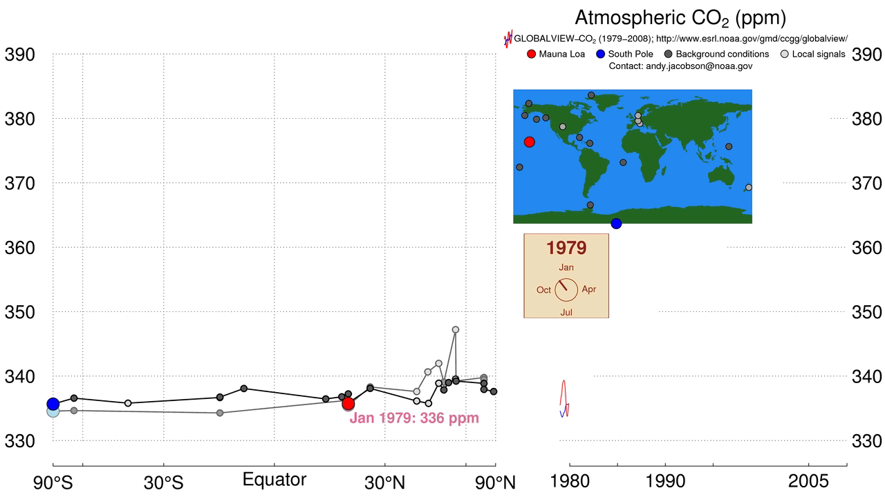
Atmospheric CO₂ Data

Slide 33
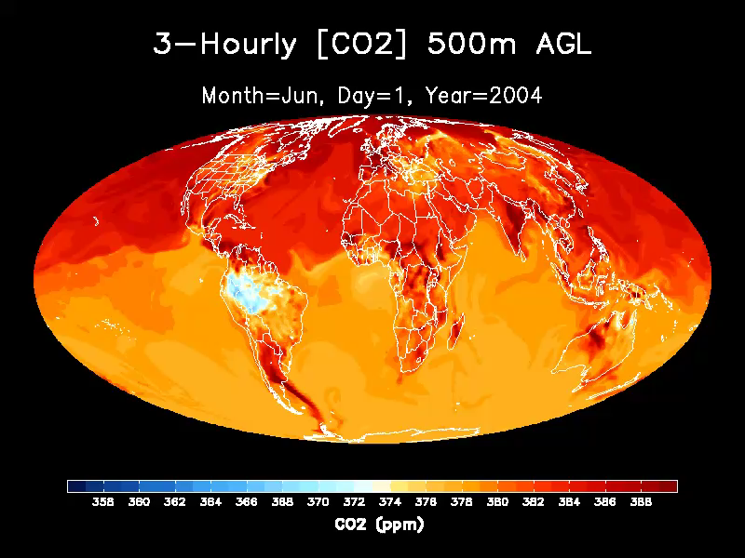

Slide 34

CO₂ “Budget” of the World
Fossil Fuel
Burning
10
ATMOSPHERE
billion
tons go in
5
billion tons added every year
800
billion tons carbon
Ocean
Land Plants and soils (net)
2.5
+
2.5
=
5
billion tons go out
Climate forcing comes from the water,
not from the faucet!

Slide 35
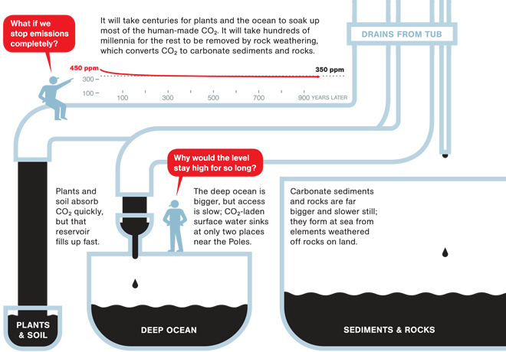
Bathtub Drainage
John Sterman, MIT
http://ngm.nationalgeographic.com/big-idea/05/carbon-bath

Slide 36
The Long Tail
Three additive exponentials
Fast,
medium,
slow
Can’t fit sum of exponentials with a
single “atmospheric lifetime”

Slide 37
Summary
Emissions of CO₂ by global industry are part of a much bigger biogeochemical cycle of carbon
About half of anthropogenic CO₂ emissions are removed from the atmosphere by perturbations to natural biogeochemistry that are not completely understood
Uncertainties in future human emissions and in the response of global biogeochemistry to changing climate are among the leading sources of uncertainty in predictions of 21st century climate
Some anthropogenic CO₂ lasts for many millennia

