Slide 1
Eddy Covariance Measurement of Ecosystem Carbon Exchange
Please read:
D. D. Baldocchi. Assessing the eddy covariance technique for evaluating carbon dioxide exchange rates of ecosystems: past, present and future. Global Change Biology, 9, 479-492, 2003

Slide 2
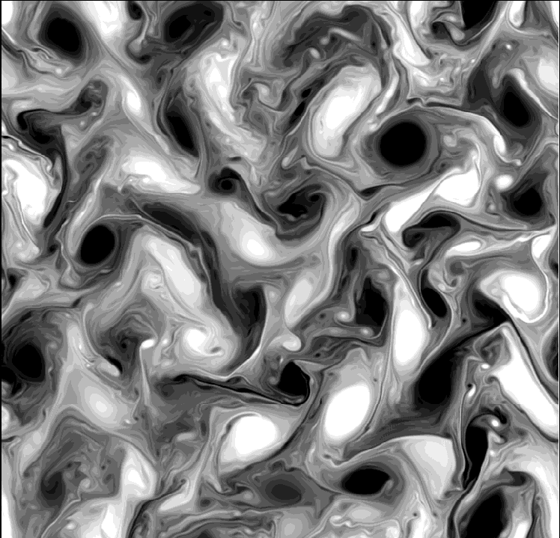
Turbulence

Slide 3
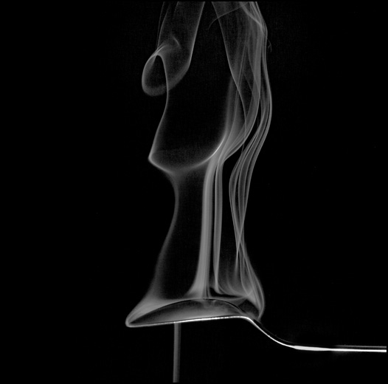

Slide 4
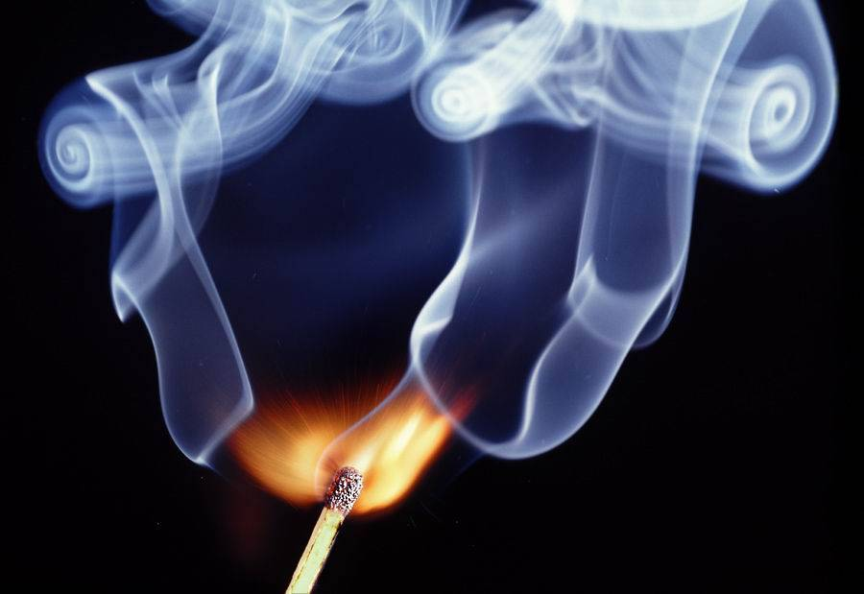

Slide 5


Slide 6
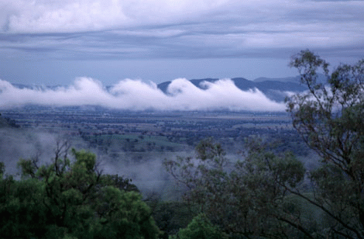

Slide 7
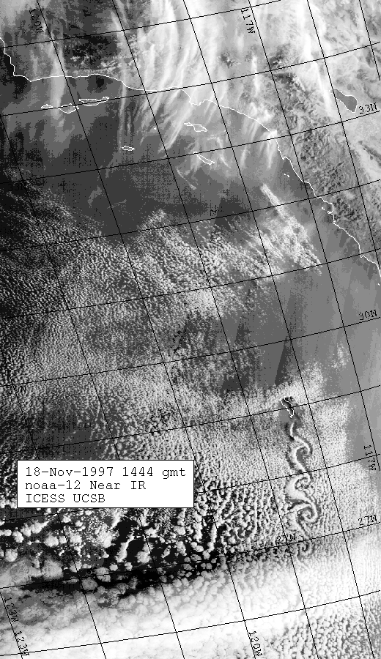
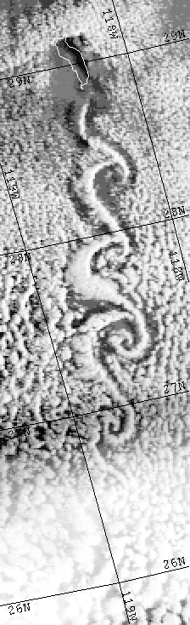

Slide 8
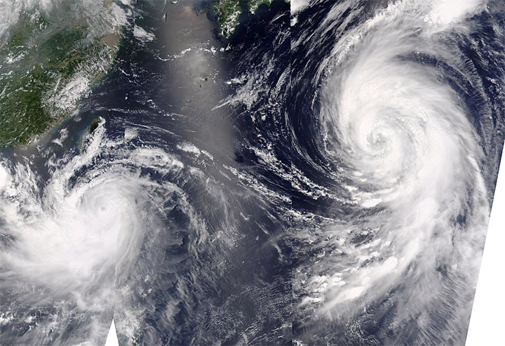

Slide 9
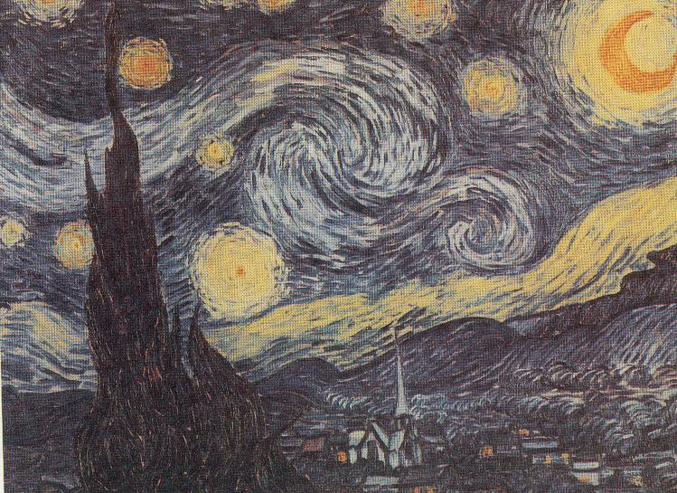

Slide 10
Rhyme
“Big whorls have little whorls,
Which feed on their velocity;
And little whorls have lesser whorls,
And so on to viscosity”
      Lewis Richardson, The supply of energy from and to Atmospheric Eddies 1920
“Great fleas have little fleas
Upon their backs to bite 'em,
And little fleas have lesser fleas,
And so, ad infinitum”
      Augustus De Morgan
      (19th century mathematician, parodying Jonathon Swift, 1733)

Slide 11
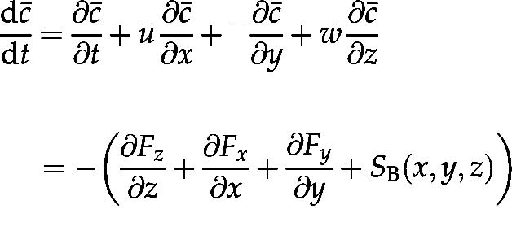
Mass Conservation Equation for CO₂
local rate
of change
advection (3D)
flux divergence (3D)
biological source/sink
c is mass mixing ratio (density of CO₂/density of air)
(u, v, w) are components of vector wind
(positive toward east, toward north, and upward)
(F_{x}, F_{y}, F_{z}) are components of vector mass flux of CO₂

Slide 12


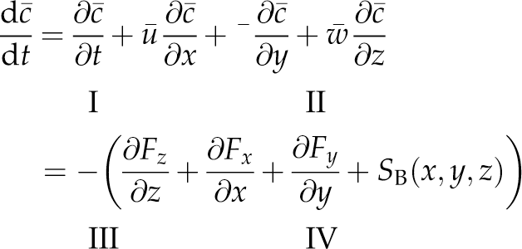
Consider Idealized Conditions
reference
surface
No change in CO₂ with time (term I ~ 0)
Wind is steady
Surface is horizontally homogeneous
Terrain is flat
Term II ~ 0
Horizontal fluxes don’t diverge … term III ~ 0

Slide 13
Turbulent CO₂ Fluxes
Imagine a turbulent eddy over an active ecosystem
Updrafts are systematically depleted in CO₂ relative to downdrafts
Updraft:
  w’c’ < 0
Downdraft:
  w’c’ < 0
Average over eddy:
w’c’ < 0
w’ < 0
c ’ > 0
w’ > 0
c ’ < 0
photosynthesizing ecosystem

Slide 14
Reynolds’ Averaging
Mean of a mean is the mean
Mean of a prime is zero
Mean of a product is not necessarily zero!
vertical mass flux of CO₂
means
0
0
perturbations

Slide 15
Variance, Covariance, Correlation
mean
perturbation
w’
variance
variance of w
c’
covariance of w and c
Normalized covariance is the correlation coefficient

Slide 16
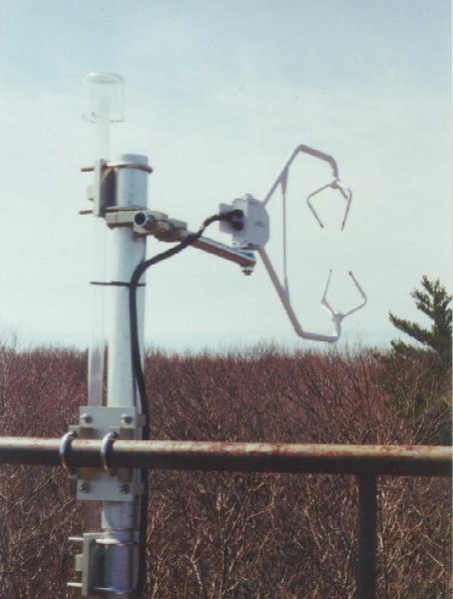
Sonic Anemometer
Measures elapsed time for sound pulses to cross air in 3D
Speed of sound is a known function of temperature
Relative motion determined accurately in 3D
Very fast instrument response time

Slide 17
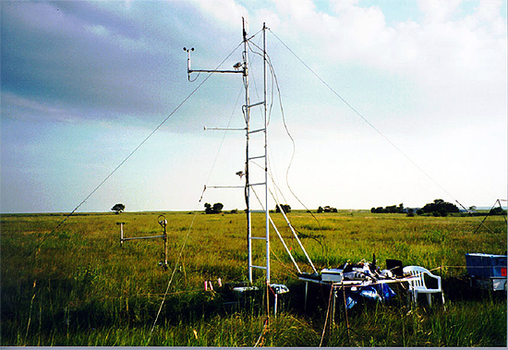
Turbulent Flux Measurements
“Eddy covariance” methods
Measure c,T, q, and 3-D wind speed (u,v,w) very frequently
  At least 10 Hz
Subtract time means to get primes
Compute products of primes to obtain fluxes
c’
t
w’
t
Oklahoma Prairie

Slide 18
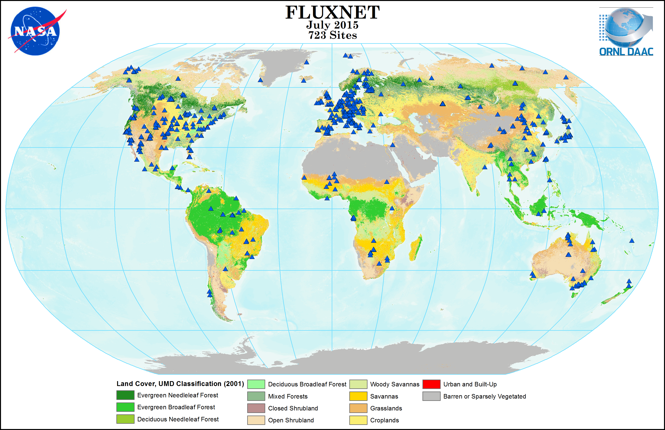

http://www.fluxnet.ornl.gov

Slide 19
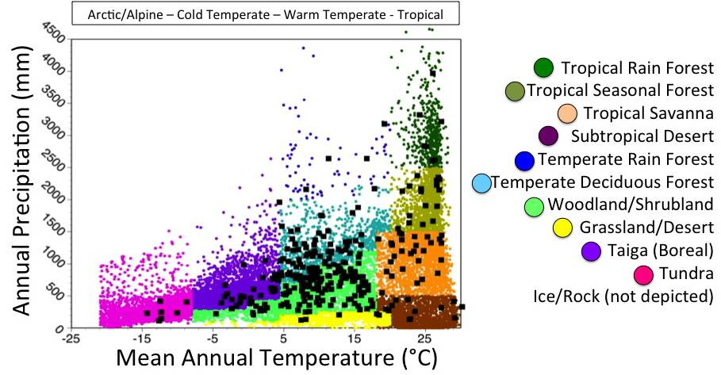
FluxNet Tower Sites
http://www.fluxnet.ornl.gov

Slide 20
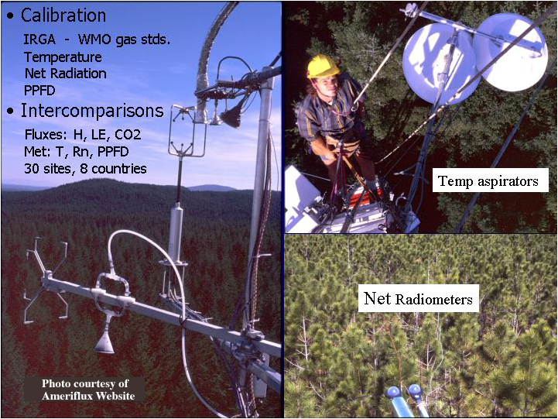
Flux Towers

Slide 21
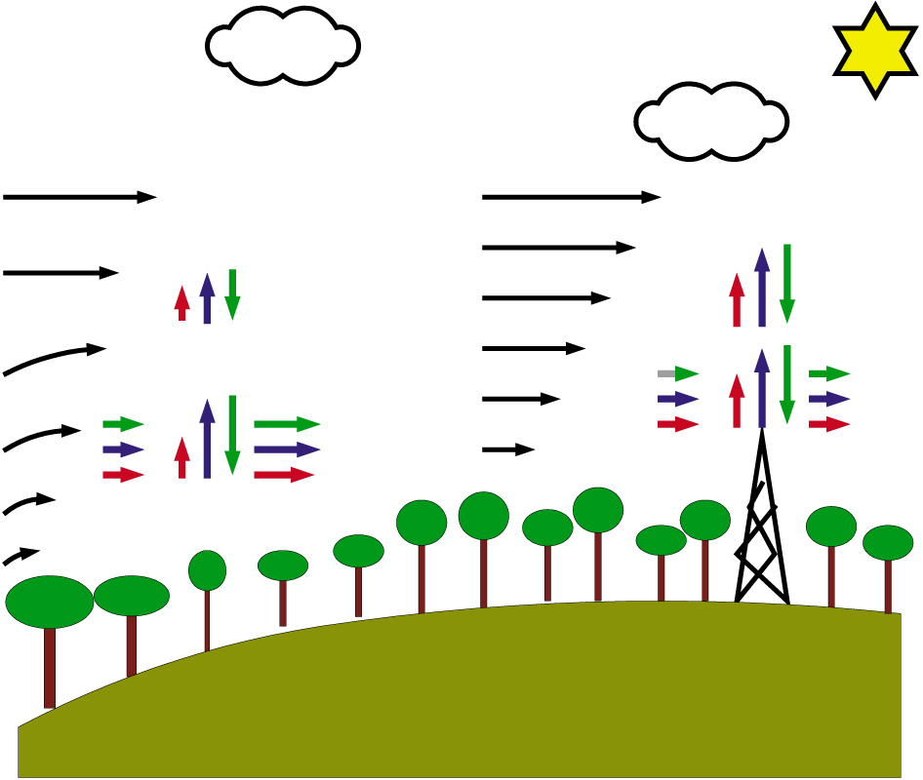
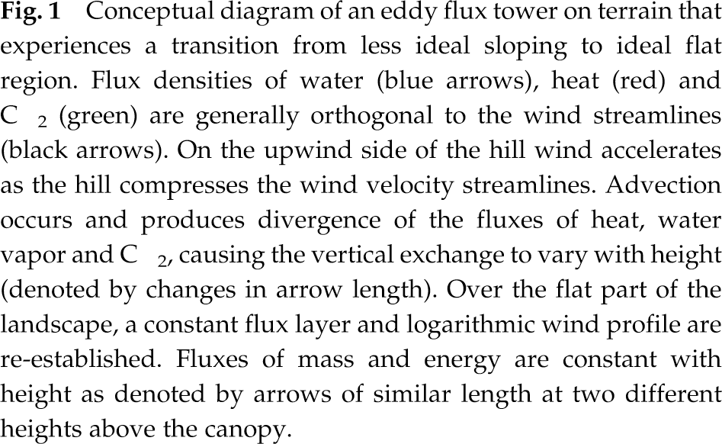
Violation of Assumptions
The real world is a messy place!
  Coordinate rotation
  Advective fluxes

Slide 22
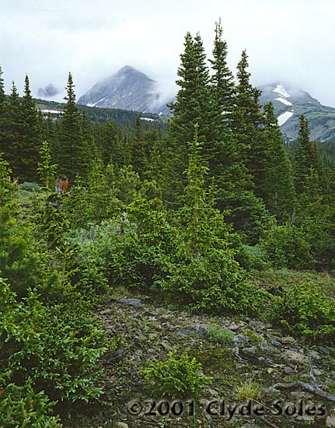
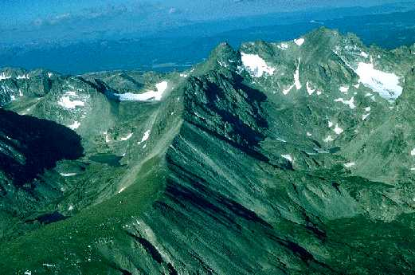
Niwot Ridge Ameriflux Site

Slide 23
Storage “Fluxes”
w’c’
Nocturnal stable layer inhibits mixing of CO₂ produced by soil respiration from reaching instruments, accumulates below reference height
  NEE underestimated
Solar heating during early morning releases stored CO₂ in a big “burst”
  NEE overestimated
Maybe OK unless stored CO₂ “leaks out” by horizontal advection or gravitational drainage flow
Try to correct for these effects by directly measuring changes in storage
R
turbulent
flux
storage
“flux”

Slide 24
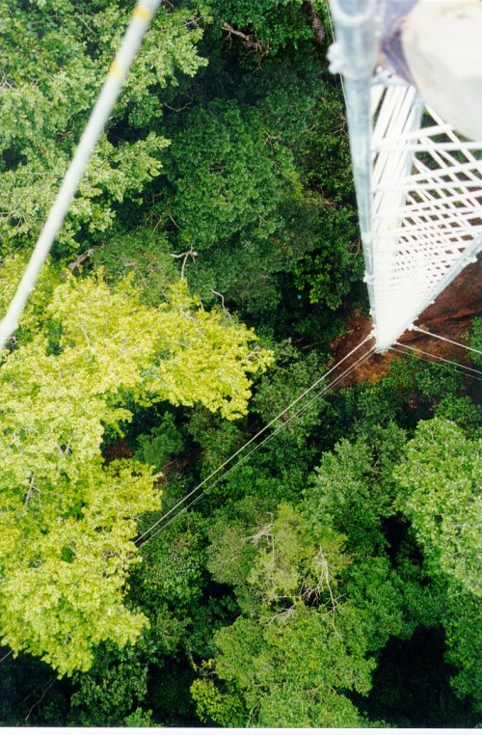
Diurnal Cycles
Underestimated night-time turbulent fluxes paired with high storage fluxes
Early morning “burps” as turbulence begins paired with strongly negative storage fluxes
Time integral conserves flux only if there is no “leakage” at night due to drainage flow or advection

Slide 25
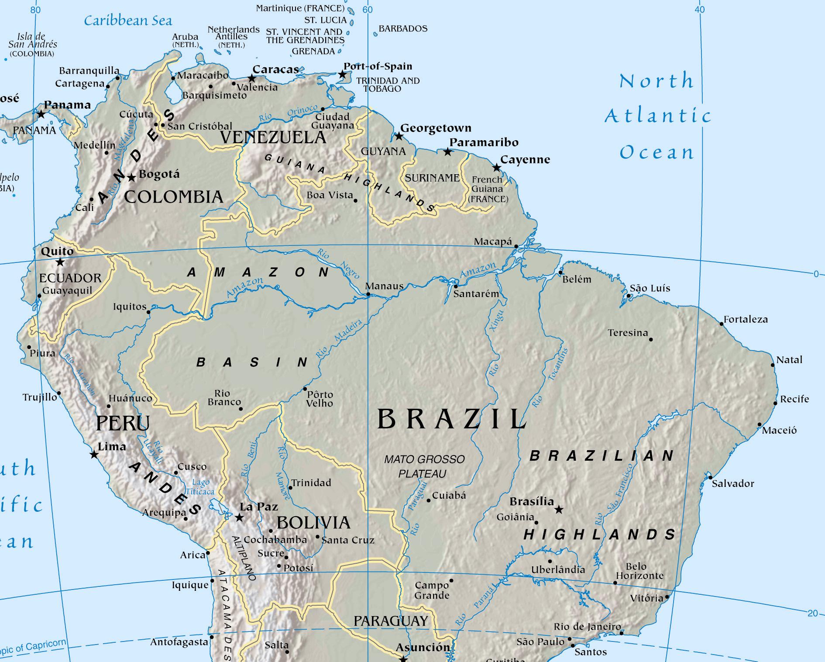
Site Locations
+
FLONA
Tapajos
+
Reserva
Jaru

Slide 26
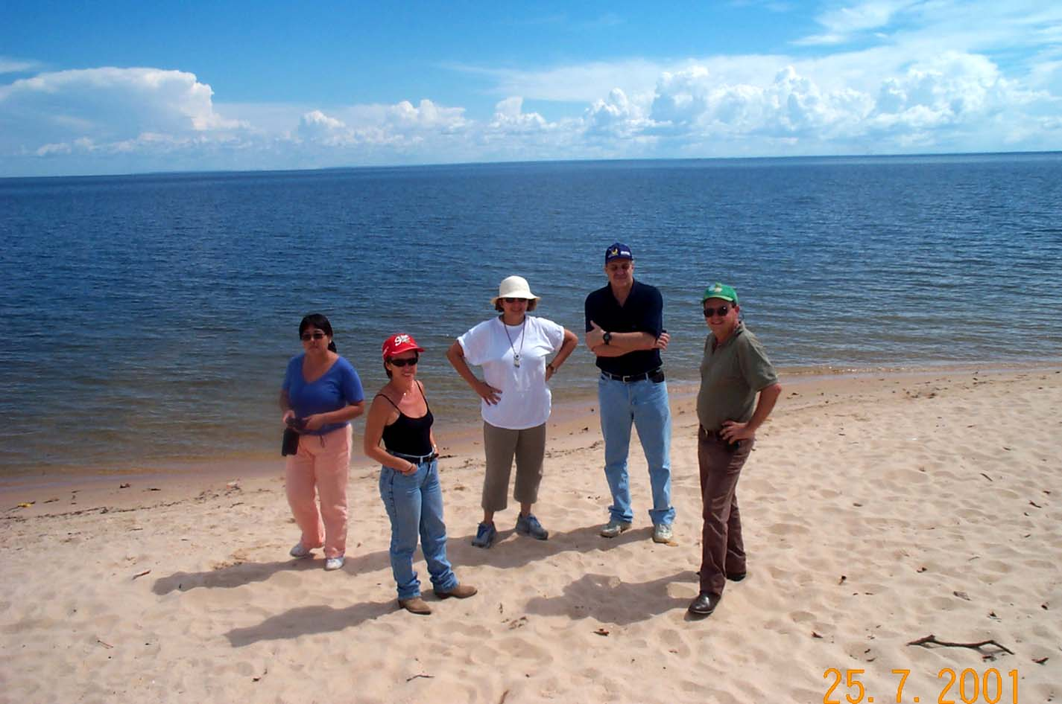

Slide 27
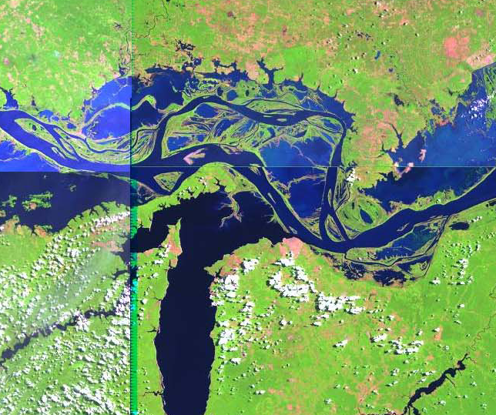

Slide 28
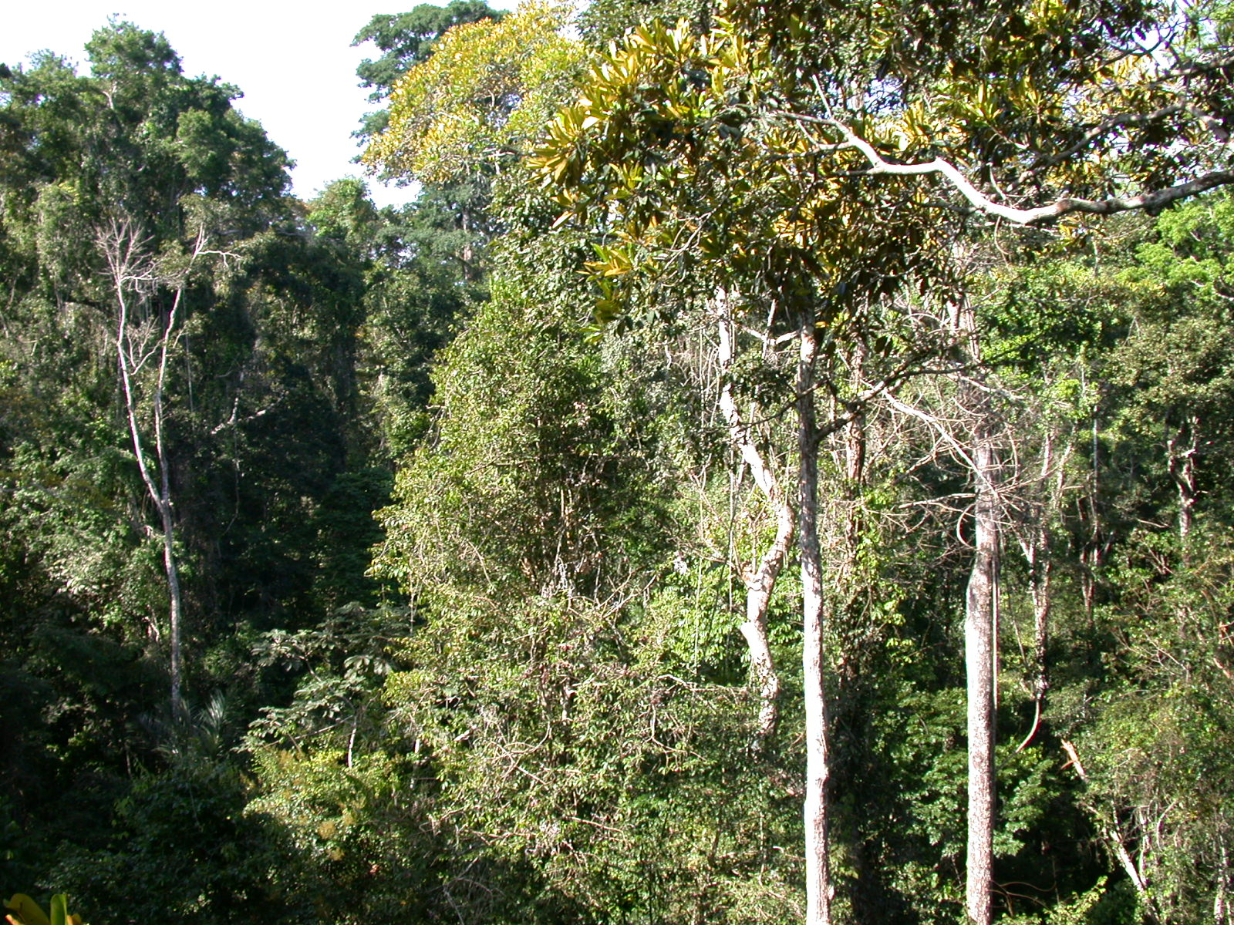

Slide 29
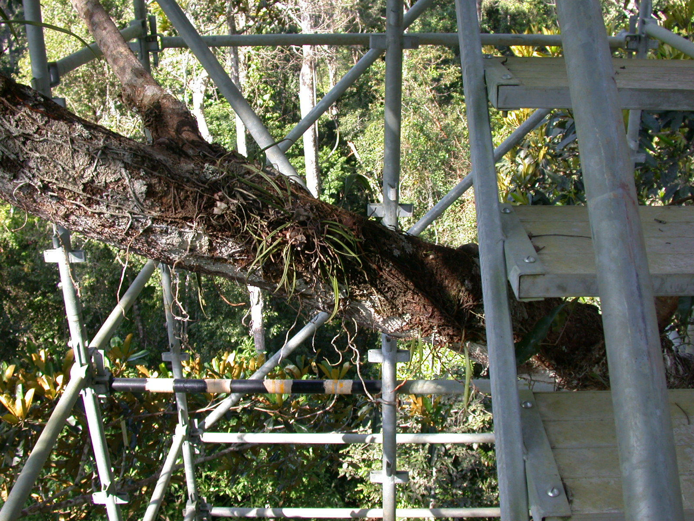

Slide 30
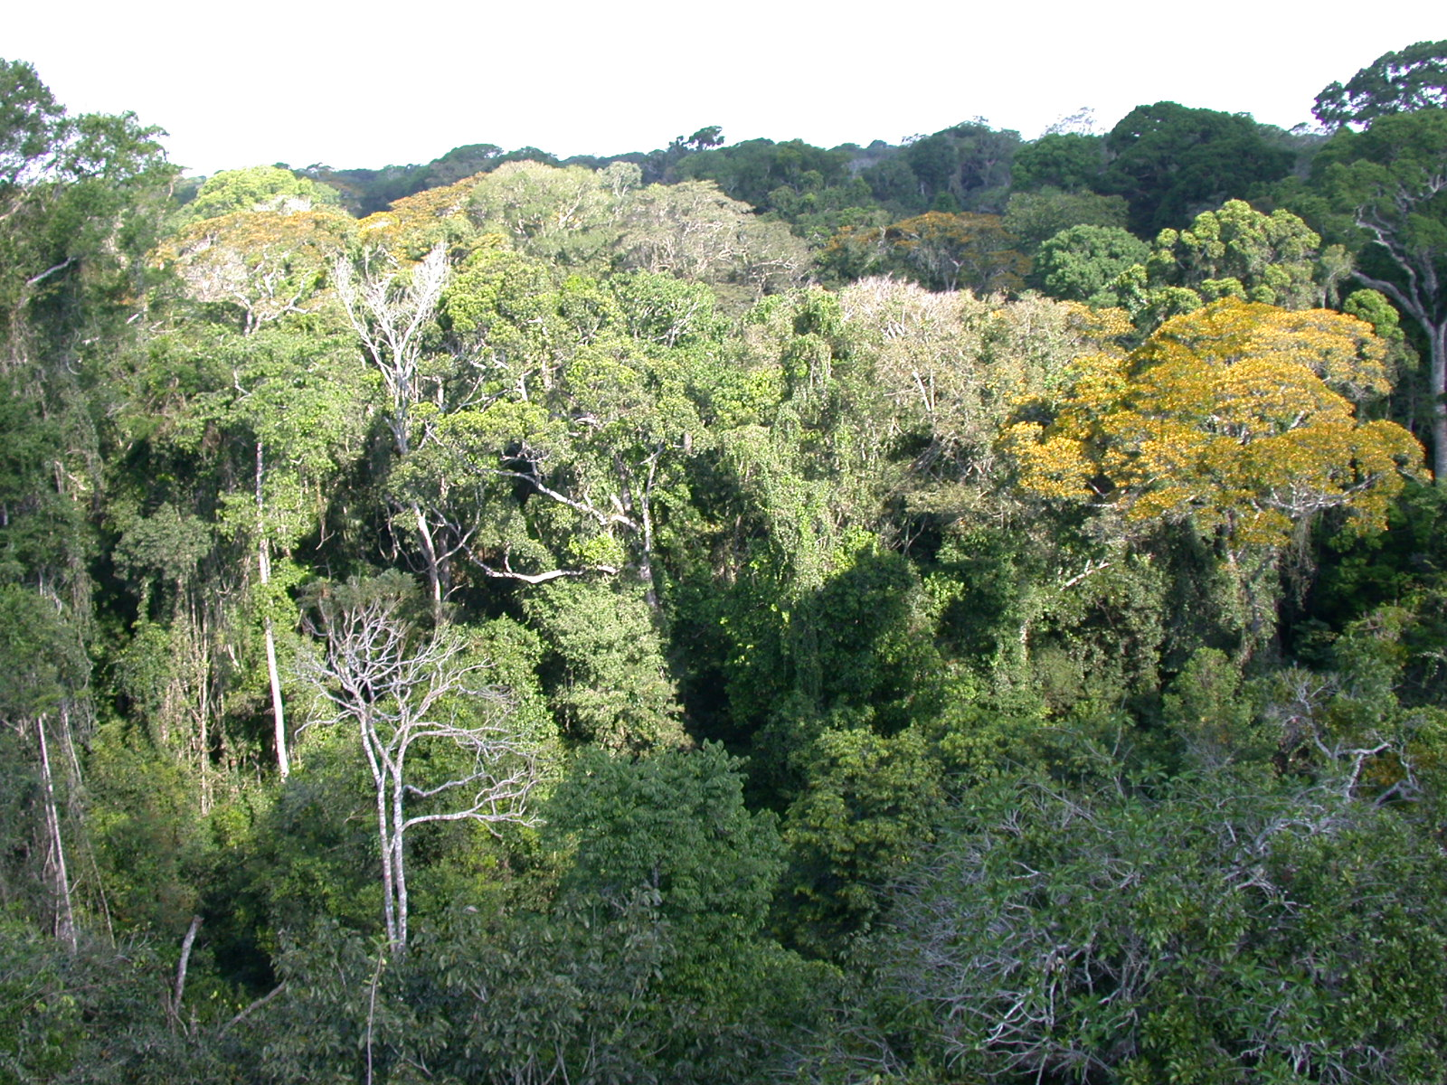

Slide 31
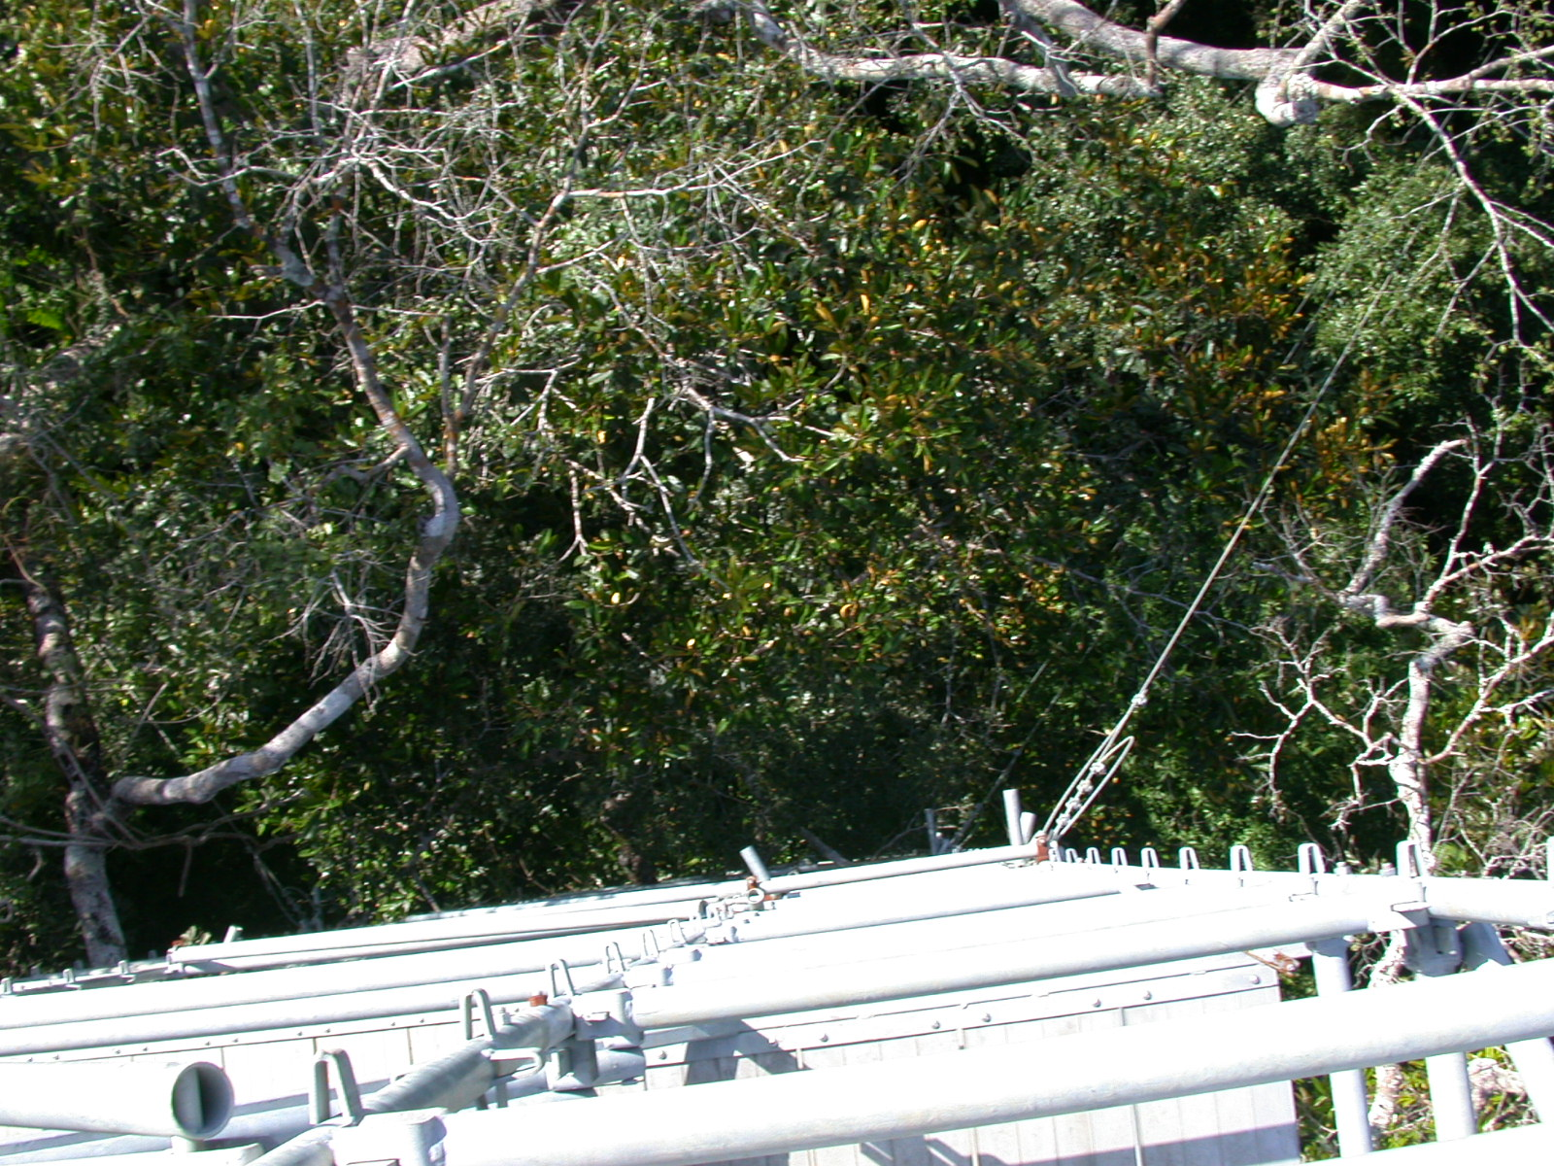

Slide 32


Slide 33
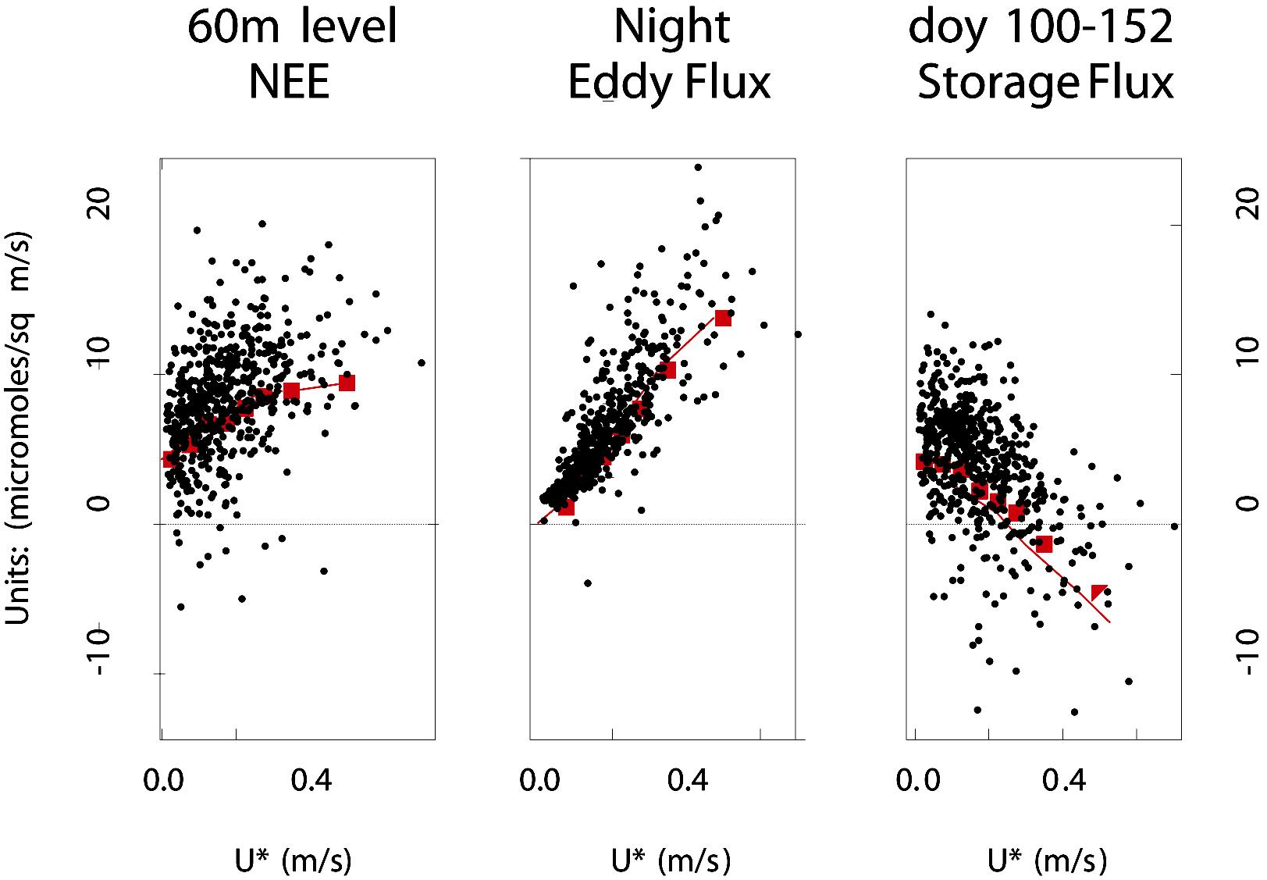
Can “u* Filtering” Avoid “Lost Fluxes”
Dependence of w’c’, storage, and NEE on u* at night suggests significant “lost fluxes
Implications for time-mean results?
Scott Saleska, Harvard University, personal communication

Slide 34
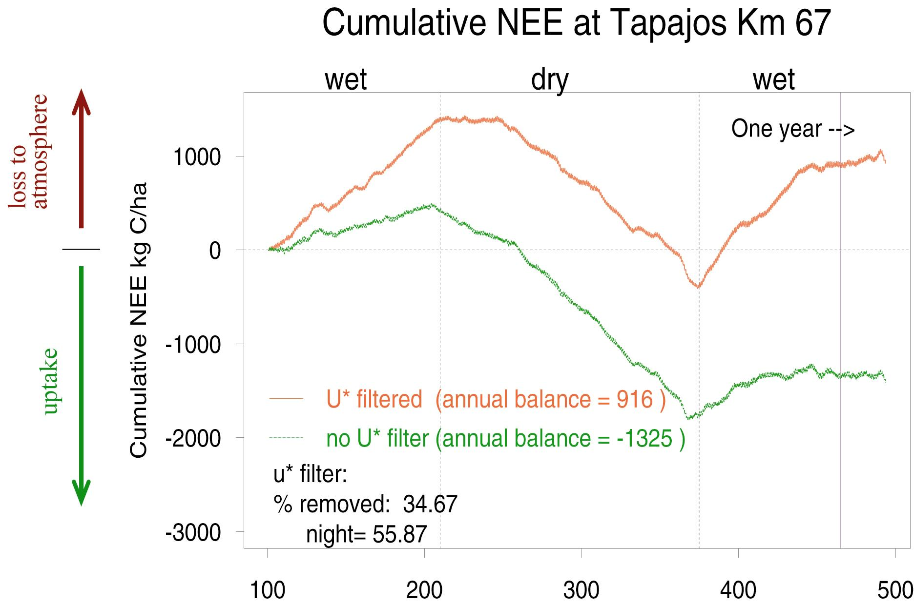
Effect of u* “Correction”
Integrated over a year, u* correction changes this site from a big sink to a big source!

Slide 35
Annualized Fluxes:
Tapajos National Forest, km 83 site
NEP was calculated by averaging the flux measurements across time of day and summing all hours.
The annualized flux using all the nocturnal data was -9.3 tC ha⁻¹ yr⁻¹.
Mike Goulden,
UC Irvine,
personal
communication
CO₂ Exchange (μmol m⁻² s⁻¹)
Time (GMT)

Slide 36
Effect of calm nights
The annualized flux calculated with all the data likely overestimates C uptake since transport mechanisms during calm periods may remove CO₂ by routes that are not included in the covariance (e.g., drainage).
CO₂ Exchange (μmol m⁻² s⁻¹)
u* (m s⁻¹)

Slide 37
Recalculated flux using just windy periods
The annualized efflux can be recalculated only considering periods windy periods.
0.3 ms⁻¹ < u*
0.2 ms⁻¹ < u*
< 0.3 ms⁻¹
0.1 ms⁻¹ < u*
< 0.2 ms⁻¹
CO₂ Exchange (μmol m⁻² s⁻¹)
u* < 0.1 ms⁻¹
Time (GMT)

Slide 39
Why is the correction for calm nights so much at km83 ?
The annual calm night correction is a function of three things:
Nocturnal hours
with significant
respiration
(T>0ºC)
(all hr yr⁻¹)
Fraction of
nocturnal hours
with low wind
(u*<0.3ms⁻¹)
(calm hr all hr⁻¹)
Difference
in CO₂ efflux
high vs low wind
(kg ha⁻¹ hr⁻¹)
Annual
Correction
(kg ha⁻¹ yr⁻¹)
X
X
=
NOBS
1400
0.54
0.5
400
km83
4000
0.92
2.5
9000

Slide 40
Most nights at km 83 are calm
km 83
NOBS
Incidence of nocturnal u*

Slide 41
Representativeness
Tons, hectares, kg, meters …
  1 t = 10³ kg
  1 ha = 10⁴ m²
Km 83 tower takes up 1 to 9 t ha ⁻¹ yr⁻¹, depending on threshold value for u* filter
Area of tropical forest in South America ~ 10⁹ ha
If this tower were representative, Amazon Basin would be a sink of 1 to 9 GtC yr⁻¹!
The neighboring tower (km 67) in old-growth rainforest is a source of CO₂

Slide 42
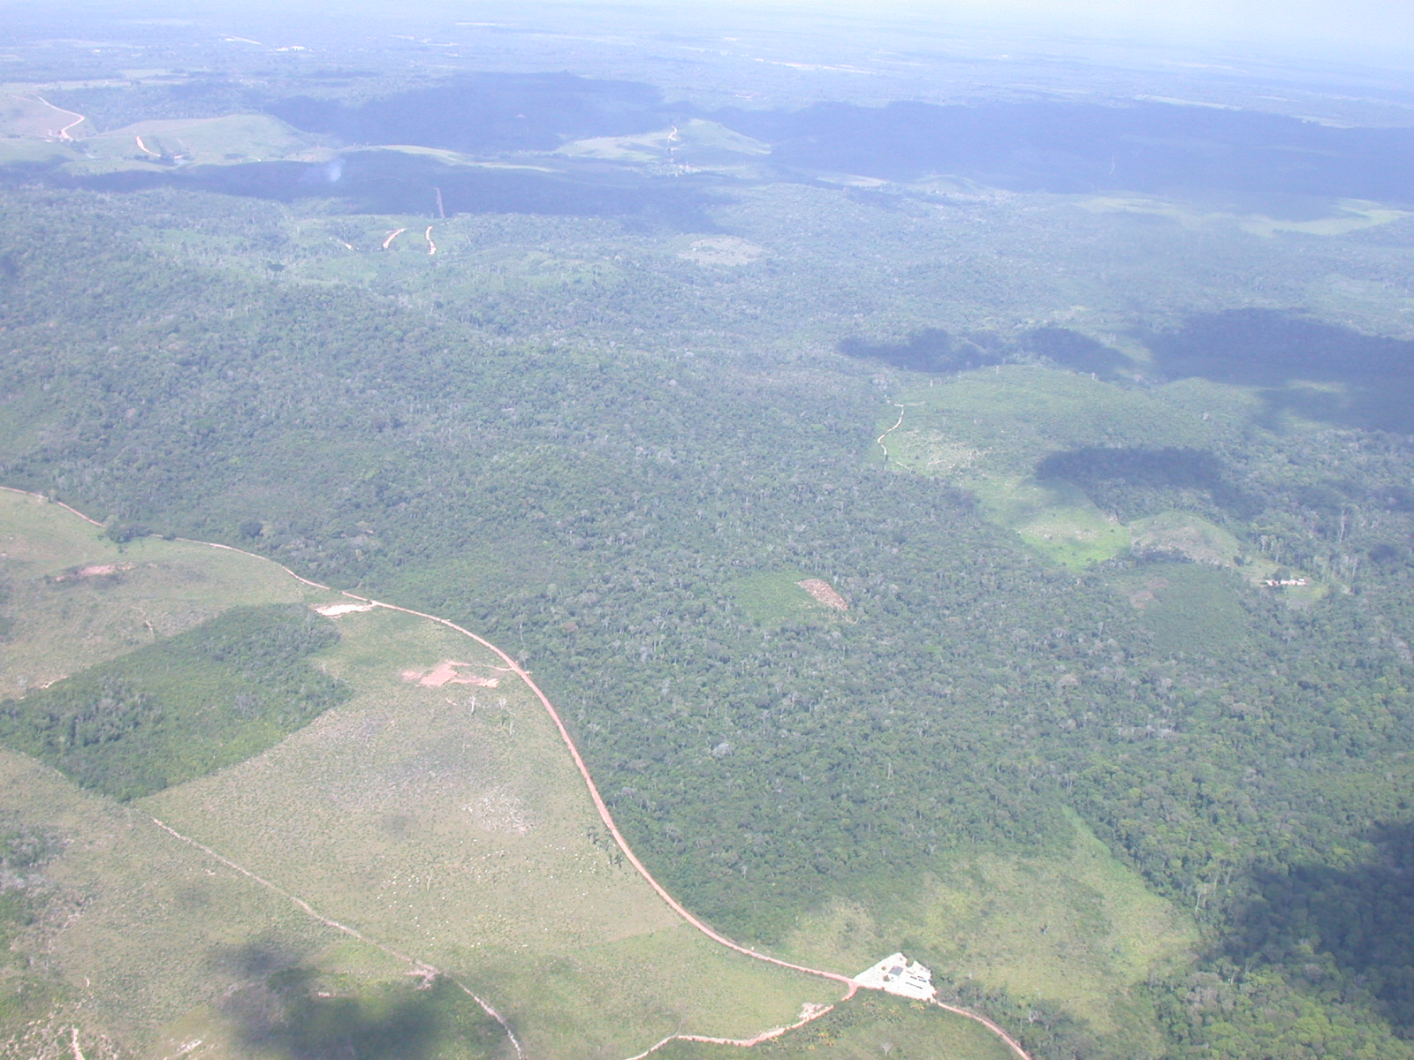

Slide 43
