Slide 1
Climate Change: Simple, Serious, Solvable
Scott Denning
Director of Education, CMMAP
Atmospheric Science, CSU
Email Scott.Denning@ColoState.edu for a copy of this presentation

Slide 2
Simple

Slide 3
Weather vs Climate what’s the difference?
If you don’t like the weather:
Wait five minutes!
If you don’t like the climate:
Move!

Slide 4
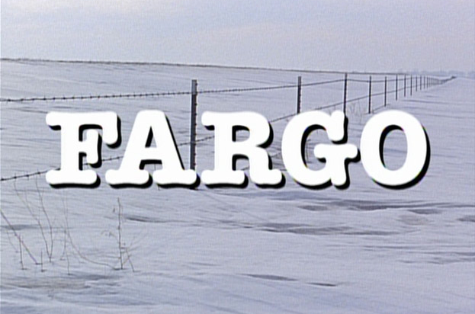
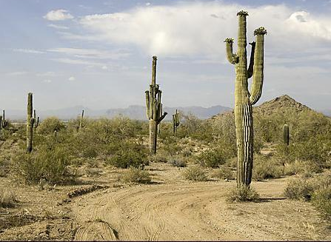
Location! Location! Location!
Climate is Place
Depends on where you live:
Latitude!
Altitude (mountains vs valley)
What’s upwind (ocean vs land)
Changes very slowly
Very predictable
We can predict that Phoenix is warmer than Fargo for precisely the same reasons that we can predict a warmer future!
PHOENIX

Slide 5
Ever Wonder Why?
Day is warmer than night
Summer is warmer than winter
Phoenix is warmer than Fargo

Slide 6
Heat Budgets
Heat in
Heat in
Heat out
Heat out

Slide 7
Dancing Molecules and Heat Rays!
Nearly all of the air is made of oxygen (O₂) and nitrogen (N₂) in which two atoms of the same element share electrons
Infrared (heat) energy radiated up from the surface can be absorbed by these molecules, but not very well
O
O
N
N
Diatomic molecules can vibrate back and forth like balls on a spring, but the ends are identical

Slide 8
Dancing Molecules and Heat Rays!
Carbon dioxide (CO₂) and water vapor (H₂O) are different!
They have many more ways to vibrate and rotate, so they are very good at absorbing and emitting infrared (heat) radiation
O
C
O
O
H
H
Molecules that have many ways to wiggle are called “Greenhouse” molecules
Absorption spectrum of CO2 was measured by John Tyndall in 1863

Slide 9
Question
How does adding CO2 to the atmosphere warm the Earth’s climate, even though it makes up only 0.004% of the air ?
CO2 is radioactive and this warms the air
Hot CO2 molecules from smokestacks and tailpipes bump into other molecules and the extra speed makes the air warmer.
Unlike most molecules in the air, CO2 molecules can vibrate in several different ways that allow them to absorb and emit photons
Only natural cycles can change the Earth’s climate.

Slide 10
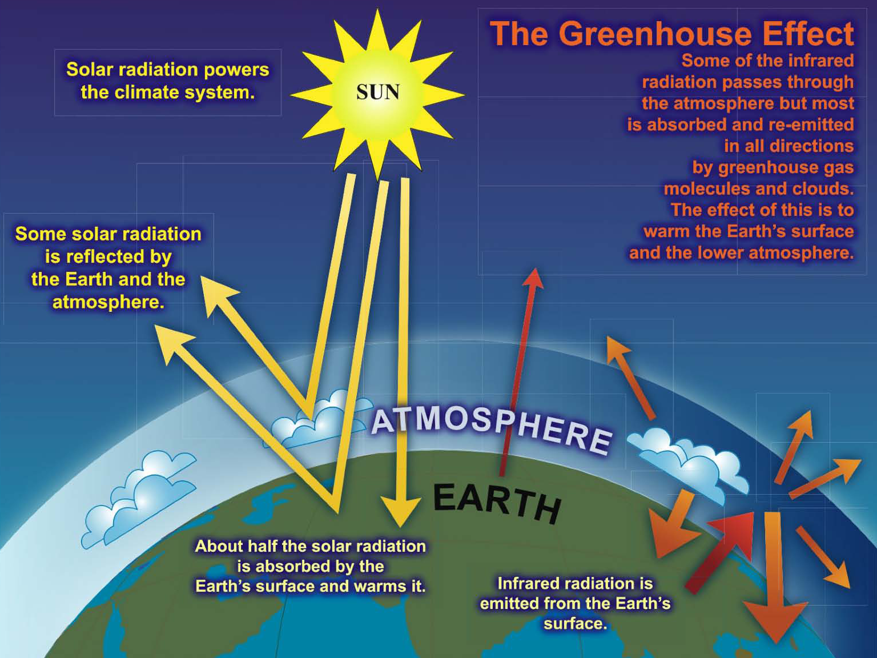

Slide 11
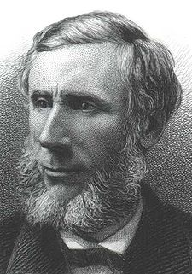
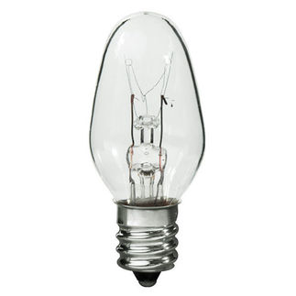
Common Sense
1 m
Doubling CO₂ would add 4 watts to every square meter of the surface of the Earth, 24/7
Doing that would make the surface warmer
This was known before light bulbs were invented!
4 Watts
1 m
John Tyndall, January 1863

Slide 12
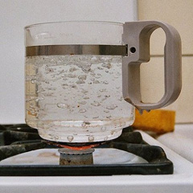
Common Myth #1
“Scientists expect a warmer future because it’s been warming up recently”
WRONG!
It’s because we know that when we add heat to things, they warm up

Slide 13
Serious

Slide 14
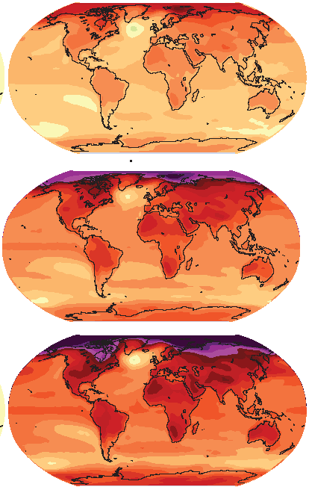
How much warmer?
Land vs ocean!
North vs South
Global mean warming of 2º to 5º C
North American warming of 3º to 6º C
= 5º to 11º F
Arctic warming of 8º to 14º F
Low
Emissions
Moderate
Emissions
High
Emissions
Rainfall? Agriculture? Water demand? Tourism?
Mass immigration?

Slide 15
Question
If CO2 doubles from preindustrial levels, how much average warming do we expect in the middle of the USA?
1 ° F
3° F
5° F
10° F
20° F

Slide 16
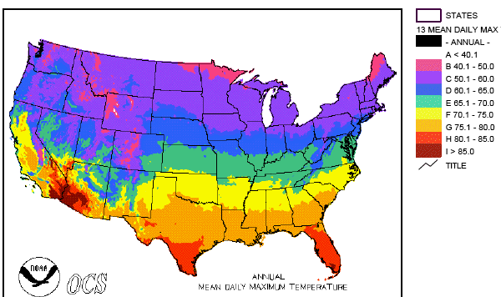
Where is it 10°F Warmer
“on average?”
Denver ➔ Amarillo
Illinois ➔ Mississippi
Washington➔ Tallahassee
Water? Crops? Real Estate? Health?

Slide 17
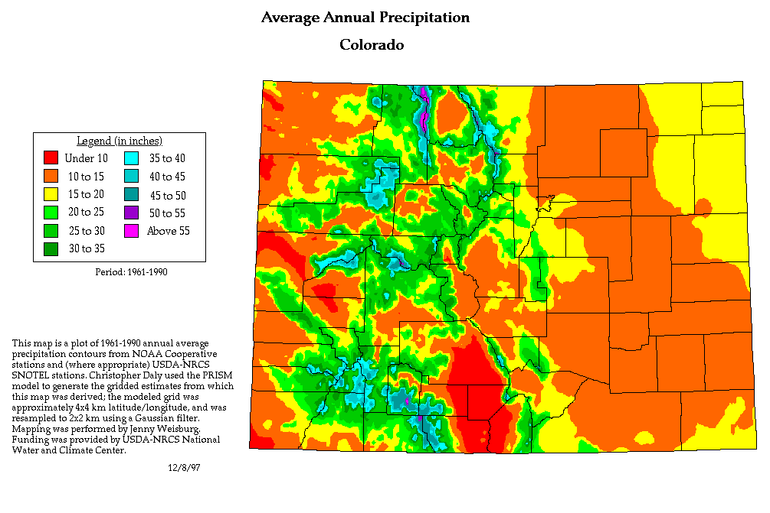
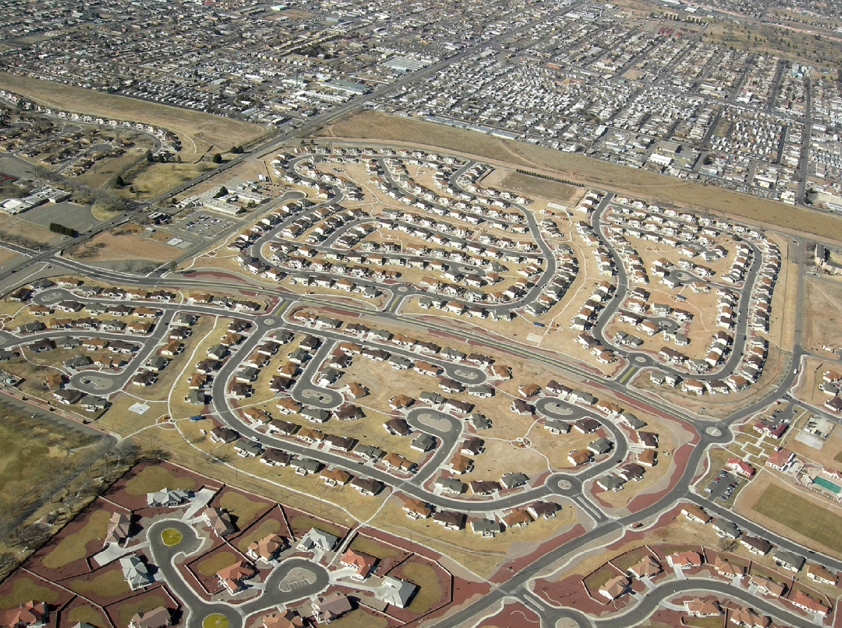
A Region On the Edge
Much of our region already receives only marginal precipitation
Just enough snow to support forests and reservoirs
Just enough irrigation water to support farming
Just enough water to support 5.3 million people

Slide 18
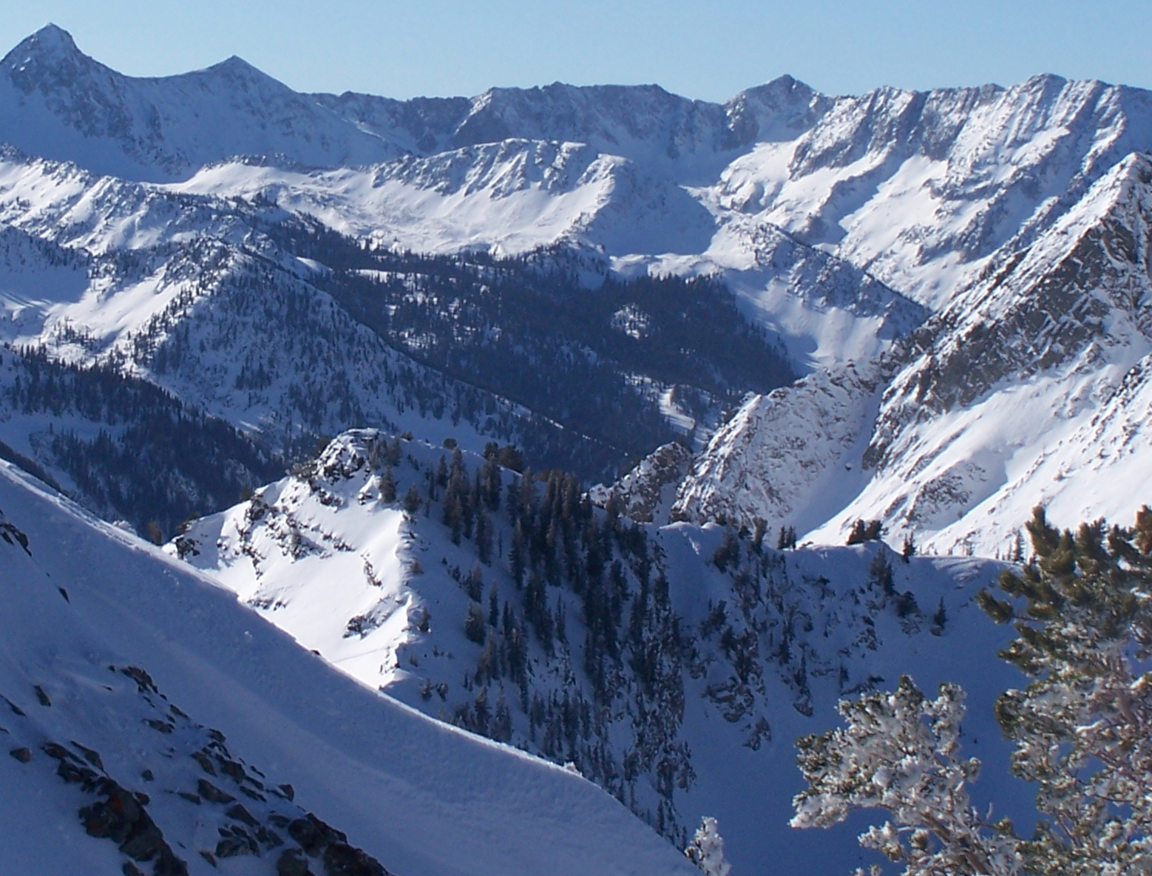
Snowpack

Slide 19
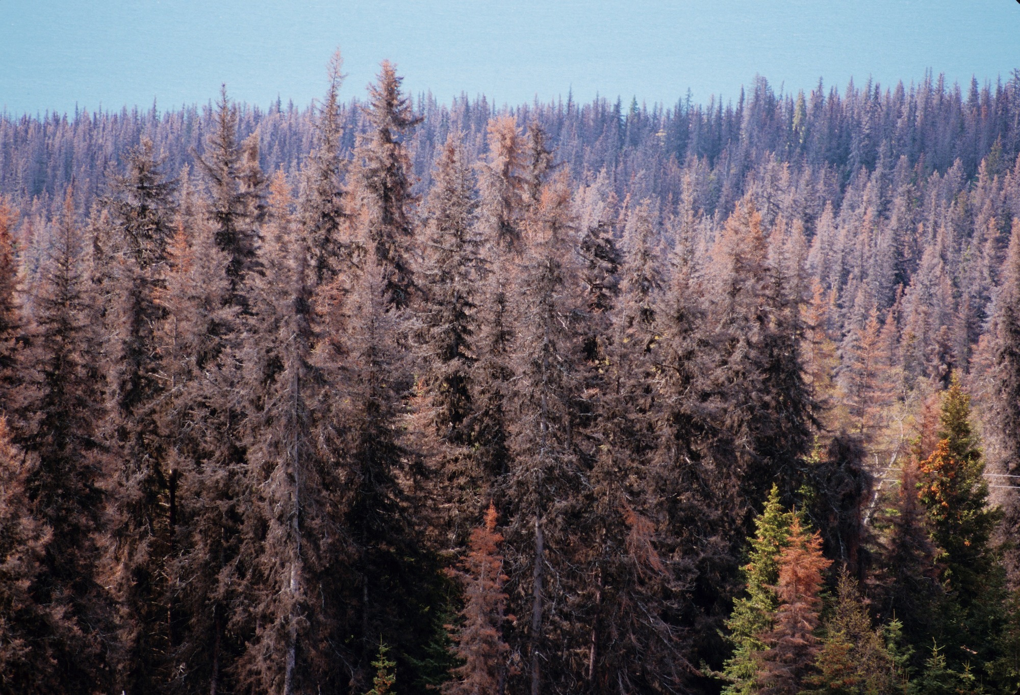
Insect Pests

Slide 20
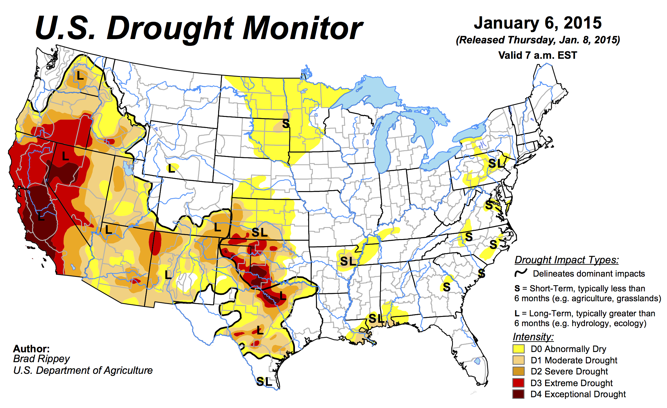
Running sum of evaporation minus precipitation
Warming increases evaporation

Slide 21
656%
656%

Slide 22
Question
How is a warmer climate related to water supplies in semi-arid regions?
Warmer air evaporates more water from the surface, so unless extra precipitation keeps up there will be more drought, less snow, and more wildfire
Warmer air can hold more water, so the world will “green up” in the future
Scientists can’t predict changes in rainfall, so we don’t know how global warming will affect water resources
Modern reservoirs can supply all the water people will need in a warmer world

Slide 23
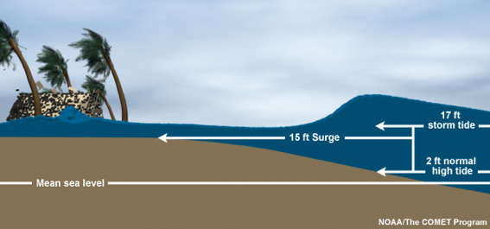
Coastal Flooding
Small floods are common, big floods are rare
Rockaway Beach, NYC
12
Sea level rise shifts the line up
What was a 100-year flood becomes a 10-year flood!
9
height above sea level (feet)
6
flooded
subway
system
3
10
100
1000
how often (years)

Slide 24
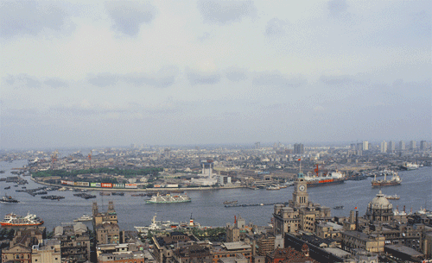
Billions and Billions Shanghai 1991 and 2012
Currently 7 billion people on Earth but only 1 billion use lots of energy
Rapid development to 4 billion energy users over coming decades
Population growth only 30% but energy growth 300% by 2100

Slide 25
For How Long?
If China and India industrialize with coal, CO₂ will rise to 4x preindustrial
Extra CO₂ will last for centuries after coal is gone
CO₂
CO₂ (ppm)
Warming (Celsius)
warming
you are
here
GtC/yr
year
The heck with Polar Bears … what would that do to cities?

Slide 26
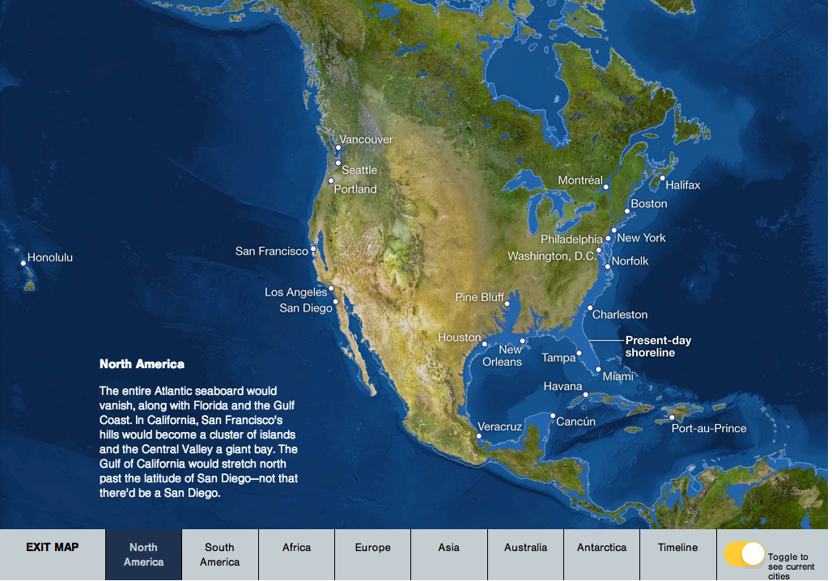
Eventually
http://www.freetech4teachers.com/2013/09/an-interactive-map-of-rising-sea-levels.html

Slide 27
Question
How does a CO2-warmed world affect coastal ecosystems and people?
If Ice Sheets melt in Greenland and Antarctica over the oceans will slowly rise to flood huge areas of low-lying coasts
Thermal expansion of seawater will lift baseline sea levels so that even without a change in storm frequency extreme coastal flooding will happen much more often
Big coastal storms may become more frequent in warmer world, causing massive coastal flooding
All of the above

Slide 28
Solvable

Slide 29
Historical Emissions
Billions of Tons Carbon Emitted per Year
16
8
Historical
emissions
0
1950
2000
2050
2100
Notes:
29

Slide 30
The “Stabilization Triangle”
Billions of Tons Carbon Emitted per Year
16
Current path = “ramp”
Stabilization Triangle
Interim Goal
8
Historical
emissions
Flat path
1.6
0
1950
2000
2050
2100
Notes:
30

Slide 31
“Stabilization Wedges”
Billions of Tons Carbon Emitted per Year
16 GtC/y
16
Current path = “ramp”
Eight “wedges”
Goal: In 50 years, same
global emissions as today
8
Historical
emissions
Flat path
1.6
0
1950
2000
2050
2100
http://www.princeton.edu/wedges/
Notes:
31

Slide 32
What is a “Wedge”?
A “wedge” is a strategy to reduce carbon emissions that grows in 50 years from zero to 1.0 GtC/yr. The strategy has already been commercialized at scale somewhere.
1 GtC/yr
Total = 25 Gigatons carbon
50 years
Cumulatively, a wedge redirects the flow of 25 GtC in its first 50 years. This is 2.5 trillion dollars at $100/tC.
A “solution” to the CO₂ problem should provide at least one wedge.

Slide 33
15 Wedges: Solved!
Energy Efficiency &
Conservation (4)
16 GtC/y
Fuel Switching
(1)
Renewable Fuels
& Electricity (4)
Stabilization
Stabilization
Triangle
Triangle
CO₂ Capture
& Storage (3)
8 GtC/y
Forest and Soil Storage (2)
2007
2057
Nuclear Fission (1)
http://www.princeton.edu/wedges/
Notes:
33

Slide 34
Question
How could CO2 emissions be held constant over coming decades as billions of people rise from poverty?
By carpooling and recycling in our local communities
By generating 20% of our electricity using solar and wind power
By worldwide adoption of a combination of efficiency, renewable energy, fuel switching and nuclear power
Emissions will inevitably grow as billions of people join the developed world

Slide 35
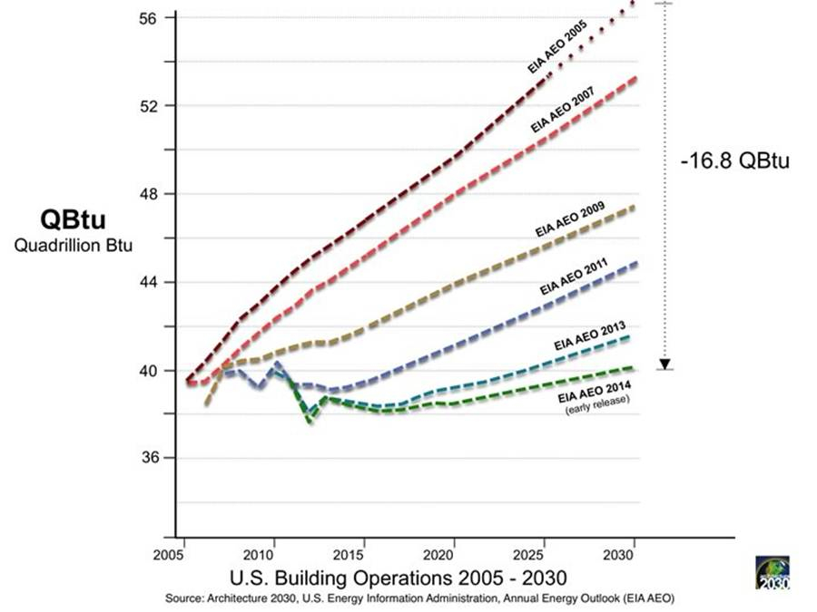
Efficient Architects!
$4.5 TRILLION

Slide 36
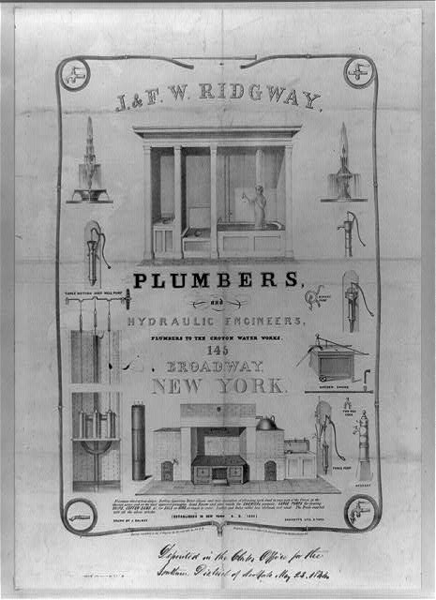
Costs
Conversion to 100% noncarbon energy will cost about 1% of GDP
That’s about what it cost to retrofit all the world’s cities with indoor plumbing a century ago …
It was worth it!

Slide 37
Imagine it’s 1800, and you’re in charge …
Somebody presents you with a grand idea for transforming the world economy:
Dig 8 billion tons of carbon out of the ground every year
Build a system of pipelines, supertankers, railroads, highways, and trucks to deliver it to every street corner on the planet
Build millions of cars every year, and millions of miles of roads to drive them on
Generate and pipe enough electricity to every house to power lights & stereos & plasma TVs
… “and here’s the itemized bill …”

Slide 38
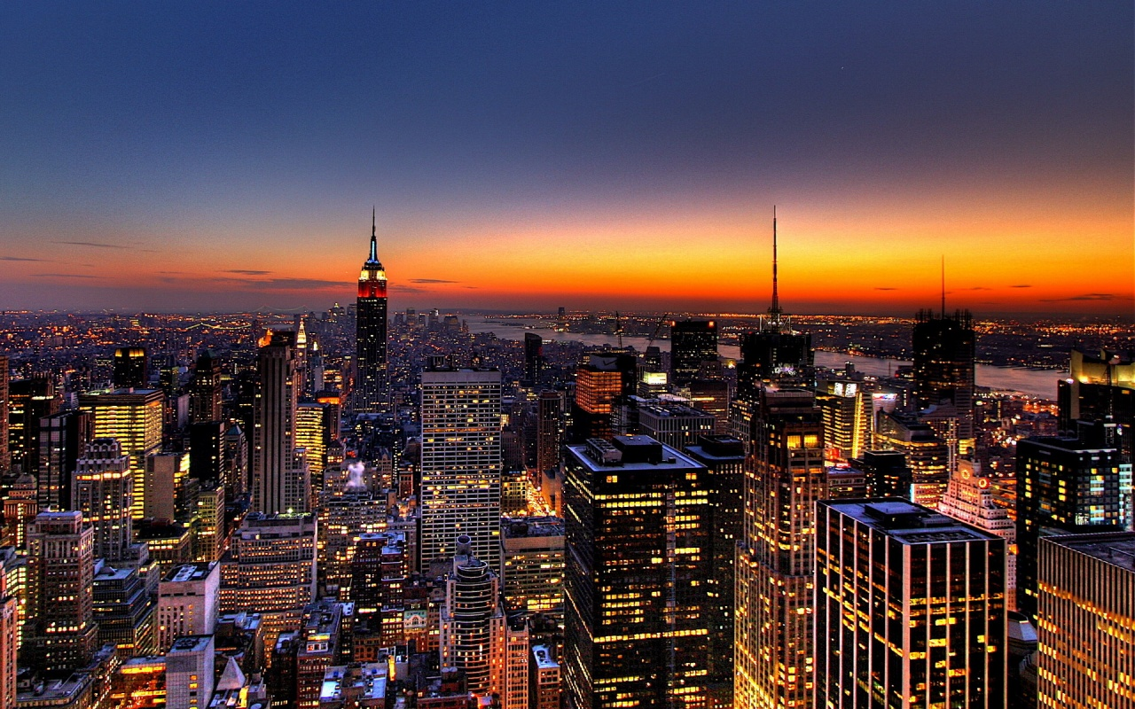
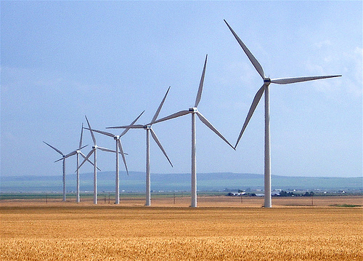
Who Built That?
Our ancestors built that very system
It cost them every dime of global GDP for 200 years (now $72T/yr)
It created every dime too!
Now our kids get to do it again!

Slide 39
Choose Your Future
Some people think:
“Our modern lifestyle is based on stuff we extract from the ground”
I prefer:
“We create our well-being through creativity, ingenuity, risk-taking, and hard work.
Our future is bright.”

