Slide 1
The Simple Biosphere Model: SiB4
Updated November 11, 2015
Self-consistent global land surface model
Minimal input data
→ Weather
→ Soil properties
→ Plant Functional Type (24 PFTs)
Carbon, Energy, Water Fluxes
  Photosynthesis: Enzyme Kinetics and Stomatal Physiology
  Respiration: Autotrophic and Heterotrophic
Dynamic Prognostic Phenology
  5 Phenological Stages
  Temperature and moisture driven
Carbon Pools
  → 6 Live Pools and 6 Dead Pools
Sub-Hourly Fluxes and Daily Pools

Slide 2



Land-Atmosphere Fluxes
> Carbon
-- Gross Primary Production (GPP)
-- Respiration (Auto- and Hetero-)
> Energy: Latent and Sensible Heat
> Water: Evapotranspiration
Weather
MERRA 0.5º x 0.67º Hourly
> Pressure and Specific Humidity
> Temperature, Wind
> Shortwave/Longwave Radiation
> Convective/Large-Scale Precipitation
-- Scaled To Monthly GPCP--
Output
The Simple Biosphere Model SiB4
Input
Biomass
> Above and Below Ground Pools
-- Leaf, Wood, Roots, Product --
> Leaf Area Index
> Net Primary Productivity
Land Cover
> MODIS 1-km Plant Functional Type
> 0.5º Crop Data (Ramankutty et al., 2008)
Soil Characteristics
Soil Properties
IGBP Soil Data Task Group
> Soil Moisture/Water Content
> Soil Carbon
> Sand and Clay Fractions
> Soil reflectance

Slide 3
SiB4 Vegetation
PFT Information
---------------------------------
Num PFT_Name Type Group
1 des_all 1 1
2 enf_tem 2 2
3 enf_bor 2 2
4 dnf_bor 3 2
5 ebf_tro 2 3
6 ebf_tem 2 3
7 dbf_tro 3 3
8 dbf_tem 3 3
9 dbf_bor 3 3
10 shb_nar 3 4
11 shb_arc 3 4
12 c3g_tro 3 5
13 c3g_tem 3 5
14 c3g_arc 3 5
15 c4g_tro 3 5
16 c4g_tem 3 5
17 cro_tro 4 6
18 cro_tem 4 6
19 mze_tro 4 6
20 mze_tem 4 6
21 soy_tro 4 6
22 soy_tem 4 6
23 wwt_all 4 6
24 mis_all 1 1
24 Plant Functional Types
4 PFT Types
1: Bare Ground
2: Evergreen
3: Deciduous
4: Crop
6 PFT Groups
1: Barren
2: Needleleaf Forest
3: Broadleaf Forest
4: Shrub
5: Grass
6: Crop

Slide 4
SiB4 Carbon Pools
Num Long_Name Short Type Location Vertical_Level
1 storage stor live soil 1
2 leaf leaf live canopy 1
3 fine root froot live soil 10
4 coarse root croot live soil 10
5 wood wood live canopy 1
6 product prod live canopy 1
7 coarse woody debris cwd dead surface 1
8 litter metabolic litmet dead surface 1
9 litter structural litstr dead surface 1
10 soil litter slit dead soil 10
11 soil slow slow dead soil 10
12 soil armored arm dead soil 10
- Carbon allocated to live pools determined by phenology
Carbon transferred between pools determined by PFT group
Vertical distribution of carbon in soil determined by PFT rooting profile

Slide 5
The Simple Biosphere Model: SiB4
Photosynthesis Rate
Light, Rubisco, Utilization
Relative Humidity
Root-Zone Water
Temperature
Respiration Rate
Assimilation
Moisture
Temperature (Q10)
Turnover Time
Pool Size
Photosynthesis:
CO₂ Uptake
Carbon Allocation
Phenology Stage
- Assimilation Rate
- Leaf Cost-To-Benefit
Weather Conditions
Respiration Rate
Moisture
Temperature (Q10)
Transfer Efficiency
Turnover Time
Pool Size
Autotrophic Respiration:
CO₂ Release
LAI /
FPAR
Product Pool
Storage Pool
Leaf Pool
Heterotrophic Respiration:
CO₂ Release
Live Pool Transfers
Phenology Stage
Moisture
Temperature (Q10)
Turnover Time
Pool Size
Stem/Wood Pool
Metabolic
Litter
Dead Transfers
Moisture
Temperature (Q10)
Transfer Efficiency
Turnover Time
Pool Size
Structural
Litter
Coarse Woody
Debris
Coarse Root Pool
Soil Litter
Leaf-Out Initiation
⬥ Temperature
⬥ Soil Moisture
⬥ Length of Day
Fine Root Pool
Soil Slow
Soil Passive

Slide 6

Carbon Release
Autotrophic Respiration
Heterotrophic Respiration
Disturbance
Pool Transfers
Carbon Assimilation
Photosynthesis
10 Minutes
SiB4 Carbon Cycle
Daily
Calculate LAI/FPAR
Sum Carbon Gains/Losses
Daily photosynthetic gain
Daily pool losses
Calculate Growth Respiration Rates
Update Pools
Determine Phenology Stage
Calculate Pool Allocation
Phenology Stage
Meteorological Conditions
Pool Size
Disturbance
Grazing
Harvest
Trigger Growing Season Start

Slide 7
Carbon Release
Autotrophic Respiration
Heterotrophic Respiration
Disturbance
Pool Transfers
Carbon Assimilation
Photosynthesis
10 Minutes
SiB4 Carbon Cycle
Daily
Calculate LAI/FPAR
Sum Carbon Gains/Losses
Daily photosynthetic gain
Daily pool losses
Calculate Growth Respiration Rates
Diurnally-Varying Processes
Model-Timestep (10 minutes)
Update Pools
Determine Phenology Stage
Land-Atmosphere Exchanges
Carbon Pool Exchanges
Calculate Pool Allocation
Phenology Stage
Meteorological Conditions
Pool Size
Carbon Assimilation
Carbon Release
Disturbance
Grazing
Harvest
Live and Dead Pool Transfers
Trigger Growing Season Start

Slide 8
Carbon Assimilation: Photosynthesis
Physiologically-Driven Stomatal Model
- Leaf stomata control rate of CO₂ diffusion in and water vapor diffusion out
- Stomatal conduction regulates the addition of CO₂ with loss of water
Stomatal conductance: Ball-Berry Relationship
g_{s} = Stomatal conductance (mol/m²/s)
m, b = Coefficients
A = Assimilation rate (mol/m²/s)
C = CO₂ concentration (Pa)
h = relative humidity
p = atmospheric pressure (Pa)
Assimilation Rate
A_{L} = Light-limited rate (mol/m²/s)
A_{R} = Rubisco-limited rate (mol/m²/s)
A_{U} = Utilization-limited rate (mol/m²/s)
Canopy Integration
Leaf Physiology
or
Radiation Rate Limit
Environmental Forcing
- Humidity
- Root-Zone Water
- Temperature
Canopy PAR Use Parameter
Collatz et al., 1991
Sellers et al., 1992
FPAR =Fraction of photosynthetically
active radiation absorbed by
the vegetation canopy
k = extinction coefficient for the flux
of PAR or visible radiation
LT = Total Leaf Area Index (LAI)

Slide 9
Carbon Release: Autotrophic Respiration
Autotrophic
Respiration Rate
(mol C/m²/s)
F_{GR} = Growth Respiration Factor (0-1)
C_{Alloc} = Carbon Allocated to Pool (mol/m²)
seconds_per_day = Conversion from
daily-calculated carbon allocation (s/day)
F_{MR} = Maintenance scaling factors (-)
- Storage and Roots:
Moisture and Temperature (Q10)
- Leaf: Temperature
- Stem, Product: Assimilation
k_{MR} = Pool maintenance
respiration rate (1/s)
C = Pool carbon (mol/m₂)

Slide 10
Carbon Release
Moisture and Temperature Factors
Moisture Factor
Temperature Factor
T=Temperature (K)
Tref = Reference Temperature
(298-300 K)
Q10 = Base (1.8-2.0)
R_{clay} = Respiration parameter
based on clay fraction
W_{sat} = Soil moisture fraction of saturation
Zm = Exponent parameter
W_{Opt}^{Zm} = Optimal soil moisture
saturation fraction

Slide 11
Carbon Release: Heterotrophic Respiration
R_{H} = Heterotrophic respiration rate (mol C/m²/s)
E_{n_To_j} = Transfer efficiency between the current pool (n)
and the pool being transferred to (j)
k_{HR} = Pool respiration rate (1/s)
C = Pool carbon (mol/m₂)
F_{HR} = Respiration scaling factors (-)
F_{moist} = Moisture factor
F_{temp} = Temperature factor (Q10)

Slide 12
Pool Transfer Rates
F_{Tr} = Pool transfer scaling factors (-)
C = Pool carbon (mol/m²)
TFrac_{n_To_j} = Transfer fraction between
pool losing carbon (j) and
pool receiving the transfer
Transfer_Loss = Transfer Loss Rate Per Pool (mol C/m²/s)
Transfer_Gain = Transfer Gain Rate Per Pool (mol C/m²/s)
k_{Tr} = Pool decay rate (1/s)
Live To Dead Pool Transfers
Dead Pool Transfers
Storage and Roots:
- Moisture and Temperature
Leaf, Stem, Product:
- Phenology Stage
k_{Tr} = k_{HR}
Brown_Add_{phen_stage} = Phenology-stage specific transfer addition
E_{n_To_j} = Transfer efficiency between the current pool (n)
and the pool being transferred to (j)
F_{moist} = Moisture Factor
F_{temp} = Temperature factor
Tr_min_{phen_stage} = Phenology-stage specific minimum transfer factor
Tr_max_{phen_stage} = Phenolog-stage specific maximum transfer factor

Slide 13
Seasonally-Varying Processes
Daily Updates
Carbon Release
Autotrophic Respiration
Heterotrophic Respiration
Disturbance
SiB4 Dynamic Prognostic Phenology
Pool Transfers
Phenology Stage
Carbon Allocation
Pool Sizes
Carbon Assimilation
Photosynthesis
10 Minutes
SiB4 Carbon Cycle
Daily
Calculate LAI/FPAR
Sum Carbon Gains/Losses
Daily photosynthetic gain
Daily pool losses
Calculate Growth Respiration Rates
Update Pools
Determine Phenology Stage
Calculate Pool Allocation
Phenology Stage
Meteorological Conditions
Pool Size
Disturbance
Grazing
Harvest
Trigger Growing Season Start

Slide 14
Daily Carbon Gains (mol C/m²/day)
Assimilation
Pool
Transfer
Daily Carbon Losses (mol C/m²/day)
Autotrophic Respiration
Heterotrophic Respiration
Pool Transfer

Slide 15
Losses are known per carbon pool; however,
daily carbon assimilated needs to be distributed
SiB4 Phenology Stages
5 Phenology Stages
0: Dormant
1: Leaf-Out
2: Growth
3: Maturity
4: Stress
5: Senescence
3 Determinants For
Start Of Growing Season
2 Determinants For Phenology Stage
Leaf Cost-To-Benefit Factor
Assimilation Factor
Day Length
Soil Moisture
Temperature

Slide 16
Leaf-Out Meteorological Triggers
Day_Length_{SiB4} = Calculated Day-Length (Hr)Day_Length_{min} = Miminum Required Day-Length (Hr)
Day_Length_{SiB4} > Day_Length_{min}
PAW_Frac_{Top} = Fraction of Plant Available Water
in top three soil levels (-)
VL = Volume of Water (kg/m3)
WP = Volumetric Wilting Point (kg/m3)
RootF = Root Fraction (-)
FC = Field Capacity (kg/m3)
PAW_FracTop_{SiB4} = Simulated Running-Mean
Moisture Availability (-)
PAW_FracTop_{min} = Minimum Required Availability (-)
PAW_FracTop_{SiB4} > PAW_FracTop_{min}
Temp_Max_{SiB4} = Simulated Running-Mean
Maximum Temperature (K)
Temp_Max_{min} = Minimum Required
Maximum Temperature (K)
Temp_Max_{SiB4} > Temp_Max_{min}
➔ All three conditions must be satisfied to start the growing season. ⬅

Slide 17
SiB4 Seasonal Cycle
Grassland
Dormant
Leaf-Out
Growth
Maturity
Stress
Senescence
Storage
Leaf
Stem
Fine Root
Coarse Root
Product
Dormant

Slide 18
Phenology Stage Determination
Leaf Cost-To-Benefit Factor
Benefit of adding new leaves decreases exponentially with leaf pool size
FPAR =
FPAR_{sat}
FPAR = Fraction of Photosynthetically Active Radiation
LAI_{daily} = Current Leaf Area Index (LAI)
LAI_{sat} = LAI magnitude where the FPAR saturates
FPAR_{sat} = FPAR value of saturation
LAI_{sat}
Phen_LeafGrowth
dLAI = Specified change in LAI (-)
dFPAR = Corresponding change in FPAR
at current LAI (-)

Slide 19
Phenophase Determination
Leaf Cost-To-Benefit Factor
Adjust the magnitude of LAI for productive vs. desert sites:
-- Scale leaf cost-to-benefit factor using climatological and real-time stress
TAW = Total Available Water (liquid and ice)
TAW_{FRW} = Root-Weighted Fraction of TAW Available
Clim_TAW_{FRW} = Climatological TAW_{FRW}
sslope = Slope of line to re-scale TAW
soffset = Offset of line to re-scale TAW
rstfac4 = Total Real-Time Plant Stress
- Humidity, Root Zone Moisture, Temperature
rstfac4_{ave} = Running-Average Daily Mean rstfac4

Slide 20
Phenophase Determination
Leaf Cost-To-Benefit Factor
Combine leaf growth with stresses: total leaf cost-to-benefit factor
Stage 5
Stage 4
Stage 3
Stage 2
Stage 1

Slide 21
Phenophase Determination
Assimilation Factor
Assim_{ave}
mol C/m²/day
Assim_{max}
Stage 1
Phen_Assim
Stage 2
Stage 3
Assim _{ave}=
Running-Mean Daily
Assimilation (mol C /m²)
Assim_{max} = Maximum
Assim_{ave} (mol C/m²)
Stage 4
Stage 5

Slide 22
Phenophase Determination
Assim_{delta} = Daily change in Assim_{ave}
IF (Assim_{delta} > 0) THEN
Potential For Growth -> USE Phen_LeafCTB
ELSE
Potential End Of Season -> USE Phen_Assim
ENDIF
Once the phenology stage is determined,
the assimilated carbon can be allocated to the pools….

Slide 23
SiB4 Dynamic Carbon Allocation
Required Allocation
Phenology Stage
+
Adjusted Allocation
Leaf and Storage Pool Sizes
Moisture Stress (dry)
Temperature Stress (cold)
=
Alloc_{nlive_pool}
Ending allocation to storage pool
Transitional allocations varying with weather
Storage
Leaf
Wood/Stem
Fine Root
Coarse Root
Product
Initial allocation to leaf pool

Slide 24
Assigning Assimilated Carbon
Carbon gain from assimilation is assigned to each pool using:
- Allocation Fraction (Alloc_{nlive_pool})
- Vertical Depth Profile (Carbon Fraction Per Layer: Distrib_{nsoil})
- Daily Total Assimilation (Assim_{daily} in mol C/m²/day)
For the storage and canopy pools:
For the soil pools:

Slide 25
Disturbance: Grazing
Graze_Loss_{daily} = Daily Grazing Loss (mol C/m²/day) for canopy pools
Accum_NPP = Total Accumulated Net Primary Production (NPP, mol C/m²)
NPP_Frac = Fraction of NPP to be grazed (0-1)
Ndays_grazed = Number of days grazing occurs
Grazing occurs when LAI > LAI_{GMin}
- Grazing amount calculated for all three canopy pools
→ C-Graze_{Leaf}; C-Graze_{Crown}; C-Graze_{Prod} (mol/m²/day)
Grazing amount calculated during spin-up
→ 40% of total accumulated NPP if LAImax > 1.0
→ 10% of total accumulated NPP if LAImax < 1.0
Daily grazing reductions determined by total grazing amount
divided by the number of days possible to graze
Daily loss due to grazing is transferred back into the atmosphere
→ Released at a constant rate (per second) the day following grazing
Graze_Resp = Grazing Carbon
Release Rate (mol C/m₂/s)
seconds_per_day = Conversion from
daily-calculated grazing (s/day)

Slide 26
Disturbance: Grazing
Daily loss of carbon due to grazing has two fates:
→ Released at a constant rate (per second) the day following grazing
Graze_Resp = Grazing Carbon
Release Rate (mol C/m₂/s)
seconds_per_day = Conversion from
daily-calculated grazing (s/day)
Gresp_Frac = Fraction of grazed carbon
released into the atmosphere (0-1)
→ Transferred to dead carbon pools
Graze_Trans_Gain_{ndead_pool} = Dead carbon pool gain from grazing (mol C/m₂/s)
GTrans_Frac_{ndead_pool} = Fraction of grazed carbon transferred to dead carbon pools (0-1)

Slide 27
SiB4 Carbon Pool Daily Updating
Assimilation: Assim_Gain_{nlive_pool}
Transfer Gains: Trans_Gain_{npool}
Autotrophic Respiration: Auto_Resp_Loss_{nlive_pool}
Heterotrophic Respiration: Het_Resp_Loss_{ndead_pool}
Transfer Losses: Trans_Loss_{npool}
Disturbance
-> Grazing: Graze_Loss
-> Harvest (crops)

Slide 28
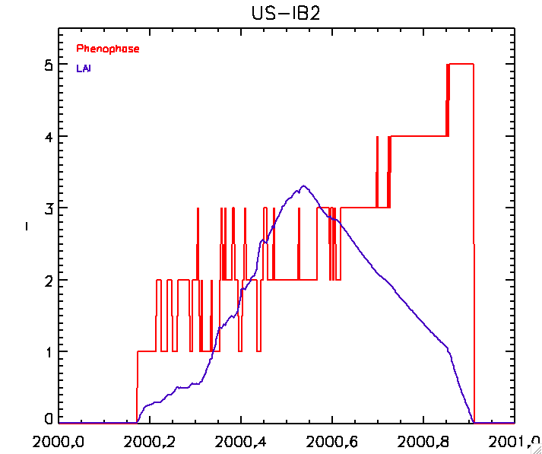
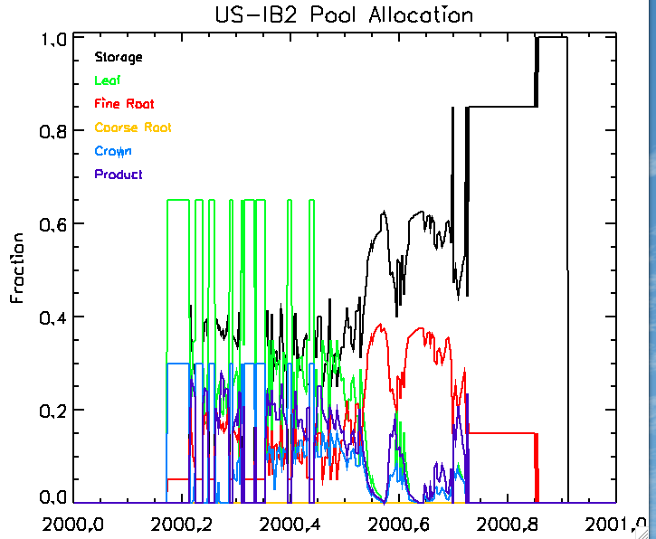
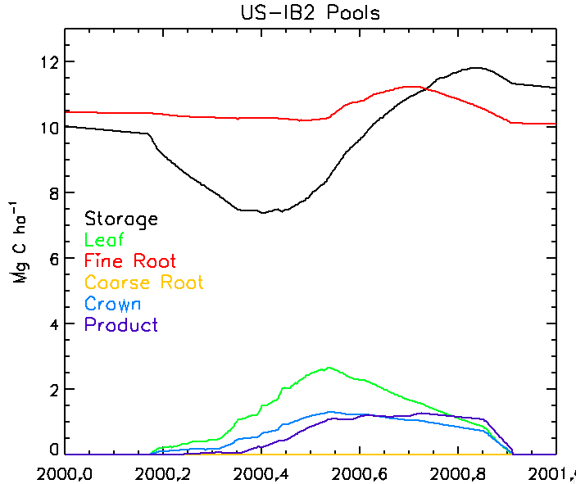
SiB4 Daily Example
Phenology Stage
LAI
Storage
Leaf
Fine Root
Coarse Root
Stem
Product
Storage
Leaf
Fine Root
Coarse Root
Stem
Product

Slide 29
Carbon Release
Autotrophic Respiration
Heterotrophic Respiration
Disturbance
Pool Transfers
Carbon Assimilation
Photosynthesis
10 Minutes
SiB4 Carbon Cycle
Daily
Calculate LAI/FPAR
Sum Carbon Gains/Losses
Daily photosynthetic gain
Daily pool losses
Calculate Growth Respiration Rates
Update Pools
Determine Phenology Stage
Calculate Pool Allocation
Phenology Stage
Meteorological Conditions
Pool Size
External Losses
Grazing
Harvest
Trigger Growing Season Start
Notes:
SiB4 Calculation Sequence
Carbon assimilation determined using enzyme kinetics
(SiB photosynthesis; per time-step)
Heterotrophic and autotrophic maintenance respiration calculated
(per time-step)
Uses current pool sizes
Uses specified turnover times and exchange coefficients
Varies with temperature and moisture
Phenological stage obtained daily
Determined by net primary productivity
Allocation fractions to live pools calculated daily
PFT-dependent
Temperature and moisture sensitive
Pools updated daily
Daily assimilated carbon allocated to live pools
Growth respiration calculated per pool
LAI calculated from the leaf pool
FPAR calculated from LAI

Slide 30
SiB References
Modified from SiB3 (Baker et al., 2008; Sellers et al., 1996)
→ Switched from biomes to plant functional types (PFTs)
→ Added tiles for fractional coverage per grid cell
→ Modified the variable structure to hierarchy of grid cells, land units and PFTs
Incorporated carbon pools following basic SiB-CASA scheme (Schaefer et al., 2008)
→ 6 live pools: storage, leaf, fine root, coarse root, wood, product
→ 6 dead pools: coarse woody debris, metabolic litter, structural litter,
soil litter, soil slow, soil armored
Utilized prognostic phenology (Stöckli et al., 2008/2011)
→ Predicts consistent carbon fluxes, pools and leaf area index (LAI)
→ Calculates sub-hourly fluxes and updates phenology/pools daily
Included crop specific phenology modules
(Lokupitiya et al., 2009; Corbin et al., 2010)
→ Maize
→ Soybeans
→ Wheat

Slide 31
SiB4 Parameters
Aerodynamic (ngrid,npft)
→ Z0 = Canopy roughness coefficient
→ ZP_DISP = Zero-Plane displacement
→ RbC = Coefficient for canopy-to-CAS aerodynamic resistance
→ RdC = Coefficient for ground-to-CAS aerodynamic resistance
Pool-Based: Per PFT Group
→ POOL_TRANS_FRAC = Transfer fractions between pools (ntpool, ntpool)
→ POOLLU_TRANS_EFF = Transfer efficiency for dead pools (ndead_pool, ndead_pool)
→ GRAZE_TRANS = Transfer fractions for grazing (ndead_pool + 2)
→ HARVEST_TRANS = Transfer fractions for harvest (ndead_pool + 2)

Slide 32
SiB4 Phenological Parameters
  Leaf and FPAR
→ SLA = Specific Leaf Area (m2/mol)
→ LAISAT = Saturation Leaf Area Index (m2/m2)
→ LAIMAX = Maximum Leaf Area Index (m2/m2)
→ FPARSAT = Saturation Fraction of Photosynthetically Active Radiation (0-1)
→ FPARMAX = Maximum Fraction of Photosynthetically Active Radiation (0-1)
    Allocation Factors (nlive_pools, nphase)
→ ALLOC_FRAC = Pool-specific phenology-based allocation fractions
  Growing Season Start Factors
→ Light_Mini = Minimum day length if day length is increasing (hr)
→ Light_Mind = Minimum day length if day length is decreasing (hr)
→ PAWFTop_Min = Minimum fraction of plant available water (PAW)
in top three layers (-)
→ TM_Min = Minimum temperature to start growing season (K)
→ PAWFTop_Len = Minimum number of PAWFTop favorable days (days)
→ TM_Len = Minimum number of temperature-favorable days (days)

Slide 33
SiB4 Phenological Parameters
  Growing Season Factors
→ Assim_AveLen = Number of days to average daily assimilation for assimilation
→ RST4_AveLen = Number of days to average rstfac4 to calculate stress factor
→ Stress_Slope = Slope of linear adjustment to climatological moisture stress
→ Stress_Offset = Offset of linear adjustment to climatological moisture stress
→ IA_Fac(nphase-1) = Thresholds for changing phases during increasing assimilation
  → DA_Fac(nphase-1) = Thresholds for changing phases during decreasing assimilation
→ ND_LeafOut = Minimum number of days for leaf out (days)
  Leaf-Out Factors
  → Init_CFrac = Carbon for initial growth (fraction of root pool)
  → Init_CFracD = Fractional daily decrease of supplemental carbon for leaf-out
  Senescence Factors (nphase)
  → Brown_FAdd = Daily added transfer factors for canopy pools (-)
  → Brown_FMin = Minimum transfer factor for canopy pools (-)
  → Brown_FMax = Maximum transfer factor for canopy pools (-)

Slide 34
SiB4 Phenological Parameters
  Grazing Factors
→ Graze_MinLAI = Minimum LAI required for grazing (-)
→ Graze_CFracP = Fraction of net accumulated carbon removed for grazing
of productive systems (0-1)
→ Graze_CFracD = Fraction of net accumulated carbon removed for grazing
of desert systems (0-1)
→ Graze_PDLAI = LAI threshold to switch between grazing fractions
for productive and desert ecosystems (-)
  Autotrophic Respiration and Transfer Variables
  → GR_Frac(nlive_pool) = Growth respiration coefficient (0-1)
  → MR_Rate(nlive_pool) = Maintenance Respiration Rate (1/s)
  → Tr_Rate(nlive_pool) = Transfer Rate (1/s)
  → A_Q10 = Base for live pool respiration/transfer temperature response function (-)
  → A_Tref = Reference temperature for live pool temperature response function (K)
  Heterotrophic Respiration and Transfer Variables
  → Turnover(ndead_pool) = Pool turnover times (yr)
  → H_Q10 = Base for dead pool respiration/transfer temperature response function (-)
  → H_Tref = Reference temperature for dead pool temperature response function (K)

Slide 35
SiB4 Physiological Parameters
→ C4 = Flag for C3 vs C4 vegetation (C3=0, C4=1)
→ CHIL=Leaf angle distribution factor (-)
→ Z1=Canopy bottom (m)
→ Z2=Canopy top (m)
→ VMAX=Rubisco velocity of sun leaf (mol/m2/s)
→ KROOT=Root density extinction coefficient (-)
→ ROOTD=Maximum rooting depth (m)
→ SLTI=Slope of lo-temp inhibition (1/K)
→ SHTI=Slope of hi-temp inhibition (1/K)
→ HLTI=1/2 point of lo-temp inhibition (K)
→ HHTI=1/2 point of hi-temp inhibition (K)
→ HFTI=1/2 point of frost inhibition (K)
→ SFTI=slope of frost inhibition (1/K)
→ WSSP=water stress shape parameter (0.1-1.0)
→ EFFCON=Quantum efficiency (mol/mol)
→ GMESO=Mesophyll conductance (mol/m^2/sec)
→ BINTER=Conductance-photosynthesis intercept (mol m^-2 sec^-1)
→ GRADM=Conductance-photosynthesis slope parameter (-)
→ ATHETA=WC WE coupling parameter (-)
→ BTHETA=WC WE WS coupling parameter (-)

Slide 36
SiB4 Physiological Parameters
→ TRANSG=Shortwave green leaf transmittance (-)
→ TRANSB=Shortwave brown leaf transmittance (-)
→ TRANLG=Longwave green leaf transmittance (-)
→ TRANLB=Longwave brown leaf transmittance (-)
→ REFSG=Shortwave green leaf reflectance (-)
→ REFSB=Shortwave brown leaf reflectance (-)
→ REFLG=Longwave green leaf reflectance (-)
→ REFLB=Longwave brown leaf reflectance (-)

