Slide 1
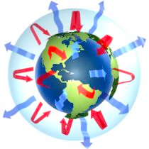
Climate Science for Poets
ATS 150 3 credits MWF from 1-1:50 in Clark C142 CRN code 22001
http://ats150.atmos.colostate.edu
Non-Science Majors Especially Welcome!
The course is open to absolutely anybody. There are NO prerequisites, and the course assumes no previous science or math background.
Simple!
Serious!
Solvable!
How climate works
How and why it's changing
Likely climate futures
What can be done about it!
auditors welcome
ats150.atmos.colostate.edu
ats150.atmos.colostate.edu
ats150.atmos.colostate.edu
ats150.atmos.colostate.edu
ats150.atmos.colostate.edu
ats150.atmos.colostate.edu
ats150.atmos.colostate.edu
ats150.atmos.colostate.edu
ats150.atmos.colostate.edu
ats150.atmos.colostate.edu
ats150.atmos.colostate.edu
ats150.atmos.colostate.edu
ats150.atmos.colostate.edu
ats150.atmos.colostate.edu
ats150.atmos.colostate.edu
ats150.atmos.colostate.edu

