Slide 1
Greenhouse Gases
ATS 150
Lecture 5
Please read Chapter 4 in Archer Textbook

Slide 2
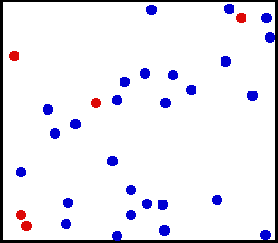
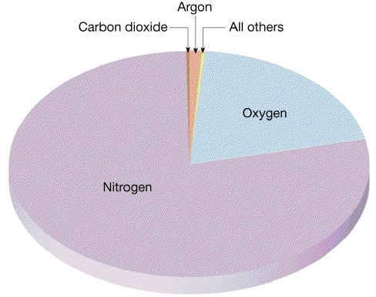
Gases
Gases are made of moving molecules separated by empty space
Kinetic energy of molecular motion is proportional to temperature
Gases don’t behave as blackbodies or even graybodies!
About 99% of Earth’s atmosphere is N₂ & O₂

Slide 3
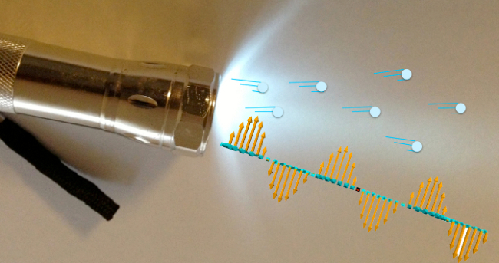
Waves and Photons
Electromagnetic radiation behaves as both waves and particles!
Experiments show both kinds of behavior:
Oscillating fields with troughs and crests (waves)
Individual packets of energy (particles)
Long Waves = small photons
Short Waves = BIG PHOTONS

Slide 4
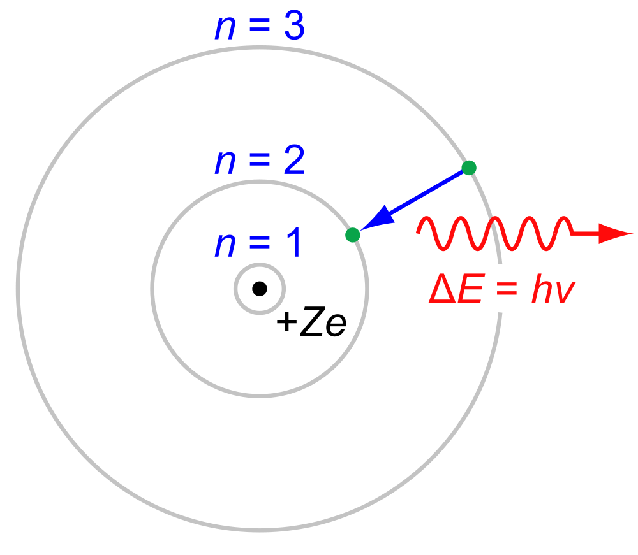
Energy is “Quantized”
When radiation interacts with atoms and molecules, only certain “jumps” in energy are possible
Electrons orbit at specific energy levels above an atomic nucleus
Absorption of a photon of just the right energy can make them “jump up” to the next level
Emission of a photon occurs when an electron “falls” down to a level below

Slide 5
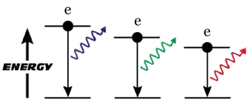
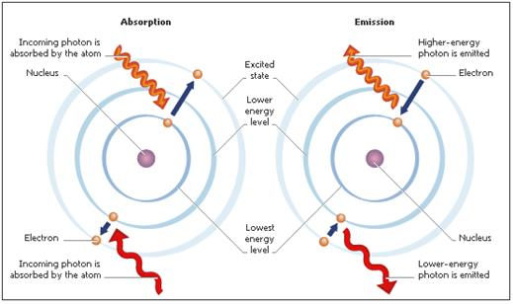
Atomic Emission
Big jumps take lots of energy, small jumps take less
Big drops emit energetic photons (short wavelengths)
Small drops emit less energetic photons (longer wavelengths)
Most electron transitions in gases absorb/emit visible or UV light

Slide 6
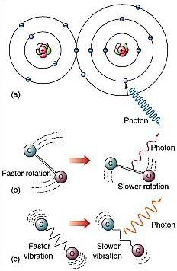
Molecules and Photons
Molecules are groups of atoms that share electrons (chemical bonds)
Molecular transitions involve changes in vibration, rotation, bending, and stretching of chemical bonds
Photons can interact with molecules to change states
Transitions involve specific amounts of energy, so only certain wavelengths are active
Molecular transitions typically absorb & emit in thermal infrared

Slide 7
PhET Simulation

Slide 8
Dancing Molecules and Heat Rays!
Nearly all of the air is made of oxygen (O₂) and nitrogen (N₂) in which two atoms of the same element share electrons
Infrared (heat) energy radiated up from the surface can be absorbed by these molecules, but not very well
O
O
N
N
Diatomic molecules can vibrate back and forth like balls on a spring, but the ends are identical
No electric dipole!

Slide 9
Dancing Molecules and Heat Rays!
Carbon dioxide (CO₂) and water vapor (H₂O) are different!
They have many more ways to vibrate and rotate, so they are very good at absorbing and emitting infrared (heat) radiation
O
C
O
O
H
H
Molecules that have many ways to wiggle are called “Greenhouse” molecules

Slide 10
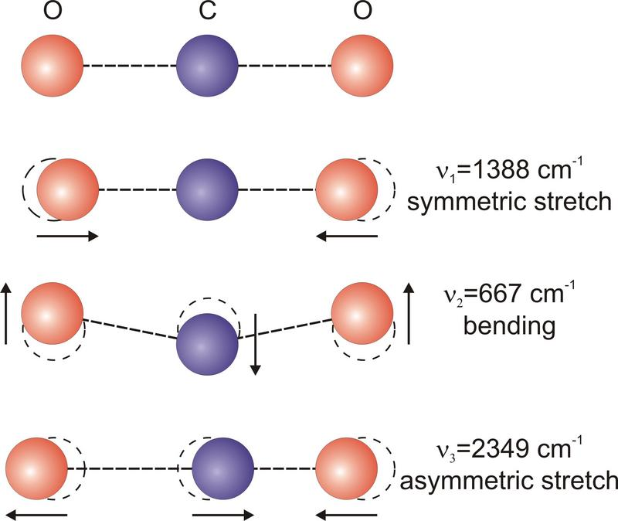
CO₂ Vibrations
Resting or ground state
O
C
O
No dipole … weak!
7.2 μm
O
C
O
15 μm
O
O
C
Temporary electric dipole … strong!
4.3 μm
O
C
O

Slide 11
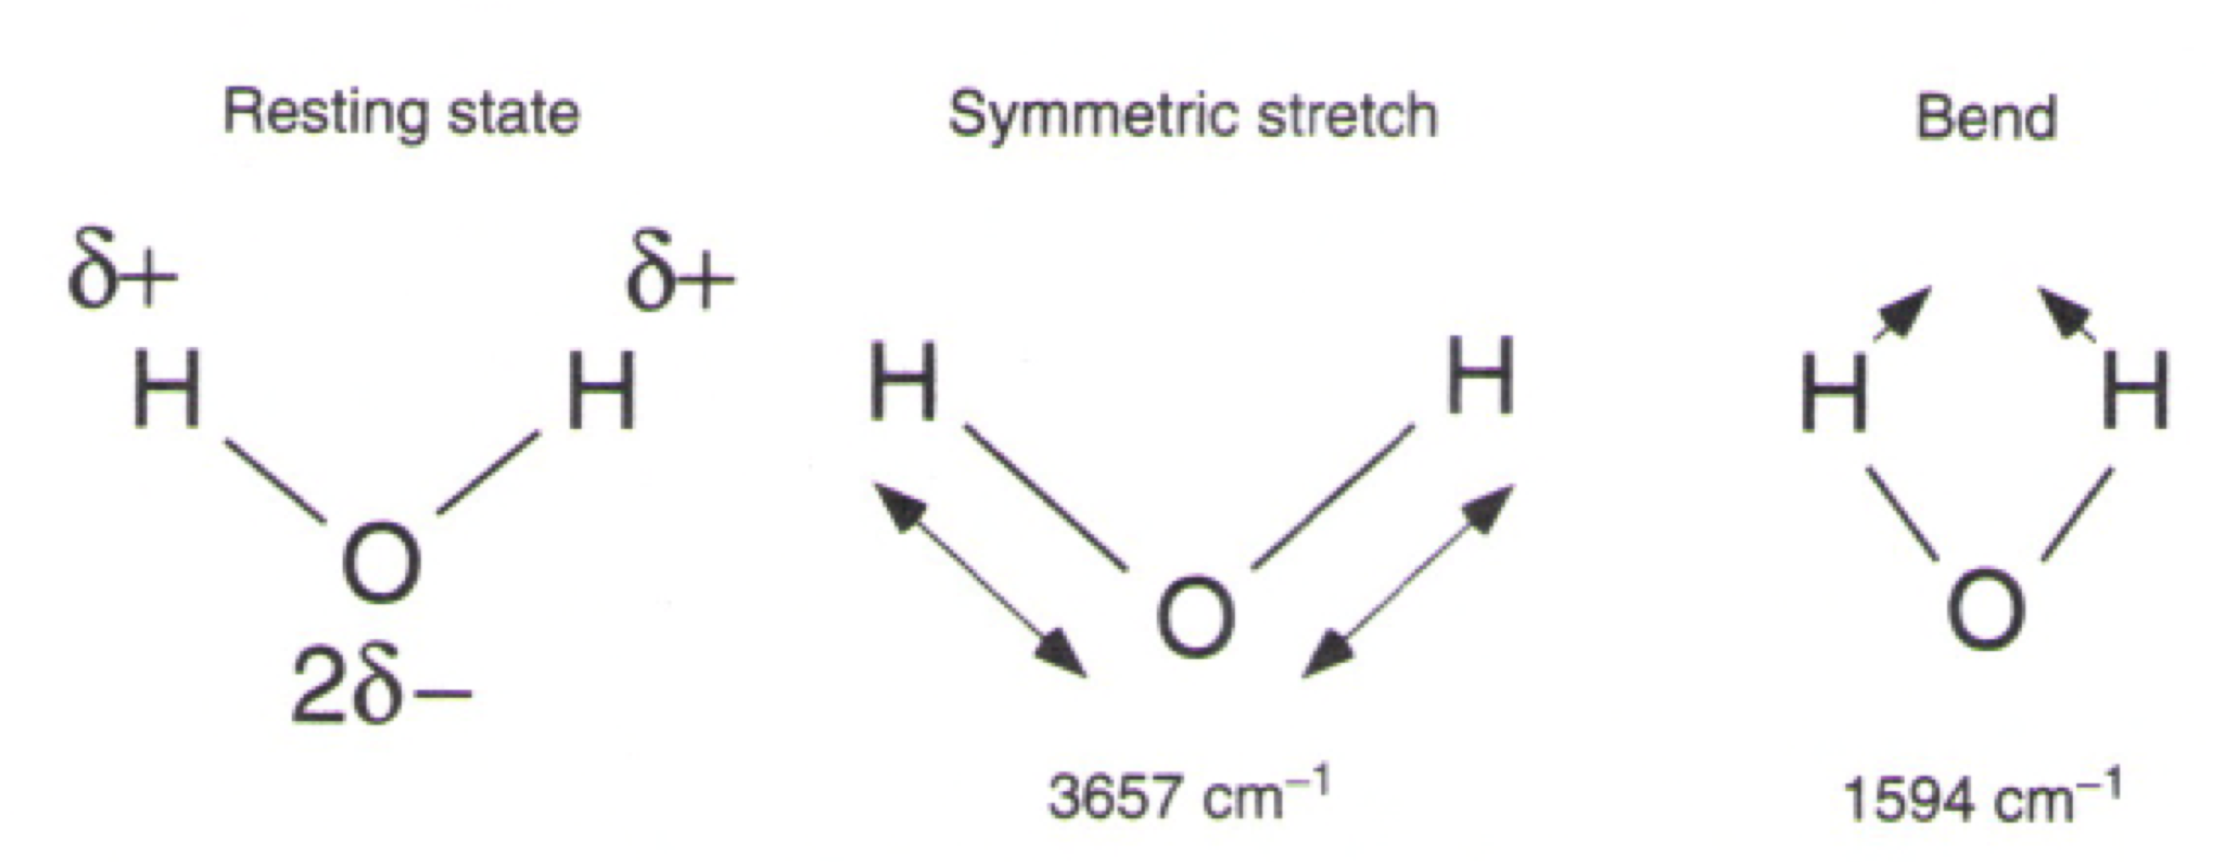
H₂O Vibrations
2.7 μm
6.3 μm
Water molecules are “bent!”
This gives them a positively charged end (with the hydrogen) and a negatively charged end (with the oxygen)
This “permanent dipole moment” allows H₂O to absorb & emit photons without moving bonds

Slide 12
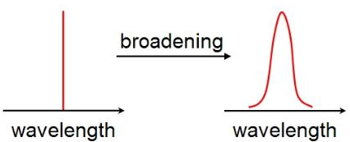
Line Broadening
Exact energy difference between states absorbs & emits very specific wavelengths
Photons collide with moving molecules – Doppler effect stretches or compresses
Combinations (e.g., vibration + rotation) produce more lines
Collisions among molecules can add or subtract energy too

Slide 13
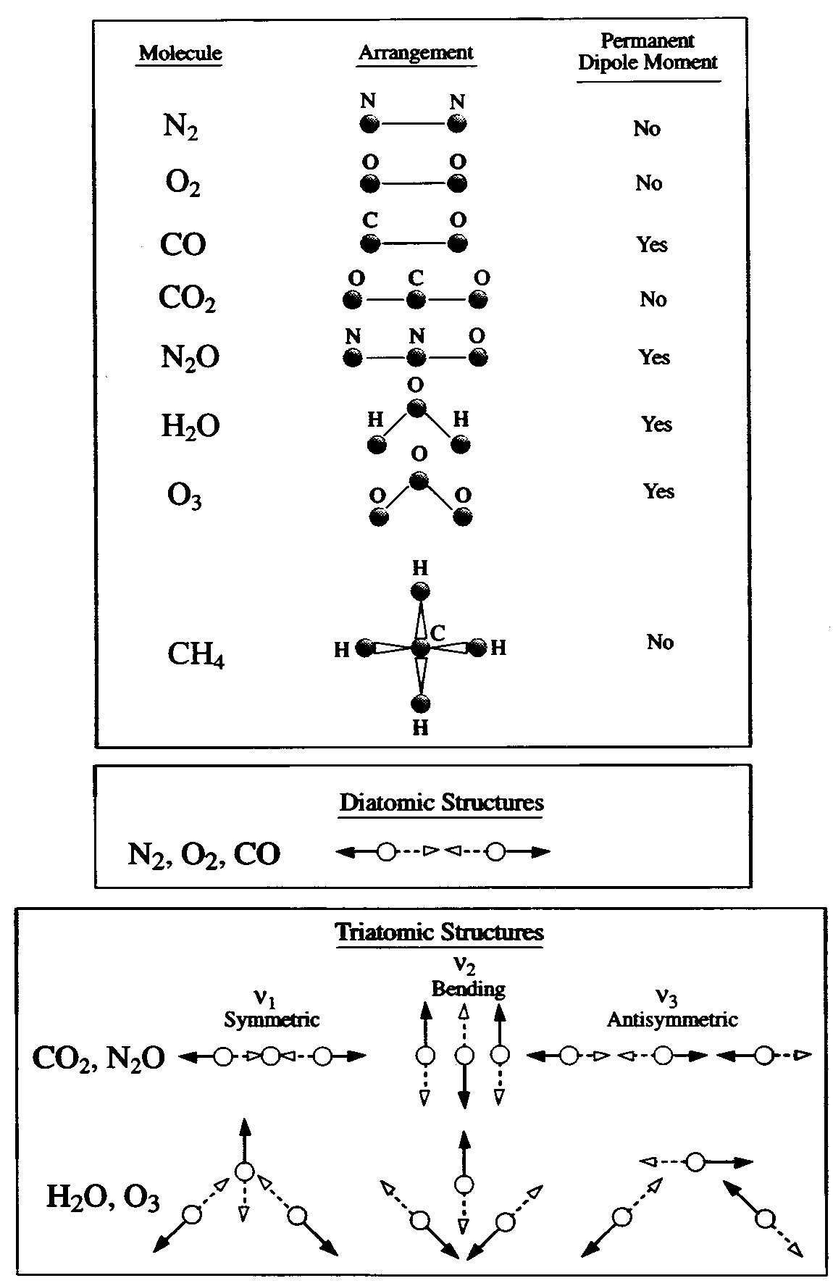
Molecular Absorbers
Remember 99% of the molecules in the atmosphere are O₂ and N₂, almost no absorption or emission in thermal infrared
Molecules that can form electric dipoles or have many ways to vibrate absorb in many wavelengths
A single methane (CH₄ ) molecule absorbs almost 100 times more thermal radiation than CO₂
But there’s 200 x more CO₂

Slide 14
Atmospheric Absorption
Visible radiation passes almost freely through Earth's atmosphere
Earth's emitted thermal energy either fits through a narrow “window” or is absorbed by greenhouse gases and reradiated
Complete absorption from 5-8 μm (H₂O) and > 14 μm (CO₂)
Little absorption between about 8 m and 11 μm (“window”)

Slide 15
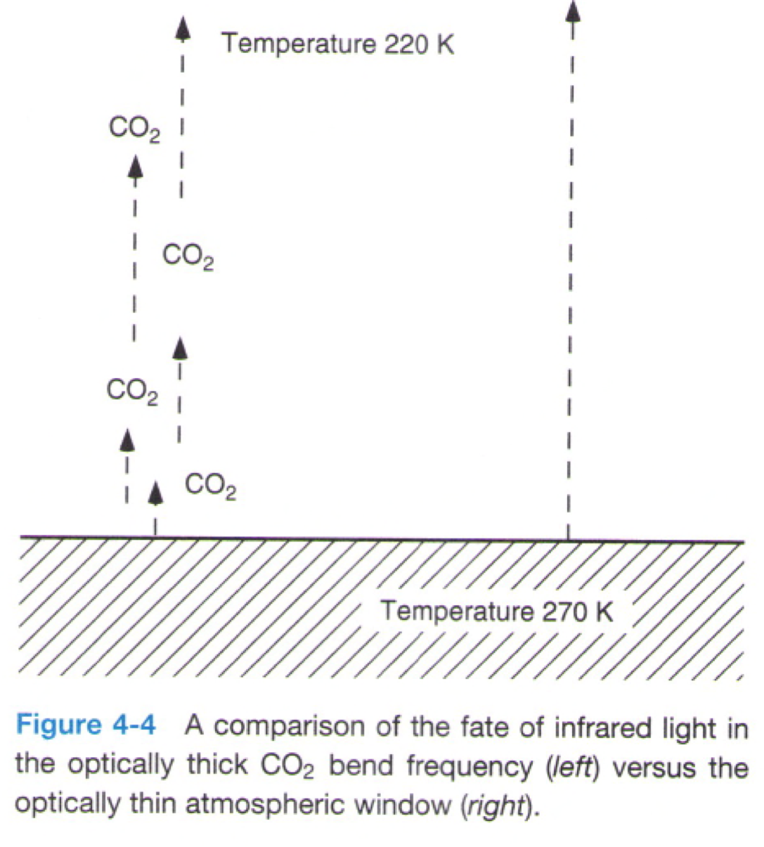
Optical “Thickness”
14.3 μm
CO₂ band
11 μm
“window”
In CO₂ absorption bands, atmosphere is totally opaque to IR photons
They get absorbed and re-emitted higher up
It’s cold up there!
Think about the Layer Model
IR photons
IR photons

Slide 16
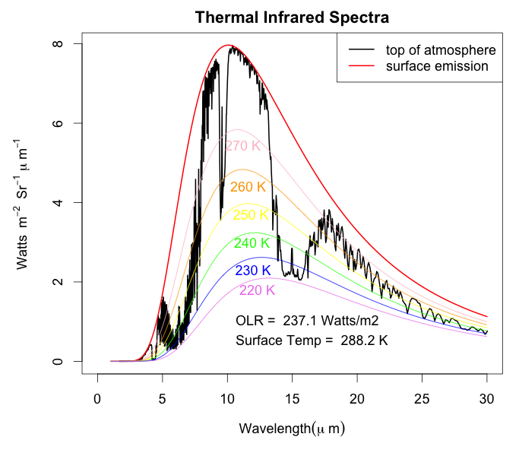
View from Space
Hot surface emits directly to space in window region
Cold upper layers emit to space in optically thick regions
Total emission much less than from sfc
O₃
CO₂
H₂O
H₂O

Slide 17
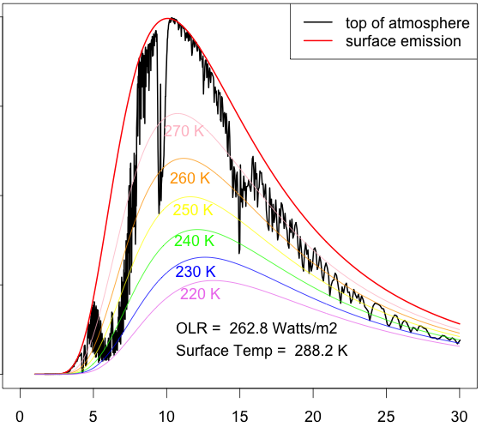
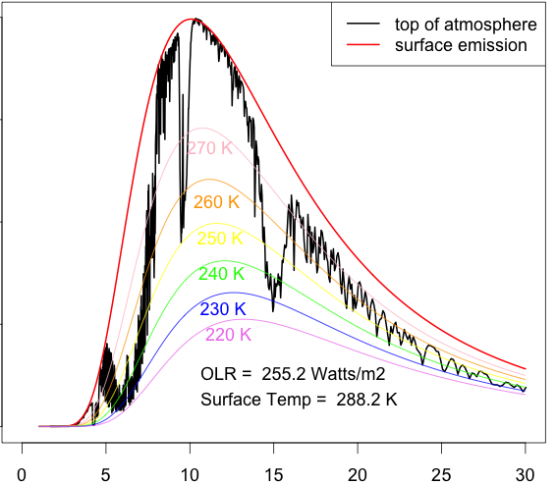
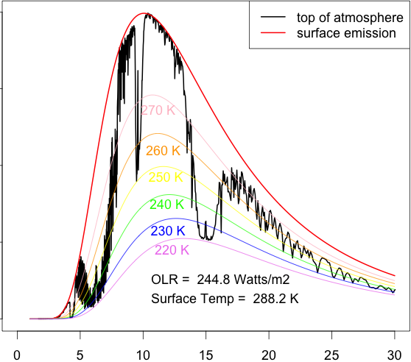
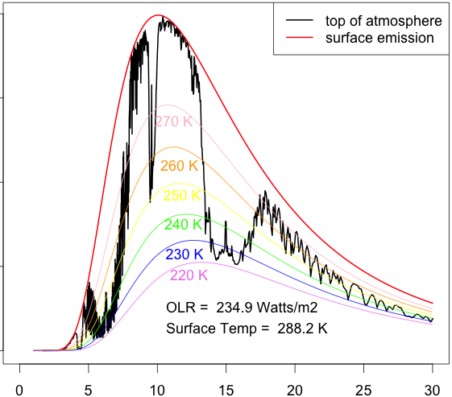
Effect of Adding CO₂
Optically thick regions are as cold as they can get
But the thick regions get wider with added CO₂
Rate of total emission (area under black curve) decreases less and less
1 ppm
10 ppm
100 ppm
1000 ppm
wavelength (μm)

Slide 18
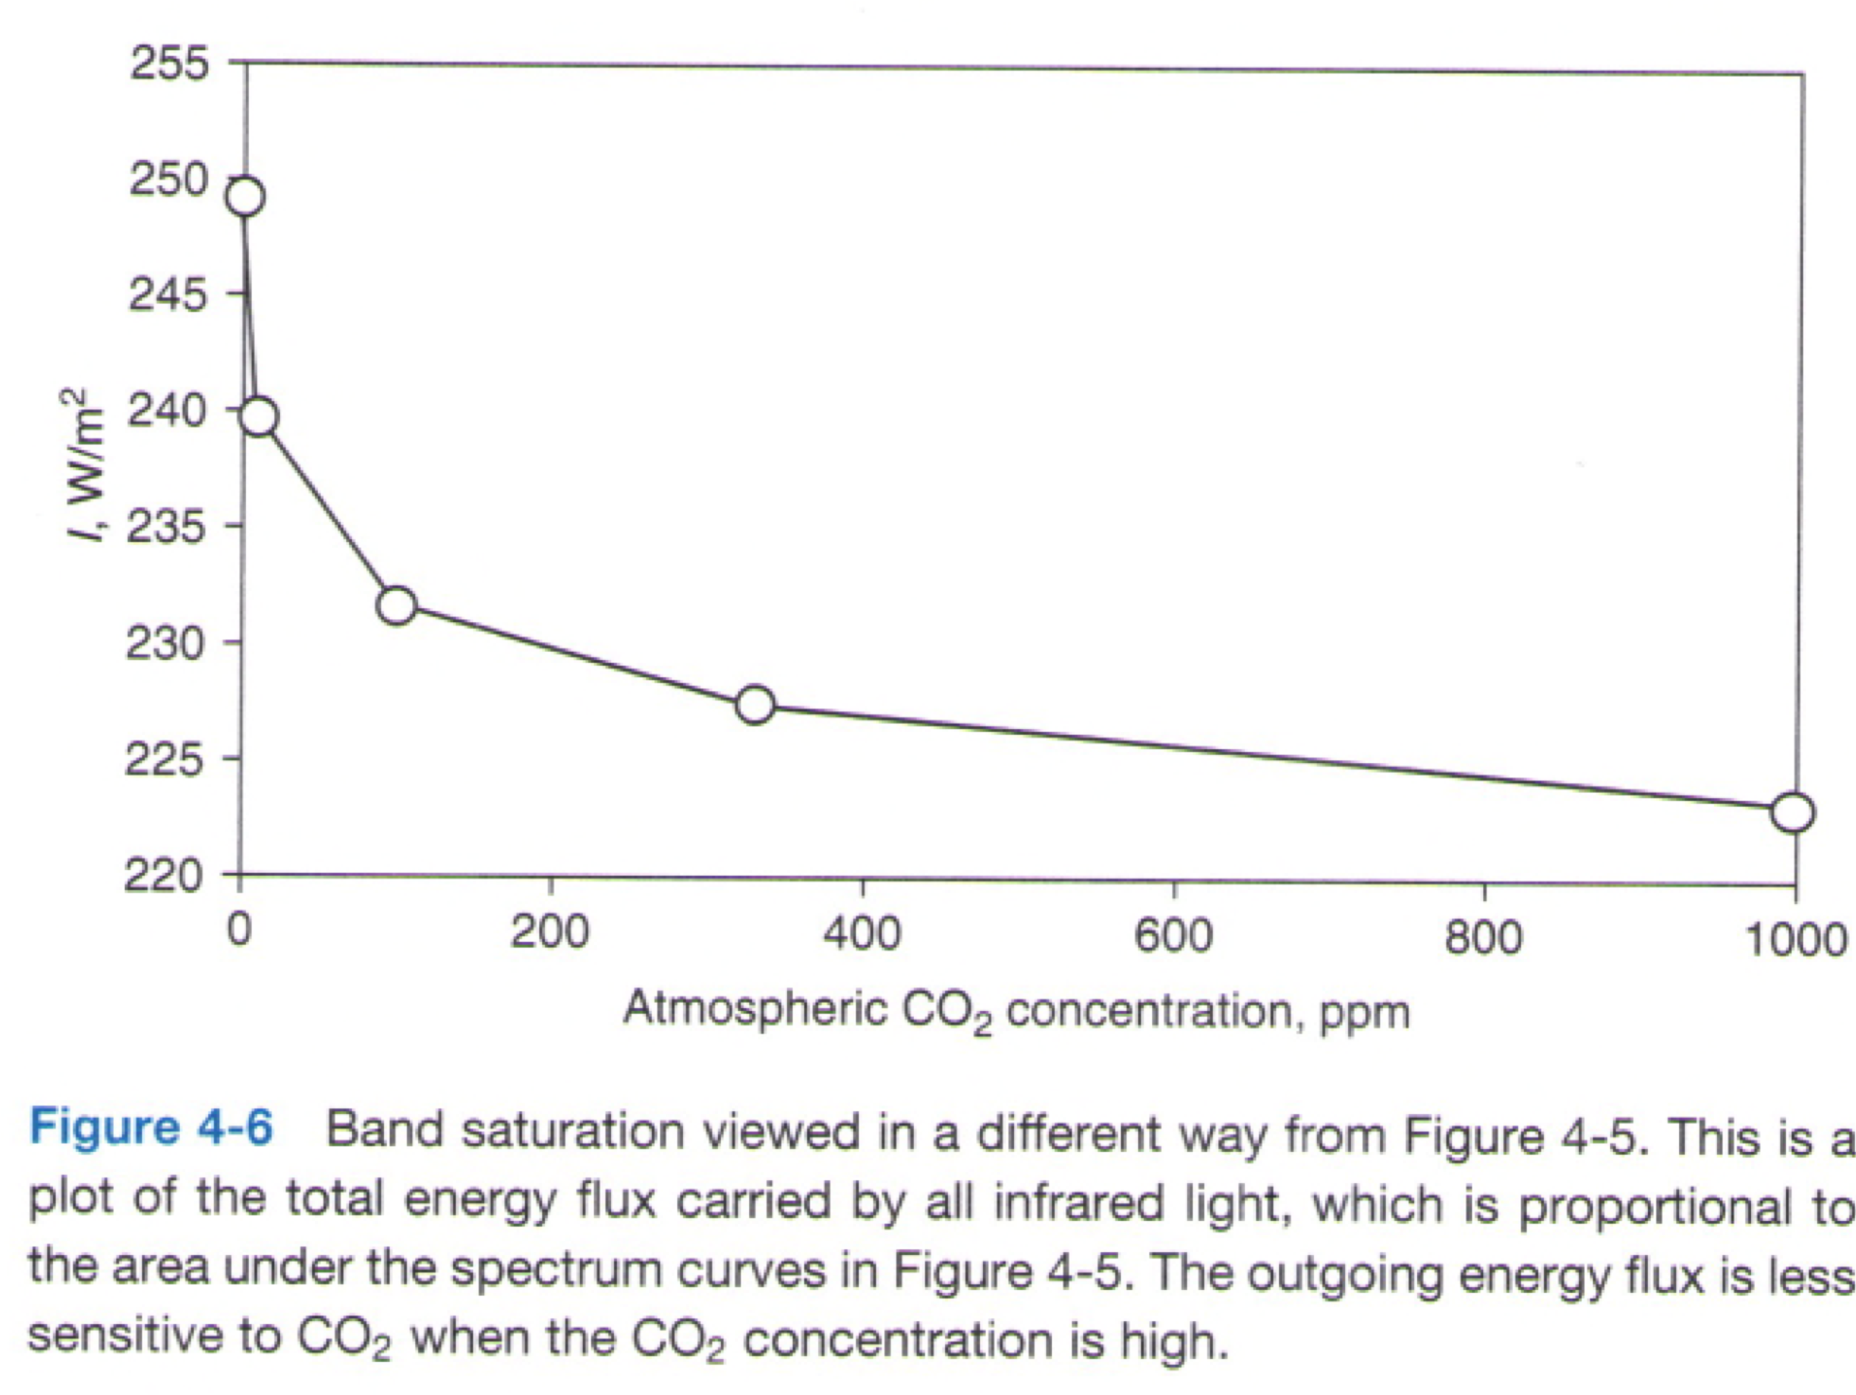
Band Saturation
As more CO₂ gets added, it has less and less effect, but never goes to zero
Total rate of cooling to space (area under spectral curve)

Slide 19
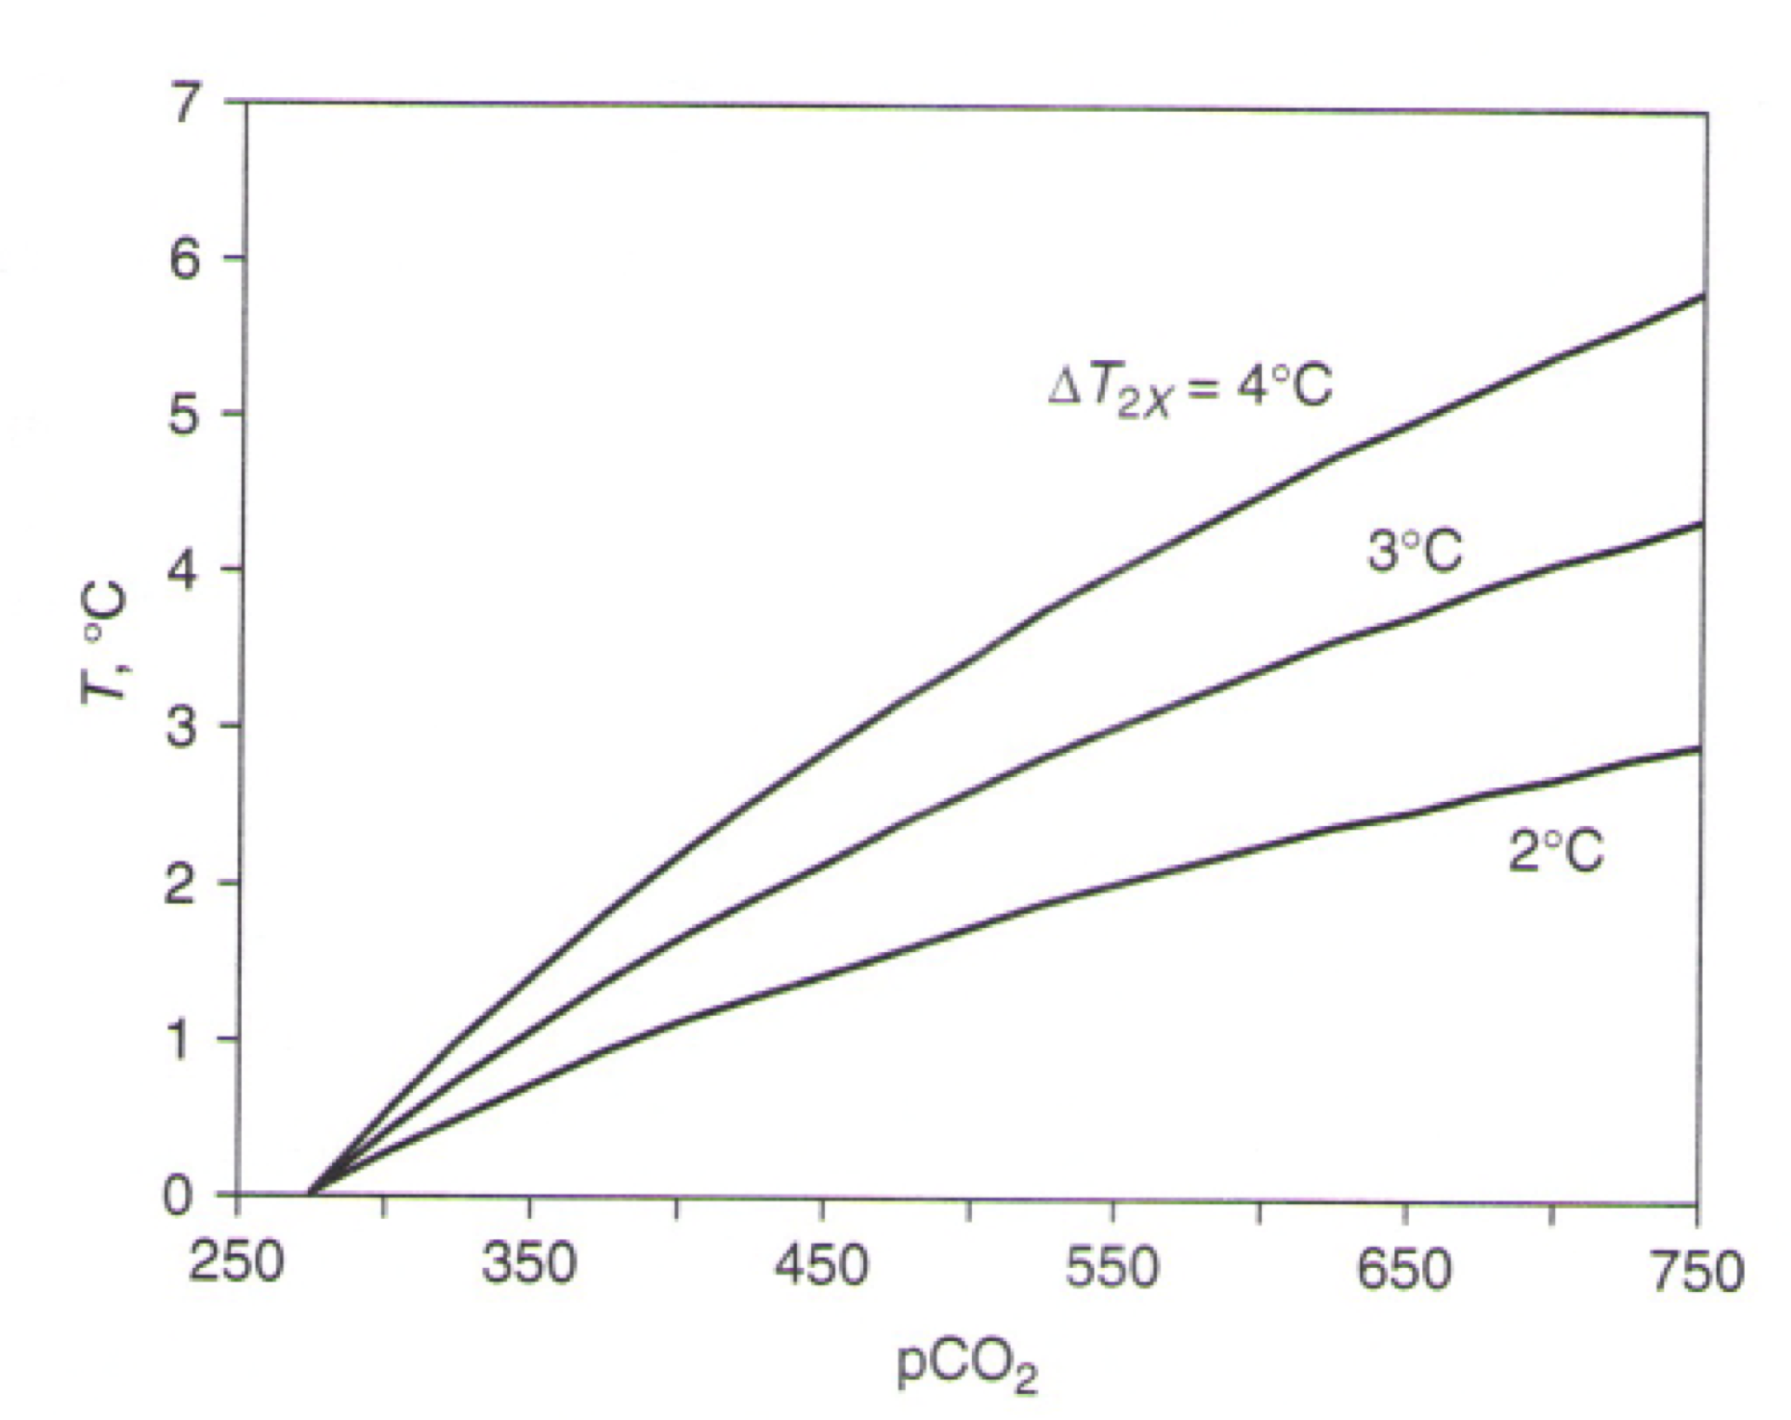
Logarithmic Effect due to band saturation
“Radiative forcing” of CO₂ is expressed as the number of Watts per square meter per doubling, not per unit change in concentration
Temperature changes are degrees per doubling too (not degrees per ppm)

Slide 20
Radiative Forcing by Increased CO₂
An instantaneous doubling of CO2 reduces outgoing infrared by 3.7 Watts per square meter if temperature stays constant
As temperature gradually rises, more infrared emission results
Eventually, outgoing infrared increases to balance absorbed sunlight again, but with higher temperatures

Slide 21
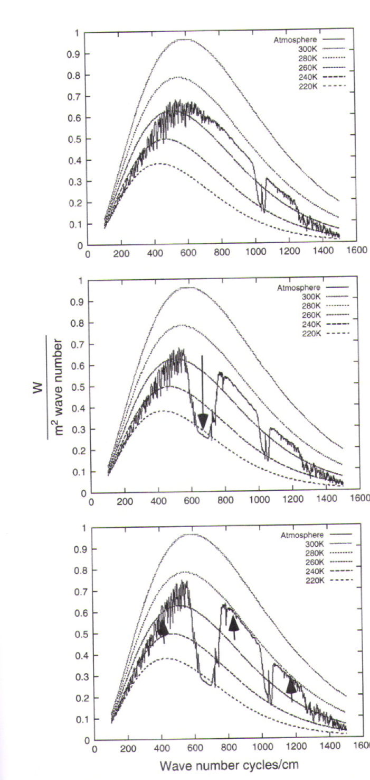
Absorption by CO₂ Causes Warming
No CO₂
I_{out} = 249 W m⁻²
1000 ppm CO₂
I_{out} = 223 W m⁻²
As CO₂ is added, big parts of the spectrum are emitted higher up where it’s colder
This reduces the rate of total heat loss below solar gain
The surface warms to compensate, emitting more from window regions, to re-establish equilibrium w/sun
1000 ppm CO₂
I_{out} = 249 W m⁻²
8.5 K
Warmer!

Slide 22
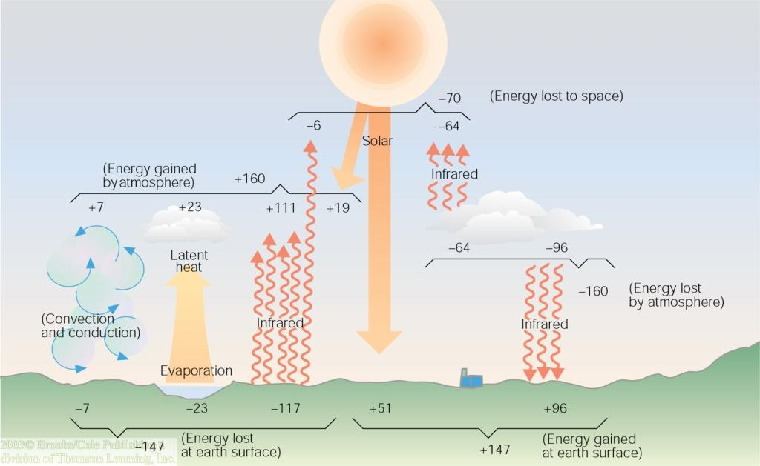
Earth-Atmosphere Energy Balance
Earth's surface absorbs the 51 units of shortwave and 96 more of longwave energy units from atmospheric gases and clouds.
These 147 units gained by earth are due to shortwave and longwave greenhouse gas absorption and emittance.
Earth's surface loses these 147 units through convection, evaporation, and radiation.

