Slide 1
The Oceans

Slide 2
Wind-Driven Gyre Circulations

Slide 3
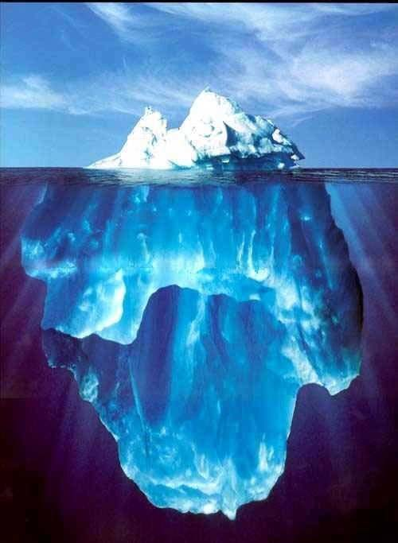
Icebergs

Slide 4
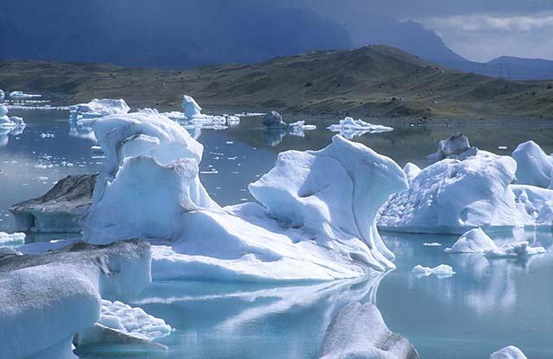
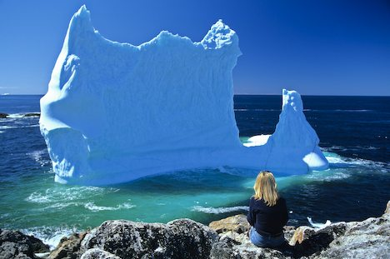

Slide 5
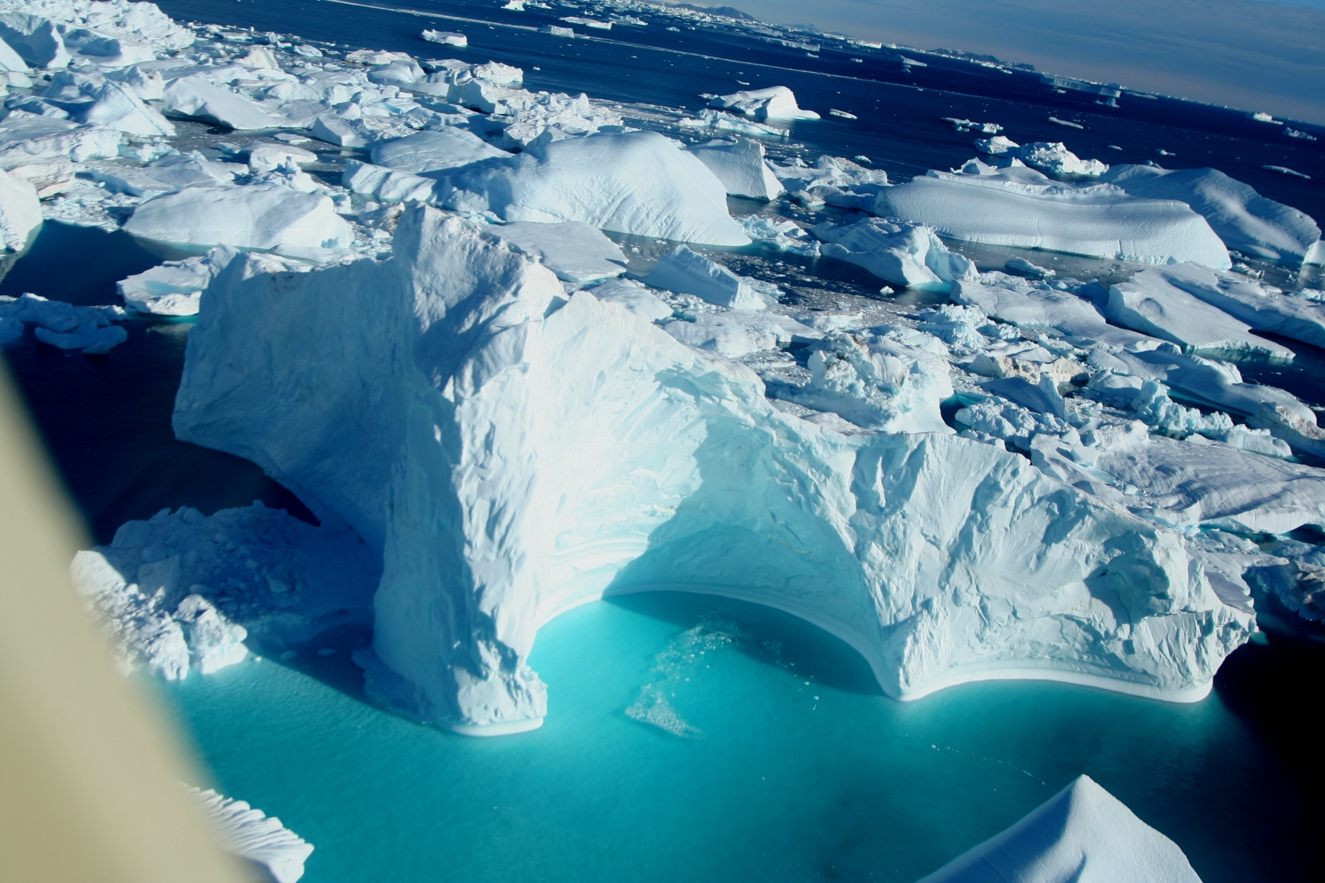

Slide 6
Surface Balance of Forces
Wind stress accelerates surface water
Friction couples surface to underlying water
Friction always acts exactly opposite current motion
Coriolis acceleration is always perpendicular to current motion
friction
wind stress
coriolis
resultant current
RESULT: Surface current directed
about 45º (right) of wind in Northern Hemisphere

Slide 7
Ekman Flow
Combined effects of Coriolis and friction on “stack” of thin layers
Each layer moves more slowly and further right than layer above
Average motion is 90º to the right of wind (in NH)

Slide 8
Ekman Pumping
Ekman flow in NH is 90º to the right of the wind stress
Cyclonic wind forces divergence in water, and upwelling
Anticyclonic wind forces convergence and downwelling

Slide 9
Idealized Gyre
Conver-gence of Ekman flow raises sea surface
Rotating “dome” results

Slide 10
Asymmetric Gyre
Real gyres aren’t symmetrical!
Boundary currents are strong in west, weak in east

Slide 11
Is there a Gulf Stream?
Trajectories of derelict (drifting) ships (19th century)

Slide 12
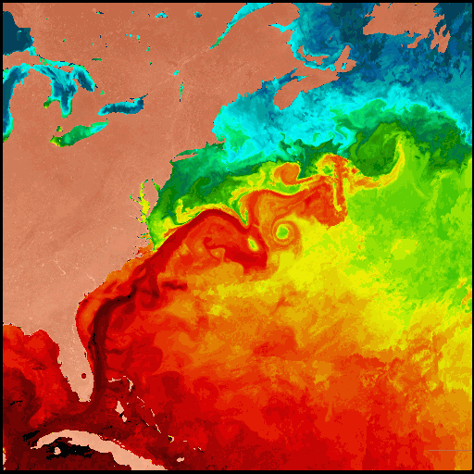
Sea-Surface Temperature from Space
Gulf Stream flows along the boundary of warm and cold water
Maximum current is about 4 “knots” (~ mph)
Note eddies and “rings” in Gulf Stream

Slide 13
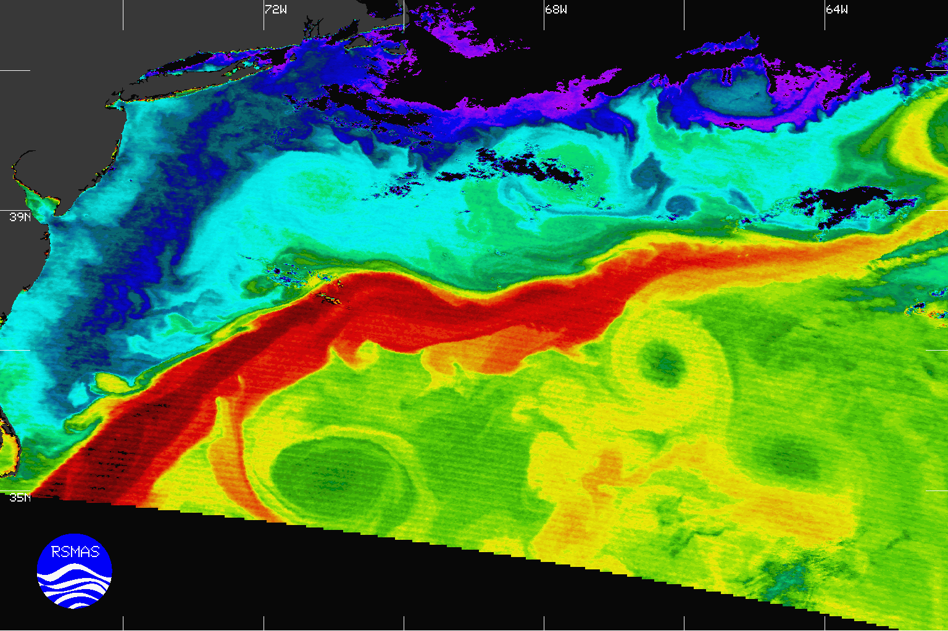

Slide 14
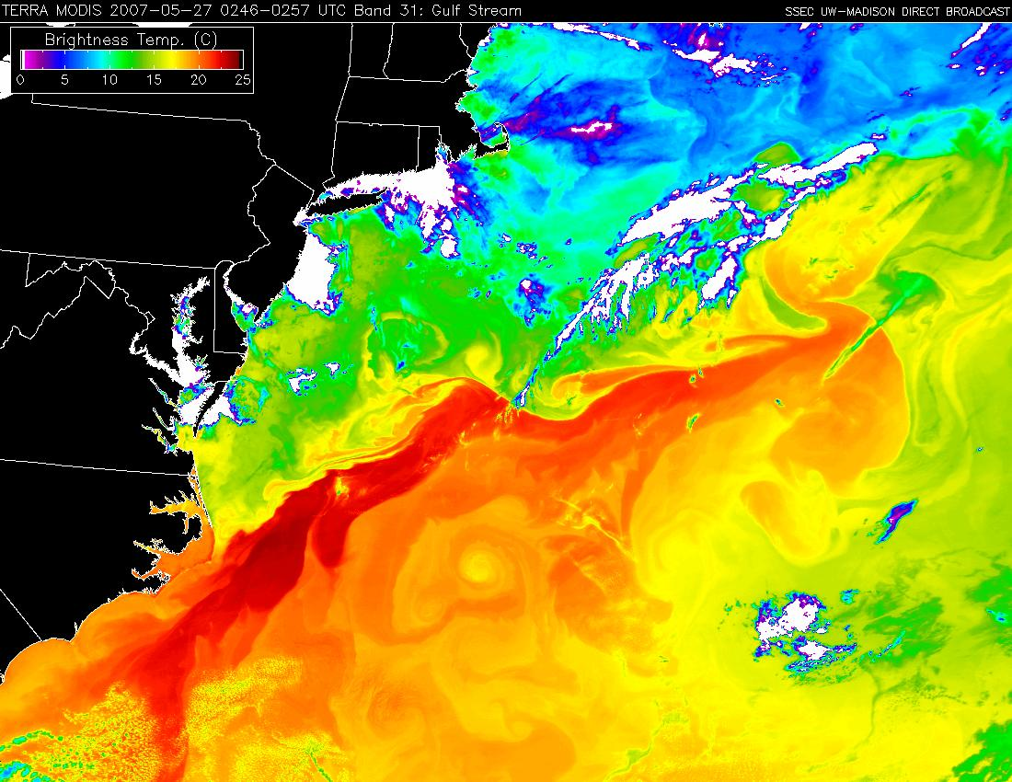

Slide 15
Ocean Currents
midlatitude “gyres”
W-E flow in tropics
circumpolar current
How are these known? Effects on poleward energy transport?

Slide 16
Tropical Oceans and El Nino

Slide 17
Tropical Winds and Currents
Atmospheric convergence produces ocean divergence
Vertical motions associated with divergent currents control SST
N.H.
Latitude
Equator
S.H.

Slide 18
Equatorial Cross-Section
turbulent coupling to winds
PGF
Depth
not coupled to winds
No Coriolis force at Equator, so wind pushes water west
Cold water gets pushed “out of the way” (downward) as warm water “piles up” on top

Slide 19
El Niño
Normal conditions: Huge accumulation of deep warm water in W. Pacific
El Niño: Relaxation of Trade Winds allows warm water to flow eastward

Slide 20
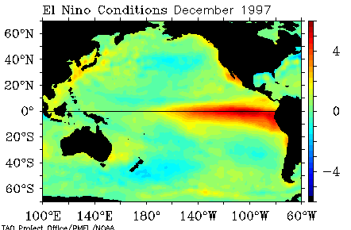
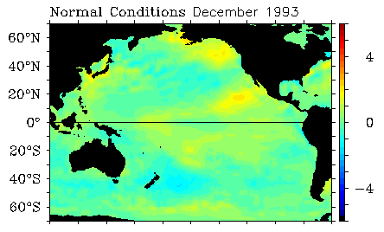
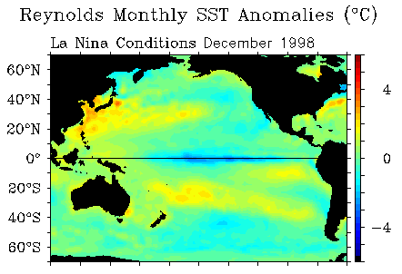
Sea Surface Temperature
Anomalies ºC
El Niño
Normal
La Niña

Slide 21
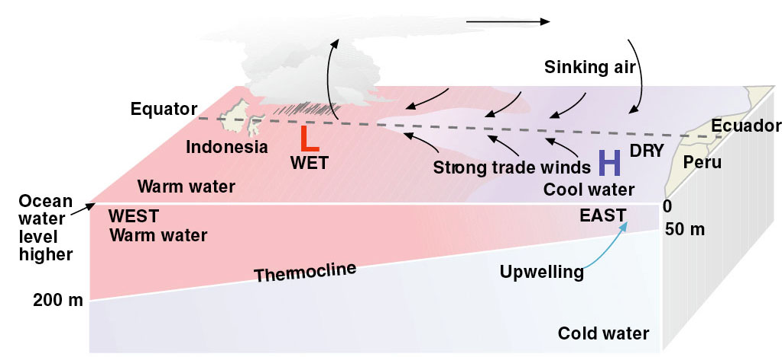
Normal (non-El Niño) Conditions
Surface water flow from east toward west
Deep thermocline and warm water in western Pacific
(associated deep convection & rainfall)
Shallow thermocline and cool SST’s in east Pacific

Slide 22
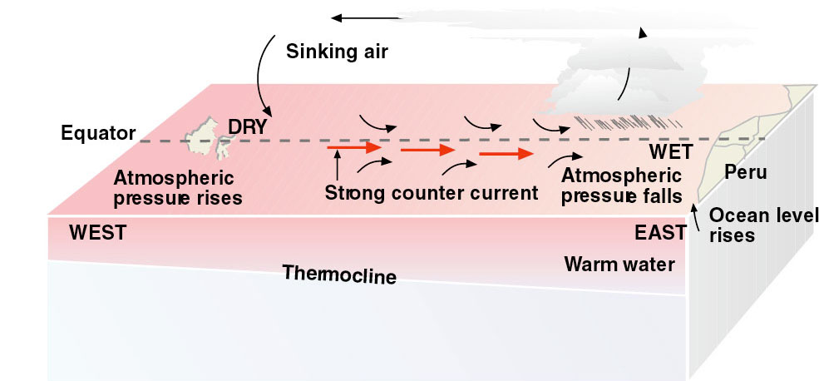
El Niño Conditions
Surface water flow toward east
Warm SSTs, convection & rainfall shift to central Pacific
Warmer SST’s in eastern Pacific

Slide 23
Thermohaline Circulation

Slide 24
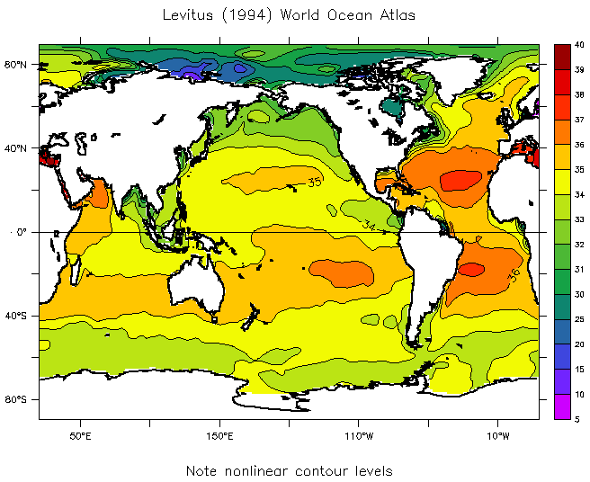
Sea Surface Salinity
Evaporation increases salinity
Precipitation decreases it (dilution)
Freshest water at highest latitudes
Saltiest water in subtropics (especially in Atlantic)

Slide 25
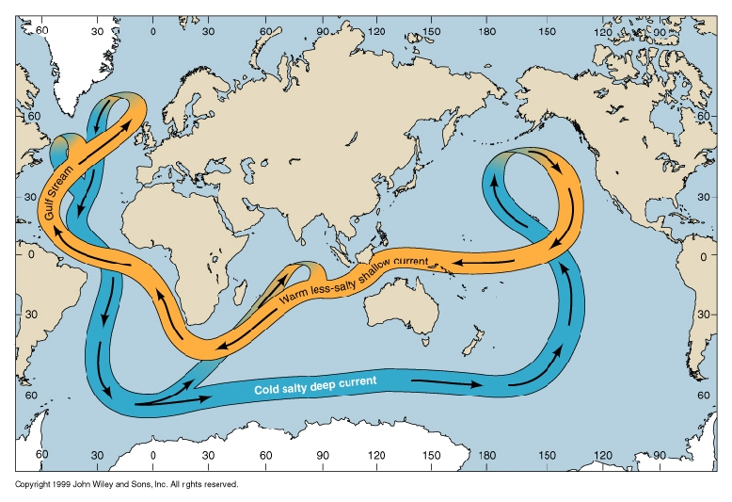
Thermohaline Circulation

Slide 26
Atlantic Water Masses
Deep water formation in North Atlantic
Bottom water formation in Antarctic
Ekman convergence in subtropical gyres forces water down against buoyancy

Slide 27
Bottom Water Flow
Deep water formed off Greenland and Norway flows south to fill Atlantic Basin

Slide 28
Antarctic Bottom Water
Continuous formation of ice along coast and in “leads” or “polynyas” forms extremely dense water

Slide 29
Thermohaline Heat Pump
Upper limb inflow to North Atlantic ~ 10º C
Lower limb outflow ~ 3ºC
dQ = c dT ~ 3 x 10⁷ J of heat released by each m³ of water during conversion from upper limb to lower limb water mass
20 Sv = 20 x 10⁶ m³ s⁻¹ of water makes this transition, releasing 6 x 10¹⁴ J s⁻¹ (= 0.6 Pw) of heat to the atmosphere
This is 35% of solar heating of North Atlantic north of 40º N latitude!

