Slide 1
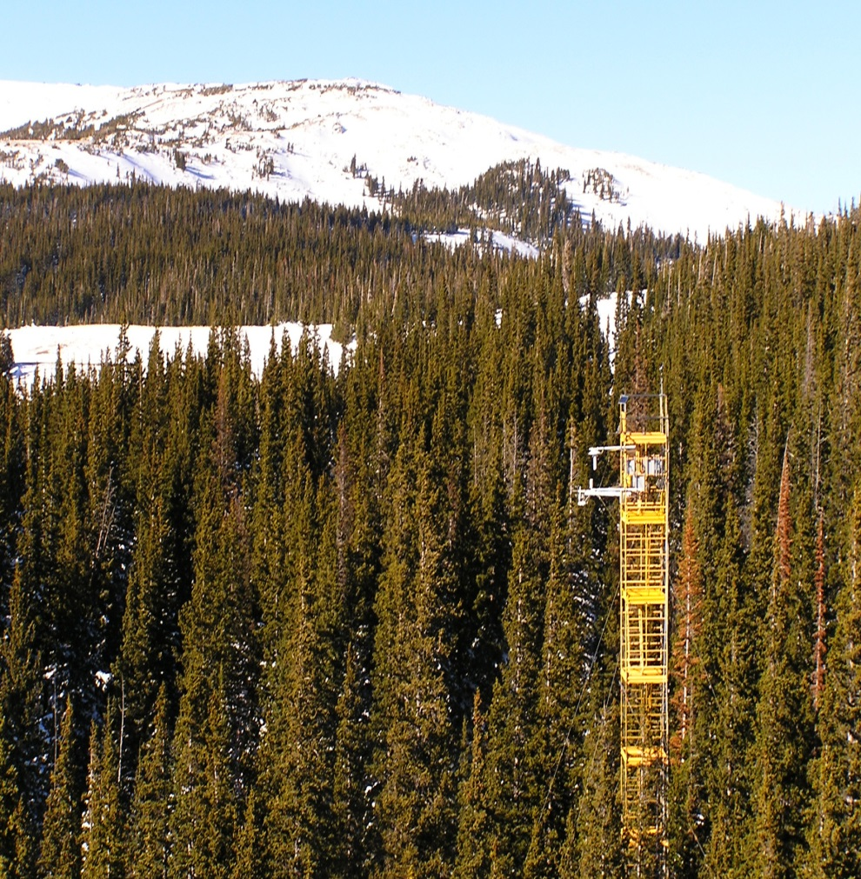
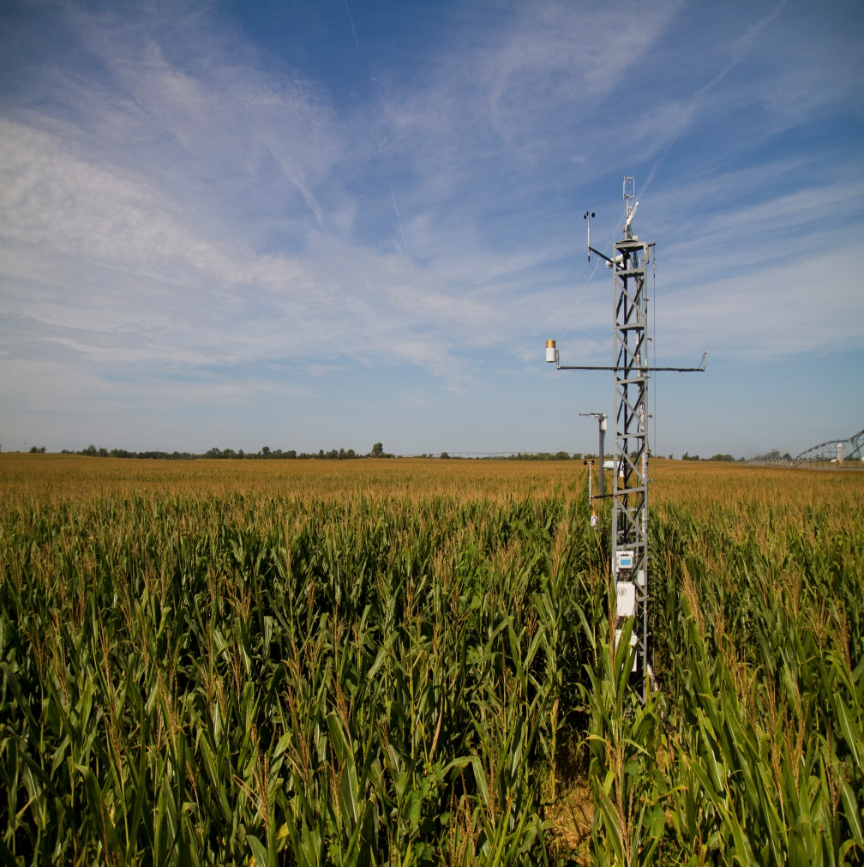
Accuracy, Uncertainty, and Limitations of
Eddy Covariance for Measuring Evapotranspiration
William J. Massman
US Forest Service
Rocky Mountain Research Station, Fort Collins, Colorado
Rocky Mountains of southern Wyoming Nebraska (Andy Suyker)
Notes:
Of course, first and foremost one needs a tower or scaffold for mounting the instruments.

Slide 2
This presentation includes contributions from
John Frank (US Forest Service, RMRS, Fort Collins, CO)
Andy Suyker (University of Nebraska – Lincoln, NE)
John Kochendorfer (ATDD, NOAA, Oak Ridge, TN)
Ray Leuning (Retired; CSIRO, Canberra, Australia)

Slide 3
OUTLINE
What is Eddy Covariance (EC)
What is the nature of the instrumentation
*Response time, Transfer function, Open- & Closed-Path Samplers
*Spectral attenuation and Spectral Corrections
(3) WPL Density “Terms” or “Corrections”
(4) How well do Eddy Covariance systems perform
*Surface Energy Balance
Sonic Anemometers & Surface Energy Balance
(6) Soil Heat Flux & Surface Energy Balance

Slide 4
[1.0] What is Eddy Covariance
Eddy Covariance is a micrometeorological technique to measure the exchange rate
of energy and mass between atmosphere and the earth’s surface by sampling
turbulent atmospheric motions and the associated fluctuations in mass concentration.
Or: Eddy Covariance measures the turbulent atmospheric fluxes of
mass [kg/m²/s] and energy [W/m²] between the atmosphere and
the biosphere (plants, soil, water bodies).
The benefit of Eddy Covariance is that it allows fairly strong inferences to be made
about the state and the functioning of the biosphere; i.e., water and carbon cycles,
soil water balance, water use efficiency and photosynthetic capacity of an ecosystem,
soil respiration, impacts of ozone on vegetation, biospheric influences on climate.
For the present purposes I will focus on Eddy Covariance fluxes of water vapor.
But much of what I have to say will apply more broadly to other trace gases as well.
Basic Assumptions are:
“Well developed”, stationary, and homogeneous atmospheric turbulence.
Horizontally homogeneous surface conditions, particularly for about
1-3 km upwind of the instrumentation.
Notes:
I will return to more precise definition of “The benefit of Eddy Covariance”.

Slide 5
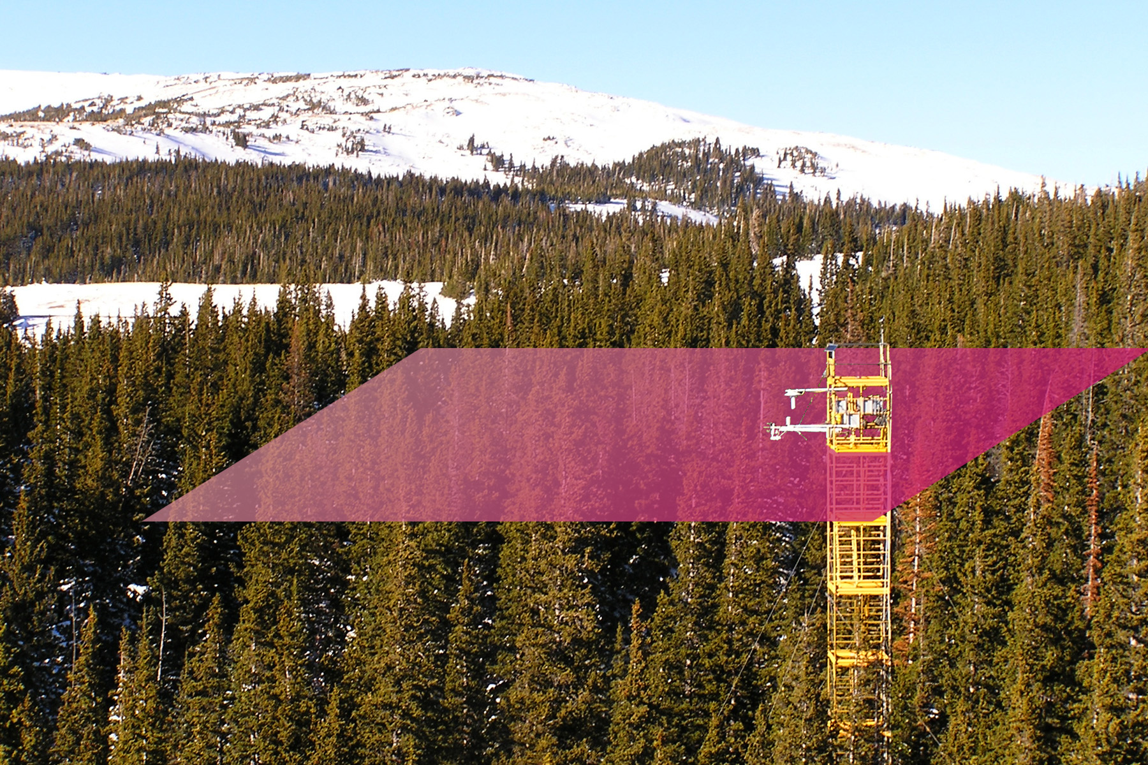
[1.1] What is Eddy Covariance?
CO₂
H₂O
T_{a}
CO₂
H₂O
T_{a}
Notes:
Schematic of how atmospheric turbulence transports mass and energy between the vegetation & soil and the atmospheric boundary layer.

Slide 6
[1.2] What is Eddy Covariance?
Water Vapor Covariance is defined as:
where w is the vertical wind speed and ρ_{v} is water vapor density. The same equation can be used for horizontal wind speed [u], temperature [T], and CO₂ [c].

Slide 7
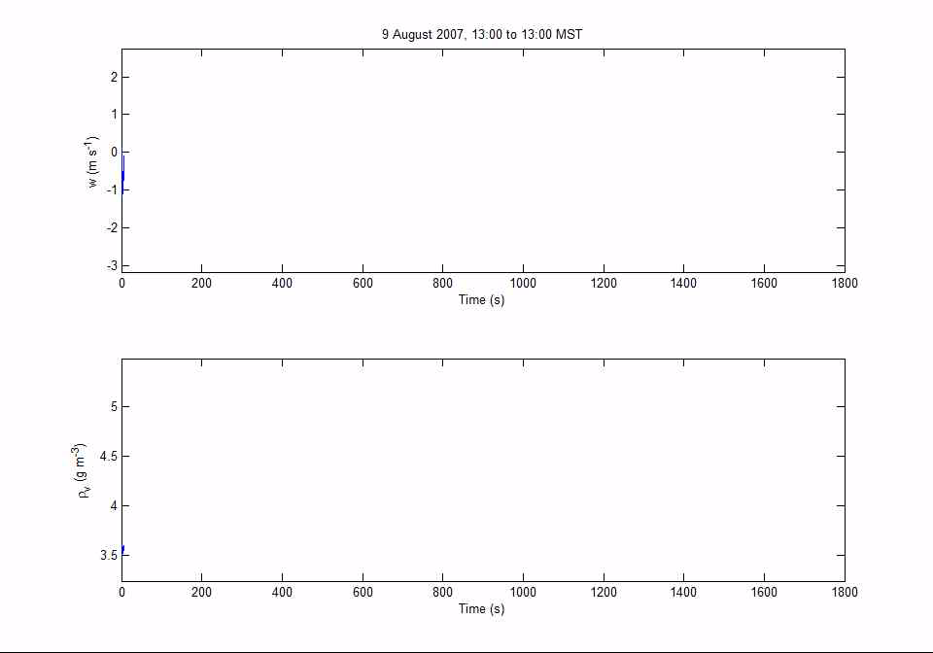
[1.3] What is Eddy Covariance?

Slide 8
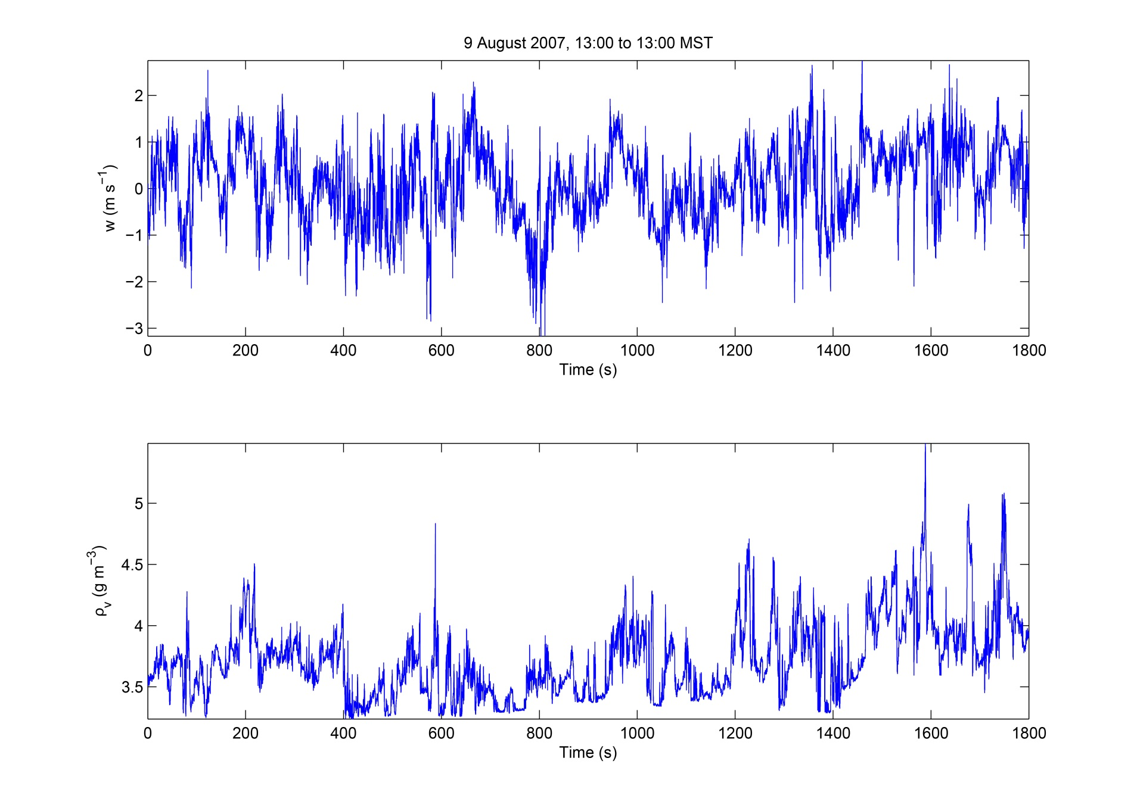
[1.4] What is Eddy Covariance?
Notes:
Visualization of the Equation on the previous slide.
Implementing this procedure requires some specialized equipment.

Slide 9
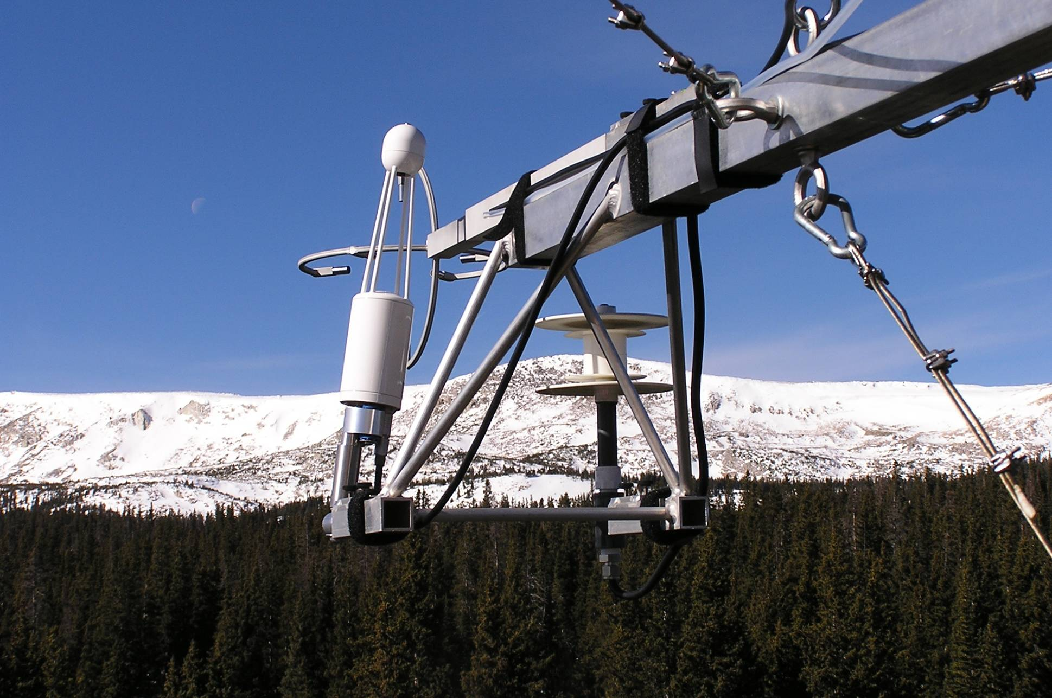
[2.0] Eddy Covariance Instrumentation
Notes:
Eddy covariance requires a set of specialized instrumentation. Most instruments are well designed and can usually be operated with only a minimum of attendance and maintenance. But, they are not perfect. The need for some spatial separation of the instruments slightly causes the covariance to misrepresent the fluxes. There are other issues as well: some instruments have inherently different response characteristics and different designs, all of which can cause further uncertainties and misrepresentations. So how do we micromet folk deal with this issues?
What follows is a brief discussion of spectral corrections. Note: Photo shows open-path sensor. Closed-path will be discussed separately.

Slide 10
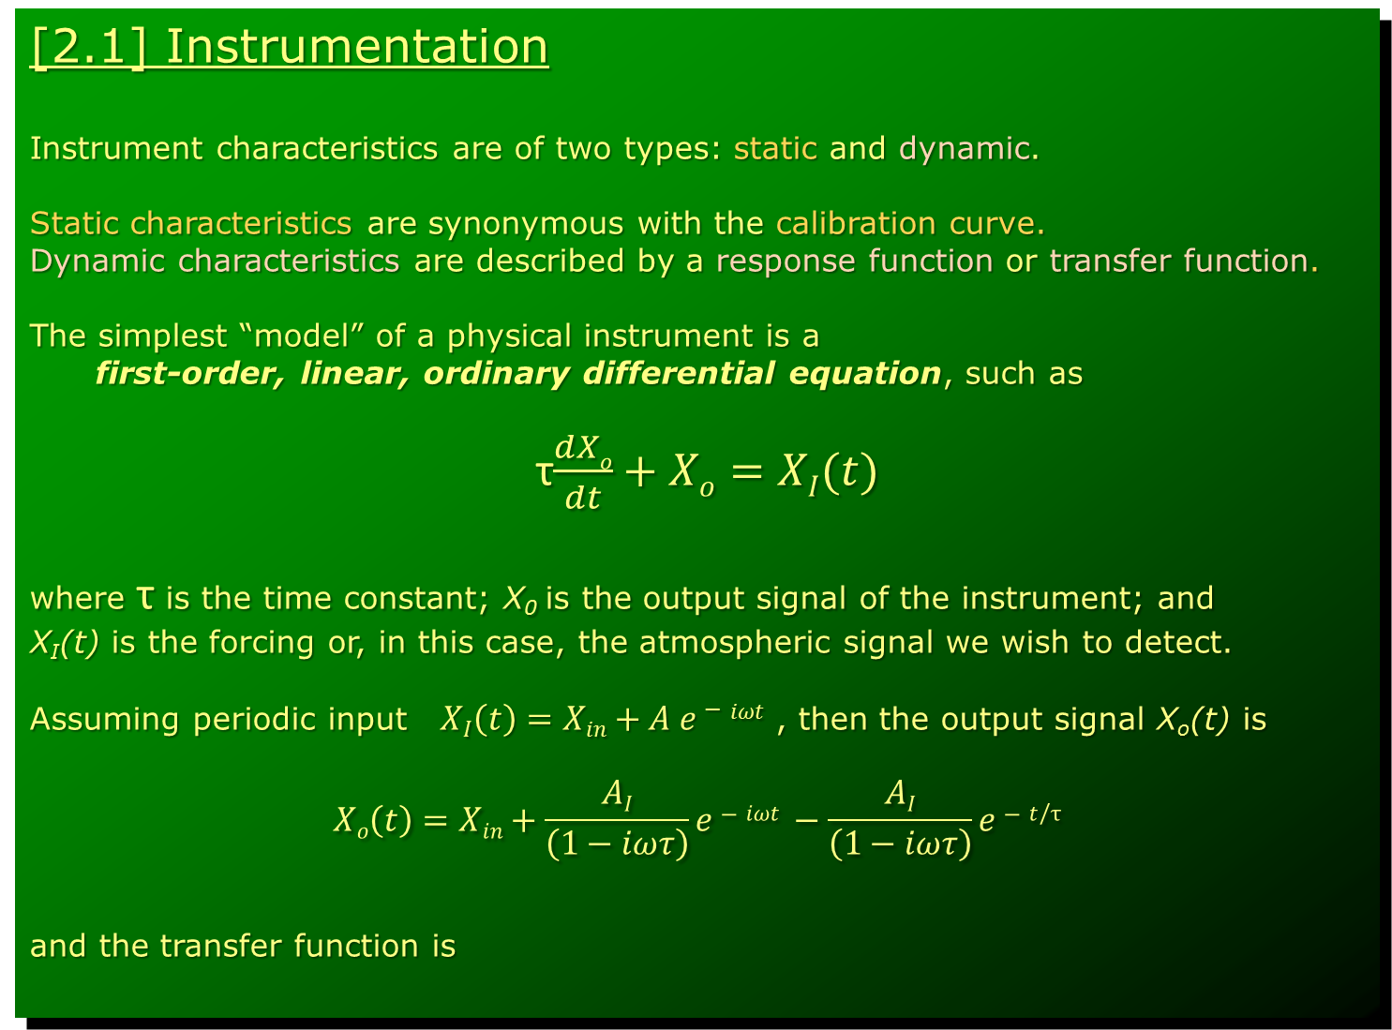
[2.1] Instrumentation
Instrument characteristics are of two types: static and dynamic.
Static characteristics are synonymous with the calibration curve.
Dynamic characteristics are described by a response function or transfer function.
The simplest “model” of a physical instrument is a
first-order, linear, ordinary differential equation, such as
τ$\frac{dXo}{dt}+Xo=XI(t)$
where τ is the time constant; X₀ is the output signal of the instrument; and
X_{I}(t) is the forcing or, in this case, the atmospheric signal we wish to detect.
Assuming periodic input $XI\left(t\right)=Xin+A e−iωt$ , then the output signal X_{o}(t) is
$$Xo\left(t\right)=Xin+\frac{AI}{\left(1−iωτ\right)}e−iωt −\frac{AI}{\left(1−iωτ\right)}e−t/τ$$
and the transfer function is
I
Notes:
First we need a model. This model indicates that h(ω,τ;t) ≈ 1 when ωτ << 1, which will generally be similar to other (possibly even more faithful) models of instrument response. Therefore, we can conclude that at high frequencies and long time constants the output signal will no longer give a faithful representation of the input signal. This will introduce greater attenuation in the amplitude of the input signal and cause the phase shift (time lag) between the input and output signals.

Slide 11
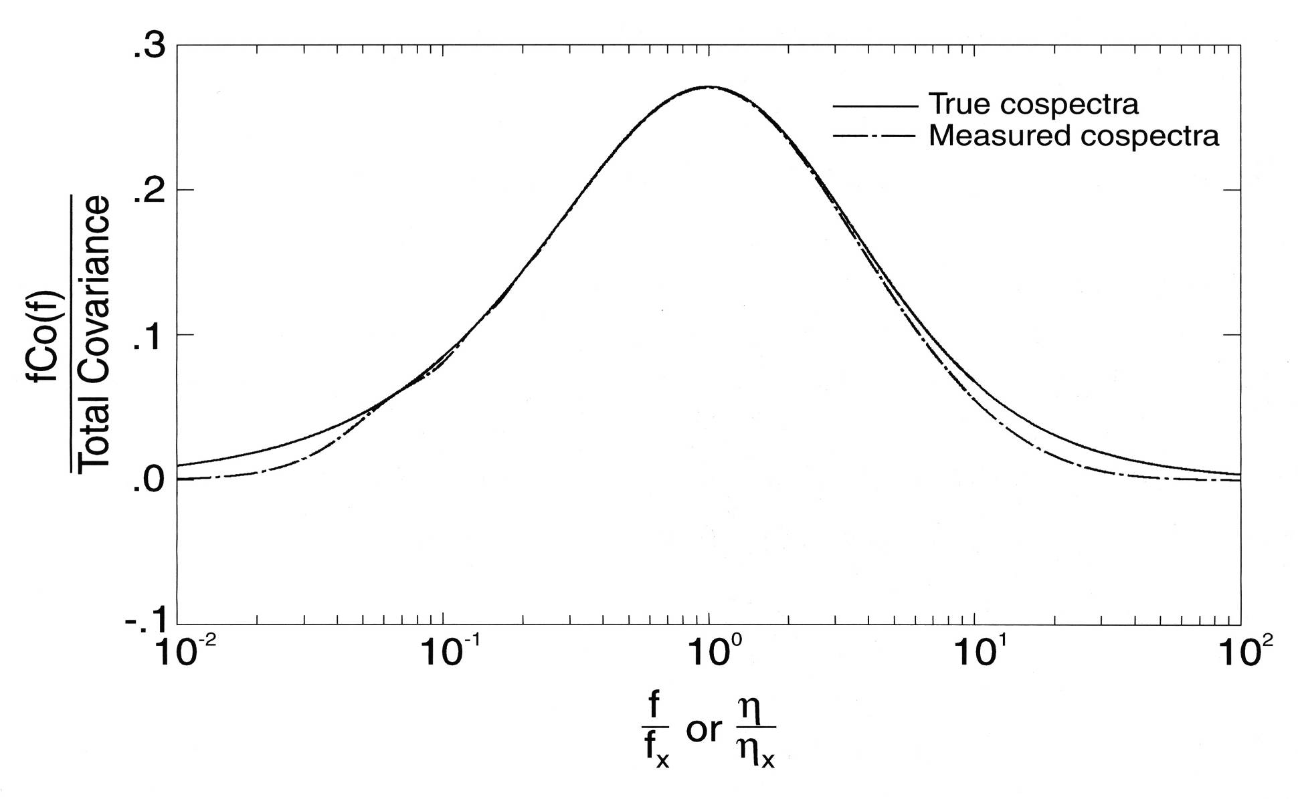
[2.1] Instrumentation
[2.2] Instrumentation
Notes:
Frequency-weighted normalized cospectra vs. non-dimensional frequency.
At high frequencies there is a loss of information, which means the fluxes will be underestimated.
But due to time averaging of the co-varying signals there is also a loss at low frequencies. Such low frequency loss is much harder to know and correct for than the low frequency loss.

Slide 12
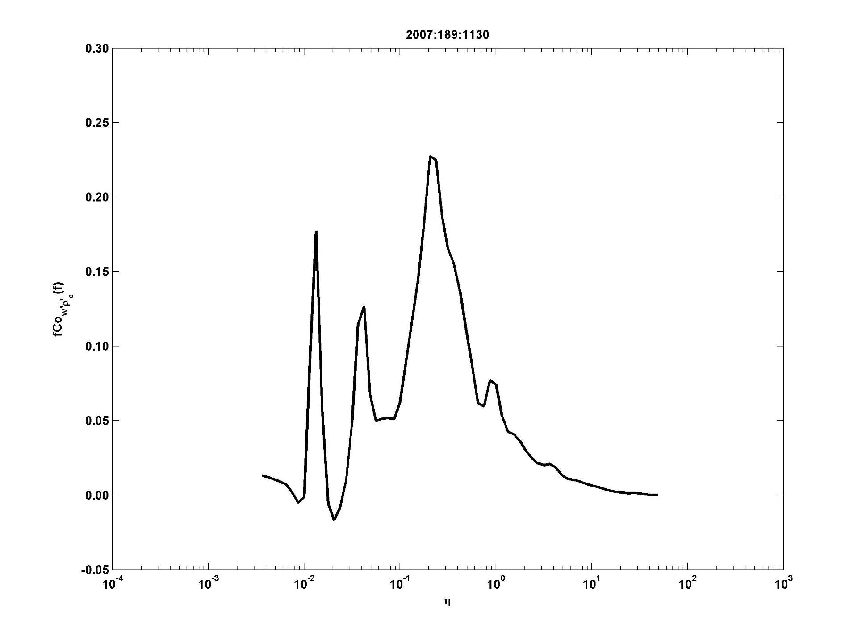
[2.3] Instrumentation
Notes:
Note the similarity between the high frequency portions of the next three slides.
And the variability between the low frequency portions.

Slide 13
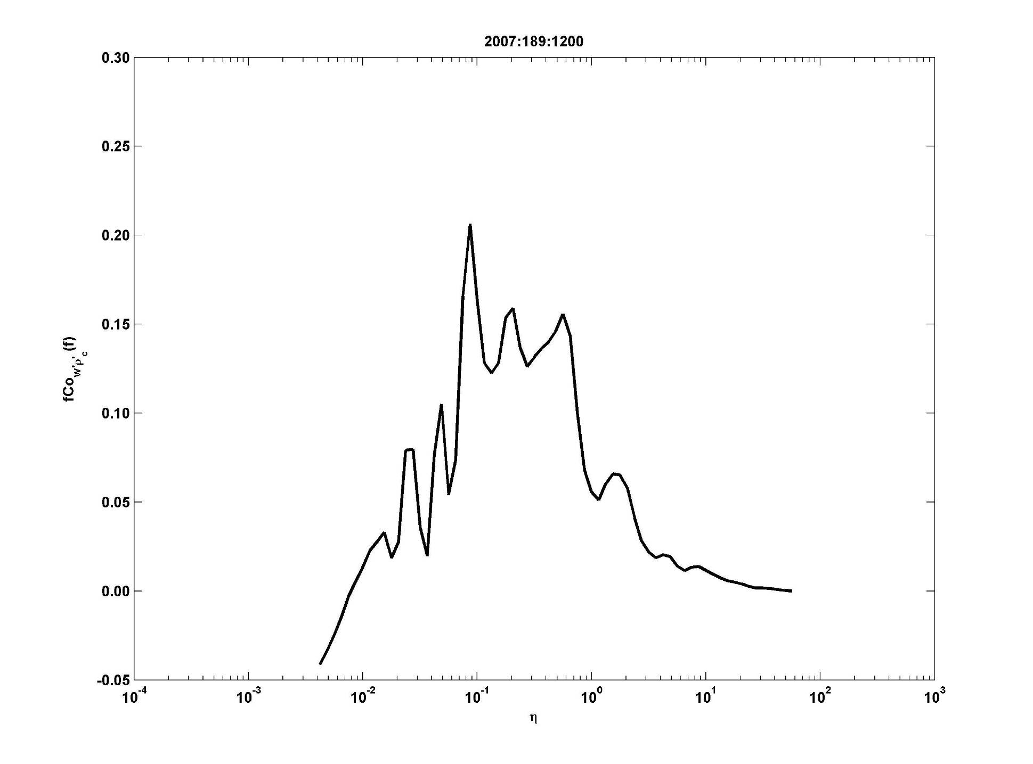
[2.4] Instrumentation

Slide 14
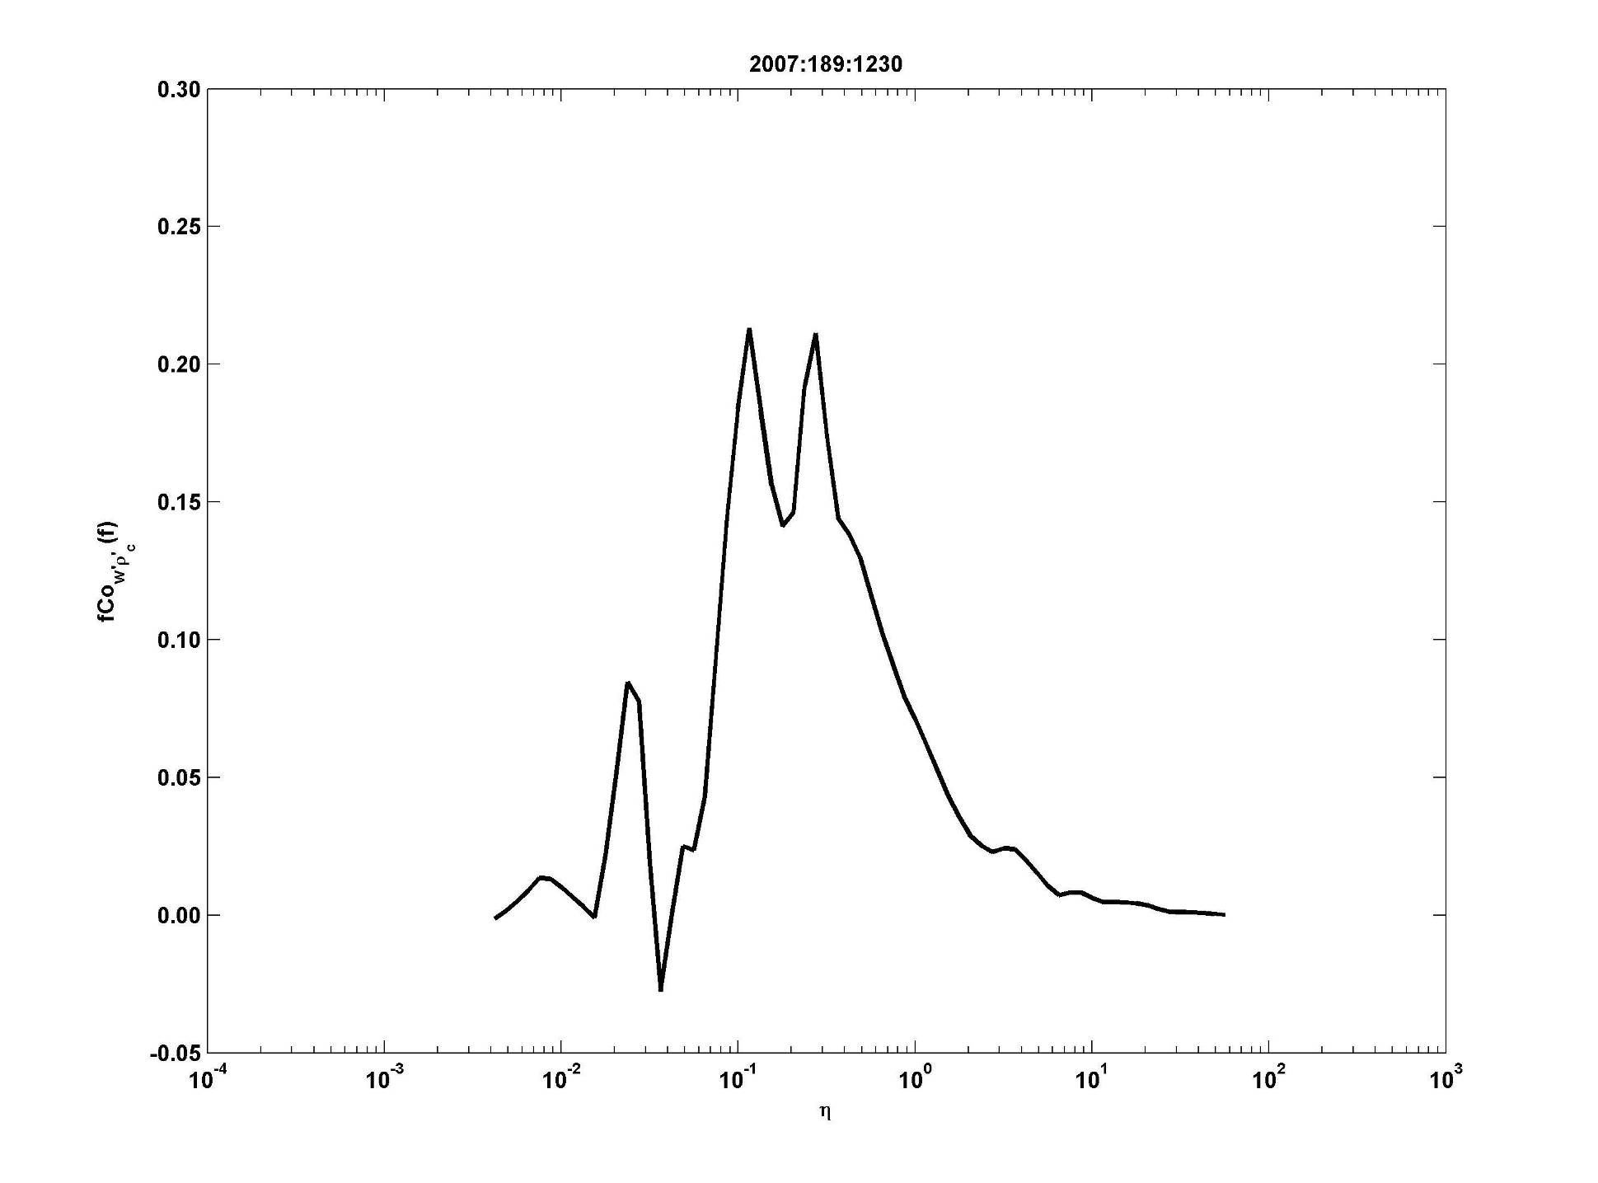
[2.5] Instrumentation

Slide 15
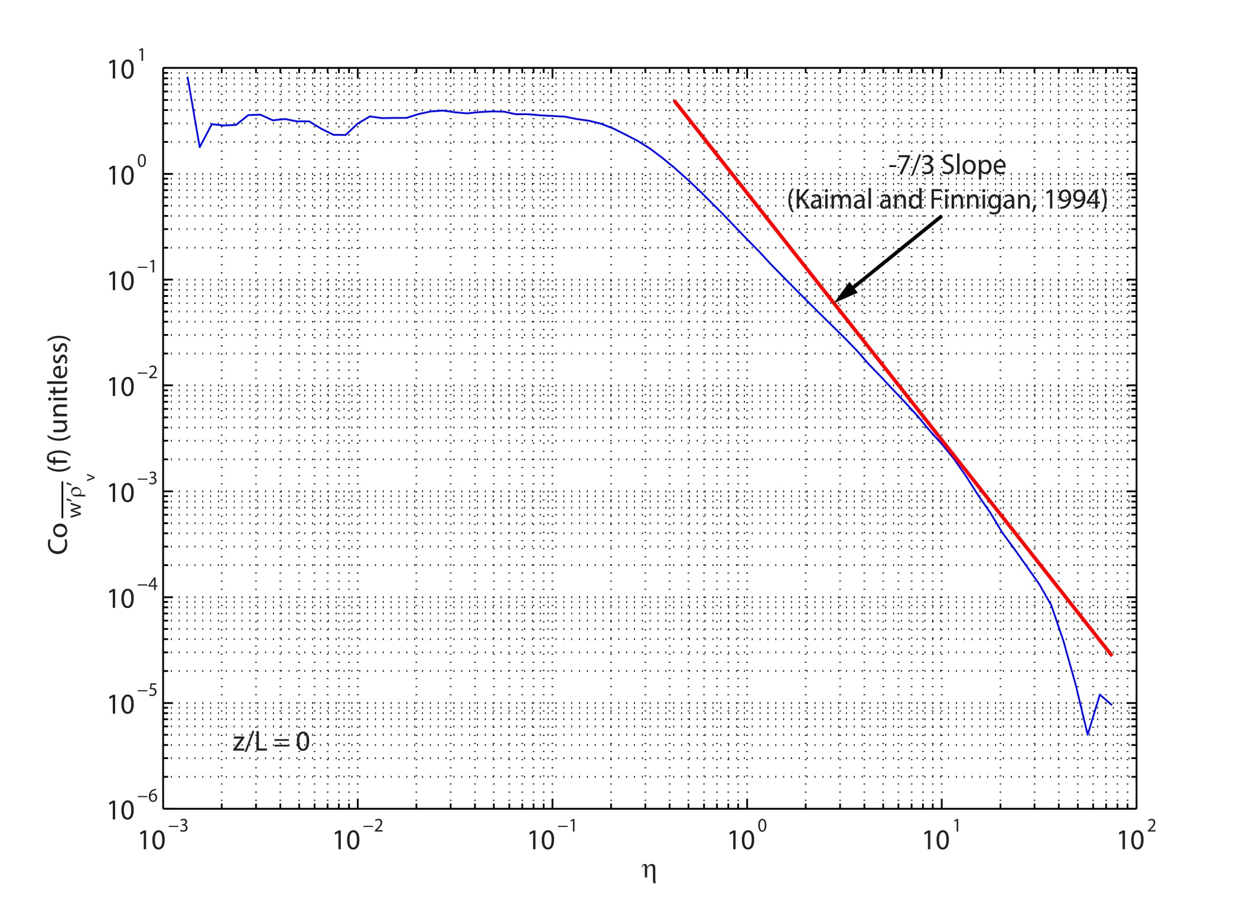
[2.6] Instrumentation

Slide 16
[2.1] Instrumentation
[2.7] Instrumentation
Unstable Stable
Smaller τ
smaller loss
Larger τ
more loss
Notes:
Frequency-weighted normalized cospectra vs. non-dimensional frequency.
At high frequencies there is a loss of information, which means the fluxes will be underestimated.
But due to time averaging of the co-varying signals there is also a loss at low frequencies. Such low frequency loss is much harder to know and correct for than the low frequency loss.

Slide 17
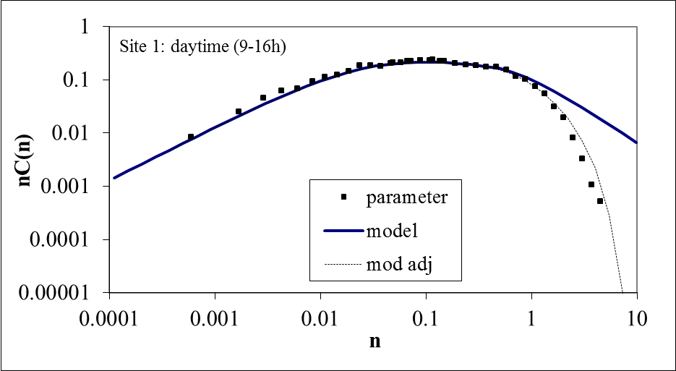
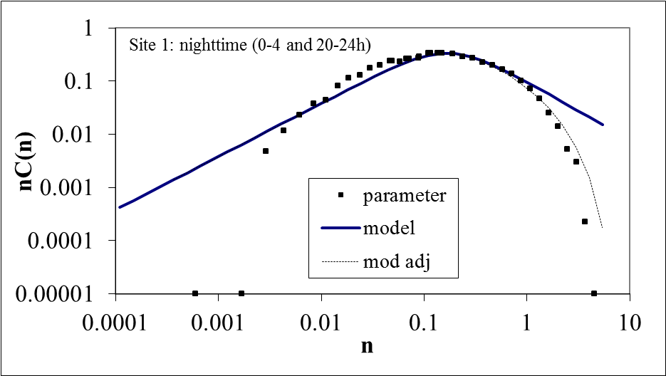
[2.8] Instrumentation
Closed-Path Sensor
Loss = 6.9%
Loss = 8.1%
Notes:
Flux loss due to co-spectral attenuation will be greater for closed-path sensors than for open-path sensors.
Such losses increase with tube length and decrease with turbulent tube-flow Reynolds number.
They also increase with adsorption/desorption along the tube wall, and in the case of water vapor ambient humidity and other environmental conditions (salt spray, dust, etc) can strongly influence and increase flux loss.

Slide 18
[2.9] Instrumentation Sensor Displacement
Need to account for the time lag between the
sonic anemometer and the EC H₂O/CO₂ sensor.
The vertical wind speed and H₂O/CO₂ time series must be
synchronized to ensure maximum covariance. There are
several reasons why these two time series can be out of synch:
different instrument processing times, sensor separation, etc.
The error from unsynchronized time series can be important ...

Slide 19
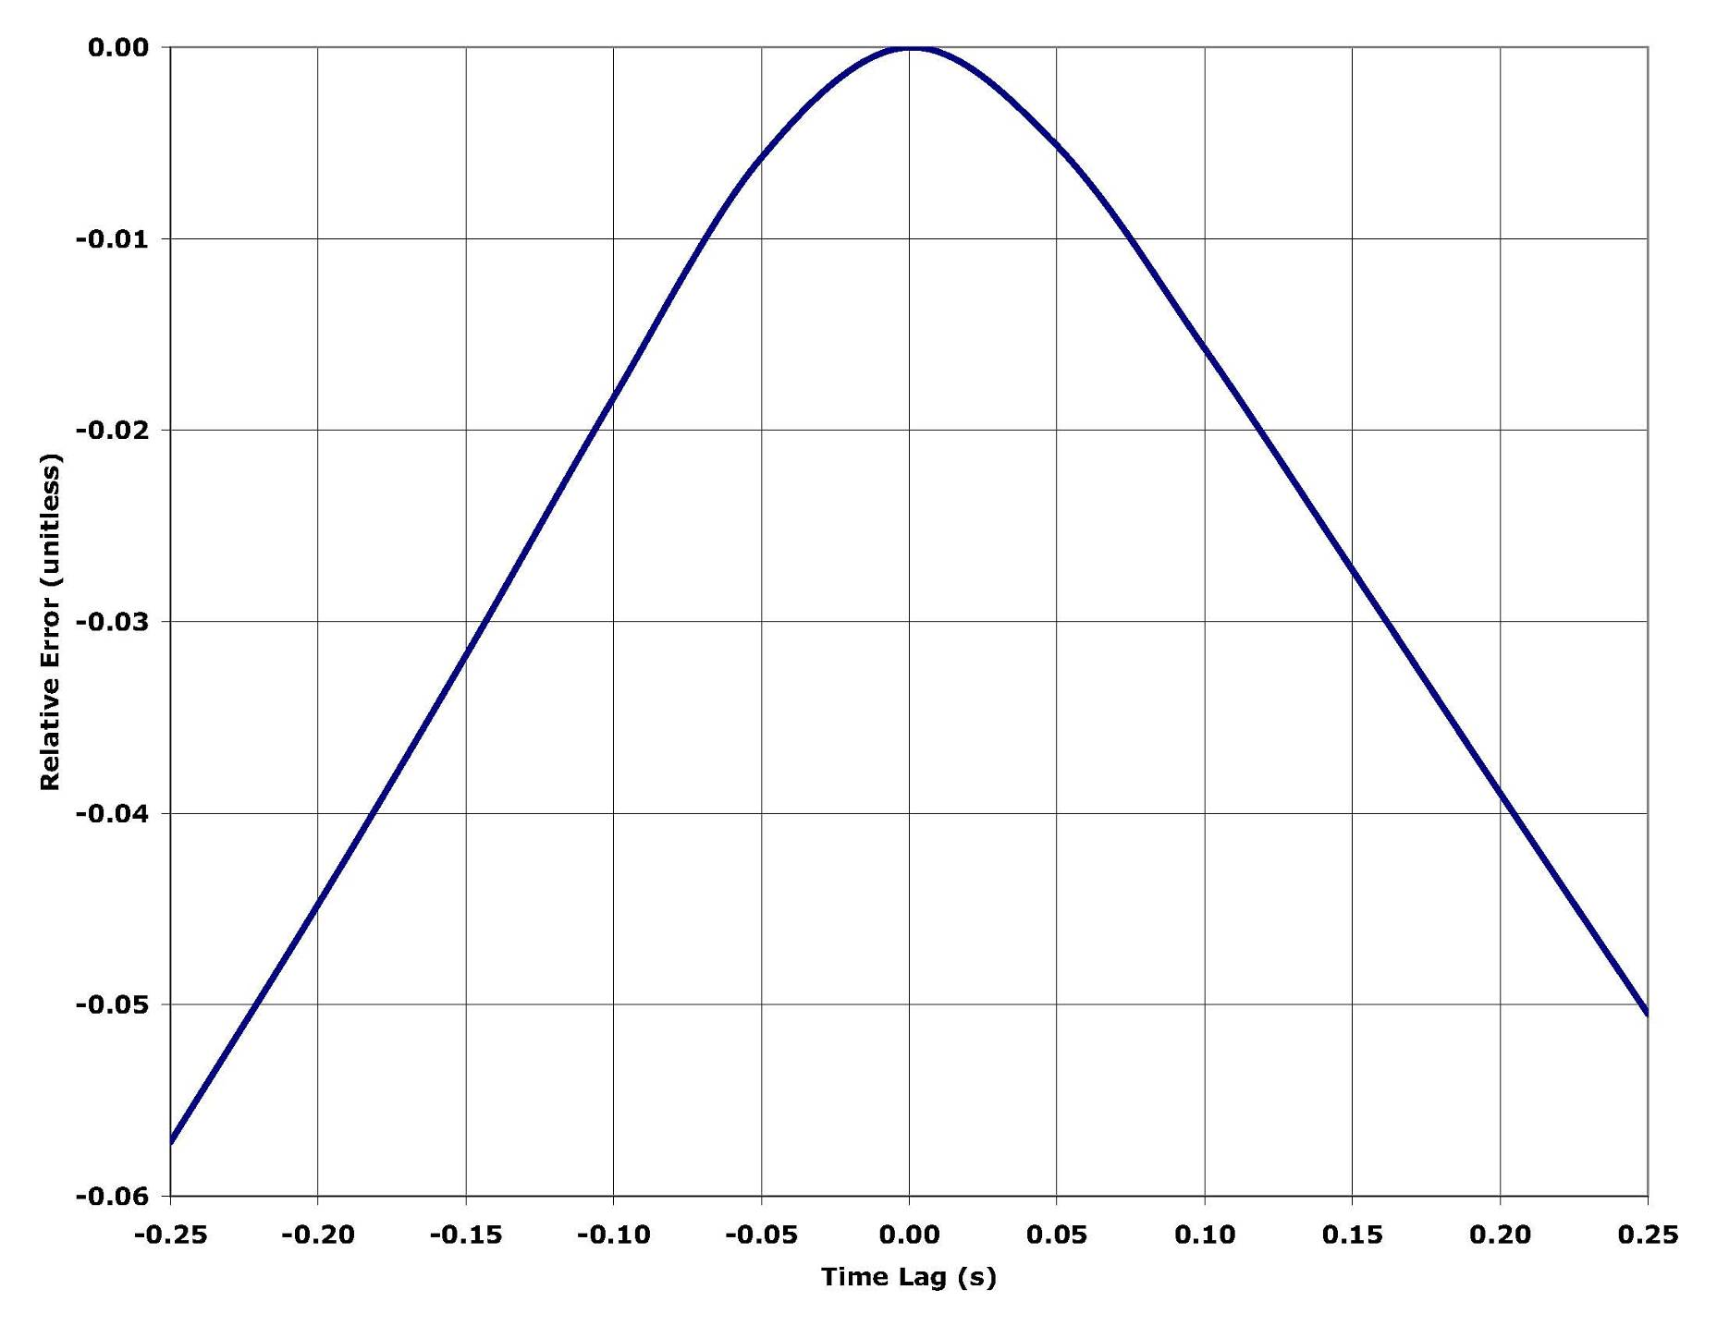
[2.10] Instrumentation Sensor Displacement

Slide 20
[2.11] Instrumentation Summary
Underestimation of EC fluxes is inevitable due to imperfect sensors.
For many applications (daytime) this should be < 8% and ‘correctable’.
(2) For heat flux (sonic thermometry) expect 1-3% loss.
(3) For vapor flux expect with 2-6% for an open-path sensor separated
from the sonic by less than 30 cm.
(4) For closed-path vapor flux co-spectral loss can be > 10%, if the
(water) vapor is adsorbing/desorbing on the tube walls.
Characterizing this loss is more difficult with greater uncertainty.
(5) BUT for stable atmospheric conditions (nighttime) co-spectral
attenuation can be significant (>20%) for any EC trace gas
instrument and corresponding flux. Nevertheless, the spectral
‘corrections’ are robust and often reasonable; they do possess
somewhat greater uncertainty.
(6) Low frequency loss (due to flux averaging time) remains uncertain.

Slide 21
[3.0] Webb-Pearman-Leuning (WPL ‘Corrections’)
So what exactly are we ‘correcting’ with these additional concerns?
We are NOT correcting the instrumentation, not in the sense of some
failing or limitation on the instrument’s part, as was just outlined in the
previous section on sensor performance.
The WPL or density terms originate from atmospheric effects that influence
the number of molecules (or mass density) of water vapor, CO₂, or any
trace gas within the sensing path of an instrument that is designed to
detect physical mass.
So above a transpiring surface we know that physical mass is being
added to the atmosphere and can be detected by modern instrumentation.
But the expansion and contraction of atmospheric volume elements during
convection or mechanical mixing associated with environmental conditions
also influence the density of the trace gas at the point of measurement.

Slide 22
[3.1] Webb-Pearman-Leuning (WPL ‘Corrections’)
The key point to remember about the WPL or density term is that
the appropriate measurement of mass fluxes to and from a surface
would be to measure the fluctuations in terms of mass mixing ratio
relative to dry air, χ_{v} [kg/kg or mol/mol], rather than in terms of
fluctuations in mass density, ρ_{v} [kg/m³]. The mixing ratio automatically
includes the effects of atmospheric density fluctuations caused by
‘external’ environmental fluctuations in temperature, pressure, and
other atmospheric trace gases.
Equally important (at least to me) is to realize (1) that the WPL is NOT
a consequence of a “mean vertical velocity”, which is how WPL (1980)
originally phrased this issue. It is rather a consequence of the conservation
of mass of dry air. In addition, (2) introducing the conservation of mass
into the derivation of the WPL terms yields the Fundamental Equation
of Eddy Covariance, which allows further insights into the other physical
processes that impact how we interpret eddy covariance fluxes.
But first, the original result from WPL (1980) is correct, although
I may take exception to the introduction of WPL’s “mean vertical velocity”.

Slide 23
[3.2] Webb-Pearman-Leuning (WPL ‘Corrections’)
Water vapor
Carbon Dioxide
These expressions derived originally by WPL (1980) assume horizontally
homogeneous conditions, i.e., essentially a 1-D problem.
Notes:
These results are for open-path sensors. Expressions for closed-path usually ignore the temperature and pressure fluctuations, which may not always be correct.
So what is the point of all this ? We want to connect the WPL, the fluxes, the biophysical processes of the surface, with the conservation of mass.
But why so much focus on the surface exchange fluxes? Because they are strongly related to the physiological functioning of the biosphere.

Slide 24
[3.3] Webb-Pearman-Leuning (WPL ‘Corrections’)
The benefit of Eddy Covariance
is made transparent by considering the relationship
between the surface fluxes (including density effects)
and the equation of mass conservation. Under the most
ideal situation the equation of (mass continuity) yields:
where z = measurement height; S_{v} = biological source (transpiration);
J_{v}(0) = soil evaporation rate.
But what happens when conditions are not ideal?
The full 3-D Conservation of Mass yields:
__ __

Slide 25
Basics: mass/energy balance on a control volume, a 3-D problem
[3.4] Webb-Pearman-Leuning (WPL ‘Corrections’)
L
Combining the 3-D conservation of mass for
water vapor (any trace gas) and dry air yields
the Fundamental Equation of Eddy Covariance.
Notes:
One way to look at this is through the “control volume” approach.

Slide 26
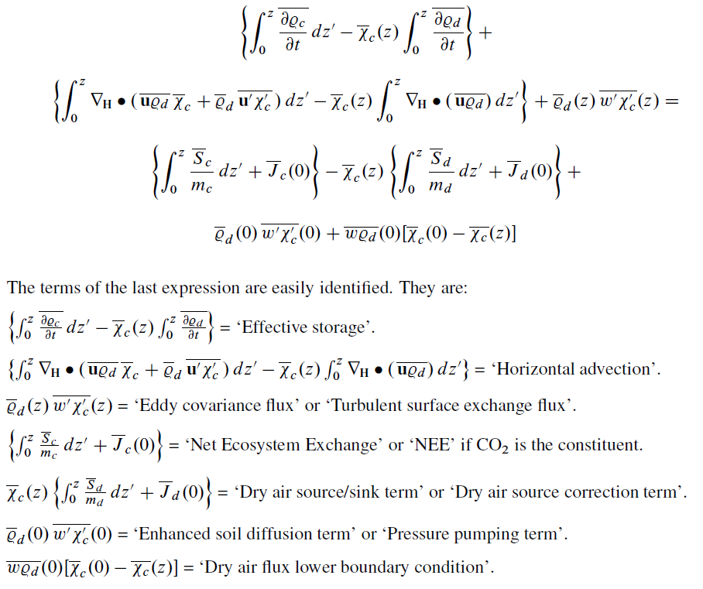
[3.5] Webb-Pearman-Leuning (WPL ‘Corrections’)
Notes:
A restatement of the control volume approach. See my notes and Gu et al. (2012).
But note that the relationship between the measured vertical exchange flux and the source term is now much more complicated.
So advective fluxes and other physical processes may not impact the measurement of the vertical flux so much as they impact the desire to interpret the vertical flux as solely related to the integrated source term.
There are some of minor issues that need to be mentioned.

Slide 27
[3.6] Webb-Pearman-Leuning (WPL ‘Corrections’)
Comment 1: Infrared gas analyzers (open-path sensors) can
have self heating issues that behave like WPL terms,
because the sensor itself is a heat source. This is
mainly a winter-time CO₂ flux problem. But it is
important to be aware of this issue for ET fluxes.
Comment 2: Horizontal advection is nearly impossible to measure
without several towers. It has the potential to be a
big source of error and uncertainty in the flux data.
But my own experience and the evidence suggests
to me that it is more likely to be a problem with ET
and trace gas (or mass) fluxes than with heat flux.

Slide 28
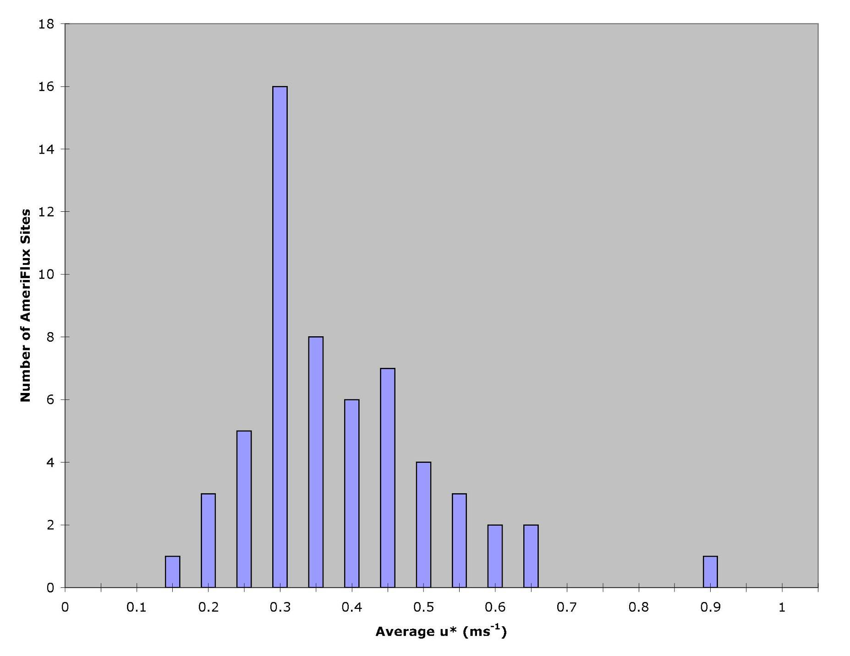
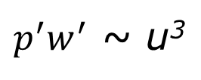
[3.7] Webb-Pearman-Leuning (WPL ‘Corrections’)
Comment 3: Pressure Covariance
The pressure covariance term can
usually be ignored, except when
there is “too much” turbulence.
____
$p^{′}w^{′}$ ~ u³
a
*

Slide 29
[4.0] EC and Energy Balance Closure
So how well does all of this stuff really work?
Closing the Surface Energy Balance: The acid test ?
R_{n} = H + LE + G_{s}

Slide 30
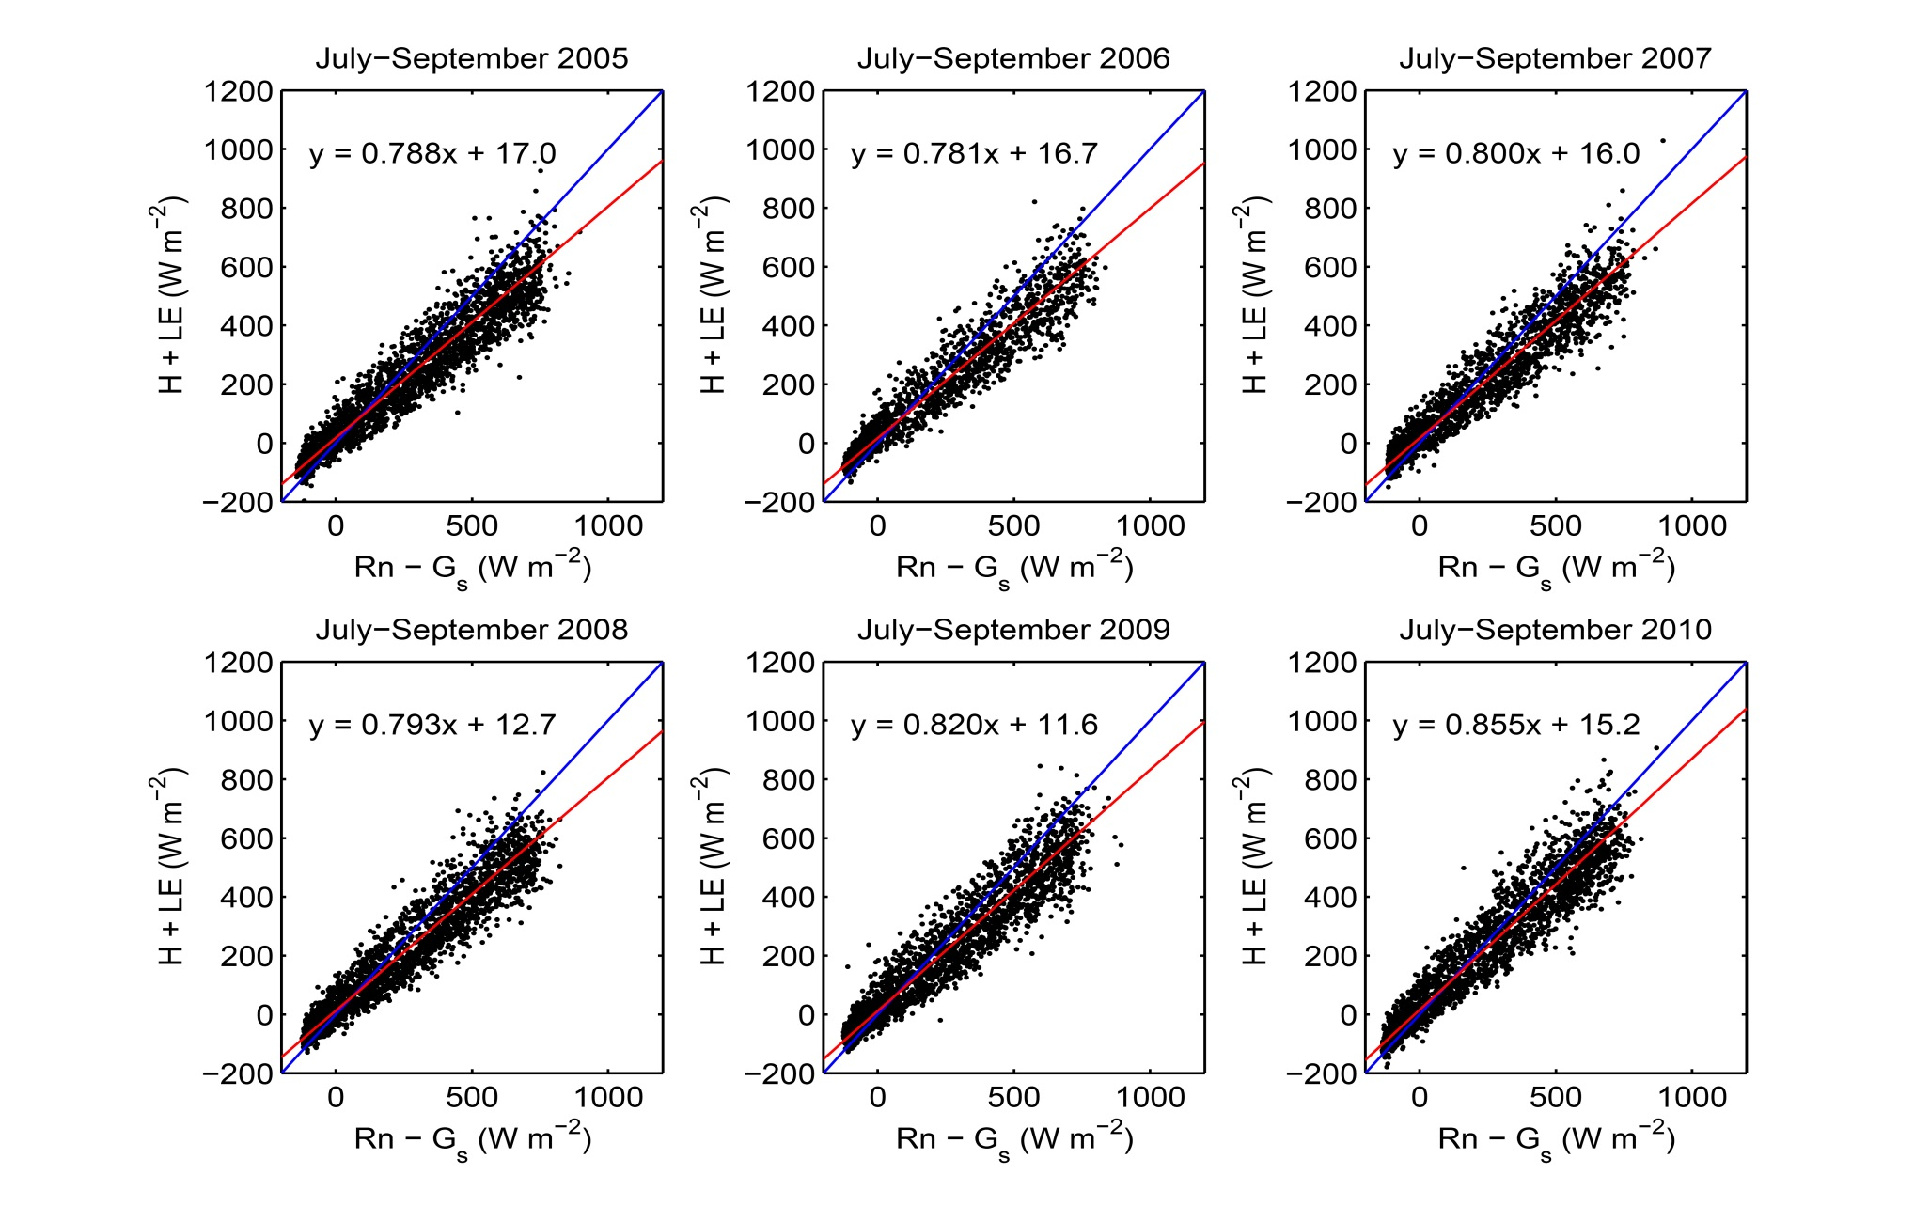
[4.1] EC and Energy Balance Closure
Notes:
For most eddy covariance sites 0.8(R_{n}-G) < LE+H < (R_{n}-G) has been true for several decades.
To me anything this systematic strongly suggests an instrument/measurement problem. But these data are taken from GLEES, the FS AmeriFlux EC site in southern Wyoming, which has been devastated during the 2005-2010 beetle epidemic. As a result ET (well T) has taken a nose dive, over the years. But, note that as ET decreases the energy balance closure improves, which further suggests to me that this “generic” lack of surface energy balance closure is likely an mass transport instrument/measurement problem.
Nonetheless, we have recently found partial confirmation of my suspicions.
NOTE: the closure coefficient is the “reduced major axis line”, which was calculated following Meeks et al (1998: paper 4.10 of the AMS Proceedings of the 23rd Conference for Agricultural and Forest Meteorology, pages 141-145).

Slide 31
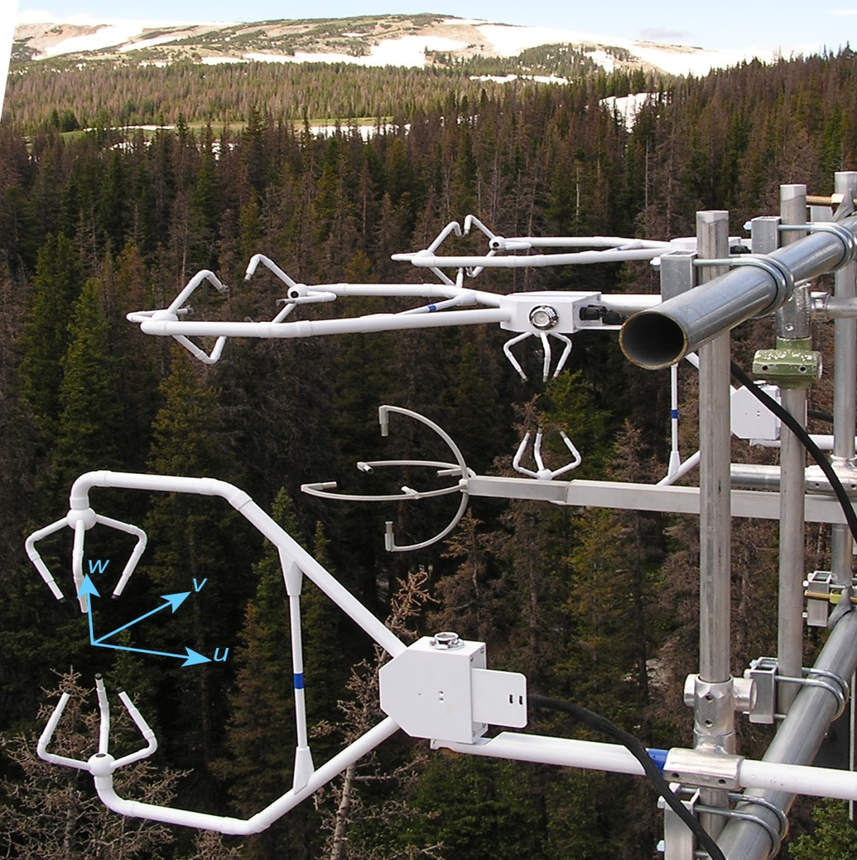
[5.0] Sonic Anemometers and Energy Balance
Kochendorfer et al (2012; 2013)
Boundary-Layer Meteorology 145: 383-398;
Boundary-Layer Meteorology 147: 337-345.
Frank et al (2013)
Agricultural & Forest Meteorology 171-172: 72-81.

Slide 32
[5.1] Sonic Anemometers and Energy Balance
These two papers report that non-orthogonal sonic
anemometers appear to underestimate the vertical
velocity fluctuation, w’, by about 10%, which then
translates into a 10% reduction in the fluxes.
Clearly this is an unexpected finding, but if
further confirmed can account for a significant
portion of the lack of energy balance closure.

Slide 33
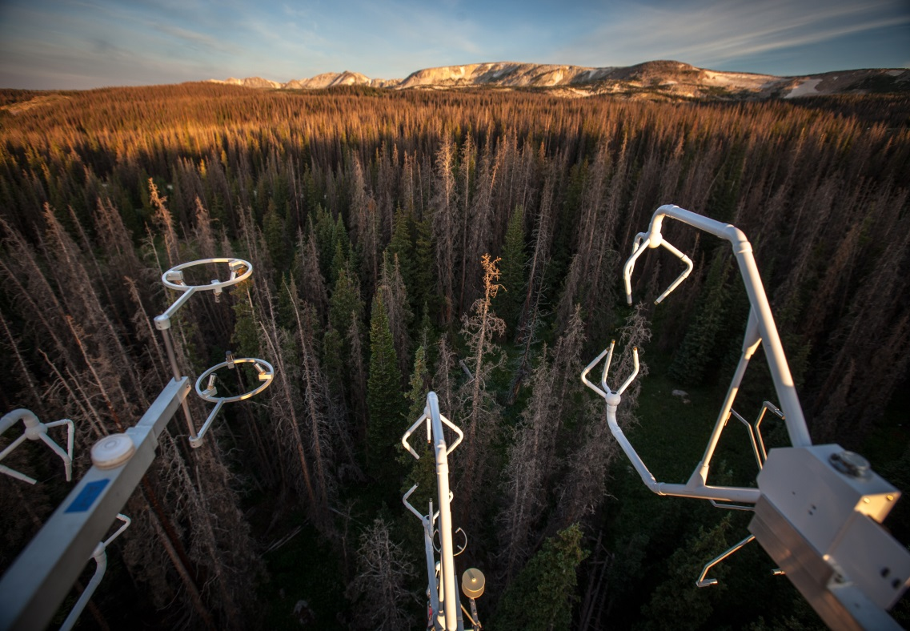
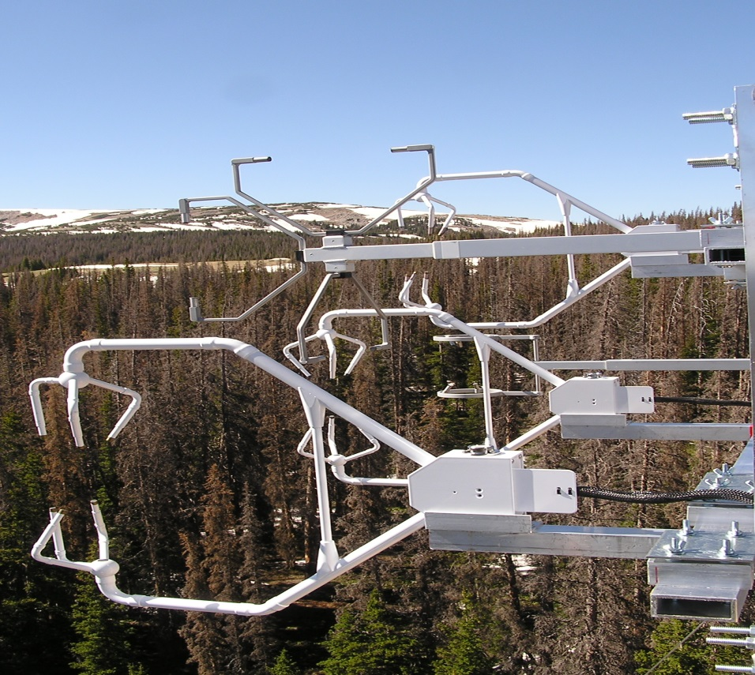
[5.2] Sonic Anemometers and Energy Balance
So our (Frank & Massman) most recent
sonic inter-comparison experiment is focused
on different non-orthogonal sonic designs.
Stay tuned for results!

Slide 34
[6.0] Soil Heat Flux & Energy Balance
Often soil heat flux and heat storage terms are
mentioned as potential causes for at least some
of the failure to close the surface energy budget.
In general, it is often important but usually not
the ultimate cause of systematic failure so often
observed.
But given the importance of soil heat flux,
soil temperature, and soil evaporation to
agriculture I have included some key papers
on these matters in my reference list. But in
truth this is really the subject of a separate talk.
Notes:
Furthermore, one page of my reference list (soil heat flux and evaporation during fires) is a shameless act of self-promotion because I list only my papers. But they are the most recent (in the ream of soil physics) and contain good summaries of all that has been done in the past.

Slide 35
(7.0) Energy Balance Summary
  Conclusions from Leuning et al. (2012)
Half-hourly averages of [H + LE] systematically
underestimate [R_{n} – G_{s}] at most flux sites.
(b) Advective flux divergences cannot explain imbalance because they
require unrealistically large and systematically positive horizontal
temperature gradients and vertical velocities.
(c) Imbalance partially explained by:
  * Phase lags due to incorrect estimates of energy storage in
  soils, air & biomass below the measurement height, but 24-hr
  averages can remove much of this bias.
  * Incorrect coordinate rotation: u’T’ contamination of w’T’.
  * Carefully implemented eddy flux systems on horizontally
  homogeneous sites can measure fluxes accurately.
  + Flow distortion associated with non-orthogonal sonics.

Slide 36
(7.1) Energy Balance Summary
  Recommendations from Leuning et al. (2012)
Do not adjust/scale time-averaged values of [H + LE] to = [R_{n} – G_{s}].
(b) Do not adjust other scalar (CO₂) fluxes either.

Slide 37
Thank You

