Slide 1
Climate 201: Modern Climate Change
OSHR 1623
Scott Denning, CSU

Slide 2
Introductions

Slide 3
Course Outline
Climate 201: Modern Climate Change
2/4 Climate Change in a Nutshell
2/11 Forcing, Feedback, & Sensitivity
2/18 What to Expect in the Future
2/25 Impacts of Climate Change
3/4 Mitigation, Adaptation, & Costs

Slide 4
Class Web Site
http://climate201.atmos.colostate.edu
All slides as printable handouts
Supplemental readings
Videos
Links to more resources

Slide 5
Climate Change Primer
Heat Budgets & Climate
Climate Sensitivity: The Past
Vulnerability
Solutions
Costs

Slide 6
Climate Change Primer
Heat Budgets & Climate
Climate Sensitivity: The Past
Vulnerability
Solutions
Costs

Slide 7
Weather vs Climate what’s the difference?
If you don’t like the weather:
Wait five minutes!
If you don’t like the climate:
Move!

Slide 8
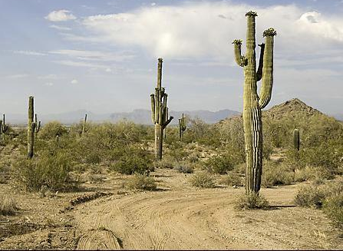
Location! Location! Location!
Climate is Place
Depends on where you live:
Latitude!
Altitude (mountains vs valley)
What’s upwind (ocean vs land)
Changes very slowly
Very predictable
We can predict that Phoenix is warmer than Fargo for precisely the same reasons that we can predict a warmer future!
PHOENIX

Slide 9
Ever Wonder Why?
Night is usually colder than day
Winter is usually colder than summer
Minneapolis is usually colder than Miami

Slide 10
Heat Budgets
Heat in
Heat in
Heat out
Heat out

Slide 11
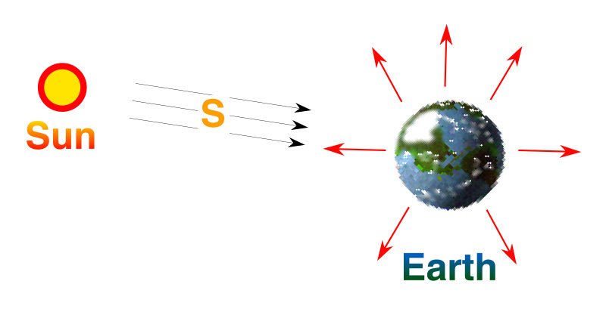
Planetary Energy Balance
Energy In = Energy Out
But the observed T_{s} is about 59 °F

Slide 12
Dancing Molecules and Heat Rays!
Nearly all of the air is made of oxygen (O₂) and nitrogen (N₂) in which two atoms of the same element share electrons
Infrared (heat) energy radiated up from the surface can be absorbed by these molecules, but not very well
O
O
N
N
Diatomic molecules can vibrate back and forth like balls on a spring, but the ends are identical

Slide 13
Dancing Molecules and Heat Rays!
Carbon dioxide (CO₂) and water vapor (H₂O) are different!
They have many more ways to vibrate and rotate, so they are very good at absorbing and emitting infrared (heat) radiation
O
C
O
O
H
H
Molecules that have many ways to wiggle are called “Greenhouse” molecules
Absorption spectrum of CO2 was measured by John Tyndall in 1863

Slide 14
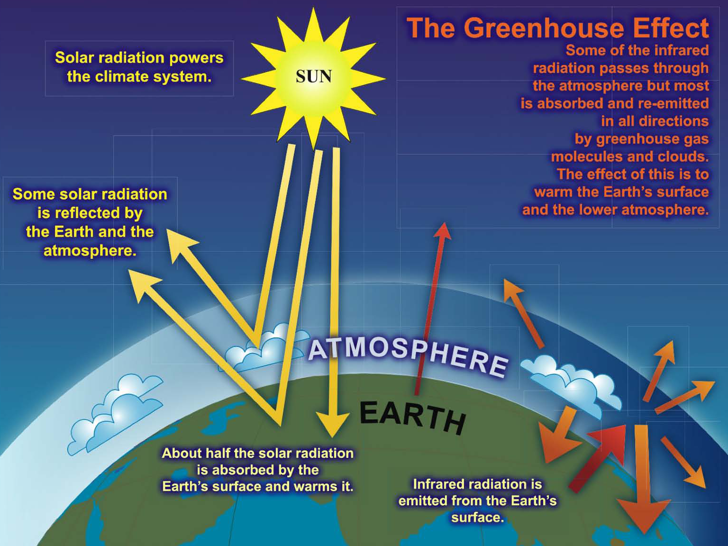

Slide 15
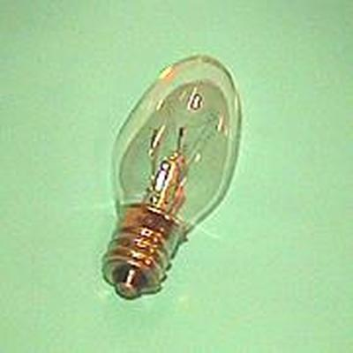
Common Sense
1 m
Doubling CO₂ would add 4 watts to every square meter of the surface of the Earth, 24/7
Doing that would make the surface warmer
This was known before light bulbs were invented!
4 Watts
1 m

Slide 16
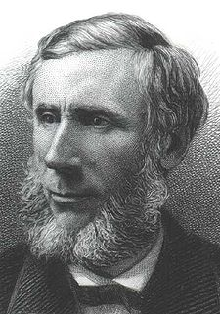
Common Sense
Doubling CO₂ would add 4 watts to every square meter of the surface of the Earth, 24/7
Doing that would make the surface warmer
This was known before light bulbs were invented!
4 Watts
John Tyndall, January 1863

Slide 17
Common Misconception #1
“People are worried about climate change because it’s been getting warmer lately”

Slide 18
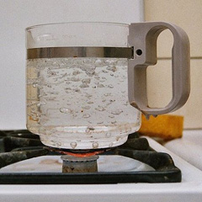
Common Misconception #1
“People are worried about climate change because it’s been getting warmer lately”
WRONG! We’re concerned because we know that when we add energy to things, they warm up

Slide 19
Climate Change Primer
Heat Budgets & Climate
Climate Sensitivity: The Past
Vulnerability
Solutions
Costs

Slide 20
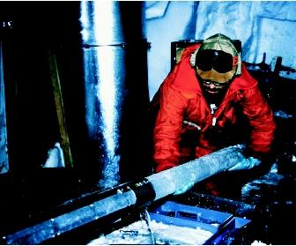
CO₂ and the Ice Ages
Over the past 420,000 years atmospheric CO₂ has varied between 180 and 280 ppm, beating in time with the last four glacial cycles
CO₂
370 ppm in 2000
ice
ice
ice
ice
Vostok (400k yr) Ice Core data (Petit et al, 1999)

Slide 21
CO₂ and the Modern Age
Over the past 420,000 years atmospheric CO₂ has varied between 180 and 280 parts per million, beating in time with the last four glacial cycles
Since the Industrial Revolution, CO₂ has risen very rapidly
CO₂
390 ppm in 2010
370 ppm in 2000
ice
ice
ice
ice
Vostok (400k yr) Ice Core data (Petit et al, 1999)
from measurements

Slide 22
CO₂ and the Future
Over the past 420,000 years atmospheric CO₂ has varied between 180 and 280 parts per million, beating in time with the last four glacial cycles
Since the Industrial Revolution, CO₂ has risen very rapidly
If China & India develop using 19th Century technology, CO₂ will reach 900 ppm in this century
CO₂
900 ppm in 2100
388 ppm in 2009
ice
ice
ice
ice
Vostok (400k yr) Ice Core data (Petit et al, 1999)
You ain’t seen nothing yet!

Slide 23
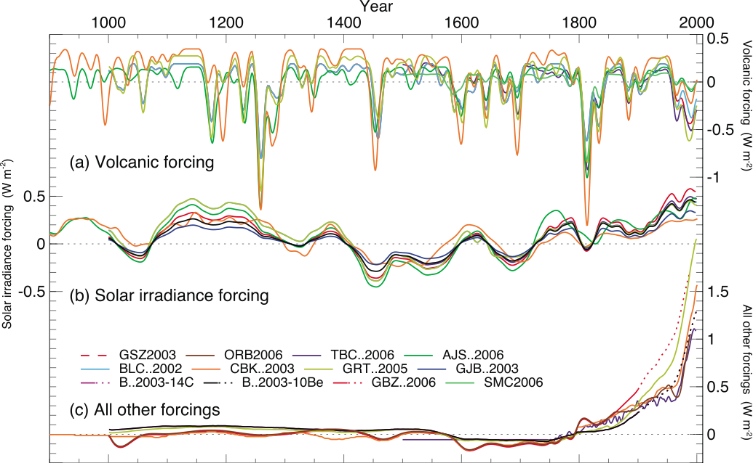
Reconstructed Radiative Forcings

Slide 24
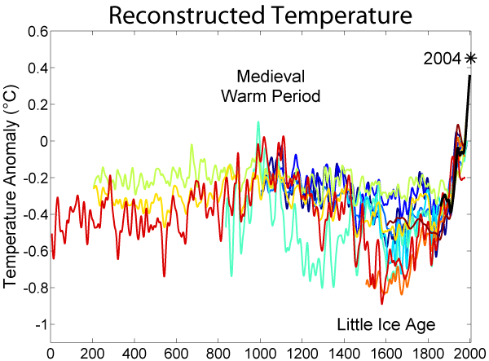
The Past 2000 Years
http://commons.wikimedia.org/wiki/File:2000_Year_Temperature_Comparison.png

Slide 25
Climate Change Primer
Heat Budgets & Climate
Climate Sensitivity: The Past
Vulnerability
Solutions
Costs

Slide 26
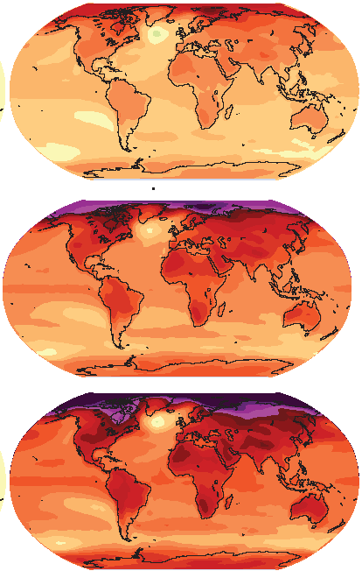
How much warmer?
Land vs ocean!
North vs South
Global mean warming of 2º to 5º C
North American warming of 3º to 6º C
= 5º to 11º F
Arctic warming of 8º to 14º F
Low
Emissions
Moderate
Emissions
High
Emissions
Rainfall? Agriculture? Water supply? Ski industry?
Mass immigration?

Slide 27
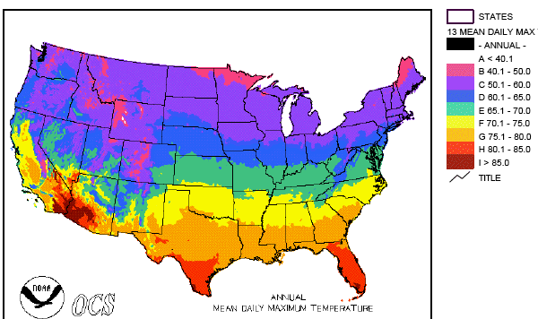
Where is it 10°F Warmer
“on average?”
Denver ➔ Amarillo
Grand Junction ➔ Tucson
Illinois ➔ Mississippi
Water? Crops? Real Estate? Health?

Slide 28
How Much Warmer?
If China and India industrialize with coal, CO₂ will rise to 4x preindustrial
Extra CO₂ will last for centuries after coal is gone
CO₂
CO₂ (ppm)
Warming (Celsius)
warming
you are
here
GtC/yr
year
The heck with Polar Bears … what would that do to farmers?

Slide 29
CO₂ “Budget” of the World
Fossil Fuel
Burning
8
ATMOSPHERE
billion
tons go in
4
billion tons added every year
800
billion tons carbon
Ocean
Land Plants and soils (net)
2
+
2
=
4
billion tons go out
Extra heat comes from the water, not the faucet!

Slide 30
Common Myth #2
“When we reduce or stop the burning of fossil fuel, the CO₂ will go away and things will go back to normal”
CO₂ from fossil fuel will react with oceans, but only as fast as they “mix”
Eventually, fossil CO₂ will react with rocks
Much of the CO2 we emit now will stay in the air for many thousands of years!
CO2 (ppm)
you are here
industrial
revolution

Slide 31
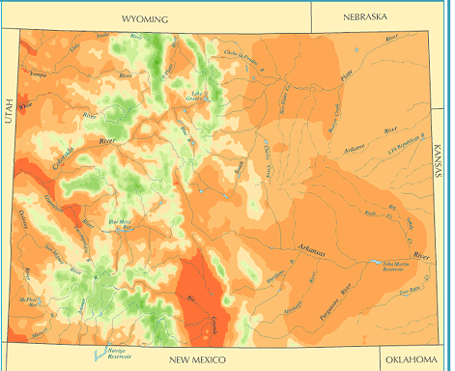
A Region On the Edge
Colorado Precipitation Map
Much of the region already receives only marginal precipitation
Just enough snow to support forests and reservoirs
Just enough irrigation water to support farming

Slide 32
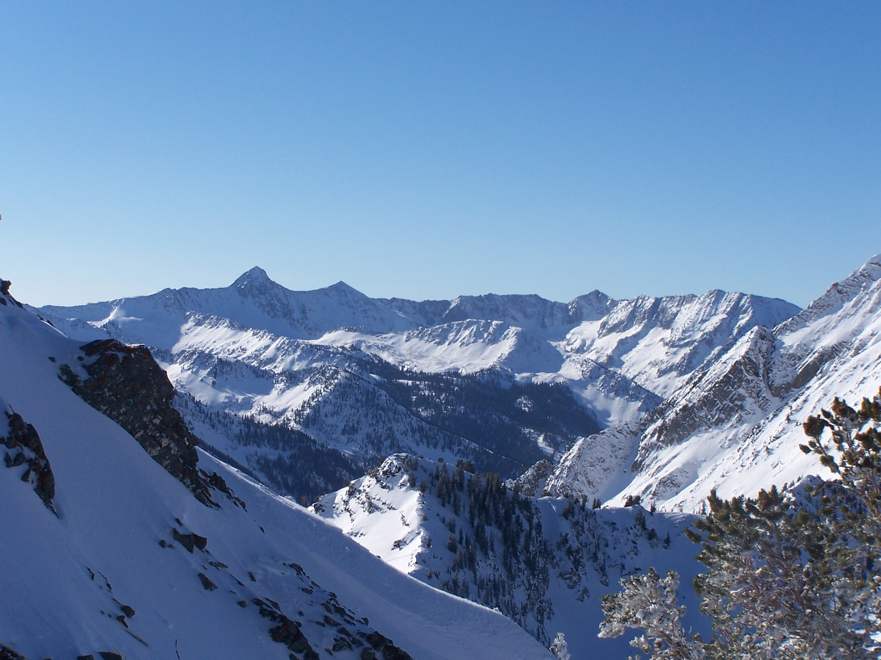
Ski Industry

Slide 33
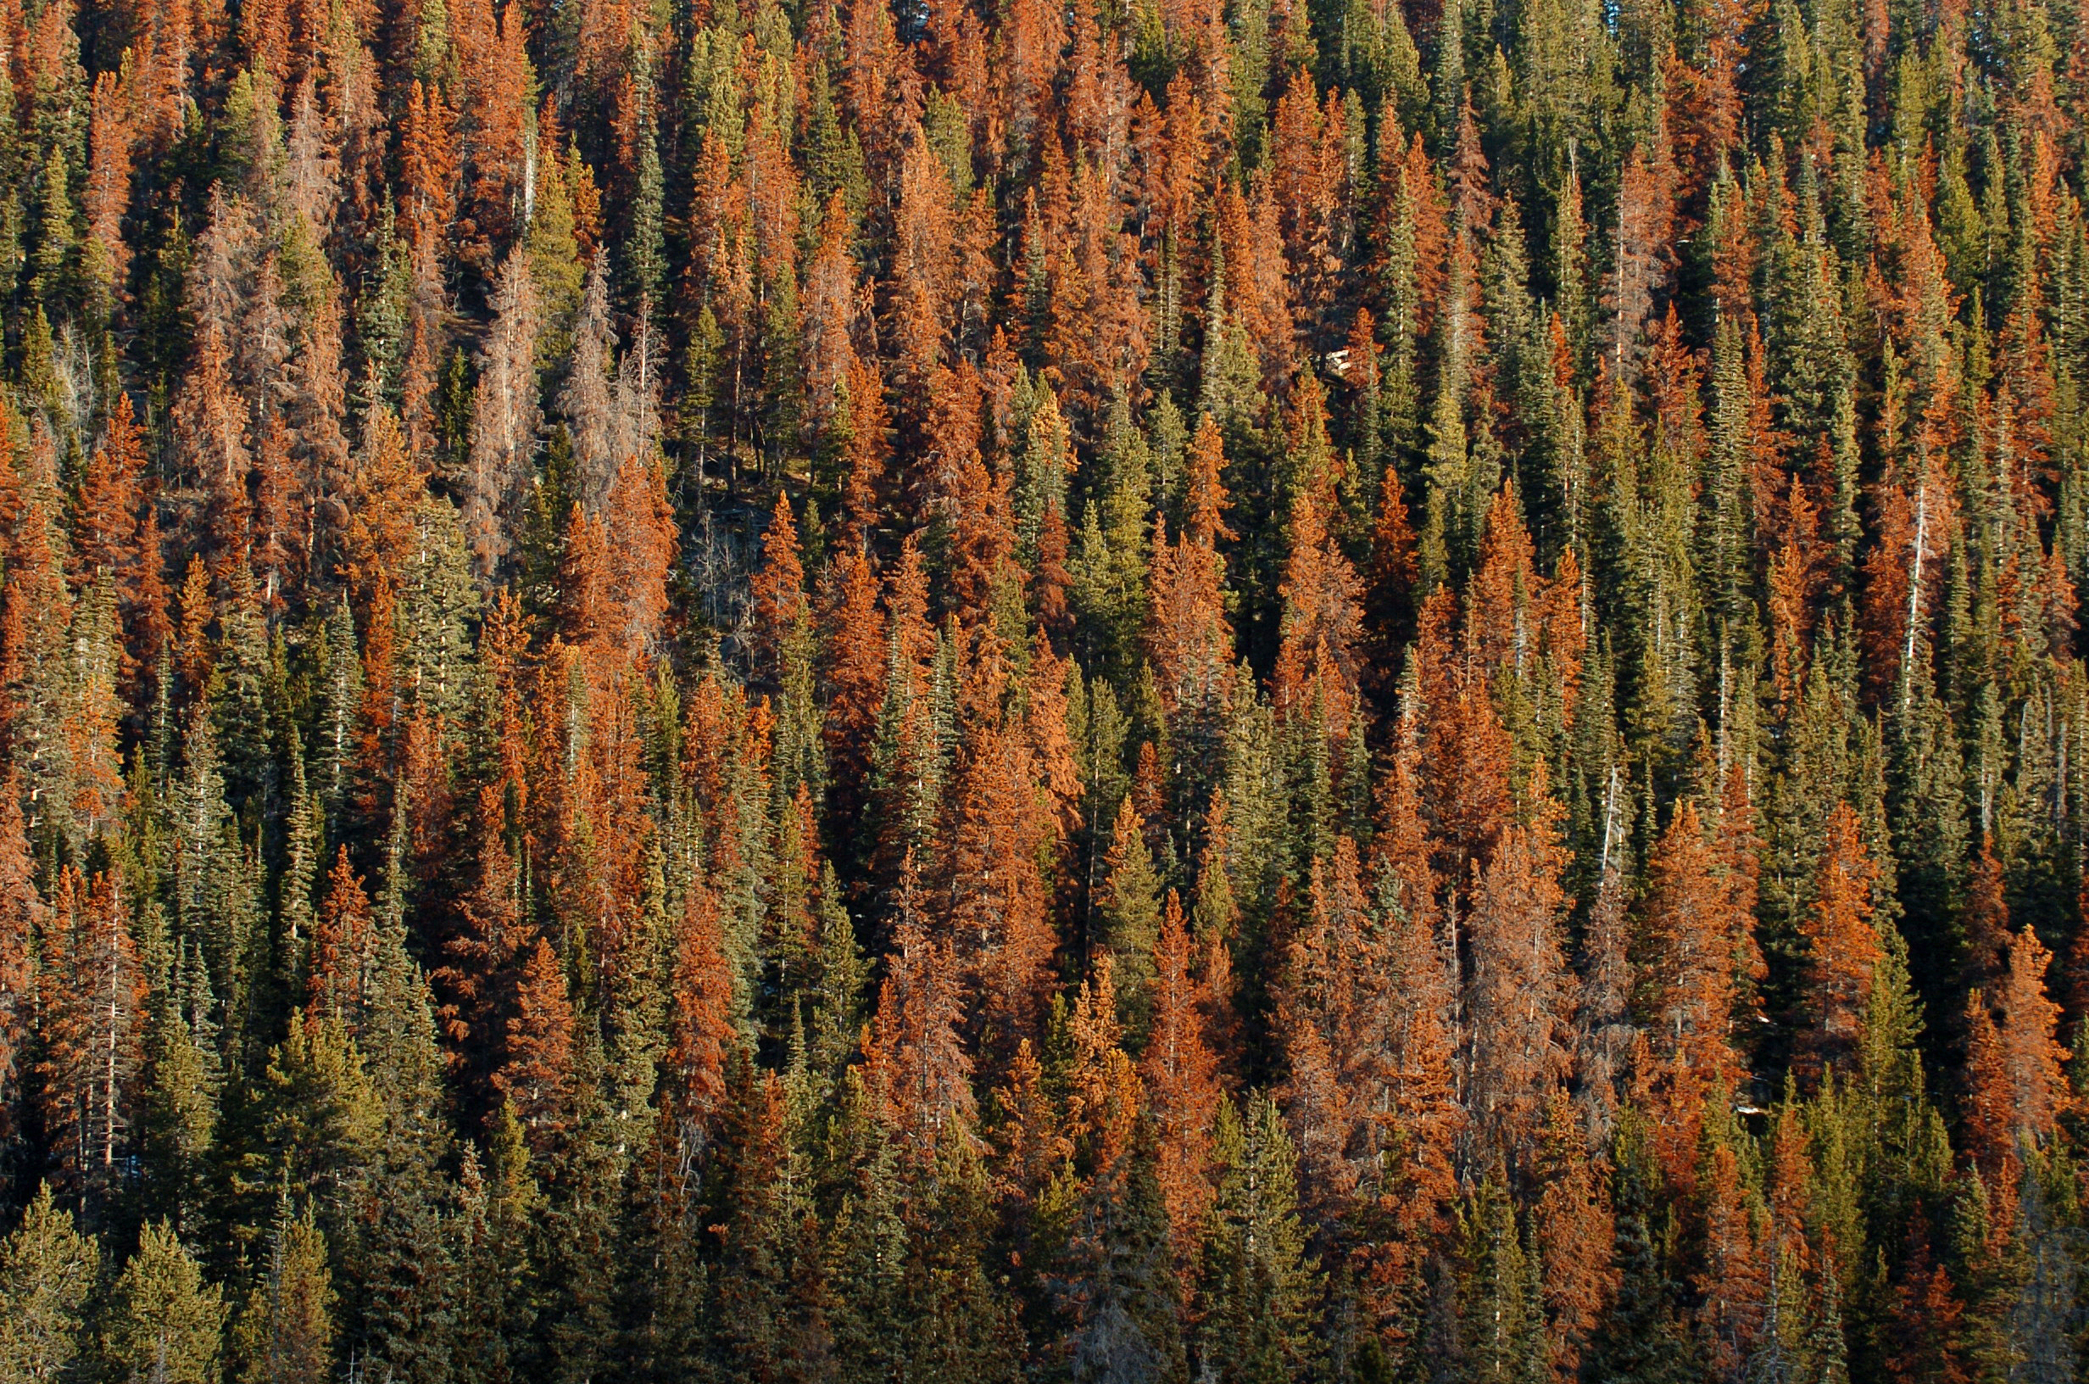
Insect Pests

Slide 34
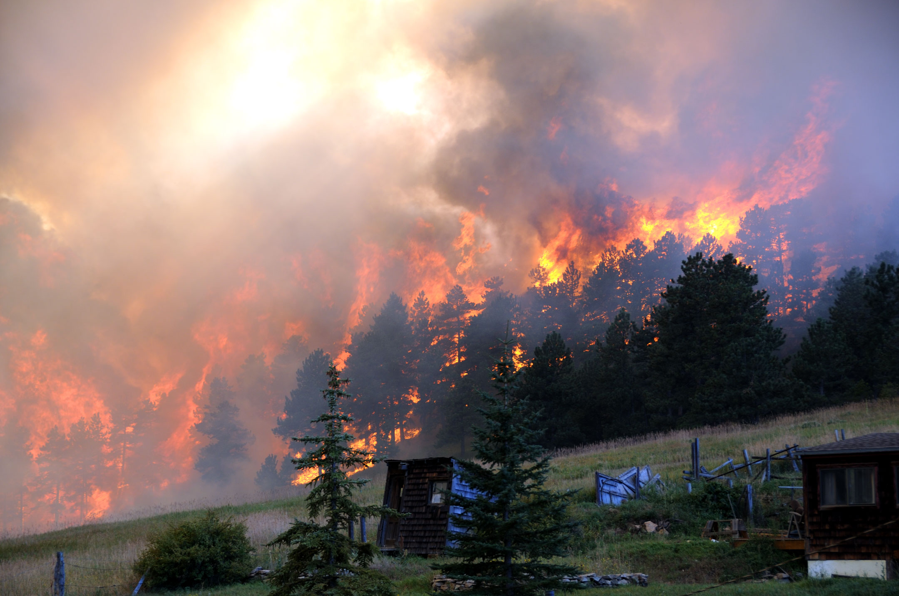
Wildfire

Slide 35
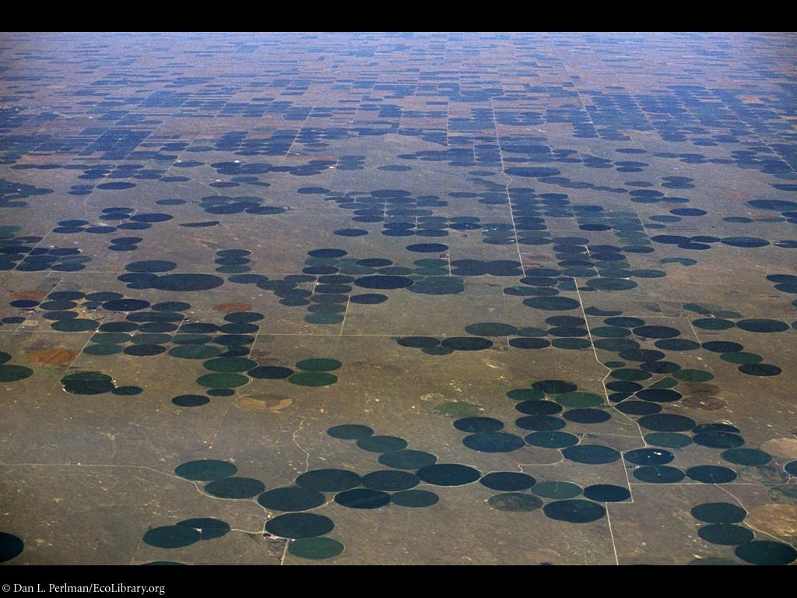
Irrigated Agriculture

Slide 36
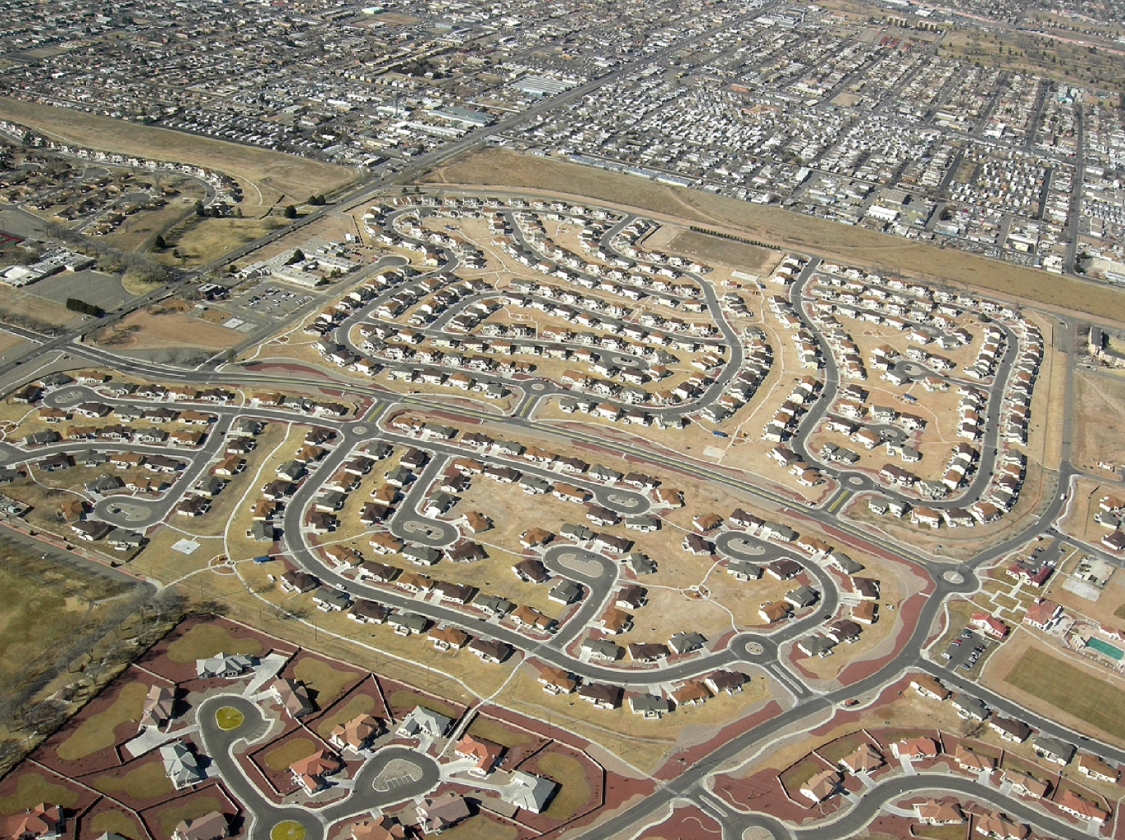
Real Estate Development

Slide 37
Climate Change Primer
Heat Budgets & Climate
Climate Sensitivity: The Past
Vulnerability
Solutions
Costs

Slide 38
Historical Emissions
Billions of Tons Carbon Emitted per Year
16
8
Historical
emissions
0
1950
2000
2050
2100
Notes:
38

Slide 39
The “Stabilization Triangle”
Billions of Tons Carbon Emitted per Year
16
Current path = “ramp”
Stabilization Triangle
Interim Goal
8
Historical
emissions
Flat path
1.6
0
1950
2000
2050
2100
Notes:
39

Slide 40
“Stabilization Wedges”
Billions of Tons Carbon Emitted per Year
16 GtC/y
16
Current path = “ramp”
Eight “wedges”
Goal: In 50 years, same
global emissions as today
8
Historical
emissions
Flat path
1.6
0
1950
2000
2050
2100
http://www.princeton.edu/wedges/
Notes:
40

Slide 41
What is a “Wedge”?
A “wedge” is a strategy to reduce carbon emissions that grows in 50 years from zero to 1.0 GtC/yr. The strategy has already been commercialized at scale somewhere.
1 GtC/yr
Total = 25 Gigatons carbon
50 years
Cumulatively, a wedge redirects the flow of 25 GtC in its first 50 years. This is 2.5 trillion dollars at $100/tC.
A “solution” to the CO₂ problem should provide at least one wedge.

Slide 42
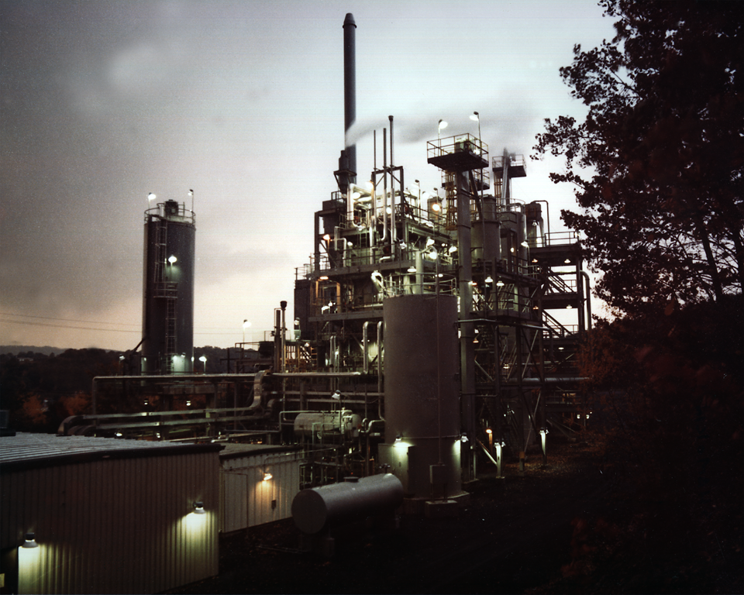
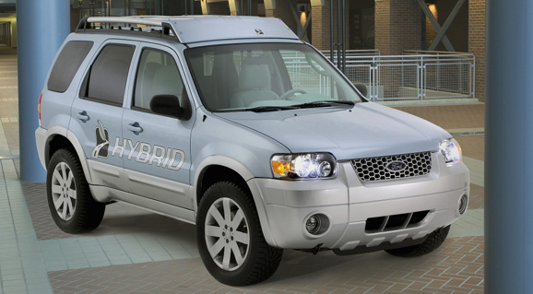
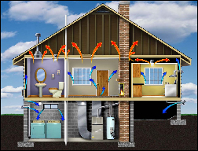
Efficiency
Photos courtesy of Ford Motor Co., DOE, EPA
Produce today’s electric capacity with double today’s efficiency
Double the fuel efficiency of the world’s cars or halve miles traveled
Average coal plant efficiency is 32% today
Use best efficiency practices in all residential and commercial buildings
There are about 600 million cars today, with 2 billion projected for 2061
Replacing all the world’s incandescent bulbs with CFL’s would provide 1/4 of one wedge
Notes:
“E,T, H” = can be applied to electric, transport, or heating sectors, $=rough indication of cost (on a scale of $ to $$$)

Slide 43
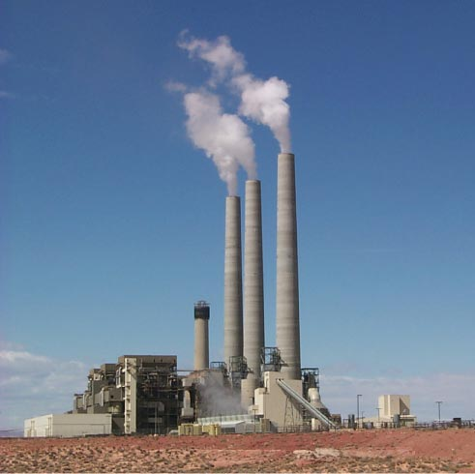
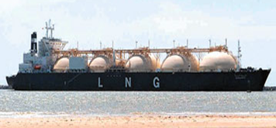
Fuel Switching
Photo by J.C. Willett (U.S. Geological Survey).
Substitute 1400 natural gas electric plants for an equal number of coal-fired facilities
A wedge requires an amount of natural gas equal to that used for all purposes today
Notes:
“E,H” = can be applied to electric or heating sectors, $=rough indication of cost (on a scale of $ to $$$)
Effort needed for 1 wedge:
Build 1400 GW of capacity powered by natural gas instead of coal (60% of current fossil fuel electric capacity)
Requires an amount of natural gas equal to that used for all purposes today
So a slice is 50 LNG tanker discharges/day by 2054 @200,000 m3/tanker, or
one new “Alaska” pipeline/year @ 4 Bscfd.
Detailed Description: NATURAL GAS TURBINES ARE BEING DEVELOPED TO PRODUCE ELECTRICITY IN A SIMPLE, LOW COST ENVIRONMENTALLY FRIENDLY WAY. DOE'S NATIONAL ENERGY TECHNOLOGY LABORATORY (NETL) INITIATED THE ADVANCED TURBINE SYSTEMS (ATS) PROGRAM AND HAS PARTNERED WITH INDUSTRY TO PRODUCE A NEW GENERATION OF HIGH EFFICIENCY GAS TURBINES FOR CENTRAL STATION ELECTRICITY PRODUCTION, USING CLEAN BURNING NATURAL GAS.
700 1-GW baseload coal plants (5400 TWh/y) emit 1 GtC/y.
Natural gas: 1 GtC/y = 190 Bscfd
Yr 2000 electricity:
Coal : 6000 TWh/y; Natural gas: 2700 TWh/y.

Slide 44
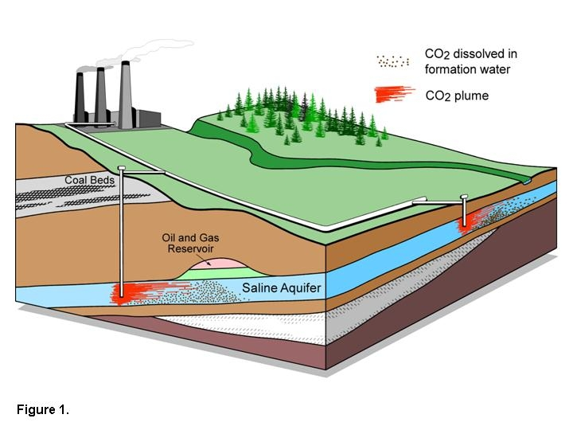
Carbon Capture & Storage
Implement CCS at
800 GW coal electric plants or
1600 GW natural gas electric plants or
180 coal synfuels plants or
10 times today’s capacity of hydrogen plants
Graphic courtesy of Alberta Geological Survey
There are currently three storage projects that each inject 1 million tons of CO₂ per year – by 2061 we’d need 3500.
Notes:
“E,T, H” = can be applied to electric, transport, or heating sectors, $=rough indication of cost (on a scale of $ to $$$)

Slide 45
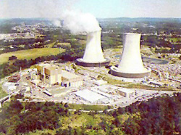
Triple the world’s nuclear electricity capacity by 2061
Nuclear Electricity
Graphic courtesy of NRC
The rate of installation required for a wedge from electricity is equal to the global rate of nuclear expansion from 1975-1990.
Notes:
“E” = can be applied to electric sector, $$=rough indication of cost (on a scale of $ to $$$)
Plutonium (Pu) production by 2054, if fuel cycles are unchanged: 4000 t Pu (and another 4000 t Pu if current capacity is continued).
Compare with ~ 1000 t Pu in all current spent fuel, ~ 100 t Pu in all U.S. weapons.
5 kg ~ Pu critical mass.

Slide 46
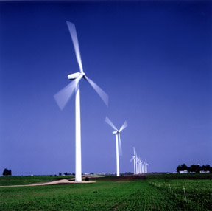
Wind Electricity
Install 1 million 2 MW windmills to replace coal-based electricity,
OR
Use 2 million windmills to produce hydrogen fuel
Photo courtesy of DOE
A wedge worth of wind electricity will require increasing current capacity by a factor of 30
Notes:
“E,T, H” = can be applied to electric, transport, or heating sectors, $-$$=rough indication of cost (on a scale of $ to $$$)

Slide 47
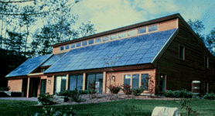
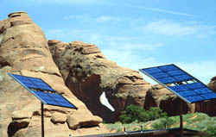
Solar Electricity
Install 20,000 square kilometers for dedicated use by 2054
Photos courtesy of DOE Photovoltaics Program
A wedge of solar electricity would mean increasing current capacity 700 times
Notes:
“E” = can be applied to electric sector, $$$=rough indication of cost (on a scale of $ to $$$)

Slide 48
Climate Change Primer
Heat Budgets & Climate
Climate Sensitivity: The Past
Vulnerability
Solutions
Costs

Slide 49
Imagine it’s 1800, and you’re in charge …
Somebody presents you with a grand idea for transforming the world economy:
Dig 8 billion tons of carbon out of the ground every year
Build a system of pipelines, supertankers, railroads, highways, and trucks to deliver it to every street corner on the planet
Build millions of cars every year, and millions of miles of roads to drive them on
Generate and pipe enough electricity to every house to power lights & stereos & plasma TVs
… “and here’s the itemized bill …”

Slide 50
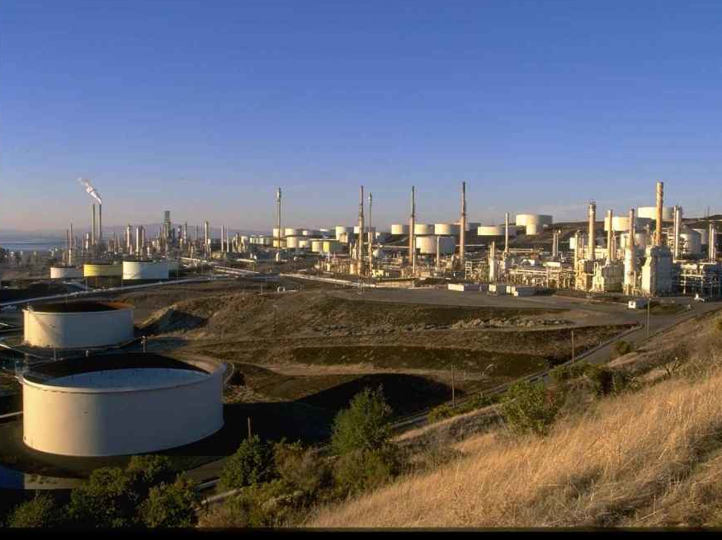
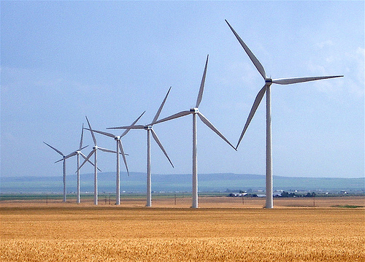
Thinking about Co$t$
Our global society built that very system
We didn’t all go broke building it …
We got rich beyond the avarice of kings!
Now we get to do it again!
How?

Slide 51
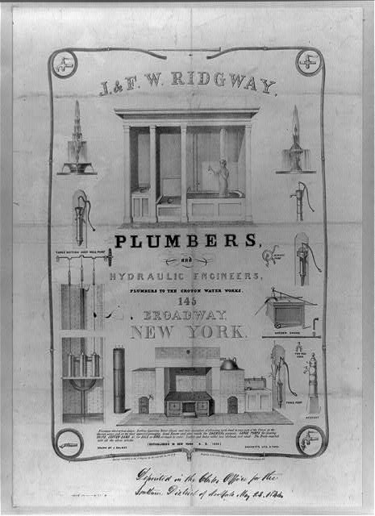
Costs
Conversion to 100% noncarbon energy will cost about 1% of GDP
That’s about what it cost to retrofit all the world’s cities with indoor plumbing a century ago …
It was so worth it!

Slide 52
Free Market Solutions
A new industrial revolution won’t happen because people want to “do the right thing”
The government can’t just pass a law and create a new global energy economy, any more than they could 200 years ago
If low-carbon-footprint goods and services cost less than “dirtier” ones, people will buy them

Slide 53
Choose Your Future
Some people say:
“Modern wealth is due to the subsidy of cheap fossil fuel. If we stop burning coal we’ll freeze in the dark!”
I prefer:
“Modern wealth results from ingenuity and hard work. Before we run out of oil, we’ll invent energy technologies for the 21st Century.
Our future is bright.”

