Slide 1


Climate Change
How it Works
Climate Sensitivity
Vulnerability
Solutions & Costs
Scott Denning
Director of Education, CMMAP
Atmospheric Science, CSU
Email Scott.Denning@ColoState.edu for a copy of this presentation

Slide 2
Climate Change Primer
Heat Budgets & Climate
Climate Sensitivity: The Past
Vulnerability
Solutions
Costs

Slide 3
Climate Change Primer
Heat Budgets & Climate
Climate Sensitivity: The Past
Vulnerability
Solutions
Costs

Slide 4


Ever Wonder Why?
Day is warmer than night
Summer is warmer than winter
Miami is warmer than Minneapolis

Slide 5


Location! Location! Location!
Climate is Place
Depends on where you live:
  Latitude!
  Altitude (mountains vs valley)
  What’s upwind (ocean vs land)
Changes very slowly
Very predictable
We can predict that Phoenix is warmer than Fargo for precisely the same reasons that we can predict a warmer future!
PHOENIX

Slide 6

Heat Budgets
Heat in
Heat in
Heat out
Heat out

Slide 7
Dancing Molecules and Heat Rays!
Nearly all of the air is made of oxygen (O₂) and nitrogen (N₂) in which two atoms of the same element share electrons
Infrared (heat) energy radiated up from the surface can be absorbed by these molecules, but not very well
O
O
N
N
Diatomic molecules can vibrate back and forth like balls on a spring, but the ends are identical

Slide 8
Dancing Molecules and Heat Rays!
Carbon dioxide (CO₂) and water vapor (H₂O) are different!
They have many more ways to vibrate and rotate, so they are very good at absorbing and emitting infrared (heat) radiation
O
C
O
O
H
H
Molecules that have many ways to wiggle are called “Greenhouse” molecules
Absorption spectrum of CO2 was measured by John Tyndall in 1863

Slide 9


Slide 10
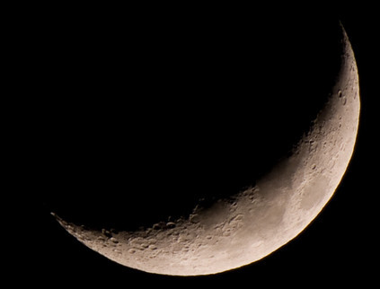
Spring Night
in Colorado
radiation
emitted
by soil
9 PM surface temperature = 15 °C = 60 °F
390 W m⁻²
4 inches
= 10 cm

Slide 11
Spring Night
in Colorado
radiation
emitted
by soil
6 AM surface temperature = -60 °C = -78 °F
9 PM surface temperature = 15 °C = 60 °F
390 W m⁻²
4 inches
= 10 cm

Slide 12
Spring Night
in Colorado
radiation
emitted
by air
radiation
emitted
by soil
340 W m⁻²
6 AM surface temperature = 5 °C = 40 °F
390 W m⁻²
4 inches
= 10 cm

Slide 13

The strongest evidence for the
Greenhouse Effect
is that we can
survive night!

Slide 14

Common Sense
1 m
Doubling CO₂ would add 4 watts to every square meter of the surface of the Earth, 24/7
Doing that would make the surface warmer
4 Watts
1 m

Slide 15

Common Sense
1 m
Doubling CO₂ would add 4 watts to every square meter of the surface of the Earth, 24/7
Doing that would make the surface warmer
This was known before light bulbs were invented!
4 Watts
1 m
John Tyndall, January 1863

Slide 16
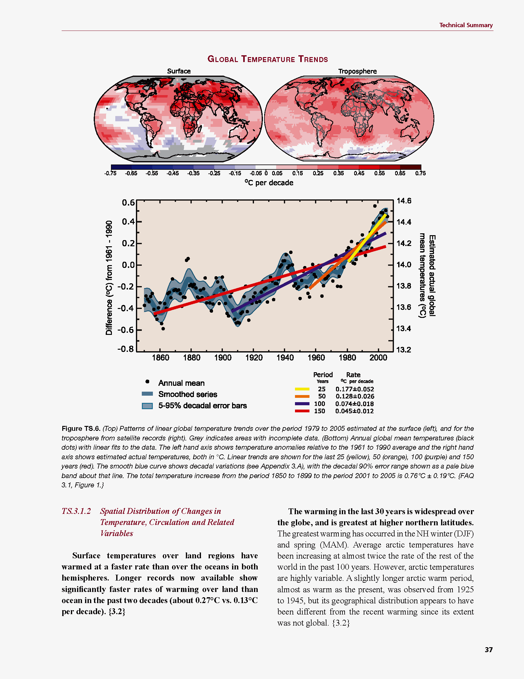
Common Myth #1
“Scientists are worried about climate change because it’s been warming up recently”

Slide 17

Common Myth #1
“Scientists are worried about climate change because it’s been warming up recently”
WRONG!
We’re worried because we know that when we add heat to things, they warm up

Slide 18
Climate Change Primer
Heat Budgets & Climate
Climate Sensitivity: The Past
Vulnerability
Solutions
Costs

Slide 19
Cause and Effect
Forcing
Watts per
square meter
Response
degrees
Celsius or F
Response
Sensitivity =
Forcing
degrees per Watt m⁻²

Slide 20

Learning from the Past
Geologic past
(100’s of millions of years)
Deglaciation analog
(18,000 years ago to preindustrial time)
Last Millennium analog
(Medieval Warm Period to Little Ice Age)
Modern Climate Record
(20th Century changes)
The further back we go, the less data we have to work with.
Using modern data, we have only brief transients to study.

Slide 21
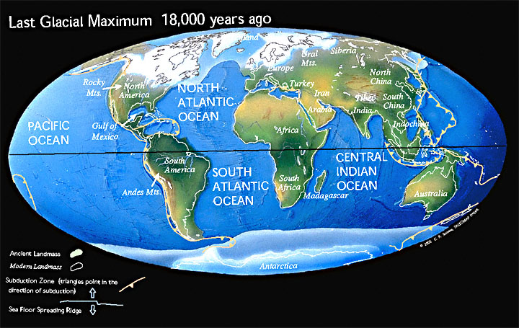
Ice Age World
High albedo
Low CO₂

Slide 22
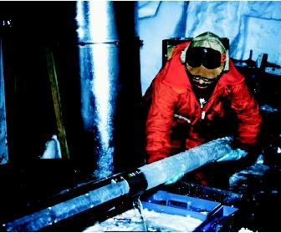
CO₂ and the Ice Ages
Over the past 420,000 years atmospheric CO₂ has varied between 180 and 280 ppm, beating in time with the last four glacial cycles
CO₂
370 ppm in 2000
ice
ice
ice
ice
Vostok (400k yr) Ice Core data (Petit et al, 1999)

Slide 23
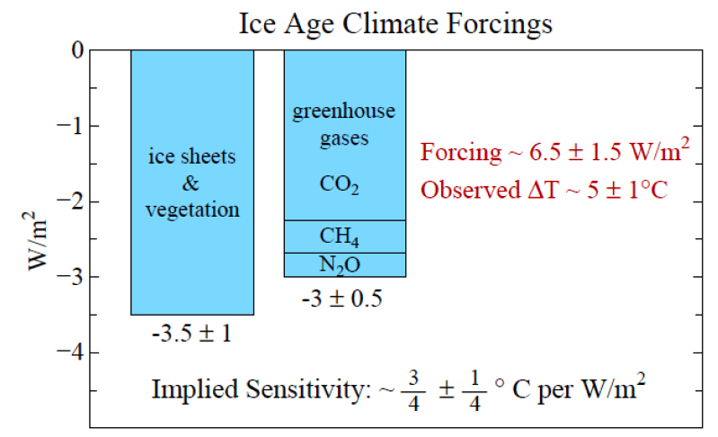
Climate Forcing
Source: Hansen and Sato (2011)

Slide 24
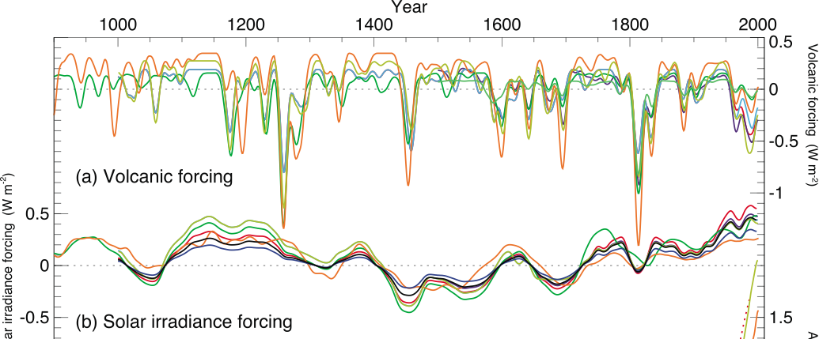
Reconstructed Climate Forcing Since 1000 AD
1816
1991
0.5
Pinatubo
Tambora
“year w/out
a summer”
1.0 W m⁻²
Volcanic particles scatter a lot of sunlight, but not for long
Solar radiation changes by just a little, over centuries

Slide 25

The Past 2000 Years
0.8 °C

Slide 26
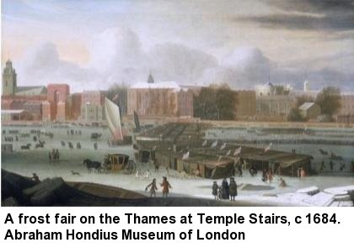
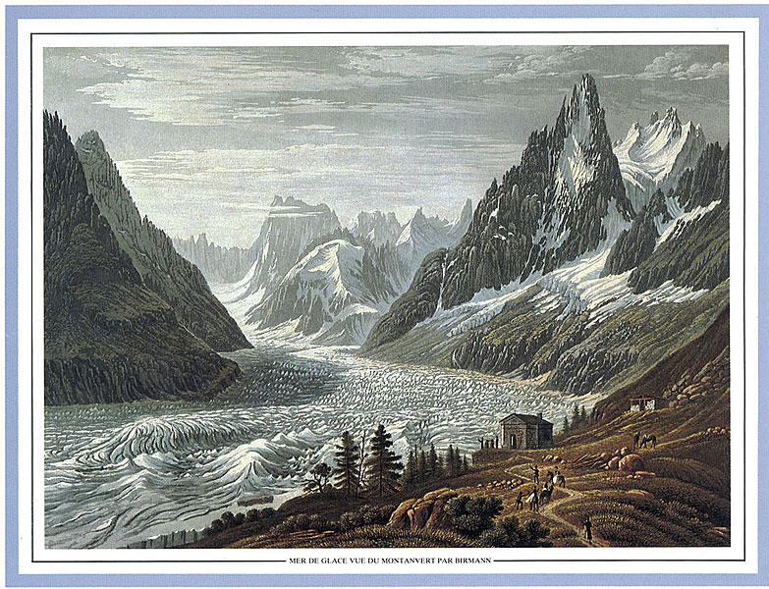
Second Millennium Analog
Cooling from Medieval Warm Period to
Little Ice Age ~ 0.8 °C
Solar forcing ~ 1.0 W m⁻²
(somewhat complicated
by volcanic forcing)
Total climate sensitivity
0.8 °C per (W m⁻²)
1826

Slide 27
Climate Sensitivity to enhanced CO₂
Volcanoes, Last Millennium, Deglaciation
all around 0.8 °C of warming per (W m⁻²)
Each doubling of CO₂
adds 4 Watts per square meter
So expect about
(4 W m⁻²) x (0.8 °C per (W m⁻²))
= 3 °C per doubling of CO₂

Slide 28
CO₂ and the Future
Over the past 420,000 years atmospheric CO₂ has varied between 180 and 280 parts per million, beating in time with the last four glacial cycles
Since the Industrial Revolution, CO₂ has risen very rapidly
If China & India develop using 19th Century technology, CO₂ will reach 1000 ppm in this century
CO₂
1000 ppm in 2100
400 ppm in 2014
ice
ice
ice
ice
Vostok (400k yr) Ice Core data (Petit et al, 1999)
You ain’t seen nothing yet!

Slide 29
Climate Change Primer
Heat Budgets & Climate
Climate Sensitivity: The Past
Vulnerability
Solutions
Costs

Slide 30


How much warmer?
Land vs ocean!
North vs South
Global mean
warming of 2º to 5º C
North American
warming of 3º to 6º C
= 5º to 11º F
Arctic warming of
8º to 14º F
Low
Emissions
Moderate
Emissions
High
Emissions
Rainfall? Agriculture?
Water supply? Ski industry?
Mass immigration?

Slide 31

Where is it 10°F Warmer
“on average?”
Denver ➔
Amarillo
Grand Junction ➔ Tucson
Illinois ➔
Mississippi
Water? Crops?
Real Estate? Health?

Slide 32
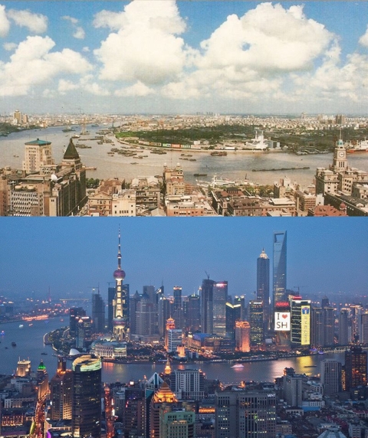
Shanghai, China 1990

Slide 33
Shanghai, China 2012

Slide 34
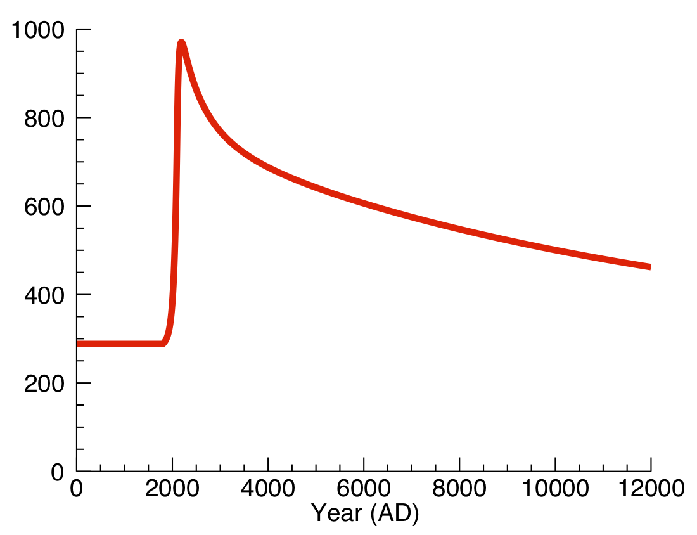
Common Myth #2
“When we reduce or stop the burning of fossil fuel, the CO₂ will go away and things will go back to normal”
CO₂ from fossil fuel will react with oceans, but only as fast as they “mix”
Eventually, fossil CO₂ will react with rocks
Much of the CO2 we emit now will stay in the air for many thousands of years!
CO2 (ppm)
you are
here
industrial
revolution

Slide 35
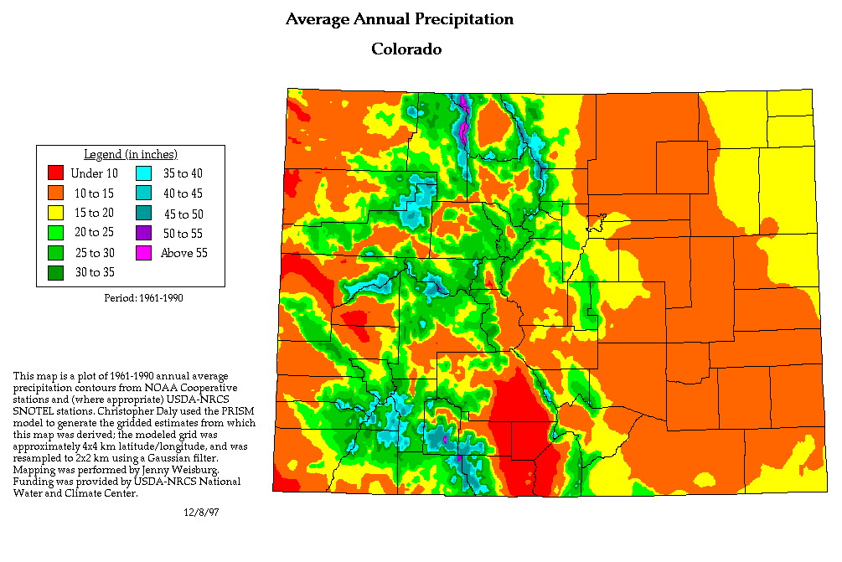
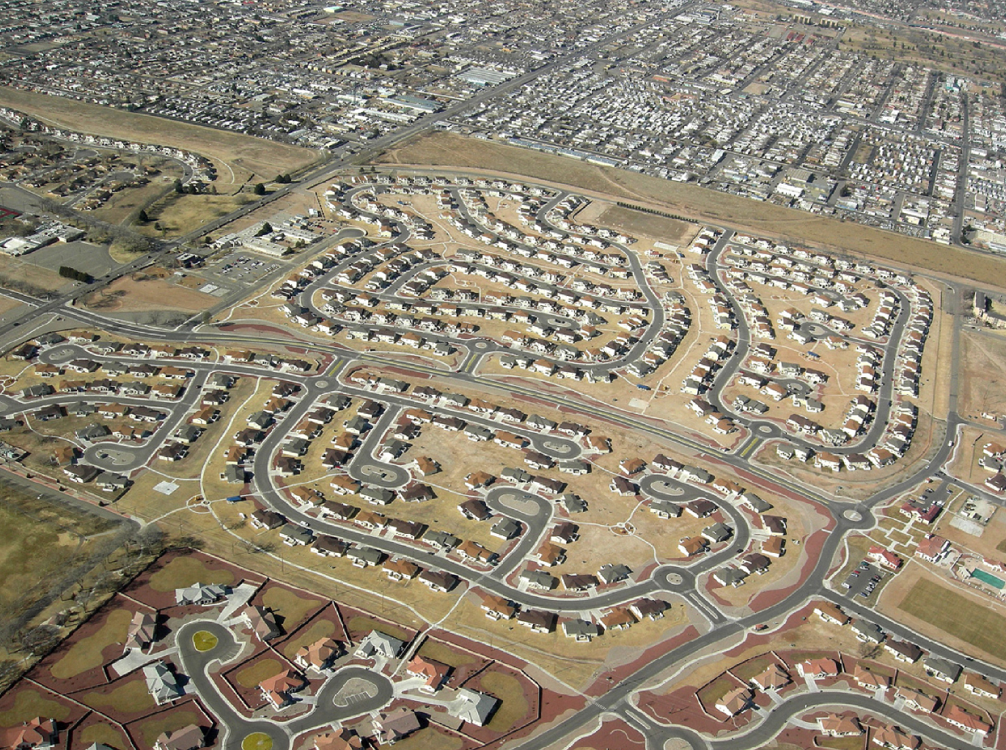
A Region On the Edge
Much of our region already receives only marginal precipitation
Just enough snow to support forests and reservoirs
Just enough irrigation water to support farming
Just enough water to support 5.1 million people

Slide 36
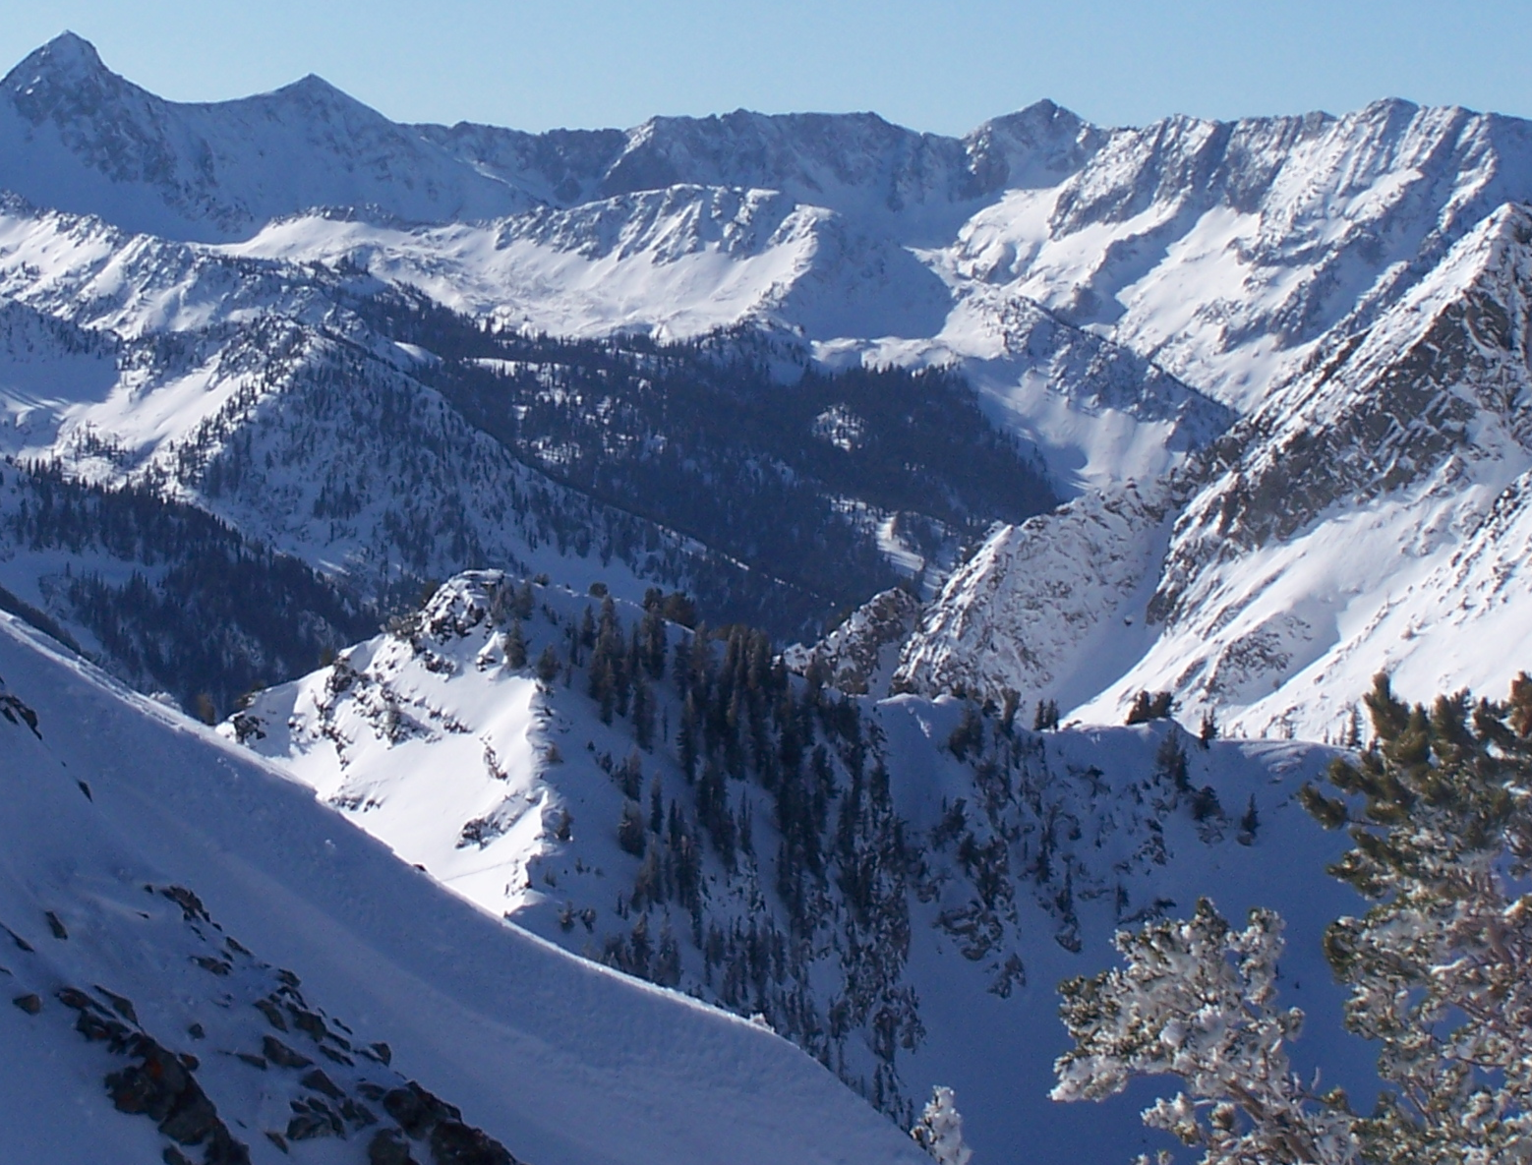
Snowpack

Slide 37
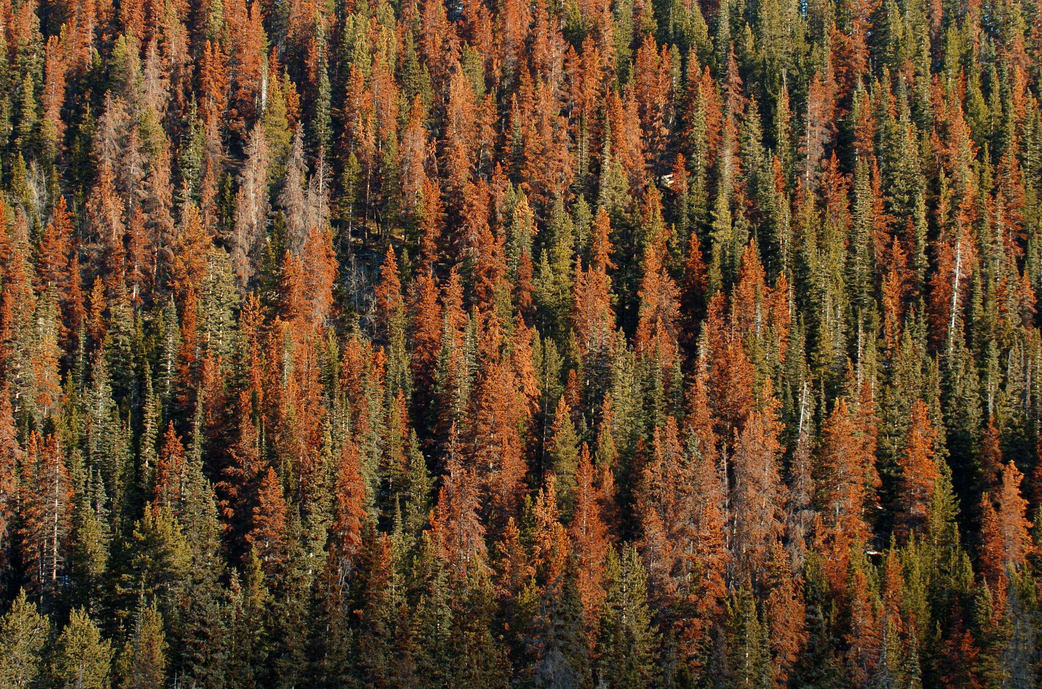
Insect Pests

Slide 38
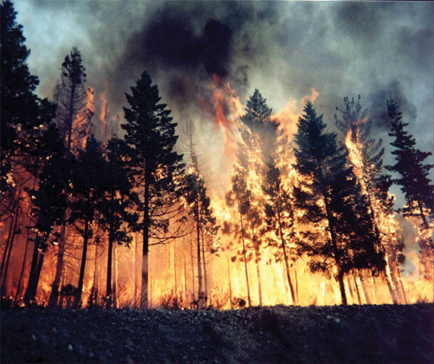
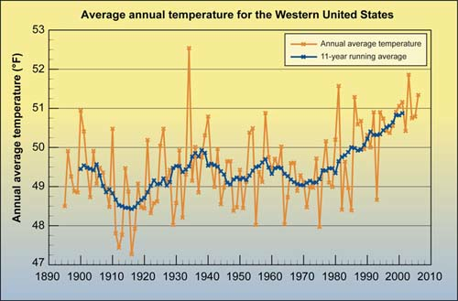
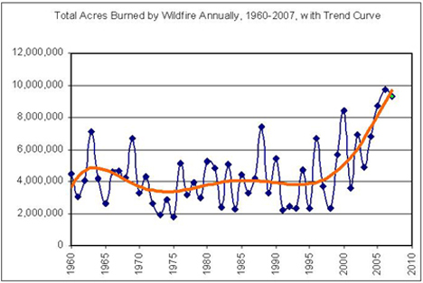
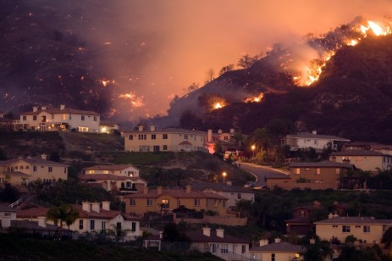
Western US Wildfires

Slide 39
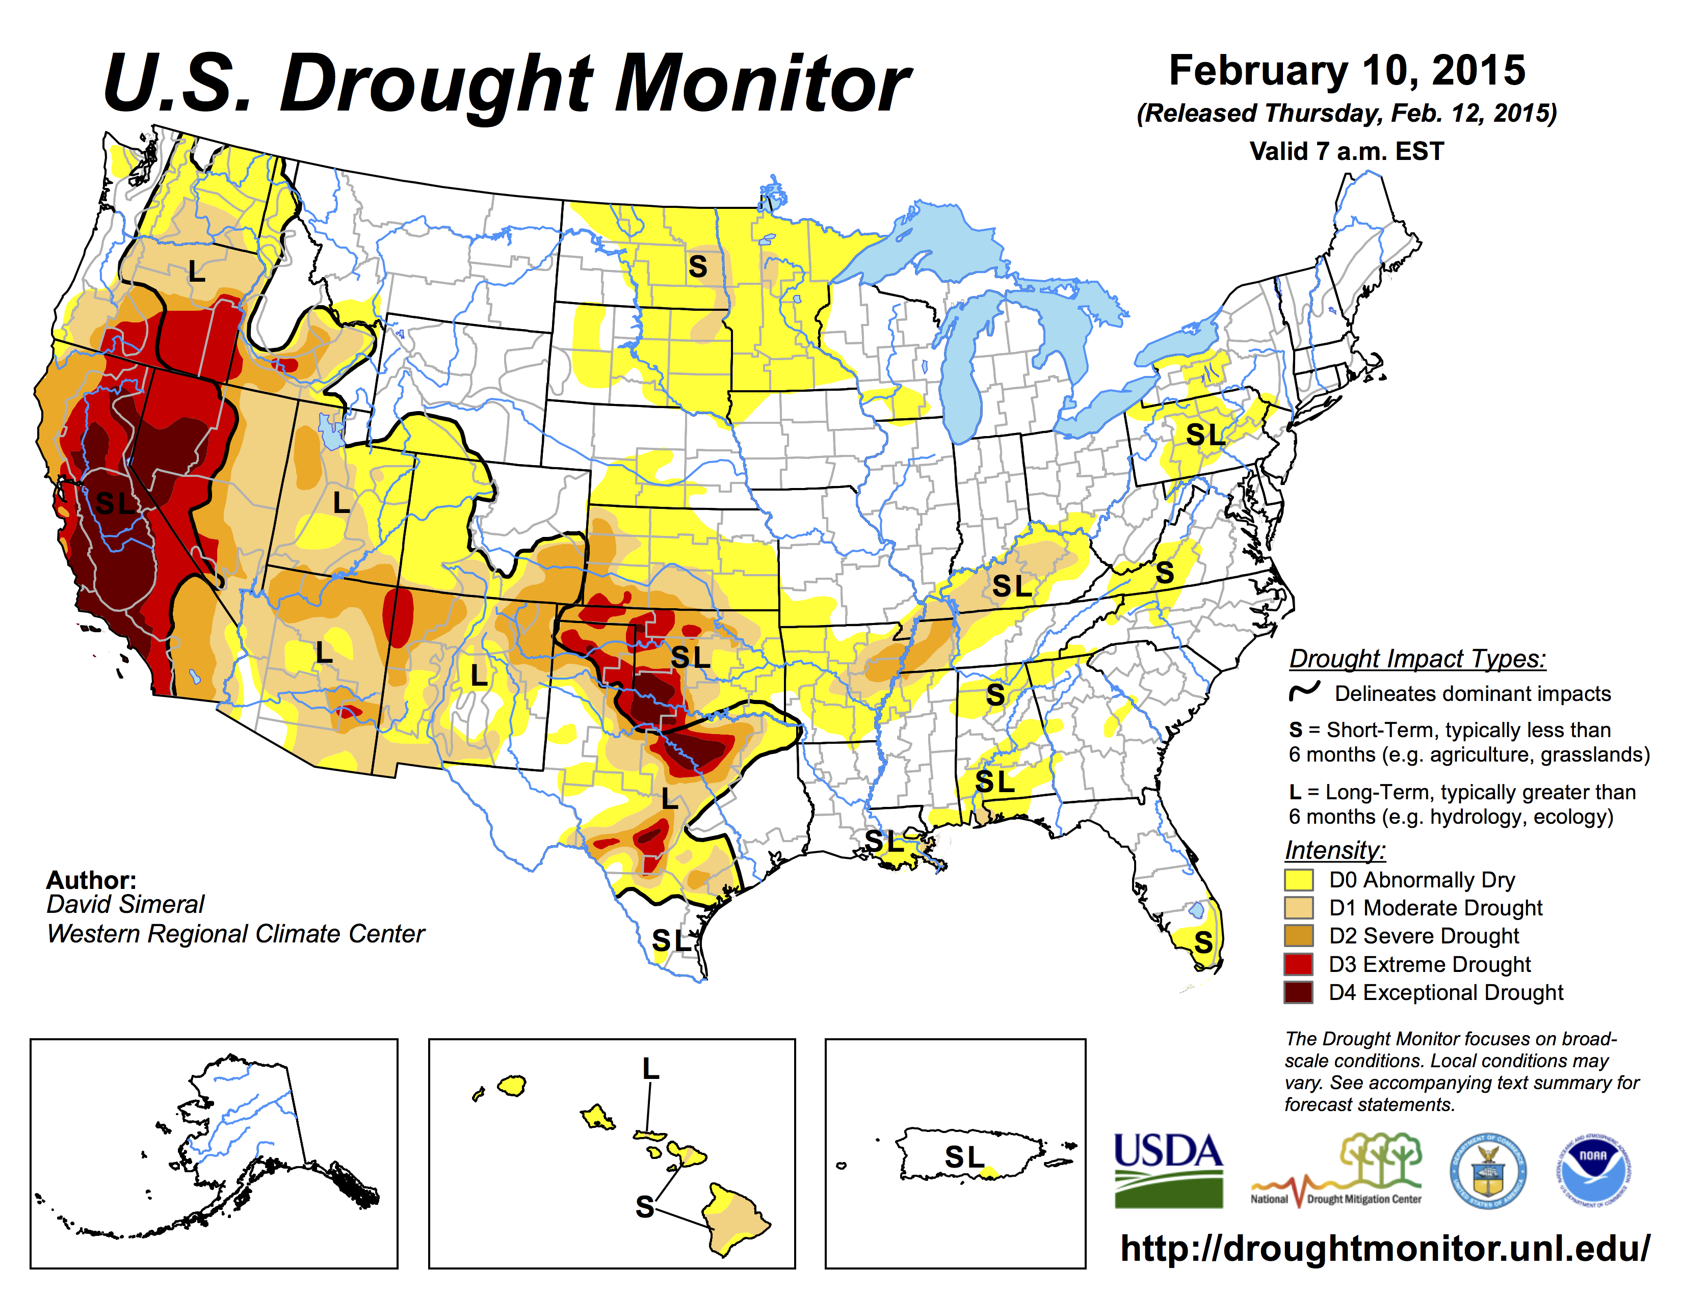

Slide 40
Economic Development
Urban water use in Colorado currently about 17% of total
Colorado projects 60% population growth by 2050, to 8 million
Combined with increased ET, this will produce tremendous pressure for increased diversion to cities

Slide 41
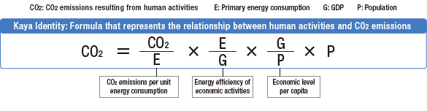

The “Kaya Identity”
Four factors determine future emissions:
  Population
  Economic activity
  Energy efficiency of economy
  Carbon efficiency of energy

Slide 42
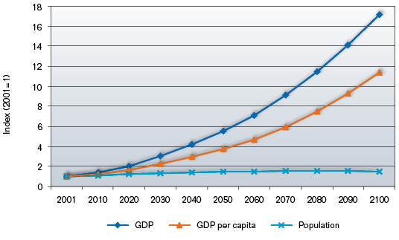
Population is not the driver of future climate!
UN Reference Scenarios
www.garnautreview.org.au
Population to grow by 40% in 100 years
Global economy to grow by 1600%
(assumes 2.8% annual GDP growth)

Slide 43

Fuel Uses in USA

Slide 44
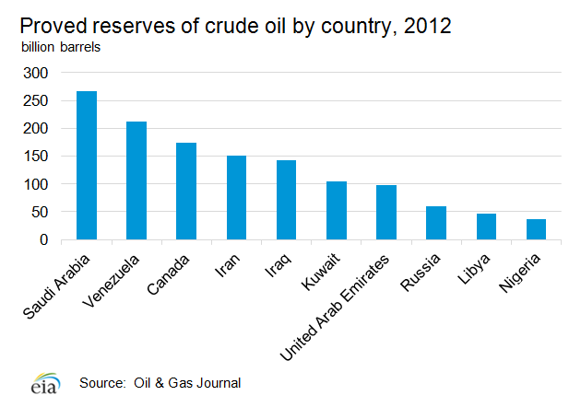
Consumption ~ 100 million bbl per year
Total Reserves ~ 120 years of consumption

Slide 45
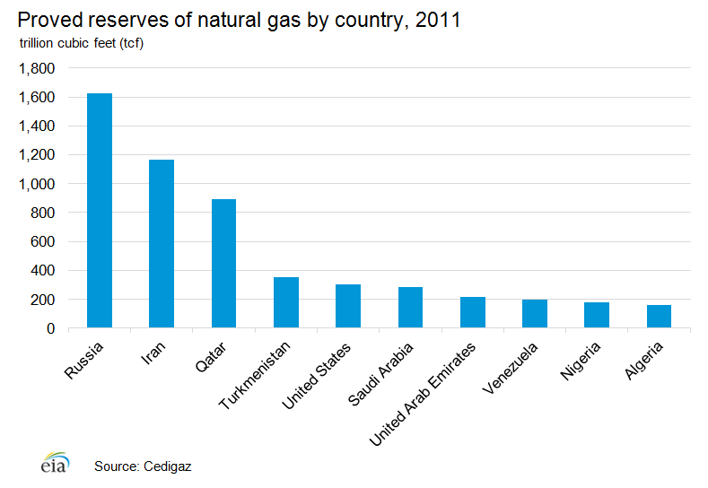
Consumption ~ 100 trillion ft³ per year
Total Reserves ~ 55 years of consumption

Slide 46
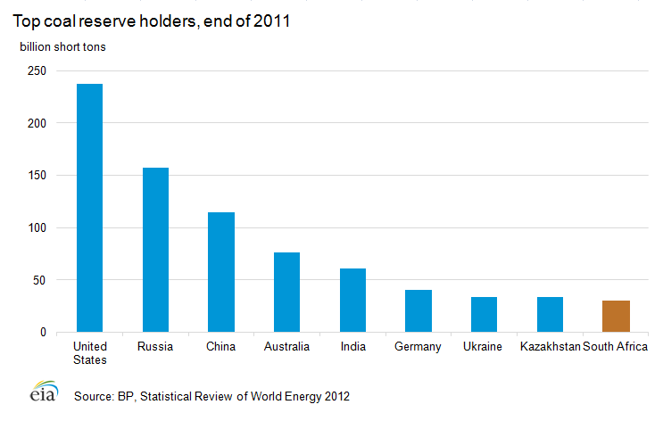
Consumption ~ 8 billion tons per year
Total Reserves ~ 100 years of consumption

Slide 47
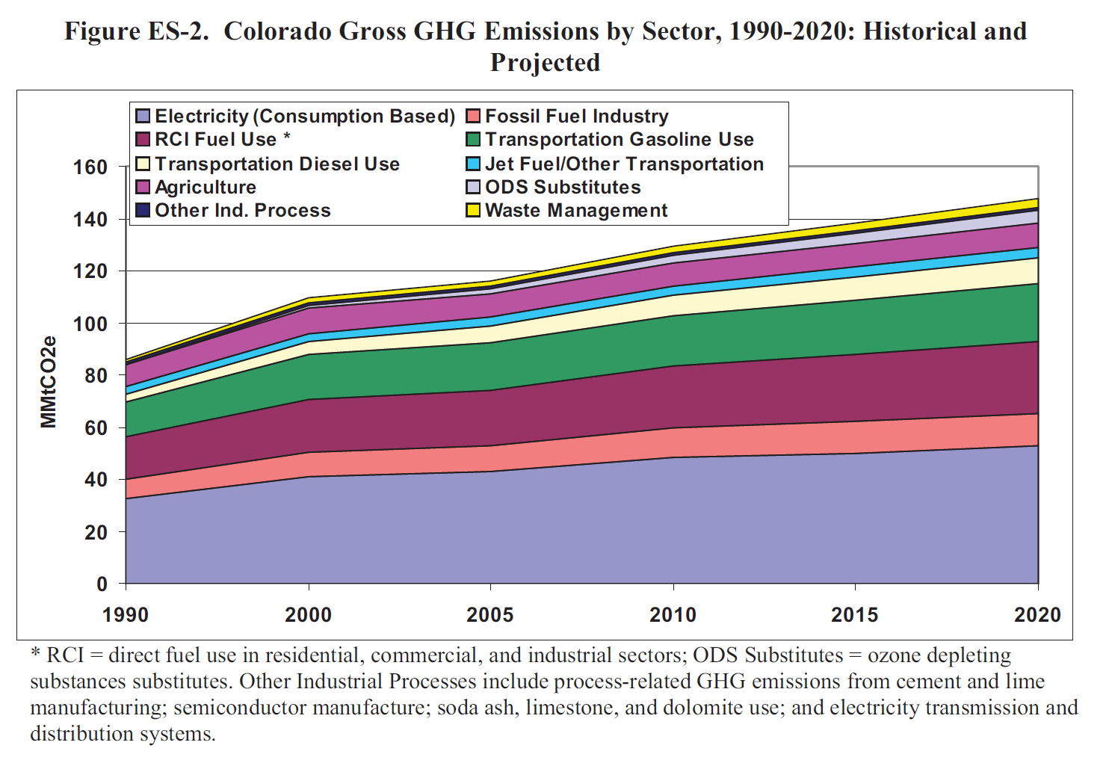
Center for Climate Strategies: http://www.coloradoclimate.org/ewebeditpro/items/O14F13894.pdf
Notes:
Assumes 20% RPS; new plants at 75% coal and 25% natural gas; generation grows at 2.5 – 2.0% annually; 125% credit toward RPS for CO-based RE; other assumptions.

Slide 48
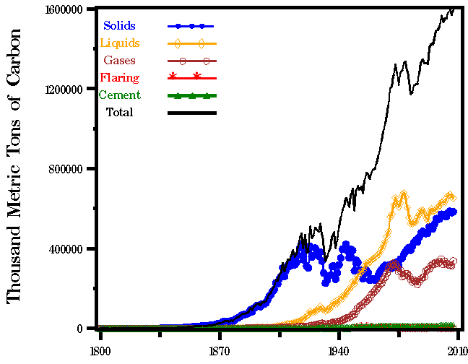
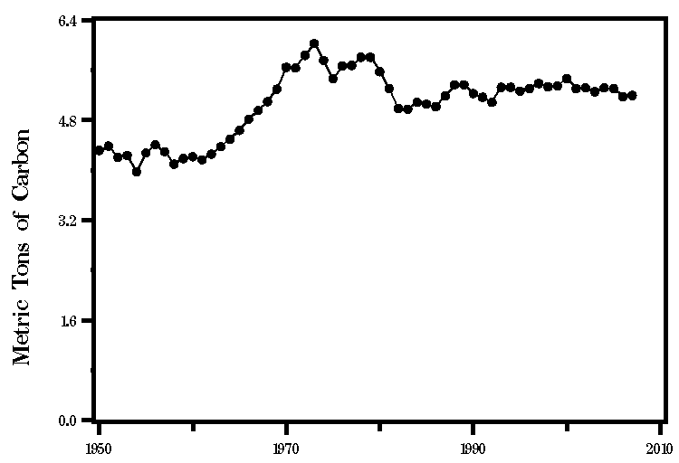
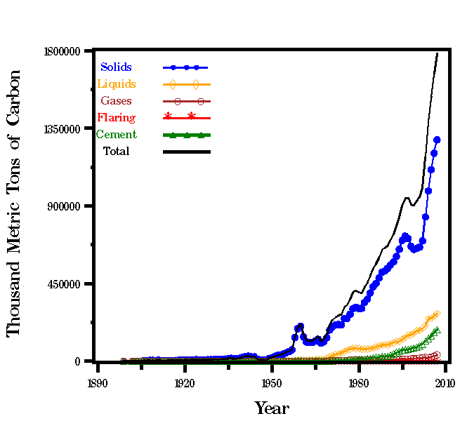
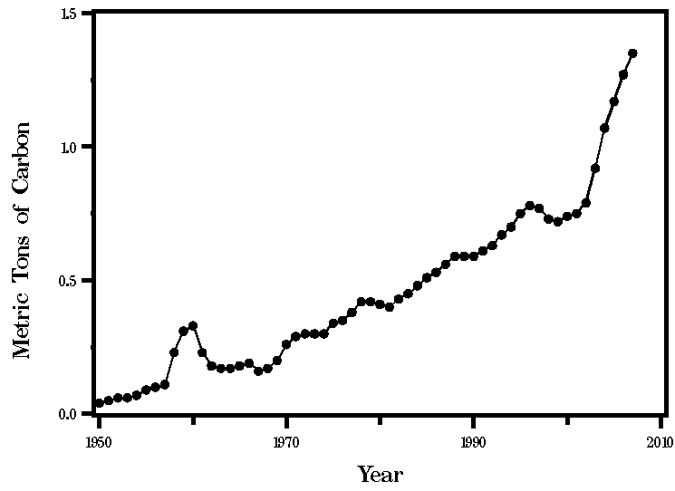
National Emissions
Total Emissions
Emissions per Person
USA
USA
China
China

Slide 49
Dramatic contrast – history versus future
Least Developed
Developing
India
China
Former Soviet
Other developed
Japan
Europe
USA
CO₂ emissions
Raupach et al. PNAS 2007

Slide 50
Climate Change Primer
Heat Budgets & Climate
Climate Sensitivity: The Past
Vulnerability
Solutions
Costs

Slide 51
Solutions
To provide a decent standard of living for billions of people on Earth
We must be able to generate huge amounts of energy without releasing CO2
This is definitely do-able
(as an engineering task) …
but expensive and politically difficult
Can’t do it by “tinkering around the edges”
Requires profound change to energy and economics

Slide 52

Historical Emissions
Billions of Tons Carbon Emitted per Year
16
8
Historical
emissions
0
1950
2000
2050
2100
Notes:
52

Slide 53
The “Stabilization Triangle”
Billions of Tons Carbon Emitted per Year
16
Current path = “ramp”
Stabilization Triangle
Interim Goal
8
Historical
emissions
Flat path
1.6
0
1950
2000
2050
2100
Notes:
53

Slide 54
“Stabilization Wedges”
Billions of Tons Carbon Emitted per Year
16 GtC/y
16
Current path = “ramp”
Eight “wedges”
Goal: In 50 years, same
global emissions as today
8
Historical
emissions
Flat path
1.6
0
1950
2000
2050
2100
http://www.princeton.edu/wedges/
Notes:
54

Slide 55
What is a “Wedge”?
A “wedge” is a strategy to reduce carbon emissions that grows in 50 years from zero to 1.0 GtC/yr. The strategy has already been commercialized at scale somewhere.
1 GtC/yr
Total = 25 Gigatons carbon
50 years
  Cumulatively, a wedge redirects the flow of 25 GtC in its first 50 years. This is 2.5 trillion dollars at $100/tC.
A “solution” to the CO₂ problem should provide at least one wedge.

Slide 56
15 Wedges in 4 Categories
Energy Efficiency &
Conservation (4)
16 GtC/y
Fuel Switching
(1)
Renewable Fuels
& Electricity (4)
Stabilization
Stabilization
Triangle
Triangle
CO₂ Capture
& Storage (3)
8 GtC/y
Forest and Soil Storage (2)
2007
2057
Nuclear Fission (1)
http://www.princeton.edu/wedges/
Notes:
56

Slide 57
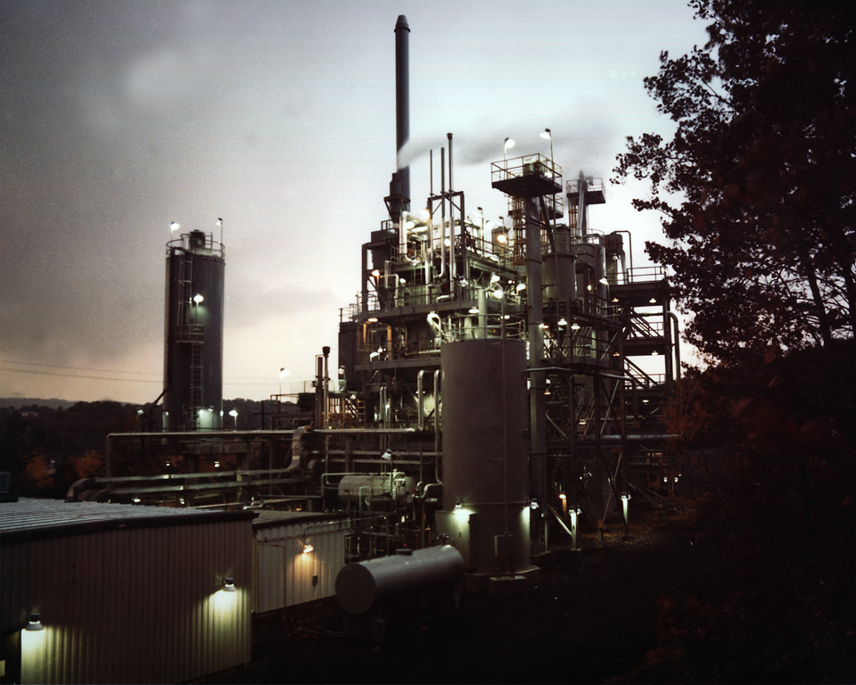
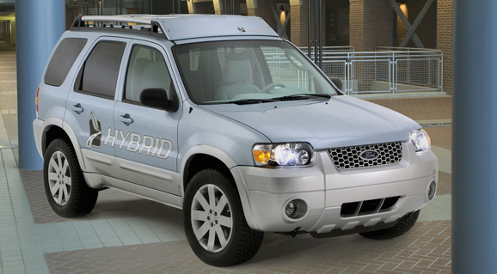
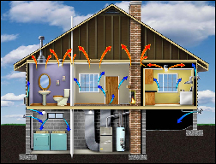
Efficiency
Photos courtesy of Ford Motor Co., DOE, EPA
Produce today’s electric capacity with double today’s efficiency
Double the fuel efficiency of the world’s cars or halve miles traveled
Average coal plant efficiency is 32% today
Use best efficiency practices in all residential and commercial buildings
There are about 600 million cars today, with 2 billion projected for 2061
Replacing all the world’s incandescent bulbs with CFL’s would provide 1/4 of one wedge
Notes:
“E,T, H” = can be applied to electric, transport, or heating sectors, $=rough indication of cost (on a scale of $ to $$$)

Slide 58
Energy Efficiency

Slide 59


Efficient Architects!
$4.5 TRILLION
Source

Slide 60
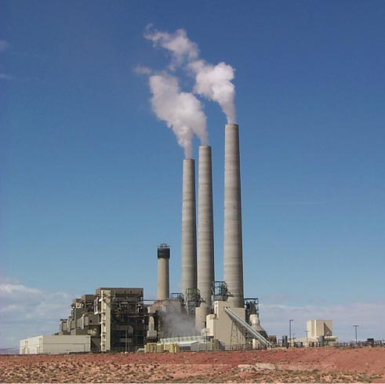
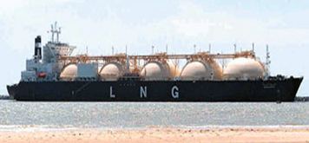
Fuel Switching
Photo by J.C. Willett (U.S. Geological Survey).
Substitute 1400 natural gas electric plants for an equal number of coal-fired facilities
A wedge requires an amount of natural gas equal to that used for all purposes today
Notes:
“E,H” = can be applied to electric or heating sectors, $=rough indication of cost (on a scale of $ to $$$)
Effort needed for 1 wedge:
Build 1400 GW of capacity powered by natural gas instead of coal (60% of current fossil fuel electric capacity)
Requires an amount of natural gas equal to that used for all purposes today
So a slice is 50 LNG tanker discharges/day by 2054 @200,000 m3/tanker, or
one new “Alaska” pipeline/year @ 4 Bscfd.
Detailed Description: NATURAL GAS TURBINES ARE BEING DEVELOPED TO PRODUCE ELECTRICITY IN A SIMPLE, LOW COST ENVIRONMENTALLY FRIENDLY WAY. DOE'S NATIONAL ENERGY TECHNOLOGY LABORATORY (NETL) INITIATED THE ADVANCED TURBINE SYSTEMS (ATS) PROGRAM AND HAS PARTNERED WITH INDUSTRY TO PRODUCE A NEW GENERATION OF HIGH EFFICIENCY GAS TURBINES FOR CENTRAL STATION ELECTRICITY PRODUCTION, USING CLEAN BURNING NATURAL GAS.
700 1-GW baseload coal plants (5400 TWh/y) emit 1 GtC/y.
Natural gas: 1 GtC/y = 190 Bscfd
Yr 2000 electricity:
Coal : 6000 TWh/y; Natural gas: 2700 TWh/y.

Slide 61
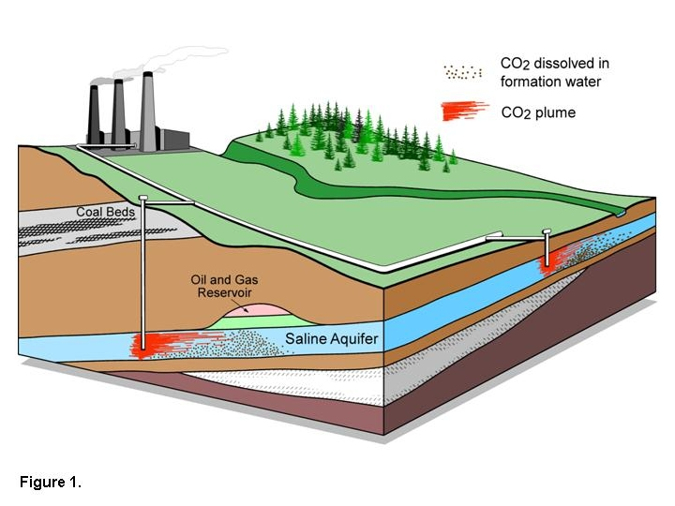
Carbon Capture & Storage
Implement CCS at
800 GW coal electric plants or
1600 GW natural gas electric plants or
180 coal synfuels plants or
10 times today’s capacity of hydrogen plants
Graphic courtesy of Alberta Geological Survey
There are currently three storage projects that each inject
1 million tons of CO₂ per year – by 2061 we’d need 3500.
Notes:
“E,T, H” = can be applied to electric, transport, or heating sectors, $=rough indication of cost (on a scale of $ to $$$)

Slide 62
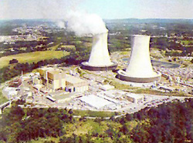
Triple the world’s nuclear electricity capacity by 2061
Nuclear Electricity
Graphic courtesy of NRC
The rate of installation required for a wedge from electricity is equal to the global rate of nuclear expansion from 1975-1990.
Notes:
“E” = can be applied to electric sector, $$=rough indication of cost (on a scale of $ to $$$)
Plutonium (Pu) production by 2054, if fuel cycles are unchanged: 4000 t Pu (and another 4000 t Pu if current capacity is continued).
Compare with ~ 1000 t Pu in all current spent fuel, ~ 100 t Pu in all U.S. weapons.
5 kg ~ Pu critical mass.

Slide 63
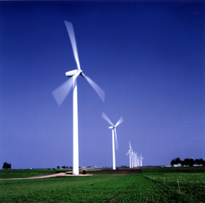
Wind Electricity
Install 1 million 2 MW windmills to replace coal-based electricity,
OR
Use 2 million windmills to produce hydrogen fuel
Photo courtesy of DOE
A wedge worth of wind electricity will require increasing current capacity by a factor of 30
Notes:
“E,T, H” = can be applied to electric, transport, or heating sectors, $-$$=rough indication of cost (on a scale of $ to $$$)

Slide 64
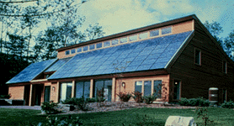
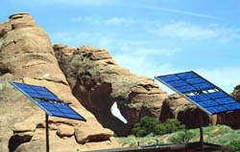
Solar Electricity
Install 20,000 square kilometers for dedicated use by 2054
Photos courtesy of DOE Photovoltaics Program
A wedge of solar electricity would mean increasing current capacity 700 times
Notes:
“E” = can be applied to electric sector, $$$=rough indication of cost (on a scale of $ to $$$)

Slide 65
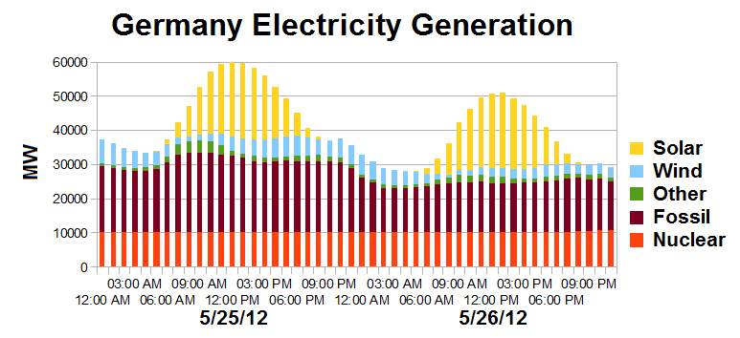
Solar Resource
US vs Germany

Slide 66

Biofuels
Scale up current global ethanol production by 30 times
Using current practices, one wedge requires planting an area the size of India with biofuels crops
T, H / $$
Photo courtesy of NREL
Notes:
“T, H” = can be applied to transport or heating sectors, $$=rough indication of cost (on a scale of $ to $$$)

Slide 67
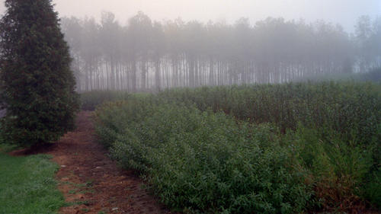
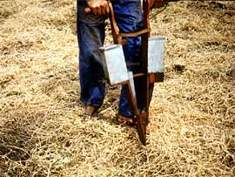
Eliminate tropical deforestation
OR
Plant new forests over an area the size of the USA
OR
Use conservation tillage on all cropland
Natural Sinks
Conservation tillage is currently practiced on less than 10% of global cropland
B / $
Photos courtesy of NREL, SUNY Stonybrook, United Nations FAO
Notes:
“B” = biostorage sector, $=rough indication of cost (on a scale of $ to $$$)

Slide 68

Wedges Summary
For stabilization of emissions
(not CO₂) pick any 8 of these 15

Slide 69
Climate Change Primer
Heat Budgets & Climate
Climate Sensitivity: The Past
Vulnerability
Solutions
Costs

Slide 70

Costs
Conversion to 100% noncarbon energy will cost about
1% of GDP
That’s about what it cost to retrofit all the world’s cities with indoor plumbing a century ago …
It was worth it!

Slide 71

Costs
Conversion to 100% noncarbon energy will cost about
1% of GDP
That’s about what it cost to retrofit all the world’s cities with indoor plumbing a century ago …
It was worth it!

Slide 72
Solar Resource
US vs Germany

Slide 73
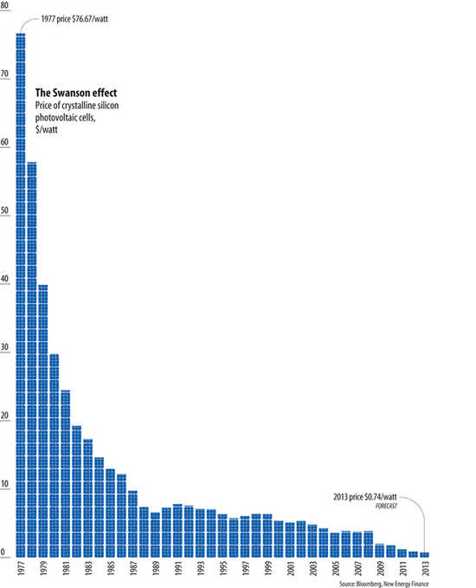
Price of Solar PV Cells
$/watt
Price per watt has fallen by 99% since I graduated from high school
Fallen 80% since 2008
Now close to parity with coal or gas
Drop in 1980s
Flatter in1990s

Slide 74
Costs & Benefits
McKinsey & Company (2009)
Height of each bar is cost per ton of CO2
Width of each bar is emissions reduction
Balance positive and negative areas

Slide 75
Imagine it’s 1800, and you’re in charge …
Somebody presents you with a grand idea for transforming the world economy:
  Dig 8 billion tons of carbon out of the ground every year
  Build a system of pipelines, supertankers, railroads, highways, and trucks to deliver it to every street corner on the planet
  Build millions of cars every year, and millions of miles of roads to drive them on
  Generate and pipe enough electricity to every house to power lights & stereos & plasma TVs

Slide 76

Imagine it’s 1800, and you’re in charge …
Somebody presents you with a grand idea for transforming the world economy:
  Dig 8 billion tons of carbon out of the ground every year
  Build a system of pipelines, supertankers, railroads, highways, and trucks to deliver it to every street corner on the planet
  Build millions of cars every year, and millions of miles of roads to drive them on
  Generate and pipe enough electricity to every house to power lights & stereos & plasma TVs
… “and here’s the itemized bill …”

Slide 77
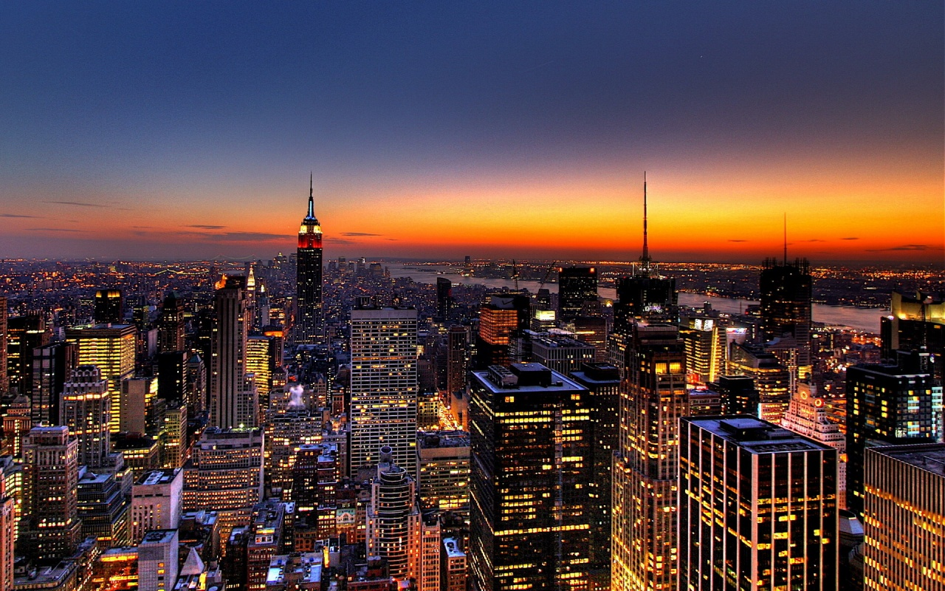
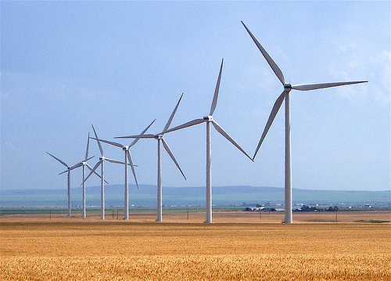
Who Built That?
Our ancestors built that very system
It cost them every dime of global GDP for 200 years (now $72T/yr)
It created every dime too!
Now our kids get to
do it again!

Slide 78
Free Market Solutions
A new industrial revolution won’t happen because people want to “do the right thing”
The government can’t just pass a law and create a new global energy economy, any more than they could 200 years ago
If low-carbon-footprint goods and services cost less than “dirtier” ones,
people will buy them
Role of policy is to set incentives and
then get out of the way

Slide 79
Choose Your Future
Some people say:
  “Modern wealth is due to the subsidy of cheap fossil fuel. When we stop burning coal we’ll freeze in the dark!”
I prefer:
  “Modern wealth results from ingenuity and hard work. Before we run out of oil, we’ll invent energy technologies for the 21st Century.
  Our future is bright.”

