Slide 1

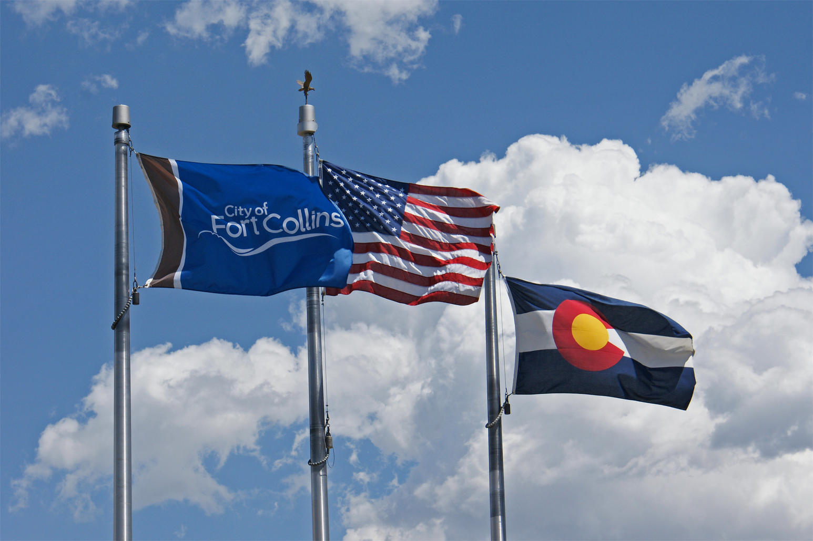

Climate Action Plan Process
April 29, 2015
Lucinda Smith
Notes:
To switch the image, click on the flag pic and delete it. Insert or paste another picture (Please note: too low of resolution and it will not look very good, too much and the file size will get very large) and then send it to back so that it goes behind the header and footer.

Slide 2
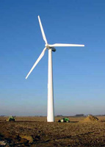

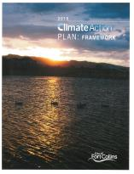
1998
1999
2000
2003
2008
2009
2015
Fort Collins Climate Action Leadership
Local
Action
Plan
Energy
Policy
Energy
Policy
Climate
Wise
formed
1st Volun-
tary
Wind
Program
Climate
Action
Plan
Climate
Action
Plan
Framework
2
Notes:
FC was first in Colorado to offer voluntary wind subscription in 1998
2003 energy policy set a renewable energy goal; was focused n operation of the electric utility
2009 Energy Policy acknowledged the role of carbon and GHG (and therefore nat gas) in energy policy
2015 Energy policy has expanded the definition of energy to elec, nat gas and transp (all usable forms of energy)

Slide 3
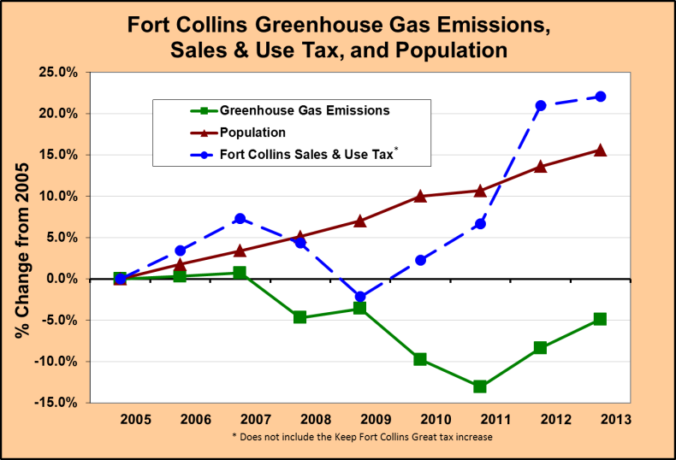
2013 Progress
3
3

Slide 4
Support for Local Economy
Energy Policy programs saved $31M during 2013
ClimateWise partners saved $15 million in 2013 alone,
over $83 million since the program began in 2000
• FortZED - testing and demonstrating new technologies,
supporting innovative businesses, and securing outside
grant funding
Waste Diversion – Jobs per 10,000 tons of discards
    Landfilling – 1 job
    Recycling - 10 jobs
    Reuse - 75-250 jobs
Source: Institute for Local Self-Reliance
4

Slide 5
What have we learned…. (Feb 2014)
          All scenarios are transformative
          It’s technically possible to be much more aspirational in goals (acceleration) – RMI
          Efficiency can largely offset expected growth
          Energy supply resources must be changed
          Long term benefits outweigh costs
          - Increased near-term investment needed
          - Invest now for long term payback
          A leadership position brings resources to accomplish the goals
5

Slide 6
April 2014 City Council Direction
Fort Collins is well-positioned to demonstrate to other communities how deep reductions in greenhouse gas emissions can be made within the span of several decades while remaining economically vibrant.
….describe the steps the Fort Collins community will need to take to achieve a community-wide greenhouse gas emissions reduction *goal of
20% by the year 2020
80% by the year 2030
100% by the year 2050 – carbon neutrality
*Goal reductions relative to 2005 levels
6

Slide 7

Resources
Community
Citizen Advisory Committee
Council Advisory Boards
Public / Stakeholders
Subject Matter Experts
Citizen Advisory Committee
Local & National experts
Consultants
Brendle Group
Rocky Mountain Institute
Platte River Power Authority
7

Slide 8
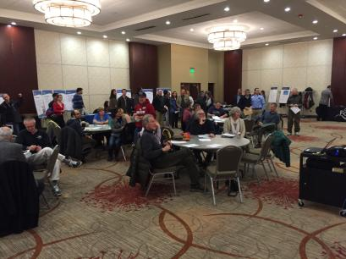
Public Engagement
15 stakeholder groups
8 City Council Advisory Boards
Three public open houses
Web comment opportunity
8

Slide 9
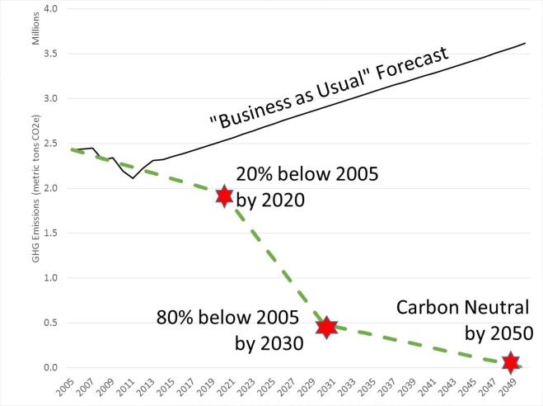
Community GHG Goals
(Adopted March 2015)
9
Notes:
Note: 2020 goal will be challenging for us to meet, but can’t be called “aspirational”. Many cities across the county have this goal and some cites have met it (
No US city has an 80% by 2030 goal that I am aware of
A few cities in the world have carbon neutral goal by 2050, including Seattle.
Vancouver BC has a goal to have 100% renewable energy within 20 years 2035
Burlington, Vermont, the state's largest city, recently became the first in the country to use 100 percent renewable energy for its residents' electricity needs.
CSU has a carbon neural goal

Slide 10

2015 CAP Framework
Climate Action Plan (CAP)
Framework
High level strategic plan
Requires periodic updates
Each action requires further analysis and vetting
10

Slide 11
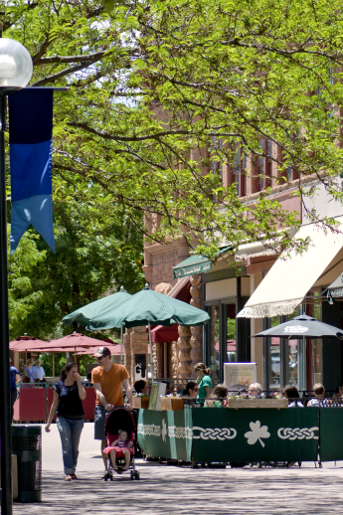
Climate Action Plan Framework
Strategies
BUILDINGS
(71% of emissions)
TRANSPORTATION
(25% of emissions)
ENERGY SUPPLY
ROAD TO ZERO WASTE
(3% of emissions)
11
11
11

Slide 12
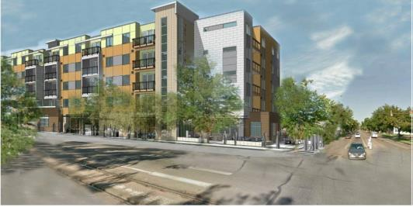
BUILDINGS
NEW Buildings
Drive incrementally downward to net zero energy
EXISTING Buildings
Increase efficiency of existing buildings (codes, incentives)
12
12
12

Slide 13
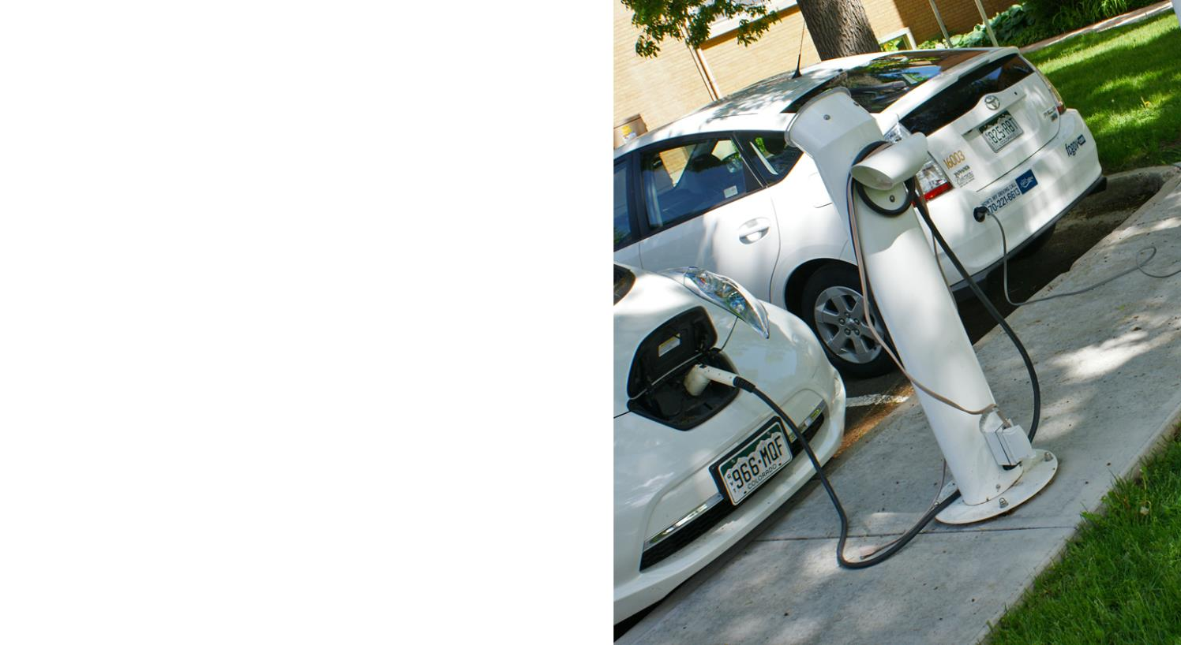
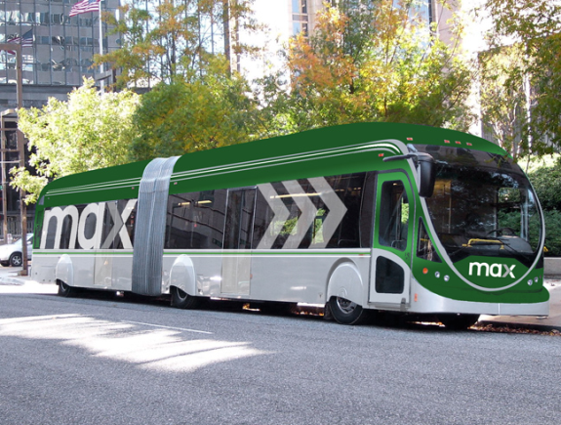
TRANSPORTATION
More Fuel Efficient & Electric Vehicles
Increase Multi-Modal Transportation
13
13
13
13
13

Slide 14

Energy Supply
ENERGY SUPPLY
Advance Utility Scale Renewable Energy Supply
Advance Residential and Commercial Solar Adoption
Shift Heating Loads to Biofuels, Geothermal, and Electrification
14
14
14
14

Slide 15
Platte River
Current Wind and Solar Supply Trend
Total Carbon Free – 32%
19% Hydro
11% Wind
2% Solar
Source: Transitions
15
15
15

Slide 16
2015 CAP Framework:
Preliminary Costs /Savings Estimates
* Note important caveats
16

Slide 17
Preliminary Costs/Saving Caveats
Cost Analysis Still Needed
Energy storage options
Infrastructure enhancements
Stranded assets
Analysis does not consider indirect economic benefits
Improved health
Job creation
Increased resiliency
17
17
17

Slide 18
Potential Financing Approaches
Municipal financing
Direct borrowing
New revenue streams
Vendor financing
Public-private partnerships
Federal funding program / grant monies
Create “Green Bank” to co-fund investments
Foundation/not-for-profits pool of capital
Sales of advertising/naming rights
Venture fund
Carbon tax or fee
18
18
18
18

Slide 19
Contacts
        Lucinda Smith Lisa Rosintoski
        Environmental Services Dir. Utilities Customer Connections Mgr.
        970-224-6085 970-416-2432
        lsmith@fcgov.com lrosintoski@fcgov.com
        fcgov.com/climateprotection
        fcgov.com/utilities
19

