Slide 1
“I’m Not a Warmist!” Effective Engagement of Difficult Audiences about Climate Change
Scott Denning
Director of Education, CMMAP
Atmospheric Science, CSU
Download a copy of this presentation @AirScottDenning

Slide 2
What Doesn’t Work
Deniers are a fringe group … ignore them
Data deluge – bury the audience with graphs, numbers
Argument from authority: credentials, consensus
Messages of fear, alarm
Point-by-point refutation of details

Slide 3
What Works Better
Emphasize the basics –
argue from personal experience, not from authority
Recognize that opposition is ideological
(not scientific). Ideas deserve respect.
Be human, passionate, authentic
Personal anecdotes, humor, a light touch
Be optimistic
Don’t sell sacrifice & doom
Stick to your message –
Don’t get sucked off into the weeds

Slide 4
Climate Change Simple, Serious, Solvable
You learned this science by 5th grade
Not based on computer models
Consequences are unacceptable
A message of hope

Slide 5
Simple

Slide 6
Ever Wonder Why?
Day is warmer than night
Summer is warmer than winter
Phoenix is warmer than Fargo

Slide 7
Heat Budgets
Heat in
Heat in
Heat out
Heat out

Slide 8
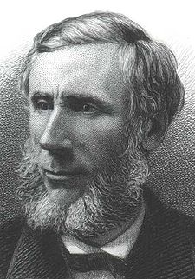
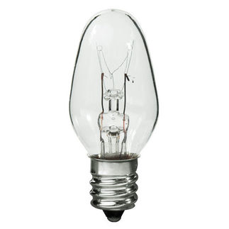
Common Sense
1 m
Doubling CO₂ would add 4 watts to every square meter of the surface of the Earth, 24/7
Doing that would make the surface warmer
This was known before light bulbs were invented!
4 Watts
1 m
John Tyndall, January 1863

Slide 9
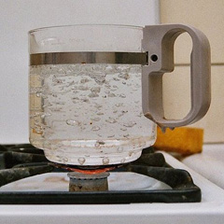
Common Myth #1
“Scientists expect a warmer future because it’s been warming up recently”
WRONG!
It’s because we know that when we add heat to things, they warm up

Slide 10
Serious

Slide 11
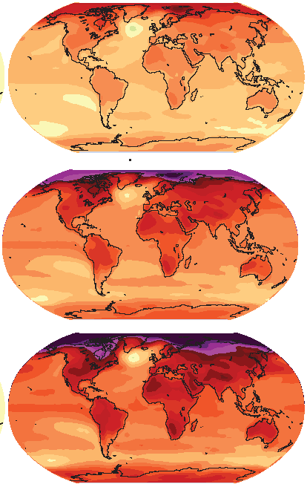
How much warmer?
Low
Emissions
Land vs ocean!
North vs South
Global mean warming of 2º to 5º C
North American warming of 3º to 6º C
= 5º to 11º F
Moderate
Emissions
High
Emissions
RULE OF THUMB:
Global Warming (Celsius)
x 1.6 (USA) x 1.8 = Fahrenheit

Slide 12
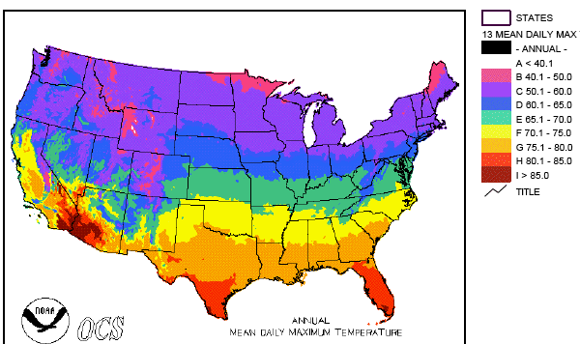
Where is it 10°F Warmer?
“on average?”
Denver ➔ Amarillo
Illinois ➔ Mississippi
Washington➔ Tallahassee
Water? Crops? Real Estate? Health?

Slide 13
World Needs to Hear from You!
In the marketplace of ideas, a rich debate on solutions is critical
Where are the free-market voices?
Political right has been AWOL
Without your solutions, you endorse “Capitalism vs the Climate”

Slide 14
Solvable

Slide 15
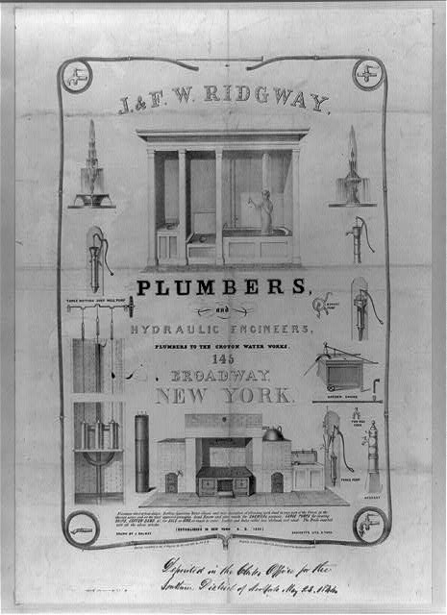
Costs
Conversion to 100% noncarbon energy will cost about 1% of GDP
That’s about what it cost to retrofit all the world’s cities with indoor plumbing a century ago …
It was worth it!

Slide 16
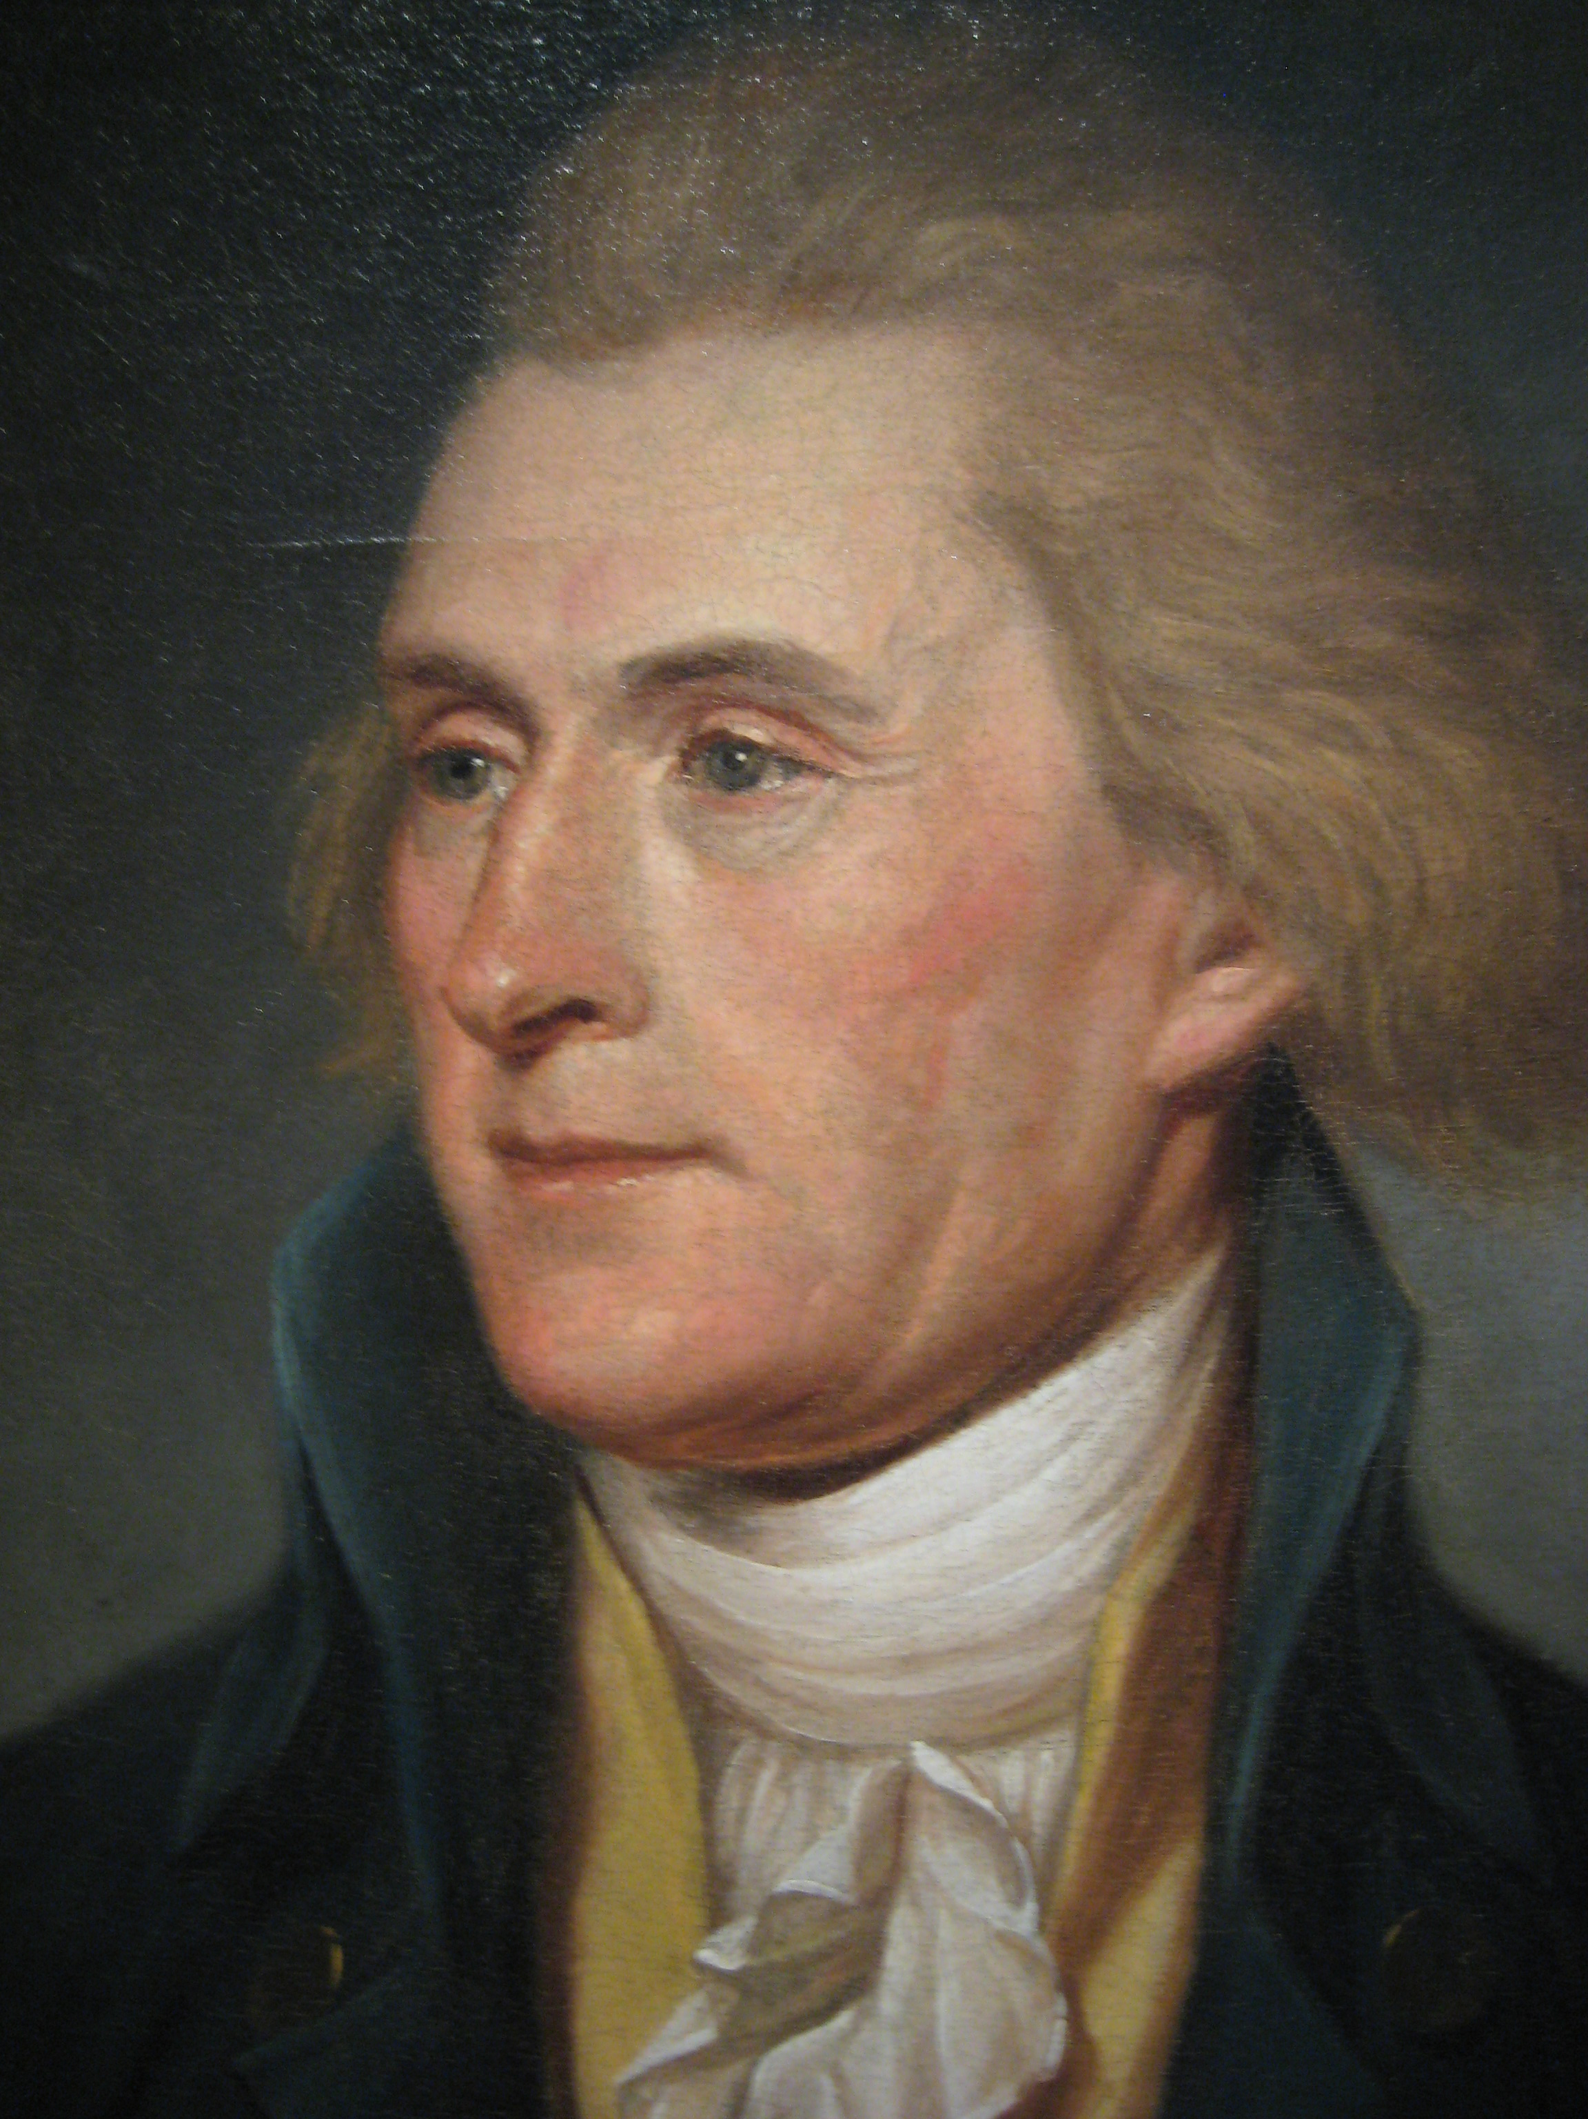
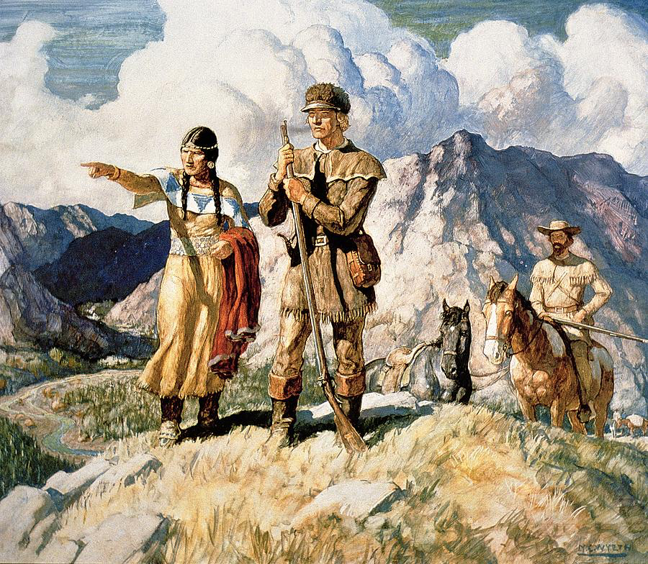
Imagine it’s 1800 …
Lewis and Clarke with Sacajawea
President Thomas Jefferson

Slide 17
Imagine it’s 1800 …

Slide 18
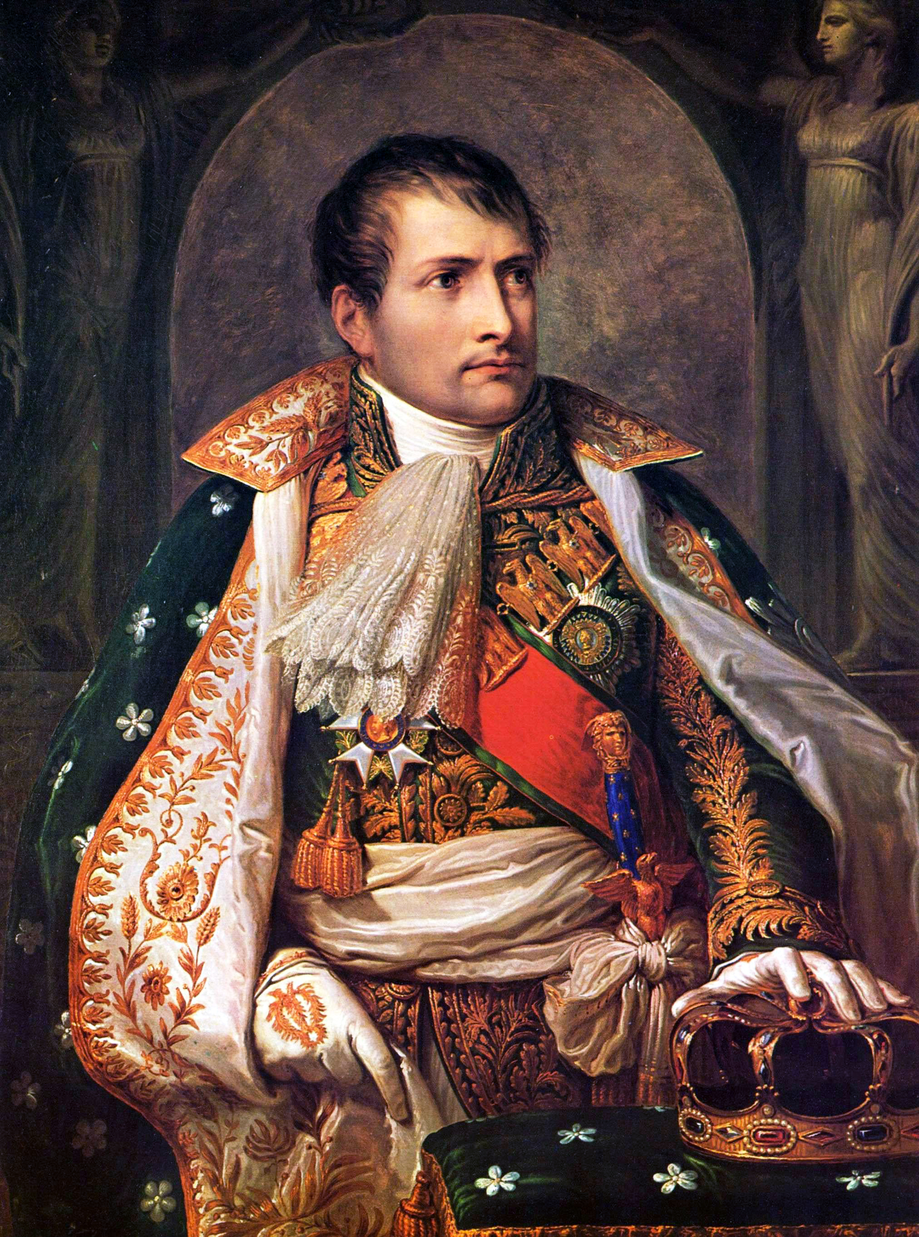
Imagine it’s 1800, and you’re in charge …
Napoleon Bonaparte

Slide 19
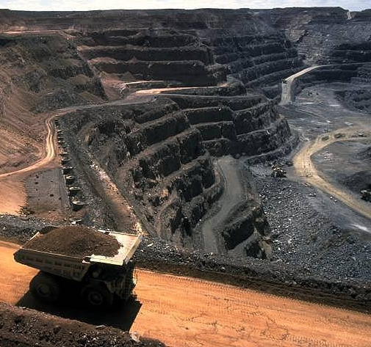
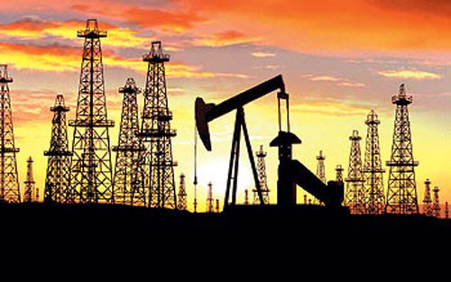
Imagine it’s 1800, and you’re in charge …
Somebody presents you with a grand idea for transforming the world economy:
Dig 10 billion tons of carbon out of the ground every year

Slide 20
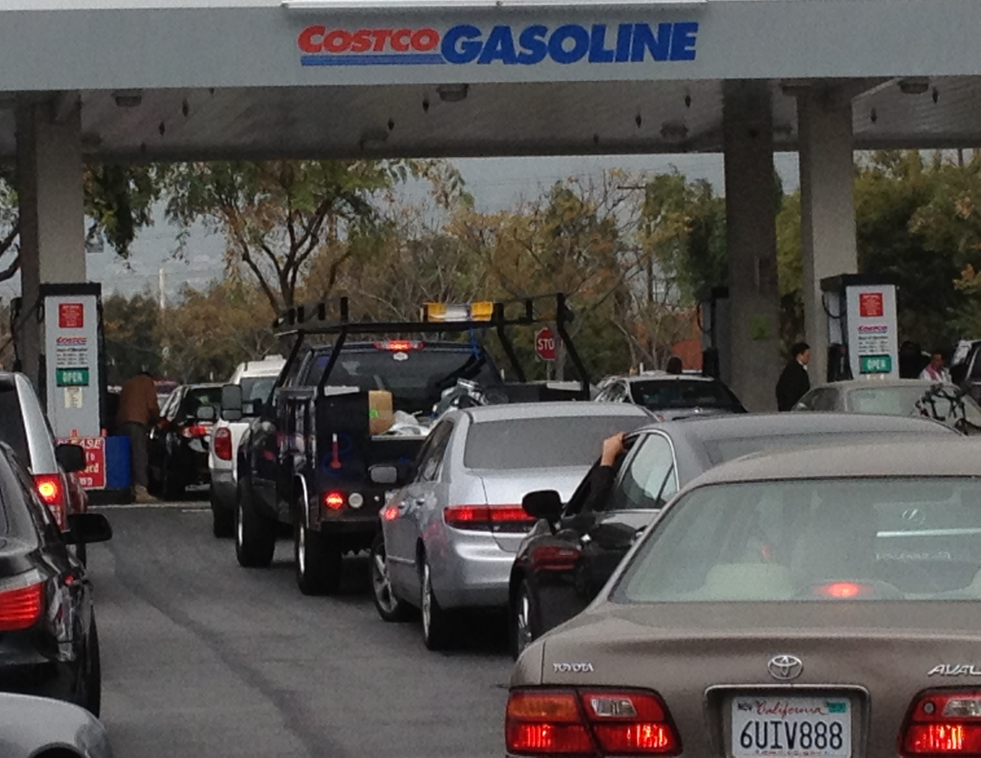
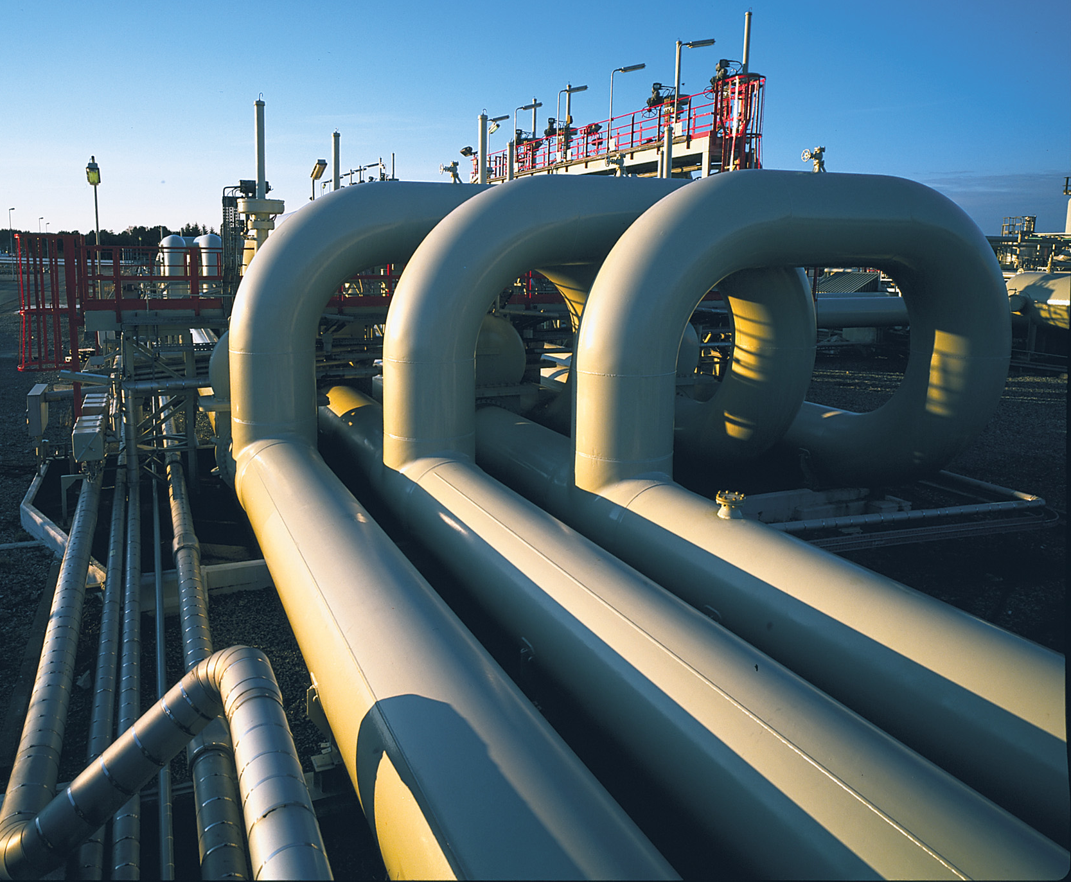
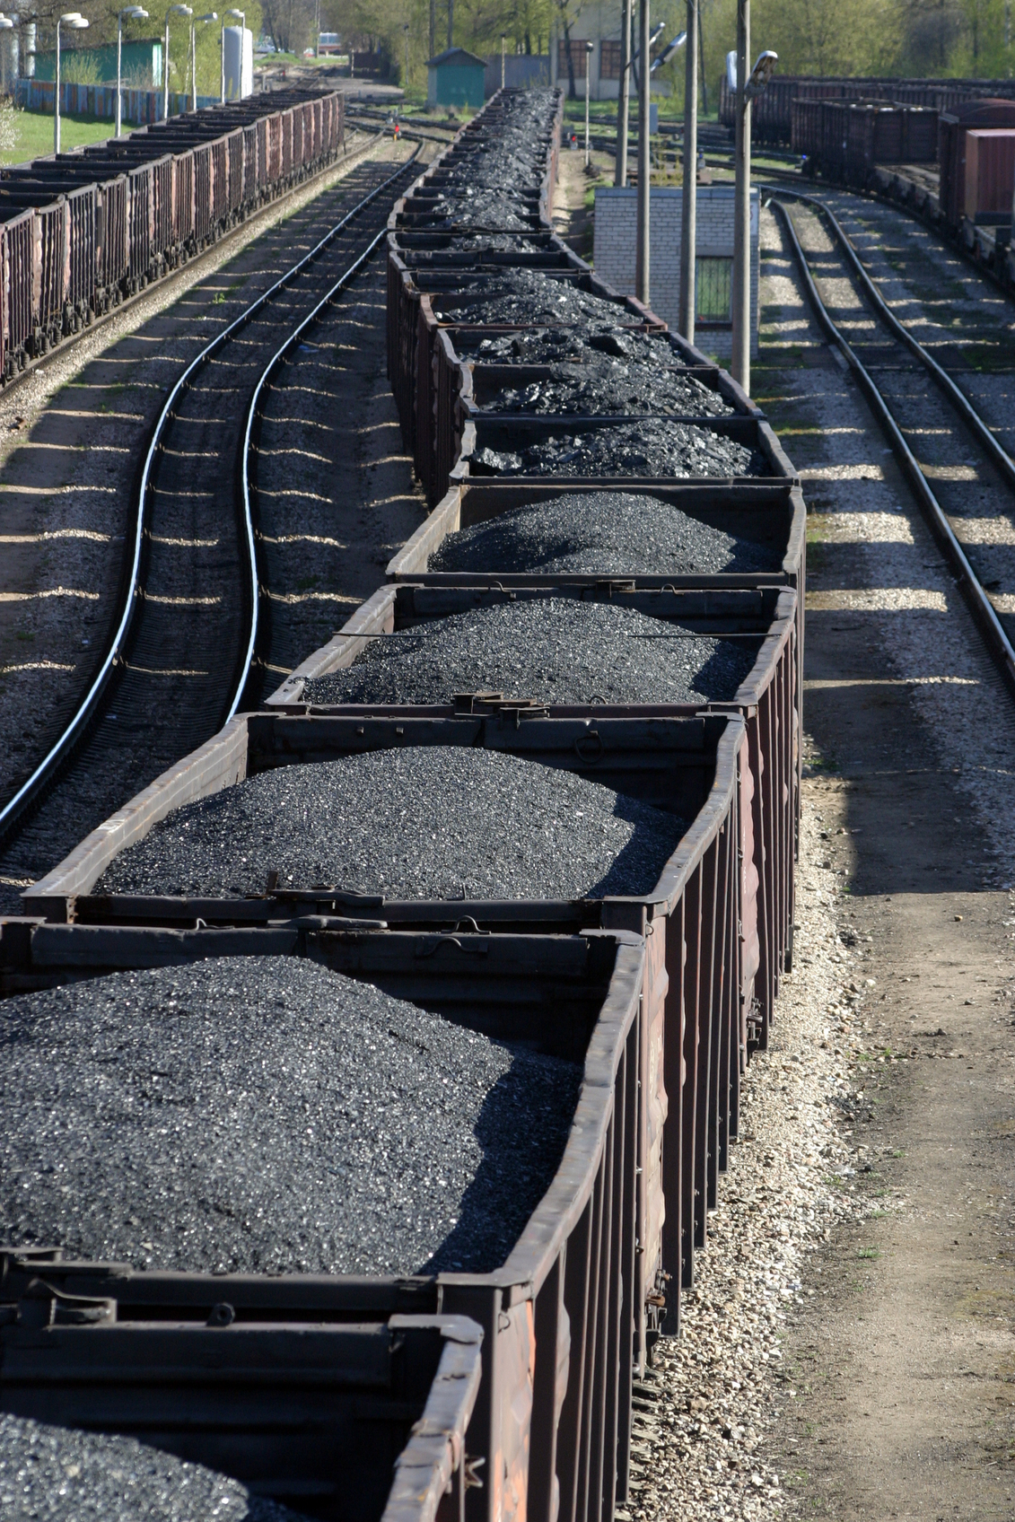
Imagine it’s 1800, and you’re in charge …
Somebody presents you with a grand idea for transforming the world economy:
Build a system of pipelines, supertankers, railroads, highways, and trucks to deliver oil & gas to every street corner on Earth

Slide 21
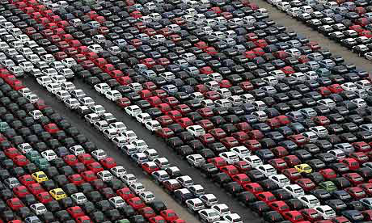
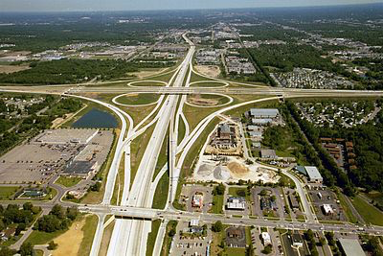
Imagine it’s 1800, and you’re in charge …
Somebody presents you with a grand idea for transforming the world economy:
Build 83 milion new cars every year, and millions of miles of roads to drive them on

Slide 22
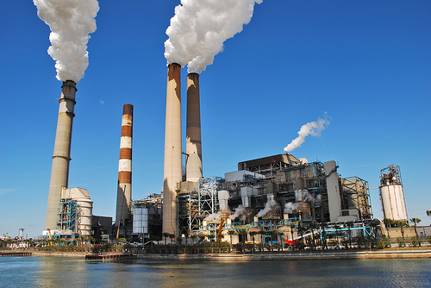
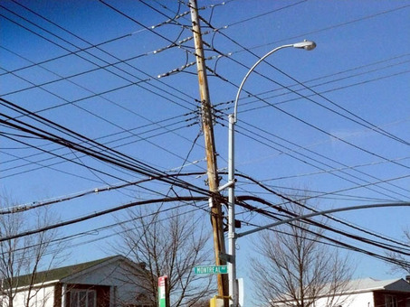
Imagine it’s 1800, and you’re in charge …
Somebody presents you with a grand idea for transforming the world economy:
Generate and pipe enough electricity to every house to power lights & stereos & LCD TVs

Slide 23
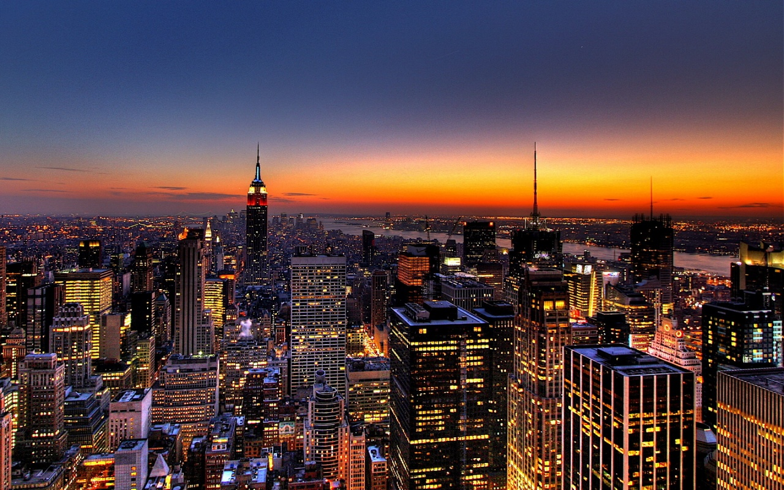
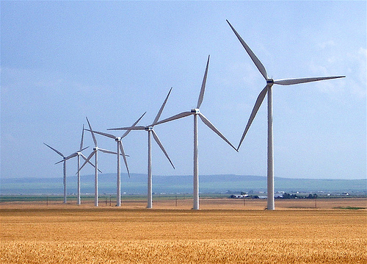
Who Built That?
Our ancestors built that very system
It cost them every dime of global GDP for 200 years (now $78T/yr)
It created every dime too!
Now our kids get to do it again!

Slide 24
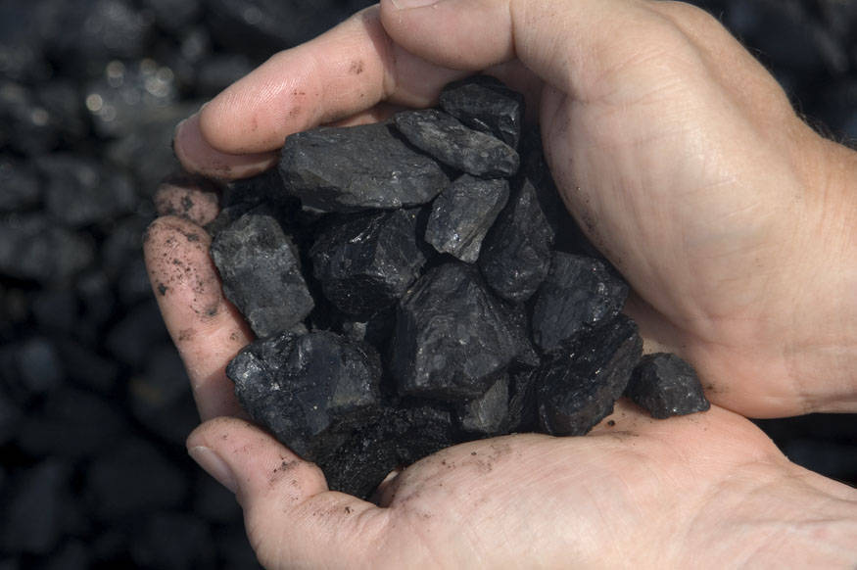
Choose Your Future
Doomsayers believe:
“Our well-being is propped up by stuff we extract from the ground”
When we stop burning coal, will our descendants shiver in the dark?

Slide 25
Choose Your Future
I prefer:
“We built our world with the sweat of our brows & the spark in our souls”
Our future is bright!

