Slide 1
Simple 2. Serious 3. Solvable

Slide 2
Simple 2. Serious 3. Solvable

Slide 3
Ever Wonder Why?
Day is warmer than night
Summer is warmer than winter
Phoenix is warmer than Fargo

Slide 4
Heat Budgets
Heat in
Heat in
Heat out
Heat out

Slide 5
Dancing Molecules and Heat Rays!
Nearly all of the air is made of oxygen (O₂) and nitrogen (N₂) in which two atoms of the same element share electrons
Infrared (heat) energy radiated up from the surface can be absorbed by these molecules, but not very well
O
O
N
N
Diatomic molecules can vibrate back and forth like balls on a spring, but the ends are identical

Slide 6
Dancing Molecules and Heat Rays!
Carbon dioxide (CO₂) and water vapor (H₂O) are different!
They have many more ways to vibrate and rotate, so they are very good at absorbing and emitting infrared (heat) radiation
O
C
O
O
H
H
Molecules that have many ways to wiggle are called “Greenhouse” molecules
Absorption spectrum of CO2 was measured by John Tyndall in 1863

Slide 7
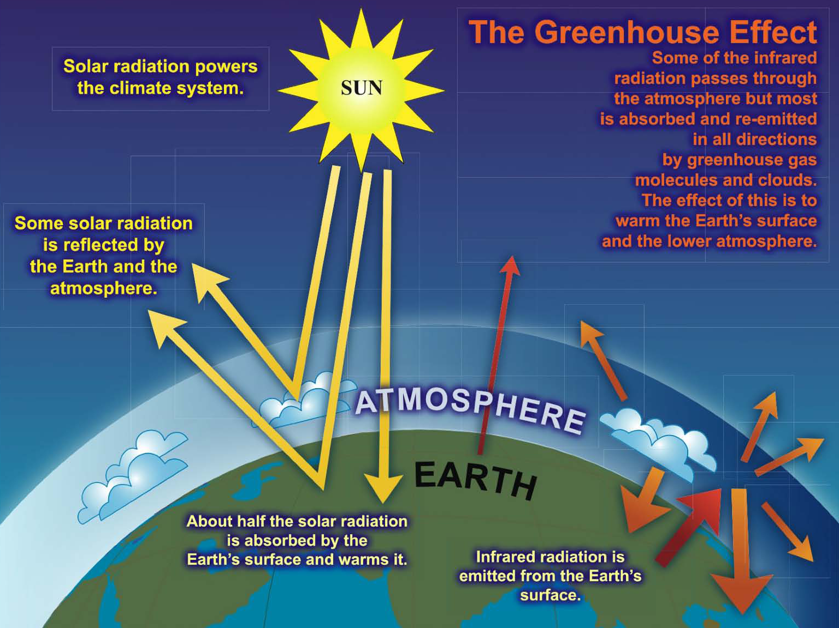

Slide 8
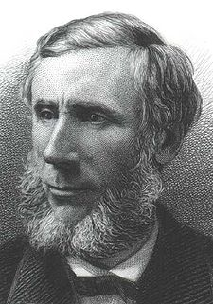
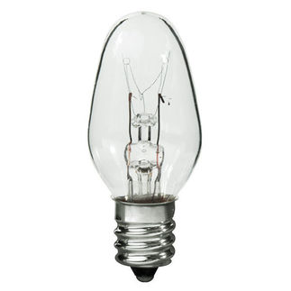
Common Sense
1 m
Doubling CO₂ would add 4 watts to every square meter of the Earth, 24/7/365
Doing that would make the surface warmer
This was known before light bulbs were invented!
4 Watts
1 m
John Tyndall, January 1863

Slide 9
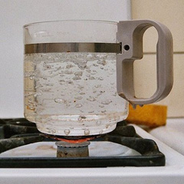
Common Myth #1
“Scientists expect a warmer future because it’s been warming up recently”
WRONG!
It’s because we know that when we add heat to things, they warm up

Slide 10
Simple 2. Serious 3. Solvable

Slide 11
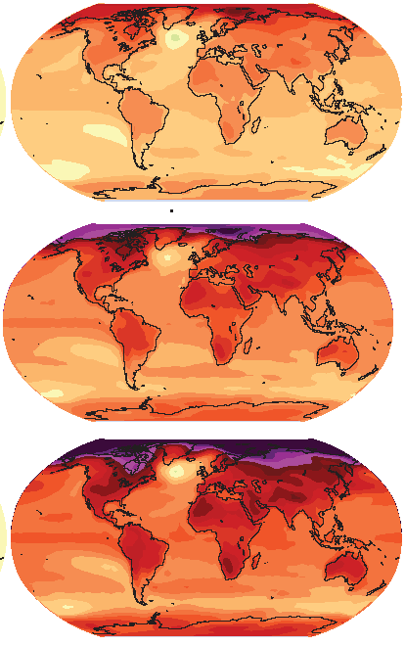
How much warmer?
Low
Emissions
Land vs ocean!
North vs South
Global average warming of 2º to 5º C
North American warming of 3º to 6º C
= 5º to 11º F
Arctic warming of 8º to 14º F
Moderate
Emissions
High
Emissions

Slide 12
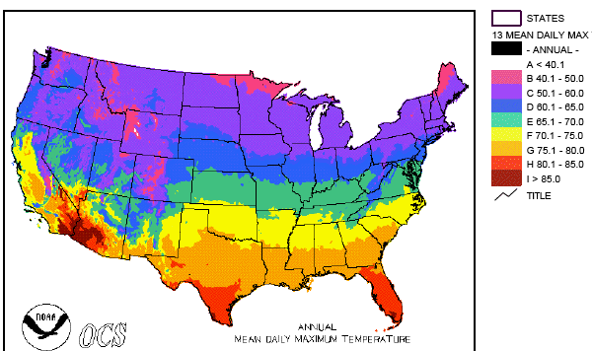
Where is it 10º F Warmer
“on average?”
Seattle ➔ Sacramento
Denver ➔ Amarillo
Illinois ➔ Mississippi
Washington DC ➔ Tallahassee
10 ºF warming is like moving 600 – 800 miles South!
Water? Crops? Real Estate? Health?

Slide 13
Zones Marching Up
In Colorado, temps drop about 10 F for each 3000 feet of elevation
Denver -> Estes Park
Estes Park -> Emerald Lake
But in 100 years instead of 100 centuries!

Slide 14
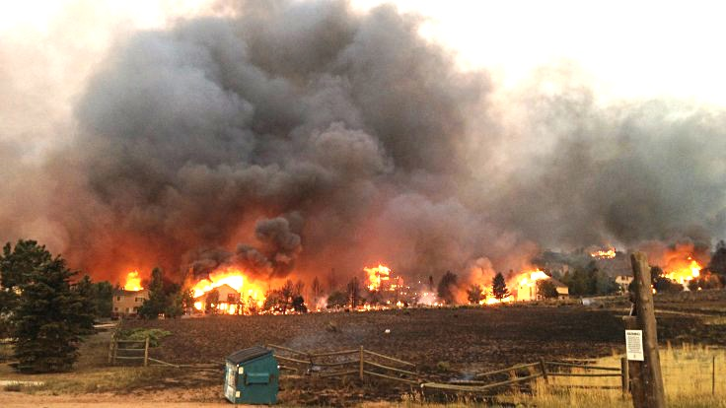
Warming Promotes Wildfire
Warmer air increases evaporative demand on forests
Longer warm season depletes soil moisture
More frequent extremely hot, dry, windy days when fires are uncontrollable
Projected Increase in Area Burned
656%
656%
NRC 2011

Slide 15
Simple 2. Serious 3. Solvable

Slide 16
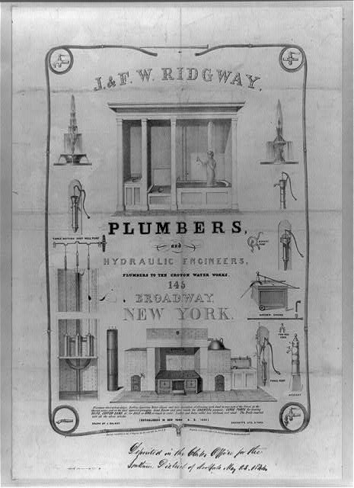
Costs
Conversion to 100% noncarbon energy will cost about 1% of GDP
That’s about what it cost to retrofit all the world’s cities with indoor plumbing a century ago …
It was SO worth it!

Slide 17
My Grandparents

Slide 18
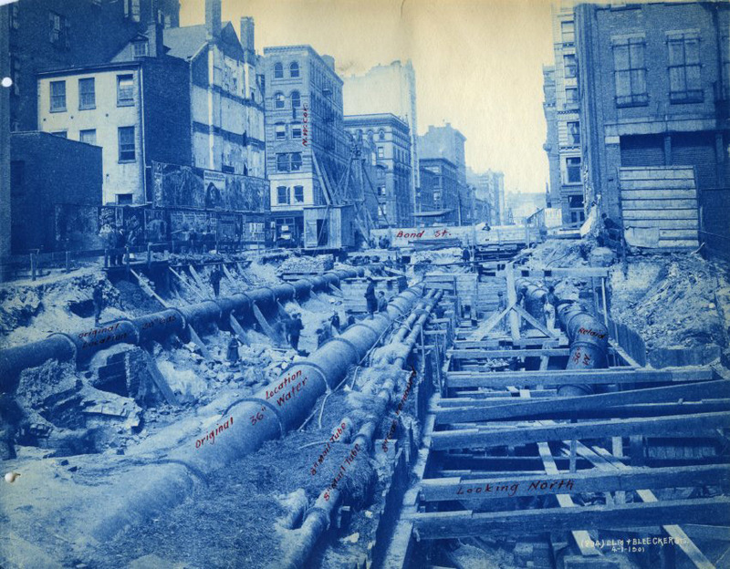
My Grandparents’ Generation
Built subways, sewers, the electrical grid, defeated the Nazis

Slide 19
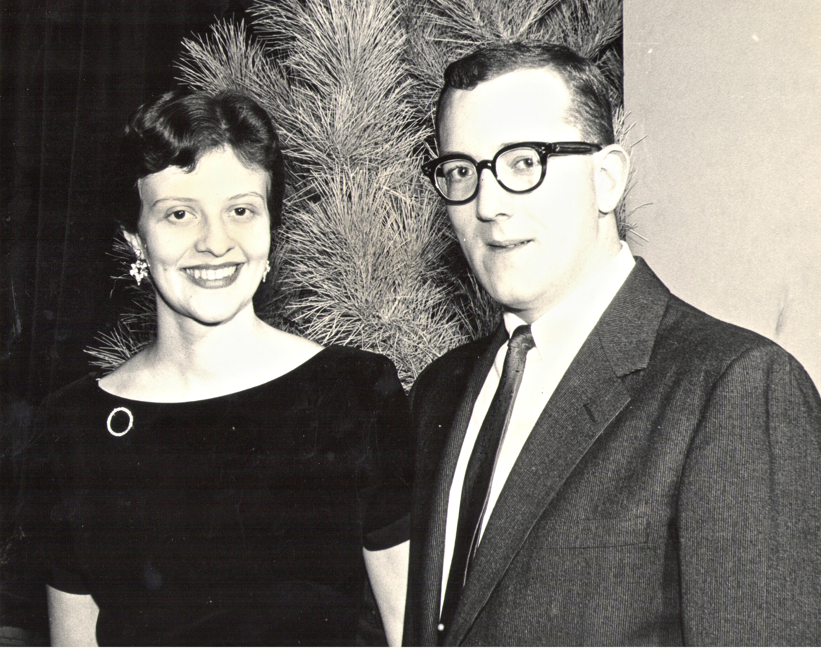
My Parents

Slide 20
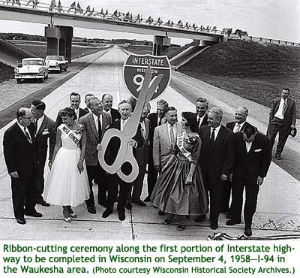
My Parents’ Generation
Built the Interstate Highways, fought the cold war, landed on the Moon!

Slide 21
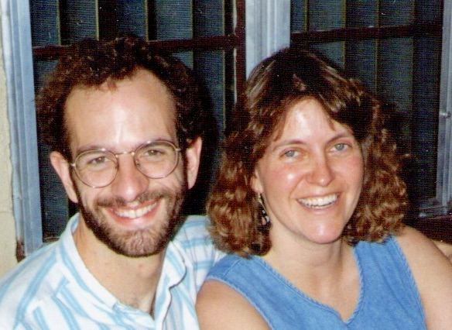
Jennifer & Me

Slide 22
My Generation
Invented the PC, Built the internet, replaced billions of land-lines with cell phones

Slide 23
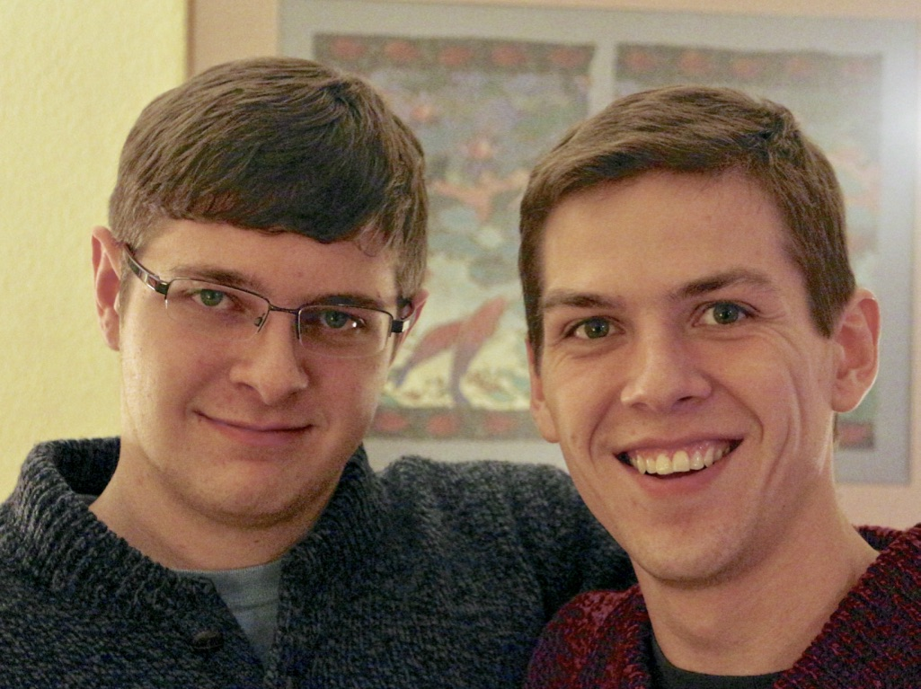
My Kids

Slide 24
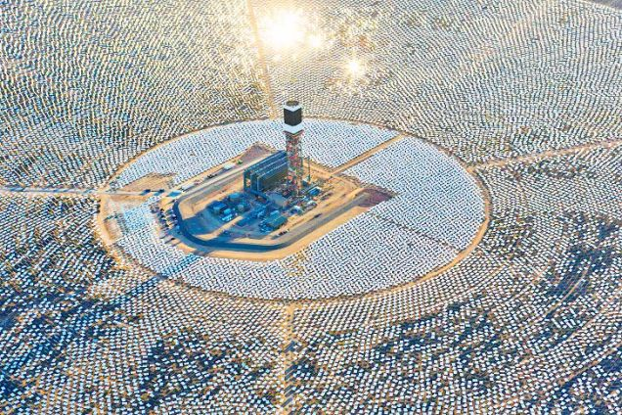
My Kids’ Generation
Will replace the world’s energy system again!

Slide 25
We don’t have to choose between progress and prosperity ...
Progress is prosperity!

Slide 26
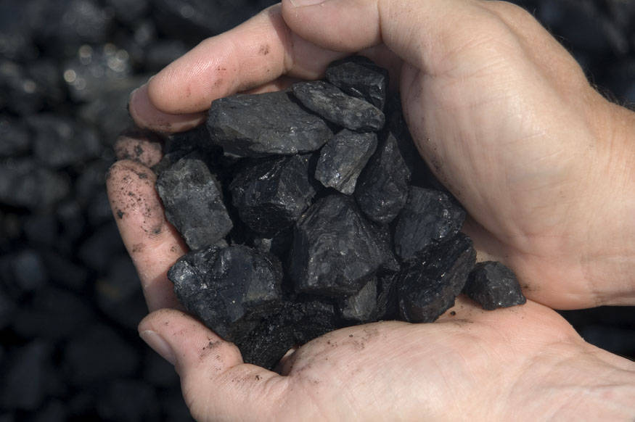
Choose Your Future
Many people think:
“Our well-being is based on stuff we extract from the ground”
When we stop burning coal, will our descendants shiver in the dark?

Slide 27
Choose Your Future
I prefer:
“We create our well-being through creativity, ingenuity, and hard work”
The future is bright!

