Slide 1
Climate Change: Simple, Serious, Solvable
Scott Denning
Atmospheric Science, CSU
Download this presentation from http://SimpleSeriousSolvable.org

Slide 2
Simple 2. Serious 3. Solvable

Slide 3
Simple 2. Serious 3. Solvable

Slide 4
Ever Wonder Why?
Day is warmer than night
Summer is warmer than winter
Phoenix is warmer than Fargo

Slide 5
Heat Budgets
Heat in
Heat in
Heat out
Heat out

Slide 6
Dancing Molecules and Heat Rays!
Nearly all of the air is made of oxygen (O₂) and nitrogen (N₂) in which two atoms of the same element share electrons
Infrared (heat) energy radiated up from the surface can be absorbed by these molecules, but not very well
O
O
N
N
Diatomic molecules can vibrate back and forth like balls on a spring, but the ends are identical

Slide 7
Dancing Molecules and Heat Rays!
Carbon dioxide (CO₂) and water vapor (H₂O) are different!
They have many more ways to vibrate and rotate, so they are very good at absorbing and emitting infrared (heat) radiation
O
C
O
O
H
H
Molecules that have many ways to wiggle are called “Greenhouse” molecules
Absorption spectrum of CO2 was measured by John Tyndall in 1863

Slide 8
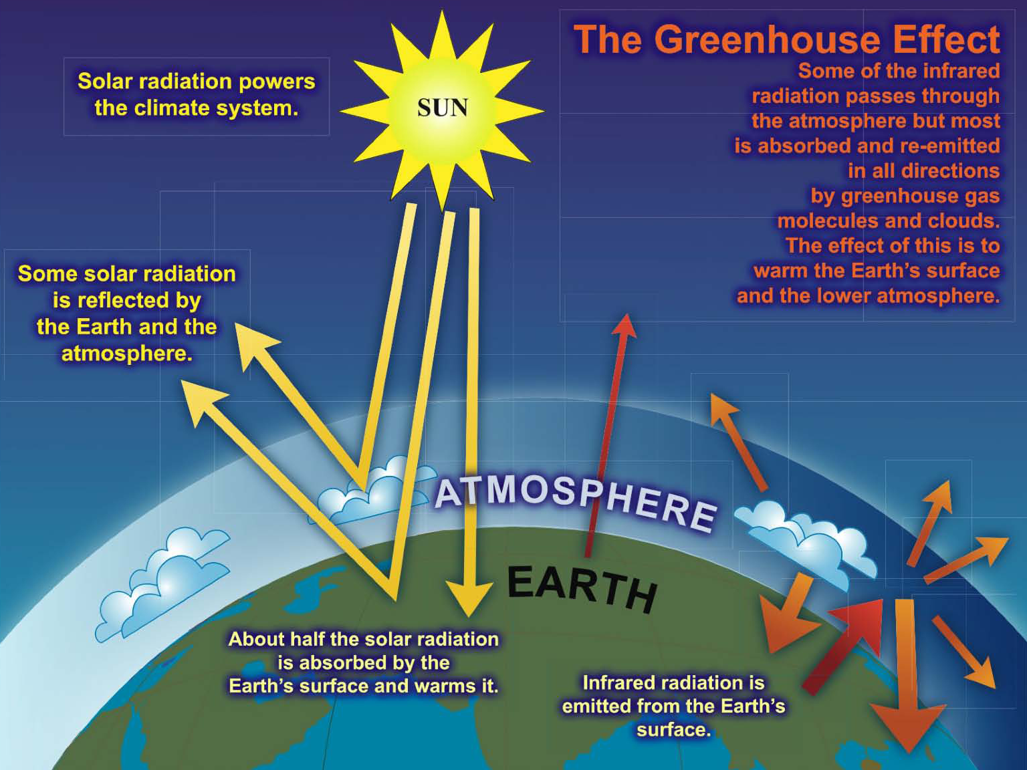

Slide 9
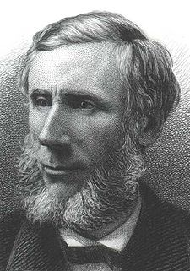
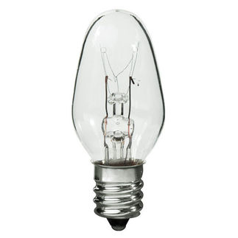
Common Sense
1 m
Doubling CO₂ would add 4 watts to every square meter of the Earth, 24/7/365
Doing that would make the surface warmer
This was known before light bulbs were invented!
4 Watts
1 m
John Tyndall, January 1863

Slide 10
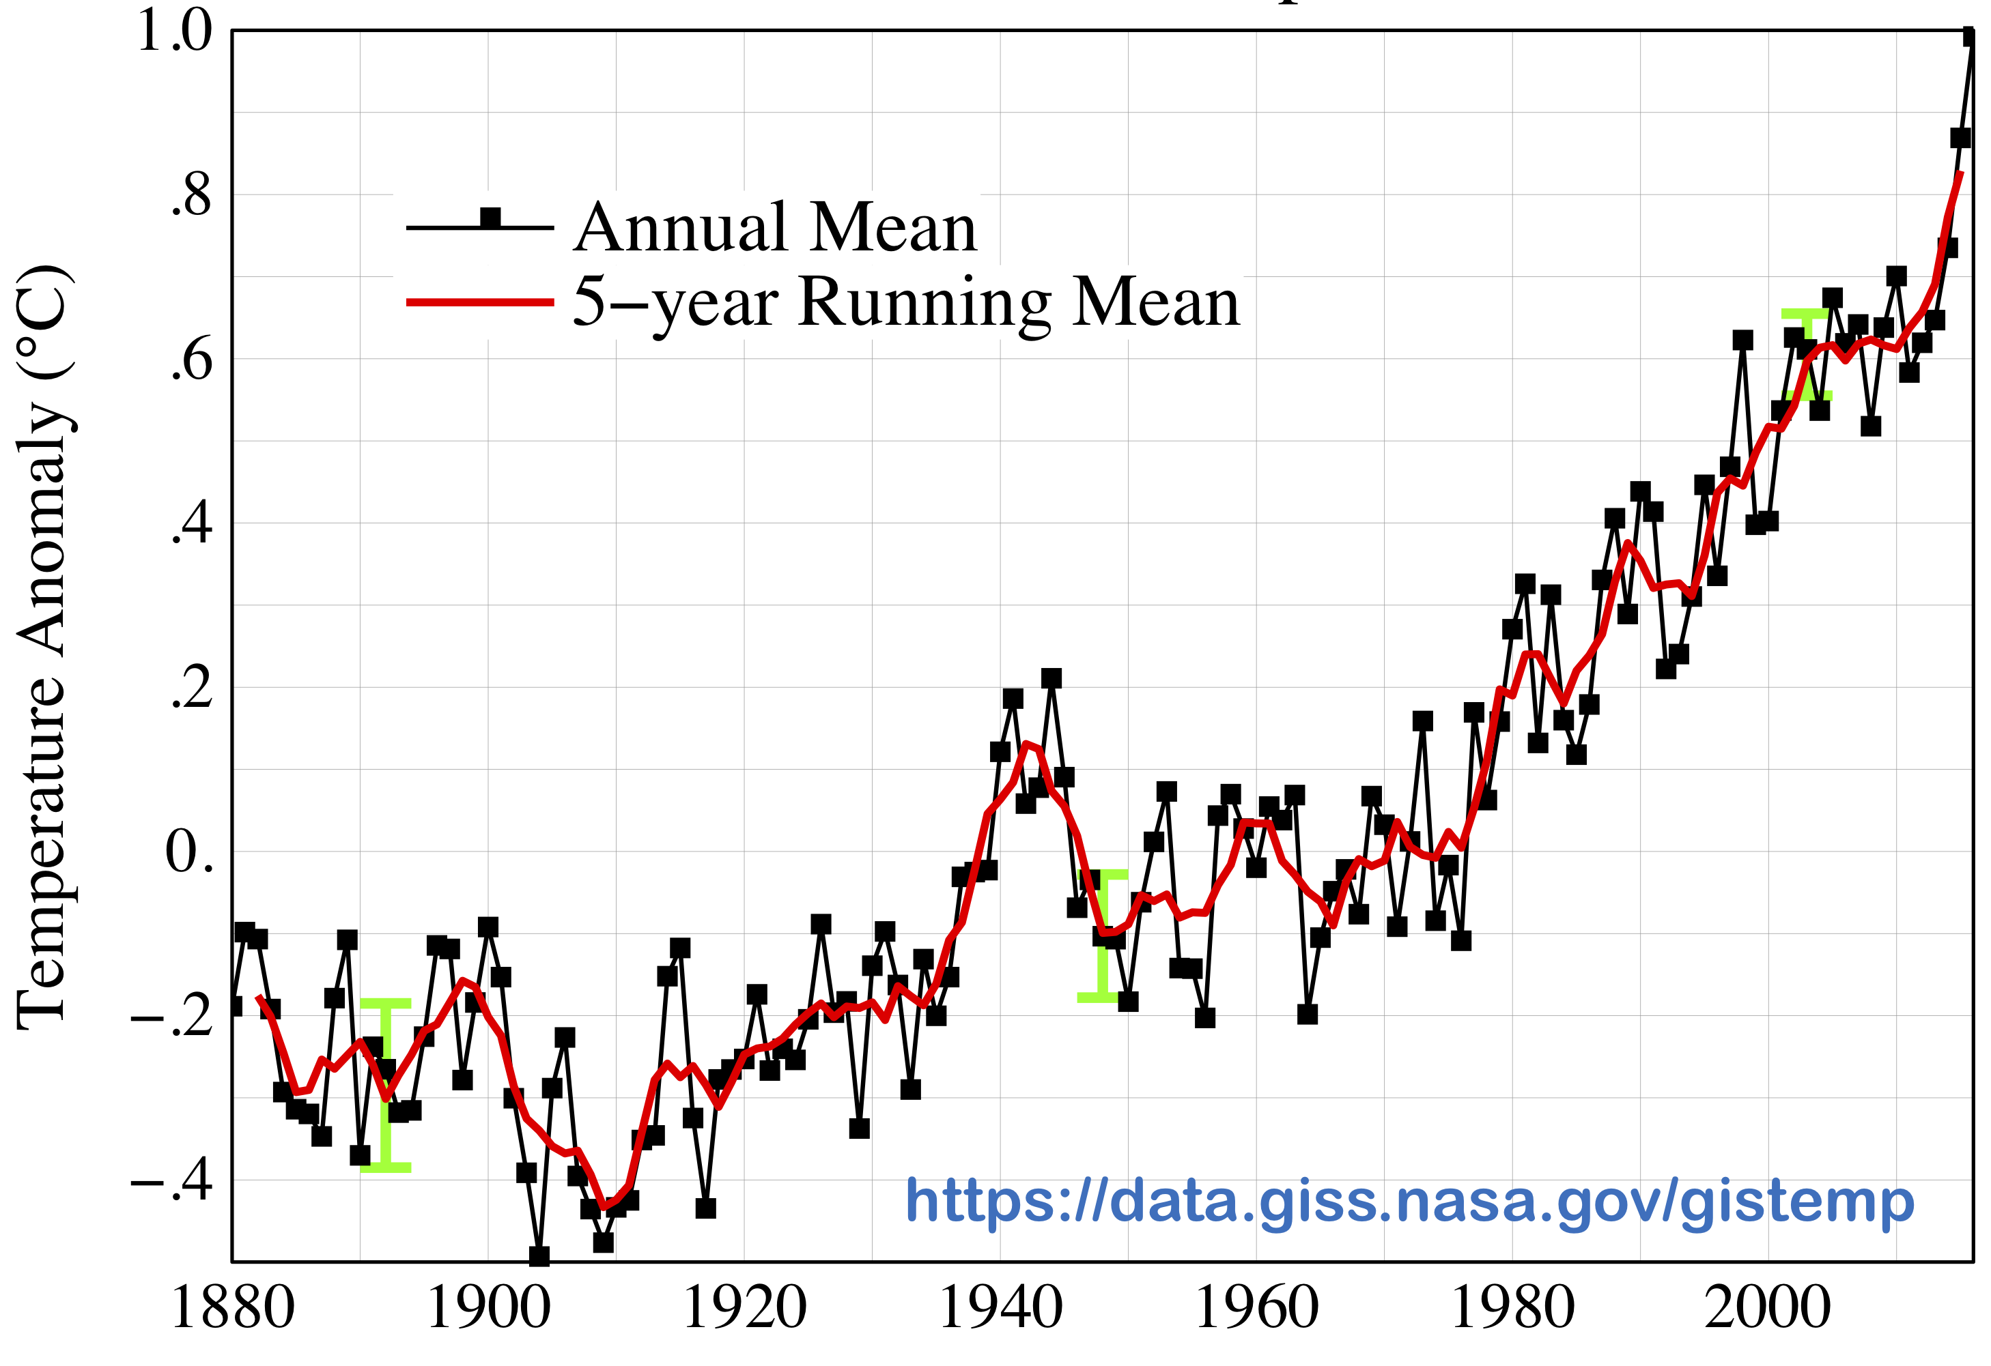
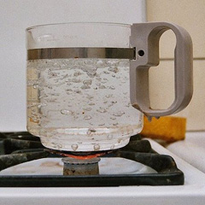
Common Myth #1
“Scientists expect a warmer future because it’s been warming up recently”
WRONG!
It’s because we know that when we add heat to things, they warm up

Slide 11
Simple 2. Serious 3. Solvable

Slide 12
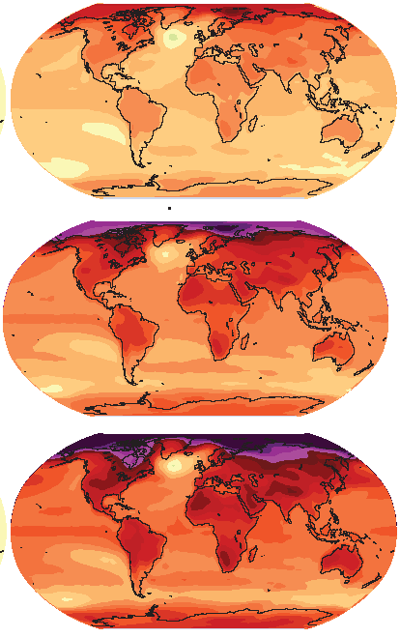
How much warmer?
Low
Emissions
Land vs Oceans !
North vs South
Snowy vs not
5 ºF
10 ºF
3 ºC
Moderate
Emissions
6 ºC
We warm up more
3 ºC to 6 ºC
5 ºF to 10 ºF
High
Emissions

Slide 13
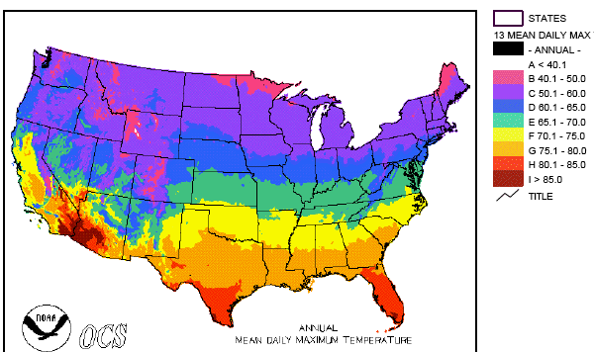
Where is it 10º F Warmer
“on average?”
Seattle ➔ Sacramento
Denver ➔ Albuquerque
Illinois ➔ Mississippi
Washington DC ➔ Tallahassee
10 ºF warming is like moving 600 – 800 miles South!
Water? Crops? Real Estate? Health?

Slide 14
Zones Marching Up
In Colorado, temps drop about 10 ºF for each 3000 feet of elevation
Denver -> Estes Park
Estes Park -> Trail Ridge Road
But in 100 years instead of 100 centuries!

Slide 15
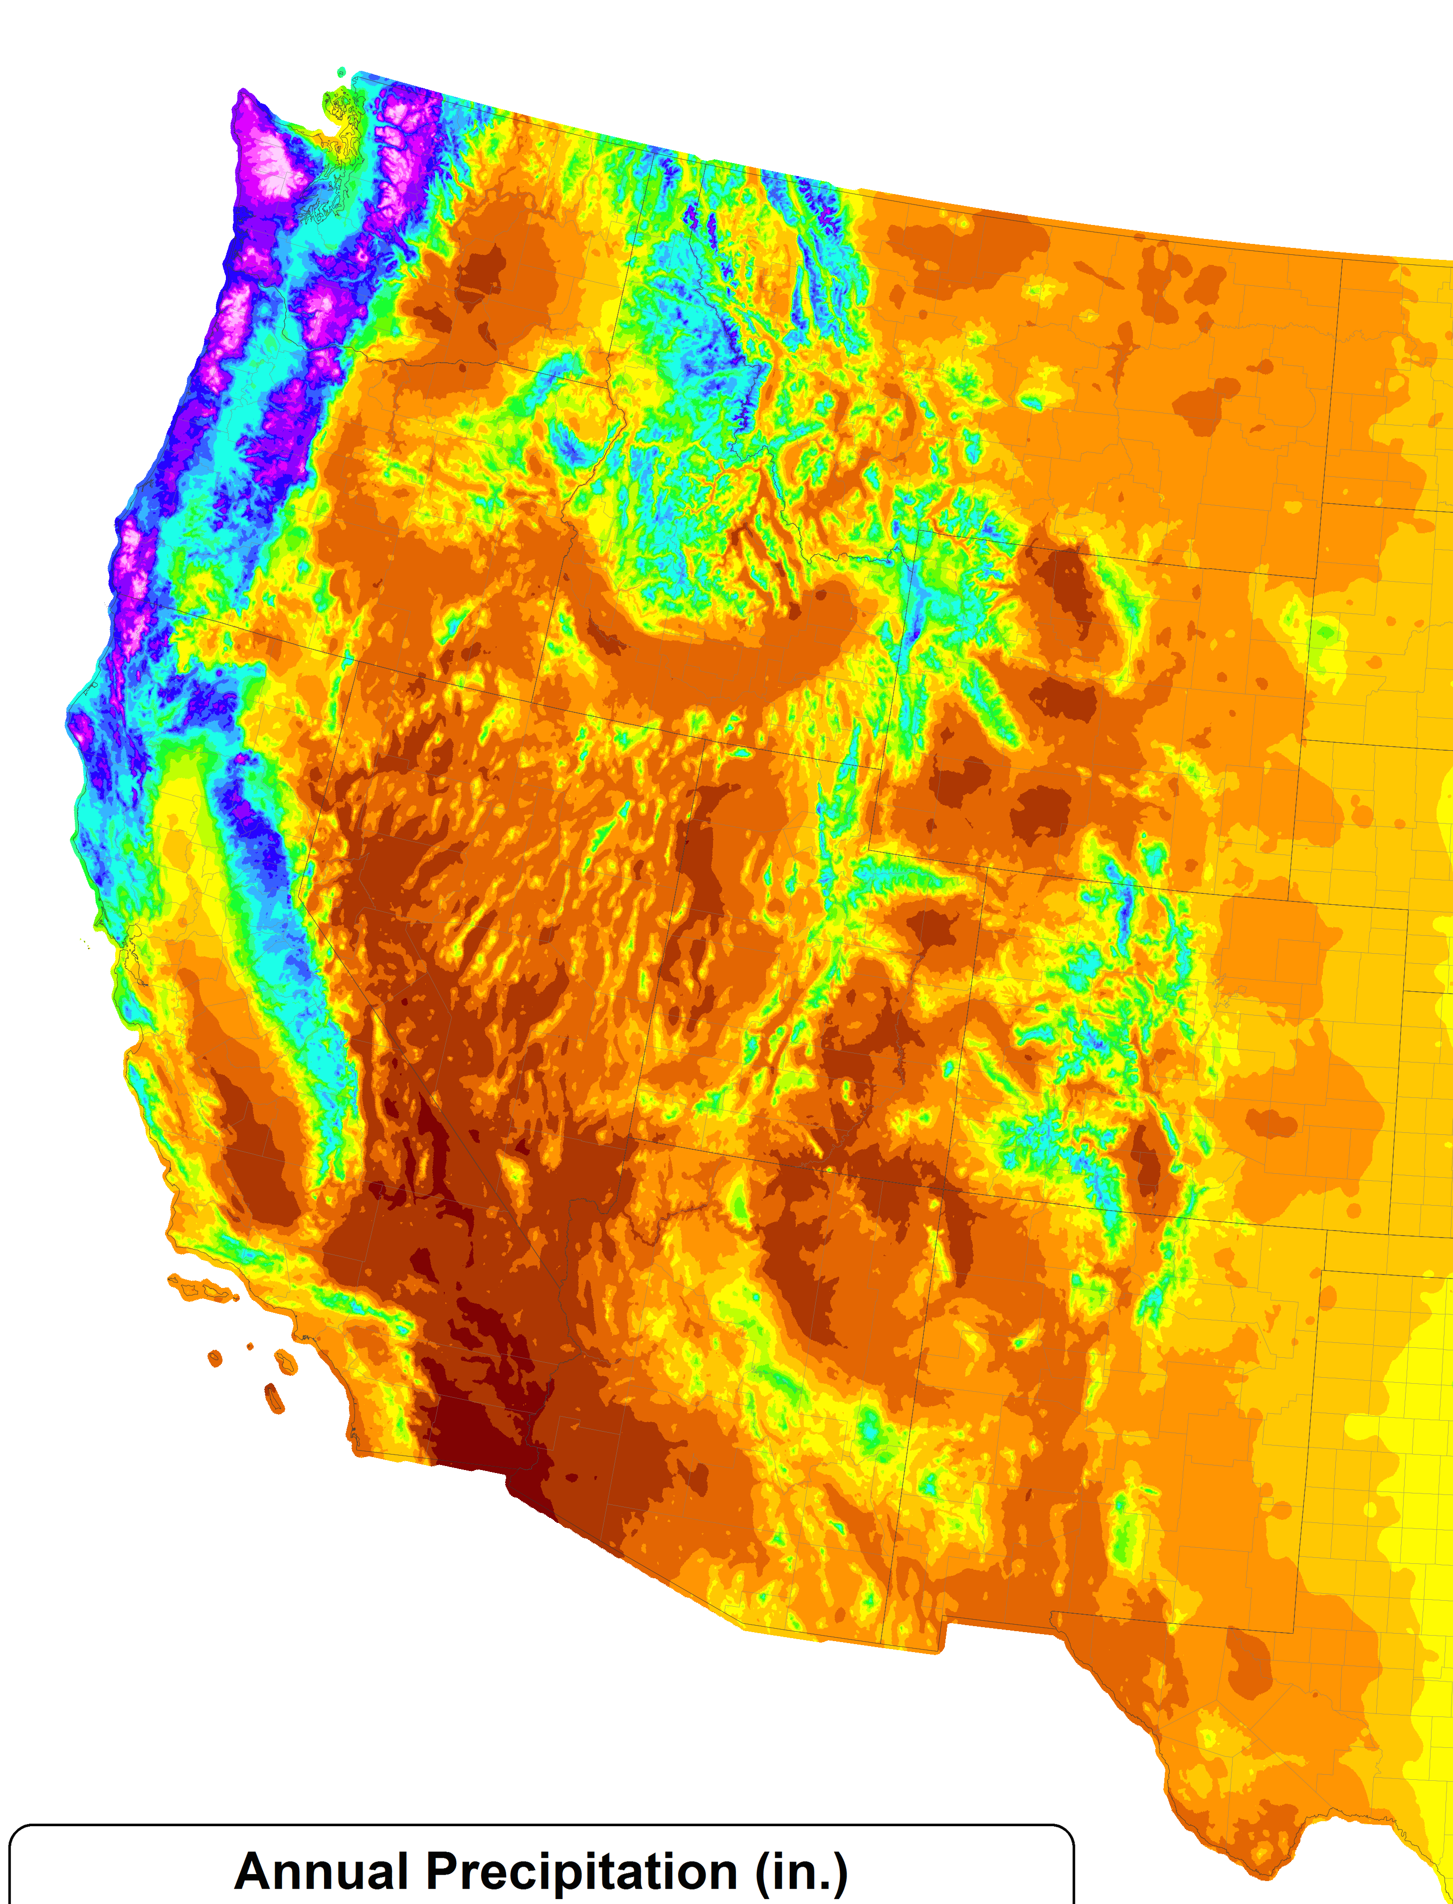
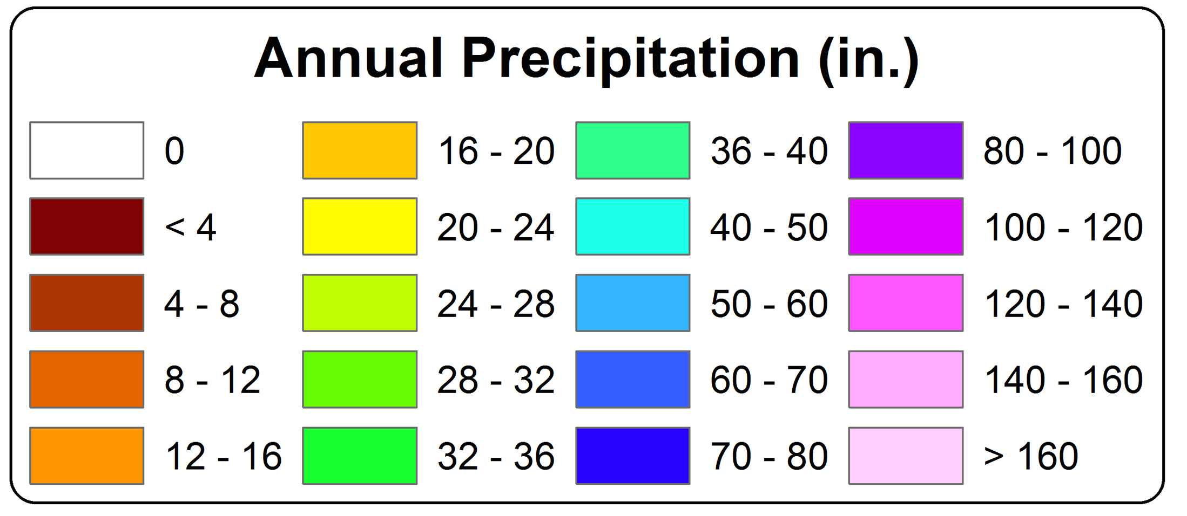
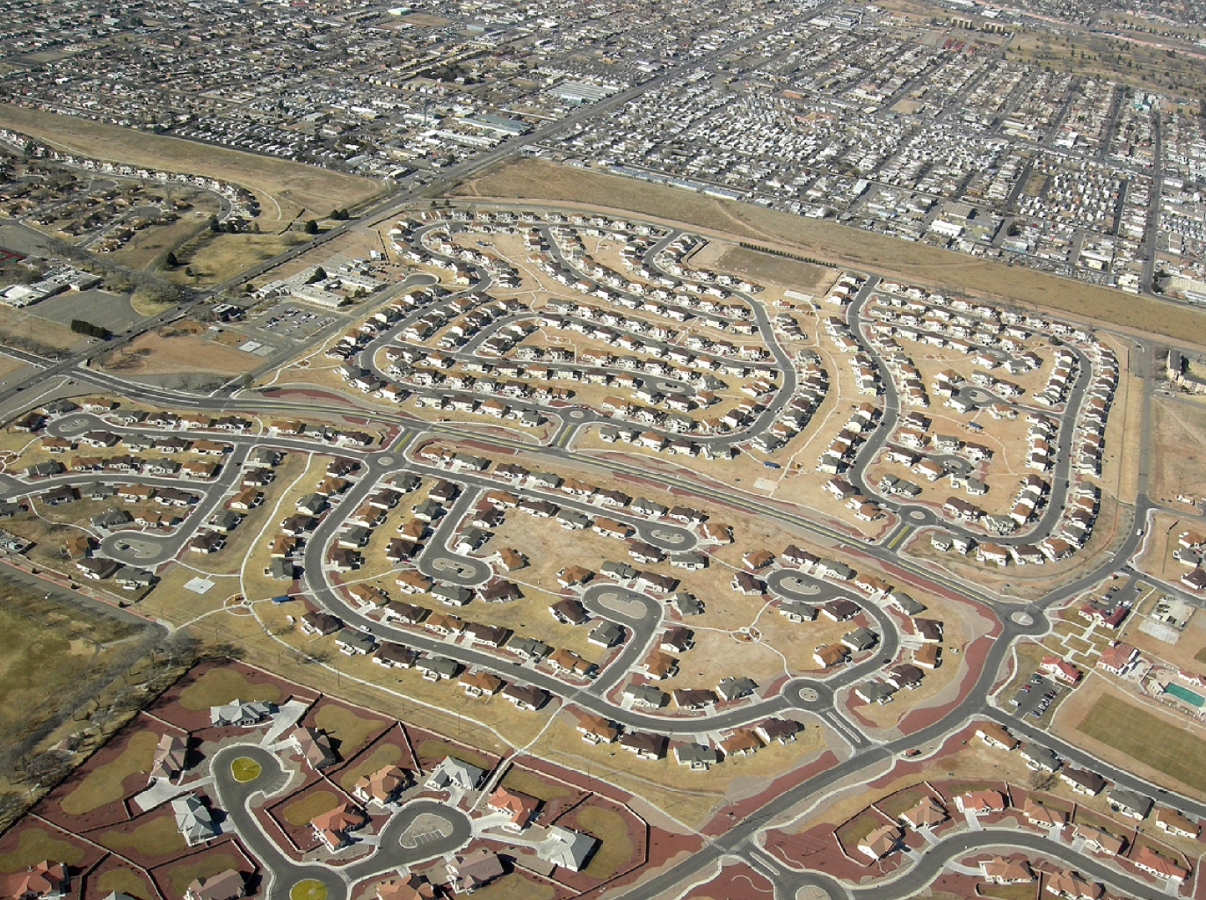
A Region On the Edge
WA
MT
OR
WY
ID
NV
UT
CO
75 million people in the western US live in a region with marginal precipitation
Just enough snow to support forests and reservoirs
Just enough irrigation water to support farming
Just enough water for cities and towns
AZ
CA
NM
TX

Slide 16
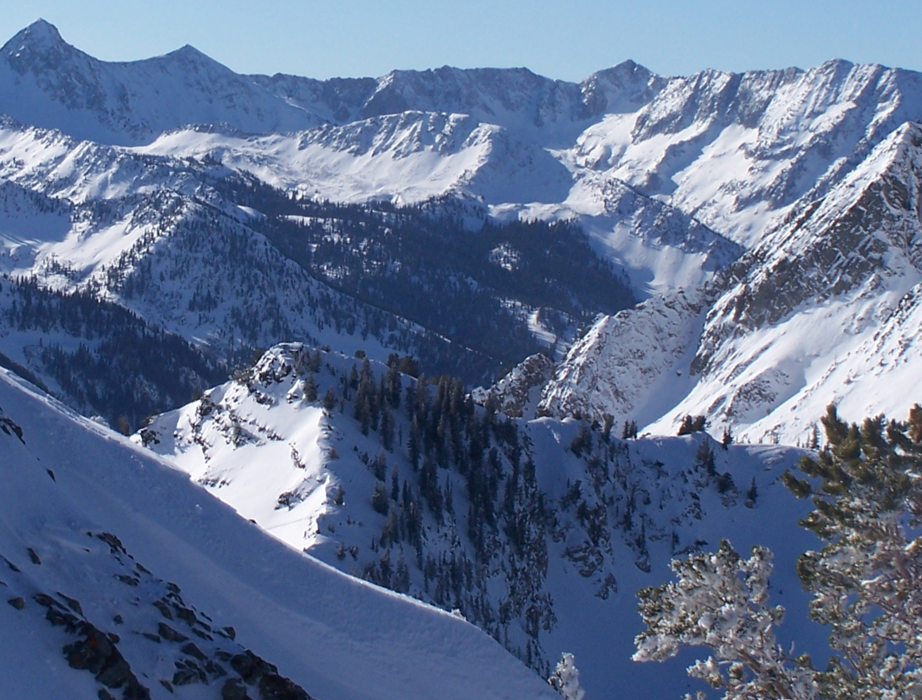
Our Water Supply

Slide 17
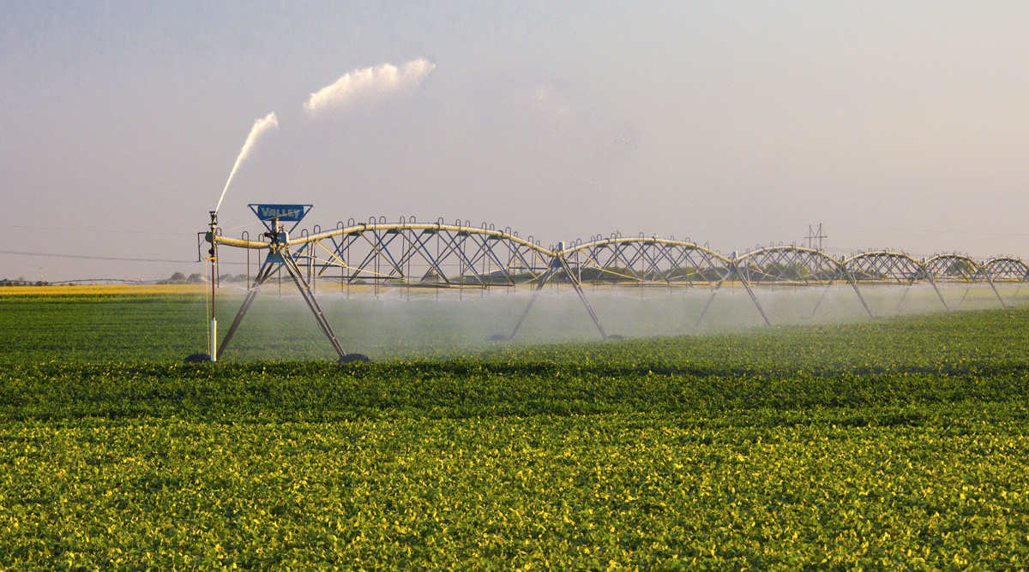
Water Budgets
Evaporative demand increases w/ temperature
In
Out
Drought is the running sum of water out minus water in

Slide 18
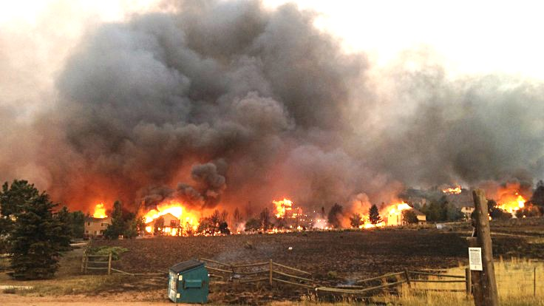
Warming Promotes Wildfire
Warmer air increases evaporative demand on forests
Longer warm season depletes soil moisture
More frequent extremely hot, dry, windy days when fires are uncontrollable
Projected Increase in Area Burned
656%
656%
NRC 2011

Slide 19
Simple 2. Serious 3. Solvable

Slide 20
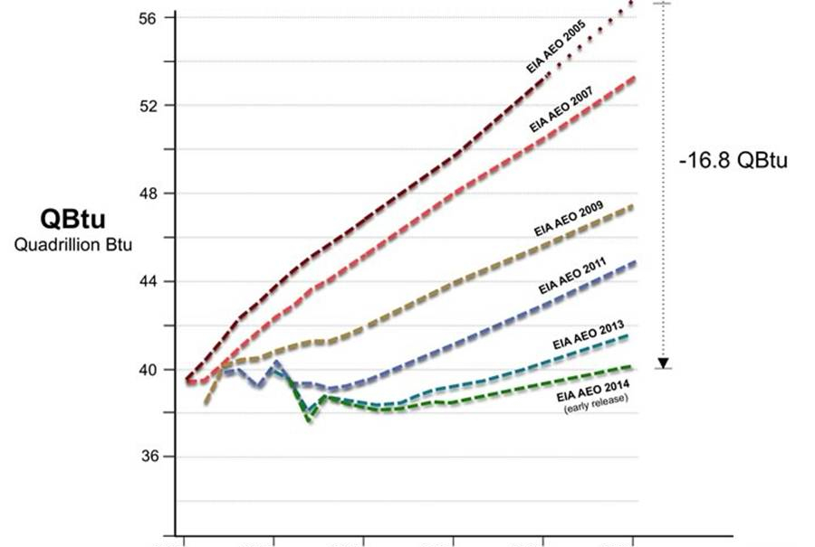
Efficient Architects!
energy / $
$4.5 TRILLION SAVINGS !
Energy to Power US Buildings
2010
2020
2030

Slide 21
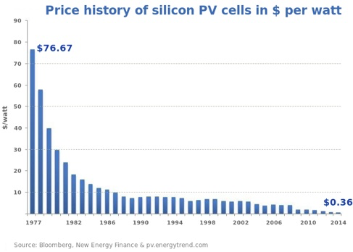
Price of Solar PV Cells ($/watt)
Price has fallen by factor of 200 since I graduated from high school
Factor of 5 since 2011
Now as cheap or cheaper than coal or gas
Drop in 1970s
Flatter in1990s

Slide 22
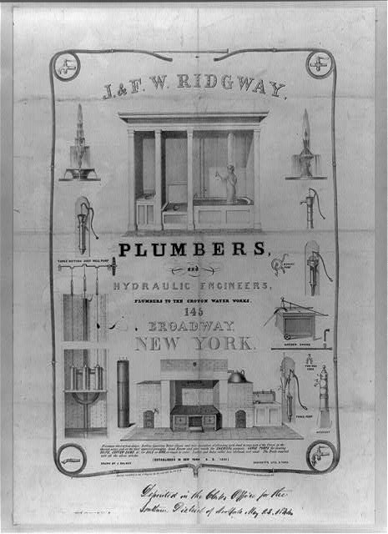
Costs
Conversion to 100% noncarbon energy will cost about 1% of GDP
That’s about what it cost to retrofit all the world’s cities with indoor plumbing a century ago …
It was SO worth it!

Slide 23
My Grandparents

Slide 24
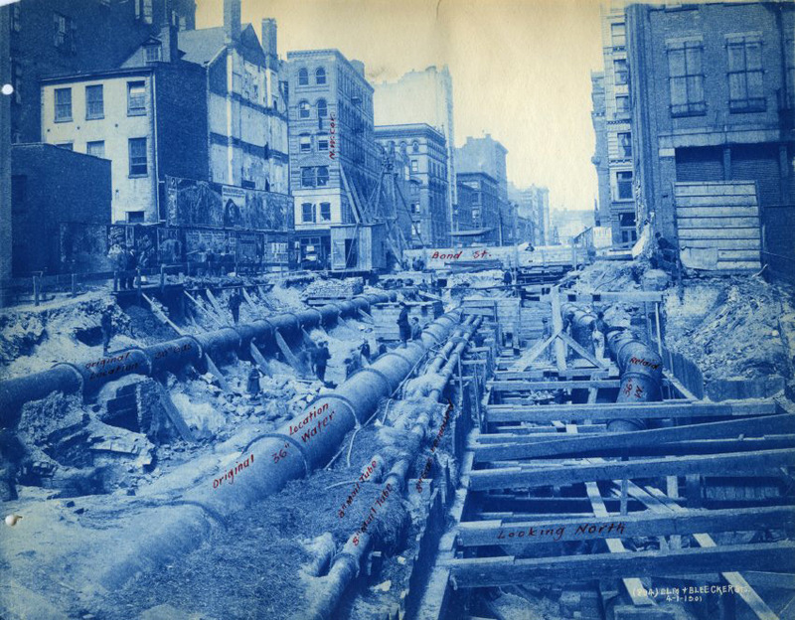
My Grandparents’ Generation
Built subways, sewers, the electrical grid, defeated the Nazis

Slide 25
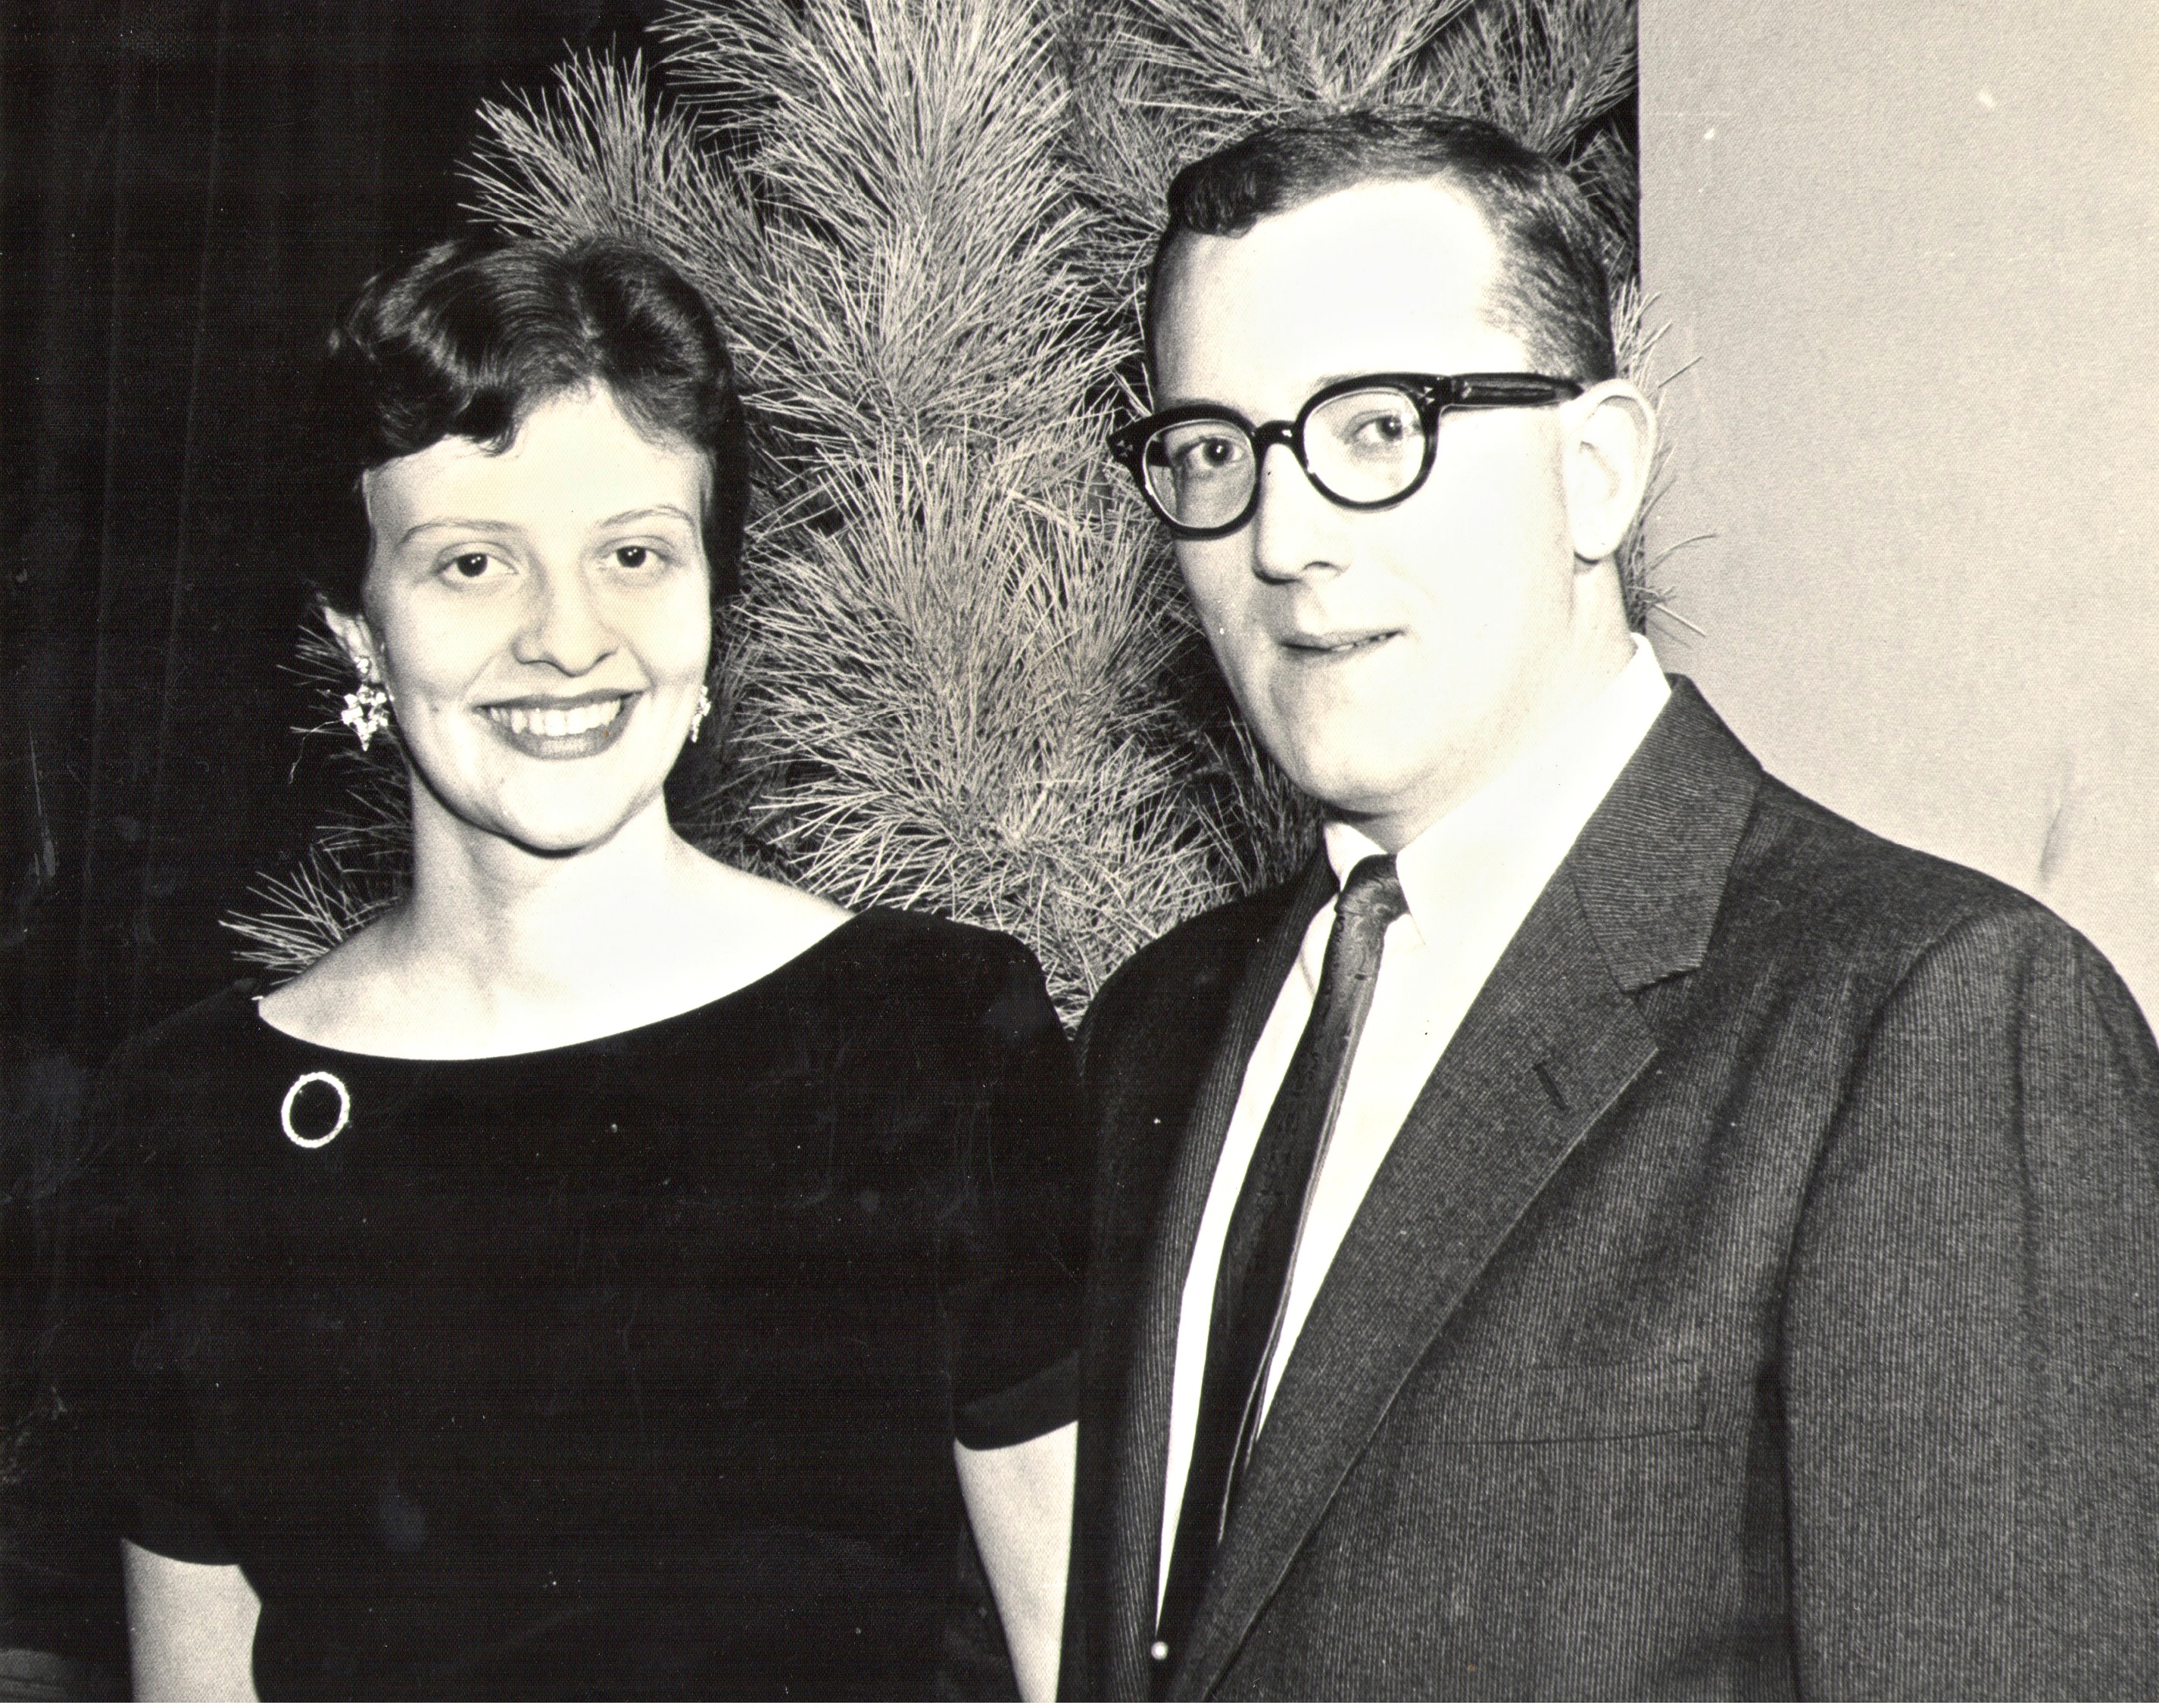
My Parents

Slide 26
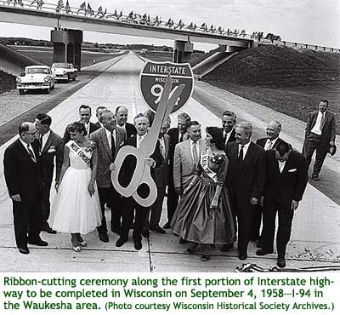
My Parents’ Generation
Built the Interstate Highways, fought the cold war, landed on the Moon!

Slide 27
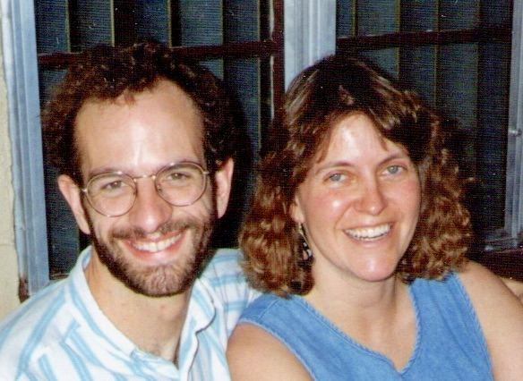
Jennifer & Me

Slide 28
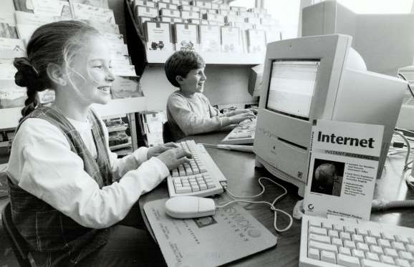
My Generation
Invented the PC, Built the internet, replaced billions of land-lines with cell phones

Slide 29
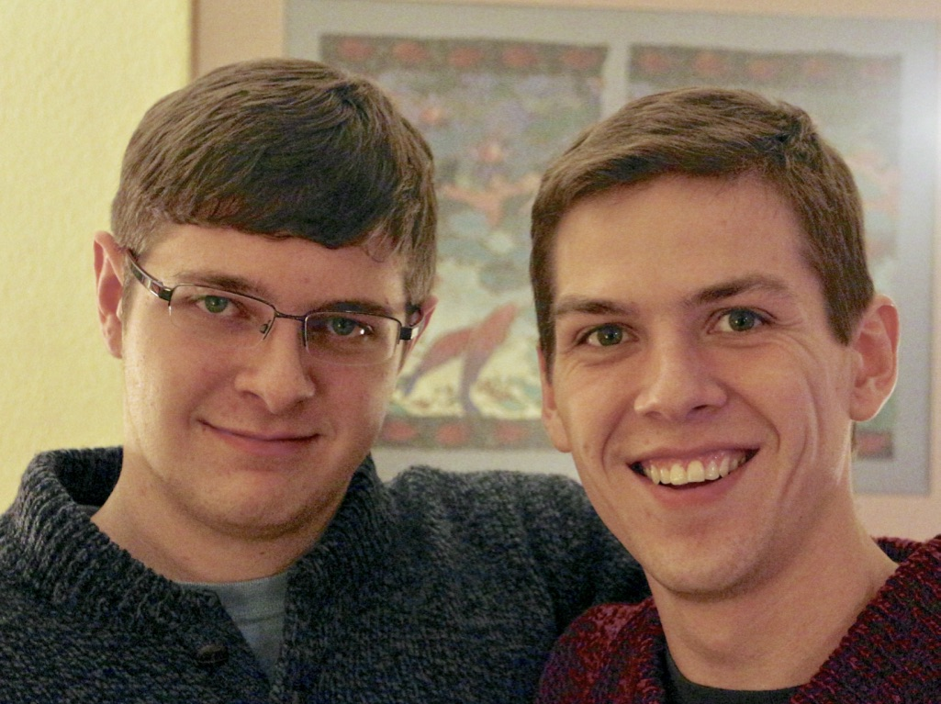
My Kids

Slide 30
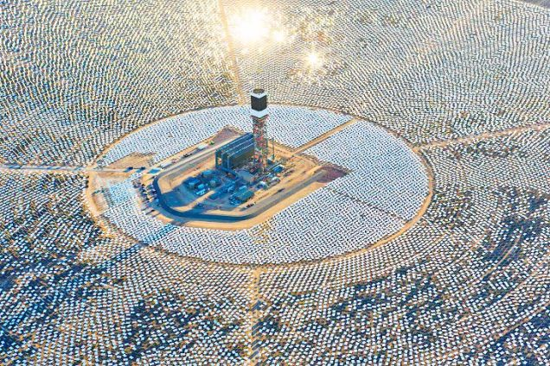
My Kids’ Generation
Will replace the world’s energy system again!

Slide 31
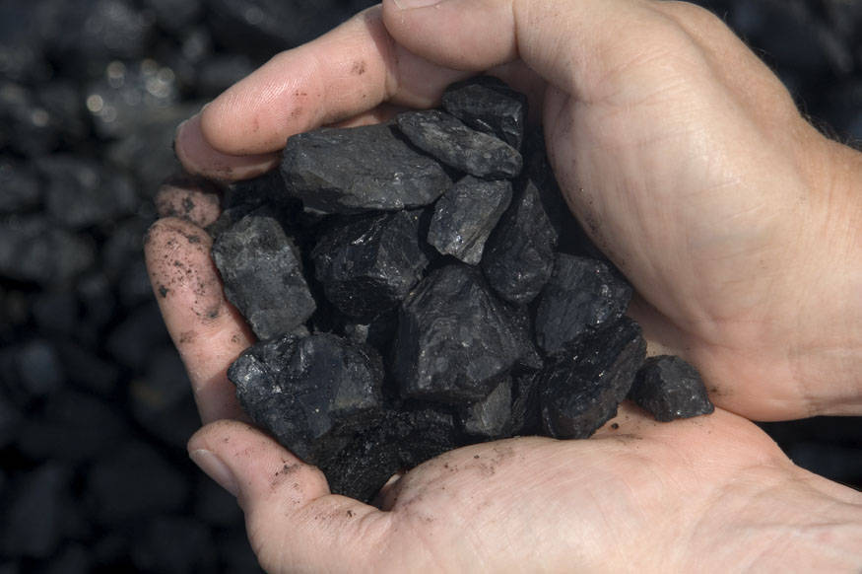
Choose Your Future
Many people think:
“Our well-being is based on stuff we extract from the ground”
When we stop burning coal, will our descendants shiver in the dark?

Slide 32
Choose Your Future
I prefer:
“We create our well-being through creativity, ingenuity, and hard work”
The future is bright!

Slide 33
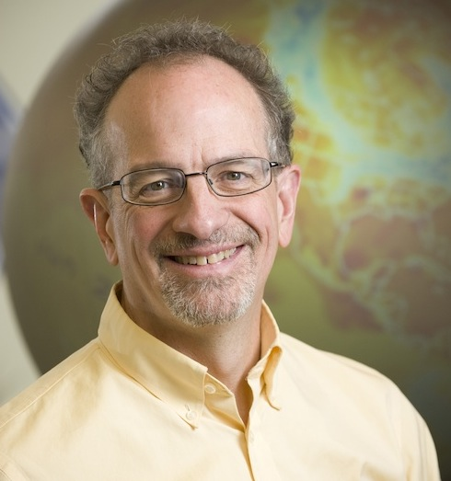
For More Info …
Download this PowerPoint or video of this presentation from SimpleSeriousSolvable.org
Email me anytime with questions or comments (remind me where we met!)
Follow me on twitter:
@airScottDenning

