Slide 1

Climate Change:
Simple, Serious, Solvable
Scott Denning
Director of Education, ESMEI
Atmospheric Science, CSU
Email Scott.Denning@ColoState.edu for a copy of this presentation

Slide 2
Simple
2. Serious
3. Solvable

Slide 3
Simple
2. Serious
3. Solvable

Slide 4


Ever Wonder Why?
Day is warmer than night
Summer is warmer than winter
Phoenix is warmer than Fargo

Slide 5

Heat Budgets
Heat in
Heat in
Heat out
Heat out

Slide 6
Dancing Molecules and Heat Rays!
Nearly all of the air is made of oxygen (O₂) and nitrogen (N₂) in which two atoms of the same element share electrons
Infrared (heat) energy radiated up from the surface can be absorbed by these molecules, but not very well
O
O
N
N
Diatomic molecules can vibrate back and forth like balls on a spring, but the ends are identical

Slide 7
Dancing Molecules and Heat Rays!
Carbon dioxide (CO₂) and water vapor (H₂O) are different!
They have many more ways to vibrate and rotate, so they are very good at absorbing and emitting infrared (heat) radiation
O
C
O
O
H
H
Molecules that have many ways to wiggle are called “Greenhouse” molecules
Absorption spectrum of CO2 was measured by John Tyndall in 1863

Slide 8


Slide 9


Common Sense
1 m
Doubling CO₂ would add 4 watts to every square meter of the
Earth, 24/7/365
Doing that would make the surface warmer
This was known before light bulbs were invented!
4 Watts
1 m
John Tyndall, January 1863

Slide 10

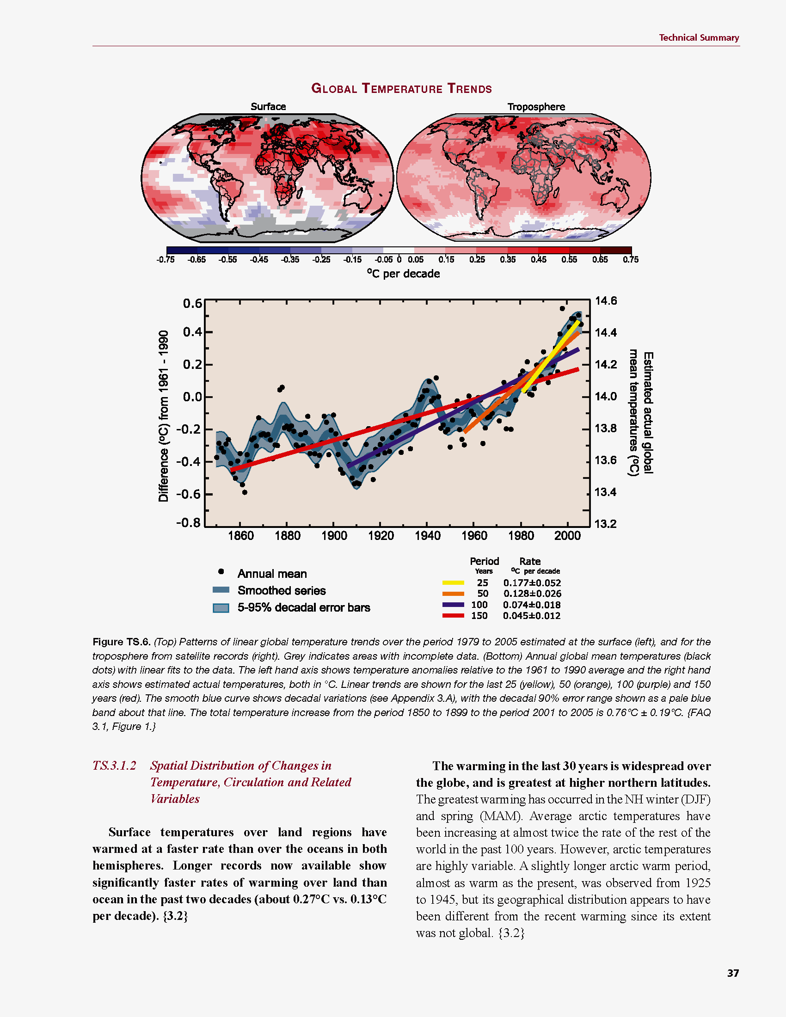
Common Myth #1
“Scientists expect a warmer future because it’s been warming up recently”
WRONG!
It’s because we know that when we add heat to things, they warm up

Slide 11
Simple
2. Serious
3. Solvable

Slide 12


How much warmer?
Low
Emissions
Land vs ocean!
North vs South
Global average
warming of 2º to 5º C
North American
warming of 3º to 6º C
= 5º to 11º F
Arctic warming of
8º to 14º F
Moderate
Emissions
High
Emissions
HOTTER WHERE WE LIVE!

Slide 13
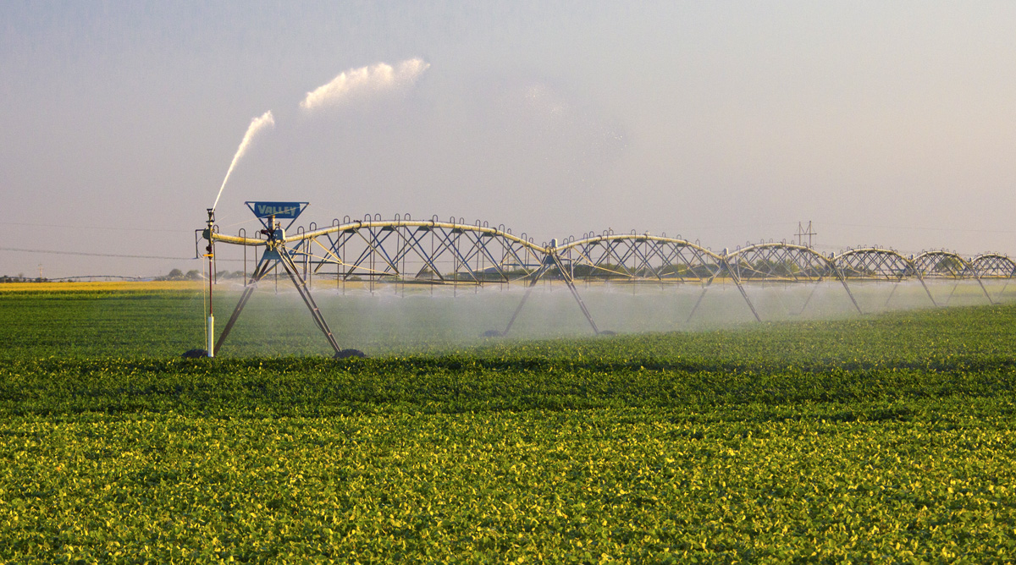
Water Budgets
Evaporative demand increases w/ temperature
In
Out
Drought is the running sum
of water out minus water in

Slide 14
Droughts Past & Future
Tree rings
Dust Bowl
Medieval Megadroughts
Climate models
Coming droughts much worse than any in past 1000 years

Slide 15
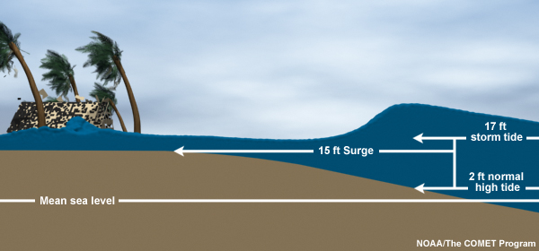
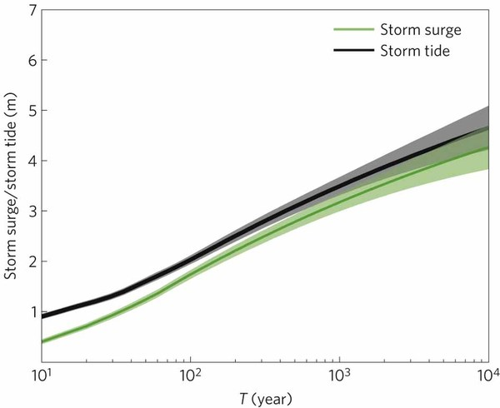
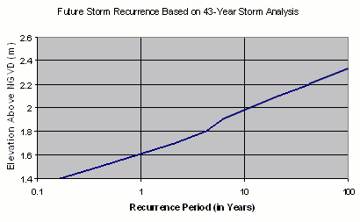
Storm Surge Frequency
Big storms push a “dome” of water onto land
Small storm surges happen
a lot
Big storm surges are more rare
Huge surges extremely rare
18
15
12
height above sea level (feet)
9
6
Coastal Flooding
Rockaway Beach, NYC
3
10 100 1000 10000
How often (years)

Slide 16

Coastal
Flooding
Sea level rise shifts the line up
Floods of a given depth happen more often
What was a
100-year flood becomes a
10-year flood!
Rockaway Beach, NYC
12
9
height above sea level (feet)
6
flooded
subway
system
3
10
100
1000
how often (years)

Slide 17
Hurricane Sandy Floods the NYC Subway

Slide 18
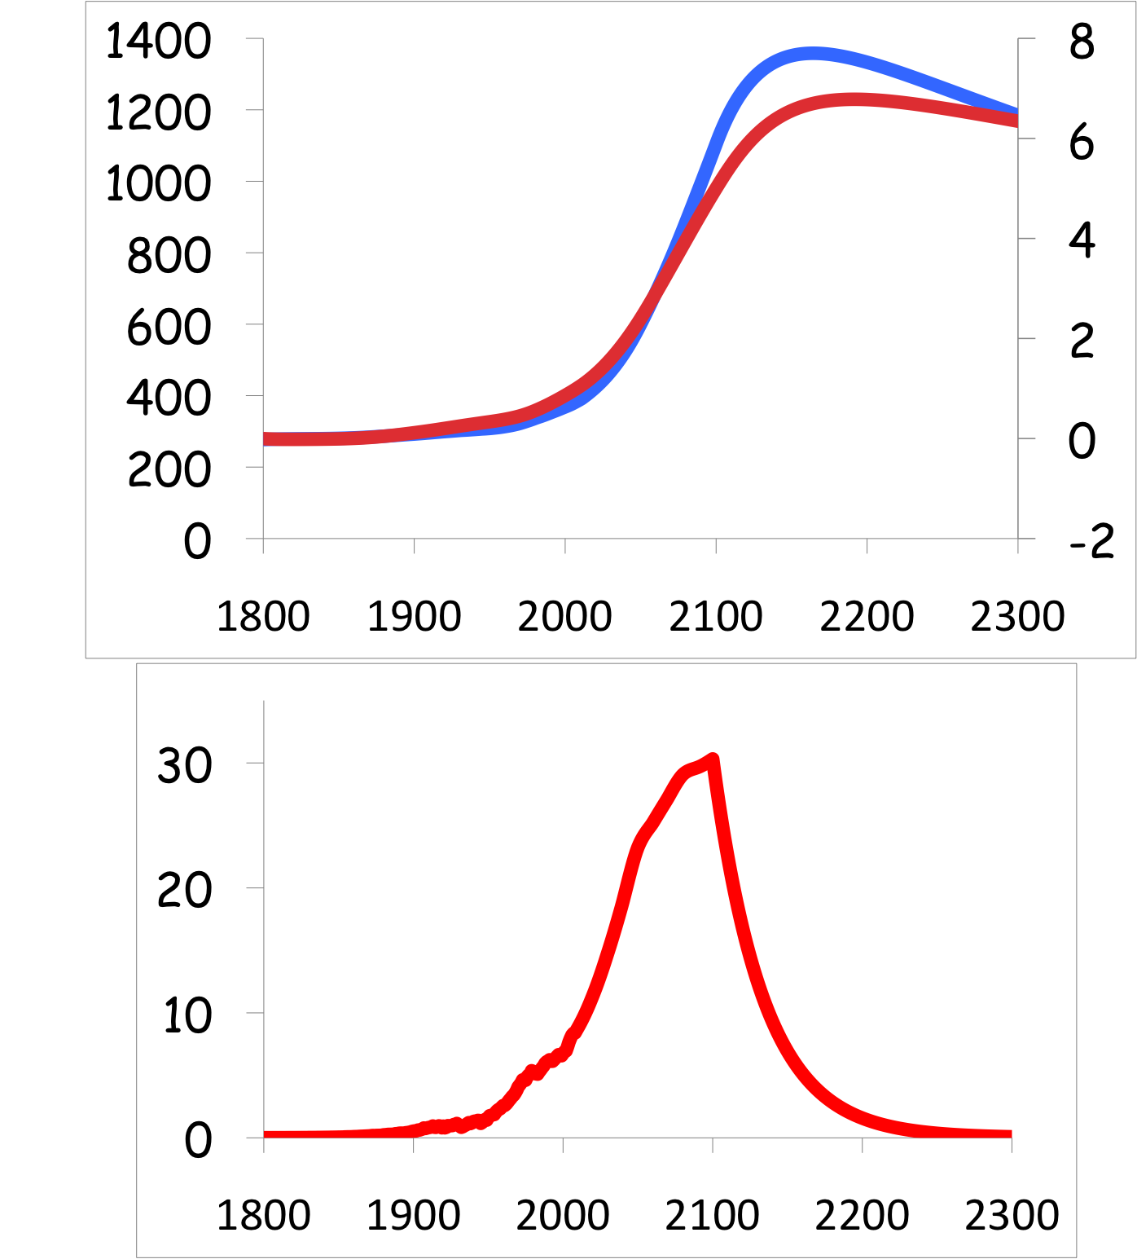
Common Myth #2
“When we reduce or stop burning fossil fuel, CO₂ will go away and things will go back to normal”
CO₂
If China and India industrialize with coal, CO₂ will rise to 4x preindustrial
Extra CO₂ will last for thousands of years after coal is gone
CO₂ (ppm)
warming
Warming (Celsius)
you are
here
emissions
GtC/yr
year
Thermostat only turns one way!

Slide 19
Simple
2. Serious
3. Solvable

Slide 20

Efficient Architects!
$4.5 TRILLION

Slide 21
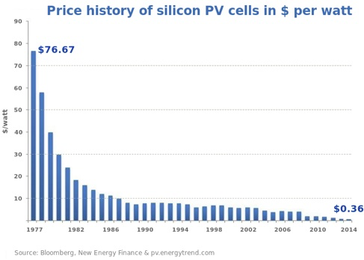
Price of Solar
PV Cells ($/watt)
Price has fallen by factor of 200 since I graduated from high school
Factor of 5 since 2011
Now cheaper than coal or gas!
Drop in 1970s
Flatter in1990s

Slide 22


Costs
Conversion to 100% noncarbon energy will cost about
1% of GDP
That’s about what it cost to retrofit all the world’s cities with indoor plumbing a century ago …
It was SO worth it!

Slide 23
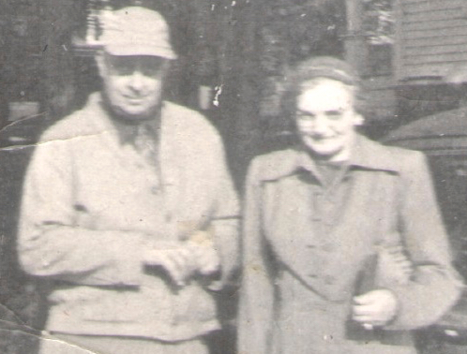
My Grandparents

Slide 24
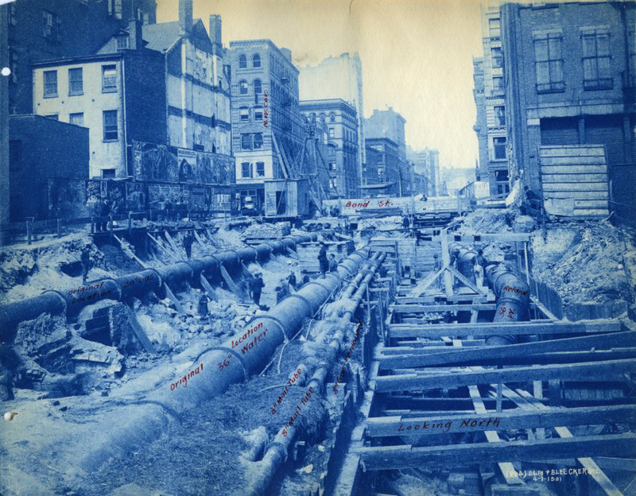
My Grandparents’ Generation
Built subways, sewers,
the electrical grid, defeated the Nazis

Slide 25
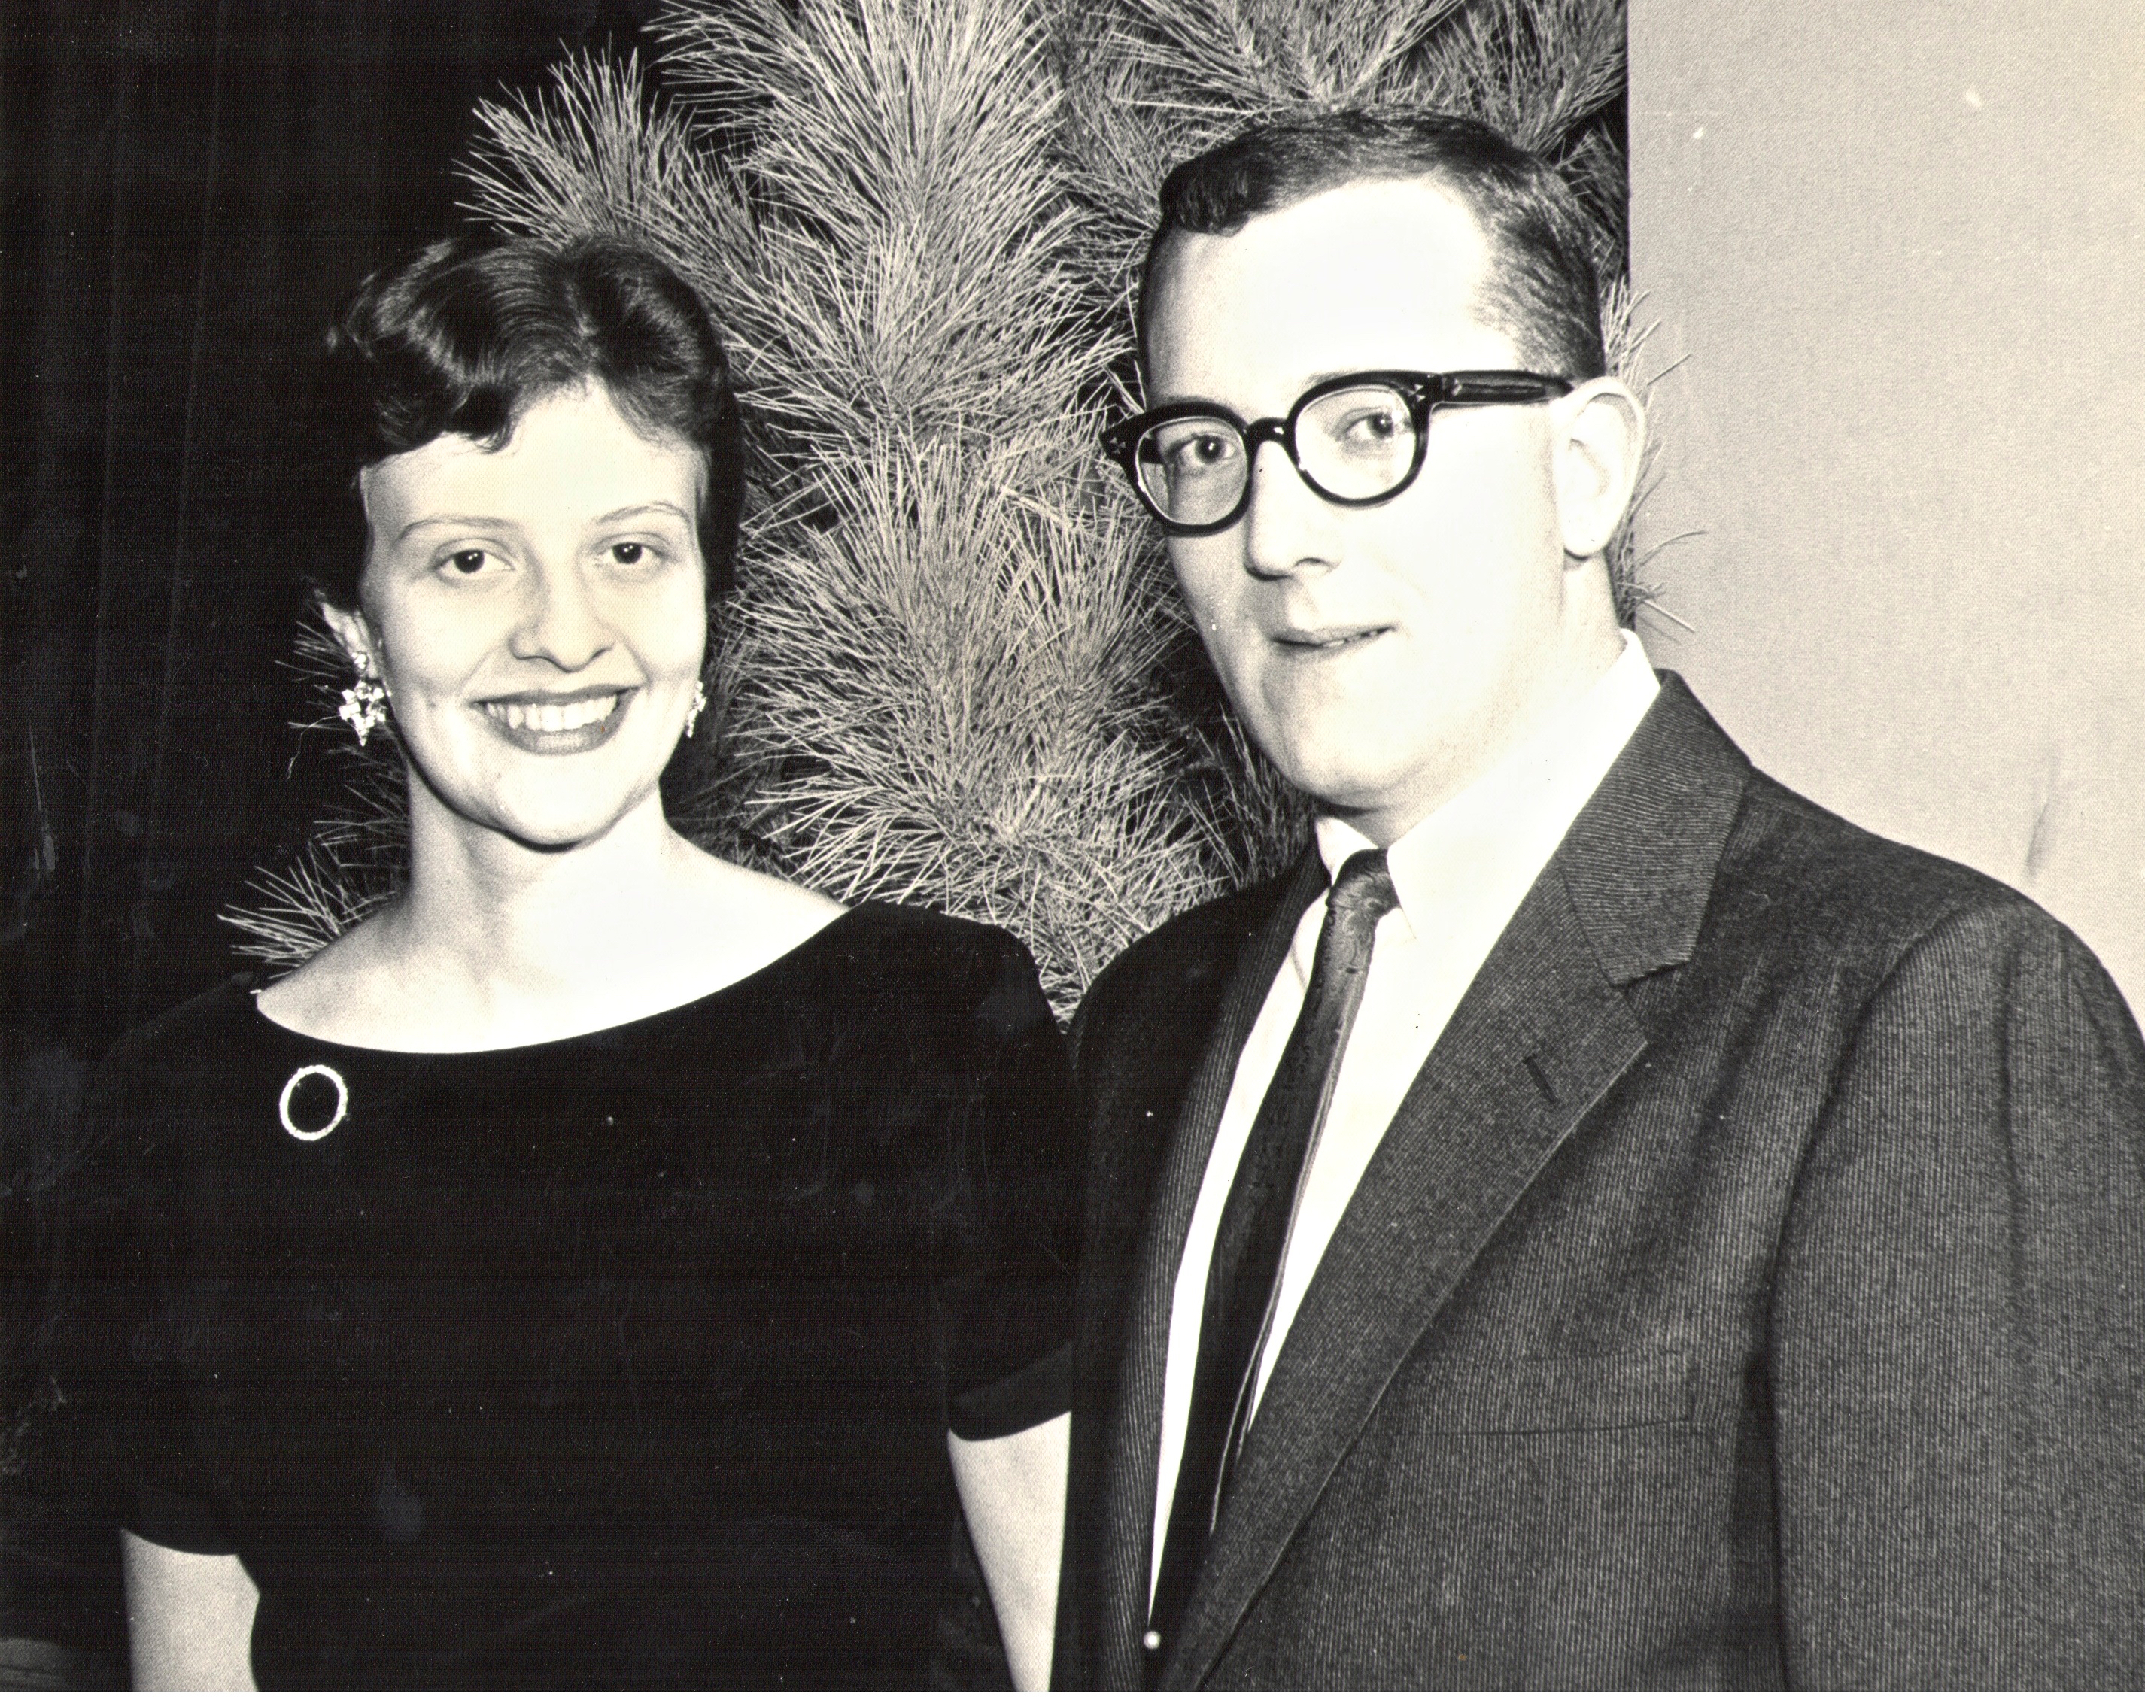
My Parents

Slide 26
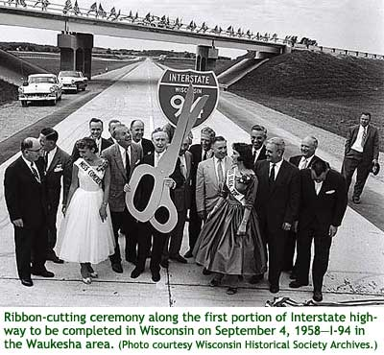
My Parents’ Generation
Built the Interstate Highways,
fought the cold war, landed on the Moon!

Slide 27
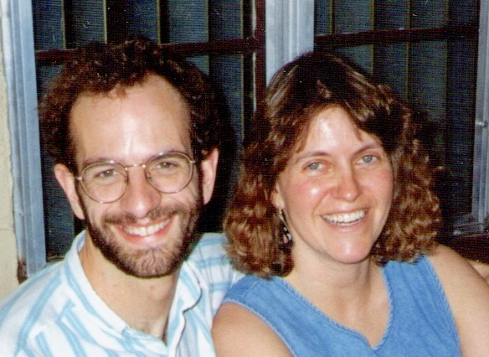
Jennifer & Me

Slide 28
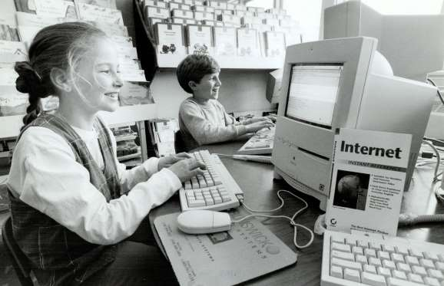
My Generation
Invented the PC, Built the internet,
replaced billions of land-lines with cell phones

Slide 29
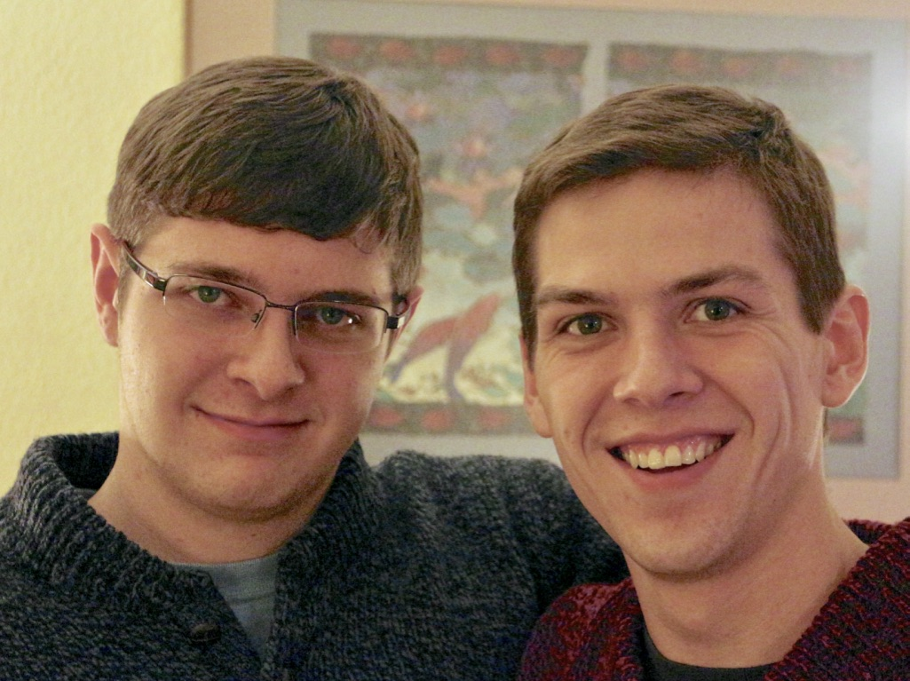
My Kids

Slide 30
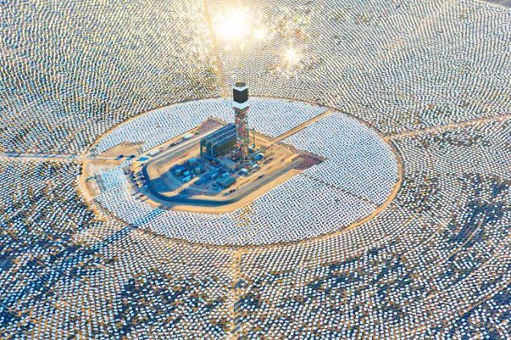

My Kids’ Generation
Will replace the world’s energy system again!

Slide 31

Choose Your Future
Many people think:
  “Our well-being is based on
  stuff we extract from the ground”
When we stop burning coal, will our descendants shiver in the dark?

Slide 32

Choose Your Future
I prefer:
  “We create our well-being through creativity, ingenuity, and hard work”
The future is bright!

Slide 33
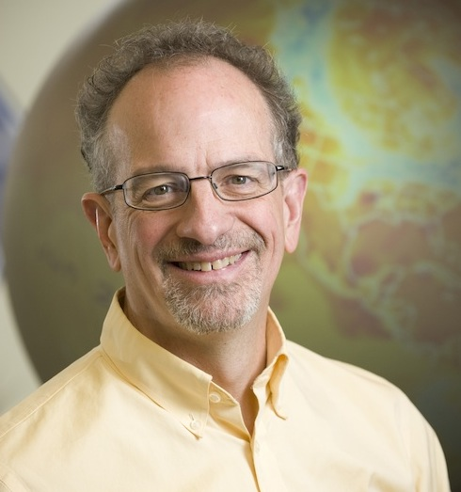
For More Info …
Email me for a link to this PowerPoint:
  Scott.Denning@gmail.com
Email me anytime with questions or comments (remind me where we met!)
Follow me on twitter:
  @airScottDenning

