Slide 1

Climate Change:
Simple, Serious, Solvable
Scott Denning
Director of Education, ESMEI
Atmospheric Science, CSU
Email Scott.Denning@ColoState.edu for a copy of this presentation

Slide 2
Simple
2. Serious
3. Solvable

Slide 3
Simple
2. Serious
3. Solvable

Slide 4
Weather vs Climate what’s the difference?
If you don’t like the weather:
  Wait five minutes!
If you don’t like the climate:
  Move!

Slide 5

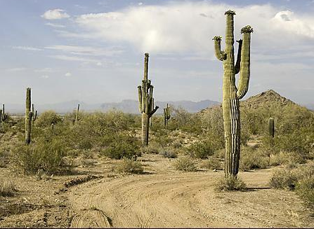
Location! Location! Location!
Climate is Place
Depends on where you live:
  Latitude!
  Altitude (mountains vs valley)
  What’s upwind (ocean vs land)
Changes very slowly
Very predictable
We can predict that Phoenix is warmer than Fargo for precisely the same reasons that we can predict a warmer future!
PHOENIX

Slide 6


Ever Wonder Why?
Day is warmer than night
Summer is warmer than winter
Phoenix is warmer than Fargo

Slide 7

Heat Budgets
Heat in
Heat in
Heat out
Heat out

Slide 8
Dancing Molecules and Heat Rays!
Nearly all of the air is made of oxygen (O₂) and nitrogen (N₂) in which two atoms of the same element share electrons
Infrared (heat) energy radiated up from the surface can be absorbed by these molecules, but not very well
O
O
N
N
Diatomic molecules can vibrate back and forth like balls on a spring, but the ends are identical

Slide 9
Dancing Molecules and Heat Rays!
Carbon dioxide (CO₂) and water vapor (H₂O) are different!
They have many more ways to vibrate and rotate, so they are very good at absorbing and emitting infrared (heat) radiation
O
C
O
O
H
H
Molecules that have many ways to wiggle are called “Greenhouse” molecules
Absorption spectrum of CO2 was measured by John Tyndall in 1863

Slide 10


Slide 11


Common Sense
1 m
Doubling CO₂ would add 4 watts to every square meter of the Earth, 24/7/365
Doing that would make the surface warmer
This was known before light bulbs were invented!
4 Watts
1 m
John Tyndall, January 1863

Slide 12

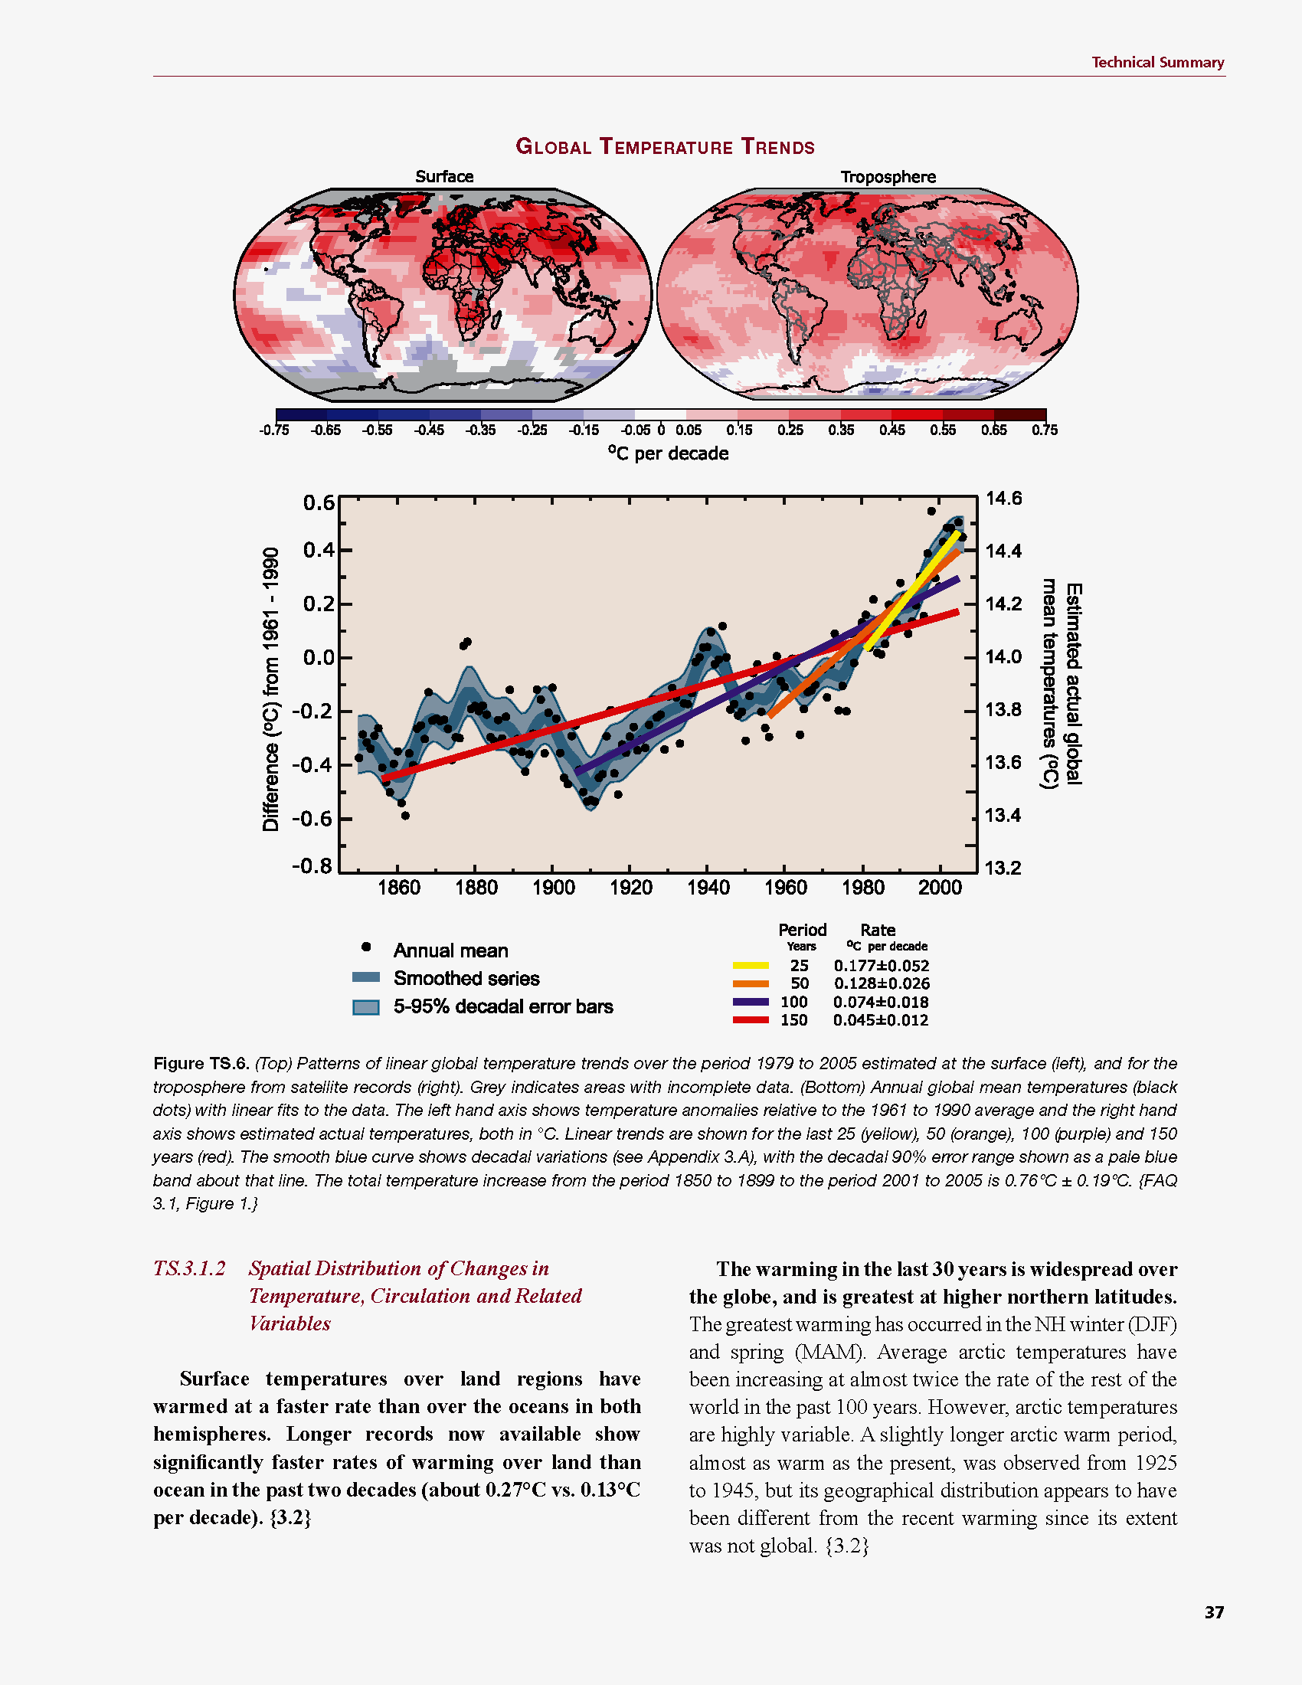
Common Myth #1
“Scientists expect a warmer future because it’s been warming up recently”
WRONG!
It’s because we know that when we add heat to things, they warm up

Slide 13
Cause and Effect
Forcing
Watts per
square meter
Response
degrees
Celsius or F
Response
Sensitivity =
Forcing
degrees per Watt m⁻²

Slide 14

Learning from the Past
Geologic past
(100’s of millions of years)
Deglaciation analog
(18,000 years ago to preindustrial time)
Last Millennium analog
(Medieval Warm Period to Little Ice Age)
Modern Climate Record
(20th Century changes)
The further back we go, the less data we have to work with.
Using modern data, we have only brief transients to study.

Slide 15
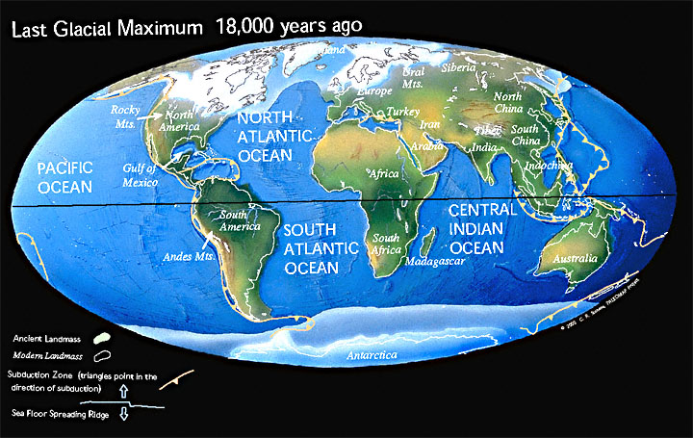
Ice Age World
High albedo
Low CO₂

Slide 16
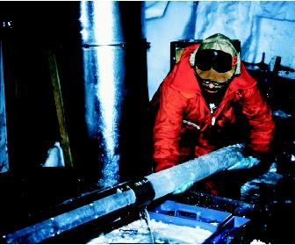
CO₂ and the Ice Ages
Over the past 420,000 years atmospheric CO₂ has varied between 180 and 280 ppm, beating in time with the last four glacial cycles
CO₂
370 ppm in 2000
ice
ice
ice
ice
Vostok (400k yr) Ice Core data (Petit et al, 1999)

Slide 17
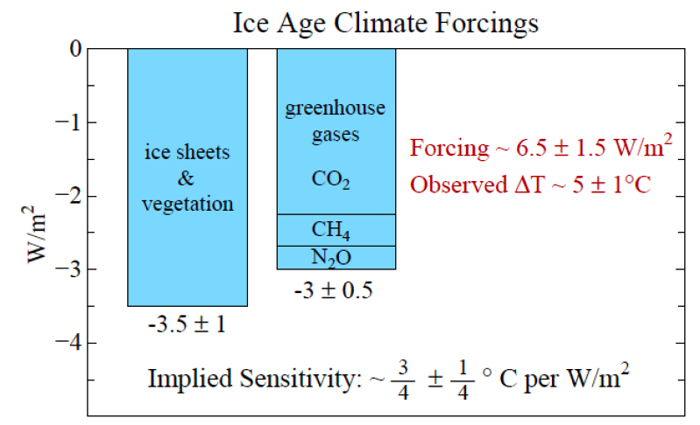
Climate Forcing
FORCING ~ 6.5 W/m2
WARMING ~ 5 ºC
Source: Hansen and Sato (2011)

Slide 18
Compare Ancient & Modern Forcing
End of Ice Age: 6.5 W m²
  Over 100 centuries (18k to 8k BP)
“Little Ice Age”: < 1 W m²
  (Roughly 1400 to 1800)
Since 1850: ~ 2 W m²
Burn 10x FF to date: 12 W m²
  (over 3 centuries if no policy)

Slide 19
Simple
2. Serious
3. Solvable

Slide 20


How much warmer?
Land vs ocean!
North vs South
Global mean
warming of 2º to 5º C
North American
warming of 3º to 6º C
= 5º to 11º F
Arctic warming of
8º to 14º F
Low
Emissions
Moderate
Emissions
High
Emissions
RULE OF THUMB:
Global Warming (Celsius)
x 1.6 (USA) x 1.8 = Fahrenheit

Slide 21

Where is it 10º F Warmer
“on the average?”
Denver ➔
Amarillo
Illinois ➔
Mississippi
Washington➔
Tallahassee
Water? Crops?
Real Estate? Health?

Slide 22
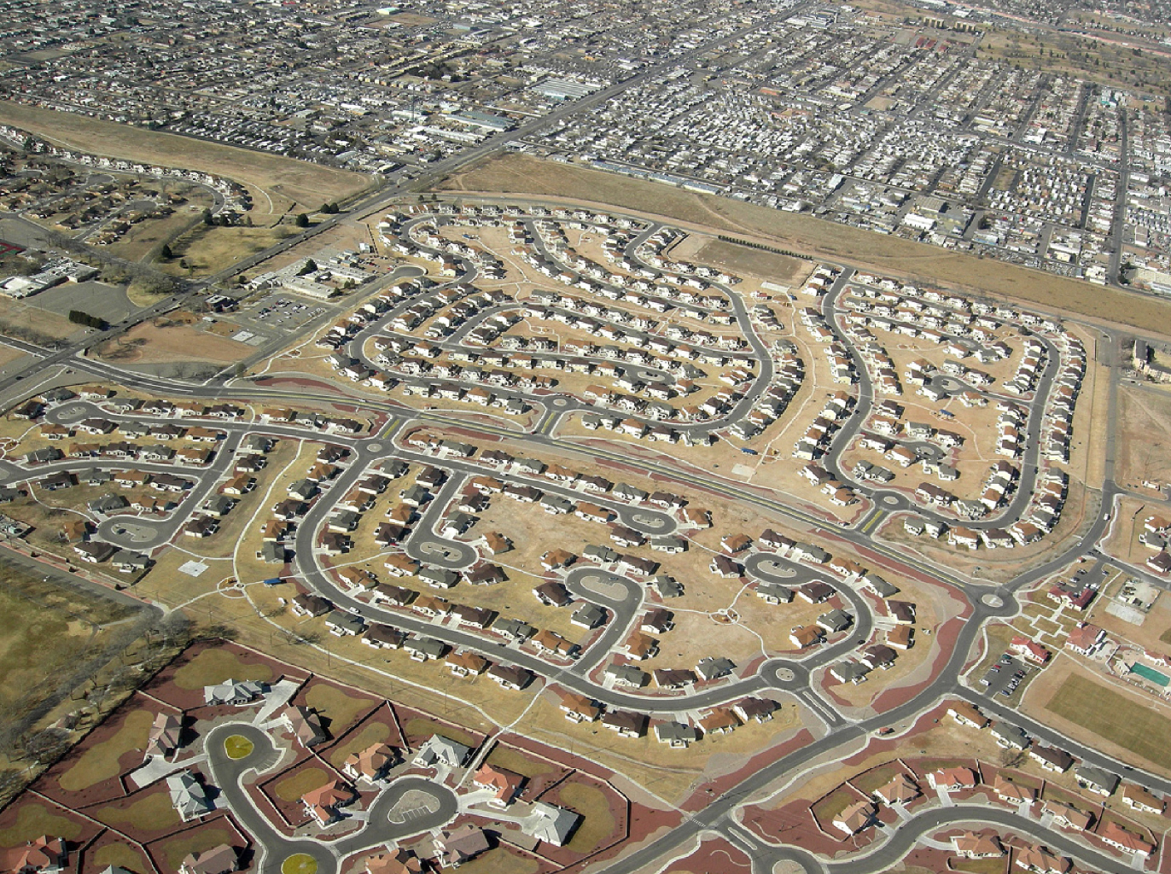
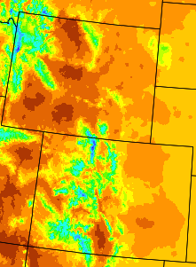
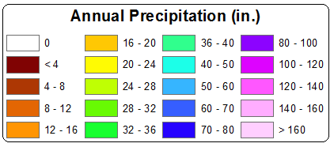
A Region On the Edge
Much of our region already receives only marginal precipitation
Just enough snow to support forests and reservoirs
Just enough irrigation water to support agriculture
Just enough water to support 5.3 million people

Slide 23
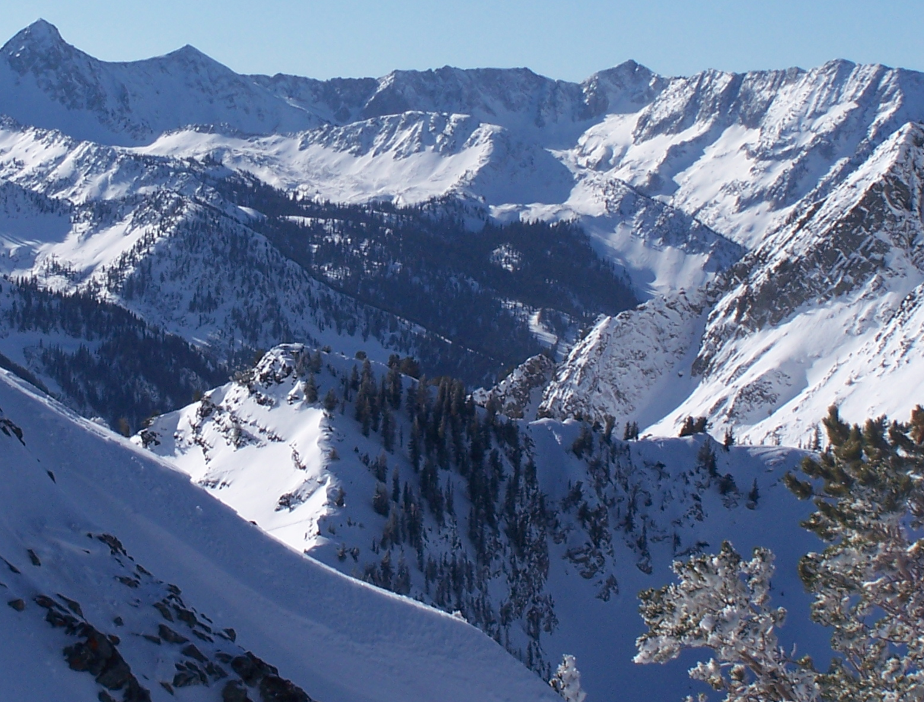
Snowpack

Slide 24
Declining Snowpack
20% less snowpack over 49 years
Less than 1 Fahrenheit average warming

Slide 25
Economic Development
Urban water use in Colorado currently about 17% of total
Colorado projects 60% population growth by 2050, to 8 million
Combined with increased ET, this will produce tremendous pressure for increased diversion to cities

Slide 26
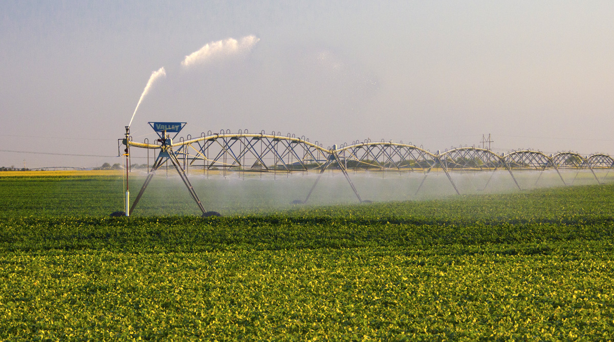
Water Budgets
Evaporative demand increases w/ temperature
In
Out
Drought is the running sum
of water out minus water in

Slide 27
Droughts Past & Future
Tree rings
Dust Bowl
Medieval Megadroughts
Climate models
Coming droughts much worse than any in past 1000 years

Slide 28

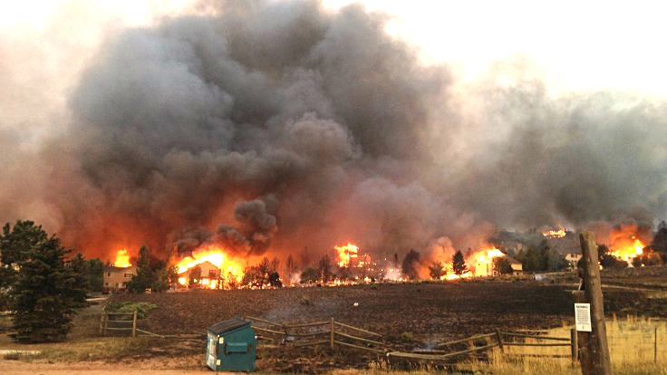
Warming Promotes Wildfire
Warmer air increases evaporative demand on forests
Longer warm season depletes soil moisture
More frequent extremely hot, dry, windy days when fires are uncontrollable
Projected Increase in Area Burned
656%
656%
NRC 2011

Slide 29
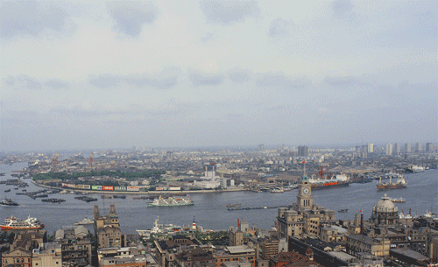
Billions and Billions
Shanghai 1991 and 2012
Currently 7 billion people on Earth
but only 1 billion use lots of energy
Rapid development to 4 billion
energy users over coming decades
Population growth only 30% but
energy growth 300% by 2100

Slide 30
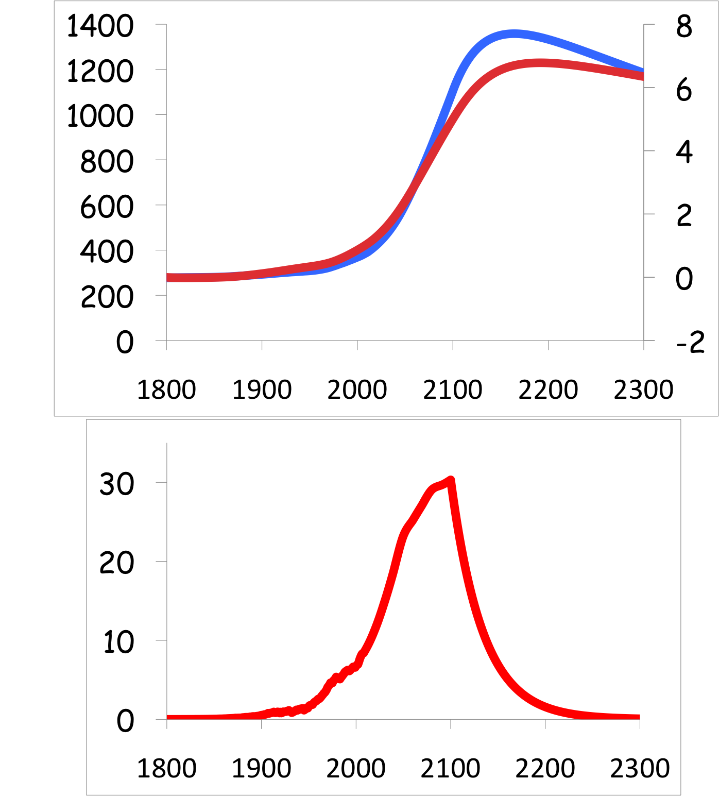
Common Myth #2
“When we reduce or stop burning fossil fuel, CO₂ will go away and things will go back to normal”
CO₂
If China and India industrialize with coal, CO₂ will rise to 4x preindustrial
Extra CO₂ will last for millennia after coal is gone
CO₂ (ppm)
warming
Warming (Celsius)
you are
here
emissions
GtC/yr
year
Thermostat only turns one way!

Slide 31
Simple
2. Serious
3. Solvable

Slide 32

Efficient Architects!
$4.5 TRILLION

Slide 33
Predictions vs Reality
SOLAR
Year after year, the International Energy Agency predicts very slow penetration of renewable energy
Year after year, they’re WAY wrong!
Why?
WIND

Slide 34
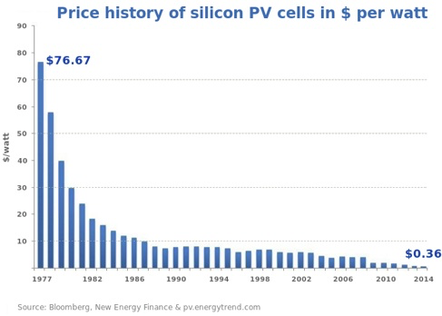
Price of Solar
PV Cells ($/watt)
Price has fallen by factor of 200 since I graduated from high school
Factor of 5 since 2011
Now as cheap or cheaper than coal or gas
Drop in 1970s
Flatter in 1990s

Slide 35
Solar Resources
US vs Germany
German electricity
4% wind & solar in 2000
28% wind & solar in 2014

Slide 36
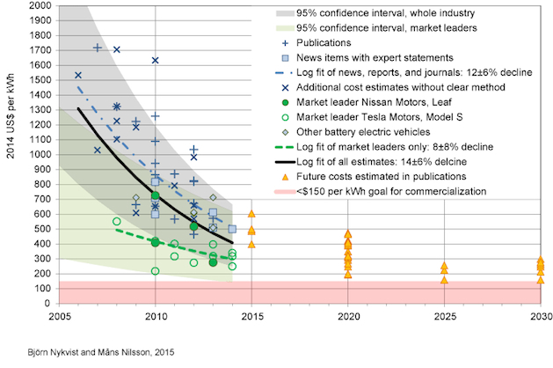
Lithium-Ion Batteries
“Optimistic” predictions for 2020
Much cheaper than expected
a few years ago!
Nissan Leaf today

Slide 37


Costs
Conversion to 100% noncarbon energy will cost about
1% of GDP
That’s about what it cost to retrofit all the world’s cities with indoor plumbing a century ago …
It was so worth it!

Slide 38
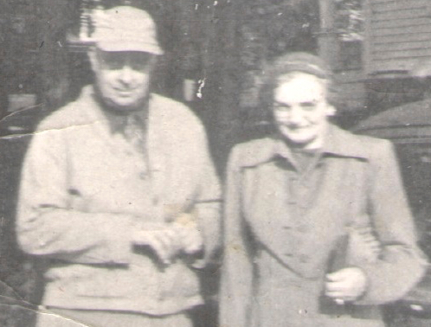
My Grandparents

Slide 39
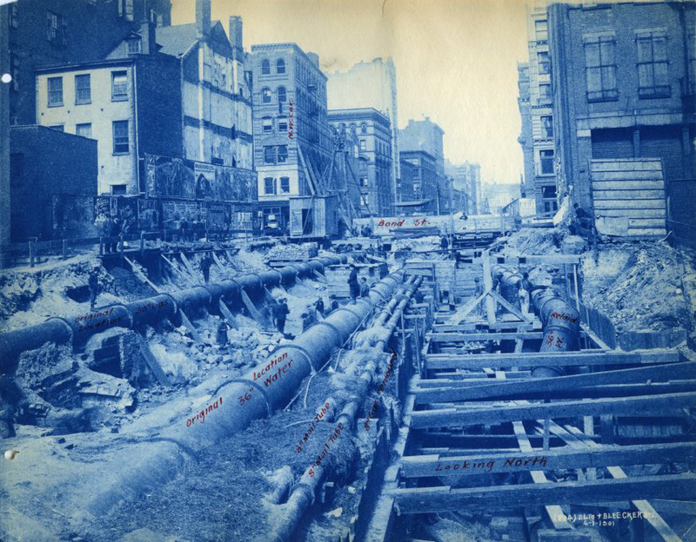
My Grandparents’ Generation
Built subways, sewers,
the electrical grid, defeated the Nazis

Slide 40
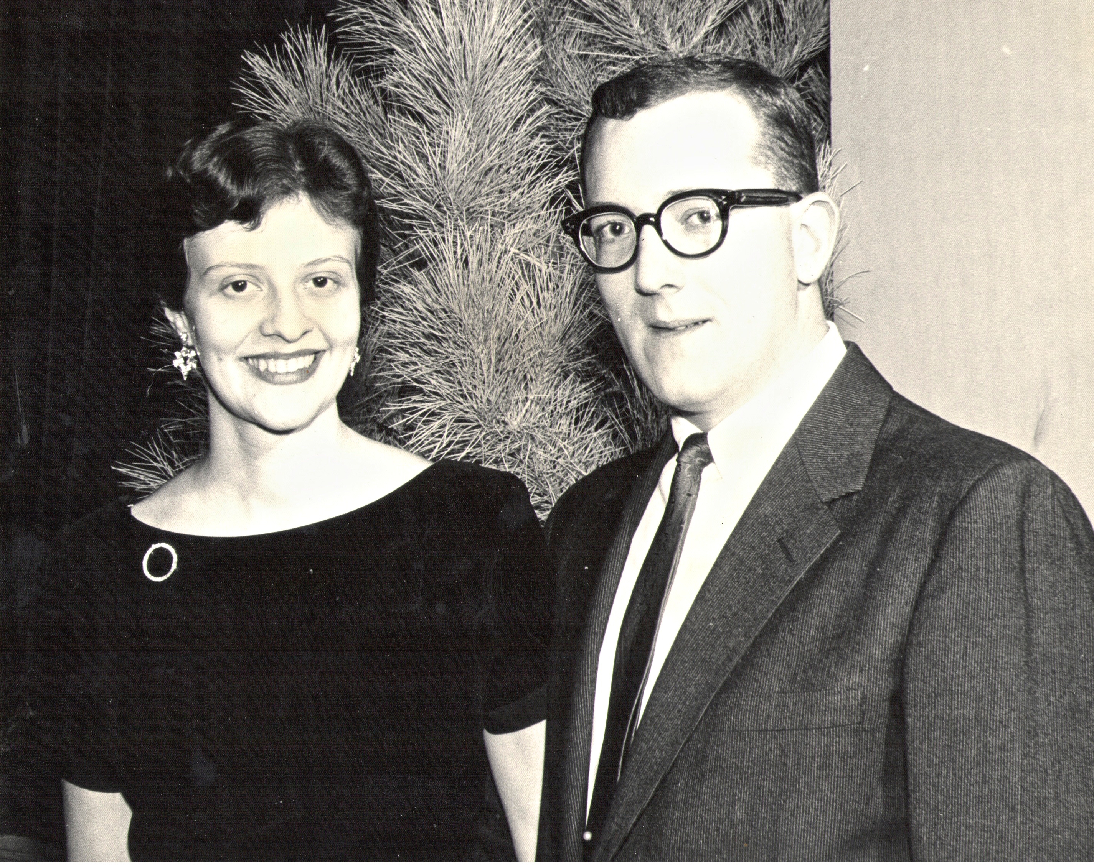
My Parents

Slide 41
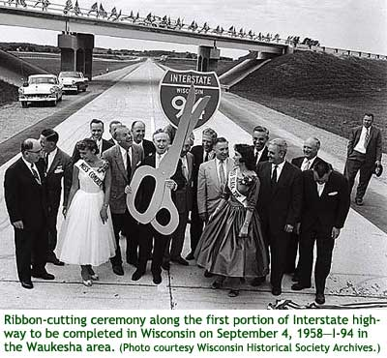
My Parents’ Generation
Built the Interstate Highways,
fought the cold war, landed on the Moon!

Slide 42
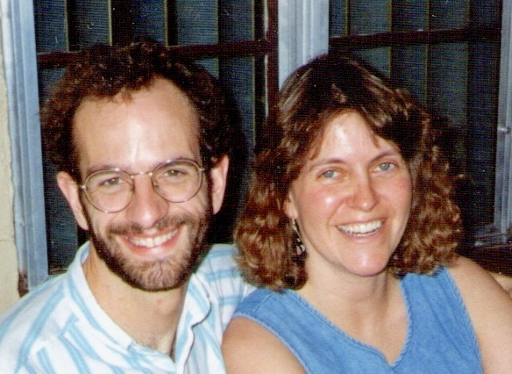
Jennifer & Me

Slide 43
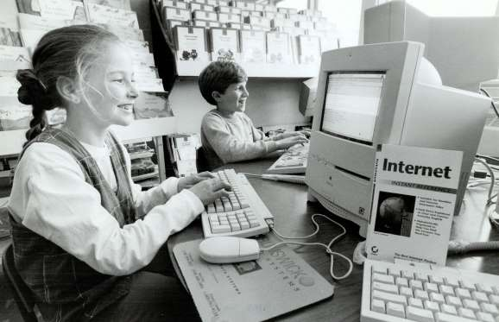
My Generation
Invented the PC, Built the internet,
replaced billions of land-lines with cell phones

Slide 44
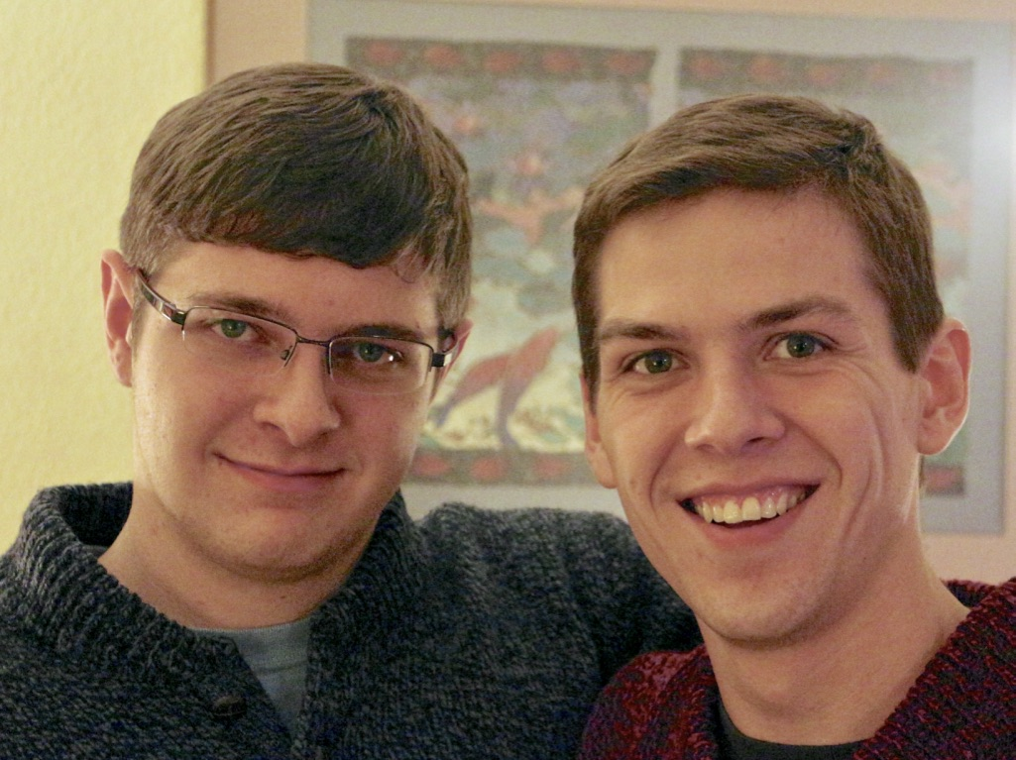
My Kids

Slide 45
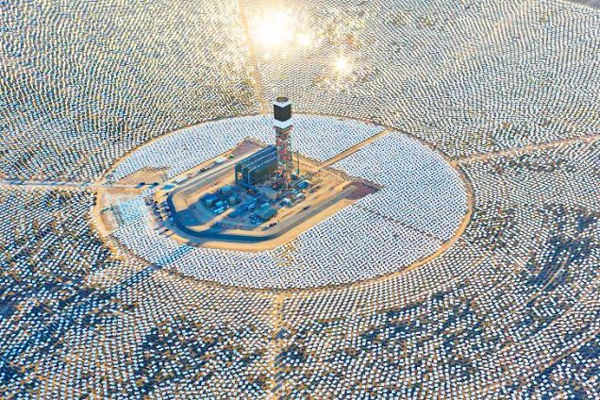

My Kids’ Generation
Will replace the world’s energy system again!

Slide 46

Choose Your Future
Many people think:
  “Our well-being is based on
  stuff we extract from the ground”
When we stop burning coal, will our descendants shiver in the dark?

Slide 47

Choose Your Future
I prefer:
  “We create our well-being through creativity, ingenuity, and hard work”
The future is bright!

Slide 48
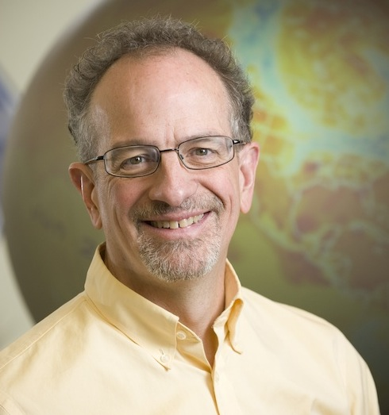
For More Info …
Email me for a link to this PowerPoint:
  Scott.Denning@gmail.com
Email me anytime with questions or comments (remind me where we met!)
Follow me on twitter:
  @airScottDenning

