Slide 1

Climate Change:
Simple, Serious, Solvable
Scott Denning
Director of Education, ESMEI
Atmospheric Science, CSU
Email Scott.Denning@ColoState.edu for a copy of this presentation

Slide 2
Simple
2. Serious
3. Solvable

Slide 3
Simple
2. Serious
3. Solvable

Slide 4


Ever Wonder Why?
Day is warmer than night
Summer is warmer than winter
Phoenix is warmer than Fargo

Slide 5

Heat Budgets
Heat in
Heat in
Heat out
Heat out

Slide 6
Dancing Molecules and Heat Rays!
Nearly all of the air is made of oxygen (O₂) and nitrogen (N₂) in which two atoms of the same element share electrons
Infrared (heat) energy radiated up from the surface can be absorbed by these molecules, but not very well
O
O
N
N
Diatomic molecules can vibrate back and forth like balls on a spring, but the ends are identical

Slide 7
Dancing Molecules and Heat Rays!
Carbon dioxide (CO₂) and water vapor (H₂O) are different!
They have many more ways to vibrate and rotate, so they are very good at absorbing and emitting infrared (heat) radiation
O
C
O
O
H
H
Molecules that have many ways to wiggle are called “Greenhouse” molecules
Absorption spectrum of CO2 was measured by John Tyndall in 1863

Slide 8


Slide 9


Common Sense
1 m
Doubling CO₂ would add 4 watts to every square meter of the Earth, 24/7/365
Doing that would make the surface warmer
This was known before light bulbs were invented!
4 Watts
1 m
John Tyndall, January 1863

Slide 10

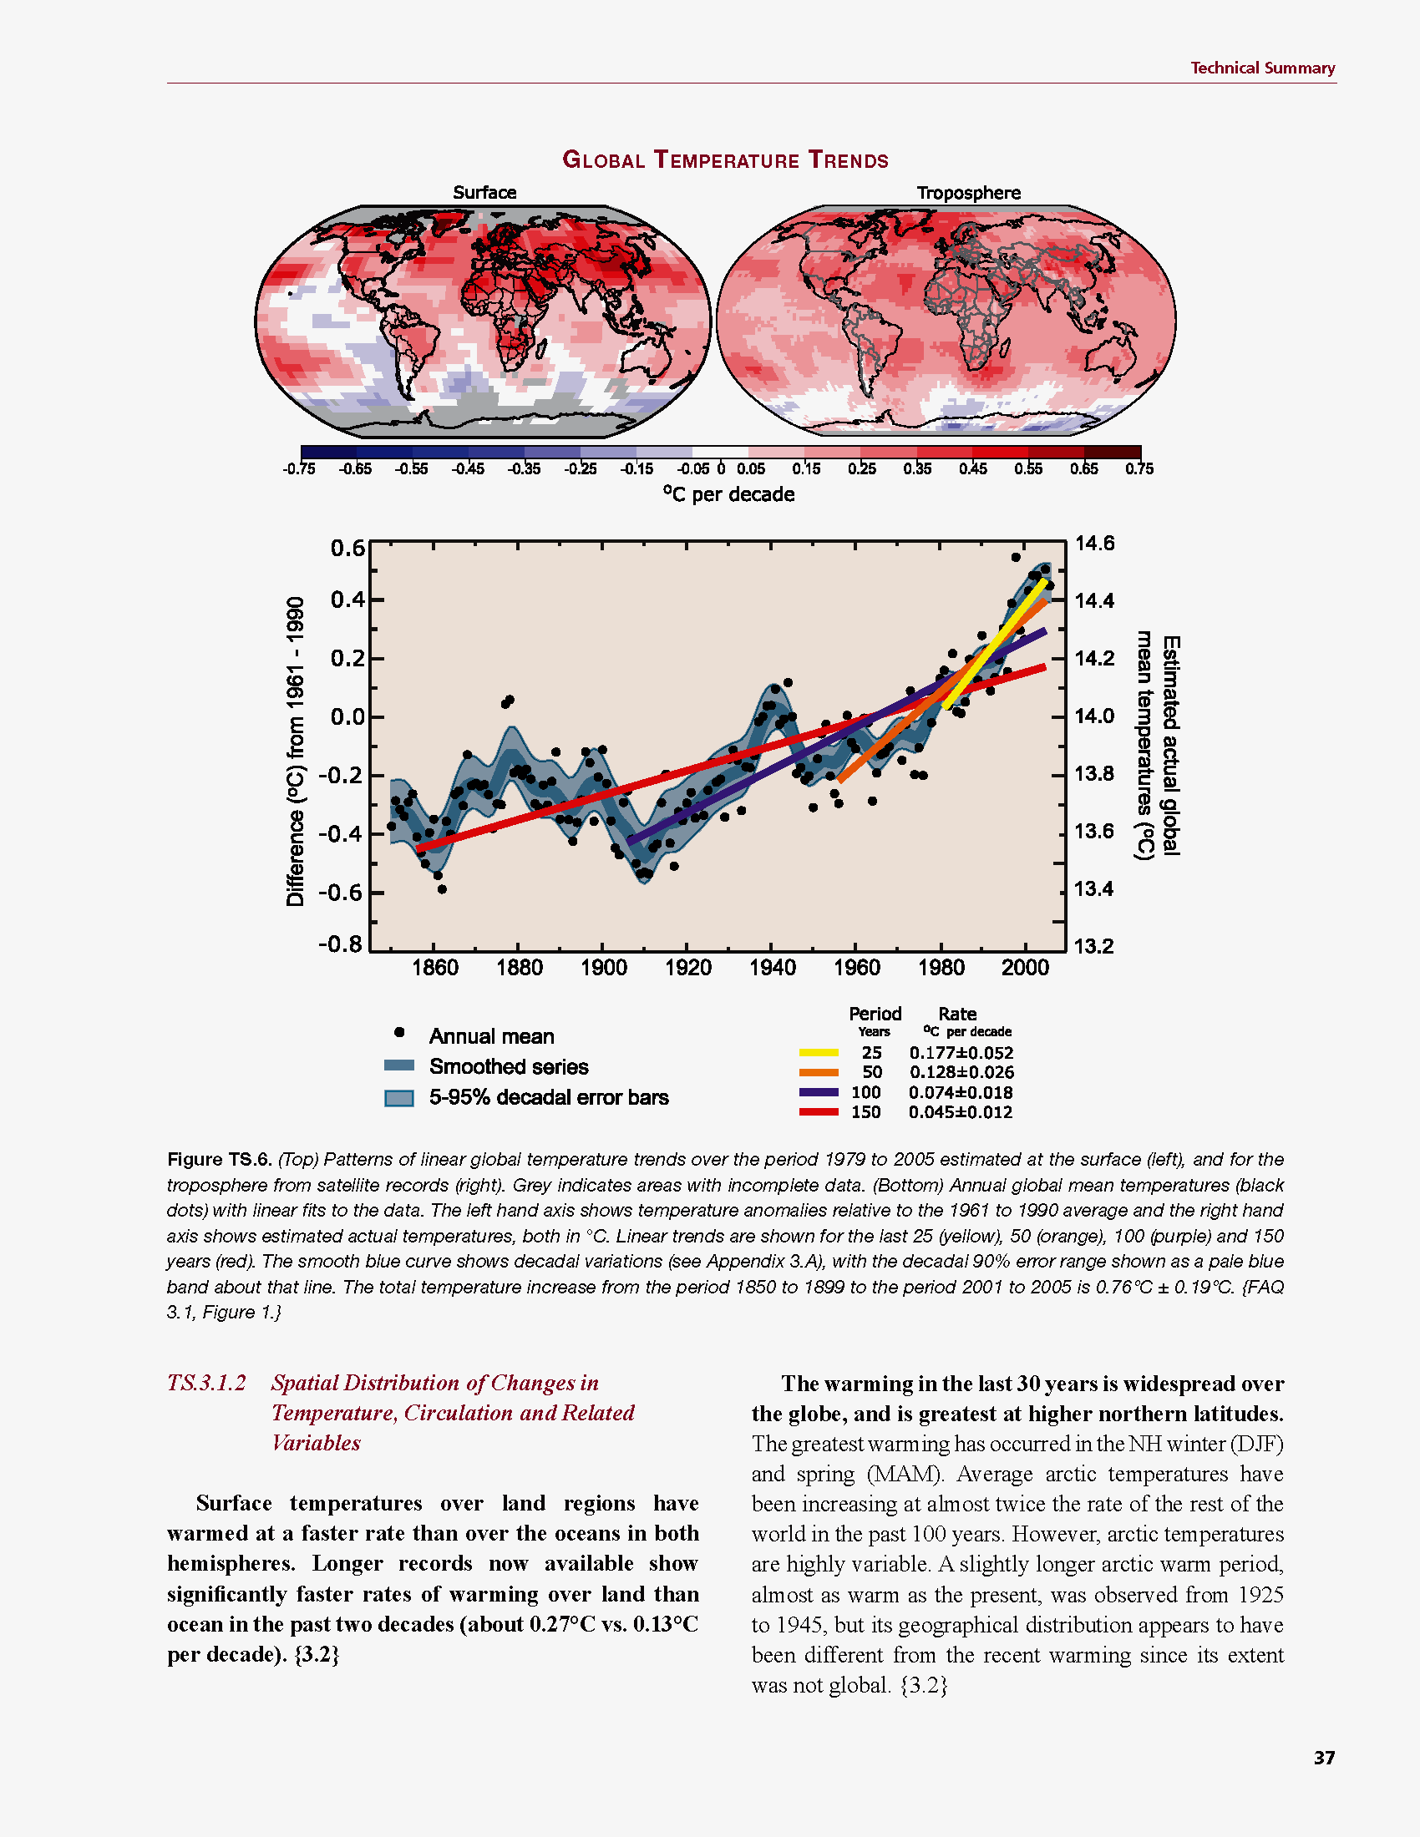
Common Myth #1
“Scientists expect a warmer future because it’s been warming up recently”
WRONG!
It’s because we know that when we add heat to things, they warm up

Slide 11
Simple
2. Serious
3. Solvable

Slide 12
Recent Changes
More warming on land than ocean
Warming since 1900 less than 1 C over ocean
Warming since 1900 around 1 C over land

Slide 13
Big Choices
Observed Change 1901-2012

Slide 14
Past and Future
Difference in climate between a low-emissions (RCP 2.6) and high-emissions (RCP 8.5) don’t become large until mid-century

Slide 15


How much warmer?
Land vs ocean!
North vs South
Global mean
warming of 2º to 5º C
North American
warming of 3º to 6º C
= 5º to 11º F
Arctic warming of
8º to 14º F
Low
Emissions
Moderate
Emissions
High
Emissions
RULE OF THUMB:
Global Warming (Celsius)
x 1.6 (USA) x 1.8 = Fahrenheit

Slide 16

Where is it 10º F Warmer
“on average?”
Seattle ➔
Sacramento
Denver ➔
Amarillo
Illinois ➔
Mississippi
Washington DC ➔
Tallahassee
10 ºF warming is like moving
600 – 800 miles South!
Water? Crops?
Real Estate? Health?

Slide 17
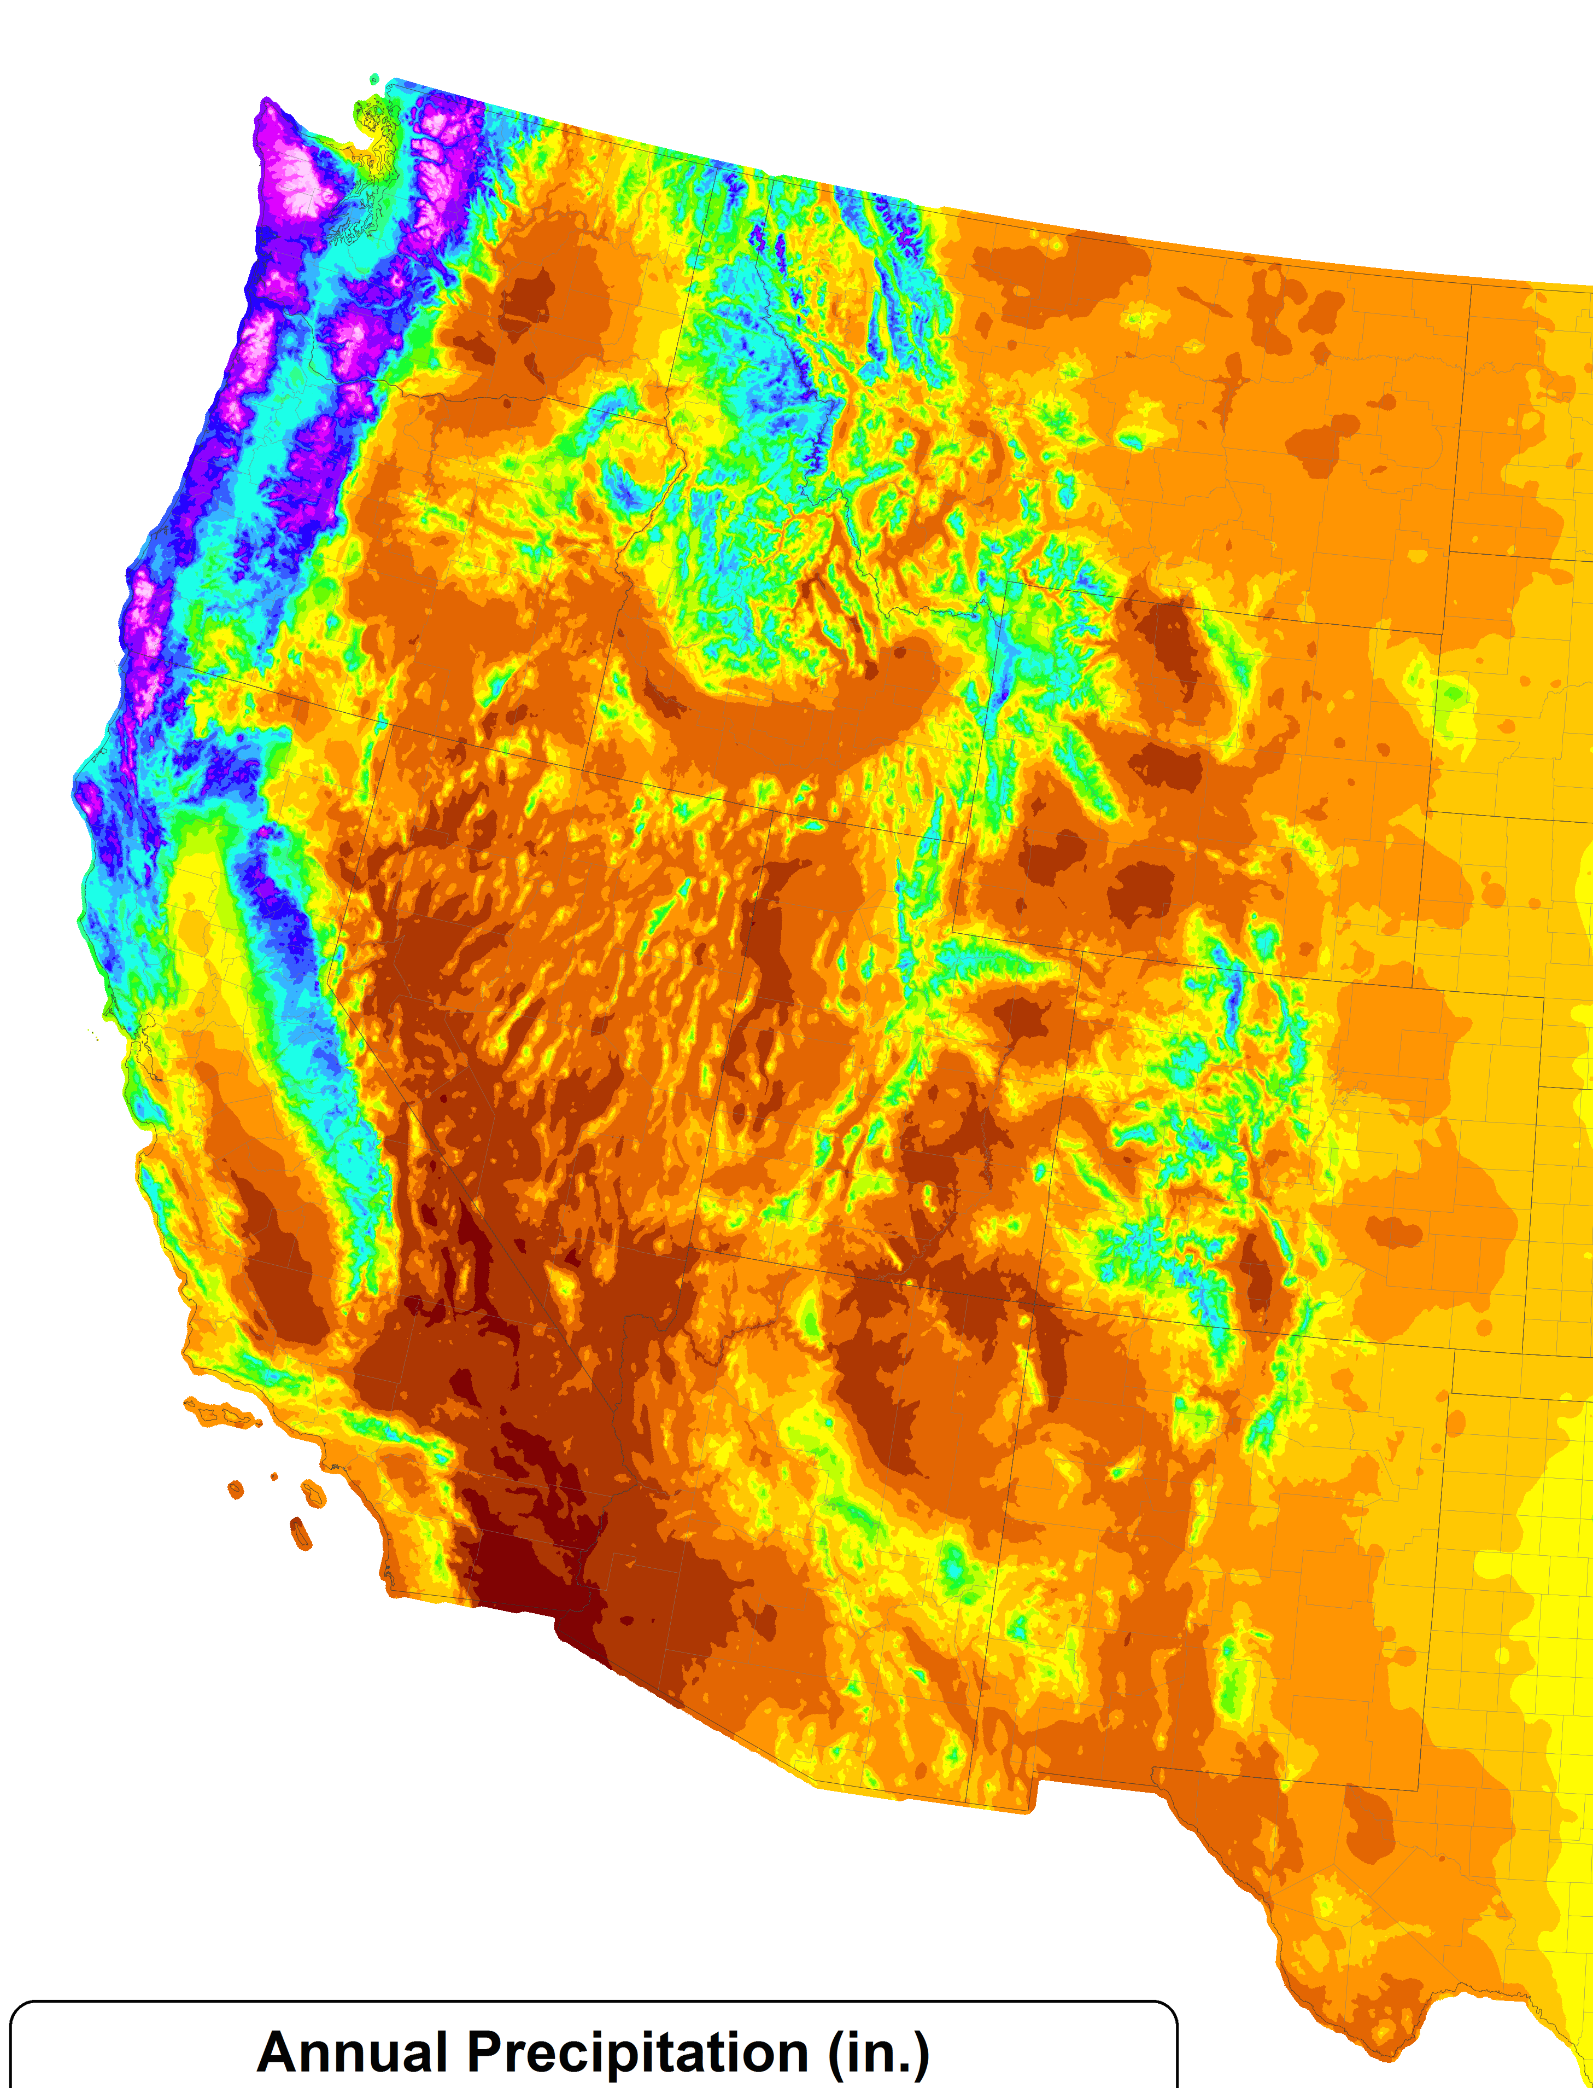
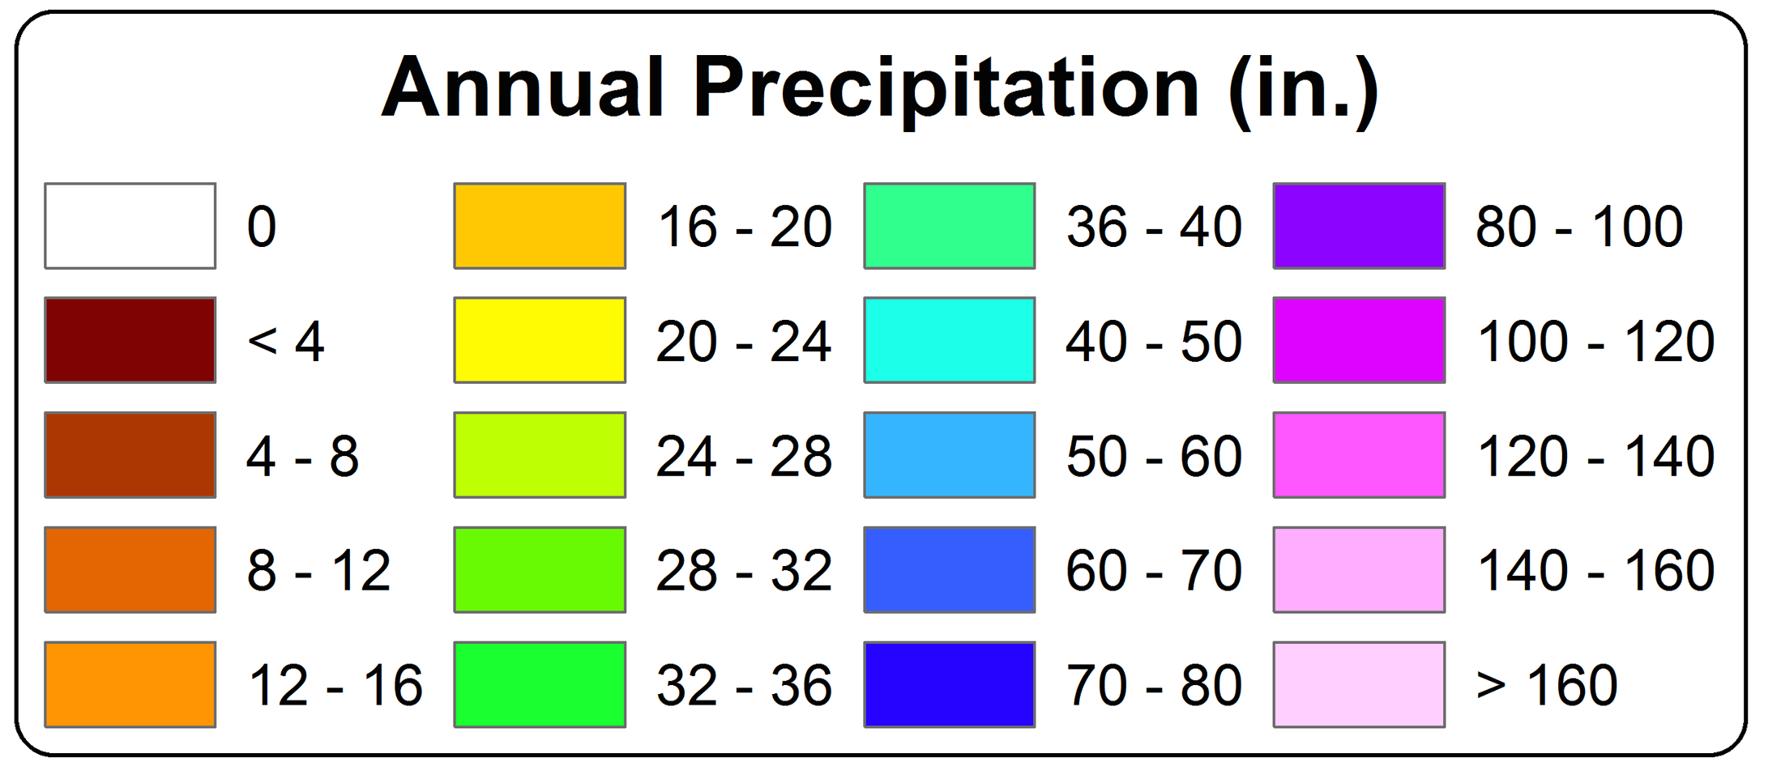
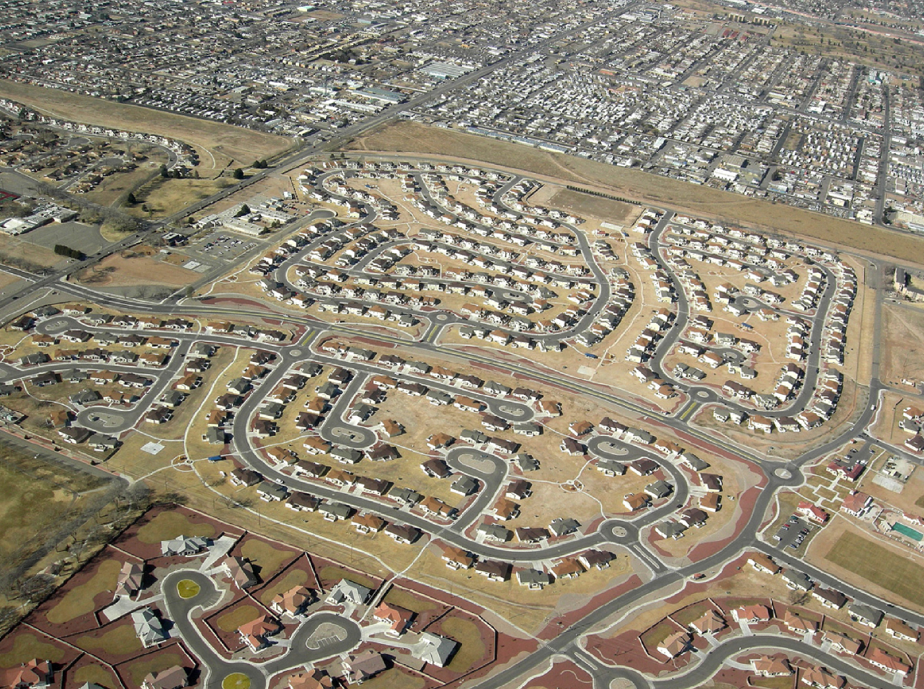
A Region
On the Edge
WA
MT
OR
WY
ID
NV
UT
CO
75 million people in the western US live in a region with marginal precipitation
Just enough snow to support forests and reservoirs
Just enough irrigation water to support farming
Just enough water for cities and towns
AZ
CA
NM
TX

Slide 18
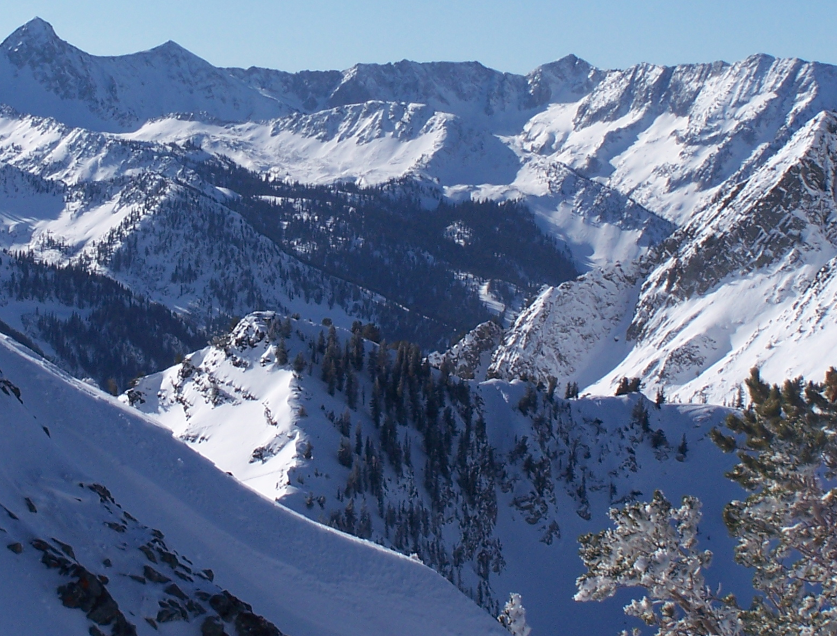
Snowpack

Slide 19
Declining Snowpack
20% less snowpack over 49 years
Less than 2 Fahrenheit average warming

Slide 20

Water Budgets
Evaporative demand increases w/ temperature
In
Out
Drought is the running sum
of water out minus water in

Slide 21
Droughts Past & Future
Tree rings
Dust Bowl
Medieval Megadroughts
Climate models
Coming droughts much worse than any in past 1000 years

Slide 22

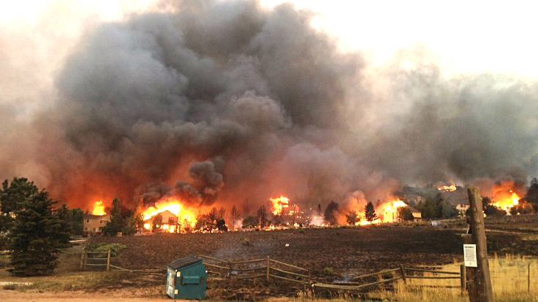
Warming Promotes Wildfire
Warmer air increases evaporative demand on forests
Longer warm season depletes soil moisture
More frequent extremely hot, dry, windy days when fires are uncontrollable
Projected Increase in Area Burned
656%
656%
NRC 2011

Slide 23
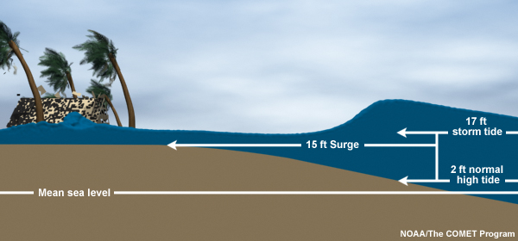
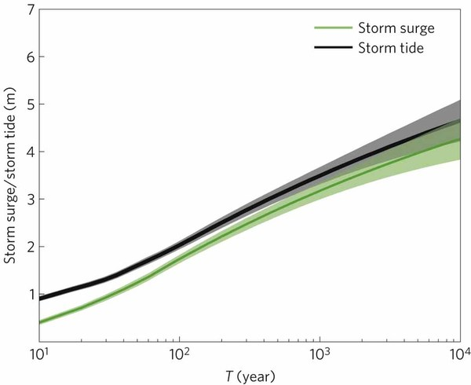
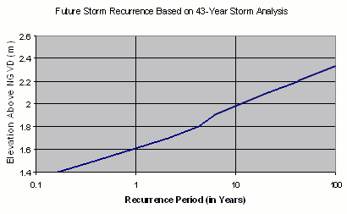
Storm Surge Frequency
Big storms push a “dome” of water onto land
Small storm surges happen
a lot
Big storm surges are more rare
Huge surges extremely rare
18
15
12
height above sea level (feet)
9
6
Coastal Flooding
Rockaway Beach, NYC
3
10 100 1000 10000
How often (years)

Slide 24

Coastal
Flooding
Sea level rise shifts the line up
Floods of a given depth happen more often
What was a
100-year flood becomes a
10-year flood!
Rockaway Beach, NYC
12
9
height above sea level (feet)
6
flooded
subway
system
3
10
100
1000
how often (years)

Slide 25
Hurricane Sandy Floods the NYC Subway

Slide 26
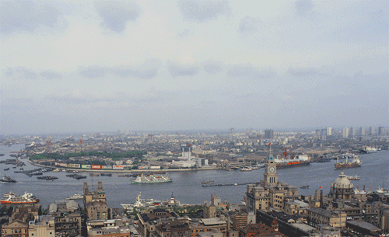
Billions and Billions
Shanghai 1991 and 2012
Currently 7 billion people on Earth
but only 1 billion use lots of energy
Rapid development to 4 billion
energy users over coming decades
Population growth only 30% but
energy growth 300% by 2100

Slide 27
Like Moore’s Law
To limit warming to 2 C, emissions have to fall 50% each decade starting now!
This will be really hard!
Future Fossil Fuel Emissions
GtC/yr
Rockstrom et al (2017)
A roadmap for rapid decarbonization
Science 24 Mar 2017:
355, 1269-1271
DOI: 10.1126/science.aah3443

Slide 28
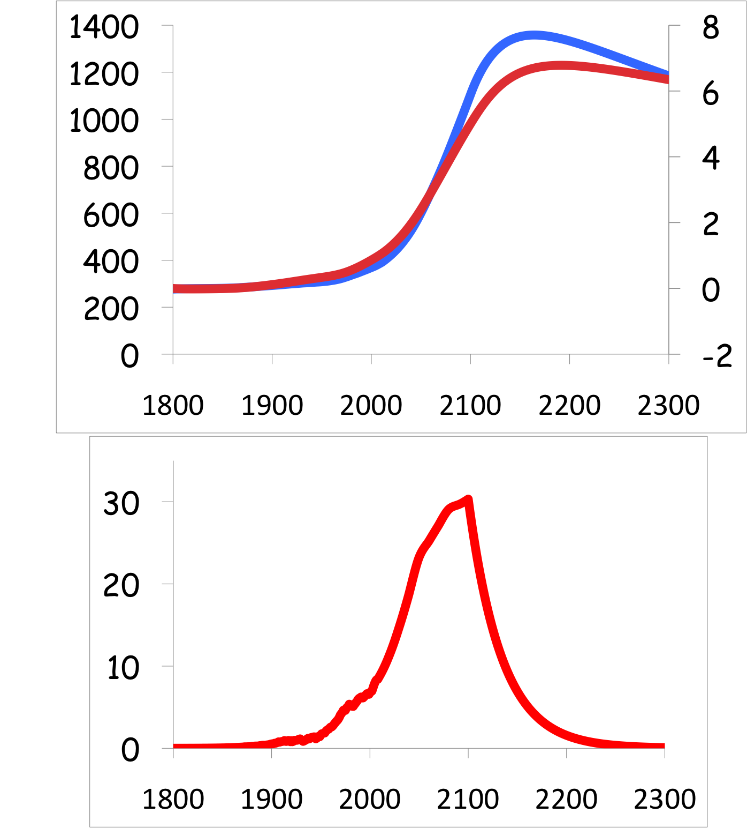
Common Myth #2
“When we reduce or stop burning fossil fuel, CO₂ will go away and things will go back to normal”
CO₂
If China and India industrialize with coal, CO₂ will rise to 4x preindustrial
Extra CO₂ will last for thousands of years after coal is gone
CO₂ (ppm)
warming
Warming (Celsius)
you are
here
emissions
GtC/yr
year
Thermostat only turns one way!

Slide 29
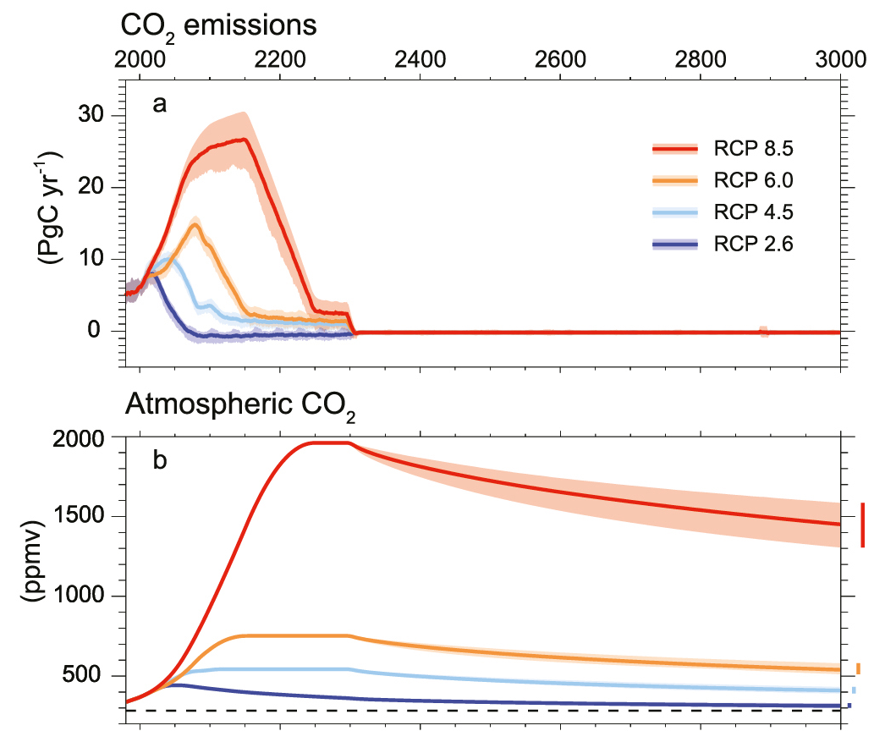
Emissions peak soon
CO₂ Lasts Much Longer

Slide 30
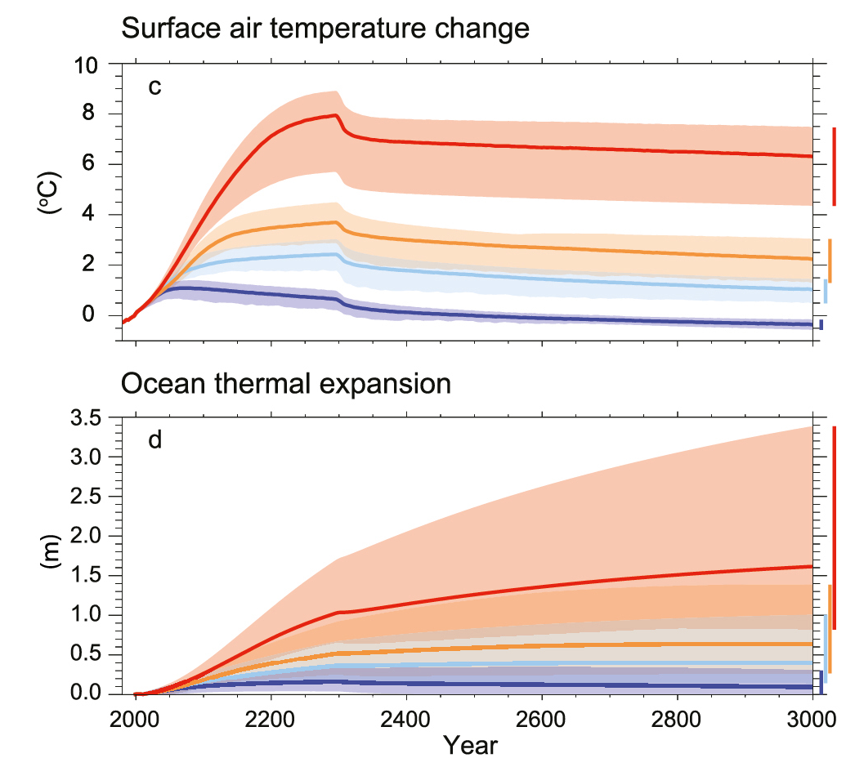
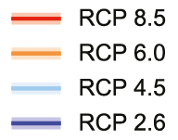
Bigger than Deglaciation
Warming is “permanent”
But 50x as fast

Slide 31
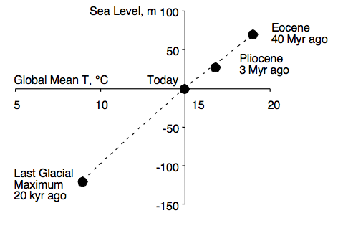
Climate and Sea Level
Linear relationship between climate & sea level over 40 million years

Slide 32
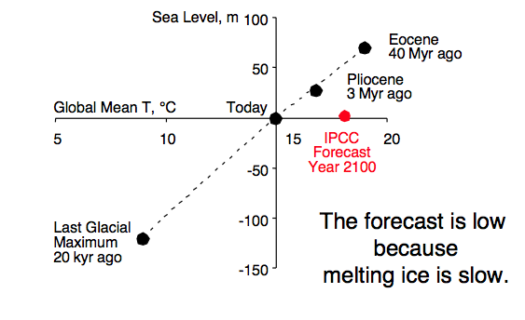
Climate and Sea Level

Slide 33
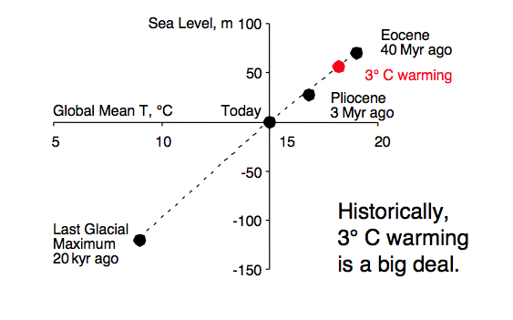

Climate and Sea Level
Seas rose 1 foot per decade for 400 years

Slide 34
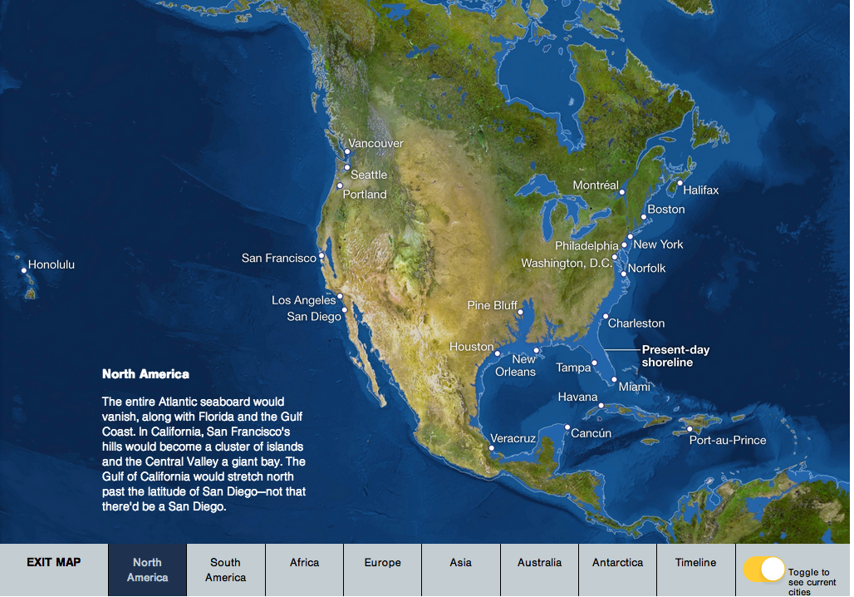
Eventually
http://www.freetech4teachers.com/2013/09/an-interactive-map-of-rising-sea-levels.html

Slide 35
Simple
2. Serious
3. Solvable

Slide 36


Efficient Architects!
$4.5 TRILLION SAVINGS !
Energy to Power US Buildings
2010
2020
2030

Slide 37
Predictions vs Reality
SOLAR
Year after year, the International Energy Agency predicts very slow penetration of renewable energy
Year after year, they’re WAY wrong!
Why?
WIND

Slide 38
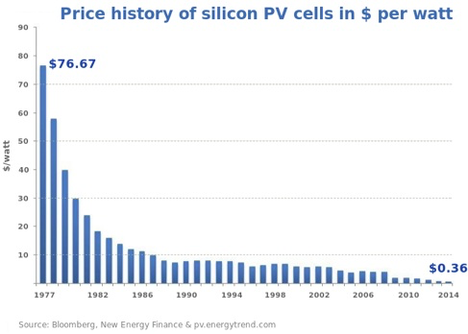
Price of Solar
PV Cells ($/watt)
Price has fallen by factor of 200 since I graduated from high school
Factor of 5 since 2011
Now as cheap or cheaper than coal or gas
Drop in 1970s
Flatter in1990s

Slide 39
Solar Resources
Germany gets less sun than Alaska!
German electricity
4% wind & solar in 2000
32% wind & solar in 2016
US vs Germany

Slide 40
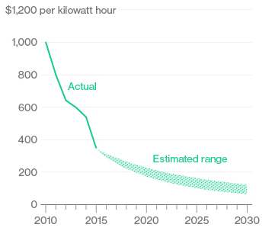
Battery Storage
In 2015, BNEF predicted $150/kWh by 2025
2017
Chevy
Bolt
Chevy Bolt reached $145 already
(8 years early)!
Now 7 times cheaper than in 2010!
Next year: Tesla “Gigafactory”
Bloomberg New Energy Finance Data

Slide 41


Costs
Conversion to 100% noncarbon energy will cost about
1% of GDP
That’s about what it cost to retrofit all the world’s cities with indoor plumbing a century ago …
It was SO worth it!

Slide 42
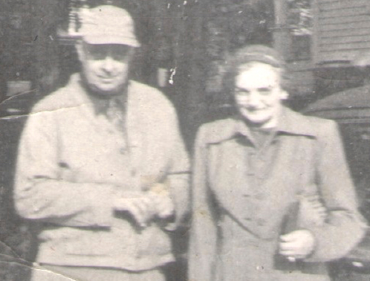
My Grandparents

Slide 43
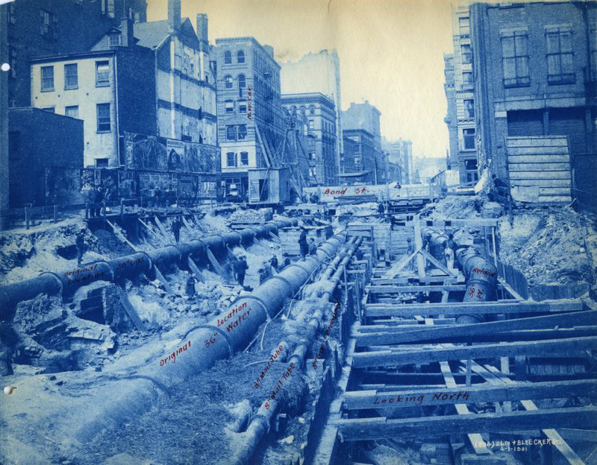
My Grandparents’ Generation
Built subways, sewers,
the electrical grid, defeated the Nazis

Slide 44
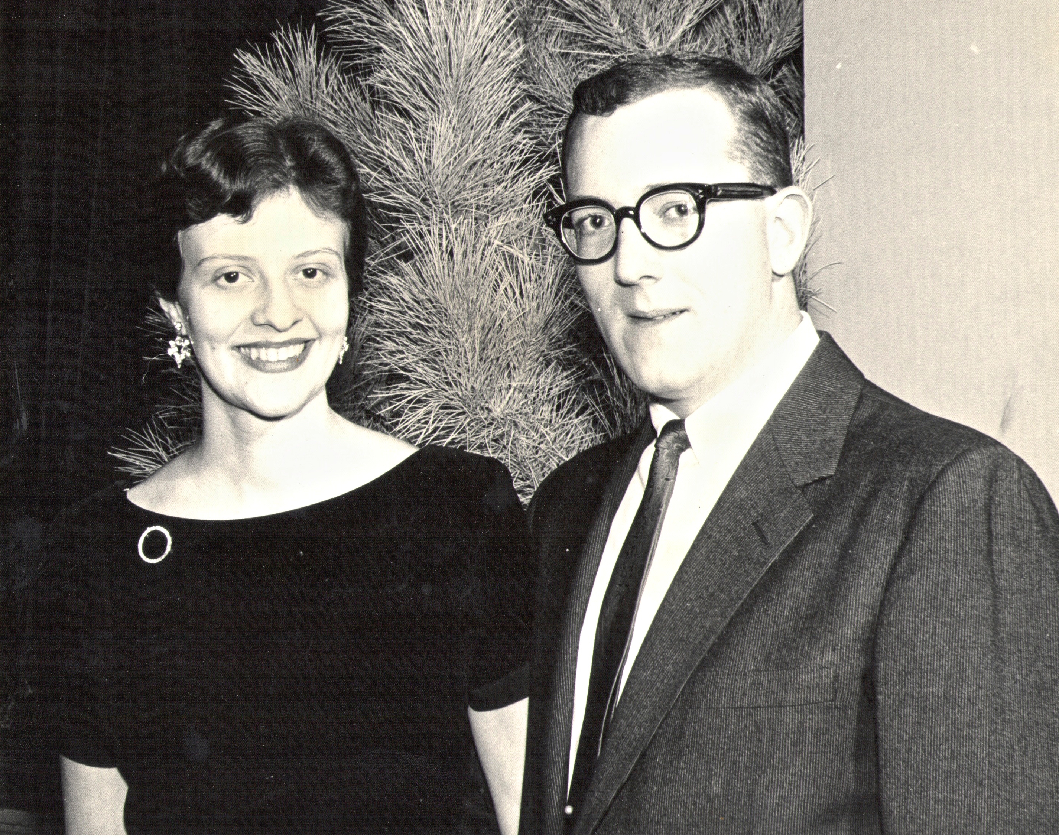
My Parents

Slide 45
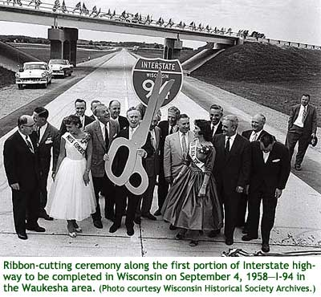
My Parents’ Generation
Built the Interstate Highways,
fought the cold war, landed on the Moon!

Slide 46
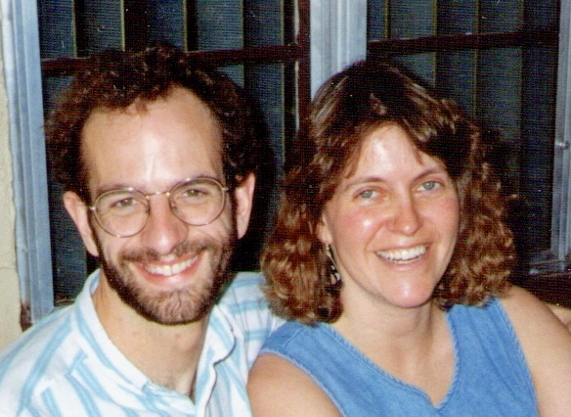
Jennifer & Me

Slide 47

My Generation
Invented the PC, Built the internet,
replaced billions of land-lines with cell phones

Slide 48

My Kids

Slide 49
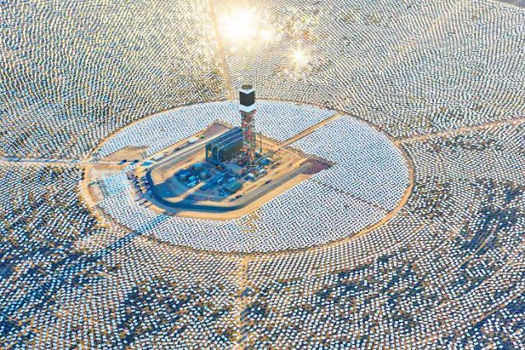

My Kids’ Generation
Will replace the world’s energy system again!

Slide 50

Choose Your Future
Many people think:
  “Our well-being is based on
  stuff we extract from the ground”
When we stop burning coal, will our descendants shiver in the dark?

Slide 51

Choose Your Future
I prefer:
  “We create our well-being through creativity, ingenuity, and hard work”
The future is bright!

Slide 52
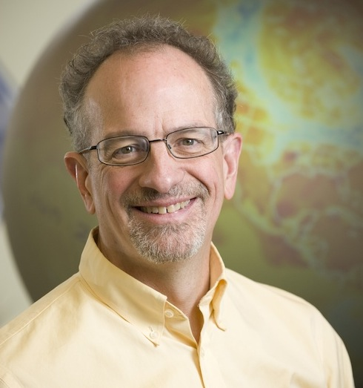
For More Info …
Email me for a link to this PowerPoint:
  Scott.Denning@gmail.com
Email me anytime with questions or comments (remind me where we met!)
Follow me on twitter:
  @airScottDenning

