Slide 1
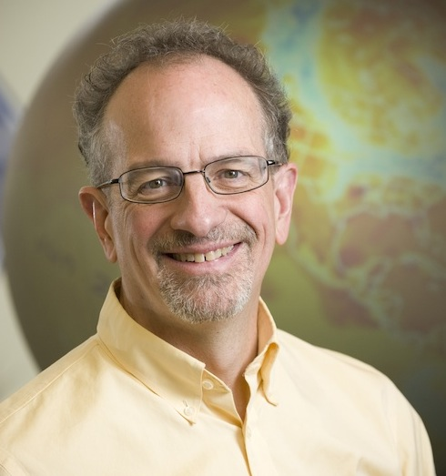
Scott Denning
Professor of
Atmospheric Science
Colorado State Univ.
Researching climate
for about 30 years
Over 100 journal articles
“Takes special delight in
engaging hostile audiences
about climate change”

Slide 2
Simple
2. Serious
3. Solvable

Slide 3
Simple
2. Serious
3. Solvable

Slide 4


Ever Wonder Why?
Day is warmer than night
Summer is warmer than winter
Phoenix is warmer than Fargo

Slide 5

Heat Budgets
Heat in
Heat in
Heat out
Heat out

Slide 6
Dancing Molecules and Heat Rays!
Nearly all of the air is made of oxygen (O₂) and nitrogen (N₂) in which two atoms of the same element share electrons
Infrared (heat) energy radiated up from the surface can be absorbed by these molecules, but not very well
O
O
N
N
Diatomic molecules can vibrate back and forth like balls on a spring, but the ends are identical

Slide 7
Dancing Molecules and Heat Rays!
Carbon dioxide (CO₂) and water vapor (H₂O) are different!
They have many more ways to vibrate and rotate, so they are very good at absorbing and emitting infrared (heat) radiation
O
C
O
O
H
H
Molecules that have many ways to wiggle are called “Greenhouse” molecules
These are greenhouse gases just because of geometry! (Bad luck)

Slide 8


Slide 9
CO₂ affects our climate
because …
  Air pollution hurts our lungs
  It focuses the sun’s rays on the ground
  Its molecules have more ways to vibrate than other gases
  Dark soot and smoke in the air blocks the sun

Slide 10


Common Sense
1 m
Doubling CO₂ would add 4 watts to every square meter of the surface of the Earth, 24/7
Doing that would make the surface warmer
This was known before light bulbs were invented!
4 Watts
1 m
John Tyndall, January 1863

Slide 11
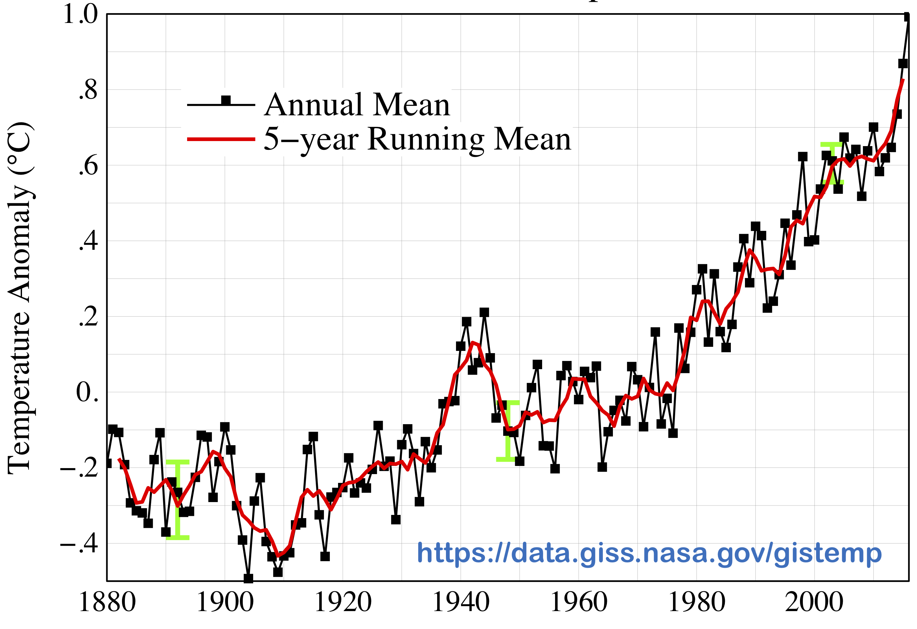

Common Myth #1
“Scientists expect a warmer future
because it’s been hot recently”
WRONG!
It’s because we know that when we add heat to things, they warm up

Slide 12
Simple
2. Serious
3. Solvable

Slide 13


How much warmer?
Land vs ocean!
North vs South
Global mean
warming of 2º to 5º C
North American
warming of 3º to 6º C
= 5º to 11º F
Arctic warming of
8º to 14º F
Low
Emissions
Moderate
Emissions
High
Emissions
RULE OF THUMB:
Global Warming (Celsius)
x 1.6 (USA) x 1.8 = Fahrenheit

Slide 14

Where is it 10º F Warmer
“on average?”
Seattle ➔
Sacramento
Denver ➔
Albuquerque
Illinois ➔
Mississippi
Washington DC ➔
Tallahassee
10 ºF warming is like moving
600 – 800 miles South!
Water? Crops?
Real Estate? Health?

Slide 15
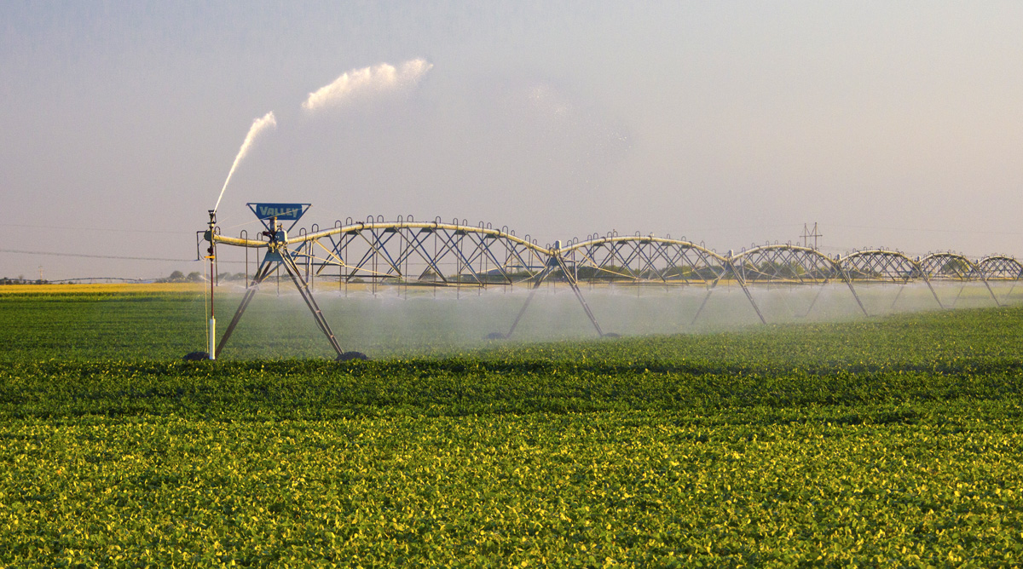
Water Budgets
Evaporative demand increases w/ temperature
In
Out
Drought is the running sum
of water out minus water in

Slide 16
Droughts Past & Future
Tree rings
Dust Bowl
Medieval Megadroughts
Climate models
Coming droughts much worse than any in past 1000 years

Slide 17

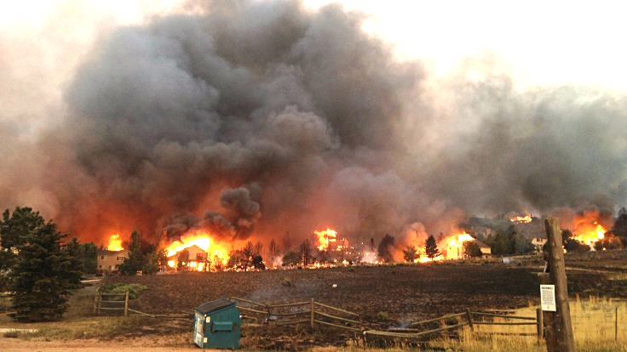
Warming Promotes Wildfire
Warmer air increases evaporative demand on forests
Longer warm season depletes soil moisture
More frequent extremely hot, dry, windy days when fires are uncontrollable
Projected Increase in Area Burned
656%
656%
NRC 2011

Slide 18
Global warming will cause more drought because …
  Clouds will produce less rain
  Storms will move to Canada
  Smoke from forest fires will absorb more humidity
  Hot weather evaporates more water from the soil

Slide 19
Past & Future Sea Level Changes
Reconstructions, modern tide gauges, satellite altimetry, and models of the future
Does not include ice sheet dynamics

Slide 20
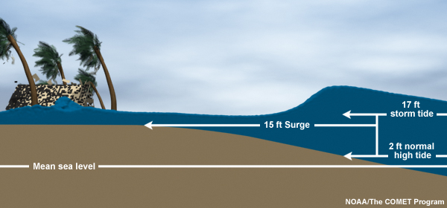
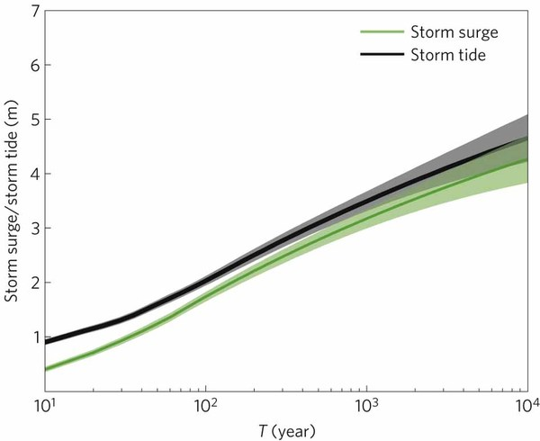
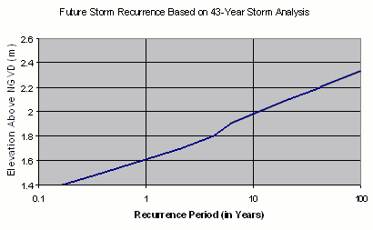
Storm Surge Frequency
Big storms push a “dome” of water onto land
Small storm surges happen
a lot
Big storm surges are more rare
Huge surges extremely rare
18
15
12
height above sea level (feet)
9
6
Coastal Flooding
Rockaway Beach, NYC
3
10 100 1000 10000
How often (years)

Slide 21

Coastal
Flooding
Sea level rise shifts the line up
Floods of a given depth happen more often
What was a
100-year flood becomes a
10-year flood!
Rockaway Beach, NYC
12
9
height above sea level (feet)
6
flooded
subway
system
3
10
100
1000
how often (years)

Slide 23
Global warming will cause more coastal flooding because …
  There will be more hurricanes
  Storm surge will reach higher because of sea-level rise
  The land will sink
  Stronger winds will make bigger waves

Slide 24
Simple
2. Serious
3. Solvable

Slide 25


Efficient Architects!
$4.5 TRILLION SAVINGS !
Energy to Power US Buildings
2010
2020
2030

Slide 26
Predictions vs Reality
IEA predictions of future deployment of
PV and wind are almost FLAT, year after year
Year after year, they’re RIDICULOUSLY wrong!
SOLAR
WIND
https://onclimatechangepolicydotorg.files.wordpress.com/2013/10/wind-and-solar-current-projections.jpg

Slide 27
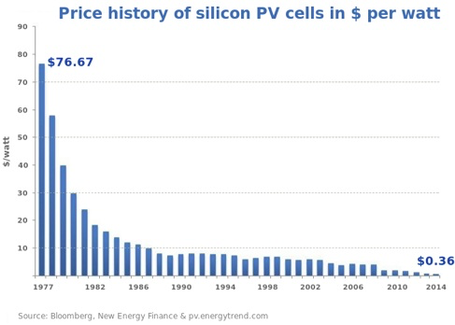
Price of Solar
PV Cells ($/watt)
Price has fallen by factor of 200 since I graduated from high school
Factor of 5 since 2011
Now as cheap or cheaper than coal or gas
Drop in 1970s
Flatter in1990s

Slide 28
Solar Resources
Germany gets less sun than Alaska!
German electricity
4% wind & solar in 2000
32% wind & solar in 2016
US vs Germany

Slide 29
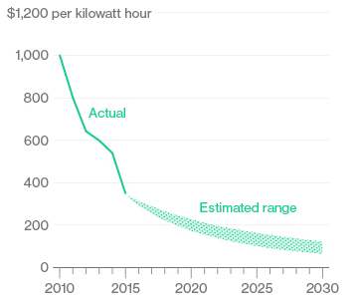
Battery Storage
In 2015, BNEF predicted $150/kWh by 2025
2017
Chevy
Bolt
Chevy Bolt reached $145 already
(8 years early)!
Now 7 times cheaper than in 2010!
Next year: Tesla “Gigafactory”
Bloomberg New Energy Finance Data

Slide 30
We must eliminate CO₂
emissions by …
  Making buildings more energy efficient
  Using solar and wind power
  Building better public transportation
  All of the above

Slide 31


Costs
Conversion to 100% noncarbon energy will cost about
1% of GDP
That’s about what it cost to retrofit all the world’s cities with indoor plumbing a century ago …
It was SO worth it!

Slide 32
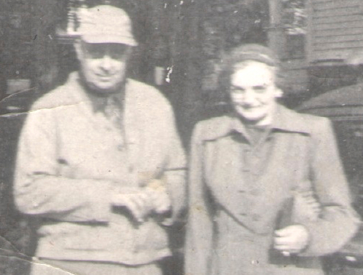
My Grandparents

Slide 33
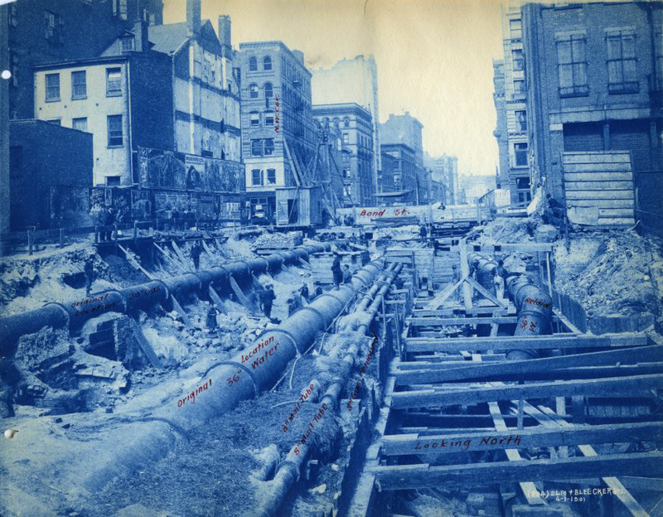
My Grandparents’ Generation
Built subways, sewers,
the electrical grid, defeated the Nazis

Slide 34
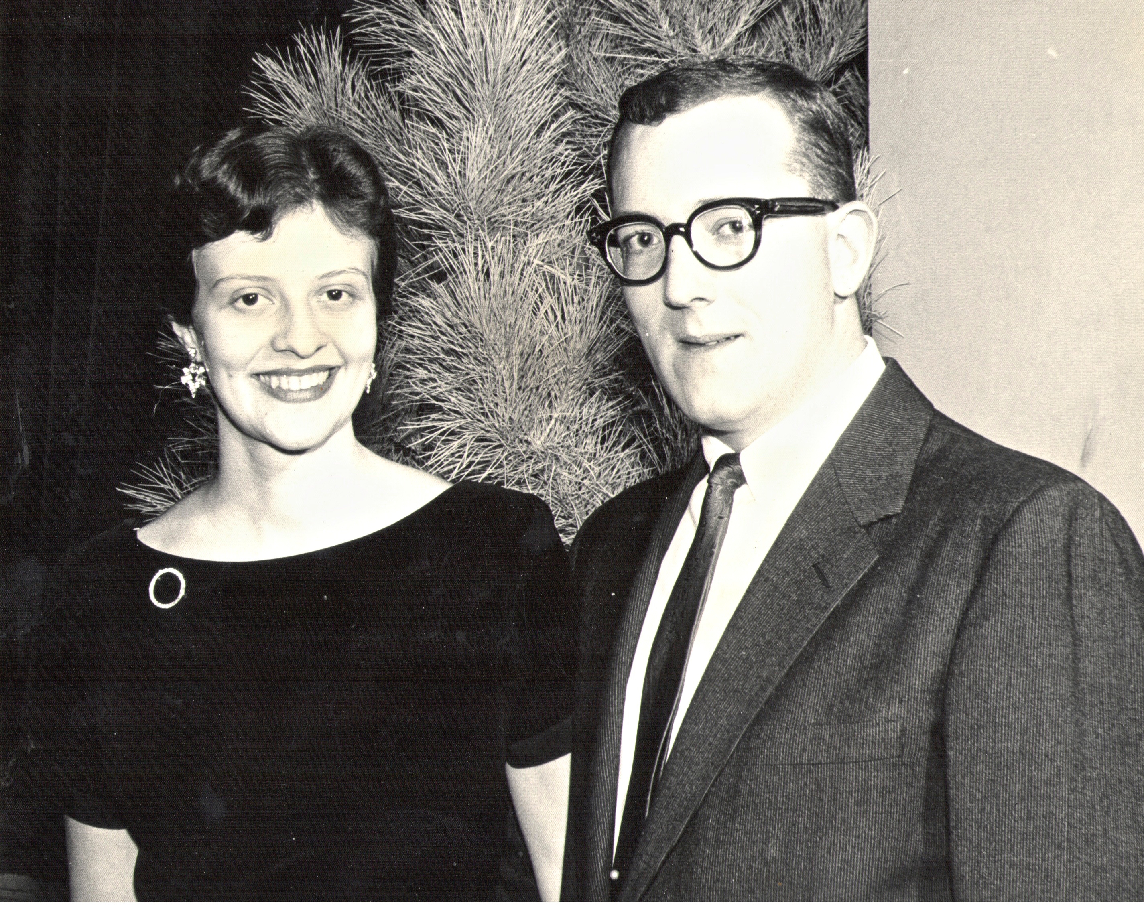
My Parents

Slide 35
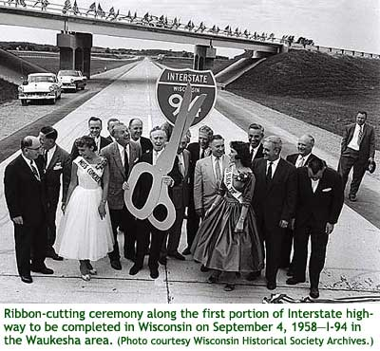
My Parents’ Generation
Built the Interstate Highways,
fought the cold war, landed on the Moon!

Slide 36
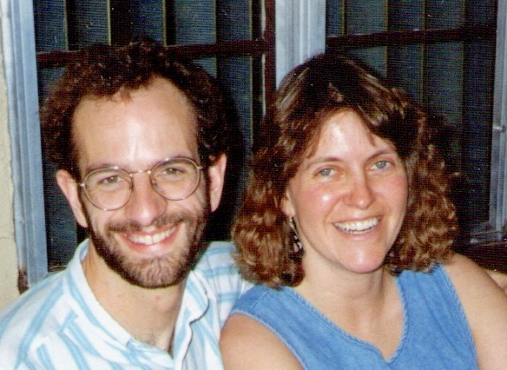
Jennifer & Me

Slide 37
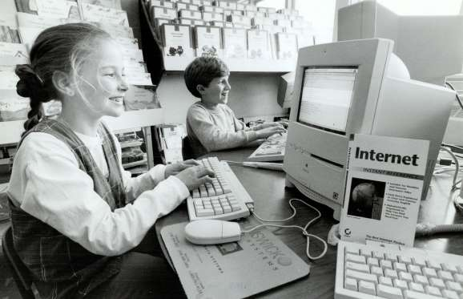
My Generation
Invented the PC, Built the internet,
replaced billions of land-lines with cell phones

Slide 38
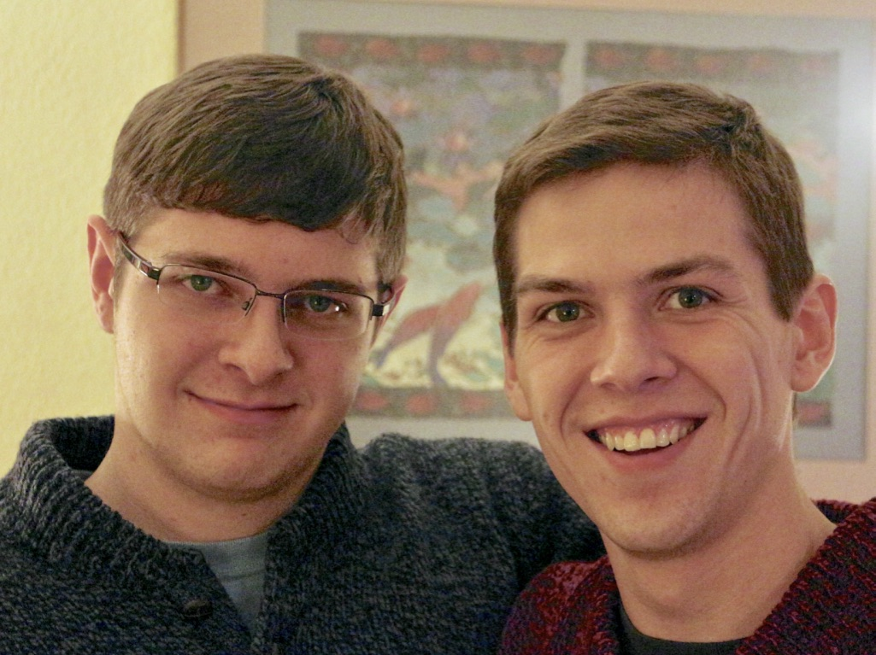
My Kids

Slide 39
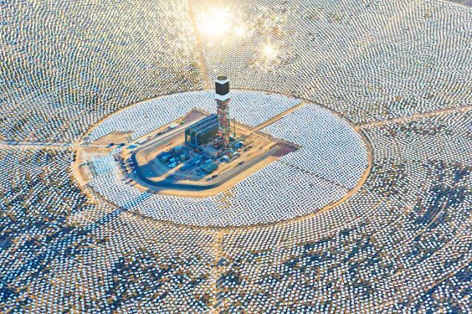

My Kids’ Generation
Will replace the world’s energy system again!

Slide 40

Choose Your Future
Many people think:
  “Our well-being is based on
  stuff we extract from the ground”
When we stop burning coal, will our descendants shiver in the dark?

Slide 41

Choose Your Future
I prefer:
  “We create our well-being through creativity, ingenuity, and hard work”
The future is bright!

