Slide 1
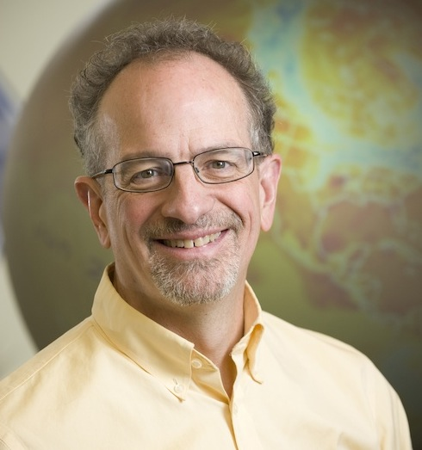
Scott Denning
Professor of
Atmospheric Science
Colorado State Univ.
Researching climate
for about 30 years
Over 100 journal articles
“Takes special delight in
engaging hostile audiences
about climate change”

Slide 2
Simple
2. Serious
3. Solvable

Slide 3
Simple
2. Serious
3. Solvable

Slide 4


Ever Wonder Why?
Day is warmer than night
Summer is warmer than winter
Phoenix is warmer than Fargo

Slide 5

Heat Budgets
Heat in
Heat in
Heat out
Heat out

Slide 6
Dancing Molecules and Heat Rays!
Nearly all of the air is made of oxygen (O₂) and nitrogen (N₂) in which two atoms of the same element share electrons
Infrared (heat) energy radiated up from the surface can be absorbed by these molecules, but not very well
O
O
N
N
Diatomic molecules can vibrate back and forth like balls on a spring, but the ends are identical

Slide 7
Dancing Molecules and Heat Rays!
Carbon dioxide (CO₂) and water vapor (H₂O) are different!
They have many more ways to vibrate and rotate, so they are very good at absorbing and emitting infrared (heat) radiation
O
C
O
O
H
H
Molecules that have many ways to wiggle are called “Greenhouse” molecules
These are greenhouse gases just because of geometry! (Bad luck)

Slide 8


Slide 9
CO₂ affects our climate
because …
  Air pollution hurts our lungs
  It focuses the sun’s rays on the ground
  Its molecules have more ways to vibrate than other gases
  Dark soot and smoke in the air blocks the sun

Slide 10


Common Sense
1 m
Doubling CO₂ would add 4 watts to every square meter of the surface of the Earth, 24/7
Doing that would make the surface warmer
This was known before light bulbs were invented!
4 Watts
1 m
John Tyndall, January 1863

Slide 11

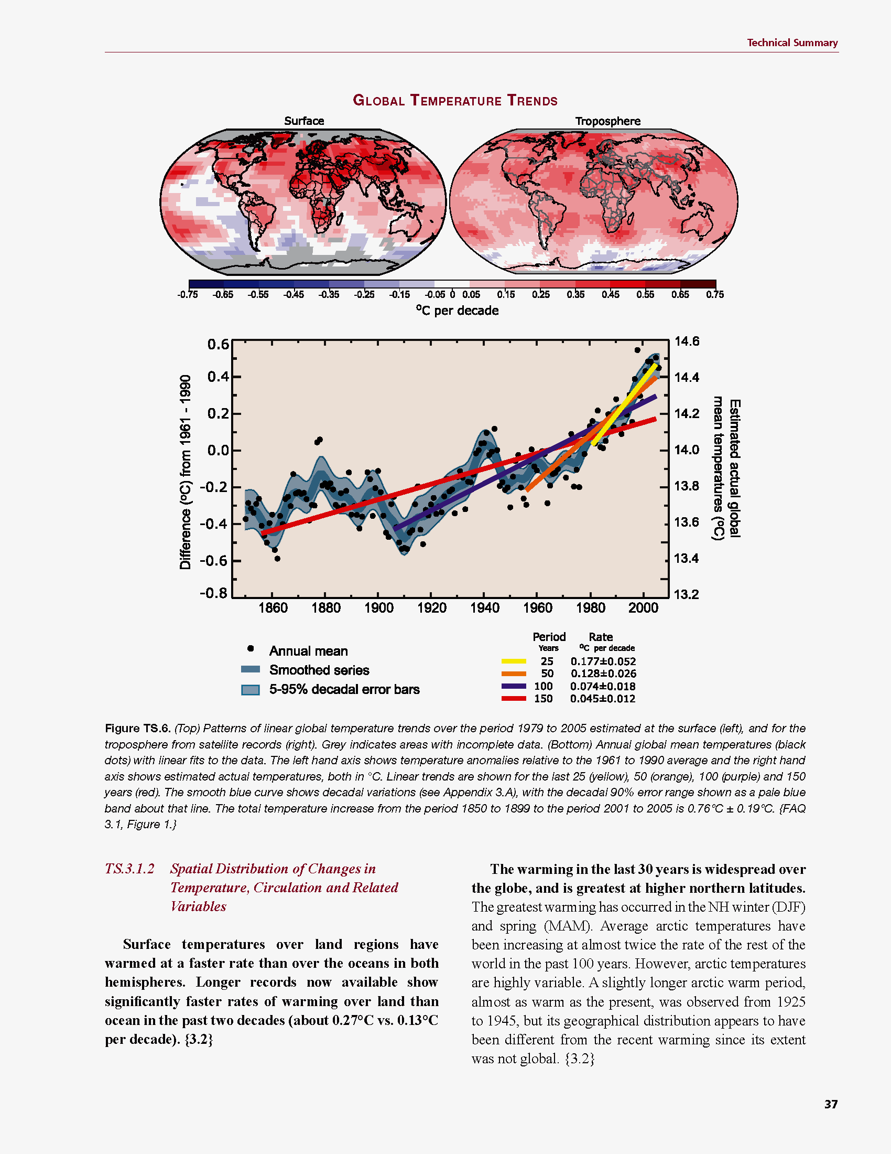
Common Myth #1
“Scientists expect a warmer future because it’s been warming up recently”
WRONG!
It’s because we know that when we add heat to things, they warm up

Slide 12
Simple
2. Serious
3. Solvable

Slide 13


How much warmer?
Land vs ocean!
North vs South
Global mean
warming of 2º to 5º C
North American
warming of 3º to 6º C
= 5º to 11º F
Arctic warming of
8º to 14º F
Low
Emissions
Moderate
Emissions
High
Emissions
RULE OF THUMB:
Global Warming (Celsius)
x 1.6 (USA) x 1.8 = Fahrenheit

Slide 14

Where is it 10°F Warmer
“on average?”
Denver ➔
Amarillo
Illinois ➔
Mississippi
Washington➔
Tallahassee
Water? Crops?
Real Estate? Health?

Slide 15
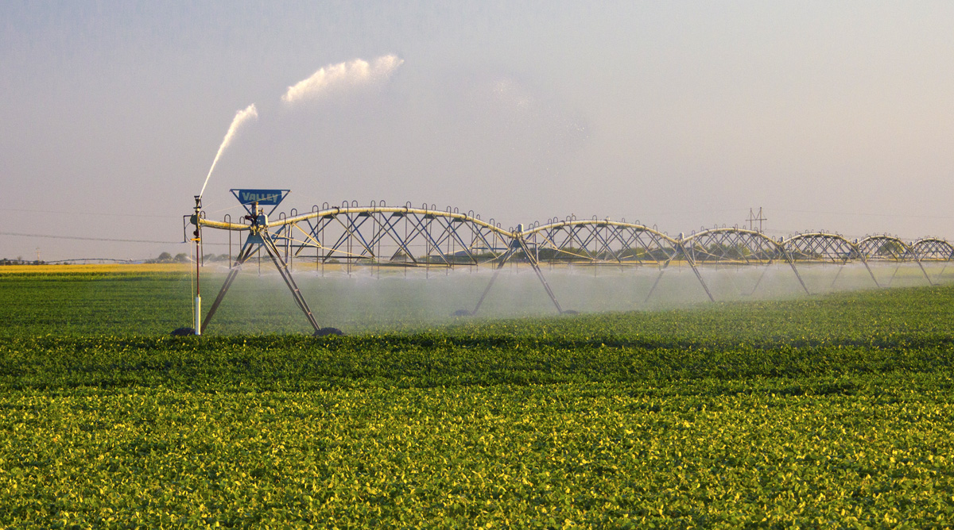
Water Budgets
Evaporative demand increases w/ temperature
In
Out
Drought is the running sum
of water out minus water in

Slide 16
Droughts Past & Future
Tree rings
Dust Bowl
Medieval Megadroughts
Climate models
Coming droughts much worse than any in past 1000 years

Slide 17

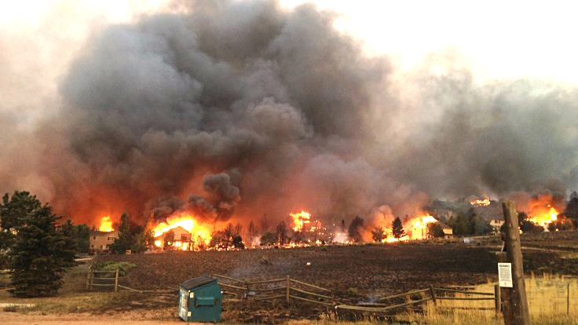
Warming Promotes Wildfire
Warmer air increases evaporative demand on forests
Longer warm season depletes soil moisture
More frequent extremely hot, dry, windy days when fires are uncontrollable
Projected Increase in Area Burned
656%
656%
NRC 2011

Slide 18
Global warming will cause more drought because …
  Clouds will produce less rain
  Storms will move to Canada
  Smoke from forest fires will absorb more humidity
  Hot weather evaporates more water from the soil

Slide 19
Past & Future Sea Level Changes
Reconstructions, modern tide gauges, satellite altimetry, and models of the future
Does not include ice sheet dynamics

Slide 20
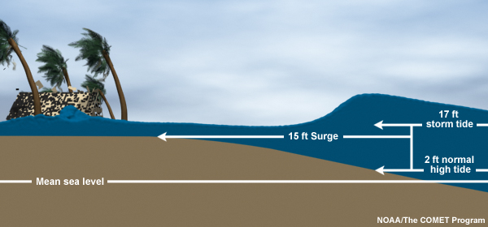
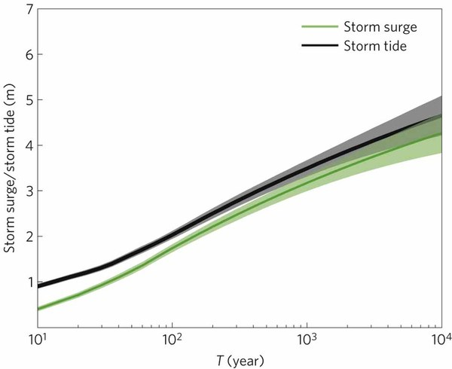
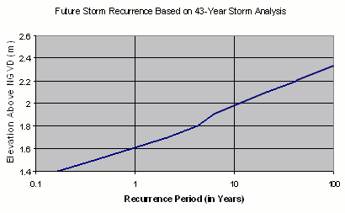
Storm Surge Frequency
Big storms push a “dome” of water onto land
Small storm surges happen
a lot
Big storm surges are more rare
Huge surges extremely rare
18
15
12
height above sea level (feet)
9
6
Coastal Flooding
Rockaway Beach, NYC
3
10 100 1000 10000
How often (years)

Slide 21

Coastal
Flooding
Sea level rise shifts the line up
Floods of a given depth happen more often
What was a
100-year flood becomes a
10-year flood!
Rockaway Beach, NYC
12
9
height above sea level (feet)
6
flooded
subway
system
3
10
100
1000
how often (years)

Slide 23
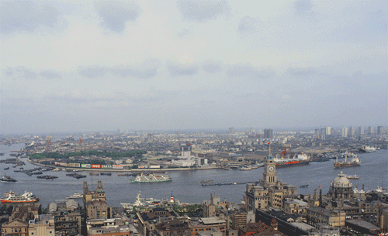
Billions and Billions
Shanghai 1991 and 2012
Currently 7 billion people on Earth
but only 1 billion use lots of energy
Rapid development to 4 billion
energy users over coming decades
Population growth only 30% but
energy growth 300% by 2100

Slide 24
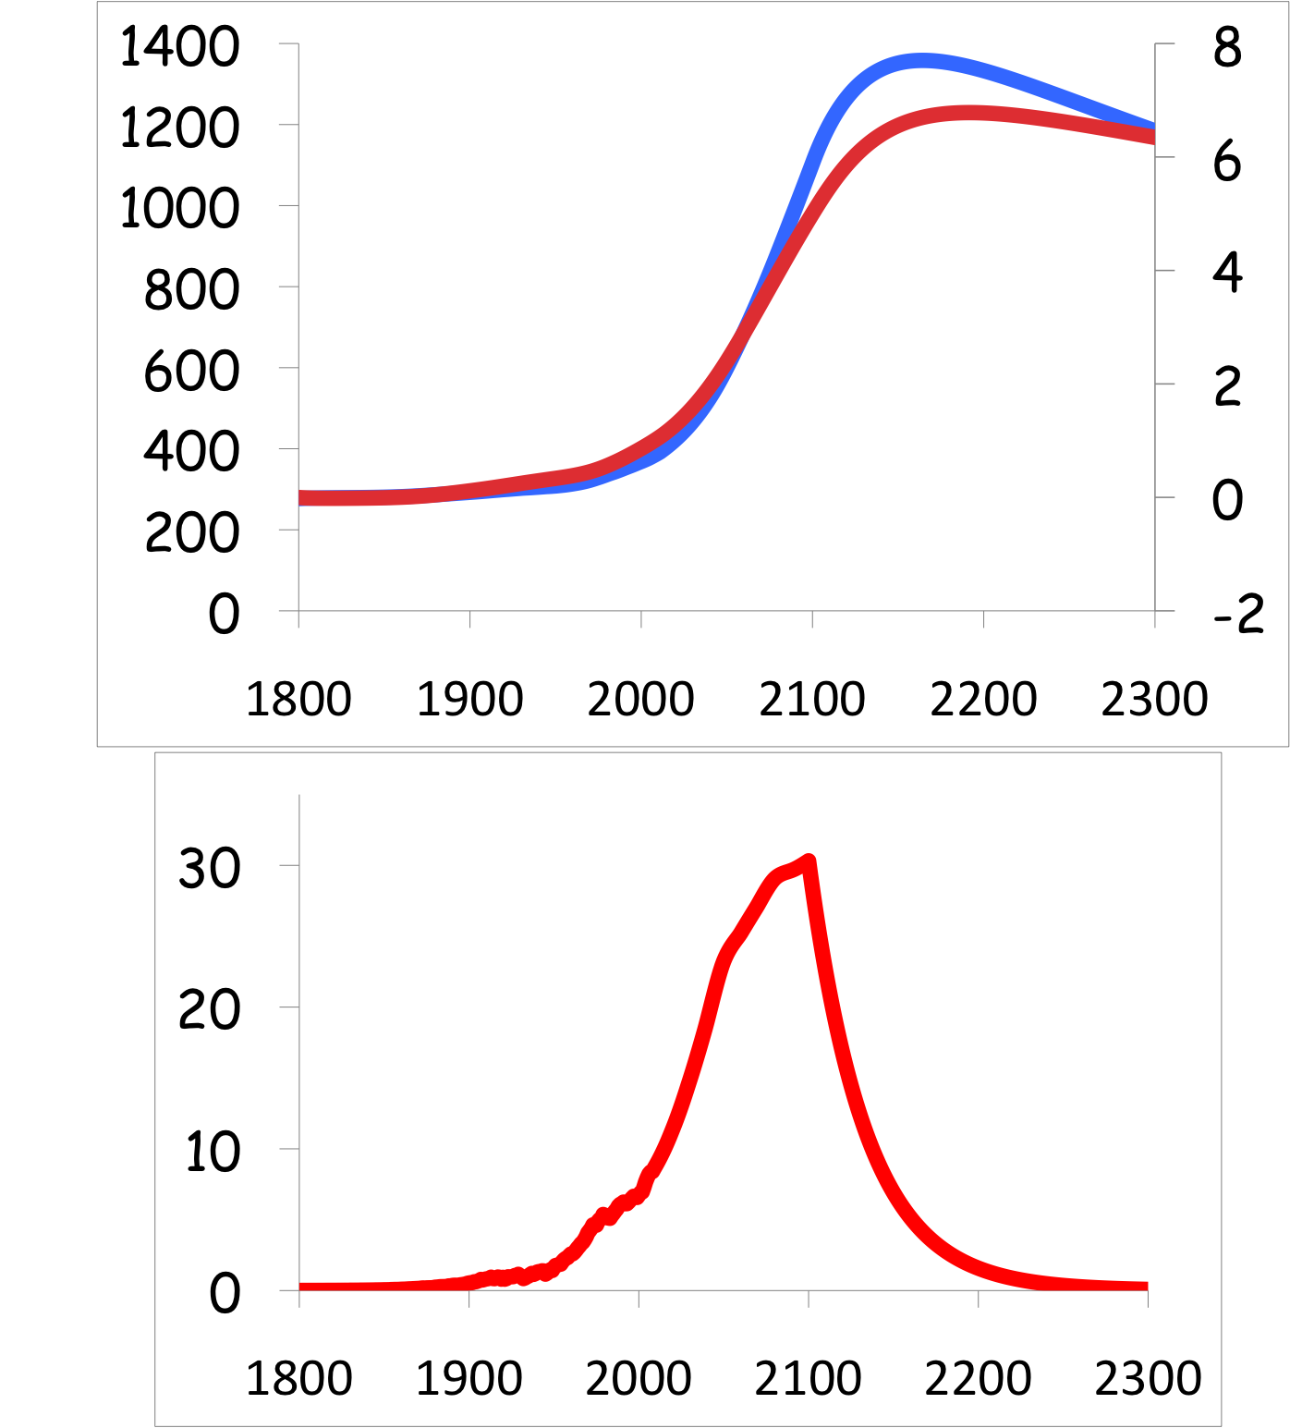
Common Myth #2
“When we reduce or stop burning fossil fuel, CO₂ will go away and things will go back to normal”
CO₂
If China and India industrialize with coal, CO₂ will rise to 4x preindustrial
Extra CO₂ will last for thousands of years after coal is gone
CO₂ (ppm)
warming
Warming (Celsius)
you are
here
emissions
GtC/yr
year
Thermostat only turns one way!

Slide 25
Global warming will cause more coastal flooding because …
  There will be more hurricanes
  Storm surge will reach higher because of sea-level rise
  The land will sink
  Stronger winds will make bigger waves

Slide 26
Simple
2. Serious
3. Solvable

Slide 27

Historical Emissions
Billions of Tons Carbon Emitted per Year
20
10
Historical
emissions
0
1950
2000
2050
2100
Notes:
27

Slide 28
“Stabilization Triangle”
Billions of Tons Carbon Emitted per Year
20 GtC/yr
20
Current path = “ramp up”
Stabilization Triangle
10
Historical
emissions
Needed Ramp Down
2
Goal: 80% reduction in 50 years
0
1950
2000
2050
2100
Notes:
28

Slide 29
“Stabilization Wedges”
Billions of Tons Carbon Emitted per Year
20 GtC/y
20
Current path = “ramp up”
18 “wedges”
Stabilization Triangle
10
Historical
emissions
Needed Ramp Down
2
Goal: 80% reduction in 50 years
0
1950
2000
2050
2100
http://www.princeton.edu/wedges/
Notes:
29

Slide 30
What is a “Wedge”?
A “wedge” is a strategy to reduce carbon emissions that grows in 50 years from zero to 1.0 GtC/yr. The strategy has already been commercialized at scale somewhere.
1 GtC/yr
Total = 25 Gigatons carbon
50 years
  Cumulatively, a wedge redirects the flow of 25 GtC in its first 50 years. This is 2.5 trillion dollars at $100/tC.
A “solution” to the CO₂ problem should provide at least one wedge.

Slide 31
18 Wedges: Solved!
Energy Efficiency &
Conservation (4)
20 GtC/y
Fuel Switching
(3)
Renewable Fuels
& Electricity (5)
2016
CO₂ Capture
& Storage (2)
Forest &
Soil Storage (2)
2 GtC/y
2066
Nuclear Fission (2)
http://www.princeton.edu/wedges/
Notes:
31

Slide 32

Efficient Architects!
$4.5 TRILLION

Slide 33
Predictions vs Reality
SOLAR
Year after year, the International Energy Agency predicts very slow penetration of renewable energy
Year after year, they’re WAY wrong!
Why?
WIND

Slide 34
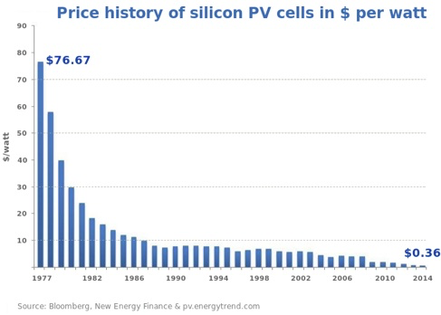
Price of Solar
PV Cells ($/watt)
Price has fallen by factor of 200 since I graduated from high school
Factor of 5 since 2011
Now as cheap or cheaper than coal or gas
Drop in 1970s
Flatter in1990s

Slide 35
Solar Resources
US vs Germany
German electricity
4% wind & solar in 2000
32% wind & solar in 2015

Slide 36
We can reduce CO₂
emissions by …
  Making buildings more energy efficient
  Using solar and wind power
  Building better public transportation
  All of the above

Slide 37


Costs
Conversion to 100% noncarbon energy will cost about
1% of GDP
That’s about what it cost to retrofit all the world’s cities with indoor plumbing a century ago …
It was worth it!

Slide 38
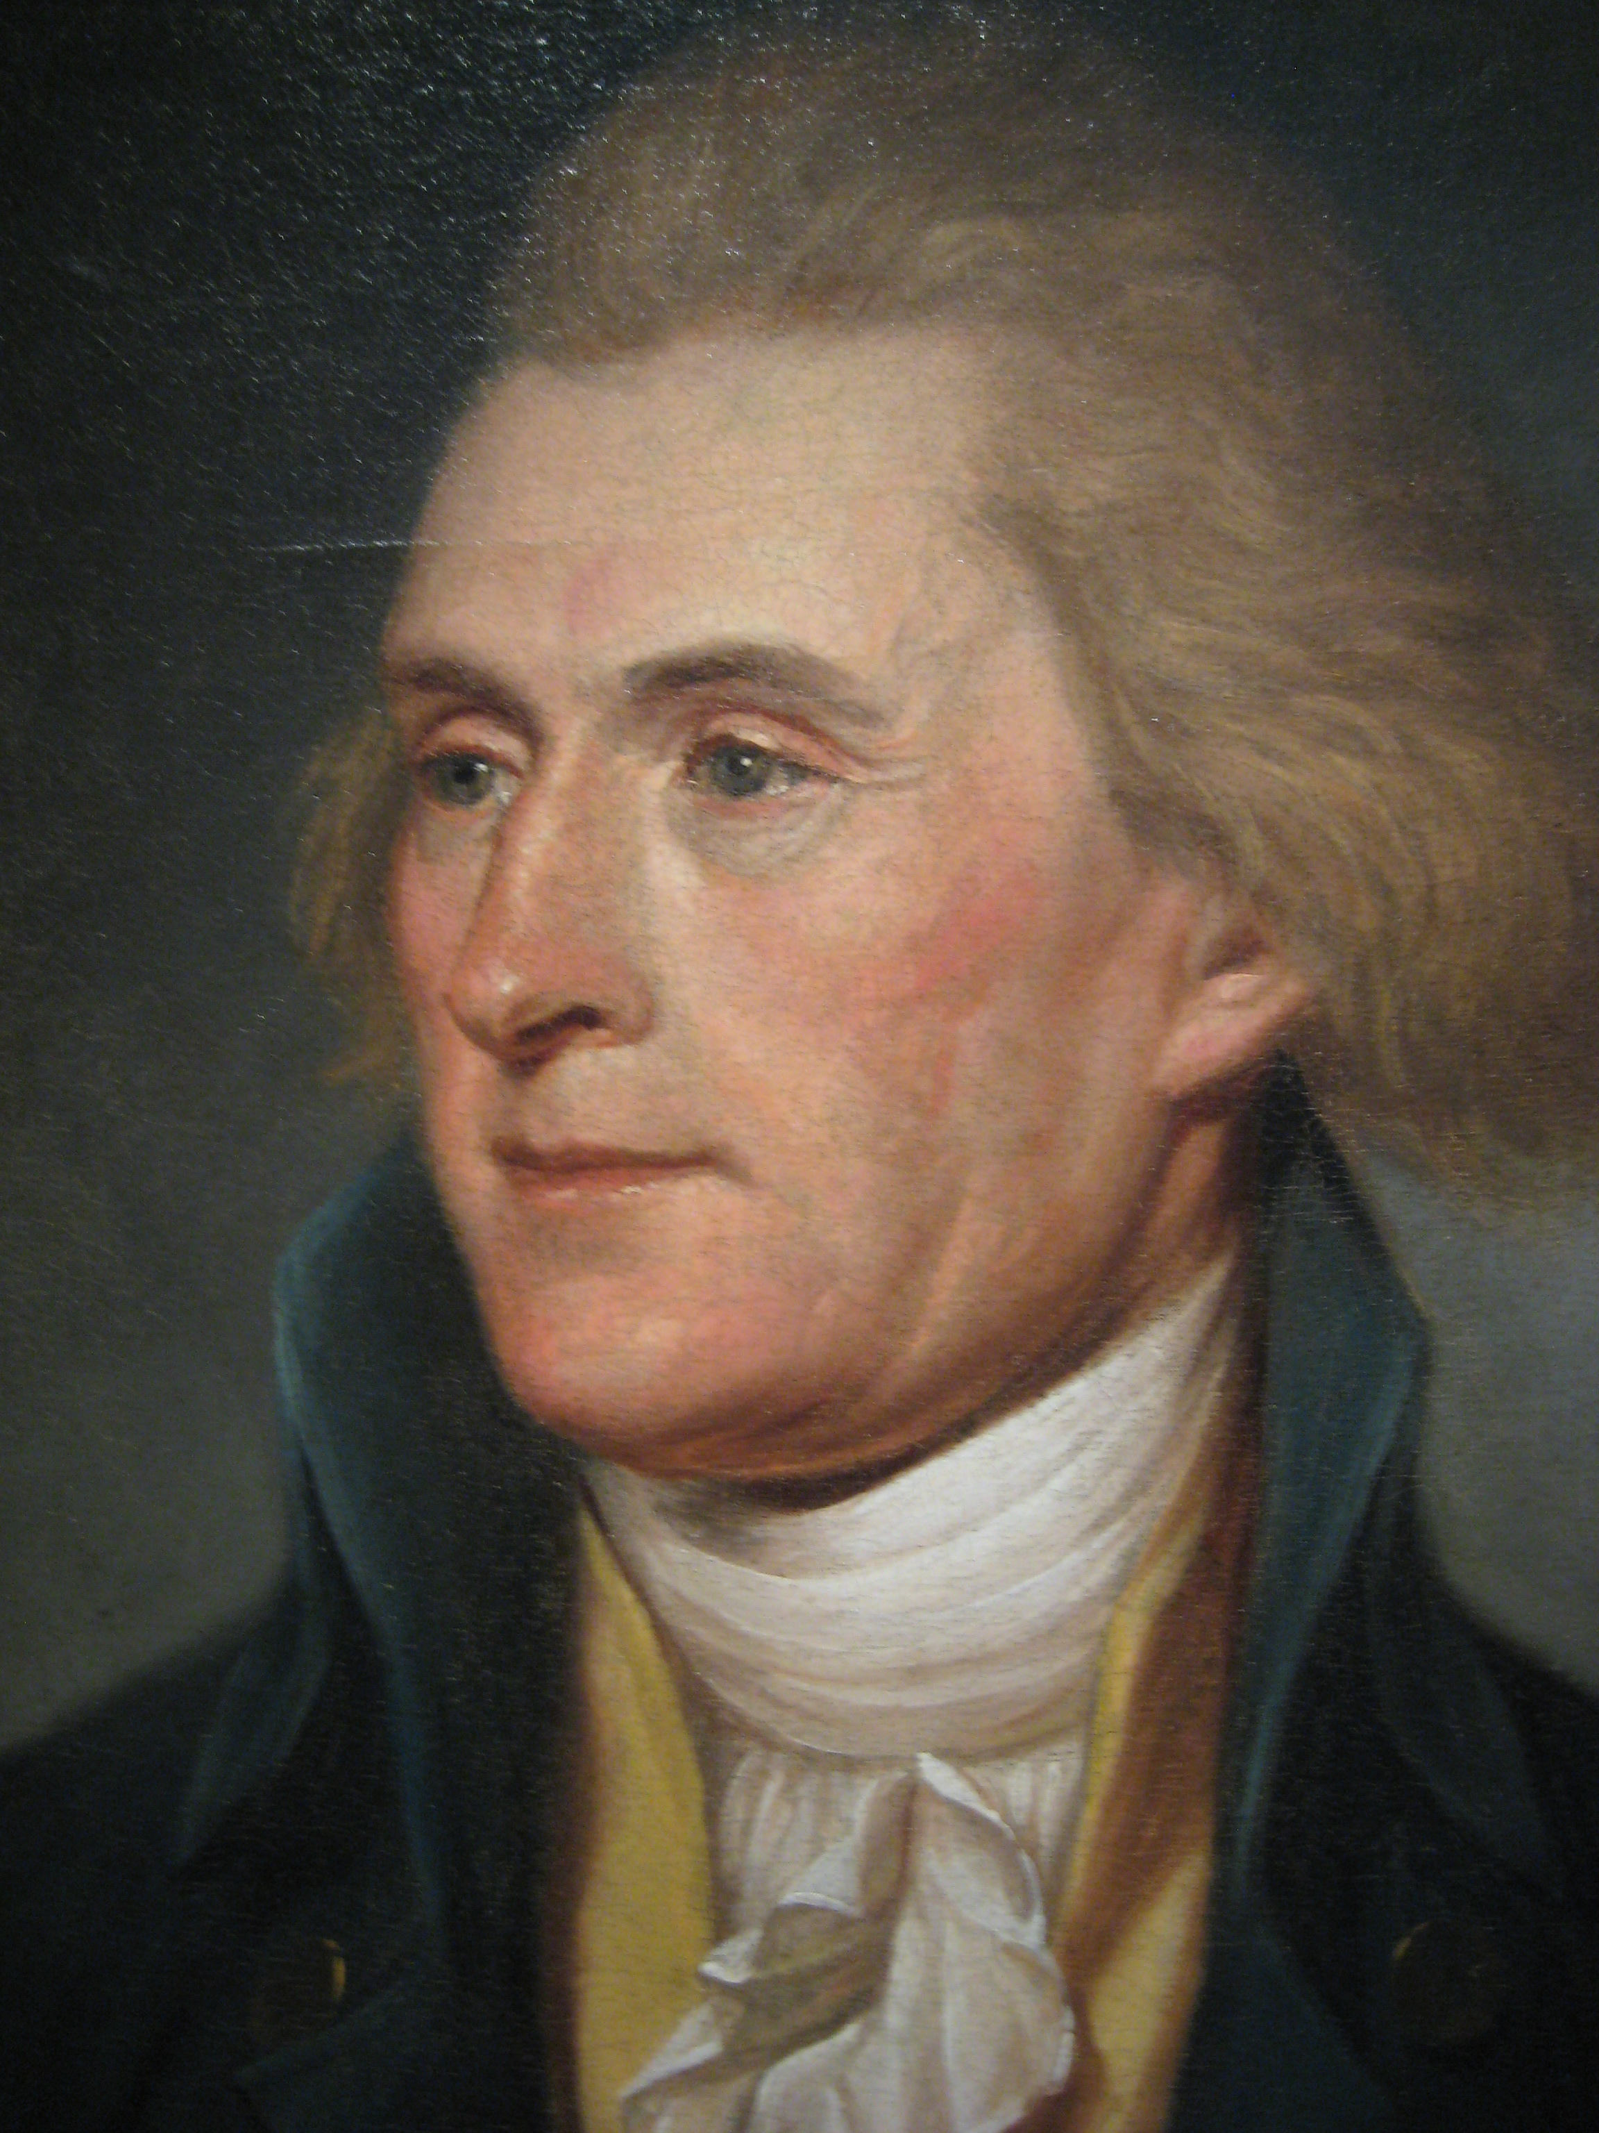
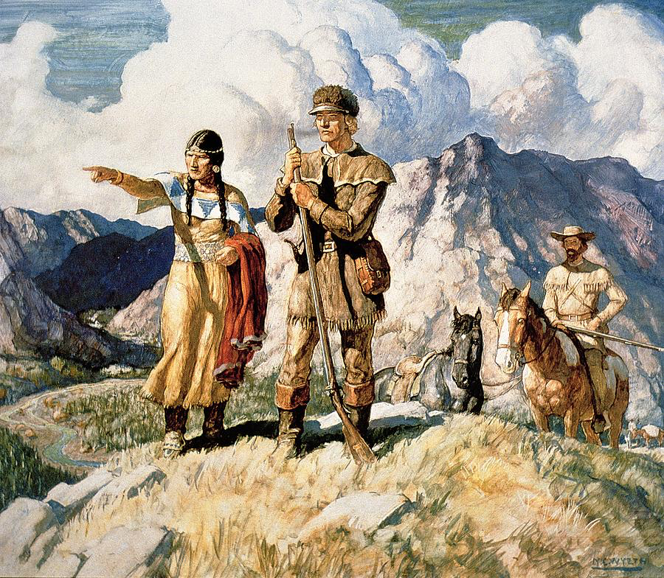
Imagine it’s 1800 …
Lewis and Clarke with Sacajawea
President Thomas Jefferson

Slide 39

Imagine it’s 1800 …

Slide 40
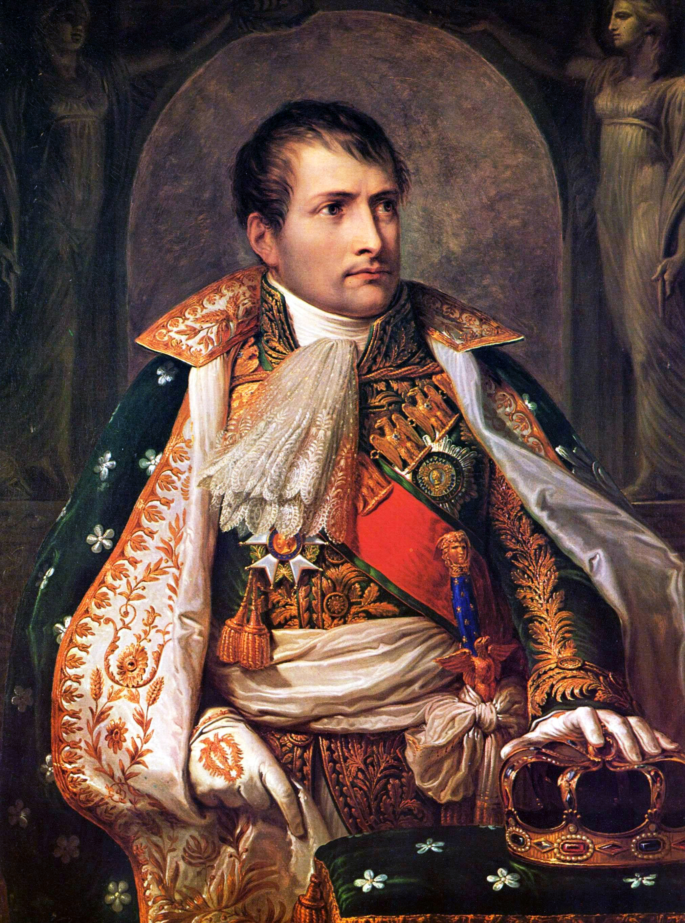
Imagine it’s 1800, and you’re in charge …
Napoleon Bonaparte

Slide 41
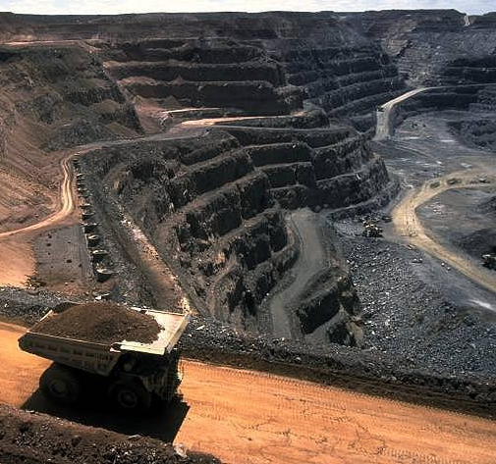
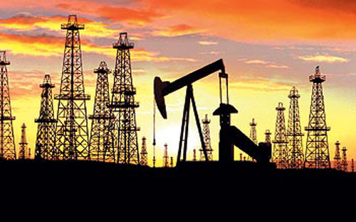
Imagine it’s 1800, and you’re in charge …
Somebody presents you with a grand idea for transforming the world economy:
  Dig 8 billion tons of carbon out of the ground every year

Slide 42
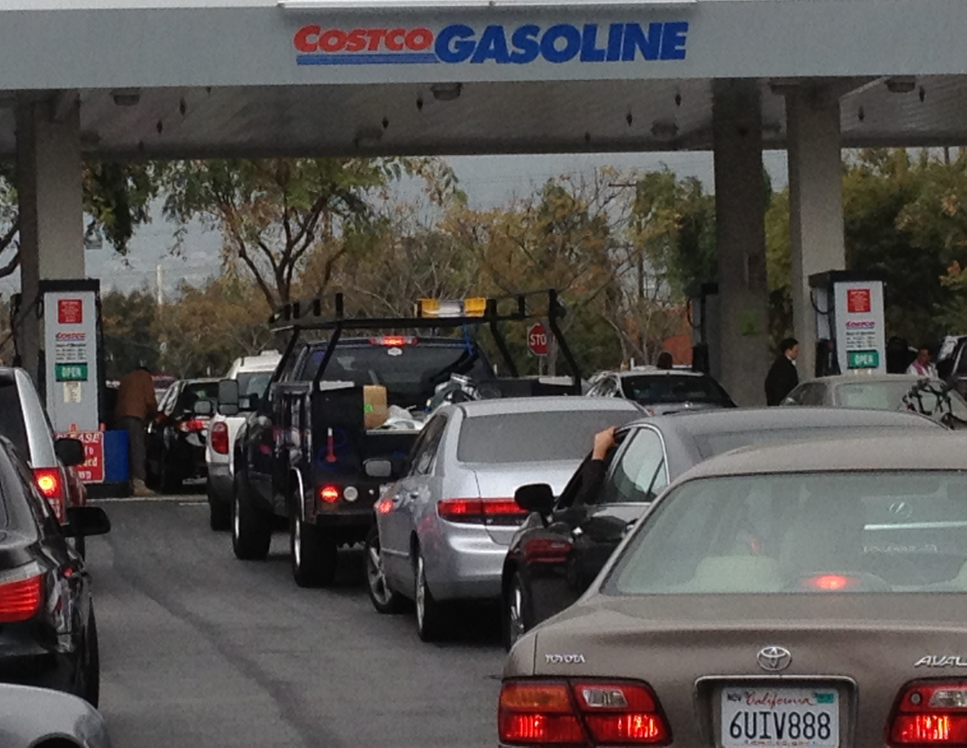
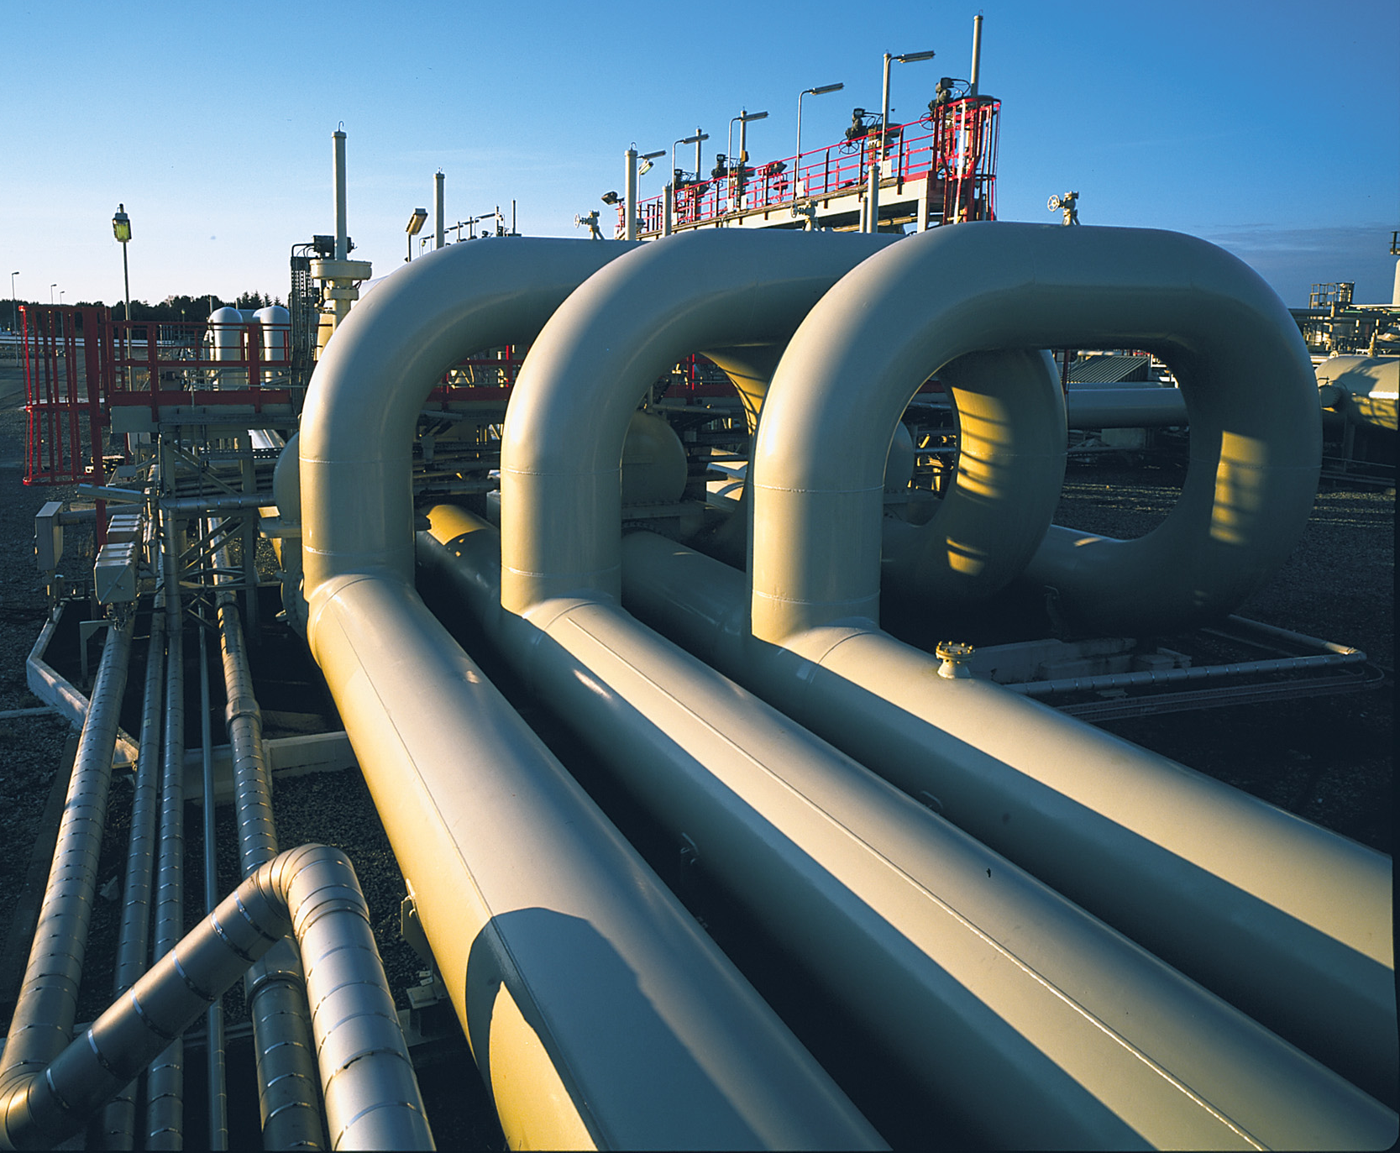
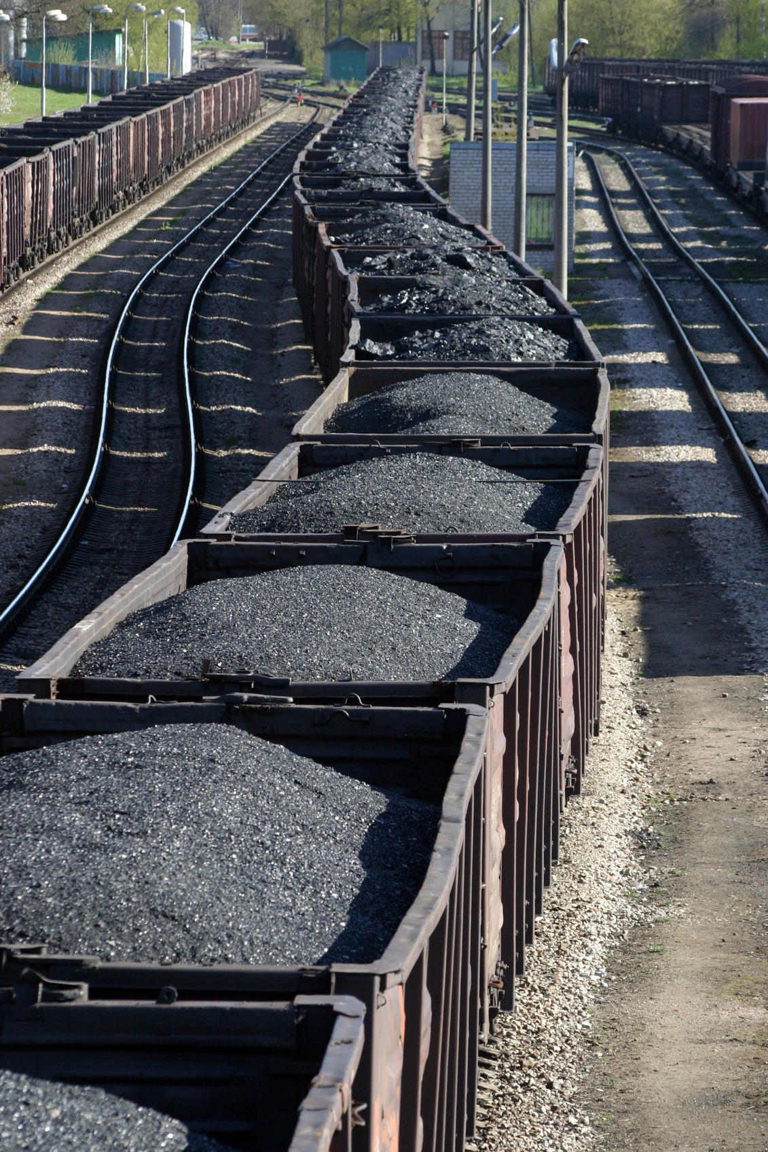
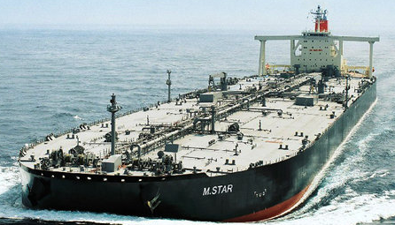
Imagine it’s 1800, and you’re in charge …
Somebody presents you with a grand idea for transforming the world economy:
  Build a system of pipelines, supertankers, railroads, highways, and trucks to deliver it to every street corner on the planet

Slide 43
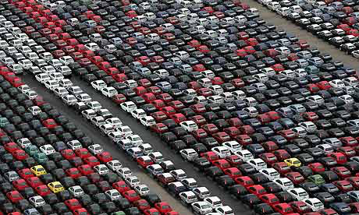
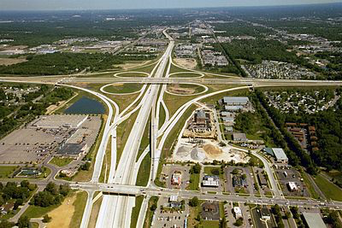
Imagine it’s 1800, and you’re in charge …
Somebody presents you with a grand idea for transforming the world economy:
  Build 80 million new cars every year, and millions of miles of roads to drive them on

Slide 44
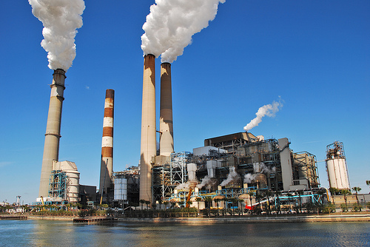
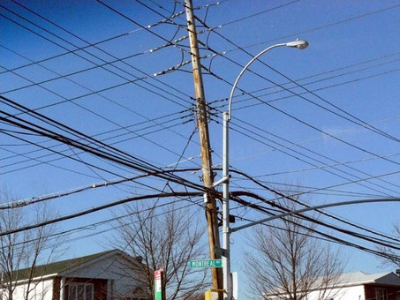
Imagine it’s 1800, and you’re in charge …
Somebody presents you with a grand idea for transforming the world economy:
  Generate and pipe enough electricity to every house to power lights & stereos & LCD TVs

Slide 45

Imagine it’s 1800, and you’re in charge …
Somebody presents you with a grand idea for transforming the world economy:
  Dig 10 billion tons of carbon out of the ground every year
  Build a system of pipelines, supertankers, railroads, highways, and trucks to deliver it to every street corner on the planet
  Build millions of cars every year, and millions of miles of roads to drive them on
  Generate and pipe enough electricity to every house to power lights & stereos & LCD TVs
… “and here’s the itemized bill …”

Slide 46
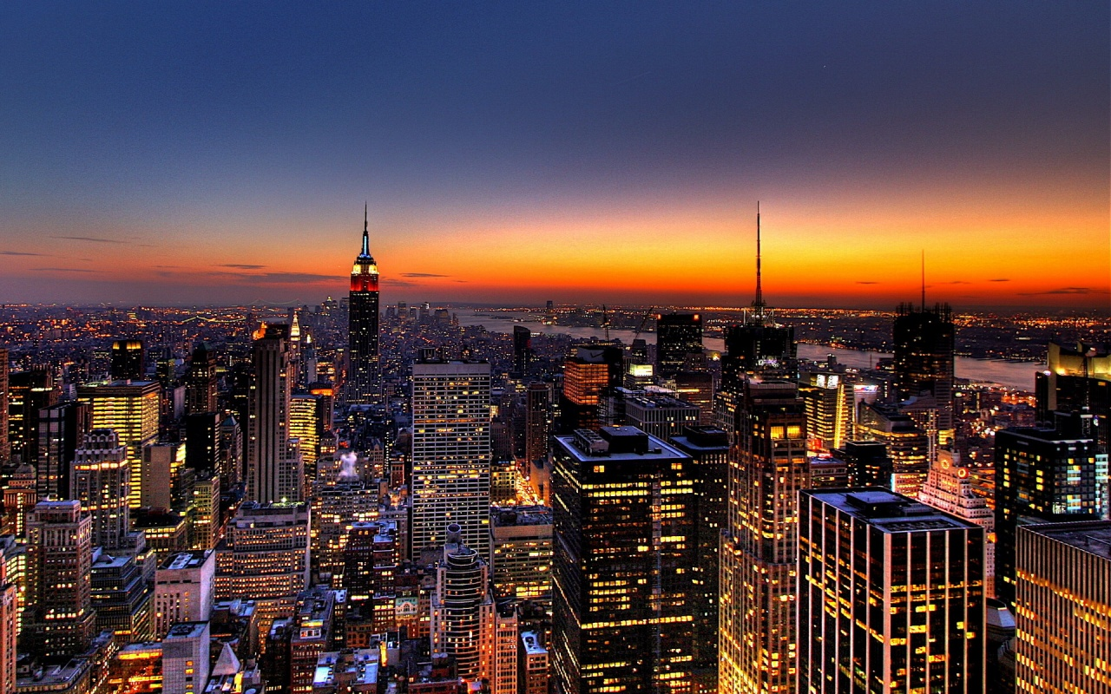
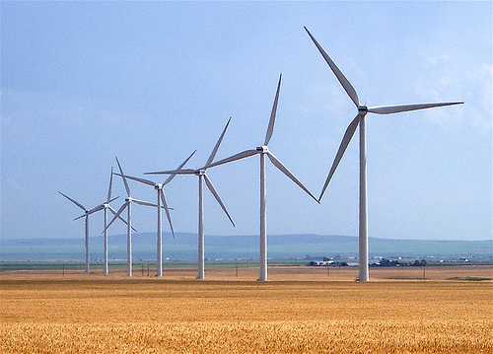
Who Built That?
Our ancestors built that very system
It cost them every dime of global GDP for 200 years (now $78T/yr)
It created every dime too!
Now our kids get to
do it again!

Slide 47

Choose Your Future
Many people think:
  “Our well-being is based on
  stuff we extract from the ground”
When we stop burning coal, will our descendants shiver in the dark?

Slide 48

Choose Your Future
I prefer:
  “We create our well-being through creativity, ingenuity, and hard work”
The future is bright!

Slide 49
For More Info …
Email me for a link to this PowerPoint:
  Scott.Denning@gmail.com
Email me anytime with questions or comments (remind me where we met!)
Follow me on twitter:
  @airScottDenning

