Slide 1
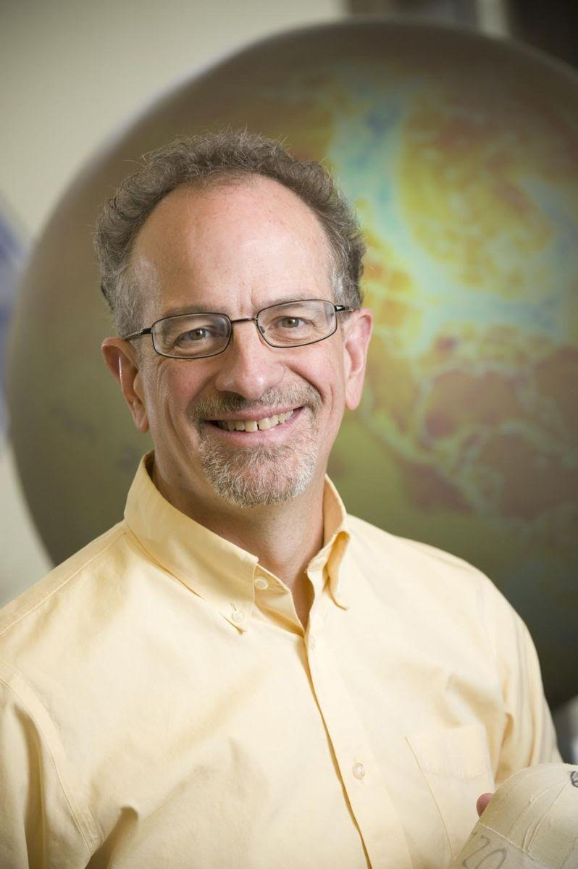

Simple, Serious, and Solvable:
The Three S’s of Climate Change
This one-hour webinar is part of the 2017 SPSSI Graduate Student Committee Policy Expert Webinar Series. As part of this series, SPSSI brings in experts from outside of psychology to talk about the science behind some of the world's most pressing issues. This webinar is open to everyone, including people who are not psychologists, SPSSI members, or graduate students.
Presenter
Scott Denning, Ph.D.
Department of Atmospheric Science
Colorado State University
Facilitator
Ashley Weinberg, Ph.D. Student
Social and Personality Psychology, York University, Toronto
Chair of the SPSSI Graduate Student Committee
Notes:
Scott Denning is Monfort Professor of Atmospheric Science at Colorado State University. He also serves as Director of Education and Diversity for CMMAP, the Center for Multiscale Modeling of Atmospheric Processes, working to enhance understanding of global climate. He is author of over 100 publications in the peer-reviewed climate literature, is a former editor of the Journal of Climate, and served for five years as founding Science Chair of the North American Carbon Program. He has served on advisory panels for NASA, NOAA, the US Department of Energy, and the National Science Foundation.
Denning leads a group of graduate students and scientists using many kinds of observations and models to understand the metabolism of the Earth’s biosphere. A key contribution of their work is the identification and prediction of sources and sinks of carbon dioxide in the atmosphere using new satellite instruments. In addition to using global satellite imagery, he uses data from the woods of Wisconsin, the farms of Iowa, the Oklahoma prairie, the African Savanna, and the Amazon rainforest.
Denning takes special delight in discussing the subject of climate change with hostile audiences and has twice been a featured speaker at the Heartland Institute’s annual conference.

Slide 2

“Research that produces nothing but books will not suffice.”
- Kurt Lewin
The Society for the Psychological Study of Social Issues (SPSSI)
  Founded in 1936, SPSSI is a group of over 3000 scientists from psychology and related fields and others who share a common interest in research on the psychological aspects of important social and policy issues.
  SPSSI seeks to bring theory and practice into focus on human problems of the group, the community, and nations, as well as the increasingly important problems that have no national boundaries.
  An independent society, SPSSI is also Division 9 of the American Psychological Association (APA) and an organizational affiliate of the American Psychological Society (APS).
  SPSSI welcomes the membership of anyone interested in the Society.
See www.spssi.org for more information

Slide 3
SPSSI’s Graduate Student Opportunities
  Graduate student members of SPSSI are looking for an intellectual home where they can connect with scholars and other students who value the importance of applying psychology to pressing social issues.
  We connect in person at conferences and also online on our Facebook page. We aim to provide student members with resources to navigate their graduate school experience and transition into early career.
  Members receive discounted conference registration, regular SPSSI emails, opportunity to apply for SPSSI awards and fellowships and to run in SPSSI elections, subscriptions to SPSSI journals and newsletters, and more.
Become a student member of SPSSI for just $25.

Slide 4
Questions or Comments?
  Please type your questions and/or comments in the chat thread on the lower left-hand side of the screen.
  If we do not have time to address your questions and/or comments please feel free to reach out to Dr. Denning at scott.denning@colostate.edu
For a video recording of this webinar please visit SPSSI’s YouTube channel: https://www.youtube.com/channel/UCLJcyTbZTJzzduYF9wCLm3g
Interested in joining our list of policy or methodology webinar presenters?
  Submit your abstract at http://tinyurl.com/spssiwebinar by Dec. 20th, 2017!
Upcoming Webinar: Methodology
  The next Methodology Webinar will be Nov. 29th at 12:00 PM ET.
  In this webinar, Katie Bentley will be presenting on Nonverbal Behavioral Coding for Researchers.

Slide 5
Simple, Serious, and Solvable:
The Three S’s of Climate Change
This one-hour webinar is part of the 2017 SPSSI Graduate Student Committee Policy Expert Webinar Series. As part of this series, SPSSI brings in experts from outside of psychology to talk about the science behind some of the world's most pressing issues. This webinar is open to everyone, including people who are not psychologists, SPSSI members, or graduate students.
Presenter
Scott Denning, Ph.D.
Department of Atmospheric Science
Colorado State University
Facilitator
Ashley Weinberg, Ph.D. Student
Social and Personality Psychology, York University, Toronto
Chair of the SPSSI Graduate Student Committee
Notes:
Scott Denning is Monfort Professor of Atmospheric Science at Colorado State University. He also serves as Director of Education and Diversity for CMMAP, the Center for Multiscale Modeling of Atmospheric Processes, working to enhance understanding of global climate. He is author of over 100 publications in the peer-reviewed climate literature, is a former editor of the Journal of Climate, and served for five years as founding Science Chair of the North American Carbon Program. He has served on advisory panels for NASA, NOAA, the US Department of Energy, and the National Science Foundation.
Denning leads a group of graduate students and scientists using many kinds of observations and models to understand the metabolism of the Earth’s biosphere. A key contribution of their work is the identification and prediction of sources and sinks of carbon dioxide in the atmosphere using new satellite instruments. In addition to using global satellite imagery, he uses data from the woods of Wisconsin, the farms of Iowa, the Oklahoma prairie, the African Savanna, and the Amazon rainforest.
Denning takes special delight in discussing the subject of climate change with hostile audiences and has twice been a featured speaker at the Heartland Institute’s annual conference.

Slide 6
Simple
2. Serious
3. Solvable

Slide 7
Simple
2. Serious
3. Solvable

Slide 8


Ever Wonder Why?
Day is warmer than night
Summer is warmer than winter
Phoenix is warmer than Fargo

Slide 9

Heat Budgets
Heat in
Heat in
Heat out
Heat out

Slide 10
Dancing Molecules and Heat Rays!
Nearly all of the air is made of oxygen (O₂) and nitrogen (N₂) in which two atoms of the same element share electrons
Infrared (heat) energy radiated up from the surface can be absorbed by these molecules, but not very well
O
O
N
N
Diatomic molecules can vibrate back and forth like balls on a spring, but the ends are identical

Slide 11
Dancing Molecules and Heat Rays!
Carbon dioxide (CO₂) and water vapor (H₂O) are different!
They have many more ways to vibrate and rotate, so they are very good at absorbing and emitting infrared (heat) radiation
O
C
O
O
H
H
Molecules that have many ways to wiggle are called “Greenhouse” molecules
Absorption spectrum of CO2 was measured by John Tyndall in 1863

Slide 12


Slide 13


Common Sense
1 m
Doubling CO₂ would add 4 watts to every square meter of the Earth, 24/7/365
Doing that would make the surface warmer
This was known before light bulbs were invented!
4 Watts
1 m
John Tyndall, January 1863

Slide 14

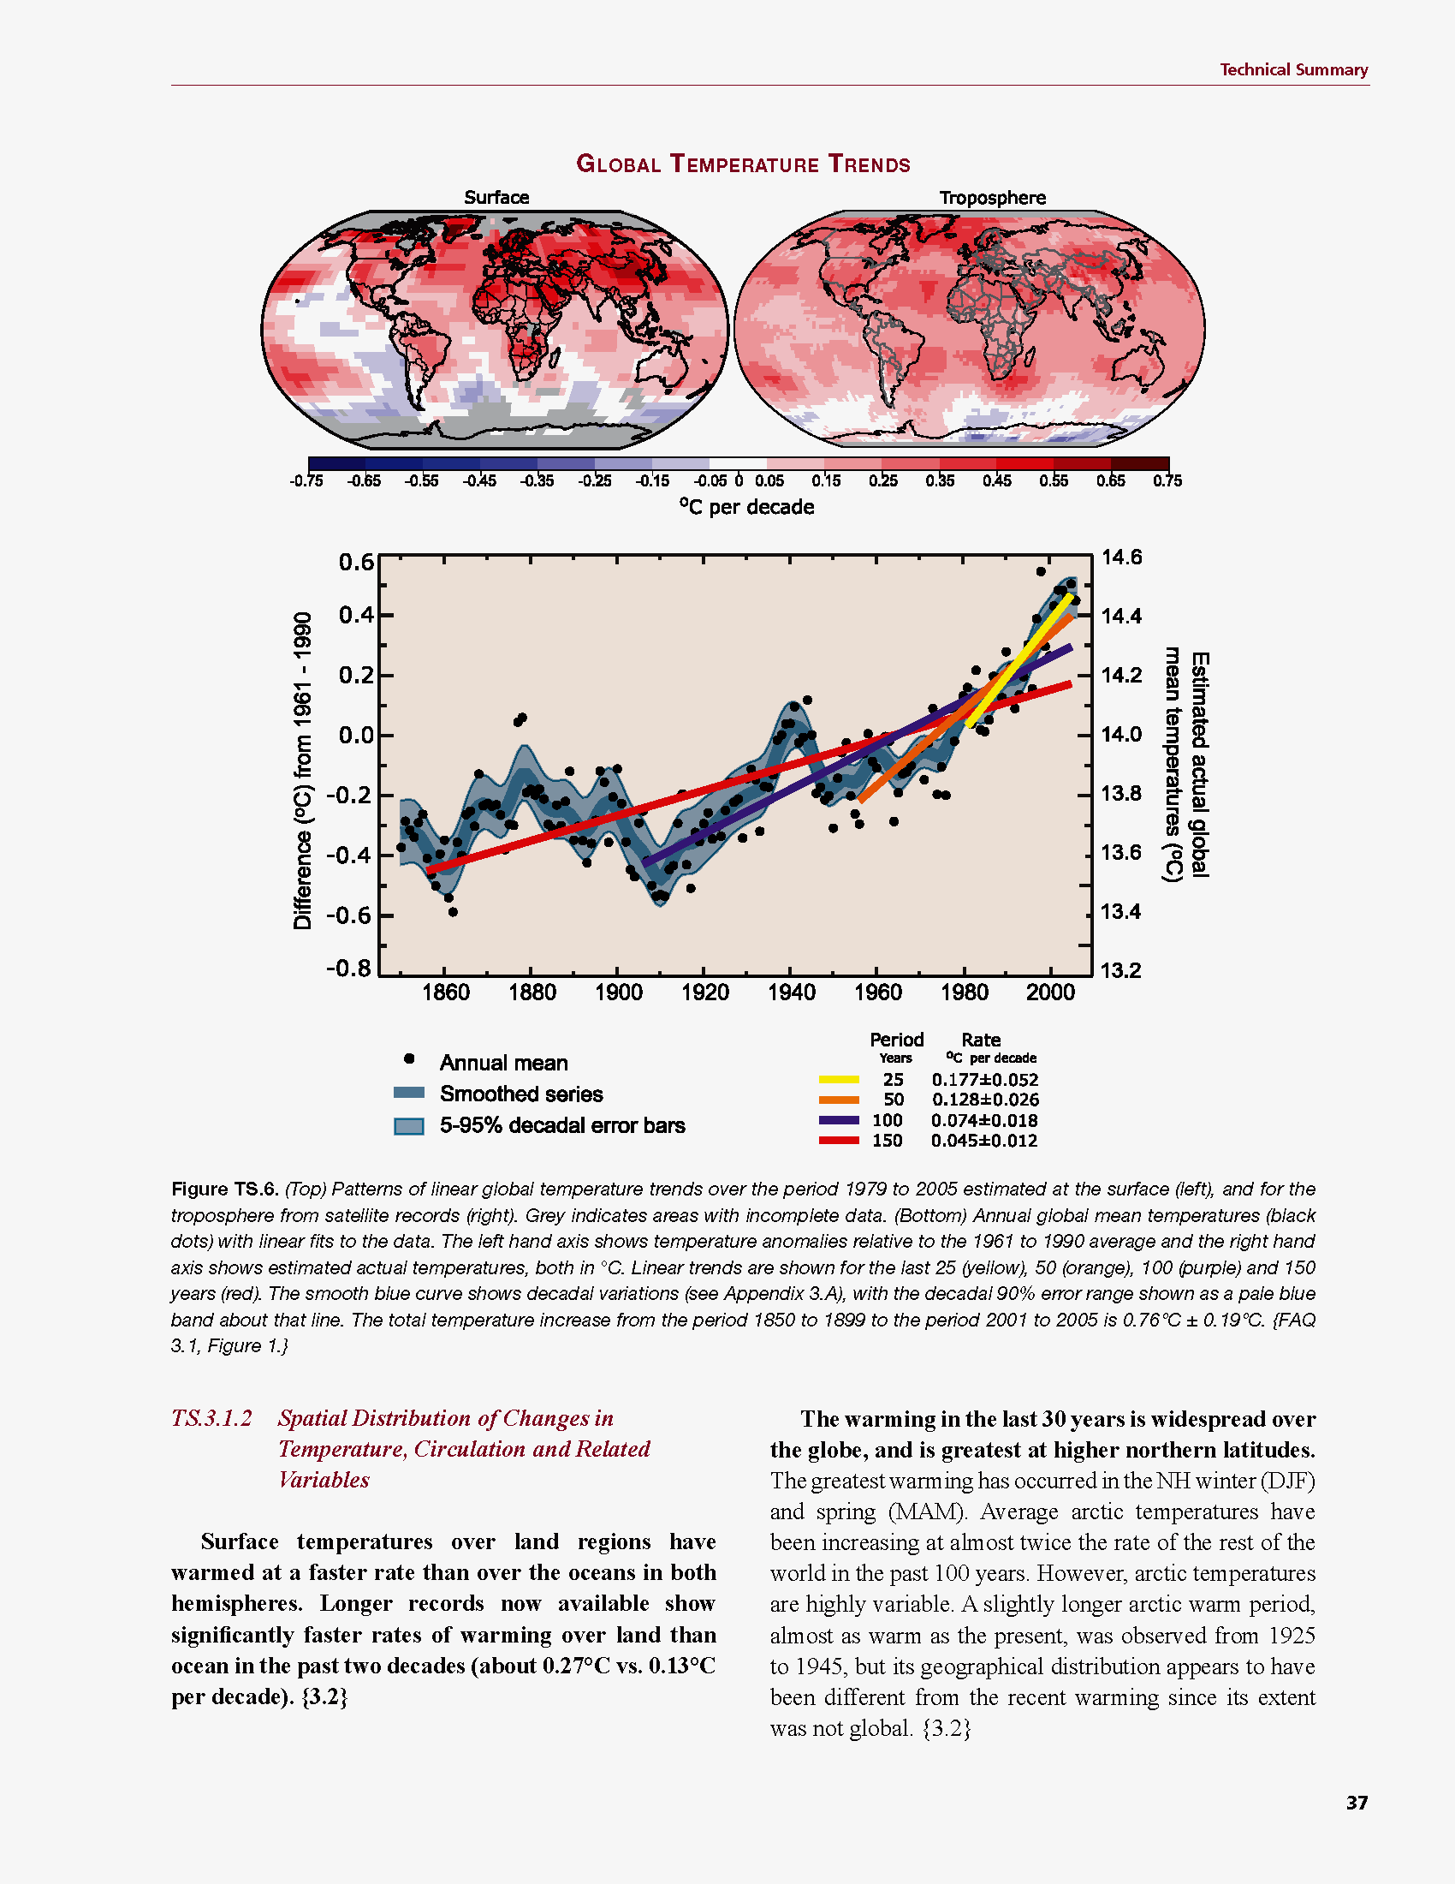
Common Myth #1
“Scientists expect a warmer future because it’s been warming up recently”
WRONG!
It’s because we know that when we add heat to things, they warm up

Slide 15
Simple
2. Serious
3. Solvable

Slide 16


How much warmer?
Land vs ocean!
North vs South
Global mean
warming of 2º to 5º C
North American
warming of 3º to 6º C
= 5º to 11º F
Arctic warming of
8º to 14º F
Low
Emissions
Moderate
Emissions
High
Emissions
RULE OF THUMB:
Global Warming (Celsius)
x 1.6 (USA) x 1.8 = Fahrenheit

Slide 17

Where is it 10º F Warmer
“on average?”
Seattle ➔
Sacramento
Denver ➔
Amarillo
Illinois ➔
Mississippi
Washington DC ➔
Tallahassee
10 ºF warming is like moving
600 – 800 miles South!
Water? Crops?
Real Estate? Health?

Slide 18
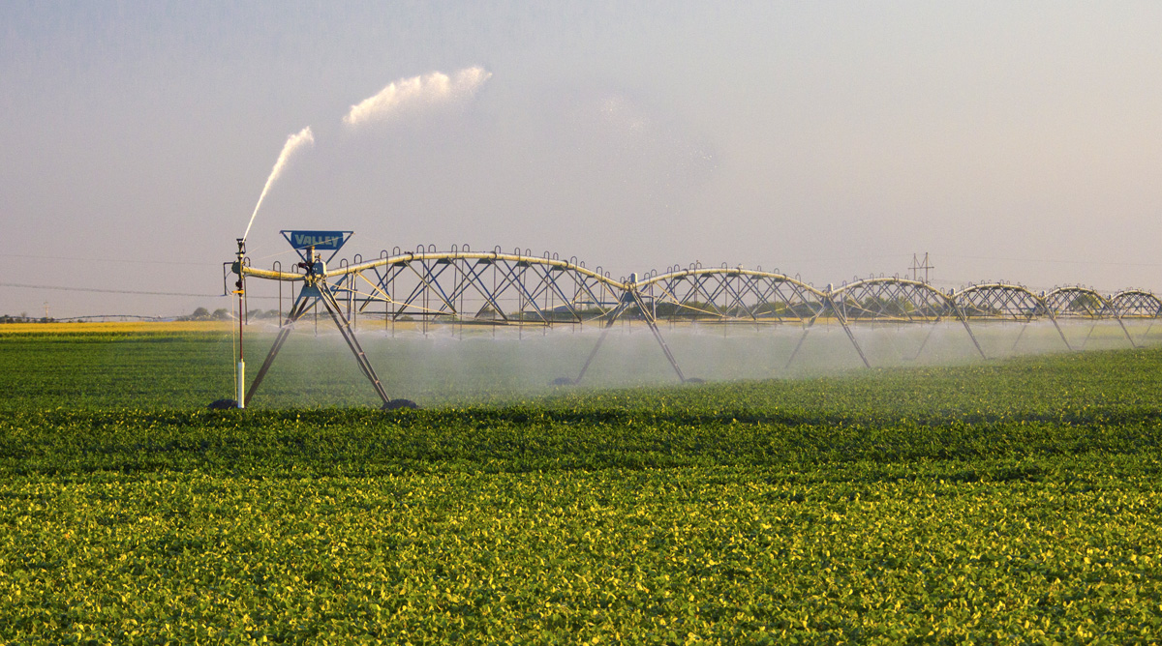
Water Budgets
Evaporative demand increases w/ temperature
In
Out
Drought is the running sum
of water out minus water in

Slide 19
Droughts Past & Future
Tree rings
Dust Bowl
Medieval Megadroughts
Climate models
Coming droughts much worse than any in past 1000 years

Slide 20

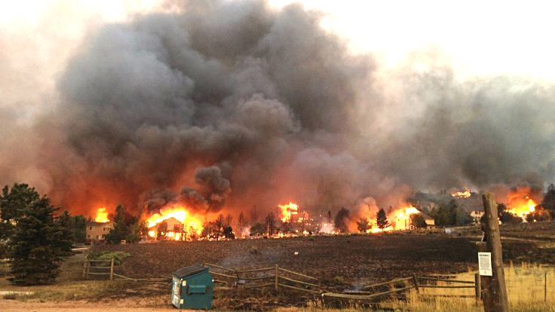
Warming Promotes Wildfire
Warmer air increases evaporative demand on forests
Longer warm season depletes soil moisture
More frequent extremely hot, dry, windy days when fires are uncontrollable
Projected Increase in Area Burned
656%
656%
NRC 2011

Slide 21
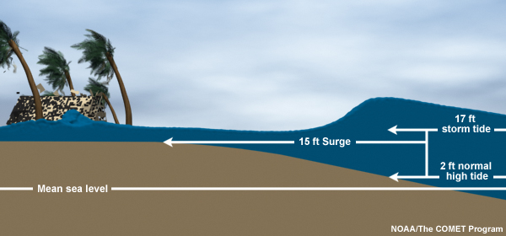
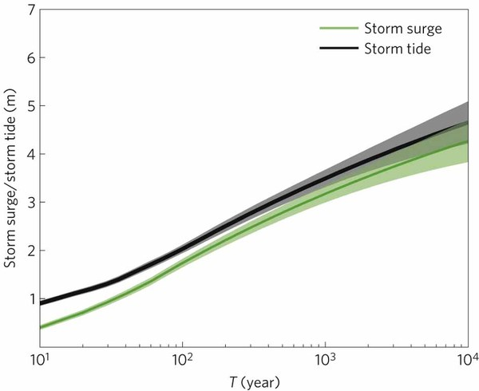
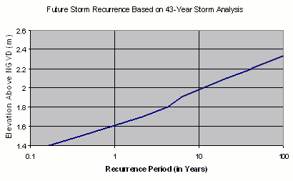
Storm Surge Frequency
Big storms push a “dome” of water onto land
Small storm surges happen
a lot
Big storm surges are more rare
Huge surges extremely rare
18
15
12
height above sea level (feet)
9
6
Coastal Flooding
Rockaway Beach, NYC
3
10 100 1000 10000
How often (years)

Slide 22

Coastal
Flooding
Sea level rise shifts the line up
Floods of a given depth happen more often
What was a
100-year flood becomes a
10-year flood!
Rockaway Beach, NYC
12
9
height above sea level (feet)
6
flooded
subway
system
3
10
100
1000
how often (years)

Slide 23
Hurricane Sandy Floods the NYC Subway

Slide 24

Billions and Billions
Shanghai 1991 and 2012
Currently 7 billion people on Earth
but only 1 billion use lots of energy
Rapid development to 4 billion
energy users over coming decades
Population growth only 30% but
energy growth 300% by 2100

Slide 25
Like Moore’s Law
To limit warming to 2 C, emissions have to fall 50% each decade starting now!
This will be really hard!
Future Fossil Fuel Emissions
GtC/yr
Rockstrom et al (2017)
A roadmap for rapid decarbonization
Science 24 Mar 2017:
355, 1269-1271
DOI: 10.1126/science.aah3443

Slide 26
Simple
2. Serious
3. Solvable

Slide 27


Efficient Architects!
$4.5 TRILLION SAVINGS !
Energy to Power US Buildings
2010
2020
2030

Slide 28
Predictions vs Reality
IEA predictions of future deployment of
PV and wind are almost FLAT, year after year
Year after year, they’re RIDICULOUSLY wrong!
SOLAR
WIND
https://onclimatechangepolicydotorg.files.wordpress.com/2013/10/wind-and-solar-current-projections.jpg

Slide 29
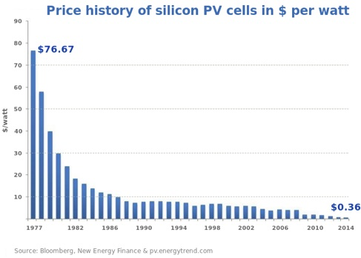
Price of Solar
PV Cells ($/watt)
Price has fallen by factor of 200 since I graduated from high school
Factor of 5 since 2011
Now as cheap or cheaper than coal or gas
Drop in 1970s
Flatter in1990s

Slide 30
Solar Resources
Germany gets less sun than Alaska!
German electricity
4% wind & solar in 2000
32% wind & solar in 2016
US vs Germany

Slide 31
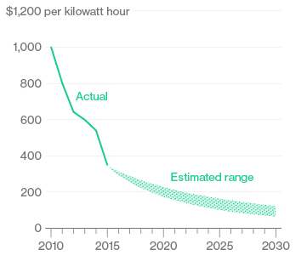
Battery Storage
In 2015, BNEF predicted $150/kWh by 2025
2017
Chevy
Bolt
Chevy Bolt reached $145 already
(8 years early)!
Now 7 times cheaper than in 2010!
Next year: Tesla “Gigafactory”
Bloomberg New Energy Finance Data

Slide 32


Costs
Conversion to 100% noncarbon energy will cost about
1% of GDP
That’s about what it cost to retrofit all the world’s cities with indoor plumbing a century ago …
It was SO worth it!

Slide 33
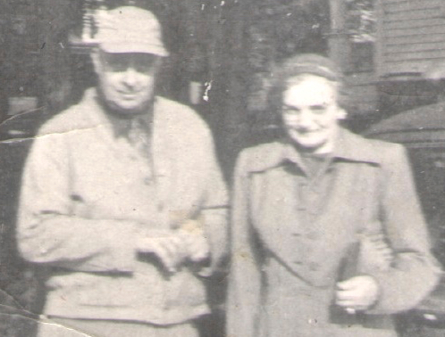
My Grandparents

Slide 34
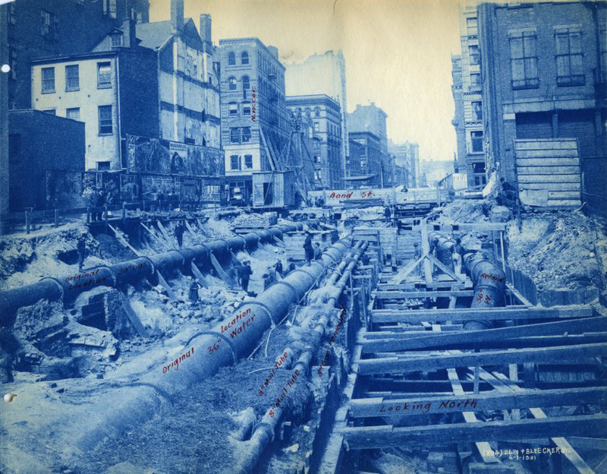
My Grandparents’ Generation
Built subways, sewers,
the electrical grid, defeated the Nazis

Slide 35
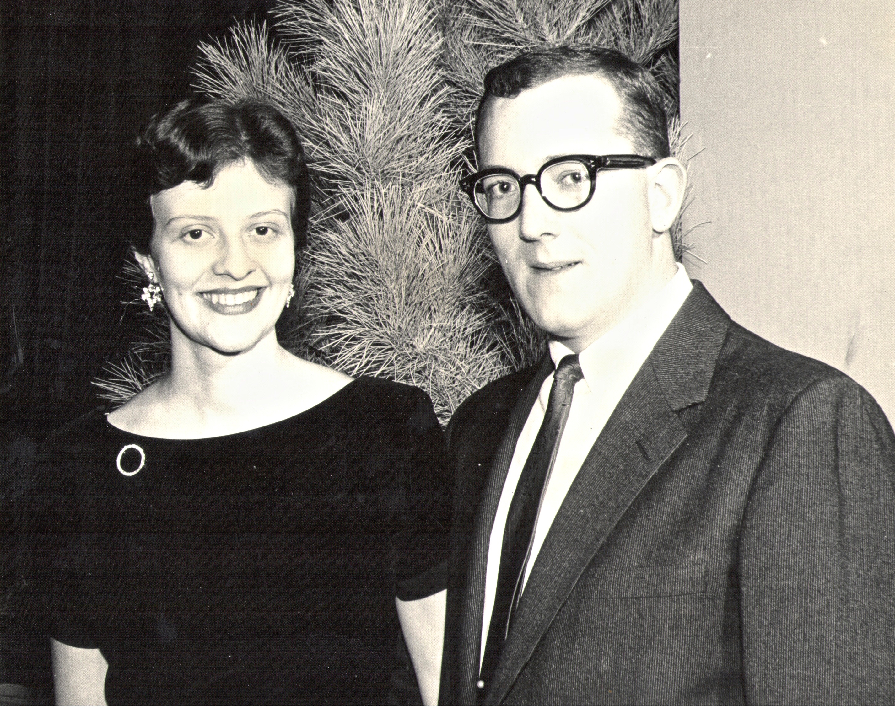
My Parents

Slide 36
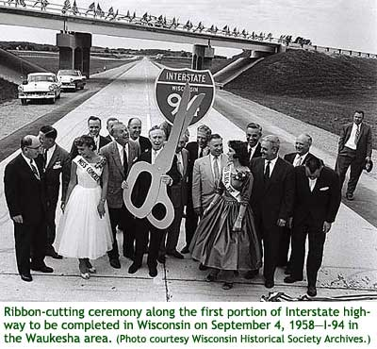
My Parents’ Generation
Built the Interstate Highways,
fought the cold war, landed on the Moon!

Slide 37
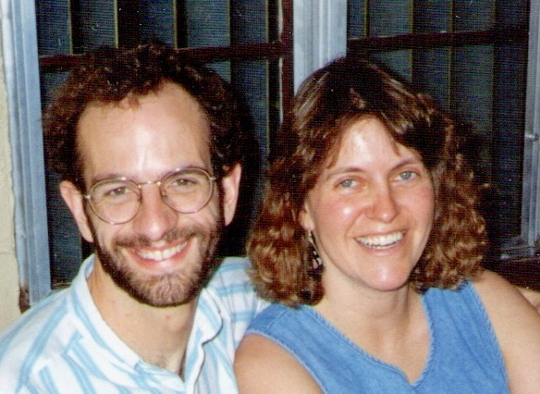
Jennifer & Me

Slide 38

My Generation
Invented the PC, Built the internet,
replaced billions of land-lines with cell phones

Slide 39
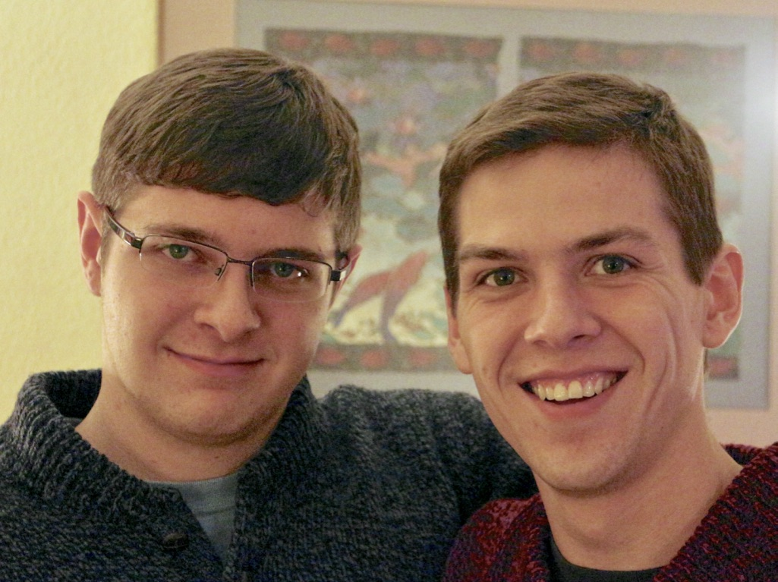
My Kids

Slide 40
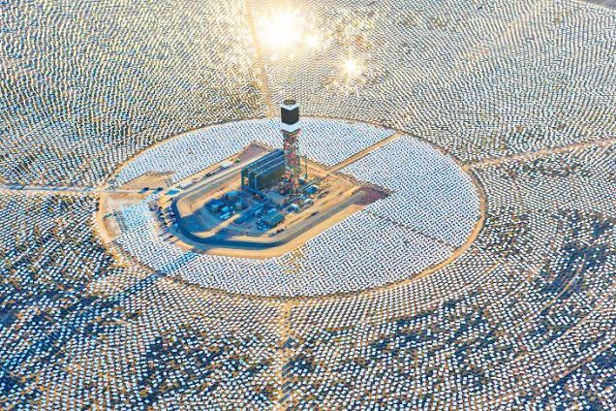

My Kids’ Generation
Will replace the world’s energy system again!

Slide 41

Choose Your Future
Many people think:
  “Our well-being is based on
  stuff we extract from the ground”
When we stop burning coal, will our descendants shiver in the dark?

Slide 42

Choose Your Future
I prefer:
  “We create our well-being through creativity, ingenuity, and hard work”
The future is bright!

Slide 43
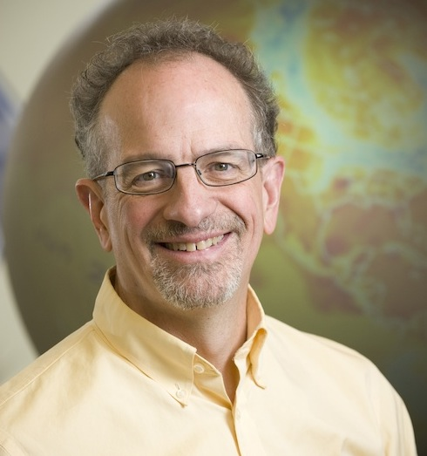
For More Info …
Email me for a link to this PowerPoint:
  Scott.Denning@gmail.com
Email me anytime with questions or comments (remind me where we met!)
Follow me on twitter:
  @airScottDenning

Slide 44

Q&A

Slide 45

Thank you for attending! and coming soon…
Wednesday, November 29th, 12 pm Eastern
  The SPSSI Graduate Student Committee is back with a new methodology-focused webinar on nonverbal behavioral coding, with Katie Bentley of Washington University in St. Louis. Additional information and a registration link will be sent out within the coming weeks.
In the works for 2018…
  A policy-focused webinar with Fred Karnas, PhD, a Senior Fellow with the Kresge Foundation
  A policy-focused webinar with Jacqueline Bhabha, JD, MSc, Professor of the Practice of Health and Human Rights at Harvard University

Slide 46
Additional Questions or Comments?
  Please feel to contact Dr. Denning at scott.denning@colostate.edu
Watch a video recording of this webinar on SPSSI’s YouTube channel: https://www.youtube.com/channel/UCLJcyTbZTJzzduYF9wCLm3g
Interested in joining our list of policy or methodology webinar presenters?
  Submit your abstract at http://tinyurl.com/spssiwebinar by Dec. 20th, 2017!
Interested in joining SPSSI and/or learning about our current grant, fellowship, and conference opportunities? Visit www.spssi.org

