Slide 1

Stardust
Fusion and elements
Hydrogen to Helium …
to carbon and oxygen!
Supernovas and a dozen “Ur-Minerals”
Chemistry

Slide 2
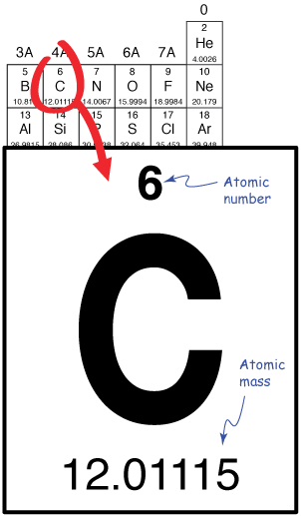
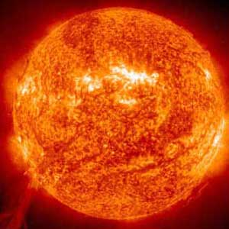
What is Carbon?
Element #6 in the Periodic Table
  6 protons
  6 neutrons (usually)
  6 electrons
All the carbon in the universe was made inside of stars!
  2 Hydrogen atoms make a Helium atom
  3 Helium atoms make a Carbon atom

Slide 3
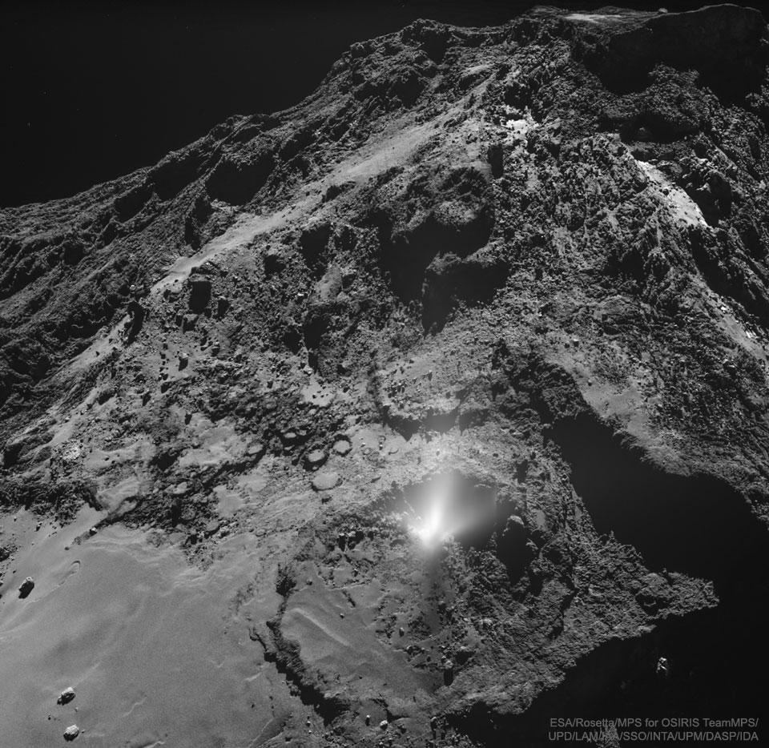

Slide 4
Carbon is Important
Outer electron shell can donate or receive 4 “valence” electrons
Basis for all of organic chemistry and life!

Slide 5
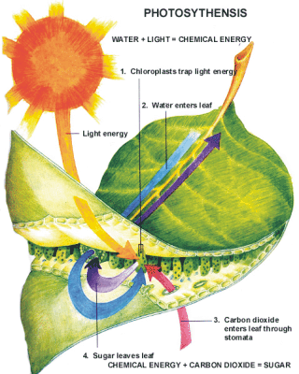
Carbon, Life, & Energy
Photosynthesis uses energy from the sun to convert inorganic air (CO2) to living biomass!
Most of this energy is released through respiration (back to CO2) when plants are eaten by animals, bacteria, people

Slide 6
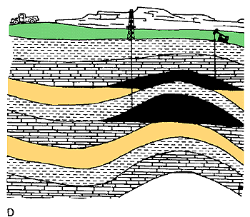
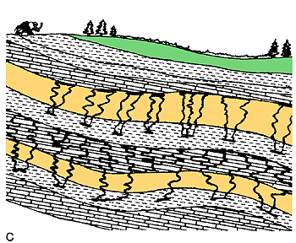

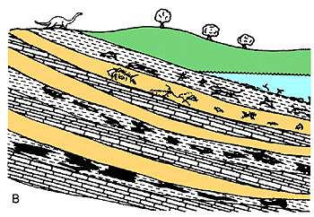
Fossil Fuels
  Some of the stored solar energy in biomass can be preserved in fossilized remains

Slide 7
Hydrocarbons, Energy, & CO2
We dig this stuff (“fossil fuels”) up and burn it, harvesting the stored energy to power civilization

Slide 8
Simple
2. Serious
3. Solvable

Slide 9
Simple
2. Serious
3. Solvable

Slide 10


Ever Wonder Why?
Day is warmer than night
Summer is warmer than winter
Phoenix is warmer than Fargo

Slide 11

Heat Budgets
Heat in
Heat in
Heat out
Heat out

Slide 12
Dancing Molecules and Heat Rays!
Nearly all of the air is made of oxygen (O₂) and nitrogen (N₂) in which two atoms of the same element share electrons
Infrared (heat) energy radiated up from the surface can be absorbed by these molecules, but not very well
O
O
N
N
Diatomic molecules can vibrate back and forth like balls on a spring, but the ends are identical

Slide 13
Dancing Molecules and Heat Rays!
Carbon dioxide (CO₂) and water vapor (H₂O) are different!
They have many more ways to vibrate and rotate, so they are very good at absorbing and emitting infrared (heat) radiation
O
C
O
O
H
H
Molecules that have many ways to wiggle are called “Greenhouse” molecules
Absorption spectrum of CO2 was measured by John Tyndall in 1863

Slide 14


Slide 15


Common Sense
1 m
Doubling CO₂ would add 4 watts to every square meter of the Earth, 24/7/365
Doing that would make the surface warmer
This was known before light bulbs were invented!
4 Watts
1 m
John Tyndall, January 1863

Slide 16
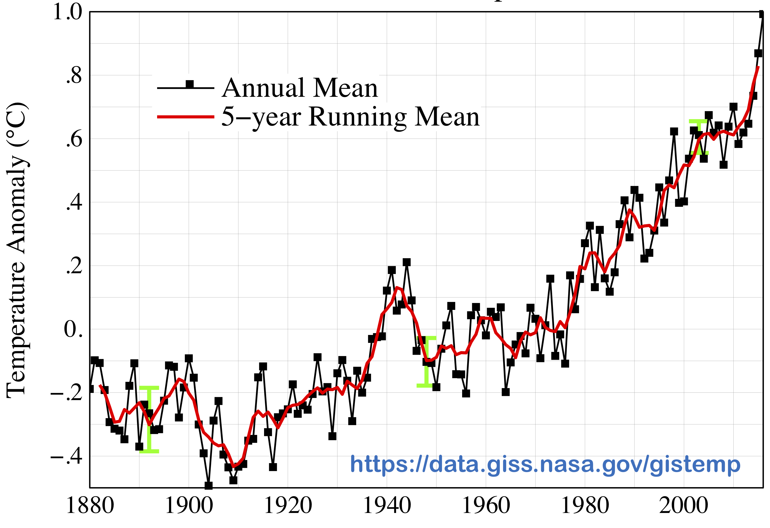

Common Myth #1
“Scientists expect a warmer future
because it’s been warming up recently”
WRONG!
It’s because we know that when we add heat to things, they warm up

Slide 17
Simple
2. Serious
3. Solvable

Slide 18
Recent Changes
More warming on land than ocean
Warming since 1900 less than 1 C over ocean
Warming since 1900 around 1 C over land

Slide 19
Big Choices
Observed Change 1901-2012

Slide 20
Past and Future
Difference in climate between a low-emissions (RCP 2.6) and high-emissions (RCP 8.5) don’t become large until mid-century

Slide 21


How much warmer?
Land vs ocean!
North vs South
Global mean
warming of 2º to 5º C
North American
warming of 3º to 6º C
= 5º to 11º F
Arctic warming of
8º to 14º F
Low
Emissions
Moderate
Emissions
High
Emissions
RULE OF THUMB:
Global Warming (Celsius)
x 1.6 (USA) x 1.8 = Fahrenheit

Slide 22

Where is it 10º F Warmer
“on average?”
Seattle ➔
Sacramento
Denver ➔
Albuquerque
Illinois ➔
Mississippi
Washington DC ➔
Tallahassee
10 ºF warming is like moving
600 – 800 miles South!
Water? Crops?
Real Estate? Health?

Slide 23
Zones Marching Up
In Colorado, temps drop about 10 F for each 3000 feet of elevation
  Denver -> Estes Park
  Estes Park -> Trail Ridge Road
But in 100 years instead of 100 centuries!

Slide 24
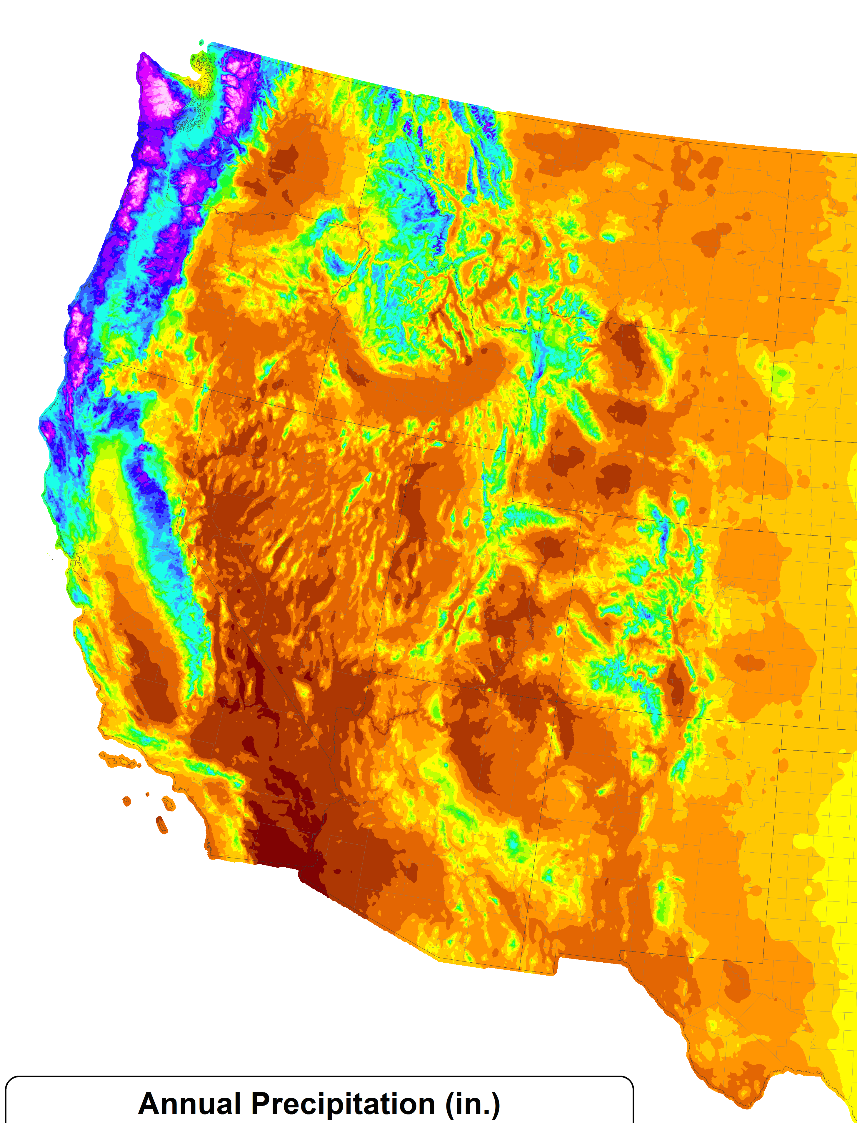
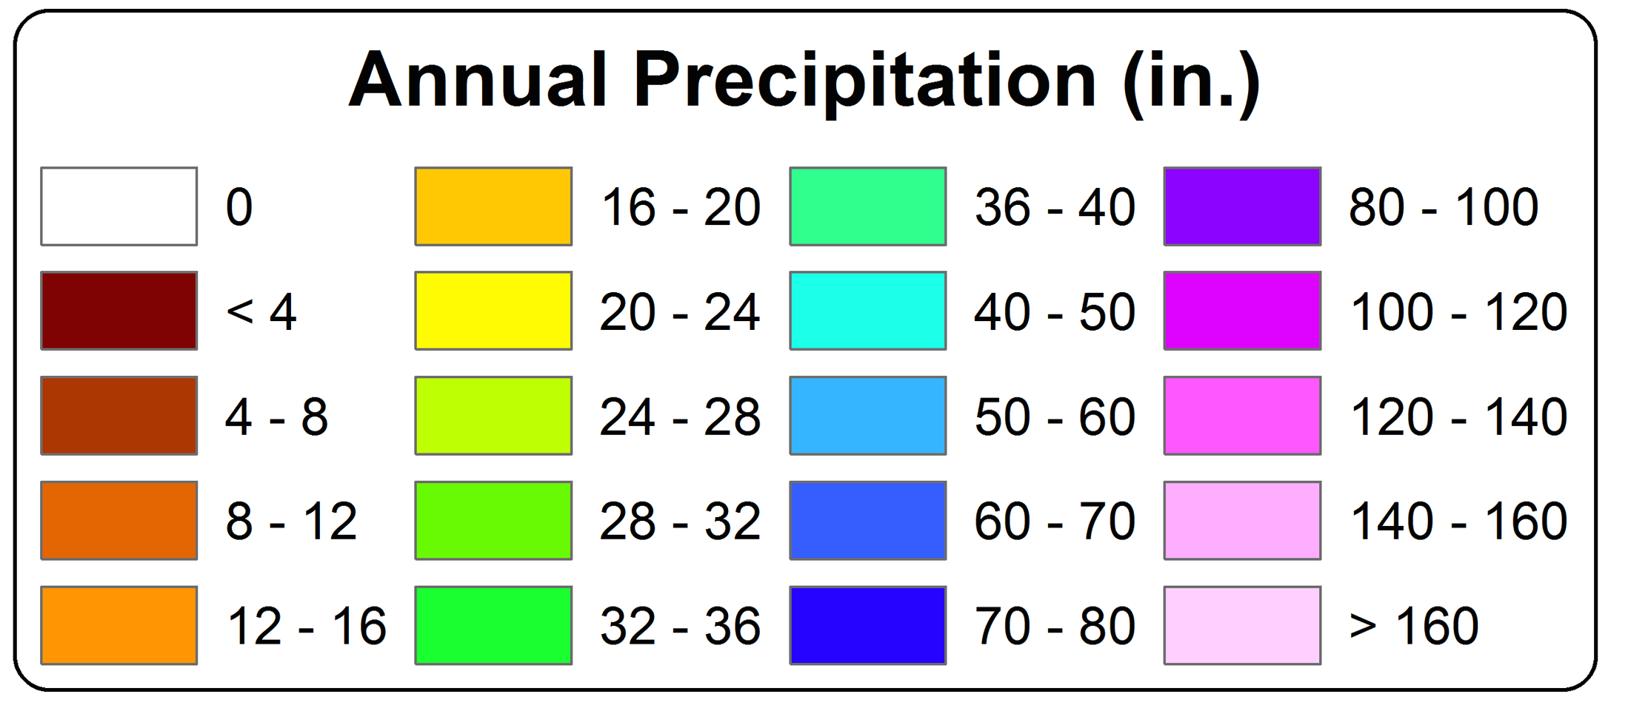
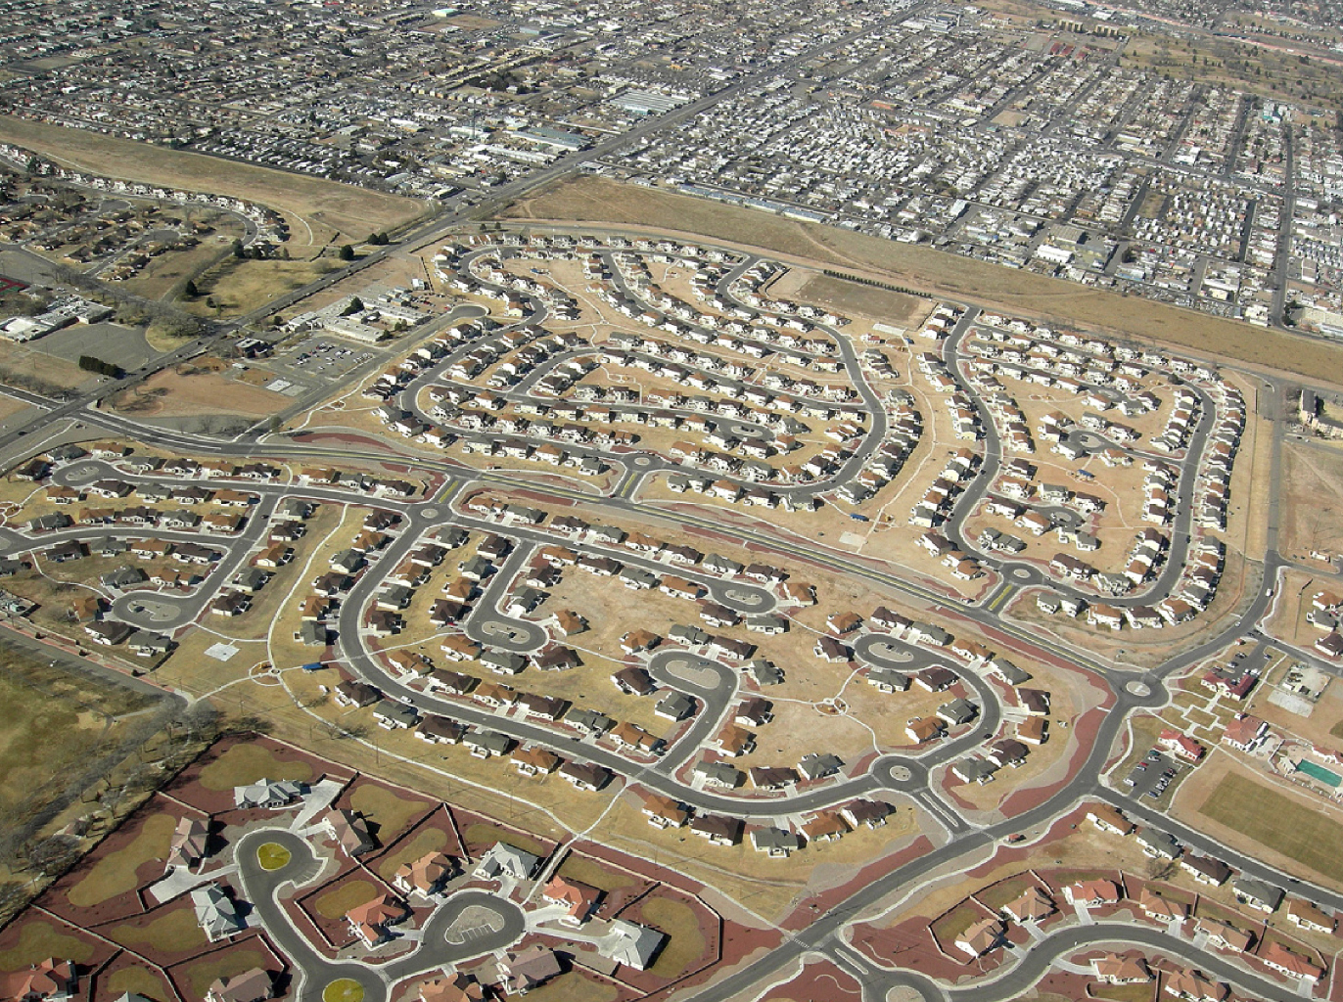
A Region
On the Edge
WA
MT
OR
WY
ID
NV
UT
CO
75 million people in the western US live in a region with marginal precipitation
Just enough snow to support forests and reservoirs
Just enough irrigation water to support farming
Just enough water for cities and towns
AZ
CA
NM
TX

Slide 25
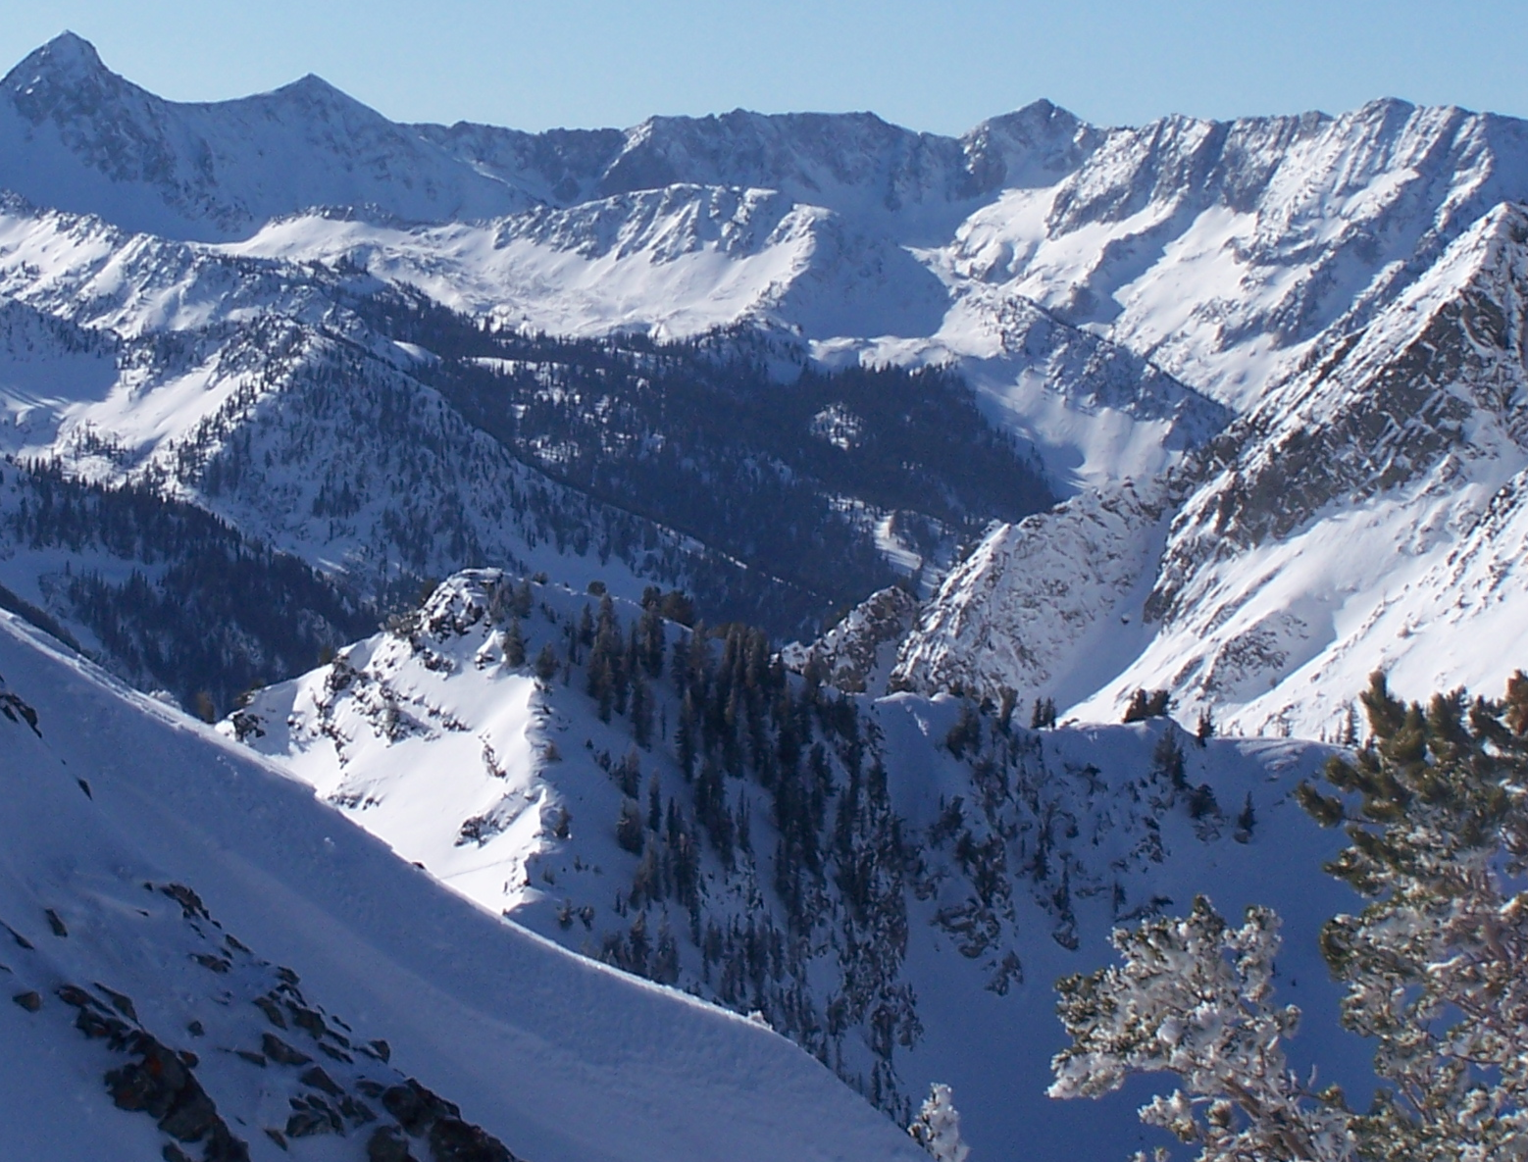
Our Water Supply

Slide 26
Declining Snowpack
20% less snowpack over 49 years
Less than 2 Fahrenheit average warming

Slide 27
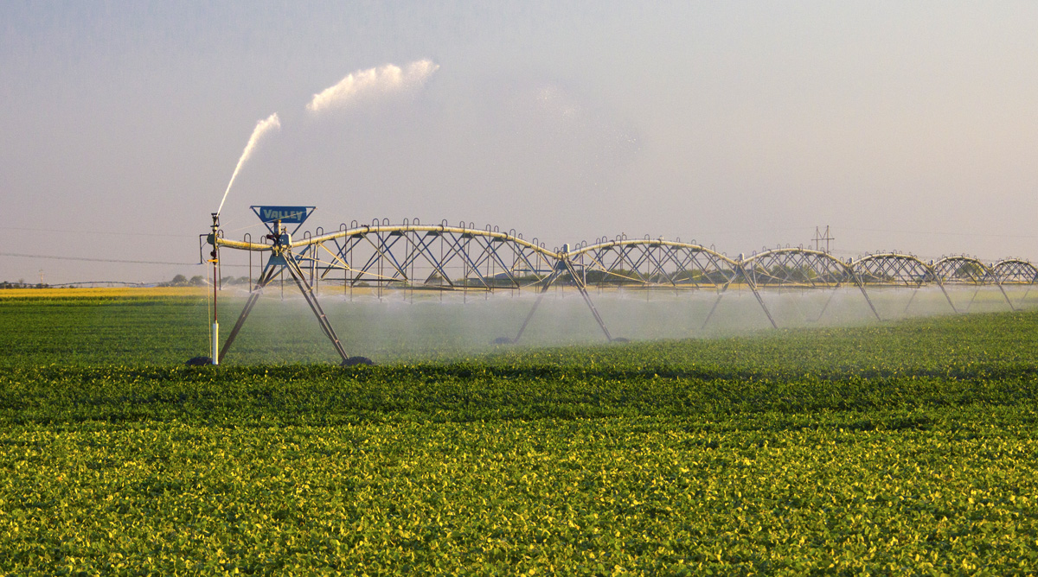
Water Budgets
Evaporative demand increases w/ temperature
In
Out
Drought is the running sum
of water out minus water in

Slide 28
Droughts Past & Future
Tree rings
Dust Bowl
Medieval Megadroughts
Climate models
Coming droughts much worse than any in past 1000 years

Slide 29

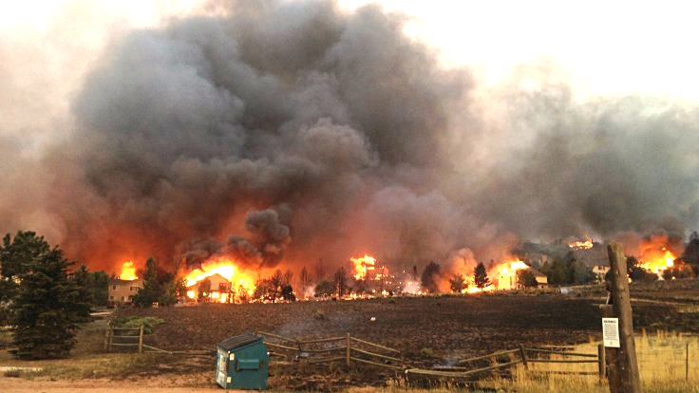
Warming Promotes Wildfire
Warmer air increases evaporative demand on forests
Longer warm season depletes soil moisture
More frequent extremely hot, dry, windy days when fires are uncontrollable
Projected Increase in Area Burned
656%
656%
NRC 2011

Slide 30
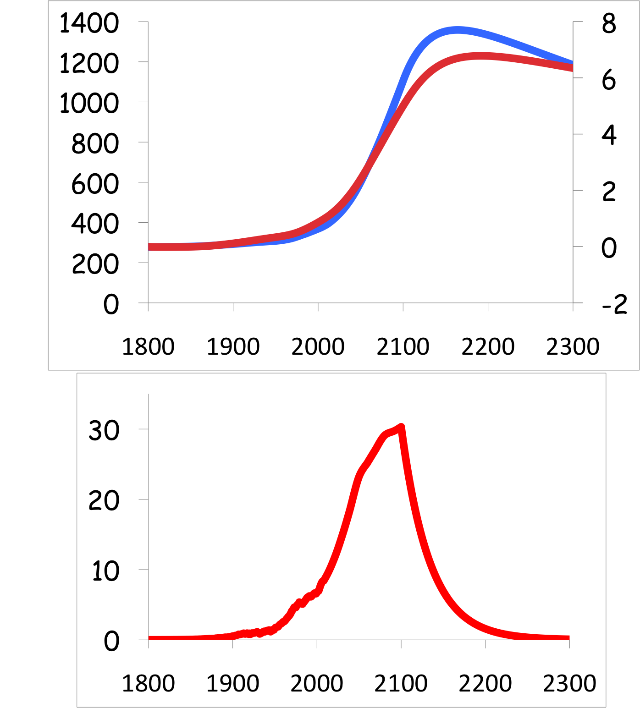
Common Myth #2
“When we reduce or stop burning fossil fuel, CO₂ will go away and things will go back to normal”
CO₂
If China, India, & Africa industrialize with coal, CO₂ will rise to 4x preindustrial
Extra CO₂ will last for thousands of years after coal is gone
CO₂ (ppm)
warming
Warming (Celsius)
you are
here
emissions
GtC/yr
year
Thermostat only turns one way!

Slide 31
Simple
2. Serious
3. Solvable

Slide 32
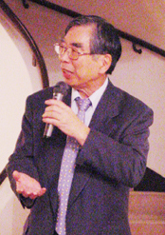
How Much Will We Burn?
CO₂ Emitted
$
E
CO₂
=
P
x
x
x
P
$
E
CO₂ /
energy
Population
$/person
energy/$
Four factors determine
fossil fuel emissions:
  Population
  Economic activity
  Energy efficiency of economy
  Carbon efficiency of energy
Kaya Identity

Slide 33
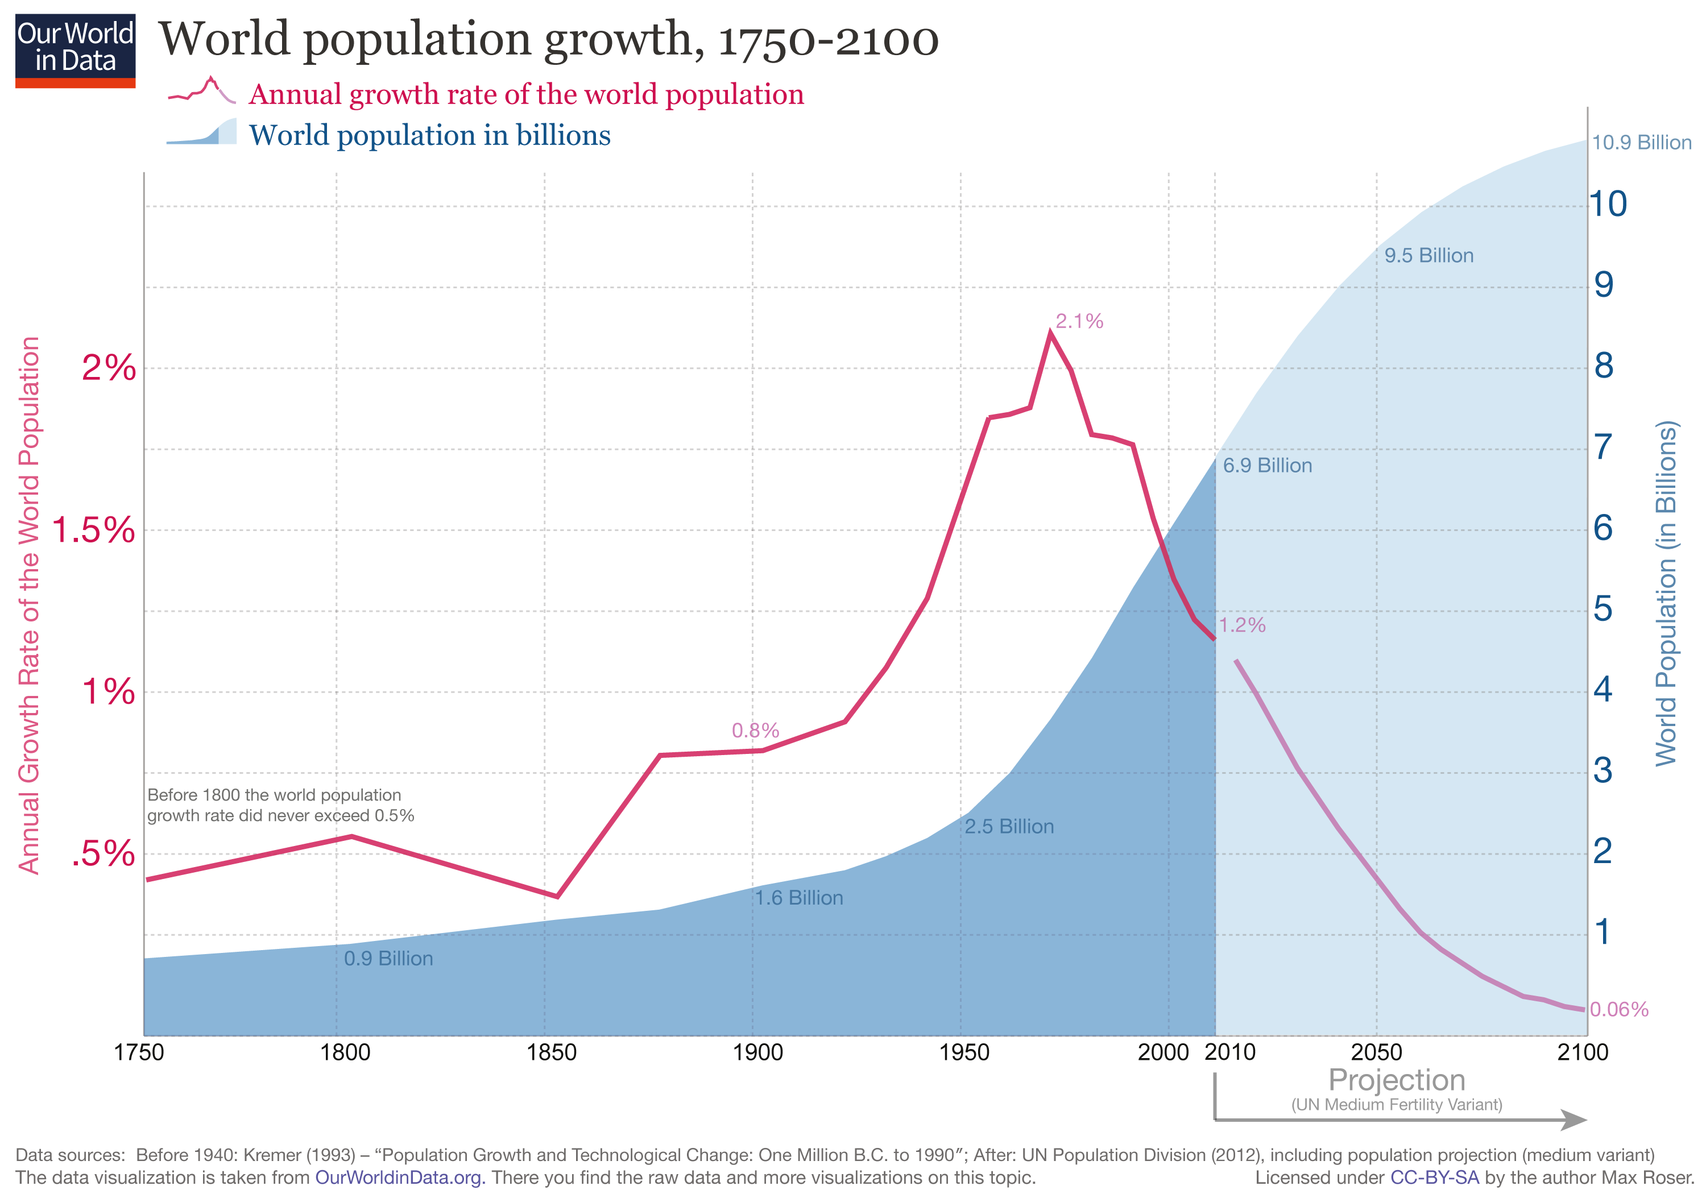
World Population
Remember
“The Population Bomb” ?
World population has more than doubled in my lifetime
It will never double again
Population growth rate is half what it was when I was a teenager
Expected to reach zero population growth by 2100

Slide 34

Billions and Billions
Shanghai 1991 and 2012
$/person
Currently 7.5 billion people on Earth
but only 1 billion use lots of energy
Rapid development to 4 billion
energy users over coming decades
Population growth only 30% but
energy growth 300% by 2100
Energy use is growing
10x faster than population

Slide 35


Efficient Architects!
energy / $
$4.5 TRILLION SAVINGS !
Energy to Power US Buildings
2010
2020
2030

Slide 36
Predictions vs Reality
CO₂ /
energy
IEA predictions of future deployment of
PV and wind are almost FLAT, year after year
Year after year, they’re RIDICULOUSLY wrong!
SOLAR
WIND
https://onclimatechangepolicydotorg.files.wordpress.com/2013/10/wind-and-solar-current-projections.jpg

Slide 37
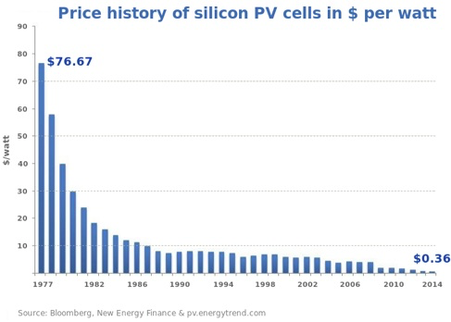
Price of Solar
PV Cells ($/watt)
Price has fallen by factor of 200 since I graduated from high school
Factor of 5 since 2011
Now as cheap or cheaper than coal or gas
Drop in 1970s
Flatter in1990s

Slide 38
Solar Resources
Germany gets less sun than Alaska!
German electricity
4% wind & solar in 2000
32% wind & solar in 2016
US vs Germany

Slide 39
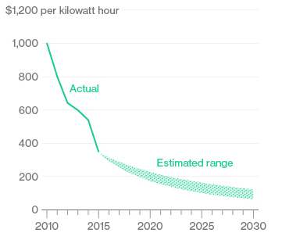
Battery Storage
In 2015, BNEF predicted $150/kWh by 2025
2017
Chevy
Bolt
Chevy Bolt reached $145 already
(8 years early)!
Now 7 times cheaper than in 2010!
Next year: Tesla “Gigafactory”
Bloomberg New Energy Finance Data

Slide 40
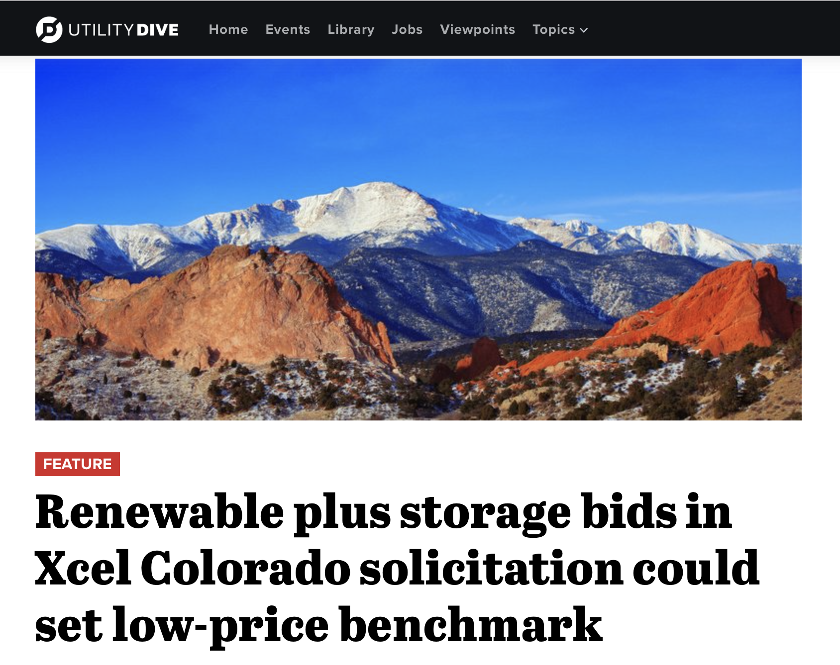
CO Excel Auction
Median price
for delivered wind+storage
was 2.1 ¢/kW-hr
< 1/2 cost of existing coal!
Jan 16, 2018

Slide 41


Costs
Conversion to 100% noncarbon energy will cost about
1% of GDP
That’s about what it cost to retrofit all the world’s cities with indoor plumbing a century ago …
It was SO worth it!

Slide 42
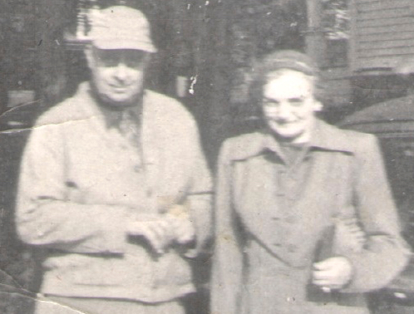
My Grandparents

Slide 43
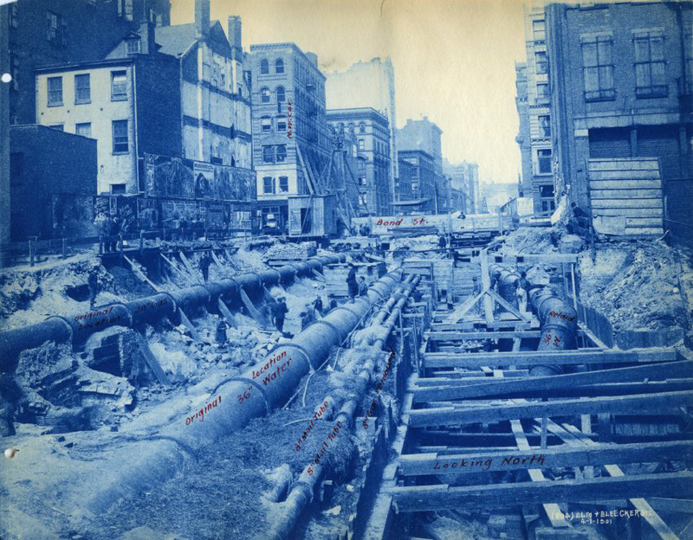
My Grandparents’ Generation
Built subways, sewers,
the electrical grid, defeated the Nazis

Slide 44
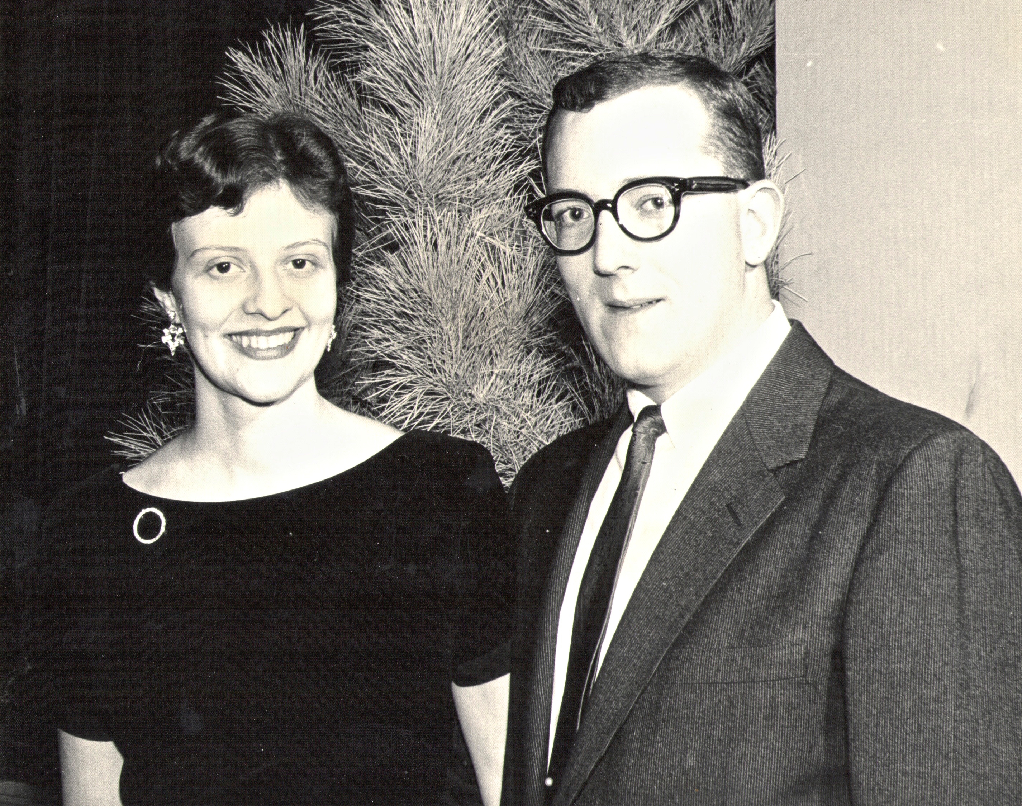
My Parents

Slide 45
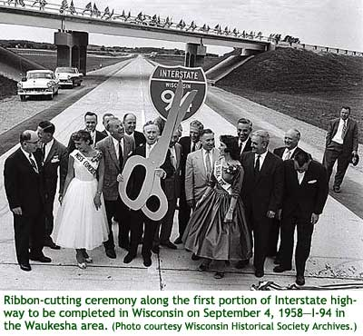
My Parents’ Generation
Built the Interstate Highways,
fought the cold war, landed on the Moon!

Slide 46
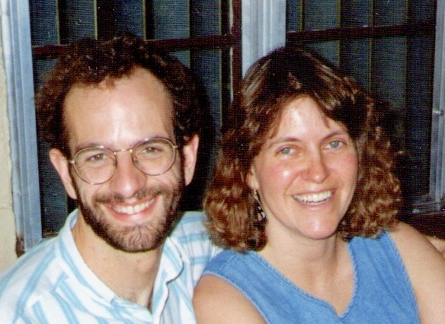
Jennifer & Me

Slide 47

My Generation
Invented the PC, Built the internet,
replaced billions of land-lines with cell phones

Slide 48

My Kids

Slide 49
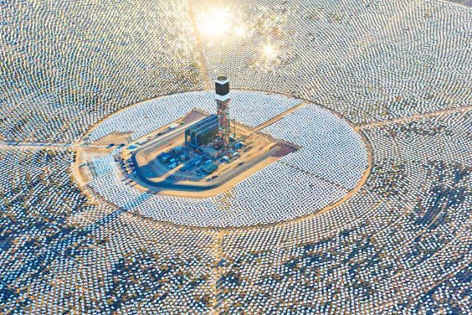

My Kids’ Generation
Will replace the world’s energy system again!

Slide 50

Choose Your Future
Many people think:
  “Our well-being is based on
  stuff we extract from the ground”
When we stop burning coal, will our descendants shiver in the dark?

Slide 51

Choose Your Future
I prefer:
  “We create our well-being through creativity, ingenuity, and hard work”
The future is bright!

Slide 52
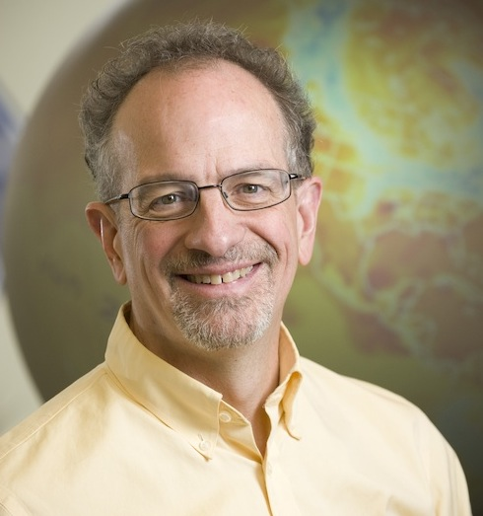
For More Info …
Download this PowerPoint or video of this presentation from SimpleSeriousSolvable.org
Email me anytime with questions or comments (remind me where we met!)
Follow me on twitter:
  @airScottDenning

