Slide 1


Climate Change:
Simple, Serious, Solvable
Scott Denning
Atmospheric Science, CSU
Email Scott.Denning@gmail.com for a copy of this presentation

Slide 2
Simple
2. Serious
3. Solvable

Slide 3
Simple
2. Serious
3. Solvable

Slide 4


Ever Wonder Why?
Day is warmer than night
Summer is warmer than winter
Phoenix is warmer than Fargo

Slide 5

Heat Budgets
Heat in
Heat in
Heat out
Heat out

Slide 6
Dancing Molecules and Heat Rays!
Nearly all of the air is made of oxygen (O₂) and nitrogen (N₂) in which two atoms of the same element share electrons
Infrared (heat) energy radiated up from the surface can be absorbed by these molecules, but not very well
O
O
N
N
Diatomic molecules can vibrate back and forth like balls on a spring, but the ends are identical

Slide 7
Dancing Molecules and Heat Rays!
Carbon dioxide (CO₂) and water vapor (H₂O) are different!
They have many more ways to vibrate and rotate, so they are very good at absorbing and emitting infrared (heat) radiation
O
C
O
O
H
H
Molecules that have many ways to wiggle are called “Greenhouse” molecules
Absorption spectrum of CO2 was measured by John Tyndall in 1863

Slide 8


Slide 9


Common Sense
1 m
Doubling CO₂ would add 4 watts to every square meter of the Earth, 24/7/365
Doing that would make the surface warmer
This was known before light bulbs were invented!
4 Watts
1 m
John Tyndall, January 1863

Slide 10

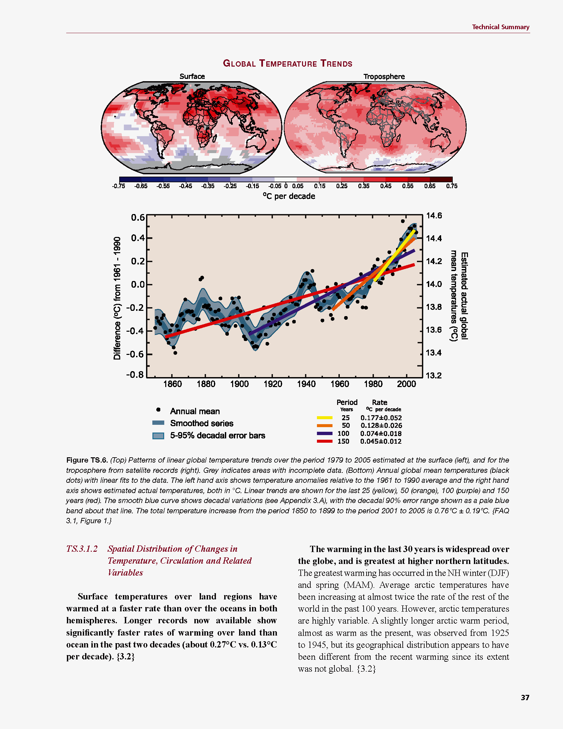
Common Myth #1
“Scientists expect a warmer future because it’s been warming up recently”
WRONG!
It’s because we know that when we add heat to things, they warm up

Slide 11
Simple
2. Serious
3. Solvable

Slide 12


How much warmer?
Low
Emissions
Land vs ocean!
North vs South
Global average
warming of 2º to 5º C
North American
warming of 3º to 6º C
= 5º to 11º F
Arctic warming of
8º to 14º F
Moderate
Emissions
High
Emissions

Slide 13

Where is it 10º F Warmer
“on average?”
Seattle ➔
Sacramento
Denver ➔
Amarillo
Illinois ➔
Mississippi
Washington DC ➔
Tallahassee
10 ºF warming is like moving
600 – 800 miles South!
Water? Crops?
Real Estate? Health?

Slide 14
Zones Marching Up
In Colorado, temps drop about 10 F for each 3000 feet of elevation
  Denver -> Estes Park
  Estes Park -> Emerald Lake
But in 100 years instead of 100 centuries!

Slide 15

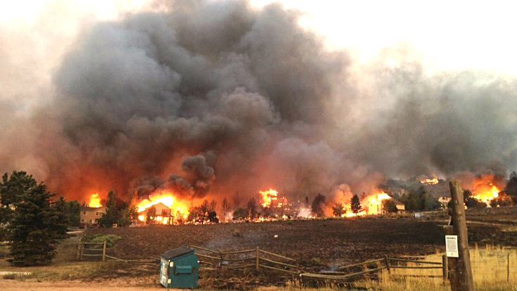
Warming Promotes Wildfire
Warmer air increases evaporative demand on forests
Longer warm season depletes soil moisture
More frequent extremely hot, dry, windy days when fires are uncontrollable
Projected Increase in Area Burned
656%
656%
NRC 2011

Slide 16
The Long Tail
Three additive exponentials
Fast,
medium,
slow
Some of the CO2 we emit today will still be warming the climate 100,000 years from now!

Slide 17
Cause and Effect
Forcing
Watts per
square meter
Response
degrees
Celsius or F
Response
Sensitivity =
Forcing
degrees per Watt m⁻²

Slide 18

Learning from the Past
Geologic past
(100’s of millions of years)
Deglaciation analog
(18,000 years ago to preindustrial time)
Last Millennium analog
(Medieval Warm Period to Little Ice Age)
Modern Climate Record
(20th Century changes)
The further back we go, the less data we have to work with.
Using modern data, we have only brief transients to study.

Slide 19
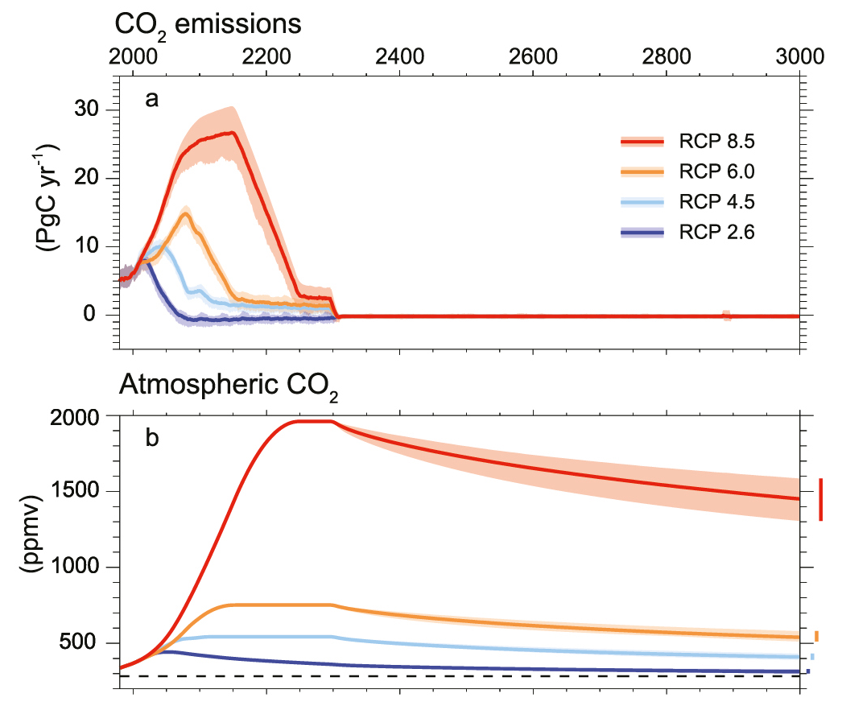
Emissions peak soon
Zero emissions from 2300 for all scenarios
1500 ppm
in 3000 AD!
CO₂ Lasts Much Longer

Slide 20
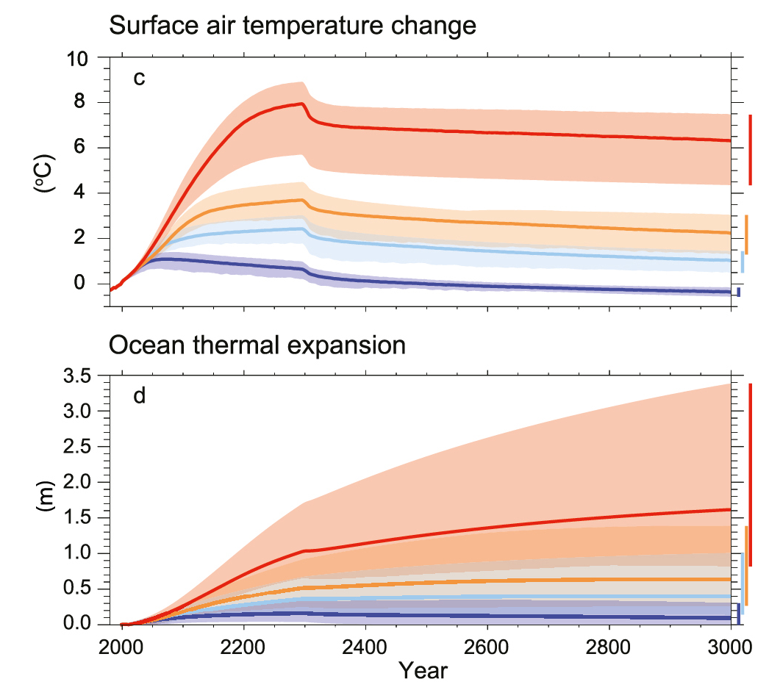
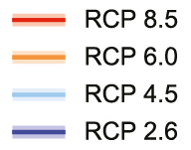
Bigger than
Deglaciation
Warming is “permanent”
You
are here
But 50x as fast!

Slide 21
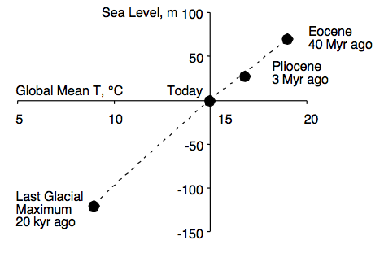
Climate and Sea Level
Linear relationship between climate & sea level over 40 million years

Slide 22
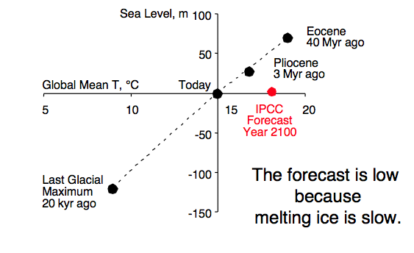
Climate and Sea Level

Slide 23
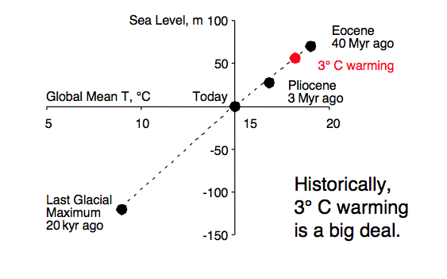

Climate and Sea Level
Seas rose 1 foot per decade for 400 years

Slide 24
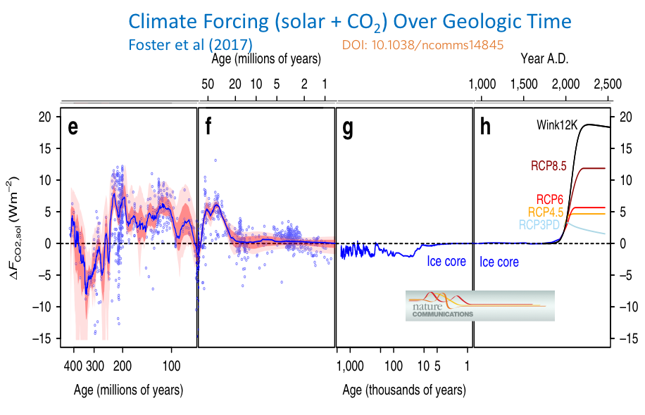
Strongest Heating in
200 Million Years!

Slide 25
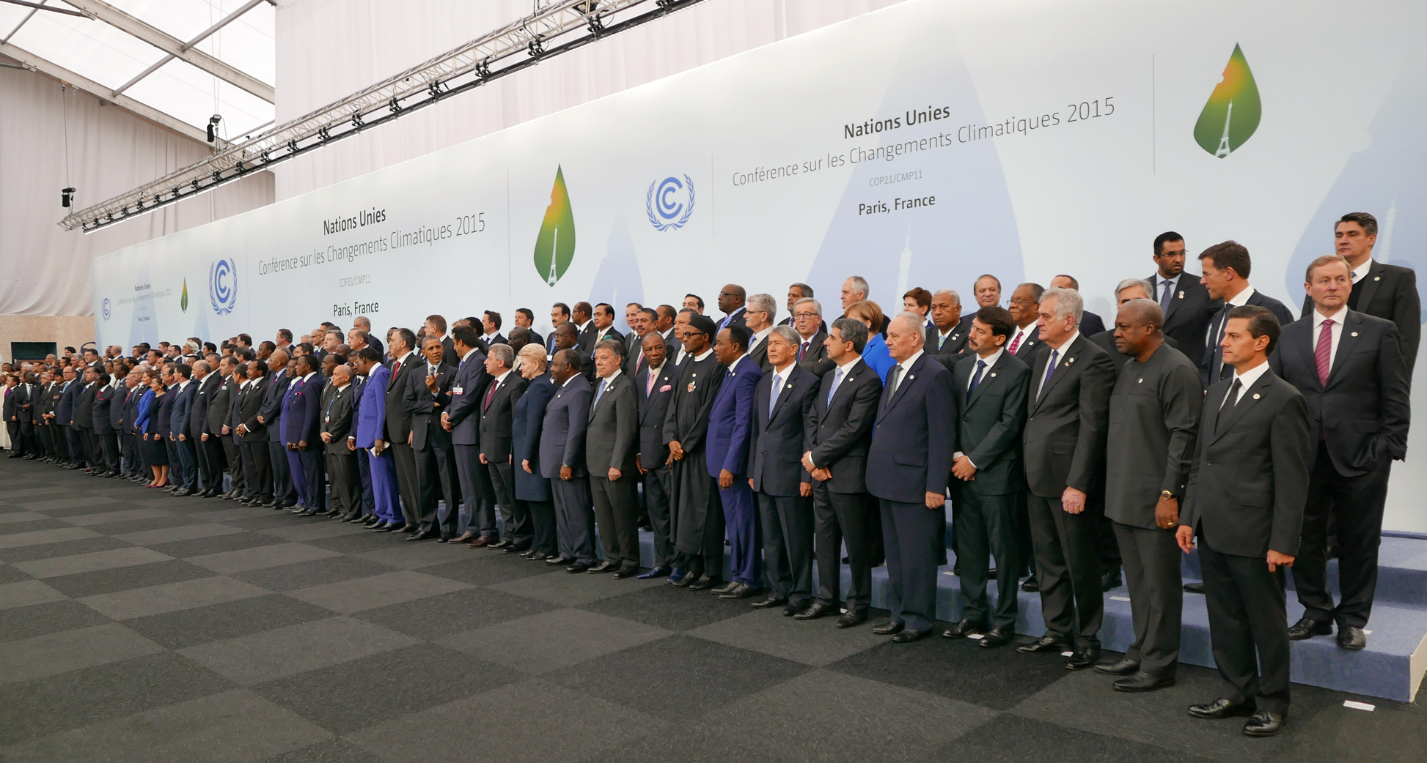
Paris Accord (COP21)
Every country on Earth has formally agreed to limit warming to 2 Celsius
Just one country has announced it will pull out, but US has less than 5% of people!
Even in the US, many states, cities, regions committed to emissions reductions
> 95% of Humanity!

Slide 26
Arithmetic
Every doubling of CO2 warms the global climate by about 3 C (5 F)
Paris commitment is to limit warming to
2 C (2/3 of a doubling)
Before Industrial Revolution, CO2 was about 280 ppm
2/3 of doubling = 450 ppm
Current CO2 is 405 ppm
We have just 45 ppm to go

Slide 27

Units of Measure
What’s a gigaton?
A gigaton is a billion (metric) tons
Precisely equal to the mass of
1 cubic km of water
1 Gt of carbon
= 3.7 Gt of CO₂ (because of the weight of the oxygen)
1 km
H₂O
1 km
1 km

Slide 28



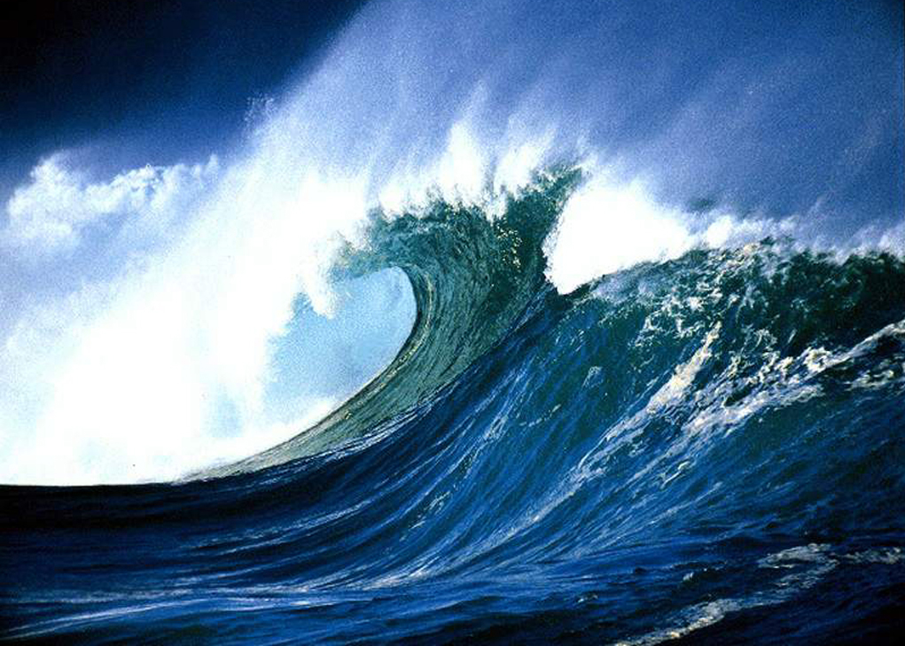
Global Carbon Cycle
“Missing” carbon is hard to find among large natural fluxes
About half the CO₂ released by humans is absorbed by oceans and land
Atmosphere
850+ 5/yr
~120
~90
~90
~120
10 GtC/yr
Ocean
Land
Humans
38,000
2000

Slide 29
Carbon Arithmetic
Every Gigaton of carbon raises CO2 by about 0.5 ppm
Paris carbon limit is 45 ppm = 90 GtC
Half the carbon goes into land and oceans. If that keeps up, we can burn 180 GtC of fossil fuel before hitting limit
Global fossil fuel combustion is 10 GtC/yr
So at current rate, we will hit the limit in 18 years (2035)
Sooner if emissions increase, later if they decrease

Slide 30
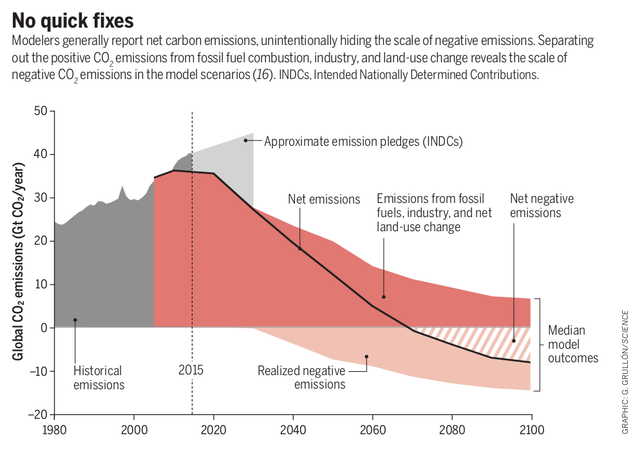

Slide 31
All Things Must Pass
Plants die.
Eventually ~ everything is eaten by microbes, which respire 100% of the carbon back to CO₂

Slide 32
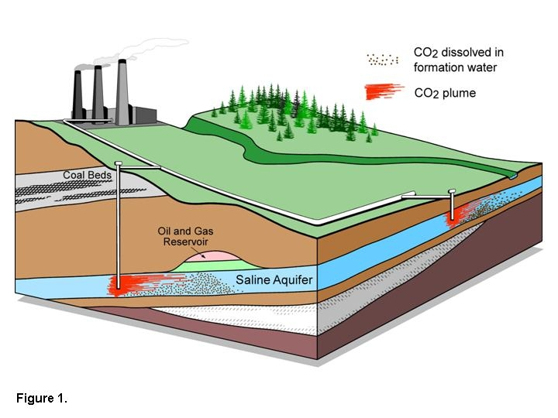

Carbon Capture & Storage
Implement CCS at
800 GW coal electric plants or
1600 GW natural gas electric plants or
180 coal synfuels plants or
10 times today’s capacity of hydrogen plants
Graphic courtesy of Alberta Geological Survey
There are currently three storage projects that each inject 1 million tons of CO₂ per year – by 2055 need 3500.
E, T, H / $$
Notes:
“E,T, H” = can be applied to electric, transport, or heating sectors, $=rough indication of cost (on a scale of $ to $$$)

Slide 33
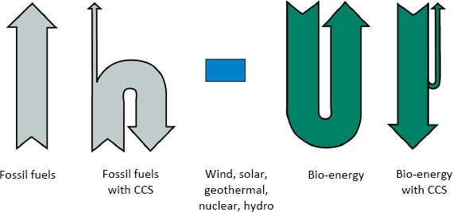
Biomass Energy + CCS (BECCS)

Slide 34
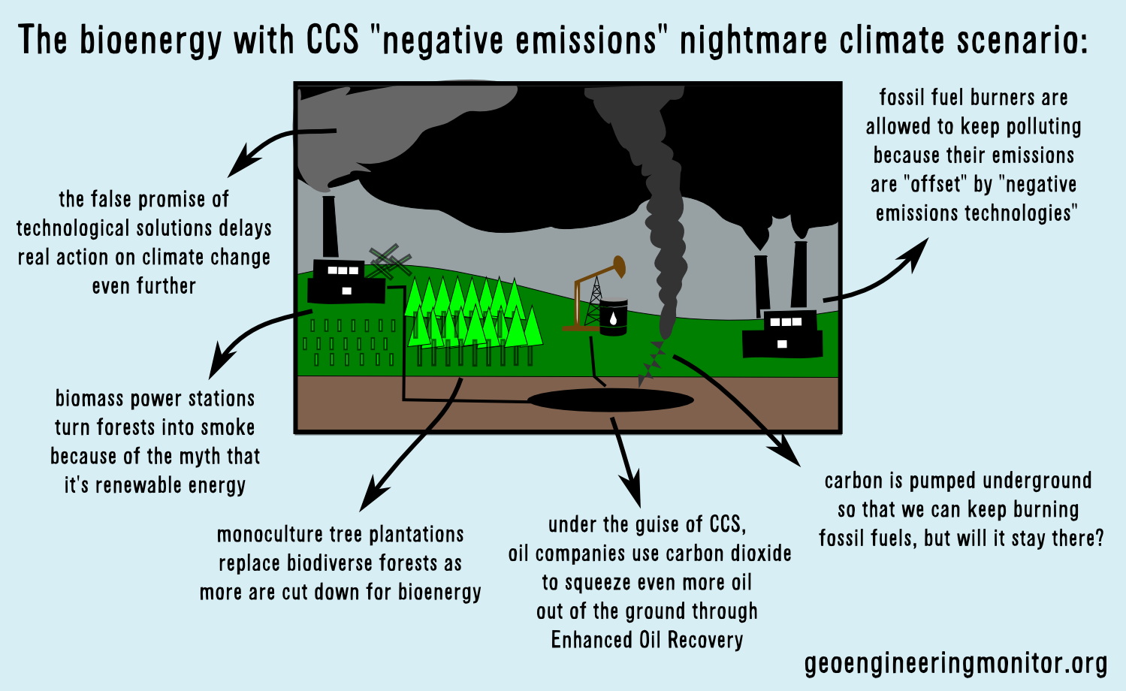
BECCS Moral Hazard?

Slide 35
Simple
2. Serious
3. Solvable

Slide 36


Efficient Architects!
$4.5 TRILLION SAVINGS !
Energy to Power US Buildings
2010
2020
2030

Slide 37
Predictions vs Reality
IEA predictions of future deployment of
PV and wind are almost flat, year after year
Year after year, they’re RIDICULOUSLY wrong!
SOLAR
WIND
https://onclimatechangepolicydotorg.files.wordpress.com/2013/10/wind-and-solar-current-projections.jpg

Slide 38
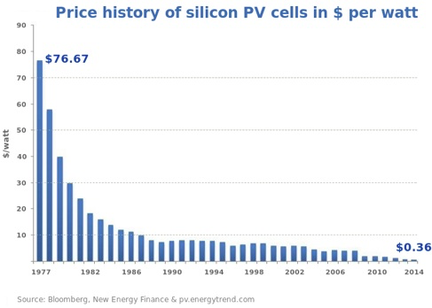
Price of Solar
PV Cells ($/watt)
Price has fallen by factor of 200 since I graduated from high school
Factor of 5 since 2011
Now as cheap or cheaper than coal or gas
Drop in 1970s
Flatter in1990s

Slide 39
Solar Resources
Germany gets less sun than Alaska!
German electricity
4% wind & solar in 2000
32% wind & solar in 2016
US vs Germany

Slide 40
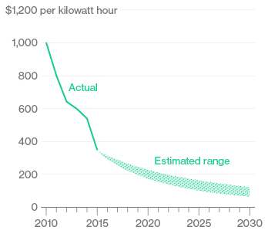
Battery Storage
In 2015, BNEF predicted $150/kWh by 2025
2017
Chevy
Bolt
Chevy Bolt reached $145 already
(8 years early)!
Now 7 times cheaper than in 2010!
Next year: Tesla “Gigafactory”
Bloomberg New Energy Finance Data

Slide 41
Problem: temporal intermittency of wind and solar
  Solution 1: combine intermittent wind & solar with baseload capacity from nuclear, hydroelectric, and geothermal power
  Solution 2: grid-scale storage
  Solution 3: compensate for temporal intermittency by spatial variations associated with large-scale weather systems

Slide 42


Costs
Conversion to 100% noncarbon energy will cost about
1% of GDP
That’s about what it cost to retrofit all the world’s cities with indoor plumbing a century ago …
It was SO worth it!

Slide 43
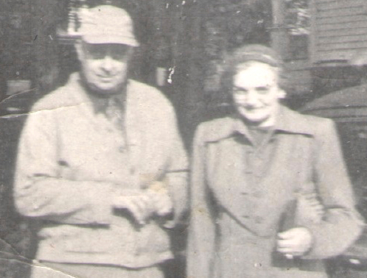
My Grandparents

Slide 44
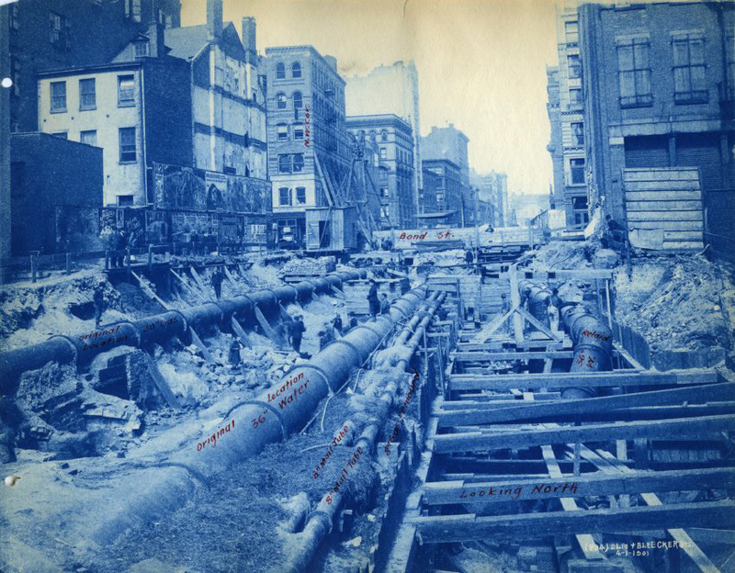
My Grandparents’ Generation
Built subways, sewers,
the electrical grid, defeated the Nazis

Slide 45
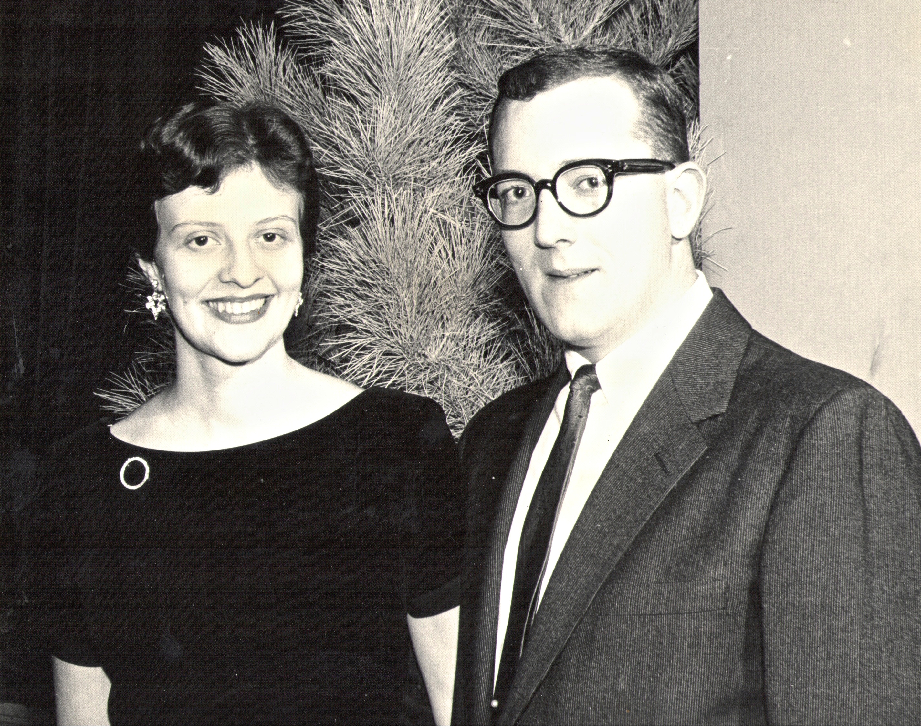
My Parents

Slide 46
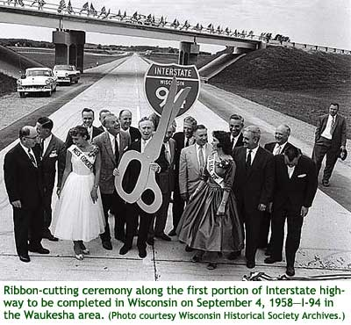
My Parents’ Generation
Built the Interstate Highways,
fought the cold war, landed on the Moon!

Slide 47
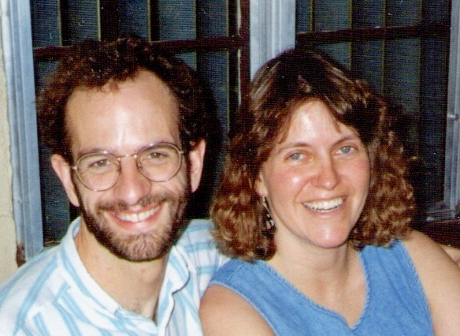
Jennifer & Me

Slide 48

My Generation
Invented the PC, Built the internet,
replaced billions of land-lines with cell phones

Slide 49
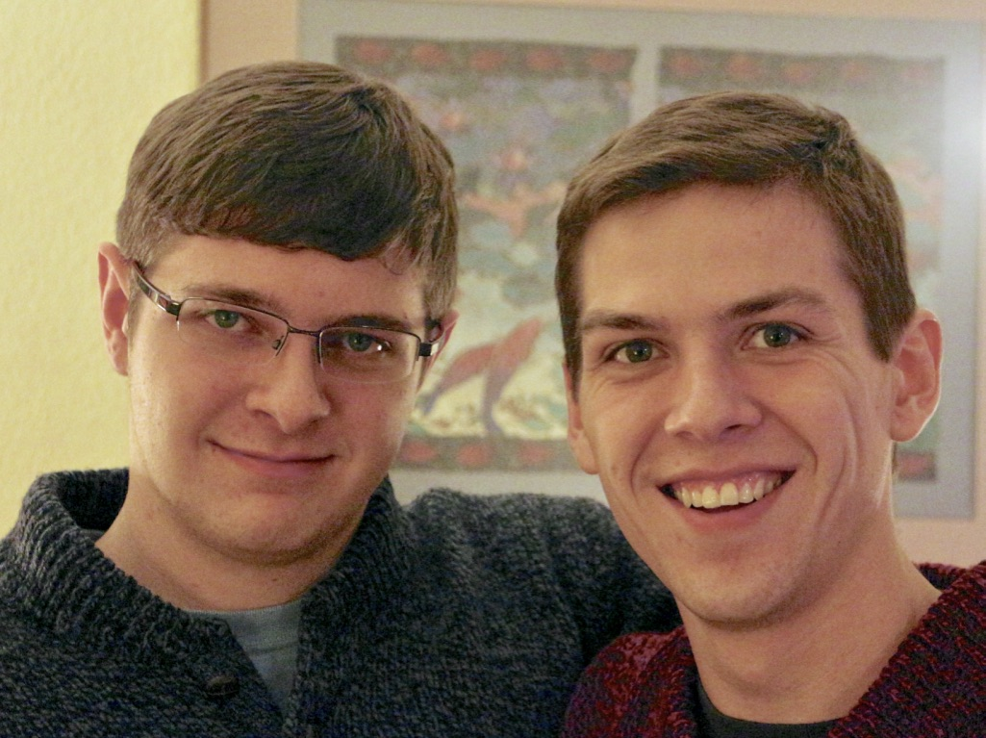
My Kids

Slide 50
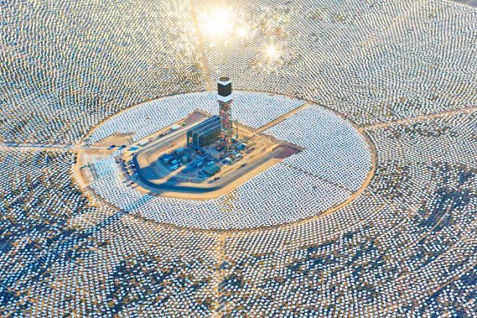

My Kids’ Generation
Will replace the world’s energy system again!

Slide 51

Choose Your Future
Many people think:
  “Our well-being is based on
  stuff we extract from the ground”
When we stop burning coal, will our descendants shiver in the dark?

Slide 52

Choose Your Future
I prefer:
  “We create our well-being through creativity, ingenuity, and hard work”
The future is bright!

Slide 53
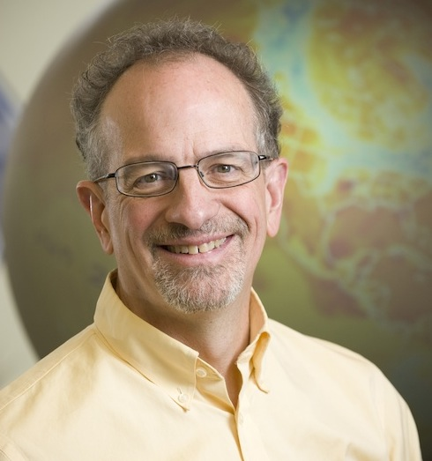
For More Info …
Email me for a link to this PowerPoint:
  Scott.Denning@gmail.com
Email me anytime with questions or comments (remind me where we met!)
Follow me on twitter:
  @airScottDenning

