Slide 1


Predicting the Future by Explaining the Past:
Constraining Carbon-Climate Feedback Using Contemporary Observations
Scott Denning
Colorado State University

Slide 2
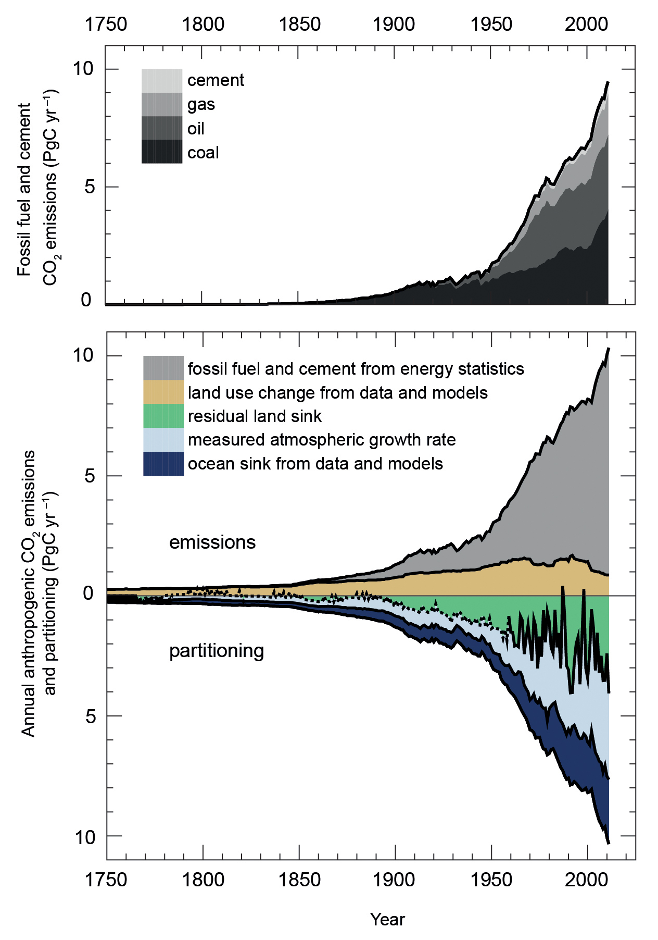
Carbon Sources and Sinks
Half the carbon from fossil fuels remains in the atmosphere
The other half goes into land and oceans
Land sink was unexpected is very noisy, and remains unreliable in future
Future of carbon sinks is much harder to predict than temperatures
Global Carbon Project

Slide 3
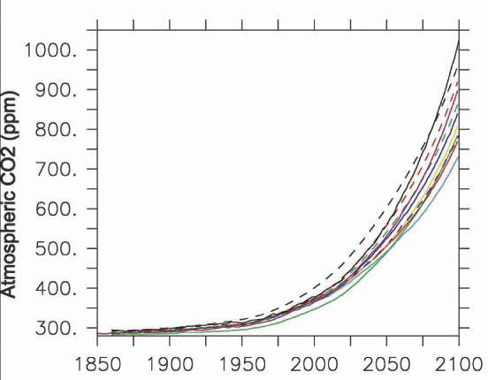
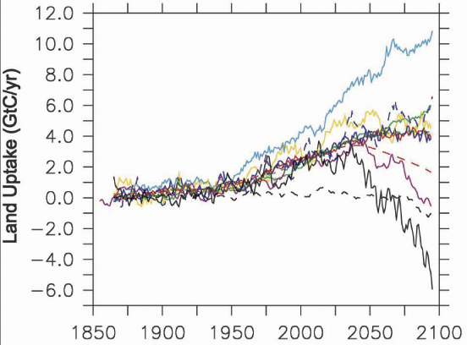
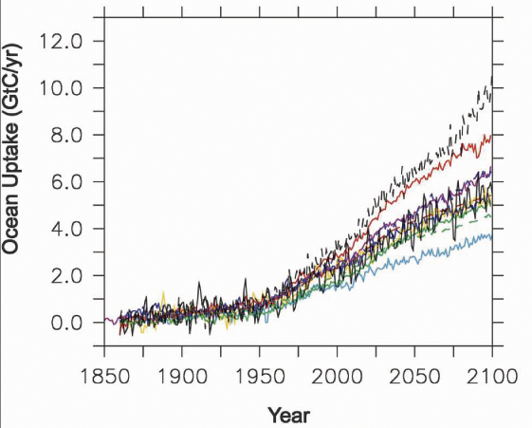
Carbon-Climate Futures
Friedlingstein et al (2006)
Land
Atmosphere
300 ppm!
Ocean
Coupled simulations of climate and the carbon cycle (CMIP3, C4MIP)
Given nearly identical human emissions, different models project dramatically different futures!
Mostly depends on CO₂ fert & temp

Slide 4
Even Worse in CMIP5 !
More processes (land use, regrowth, nitrogen, fire)
Now more than 350 ppm spread in CO₂!
For identical emissions, radiative forcing varies by almost 2 W m⁻² (more than RCP 4.5 vs RCP 6)
Warming varies by 1.5 °C (comparable to spread in physical climate)
Carbon cycle impacts climate uncertainty as much as clouds or people!
Hoffman et al (2014)

Slide 5
Past as Prelude
Models that underpredict contemporary CO₂ also predict low CO₂ in the future, and vice versa
Evaluation of past carbon cycle simulations constrain future feedback
Hoffman et al (2014)

Slide 6
Carbon Constraint
Predicted CO₂ in 2100
(identical emissions)
Hoffman et al (2014)
Fivefold reduction in model spread in 2100
No mechanism … simple scalar multiplication of sinks

Slide 7
Diagnosis for Prediction
Currently see disjoint sets of models used for carbon cycle analysis (CASA-GFED, SiB, CENTURY) and prediction (TRENDY-style models like CLM, ED, ESM2)
In the coming decade, we need to use analyses of the past to initialize model states (pools, biomass) for better prediction
Seek to use same algorithms for hindcasting and forecasting, so that data constraints can improve future simulations
Hoffmann et al showed that most of the spread in 21st Century carbon sinks in CMIP5 could be explained by under- or over-prediction of global mean 20th Century CO2
We should hold CMIP models to a much higher standard!

Slide 8
CMIP Procedure
Initialize models to preindustrial steady-state
Spin up to 2015 using disturbance histories,
agricultural data, N-deposition, CO2 fertilization
Build model diagnostics that are matched to satellite observations as closely as possible
Evaluate time mean spatial patterns, seasonal and interannual variations of
          LAI and Solar-induced Fluorescence to constrain GPP
          LIDAR or RADAR to constrain above-ground biomass
          Atmospheric CO2 to constrain NEE

Slide 9
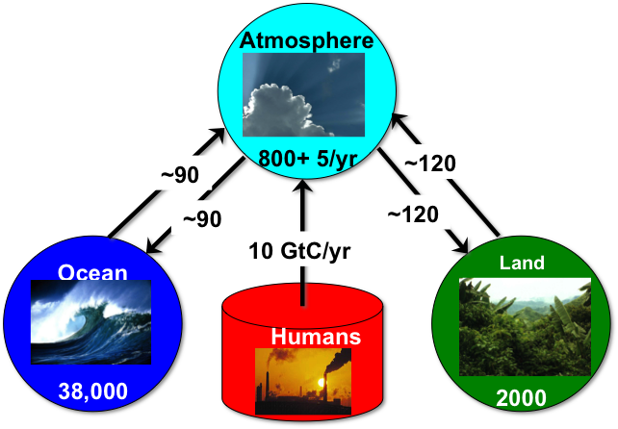
Only One Carbon Cycle!
People, Land, Ocean, Atmosphere
The more we learn about each component,
the better constrained the others become
Coupled Climate / Carbon Cycle models are developed in the context of satellite data & in-situ networks
My specialty is the land & atmosphere, but hope my comments are generally applicable

Slide 10
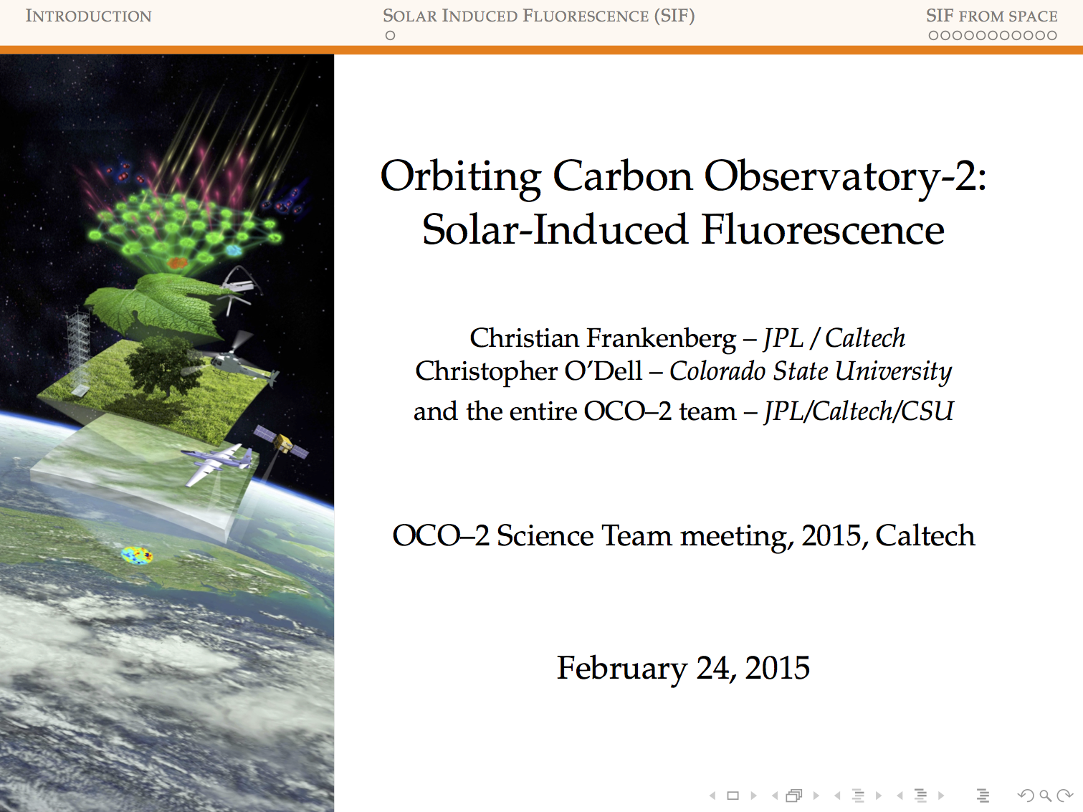

Slide 11
Surprisingly robust to clouds & aerosol!

Slide 12
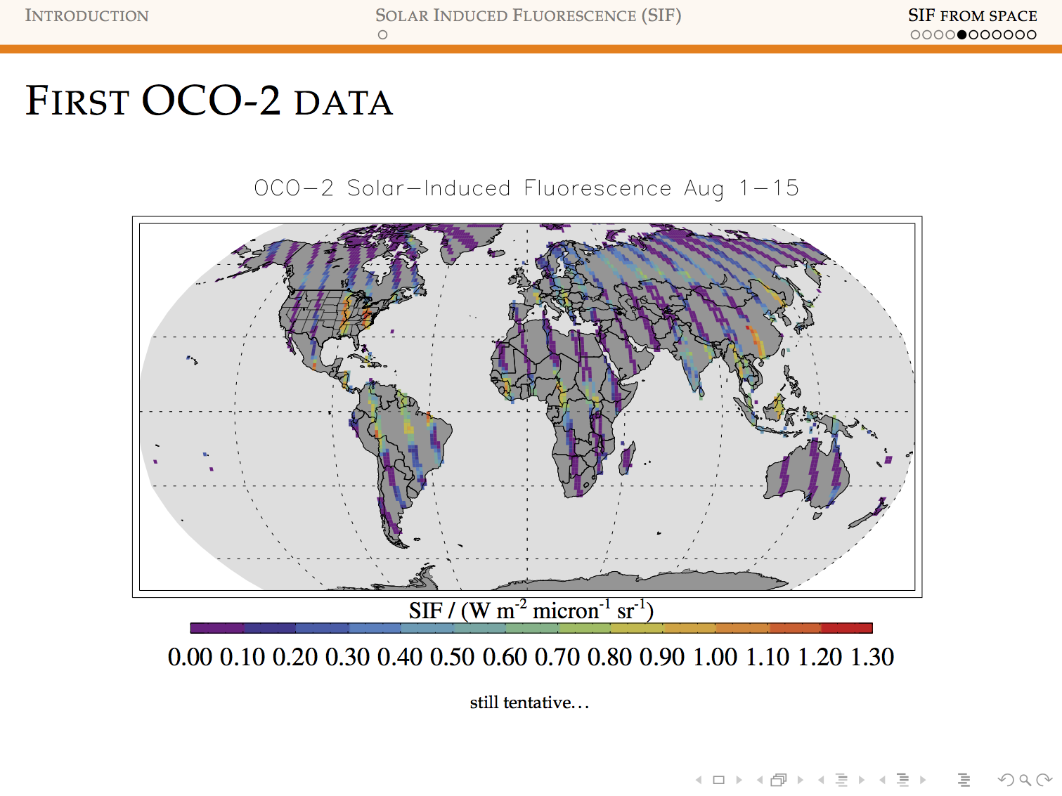

Slide 13
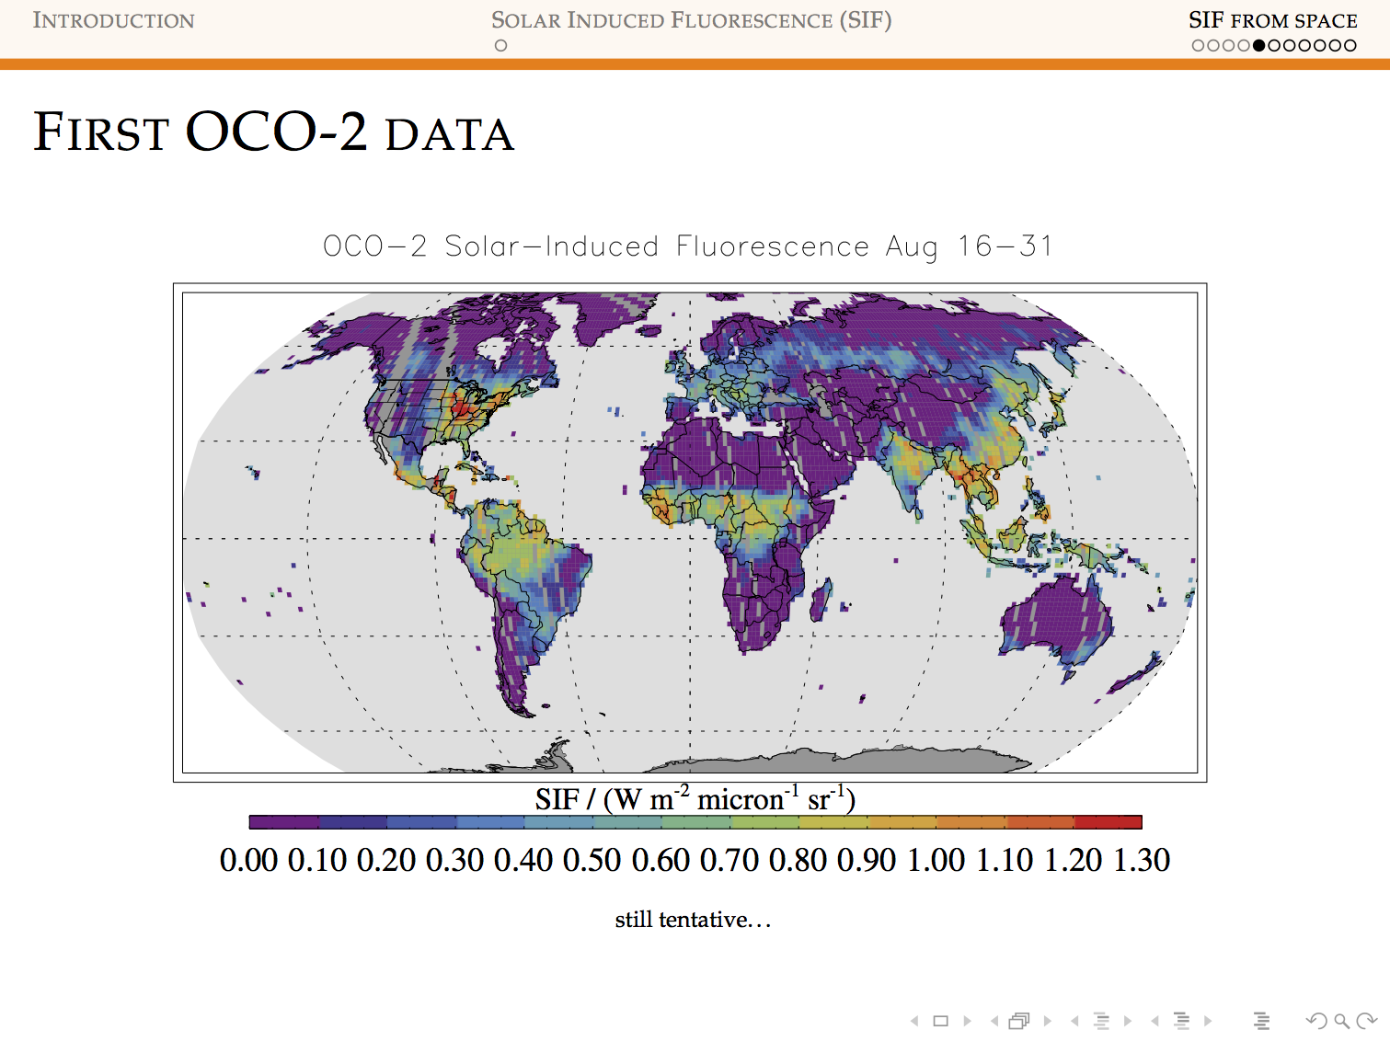
NOTE TROPICAL COVERAGE!

Slide 14
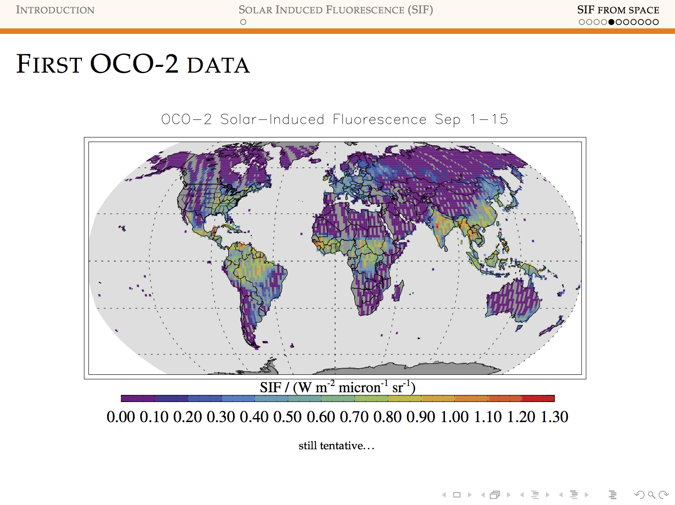
NOTE TROPICAL COVERAGE!

Slide 15
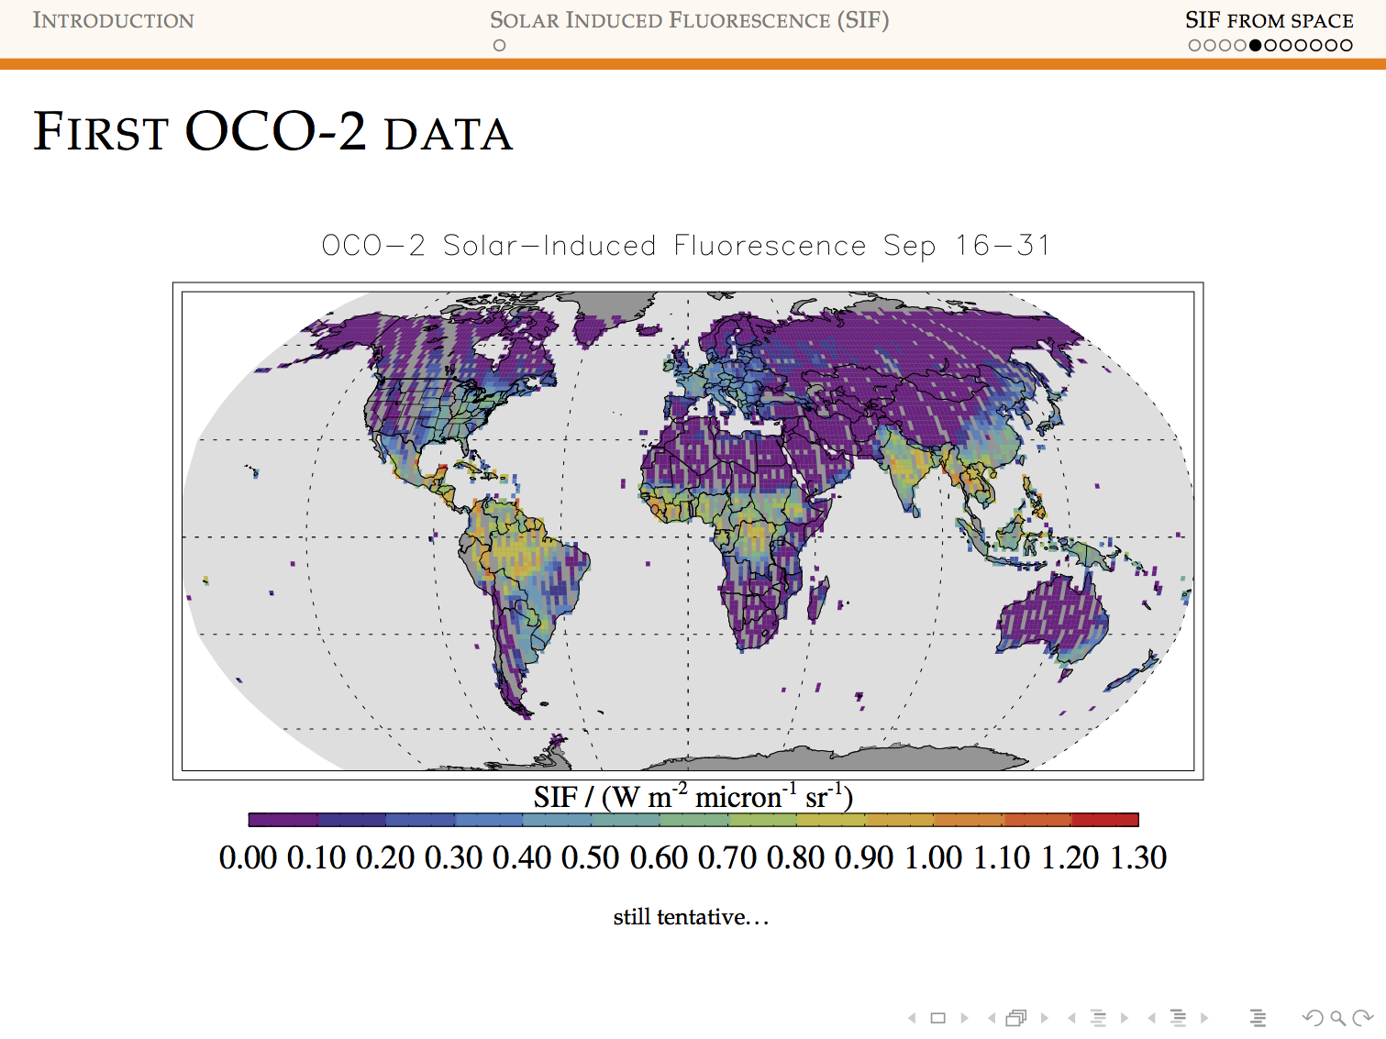
NOTE TROPICAL COVERAGE!

Slide 16

NOTE TROPICAL COVERAGE!

Slide 17
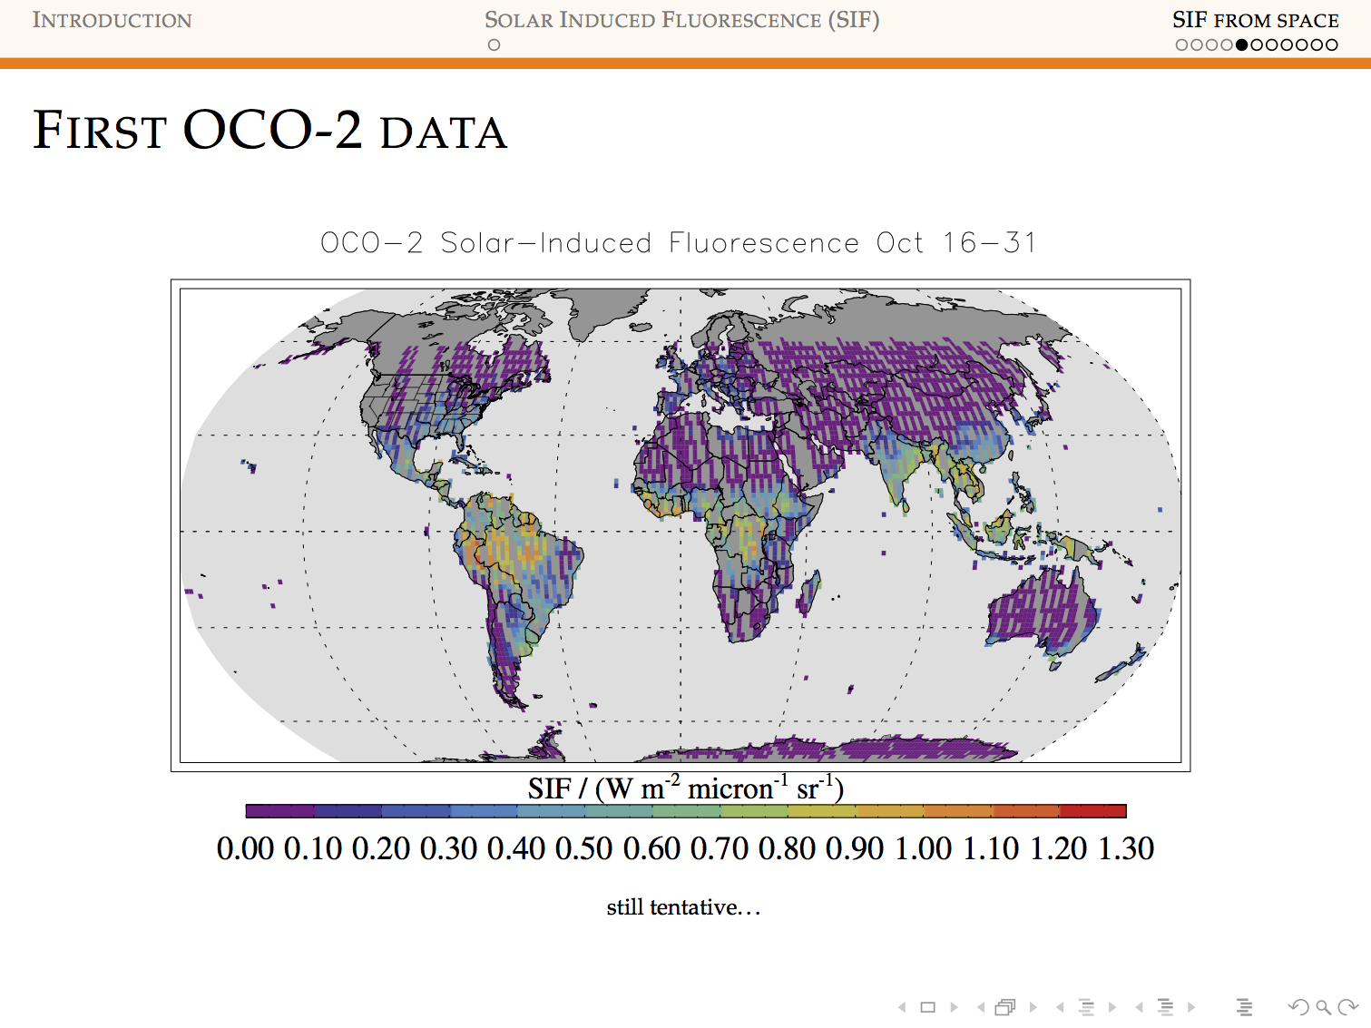
NOTE TROPICAL COVERAGE!

Slide 18
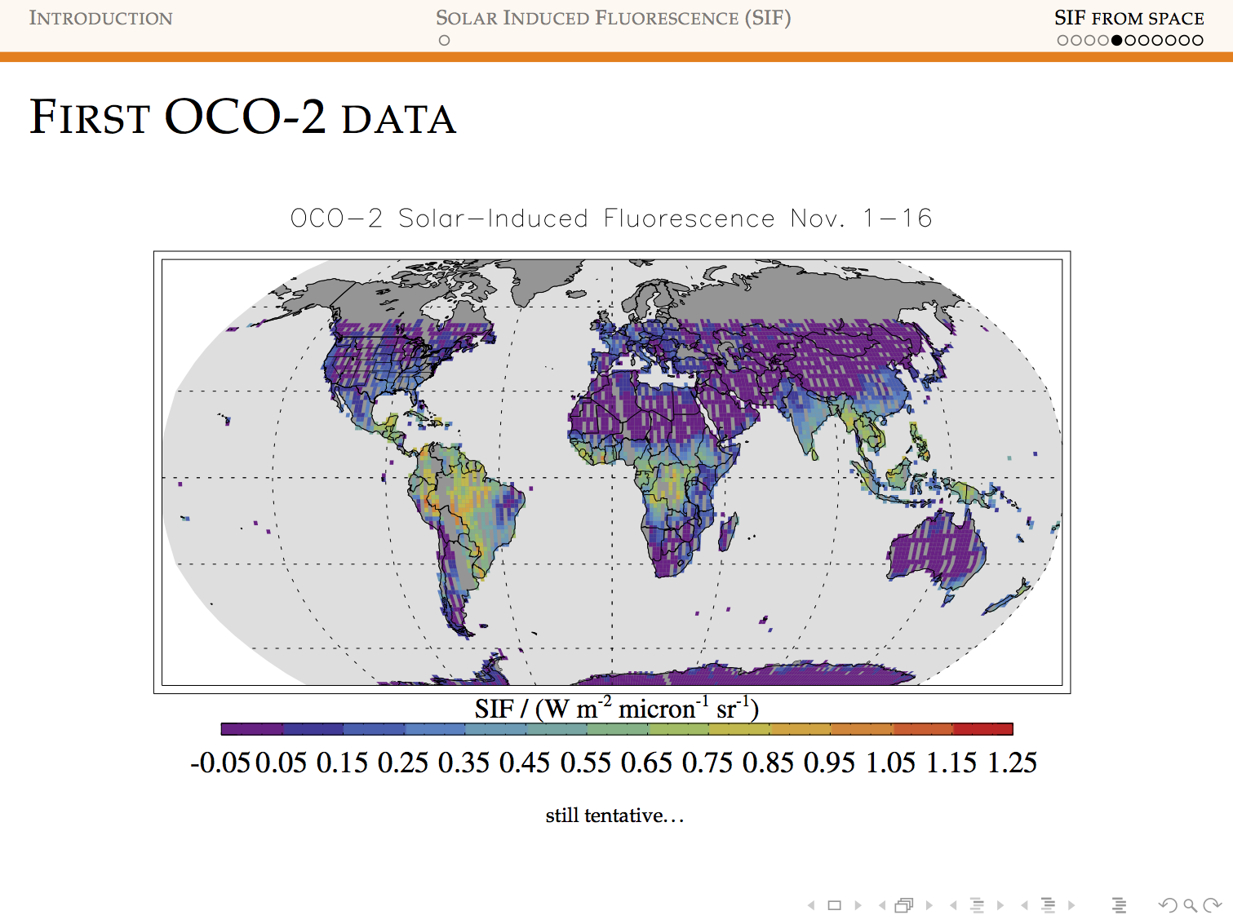
NOTE TROPICAL COVERAGE!

Slide 19
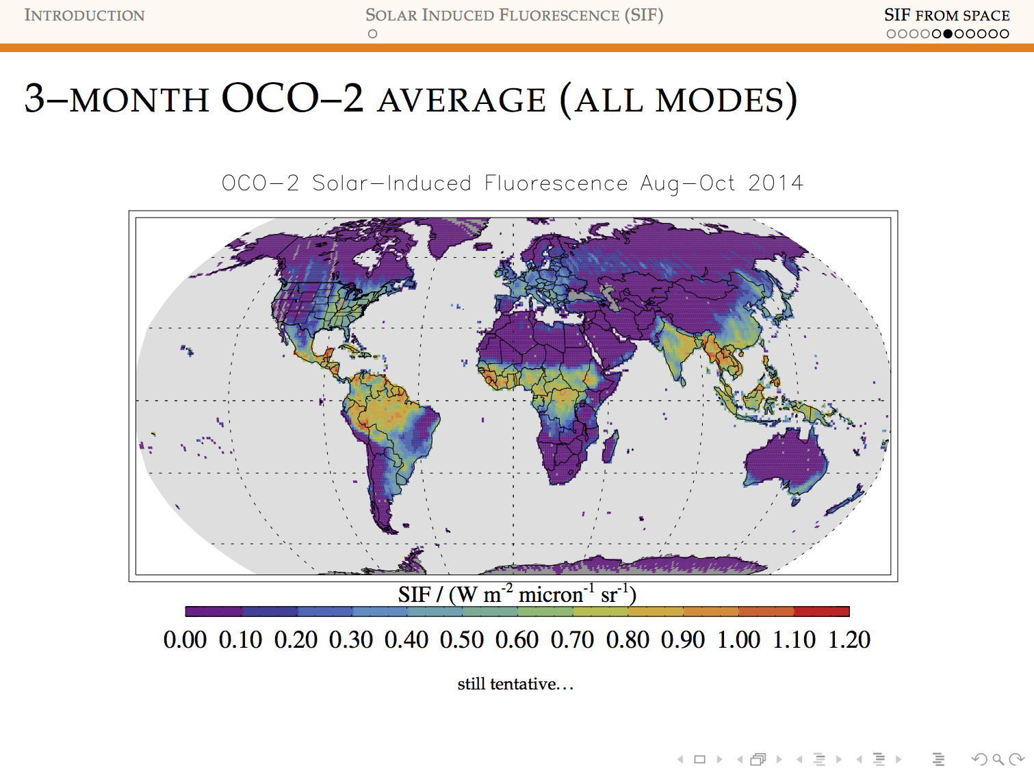
NOTE TROPICAL COVERAGE!

Slide 20
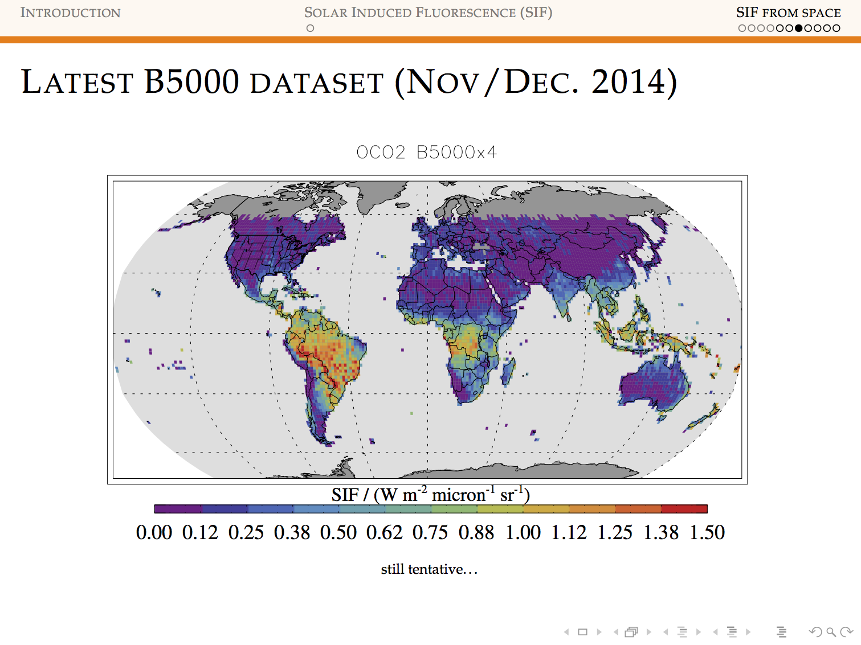
NOTE TROPICAL COVERAGE!

Slide 21
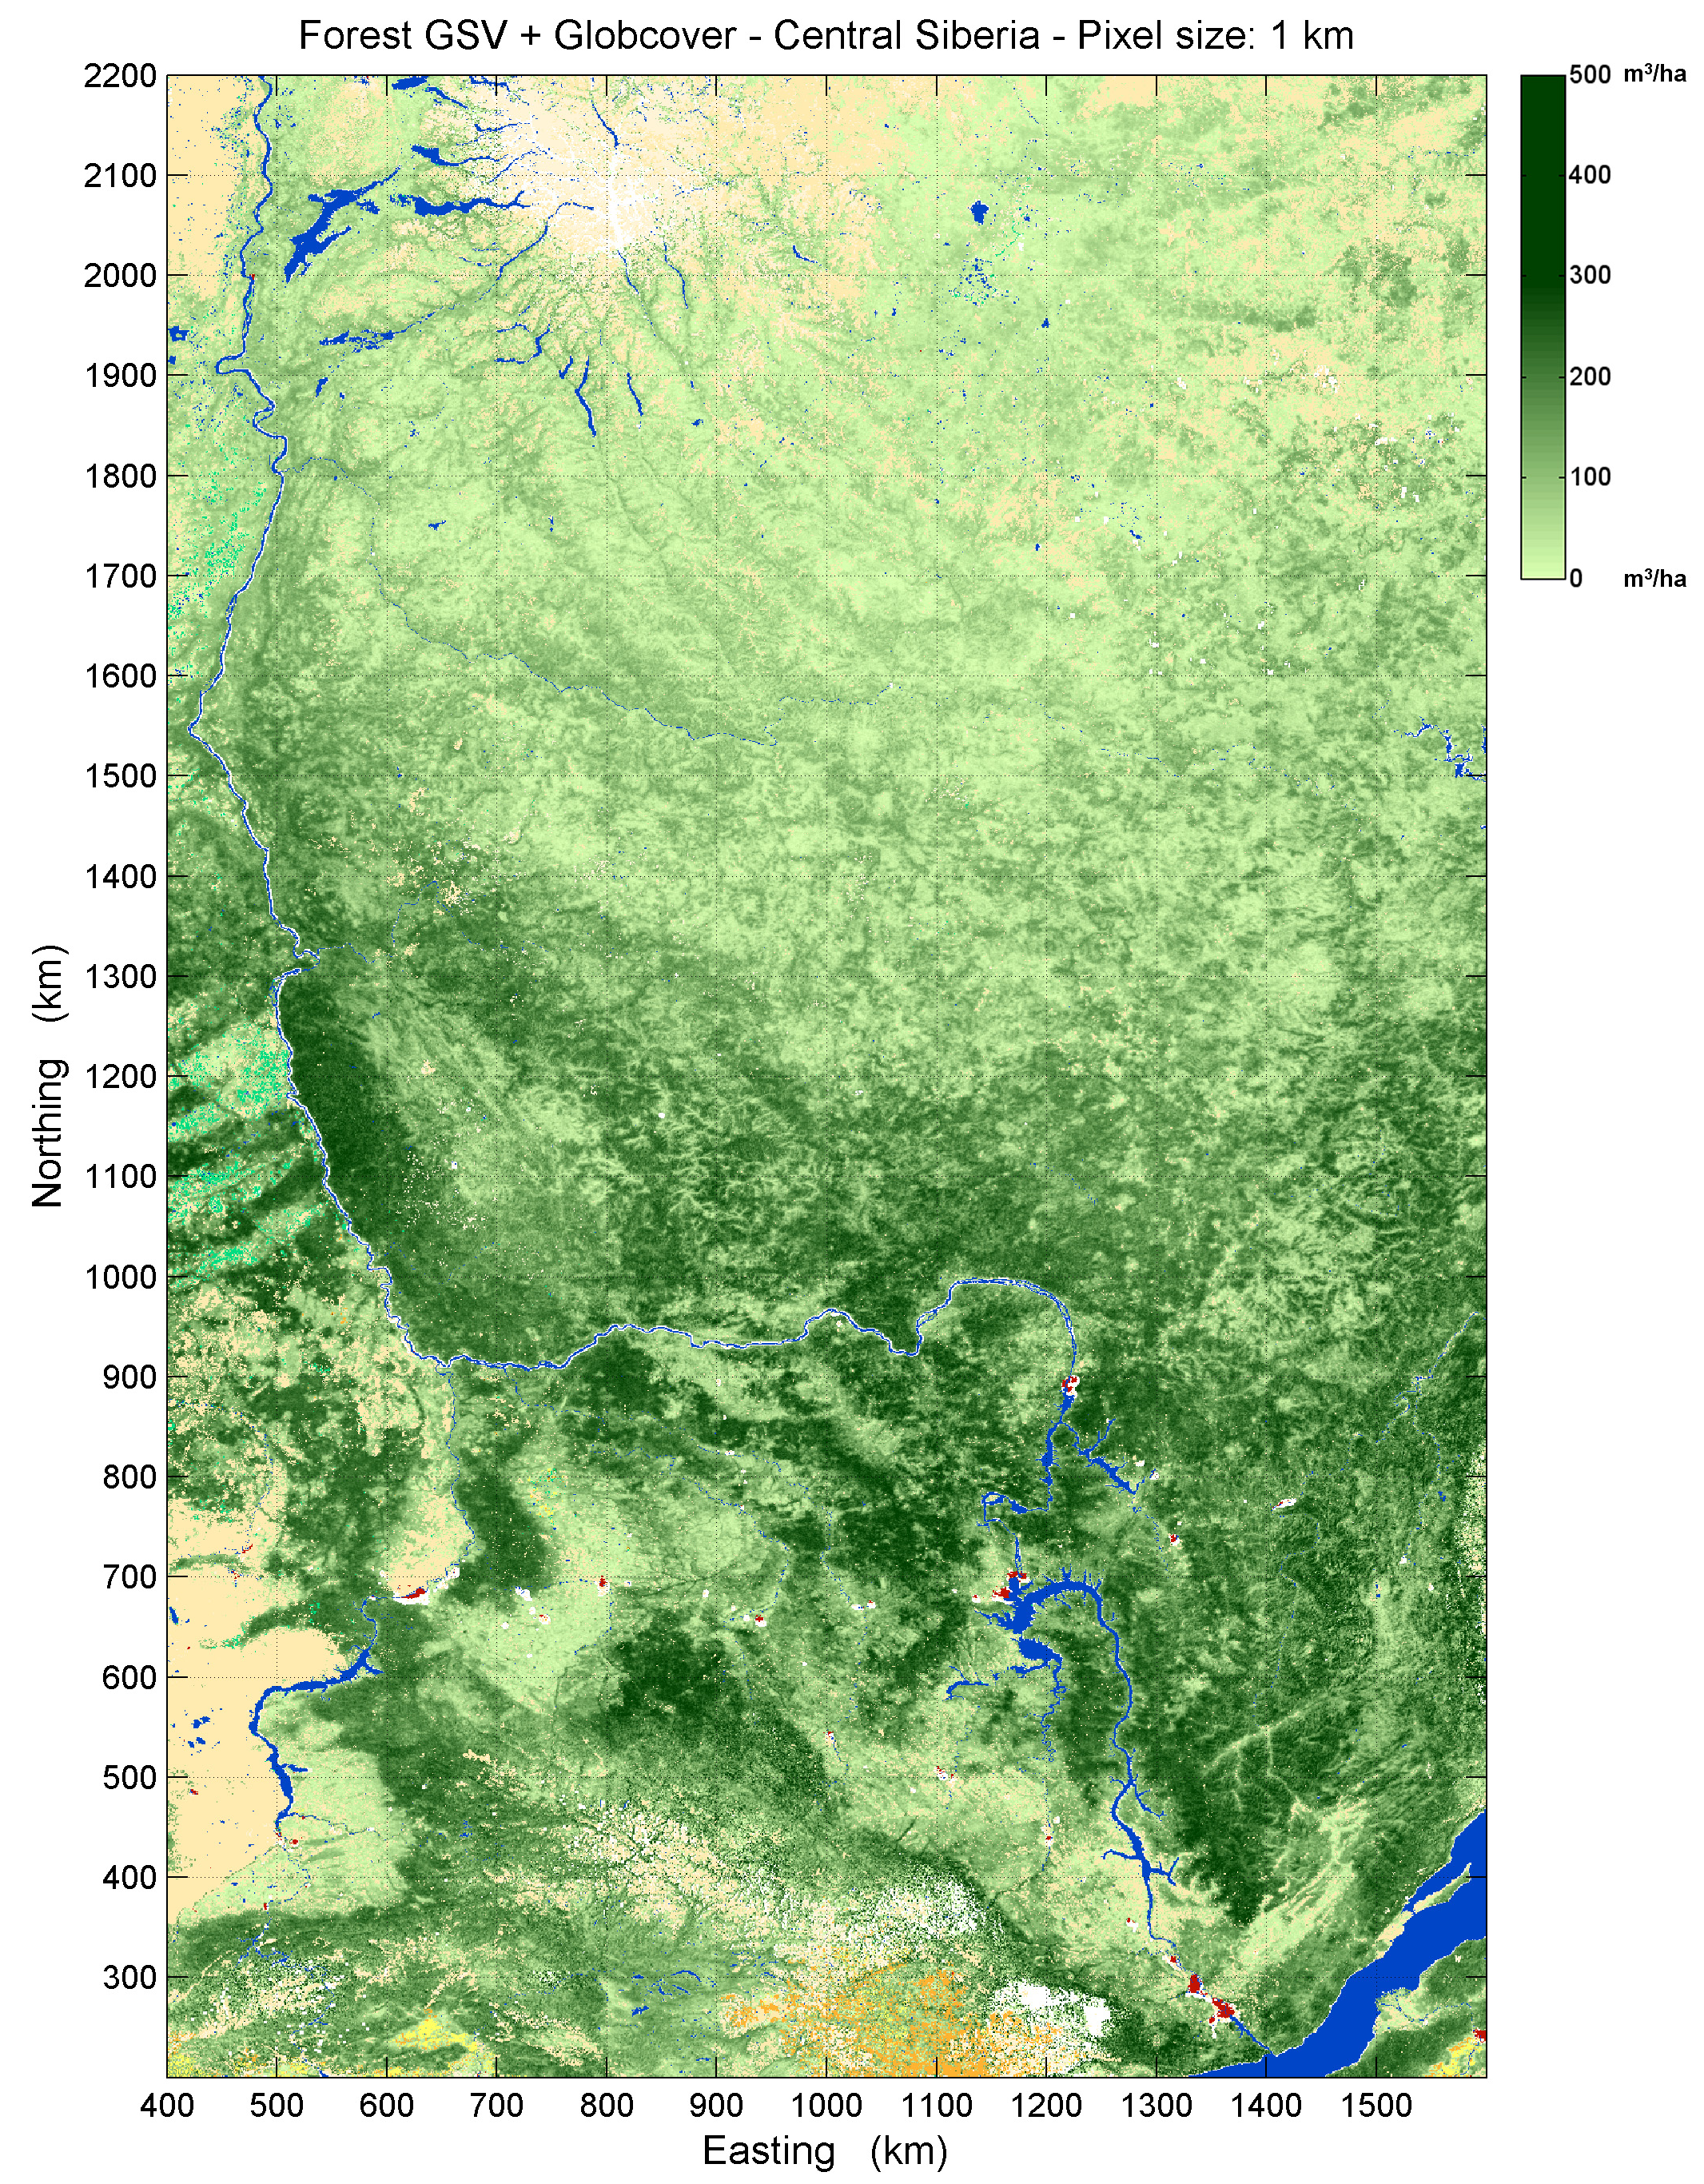
Biomass Mapping by Radar
Canopy-penetrating
L-band radar on EnviSat
Unaffected by cloud cover
1 km global coverage
Christiane Schullius, pers. Comm.

Slide 22
Additional
Atmospheric Tracers
COS to distinguish CO₂ uptake between
land plants and other processes (air-sea gas exchange)
CH4 to detect changes in wetlands,
tundra, and permafrost
CO to distinguish combustion from
other sources of CO₂
¹⁴CO₂ to distinguish between fossil and other CO₂

Slide 23
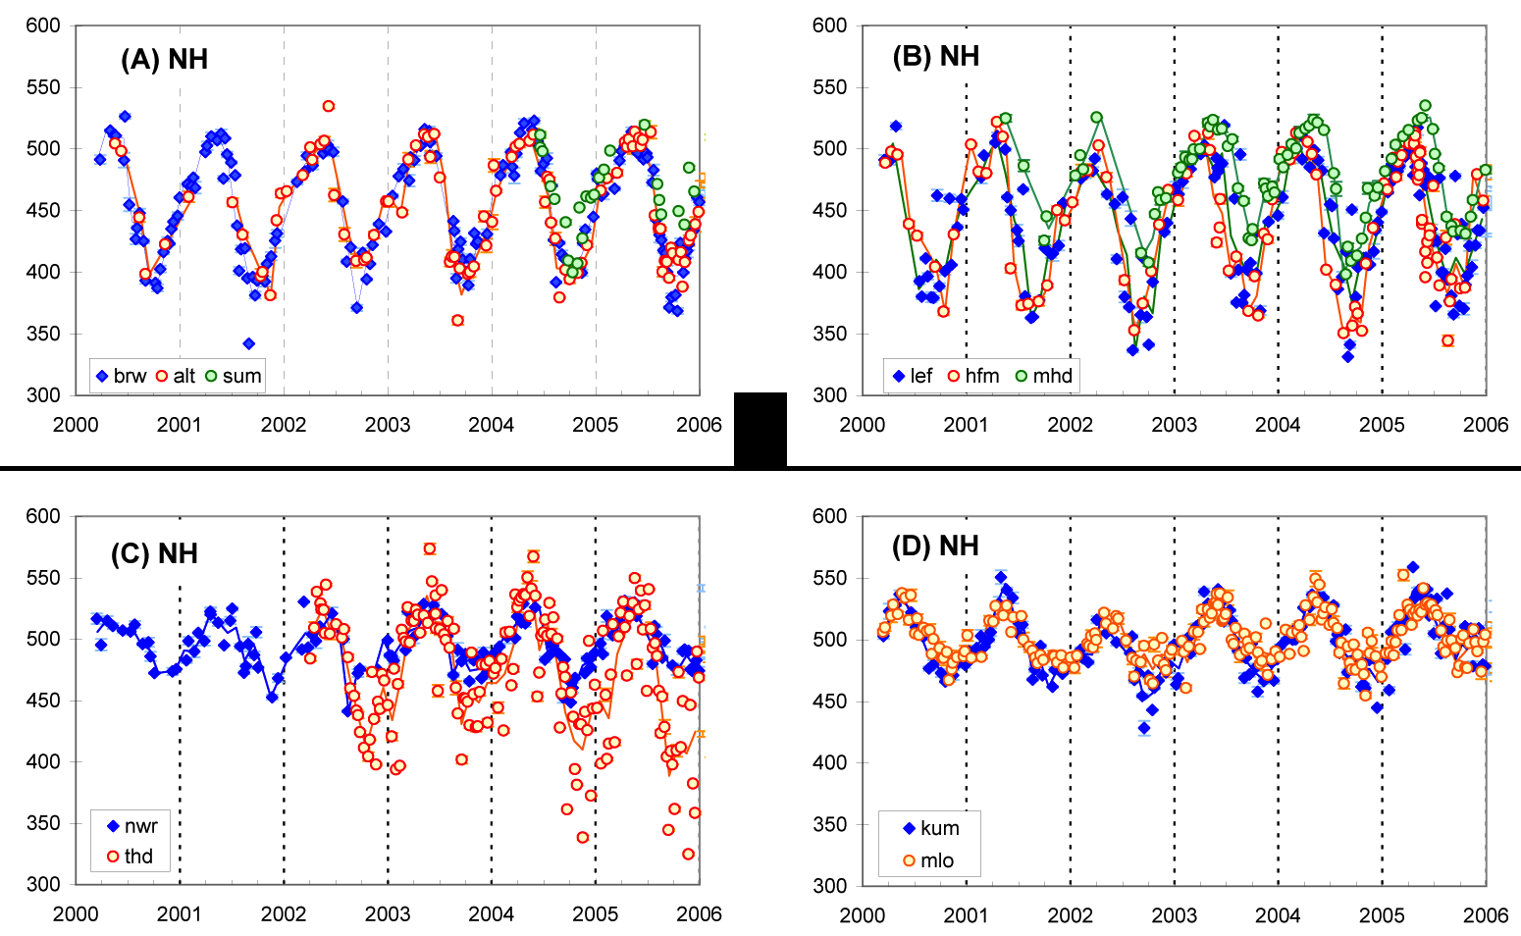
COS Seasonal Cycles
Similar phase to [CO₂]
Much greater amplitude (25% of mean over northern continents !)
GPP not NEE
Signal:noise
Interannual variations
Montzka et al (2006)

Slide 24
Scaling in Space & Time
Comparing models to obs is hard
Earth System Models are supposed to use mechanisms derived locally to estimate emergent changes at much larger scale
Lab and field data from chloroplasts to cuvettes to eddy covariance get extrapolated to climate model grid cells
        An emphasis on “carbon weather” in the observations, but critical qustions about “carbon climate” in the models
        Sampling vs averaging
        Seeing the forest for the trees

Slide 25
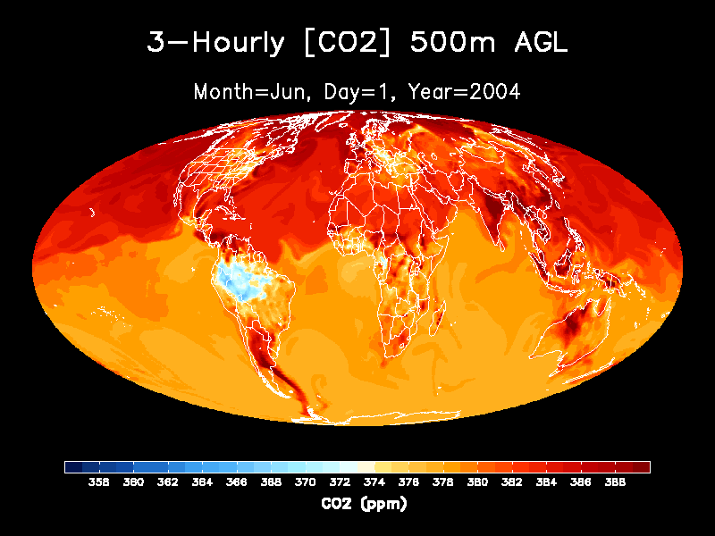

Slide 26

Time-Filtered Inversion
Assume biased component fluxes
Solve for bias terms
Time mean
Seasonal
synoptic

Slide 27
Time-Filtered Inversion prototype using flux towers
Observed NEE & estimated GPP from tower
Simulated GPP & RESP from SiB
Use daily fluxes with large errors to estimate seasonal & mean biases in GPP & RESP
Much better recovery of annual source/sink than control
Harvard Forest
control
Annual NEE
TF
truth
97
98
99
00
01
02
03
04
Year
Nick Geyer, in prep

Slide 28
Diagnostic Modeling for improved land prediction
Major sources of carbon spread in CMIP5
Tropical forest dieback due to increased drought stress
Changes in Boreal and Arctic ecosystems
Differences in model responses to CO2 and nutrients
Critical questions on decadal time scales
Each of these can be evaluated against past data!

Slide 29
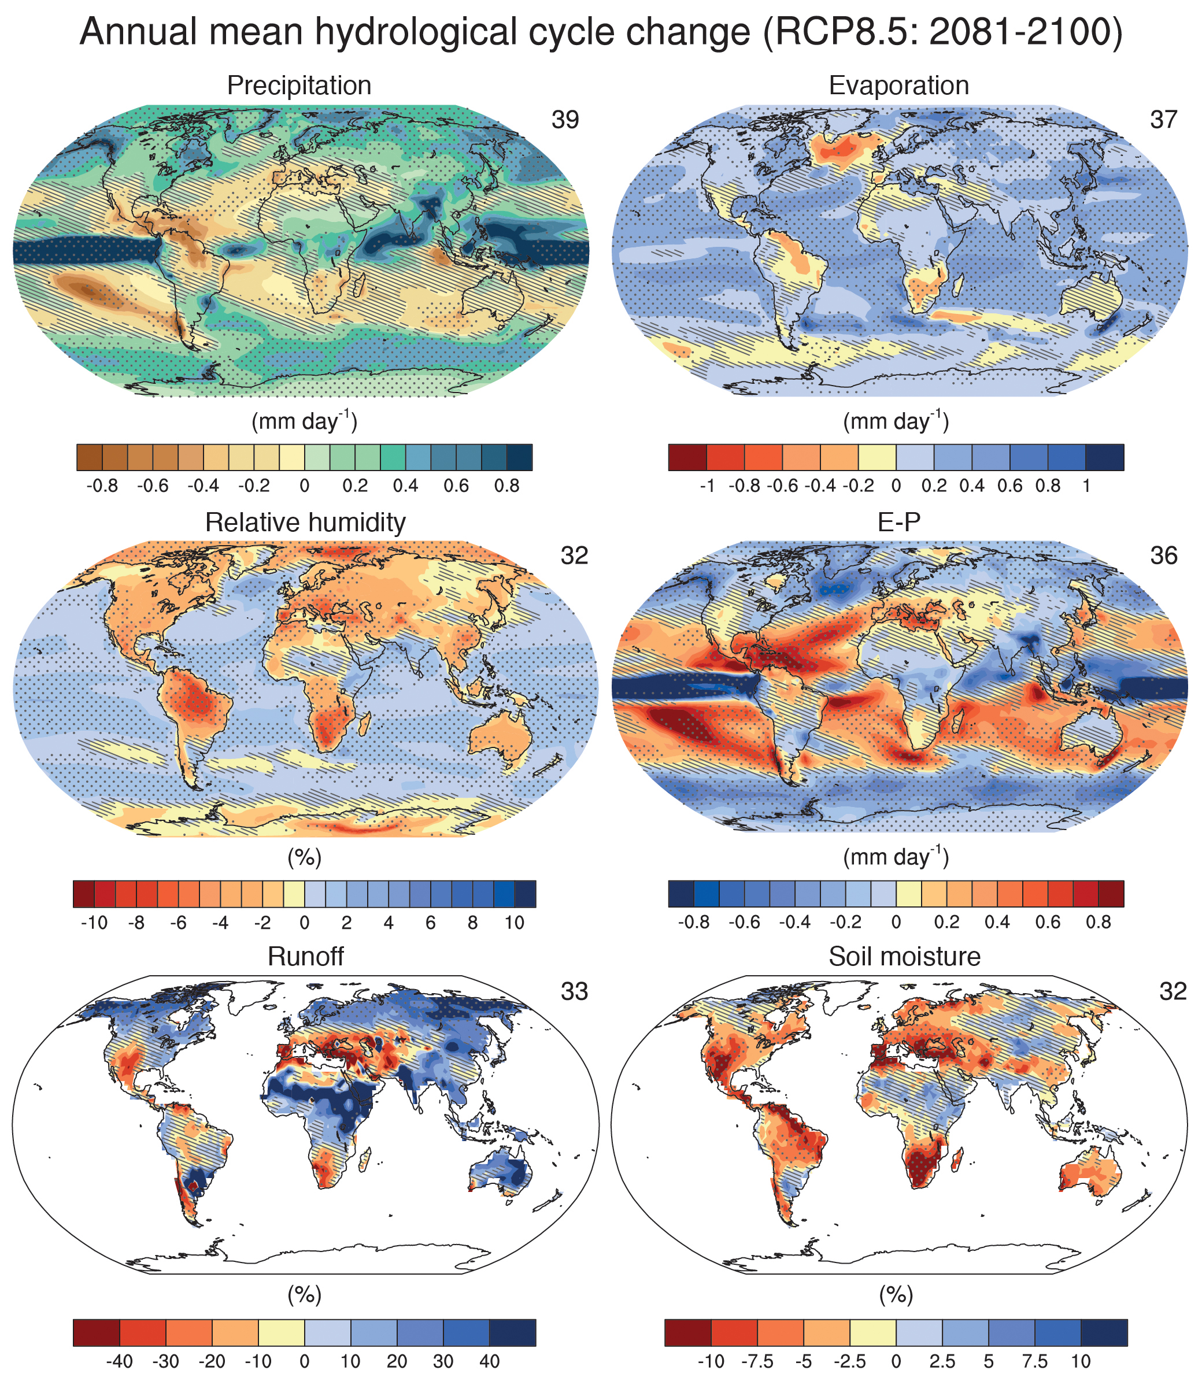
Changing Hydrologic Cycle
Much more rainfall over tropical Pacific
Amazon gets less rain (Walker Cell)
Lower RH
Less soil moisture
Amazon dieback in some models releases lots of CO₂

Slide 30
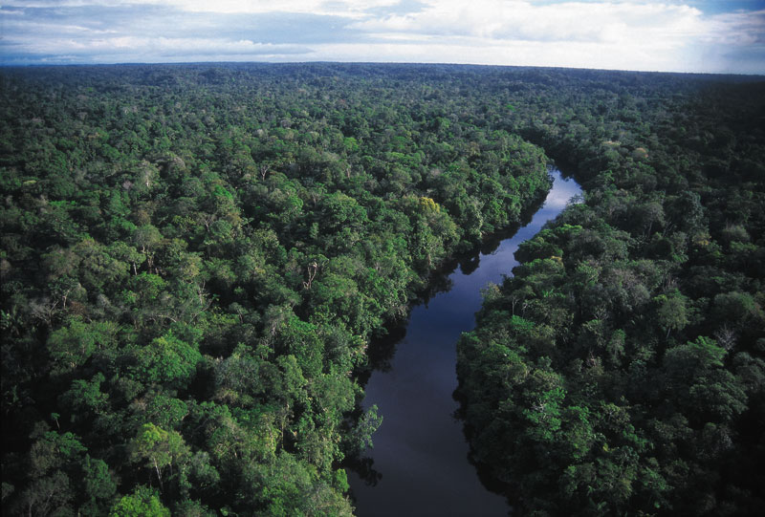
Mechanistic Constraints on Amazon Drought Response
Seasonal drought response
Space-for-time (Transect)
Interannual drought response
Severe persistent drought
Climatological drought

Slide 31
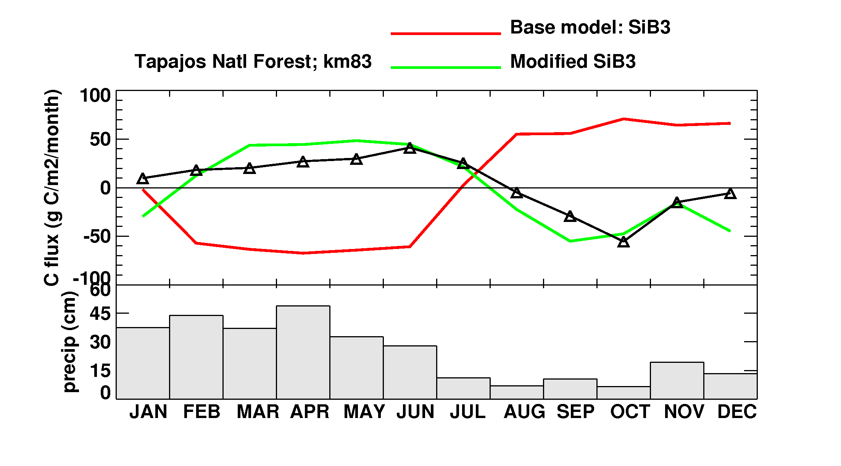
Seasonal Drought
Saleska et al (2003)
Baker et al (2008)
Dry season CO₂ uptake, wet season CO₂ release
A decade ago, most models got this badly wrong!
Most now account for root uptake at depth

Slide 32
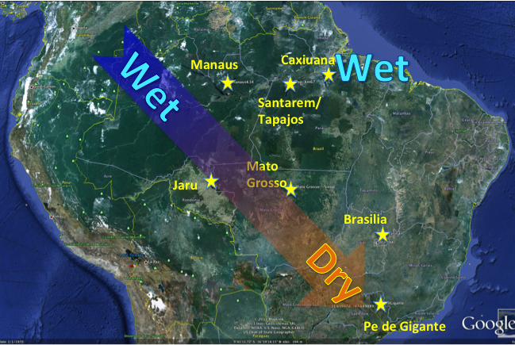
Space-for-Time: Amazon Transect

Slide 33
Amazon Transect
Less annual precip and longer dry seasons from
NW to SE
Transition from aseasonal GPP to dry season uptake to wet season uptake
non-seasonal
GPP & NEE
dry season
uptake
dry season
uptake
dry season
emission
dry season
emission
Baker et al (2013)

Slide 34
Severe Interannual Drought: 2010
Lewis et al (2011)
Gatti et al (2014)
CO2 flux footprints
Precip – Evaporation Deficit
Lewis et al (2011)
Lowest Amazon flow ever measured at Manaus
Basin-wide NEE reduced by 0.5 GtC yr⁻¹ estimated from CO₂ vertical profiles
Severe depression of GPP simulated across southern Amazon and Cerrado
SiB Sept GPP:
2010 - 2009

Slide 35
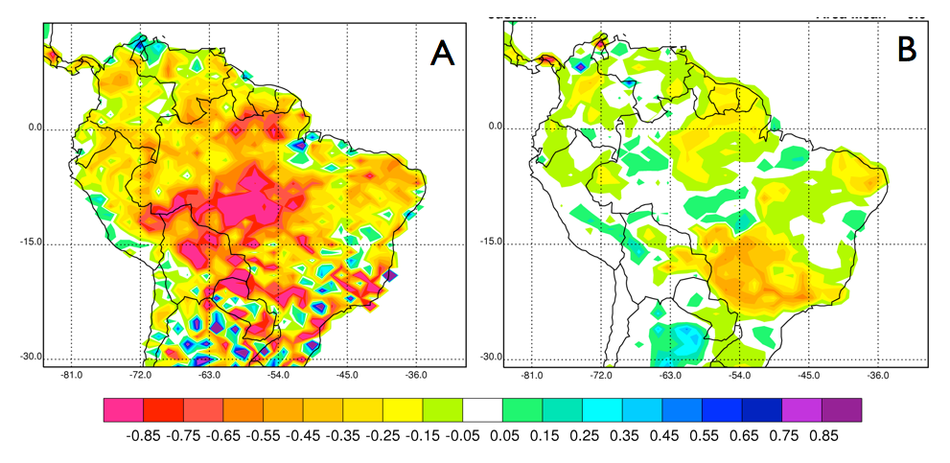
Chrlorophyll Fluorescence
Sept 2010
Minus
Sept 2009
GOME2
SiB4
GPP
Solar-Induced Fluorescence (W m⁻² Sr⁻¹ nm⁻¹) Sept 2010 – Sept 2009
retrieved from GOME2 (Joanna Joiner, pers comm.) and simulated by SiB4

Slide 36
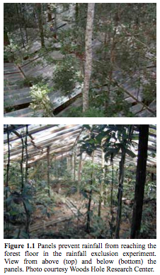
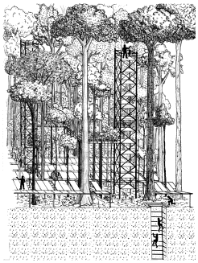
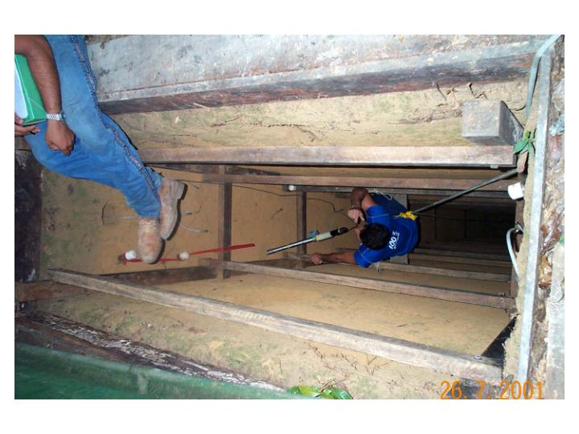
Persistent Drought
Panels used to divert rainfall from forest floor.
50-60% of rainfall was diverted from 2000-2004
Used observations from tower (2001-2003) to drive SiB, reduced rain by 60% during wet seasons

Slide 37
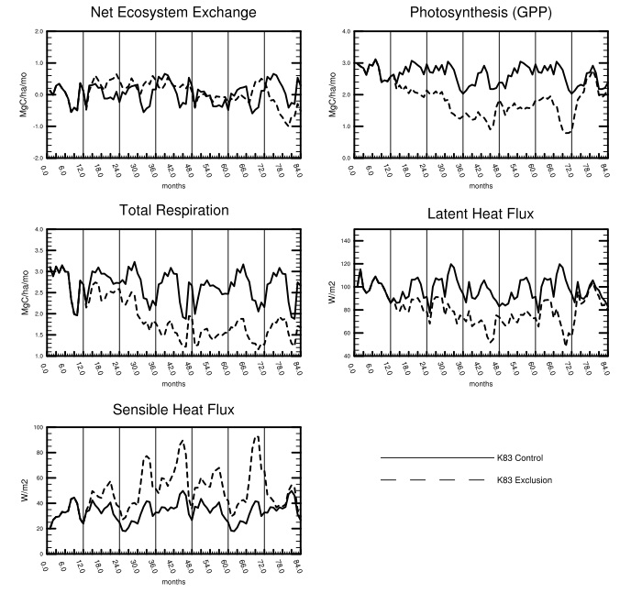
5 Years of (Simulated) Hell
Year 1: Normal
Year 2-6 Drought
Year 7: Normal
Impact noticeable from year 2, but drops in GPP & Resp cancel
Response stabilized from years 4-6
Recovery in year 7

Slide 38
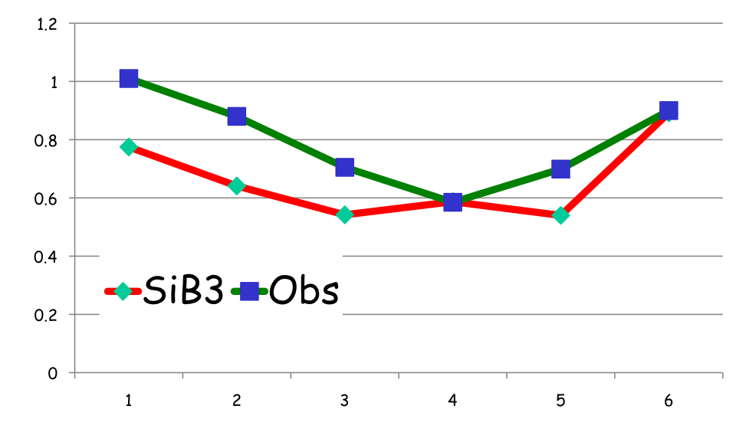
Simulated Response to Persistent Drought
Annual NPP
(drought/control)
Year
Model responds too strongly to imposed drought stress in first three years
Long-term response and recovery pretty good

Slide 39
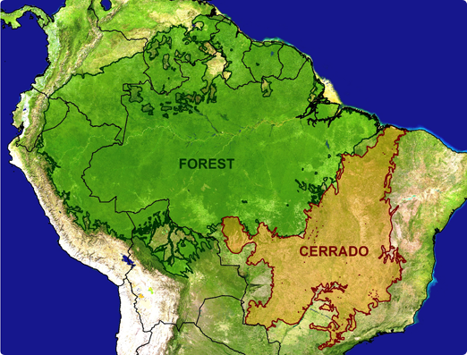
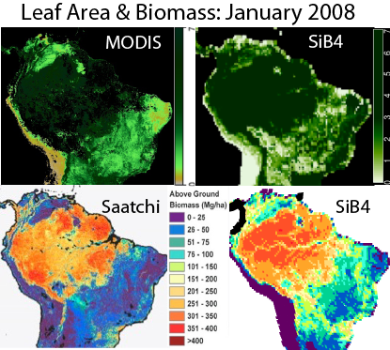
Climatological Drought Response
Position of Forest-Cerrado ecotone is a result of long-term adjustment to climate and disturbance
Dynamic global vegetation models (DGVM) must simulate this boundary
Evaluate physiology, allocation, competition, disturbance
Most relevant timescales for climate change

Slide 40
Priorities
Column CO2 from space
(add day/night cycle and high-latitude data)
Fluorescence for constraint of GPP
(requires improved treatment of mechanism in ESMs)
LIDAR and/or RADAR biomass to constrain initial pools and turnover in land models
More detailed diagnostics of carbon-climate feedbacks in satellite era to improve coupled climate models (use ESMs for diagnostic modeling, not just offline!)
Targeted experiments to test hypotheses about carbon-climate feedback in full ESMs against data
Consider satellite analysis a critical part of ESM initialization, to obtain model states

