Slide 1


Climate Change:
Simple, Serious, Solvable
Scott Denning
Director of Education, CMMAP
Atmospheric Science, CSU
Email Scott.Denning@ColoState.edu for a copy of this presentation

Slide 2
Simple

Slide 3
Weather vs Climate what’s the difference?
If you don’t like the weather:
  Wait five minutes!
If you don’t like the climate:
  Move!

Slide 4
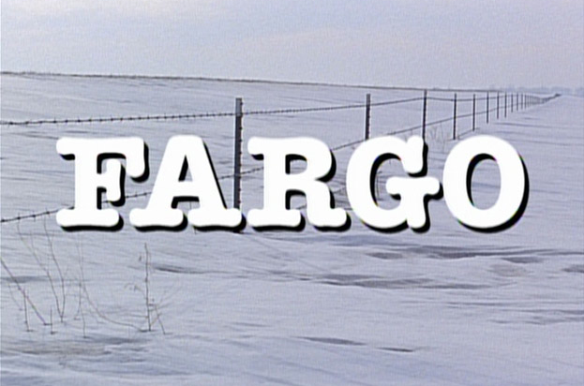
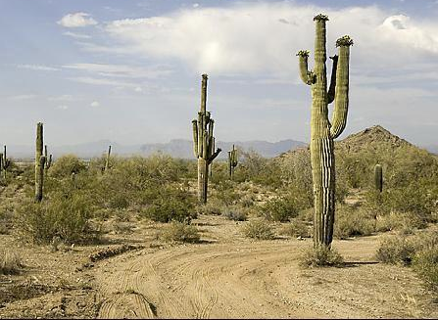
Location! Location! Location!
Climate is Place
Depends on where you live:
  Latitude!
  Altitude (mountains vs valley)
  What’s upwind (ocean vs land)
Changes very slowly
Very predictable
We can predict that Phoenix is warmer than Fargo for precisely the same reasons that we can predict a warmer future!
PHOENIX

Slide 5


Ever Wonder Why?
Day is warmer than night
Summer is warmer than winter
Phoenix is warmer than Fargo

Slide 6

Heat Budgets
Heat in
Heat in
Heat out
Heat out

Slide 7
Dancing Molecules and Heat Rays!
Nearly all of the air is made of oxygen (O₂) and nitrogen (N₂) in which two atoms of the same element share electrons
Infrared (heat) energy radiated up from the surface can be absorbed by these molecules, but not very well
O
O
N
N
Diatomic molecules can vibrate back and forth like balls on a spring, but the ends are identical

Slide 8
Dancing Molecules and Heat Rays!
Carbon dioxide (CO₂) and water vapor (H₂O) are different!
They have many more ways to vibrate and rotate, so they are very good at absorbing and emitting infrared (heat) radiation
O
C
O
O
H
H
Molecules that have many ways to wiggle are called “Greenhouse” molecules
Absorption spectrum of CO2 was measured by John Tyndall in 1863

Slide 9


Slide 10
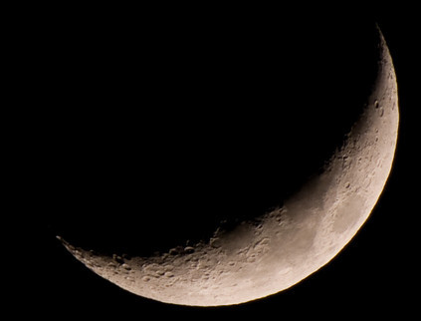
Spring Night
in Colorado
radiation
emitted
by soil
5 PM surface temperature = 15 °C = 60 °F
390 W m⁻²
4 inches
= 10 cm

Slide 11
Spring Night
in Colorado
radiation
emitted
by soil
6 AM surface temperature = -60 °C = -78 °F
9 PM surface temperature = 15 °C = 60 °F
390 W m⁻²
4 inches
= 10 cm

Slide 12
Spring Night
in Colorado
radiation
emitted
by air
radiation
emitted
by soil
340 W m⁻²
6 AM surface temperature = 5 °C = 40 °F
390 W m⁻²
4 inches
= 10 cm

Slide 13
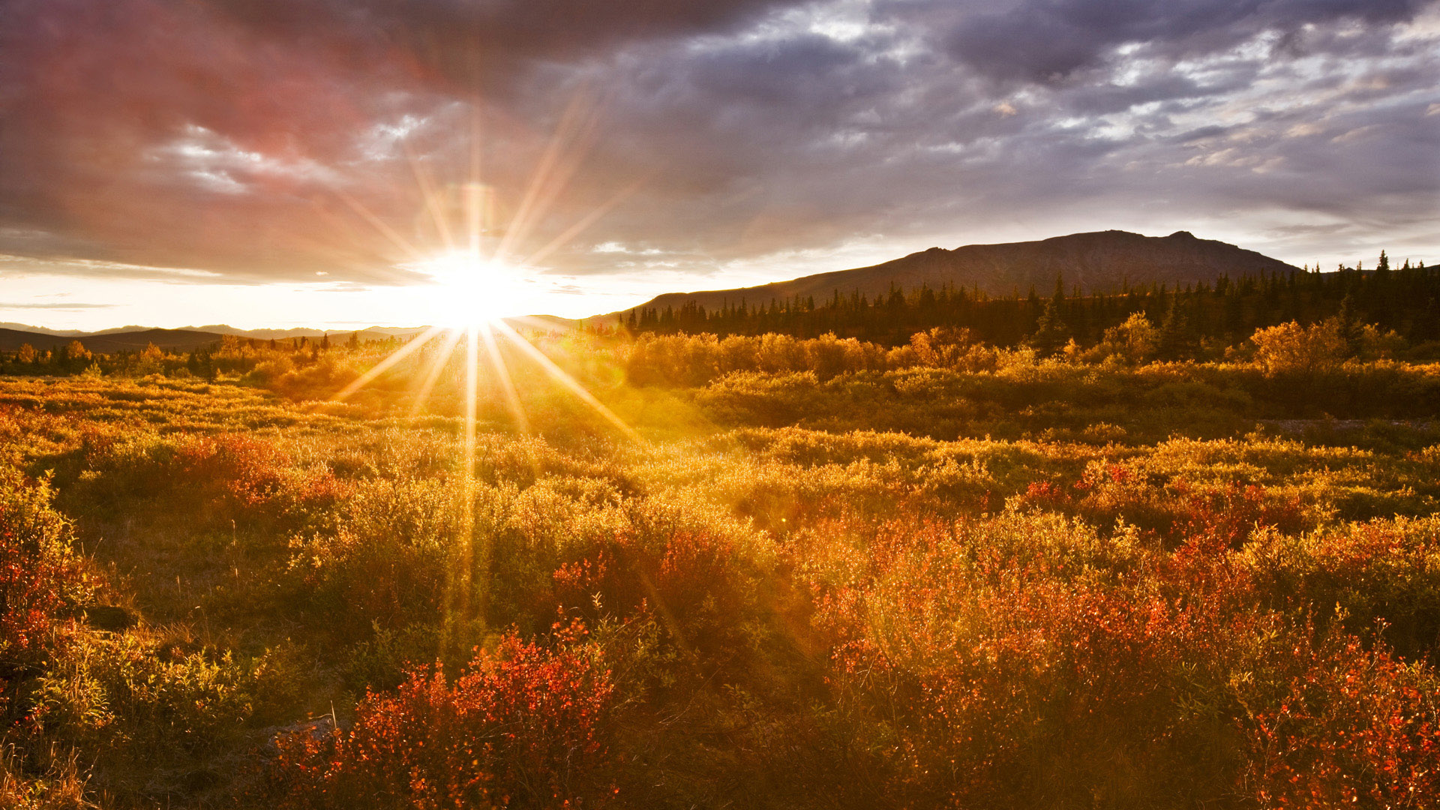
The strongest evidence for the
Greenhouse Effect
is that we can
survive night!

Slide 14


Common Sense
1 m
Doubling CO₂ would add 4 watts to every square meter of the surface of the Earth, 24/7
Doing that would make the surface warmer
This was known before light bulbs were invented!
4 Watts
1 m
John Tyndall, January 1863

Slide 15

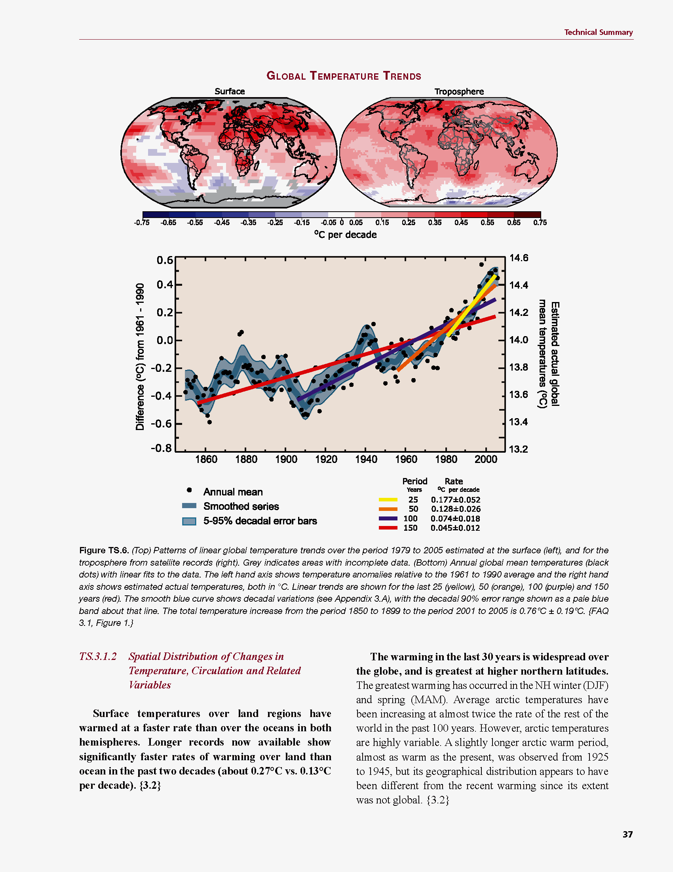
Common Myth #1
“Scientists expect a warmer future because it’s been warming up recently”
WRONG!
It’s because we know that when we add heat to things, they warm up

Slide 16
Serious

Slide 17


How much warmer?
Land vs ocean!
North vs South
Global mean
warming of 2º to 5º C
North American
warming of 3º to 6º C
= 5º to 11º F
Arctic warming of
8º to 14º F
Low
Emissions
Moderate
Emissions
High
Emissions
Rainfall? Agriculture?
Water demand? Tourism?
Mass immigration?

Slide 18

Where is it 10°F Warmer
“on average?”
Denver ➔
Amarillo
Illinois ➔
Mississippi
Washington➔
Tallahassee
Water? Crops?
Real Estate? Health?

Slide 19
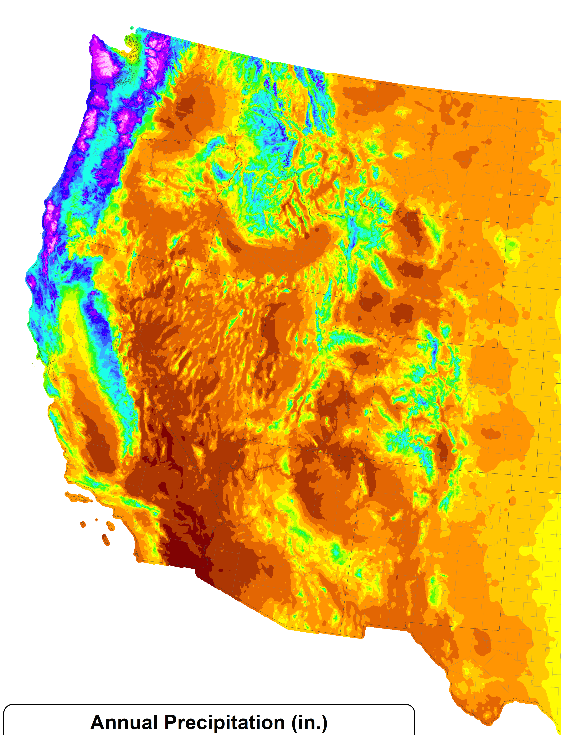
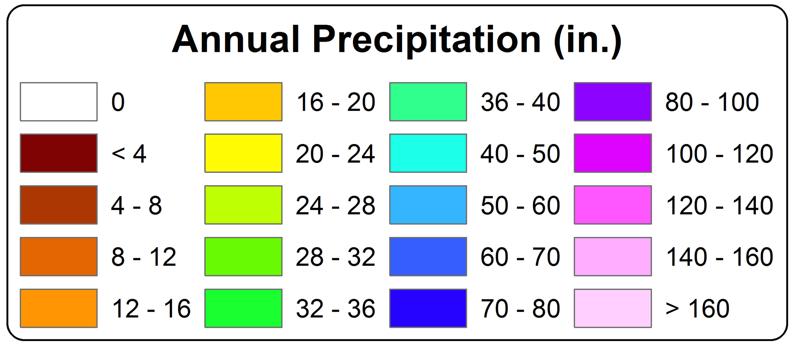
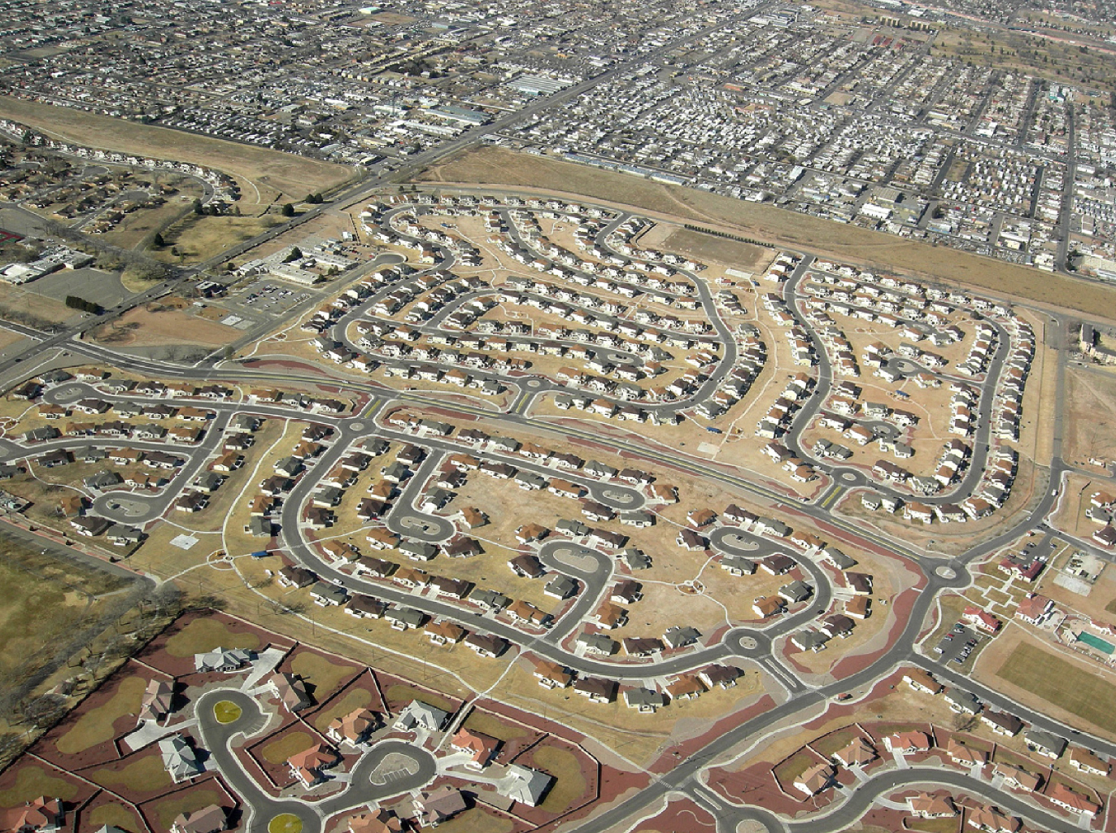
A Region
On the Edge
Much of our region already receives only marginal precipitation
Just enough snow to support forests and reservoirs
Just enough irrigation water to support farming
Just enough water for cities and towns

Slide 20
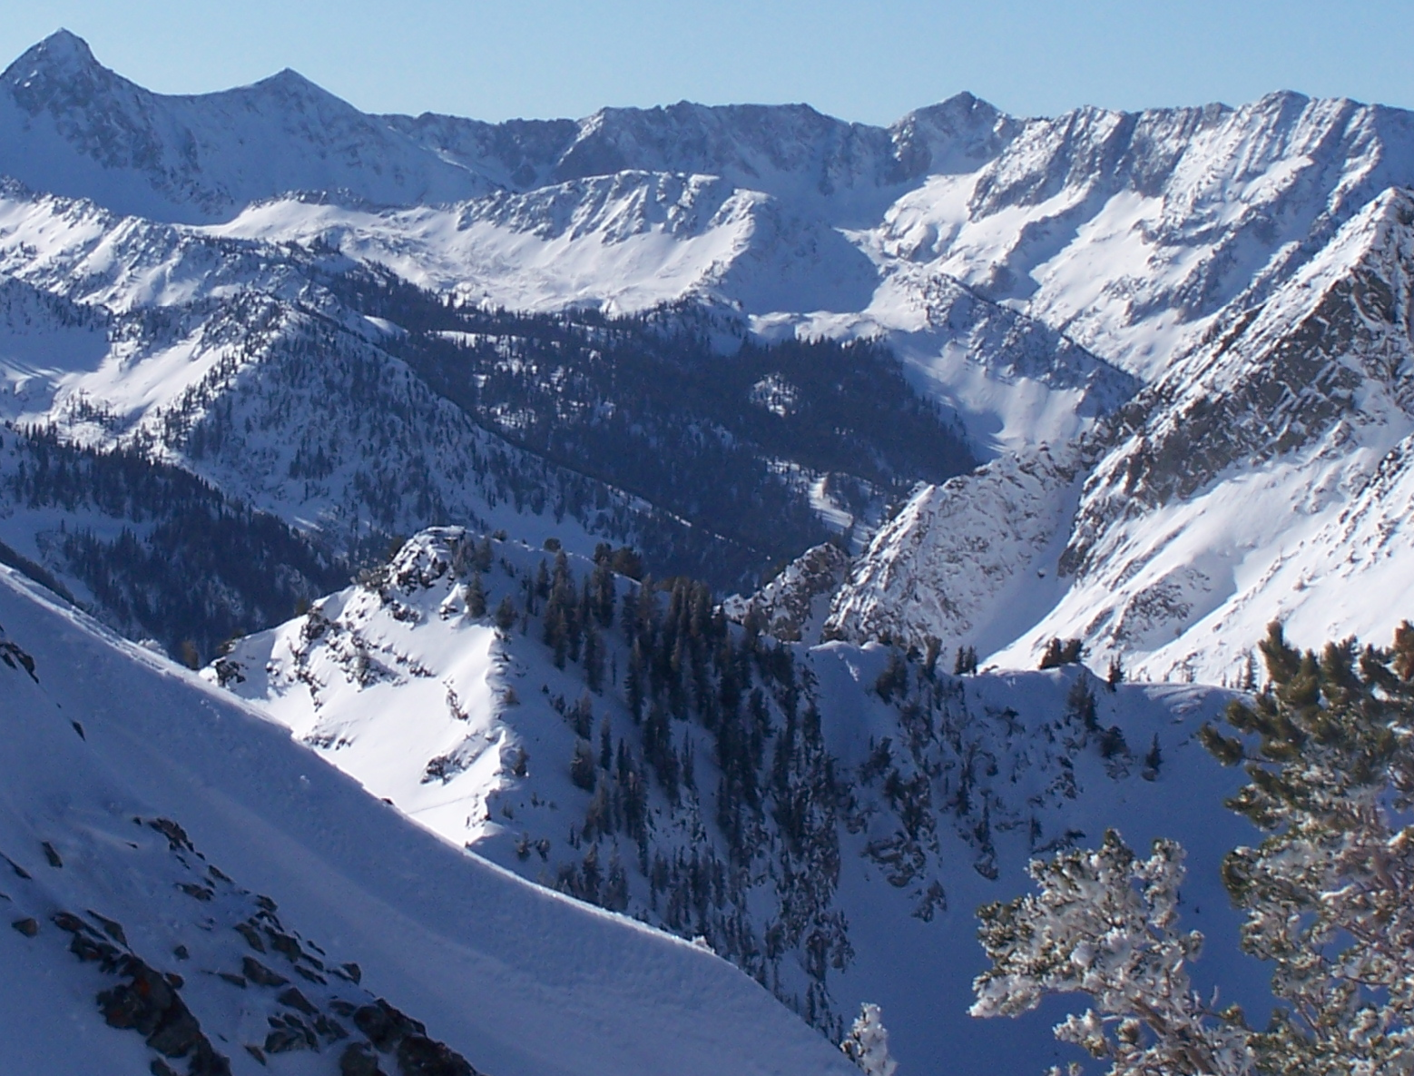
Snowpack

Slide 21
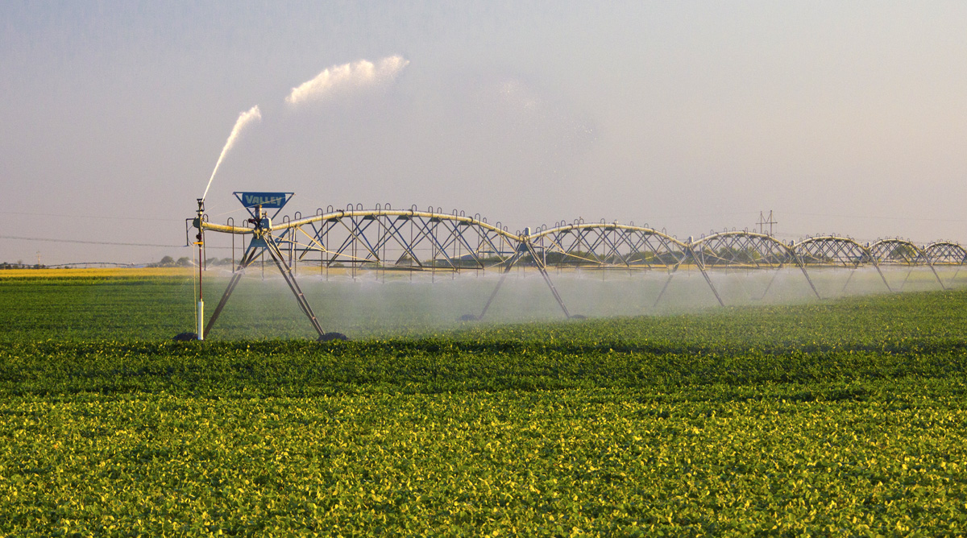
Water Budgets
Evaporative demand increases w/ temperature
In
Out
Drought is the running sum
of water out minus water in

Slide 23
Droughts Past & Future
Dust Bowl
Medieval Megadroughts

Slide 24
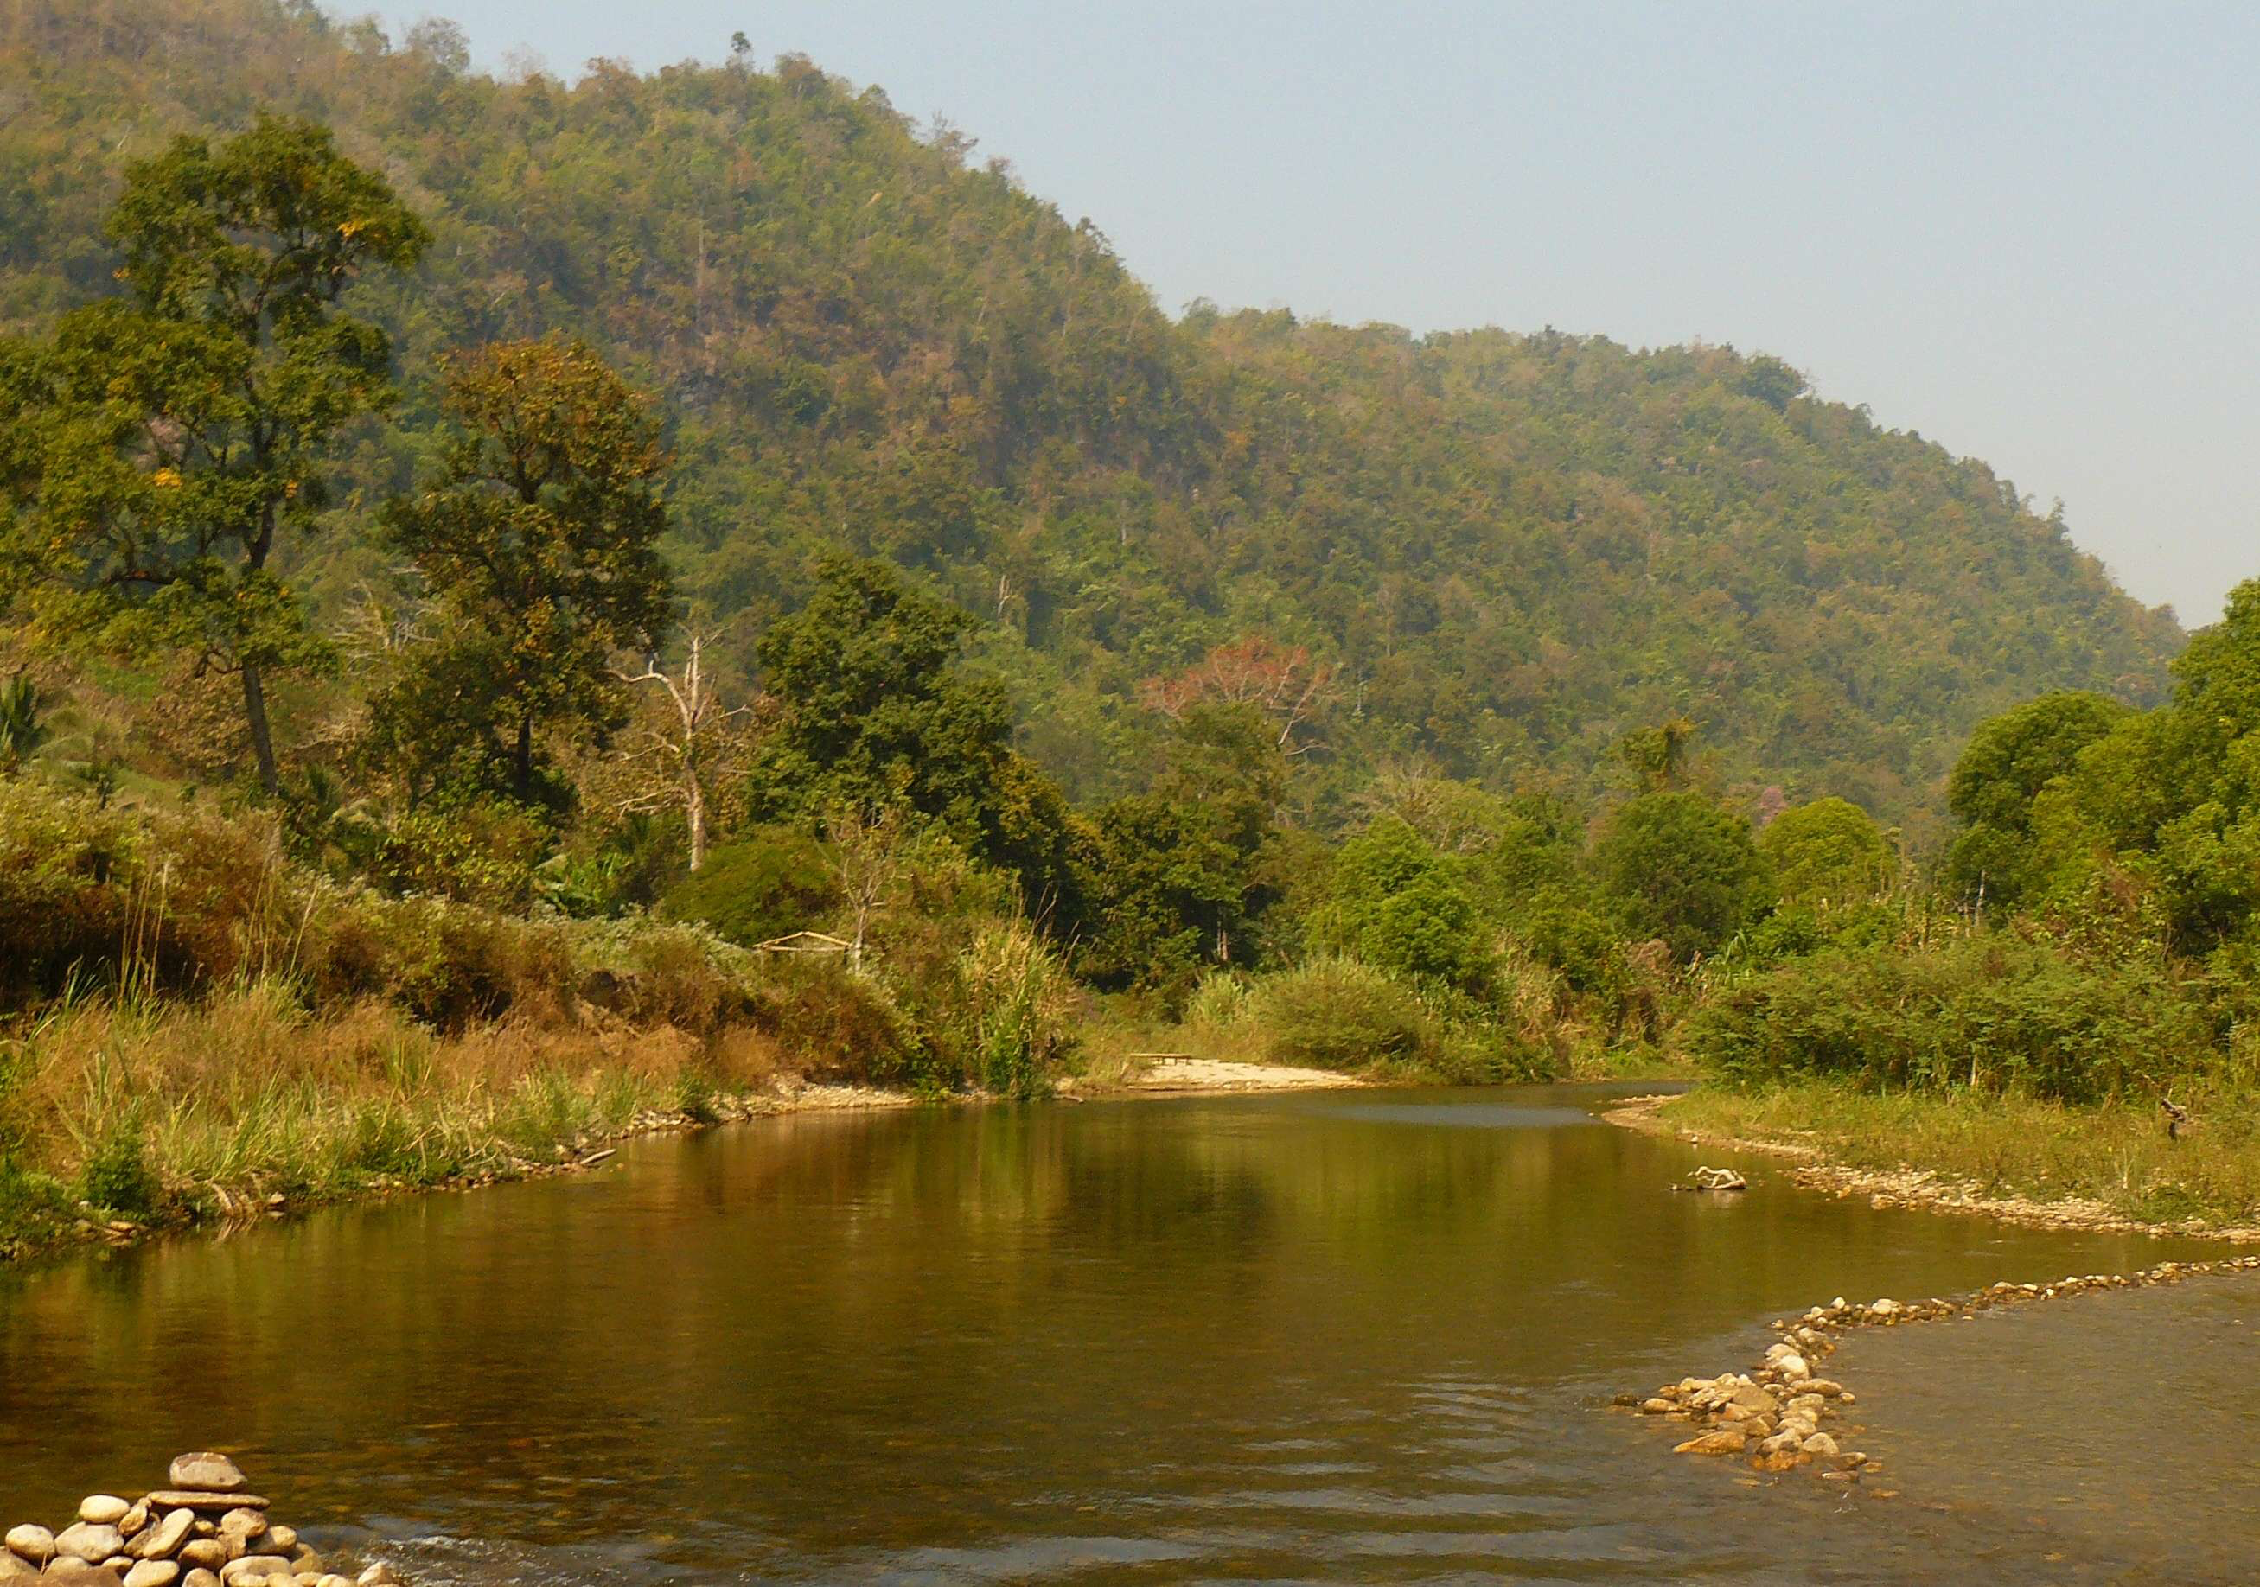
LandscapeTransition
Forest

Slide 25
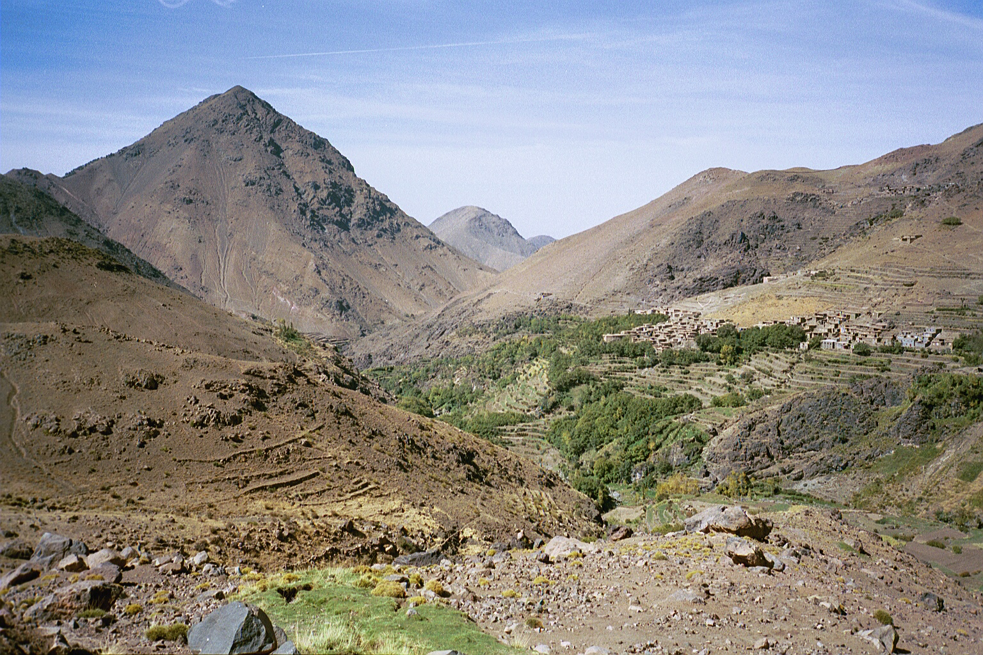
LandscapeTransition
Gradual Conversion
to Semi-Arid Landscape?

Slide 26
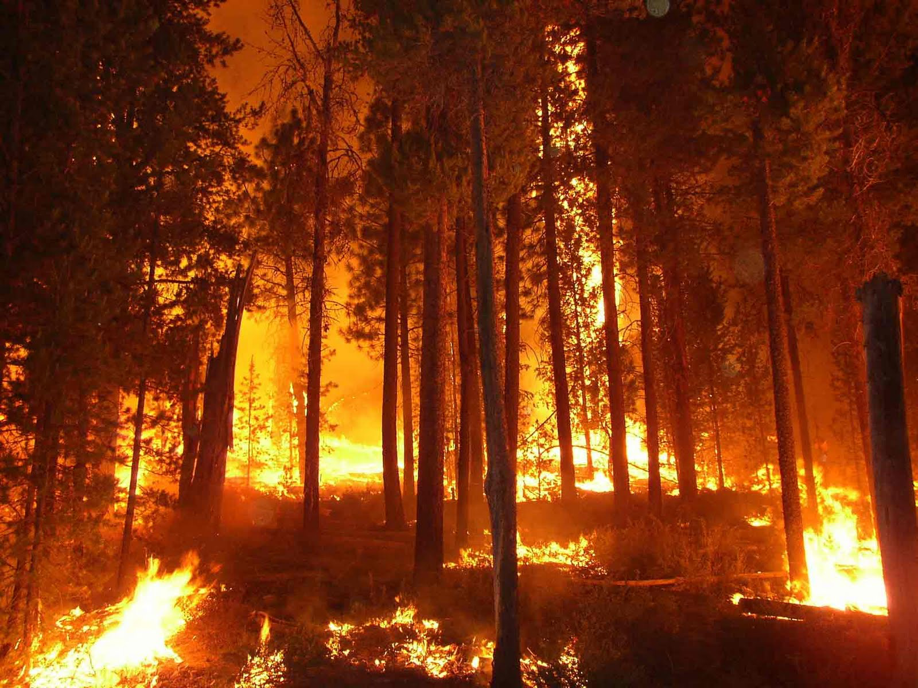
Sudden
Landscape Conversion

Slide 27

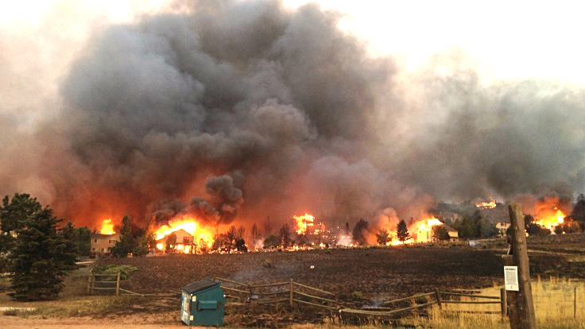
Warming Promotes Wildfire
Warmer air increases evaporative demand on forests
Longer warm season depletes soil moisture
More frequent extremely hot, dry, windy days when fires are uncontrollable
Projected Increase in Area Burned
656%
656%
NRC 2011

Slide 28
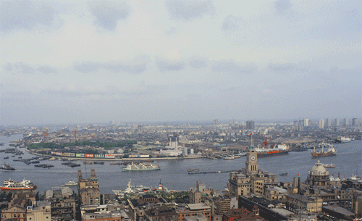
Billions and Billions
Shanghai 1991 and 2012
Currently 7 billion people on Earth
but only 1 billion use lots of energy
Rapid development to 4 billion
energy users over coming decades
Population growth only 30% but
energy growth 300% by 2100

Slide 29
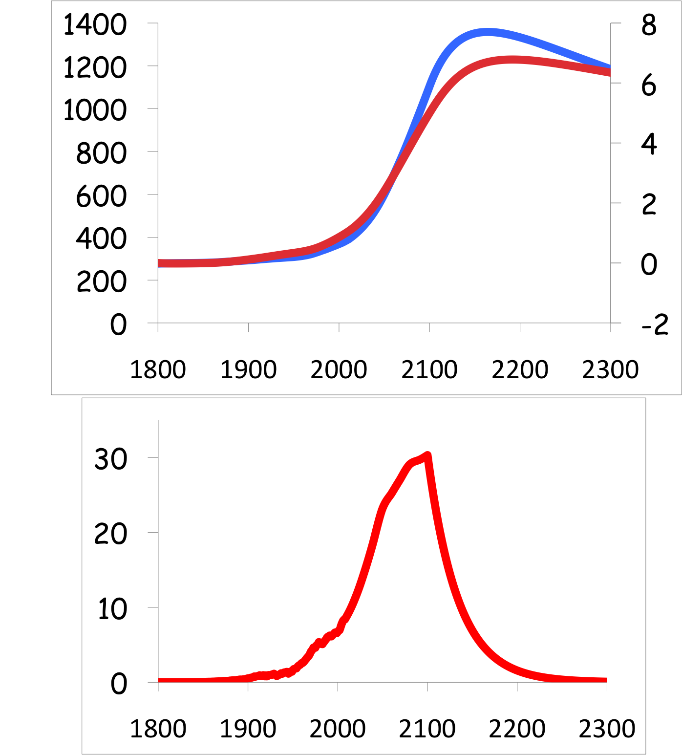
Common Myth #2
“When we reduce or stop burning fossil fuel, CO₂ will go away and things will go back to normal”
CO₂
If developiong countries industrialize with coal, CO₂ will rise to 5x preindustrial
Extra CO₂ will last for millennia after coal is gone
CO₂ (ppm)
warming
Warming (Celsius)
you are
here
emissions
GtC/yr
year
Not just Polar Bears … what would that do to farmers?

Slide 30
Solvable

Slide 31

Historical Emissions
Billions of Tons Carbon Emitted per Year
16
8
Historical
emissions
0
1950
2000
2050
2100
Notes:
31

Slide 32
The “Stabilization Triangle”
Billions of Tons Carbon Emitted per Year
16
Current path = “ramp”
Stabilization Triangle
Interim Goal
8
Historical
emissions
Flat path
1.6
0
1950
2000
2050
2100
Notes:
32

Slide 33
“Stabilization Wedges”
Billions of Tons Carbon Emitted per Year
16 GtC/y
16
Current path = “ramp”
Eight “wedges”
Goal: In 50 years, same
global emissions as today
8
Historical
emissions
Flat path
1.6
0
1950
2000
2050
2100
http://www.princeton.edu/wedges/
Notes:
33

Slide 34
What is a “Wedge”?
A “wedge” is a strategy to reduce carbon emissions that grows in 50 years from zero to 1.0 GtC/yr. The strategy has already been commercialized at scale somewhere.
1 GtC/yr
Total = 25 Gigatons carbon
50 years
  Cumulatively, a wedge redirects the flow of 25 GtC in its first 50 years. This is 2.5 trillion dollars at $100/tC.
A “solution” to the CO₂ problem should provide at least one wedge.

Slide 35
15 Wedges: Solved!
Energy Efficiency &
Conservation (4)
16 GtC/y
Fuel Switching
(1)
Renewable Fuels
& Electricity (4)
Stabilization
Stabilization
Triangle
Triangle
CO₂ Capture
& Storage (3)
8 GtC/y
Forest and Soil Storage (2)
2007
2057
Nuclear Fission (1)
http://www.princeton.edu/wedges/
Notes:
35

Slide 36

Efficient Architects!
$4.5 TRILLION

Slide 37
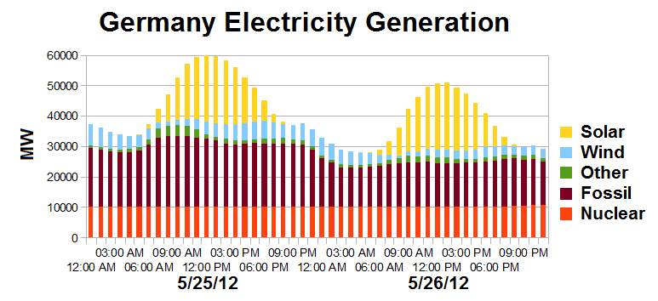
Solar Resource
US vs Germany

Slide 38
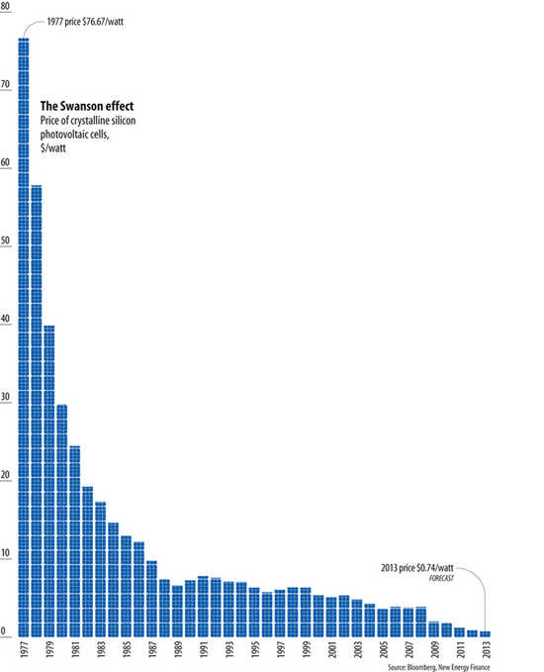
Price of Solar PV Cells
$/watt
Price per watt has fallen by 99% since I graduated from high school
Fallen 80% since 2008
Now close to parity with coal or gas
Drop in 1980s
Flatter in1990s

Slide 39


Costs
Conversion to 100% noncarbon energy will cost about
1% of GDP
That’s about what it cost to retrofit all the world’s cities with indoor plumbing a century ago …
It was worth it!

Slide 40
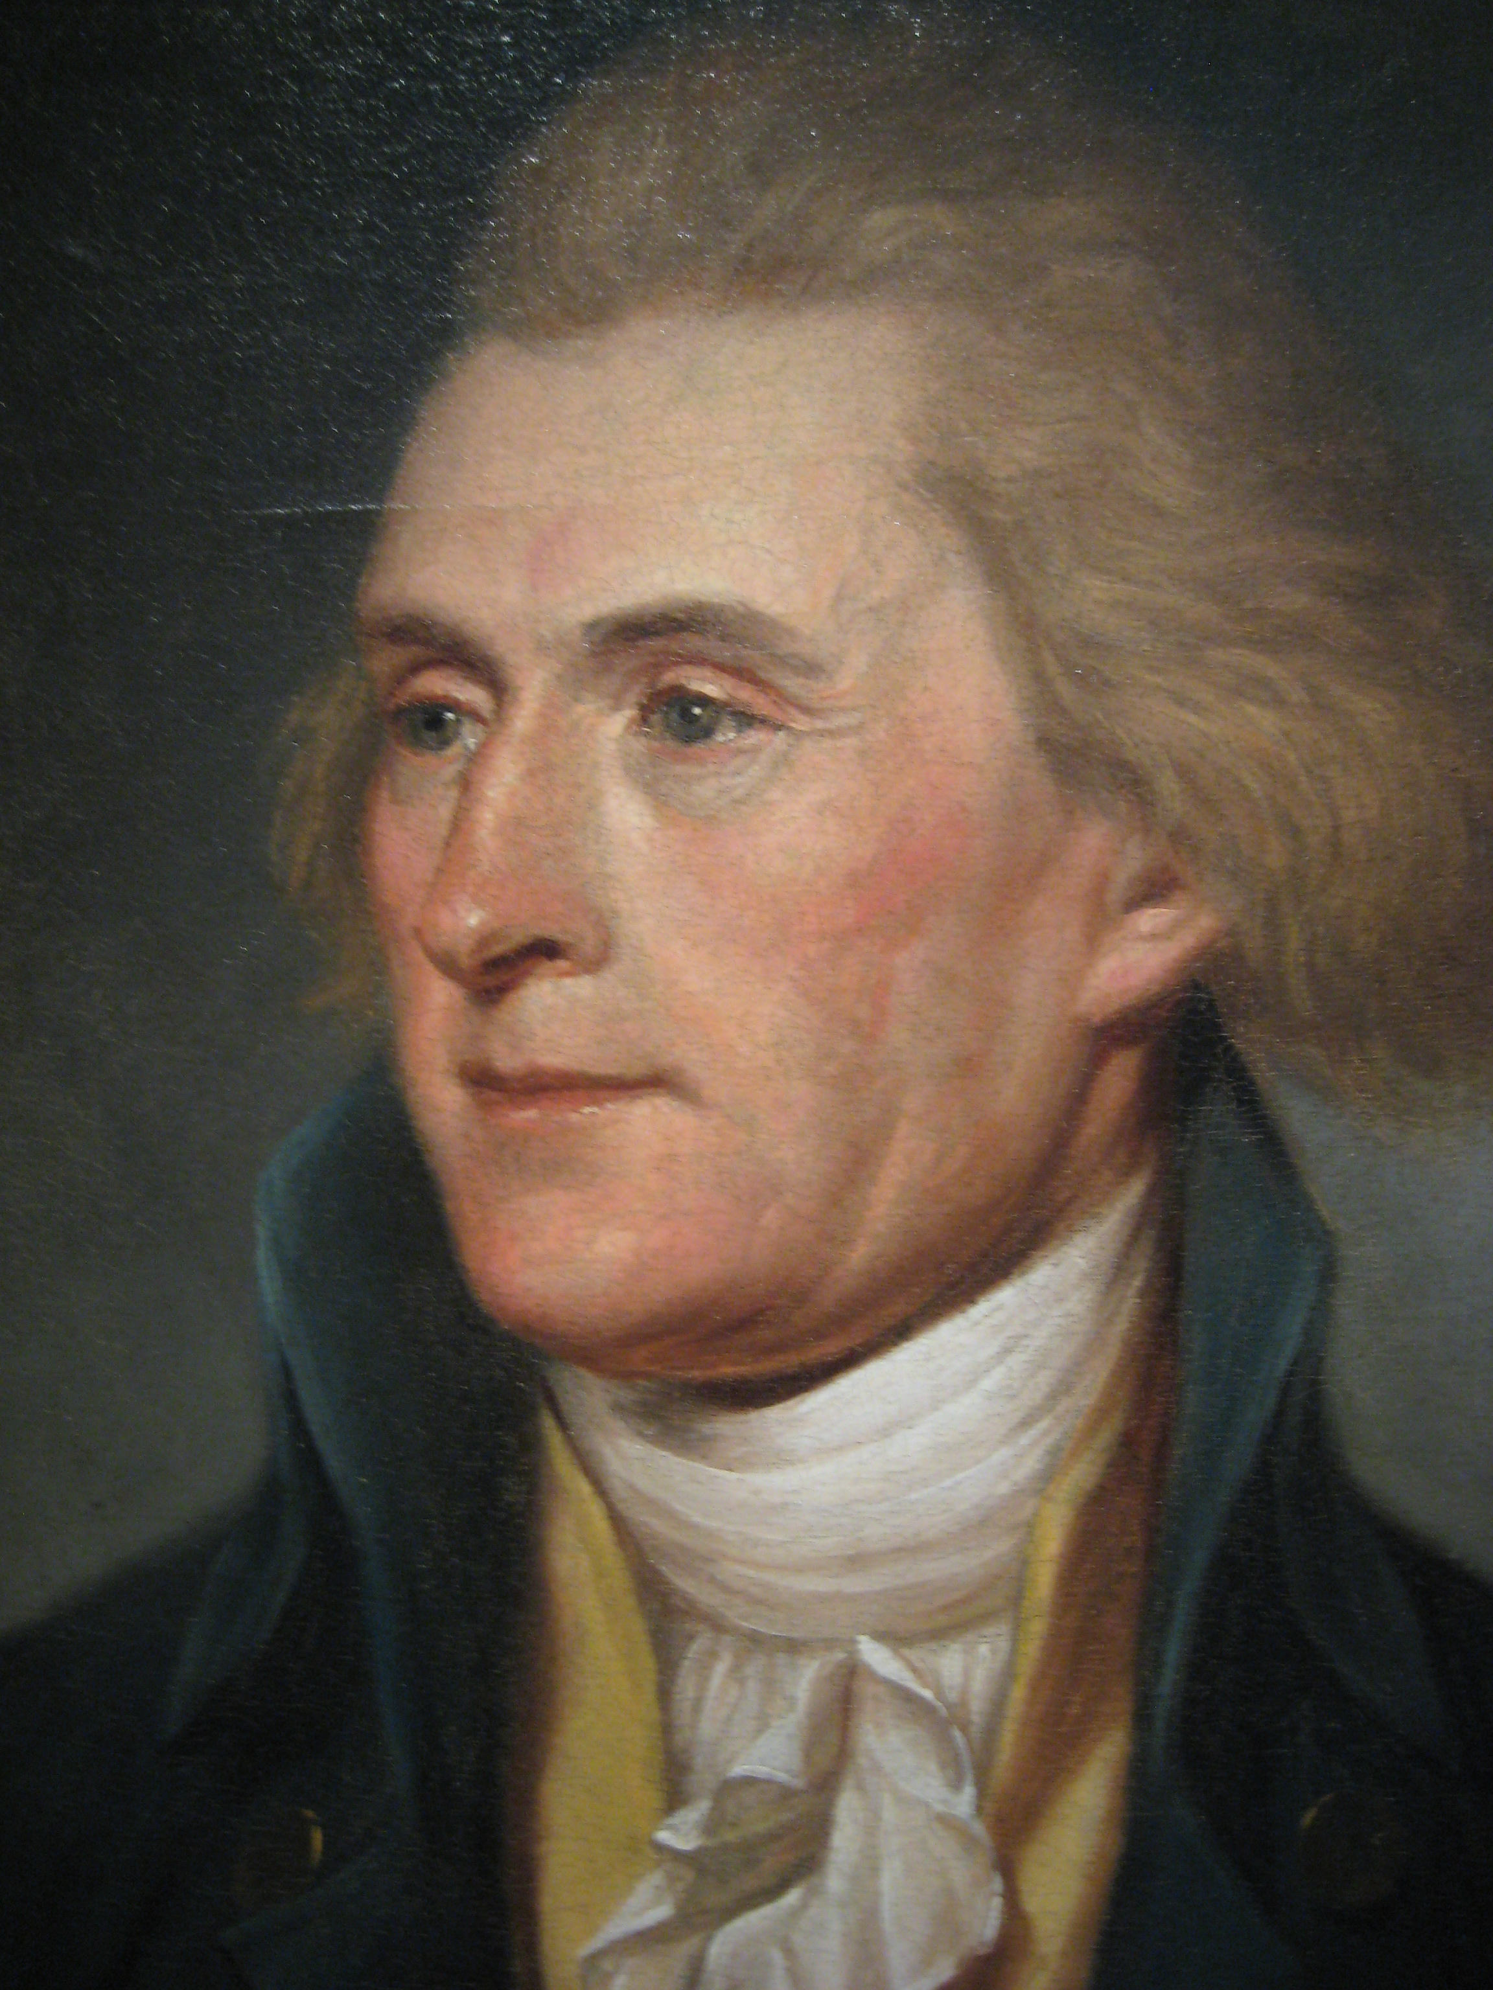
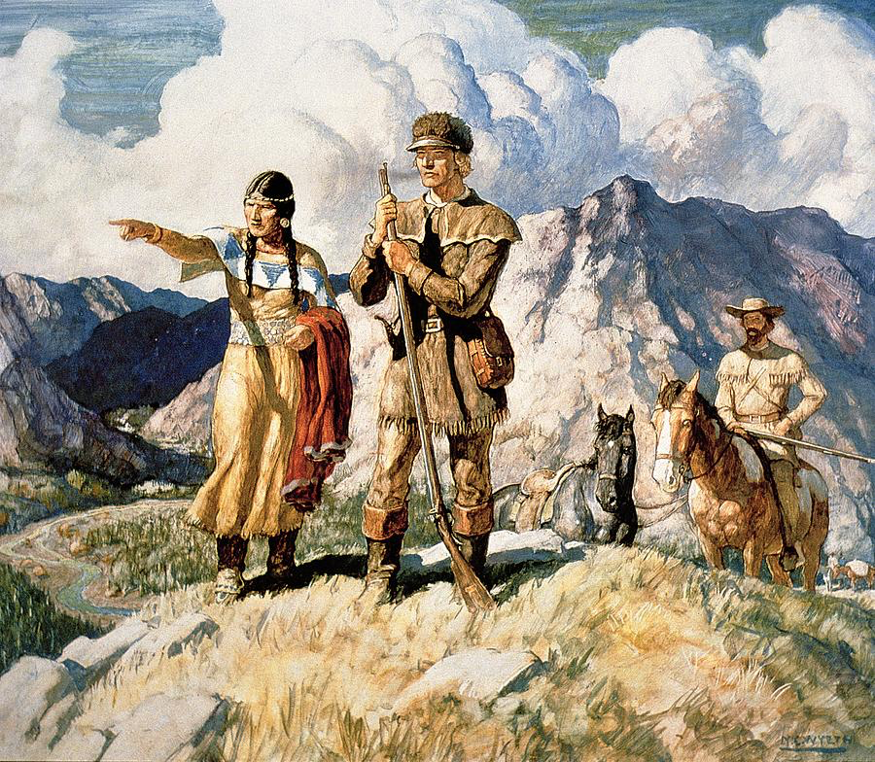
Imagine it’s 1800 …
Lewis and Clarke with Sacajawea
President Thomas Jefferson

Slide 41

Imagine it’s 1800 …

Slide 42
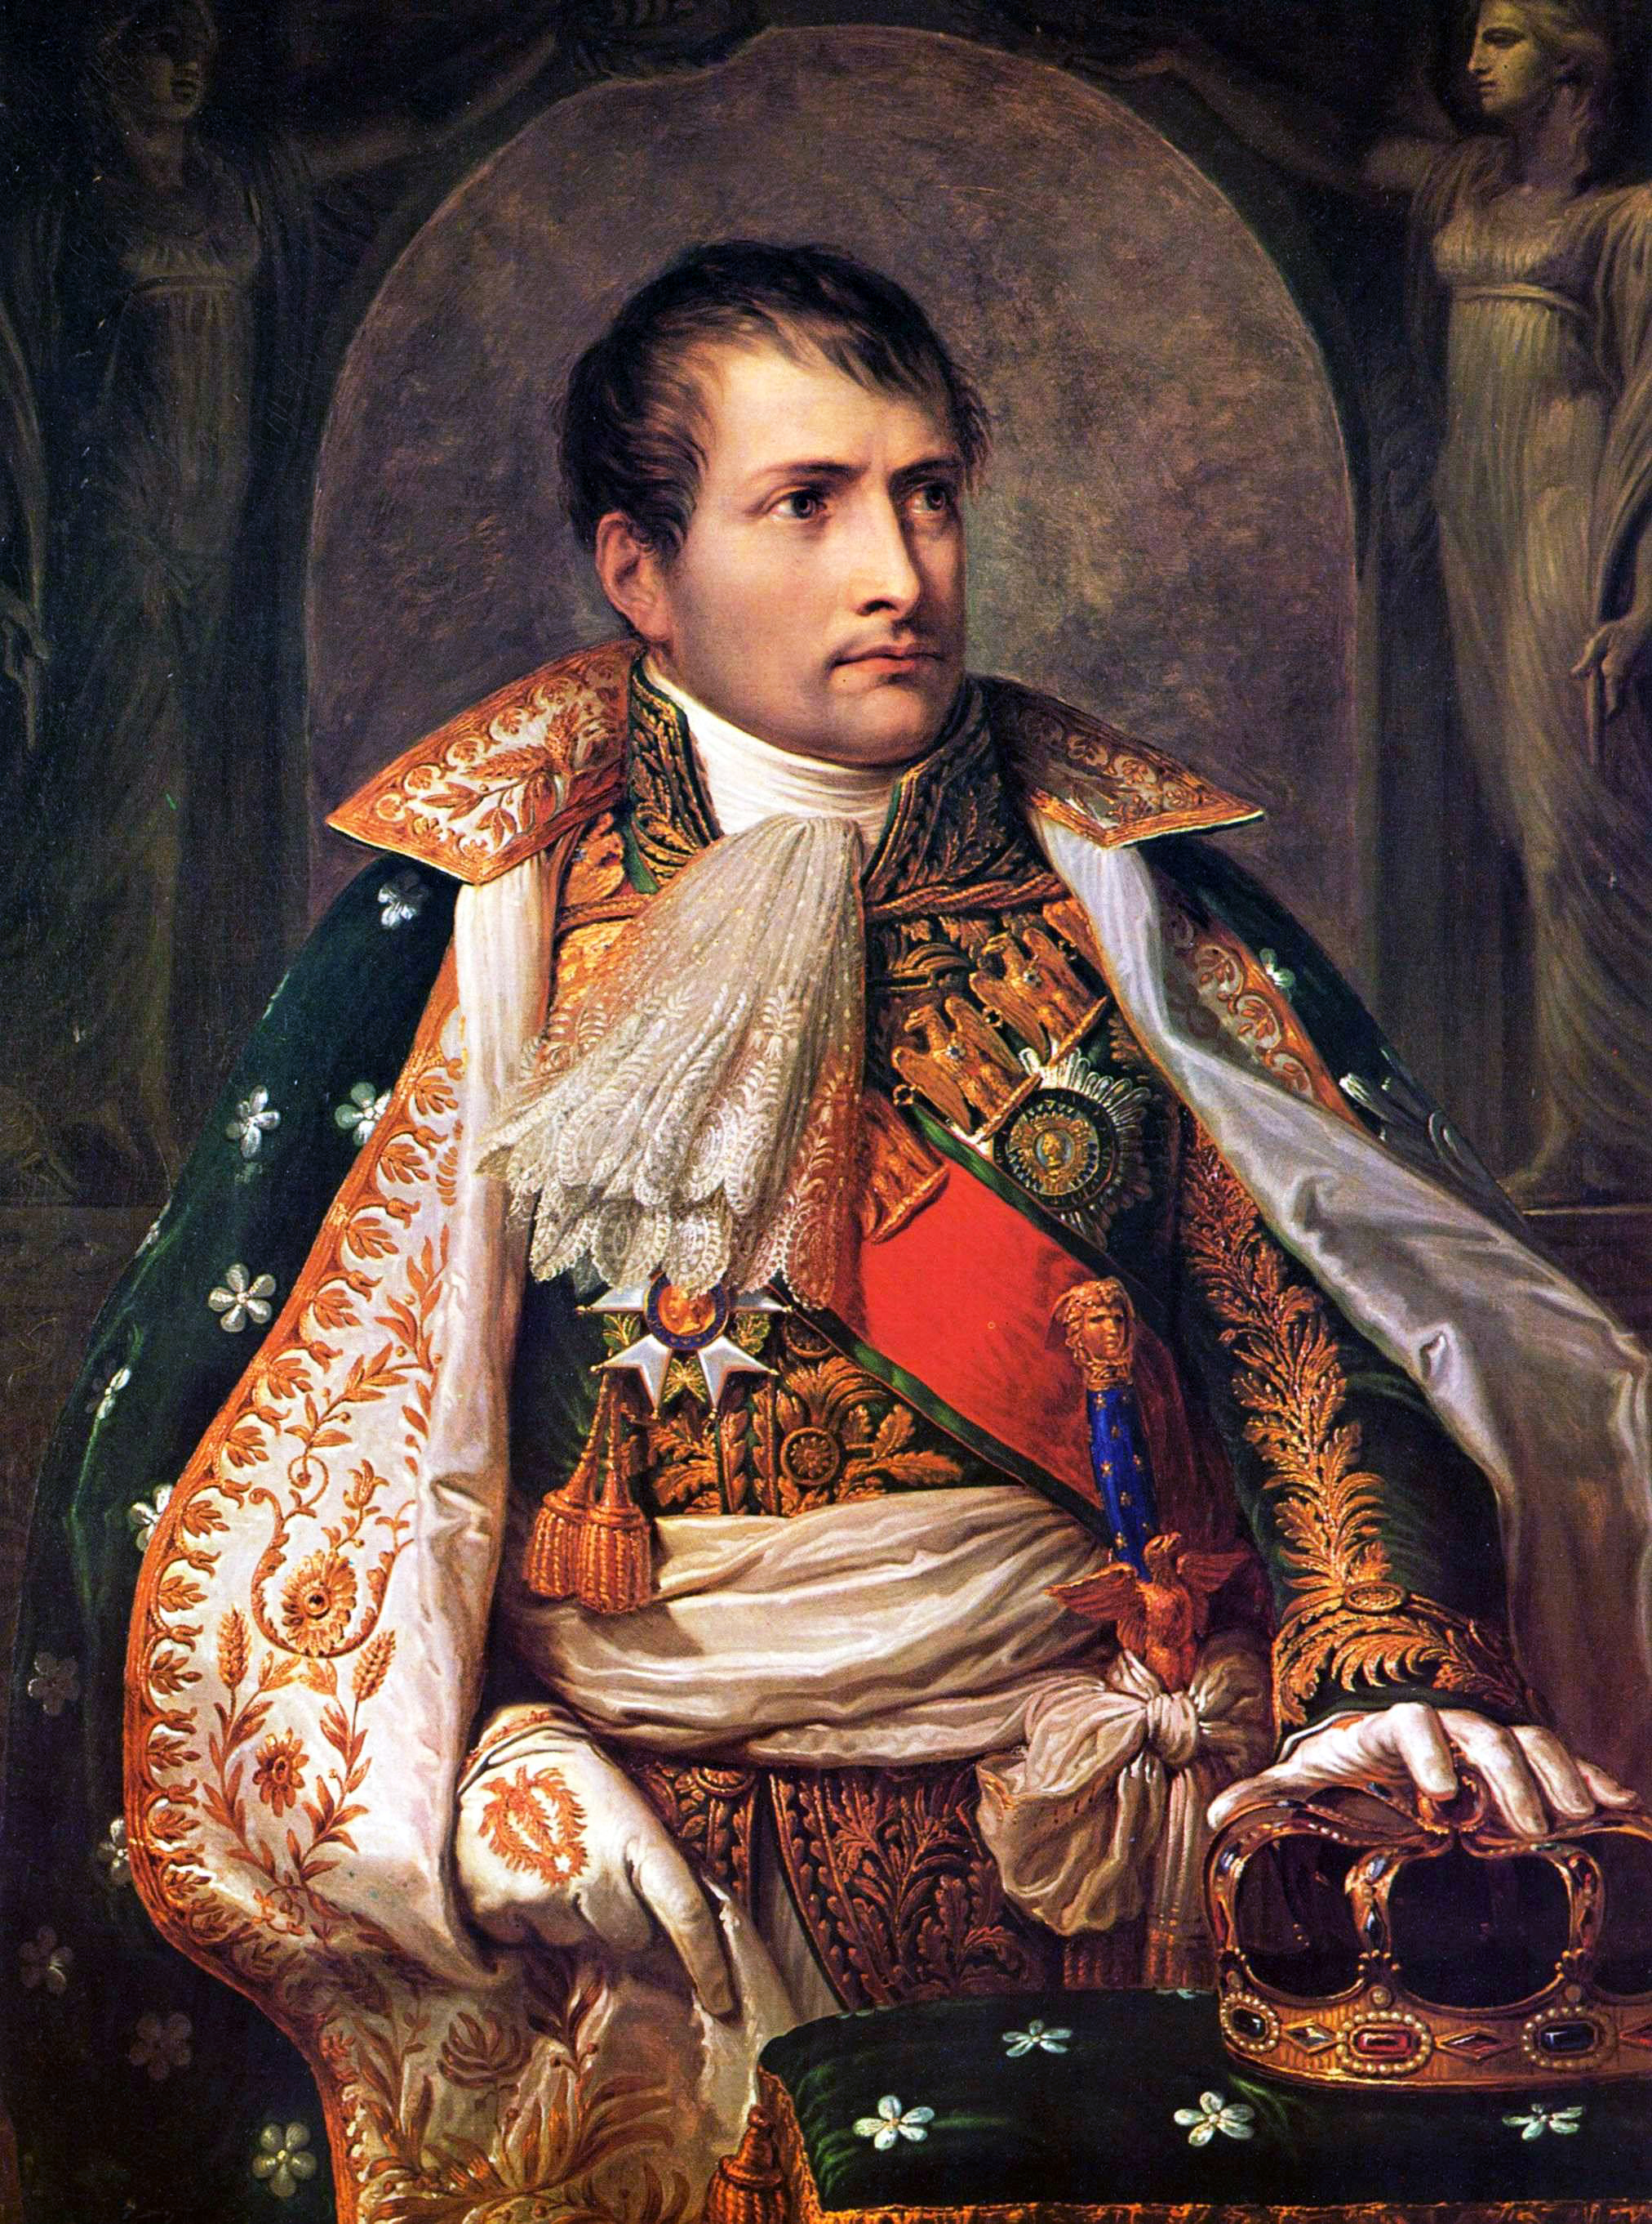
Imagine it’s 1800, and you’re in charge …
Napoleon Bonaparte

Slide 43
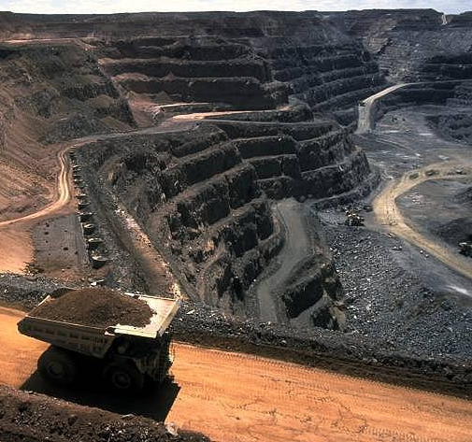
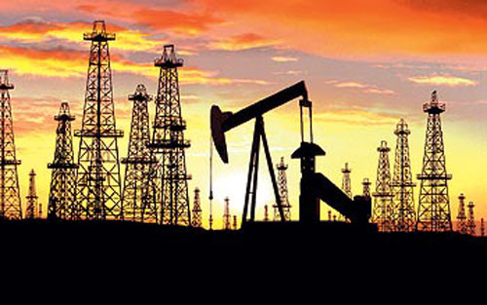
Imagine it’s 1800, and you’re in charge …
Somebody presents you with a grand idea for transforming the world economy:
  Dig 10 billion tons of carbon out of the ground every year

Slide 44
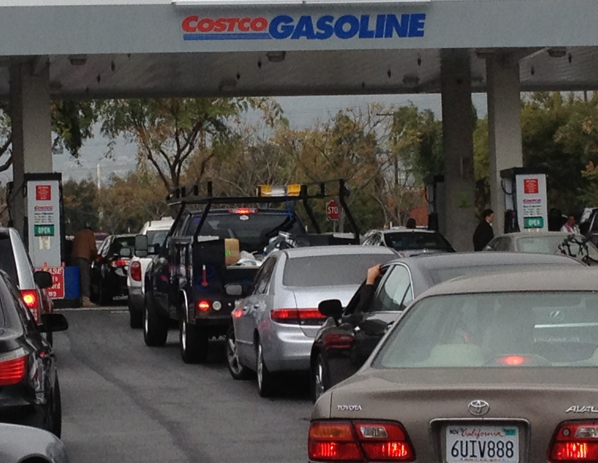
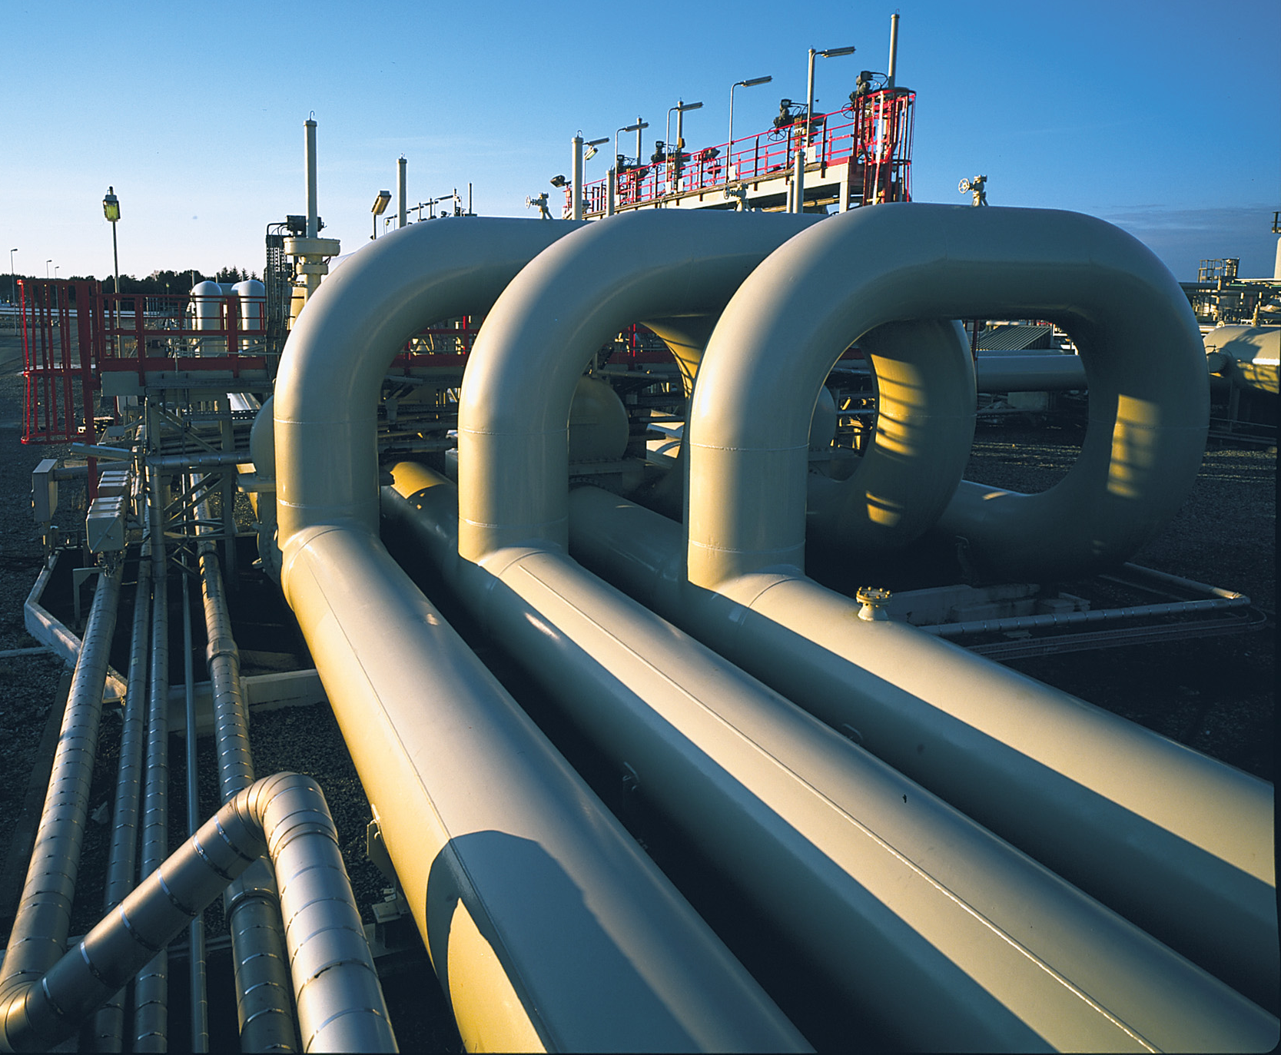
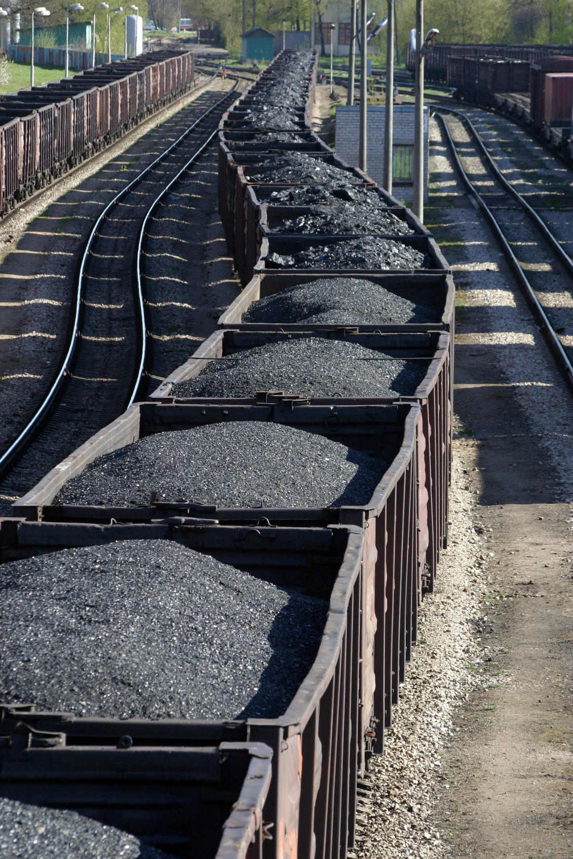
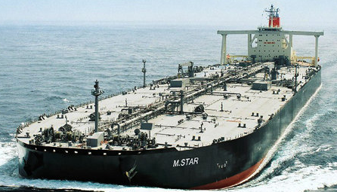
Imagine it’s 1800, and you’re in charge …
Somebody presents you with a grand idea for transforming the world economy:
  Build a system of pipelines, supertankers, railroads, highways, and trucks to deliver it to every street corner on the planet

Slide 45
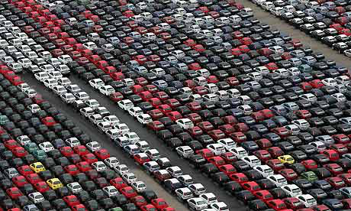
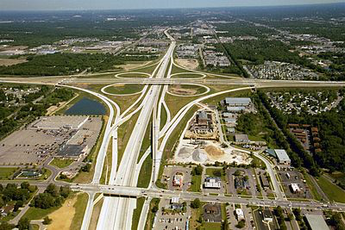
Imagine it’s 1800, and you’re in charge …
Somebody presents you with a grand idea for transforming the world economy:
  Build 10 million miles of paved roads
  and 100 million cars every year to drive on them

Slide 46
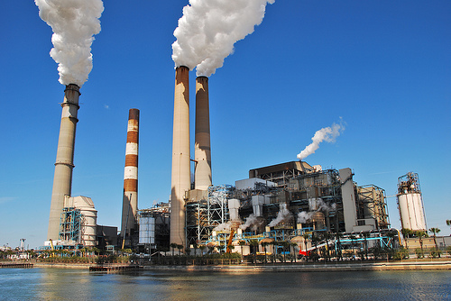
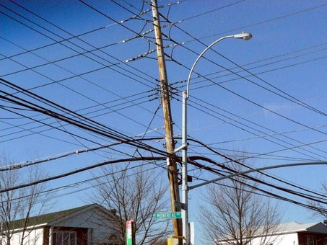
Imagine it’s 1800, and you’re in charge …
Somebody presents you with a grand idea for transforming the world economy:
  Generate and pipe enough electricity to every house to power lights & stereos & LCD TVs

Slide 47

Imagine it’s 1800, and you’re in charge …
Somebody presents you with a grand idea for transforming the world economy:
  Dig 10 billion tons of carbon out of the ground every year
  Build a system of pipelines, supertankers, railroads, highways, and trucks to deliver it to every street corner on the planet
  Build millions of cars every year, and millions of miles of roads to drive them on
  Generate and pipe enough electricity to every house to power lights & stereos & LCD TVs
… “and here’s the itemized bill …”

Slide 48
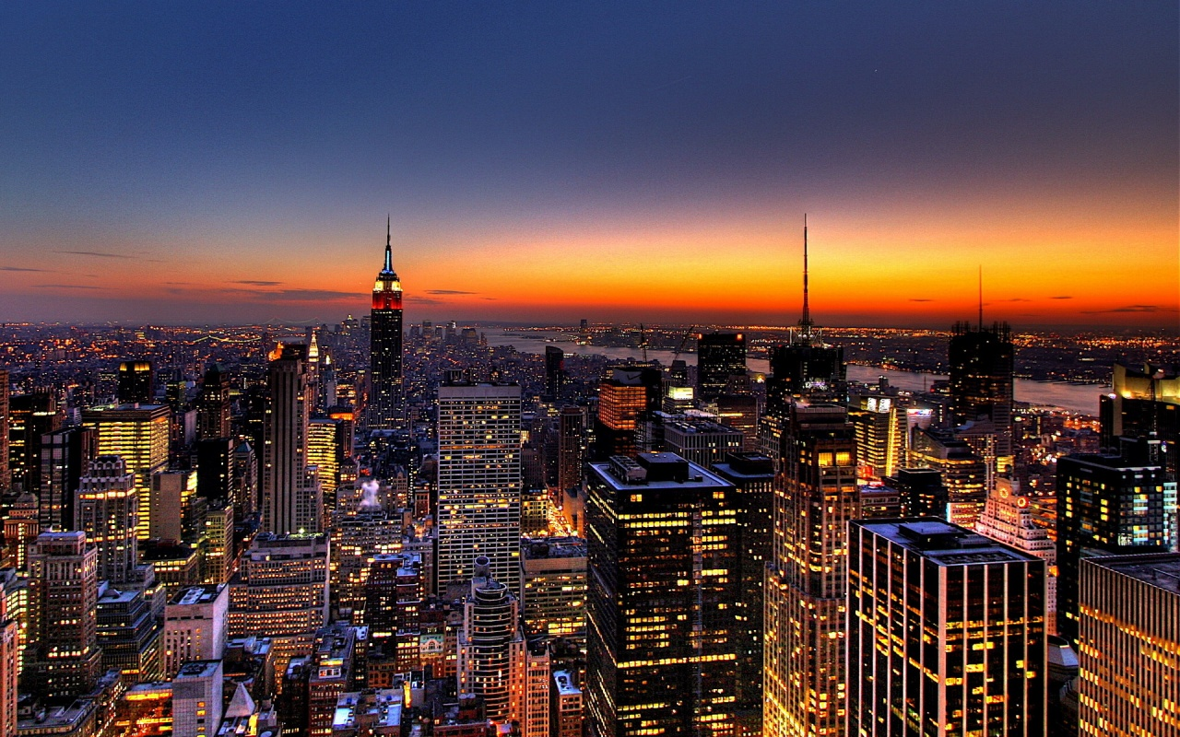
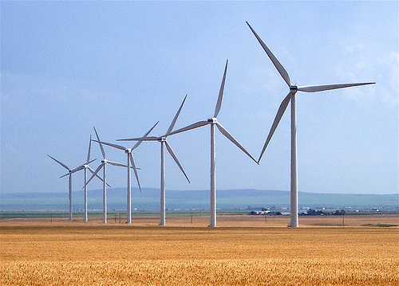
Who Built That?
Our ancestors built that very system
It cost them every dime of global GDP for 200 years (now $78T/yr)
It created every dime too!
Now our kids get to
do it again!

Slide 49

Choose Your Future
Many people think:
  “Our well-being is based on
  stuff we extract from the ground”
When we stop burning coal, will our descendants shiver in the dark?

Slide 50

Choose Your Future
I prefer:
  “We create our well-being through creativity, ingenuity, and hard work”
The future is bright!

