Slide 1



How Can Climate be Predictable when Weather Isn’t?
Scott Denning
Director of Education, CMMAP
Monfort Prof. Atmospheric Science, CSU
Email Scott.Denning@ColoState.edu for a copy of this presentation

Slide 2
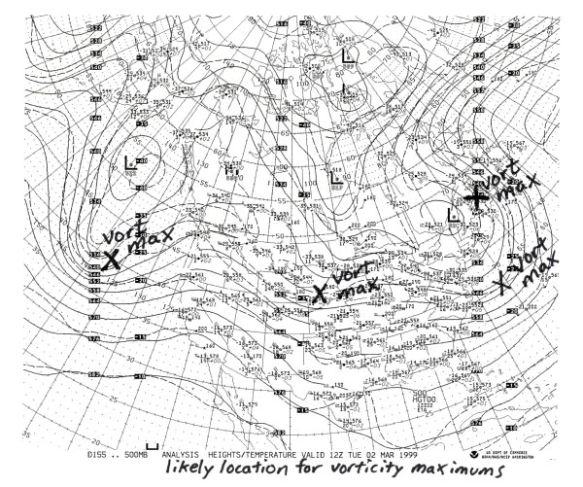
Weather Forecasting is Hard!
You learned about this in a University
Air masses and fronts
Convergence and divergence
Vorticity maxima and shortwaves
Quasigeostrophic lift
Convective available potential energy

Slide 3
Weather vs Climate what’s the difference?
If you don’t like the weather:
  Wait five minutes!
If you don’t like the climate:
  Move!
You learned about this in grade school

Slide 4
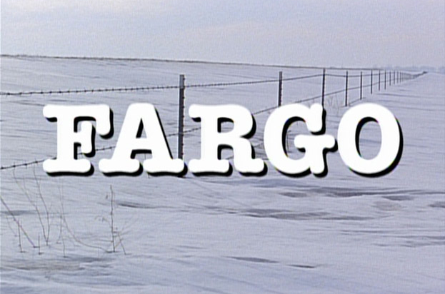
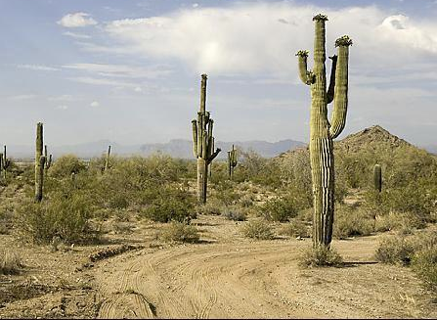
Location! Location! Location!
Climate is Place
Depends on where you live:
  Latitude!
  Altitude (mountains vs valley)
  What’s upwind (ocean vs land)
Changes very slowly
Very predictable
We can predict that Phoenix is warmer than Fargo for precisely the same reasons that we can predict a warmer future!
PHOENIX

Slide 5

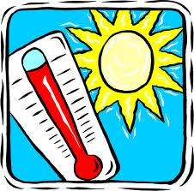
Ever Wonder Why?
Day is warmer than night
Summer is warmer than winter
Miami is warmer than Minneapolis

Slide 6

Heat Budgets
Heat in
Heat in
Heat out
Heat out

Slide 7
Climate Forcing & Forecasting
If there’s a deterministic relationship between forcing and response
… and the forcing is strong & predictable
… then the response can be predictable as well!
Examples:
  Day vs night
  Summer vs winter
  Miami vs Minneapolis
  El Niño / La Niña
  “Little Ice Age”
  Glacial-interglacial
  21st Century warming

Slide 8
Dancing Molecules and Heat Rays!
Nearly all of the air is made of oxygen (O₂) and nitrogen (N₂) in which two atoms of the same element share electrons
Infrared (heat) energy radiated up from the surface can be absorbed by these molecules, but not very well
O
O
N
N
Diatomic molecules can vibrate back and forth like balls on a spring, but the ends are identical

Slide 9
Dancing Molecules and Heat Rays!
Carbon dioxide (CO₂) and water vapor (H₂O) are different!
They have many more ways to vibrate and rotate, so they are very good at absorbing and emitting infrared (heat) radiation
O
C
O
O
H
H
Molecules that have many ways to wiggle are called “Greenhouse” molecules
Absorption spectrum of CO2 was measured by John Tyndall in 1863

Slide 10


Slide 11
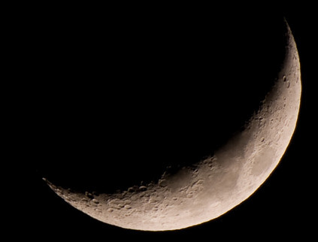
Fall Night
in Colorado
radiation
emitted
by soil
6 AM surface temperature = -60 °C = -78 °F
9 PM surface temperature = 15 °C = 60 °F
390 W m⁻²
4 inches
= 10 cm

Slide 12
Fall Night
in Colorado
radiation
emitted
by air
radiation
emitted
by soil
340 W m⁻²
6 AM surface temperature = 5 °C = 40 °F
390 W m⁻²
4 inches
= 10 cm

Slide 13
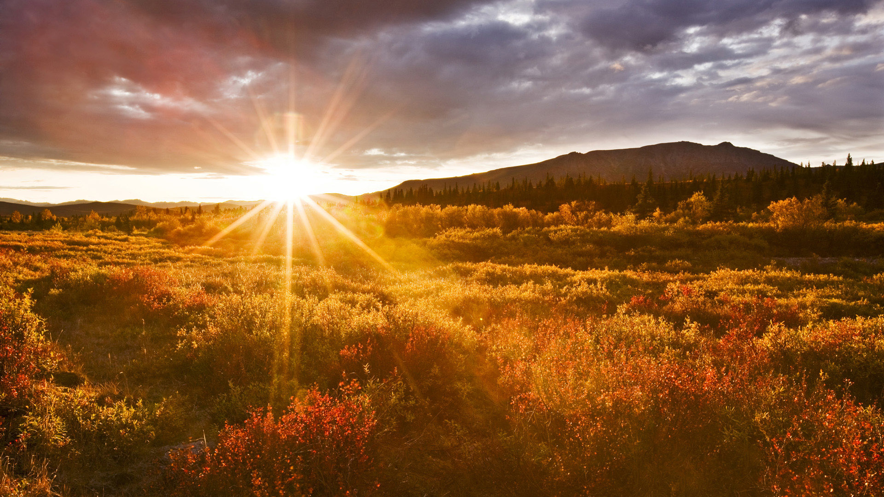
The strongest evidence for the
Greenhouse Effect
is that we can
survive night!

Slide 14


Common Sense
1 m
Doubling CO₂ would add 4 watts to every square meter of the surface of the Earth, 24/7
Doing that would make the surface warmer
This was known before light bulbs were invented!
4 Watts
1 m
John Tyndall, January 1863

Slide 15

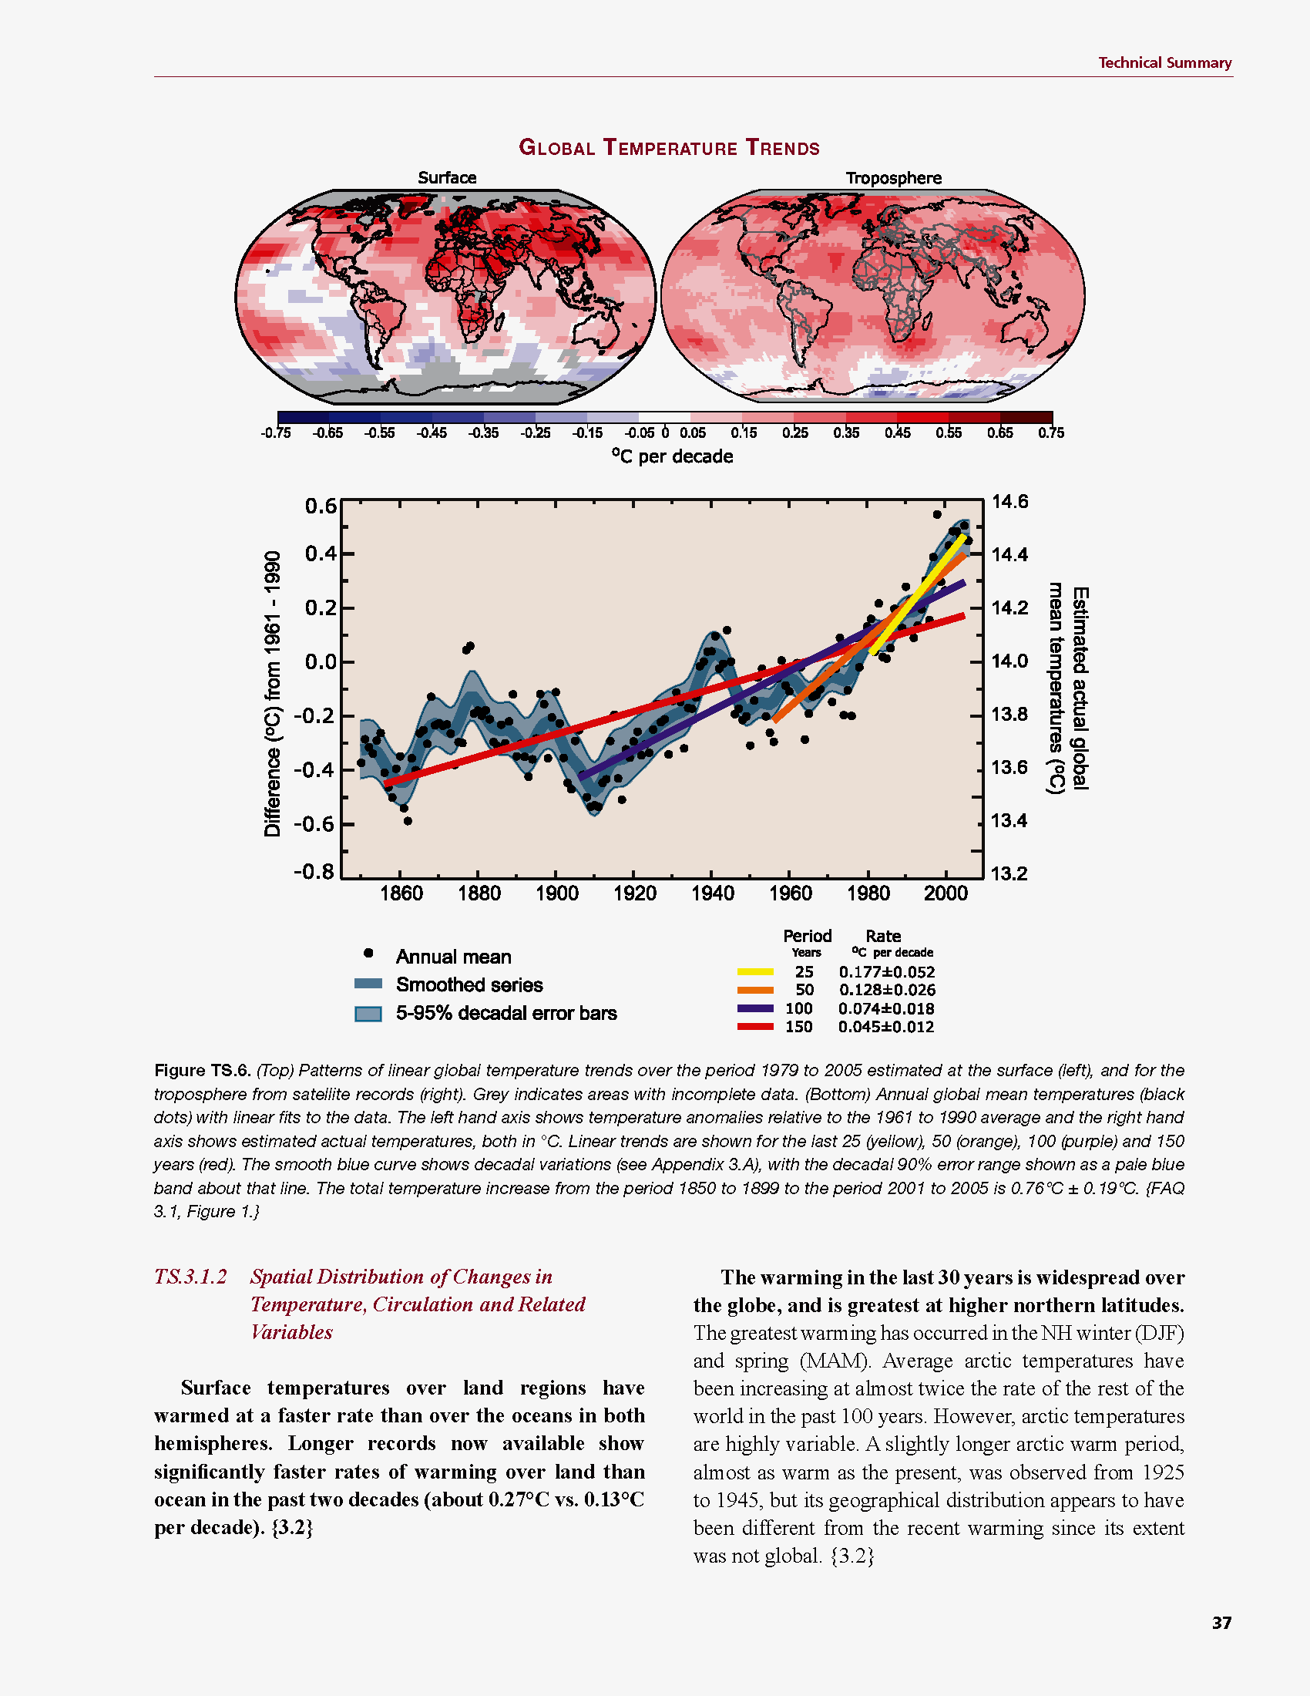
Common Myth #1
“Scientists confident about climate change because it’s been warming up recently”
WRONG!
We’re confident because we know that when we add heat to things, they warm up

Slide 16
Cause and Effect
Forcing
Watts per
square meter
Response
degrees
Celsius or F
Response
Sensitivity =
Forcing
degrees per Watt m⁻²

Slide 17

Learning from the Past
Geologic past
(100’s of millions of years)
Deglaciation analog
(18,000 years ago to preindustrial time)
Last Millennium analog
(Medieval Warm Period to Little Ice Age)
Modern Climate Record
(20th Century changes)
The further back we go, the less data we have to work with.
Using modern data, we have only brief transients to study.

Slide 18
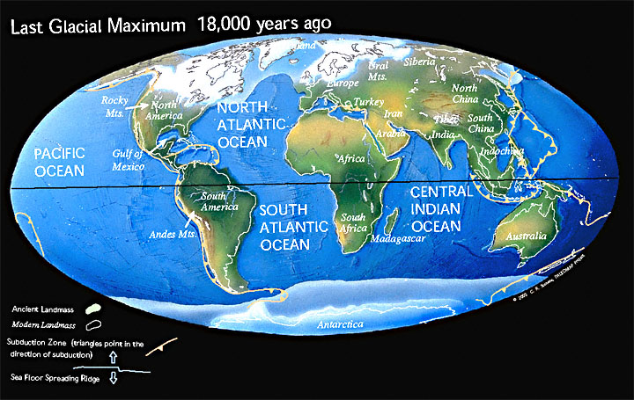
Ice Age World
High albedo
Low CO₂

Slide 19
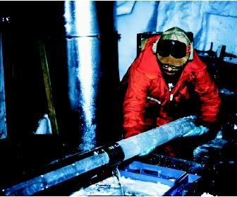
CO₂ and the Ice Ages
Over the past 420,000 years atmospheric CO₂ has varied between 180 and 280 ppm, beating in time with the last four glacial cycles
CO₂
370 ppm in 2000
ice
ice
ice
ice
Vostok (400k yr) Ice Core data (Petit et al, 1999)

Slide 20
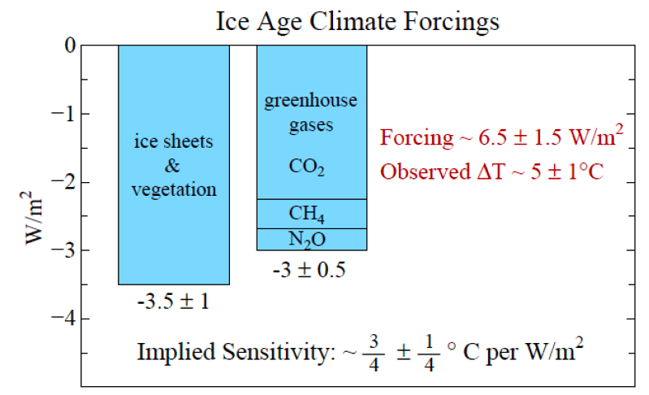
Climate Forcing
Source: Hansen and Sato (2011)

Slide 21
Climate Sensitivity to enhanced CO₂
Volcanoes, Last Millennium, Deglaciation
all around 0.8 °C of warming per (W m⁻²)
Each doubling of CO₂
adds 4 Watts per square meter
So expect about
(4 W m⁻²) x (0.8 °C per (W m⁻²))
= 3 °C per doubling of CO₂

Slide 22
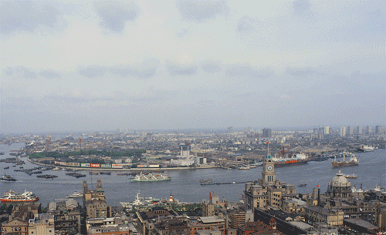
Billions and Billions
Shanghai 1991 and 2012
Currently 7 billion people on Earth
but only 1 billion use lots of energy
Rapid development to 4 billion
energy users over coming decades
Population growth only 30% but
energy growth 300% by 2100

Slide 23

Climate Forcing
If developing countries build modern economies based on coal …
Earth will gain more heat in 21st Century than it did when warming after Last Ice Age!
… but warming after Ice Age took 100 Centuries
1 meter
7.4 W m⁻²
1 meter

Slide 24


How much warmer?
Land vs ocean!
North vs South
Global mean
warming of 2º to 5º C
North American
warming of 3º to 6º C
= 5º to 11º F
Arctic warming of
8º to 14º F
Low
Emissions
Moderate
Emissions
High
Emissions
Rainfall? Agriculture?
Water demand? Tourism?
Mass immigration?

Slide 25

Where is it 10°F Warmer
“on average?”
Denver ➔
Amarillo
Illinois ➔
Mississippi
Washington➔
Tallahassee
Water? Crops?
Real Estate? Health?

Slide 26

Bell Curves
“Normal distribution” or “Gaussian”
Average = Mean = Median = Mode
“Standard deviation” σ measures “width”
  68% of values fall within 1σ of mean
  95% within 2σ of mean, 99.6% within 3σ

Slide 27
Means & Extremes
People care more about extremes (tails) than averages
Small changes in averages produce large changes in extremes
Changes in the “spread” also produce changes in extremes

Slide 28
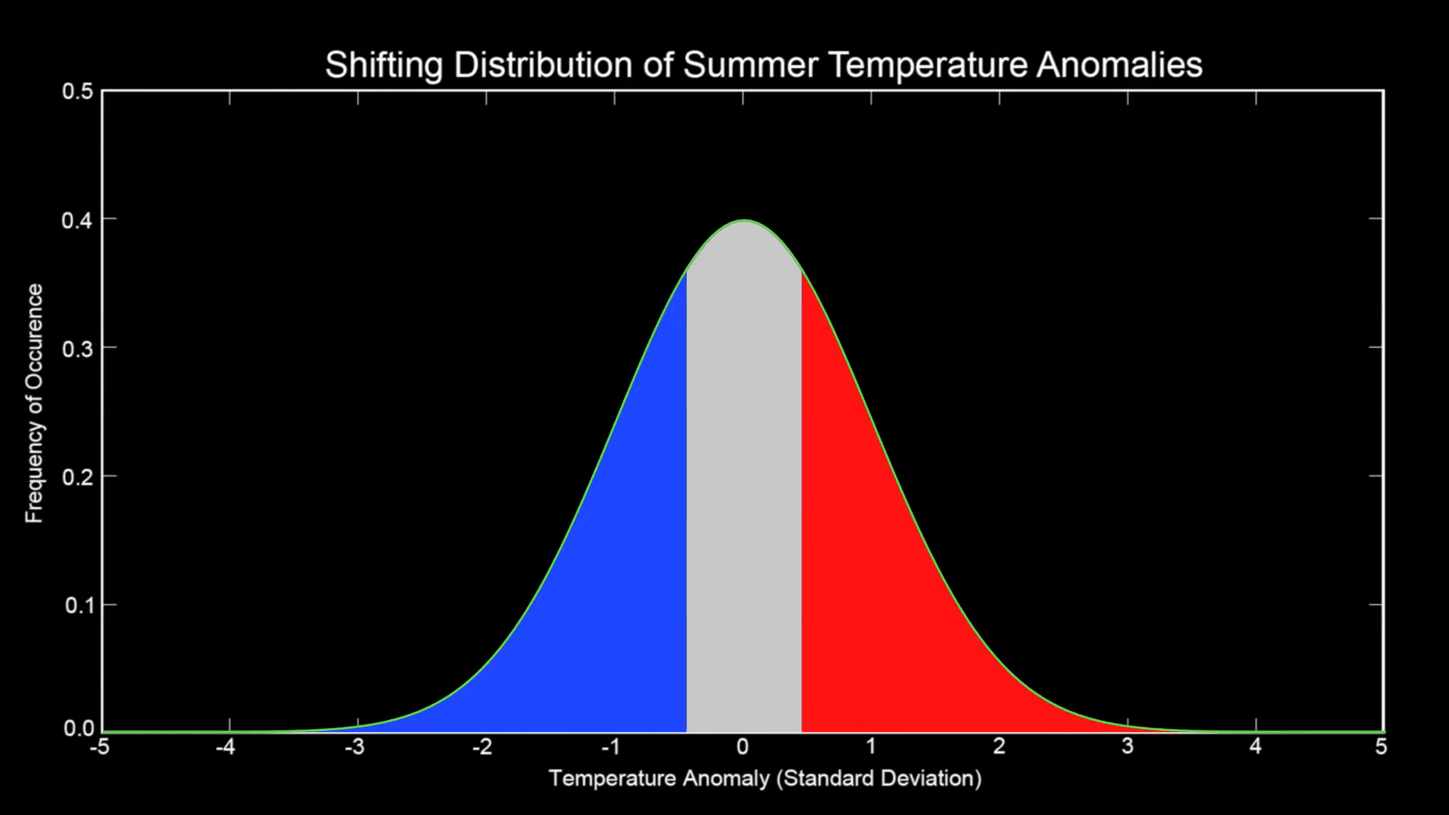
Historic Land Temps

Slide 29
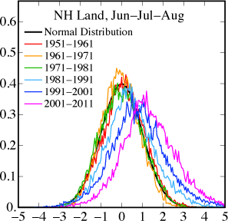
Summer Temperatures
Shift of mean by about +1 σ
1970’s
2000’s
Increase in variability (σ) as well
15-fold increase in freq of temps that were at 99%-ile in 1970

Slide 30
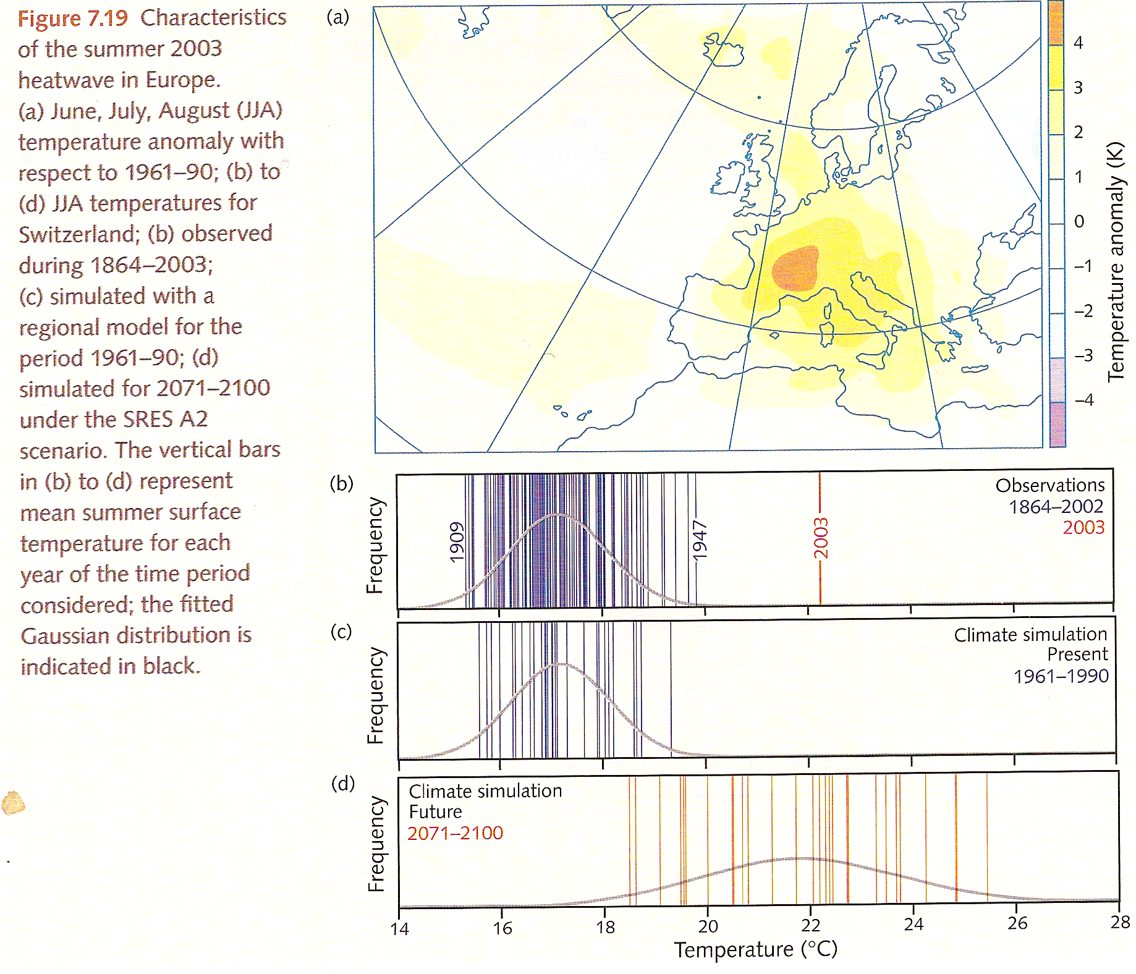
Heat Wave Statistics
2003
once
in
10,000
years
ΔT = 5 °C = 9 °F
50,000
deaths
5σ
Past
Obs
GCM
Past
2 years
out of 3
Future
GCM

Slide 31
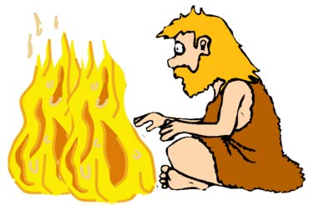
What We Know for Sure
Heat warms things up (100,000 BC)
CO₂ absorbs and emits heat (1863)
Each doubling of CO₂ adds
4 Watts/m² (1896)
Climate can change (19th Century)

Slide 32
Very High Confidence
Familiar climates:
Warm summers, cold winters, warmer in tropics than poles, wet places & dry places
Gradual but permanent warming of around 0.8 °C per Watt/m²
If China and India build industrial economies based on fossil fuel,
CO₂ will double or triple
That would add additional 4 to 6 Watts/m²
Eventual warming of global mean temperatures by 3 to 5 °C

Slide 33
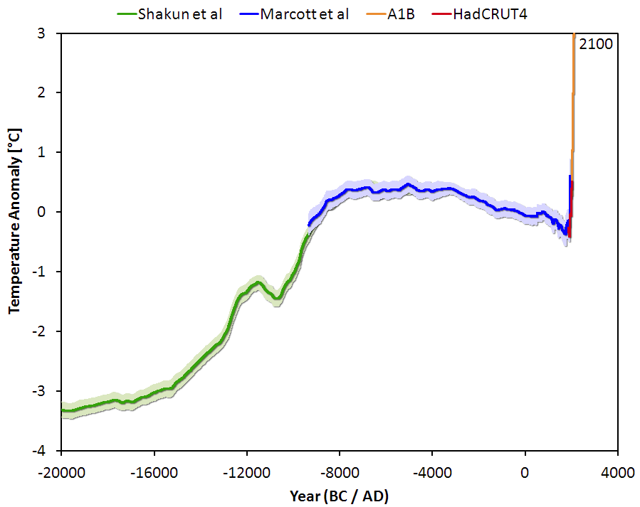
Since the Ice Age
IPCC
Holocene
“Optimum”
Modern
Record
Little
Ice Age
Modern warming will be comparable to warming after Last Ice Age but 100x faster
Deglaciation

Slide 34
High Confidence
More warming over land, in the NH, where it snows (around 60% more than global)
8 °F to 14 °F in central USA
Much more frequent “very hot” days
More evaporative demand -- drought
Shift toward higher precipitation intensity
Some of the extra CO₂ will last for thousands of years after emissions stop

Slide 35
Uncertainty
How fast economies will grow and adopt new technologies across the world
Energy mix of developing economies
Amount of water shortage in Central USA
Rapid loss of ice sheets – fast rising water
Rapid thawing of permafrost –
fast rising CO₂ beyond FF emissions

Slide 36

Unknown
Exactly how and when climate will change locally and regionally
Detailed impacts on agriculture, insurance, financial markets, real estate, and economy in general
Resulting changes in social and
political environment
What people will decide to do
about all this!

Slide 37
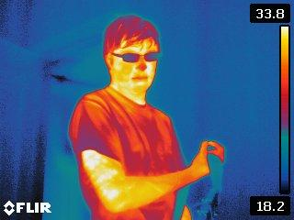
From the Heart
Simple
Serious
Solvable
email questions anytime at Scott.Denning@ColoState.edu
On twitter @airScottDenning

