Slide 1



























Center for Multiscale Modeling
of Atmospheric Processes
LaRC

Slide 2
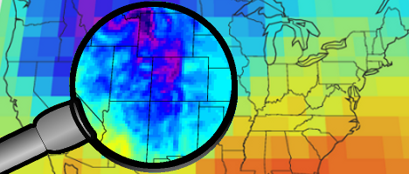
Dynamic Downscaling
Climate models use grid scales ~ 100 km with highly parameterized clouds, precipitation, radiation,
turbulence, but can run globally for centuries
Run WRF with nested grids using CMIP5 archival
output for lateral boundary conditions
Improved precipitation processes, surface hydrology, topography, urban processes
Disadvantages: limited domains in space & time,
no feedback to larger scales

Slide 3

Resolve clouds?
Modest increases in resolution don’t improve the simulation of convective processes. A big increase is needed.
Global cloud-resolving models are still too expensive for IPCC-style work, although this may change in 10 to 15 years.
Super-parameterization is a relatively affordable alternative approach.
need a factor of ~ 1 million x more computing!

Slide 4
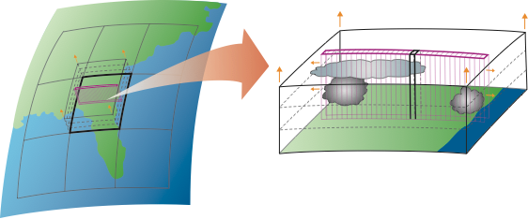
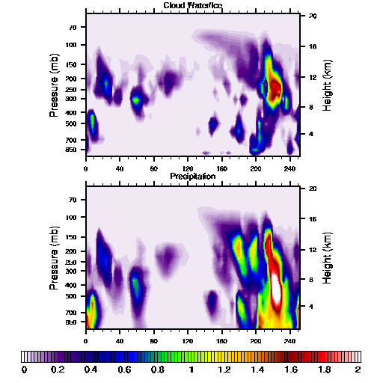
SuperParameterization (SP)
“Curtain” of cloud-resolving nonhydrostatic models (CRMs) embedded in each CAM grid cell
CRM replaces all subgrid-scale parameterizations in SP-CAM
~300 km
Cloud Water/Ice
Strengths:
  Explicitly captures turbulence, cloud, and boundary processes
  Allows clouds and radiation to interact in a more natural manner
  Cloud-scale computation of precipitation intensity, frequency, & duration
0 40 80 120 160 200 240 km
Precipitation
Weaknesses:
  CRM two dimensionality
  Computationally expensive
  CRM periodic boundary conditions
0 40 80 120 160 200 240 km
mm/hr
Courtesy: M. Khairoutdinov

Slide 5
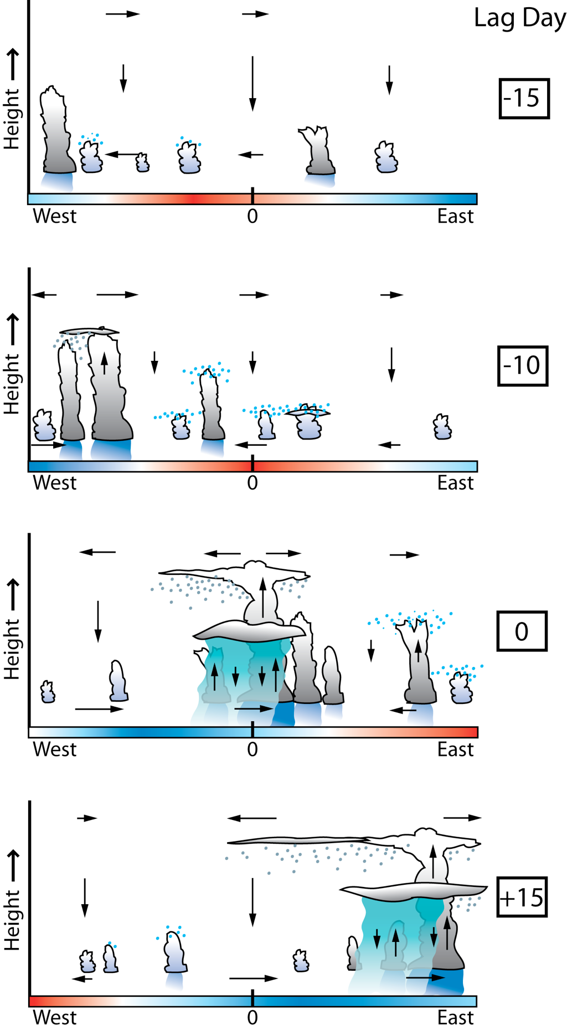
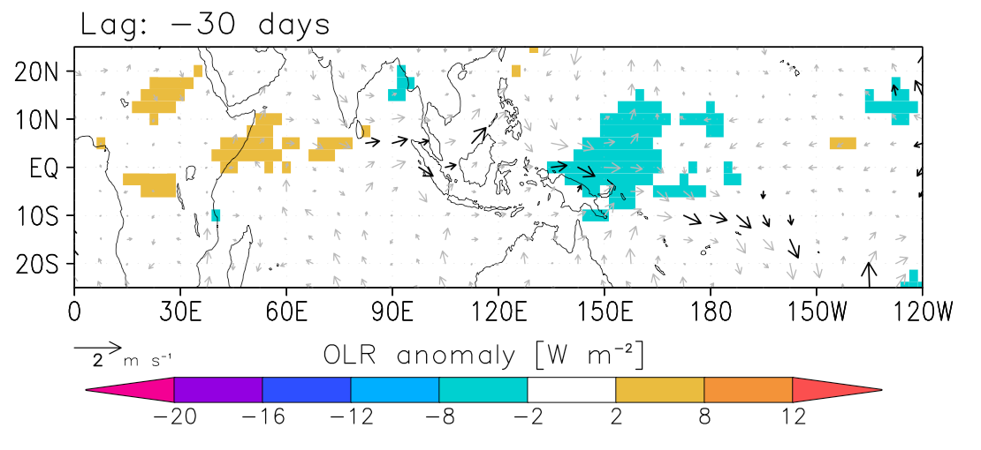
Madden-Julian Oscillation
MJO dominates equatorial atmospheric variability on intraseasonal timescales (20-100 days)
Disturbance propagates eastward at ~5 m/s from Indian into Pacific Ocean
Convective signal dissipates near 180°E, dynamical signal (“dry” Kelvin wave) continues eastward at ~30 m/s
Regressed OLR and 850 hPa wind anomalies
Jim Benedict, LBNL
Notes:
We do not understand why MJO convection tends to develop over the West Indian Ocean

Slide 6
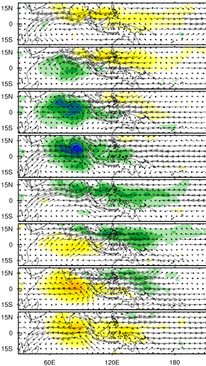
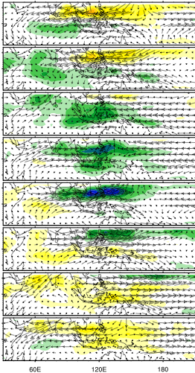
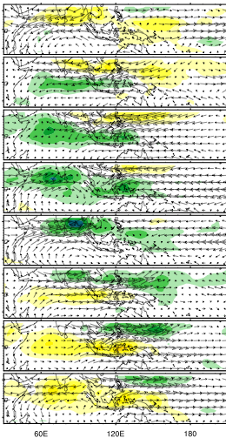
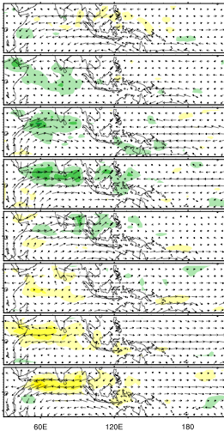
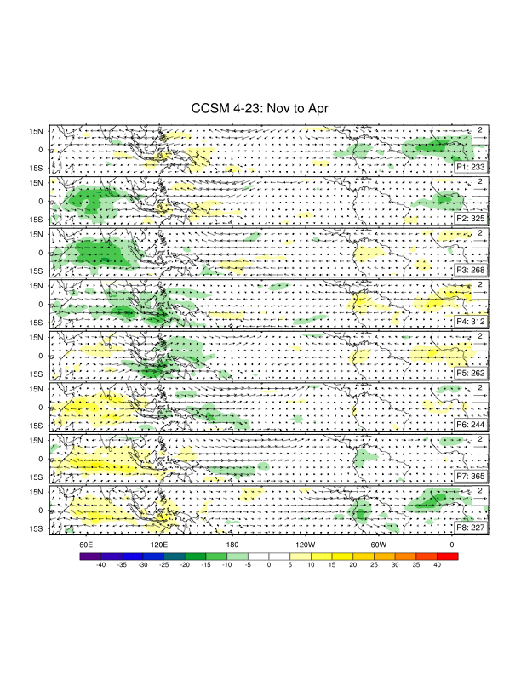
May-Oct Composite MJO
OBS
SpCAM
SpCESM
CESM
P1
P2
P3
P4
P5
P6
P7
P8
OLR anomaly
Notes:
This is the May-Oct 8-phase composite of the ISO constructed according to the PC1 vs PC2 phase space diagram.
Both Sp models produce the eastward-propagating ISO.
Northward propagation is also captured in these composites.
Note that SpCCSM is the only model to correctly reproduce the “tilted” rainband at Phase 5.
We will look at composite northward propagation by averaging longitudinally between the red lines.

Slide 7

Eastward Propagating Convection over Central USA
Terrain-forced initiation on east slopes of Rockies
Eastward propagation, mesoscale organization
Even though CRM has cyclic lateral boundaries!
Michael Pritchard, UC Irvine

Slide 8
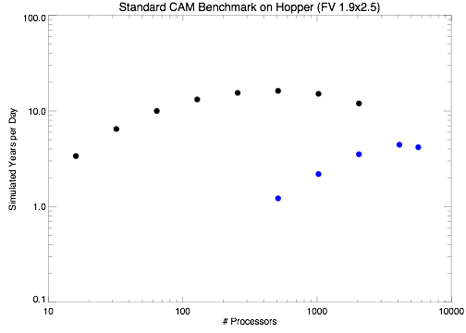
Benchmarks
Computing
CAM
SP-CAM
Bad news: 200x more computing than standard model!
Good news: 200 is a lot less than 1,000,000
Embarrassingly parallel — excellent scaling

Slide 9
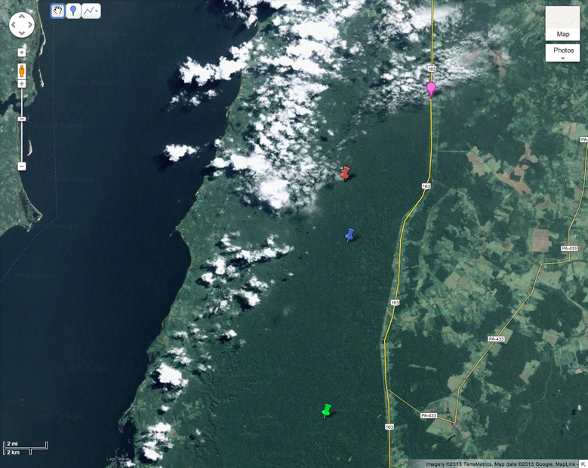
Tapajos Forest Equatorial Amazon
GCM-scale coupling
vs. CRM-scale coupling
10 km

Slide 10
Three Ways to Couple
SASL
MASL
MAML
CAM
CRM
CRM
CLM
CLM
CLMs
Single Atmosphere
Single Land
(standard CESM)
Multi-Atmosphere
Single Land
(SP CESM)
Multi-Atmosphere
Multi-Land
(“multi-instance”
SP CESM)

Slide 11

More Intense Rainfall

Slide 12
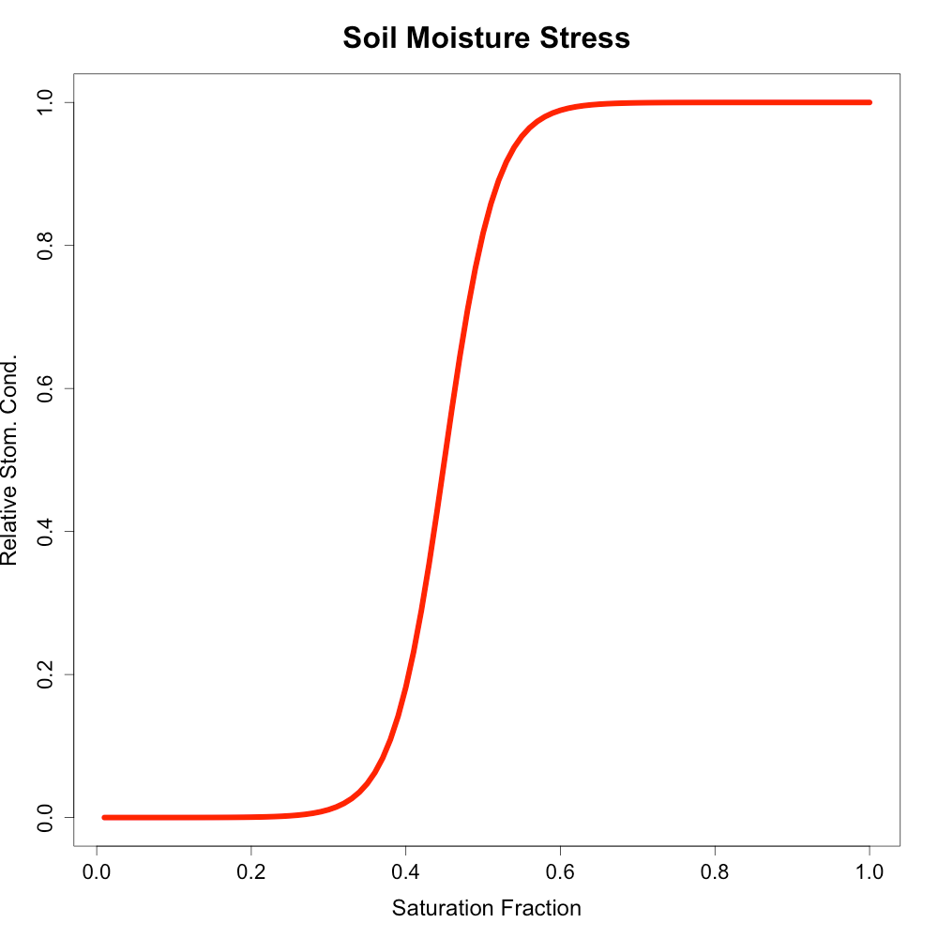
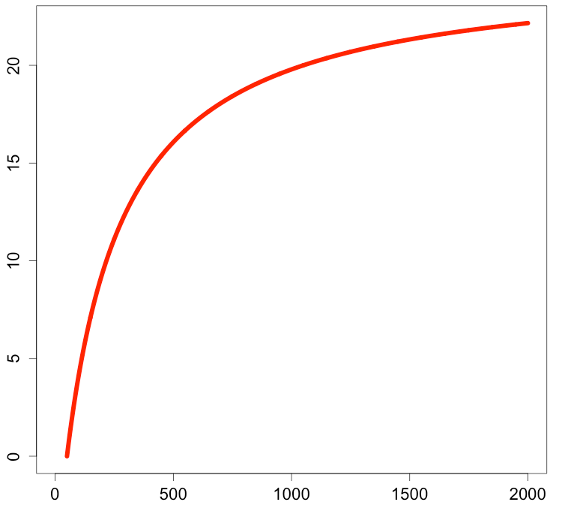
Nonlinear Coupling
Photosynthetic Light Response
Soil Moisture Stress
(a)
(b)
Relative Stomatal Conductance
Relative Stomatal Conductance
PAR (µMol m⁻² s⁻¹)
Saturation Fraction

Slide 13
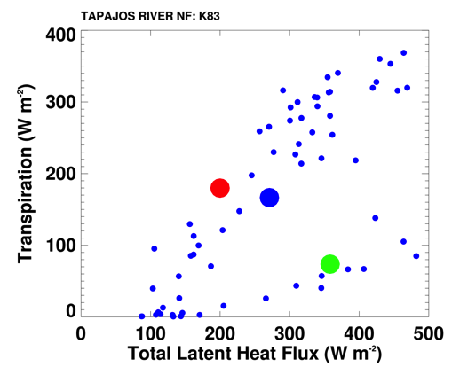
Impact of Coupling Scale
sunny
& dry
Individual MAML cells experience a huge range of weather
  sunny & dry (transpiration)
  sunny & wet
  (canopy evaporation)
  dark & raining
Very different LE partition
(SASL, MASL, MAML)
Jan 1, 2003 14 LT
indiv
MAML
cells
SASL
MAML
MASL
sunny
& wet
raining

Slide 14
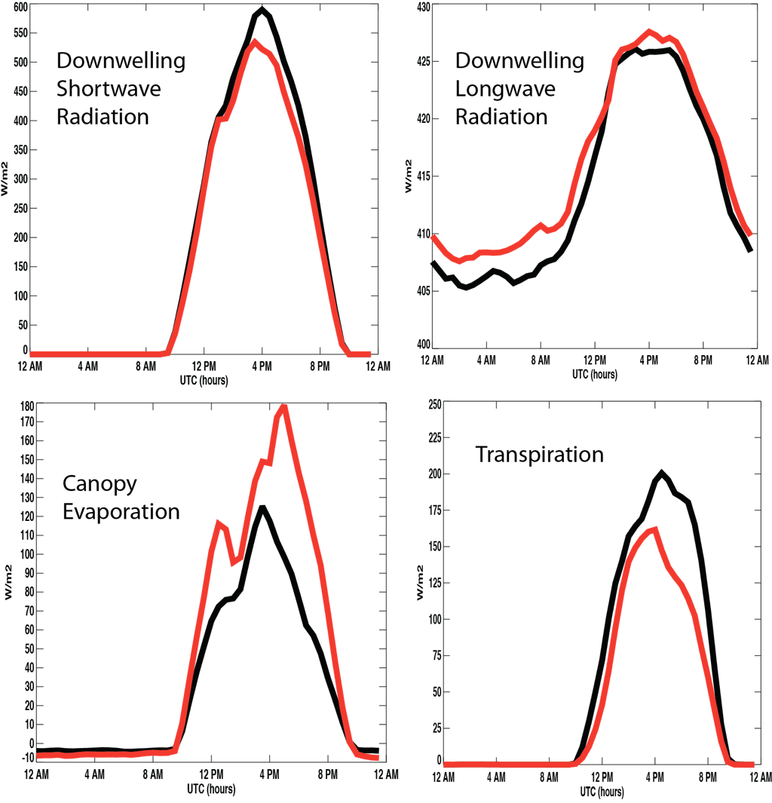
Energy Budgets
20 days, mean diurnal cycles
Changes to clouds, radiation, and surface fluxes
Huge shift of latent energy from canopy evaporation to transpioration
red = MASL
black = MAML

Slide 15
Global Multiscale Climate Simulations with SP-CESM
Five-year integrations of SP-CESM
Prescribed SSTs
Coupled two ways: MASL and MAML
MAML run uses 32 instances of CLM with identical parameters in each CAM column, each coupled to its own CRM column
Plots show multiyear differences:
MAML minus MASL

Slide 16
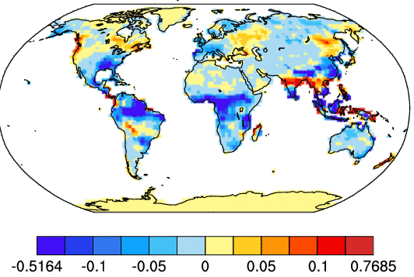
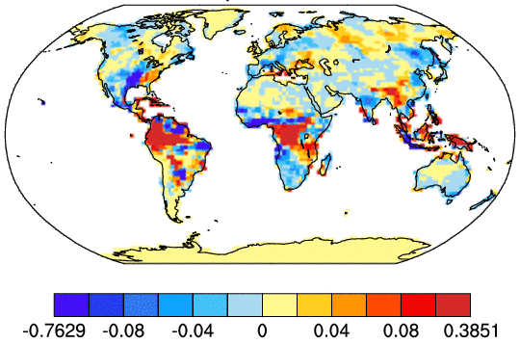
Canopy Hydrology
Canopy Interception
Transpiration
5-yr mean
mm / day
Shift from canopy interception & evaporation to throughfall, infiltration, and transpiration, especially in the tropics

Slide 17
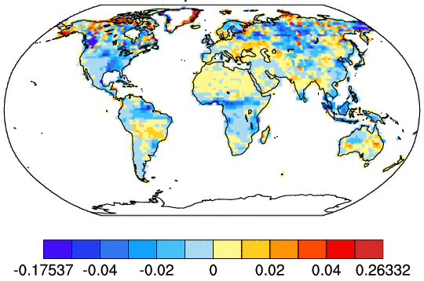
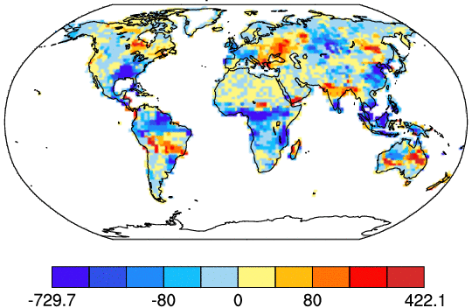
Surface Wetness
5-yr mean
Water Table at Surface
Total Water Storage
fraction of grid cell
mm
Less inundation, shifts in water storage

Slide 18
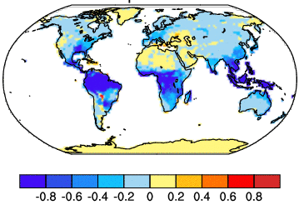
Photosynthesis
Gross Primary Production
g C m⁻² day⁻¹
More moisture but less light over tropics
5-yr mean

Slide 19
Summary
Multiscale means sampling,
not averaging, w/ two-way interaction
Multidecadal global simulation of
high-resolution, nonhydrostatic precipitation, radiation, turbulence, and surface hydrology
Much more realistic precipitation intensity and frequency
Applications to management!

